Slide 1
Stereoscopic cloud imaging for future 3-D wind constellation
Dong L. Wu
Climate and Radiation Laboratory (613)
NASA Goddard Space Flight Center
Working Group on Space-Based Lidar Winds Boulder, CO April 28-29, 2015

Slide 2
Outline
Atmospheric dynamics and cloud properties
  Spatial and temporal variability
  Water vapor, aerosol, and cloud features as a dynamic tracer
Passive VIS/IR imaging for winds
  International Winds Working Group (IWWG)
  Methods and limitations; Where lidar winds are mostly needed?
Stereoscopic information
  The 2-GOES study
  Terra/MISR aerosol/cloud imaging and winds
  Future stereoscopic remote sensing

Slide 3
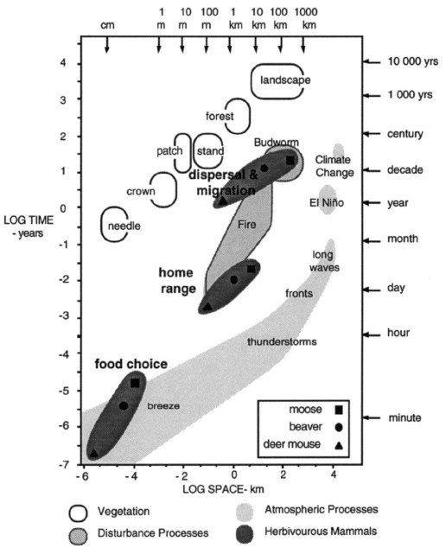
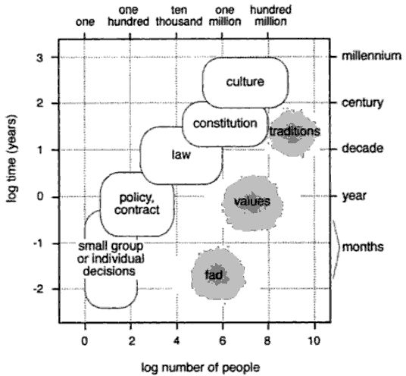
Spatial vs Temporal Variabilities of the Atmosphere
Holling etal
(1992)
Westley et al. [2002]
GOES
MISR

Slide 4
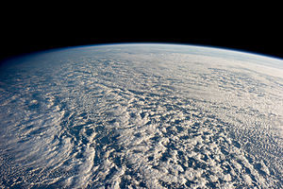
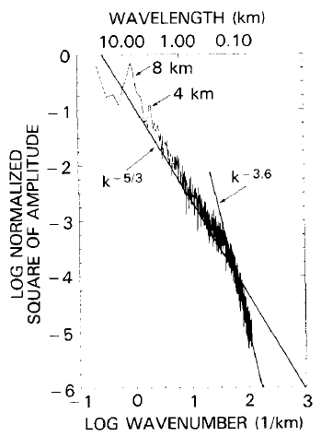
Tracking feature patterns in water vapor, aerosol and cloud for atmospheric motion
A critical scale (~200 m) that separates between wave features and turbulence
What is the relationship between pattern height and IR thermal height?
~200 m
Cahalan and Snyder
(1989)

Slide 5
International Winds Working Group (IWWG)
Coverage of Global Atmospheric Motion Vectors (AMVs)
MODIS
GEO
MODIS
Operation algorithms:
  Feature selection (e.g. contrast test, multi-layer cloud discrimination)
  Height assignment
  Feature tracking
  Quality control
Geo-registration of images with landmark; Triplet set of images for pattern matching
Where are the data gaps?
  Fast, dynamic regions
  Strong vertical wind shear
  Dry atmosphere and night

Slide 6
Limitations in Current Data Sets and Algorithms
Height assignment methods
  IR window
  CO₂ slicing
  H₂O intercept
Synoptic and upper-mesoscale
  Temporal vs spatial resolution of the triplet images
  Pointing stability (e.g., GEO)
Clustered in certain vertical levels
Moderate vertical resolution
  2-3 km
No winds in the dry atmosphere and above cloud and water vapor layers

Slide 7
Stereoscopic Imaging Techniques

Slide 8
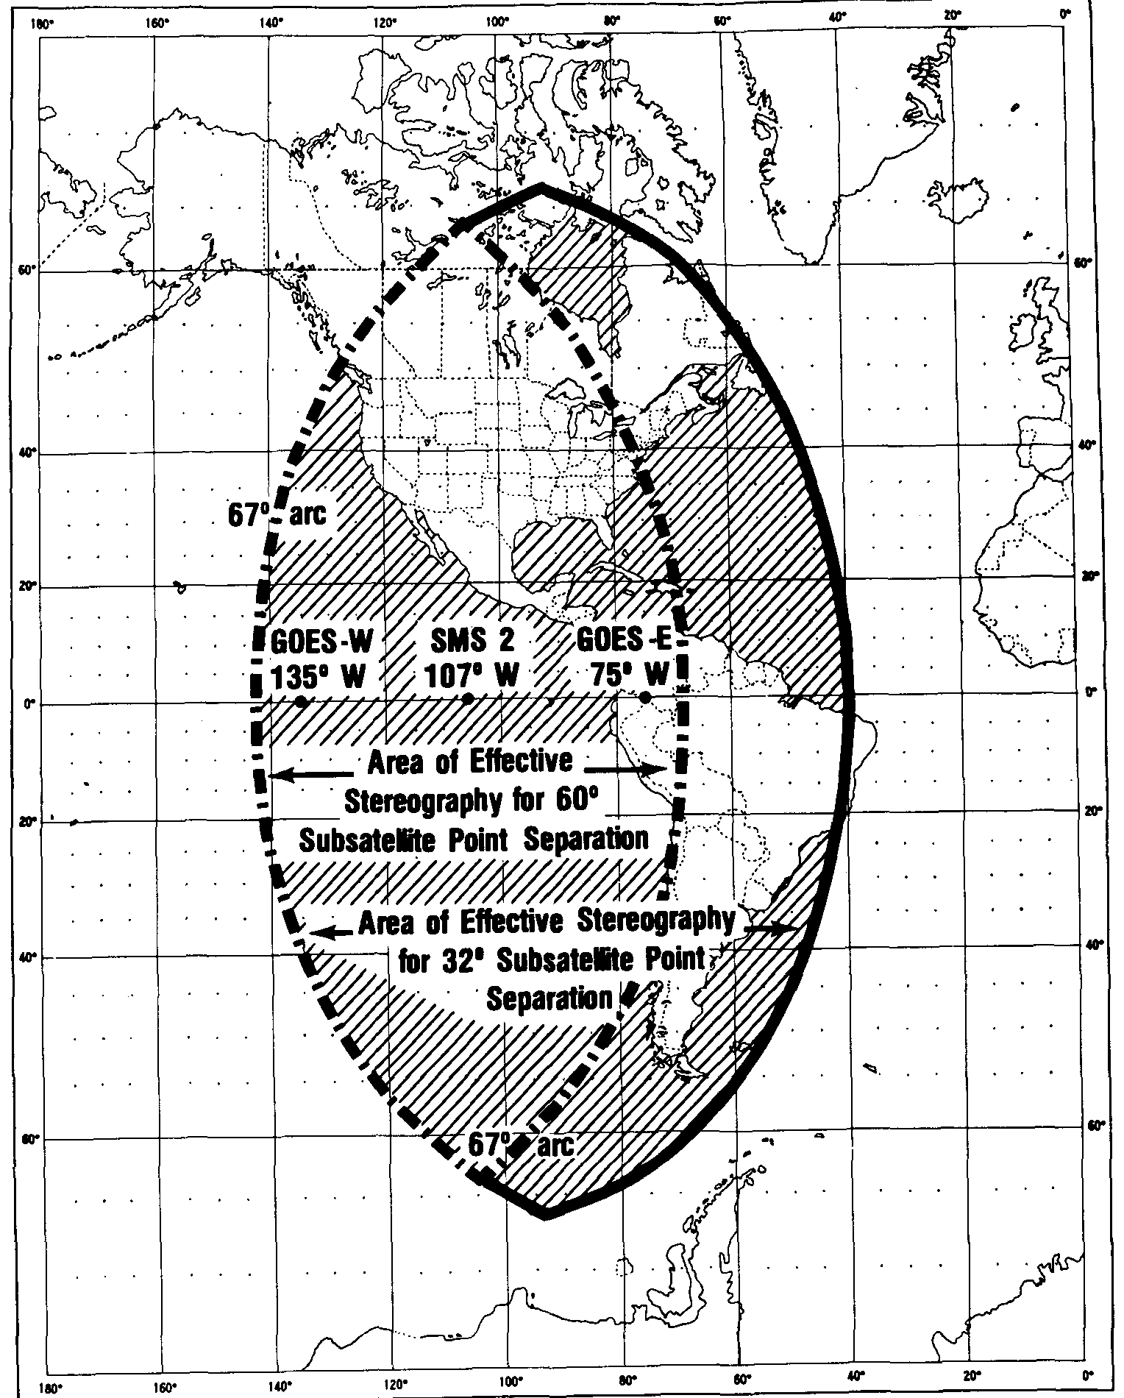
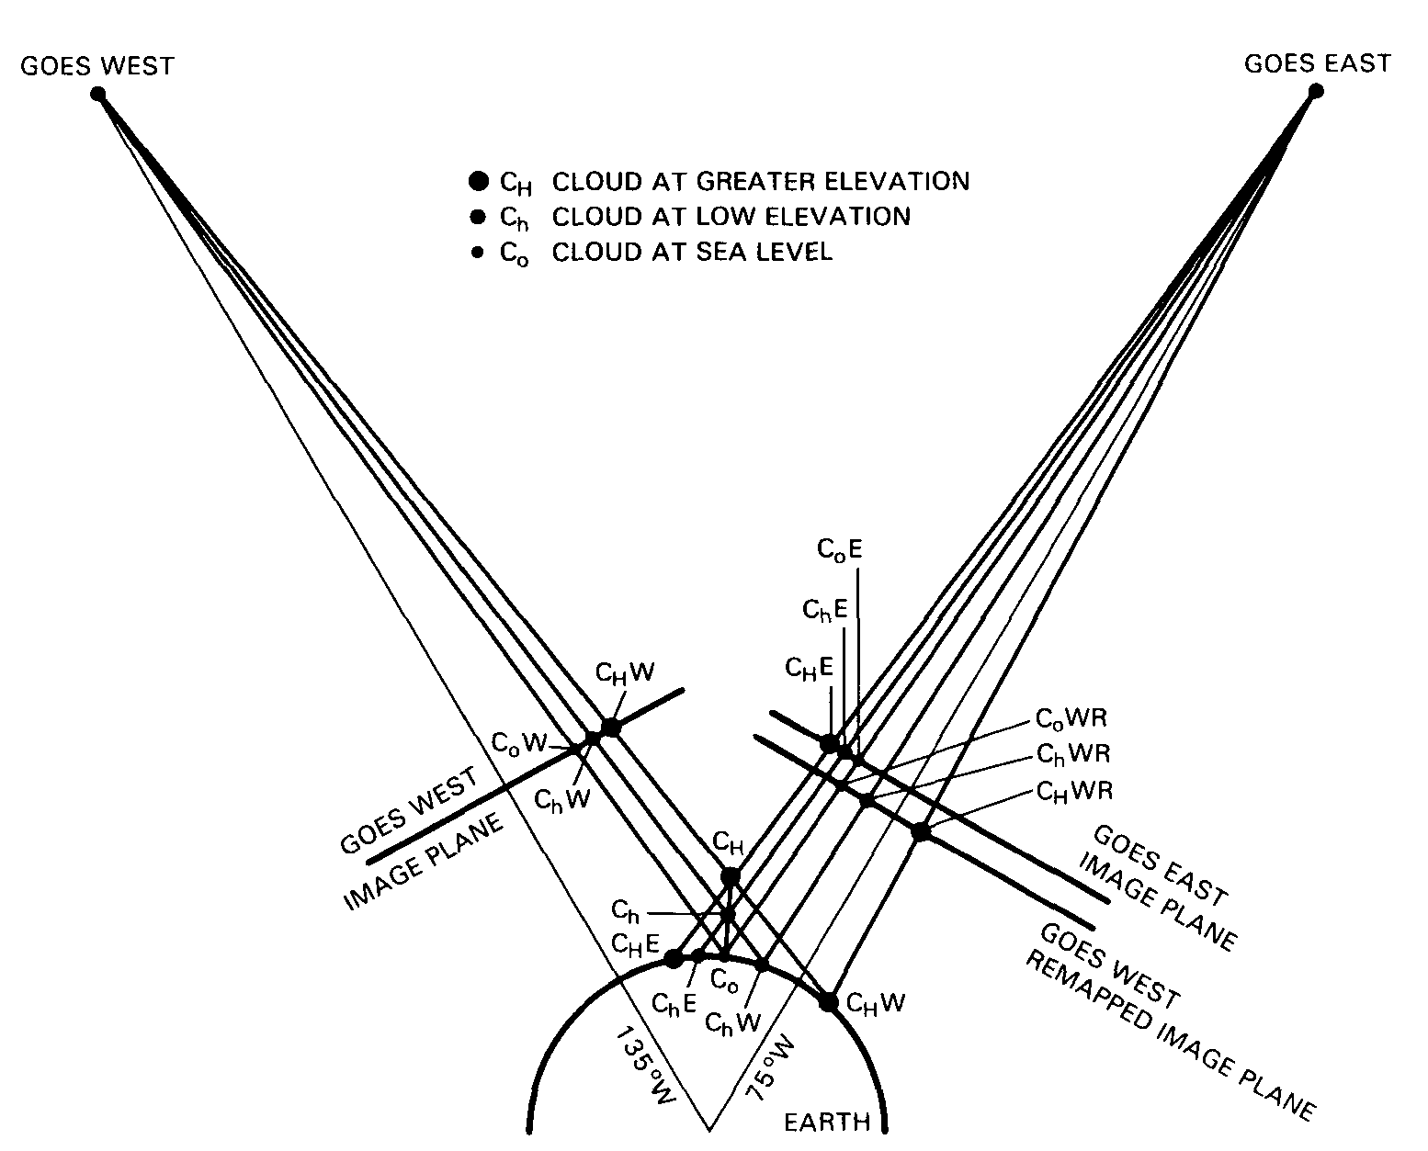
Shenk (1971) Apollo6
2-GOES Stereo
Hasler (1981)
Black (1982)
Fujita and Dodge (1982)
60°

Slide 9
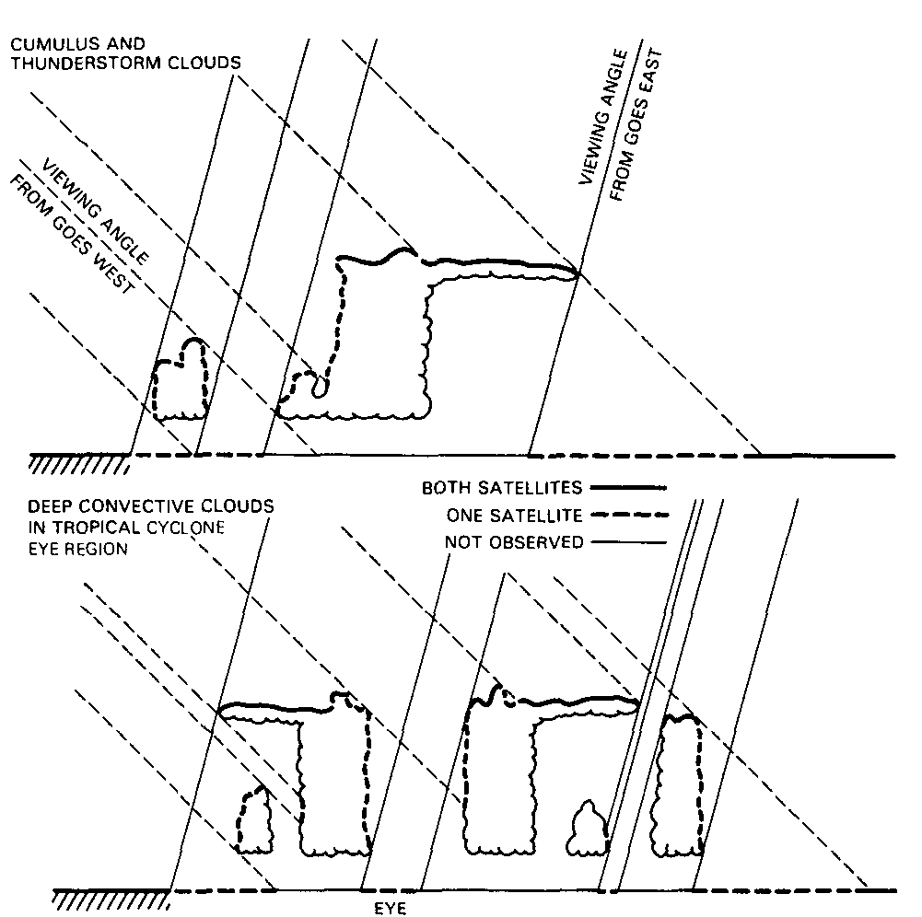
Hasler (1981)

Slide 10
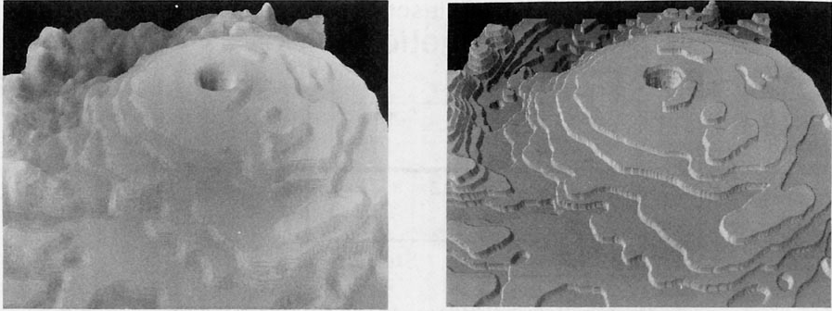
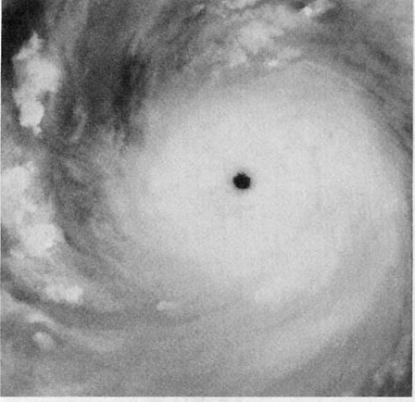
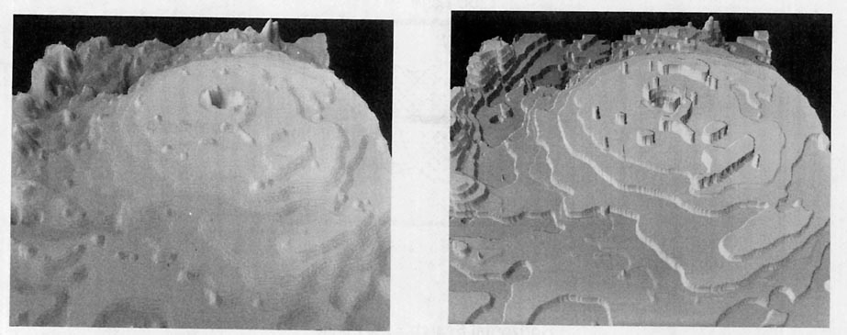
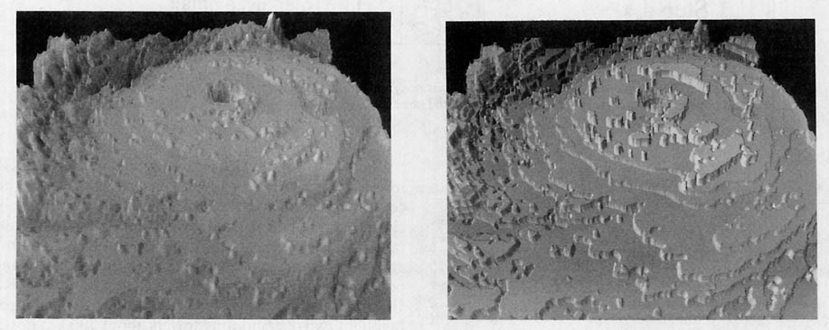
Hasler et al. (1991)

Slide 11
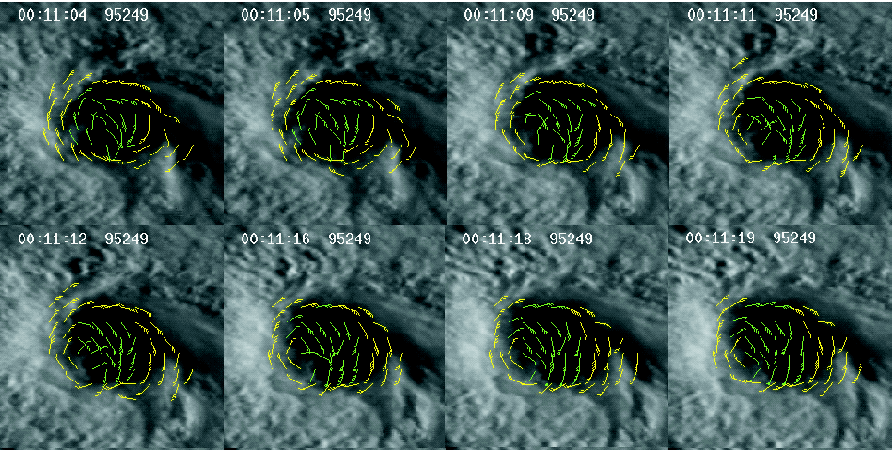
Hasler et al. (1998)

Slide 12
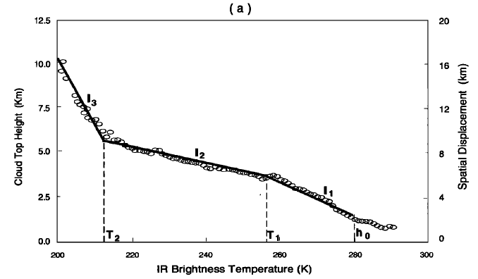
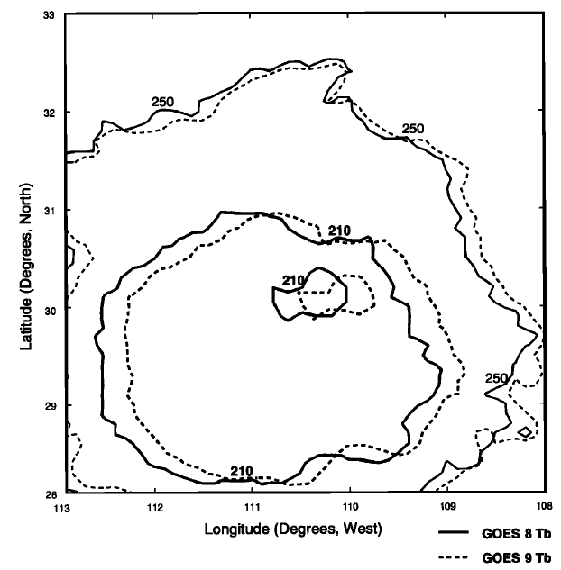
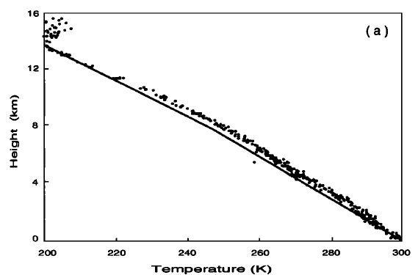
IR Thermal Height (Pixel) vs. Stereo Height (Pattern)
Mahani et al., (2000)
8 K/km
Δh =0.3-0.8 km
TEFLUN-B
radiosonde
Baja Peninsula (July 12, 1998)

Slide 13
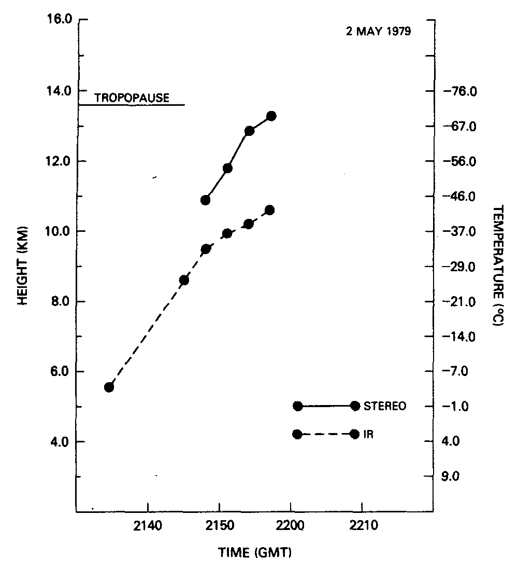
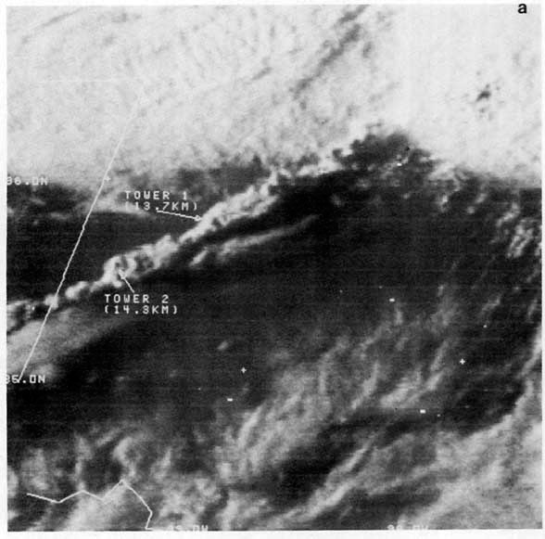
Mack et al. (1983)

Slide 14
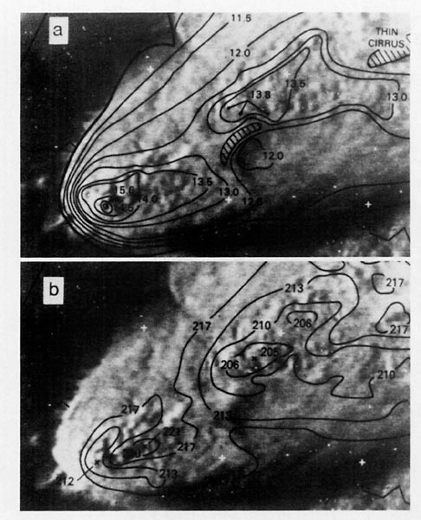
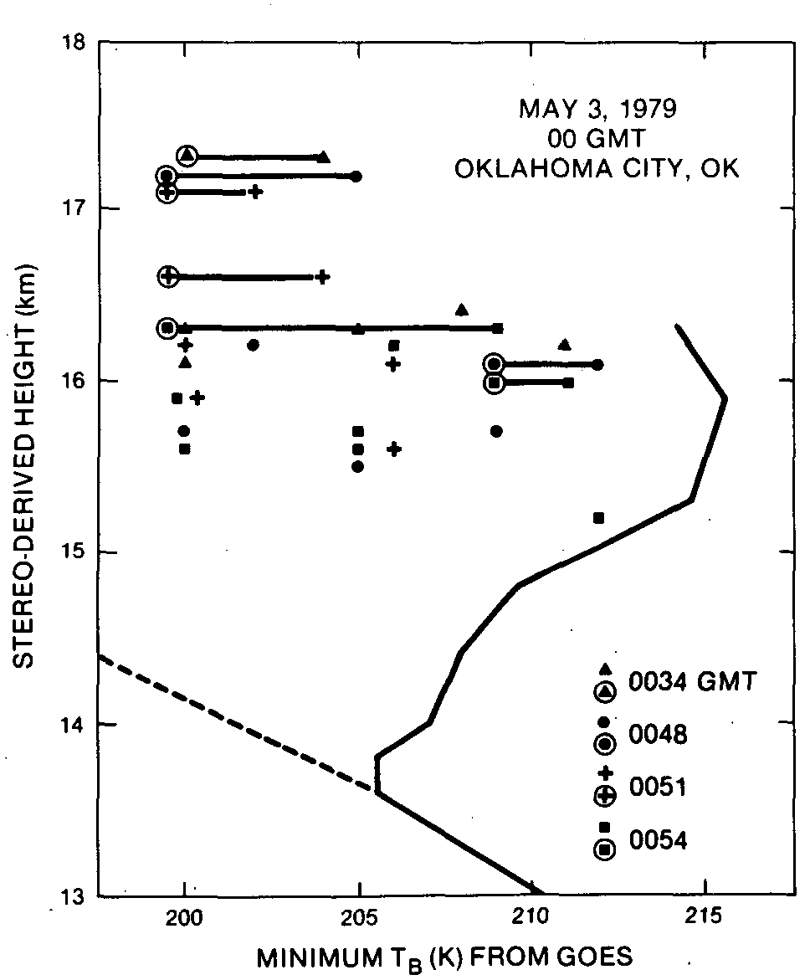
Adler and Mack (1986)

Slide 15
Stereoscopic Imaging from Terra/MISR

Slide 16
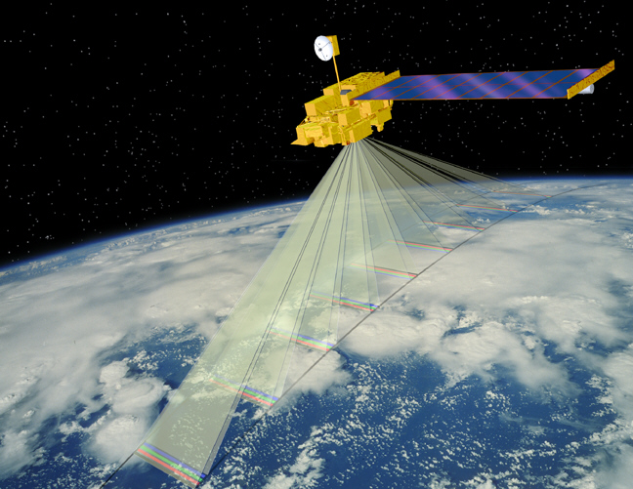
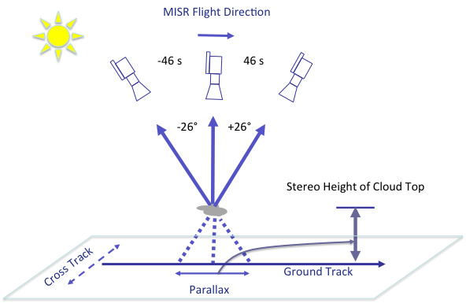
Multi-angle Imaging SpectroRadiometer (MISR)
9 view angles at Earth surface: Nadir, ±26º, ±46º,±60º, ±70º
4 bands: 446, 558, 672, 866 nm
400-km swath and daytime only
275 m - 1.1 km resolution
7 minutes

Slide 17
MISR Flight Direction
Stereo Technique
Cross Track
Ground Track

Slide 18
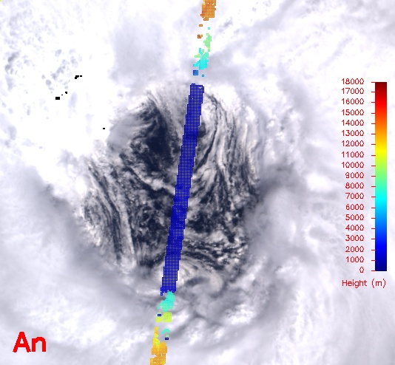
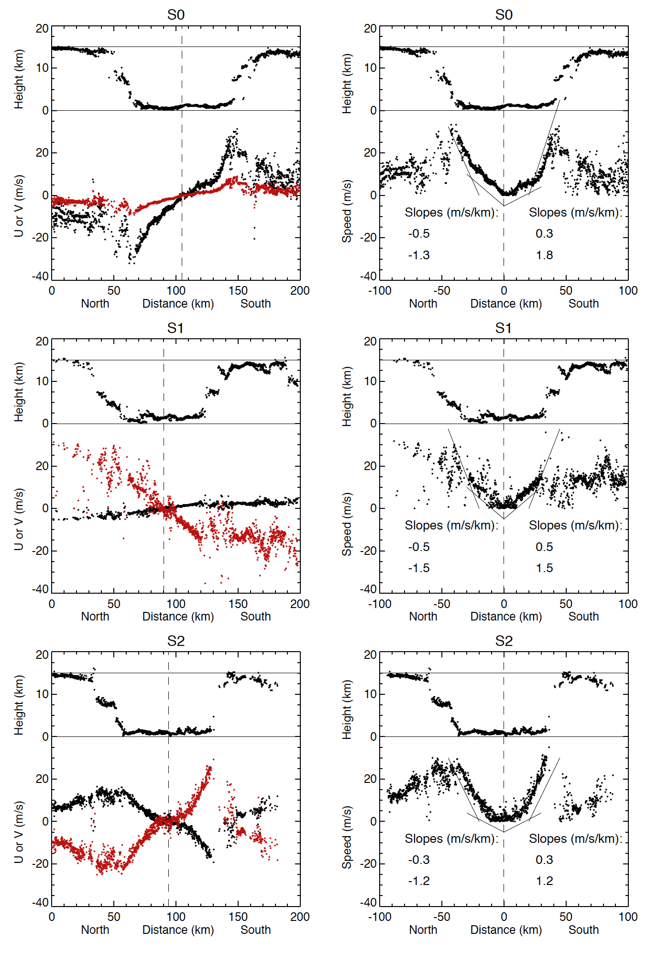
Inner-Core Dynamics: Tangential Velocity (V_{t})
Hurricane
Alberto (2000)
Only tangential velocity assumed inside hurricane eyewall determined from MISR
A priori wind direction needed to determine wind speed
Hurricane rotating at different angular velocities inside eye
The angular velocity near near eyewall proportional to cyclone intensity
V_{t}

Slide 19
Isabel
(2003)
Wilma
(2005)
Wu et al. (2010)
Emily
(2005)
Alberto
(2000)
Franklin
(2005)

Slide 20
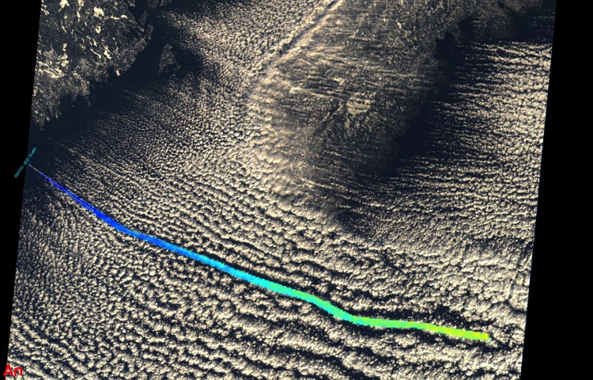
Arctic Boundary-Layer Dynamics
Sea Ice
MISR
Open Water

Slide 21
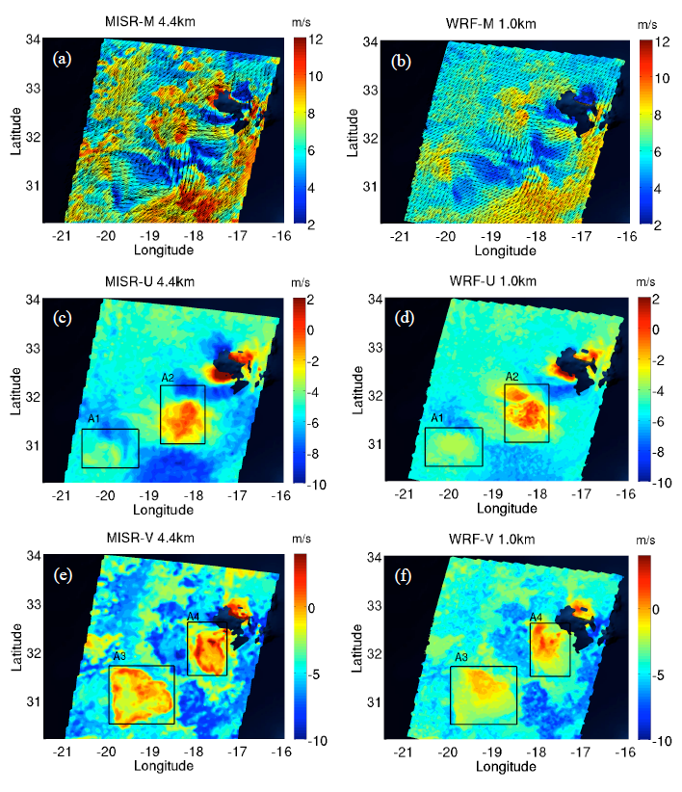
Kármán Vortices
Courtesy of Akos Horvath and Kevin Mueller
Vortex streets as a 3D pattern in 2D inviscid flow over a obstacle
MISR research algorithm to produce 4.4 km winds, capturing the fine structure of Madeira island wake flows
Good agreement found between the observed and WRF-simulated winds at instantaneous cloud-levels

Slide 22
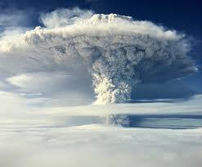
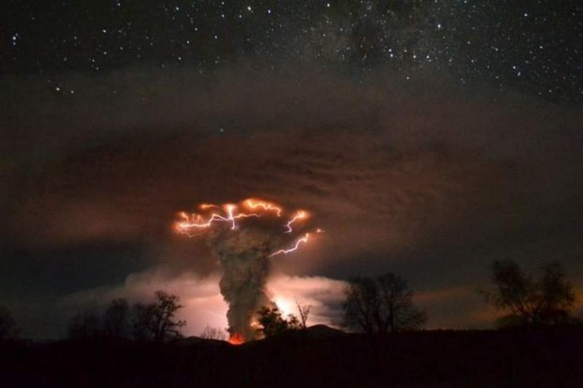

Courtesy of Terra/MISR and Aura/OMI teams
Tracking aerosol features and their motion
Puyehue-Cordón Caulle, Chile (June, 2011)
Notes:
By 18 June the ash cloud had completed its first circle of the globe. The Chilean civil aviation authority said that "the tip of the cloud that has travelled around the world has more or less reached the town of Coyhaique", about 600 kilometres south of the Puyehue-Cordón Caulle.[3] An estimated one hundred million tons of ash, sand and pumice were ejected – requiring power equivalent to 70 atomic bombs.[4]

Slide 23
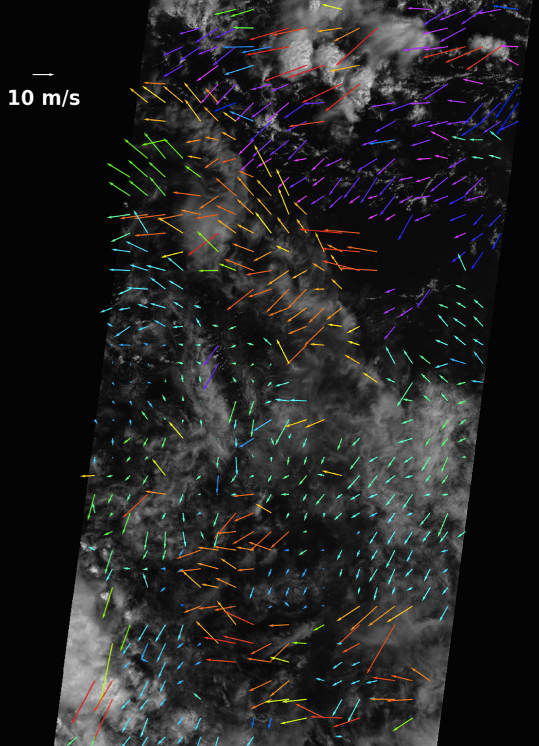
AMV: 70 km 18 km 4 km 2 km
AMV for data assimilation and process studies
Z
Z
Z
u
u
u
Analysis/Model
IR Wind
High-Res Wind
MISR 17.6 km CMV
(courtesy of K. Mueller)
0.75° x 0.75°
< 4 km

Slide 24
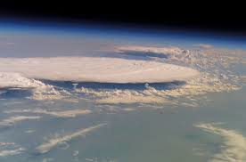
Future Multi-platform Multi-angle Imaging
CubeSat
5-15 min
CubeSat
30°
30°
30°
30°
600-1500 km

Slide 25
Summary
3D winds form passive imaging are complementary to lidar winds, by providing wide horizontal coverage.
Regions with dry air or strong vertical shear, above cloud and water vapor layers, and at night, in particular, need lidar wind profiles.
Stereoscopic information in satellite imagery, which can improve the AMV vertical resolution and sampling, is currently under utilized.
Multi-platform and multi-angle imaging from space has become a cost-effective approach for future 3D wind constellation.

Slide 26
Extra

Slide 27
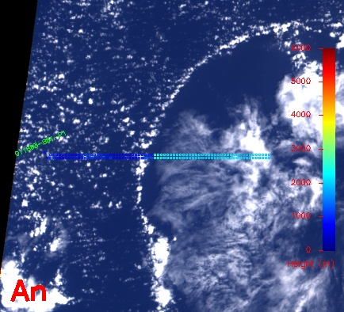
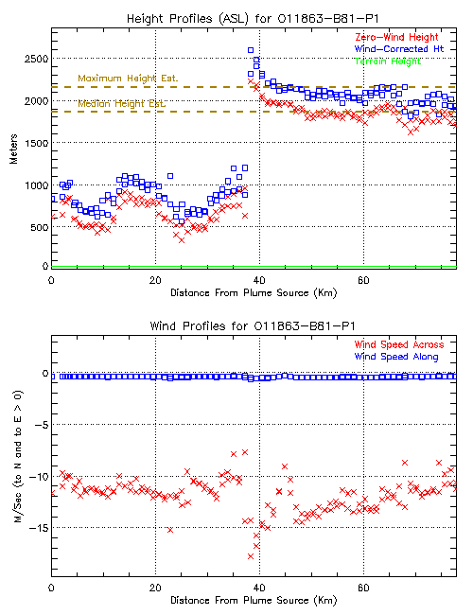
PBL Cloud/Precip Dynamics:
(Example of cold pool processes)
Subtropical Cold Pool
Resolution: 1.1 km
Precision:
height: ~100 m
wind: ~0.3-1 m/s

Slide 28
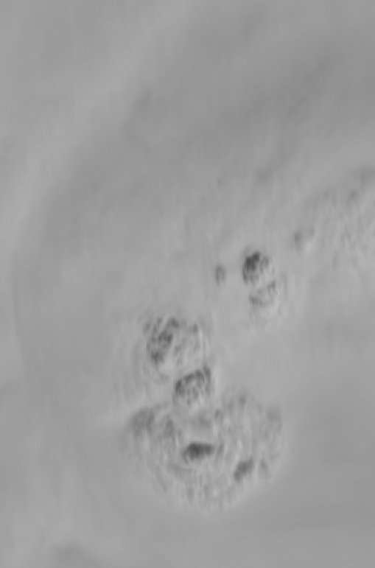
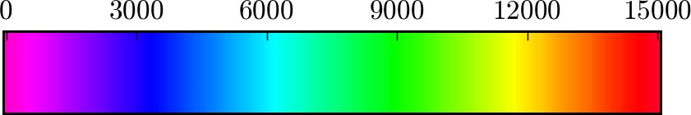

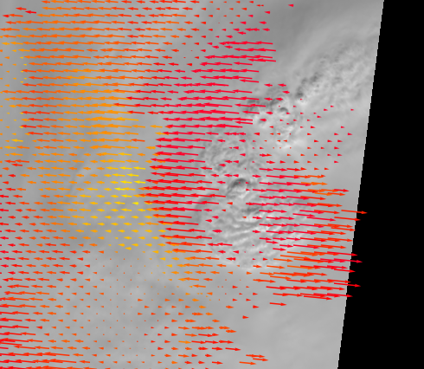
Rapid cell development from deep convection:
Hurricane Ida (Nov.8, 2009)
Wind Speed
MISR
Height (meters)
Courtesy of M. Garay and K. Mueller

