Slide 1
The ATHENA-OAWL Doppler Wind Lidar Mission
NASA Review – Comments and Request for Community Input
Carl Weimer and Sara Tucker,
Ball Aerospace and Technologies Corporation

Slide 2
What Is ATHENA-OAWL (A-OAWL)?
Earth Venture Instrument – 2 (EVI-2) Proposal to NASA in 2013
  Not Selected for space mission – Category 3
  Was selected for Earth Venture Risk Reduction Funding (“Venture Tech”) to advance its Technology Readiness
Led by PI Lars Peter Riishojgaard University of Maryland (now WMO)
  Mike Hardesty (CU/CIRES) as Deputy PI (also Venture Tech PI), Wayman Baker (Retired) Project Scientist
  Ball Aerospace is the Instrument Provider – Doppler Wind Lidar based on the OAWL technique
Focused Science Mission
  Tropospheric dual Line of Sight Winds plus aerosols
Earth Venture Instrument is Cost Constrained – Design to Cost
  ≤ $94 M with 25% reserves
  Uses International Space Station (ISS) and its Mission Operations, and TDRSS downlink
  Met the WMO requirement for < 3 m/s precision, < 0.5 m/s bias
Medium Risk Mission - Leverage Heritage Designs from CALIPSO and other Instruments
  One Year Lifetime
  NASA Class C (Medium to Low Complexity)
A Stepping Stone to the Decadal Survey 3-D Winds Mission

Slide 3
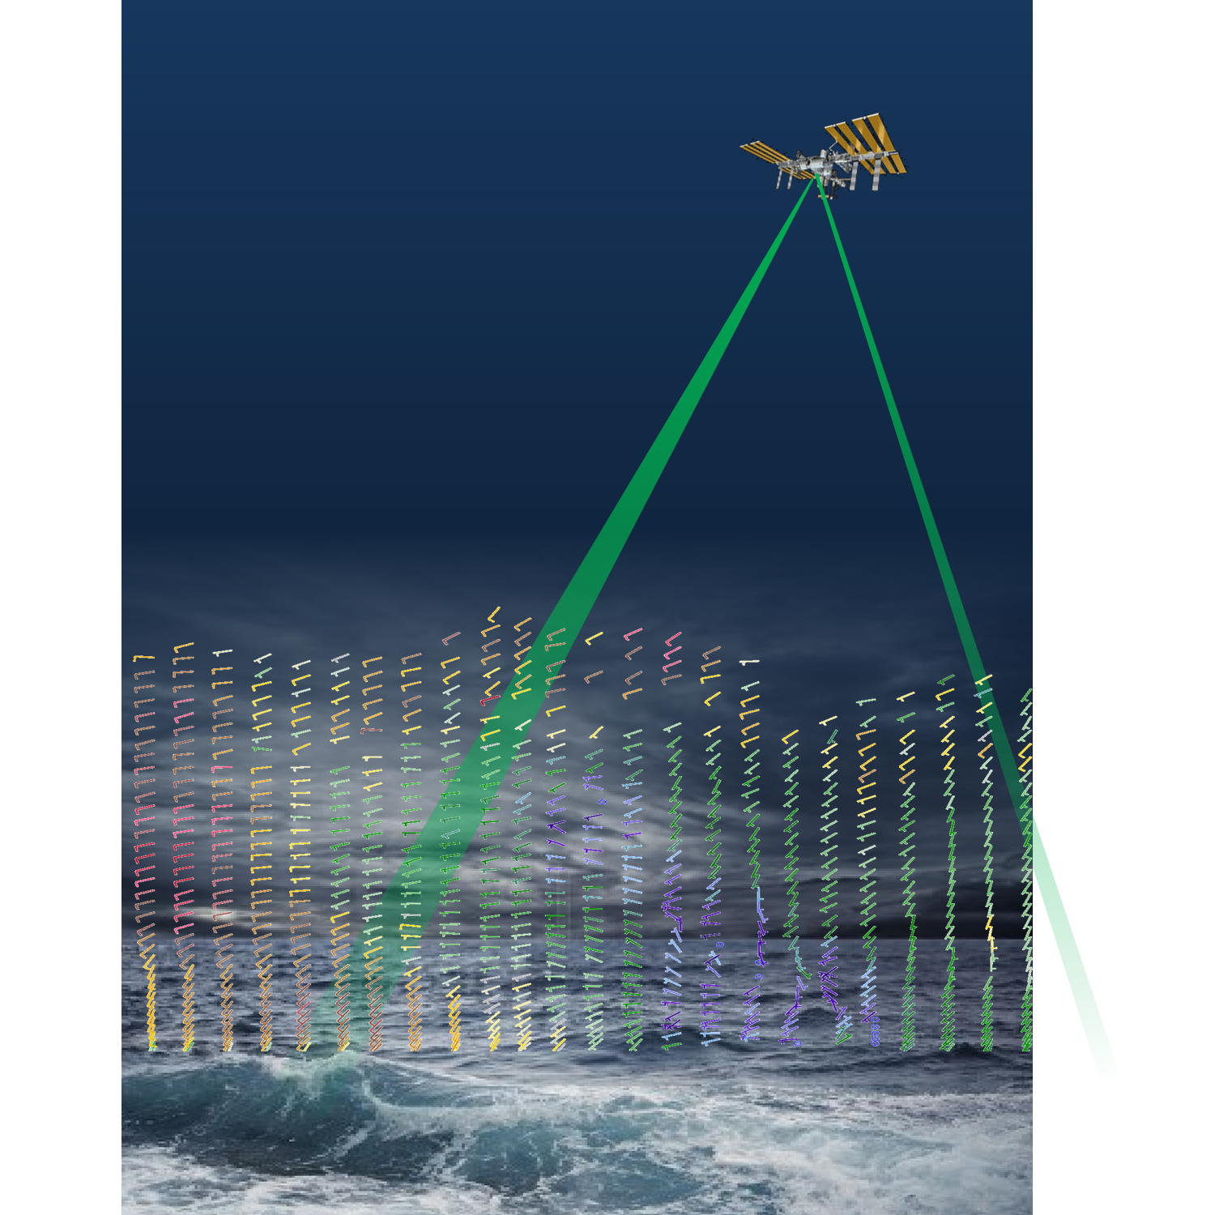






ATHENA-OAWL
Atmospheric Transport, Hurricanes,
and Extratropical Numerical
weAther prediction with the
Optical Autocovariance Wind Lidar

Slide 4
Earth Venture Programmatic Objectives
Advance scientific knowledge of earth processes and systems;
add scientific data and other knowledge-based products to data archives for scientific
and public access;
result in scientific progress and results published in the peer-reviewed literature to encourage,
the maximum possible extent possible, the fullest use of knowledge gained;
expand the pool of well-qualified Principal Investigators and Project Managers for implementation
of future NASA Missions;
implement technology advancements accomplished through related programs;
communicate scientific progress and results accomplished through popular media, scholastic
curricula, and outreach materials that can be used to inspire and motivate students to pursue
careers in science, technology engineering, and mathematics.

Slide 5
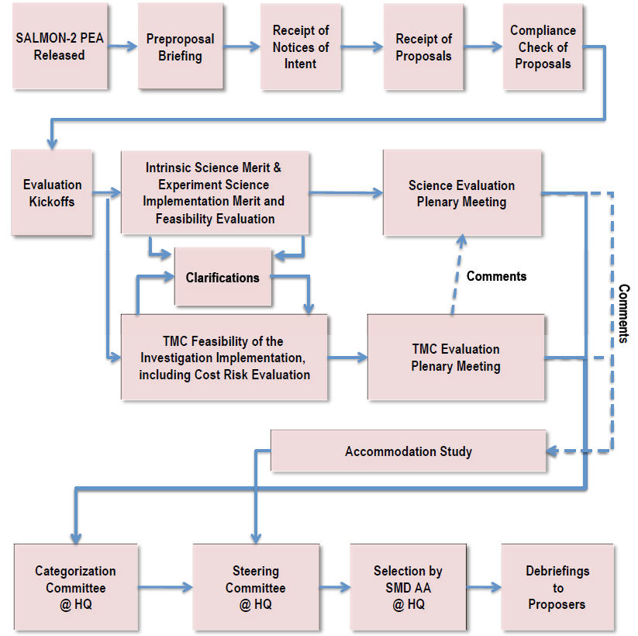
Review Process
Technical Management
Cost

Slide 6
Criterion 1: Intrinsic Science or Exploration Technology Merit
Factor A-1. Compelling nature and priority of the proposed investigation’s science or exploration of technology goals and objectives
Factor A-2. Programmatic value of the proposed investigation
Factor A-3. Likelihood of science or exploration technology success
Factor A-4. Science or exploration technology value of the Threshold Science Investigation

Slide 7
Criterion 2: Experiment Science Implementation Merit and Feasibility of the Investigation
Factor B-1. Merit of the instruments and investigation design for addressing the science, exploration, or technology goals and objectives
Factor B-2. Probability of Technical Success
Factor B-3. Merit of the data and/or sample analysis plan
Factor B-4. Science, exploration, or technology resiliency
Factor B-5. Probability of instigation team success
Factor C. TMC feasibility of the Investigation Implementation including Cost Risk is not included in this presentation
For Each Factor A, B, C: Major and Minor Strength; Major and Minor Weakness identified

Slide 8
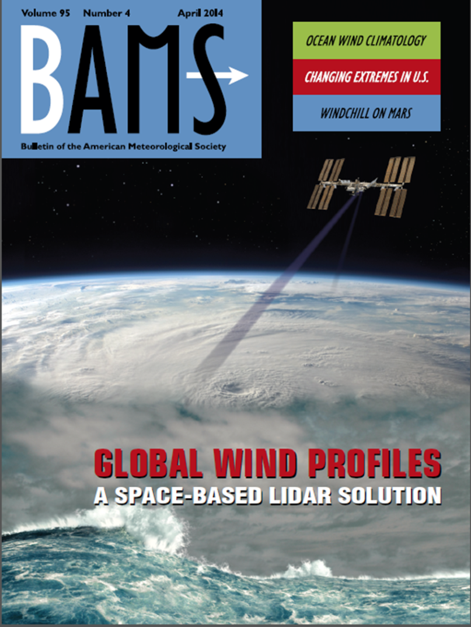
Our Challenge
The Wind Lidar Community has established the importance, value, and promise of space-based lidar over 4 decades – how together do we reach consensus, convince reviewers, and take this next crucial step?
Following are selections from the Science Review:

Slide 9
Highlights/comments on review – Some Strengths
“The capability to measure atmospheric wind profiles globally (especially over the tropics and SH) is perhaps the most glaring weakness of the current global NWP/Climate observing system”. Reviewers well-understood the need for winds for their impact on understanding atmospheric dynamics, NWP, water cycle
OSSEs are understood as important to “provide enhanced confidence that goals .. will be successfully achieved”
“The problem of when and why measured winds are preferred over indirect estimates from the temperature/mass field is well understood”
“ A successful demonstration mission like A-OAWL would provide much needed impetus and potentially accelerate development of the 3-D winds mission”
The aerosol particle distribution with altitude developed by Simpson Weather was not questioned.

Slide 10
Highlights/comments on review – Some Weaknesses
“The goal of only doubling the wind-profile acquisition rate achieved by the radiosonde network seems surprisingly modest” (though the increased coverage uniformity compared to radiosondes is advantageous) – proposal only used the “background mode” value
  So if 2x is too modest, what is a better value? And what metric drives “better”?
“…. The lidar sensing of wind being a unique capability has unavoidable risk. How does the presence of clouds hinder or change representativeness of measurements”
  Simpson Weather cloud impacts was included, why isn’t this enough?
    These models are included in the OSSEs

Slide 11
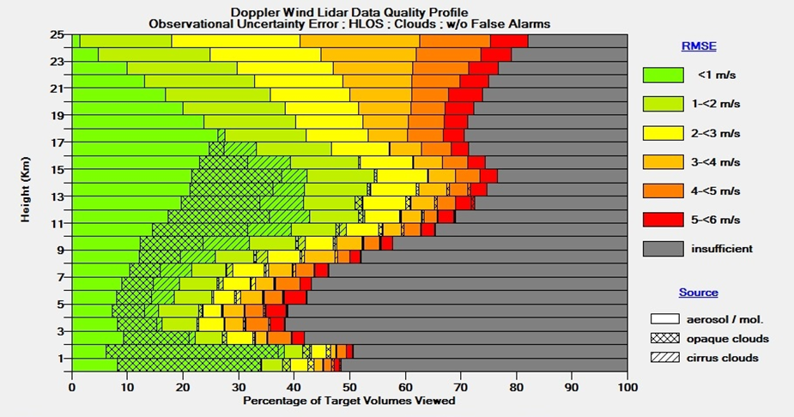
Estimated Global Performance - Night
Predicted A-OAWL performance vs. altitude for nighttime conditions with clouds and with background aerosol mode, demonstrate ~30% or greater percentage of wind estimates with 3 m/s or better precision.
Courtesy of Simpson Weather and Associates – See Monday Talk by Dave Emmitt

Slide 12
Highlights/comments on review – Weaknesses
“Field demonstration has significant shortcomings. The amount of airtime the OAWL airborne demonstrator has logged is small (23 flight hours) and most of the data provided … is from ground based testing/validation”
  What defines what is adequate aircraft time to prove out the measurements to the community?
  Why is ground testing against a NOAA wind lidar as a standard viewed as inadequate?
Note: The TMCO (Technical, Management, Cost and Other) branch of the review does not consider aircraft testing as a relevant environment for space and so it cannot be used to claim technology readiness for space – a driver for the mission readiness and cost.

Slide 13
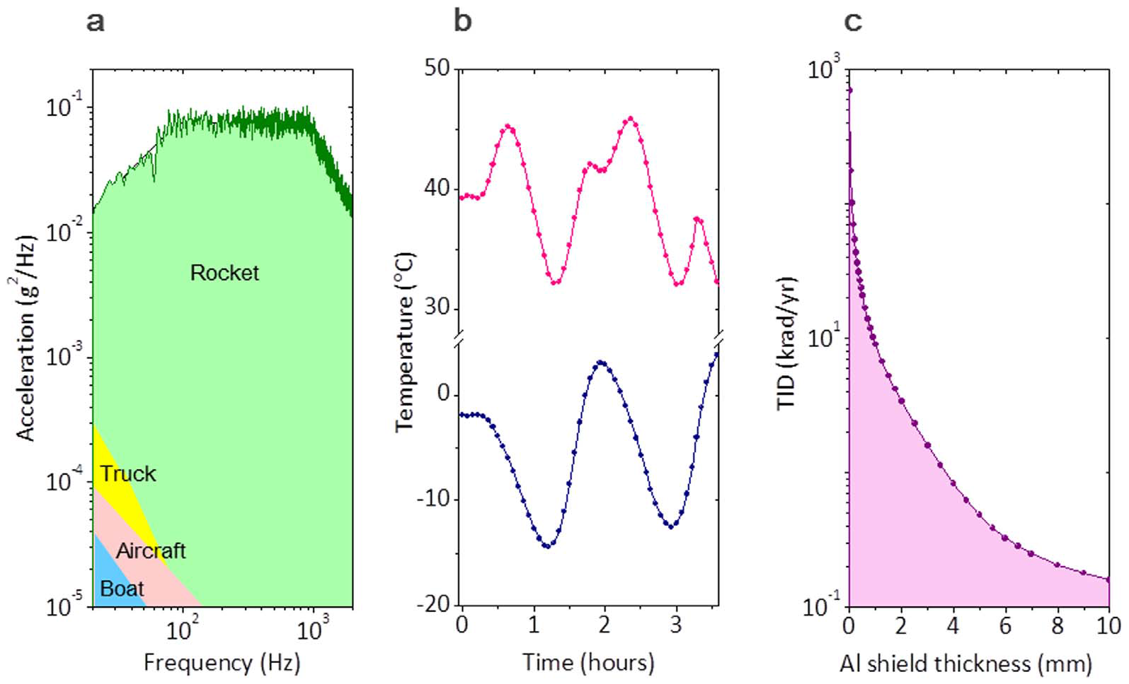
Example of Launch and Space Environment
From J. Lee et al Scientific Reports 2014

Slide 14
Highlights/comments on review – Weaknesses
“The proposal provides insufficient discussion of the methodology validation …. The Radar Winds Profiler ground-based system do not provide quantitative comparisons, and are shown for altitudes up to 6 km.”
  Is there a validation methodology that the community accepts as adequate to prove out that an aircraft based lidar is ready for space?
  How representative does that intercomparison need to be?
  What altitude range, what aerosol range, how spatially co-located, etc?
  Ultimately, what is “good enough” to move forward on an Earth Venture science demonstration (not the 3D – Winds mission)?

Slide 15

Ideas
Under Wayman the WLWG has used different types of advocacy, how can we continue this legacy?
More White Papers – To NRC? Other places?
Special Workshop at AMS on winds?
Topic for the NASA Advisory Committee (NAC)?
Editorials in Space news, letters to editors – Science, Nature
?????

