Slide 1
A US Effort for ADM/Aeolus Calibration and Validation
M. Hardesty, S. Boukabara, A. Brewer, J. Dunion,
D. Emmitt, R. Ferrare, I. Genkova, B. Gentry,
G. Gimmestad, J. Hair, R. Hoffman, C. Hostetler,
M. Kavaya, M. McGill, Z. Pu, S. Tucker, C. Velden, J. Yoe
Aeolus Cal-Val Workshop
9 -13 Feb 2015

Slide 2
Elements of the US Cal-Val Effort for Aeolus
A broad proposal for the US cal-val effort includes multiple organizations, investigators, and instruments
Major components of the efforts are:
  Airborne lidar underflights
    Direct and coherent detection lidars
    Multi-wavelength, HSRL aerosol lidars
  Surface observations during overpasses
    Upward-looking Doppler and aerosol lidars
  Atmospheric Motion Vector Studies
  Data Assimilation Studies

Slide 3
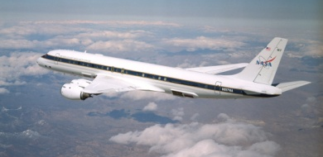
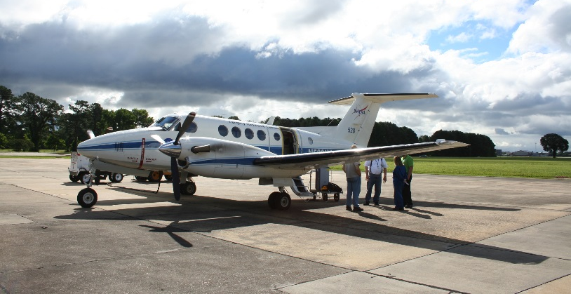
NASA DC-8: DAWN Wind Profiling Lidar (Kavaya)
NASA/Langley DAWN system is a 250 mJ/pulse, 10 Hz nadir-pointing coherent lidar
Wedge scanner provides conical scans
Operated previously on DC-8 for hurricane and arctic studies
More details on DAWN capability in the next talk (Emmitt)
DAWN Lidar vs. dropsonde
1 Sept. 2010, DC-8
Lidar 33 s; dropsonde 13 min.
DAWN Lidar vs. ground radar
12 June 2013, UC-12B
Lidar 23 s; radar 30 min.

Slide 4
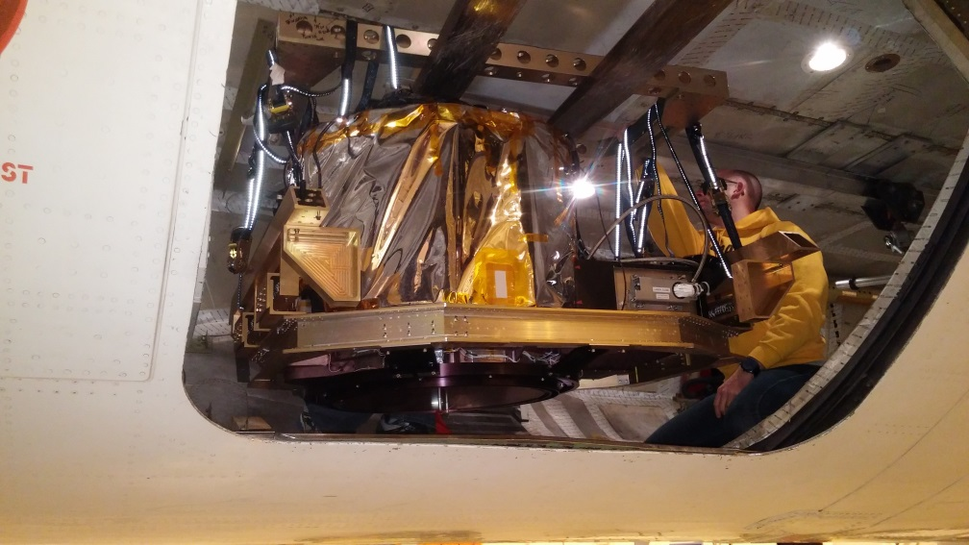
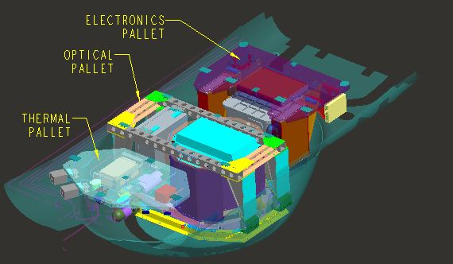
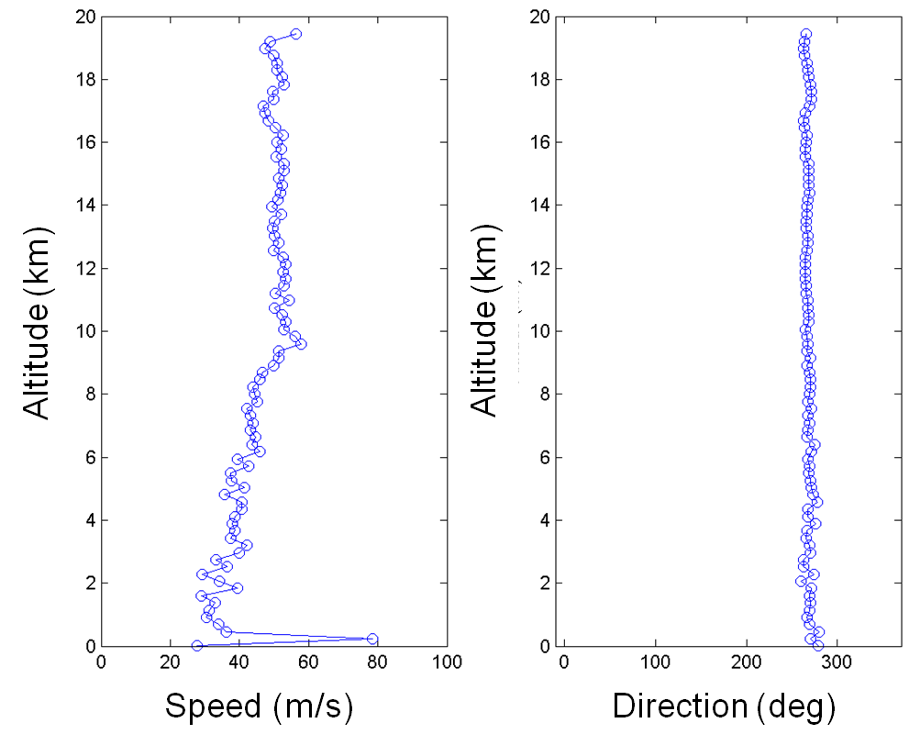
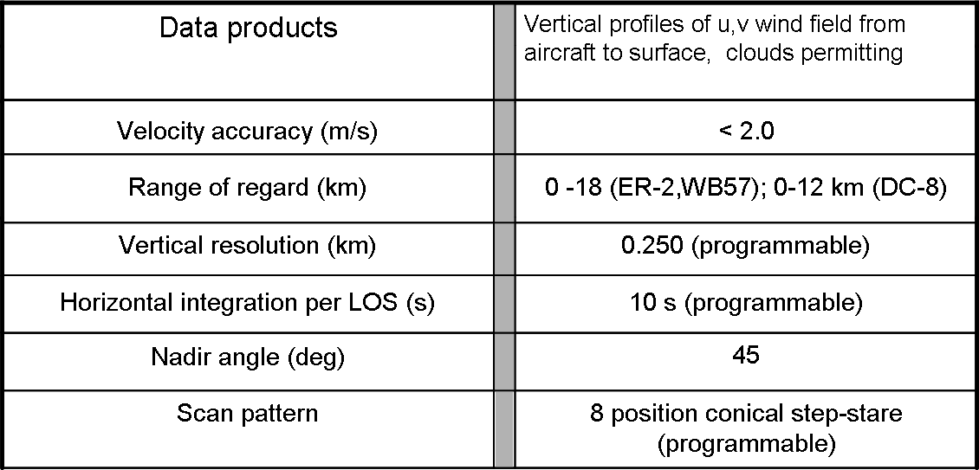
Potential NASA DC-8 – TWiLiTE (Gentry)
TWiLiTE is a compact, molecular direct detection scanning Doppler lidar designed to measure wind profiles in clear air from 20 km to the surface.
TWiLiTE is modular and operates autonomously on NASA research aircraft (ER-2, DC-8, WB-57, Global Hawk).
Engineering flight tests on the NASA ER-2 in 2009, 2011 and 2012 demonstrated autonomous operation of all major systems.
TWiLiTE was recently configured to fly in Zone 25 of the NASA Global Hawk (AV6) and is now being modified to install in the DC-8.
TWiLiTE system configured for the Global Hawk
TWiLiTE Performance Summary
Speed (m/s)
Direction
Notes:
TWiLiTE was developed as an IIP program funded by NASA ESTO. Additional support from the AITT program allowed integration and flight testing on the NASA ER-2.
TWiLiTE Supports the 3DWinds NRC Decadal Survey Mission. It represents the direct detection molecular or ‘clear air’ portion of the recommended ‘Hybrid Doppler lidar concept’. The coherent Doppler lidar utilizes aerosol backscatter a complementery measurement capability and is the other half of the Hybrid concept.
(Lower left panel) The TWiLiTE Doppler lidar operates at 355 nm in the uv and measures wind profiles by measuring the Doppler shift of the laser backscattered return from molecules in the atmosphere using a ‘double edge’ etalon receiver (similar to the ADM-Aeolus molecular channel).
Designed to measure full profiles of horizontal winds from the flight altitude of the NASA ER2 or Global Hawk (20 km) to the surface with 250 m vertical resolution and <2 m/s accuracy
Advances TRL of key technologies identified for future space missions e.g the single frequency uv NdYAG laser; the molecular Doppler receiver; Tunable Fabry-Perot etalon filter and the rotating conically scanned telescope.
These technologies have all been demonstrated at the system level in engineering flights of TWiLiTE on the NASA ER-2 high altitude aircraft in 2009, 2011 and 2012.
TWiLiTE was reconfigured, but not flown, for the NASA Global Hawk as part of the Hurricane and Severe Storm Sentinel (HS3) Venture Class Mission.
Small modifications to the instrument are underway to allow integration on the NASA DC-8 in the Nadir Port 2 location (DAWN goes in Nadir 7).
DC-8 flights are planned in February, 2015 to validate TWiLiTE performance on the DC-8

Slide 5
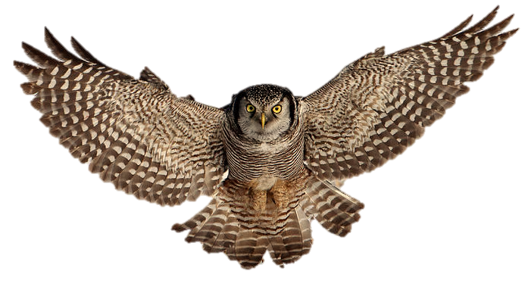
HAWC-OAWL (“HAWC”)
NASA WB-57: ATHENA-OAWL and HAWC-OAWL
Airborne OAWL demonstrations (Tucker)
ATHENA-OAWL Venture-Tech
Green-OAWL (GrOAWL): wind measurements at the 532 nm wavelength
High altitude (15-20 km) NASA WB-57 flights out of Houston: Johnson Space Center Ellington Field
  Develop robust airborne platform/data system and demonstrate performance
  First flights planned for April/May 2016: Aiming to have 355 nm HAWC channels online for these flights, TBD. (best comparison for Aeolus)
  Primary focus: OAWL validation. Flight plans around ground-based radiosondes, potential for automated dropsonde system on WB-57
  Secondary focus: Underfly Aeolus for comparison.
Team: University of Colorado-Mike Hardesty (PI), Ball-Sara Tucker, Fibertek -Floyd Hovis.
HSRL (High Spectral Resolution Lidar) for Aerosols, Winds, and Clouds
(HAWC) using Optical Autocovariance Wind Lidar (OAWL)
  OAWL: Wind measurements at 532 nm & 355 nm wavelengths
  HAWC: Adding concurrent HSRL (aerosol backscatter (β), extinction (α), and
  depolarization (δ) ) retrievals to OAWL winds
A NASA Earth Science Technology Office Instrument Incubator Program (IIP)
Additional flights tentatively late 2016/Early 2017: Focus on wind + HSRL data
Flight location TBD
A northern hawk-owl

Slide 6
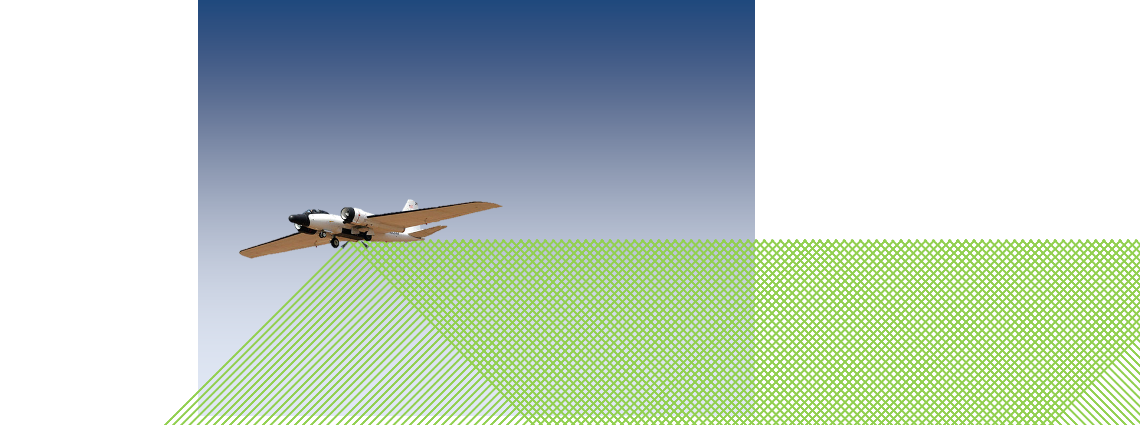
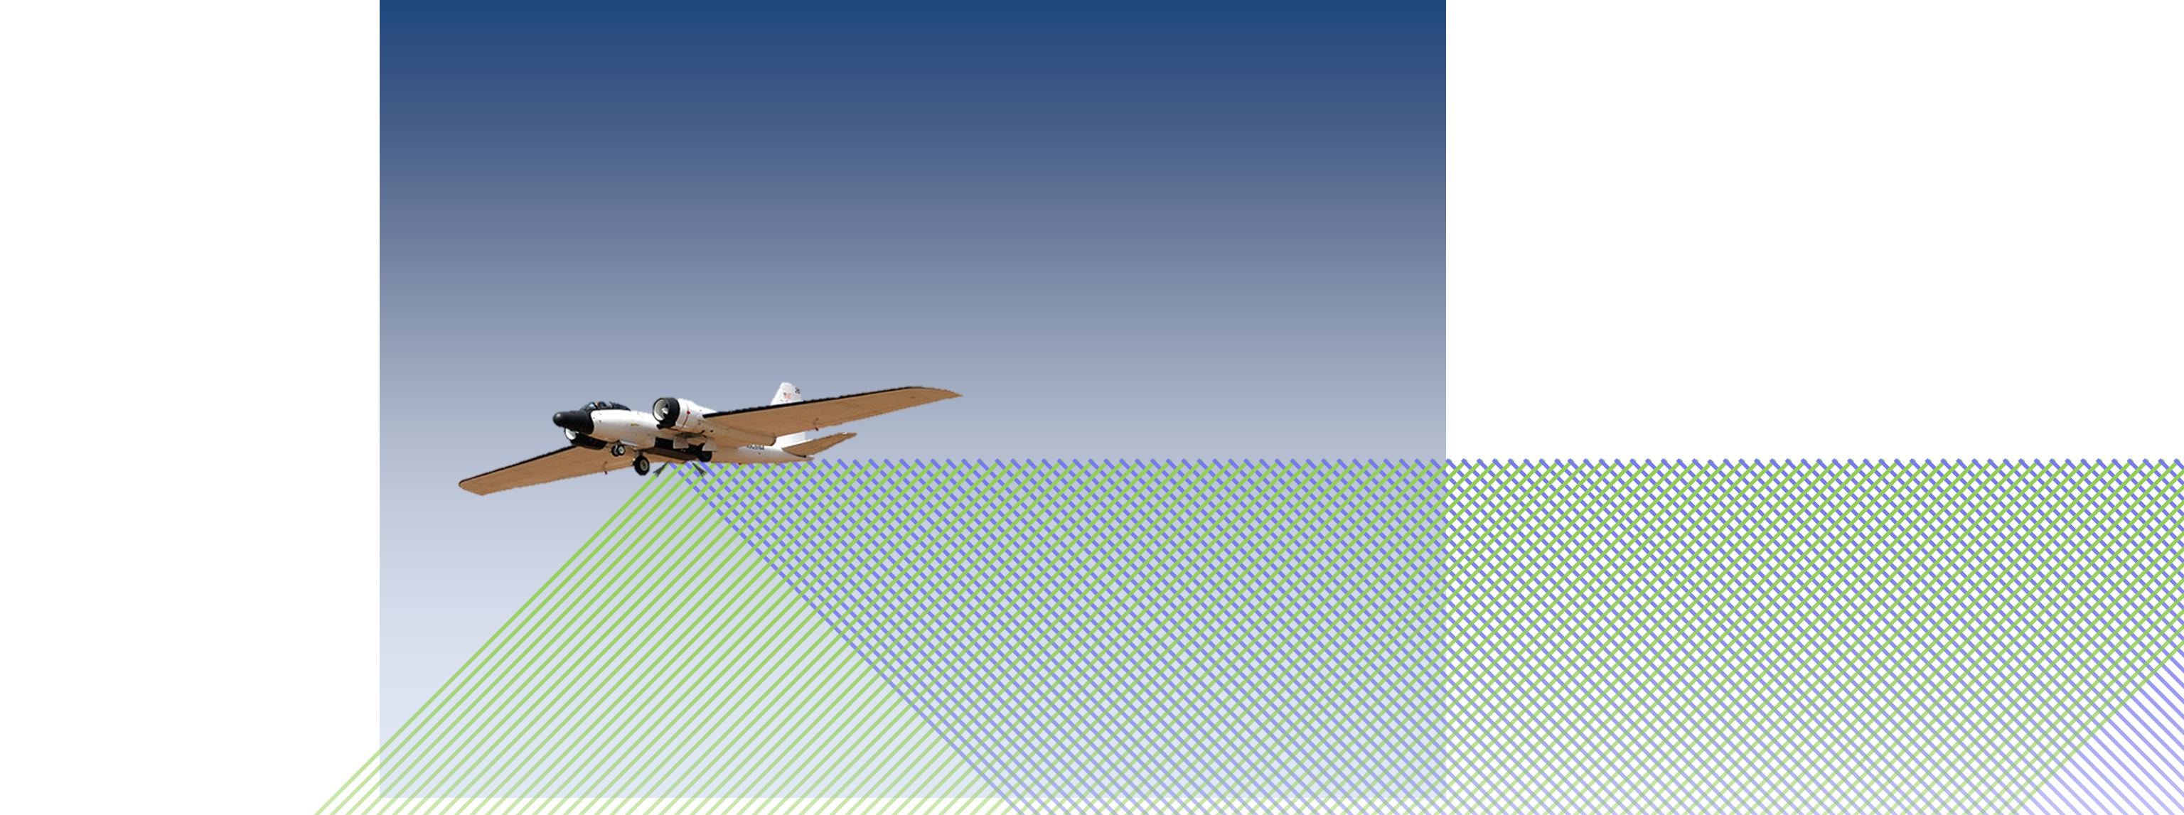
Two Looks from the NASA WB-57 aircraft
AOVT & HAWC: Airborne Systems
  Two telescopes
  Two looks
AOVT: Two lasers for an ATHENA-like configuration - one per direction.
  Existing OAWL laser
    Runs at both 355 nm & 532 nm wavelengths – use 532 nm only
  Second (new) Fibertek laser
    532 nm wavelength only
    355 nm compatible with future upgrades
  Lasers with alternate pulses (looks)
    2x200 Hz PRF = 400 Hz PRF for the data system
    2x150 Hz planned for space version
HAWC: adds 355 nm wavelength channels
  Existing OAWL laser still used
  Add 355 nm data channels and processors
  Data acquisition is 50% higher rate (two processor boards)
AOVT
HAWC-OAWL

Slide 7
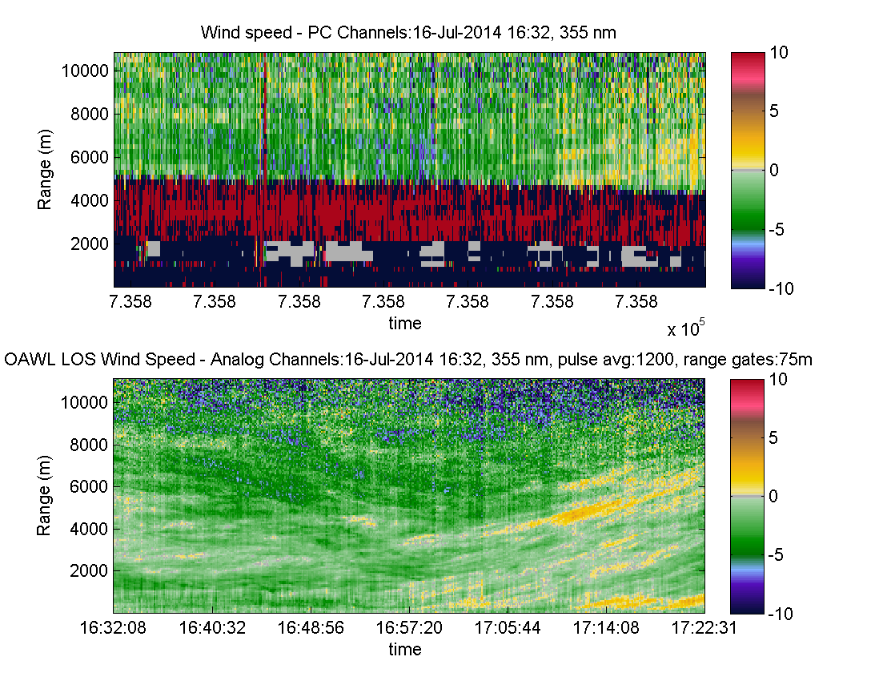
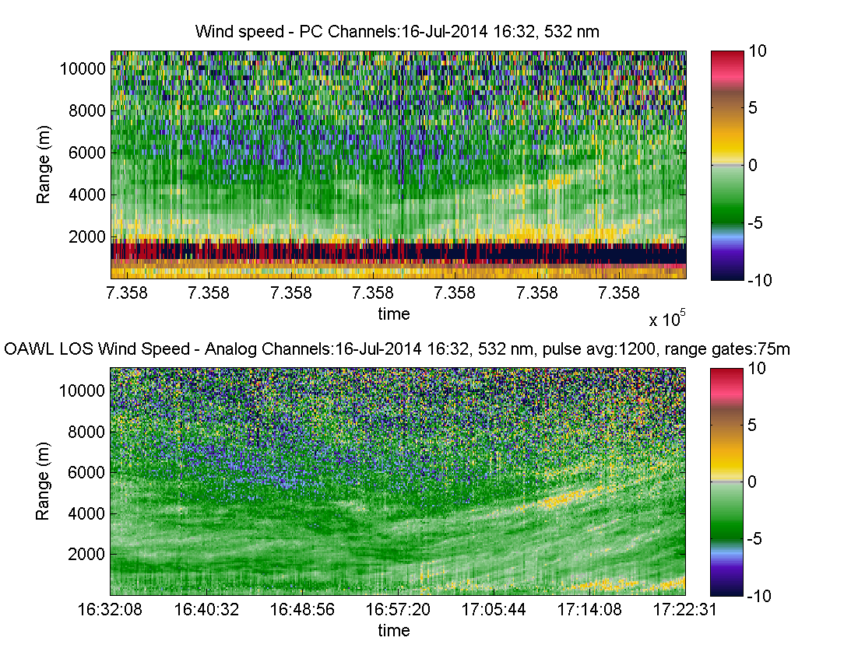
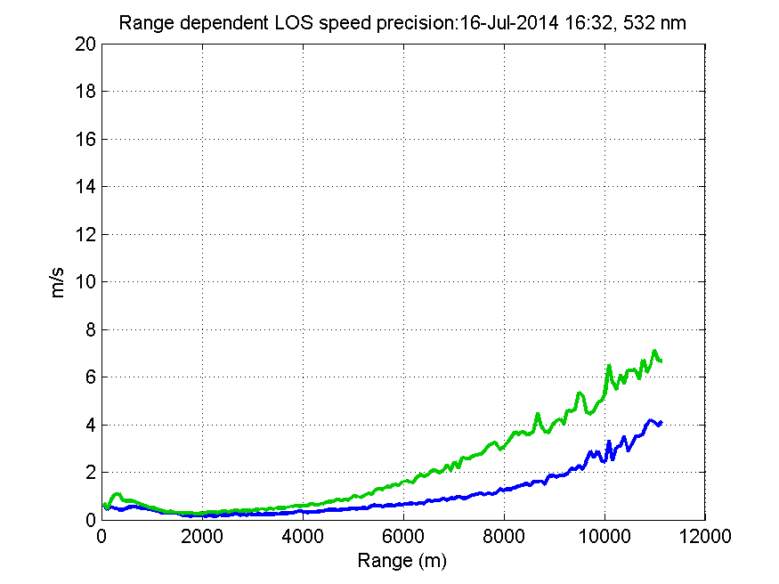
355 & 532 nm Winds using OAWL
Horizontal views out to > 11km (analog)
75m, 6s accumulation
Strong extinction (~0.3 km⁻¹)
355 nm
~ 4W
532 nm
<0.4 W
Precision (m/s)

Slide 8
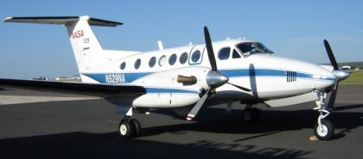
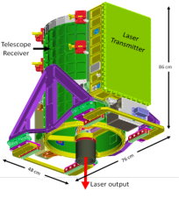
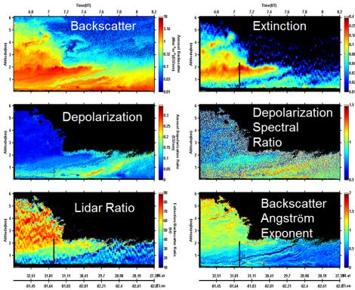
NASA Langley Airborne HSRL-1 (Hostetler, Hair, Ferrare)
Typically deployed on NASA/LaRC King Air
Also flown on NASA P-3
Flight altitude ~ 9 km
Nadir pointing lidar
HSRL Technique:
Independently measures aerosol backscatter, extinction, and optical thickness
HSRL-1 Aerosol Data Products:
Backscatter coefficient (532,1064 nm)
Depolarization (532, 1064 nm)
Extinction Coefficient (532 nm)
Optical Depth (AOD) (532 nm)
Mixed Layer (ML) Height
Aerosol Classification

Slide 9
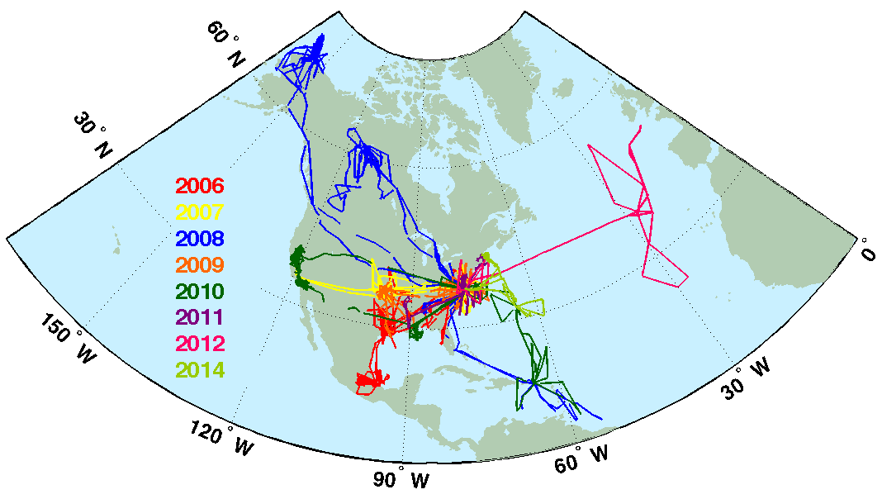


The NASA Langley HSRL-1 instrument has flown extensively in diverse regions and different seasons
NASA LaRC Airborne HSRL-1 has flown on 26 field missions since 2006
During this time, it has acquired >1000 hours of data on >350 flights
LaRC UC-12
Airborne HSRL-1 data have been used to:
  Validate satellite measurements (CALIPSO, MODIS, MISR)
  Provide detailed aerosol measurements for air quality studies
  Evaluate regional (WRF-Chem) and global (GEOS-5, ECMWF) aerosol models
  Evaluate aerosol measurements from airborne in situ instruments
  Classify aerosol types for evaluating models and satellite retrievals
Notes:
9
Shown here is our HSRL-1 instrument. It implements the HSRL technique at 532 nm and the standard backscatter technique at 1064 nm. It is also polarization sensitive at both wavelengths.
This is a workhorse instrument used for many purposes: satellite validation (CALIPSO, MODIS, MISR); ….
The accuracy of the measurements is due not only to the implementation of the HSRL technique but also to significant attention to calibration. Standard backscatter lidars must calibrate to the atmosphere: typically one looks for regions that are aerosol-free; however, there is always some aerosol present and the calibration hence requires a guess on the backscatter contribution by the aerosols in the scene. HSRL-1 is internally calibrated in several respects, and does not require any assumptions about the scene to retrieve accurate products.
It has also been a very reliable instrument. We have flown the instrument in over 330 flights for over 1000 hours of operation. If memory serves we have only missed one flight due to an instrument problem.

Slide 10
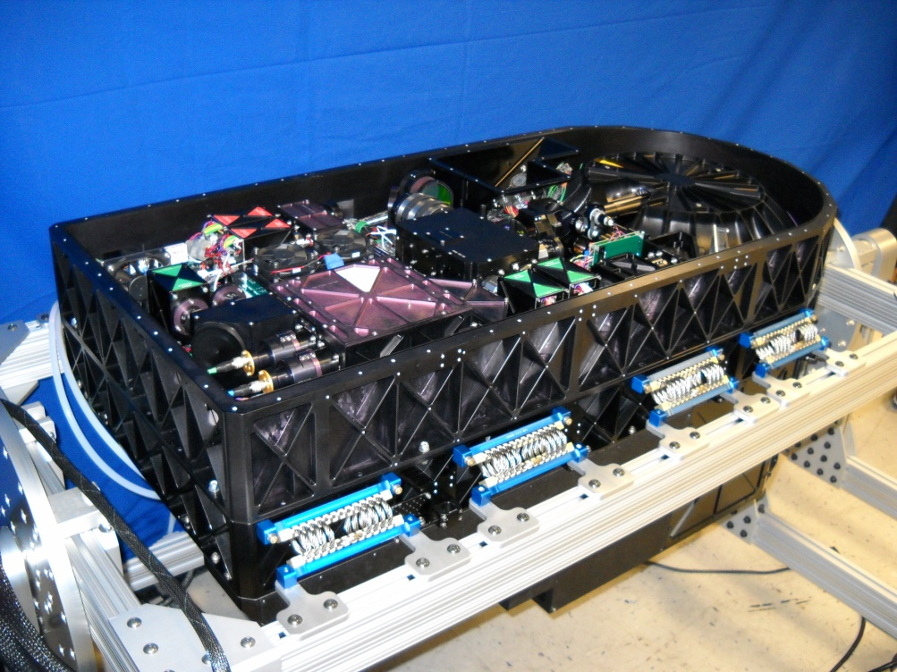
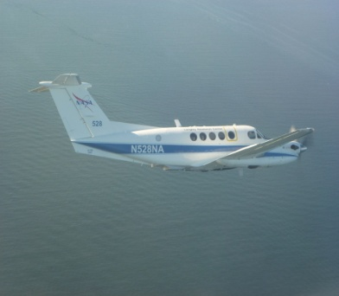
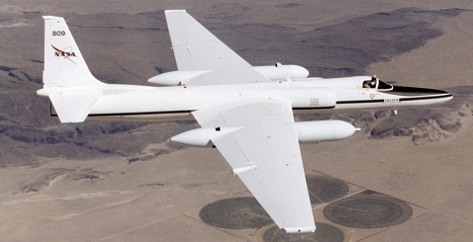
Second Generation HSRL-2: 3β+2α+3δ Lidar
IIP-04 and AITT-07
HSRL-2
B200 King Air
ER-2
Measurements
  Backscatter: 355, 532, 1064 nm (3β)
  Extinction 355 and 532 nm (2α)
  Depolarization at 3 wavelengths (3δ)
Deploys on ER-2 and other aircraft
Flown on 4 field missions to-date
Fully operational data processing code
Notes:
To demonstrate the technology and assess the required retrievals, we are building a full-up ACE lidar simulator for the ER-2. We hope to be conducting test flights within a year and plan fly the instrument on the Southeast Asia field mission in 2012. This prototype along with other ACE prototype instruments will allow us to look at lidar-only retrievals as well as combined lidar-polarimeter retrievals and lidar-radar retrievals.
10

Slide 11
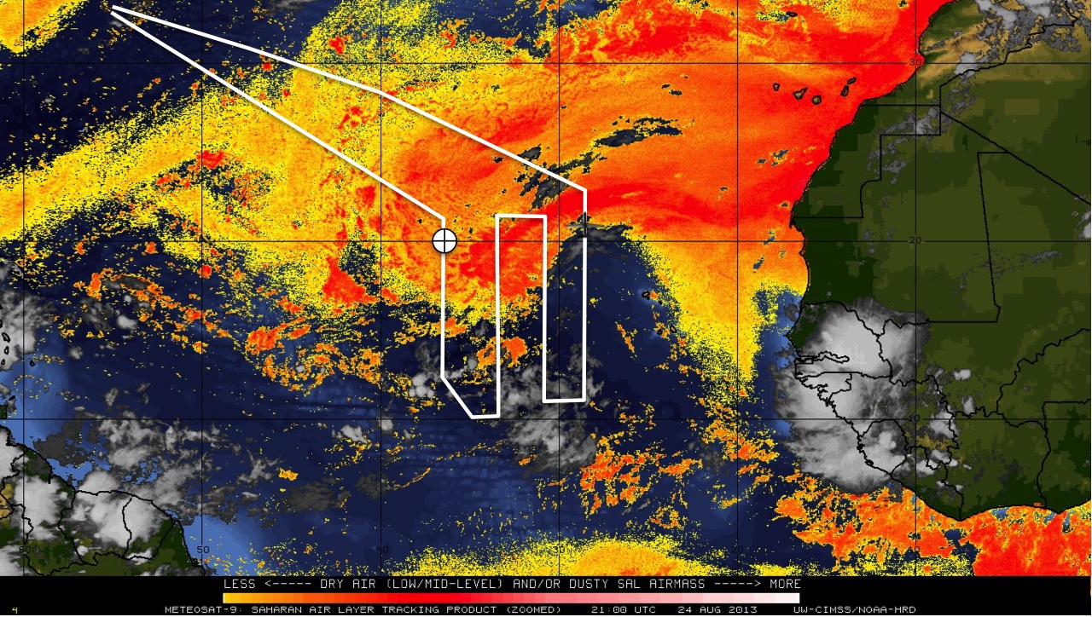
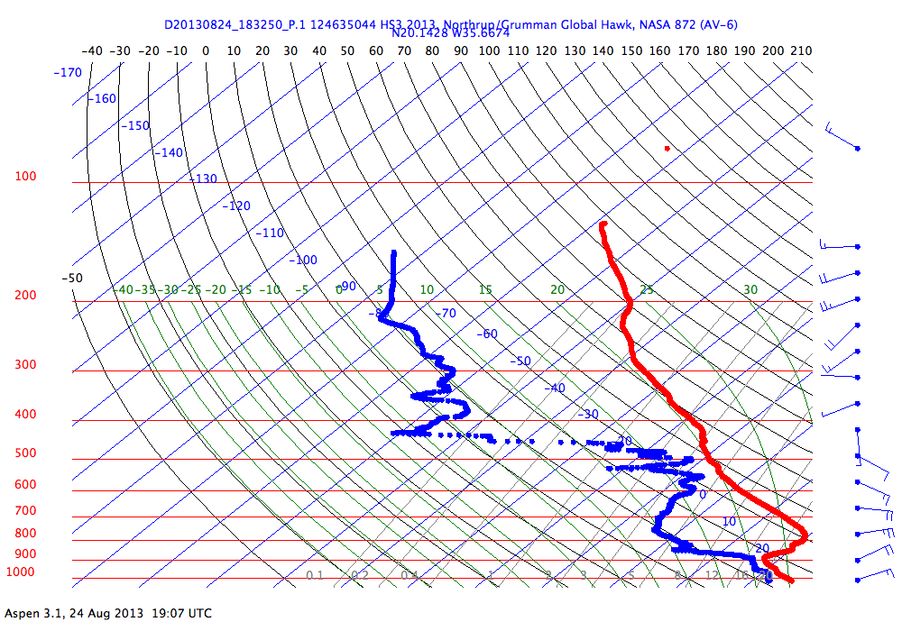
Aeolus Cal/Val: Saharan Aerosol Layer (Dunion)
Objectives:
Obtain aircraft measurements of wind speed and aerosol structure/backscatter/extinction under the Aeolus flight track using GPS dropsondes and the NOAA P-3 Doppler Wind Lidar;
Analyze aircraft measurements to assess precision, bias, errors, sources of error, and representativeness of Aeolus measurements >> improve Aeolus methods & algorithms;
Compare Aeolus retrieved radial winds with collocated GPS dropsonde observations made by the NOAA G-IV high altitude jet and P-3 Orions flying in the environments of the SAL and TCs, and examine the capability of Aeolus to measure important dynamical features in these regions;
NASA Global Hawk Mission: 24 August 2013
GPS Dropsonde Profile: 1833 UTC
Saharan
Air Layer
Saharan
Air Layer
Dewpoint
Temperature
African Easterly Jet: 38 kt
SAL

Slide 12
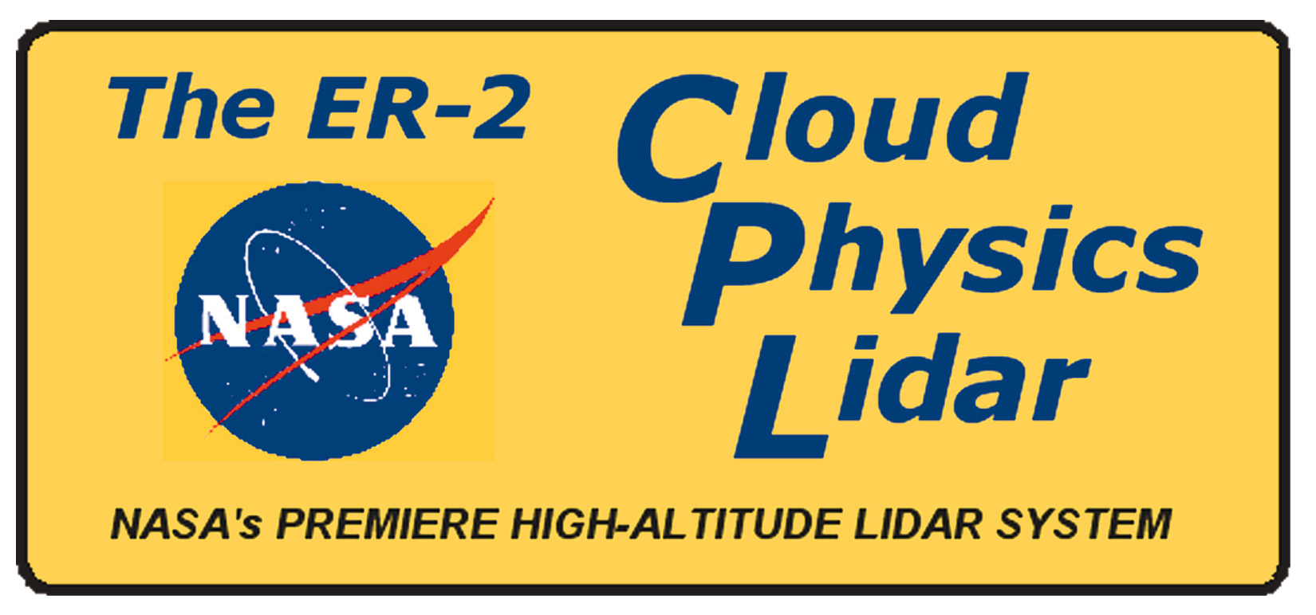
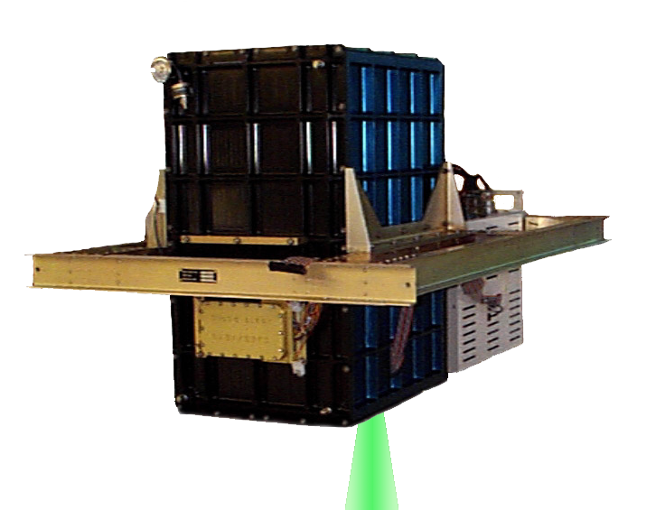
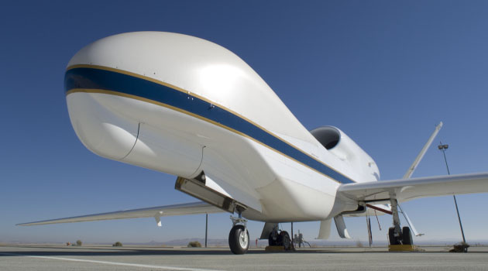
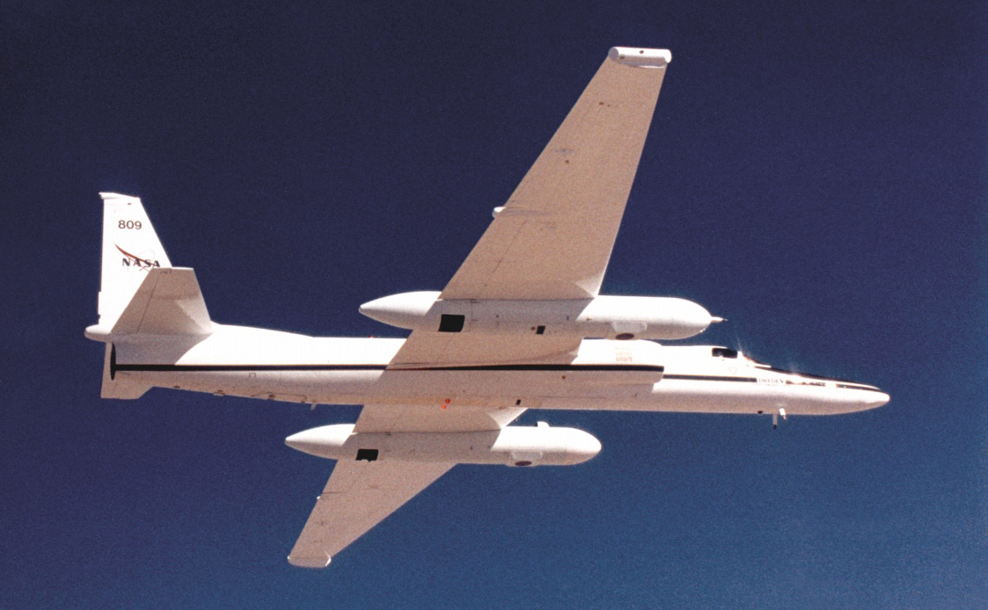
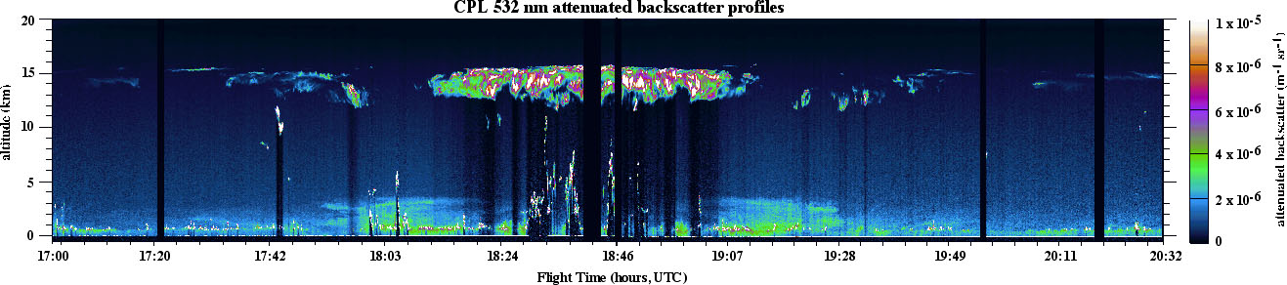
The Cloud Physics Lidar (McGill)
CPL is a self-contained, autonomous backscatter lidar
optical depth
extinction
depolarization
subvisual cirrus
cirrus
Saharan dust
low-level cumulus
convective clouds
boundary layer aerosol

Slide 13
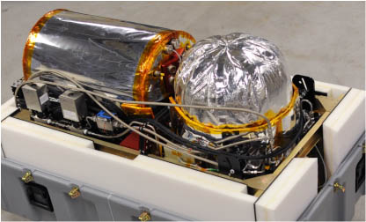
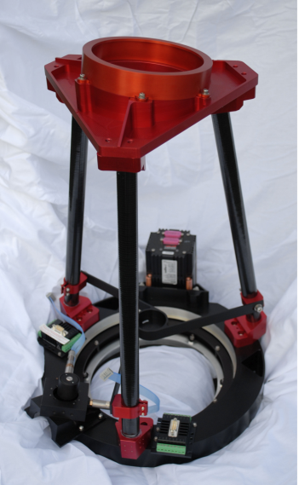
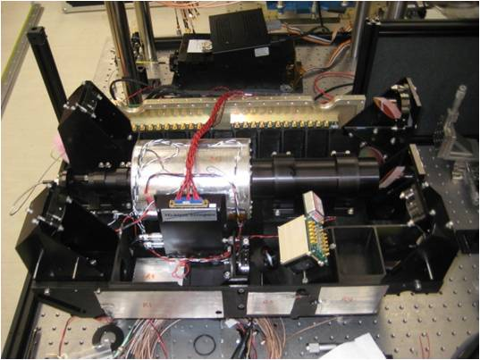
Airborne Cloud-Aerosol Transport System
(ACATS) instrument
From single wavelength (532 nm) profiling at 45 degrees:
1) Direct measurements:
a) Line-of-sight wind profile
b) Corrected backscatter ratio profile
c) Layer and surface locations
Semi-direct measurements assuming atmospheric density profile
(from radiosonde or similar):
a) Corrected particulate backscatter profile
b) Particulate extinction profile
c) Cumulative particulate optical depth profile
d) Particulate extinction-to-backscatter ratio (S) profile
e) Aerosol/cloud discrimination
Telescope Subsystem
Receiver Optics and Etalon

Slide 14
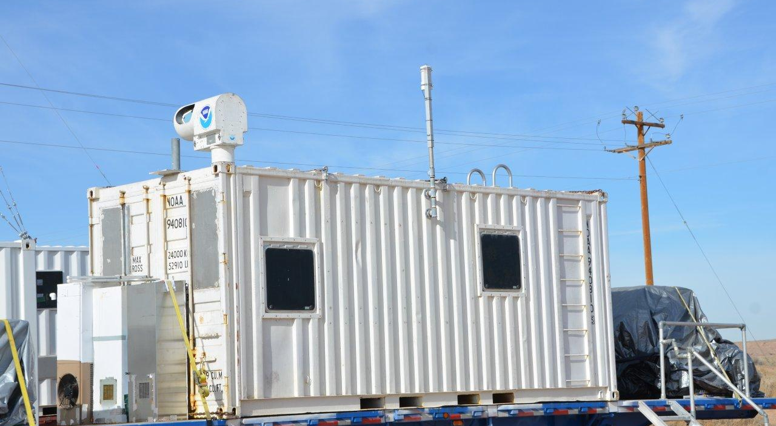
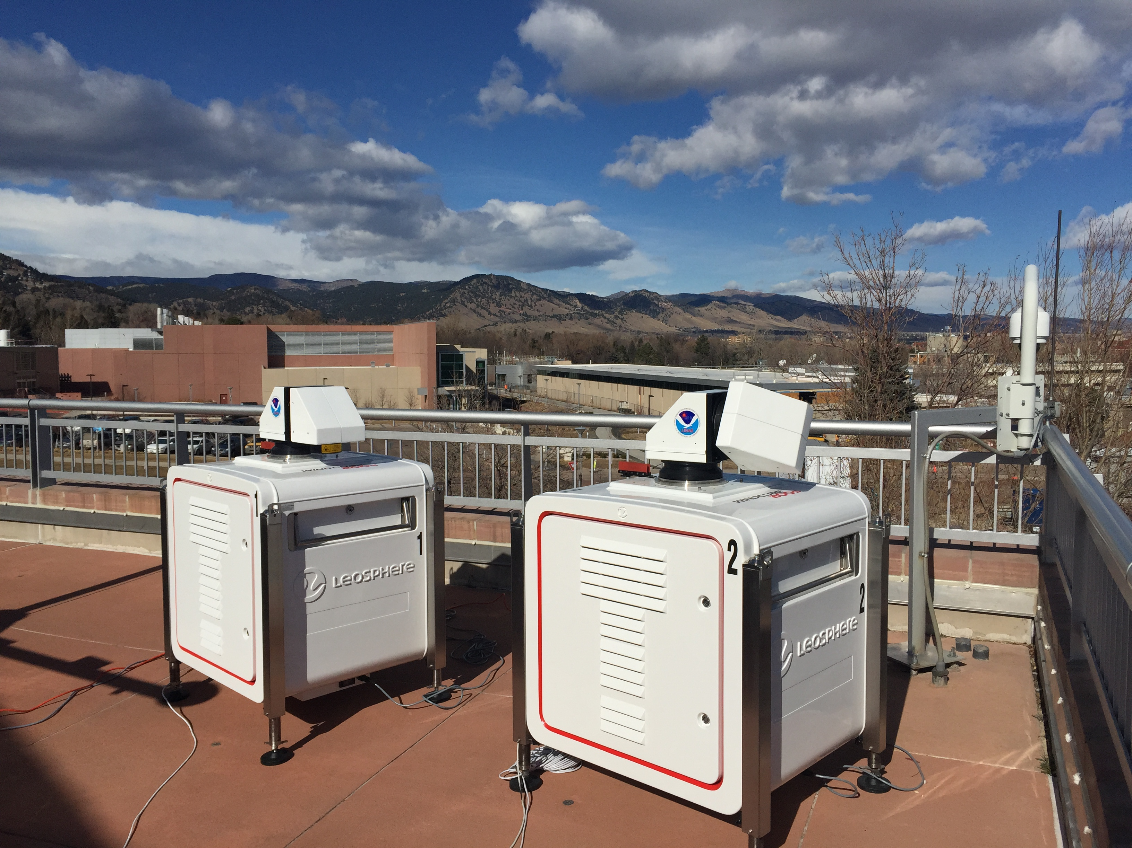
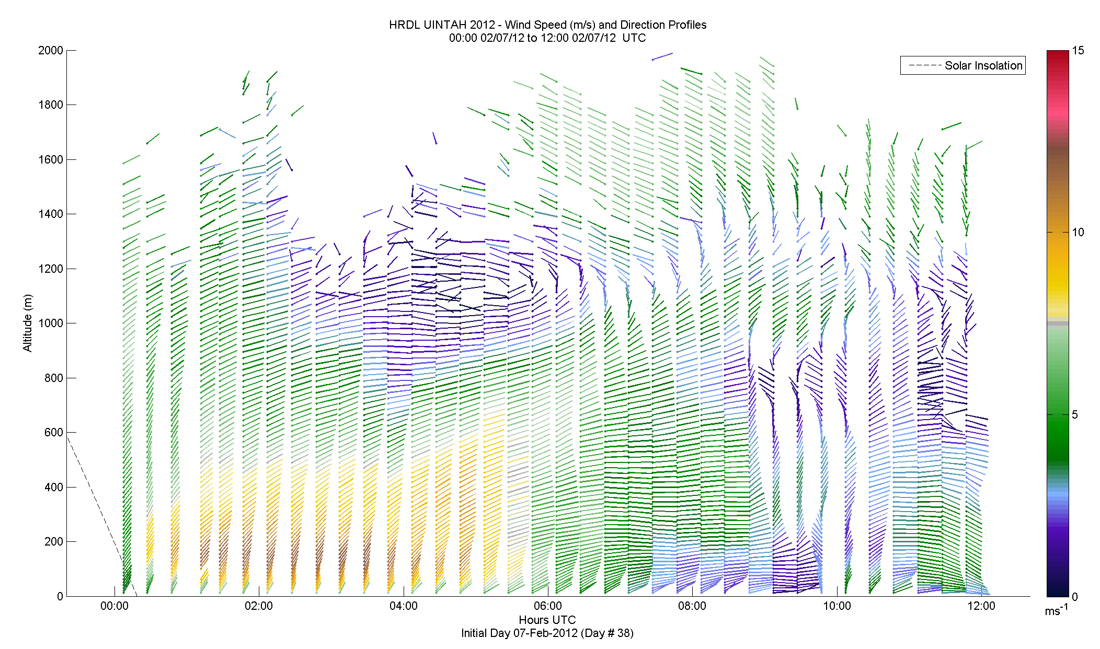
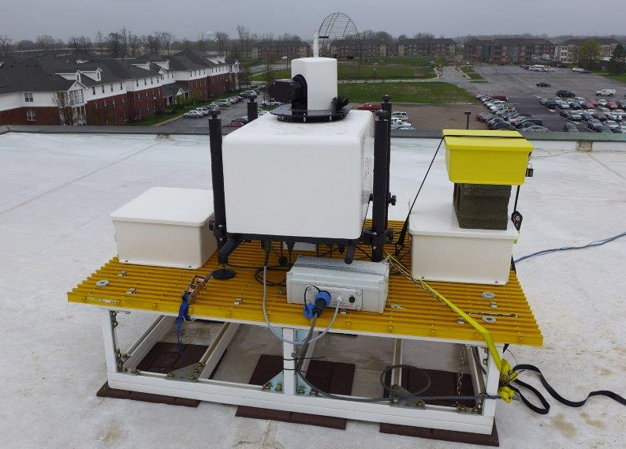
NOAA surface wind measurements (Brewer)
NOAA operates four coherent Doppler lidars for ground-based, boundary layer studies
These lidars operate unattended for extended periods of time, generating several profiles per hour
During Spring 2016 the instruments will be deployed in Washington, Colorado, and Indiana

Slide 15
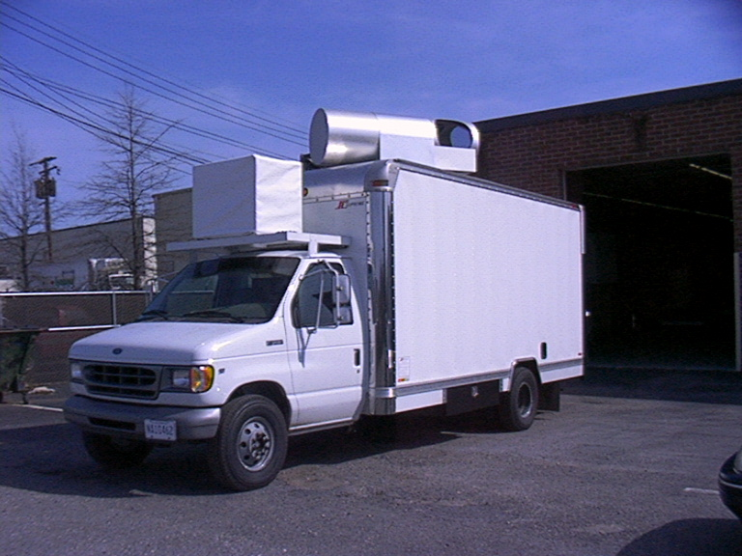
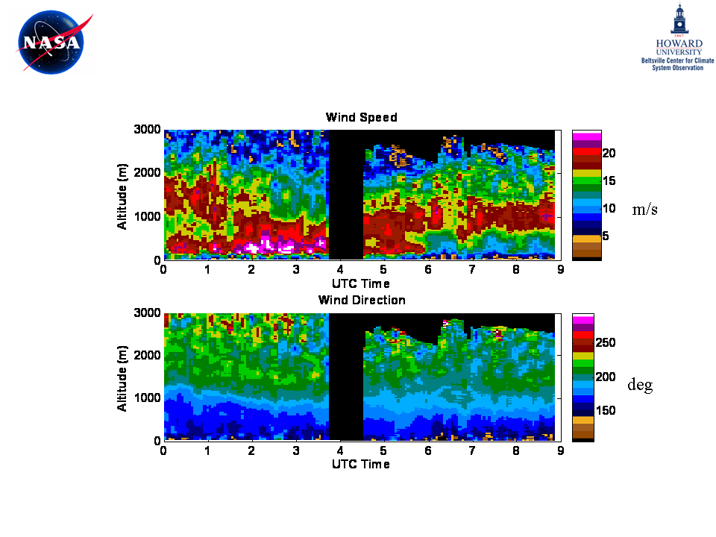
Goddard Lidar Observatory for Winds (GLOW) (Gentry)
Time series of GLOW lidar profiles of wind speed and direction from IHOP_2002. June 20, 2002.
Data Products:
Radial wind speed profiles
Wind speed and direction profiles derived from multiple LOS
Useful altitude range: 0.1 to 30 km
Minimum range res: 45 m
Azimuth/Elevation range: 0-360 deg/ 0-90 deg
Velocity Accuracy (typ): 0.3 to 5 m/s (signal dependent)
Notes:
15

Slide 16
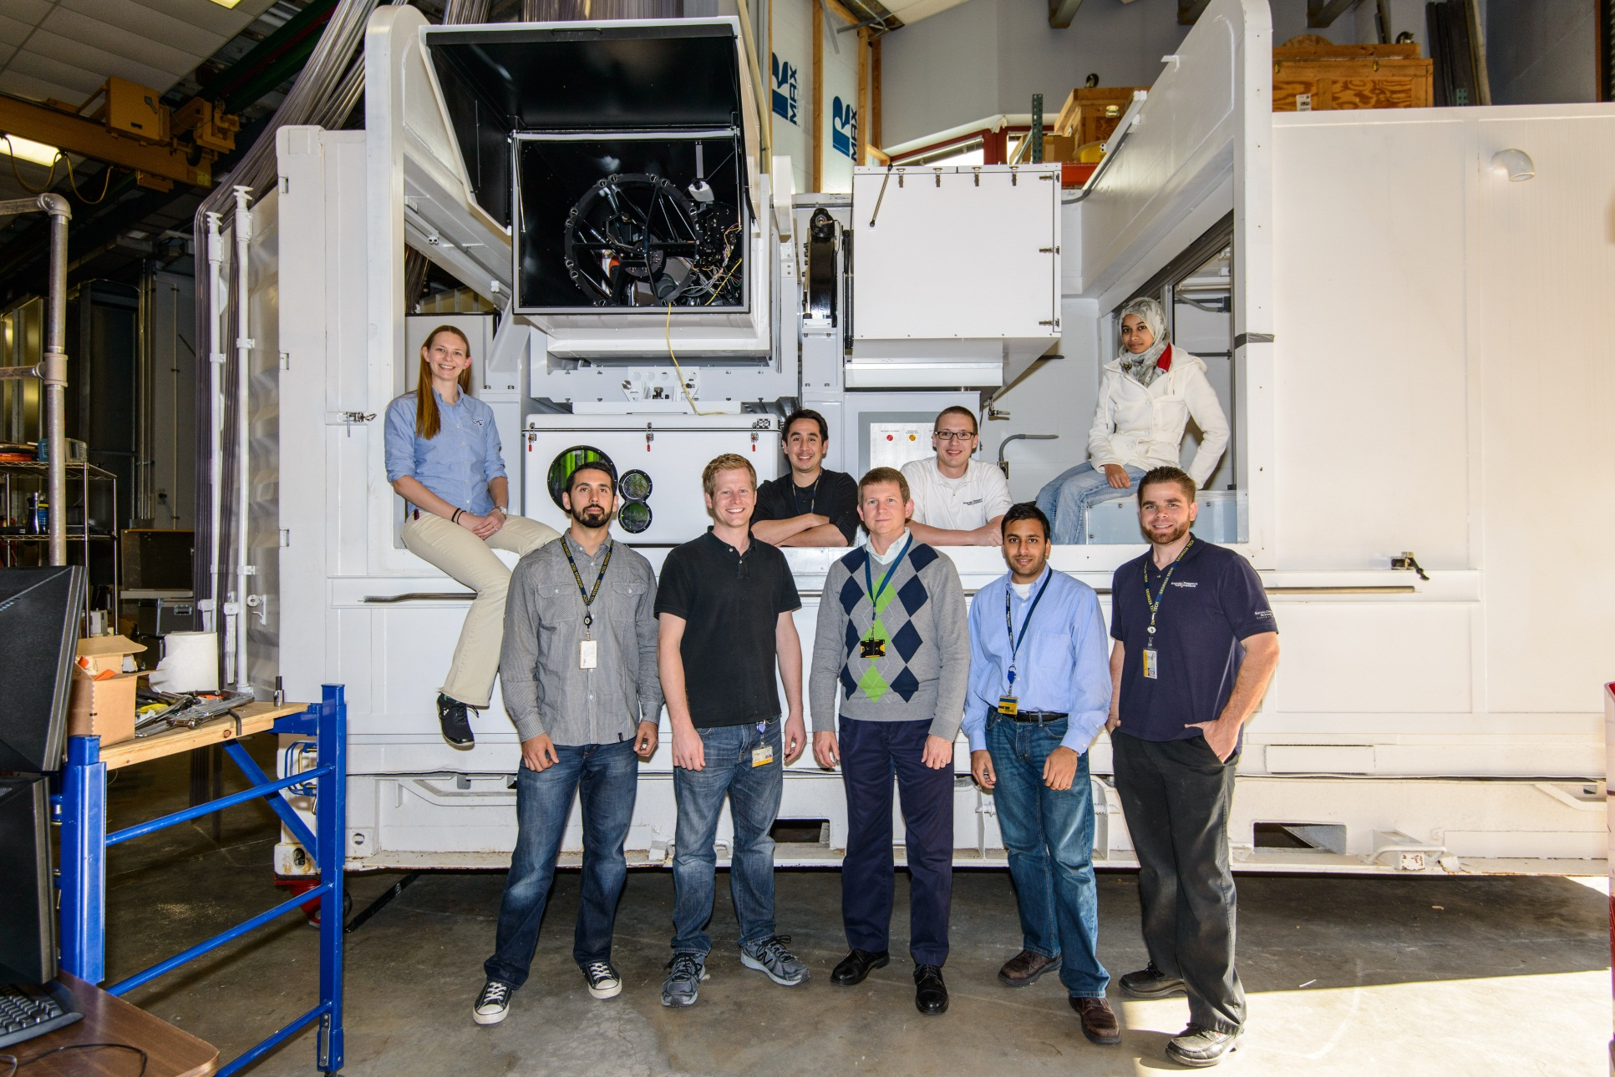
Ground-based aerosol studies: GTRI H₂O Raman lidar (Gimmestad)
Transportable, in modified 20-foot
shipping container.
On two-axis mount, with elevation angles
from horizontal to vertical.
Based on NASA GSFC designs:
  Pulse Energy: 300 mJ
  Wavelengths: 0.3547 μm transmitted
                0.3547 μm received (elastic)
            0.3867 μm received (N2)
            0.4075 μm received (H2O)
  PRF: 50 Hz
  Receiver aperture diameter: 50.8 cm
  Detectors Hamamatsu R9880 PMTs
  Data acquisition Licel hybrid analog/photon counting system
Notes:
We do not have a wind-sounding lidar, but we do have a very capable 355 nm lidar that is transportable and pointable.
Dave Whiteman was a consultant on this project, so the lidar design is very much a copy of NASA GSFC technology.
The laser is a custom injection-seeded model from Continuum.
There are actually three lidars in the overall package. It also includes a Cimel sun photometer and a weather station.
The project took about 6 years and cost $7 M.
We are just finishing it up now. The sponsor is going to GFE the whole system to Georgia Tech! We can use it however we wish.
Perhaps it will be useful for L2A data products (molecular & aerosol backscatter, PBL height, cloud geometrical and optical properties).
GTRI is 33 degrees 46 minutes N and 84 degrees 23 minutes W, at 336 m MSL.

Slide 17
JCSDA Data Assimilation (Boukabara, Yoe)
Via Joint Center for Satellite Data Assimilation
  NASA’s Global Modeling and Assimilation Office
    GEOS-5 Model and GSI analysis
  NOAA’s NESDIS/STAR and NWS/NCEP
    GFS Model and GSI, 4D Hybrid DAS
JCSDA will investigate ADM/Aeolus DWL wind assimilation as well as that for AMVs
- Compile Innovation Statistics
      L2b products from ECMWF, KNMI processors
- Perform Data Impact Experiments LOS winds
      Use multiple standard forecast diagnostics
      Data selection criteria, observations error statistics based on innovations initially

Slide 18
Comparing ADM-Aeolus winds to conventional Atmospheric Motion Vectors (AMVs) (Velden and Genkova)
Compare ADM Aeolus global-coverage line-of-sight wind profiles with current state of the art feature-tracked AMVs.
  By comparing the ADM wind profiles with this global AMV data set, ADM vector coverage, quality and differences with AMVs will be documented, thus assessing the complementary value of the ADM winds to the existing upper-air winds observing system.
Investigate how ADM-Aeolus wind profiles can be used to assess the uncertainty introduced by the assumption that cloud and water features are ideal tracers, and additionally interpret how the ADM cloud top heights and cloud-independent wind vector altitudes correlate.
  Such study would be most valuable over ocean where limited RAOBs are available for similar type studies. Further analysis will improve utilization of the U and V winds components separately in NWP models.

Slide 19
Aeolus data for optimizing
AMV’s (Hoffman)
Optimize use of AMVs by comparing to AEOLUS winds and cloud tops
Co-location of AEOLUS and AMVs to develop joint statistics
  Identify and possible correct cloud top assignment errors.
  Determine best vertical averaging of analysis system first guess (background) by testing versus DWL profiles.
Test these ideas in data impact studies with the Research to Operations DA system at JCSDA.
Use Aeolus data to improve the AMVs in an analogous way that the Global Precipitation Measurement Mission Precipitation Radar is used as the standard to improve precipitation retrieved from IR/MW.

Slide 20
Summary and Future Plans
A variety of assets from the US can potentially be brought to bear for Aeolus calibration and validation: airborne, surface-based, AMV studies, assimilation and modeling
After this workshop we will move forward to develop the implementation plan for the efforts
Key aspect: prioritize the efforts and secure funding

