Slide 1
Preparing for ADM cal/val using DAWN and TWiLiTE in two arctic campaigns
G. D. Emmitt and S. Greco
Simpson Weather Associates
M. J. Kavaya, G. Koch and U. Singh
NASA LaRC
B. Gentry
NASA GSFC
Wind Lidar Working Group Meeting
Boulder, 2015

Slide 2
NASA’s PolarWinds and ADM Cal/Val
Two Campaigns:
Campaign 1 November 2014 on UC-12B based Kangerlussuaq, Greenland
Campaign 2 May 2015 on DC-8 based Keflavik, Iceland
Purposes are to conduct basic polar science investigations and to demonstrate technology readiness for ADM Cal/Val
Critical support from NASA Headquarters (Kakar) and LaRC(Singh)
Science and Instrument Team
Emmitt (SWA) , Principal Investigator
M. Kavaya(NASA/LaRC), Technology Lead
G. Koch (NASA/LaRC), Instrument Chief Engineer
S. Greco (SWA)
K.Godwin (SWA)
D. Bromwich (OSU)
K. Heins (OSU)
J. Cassano (CU)
R. Foster (U Wash)
M. Shapiro (NCAR)
D. Winker (NASA/LaRC)
B. Gentry (NASA/GSFC), TWiLiTE Lead

Slide 3
Background
The launch of ESA's wind measuring Atmospheric Dynamics Mission (ADM) is currently scheduled for 2016-2017.
Although ESA has conducted preliminary studies of the predicted instrument performance utilizing ground-based lidars (2006, 2007) and airborne lidars (2007, 2008, and 2009), they have also expressed a desire for additional pre-launch exercises beginning this spring (2015) that would include joint USA-ESA airborne DWL flights near Iceland/Greenland.
The combination of ESA's airborne A2D and 2um Doppler lidars coupled with NASA's coherent detection DAWN (Doppler Aerosol WiNd lidar) and direct detection TWiLiTE would provide the critical combination of similar and dissimilar technologies appropriate for cross technology calibrations.

Slide 4
Campaign 1 Objectives
Demonstrate the readiness of DAWN to participate in the joint ESA/NASA exercises in the spring of 2015
Conduct underflights of currently orbiting sensors (MODIS, ASCAT and CALIPSO) to refine techniques for cal/val between a space-based lidar and an airborne set of sensors
Conduct tests to evaluate the optimal scanning configurations of the DAWN to support ADM cal/val questions to be addressed in May 2015.
Use this opportunity to conduct a subset of the Polar Winds and Arctic science objectives such as model validation and the documentation and analysis of lower level atmospheric phenomenon such as low-level jets, organized large eddies and other boundary layer flows.
Tomorrow morning

Slide 5
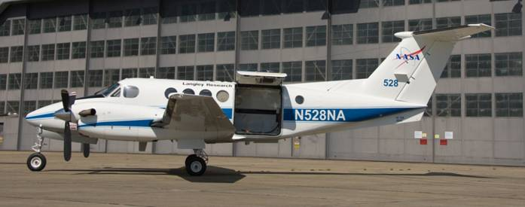
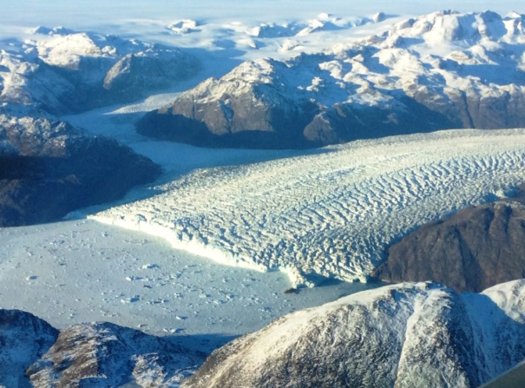
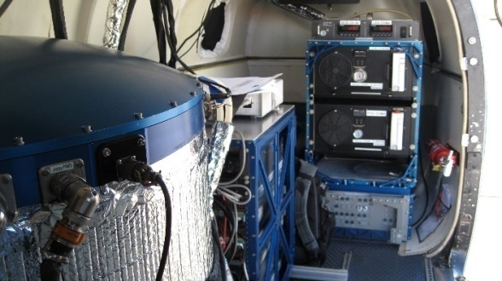
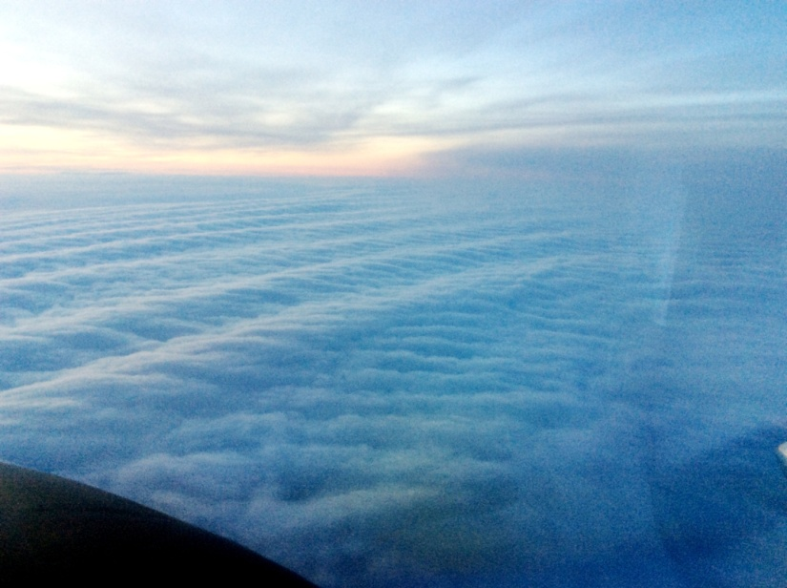
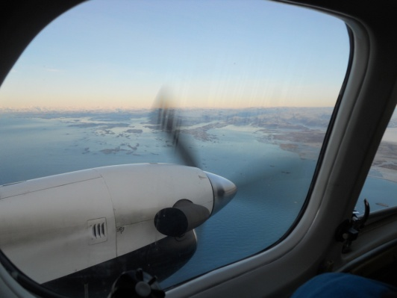
NASA/LaRC UC-12B
ADM/PolarWinds Campaign1
2014
2 um
220 mJ
10 Hz
15 cm
DAWN
Complex terrain
and surfaces
Stable Boundary Layer Laboratory
Coastal transitions

Slide 6
Mission Types
Satellite Under Pass (SUP) missions
Model Validation (MVAL) missions
ADM Cal/Val (ADM_CV) missions
OLE experiments
Tip Jet missions
Ice Cap Missions

Slide 7
General Missions Summary
14 flights on 13 days
~ 45.5 science flight hours
22 ADM simulation segments
3 CALIPSO segments
~ 10 MODIS segments
~ 10 ASCAT segments
2 “Tip Jet” missions
Numerous missions overflying the Ice Cap and regions of BL rolls/waves.

Slide 8
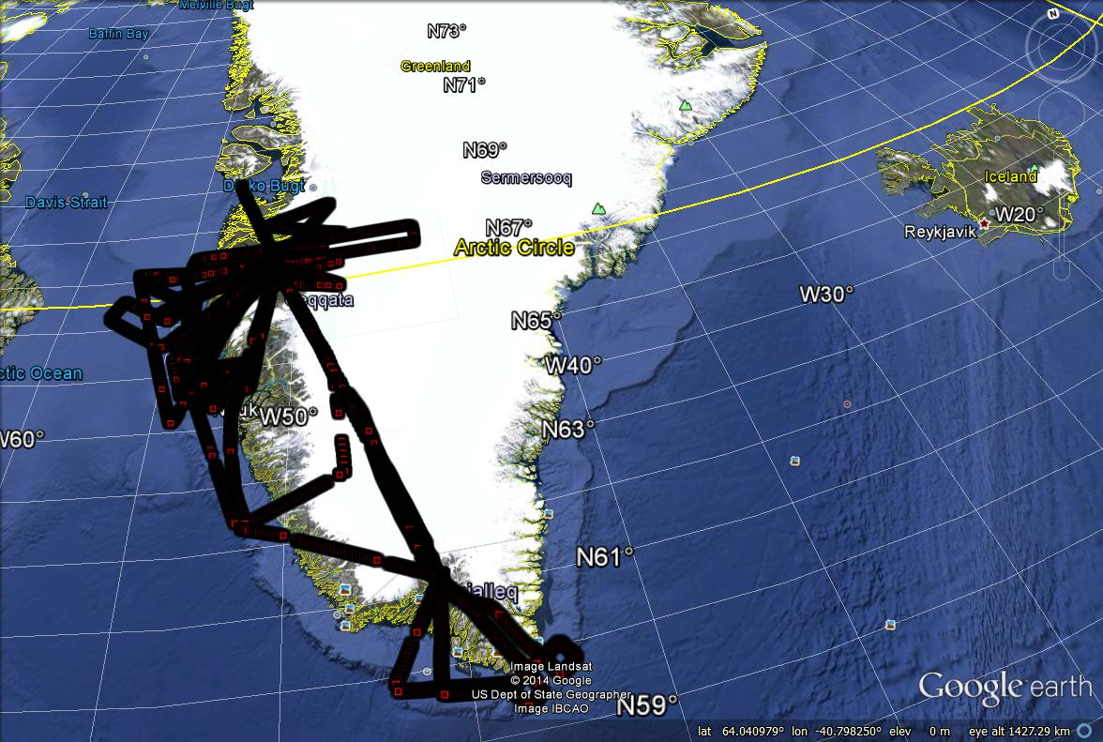
Composite of flight tracks

Slide 9
ADM Cal/Val practice
Primary issues addressed
Heterogeneous backscatter situations with wind shear.
Blowing snow/ice adjacent to the surface
Water/salt sprays adjacent to the sea surface during white cap situations
22 cases of 50 -75 km legs with single perspective stare
6 over ice
4 snow/land
12 over water
2 visible cloud free
7 partly cloudy
3 clouds below

Slide 10
Changing integration parameters
Post flight processing coherent wind observations with a range of vertical and horizontal resolutions.
Computing average winds over 50 -75 km flight segments in an Aeolus manner and comparing to the non-SNR weighted coherent measurements
Coherent (<50m vertical, 200m – 1km horizontal)
Direct (250m vertical, 1km -75km horizontal)

Slide 11
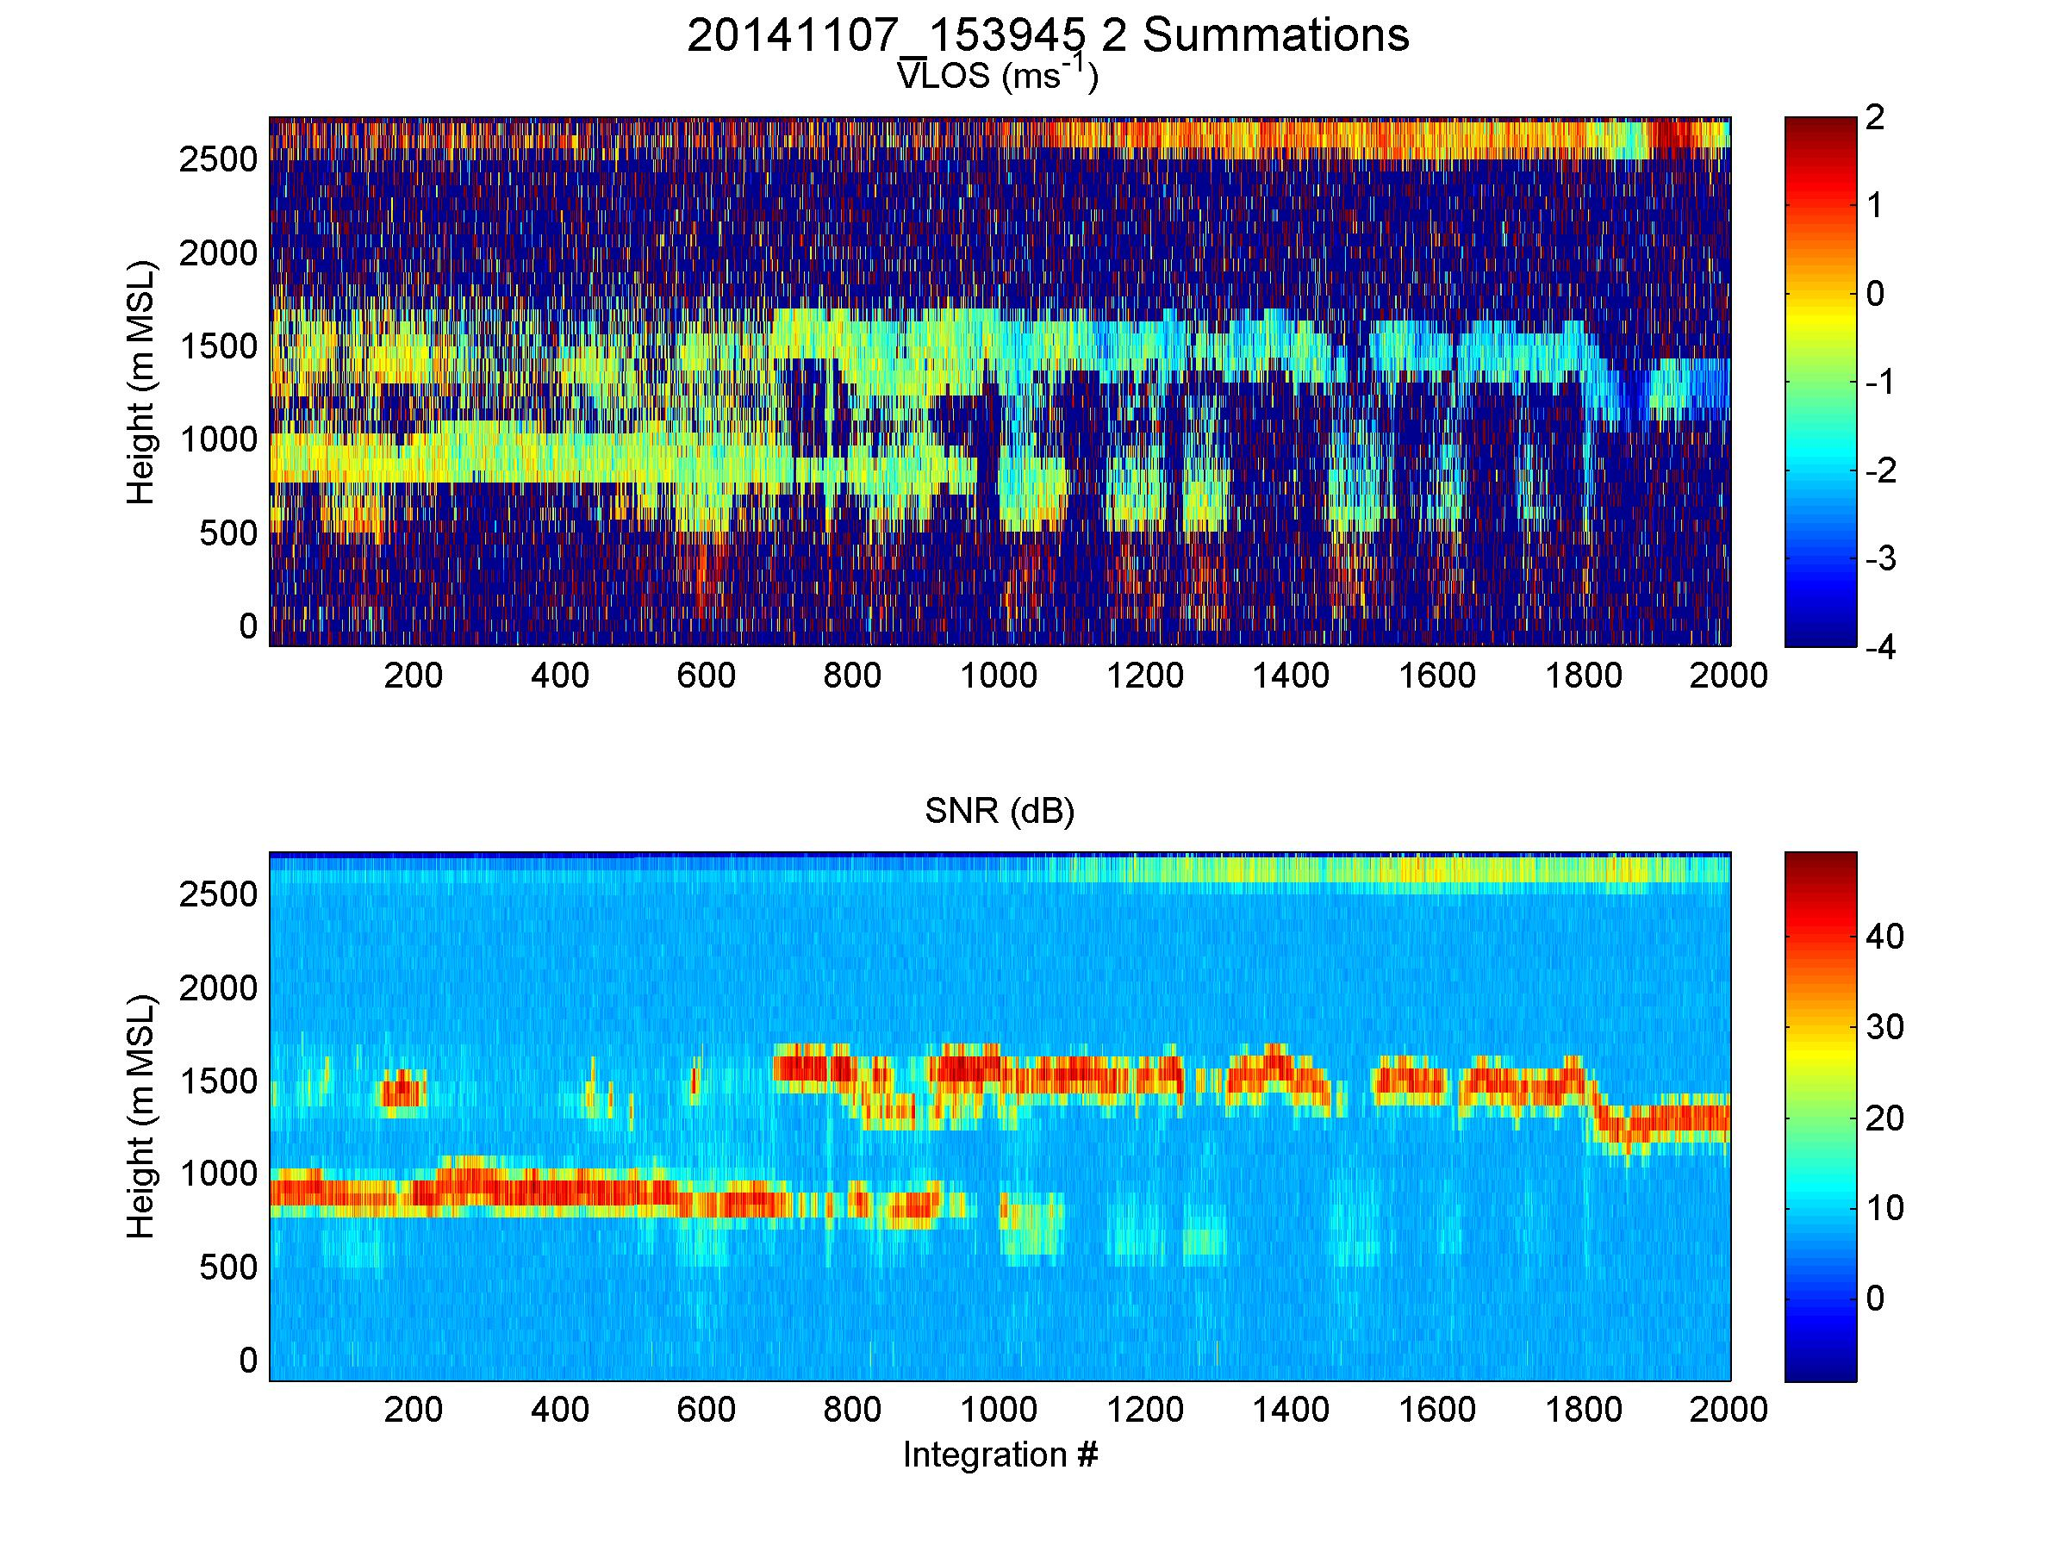
20m

Slide 12
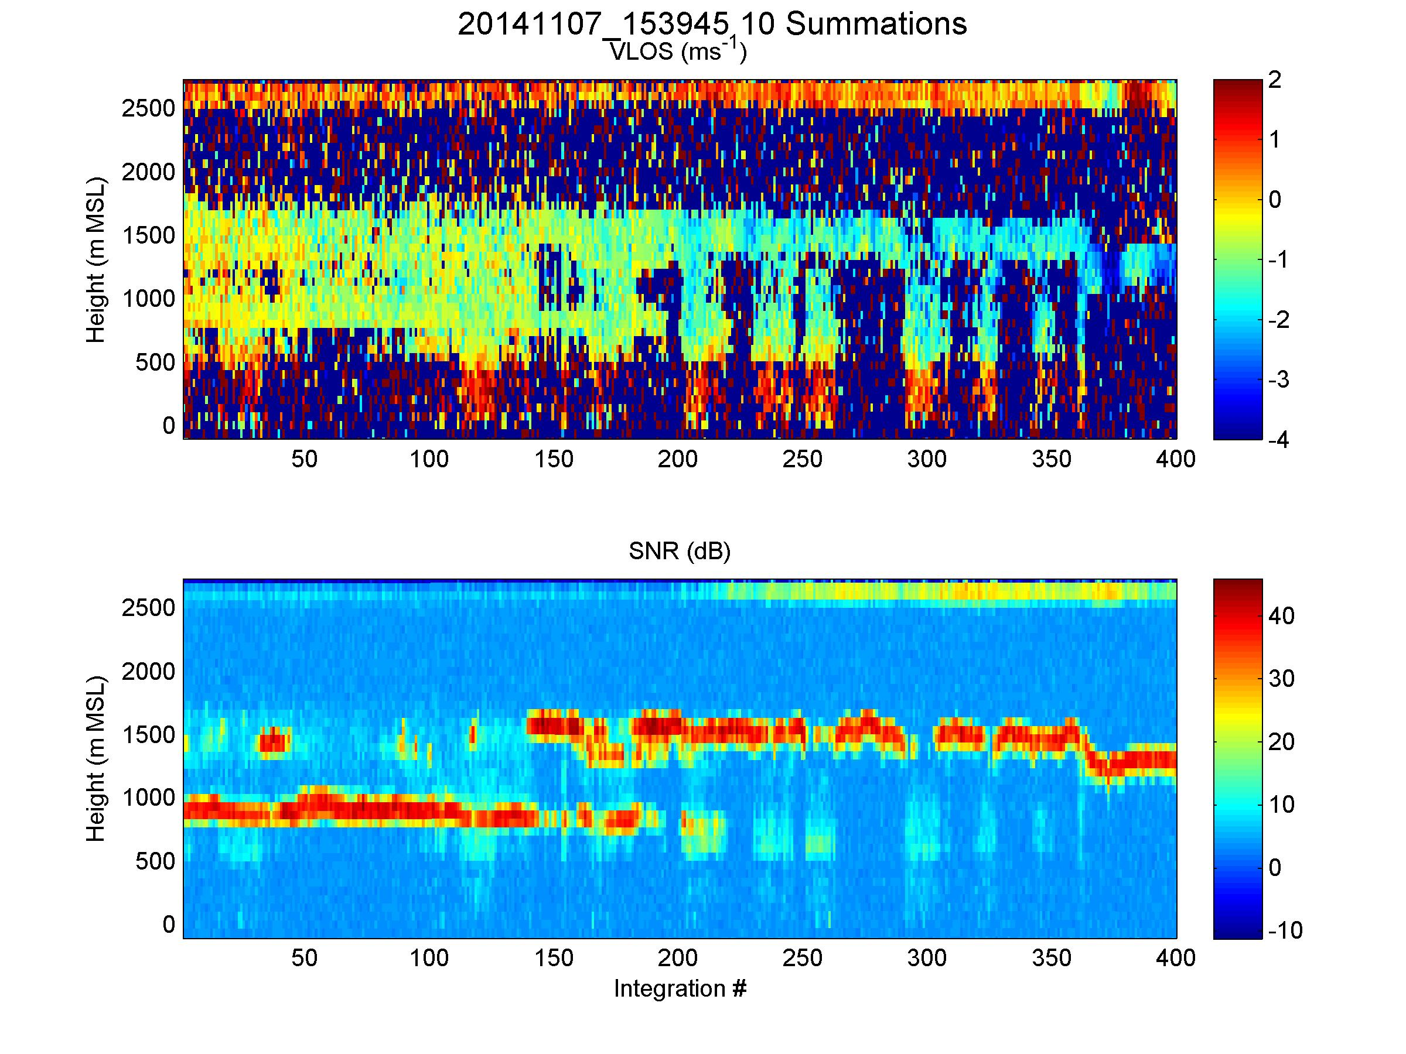
100m

Slide 13
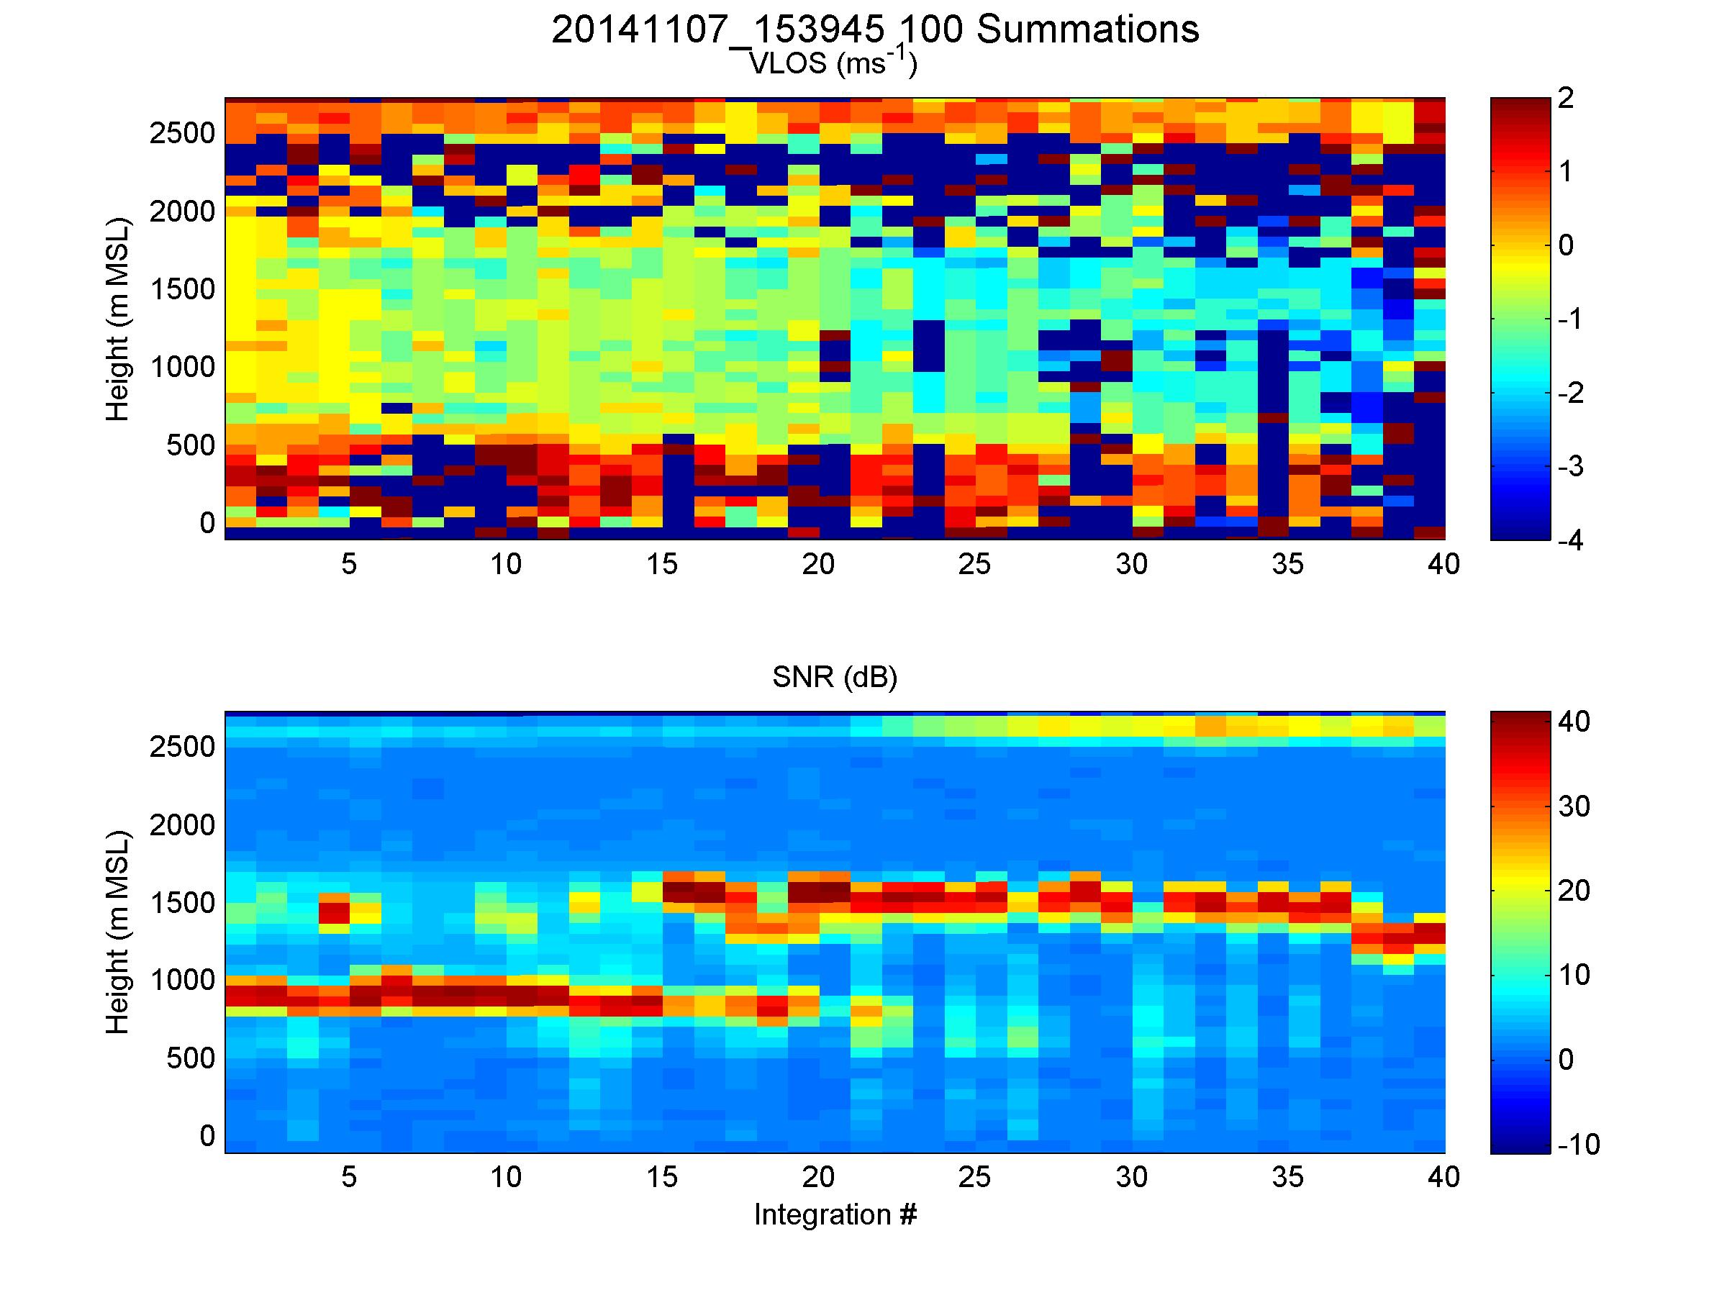
1000m

Slide 14
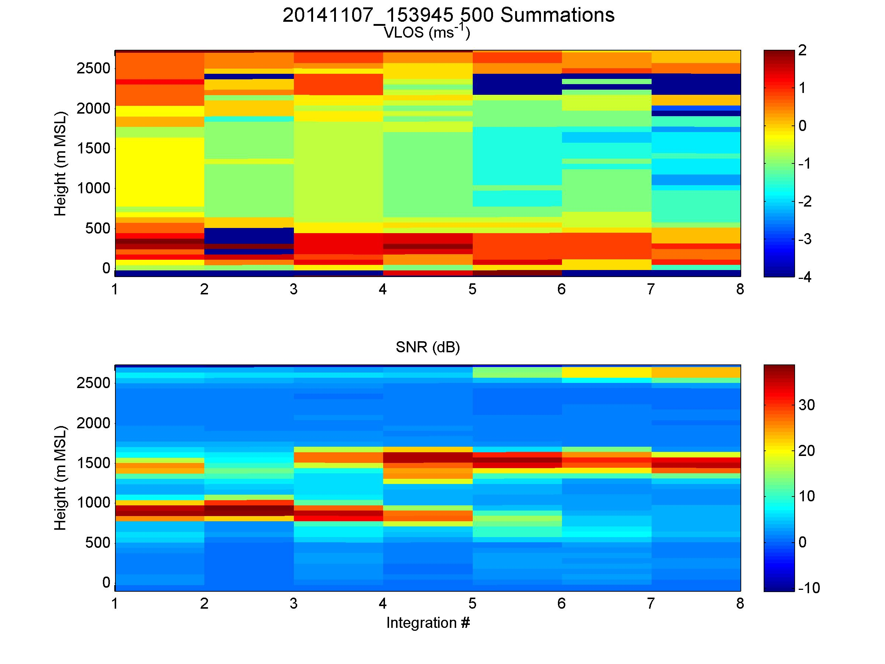
5000m

Slide 15
CALIPSO under flights
Provide near surface winds for comparison with CALIPSO derived wind speeds
Fly DAWN near CALIPSO track for backscatter comparisons
Three underpasses during Campaign 1
Challenges
Off shore cloud forecasts (imagery) not reliable
Get only “snapshots” (a few seconds) of near coincidence
Range of aircraft limited intercepts

Slide 16
CALIPSO Case Study 11/03/15

Slide 17
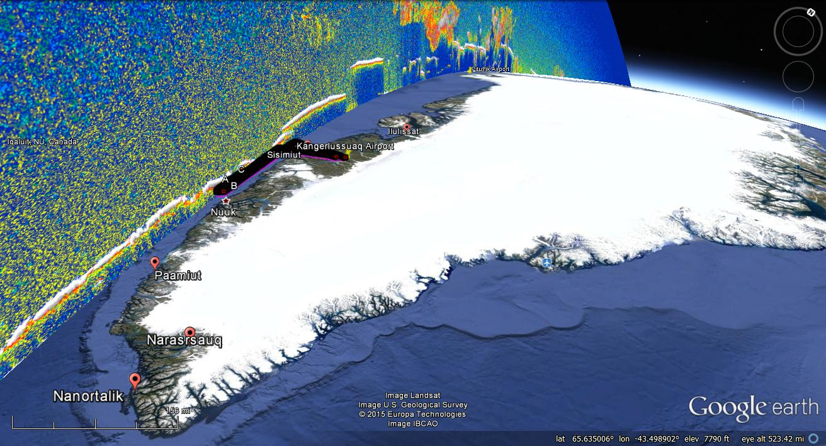

Slide 18
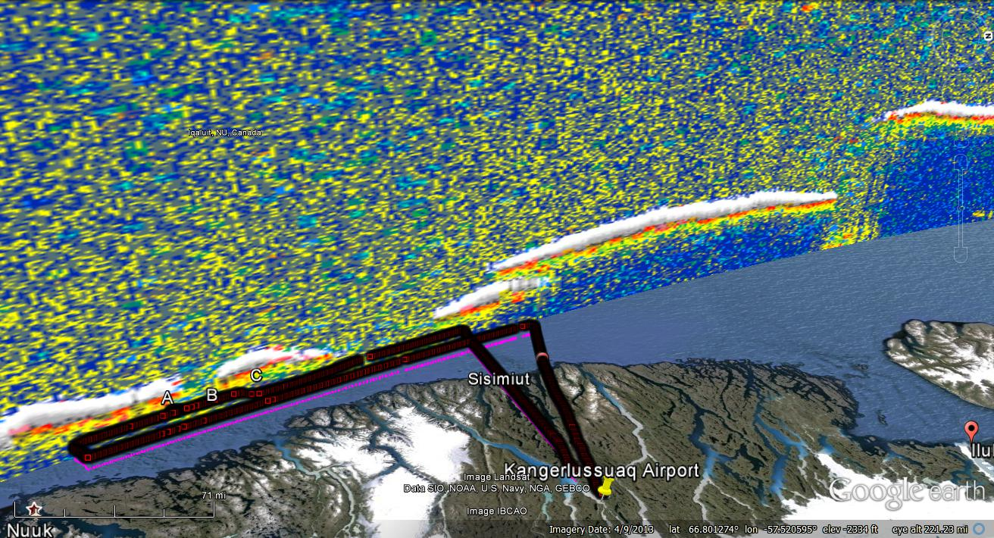
B
C
A

Slide 19
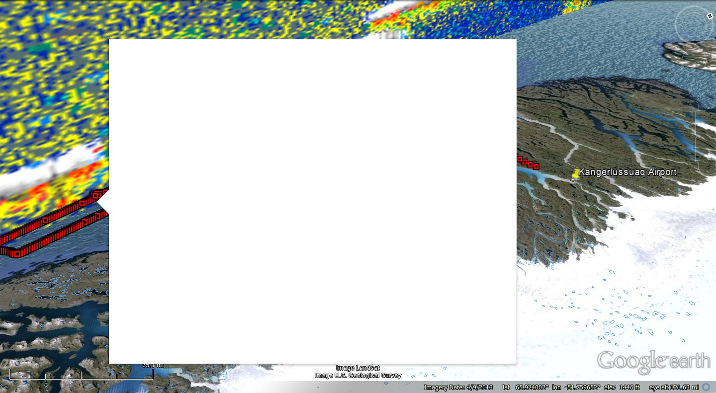
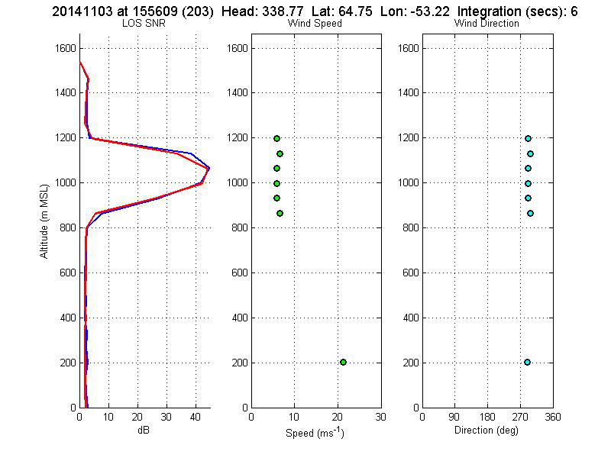
CALIPSO AND DAWN at Point A

Slide 20
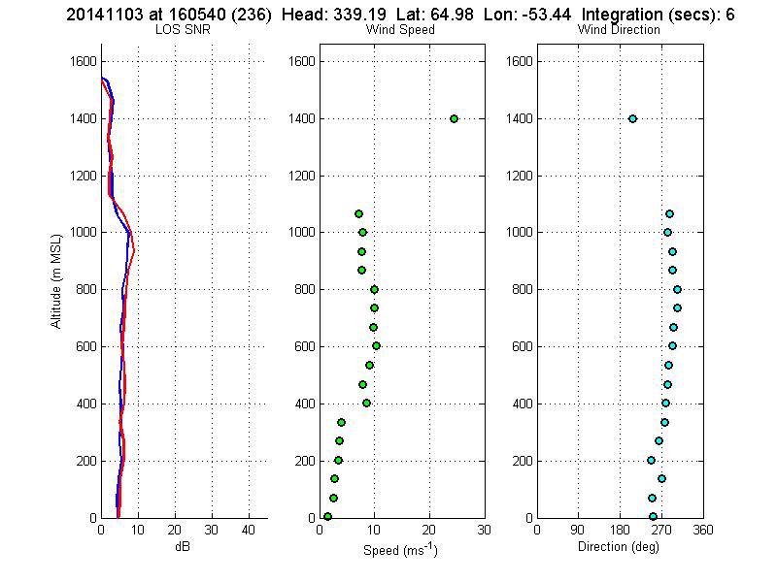
CALIPSO AND DAWN at Point B

Slide 21
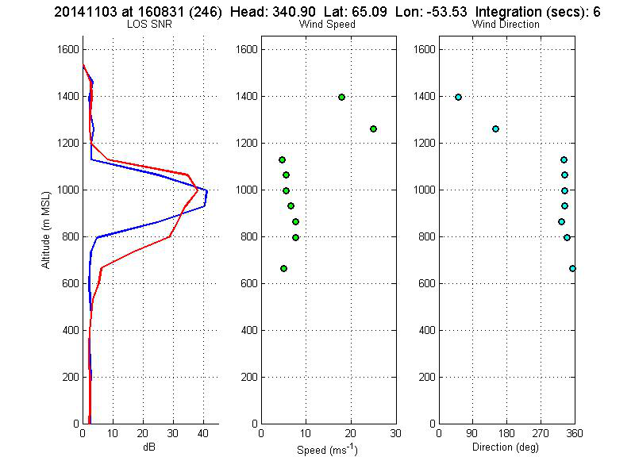
CALIPSO AND DAWN at Point C

Slide 23
MODIS under flights
More than 10 under flights
Both cloud and water vapor AMVs
Case study 11/07/2014

Slide 24
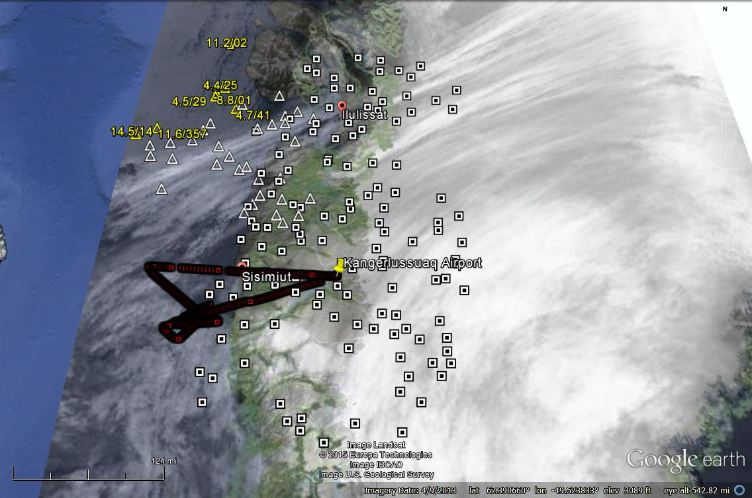
MODIS AMVs, Aircraft Track and DMI Satellite Imagery
11/07/14
Flight Track: 1420-1650 GMT; DMI Sat: 1528 GMT; MODIS Winds : 1500 – 1600 GMT
Yellow Triangle: AQUA Low; Yellow Square: Terra Low;White Triangle: AQUA High; White Square: Terra High

Slide 25
ASCAT under flights
More than 11 occasions
Significant differences found
Time syncs are difficult
Near coast environment quite variable
Footprints are different

Slide 26
NASA’s PolarWinds and ADM Cal/Val Campaign 2
Based out of Keflavik, Iceland
May 11 – 29, 2015
NASA DC-8 core instrument suite
DAWN (Nadir port 7)
Yankee dropsondes (50 -100)
TWiLiTE (Nadir port 5)

Slide 27
ADM Cal/Val Campaign 2 Plans
ADM Calibration/Validation Preparations
Coordinated flights with DLR Falcon equipped with Coherent DWL and A2D
ADM simulated sampling using fixed starboard stare at 30 degrees off nadir
Flight altitude of ~ 35000’
Flight legs on order of 250 km
Cloud free and partly cloudy conditions
Under flights of ASCAT, CALIPSO and MODIS as practice for ADM as well building collaborations with these other wind and aerosol instrument teams.
Detailed mission scenarios available.

Slide 28
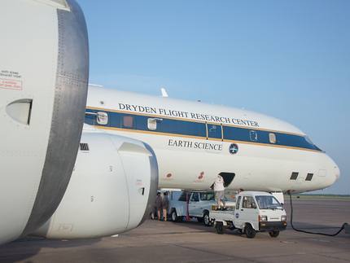

Slide 29
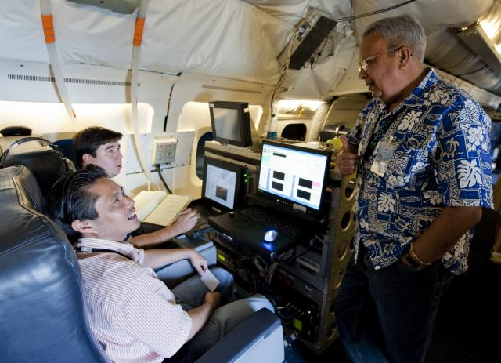
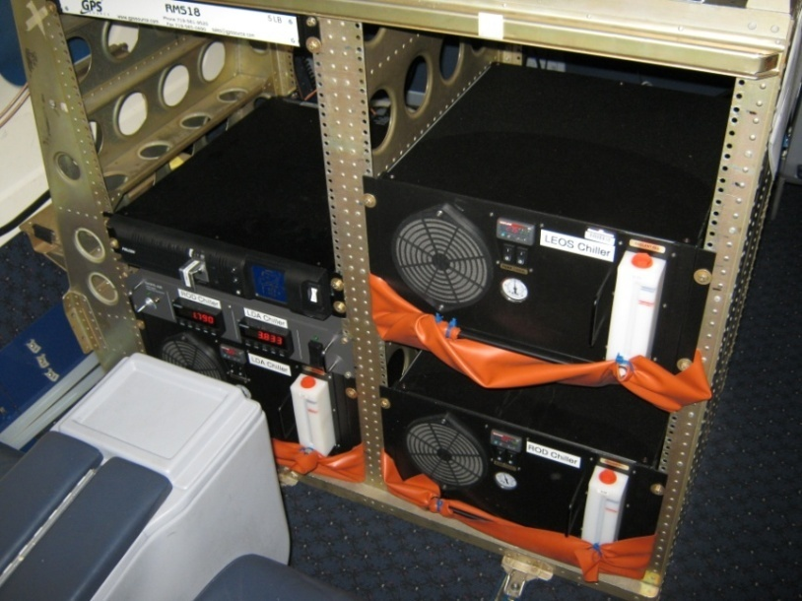
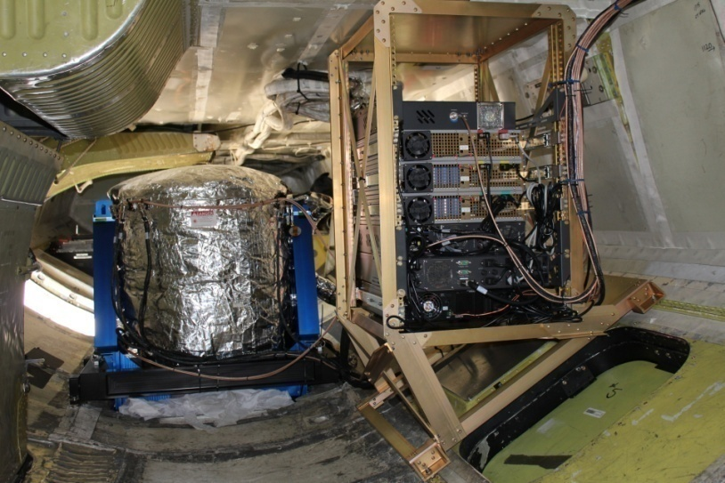
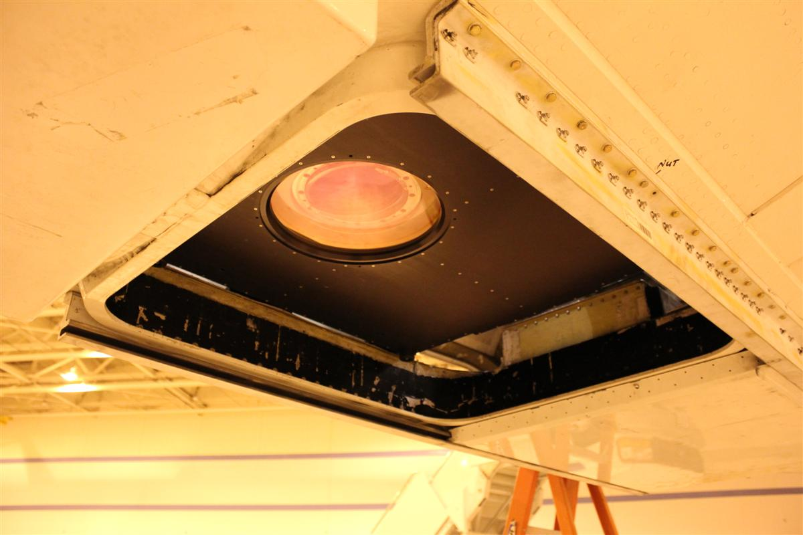
NASA Langley DAWN Wind Profiling Lidar on NASA DC-8
Operator Stations in Passenger Level
Laser Chillers in Passenger Level
2-micron
Pulsed
MOPA
0.25 J
10 Hz
200 ns
15 cm
Step-stare conical scan
30-deg nadir
Dual-balanced heterodyne detection
Laser, Optics, and Some Electronics in Cargo Level
Centered Nadir Port #7 with Shutter Open

Slide 30
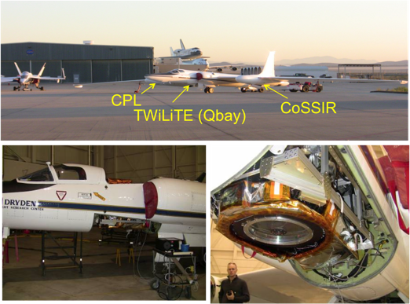
TWiLiTE on ER2

Slide 31
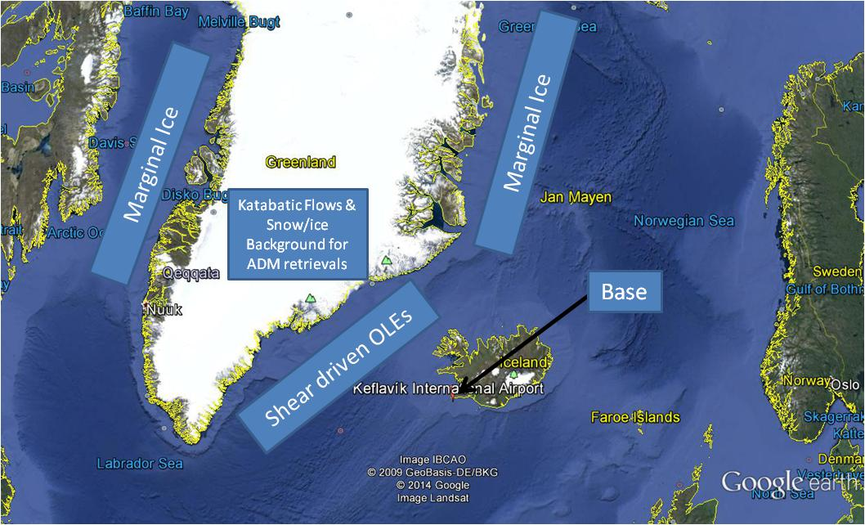

Slide 32
ADM dedicated missions using both DC-8 and Falcon aircraft
ADM Mission Name | Falcon altitude | DC-8 altitude | Falcon operations | DC-8 operations | Comments
Spiral | 38000’ | 37000’ | 20 degree bank for > 10 minutes | Race track pattern keeping Falcon within 25 nm
Instrument comparisons (FL > 35000’) | >35000’ | >35000’ | Straight and level | Straight and level | Legs > 100km with a dropsonde at each end.
Instrument comparisons (FL ~ 10000 agl) | ~ 10000’ agl | ~10000’ agl | Straight and level | Straight and level | Legs >100km too low to use dropsondes (?)
Water surface and near surface returns | >35000’ | ~10000’agl | Straight and level | Straight and level | Legs > 100 km with no dropsondes
Ice surface and near surface returns | >35000’ | ~10000’agl | Straight and level | Straight and level | Legs > 100 km with no dropsondes
Cloud top returns (broken cloud coverage preferred) | >35000’ | ~10000’ above cloud | Straight and level | Straight and level | Legs > 100 km with no dropsondes

Slide 33
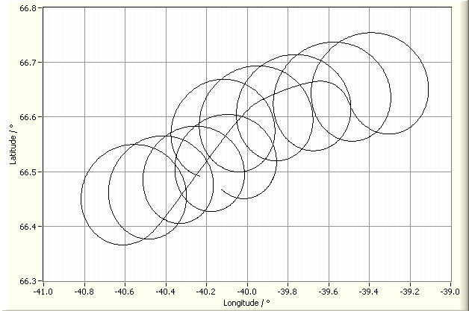
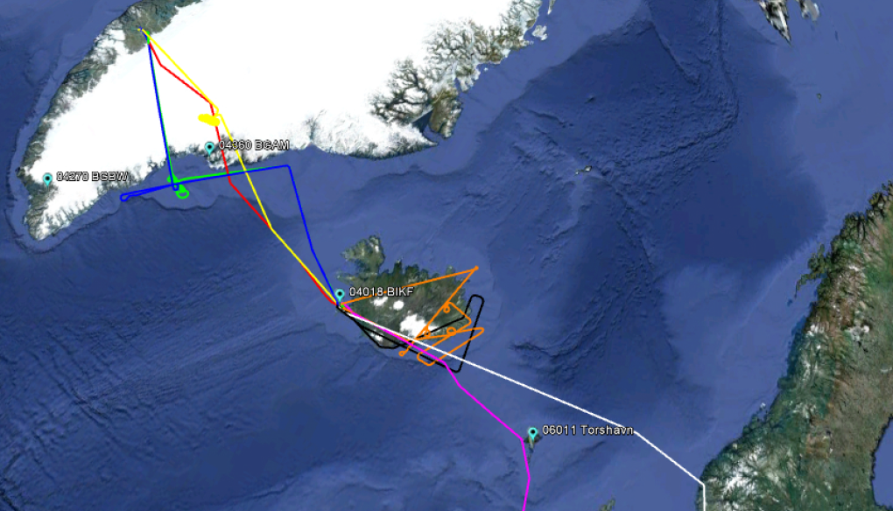
3rd Aeolus Campaign in Sept. 2009
26 km → 6 min
2 calibrations
wind observations

Slide 34
Acknowledgements
This project is being funded by NASA
Ramesh Kakar (PM)
Credit goes to the DAWN instrument team at NASA/LaRC and the UC-12B crew that flew in challenging weather conditions during Campaign 1

