Slide 1
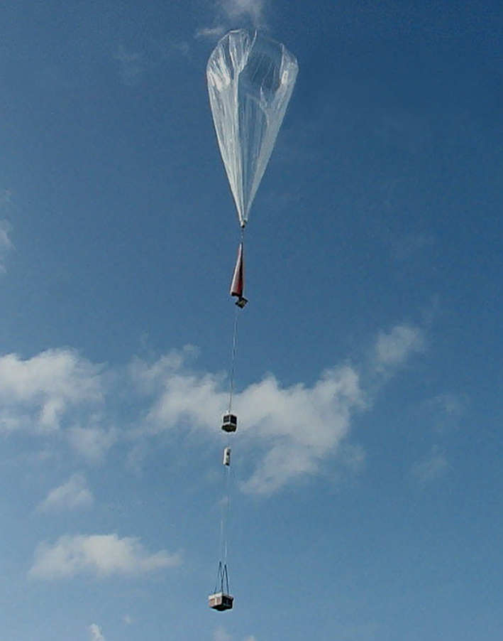
Driftsondes and Dropsondes for Wind Measurements
Holger Vömel, Terry Hock
NCAR EOL
Working Group Meeting on Space‐based Lidar Winds
28 April 2015

Slide 2
Global Hawk as Platform

Slide 3
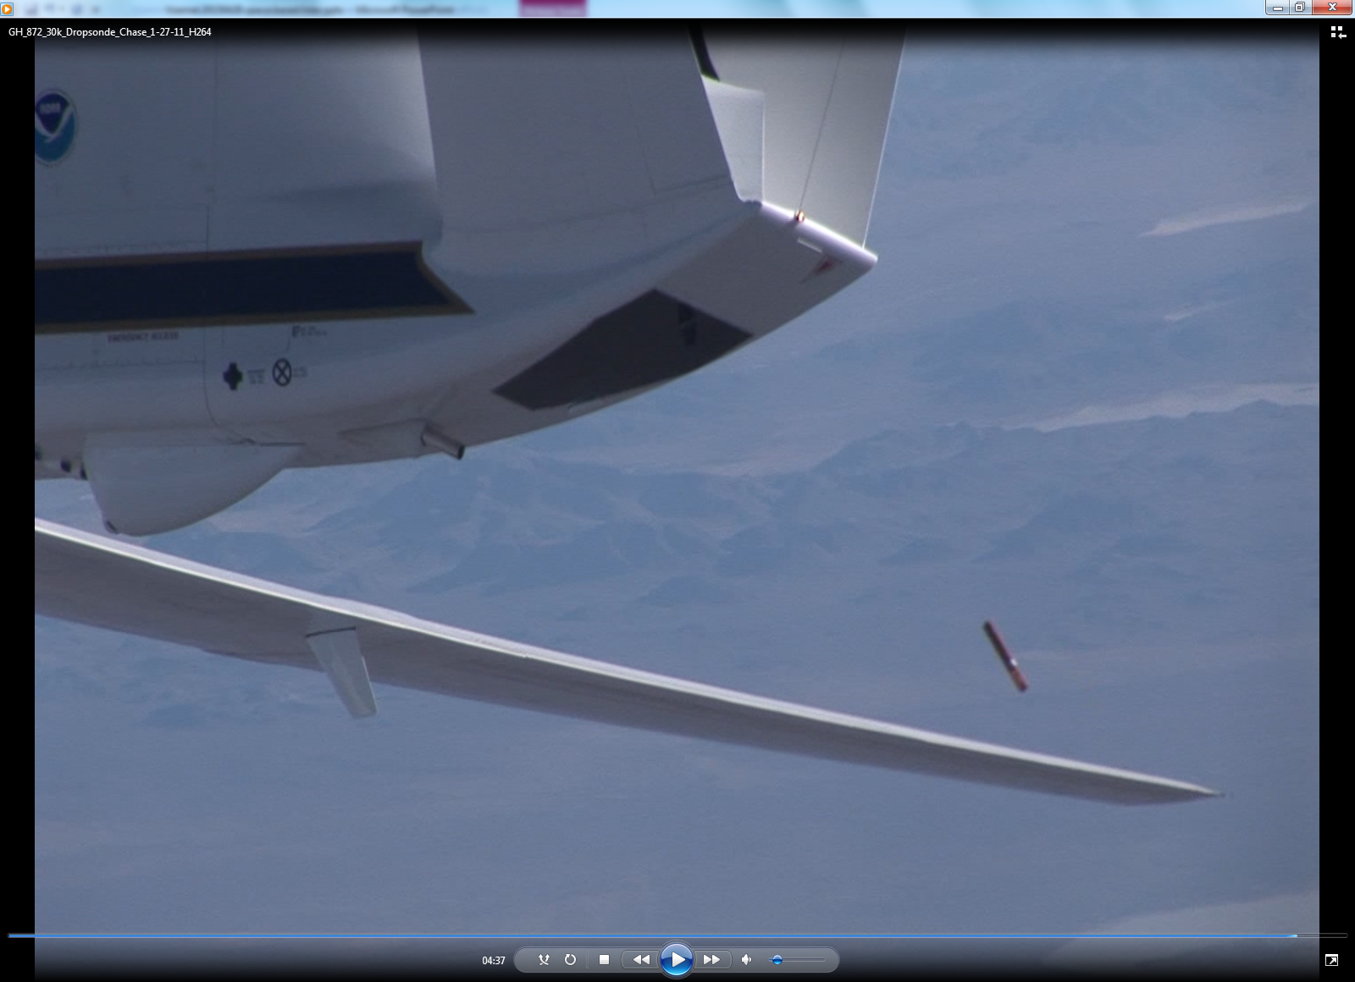
Global Hawk as Platform

Slide 4
Drops during HS3, 2011 - 2014

Slide 5
Driftsonde
Large zero-pressure or
super-pressure balloon
aloft for days to months
Iridium Satellite
Float altitude
~18 to 30 km
Driftsonde Gondola
→54 dropsondes
Dropssonde :
Pressure
Temperature
Relative humidity
Wind
Ground station
(web based
remote operation)
Sondes dropped on command or a pre-programmed schedule

Slide 6
Past campaigns
AMMA (2006)
T-PARC (2008)
Pre-Concordiasi (2010)
Concordiasi(2010)

Slide 7
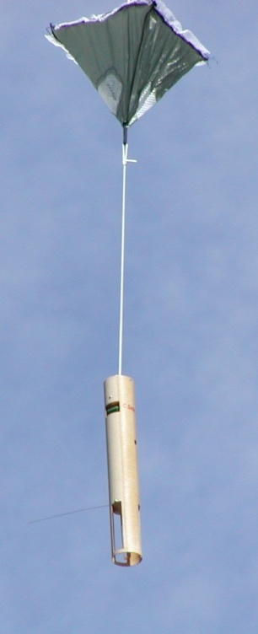
Miniature In-situ Sounding Technology (MIST Sonde)
GPS Antenna
Back Side Components
Cone Parachute
GPS Receiver
Lithium
Battery
Microcontrollers
400 MHz Transmitter
Pressure Sensor
400 MHz Antenna
Humidity Sensors
Temperature Sensor

Slide 8
Miniature In-situ Sounding Technology (MIST Sonde)
Vaisala RS-92 radiosonde sensor module
Pressure, Temperature, Humidity
Update rate 0.5 sec
Winds based upon OEM GPS receiver
0.1 m/s resolution
0.25 sec (4 Hz) update rate for wind data
Mass: 182 grams

Slide 9
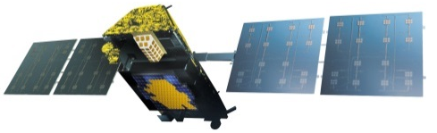
System Communications and Data Flow
RF link
RF Link
1620 MHz
Iridium Satellite
Iridium Ground System
Arizona U.S.
Driftsonde
Gondola
Telephone
Lines
Boulder Telephone
Modems (min qty 4)
RF Link
400 MHz
NCAR
Ground
Control
Boulder, CO
Boulder Servers
Back End control &
Data Storage
Dropsonde
PTU & Winds
Internet
Web Interface
and Control
Web Interface
and Control
Web Interface
and Control
Boulder
Seychelles
Toulouse

Slide 10
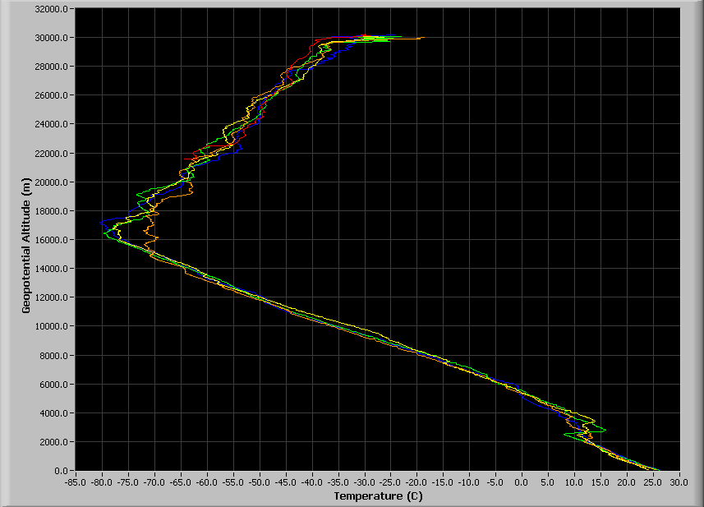
Dropsondes on other platforms
Driftsonde - Zero Pressure balloon
Driftsonde –Super Pressure Balloon
& UAS Global Hawk
G-5 Aircraft
C-130 Aircraft
P-3 Aircraft

Slide 11
Pre-Concordiasi Feb – May 2010
Launch at Seychelles: 8, 19 and 21 February 2010
3 balloons, 3 months each
Courtesy of CNES

Slide 12
Pre-Concordiasi Feb – May 2010
Dropsondes Western Indian Ocean:
Notes:
41 soundings over 37 days from two different driftsonde balloons in the Western Indian Ocean.
It took both payloads about three weeks to reach the African coast.

Slide 15
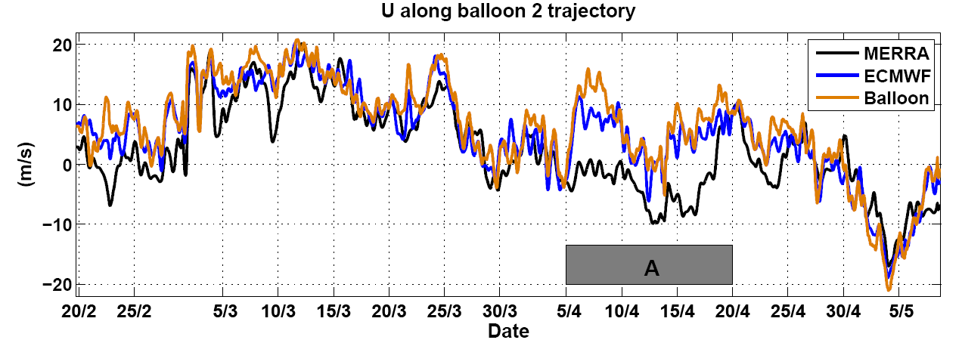
Comparisons of measured and analyzed winds
Podglajen, A., et al., J. Geophys. Res. Atmos., 119, 11,166–11,188
Notes:
Work by Aurélien Podglajen et al.

Slide 16
Comparisons of measured and analyzed winds
Large, long-lasting errors in the equatorial dynamics in current NWP products
Mostly due to poorly simulated equatorial waves
Main cause of error is the lack of wind observations
Podglajen, A., et al., J. Geophys. Res. Atmos., 119, 11,166–11,188

Slide 17
Strateole-2
Strateole-2 long duration drift sonde campaign focuses on tropics in particular tropical tropopause layer
Validation flights planned 2017/2018
Main campaigns planned for 2018/2019 season and launch site TBD
Two campaigns scheduled about one year apart
Funding not yet secure

Slide 18
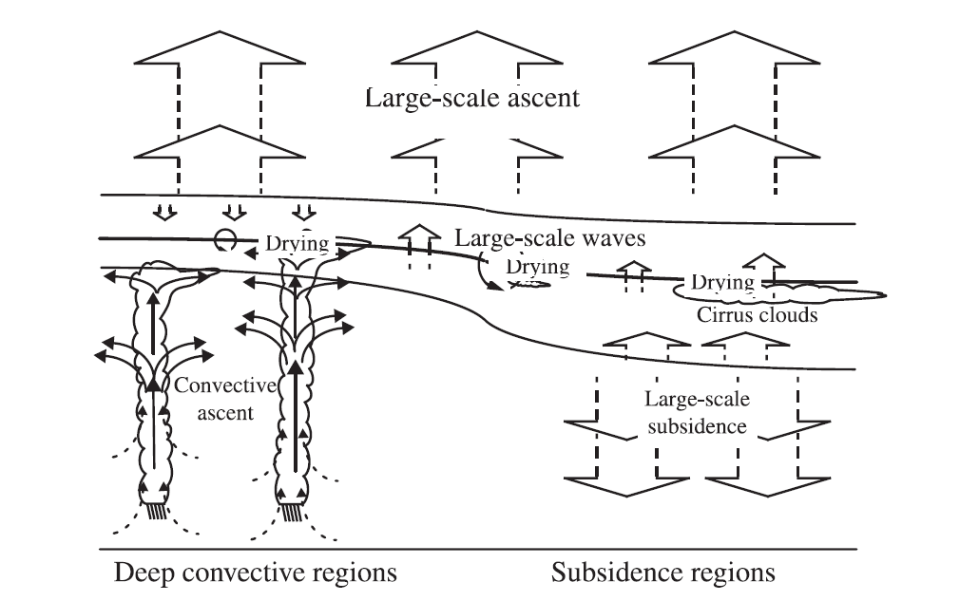
Different regions in the tropics
Top of tropopause layer
Tropopause
Level of mean convective outflow
From Vömel et al., 2002
Notes:
Challenge:
Identify and quantify regions, that contribute to dehydration
Quantify the importance of the different dehydration processes:
Convective dehydration
Slow scale dehydration
Wave driven dehydration
Superstaturation in clouds
Increase the reliability in water vapor observations
Increase the number of observations
Validate global scale systems
Provide continuity to these observations

Slide 19
Different regions in the tropics
Strateole-2 region
Top of tropopause layer
Tropopause
Level of mean convective outflow
From Vömel et al., 2002
Notes:
Challenge:
Identify and quantify regions, that contribute to dehydration
Quantify the importance of the different dehydration processes:
Convective dehydration
Slow scale dehydration
Wave driven dehydration
Superstaturation in clouds
Increase the reliability in water vapor observations
Increase the number of observations
Validate global scale systems
Provide continuity to these observations

Slide 20
Campaign plan
Lower altitude in situ flights: 70 hPa, 18.5 km
4 times: Meteorology, particle, ozone, water vapor (TTL1)
4 times: Meteorology, particle, tracer, water vapor (TTL2)
Higher altitude profiling flights: 50 hPa, 20 km
4 times: Meteorology, Lidar, fiber optic, GPS ROC (Strat-1)
12 times: Meteorology, driftsondes (Strat-2)
Second campaign roughly one year later
Notes:
Scientific payload weight up to 24 kg including power.

Slide 21
Summary
Dropsondes provide in situ profiles of winds and PTU on demand
Airborne platforms: NCAR G-V, C130, NOAA G-IV, Global Hawk
Driftsondes carry up to 54 dropsondes per payload.
Driftsondes highly suitable for tropical region and very remote regions
Driftsondes provide profiles between ~20 km and surface

Slide 23
In situ Instruments
Meteorology: GPS position and horizontal wind (CNES) Pressure and Temperature (LMD)
Water Vapor: Tunable diode laser hygrometer (GSMA) Frost point hygrometer (LMD)
Ozone: UV Ozone photometer (LMD and LASP)
Particle counters: WPC (U. Wyoming) LOAC (LPC2E)
Carbon dioxide/Methane: Tunable diode laser (GSMA)
Radiative fluxes: Upward infrared and visible fluxes (LATMOS)
Notes:
GSMA : (Groupe de Spectrométrie Moléculaire et Atmosphérique, Université de Reims
LPC2E-CNRS: Laboratoire de Physique et Chimie de l'Environnement et de l'Espace Université d’Orléans

Slide 24
Profiling Instruments
Driftsonde: T, wind, P, humidity from balloon altitude to ground (NCAR)
Fiber Optic: Continuous temperature profile measurements within a few kilometers below the balloon (LASP)
GPS Radio-Occultation: Temperature and humidity profiles from balloon altitude to ground (Scripps)
Lidar: Downward looking backscatter profiles at 532 nm (CNR)
Notes:
GSMA : (Groupe de Spectrométrie Moléculaire et Atmosphérique, Université de Reims
LPC2E-CNRS: Laboratoire de Physique et Chimie de l'Environnement et de l'Espace Université d’Orléans

Slide 25
Dropsondes Western Indian Ocean:

Slide 26
Dropsondes Western Indian Ocean:

Slide 27
Pre-Concordiasi Feb – May 2010
NCAR
Driftsonde
Payload

Slide 28
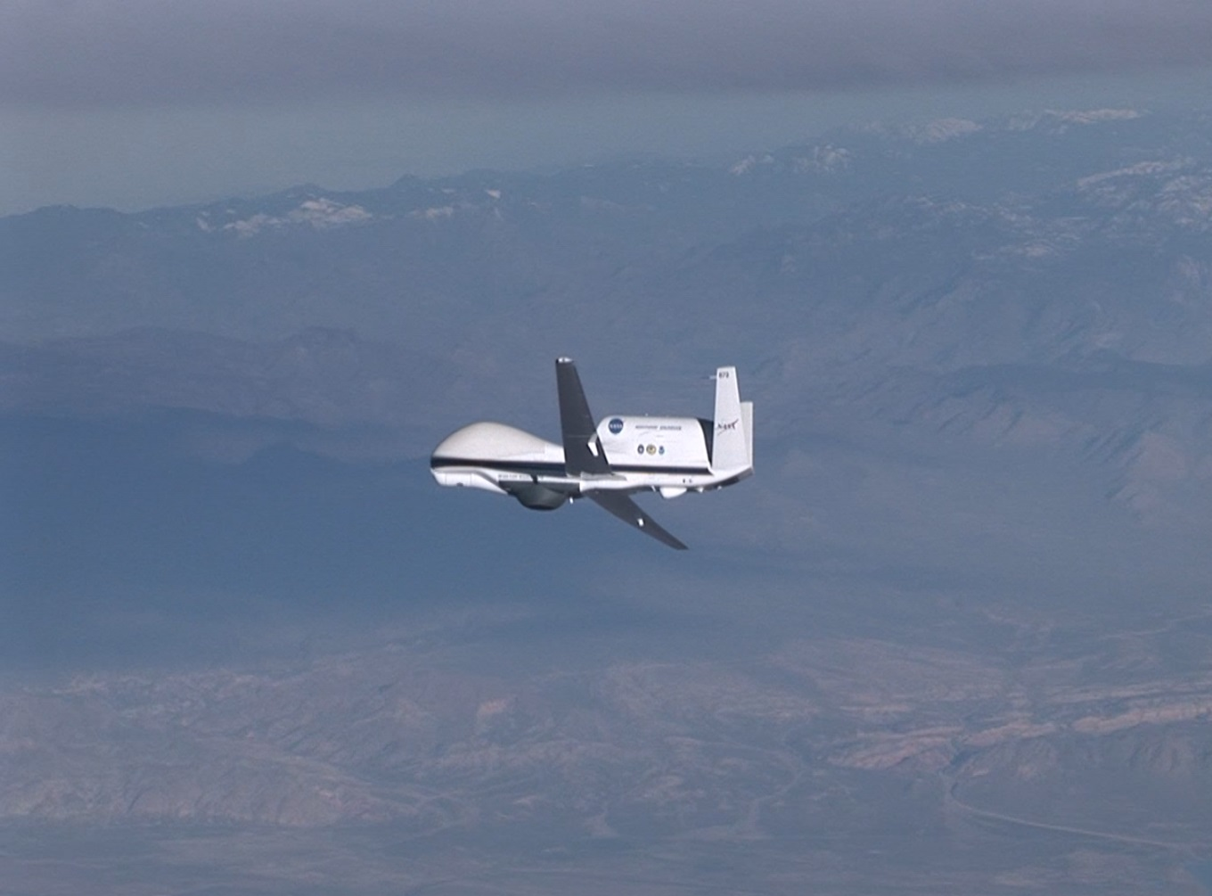

Slide 29
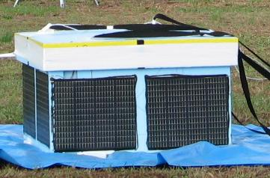
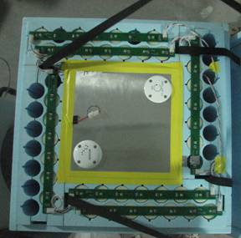
Driftsonde Gondola
MIST Sonde Capacity: 54 units
Operational Life: ~ 6+ weeks
Mass: ~24kg (with sondes)
Size: 71 cm x 71 cm x 45 cm
Power: Lithium SO₂ Batteries
Solar Panel Heaters for batteries and electronics
Automated Radiosonde Sounding System
Iridium Satellite Communications
System Health Engineering Monitoring
Position & Velocity - GPS Receiver
Pressure Sensor
Battery voltages
Solar Panel voltage
Component Temperatures

Slide 30
Sonde Fall Velocity

Slide 31
Miniature In-situ Sounding Technology (MIST Sonde)
Size: 30.5 cm height x 4.40 cm diameter
Mass: 182 grams
Fall time: ~ 17 minutes from 60 mb
Fall Velocity: ~40 m/s @ 60 mb, ~10 m/s @ surface
Vaisala RS-92 radiosonde sensor module
Pressure, Temperature, Humidity
Update rate 0.5 sec
Winds based upon OEM GPS receiver
0.1 m/s resolution
0.25 sec (4 Hz) update rate for wind data
Cone parachute
Transmission at 403-406 MHz

Slide 32
Global Operations
Engineering Monitoring
Boulder, USA
Scientific Flight Operations Center & Flight Control
Toulouse, France
Balloon Launch Location
Victoria, Seychelles
Past Launch and Flight Operations Locations

Slide 33
Pre-Concordiasi Feb – May 2010
Dropsondes Atlantic crossing:
Notes:
19 soundings across the Atlantic on the driftsonde, which was pulled out of the equatorial belt. The Atlantic crossing took 10 days, which means we have about twice daily soundings across this region.

Slide 36
Dropsondes Atlantic crossing:

