Slide 1
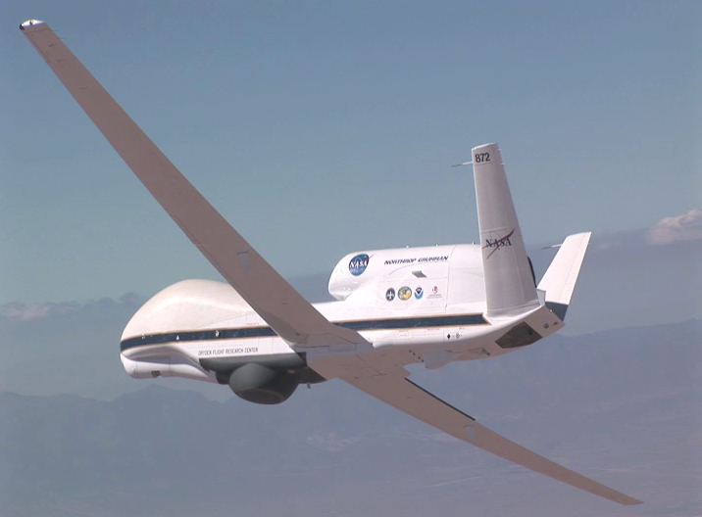


The NOAA Unmanned Aircraft Systems (UAS) Program:
Status and Activities
The NOAA Unmanned Aircraft Systems Program:
High-Impact Weather Activities
Gary Wick
Robbie Hood, Program Director
Gary A. Wick and Robbie E. Hood
NOAA UAS Program

Slide 2
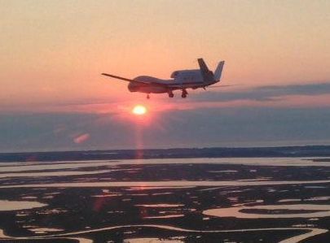
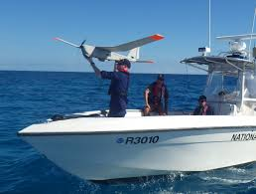
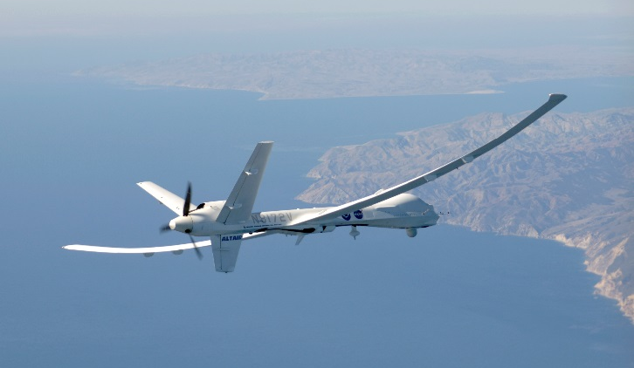
NOAA UAS Program
Begun in 2007
Vision
  UAS observations will become an essential component of the NOAA observing system
Key Roles
  Serve as the NOAA subject matter experts for UAS technology and observations
  Assist with the research, development, demonstration and transition to application of select UAS observing strategies

Slide 3
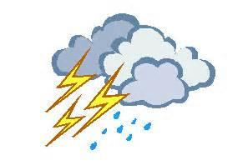


Science Focus Areas
High Impact Weather
  Can UAS observations enable improved forecasts, scientific understanding and decision support?
Marine
  Can UAS observations provide reliable, timely and affordable environmental intelligence information for resilient coastal communities and healthy oceans?
Polar
  Can UAS observations contribute to NOAA’S Arctic vision and strategy?

Slide 4
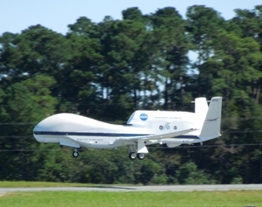
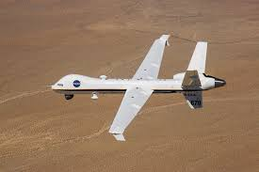
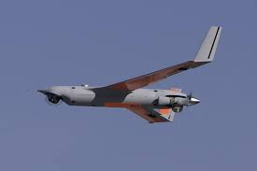
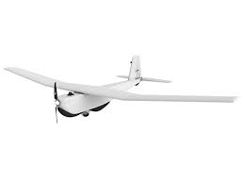
Fixed-Wing UAS Capabilities
High Altitude Long Endurance (HALE)
  Maximum Altitude 65,000 ft
  Maximum Endurance 25 hrs
  Maximum Payload Weight 1200 lbs
Medium Altitude Long Endurance (MALE)
  Maximum Altitude 40000 ft
  Maximum Endurance 24 hrs
  Maximum Payload Weight 400 lbs int, 2000 lbs ext
Low Altitude Long Endurance (LALE)
  Maximum Altitude 19,500 ft
  Maximum Endurance 24 hrs
  Maximum Payload Weight 13.5 lbs
Low Altitude Short Endurance (LASE)
  Maximum Altitude 1000 ft (operating altitude, higher capable)
  Maximum Endurance 2 hrs
  Maximum Payload Weight approx 2 lbs

Slide 5
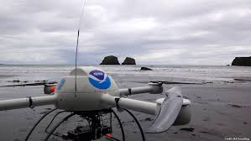
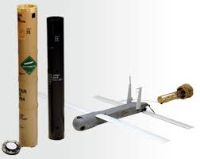
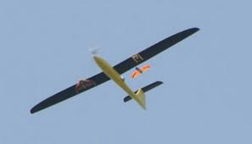
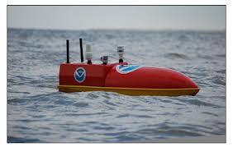
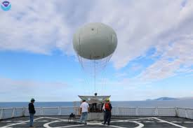
Other Unmanned Capabilities
Vertical Takeoff and Landing (VTOL)
  Maximum Altitude 3280 ft
  Maximum Endurance 1.4 hr
  Maximum Payload Weight 1.7 lb
Aircraft-launched UAS (ACL)
  Maximum Altitude 20,000 ft
  Maximum Endurance 1.5 lbs
  Maximum Payload Weight 0.9 lbs
Balloon-launched UAS (BL)
  Maximum Altitude 100,000 ft
  Maximum Endurance N/A
  Maximum Payload Weight 3 lbs
Surface Unmanned Vehicles (SUV)
  Maximum Altitude Sea Level
  Maximum Endurance 8.6 hr
  Maximum Payload Weight 15 lb
Tethered Balloons (TB)
  Maximum Altitude 25,000 ft
  Maximum Endurance N/A
  Maximum Payload Weight 2,200 lbs

Slide 6

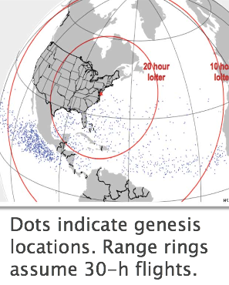
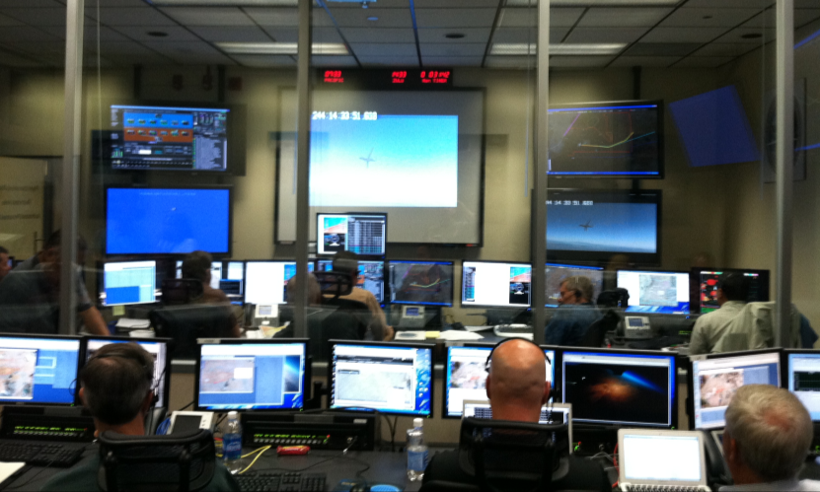
NASA Global Hawk Capabilities
Flight Level: ~55-63,000 ft
Duration: ~26 hr
Range: 11,000 nm
Payload: 1,500+ lbs
Deployment Sites:
  NASA Wallops Flight Facility
  (Wallops Island, VA)
  NASA Armstrong Flight Research
  Center (Edwards AFB)

Slide 7

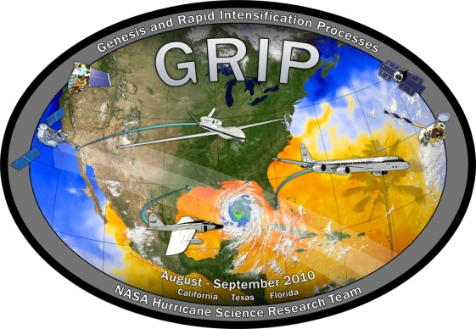
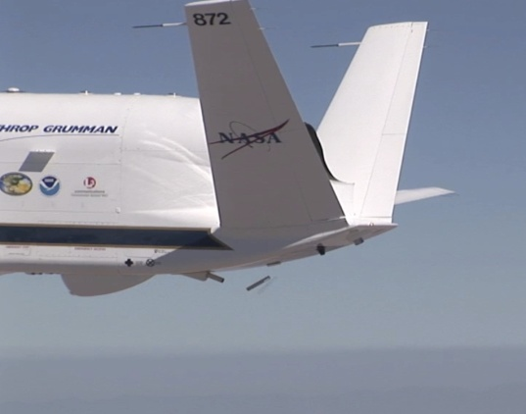
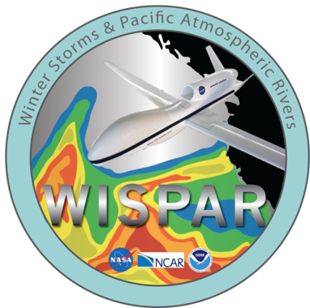
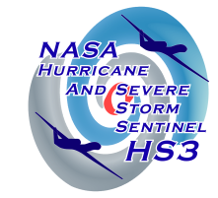
NOAA Participation in Global Hawk Missions
NASA / NOAA Global Hawk Pacific (2010)
  First Global Hawk science mission
  Long duration and range; latitudes from 12 to 85 deg N
NASA Genesis and Rapid Intensification Processes (2010)
  First Global Hawk flights over tropical cyclones
  Real-time data delivery
  Coordination of the Global Hawk with other aircraft
NOAA Winter Storm Pacific and Atmospheric Rivers (2011)
  First operational dropsonde deployment, 177 sondes total
  First dropsonde in the Arctic since 1950s
  Real time changes of drop locations
NASA Hurricane and Severe Storm Sentinel (2011 – 2014)
  Remote deployment of 2 Global Hawks
  Dropsonde data delivered in real-time to National Hurricane Center
  G-IV dropsonde intercomparison
  Increased flight planning/modification flexibility
NASA Airborne Tropical Tropopause Mission (2011 - 2014)
  Climate-relevant observations of stratospheric humidity and ozone
  Multiple NOAA instrument payloads
Notes:
Detailed Specs… Would focus on the measurements provided and the size/weight.

Slide 8
Winter Storms and Pacific Atmospheric Rivers
WISPAR Feb-Mar 2011, NASA Dryden Flight Research Center, Edwards, CA
Collaborative effort between NOAA-NASA-NCAR
WISPAR flights were designed to:
  Demonstrate the NOAA/NCAR GH dropsonde system for NOAA operations and research
  Evaluate the capabilities of the GH for operational observations of atmospheric rivers (ARs), winter storms, and remote Arctic atmosphere
177 soundings performed on 3 high-altitude long-endurance science flights

Slide 9
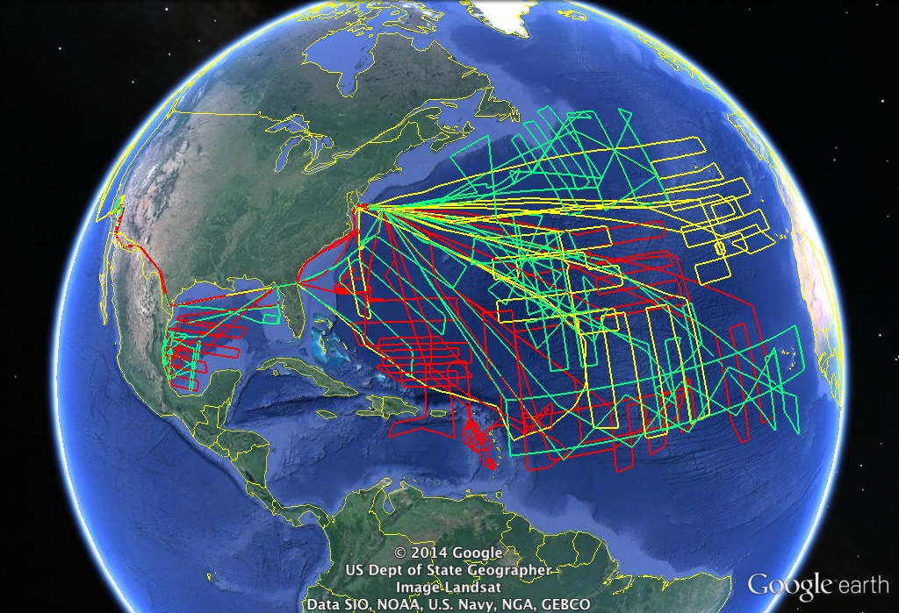
NASA Hurricane and Severe Storm Sentinel
6 flights in 2012 into Leslie and Nadine
Range capabilities clearly demonstrated
337 soundings obtained
Data processed and transmitted in near-real time
Graphic courtesy NASA

Slide 10
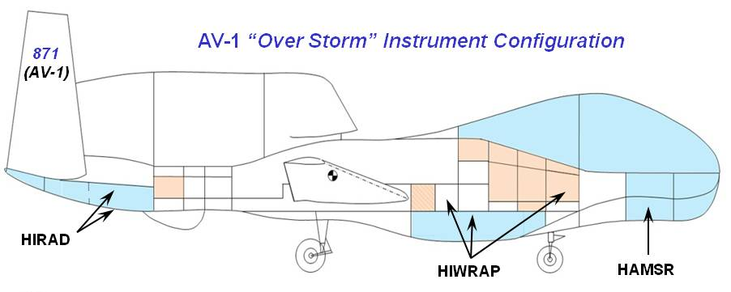
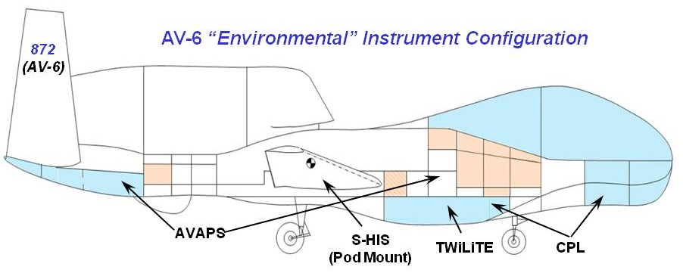
HS3 Global Hawk Planned Payloads
Graphics courtesy Scott Braun, NASA

Slide 11
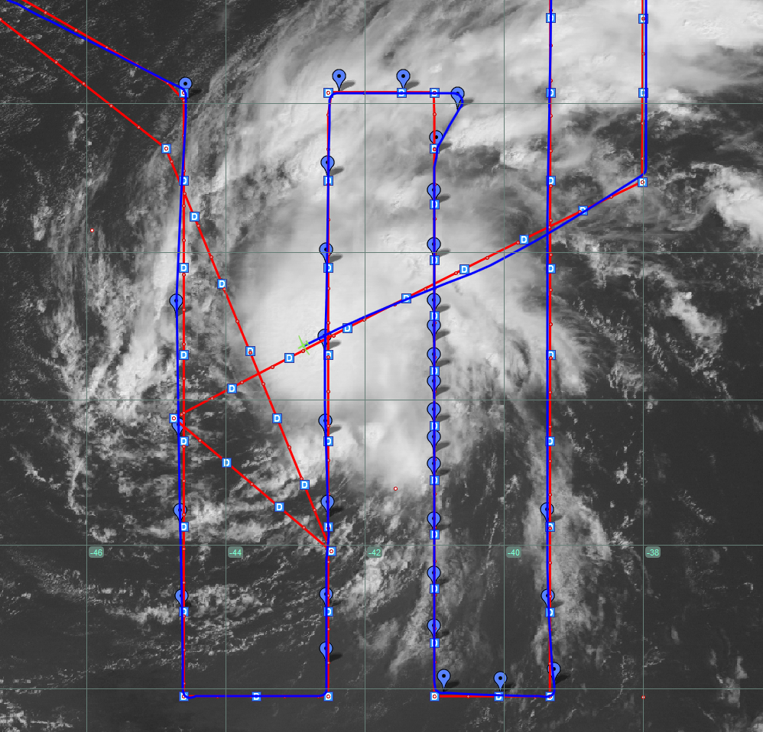
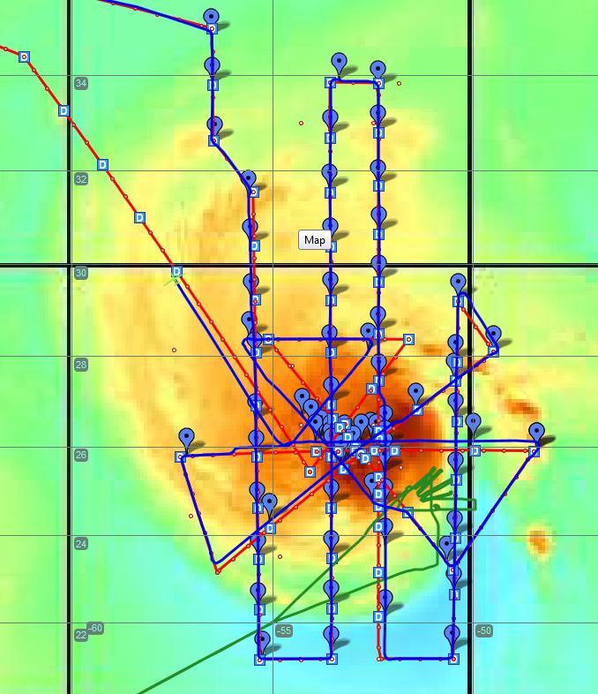
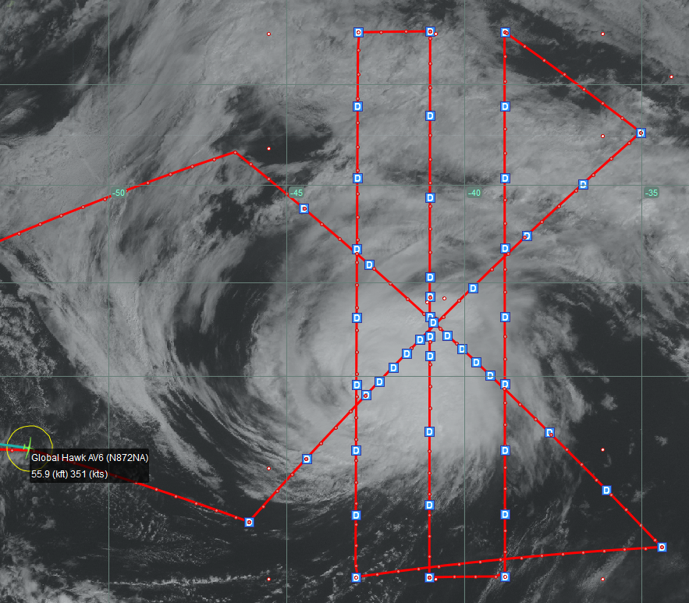
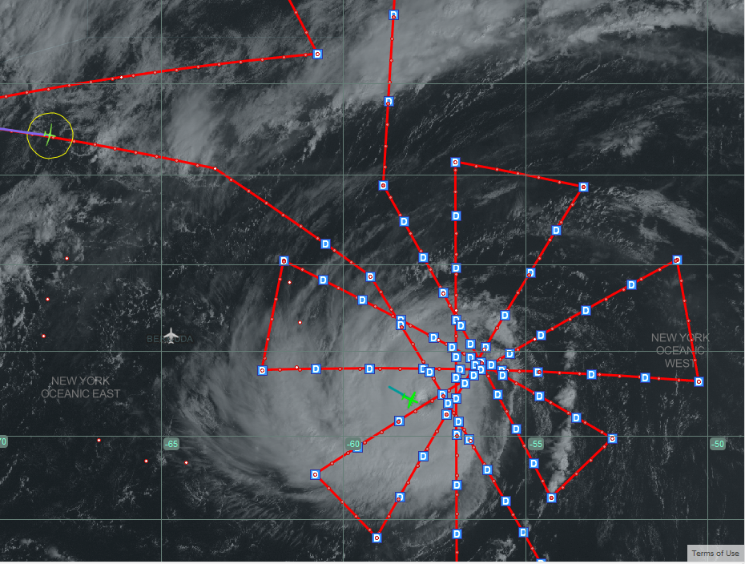
Global Hawk Sampling of Edouard (2014)
Four flights sampled the complete life cycle of Edouard
11 September, Tropical Storm
14 September, Category 1
282 total dropsondes deployed during more than 58 hours around storm
Multiple drops into eye and eye wall from Global Hawk altitude
Data suggesting rapid intensification on 15 September
Novel observations documenting storm decay over colder waters
Data processed in real time and, transmitted to NWS gateway
Observations will facilitate forecast impact studies with multiple numerical models
16 September, Category 3
18 September, Decay

Slide 12
What’s Next?
Sensing Hazards with Operational Unmanned Technology (SHOUT)
Overall Goal
Objective 1
Objective 2
Demonstrate and test prototype UAS concept of operations that could be used to mitigate the risk of diminished high impact weather forecasts and warnings in the case of polar-orbiting satellite observing gaps
Conduct data impact studies
Observing System Experiments (OSE) using data from UAS field missions
Observing System Simulation Experiments (OSSE) using simulated UAS data
Evaluate cost and operational benefit through detailed analysis of life-cycle operational costs and constraints

Slide 13
Guidance on Missions and Payloads
Forecast impact is primary objective
  Hurricanes and tropical cyclones
  High-impact Pacific weather
Preliminary hurricane data impact study released
  Based primarily on data collected in HS3
  Initial results suggest UAS observations can positively impact forecasts and provide critical real-time guidance
Payloads evaluated based on potential forecast improvement, satellite-like capabilities, and maturity level
What about wind lidar?
  At or near top of wish list, but…
  Project risk only supports flying previously integrated instruments

Slide 14
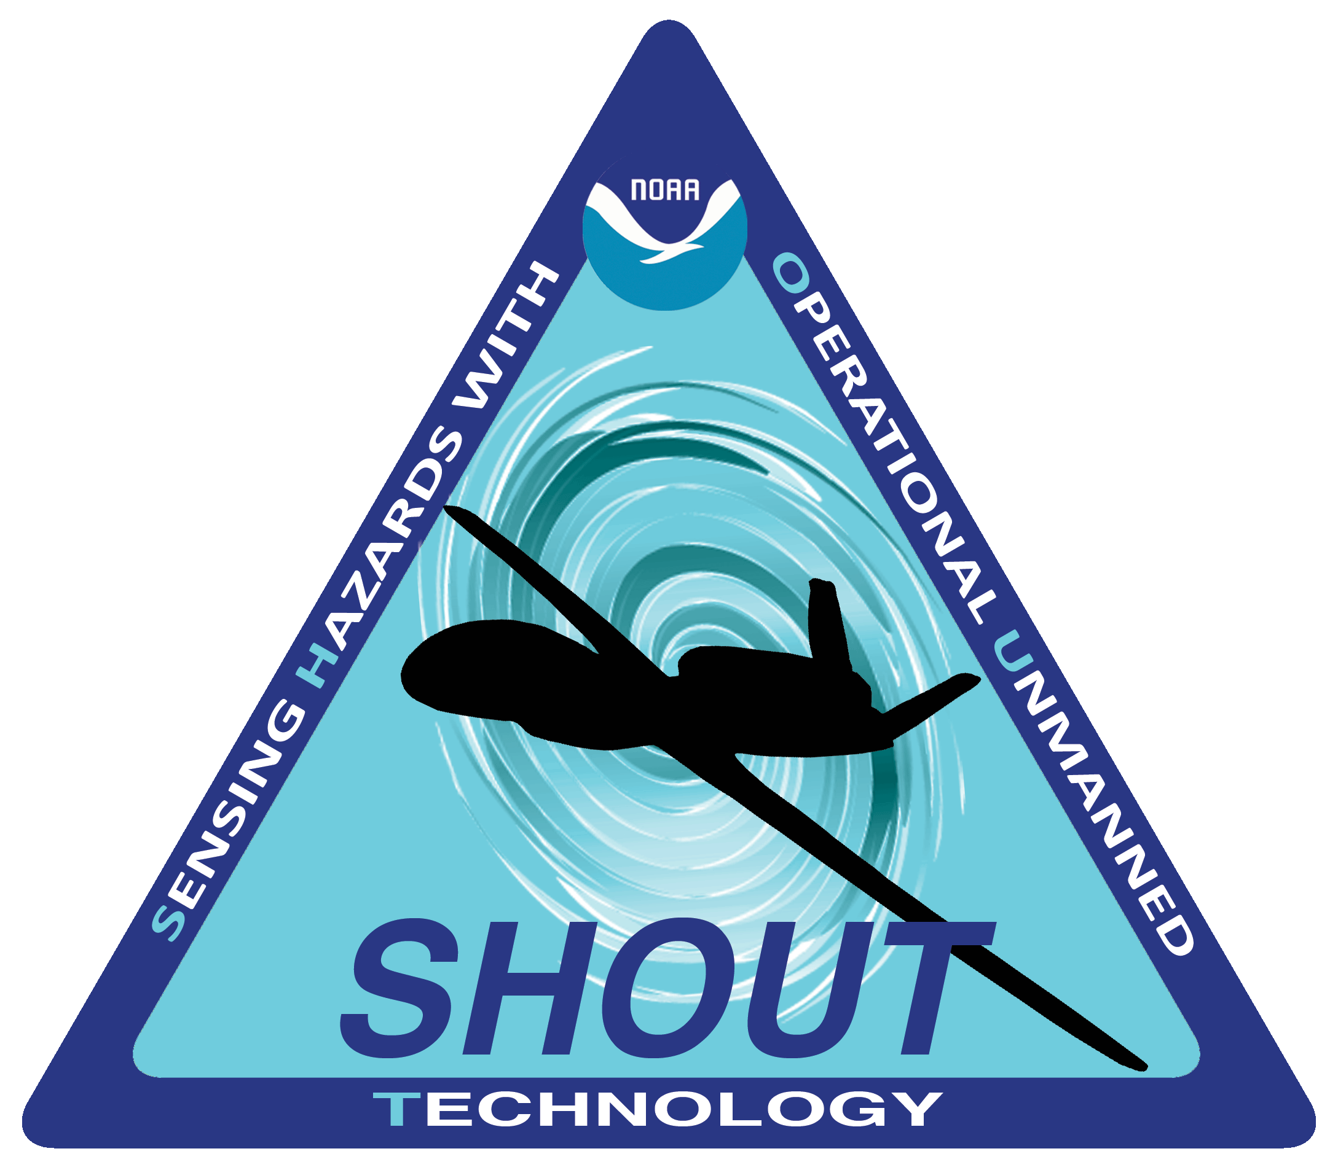
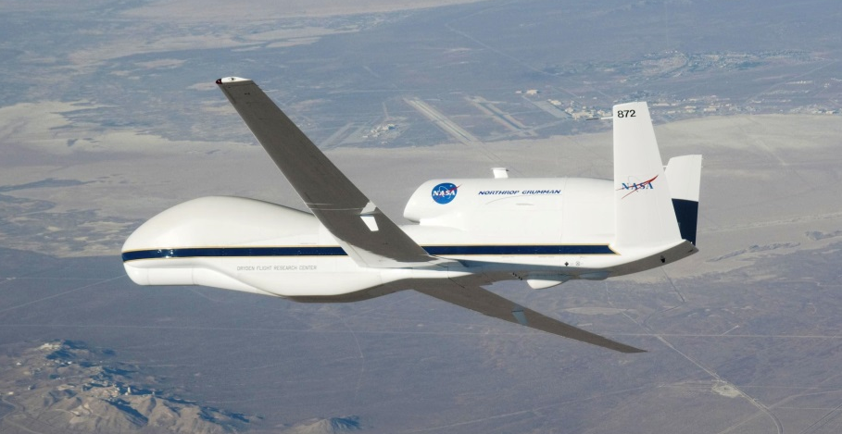
SHOUT 2015 Overview
Scientific objective: Atlantic tropical cyclones
  Focus on improvement of storm forecasts of track and intensity
  Flight plans to optimize forecast impact
Flights from WFF, August-September 2015
  5 weeks of science flights
  Payloads to include AVAPS, HAMSR, HIWRAP, LIP
Tempo to support 2-3 flights per week
  ~10 total flights

Slide 15

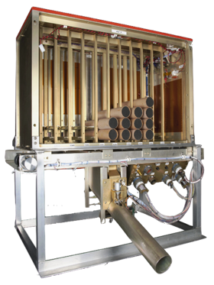
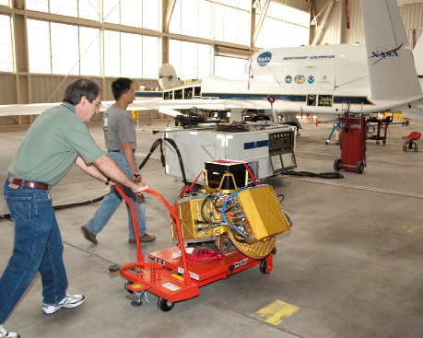
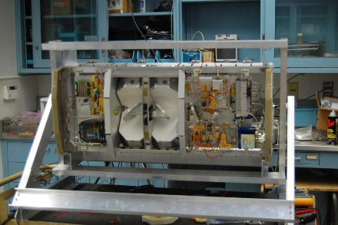
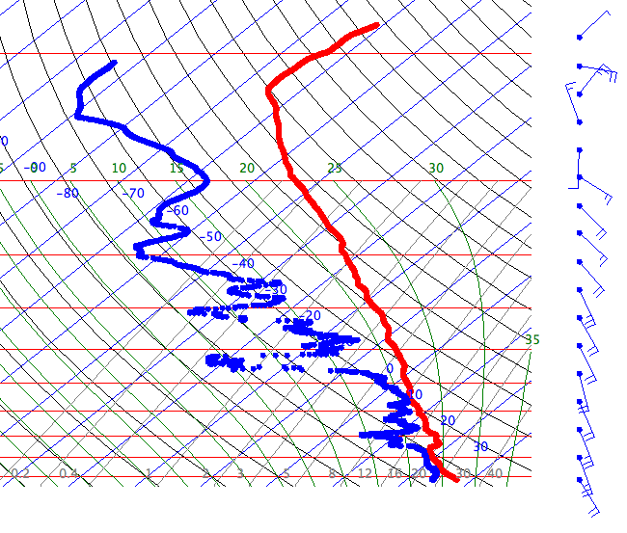
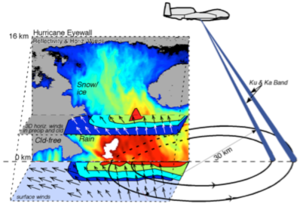
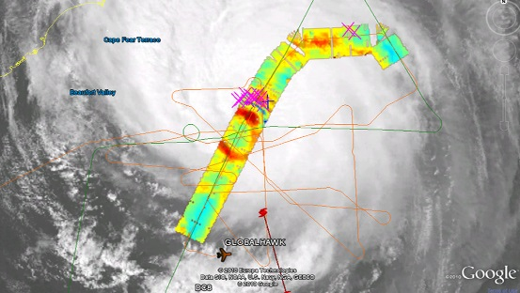
Example Global Hawk Instrumentation
Airborne Vertical Atmospheric Profiling System (AVAPS)
High Altitude Monolithic Microwave Integrated Circuit (MMIC) Sounding Radiometer (HAMSR)
High-Altitude Imaging Wind and Rain Airborne Profiler (HIWRAP)
PI: Dr. Bjorn Lambrigtsen, Jet Propulsion Laboratory
Measurements: Microwave radiometer sounder operating at 25 spectral channels in 3 bands (50-60 GHz, 118 GHz, and 183 GHz): 3-D distribution of temperature, water vapor, and cloud liquid water; Resolution: 2 km vertical, 2 km horizontal (nadir), 40 km wide swath
PI: Dr. Gerald Heymsfield, NASA GSFC
Measurements: Dual-frequency (Ka- and Ku-band), dual beam, conical scanning Doppler radar: 3-D winds, ocean vector winds, and precipitation;
Resolution: 60 m vertical, 1 km horizontal;
PI: Terry Hock, NCAR
Measurements: Temperature, Pressure, wind, humidity vertical profiles; 88 sondes per flight
~80-115 hPa

Slide 16
SHOUT FY16-17
Desire at least one more field campaign
Proposed deployments:
  Pacific Winter Storms Mar 2016
  Arctic/Alaska High Impact Weather Sep 2016
Objectives:
  Forecast improvement for threats such as extreme precipitation
  and damaging winds
  Targeted lead times of 3-7 days
  One month deployment/10 flights
Instrument change possible
Decision required soon

Slide 17
Concluding Remarks
Initial UAS capabilities demonstrated through multiple missions
Preliminary impact assessment extremely positive
Potential benefits to NOAA include:
  Extended targeted observations in harsh, remote regions
  Better warning capabilities of high impact weather systems as they travel across both ocean and land
  Satellite gap mitigation
Evaluation of utility for operational application underway

Slide 18
Backup Slides

Slide 19
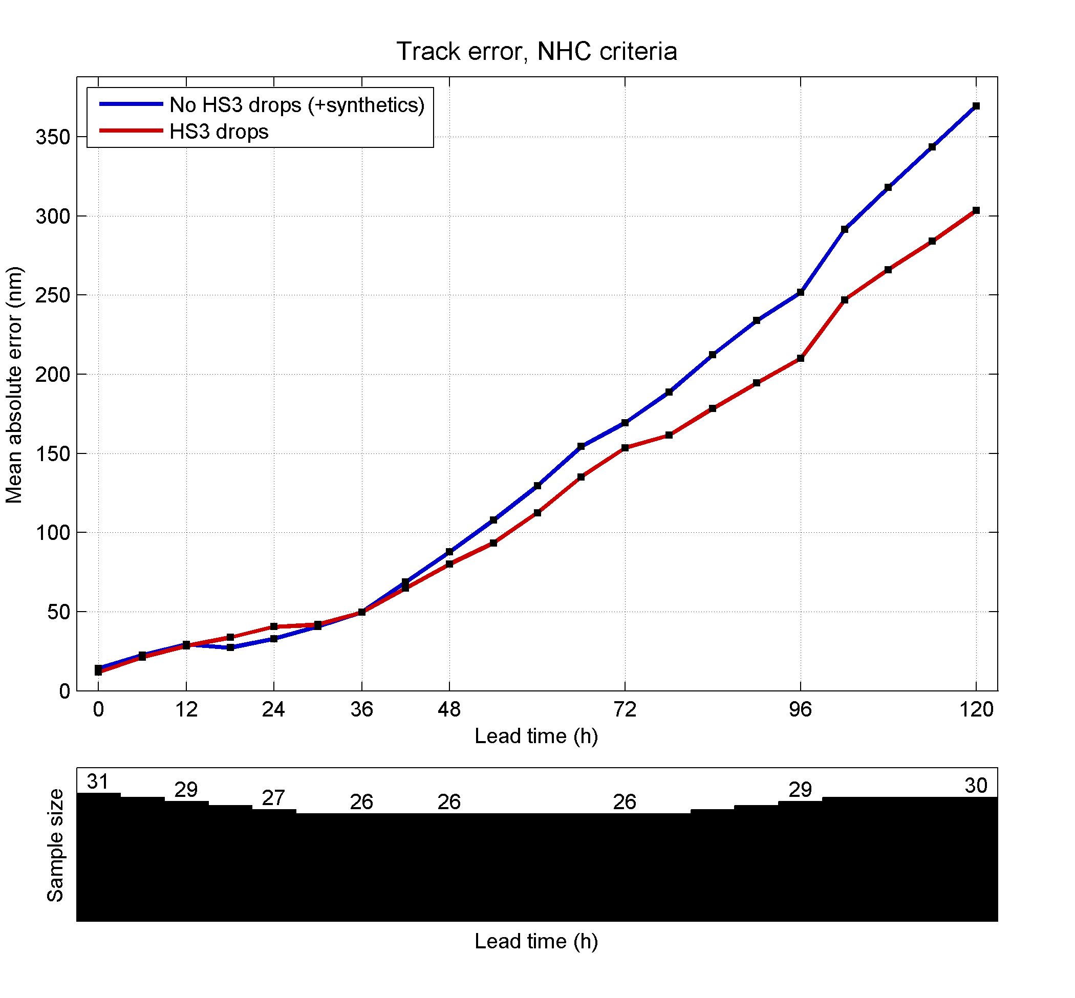
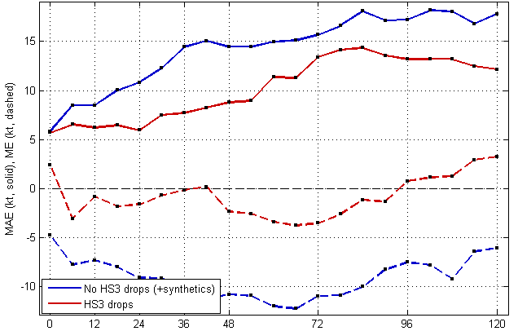
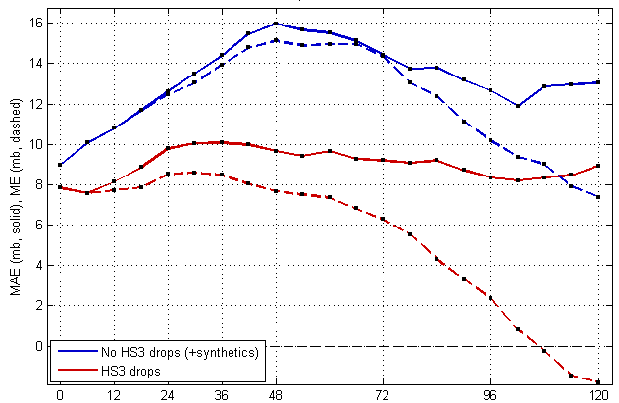
Impact of HS3 Dropsondes for Navy COAMPS-TC Hurricane Nadine Predictions
Track Error (nm)
Intensity: Max. Wind Error (kts)
No drops
No drops
HS3 drops
HS3 drops
Bias (dash)
Intensity: Min. SLP Error (hPa)
No drops
Dropsonde impact experiments performed for 19-28 Sep. (3 flights)
  Red: with HS3 drops
  Blue: No drops with synthetics
COAMPS-TC Intensity and Track skill are improved greatly through assimilation of HS3 Drops.
HS3 drops
Bias (dash)
Slide courtesy of James Doyle / NRL

Slide 20
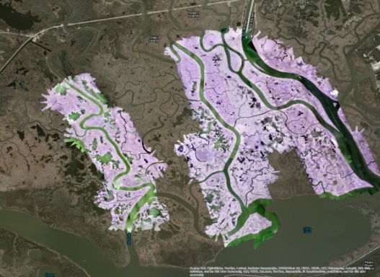
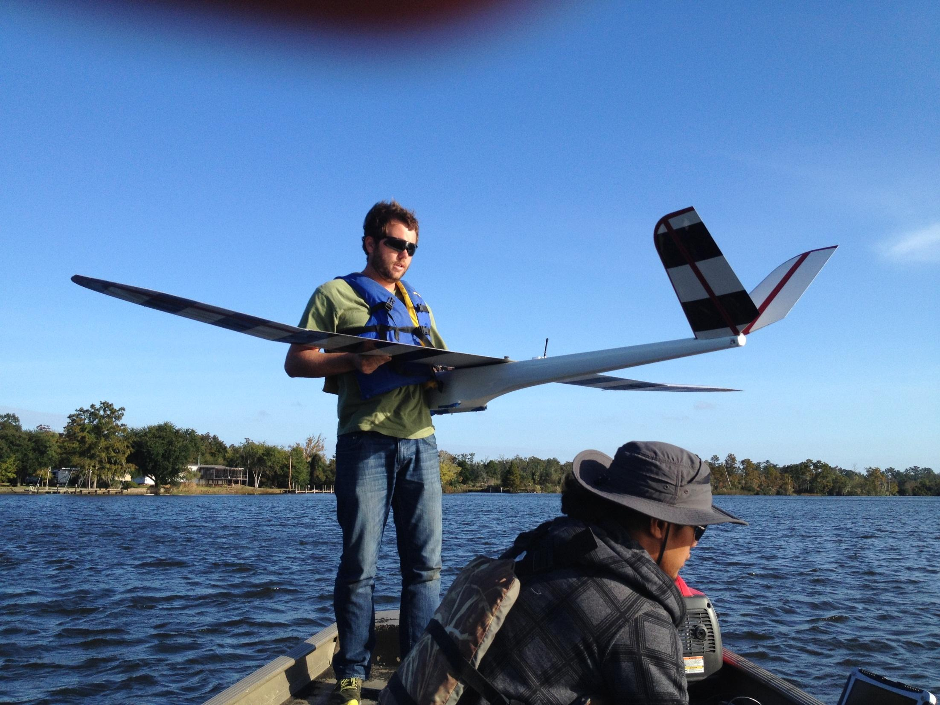
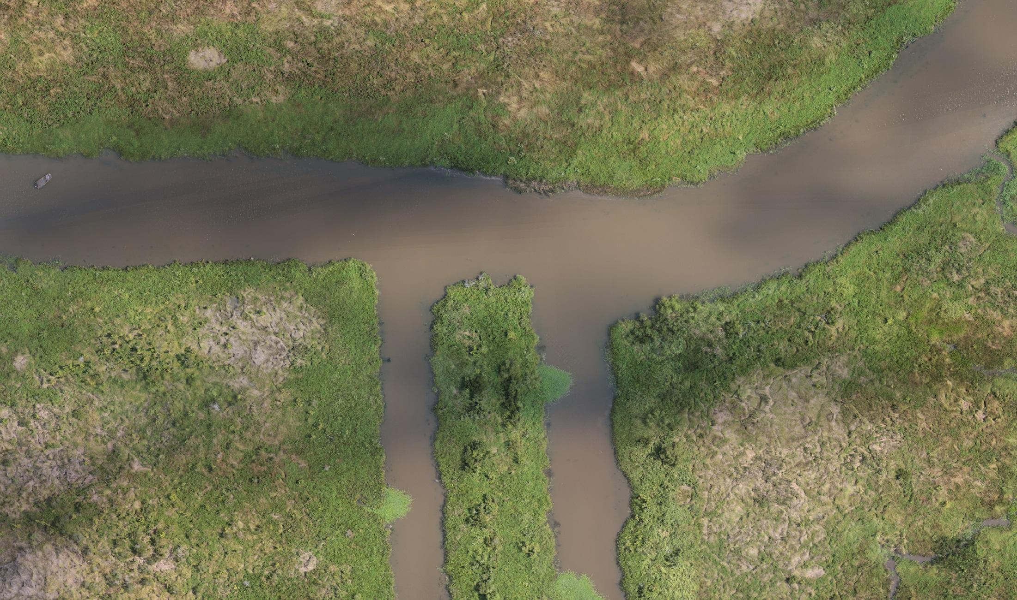
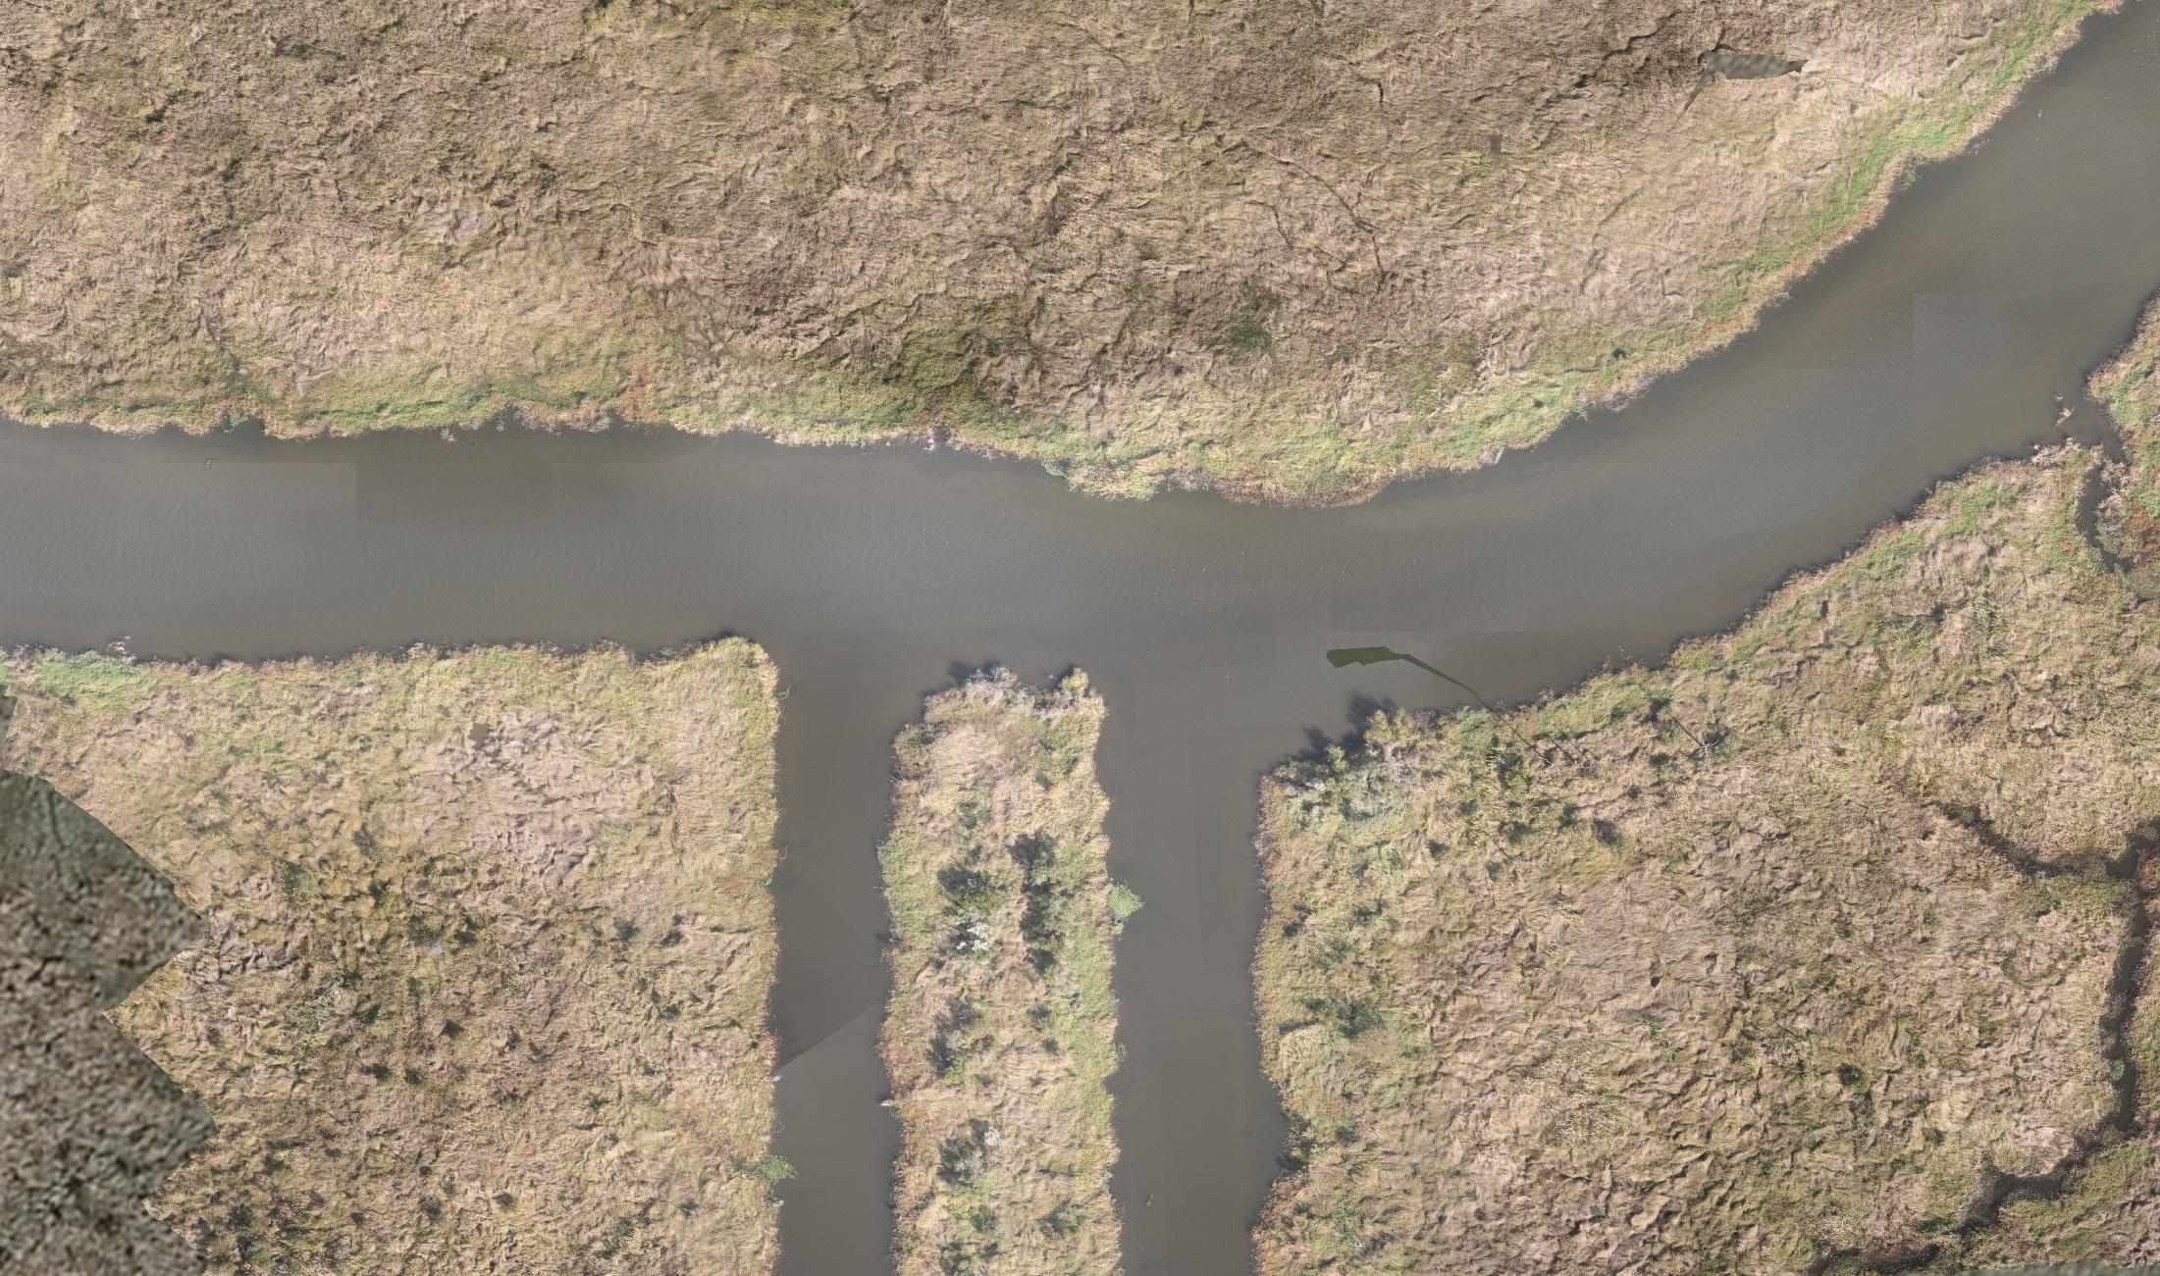
Support for River Forecasting
Objective
Support River Forecast Centers through high-resolution monitoring of remote river basins
  Detailed land/water maps
  Digital elevation maps
  Flow estimates
Demonstrations
Sampling of Pearl River Basin with Puma and Altavian aircraft
Summer
Winter

Slide 21
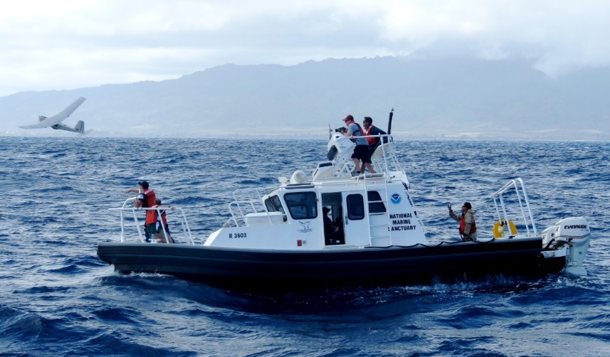
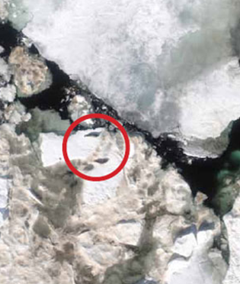
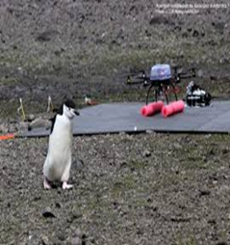
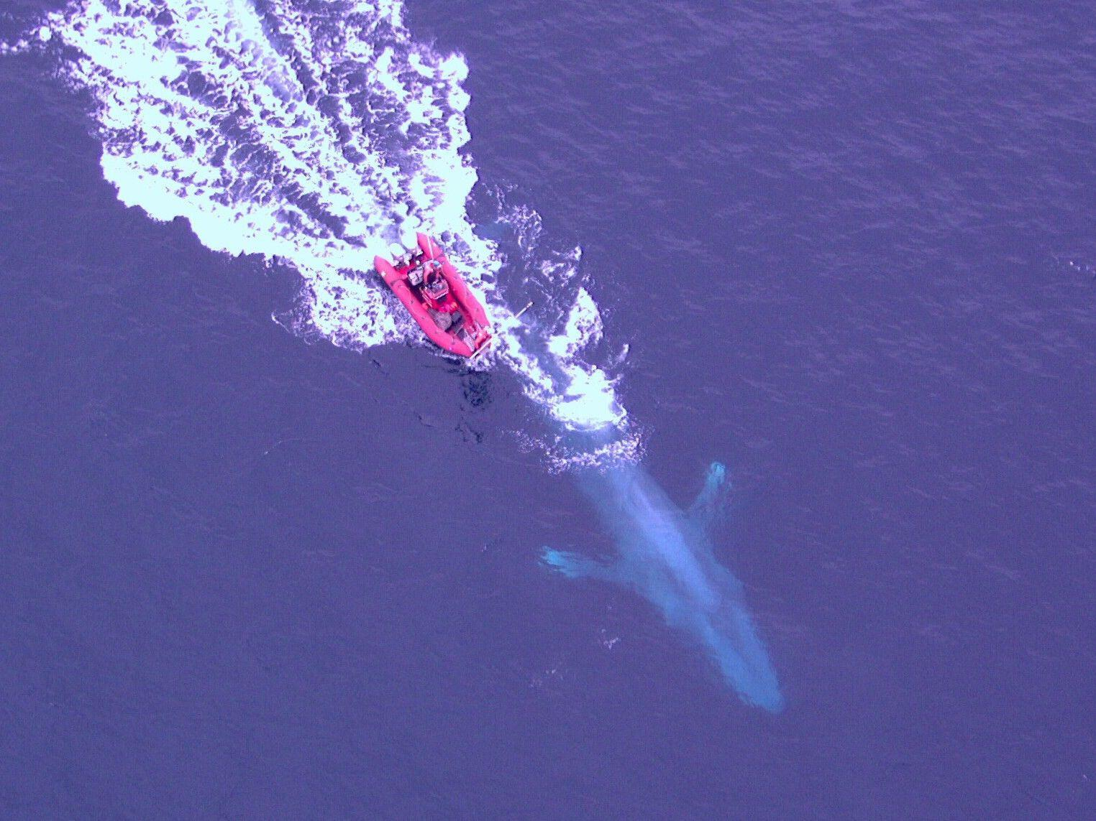
Collaboration with NOAA Fisheries
Participating in many collaborative experiments demonstrating capabilities of small UAS to monitor:
  Fish
  Marine mammals
  Sea birds
Facilitates mandated surveys and species counts in remote and hazardous regions
Platforms include small fixed-wing and vertical take off and landing (VTOL) aircraft

