Slide 1
NASA Science Overview
Ramesh Kakar
NASA Program Scientist for Wind Lidar
(also, Aqua, TRMM, GPM and CYGNSS)
28 April, 2015

Slide 2
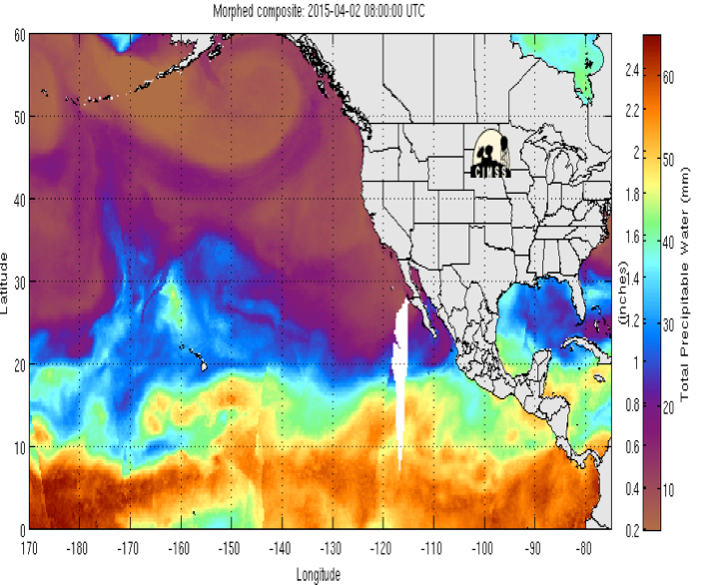
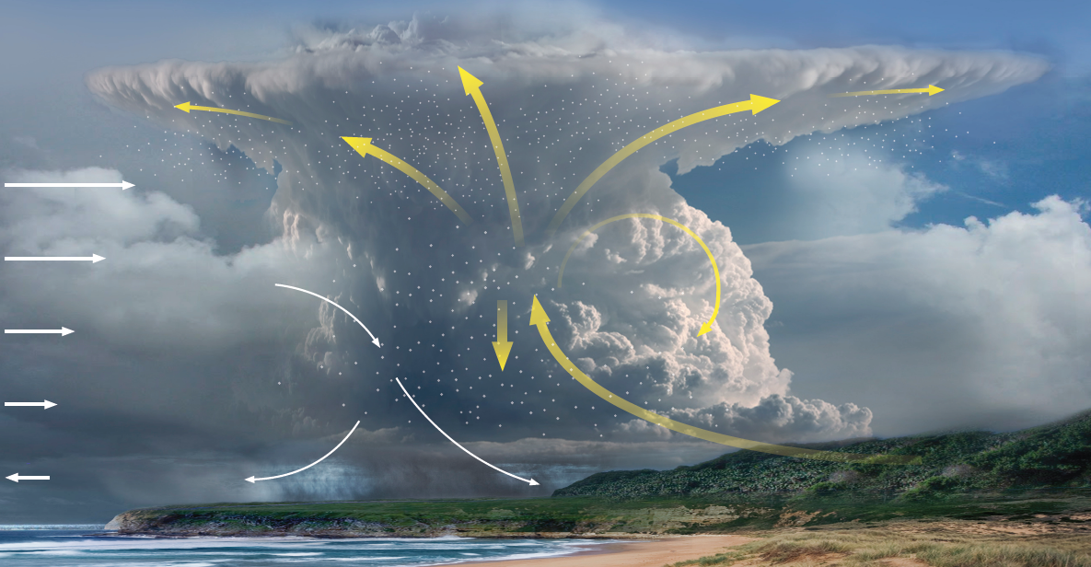
NASA Weather Focus Area Workshop Preliminary Result, April 7 – 9, Arlington, VA
About 80 people attended the two and a half days NASA weather focus area workshop
Top phenomena:
Extreme events
Top observations:
high res wind profile obs in all weather
high res temp and moisture profiles
Atmosphere – Land fluxes
Top system capability development
advanced DA (including coupled)
high res global models
OSSE

Slide 3
Brief Points
A coordinated airborne wind lidar campaign is scheduled for May 11-27, 2015 from Keflavik, Iceland. Both ESA- and NASA-provided instruments and platforms will be flying coordinated trajectories to get information of 3-dimensional atmospheric wind profiles that will be useful in the final planning of ESA’s ADM-AEOLUS mission, in processing the ADM-AEOLUS wind data, and in conducting cal/val activities when it is in orbit.
Underflights of MODIS, CALIPSO and ASCAT will provide lidar winds and cloud/aerosol information useful to these instruments’ science teams. The planned measurements will also aid longer-term studies by NASA for the 3D WINDS mission called for in the 2007 Decadal Survey for Earth Science.
The ESA and NASA aircraft will be the DLR Falcon and the DC-8, respectively. NASA’s DC-8 will carry the Doppler Aerosol WiNd (DAWN) pulsed wind-profiling coherent-detection lidar system from Langley Research Center, the Tropospheric Wind Lidar Technology Experiment (TWiLiTE) pulsed wind-profiling direct-detection lidar system from Goddard Space Flight Center, and parachute-less dropsondes from Yankee Environmental Systems, Inc.
NASA demonstrated the viability of its primary payload, the DAWN lidar, using the NASA UC-12B aircraft, in an October-November 2014 airborne campaign from Kangerlussuaq, Greenland.
Evaluation of ATHENA-OAWL is ongoing.

Slide 4
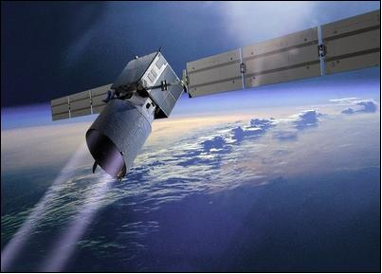
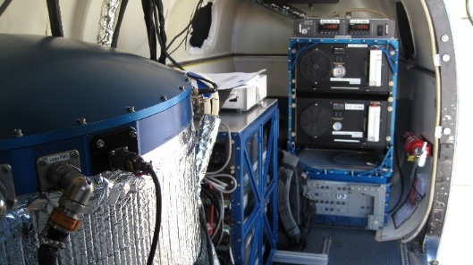
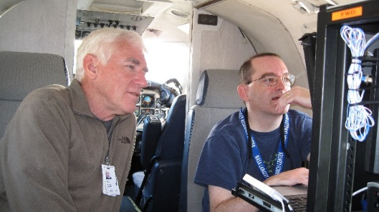
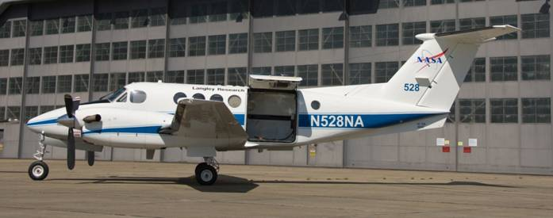
PolarWinds and ADM Cal/Val Preparatory Campaigns
Campaign 1: 10/26 – 11/14/14; LaRC’s UC-12B; Kangerlussaq, Greenland
Campaign 2: 05/11 – 05/29/15; NASA DC-8; Keflavik, Iceland
Leads: NASA LaRC and Simpson Weather Associates (PI)
Science Team: Colorado University, Ohio State University, University of Washington
NASA LaRC, Simpson Weather Associates.
Campaign Objectives:
PolarWinds
Mesoscale model validation/development
Stable boundary layers; katabatic flows; marginal ice zone dynamics
ESA ADM Cal/Val
Obtain DWL LOS observations that mimic those expected with ADM
Co-fly with DLR Falcon in Campaign 2 to calibrate Aeolus simulator (A2D)
Instrumentation:
Campaign 1: DAWN only
Campaign 2: DAWN, Yankee dropsondes,
TWiLiTE

