Slide 1
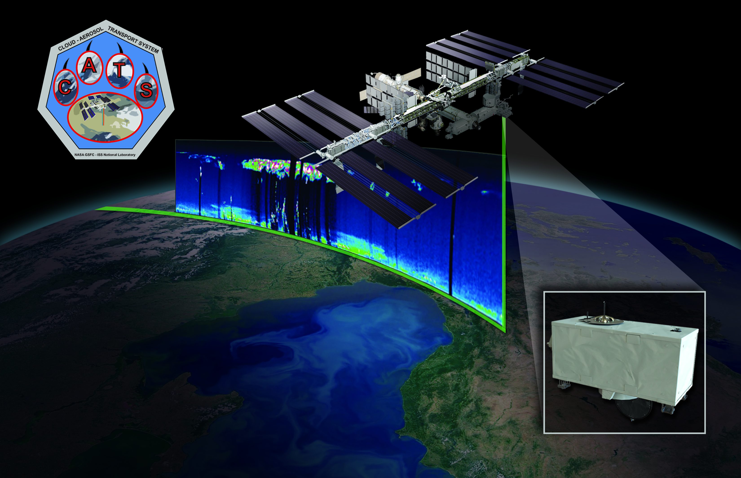
The Cloud-Aerosol Transport System (CATS)
A New Earth Science Capability for ISS
Matthew McGill, Goddard Space Flight Center, Principal Investigator
John Yorks, Goddard Space Flight Center, Science Lead & Algorithms
Charles Trepte, Langley Research Center, Algorithm Support
Hal Maring, NASA HQ, Program Scientist

Slide 2
CATS Overview
ISS | Earth Science
The Cloud-Aerosol Transport System (CATS) is a lidar remote sensing instrument built for use on the International Space Station. CATS is a directed opportunity funded by the ISS Program.
Payload Developer is NASA-Goddard Space Flight Center
“customer” is the ISS Program (HEOMD)
SMD is assisting with funding algorithm/processing development (which is a joint effort with LaRC/CALIPSO team)
CATS was designed to provide vertical profiles of cloud and aerosol properties at up to 3 wavelengths (355, 532, 1064 nm)
CATS is based on existing instrumentation built and operated on the high-altitude NASA ER-2 aircraft
The CATS project has three simultaneous goals:
Provide long-term (6 months to 3 years) science from ISS
Prove that low-cost, streamlined project approach can work
Provide tech demo on-orbit (target ACE mission)
high rep rate laser
photon-counting detection
UV (355 nm) laser operation in space
HSRL receiver concept

Slide 3
Why ISS and Why CATS?
ISS | Earth Science
Why the ISS makes sense for Earth Science:
Use what we already have (i.e., the ISS) to achieve rapid results within an affordable budget – essential in our cost-constrained environment
ISS payloads can easily trade mass for cost – the impact on cost can be huge
Embrace strict build-to-cost/build-to-schedule mentality to minimize development cycle and cost – multiple lower-cost Class D instruments can accomplish more than one giant Class B instrument
Incrementally enhance the ISS Earth observing capability, and grow it to become a vital part of the Earth Science system
Build international partnerships for collaborative climate monitoring and exploration
ISS orbit covers significant portion of the Earth’s surface, land area, and populated areas
With that rationale, CATS was funded to be a forcing function for Earth Science from ISS and to be a pathfinder for NASA-developed ISS payloads.
Notes:
Always remember what CATS is: a demo, a forcing function, an experiment in management….NOT an operational science mission, nor high-reliability.

Slide 4
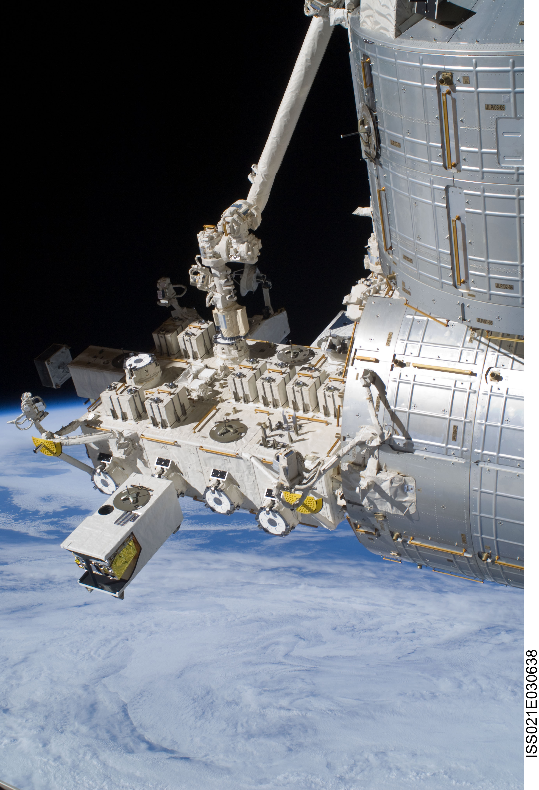
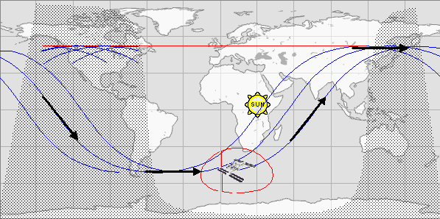
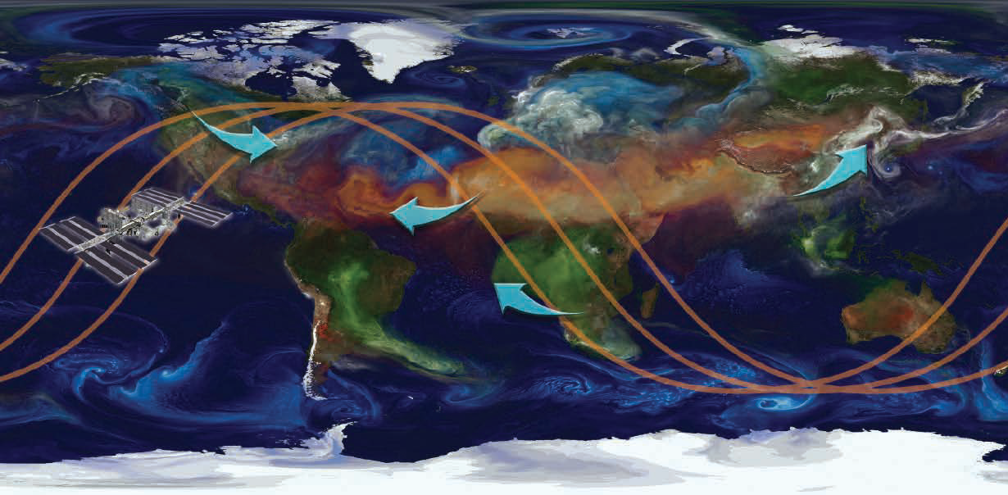
ISS Utilization
ISS | Earth Science
ISS provides a low-cost platform for earth science capabilities
CATS will be installed on the Japanese Experiment Module – Exposed Facility (JEM-EF)
Orbit is a 51º inclination orbit at an altitude of about 405 km
Provides comprehensive coverage of tropics and mid-latitudes
Primary aerosol transport paths
Permits study of diurnal changes in clouds/aerosols
Japanese Experiment Module-Exposed
Facility (JEM-EF) on the
International Space Station (ISS)

Slide 5
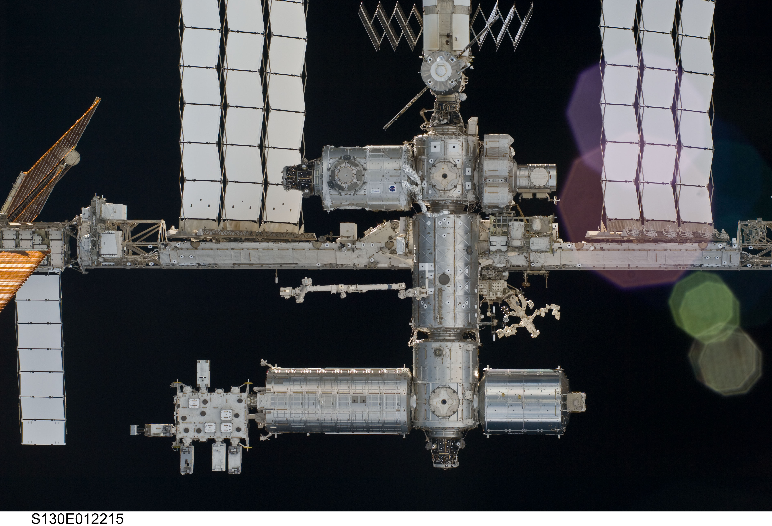
ISS & JEM-EF
ISS | Earth Science
JEM-EF
payloads
Japanese Experiment Module – Exposed Facility (JEM-EF)

Slide 6
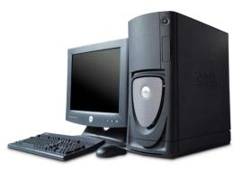
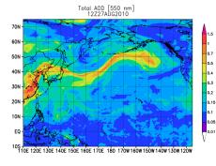
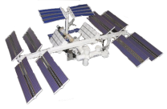
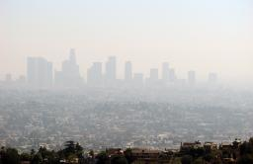
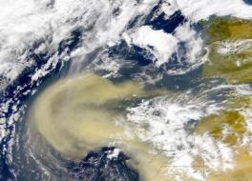
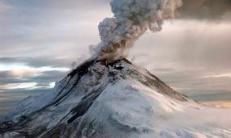
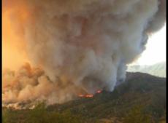
CATS Science Applications
ISS | Earth Science
ISS
CATS Processing Center
NASA GSFC
Operational Aerosol Forecast Models
CLOUD PROPERTIES
Research
AIR QUALITY MONITORING
Forecasting
AEROSOL PROPERTIES
VOLCANIC PLUME TRACKING
WILDFIRE DETECTION
Notes:
Although CATS is highly programmatic in nature, we DO have real science goals

Slide 7
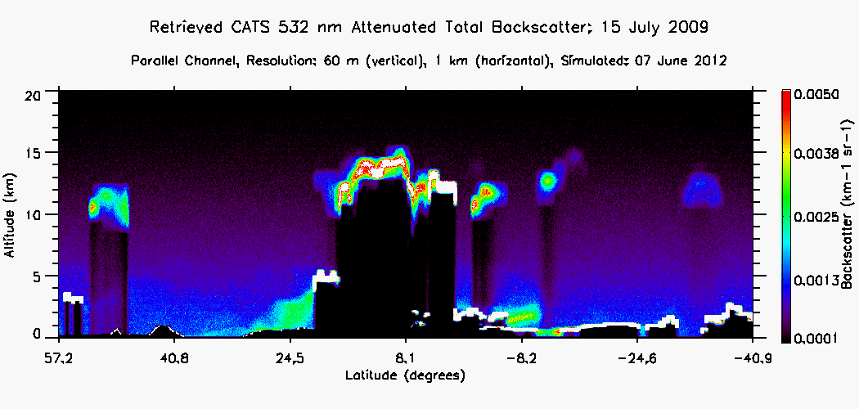
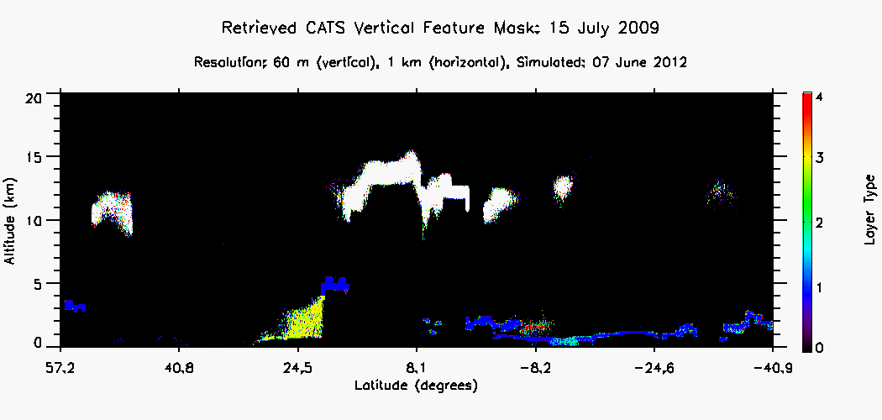
Backscatter Measurements
ISS | Earth Science
Vertical profiles of backscatter provide important climate information on Earth’s radiation budget
However, layer type (i.e., composition) cannot be determined using backscatter at a single wavelength
Determining layer type is important because:
Different layers have different microphysical properties which impact radiative balance in different ways
Climate models need to know the vertical/horizontal distribution and properties of atmospheric layers
Current climate models do not accurately predict the vertical structure of cloud and aerosol layers
Lidar data can be used to initialize models for better vertical structure in model output
We want to take the measured profile data
And turn it into a vertically-resolved “feature mask” that identifies the different types of layers.
Ice Clouds
Smoke
Dust
Sea Salt
Water Clouds
Notes:
Layer Typing is important because:
Current climate models do not accurately predict the vertical structure of cloud and aerosol layers
Lidar data can be used to initialize models for better vertical structure in model output

Slide 8
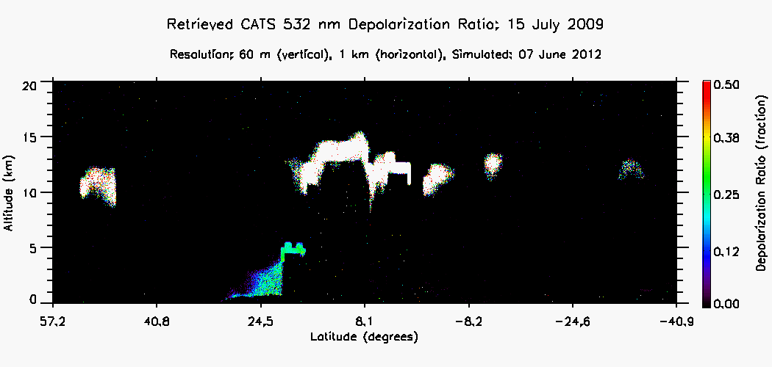
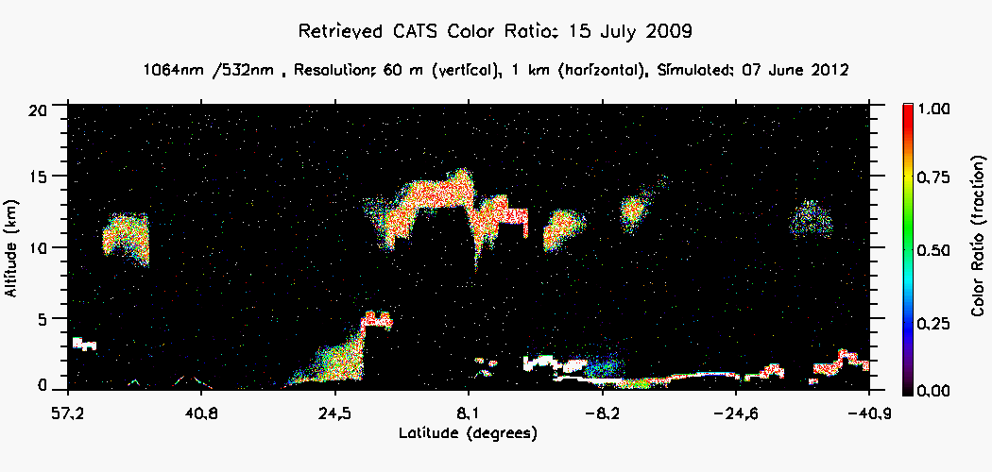
Multiple Wavelengths and Depolarization
ISS | Earth Science
Depolarization ratio (δ) provides information about particle shape
Multiple wavelengths provide information about particle size by ratio of the backscatter (color ratio, χ)
Both are needed to accurately determine layer type
Dust:
0.20 < δ < 0.30
Ice Clouds:
> 0.40
χ > 0.85
Water Clouds:
~ 0.0
χ > 0.85
Smoke:
χ ~ 0.20

Slide 9
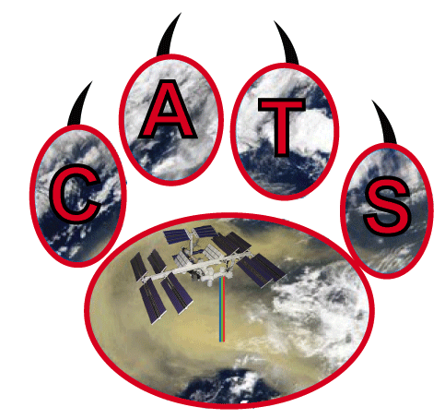
Science Modes
Backscatter: 532, 1064 nm
No HSRL
Depolarization: 532, 1064 nm
Backscatter: 532, 1064 nm
HSRL: 532 nm
Depolarization: 1064 nm
Backscatter: 355, 532, 1064 nm
No HSRL
Depolarization: 532, 1064 nm
Mode 1: Multi-Beam
Mode 2: HSRL Demo
Mode 3: UV Demo
-0.5º
+0.5º
405 km
405 km
405 km
14.38 m diameter
14.38 m diameter
14.38 m diameter
RFOV
LFOV
AFOV
7 km
FFOV

Slide 10
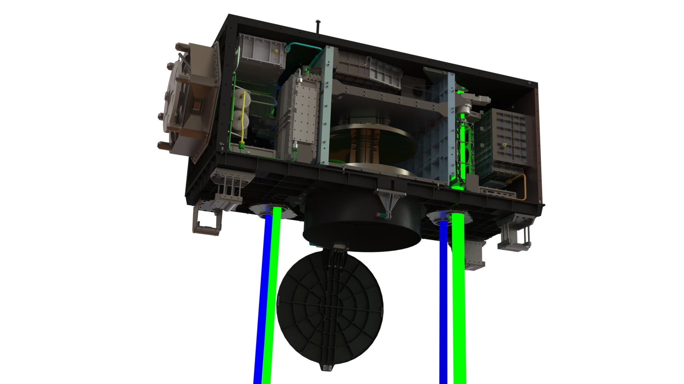
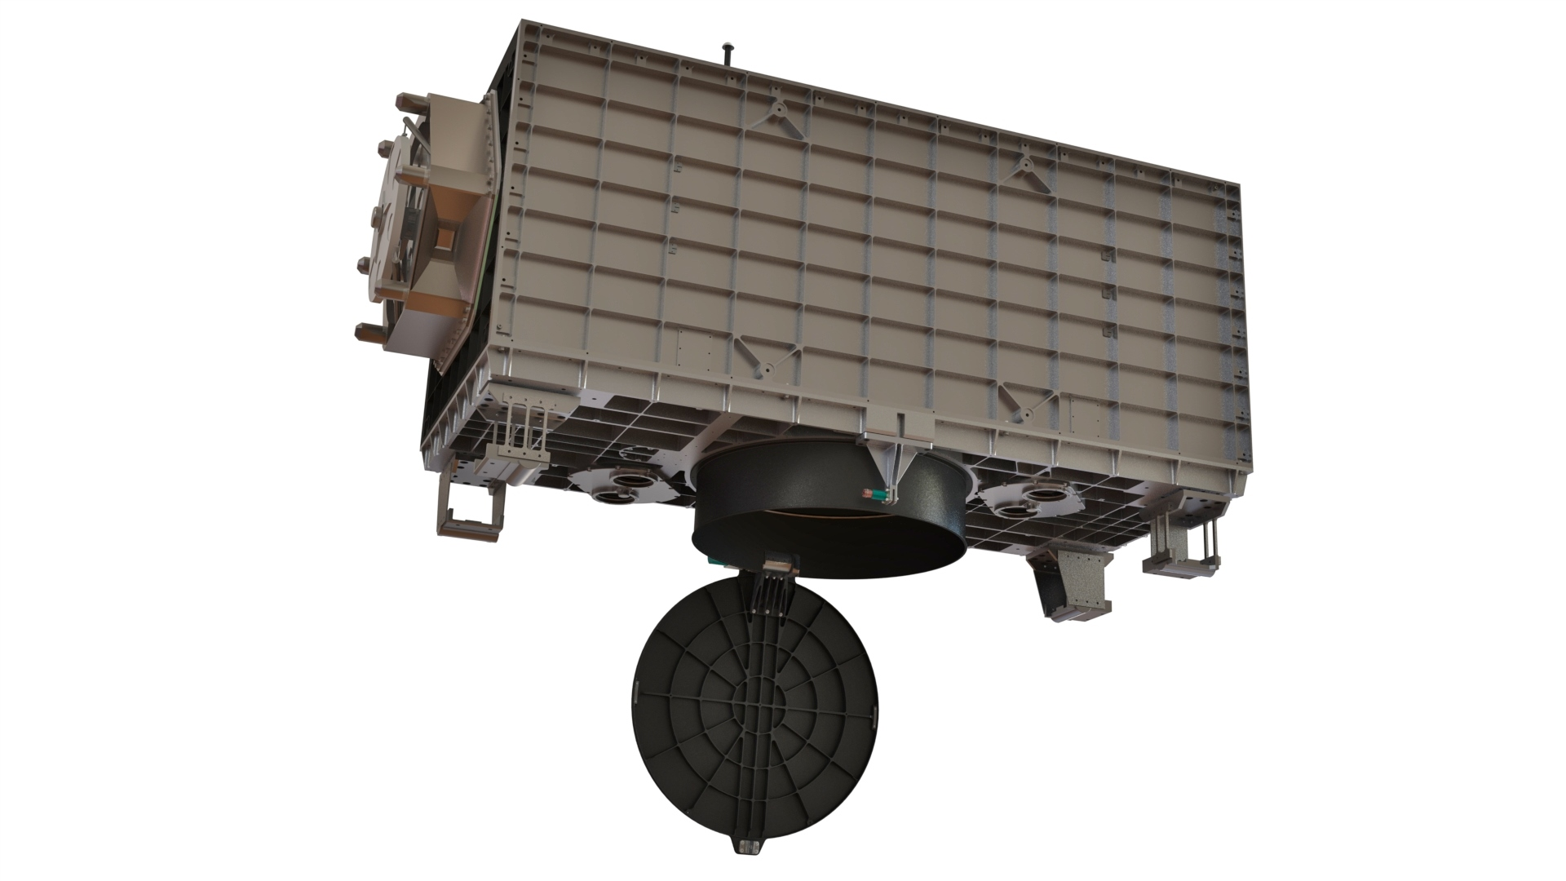
CATS Instrument
ISS | Earth Science
CATS employs 2 high repetition rate lasers
One operates at 532, 1064 nm
Second is seeded to provide narrow linewidth for HSRL measurements and frequency-tripled for use at 355 nm
CATS has a 60 cm beryllium telescope with narrow field-of-view (FOV)
4 instantaneous fields of view (IFOV)
Laser 1 Type | Nd: YVO₄
Laser 1 Wavelengths | 532, 1064 nm
Laser 1 Rep. Rate | 5000 Hz
Laser 1 Output Energy | ~1 mJ/pulse
Laser 2 Type | Nd: YVO₄, seeded
Laser 2 Wavelengths | 355, 532, 1064 nm
Laser 2 Rep. Rate | 4000 Hz
Laser 2 Output Energy | ~2 mJ/pulse
Telescope Diameter | 60 cm
View Angle | 0.5 degrees
Telescope FOV | 110 microradians
Primary Power Supply
Other Detector Boxes
Payload Interface Unit (PIU)
HSRL Detector Box
Laser 1
Telescope
Telescope Cover

Slide 11
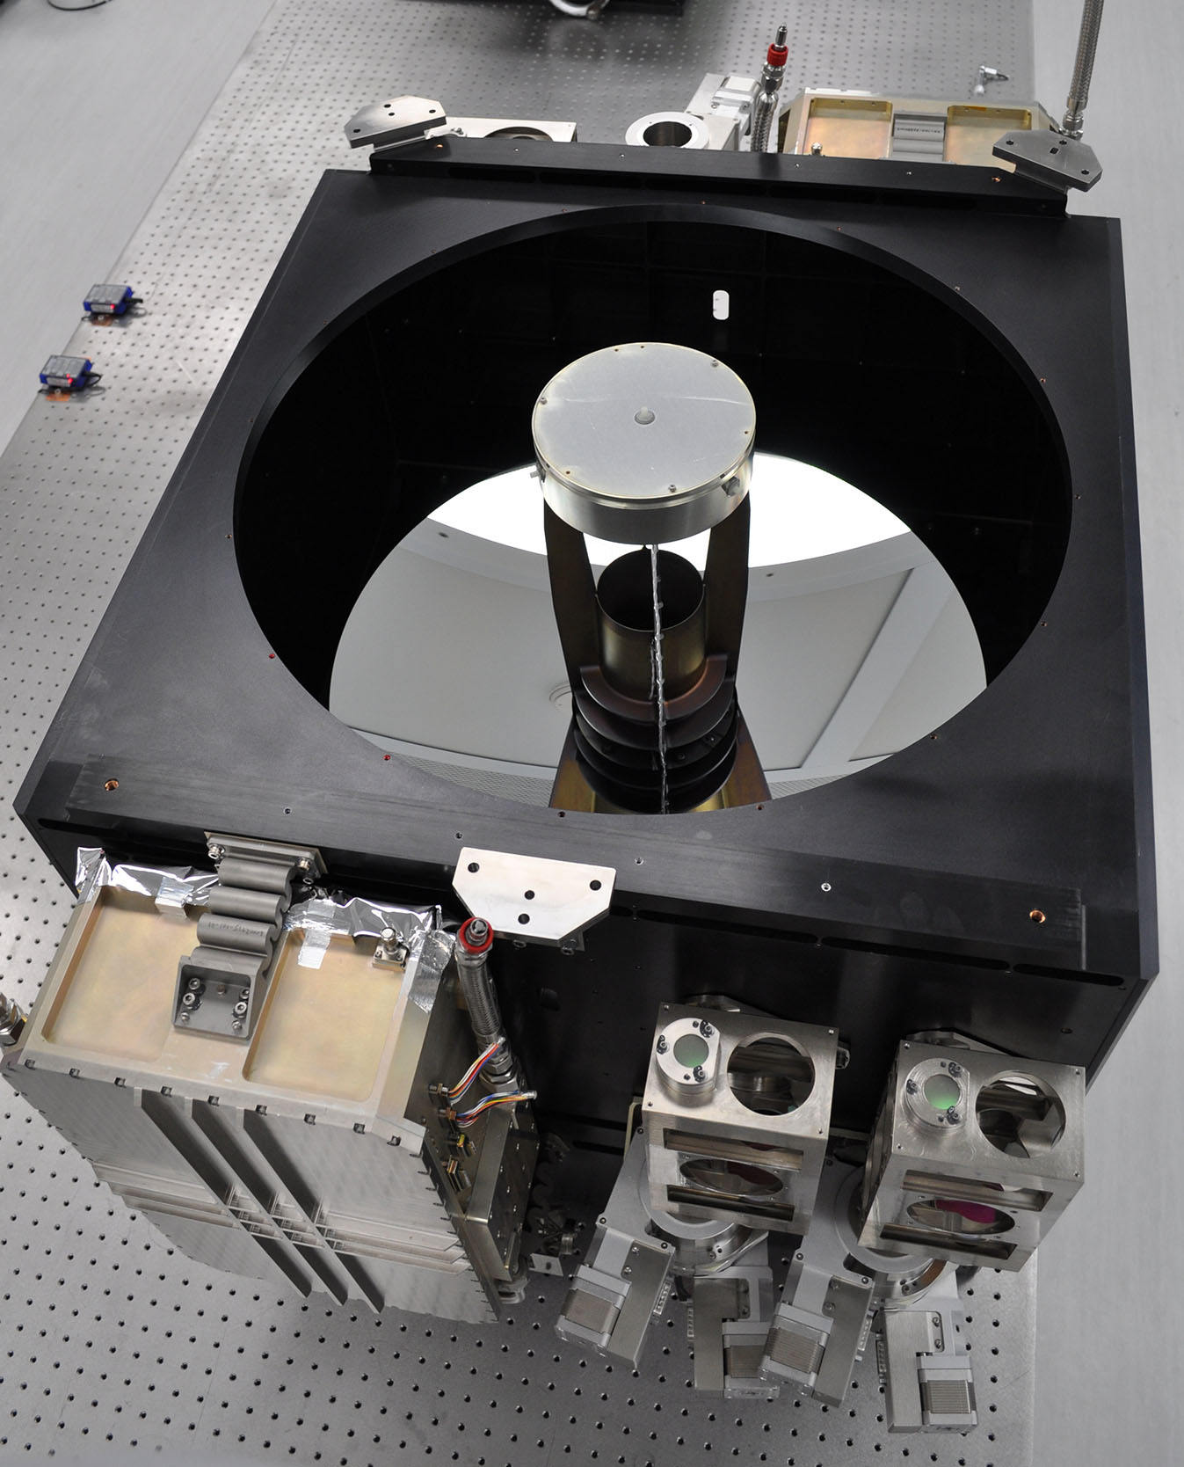
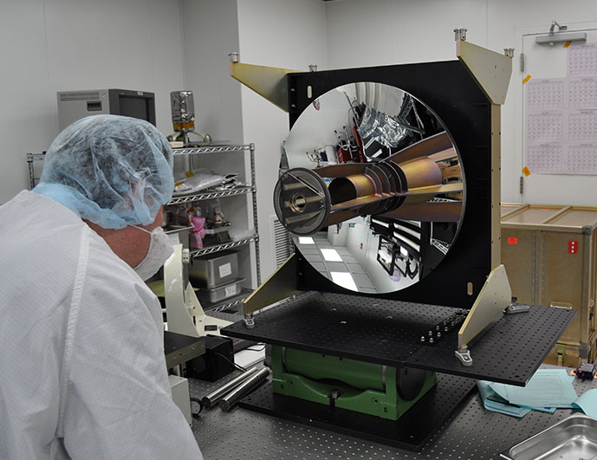
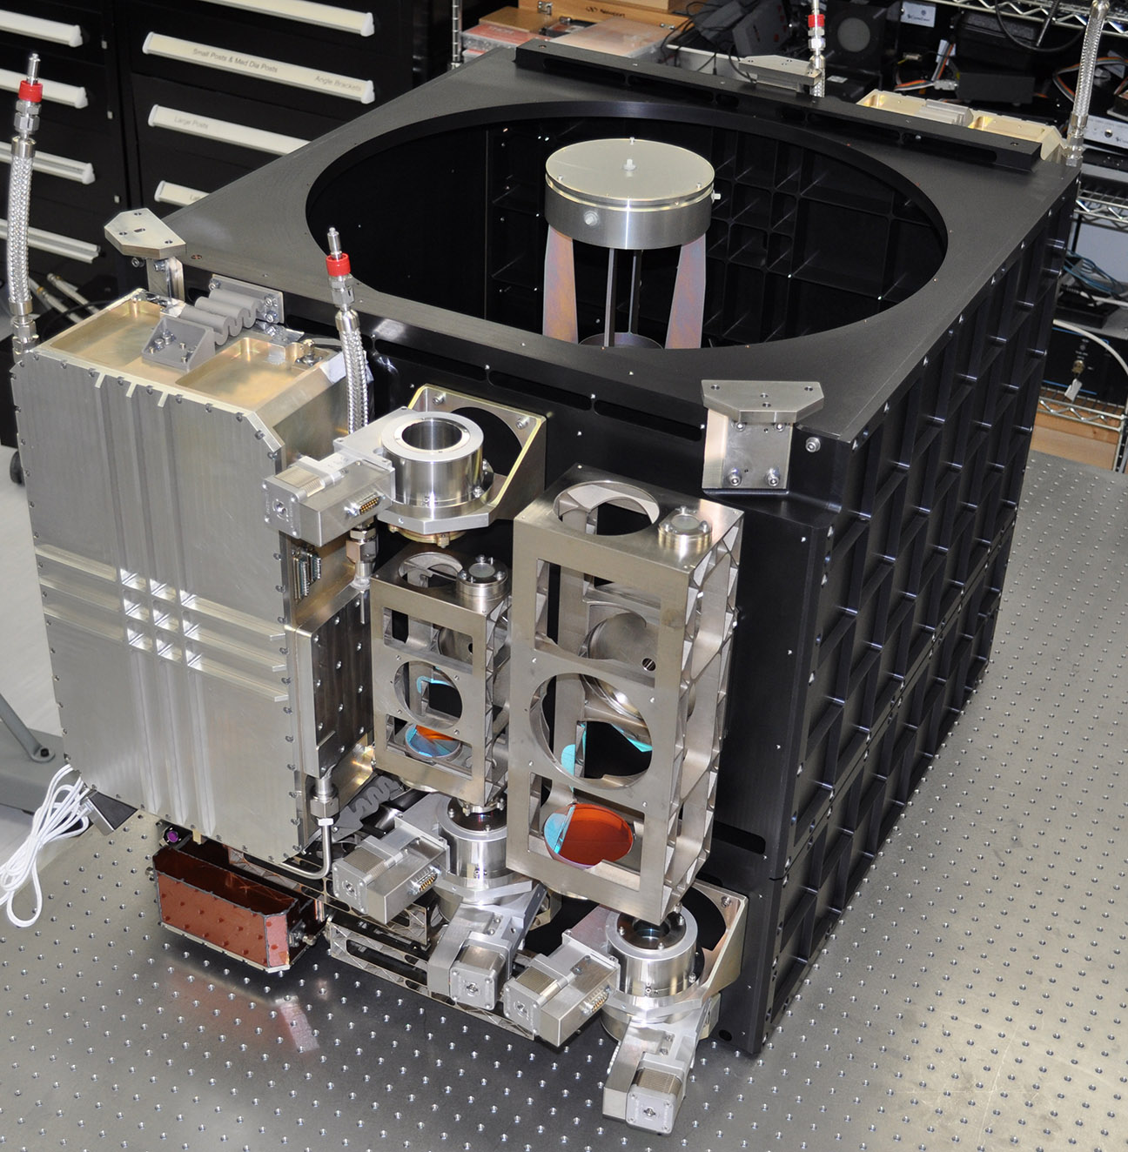
Building the Transceiver
ISS | Earth Science
Laser 1 bench subassembly side
60 cm beryllium telescope,
110 μrad field of view
Laser 2 bench subassembly side

Slide 12
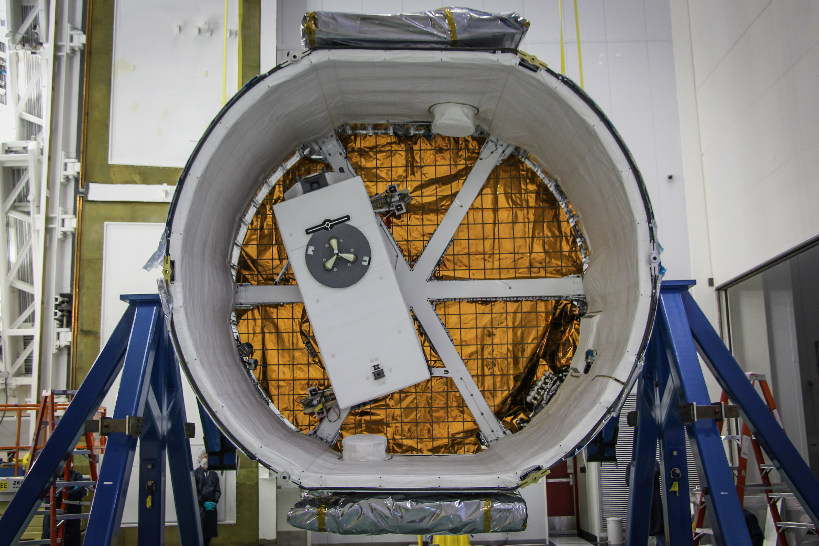
Integrated and DONE!
ISS | Earth Science
The instrument shipped to SpaceX for integration on Sep 30, 2014
Integration to the SpaceX Dragon Trunk completed Oct 8, 2014
Expected launch date was Dec 16, 2014; actual was Jan 10, 2015

Slide 13
CATS Status
ISS | Earth Science
The Cloud-Aerosol Transport System (CATS) is a lidar remote sensing payload utilizing ISS as an affordable Earth Science observing platform.
CATS is designed to study clouds and aerosol properties in the Earth’s atmosphere to
Monitor effects of climate change
Monitor dynamic events
Demonstrate pathfinder instrument for earth science
CATS is not an operational science mission -- is an experiment.
CATS provides in-space demonstration of technologies for future satellite missions (e.g., ACE) while demonstrating build-to-cost project development with streamlined management structure.
TIMELINE
Jan 10: CATS launched on SpaceX5
Jan 22: installed to JEM-EF
Feb 5: “first light” with laser
Feb 10: first “science quality” data
Feb 10: first underflight with aircraft
Feb 12: first continuous 24-hr operation
Feb 17 & 20: additional aircraft underflights
Feb 12- present: continuing operations, as continuously as possible, within operational constraints
To-date on-orbit:
Laser #1: 13 billion laser shots, 730+ hrs operation
Laser #2: 3 ½ billion laser shots, 250+ hrs operation
(that’s abut 65% availability to-date, which is not bad at all for just getting started and dealing with operational constraints of ISS)

Slide 14
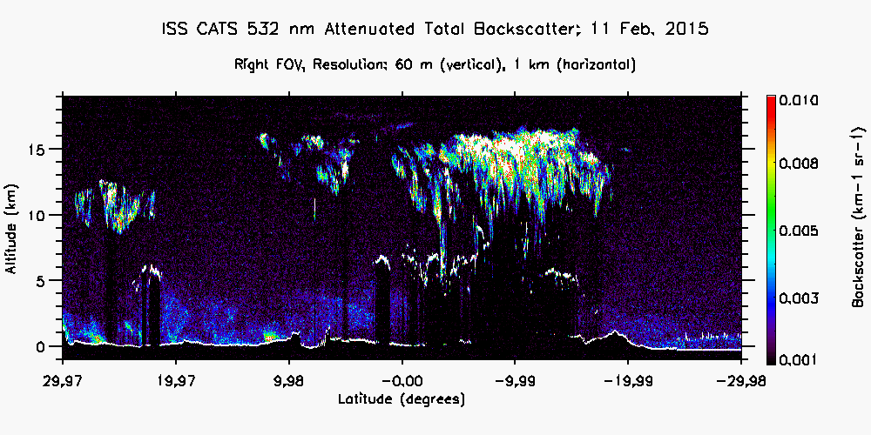
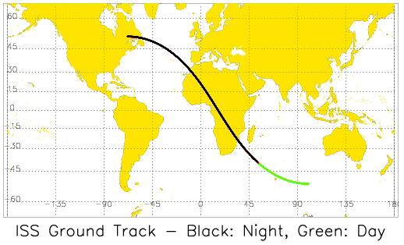
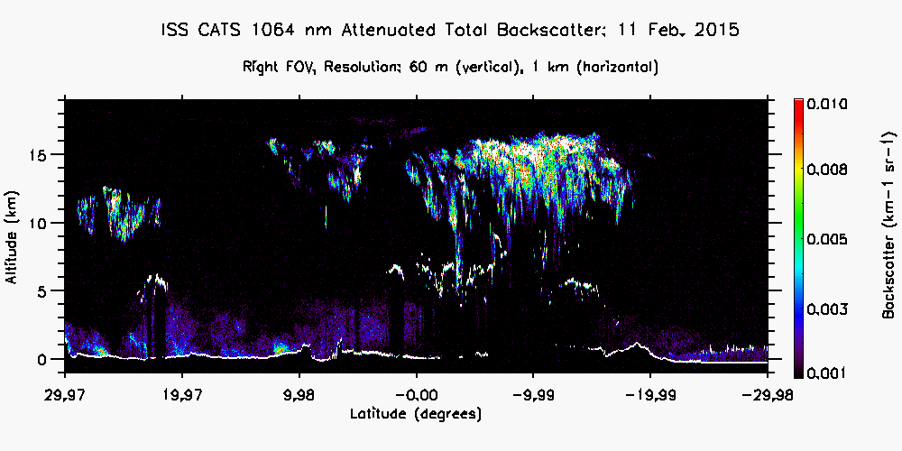
First Science Data!
ISS | Earth Science
L1a data from Feb 11, 1830-1915 UTC. Top image is 532 nm attenuated total backscatter, bottom image is 1064 nm attenuated total backscatter, and the ISS track corresponding to the data.

Slide 15
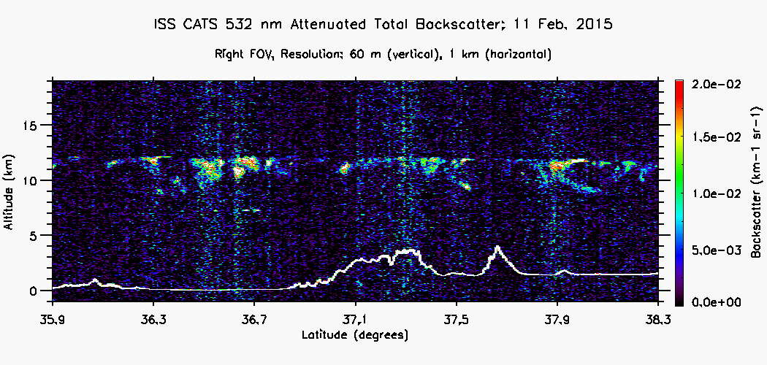
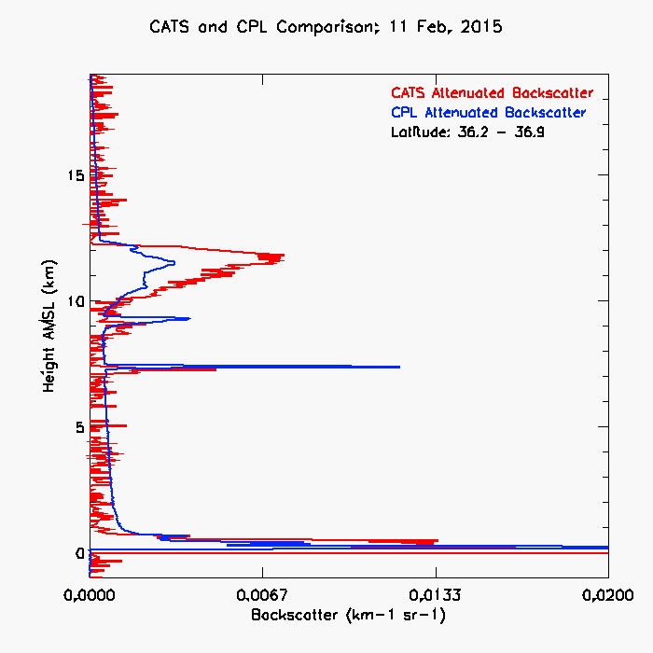
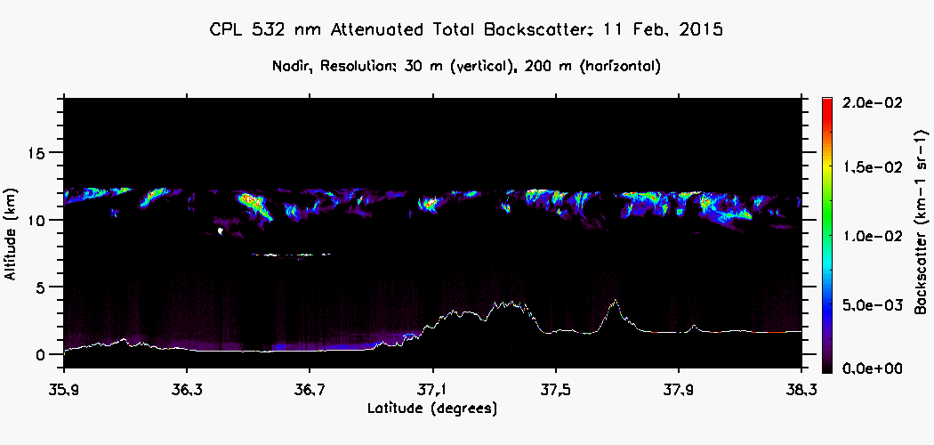
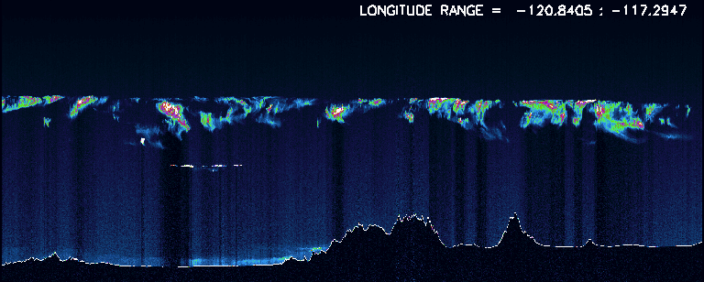
Airborne Validation
ISS | Earth Science
cirrus cloud heights agree
mid-cloud heights agree
surface return
Data from Feb 11. Top image is 532 nm normalized relative backscatter (i.e., not yet calibrated) from CATS, bottom image is same for CPL on the ER-2 – the visual correspondence is spectacular.

Slide 16
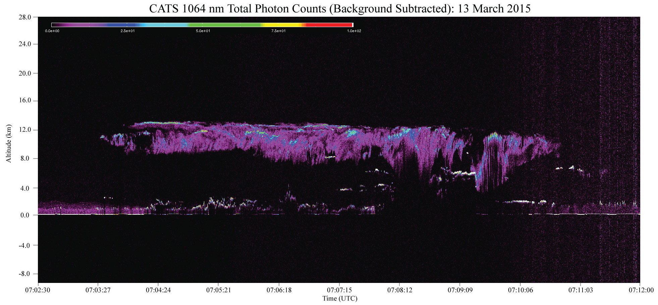
High Rep Rate Works!
ISS | Earth Science
This is raw, 350 m x 60 m profile data (1064 nm) – spectacular detail!
CATS is the first on-orbit demonstration of high repetition-rate, photon-counting lidar. This raw data shows excellent detail and fine structure at raw resolution with a paltry 1-2 mJ pulse energy (at least at night).
This is raw, 350 m x 60 m profile data (1064 nm) – spectacular detail!

Slide 17
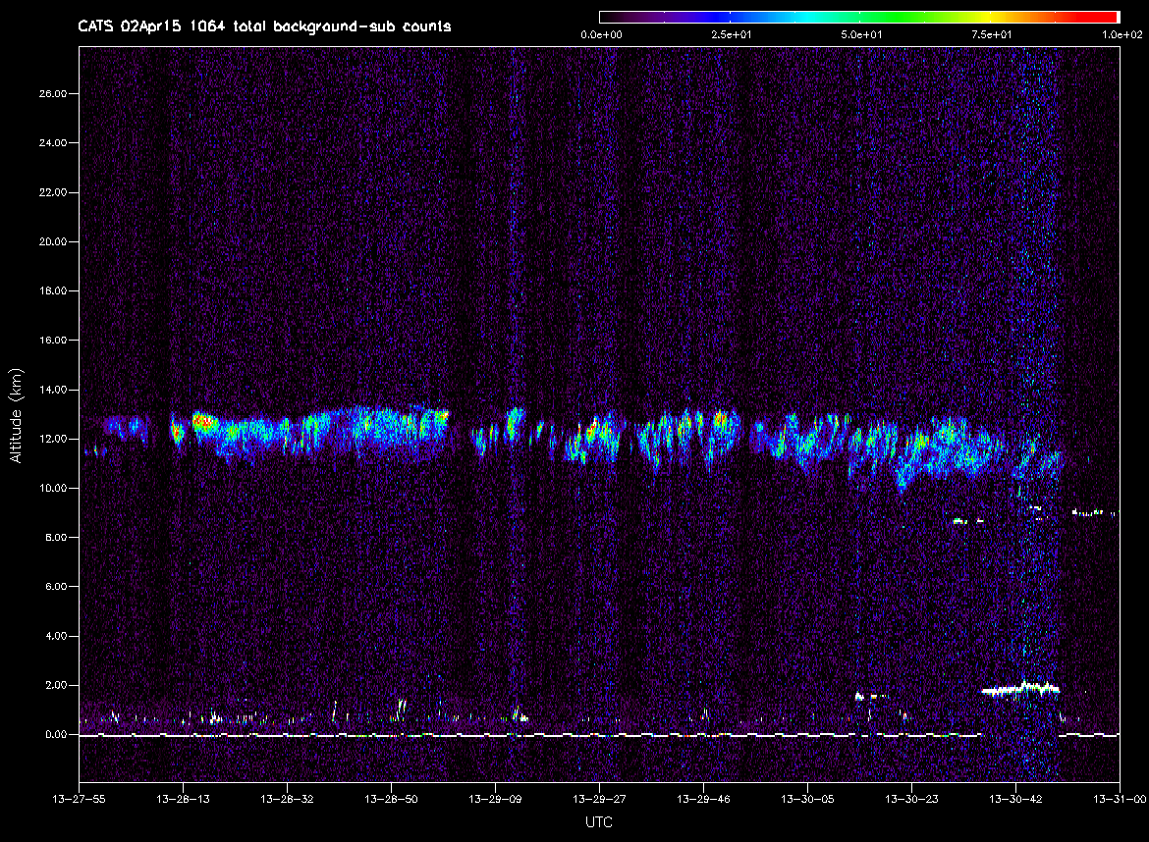
Spectacular Cirrus!
ISS | Earth Science
Exceptional cirrus, April 2, 2015
We just happened to be watching the real-time data feed and saw this wonderful cirrus structure.
This is raw, 350 m x 60 m profile data (1064 nm) – spectacular detail!

Slide 18
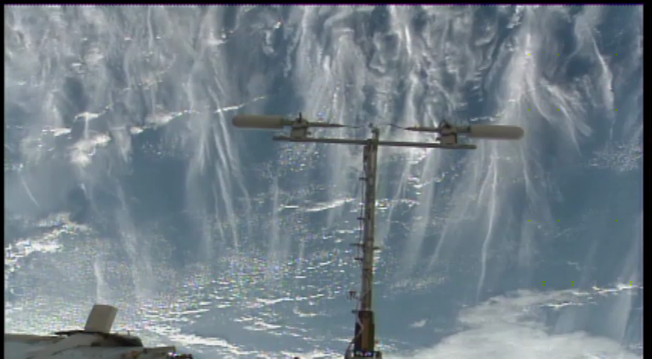
Spectacular Cirrus!
ISS | Earth Science
Exceptional cirrus, April 2, 2015
ISS nadir(-ish) video camera view at 13:30:42 UTC, spans ~700 km distance
This is raw, 350 m x 60 m profile data (1064 nm) – spectacular detail!

Slide 19
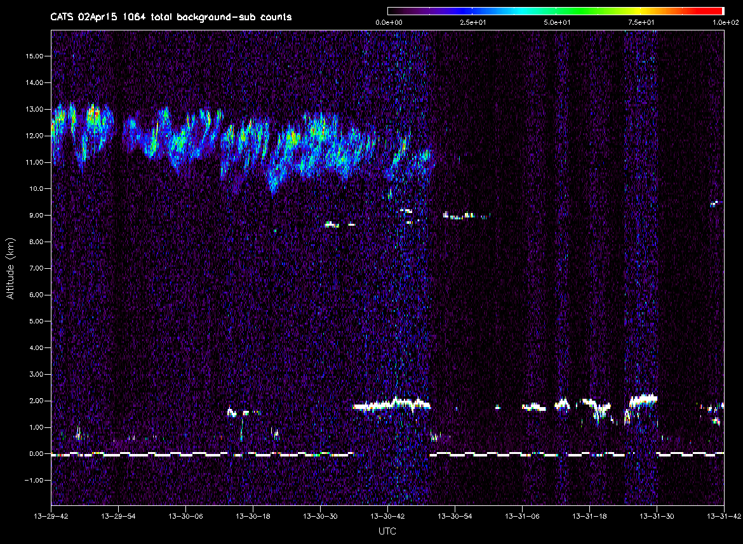
Spectacular Cirrus!
ISS | Earth Science
Exceptional cirrus, April 2, 2015
ISS nadir(-ish) video camera view at 13:30:42 UTC, spans ~700 km distance
This is raw, 350 m x 60 m profile data (1064 nm) – spectacular detail!

Slide 20
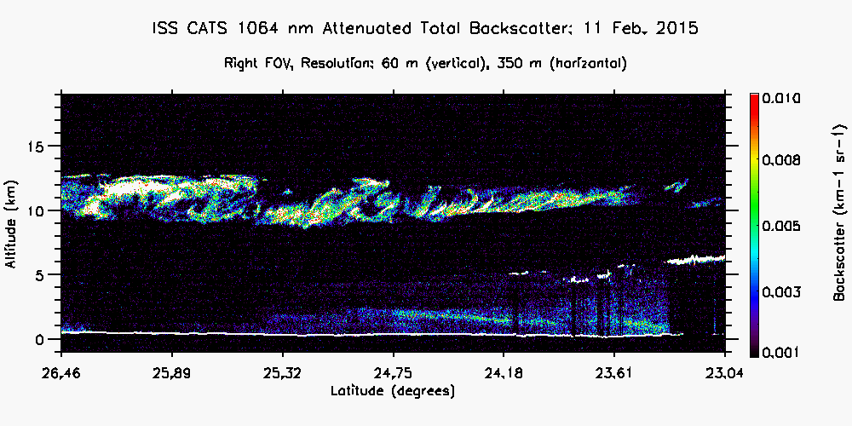
Excellent On-Orbit Demonstration!
ISS | Earth Science
This is 350 m x 60 m profile data (1064 nm) – spectacular detail!
Again, excellent structure and detail in the cirrus cloud. Aerosol below is resolved. This is near-aircraft-quality resolution. Preliminary data indicates excellent detection sensitivity using the photon-counting detection.

Slide 21
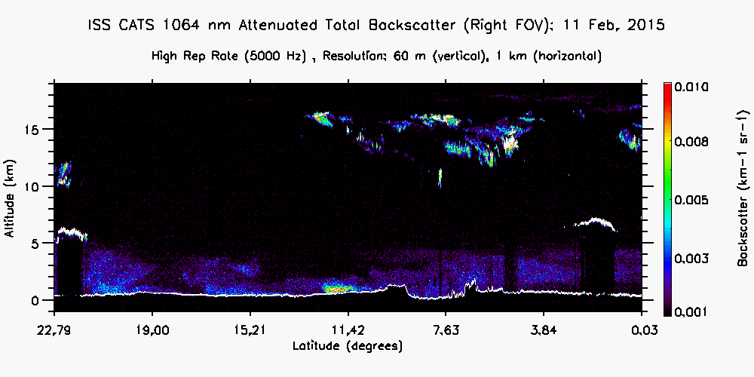
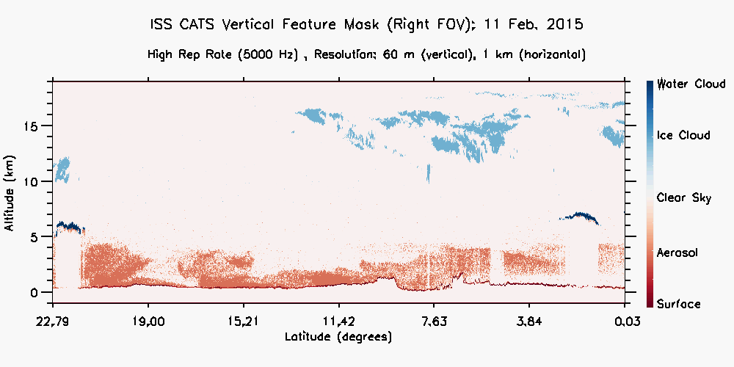
CATS Level-2 Data
ISS | Earth Science
Hot off press.
First attempt at cramming data through Level-2 processing to retrieve vertical feature mask.
For first attempt, not bad at all – now moving towards processing backlog of data and settling in to regular processing routine.
This is raw, 350 m x 60 m profile data (1064 nm) – spectacular detail!

Slide 22
Summary
ISS | Earth Science
CATS is a spectacular opportunity, and the latitude given by the ISS Program to apply sound engineering and management judgment in the pursuit of generating good science has been demonstrated to work.
ISS Program trusted the Payload Developer to derive our own science requirements instead of subjecting the project to externally-derived requirements and oversight
Instrument design and requirements are consistent with the [self-generated] science requirements.
CATS team has proven that a large attached payload can be built for ~$15M and ~2 years development time.
On-time/on-cost completion
Succesfully launched and operating
The CATS experience and approach is directly applicable to Earth Venture Instrument (EVi) and Earth Venture Mission (EVm) competitive opportunities.
The GSFC Class D Constitution has been an important outcome of the CATS effort.
http://cats.gsfc.nasa.gov
Notes:
From customer’s standpoint, we met our goals before even launched.

