Slide 1
NASA Earth Science Technology Update
Presented to Doppler Wind Lidar Working Group
April 28, 2015
George J. Komar
Associate Director/Program Manager
Earth Science Technology Office

Slide 2
Earth Science Program Overall Strategy
Maintain a balanced program that:
advances Earth System Science
delivers societal benefit through applications development and capacity building
provides essential global spaceborne measurements
develops and demonstrates technologies for next-generation measurements, and
complements and is coordinated with activities of other agencies and international partners

Slide 3
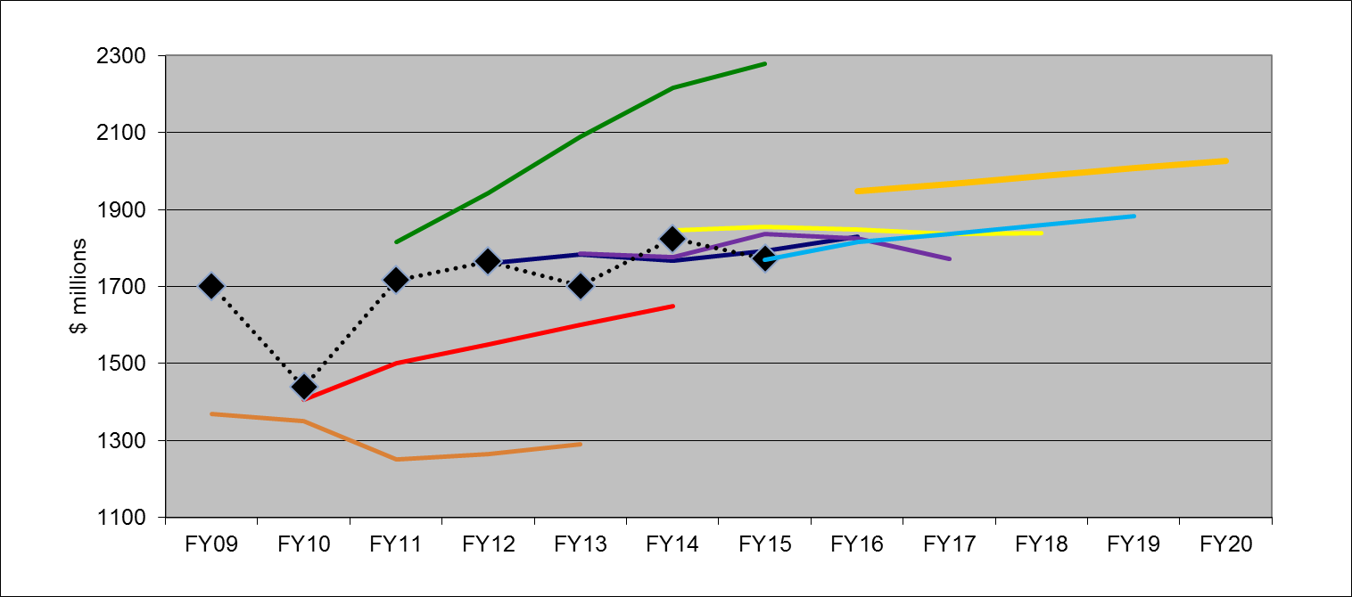
Earth Science Budget: FY16 Request/FY15 Appropriation
FY11 request
FY16 request
FY14 request
FY12 request
Appropriation
FY15 request
FY13 request
FY10 request
FY09 request
(previous Admin)

Slide 4
Earth Science Budget Increase
NASA now has mandate for additional long-term measurements for the nation:
Altimetry after Jason-3
Solar Irradiance, Ozone Profile, Earth Radiation Budget all starting in FY16
Sustainable Land Imaging Program (w/USGS; NASA funds flight hardware):
TIR-FFD (2019)
Upgraded Landsat-9 (2023)
Focused technology development to inform designs of Landsat-10+
Continued development and launch of: SAGE-III/ISS, ECOSTRESS/ISS, GEDI/ISS, CYGNSS, TEMPO, GRACE-FO, ICESat-2, SWOT, NISAR, PACE
Continue Venture Class on schedule with full funding
OCO-3 completion and flight to ISS in late 2017
CLARREO Technology Demonstration instruments on ISS - development and flight in late 2019 (2 instruments, Reflected Solar/HySICS and IR Pathfinder)

Slide 5
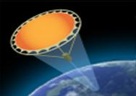
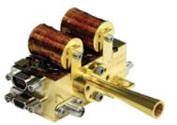
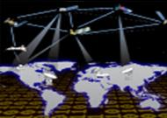
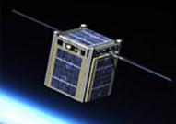
ESTO Product Lines
The Earth Science Technology Office is a targeted, science-driven, competed, and actively managed technology program. The investment elements include:
Instrument Incubator Program (IIP) robust new instruments and measurement techniques 17 new projects added in FY14 (total funding approximately $71M over 3 years)
Observation
Advanced Component Technologies (ACT) development of critical components and subsystems for instruments and platforms 11 new projects added in FY14 (total funding approximately $13M over 3 years)
Advanced Information Systems Technology (AIST) innovative on-orbit and ground capabilities for communication, processing, and management of remotely sensed data and the efficient generation of data products 24 new projects added in FY15 (total funding approximately $25M over 2 years)
Information
In-Space Validation of Earth Science Technologies (InVEST) on-orbit technology validation and risk reduction for small instruments and instrument systems that could not otherwise be fully tested on the ground or airborne systems 5 projects added in FY13/14 (total funding approximately $17M over 3 years)
Validation
The current portfolio of active investments supports all of the 2007 NRC Decadal Survey mission concepts. 65% directly support Tier 1 and 2 missions, ~ 15% support Tier 3 missions, and the remainder are crosscutting.

Slide 6
Technology Program Budget/Schedule
($M) | FY15 |  |  |  | FY16 |  |  |  | FY17 |  |  |  | FY18 |  |  |  | FY19 |  |  |  | FY20 |  |  |  | FY21
Q | 1 | 2 | 3 | 4 | 1 | 2 | 3 | 4 | 1 | 2 | 3 | 4 | 1 | 2 | 3 | 4 | 1 | 2 | 3 | 4 | 1 | 2 | 3 | 4 | 1 | 2 | 3 | 4
ROSES Solicitations
ATI/ACT & InVEST Solicitation NRA Release | InVEST-15 |  |  |  |  |  |  |  | ACT-17 |  |  |  | InVEST-18 |  |  |  |  |  |  |  | ACT-20 |  |  |  | InVEST-21
Budget | 18.4 |  |  |  | 18.1 |  |  |  | 18.8 |  |  |  | 18.2 |  |  |  | 17.9 |  |  |  | 18.8 |  |  |  | 19.1
IIP Solicitation NRA Release |  |  |  |  | IIP-16 |  |  |  |  |  |  |  |  |  |  |  | IIP-19
Budget | 27.8 |  |  |  | 28.3 |  |  |  | 28.6 |  |  |  | 28.6 |  |  |  | 28.6 |  |  |  | 29.5 |  |  |  | 29.9
AIST Solicitation NRA Release |  |  |  |  | AIST-16 |  |  |  |  |  |  |  | AIST-18 |  |  |  |  |  |  |  | AIST-20
Budget | 13.6 |  |  |  | 14.3 |  |  |  | 14.1 |  |  |  | 14.1 |  |  |  | 14.1 |  |  |  | 14.5 |  |  |  | 14.7
In-Guide Totals ($M) | 59.7 |  |  |  | 60.7 |  |  |  | 61.4 |  |  |  | 60.9 |  |  |  | 60.6 |  |  |  | 62.7 |  |  |  | 63.7
Total ESD Budget ($M) |  | 1773 | 1947 | 1967 | 1988 | 2009 | 2027 | 2027
% of ESD Budget |  | 3.4% | 3.1% | 3.1% | 3.1% | 3.0% | 3.1% | 3.1%
2

Slide 7
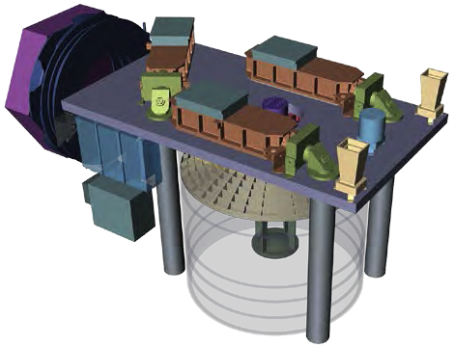
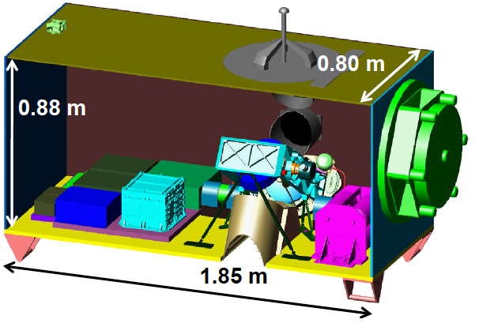
EVI-2 Technology Heritage
GEDI Lidar
Provide the first global, high-resolution observations of forest vertical structure.
ESTO investment - Laser Risk Reduction Program (LRRP05) the High-Output Maximum Efficiency Resonator (HOMER) Laser
ECOSTRESS
Provide the first high spatial temporal resolution thermal infrared measurements of Earth’s surface from ISS.
ESTO investment – IIP07/10 HyTES instrument

Slide 8
Conclusions and Current Status
A focused, Earth science-driven approach (technology investments guided by DS measurements and science questions.
Peer-reviewed process; open, competitive program.
Regular solicitations ensure current technology approaches and create multiple opportunities for PIs.
Technology options rather than point solutions.
Currently funded technologies are providing state-of-the-art instruments, components, information systems and tech space validation capabilities for a wide range of Earth science measurements as well as all of the Earth Science Decadal Survey mission concepts.
ESTO investments directly benefit the Earth Science’s flight missions and science campaigns.
ACT/ATI | 1999, 2002, 2005, 2008, 2010, 2013
AIST | 1999, 2002, 2005, 2008, 2011, 2014
IIP | 1998, 2001, 2002, 2004, 2007, 2010, 2013
InVEST | 2011 (RFI), 2012, 2015

