Slide 1
Recent Progress on the ICESat-2 & High Efficiency UV Demonstrator Lasers
Fibertek, Inc.
13605 Dulles Technology Drive
Herndon, VA 20171
fhovis@fibertek.com
703-471-7671

Slide 2
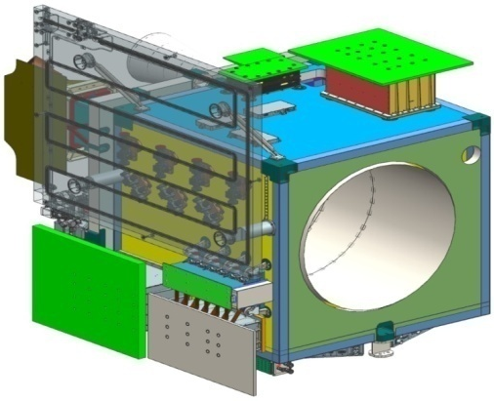
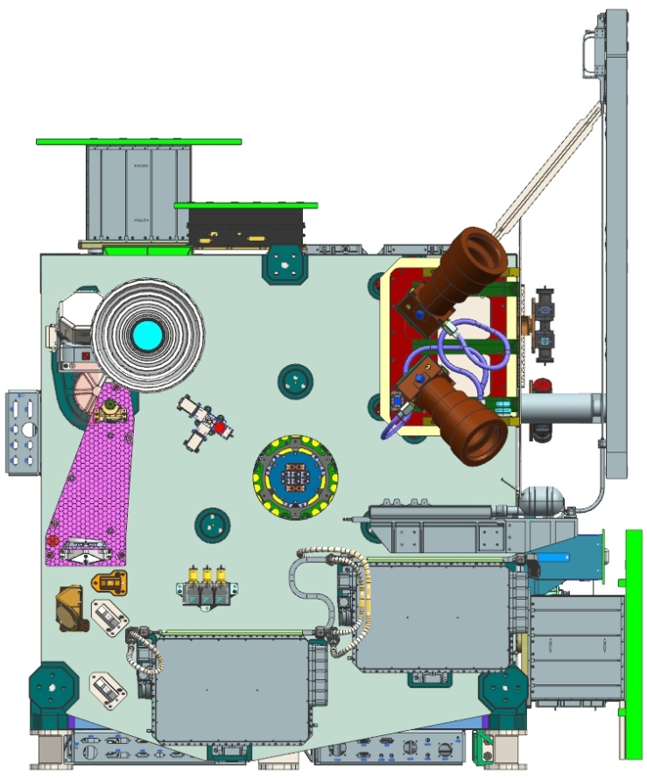
ICESat-2 Mission Overview
The ATLAS instrument is a multi-beam, micro-pulse, laser altimeter with a dense along-track sampling of 70 cm
Science Objectives:
  Quantifying polar ice-sheet changes and the linkages to climate conditions.
  Quantifying regional signatures of ice-sheet changes
  Estimating sea-ice thickness
  Measuring vegetation canopy height
  Enhancing the utility of other Earth observation systems

Slide 3
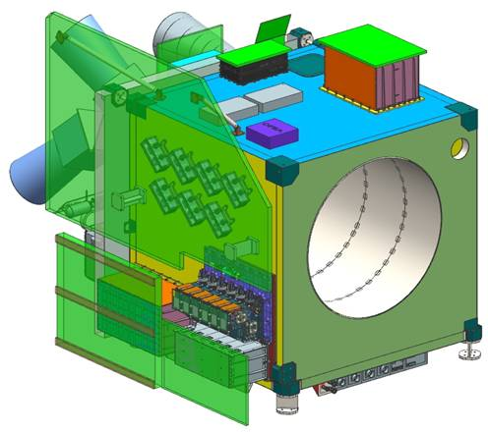
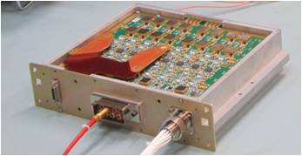
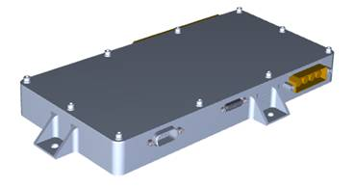
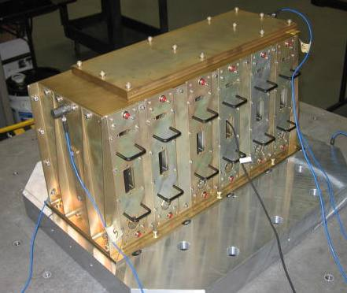
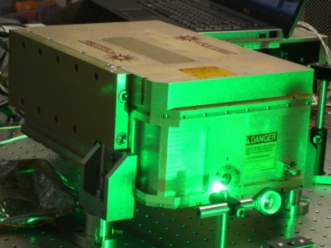
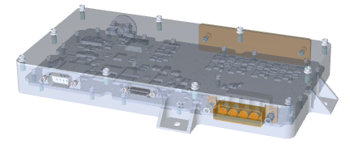
Fibertek ICESat-2 Deliverables
  Start Pulse Detector
  Altimeter T_{o} Signal
  (Integrate and Test)
  Photon Counting CFD circuits (120 PMT Channels)
Delivery: June 2014
Lasers
  Laser Wavelength Control Electronics (Integrate and Test)
Delivery: June 2014
Final Flight Laser Delivery: May 2015
Delivery: May 2014

Slide 4
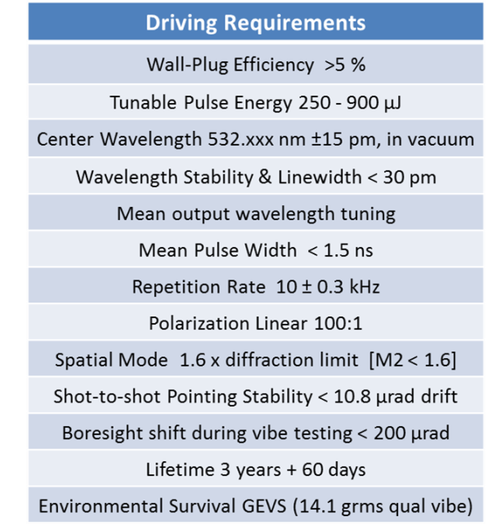
ICESat-2 Laser Driving Requirements
The Qualification Unit and both flight lasers meet all requirements with margin

Slide 5
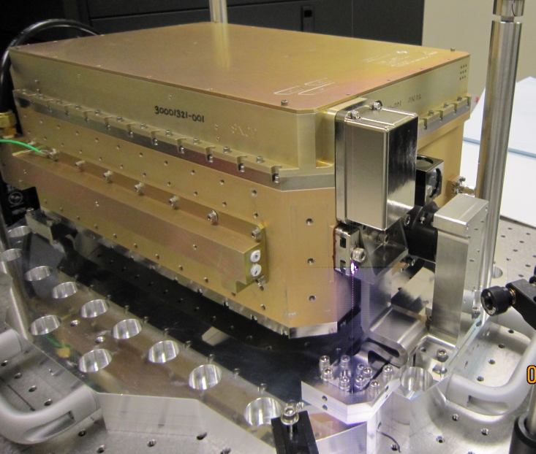
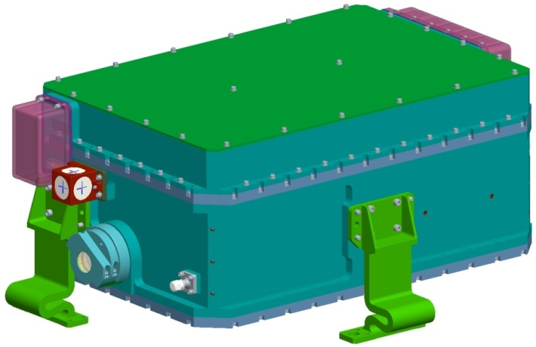
Flight Laser System Packaging Overview
Integrated LOM/LEM with single thermal interface
  Mass < 19.85 kg
  <50 cm x 30 cm x 15 cm
  Robust to GEVS random vibe
Wavy flexure mounts
  Filters high-frequency content of GEVS 14.1 g_{rms} random vibe inputs
  Provides short-term & long term pointing stability
Dual compartment LOM with pressure insensitive center plane
  Allows air pressurization for long optical reliability
  Short term & long term pointing stability
Packaging approach meets key mechanical driving requirements

Slide 6
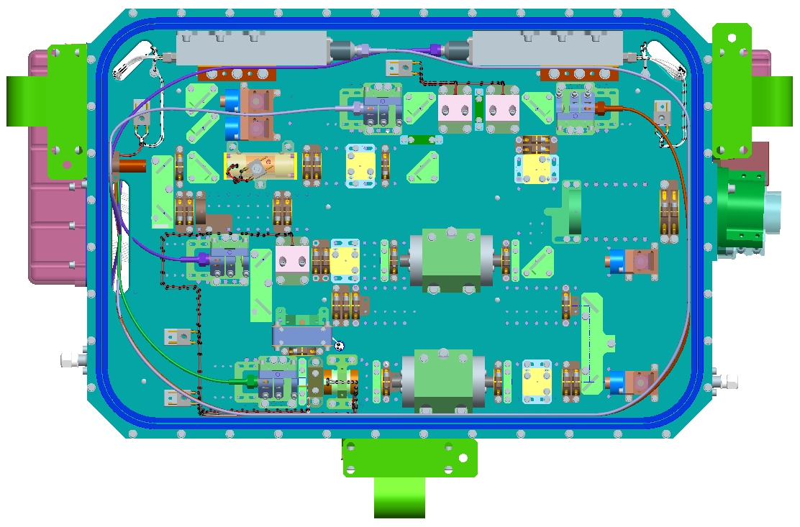
Flight Optical Configuration
Fiber-coupled diode pump modules
Short, electro-optic (E-O) Q-switched oscillator
  1.3 ns pulse width
  100:1 linear polarization
End-pumped gain medium
  M² ~ 1.3
  7% wall plug efficiency @ 532 nm
MOPA configuration
  250-900 µJ/pulse
LBO doubled Nd:YVO4
  532 nm
Internal telescope
  10 mm output beam
Diode pump modules
Power amp
SHG
Output telescope
Preamp
Oscillator
Frequency doubled Nd:YVO₄ MOPA achieves key optical requirements with margin

Slide 7
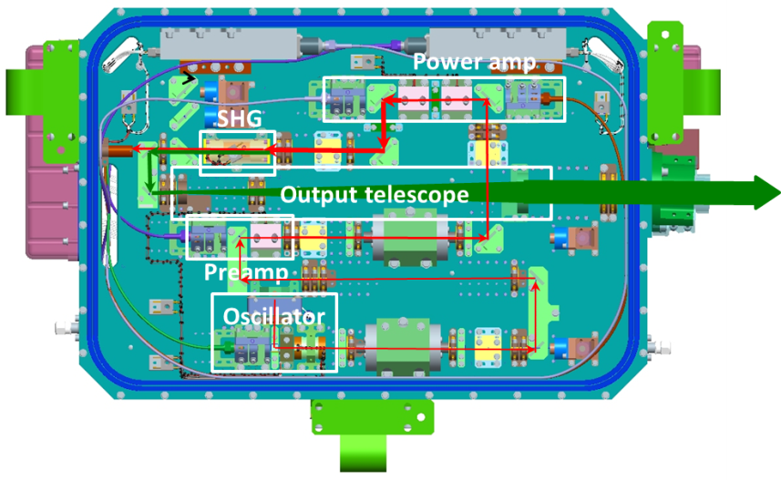
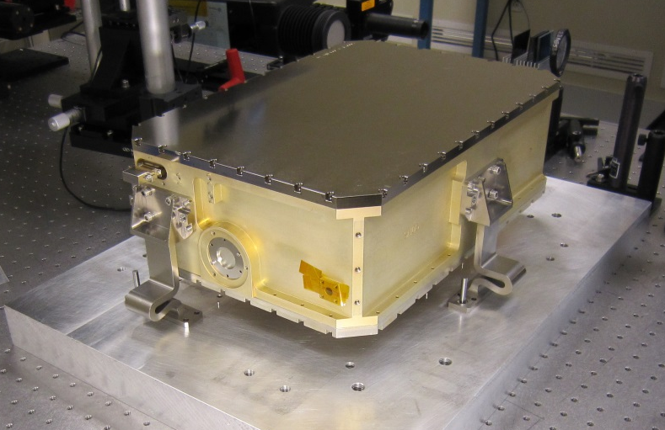
ICESat-2 Laser Build Status
Integration and Test Laser (qual unit)
  Qualification testing complete
    Meets all performance specs with margin
  Laser has been delivered to GSFC
Flight SN2
  Acceptance testing complete
    Meets all performance specs with margin
  Laser has been delivered to GSFC
Flight SN1
  Acceptance testing complete
    Meets all performance specs with margin
  Final paperwork close-out is in work, laser will be delivered first week of May, 2015
Flight Laser SN1 after flexure installation

Slide 8

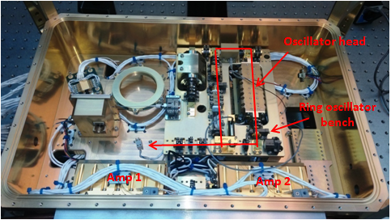
High Efficiency UV Demonstrator
PI: Floyd Hovis, Fibertek
Objective
Develop and demonstrate a highly efficient, ruggedized UltraViolet (UV) laser with a lifetime in excess of a billion shots needed for many future space-based Earth Science active remote sensing measurements (ACE, 3D-WINDS, GACM).
Use the laser as a test bed for high energy 532 nm and UV conversion technologies and non-linear optical materials evaluation
Advance the space flight readiness of 532 nm and UV laser technology
Main housing with diode-pumped heads and ring oscillator components installed
Approach
Key Milestones
  Develop an improved 1064 nm final power amplifier that can achieve 250 mJ/pulse at 150 Hz repetition rate
  Develop a purely conductively cooled laser optics module design for packaging the 150 Hz, 250 mJ, 1064 nm pump laser
  Develop a UV conversion module design with a lifetime of >10⁹ shots that converts the 250 mJ pump to 100 mJ at 355 nm
  Execute an initial 20 kHz UV lifetest to aid in the final LBO coating choice
  Build and test the pump laser and UV conversion modules
  Execute a 4 month life test of the pump laser with only 532 nm generation
  Execute an 8 month life test of the pump laser and UV conversion module
Conclude power amplifier conceptual study 07/13
Conclude power amplifier modeling 09/13
Conclude final power amplifier design and test 02/14
Complete UV conversion module design 04/14
Conclude pump laser opto-mechanical design 06/14
Complete testing of electronics module 10/14
Complete integration of the laser system 06/15
532 nm lifetest complete 11/15
Low power 355 nm lifetest complete 03/16
High power 355 nm lifetest complete 08/16
TRL_{in} = 4 TRL_{current} = 4
Co-Is/Partners: Mike Albert and Fran Fitzpatrick, Fibertek
5/31
ATI-QRS-13-0002

Slide 9
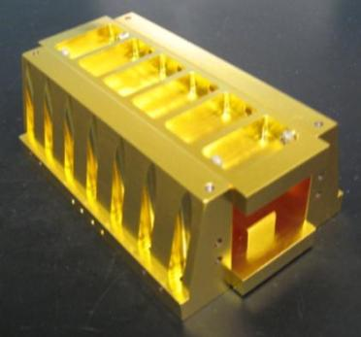
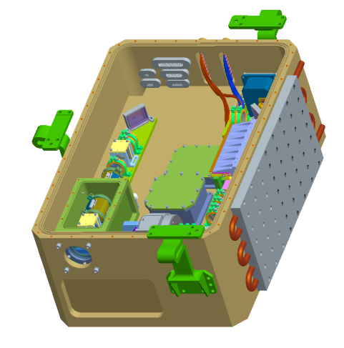
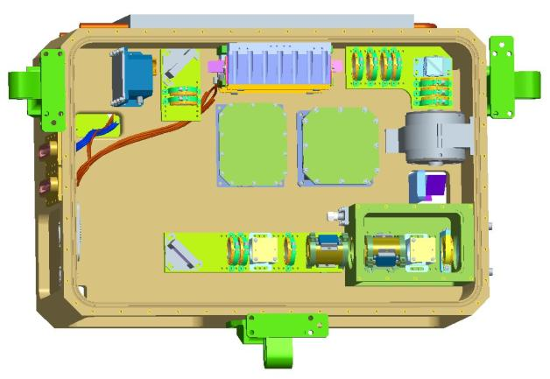
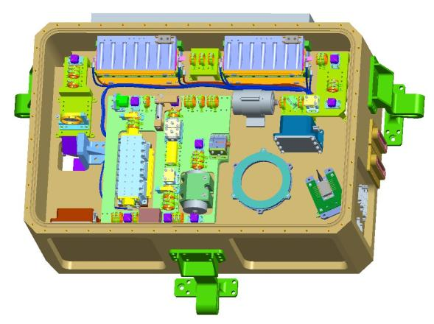
High Efficiency UV Demonstrator (HEUVD) Original Objectives
ESTO funded risk reduction program
Improved 1064 nm final power amplifier
  750 mJ/pulse @ 50 Hz with an M² < 2
Purely conductively cooled Laser Optics Module (LOM)
Long lived UV conversion module
  Lifetime >10⁹ shots for 350 mJ at 355nm
Advance the design TRL from 4 to 6
8 month life test of the pump laser and UV conversion module
Upgraded power amp design
Single thermal interface
Power amp
Amps 1 & 2

Slide 10
Updated Program Objectives & Approach
Develop a 100 mJ, 150 Hz UV laser transmitter with a lifetime of > 10⁹ shots
  Design architecture & critical componentry based on proven HSRL &
  GOLD laser transmitters
  Develop an improved 1064 nm final power amplifier that can achieve
  250 mJ/pulse at 150 Hz with an M² ≤ 2
  Develop a purely conductively cooled Laser Optics Module (LOM) design
  Develop a UV module design that converts the 250 mJ pump to 100 mJ at 355 nm
Conduct initial high repetition rate (20 kHz) UV testing of candidate LBO triplers
Conduct extended life testing of the laser transmitter to validate 532 nm lifetime
Conduct extended life testing of the laser transmitter to assess UV lifetime
Conduct environmental testing to advance design from TRL 4 to TRL 6
  Thermal-vacuum & vibration

Slide 11
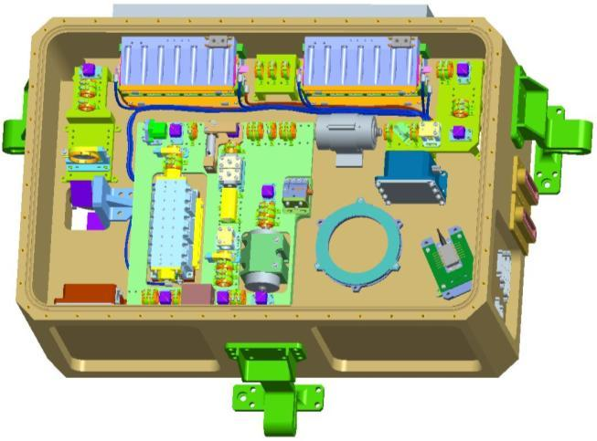
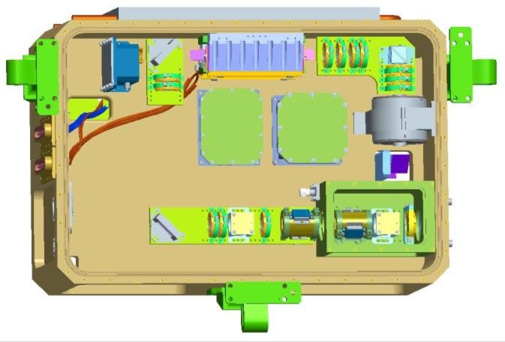
HEUVD Design Overview
Amp 2
Amp 1
Amp 3
Ring osc
SHG
THG
Flexure-mounted, dual compartment design
All amplifiers conductively cooled to a single wall
Ring oscillator and first two amps lifted from HSRL-2
New final power amplifier design
  Higher power and beam quality pump on bounce design
Near polymer free UV conversion module
  Only polymers are seal o-rings
  Includes an internal beam expander
Electronics are a mix of COTS and custom designs

Slide 12
Program Background
Schedule Summary
A new schedule based on the updated SOW has been developed

Slide 13
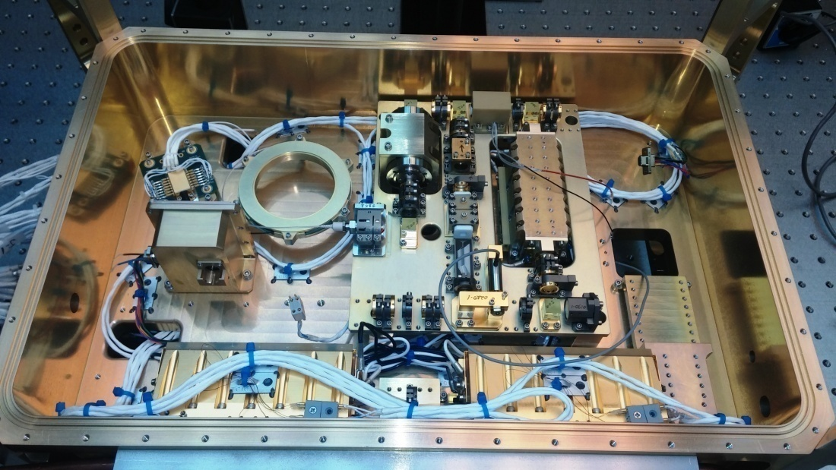
Hardware Assembly Status
LOM – Main Housing
Assembly & processing complete
Major component fit checks completed
He leak check in vacuum environment completed
Harnessing of the housing is complete
All four laser pump heads have been installed and thermally balanced
Alignment of the ring oscillator and first two amplifier is complete
Oscillator head
Ring oscillator bench
Amp 1
Amp 2
Main housing with diode-pumped heads and ring oscillator components installed

Slide 14
Resonator Performance Summary
Parameter | Units | Goal | Demo’d | Status
Wavelength | nm (air) | 1064 (nom) | 1064.393 | ☑
Pulse Rate | Hz | 150 | 150 | ☑
Pulse Energy | mJ | ≥ 25 | 34 | ☑
Pulse Width | ns | 10 – 20 | 14 | ☑
Beam Quality | M² | ≤ 1.5 | 1.3 | ☑
Spectral Width | MHz | ≤ 100 | ≤ 70 | ☑

Slide 15
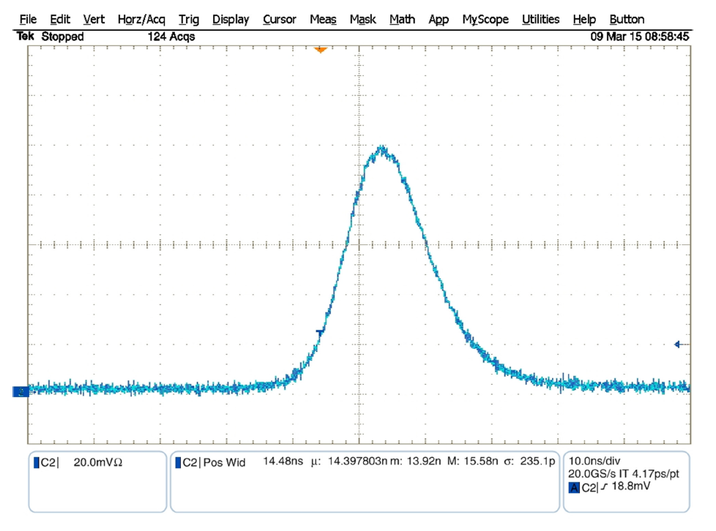
Resonator Performance Summary
Resonator Temporal Pulse Width
14.4 ns

Slide 16
Resonator Performance Summary
Resonator Spatial Distribution
Intra-Cavity Field Distribution
Far Field Distribution
Imaged Location
2.5 mm intra-cavity aperture
Divergence
890 μrad

Slide 17
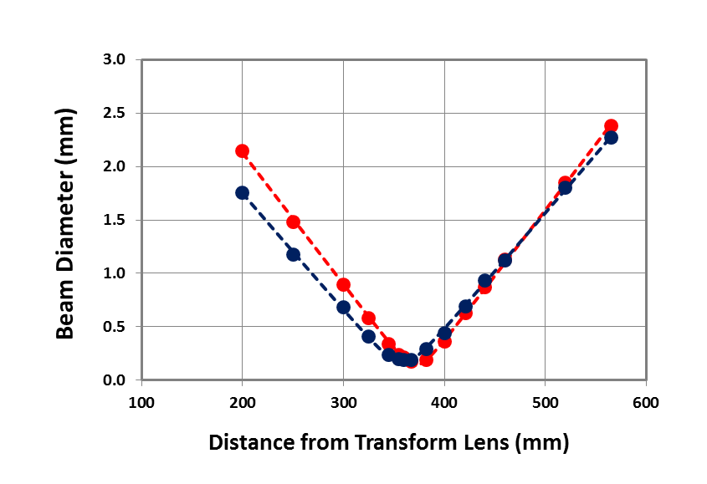
Resonator Performance Summary
Resonator Beam Quality
M²_{X} = 1.28
M²_{Y} = 1.29

Slide 18
Resonator Performance Summary
Resonator Spectral Content
Spectral Histogram
FSR = 1,500 MHz
Δν ~ 70 MHz
Data collected with a scanning confocal Fabry-Perot interferometer

Slide 19
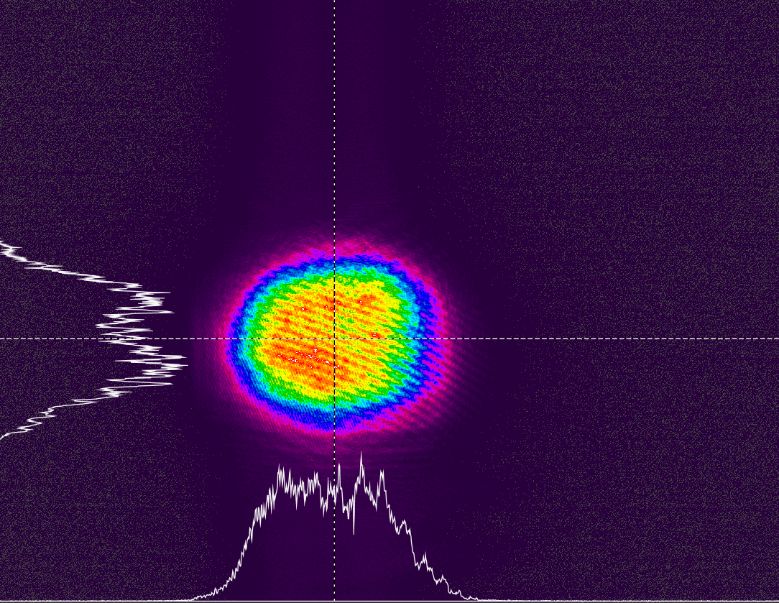
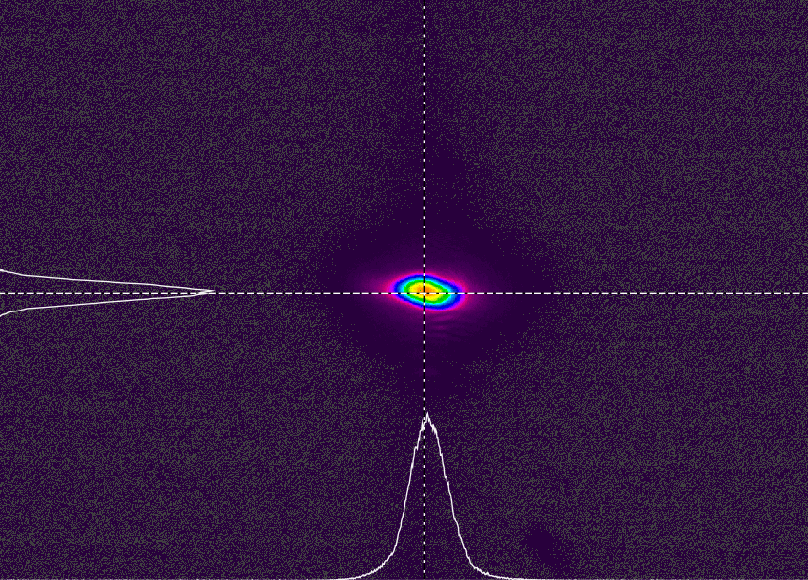
Amplifier 1 & 2 Performance Summary
Near Field
Far Field
Power 26 W @ 150 Hz (173 mJ/pulse)
M² = 1.4
Results for Amps 1 & 2 should allow final design goals to be met with margin

Slide 20
Key HEUVD Milestones
Begin high rep rate UV screening testing
  May 2015
Laser assembled through SHG and begin 532 nm lifetest
  June 2015
Complete 532 nm lifetest
  November 2015
Laser assembled through THG and begin low power UV lifetest
  November 2015
Complete low power UV lifetest and begin high power UV lifetest
  March 2016
Complete high power UV lifetest
  August 2016
Environmental testing (vibe and TVAC)
  September through August 2016

