Slide 1
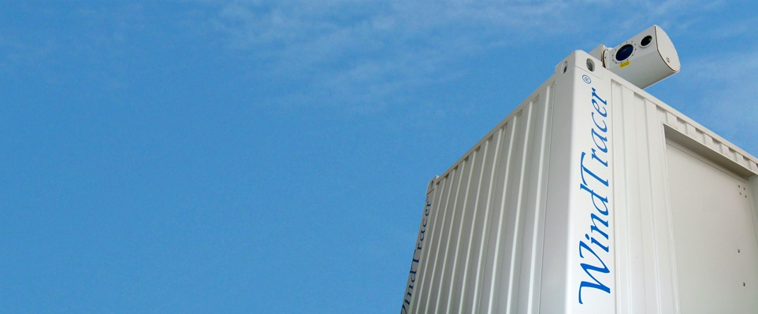

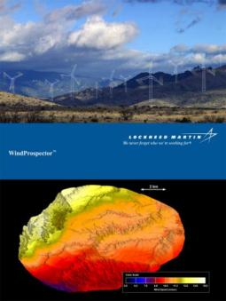
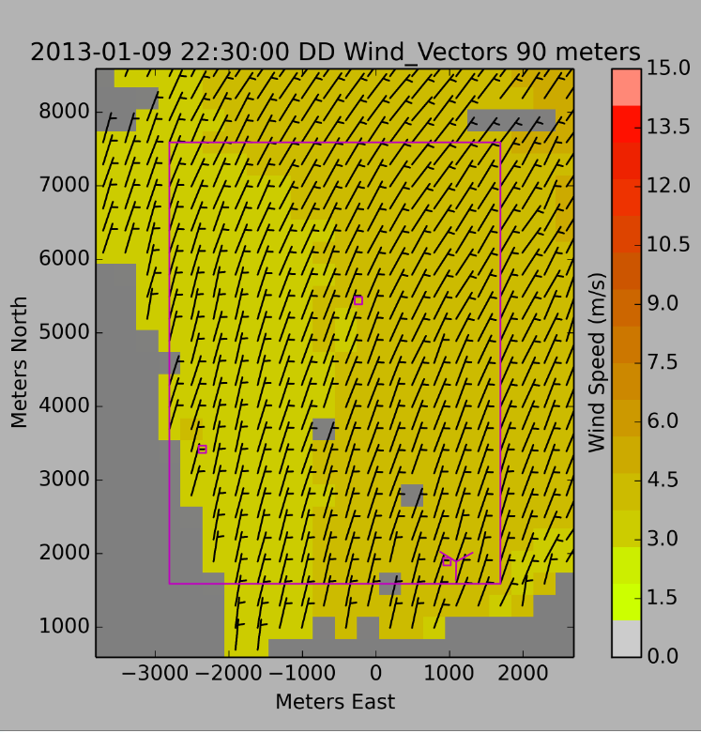
WindTracer® BAO Tower Experiment Results
2 km
2 km
Keith Barr & Phil Gatt
April 28, 2015
Working Group on Space-based Lidar Winds

Slide 2

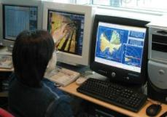
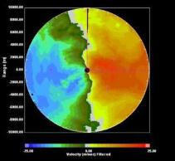
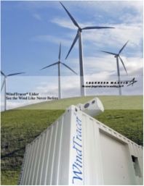
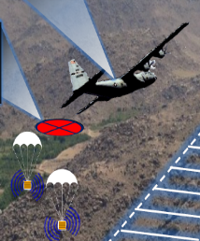

WindTracer® Applications
WindTracer is a long-range scanning Doppler lidar
Real-Time Wind Hazard Detection, Tracking, and Alerting
Wake Vortex Characterization for Improved Aviation Safety and Efficiency
Wind Energy Resource Assessment
Boundary Layer Atmospheric Research, Aerosol Plume Detection and Tracking
Precision Airdrop and Ballistic Winds

Slide 3
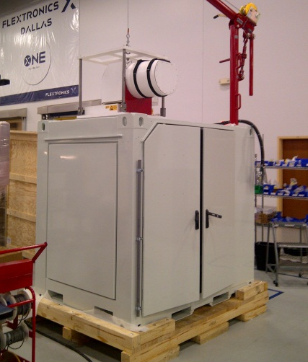
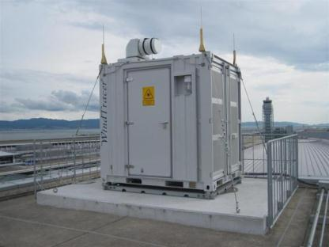
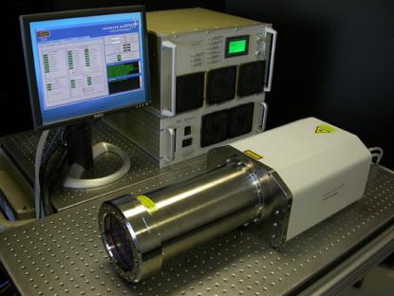
WindTracer® Overview
Coherent Doppler lidar
1.67 um, 2.3 mJ, 750 Hz, 300 ns, 12.5 cm
Wind measurement range
  Typically from 300 m to 20 km
  Demonstrated performance to 33 km
Minimum range resolution > 50 m
Demonstrated velocity accuracy better than 0.15 m/s for modest averages
Full scanning capability
  Slip rings prevent cable winding
Multiple packaging options

Slide 4
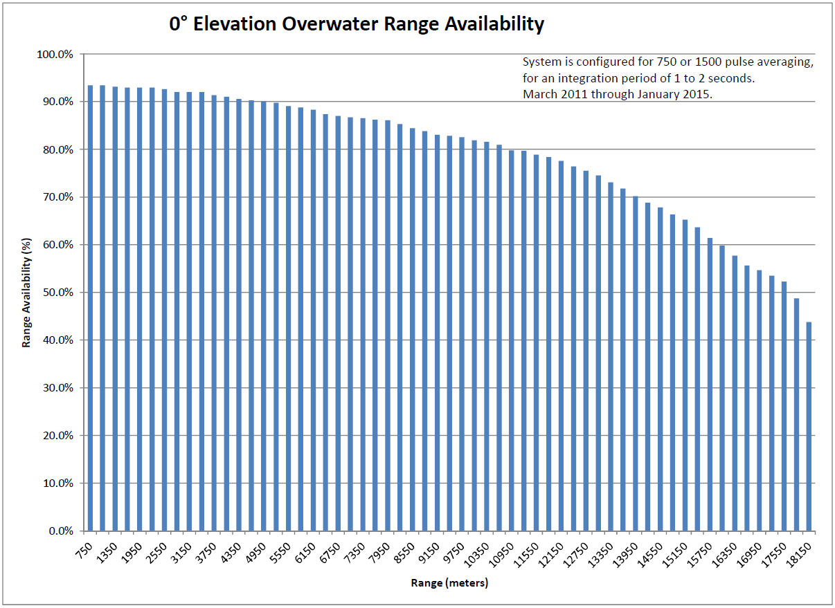
New Jersey
3.75 Year Historical Range Availability

Slide 5
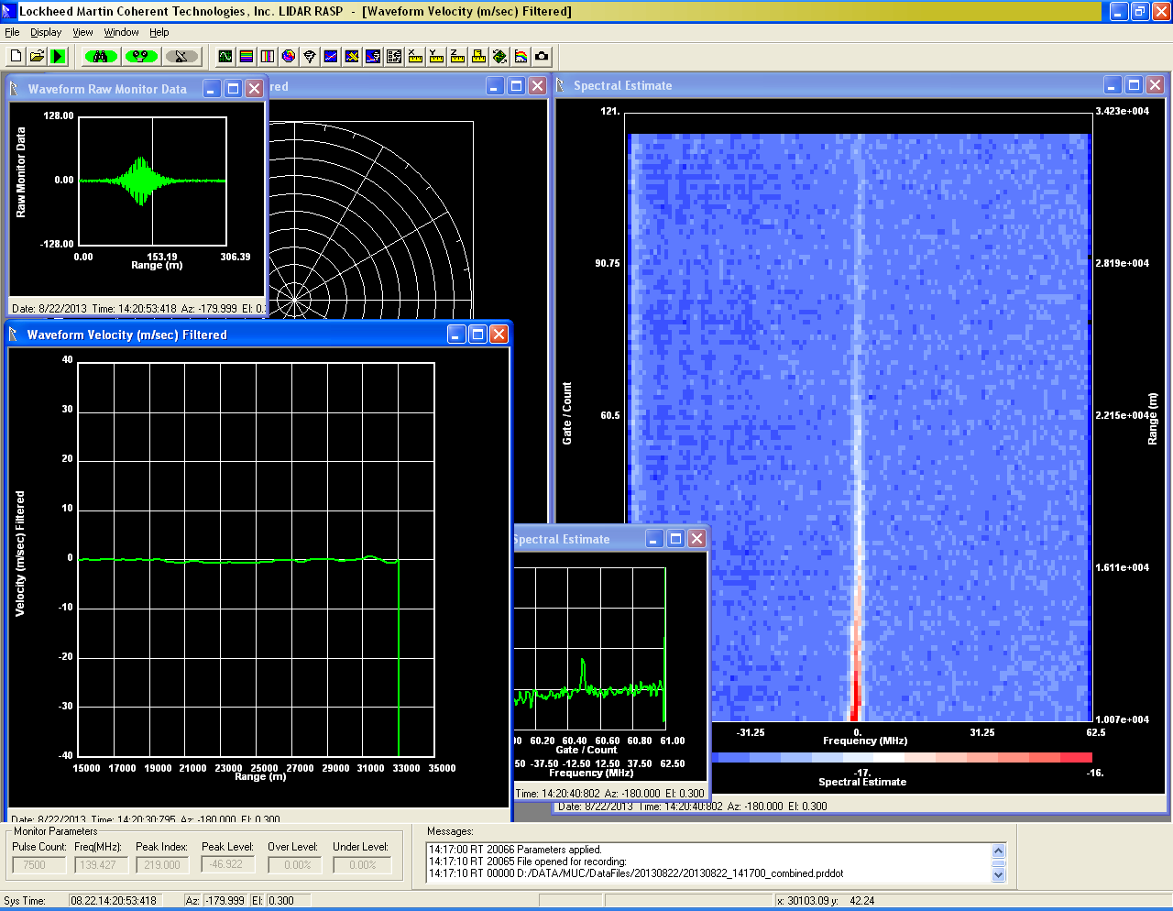
> 33 km Performance
33 km
Velocity
33 km

Slide 6
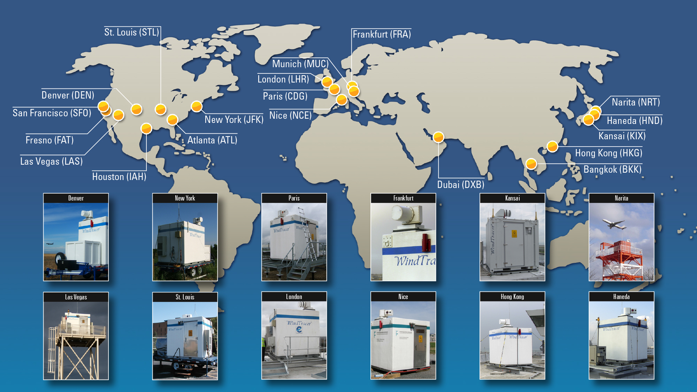
History of Airport Installations
12 Years of Operational Wind Hazard Detection and
Wake Measurements for Air Traffic Management

Slide 7
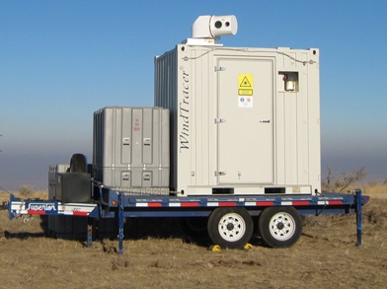
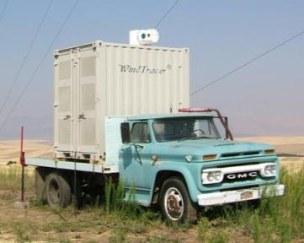
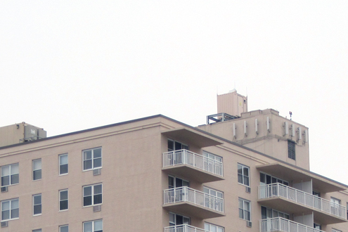
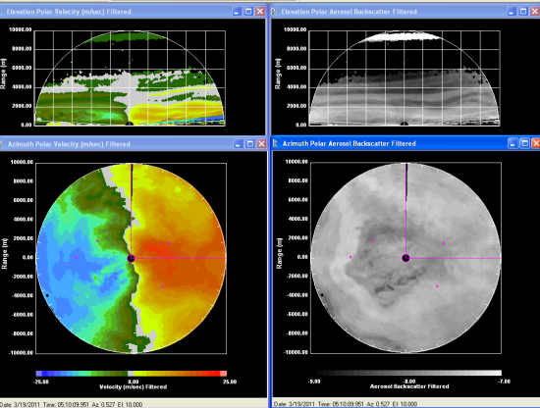
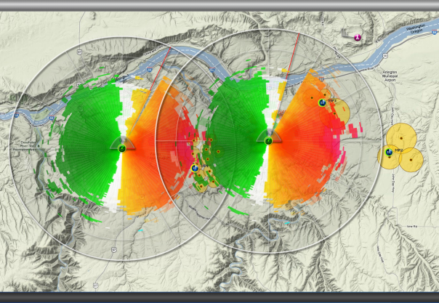
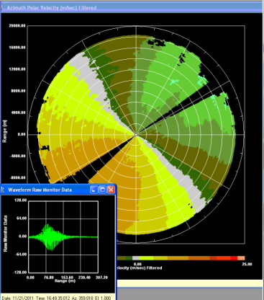
Wind Energy Deployments
Wind Farm Site Surveys in Western USA
Wind Forecasting at Wind Farm in Western USA
Offshore Wind Farm Site Survey in Eastern USA
10 km
18 km
20 km
Wind farm sites

Slide 8
Boulder Atmospheric Observatory
Experiments Overview
  BAO Experiments designed to compare WindTracer performance against currently accepted measurement techniques
  Sonic anemometer & Vane
  Short-range fiber laser vertical wind lidar profiler (ZephIR 300)
BAO1: 2013
Short to medium range, rapid volume scanning
Demonstrate terrain following wind fields
  As a complete replacement to offshore met-towers
  To reduce onshore siting risk
BAO2: 2014
Longer range (>20 km) comparison consistent with potential off-shore wind energy prospecting programs
Potential replacement of offshore met-towers

Slide 9
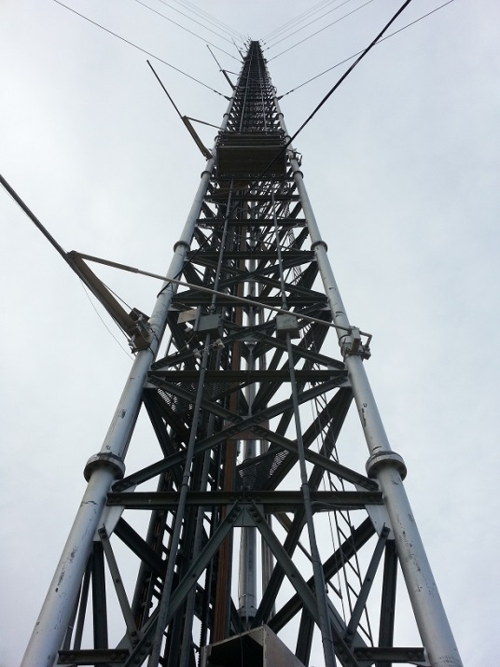
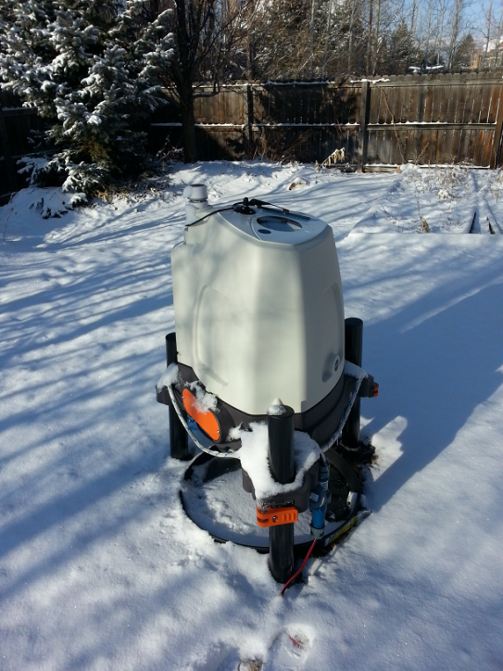
BAO1 and BAO2 Instrumentation
Boulder Atmospheric Observatory Tower (BAO)
  300 meter tall lattice tower, near Erie, Colorado
  Triangular cross-section, 10 feet on each side
  15 foot retractable booms on NW and SE side of tower every 50 meters
New instrumentation installed in late 2012
  MEASNET Class 1 Anemometers (NRG 5967)
  NRG #200P Vanes
  At 100, 150, and 200 meters
  On both northwest and southeast sides of the tower to mitigate tower shadowing effects

Slide 10
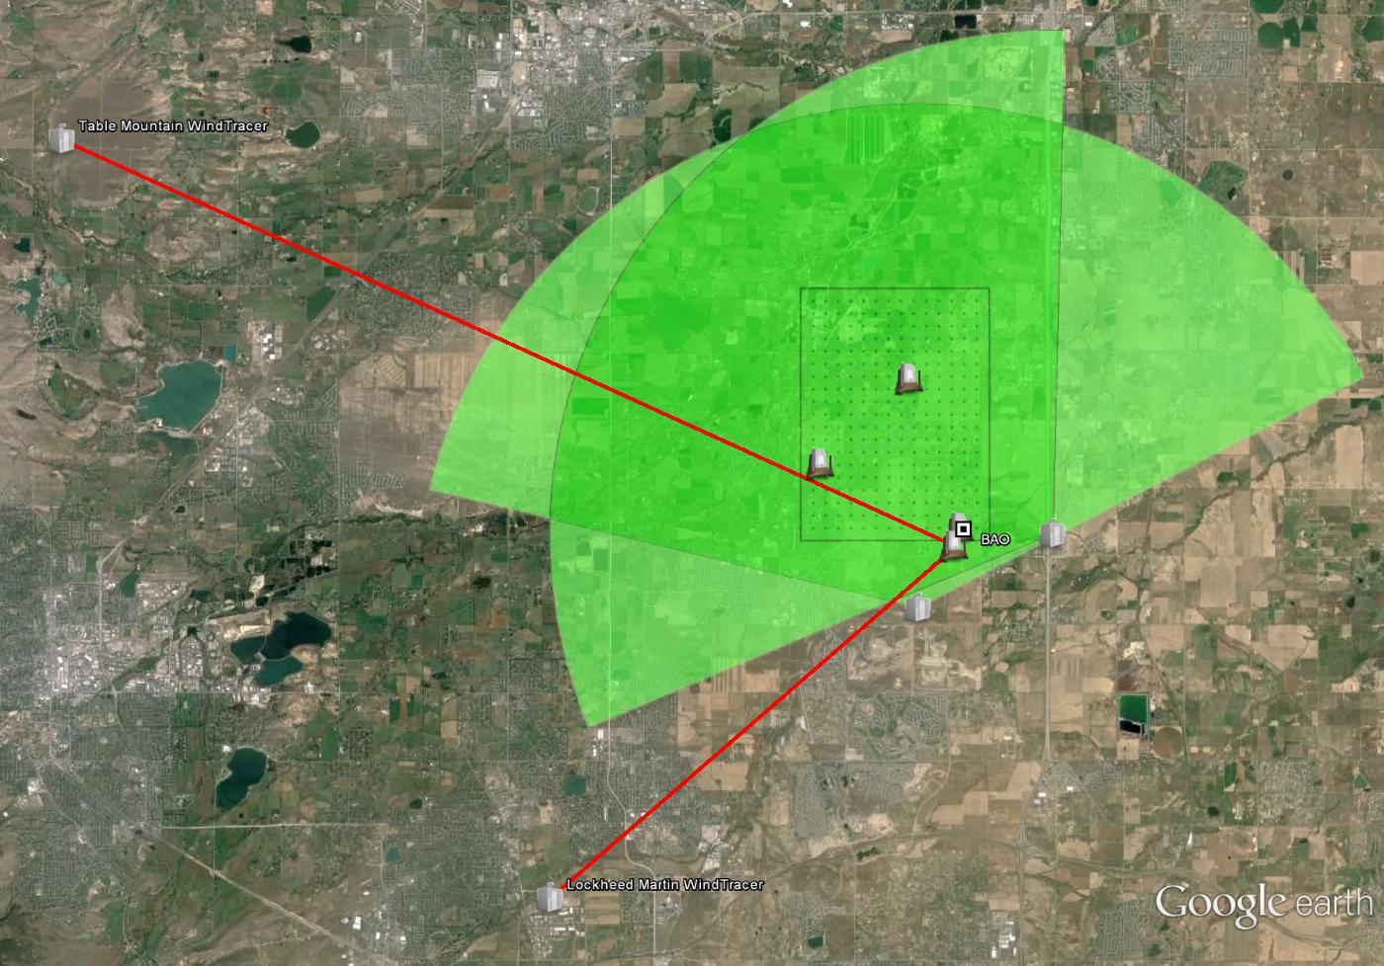
BAO1 and BAO2 Area Overview
TMWT
4.5 km
23 km
300 x 300 m
Grid
6 km
BAO
SRFWT
2.1 km
BFWT
2.2 km
13 km
LMWT

Slide 11
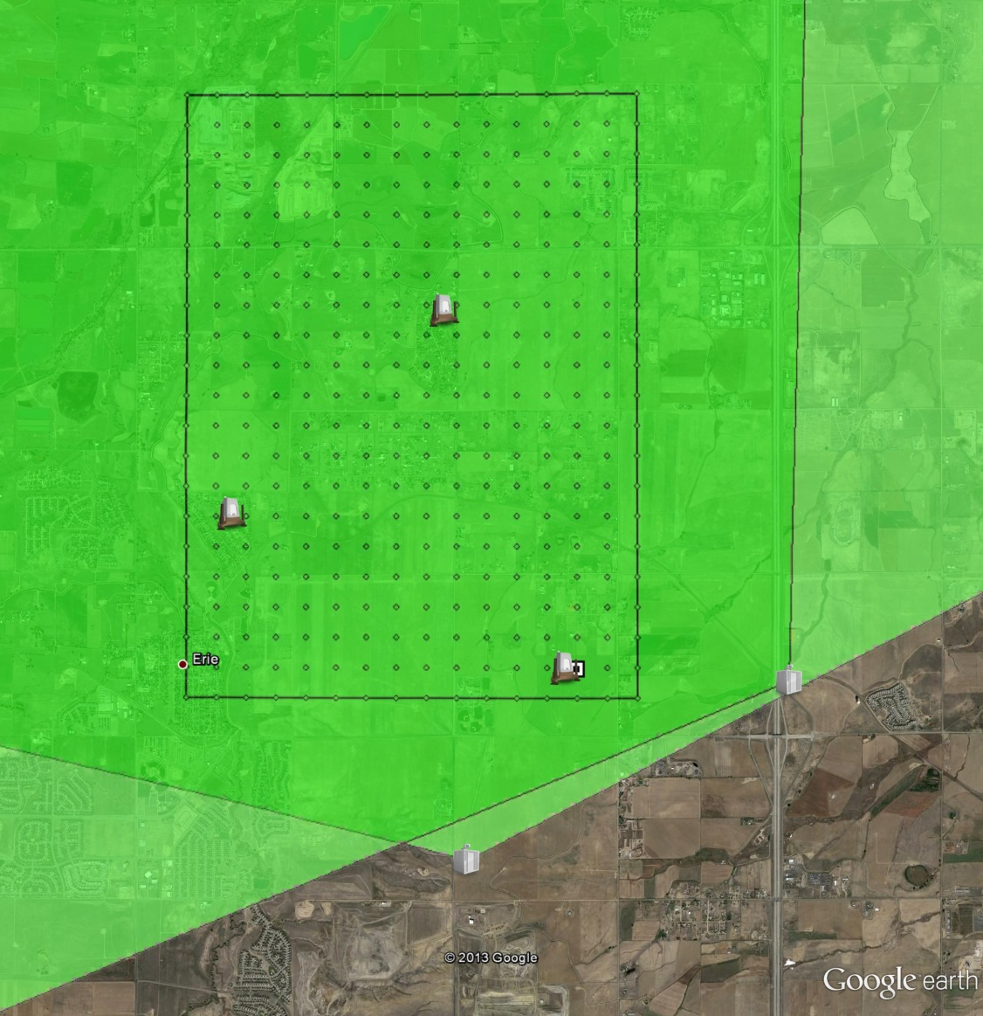
BAO1 Project Layout
Project-sized area for a field of gridded measurements
Multi-month site assessment
Multiple elevation PPI and starring beams
Comparisons with tower and vertical lidar measurements
Single- and Dual-Doppler vector retrievals from both scanned and staring beam data sets
4.5 km
300 x 300 m grid
Z372
6 km
Z373
BAO
Z375
SRFWT
BFWT

Slide 12
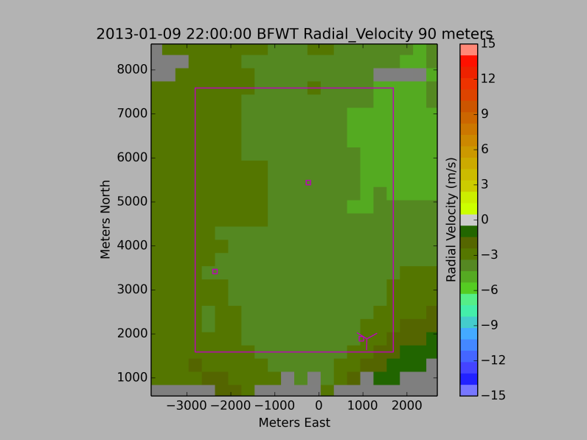
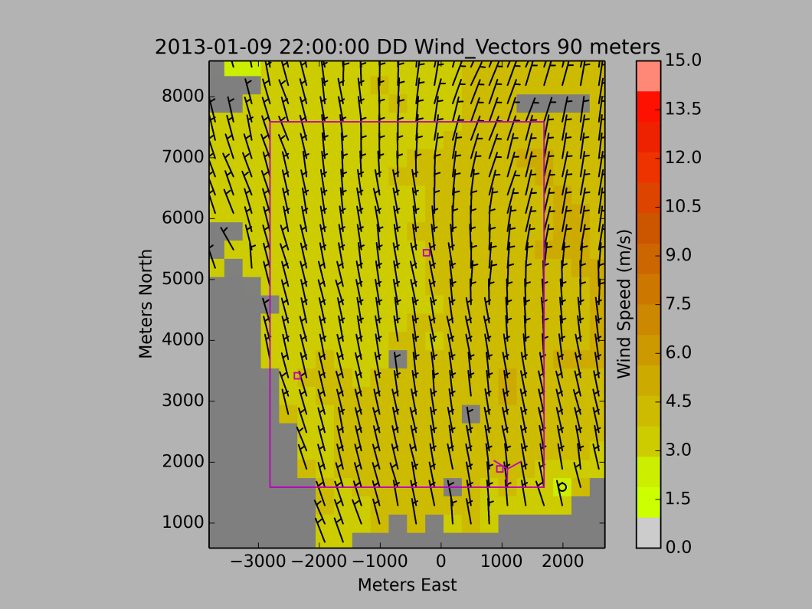
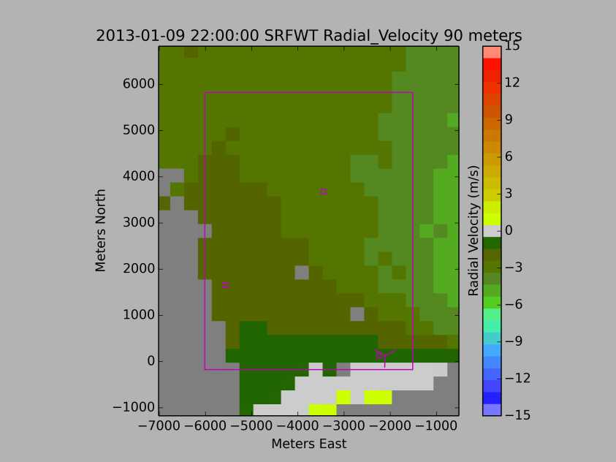
BAO1 Single Doppler to Dual-Doppler
Multiple PPI tilts from both systems combined to create terrain following (e.g., 90 m AGL) radial wind velocity
Single-Doppler terrain following radial velocity combine to produce Dual-Doppler vector wind field
Individual DD fields used to generate daily, weekly, monthly averages

Slide 13
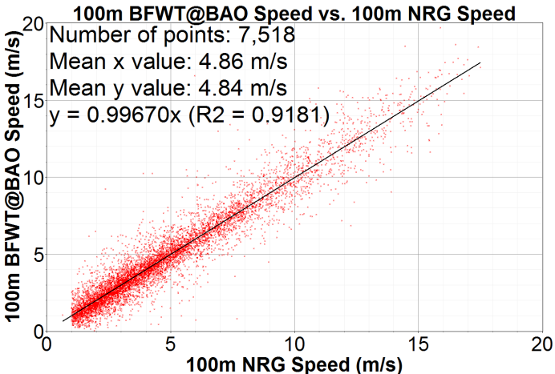

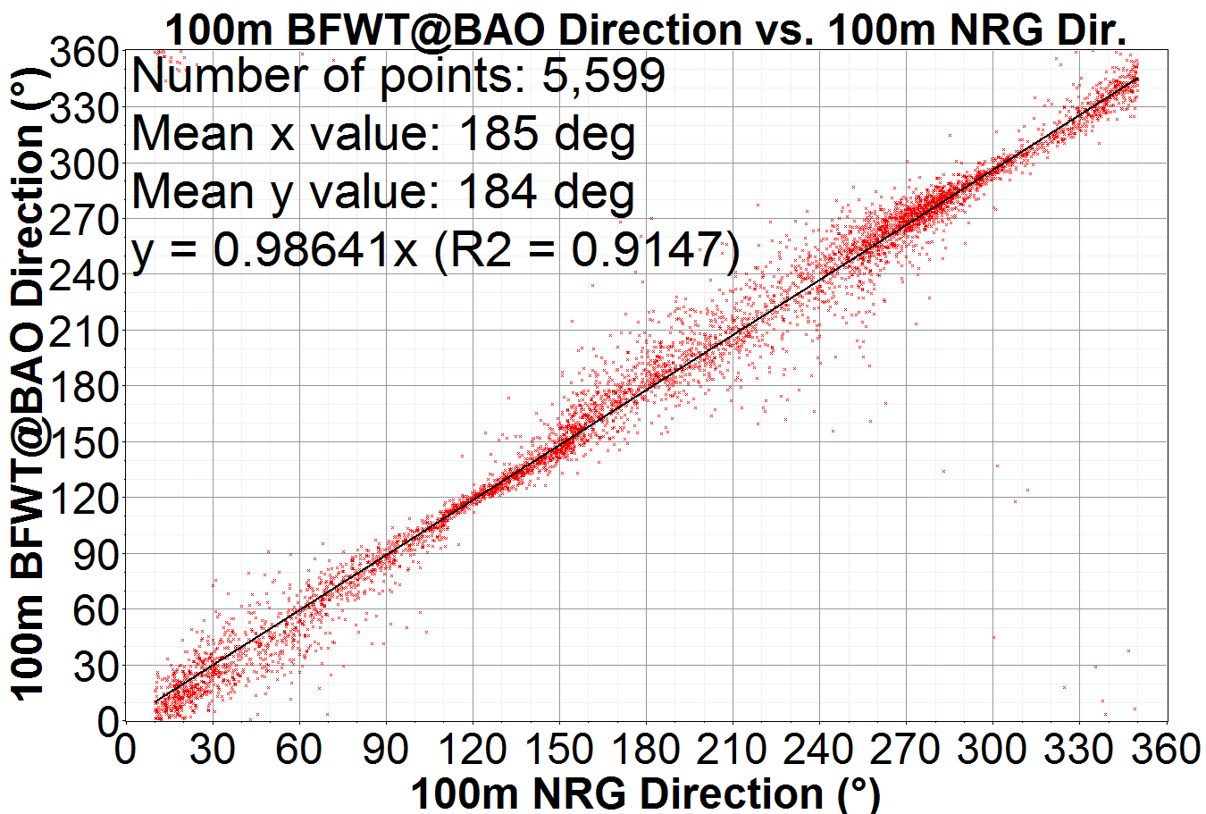

BAO1 Scanning Single-Doppler Comparison
SD vector winds computed +/- 15 deg PPI arc scanned at 10 deg/sec
Wind Speed
Average < 15 cm/sec
Slope
  < .4% of tower
  < 3.4% of ZephIR
Wind Direction
Average difference
  < 2 deg tower
  < 1 deg ZephIR
Slope
  < 1.4% of tower
  < 1% of ZephIR
Single-Doppler WindTracer
vs. NRG vane
Single-Doppler WindTracer
vs. ZephIR 375 (125m W of BAO)

Slide 14
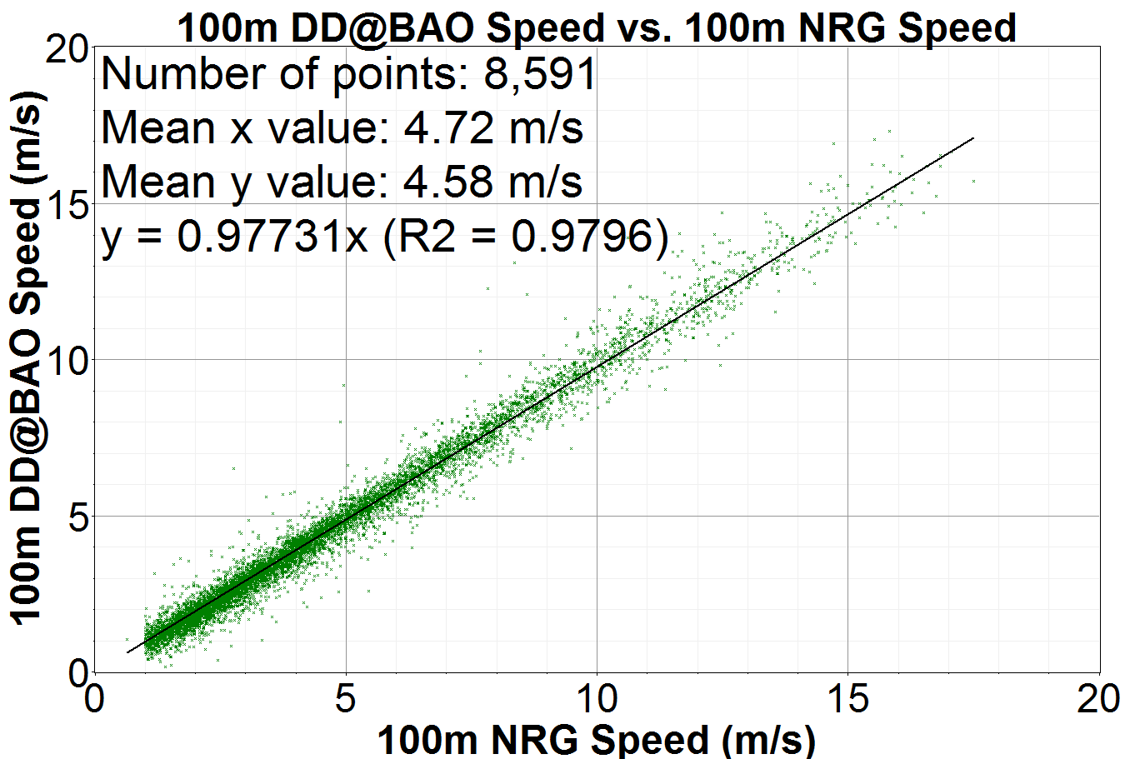
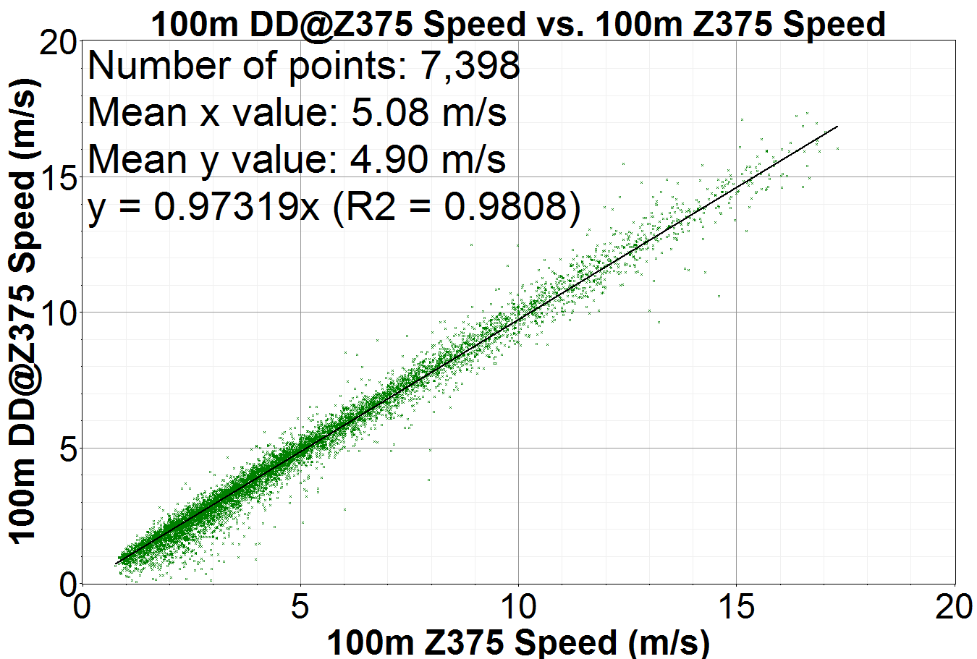
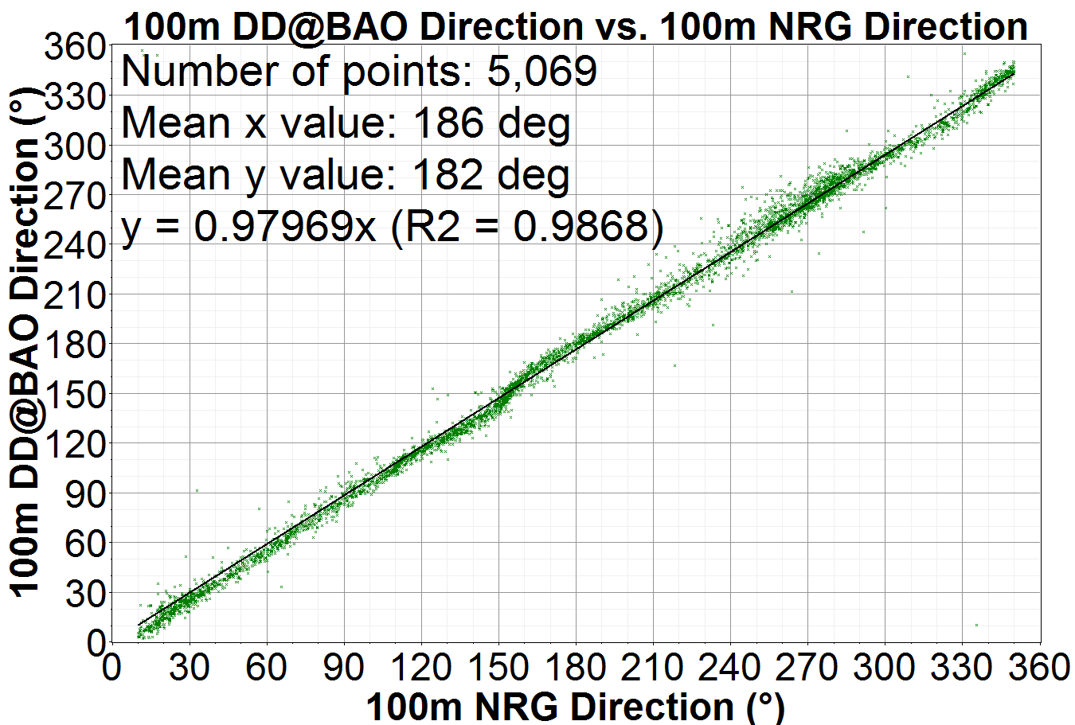
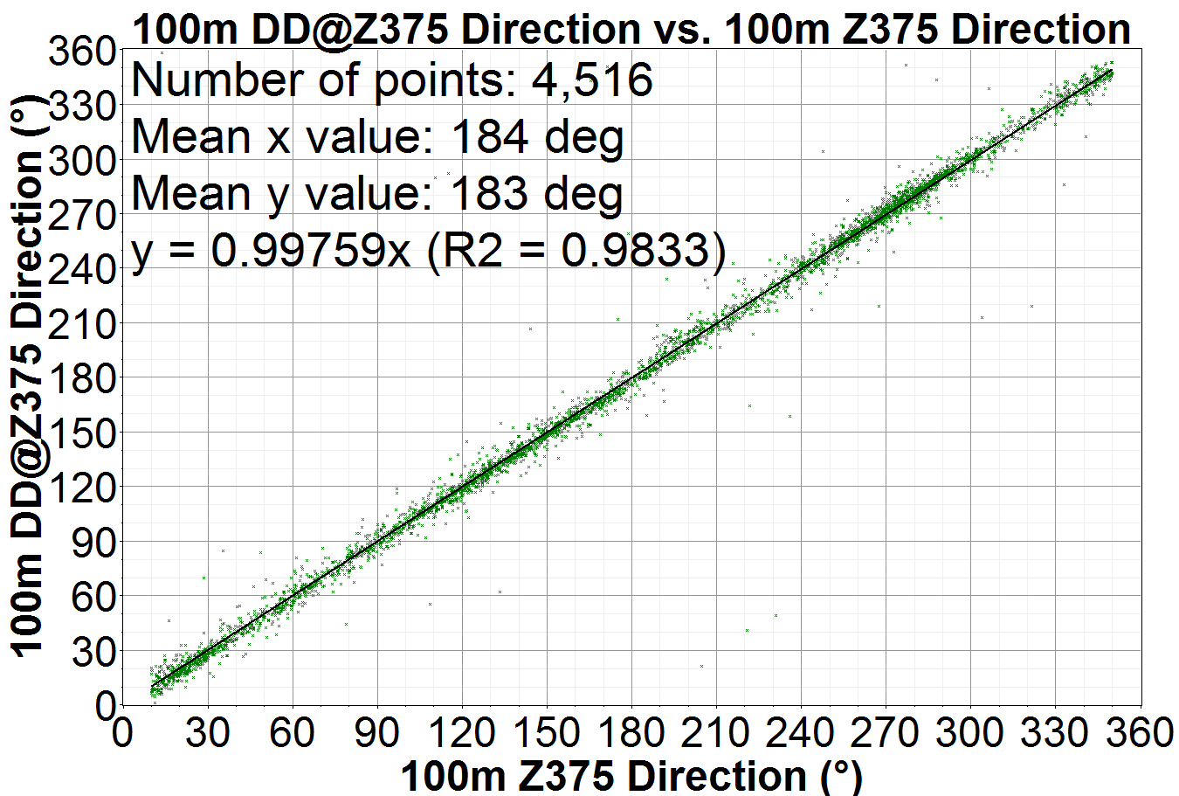
BAO1 Scanning Dual-Doppler Comparison
DD vector winds computed form 10 minute average radial velocity
Wind Speed
Average < 20 cm/sec
Slope
  < 2.3% of tower
  < 2.7% of ZephIR
Wind Direction
Average difference
  < 4 deg tower
  < 1 deg ZephIR
Slope
  < 2.1% of tower
  < 0.3% of ZephIR
Dual-Doppler WindTracer
vs. NRG anemometer/vane
Dual-Doppler WindTracer
vs. ZephIR 375 (near BAO)

Slide 15
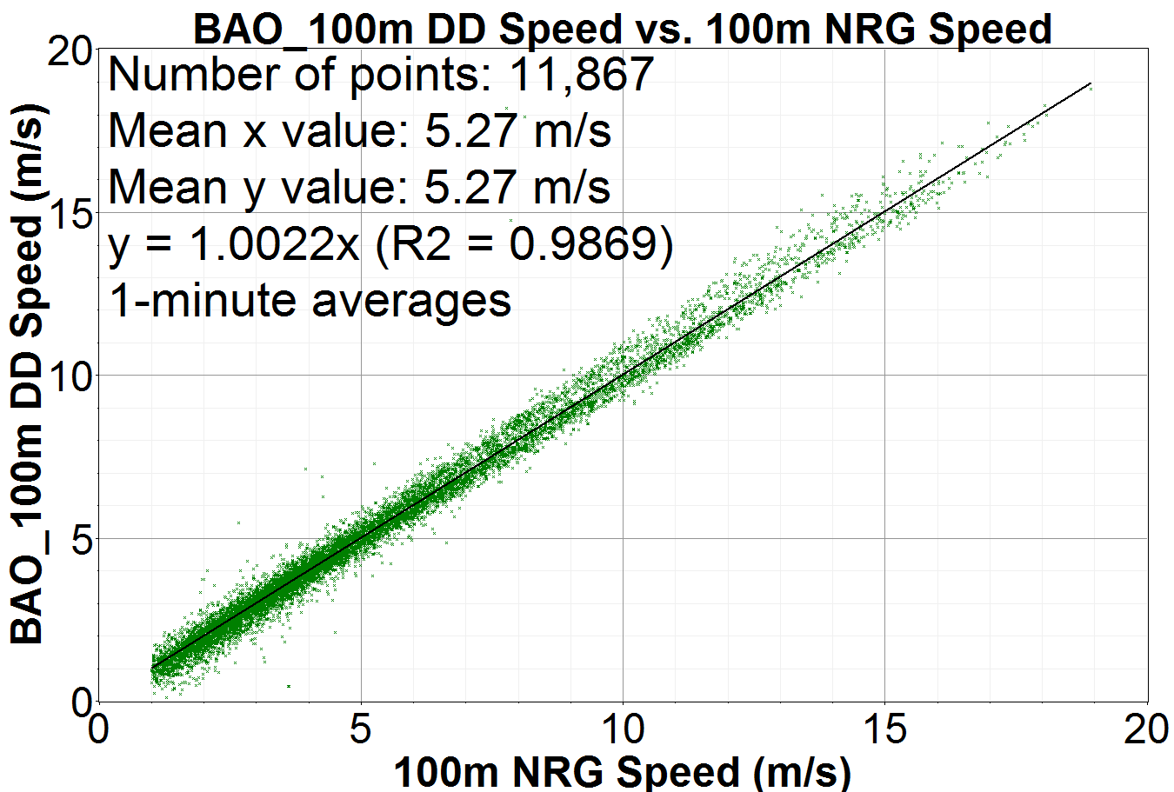
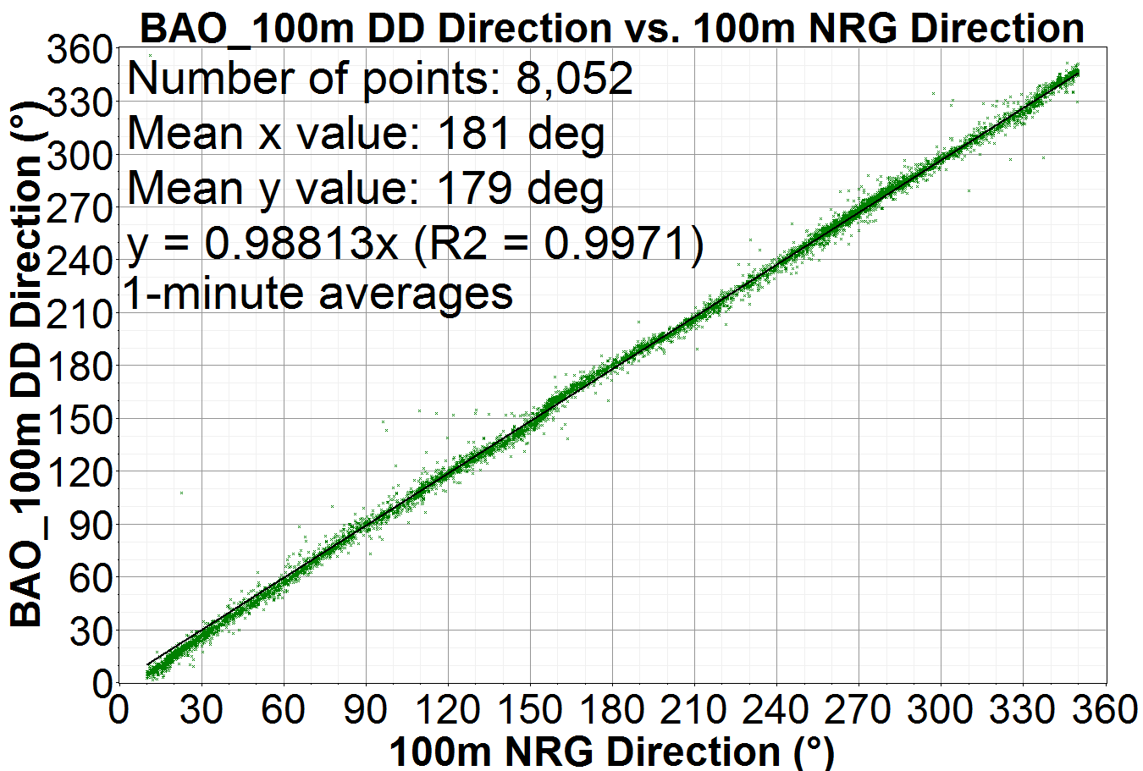
BAO1 Staring Dual-Doppler Compared to Tower
During the last 10 minutes of each hour both WindTracers were operated in staring beam mode at a high data rate (10 Hz).
The data was averaged to one minute segments for this analysis and the BFWT and SRFWT streams combined to create these dual-Doppler measurements.
Speed performance is excellent with identical average speeds, slope within 0.22%, and high R² values.
Direction performance is also excellent with slopes within 1.2% and high R² values.
  Correlation reduced due to tower effect meander

Slide 16
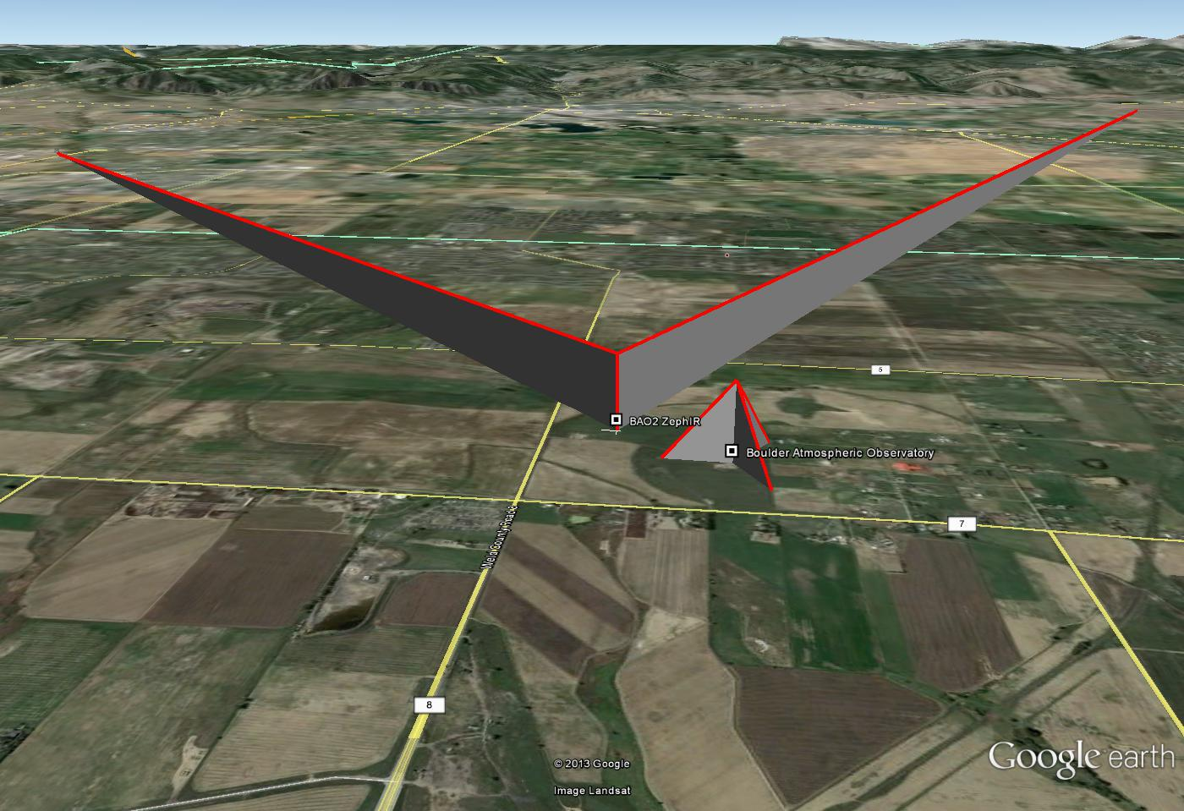
BAO 2 Geometry
TMWT
23 km
LMWT
13 km
ZephIR
BAO Tower
500 m

Slide 17
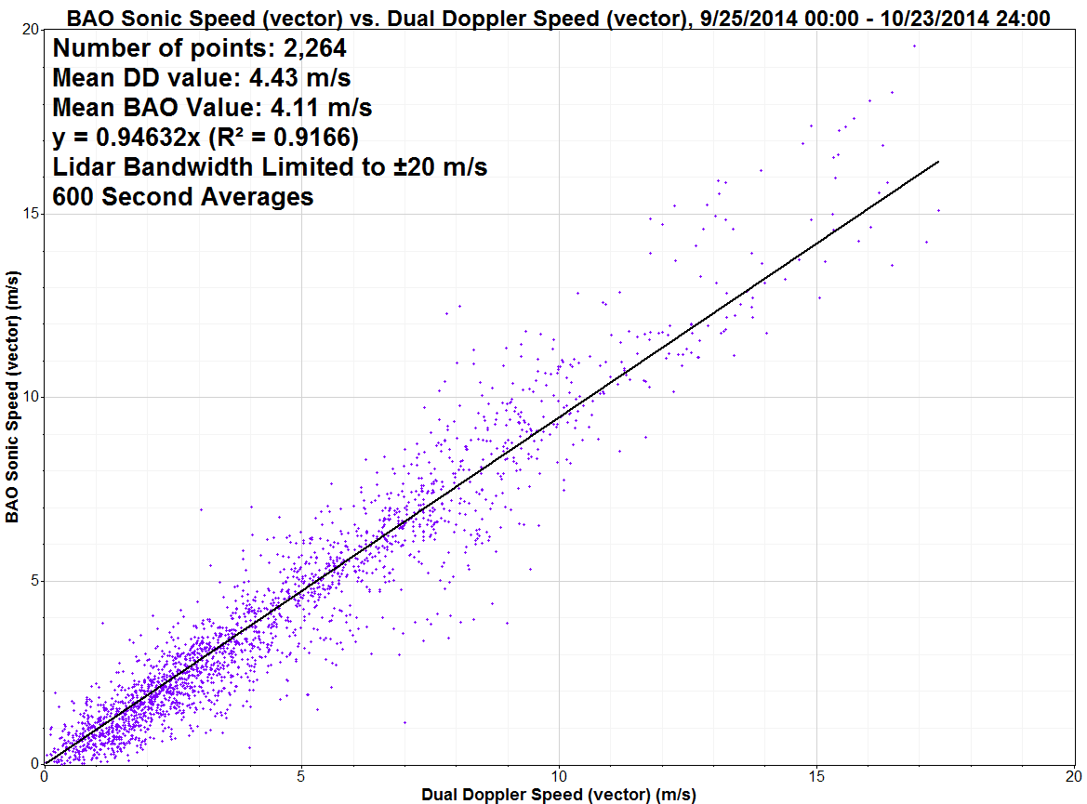
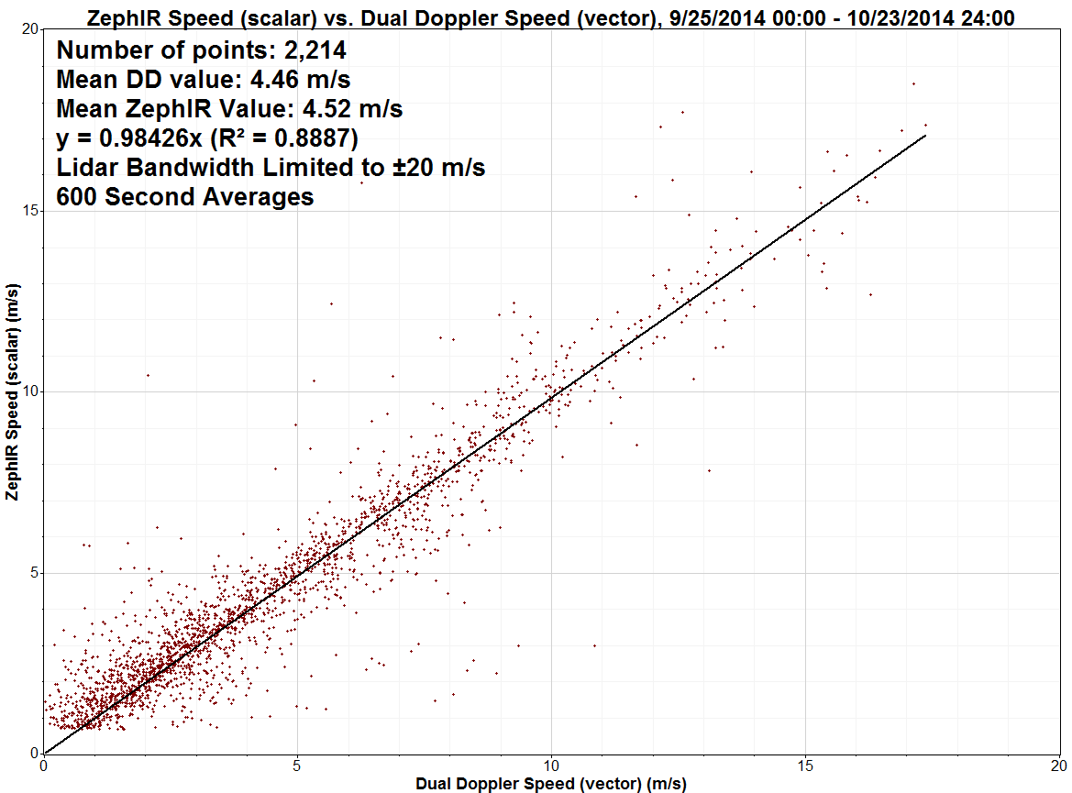
BAO2 DD Wind Speed Comparison
600 second average
WTX vs Sonic Anemometer
    Slope ~ 0.95,
      tower is 500m from the measurement point
  R² value of 0.92
WTX vs ZephIR 300
    Slope ~ 0.98
  R² value of 0.89
Dual WT vs. Sonic Ann.
Dual WT vs. ZephIR 300

Slide 18
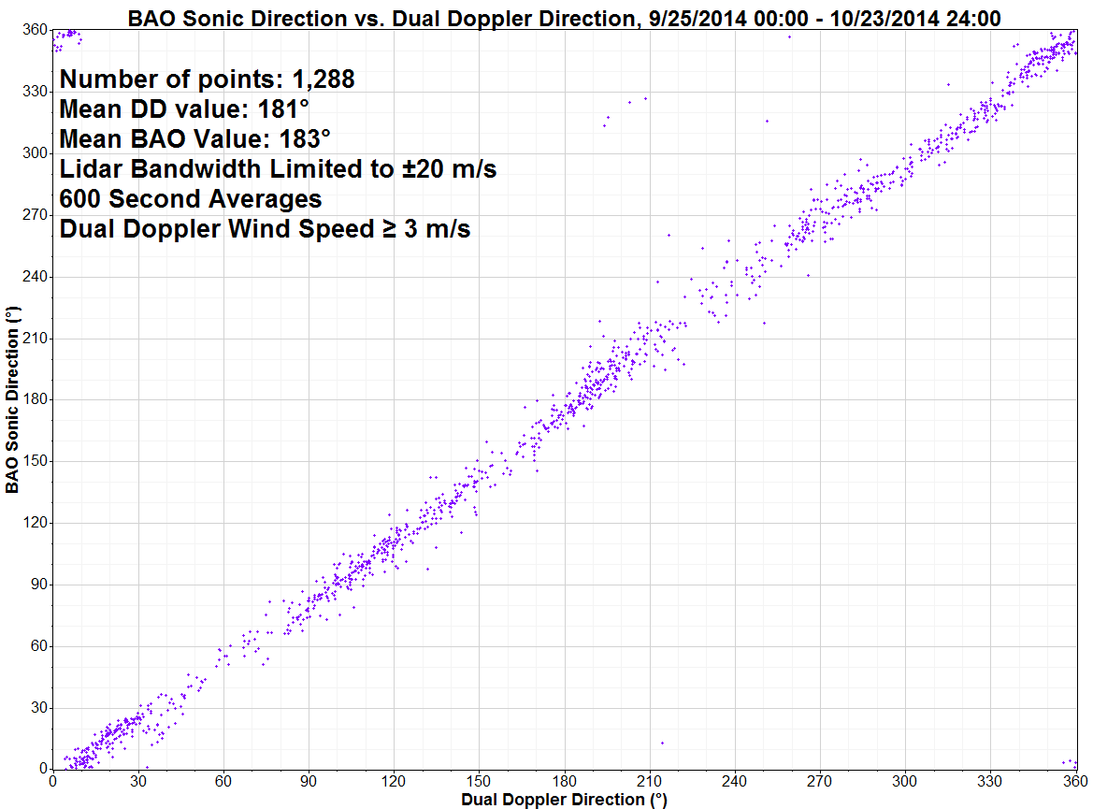
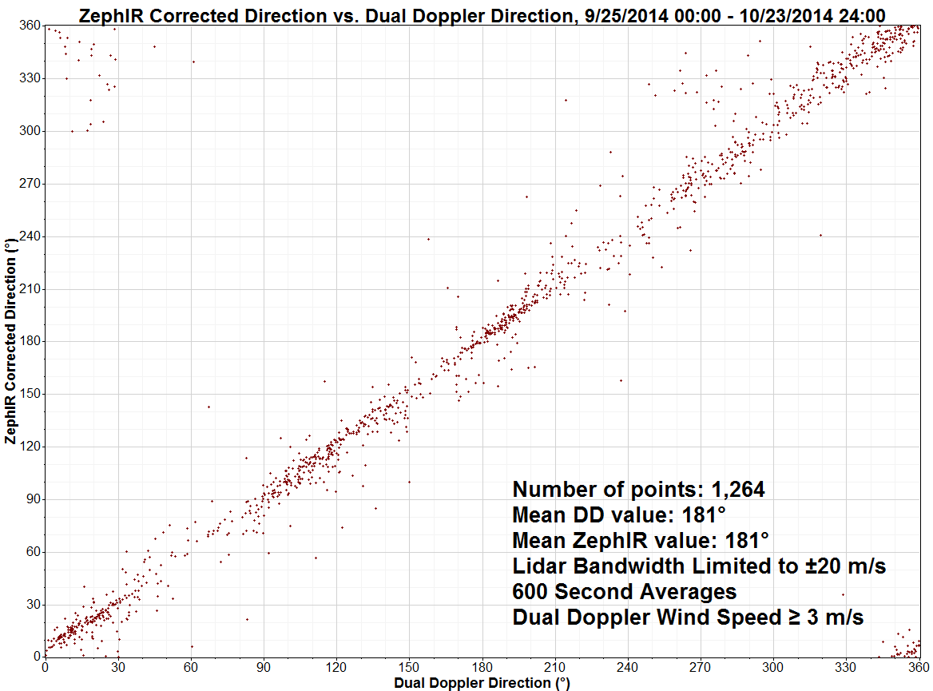
BAO2 DD Wind Direction Comparison
600 second average
Overall direction comparison is good
WTX vs Sonic Anemometer
    2 degree offset
    Sonic alignment is “eye-balled”
WTX vs ZephIR 300
    ~ 0 degree offset
  ZephIR incorporates a high accuracy electronic
Dual WT vs. Sonic Ann.
Dual WT vs. ZephIR 300

Slide 19
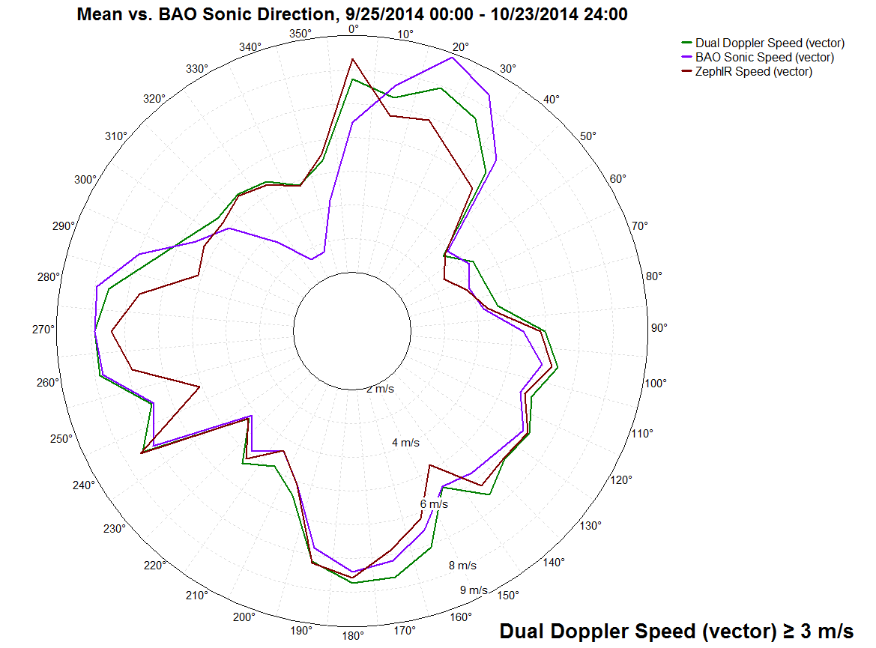
BAO2 Wind Rose
Tower
Effect!

Slide 20
Summary
WindTracer® is a versatile tool wind energy applications
  Virtual met tower array over complex terrain
  Long range vector winds for offshore applications
Dual-Doppler vector retrieval is more accurate than Single-Doppler
  SD Accuracy is subject to wind variability over measurement arc
  SD speed errors are greater when wind is perpendicular to arc LOS
  SD direction errors are minimum when wind is parallel to arc LOS
Scanning and staring beam configurations both compare well with currently accepted measurements
  Long term averages generally within a few cm/s

Slide 21
© 2015 Lockheed Martin Corporation. All Rights Reserved.

Slide 22
Backup Charts

Slide 23
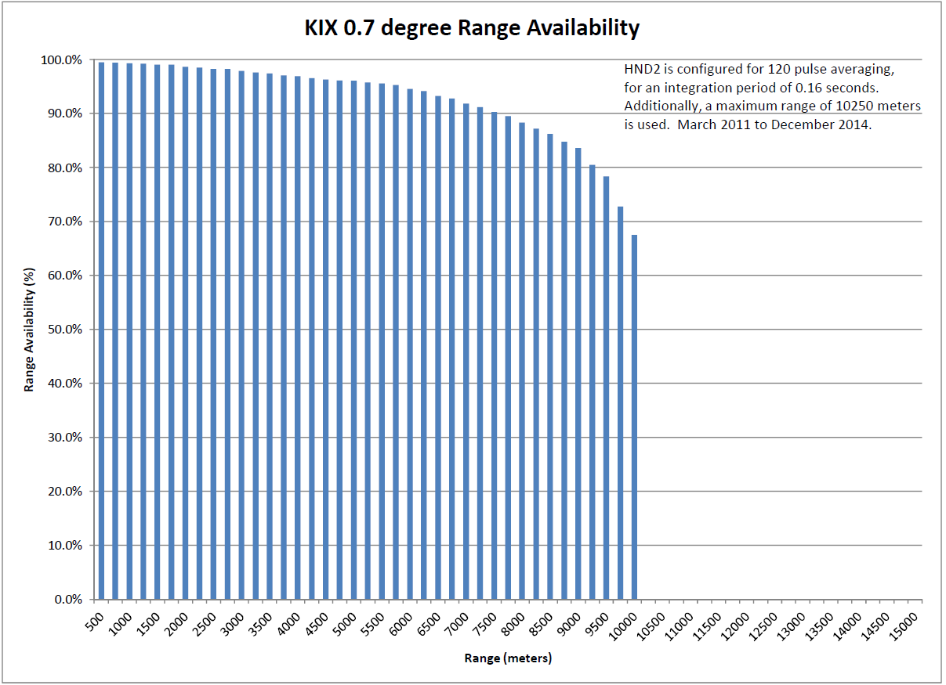
Kansai Historical Range Performance

Slide 24
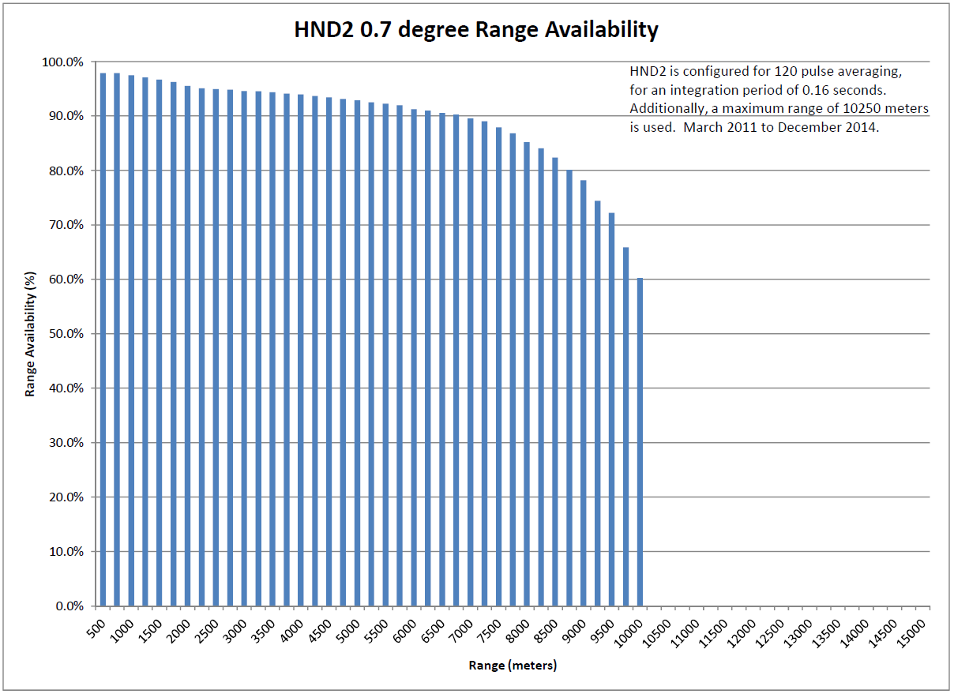
Haneda 2 Historical Range Performance

Slide 25
New Jersey Historical Range Availability

Slide 26
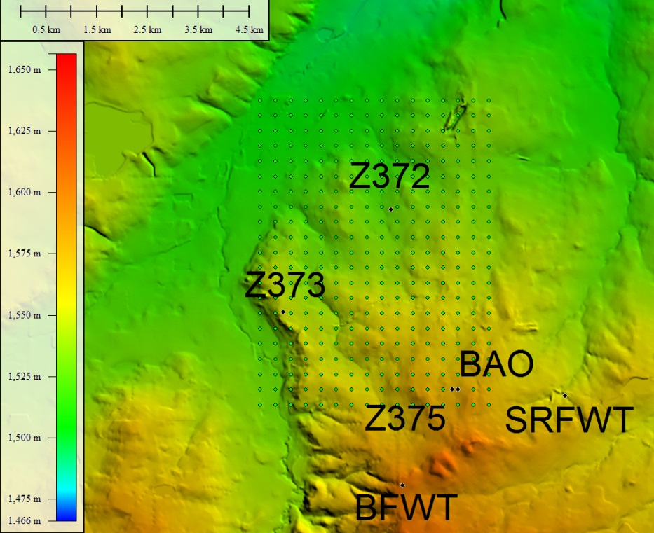
BAO1 Terrain

Slide 27
33 km Performance

Slide 28
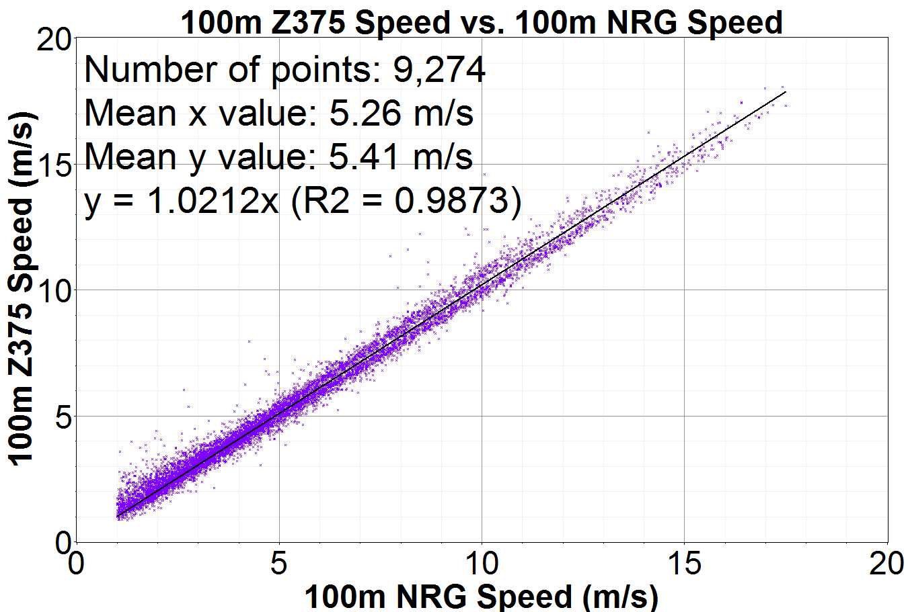
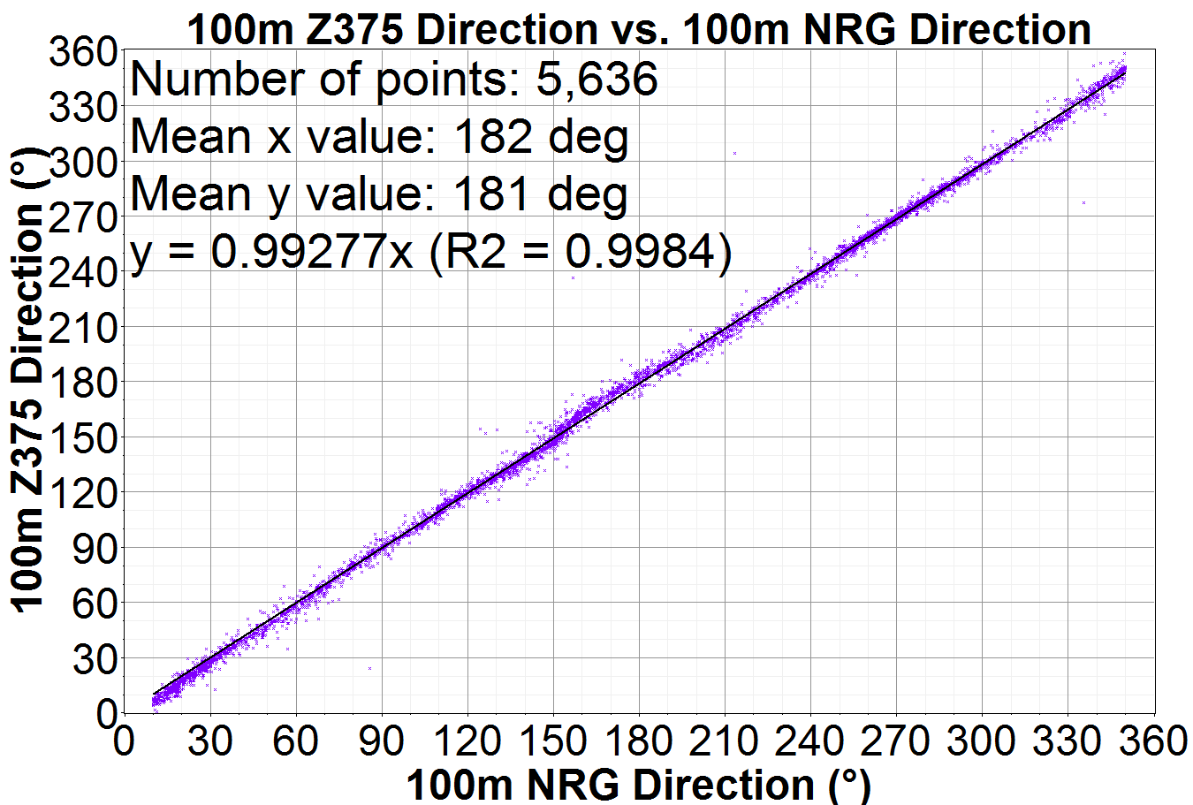
Tower vs. Vertical Lidar
One vertical lidar was placed 125 meters west of the BAO tower to compare the two currently accepted measurement methods.
Overall correlations were good, with 2.1% difference in slope for speed.
Direction data filtered to remove flipped data and speeds < 3 m/s.

Slide 29
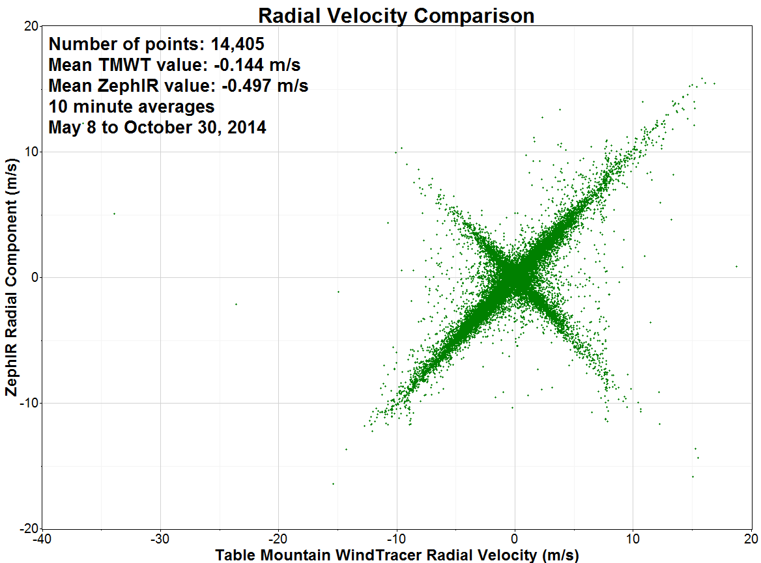
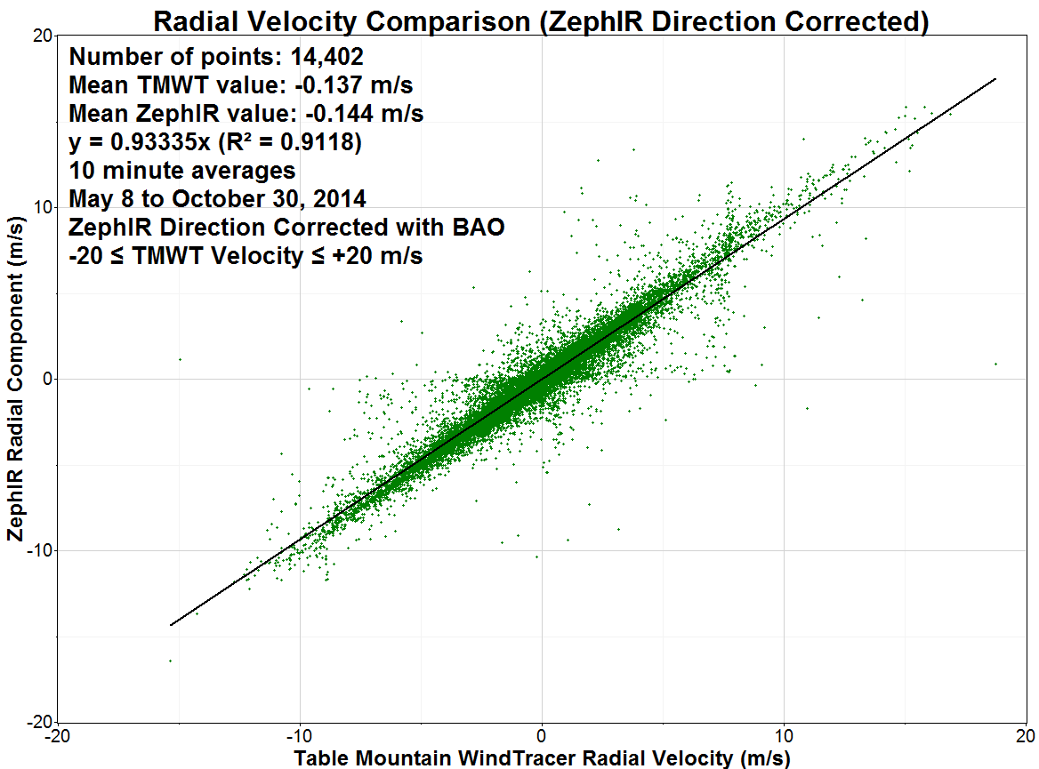
Radial Velocity vs. ZephIR 300
Top plot shows comparison with all points.
There is a known issue with ZephIR direction retrievals when the wind speed near the ground is low.
  This causes the sign on the radial component to be swapped
Direction has been corrected using the BAO 300 m sonic direction
The bottom plot shows the ZephIR corrected data along with the removal of the 3 bad TMWT measurements.

Slide 30
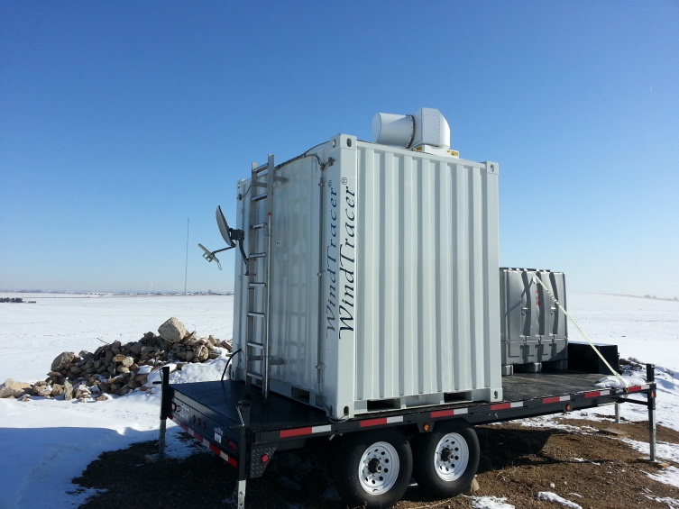
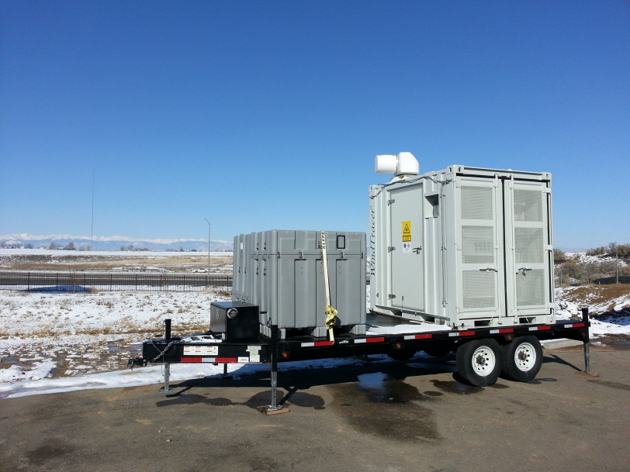
BAO1 WTX WindTracers®
Two WindTracer units
  Boulder Flatworks (BFWT) site 2.2 km southwest of BAO tower
  Split Rail Fence (SRFWT) site 2.1 km east of BAO tower
Two scan configurations every hour
  0 to 50 minutes: Multi-tilt PPI scans to generate terrain following field data
    60, 90, and 120 meters AGL in full field
    60, 90, 100, 120, 150, 200, and 300 meters AGL at BAO tower
    The PPI volume scan required 5 minutes to complete, guaranteeing at least two measurements at every point in each 10 minute average
  50 to 60 minutes: Staring beam near northwest 100m BAO anemometer/vane
    High rate data (10 Hz) taken for future turbulence analysis
Boulder Flatworks WindTracer
Split Rail Fence WindTracer

Slide 31

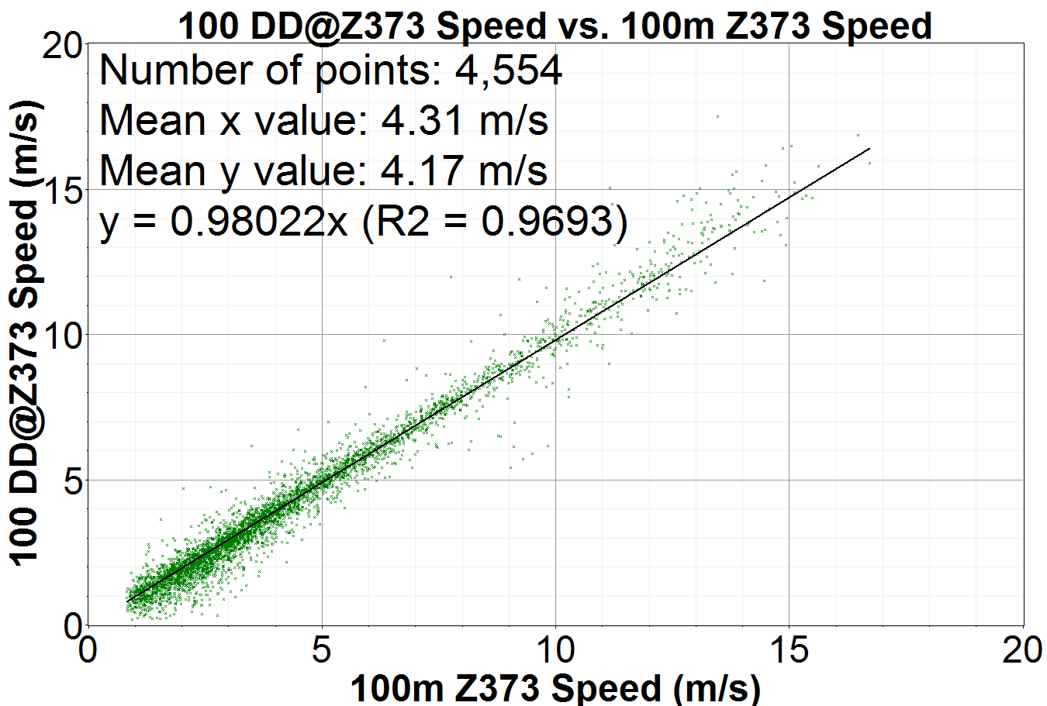


Remote Site Scanning Dual-Doppler
Even though range is more than doubled, correlation is still similar.
Speed slopes within 2.2%
Direction slopes within 0.9%
Number of direction points reduced due to flipped direction filtering
  Especially for Z373 which was in a backyard with privacy fences
Dual-Doppler WindTracer
vs. ZephIR 372 (NNW of BAO)
Dual-Doppler WindTracer
vs. ZephIR 373 (WNW of BAO

Slide 32




Single-Doppler Terrain-Following Fields
Multiple PPI tilts from both systems combined to create terrain following radial wind field maps
Cartesian grid, 300x300m spacing, 90 m AGL

Slide 33

Table Mountain WindTracer (TMWT)
Standard WTX WindTracer
Configured to stare at a point 296 meters above the ZephIR 300
  Azimuth to ZephIR: 114.275°
  Range to ZephIR: 23,254 meters
Available 8-May-2014 through 29-October-2014

Slide 34

LMCT WindTracer (LMWT)
Standard WTX WindTracer
Configured to stare at a point 296 meters above the ZephIR 300
  Azimuth to ZephIR: 48.904°
  Range to ZephIR: 12,720 meters
Available
  12-Aug-2014 to 19-Aug-2014
  25-Sept-2014 to 23-Oct-2014

Slide 35



Single-Doppler Results
100 Days of data was collected from TMWT.
100 days of BAO data available.
Data recording problems reduced ZephIR availability to 65 days.

Slide 36

Radial Velocity Comparison
TMWT configured to stare at 296 meters over ZephIR
  500 meters from the sonic anemometer….expect looser correlation.
  296 meters above ZephIR is at the same height (MSL) as the 300 meter sonic.
  30 second integration periods
TMWT vs. ZephIR 300
TMWT vs. ZephIR 300

Slide 37
Dual Doppler Results
The following plots only show the timeframe when all devices were available to allow “apples-to-apples” comparison.
  More Dual-Doppler WindTracer results do exist.
  The plots show one month of data from September 25 to October 23, 2014.
We expect the correlation with BAO values to be lower because:
  The tower is 500 meters away from the measurement point above the ZephIR.
  Tower effects alter measurements.

Slide 38

Scatter Frequency Analysis
While scatter exists, most points are tightly around the 1:1 correlation line.

Slide 39
Single-Doppler Terrain-Following Fields
Multiple PPI tilts from both systems combined to create terrain following radial wind field maps
Cartesian grid, 300x300m spacing, 90 m AGL

