Slide 1


Laser Technology Investments by ESTO
Working Group on Space-based Lidar Winds
Parminder Ghuman
Earth Science Technology Office
p.ghuman@nasa.gov
(301) 286-8001
April 28, 2015

Slide 2
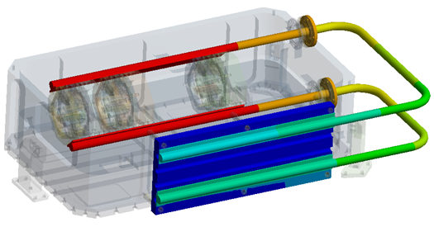
  Design and Fabrication of a Breadboard, Fully Conductively Cooled, 2-Micron, Pulsed Laser for the 3-D Winds Decadal Survey Mission
PI: Upendra Singh; NASA LaRC
Project Start/End Date: May 2012 – Dec. 2015
Develop a 2 micron, space-qualifiable, fully conductively cooled, 2-micron, pulsed laser breadboard to enable space-based Doppler wind profiling
  Wavelength: 2.053 um
  Pulse Energy / Rep Rate: 250 mJ / 10 Hz
Incorporate design changes from 1st generation system to achieves higher reliability, higher efficiency, lower weight and increased mechanical strength:
2 micron, space-qualifiable, conductively-cooled pulsed laser design for 3D Winds
  Simplify thermal design by replacing the 792 nm ambient temperature pump diodes with 804 nm pump diodes that are cooled to ~ -20˚C.
  Enhance system reliability by replacing the current 6-bar diode stacks (based on 100 W bars) with a newer generation of lensed 3-bar stacks that use 300 W bars.
  Improve pump efficiency and gain distribution by incorporating lensed arrays.
  Simplify the mechanical design and improve diode lifetime by operating the pump diodes at lower temperatures, similar to that of the rod, eliminating the need for diode heaters.
  Replacing the liquid cooled tubes with heat pipes.

Slide 3
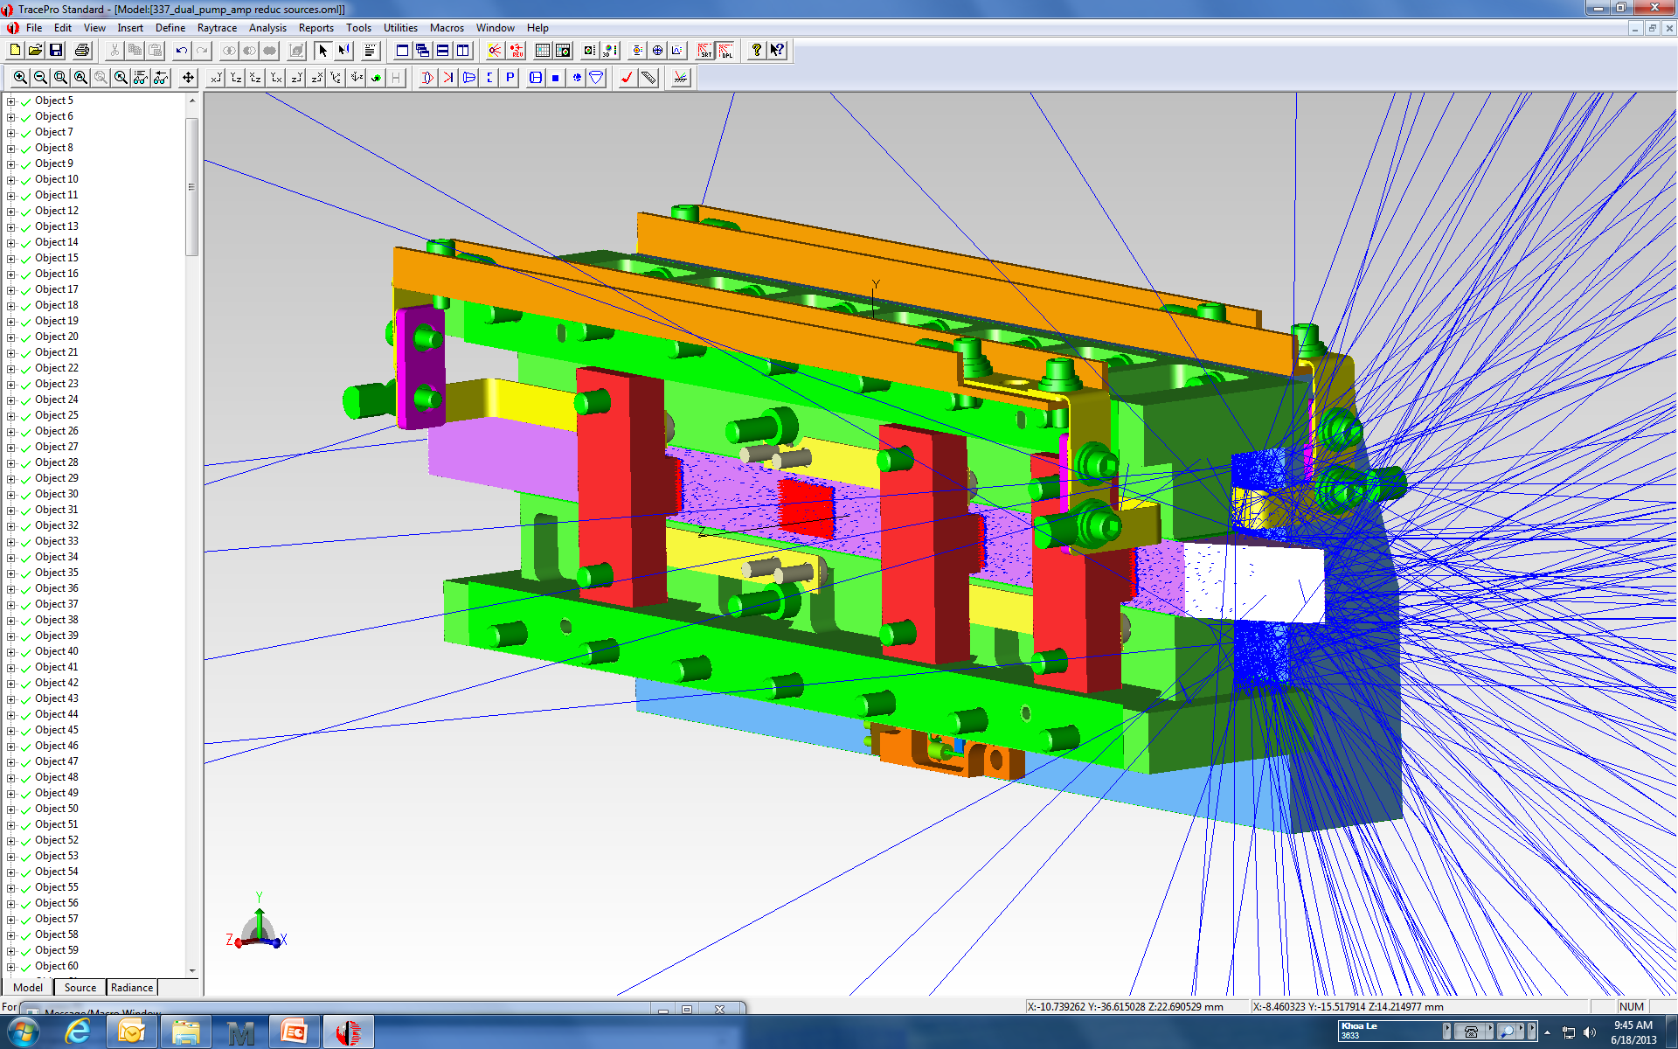
  High Efficiency UV Laser Demonstrator
PI: Floyd Hovis; Fibertek, Inc.
Project Start/End Date: Apr. 2013– Aug. 2016
Develop and demonstrate a highly efficient, ruggedized UV laser (100 mJ, 150 Hz) with with a lifetime in excess of a billion shots needed for future Earth Science measurements of Tropospheric winds, clouds, and aerosols.
Conduct a 4 month lifetest of the pump laser with 532 nm generation
Conduct an 8 month lifetest of the pump laser and UV conversion module
Conduct environmental testing (TVAC) to advance the design from TRL 4 to TRL 6
Conceptual laser head design with ray tracing of exiting pump rays, and modeled laser spot following amplification

Slide 4
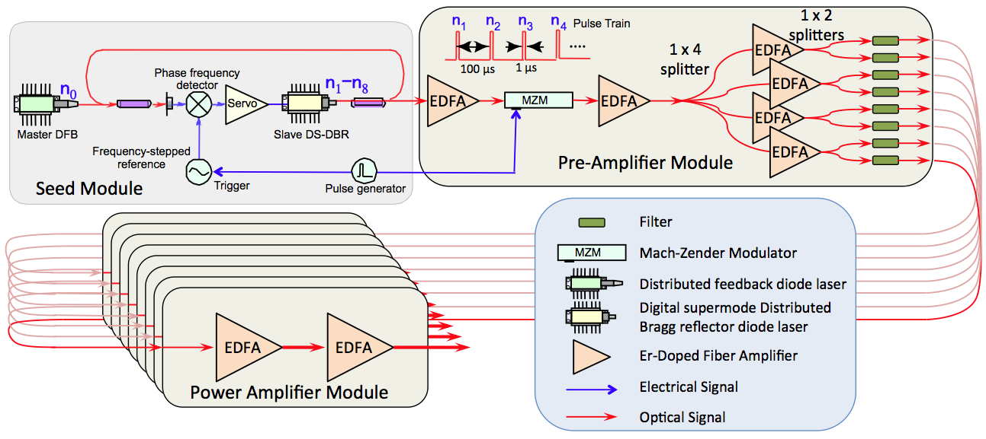
  Fiber-based, Trace-gas, Laser Transmitter Technology Development for Space
PI: Mark Stephen; NASA GSFC
Project Start/End Date: Jan. 2015 – Jul. 2017
Develop the key laser technologies of a pulsed 1.57µm fiber-laser to reduce the cost and risk of active CO₂ profiling from space
  Pulse Energy: >2.5 mJ
  Rep Rate: 7.5 KHz
  Linewidth: ≤100 MHz (each channel)
  Wavelength Stability: <0.3 MHz (each channel)
  Wall-plug Efficiency: >10 %
Block diagram of the fiber-based laser transmitter architecture
  Demonstrating the technology readiness of a laser transmitter with full power and optical performance required for space will enable faster development for an active CO₂ sensing mission
  The laser requirements are consistent with the needs of a space-based CO₂ IPDA lidar (the CO₂ Sounder), but the laser technology developed will be very useful for meeting other NASA Earth Science laser needs
  Uses a fiber-based master oscillator power amplifier (MOPA) architecture for modularity and performance
The seed and pre-amplifier modules will be built in-house at GSFC, while the power amplifier will be developed by a commercial vendor
Build a prototype unit that meets all the performance requirements and take it through environmental testing to achieve TRL-6.

Slide 5
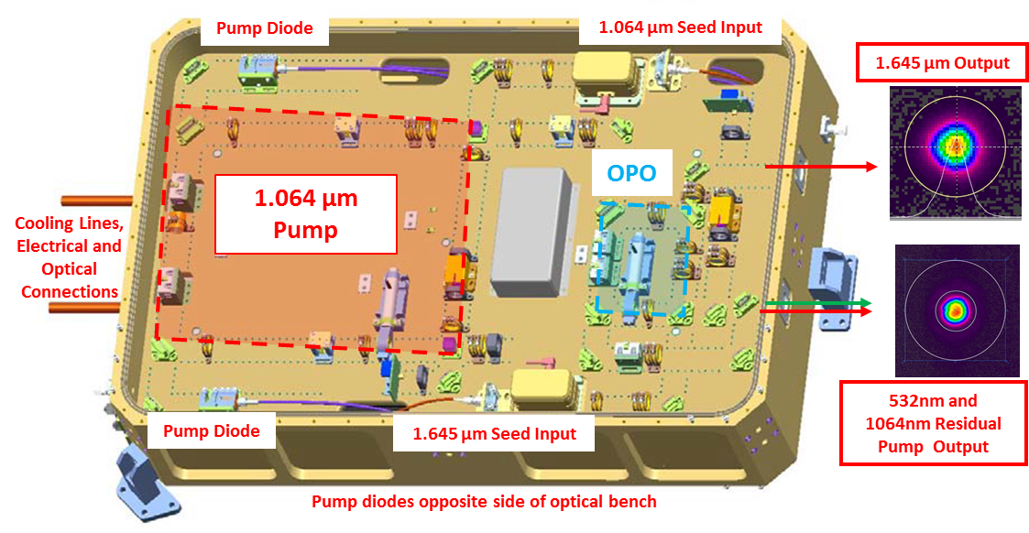
  Laser Source for Methane DIAL
PI: Tim Shuman; Fibertek, Inc.
Technical Monitor: Amin Nehrir; LaRC
Develop a hardened, tunable single frequency OPO operating at 1.645 µm capable of airborne operation to measure column and multi-layer methane
  15 W, 1 kHz PRF Injection seeded Nd:YAG oscillator as pump.
  Injection seeded and locked ring 1.645 µm OPO
  Residual pump energy used for HSRL measurements
  Pump and OPO cavity w/ Pound-Drever-Hall locking
Integrate into HALO, a new mulit-function lidar targeting methane, water vapor, and aerosol measurements from high altitude platforms

Slide 6
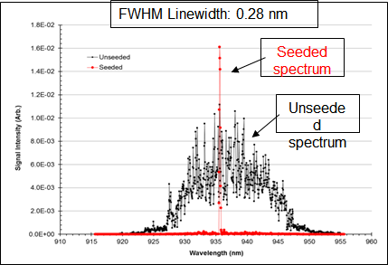
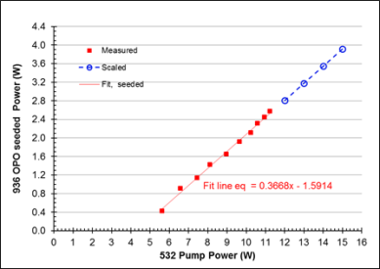
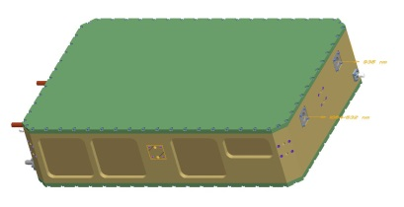
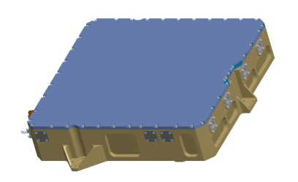
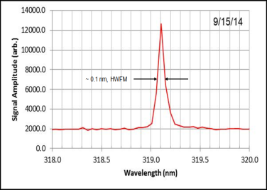
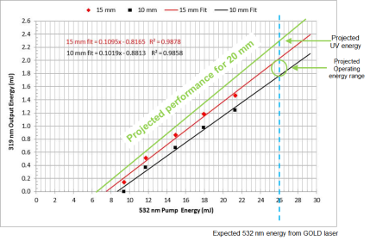
  Water Vapor and Ozone DIAL Transmitters
PI: Ti Chuang; Fibertek, Inc.
Technical Monitor: Amin Nehrir; LaRC
Design, build and test a >3 W water vapor DIAL transmitter based on seeded and locked OPO technology, pumped by a single-frequency Nd:YAG MOPA operating at 1 kHz PRF at 30 W average power.
  Incorporate the design into an environmental housing compatible with airborne operation
  Provide fiber coupled seed laser capable of locking to water vapor transitions near 935 nm
Design, build and test a UV converter for ozone DIAL compatible with operation with the NASA GOLD pump laser. Target UV lines at 304 nm and 316 nm.
  Incorporate the design into an environmental housing compatible with GOLD pump laser
  Test wavelength converter using Fibertek-owned pump lasers or GOLD laser if available
Water Vapor DIAL Transmitter enclosure, expected performance
Ozone UV DIAL Transmitter enclosure, expected performance

Slide 7

  A compact Trace Gas Lidar for Simultaneous Measurements of Methane and Water Vapor Column Abundance
PI: Harris Riris; NASA/GSFC
Project Start/End Date: Mar. 2015 - Mar. 2018
Develop a multi-wavelength laser transmitter to enable CH₄ and H₂O measurements at 1651 nm and 1652 nm respectively from airborne and spaceborne platforms
  Pulse Energy/Rep Rate: 300 uJ / 10 KHz
  Pulse Width: 30 nsec
  Laser Divergence: 100 urad
Demonstrate and validate simultaneous, high precision CH₄ and H₂O measurements with a CH₄ column abundance of 1% precision
  Scale the power of the existing pump laser TRL and reducing its Stimulated Brillouin Scattering (SBS)
  Using an Optical Parametric Oscillator (OPO), increase the laser transmitter energy to 300 μJ per pulse
  Add 2-6 additional seed lasers to span the CH₄ absorption line
  Replace the inefficient PMT with a more sensitive e-APD detector having 70% quantum efficiency
OPO
Electronics
λ Seed
λ Signal
(Amplified Seed)
Detector
Transmit Optics
Receiver Optics
CH₄ Absorption
λ₁…λ_{N}
To surface
Reflection
from surface
Basic Instrument Concept
Atmospheric Transmittance Spectrum at 1650 – 1653 nm

