Slide 1
Upendra N. Singh, Mulugeta Petros, Jirong Yu, and Michael J. Kavaya
NASA Langley Research Center, Hampton, Virginia 23681 USA
Timothy Shuman and Floyd Hovis
Fibertek, Inc, Herndon, Virginia, USA
(757).864.1570
Upendra.N.Singh@nasa.gov
Development of a Space-qualifiable, Conductively-cooled 2-micron Coherent Lidar Transmitter for Global Wind Measurements
Acknowledgements: The authors appreciate the support of George J. Komar, NASA Earth Science Technology Office and Ramesh K. Kakar Science Mission Directorate at NASA HQ
Working Group on Space-based Lidar Winds
Boulder, Colorado
April 28-29, 2015,

Slide 2
Outline
  Background and motivation
  Technology Development
  Compact 2µm wind lidar transceiver
  Conductive cooled 2µm Oscillator/Amplifier development
  Ground and Airborne campaigns
  Fully Conductively-cooled Risk Reduction Laser
  Conclusions

Slide 3
Background and Motivation

Slide 4



Motivation for 2µm Laser/Lidar Development
NRC Recommended “3-D Winds” Mission
“Knowledge derived from global tropospheric wind measurement is an important constituent of our overall understanding of climate behavior.” [1]
Global Winds 9 Societal Benefits
Extreme Weather Warnings | P
Human Health | P
Earthquake Early Warning
Improved Weather Prediction | P#1
Sea-Level Rise
Climate Prediction
Freshwater Availability
Ecosystem Services
Air Quality | P
[1] Baker et al, Lidar measured Wind Profiles – The Missing Link in the Global Observing System, Bulletin American Meteorological Society 95 (4), 515-519 (April 2014)

Slide 5
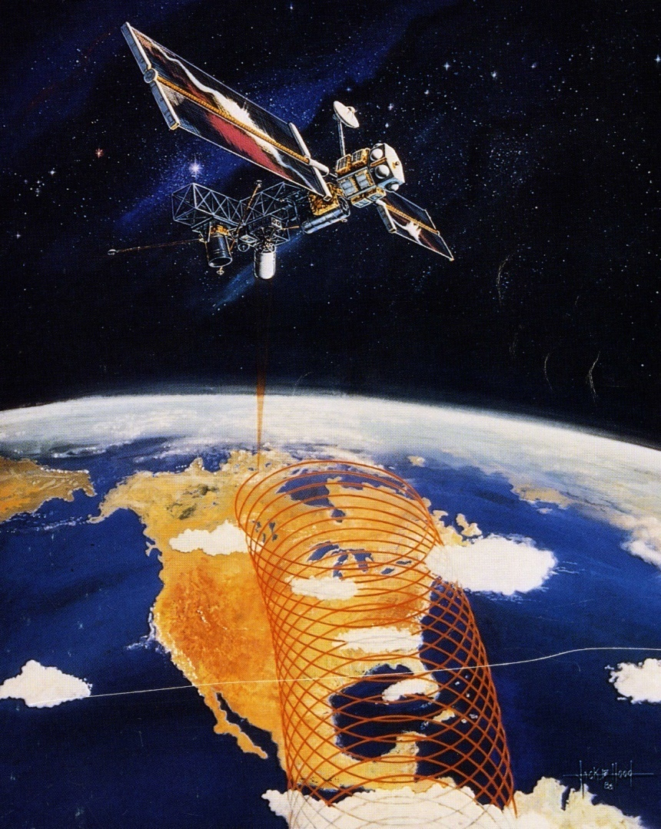
  Early Mission Concept for Earth Winds
  Laser Atmospheric Wind Sounder (LAWS)
525 km orbit height
Single, pulsed coherent Doppler lidar system covers troposphere
Line of sight (LOS) wind profiles from each laser shot
CO₂ TEA laser at 9 microns with high voltage discharge pumping & catalyst to repair gas
~ 20 J pulse energy at 10 Hz
Continuously rotating 1.5-m diameter telescope/scanner
HgCdTe detector cooled to 77K by mechanical cryo-cooler
Required: eye-safe laser

Slide 6
Laser Technology Development
for Coherent Doppler Lidar

Slide 7
Laser Technology Development
for Coherent Doppler Lidar
Adapted as mission design and coherent lidar requirements changed
Conducted in parallel with direct detection Doppler lidar development
Part of NASA’s Laser Risk Reduction Program (FY02 – FY10)
Comprised technology development, ground and airborne technology validation, and scientific use of technology
Series of several individual projects
Validation and scientific use of liquid-cooled laser in parallel with laser advancement to conductive-cooled

Slide 8
  Basic Performance Goals for 2-µm Doppler Lidar
Wavelength | 2.053 -µm
Laser Pulse Energy | 250 mJ
Repetition Rate | 10 Hz
Pulse Width | >150 ns
Beam Quality | M² < 1.2
Pulse Spectrum | Single frequency (seeded)
Cooling | Conductively cooled via heat pipes
Laser Size | 23.9” x 14” x 7.7” (L x W x H) Including heat pipes and condenser

Slide 9


  Parallel Hybrid Doppler Lidar Development, Validation, Space Qualification
2-µm Coherent Doppler Lidar
2 -µm laser
Diode Pump Technology
Inj. Seeding Technology
High Energy Technology
Conductive Cooling Techn.
Compact Packaging
Doppler Lidar Ground Demo.
Autonomous Oper. Technol.
Space Qualif.
Lifetime Validation
Pre-Launch Validation
7-Yr. Lifetime Validation
Hybrid Aircraft Operation
UAV Operation
Hybrid Demonstration
Hybrid Operational
Autonomous Oper. Technol.
Space Qualif.
Lifetime Validation
Pre-Launch Validation
7-Yr. Lifetime Validation
1 µm laser
Diode Pump Technology
Inj. Seeding Technology
Conductive Cooling Techn.
High Energy Technology
Compact Packaging
Doppler Lidar Ground Demo.
0.355-µm Direct Detection Doppler Lidar
Global Winds Approach Using Hybrid Doppler Lidar

Slide 10
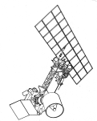

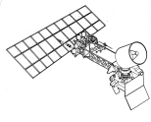
Laser Risk Reduction Program (LaRC-GSFC)
(NASA HQ Funded Directed Program 2001-2010)
2 Lasers, 4 Techniques, 6 Priority Measurements
Pulsed
Laser Development
2.05 micron
DIAL: CO₂
Doppler Lidar: Coherent Ocean/River
Surface Currents
Backscatter Lidar: Aerosols/Clouds
2 MICRON
2.05 micron
Atmosphere:
Lower Upper
Key Technologies in Common
Laser Diodes
Laser Induced Damage
Frequency Control
Electrical Efficiency
Heat Removal
Ruggedness
Lifetime
Contamination Tolerance
Doppler Lidar: Wind
Coherent
Winds
Coherent
Direct
Noncoherent
Winds
X3
0.355 micron
1 MICRON
X2
Altimetry:
1.06 micron
Surface Mapping, Oceanography
DIAL: Ozone
X2
0.532 micron
0.30-0.32 micron
Backscatter Lidar:
Aerosols/Clouds
OPO

Slide 11
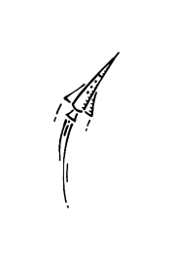

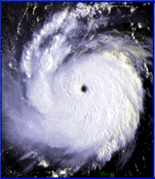


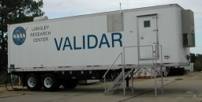
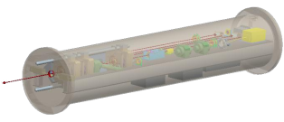
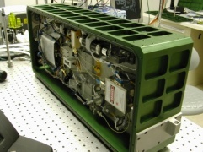
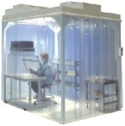
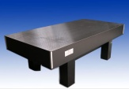
  Technology Development, Validation, and Scientific Use
Tech
Technology
Science Science
NRC Decadal Survey
3-D Winds Space Mission
Polar Winds: Greenland Iceland
Venture Class Science Flights
7 years
SMD-ESD
ACT
DAWN UC-12B
12 15
GRIP Hurricane Campaign
SMD-ESD
15
SMD-ESD
5 years
SMD-ESD
LaRC
13
DAWN-AIR2
SMD-ESD
10
12
DAWN-AIR1
09
ESTO
11
08
SMD-ESD
10
Ground Intercomparison
IPP
08
SMD-ESD
09
DAWN
08
SMD-ESD
10
LRRP
06
ESTO
08
ATIP
02
ESTO
09
98
ESTO
01
Technology

Slide 12
  Parallel Advancement of Conductive Cooled with Use of Liquid Cooled

Slide 13
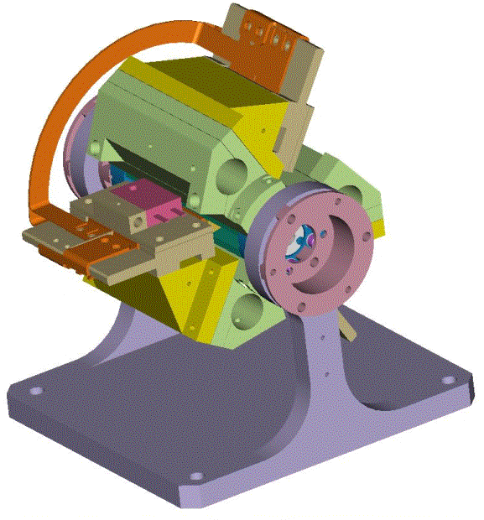
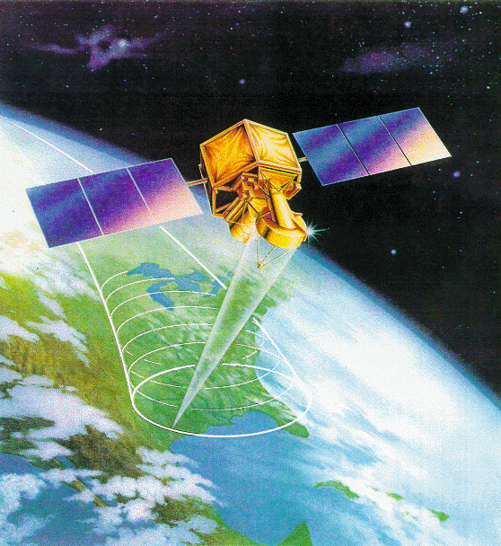
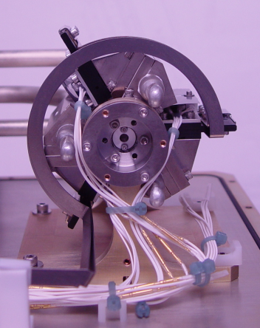
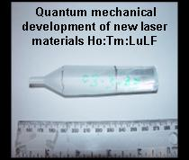
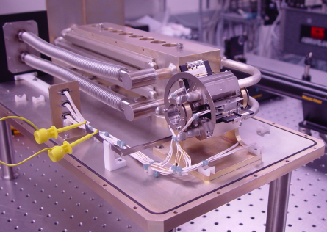
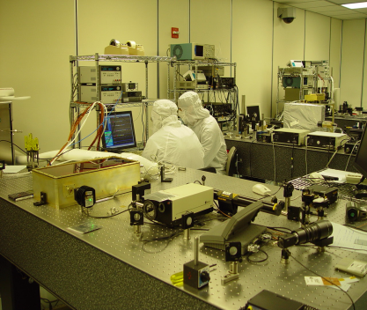
Laser Technology Maturation
A fully conductively cooled 2-micron solid-state pulsed laser has been demonstrated for the first time.
Technology Enables: Measurement of global 3-D Winds
Analysis & Design
Space Qualifiable Design
Fabrication
Quantum Mechanical
Modeling
System Integration
Testing and Model Verification

Slide 14
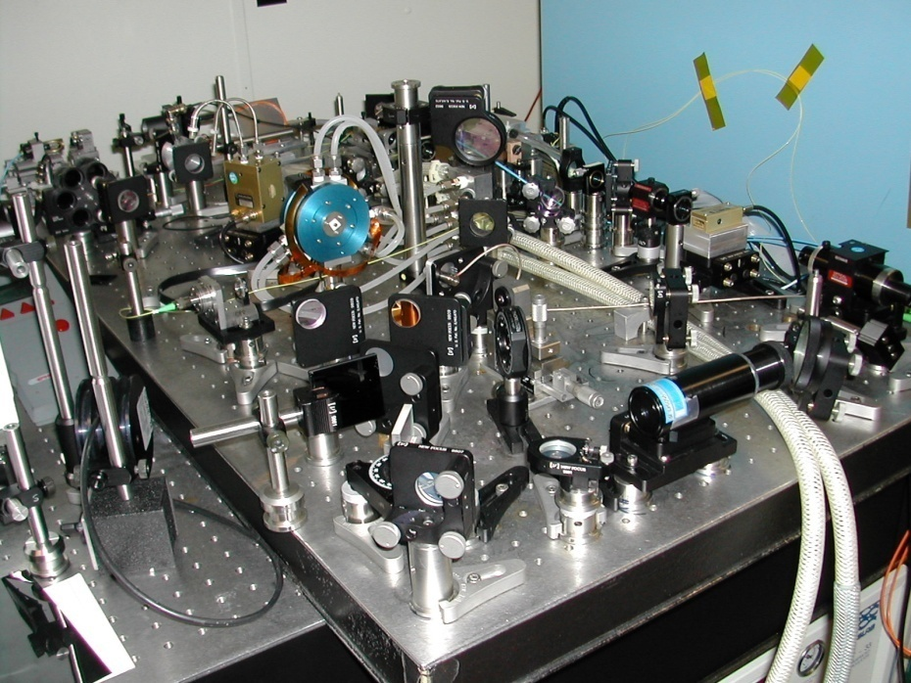
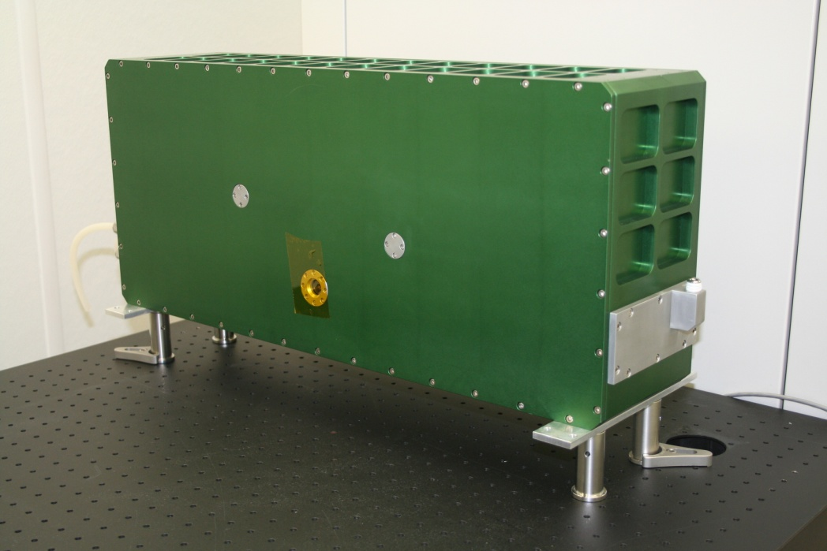
Mobile Ground-Based High Energy Wind Lidar Transceiver – LRRP/DAWN Funded
Table Top Transceiver (Transmitter + Receiver)
90 mJ/pulse, 5 pulses/sec.
3’x4’ Optical Table
(no telescope or scanner)
Engineered Transceiver
250 mJ/pulse, 10 pulses/sec.
5.9” x 11.6” x 26.5”, 75 lbs.;
15 x 29 x 67 cm, 34 kg
(no telescope or scanner)

Slide 15
Ground and Airborne Campaigns

Slide 16
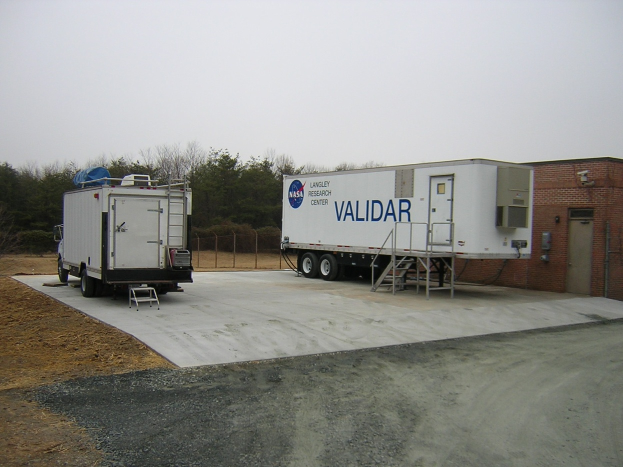
Ground-Based Hybrid Wind Lidar Demo
GSFC 355-nm
Doppler lidar
LaRC 2-μm
Doppler lidar
The LaRC mobile lidar is deployed as part of NASA HQ funded Program
Utilized NASA LaRC Compact DAWN Lidar Transceiver for 2-µm lidar
Site at Howard University Research Campus in Beltsville, Maryland

Slide 17
Comparison of Coherent Lidar and Sonde
Root-mean-square of difference between two sensors for all points shown is 1.06 m/s for wind speed and 5.78 deg. for wind direction

Slide 18
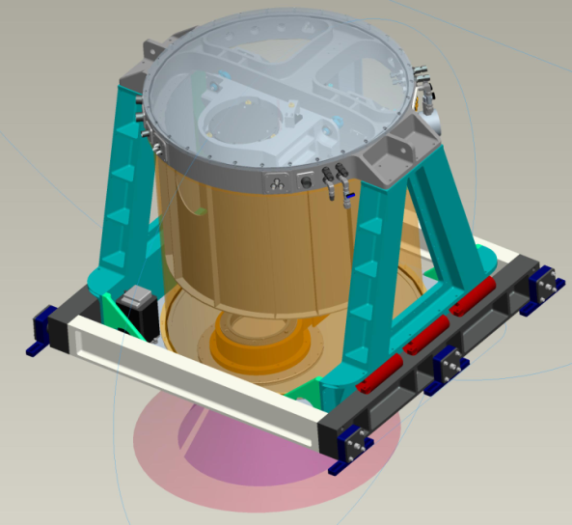
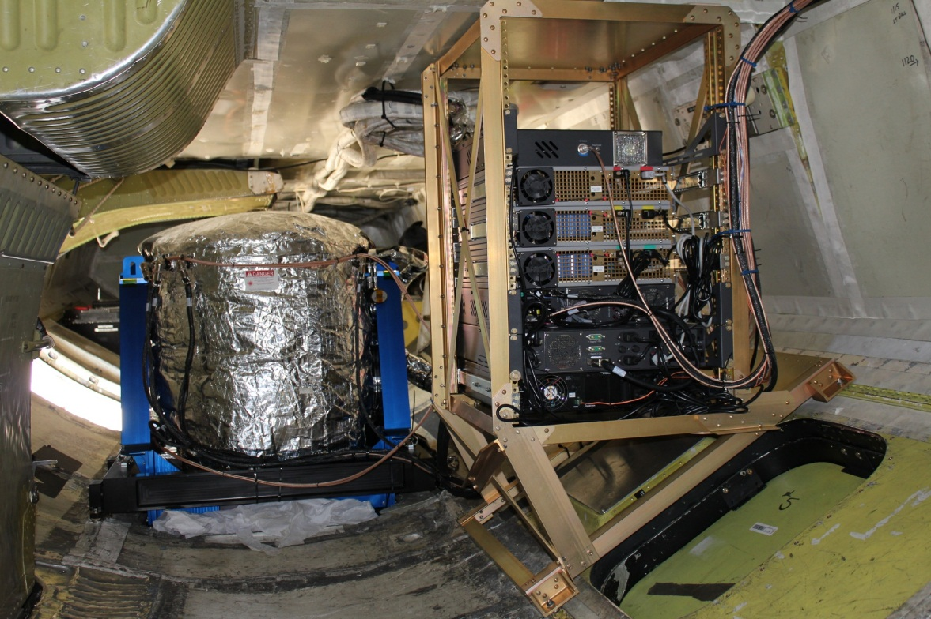
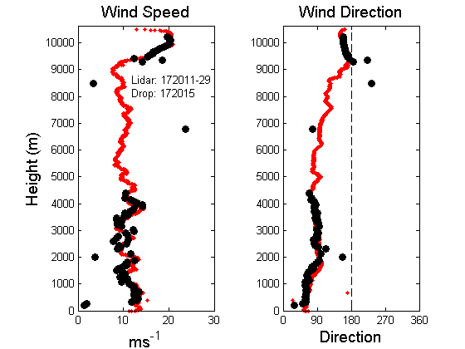
DC-8 Wind Lidar During GRIP (2010)
Harden the transmitter for airborne application
Add telescope and scanner within the enclosure
Airborne wind measurement during GRIP campaign

Slide 19
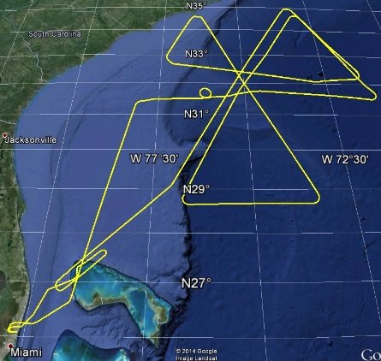
GRIP – 2 Sept 2010 – Hurricane Earl
APR-2 Radar
LASE Aerosols
DAWN SNR
DAWN Wind Speed
DAWN Wind Dir
~400 minutes data
5 eye “crossings”
DC-8 Track

Slide 20
Ground and Airborne Campaigns
Date | Platform | Location | Objective | Publications
2004-2005 | VALIDAR Trailer | Hampton, VA | Technology Validation | G. J. Koch, J. Y. Beyon, B. W. Barnes, M. Petros, J. Yu, F. Amzajerdian, M. J. Kavaya, and U. N. Singh, “High-Energy 2-micron Doppler Lidar for Wind Measurements,” Opt. Engr. 46(11), 116201-1 to 116201-14 (2007)
Mar 2009 | VALIDAR Trailer | Howard University, Beltsville, MD | Wind Intercomparisons between sensors | Grady J. Koch, Jeffrey Y. Beyon,, Paul J. Petzar, Mulugeta Petros, Jirong Yu, Bo C. Trieu, Michael J. Kavaya, Upendra N. Singh,, Edward A. Modlin, Bruce W. Barnes, and Belay B. Demoz , “Field Testing of a High-Energy 2-Micron Doppler Lidar,” Journal of Applied Remote Sensing, Vol. 4, 043512 (2010) B. Demoz, B. Gentry, T. Bacha, K. Vermeesch, H. Chen, D. Venable, E. Joseph G. Koch, U. Singh, M Boquet, L. Sauvage, “Multi-instrument Wind Comparisons at Howard University Beltsville campus: An update,” Working Group on Space-Based Lidar Winds, Bar Harbor, ME (24-26 Aug 2010)
Sep 2010 | DC-8 | Based Fort Lauderdale, FL | NASA GRIP campaign | M. J. Kavaya, J. Y. Beyon, G. J. Koch, M. Petros, P. J. Petzar, U. N. Singh, B. C. Trieu, and J. Yu, “The Doppler Aerosol Wind Lidar (DAWN) Airborne, Wind-Profiling, Coherent-Detection Lidar System: Overview, Flight Results, and Plans,” Journal of Atmospheric and Oceanic Technology (JTECH) 34 (4), 826-842 (April 2014)
Oct 2011 | VALIDAR Trailer | Fort Story, Virginia Beach, VA | Offshore wind turbine energy research | G. Koch, J. Beyon, E. Modlin, P. Petzar, S. Woll, M. Petros, J. Yu, and M. Kavaya, “Side-scan Doppler lidar for offshore wind energy applications,” J. Appl. Remote Sens. 6(1), 063562 (2012)
Nov 2012 & July 2013 | UC-12B | Ocean off Virginia Beach, VA and Ocean City, MD | Offshore wind turbine energy research & technology validation | Grady J. Koch, Jeffrey Y. Beyon, Larry J. Cowen, Michael J. Kavaya, and Michael S. Grant, “Three-dimensional wind profiling of offshore wind energy areas with airborne Doppler lidar,” Journal of Applied Remote Sensing 8 (1), 083662 (2014)
Oct-Nov 2014 | UC-12B | Kangerlussuaq, Greenland | ADM cal/val investigations & arctic warming science | G. D. Emmitt, M. Kavaya, G. Koch, S. Greco, R. Kakar, and U. Singh, “USA Airborne Participation in ADM Cal/Val and Lessons Learned from Satellite Validation Campaigns,” ADM Cal/Val Workshop, Frascati, Italy (10-13 February 2015)
PLANNED May 2015 | DC-8 | Keflavik, Iceland | ADM cal/val investigations with DLR Dassault Falcon 20E & arctic warming science

Slide 21
Fully Conductively-Cooled Risk Reduction Laser

Slide 22
LaRC Partnership with Fibertek for Space Qualifiable 2-micron Laser Development for NASA 3-D Wind Mission
Laser Risk Reduction Program (ESTO) - 2001-’10
  LaRC has demonstrated fully conductively cooled oscillator/amplifier to 400 mJ, 5 Hz (08/07)
Partnership with Fibertek:
Innovative Partnership Program (LRRP/ESD/Fibertek)
  3-m cavity, 792 nm pumped, conductively cooled 200 mJ, single frequency output at 5 Hz – first generation
  Advanced Component Technology (LaRC/ESTO/Fibertek)
  Compact, 1.5 meter cavity, 808 nm pumped, fully conductively cooled laser transmitter delivering wind quality 250 mJ 10 Hz output for 3-D Wind mission

Slide 23
Innovative Partnership Program (LRRP/ESD/Fibertek)
2007-2010
(PI: Singh, Co-I: Yu, Kavaya LaRC; Co-I: Hovis, Fibertek)
Single frequency 2-micron Laser (200 mJ/5Hz) built and delivered by Fibertek to NASA LaRC
2-micron Risk Reduction Laser Transmitter

Slide 24
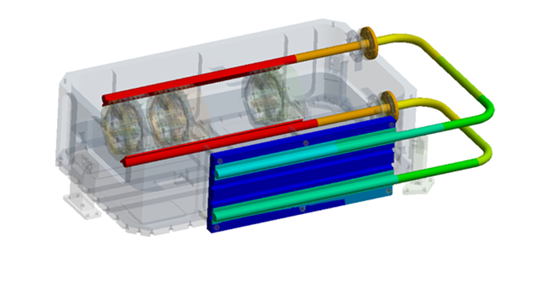
Design and Fabrication of a Breadboard, Fully Conductively Cooled,
2-Micron, Pulsed Laser for the 3-D Winds Decadal Survey Mission
PI: Upendra Singh, NASA LaRC
Design and fabricate a space-qualifiable, fully conductively-cooled, 2-micron pulsed laser breadboard meeting the projected 3-D Winds mission requirements
  Utilize improvements in key technologies including high-power, long-life space-proven 804 nm pump diodes; derated diode operation, and heat pipe conductive cooling
Perform a long-duration life test on the laser system to evaluate mission readiness.
2-Micron Space Qualifiable Pulsed Laser for 3-D Winds
  Leverage LaRC 2-micron laser development from earlier efforts
  Utilize Fibertek CALIPSO mission flight laser design and development knowledge
  Upgrade previous Fibertek two-micron laser design for flight-like laser based on space heritage
  Utilize space-ready, sealed cylindrical package
  Perform vacuum test while operating at the output requirements of the 3-D Winds mission
Complete laser mechanical design update 01/13
and improved laser thermal modeling
Assemble and test heat pipe cooled module 04/13
Fabricate and test ring laser with heat pipe 12/13
cooled module
Install and test amplifiers 03/14
Integrate with canister and test 04/14
Vacuum-test laser 10/14
Complete acceptance testing 07/15
Complete analysis and performance testing 12/15
Co-Is/Partners: Jirong Yu, Michael Kavaya, LaRC; Floyd Hovis, Tim Shuman, Fibertek, Inc.
TRL_{in} = 3 TRL_{out} = 5
04/12

Slide 25
ACT Program Summary
Technical Objective(s)–
  Deliver a ruggedized 2.053 µm MOPA laser with the following parameters:
    250 mJ pulse energy
    10 Hz repetition rate
    Beam quality (M² ) < 1.2
    >100 ns pulse width
    Conductively cooled via heat pipes
  Reach Technical Readiness Level (TRL) 5 by surviving a thermal-vac test.
Period of Performance – 38 months
Deliverable Items - 2 µm laser meeting the performance requirements after surviving a thermal vac test, monthly technical and financial reports, quarterly and yearly financial reports, thermal vac test definition and results report, oscillator test procedure and results report, final technical report
  2 µm laser transmitter meeting the performance requirements and surviving a thermal-vac test
  Thermal vac test procedure and results report
  Oscillator and amplifier performance report

Slide 26
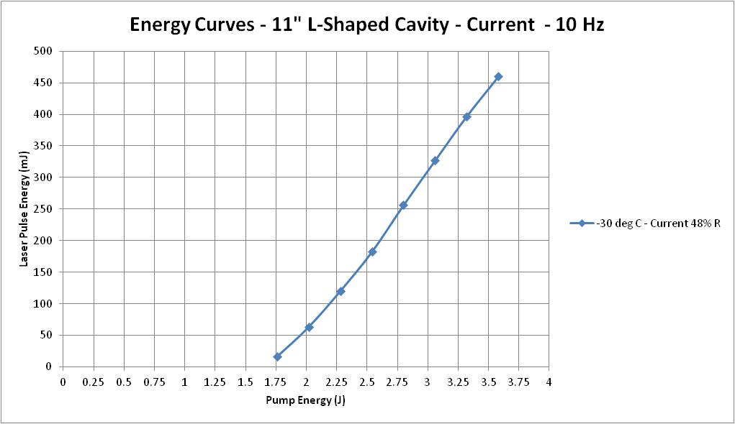
Linear Cavity Data
Now reaching energies
expected from a short cavity!

Slide 27
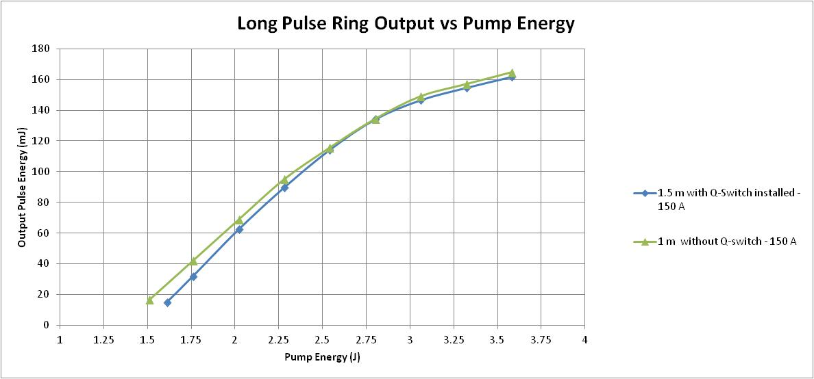
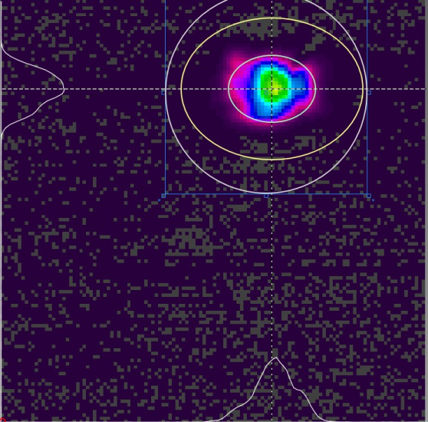
Current Ring Laser Results – Long Pulse
10 Hz, 150 A
Expect 80 mJ of Q-switched output for 3.6 J of pump energy
Phase II achieved 3X amplification – on track for 240 mJ
after amplifier pair
2.36 mm

Slide 28
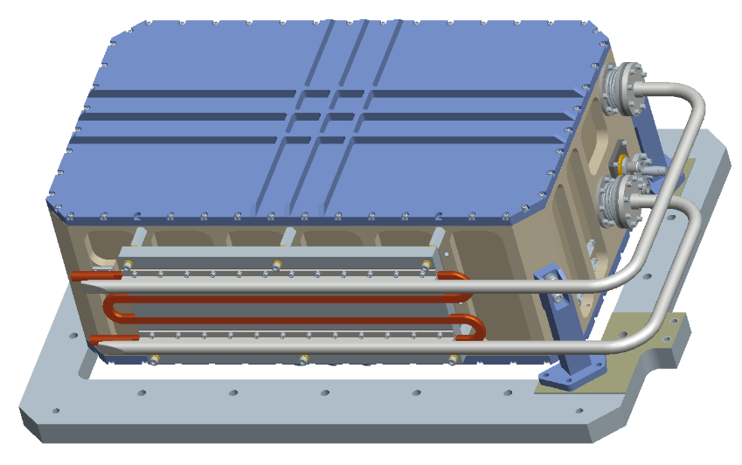
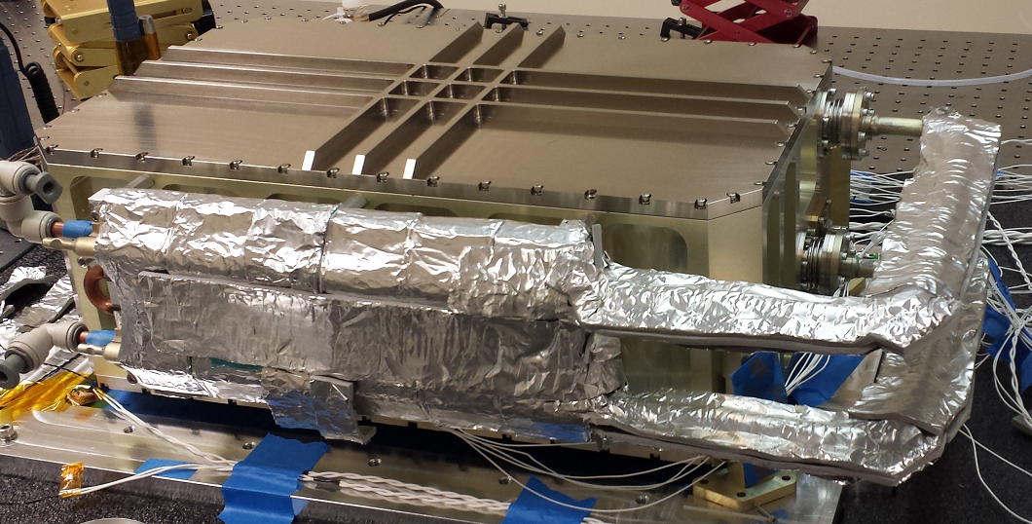
Conductively Cooled Laser Design
Box dims: 19”x11”x7.1” (LxWxH)
ICESat-2: 16”x11”x4.4” (LxWxH)
Mounting feet for illustration only
Housing itself: 19”L x 11”W x 6.1”H
Complete assembly : 23.9”L x 14”W x 7.7”H

Slide 29

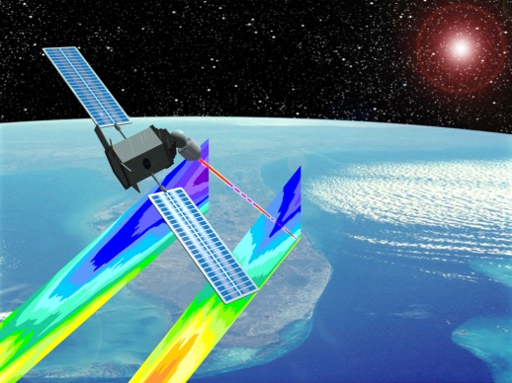
Summary and Conclusions
Past
525 km
12 cross-track positions
1 shot measurement
Continuously rotating 1.5-m telescope
Single coherent Doppler lidar
Gas laser*
20 mJ 2-µm solid state energy*
Space required energy = 20 J*
Energy deficit = 1,000*
2-µm lidar not aircraft validated*
Today
400 km
2 cross-track positions
Multiple shot accumulation
4 stationary 0.5-m telescopes
Dual coherent & direct “hybrid” Doppler lidar
Solid-state eyesafe laser*
1200 mJ 2-µm solid state energy*
Space required energy = 0.25 J*
Energy surplus = 5*
2-µm lidar is aircraft validated*
*coherent

Slide 30
Questions?

