Slide 1

Progress on whole atmosphere lidar
John Smith
Research Associate, CIRES
April 28th, 2015
Working Group on Space-based Lidar Winds

Slide 2
Whole atmosphere lidar concept, Fe-Doppler system
from Chu et al, Proc. of 24th ILRC, 2008

Slide 3
Measurement capability
Temperature only
Rayleigh technique
Temperature and wind
Fe Doppler technique
Routine
Sporadic
Wind
Rayleigh Doppler technique
Future capability

Slide 4
Comparing Na and Fe Doppler lidars for whole atmosphere wind and temperature profiling
 | Na Doppler (589 nm) | Fe Doppler (372 nm)
Typical transmitter power | 0.5 W | >4 W
Terrestrial Rayleigh volume backscatter coefficient | 1.19∙10⁻⁶ 1/km/sr | 7.90∙10⁻⁶ 1/km/sr
Max. output current for available high QE PMT | 2 μA (GaAsP) | 100 μA (UBA)
Ratio of stimulated emission timescale to natural lifetime (τ_{S}/τ_{N}) | 40 | 221
Optical pumping effects | Yes | No
8x
6x

Slide 5
Mach-Zehnder approach
XMZ technique:
Measurement is independent of source spectrum and instrument defects

Slide 6
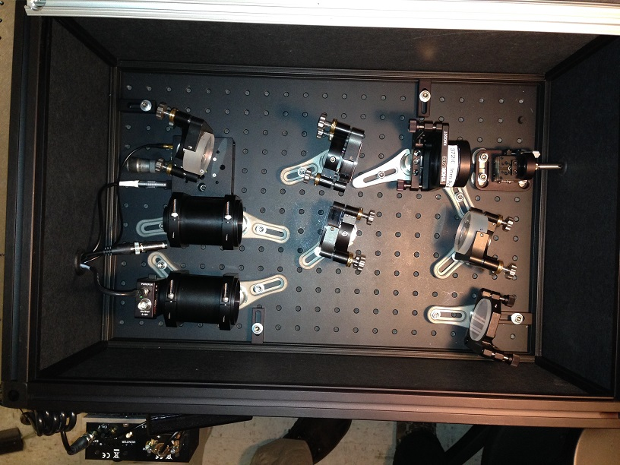
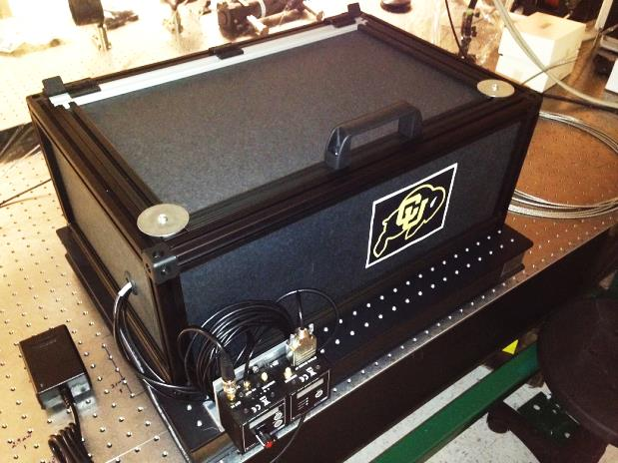
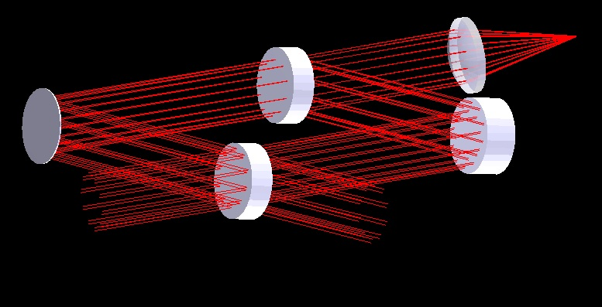
Progress on instrumentation
$30k budget

Slide 7
Instrument tests
Source fiber core (filled) diameter 1000 μm, NA 0.22

Slide 8
Expected performance
XMZ
technique
Fe Doppler
technique

Slide 9
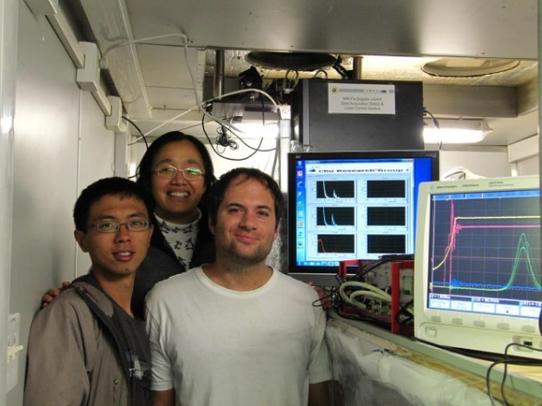
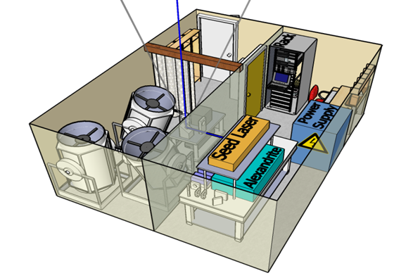
Fe Doppler status
First light attained on Sept. 7, 2014
Wavelength stabilization accomplished using high precision wavemeter in the field
Optical heterodyne detection of UV reference pulse obtained in the lab
Wavelength stabilization to Fe fine structure achieved in the lab

Slide 10
Conclusions
Fe is competitive with Na in wind and temperature of the mesopause region and far superior below the metal layer
The Mach-Zehnder technique preserves all signal and allows profiling of wind at the same time as wind and temperature in the mesopause
Ratios of colors/frequencies and channels can be solved for the Doppler shift independent of variations in backscatter spectrum and instrument defects
Good fringe contrast has been demonstrated for a source representative of the real optical extent
Progress is being made on the base Fe Doppler lidar, first measurements expected by July

