Slide 1
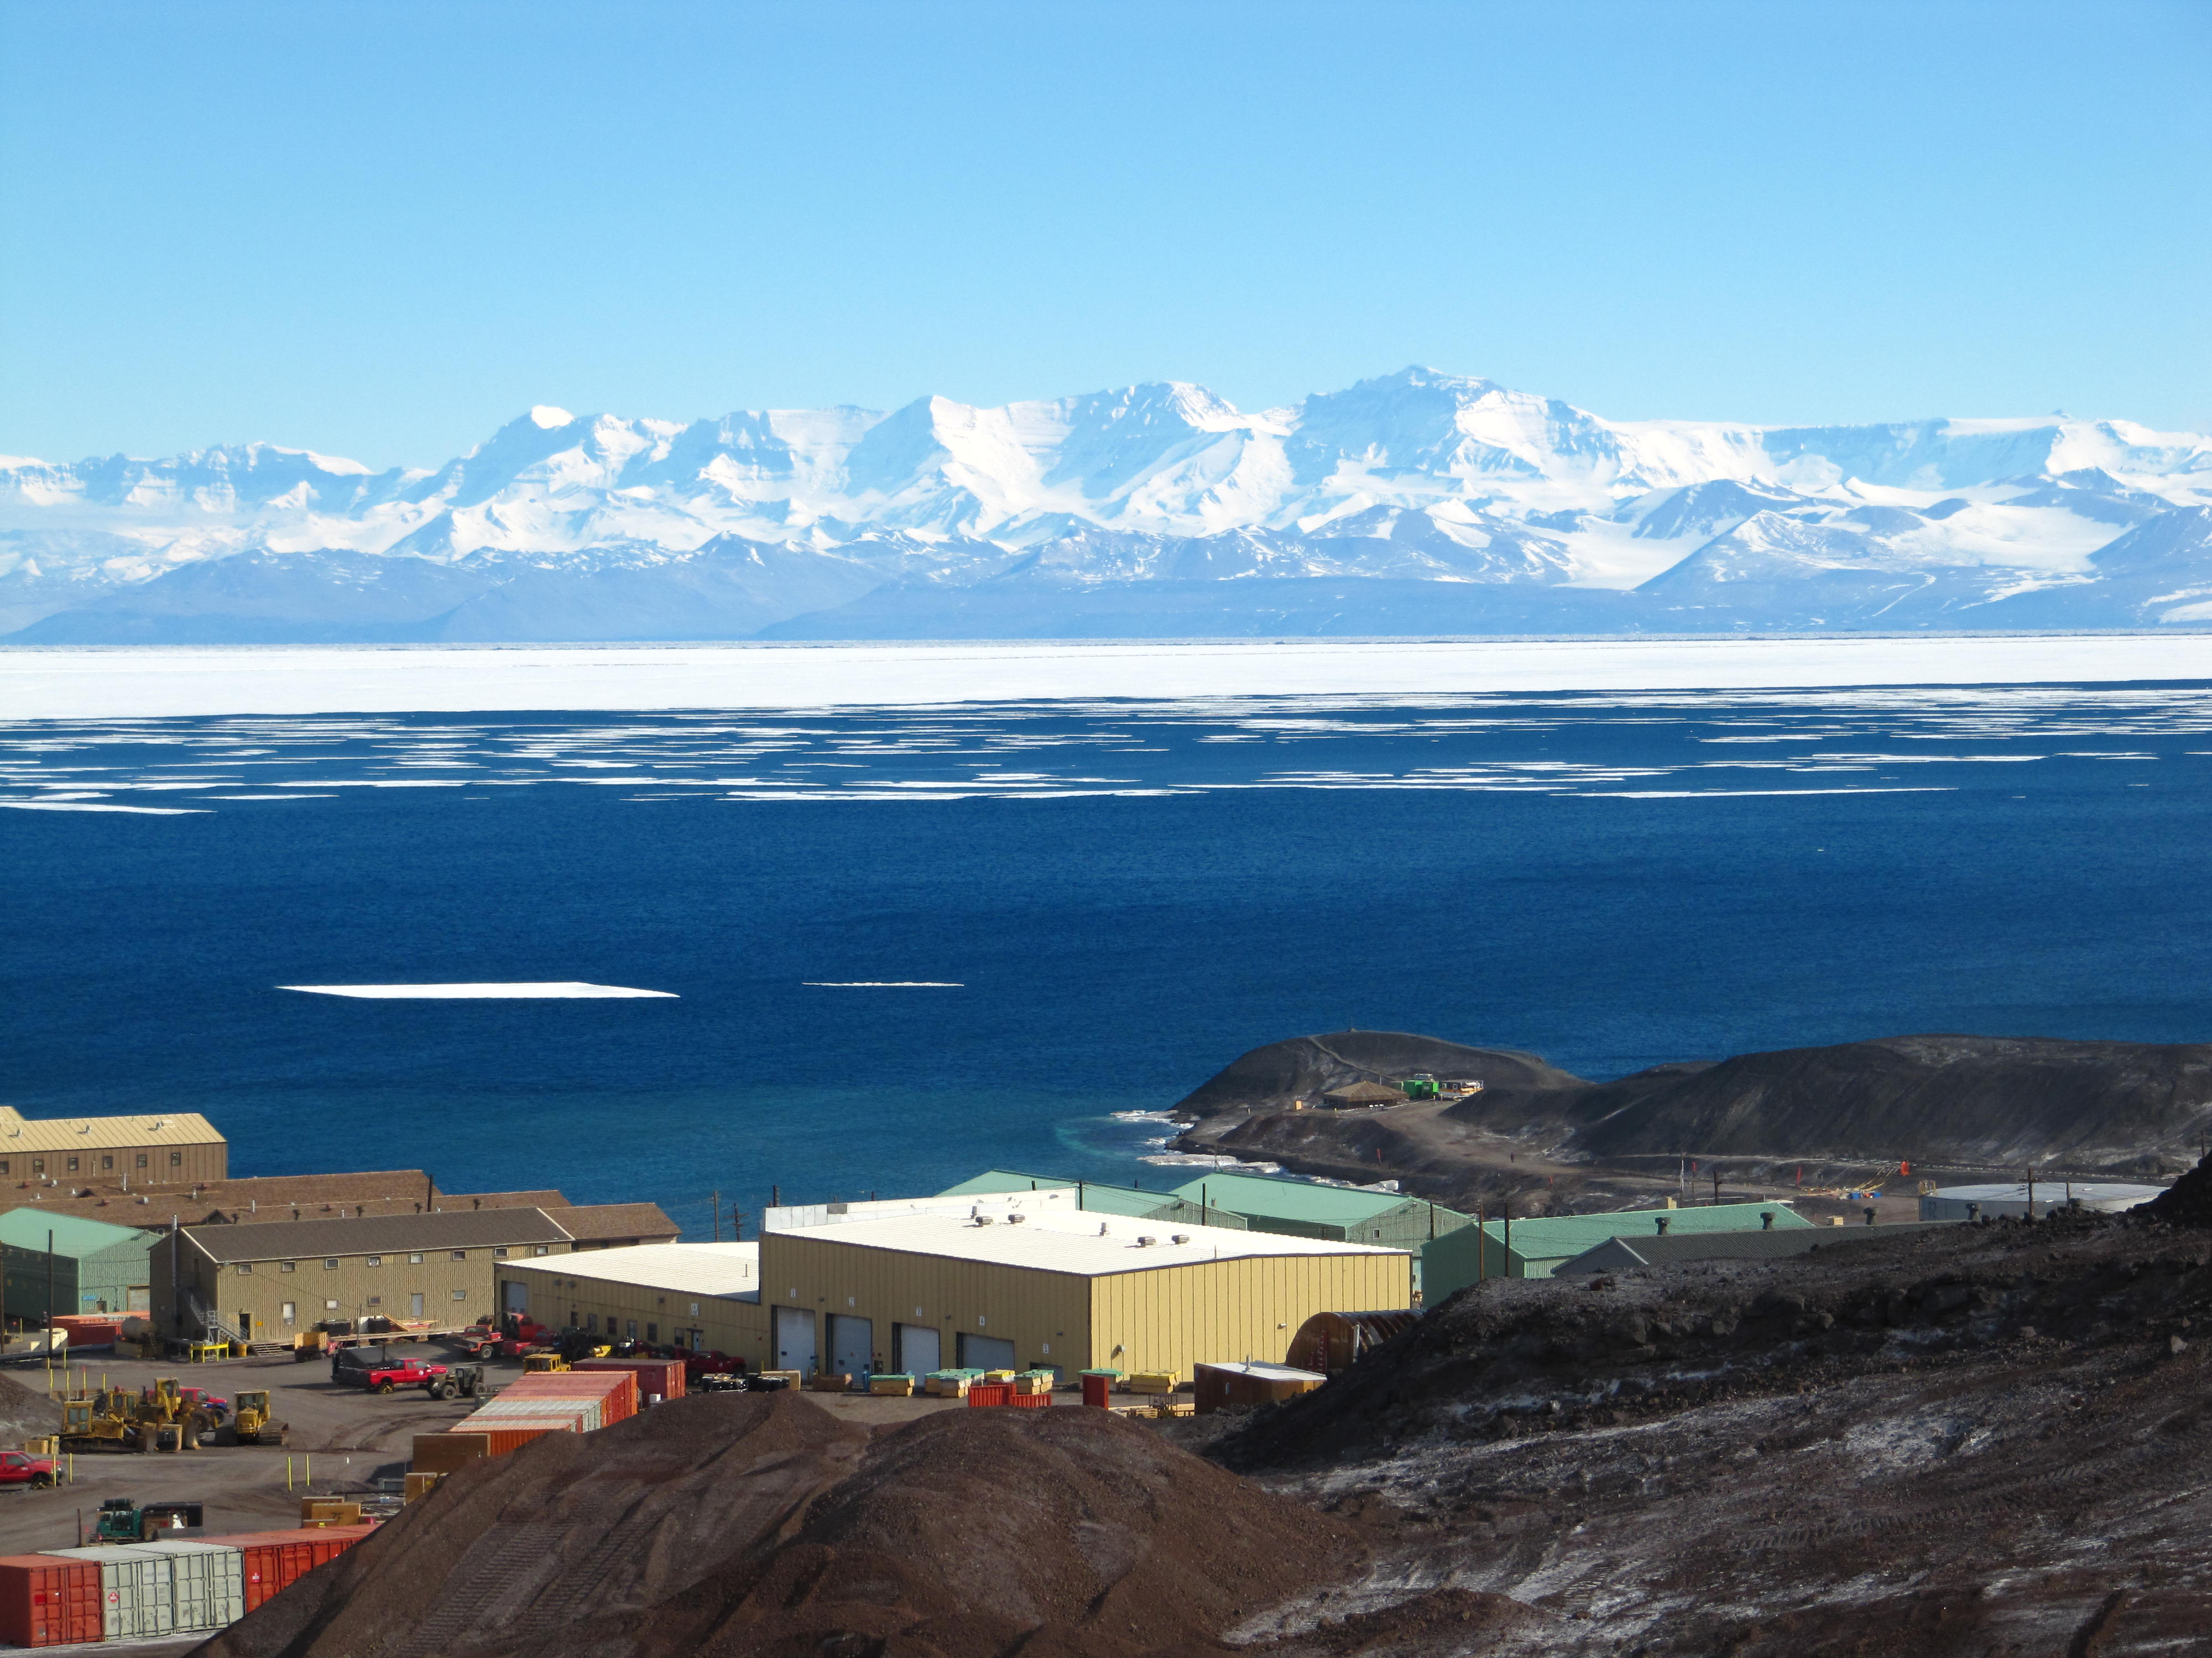
Lidar Wind Measurements in the Mesosphere and Thermosphere
Xinzhao Chu, John Smith, Weichun Fong, Xian Lu, and Wentao Huang
University of Colorado Boulder
Wind Lidar Workshop, Boulder, April 28, 2015
Notes:
This work is to study plasma-neutral coupling in Antarctica from 90-200 km altitude using lidar observations and numerical simulations. I’d like to acknowledge all coauthors for their contributions, especially my students and colleagues who wintered over McMurdo to take lidar data – Zhibin Yu, Weichun Fong, Cao Chen, Brendan Roberts, Jian Zhao, and Wentao Huang.

Slide 2
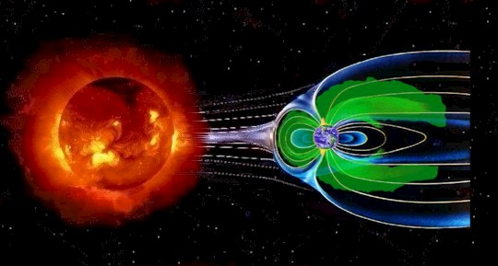
Earth Habitable throughout ~3.5 By
Early life forms began to modify the composition and chemistry of the oceans and atmosphere. Occurrence of life capable of photosynthesis dramatically increased the atmosphere concentration of O₂ while reducing CO₂ levels. Throughout the long 3.5 By period, during which Earth has harbored life, the Sun’s luminosity increased by more than 20%.
In spite of this large change in solar radiation and significant modification of the atmosphere by life itself, Earth has remained habitable because of the effects of a set of key universal processes that govern the evolution of planetary atmosphere everywhere.
For example, the Earth’s magnetic field shields our atmosphere from the energetic particles in the solar wind that are partially responsible for stripping Mars of its primordial atmosphere.
The Earth’s carbonate-silicate cycle provides a feedback mechanism that controls atmosphere CO₂ level and climate over long time scales, preventing the runaway greenhouse effect that is responsible for the high temperatures on Venus today.
[OASIS Report, 2014]

Slide 3
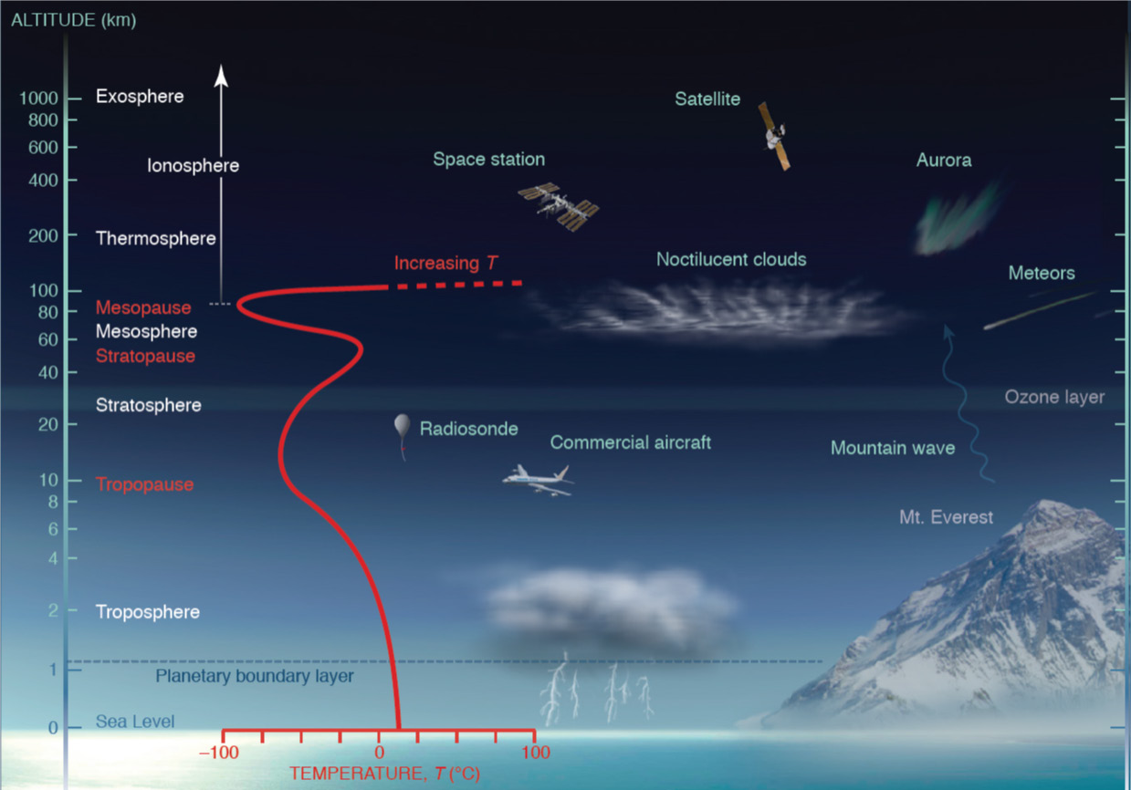
Space-Atmosphere Interaction Region
Many coupled feedback processes are at play in a planetary atmosphere system. But many are unknown and cannot be addressed without a complete description of the atmosphere, from its lower interaction with land and oceans to its upper interaction with space.
The natural upward extension of a planet’s atmosphere ultimately leads to its interaction with space, where atmospheric neutral gasses entwine with the dynamic plasma of space. This space-atmosphere-interaction region (SAIR) is common to all planetary systems, yet its properties, and the processes that govern them, are not sufficiently described to fully understand its role in an atmosphere’s development and evolution. However, the SAIR is known to be essential for sustaining life on Earth by absorbing extreme solar radiation, ablating meteoric material, regulating gaseous escape, dissipating energetic particles and fields from space, while balancing influences from the planet itself in the form of wave energy and momentum originating from the lower atmosphere.
Notes:
Unfortunately, there is no set of observations that adequately captures these properties nor are there numerical models that can adequately predict upper atmosphere behavior and how it influences weather and climate on the surface.
the OASIS overarching goal – to substantially advance our understanding of the fundamental, universal processes that occur in the Earth’s space-atmosphere-interaction region (~50 km and above) and how they shape the atmospheres of Earth-like planets throughout our galaxy.

Slide 4

Quest for Exoplanets -- Signatures
Three basic questions that have commanded the attention of atmosphere and space scientists for generations:
1. What are the fundamental processes that shape the Earth’s upper atmosphere and govern its evolution?
2. How do these processes affect weather and climate?
3. What roles do they play on other planets?
These questions are especially relevant today as rising concentrations of greenhouse gases are changing Earth’s climate and increasing numbers of extra-solar planets (exoplanets) are being discovered in our galaxy.
To advance our understanding of the fundamental universal processes in the Earth’s SAIR and how they shape the atmosphere of Earth-like planets throughout our galaxy with Whole Atmosphere Lidar!

Slide 5
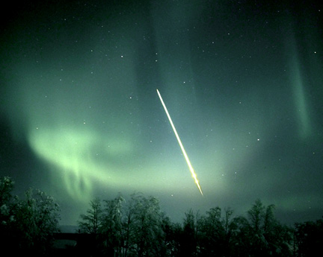
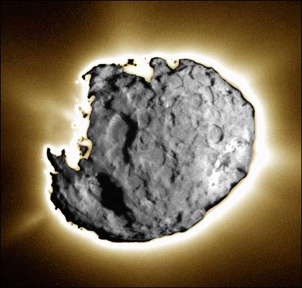
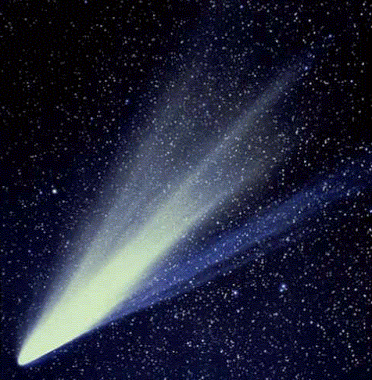
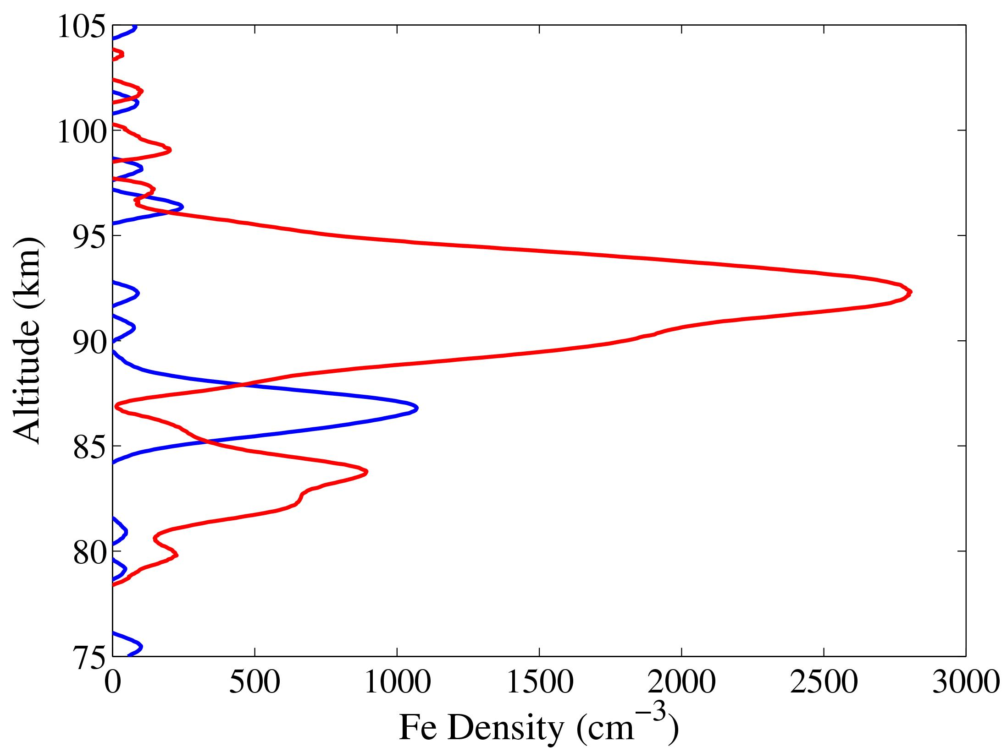
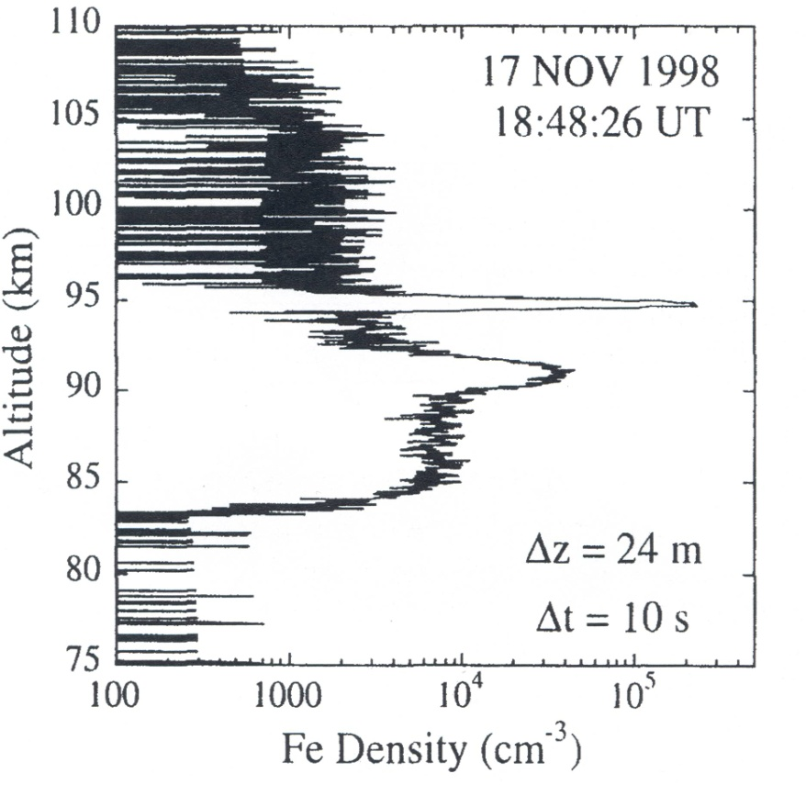
Cosmic Dust as Lidar Tracers
South Pole
Fe
PMC
[Plane, Murray, Chu, and Gardner, Science, 304, 426-428, 2004]
Profile on an Fe meteor trail measured by lidar [Chu et al., GRL, 2000b]
Notes:
Why doing McMurdo campaign? From 1999 to 2005 we made lidar observations at the South Pole and Rothera stations. Many science discoveries were resulted from these campaigns. However, a critical data gap existed between the Pole and the Antarctic Circle. The McMurdo lidar campaign was proposed to fill this gap. We aim to measure Fe layers, PMC, temperatures and study wave dynamics.
-- The unique location of McMurdo (high geographic and magnetic latitudes 78S and 80S) provides excellent opportunities to study how neutral and ionized Fe are connected, and how geomagnetic activities influence upper atmosphere.

Slide 6
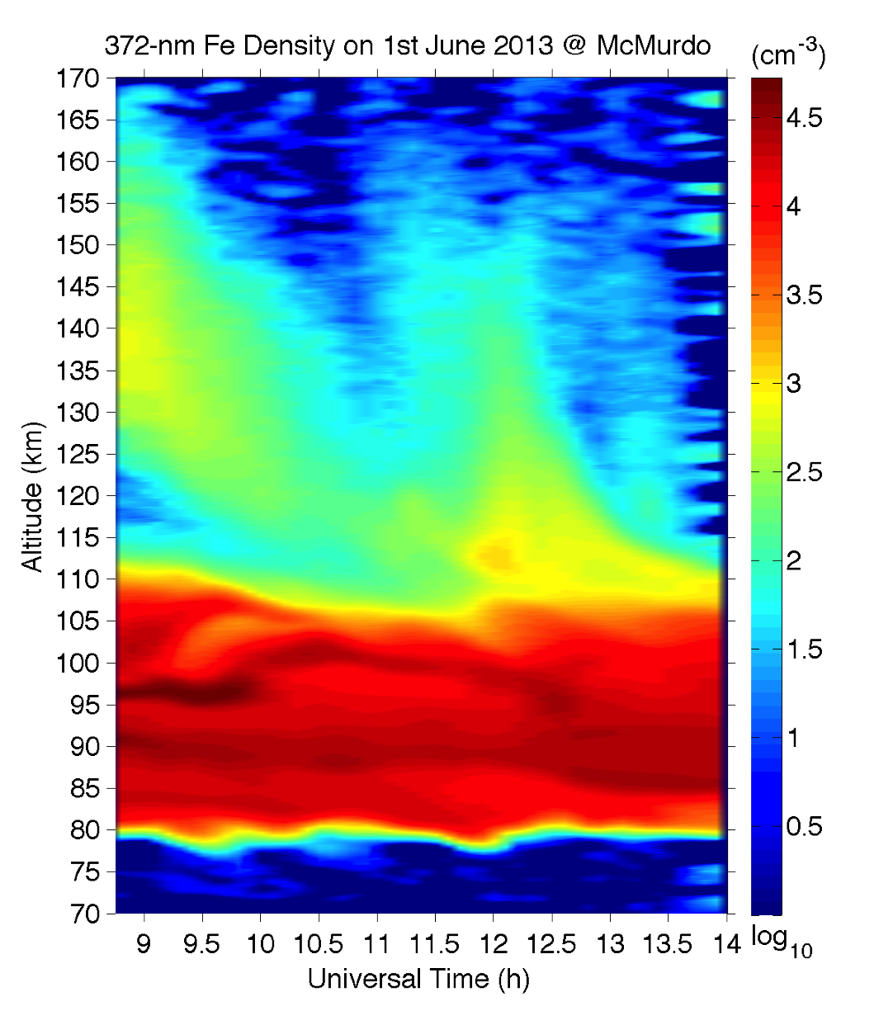
Thermospheric Fe Layers up to ~200 km
Fe layers up to 170 km by lidar at McMurdo on 1st June 2013 [Chu et al., CEDAR, 2013]
McMurdo lidar observations have led to the discoveries of neutral Fe (iron) layers in the thermosphere of 100-200 km altitude range.
Such discoveries enable the direct measurements of neutral properties (e.g., neutral winds and temperatures) with ground-based instruments.
Notes:
Excellent tracer for measurements of neutral properties!

Slide 7
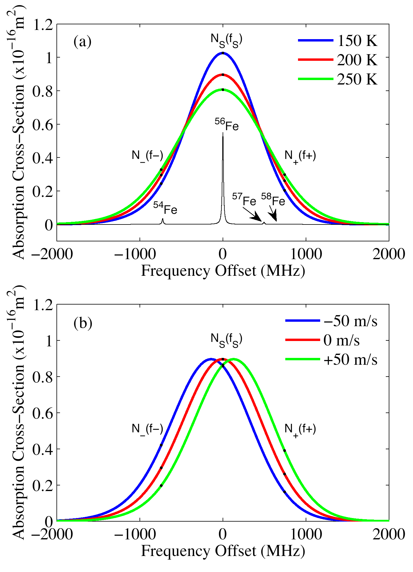
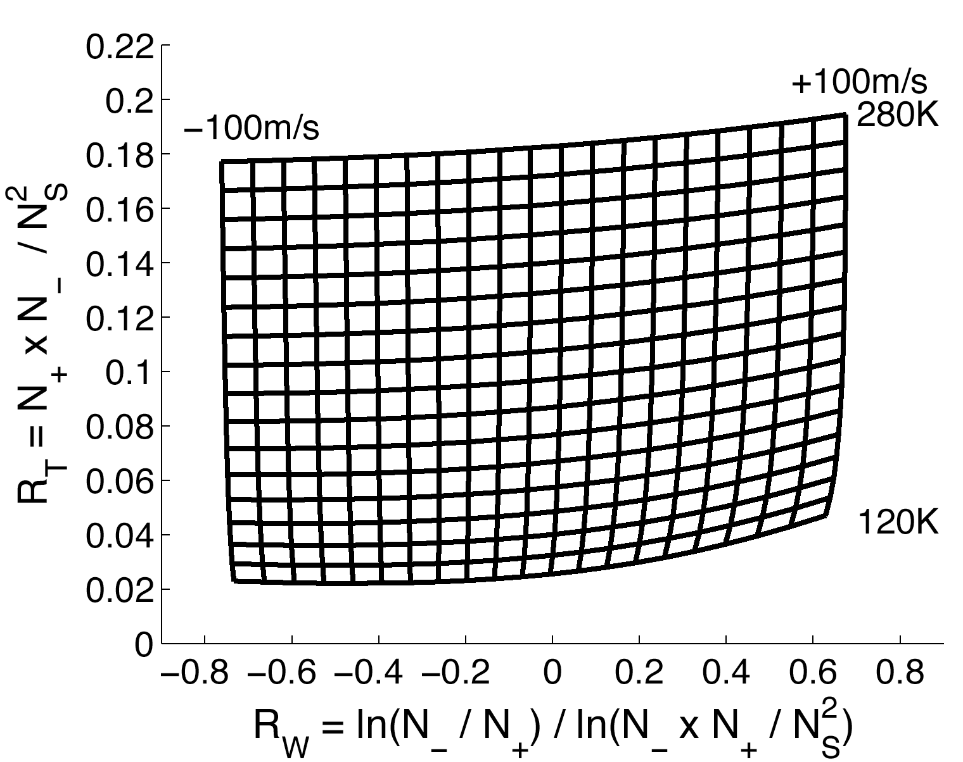
MRI Fe/Rayleigh/Mie Doppler Lidar
Fe (iron)
Notes:
The Fe absorption line is Doppler shifted by LOS wind, and Doppler broadened due to the random thermal motions of Fe atoms. Thus, tuning a narrowband transmitter frequency through the absorption line to measure the shift and broadening, we can derive the LOS wind and temperature simultaneously.
To achieve the highest resolution, we choose the proven 3-freq ratio technique as the nominal operation mode. Ratio R_T is a sensitive function of temperature, while R_W is sensitive to LOS wind. By taking these two ratios from three freq channels, we can infer the wind and temp from the calibration curve that is computed from quantum physics and spectroscopy.

Slide 8
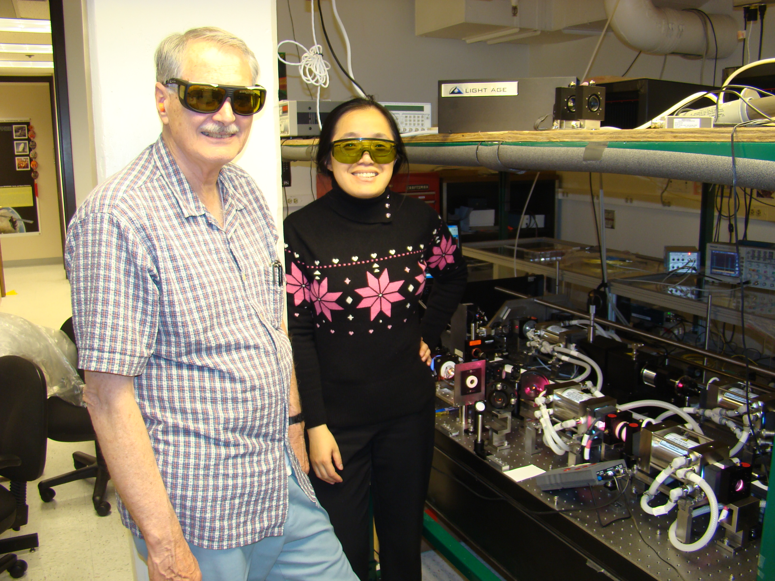
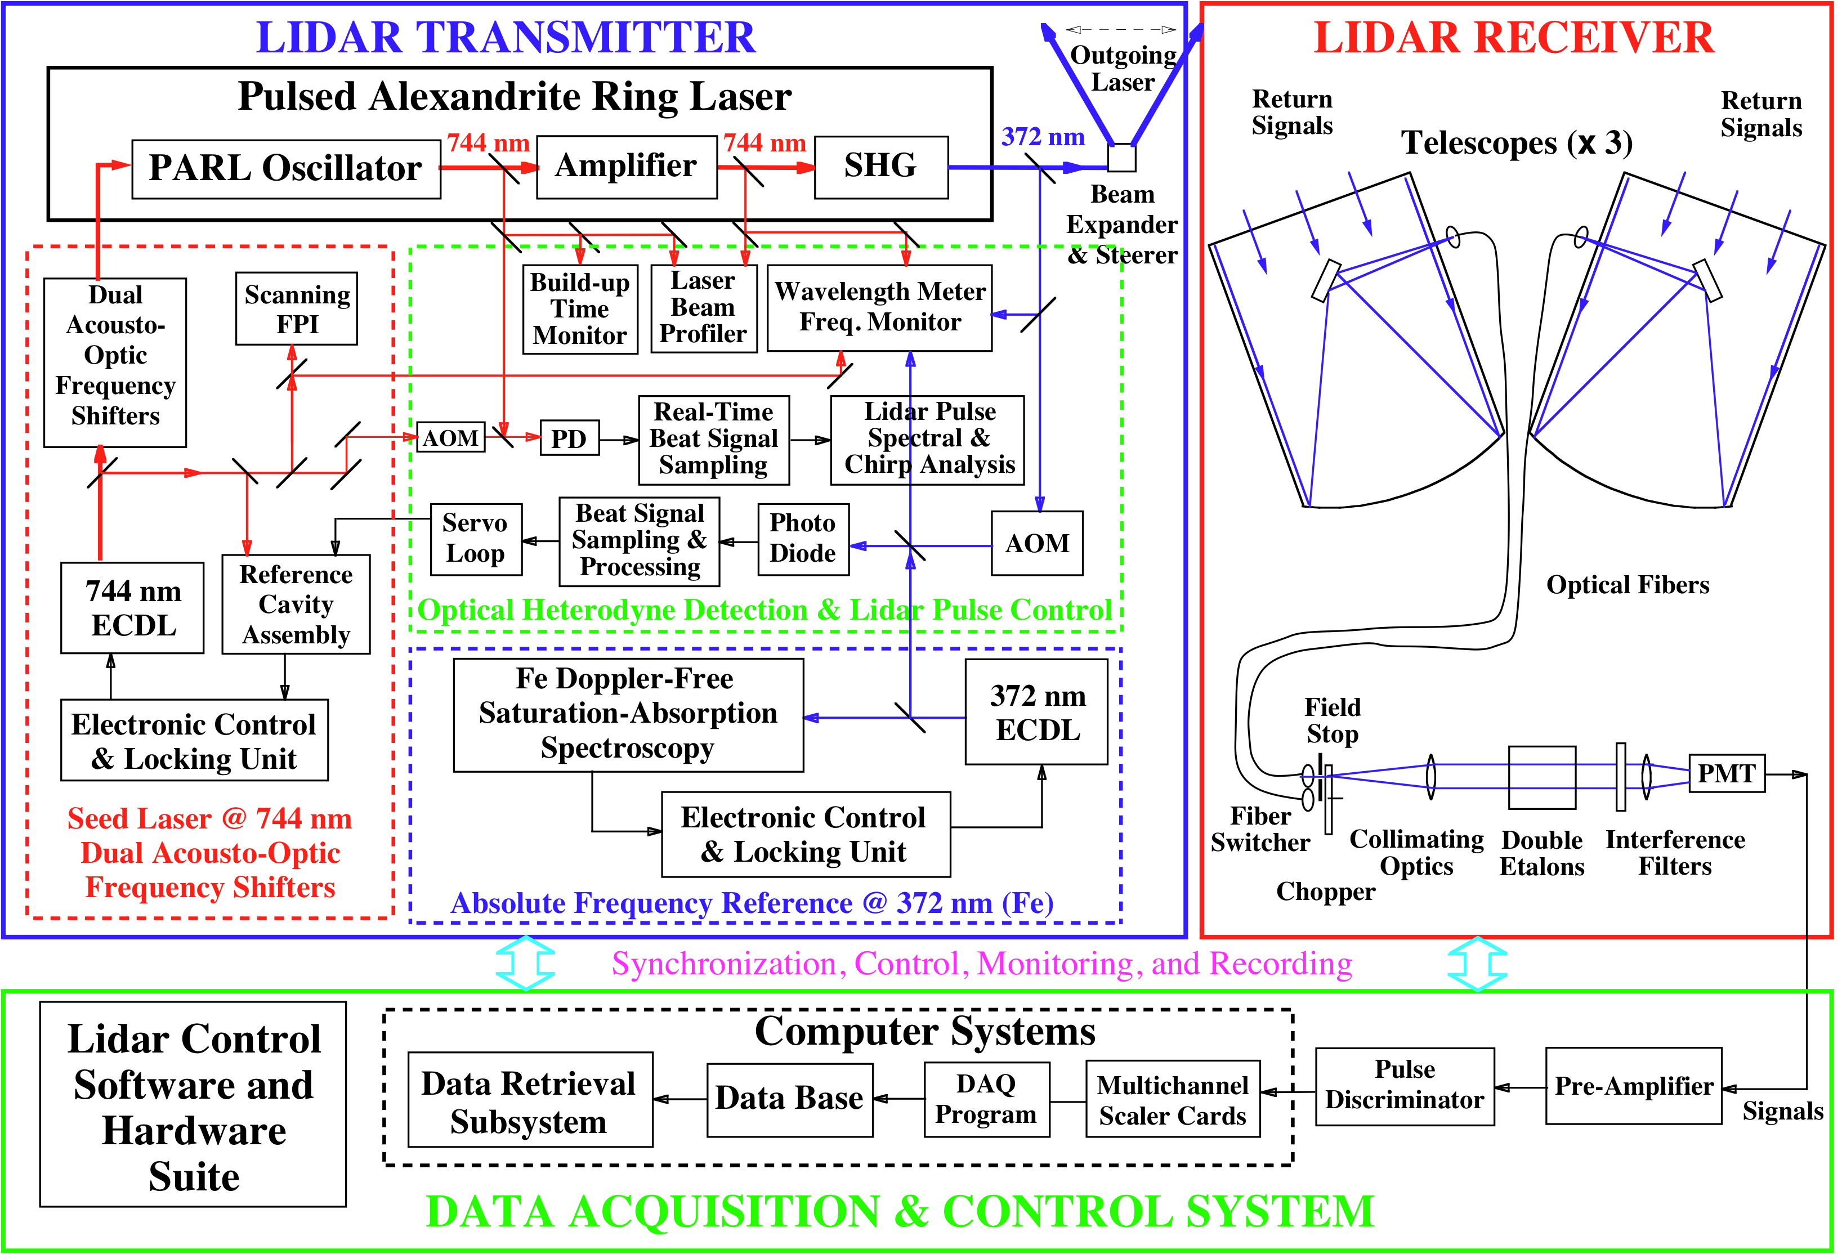
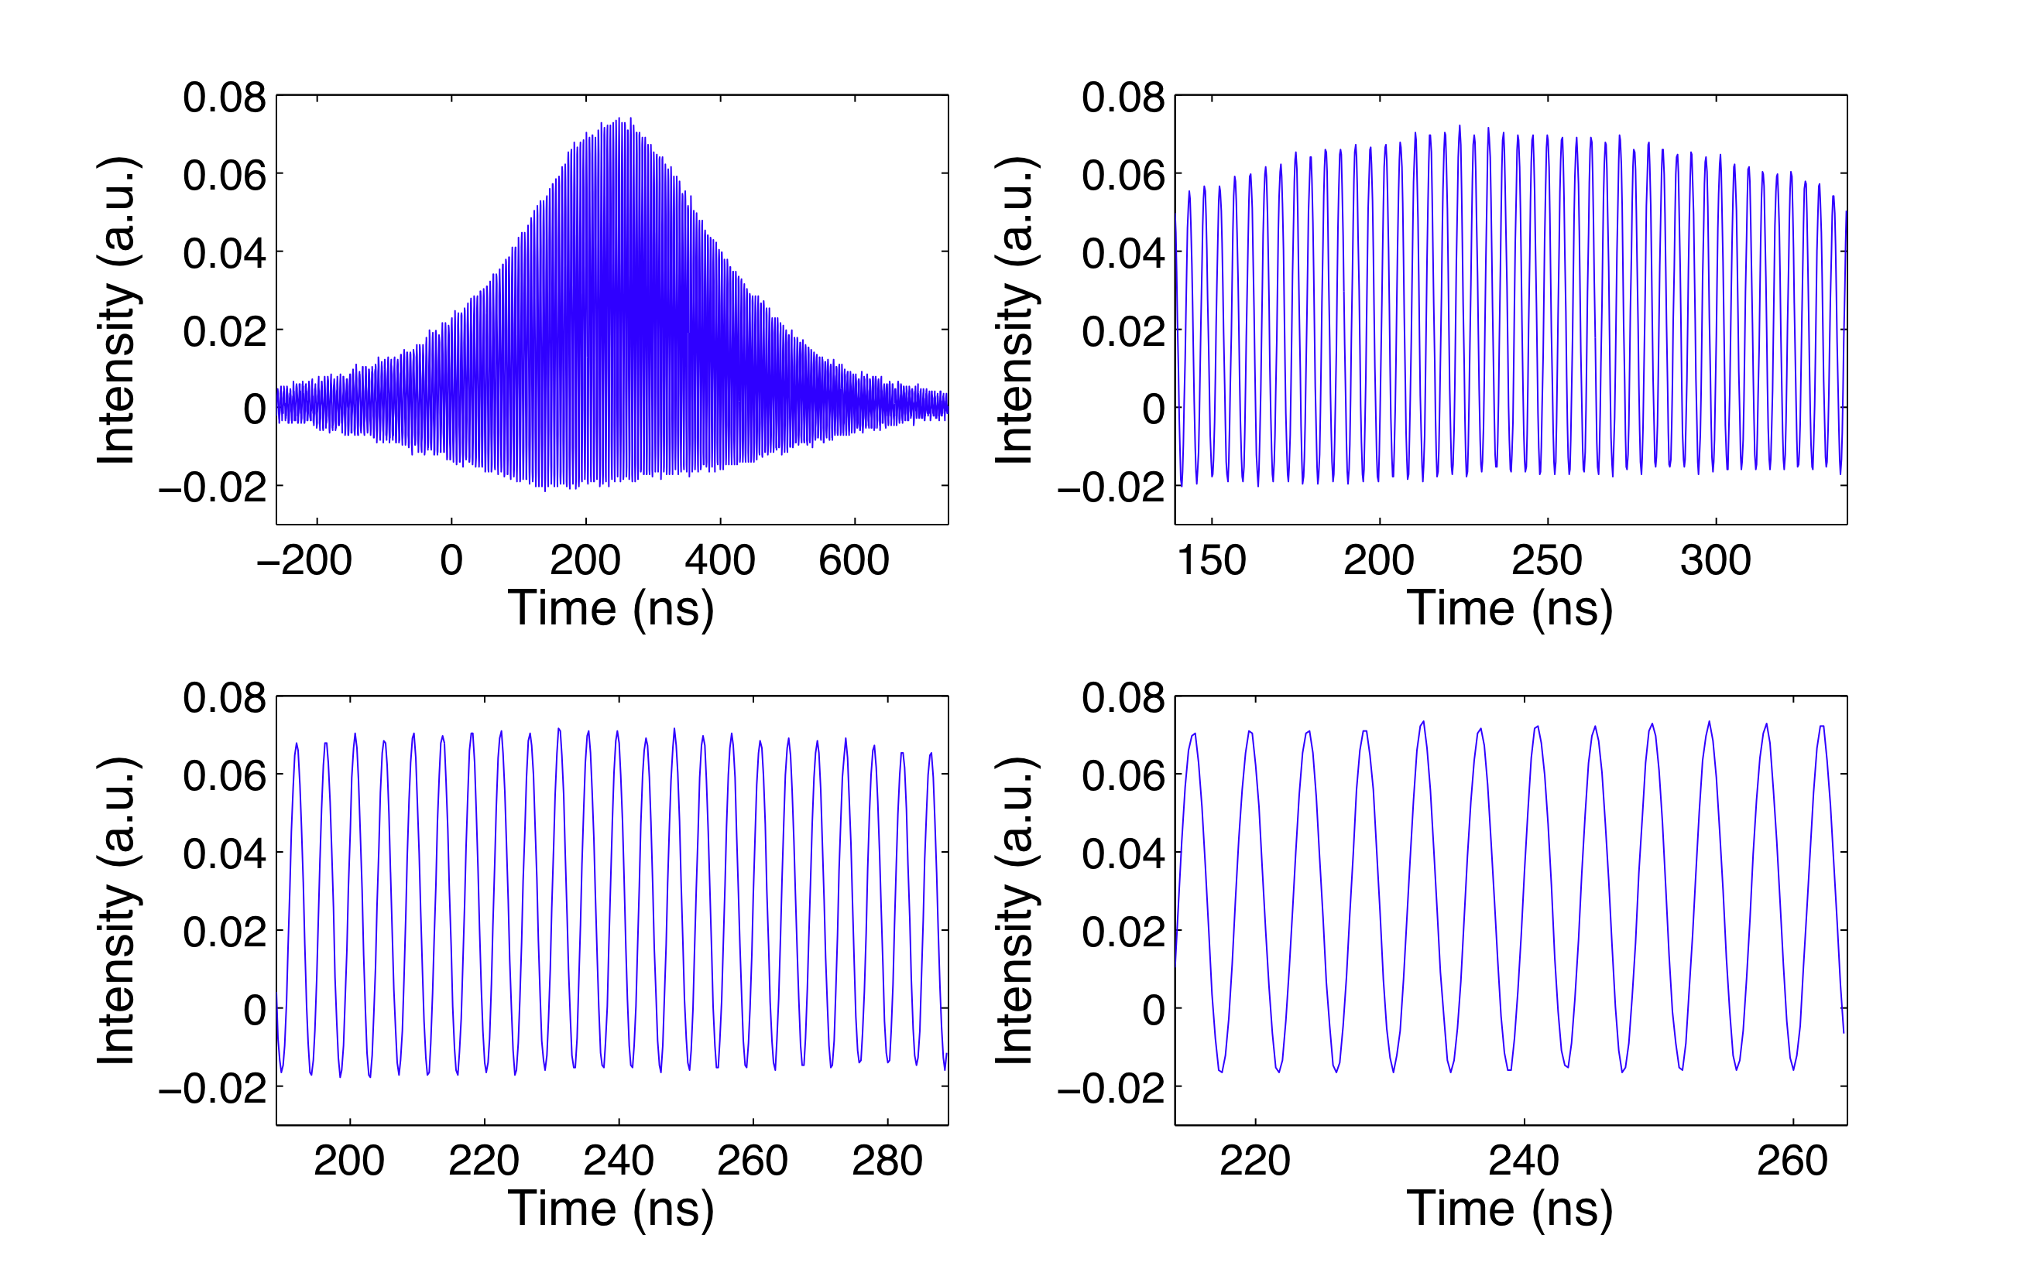
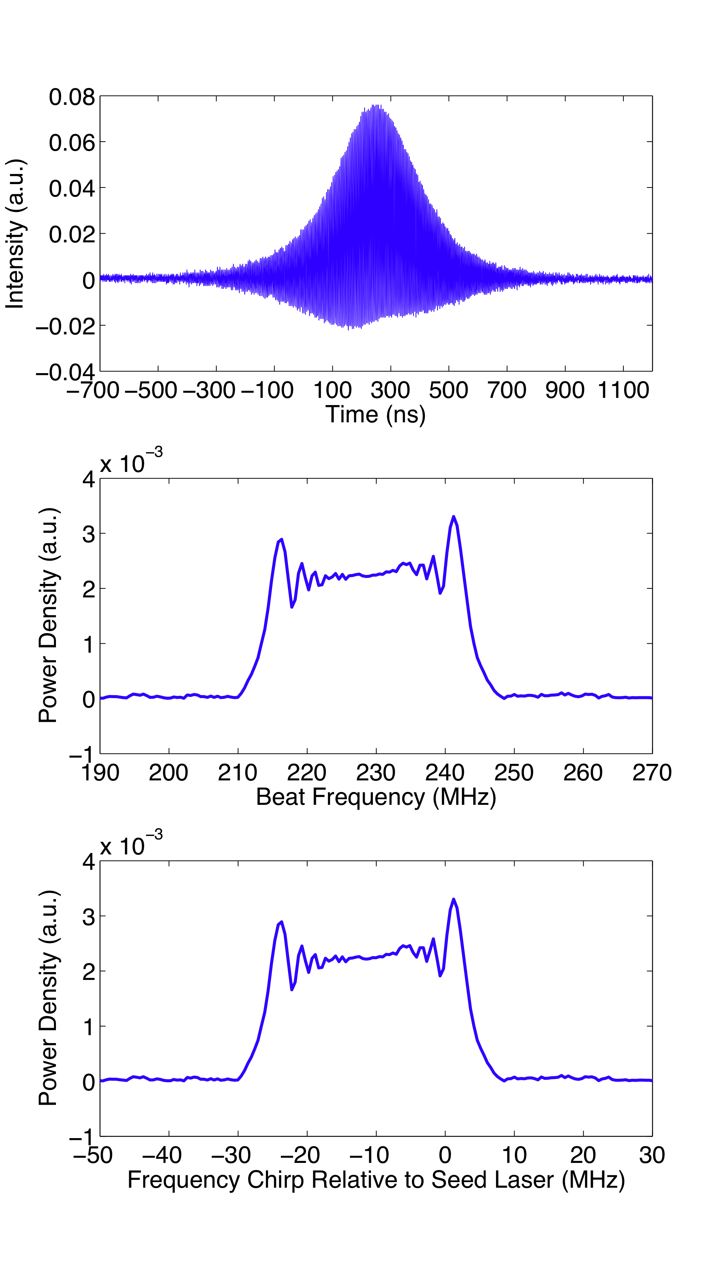
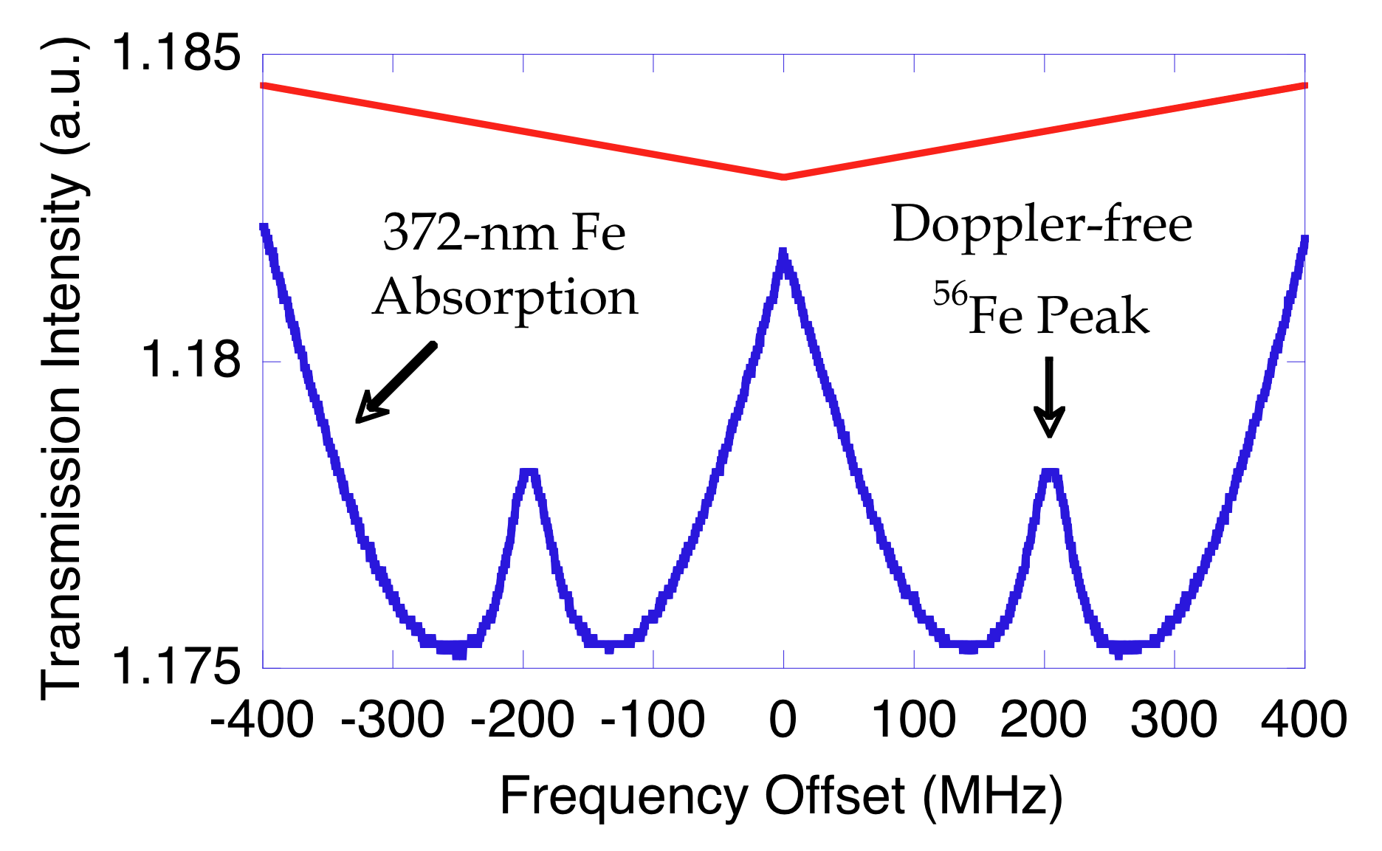
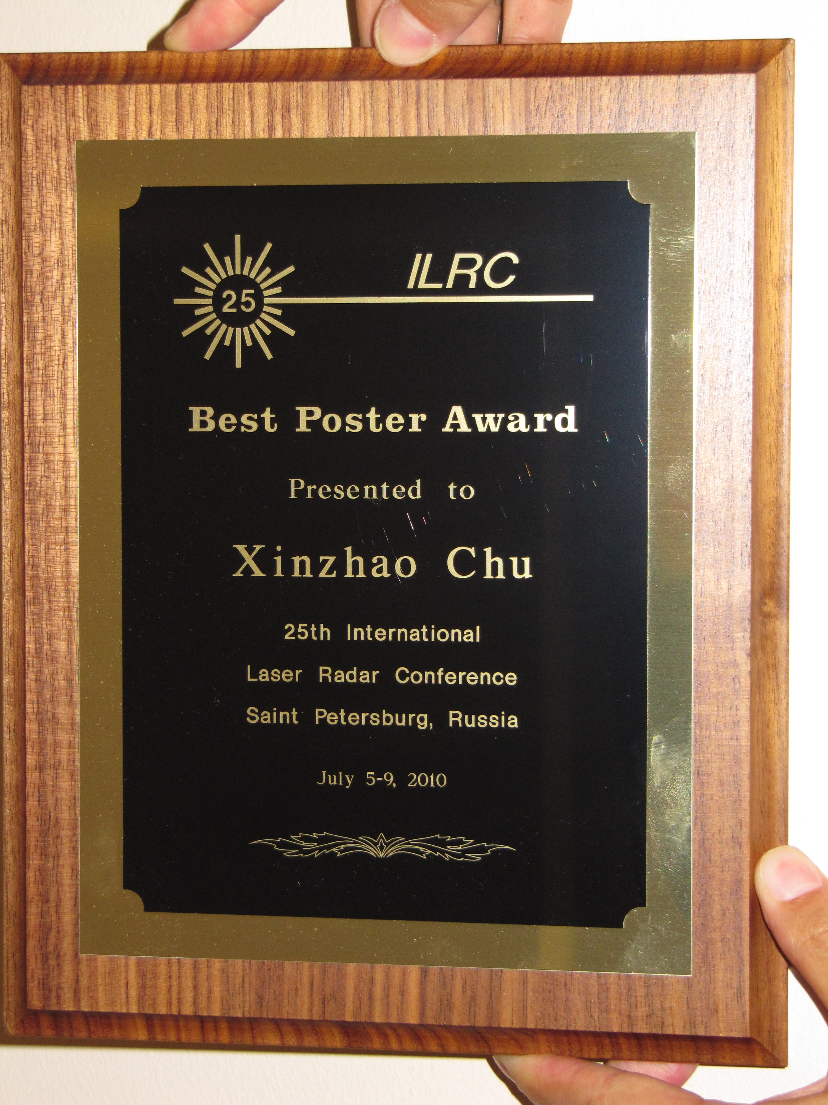
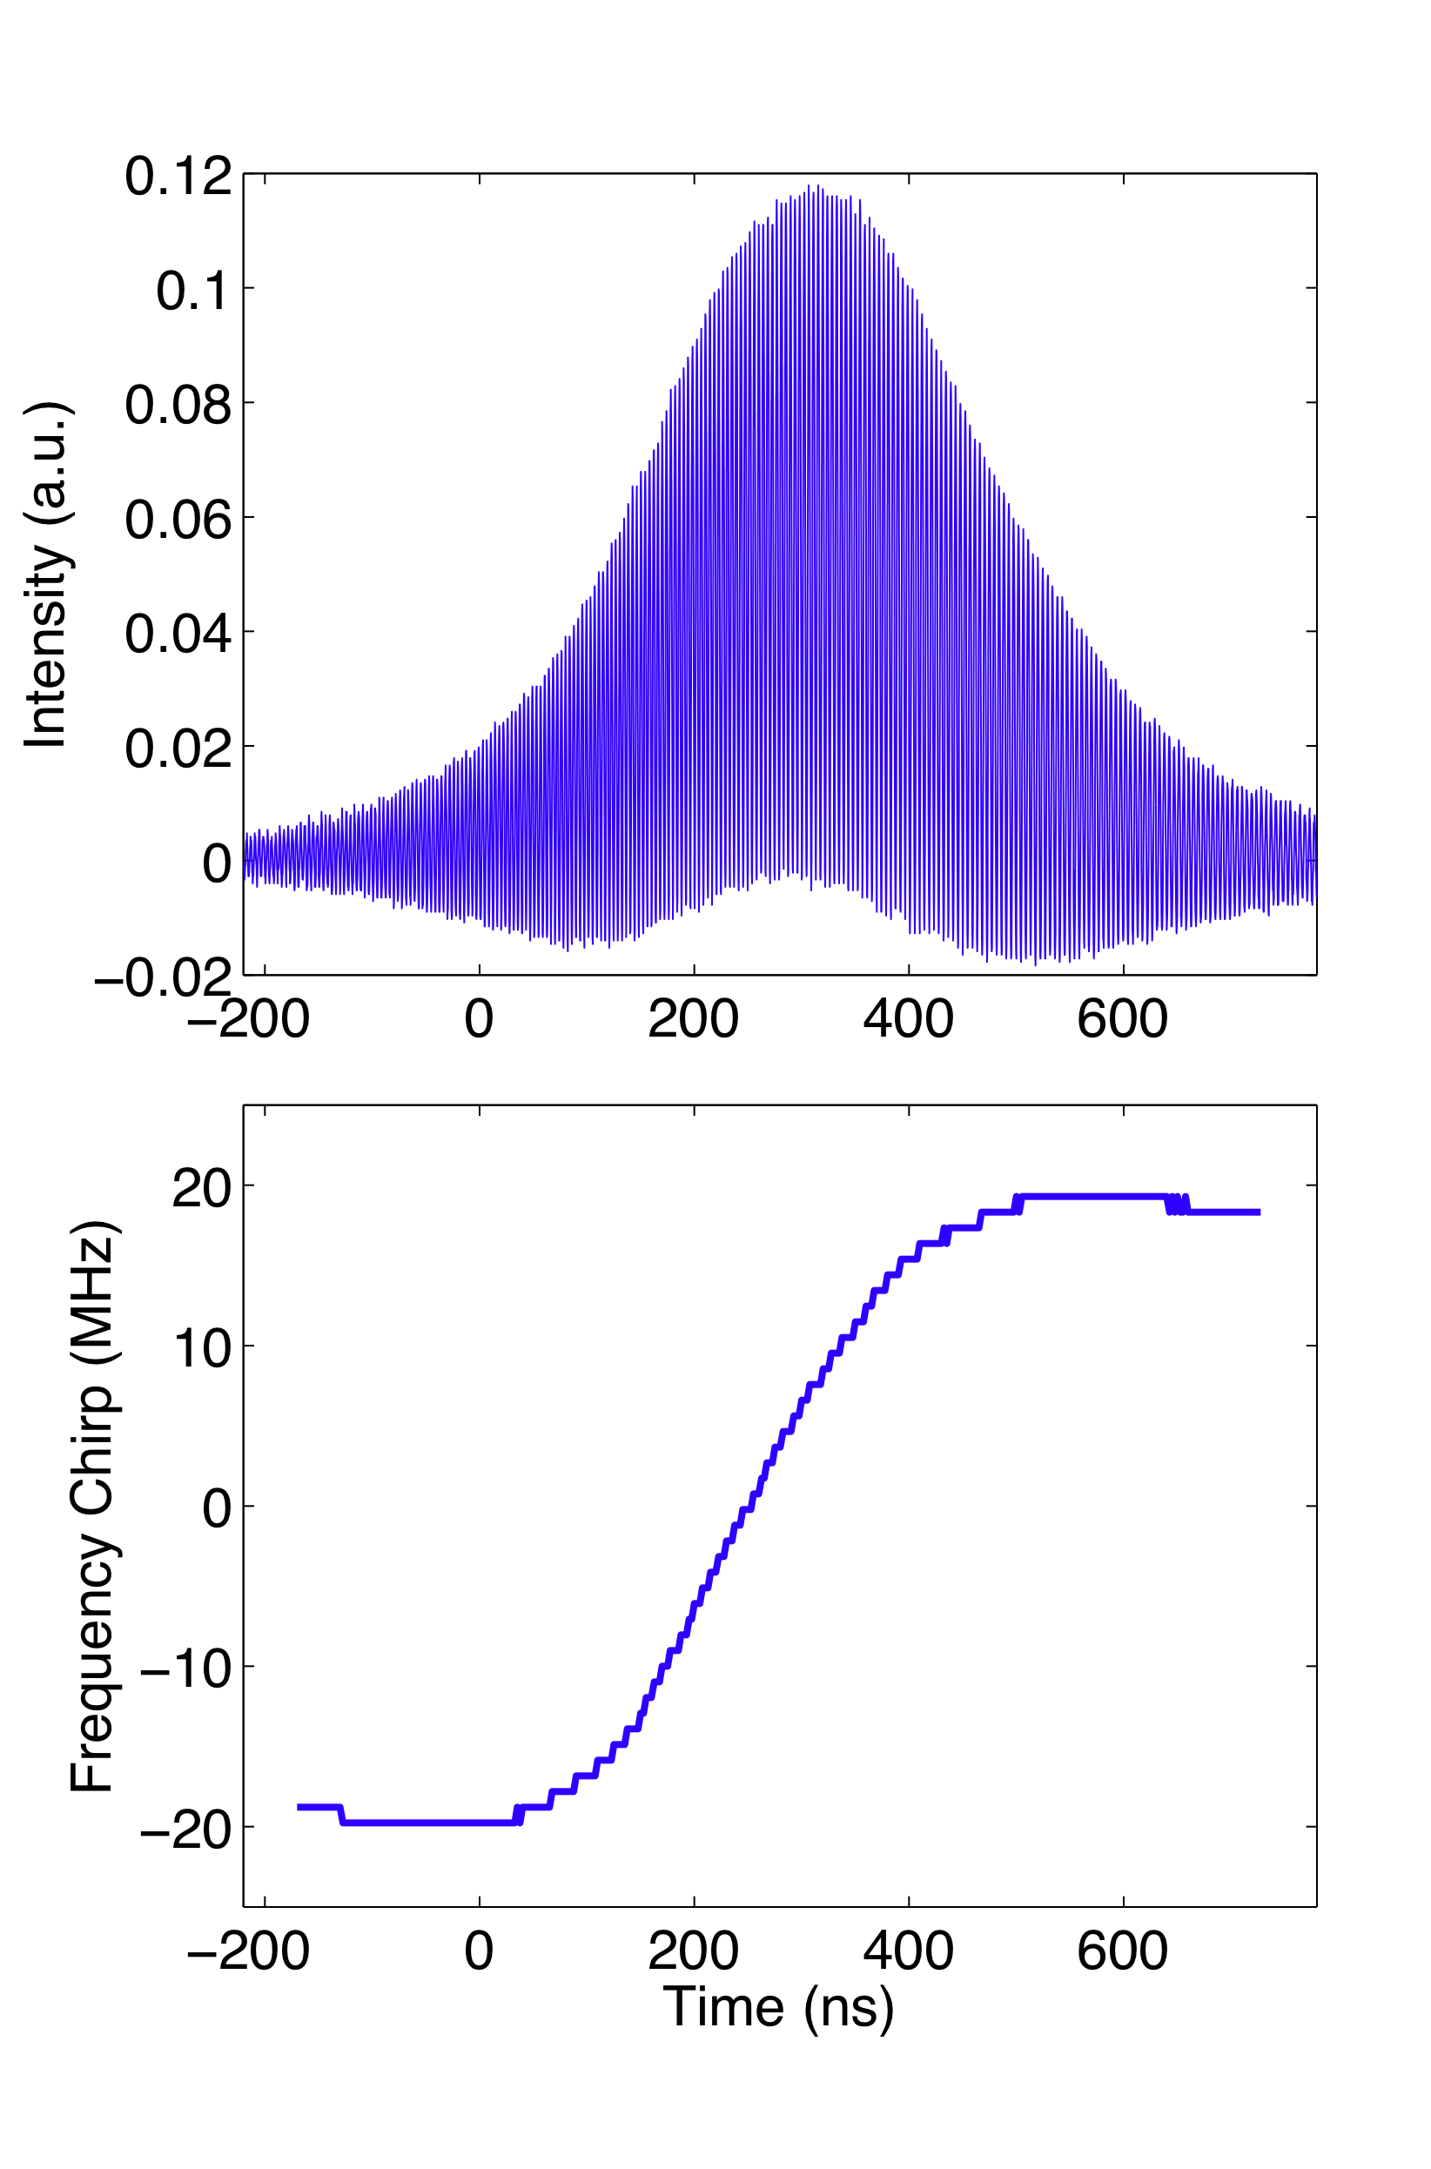
Lidar Technology Breakthroughs
MRI Fe-Resonance/Rayleigh/Mie Doppler Lidar
Fe Doppler-free Spectroscopy
Optical Heterodyne Detection
Pulsed Alexandrite Ring Laser
Bias-free Fe Doppler Lidar
[Chu and Huang, 2010; Chu et al., 2010]

Slide 9
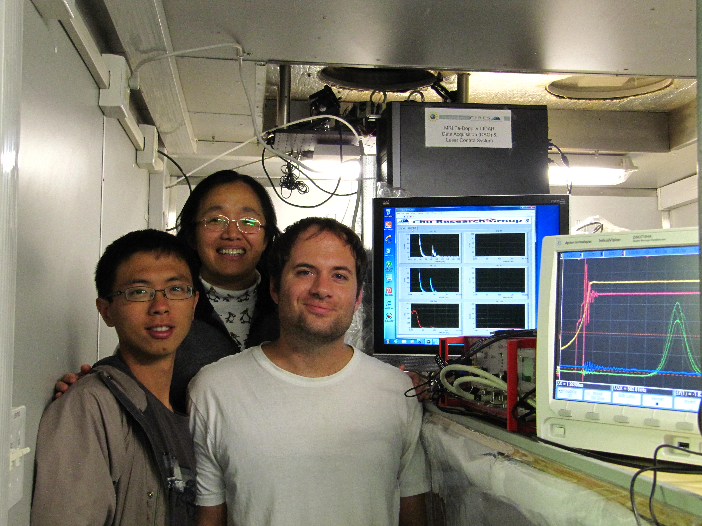
First Light of MRI Fe Doppler Lidar from Boulder
The MRI Fe Doppler lidar forms the basis for a whole atmosphere lidar (see John’s talk)
Notes:
Here I show the Fe layers in linear scale with the main layer plot saturated. Once we don’t saturate the main layer, you can see how dynamical the Fe layers are on June 1st: Three layers in the MLT region, and an indication of overturning event.
There was a very strong geomagnetic storm going on June 1. Overall from our nearly three years of lidar obs., McMurdo Fe layers are very dynamical on different time scales, in the main layer, bottomside and the thermosphere …

Slide 10
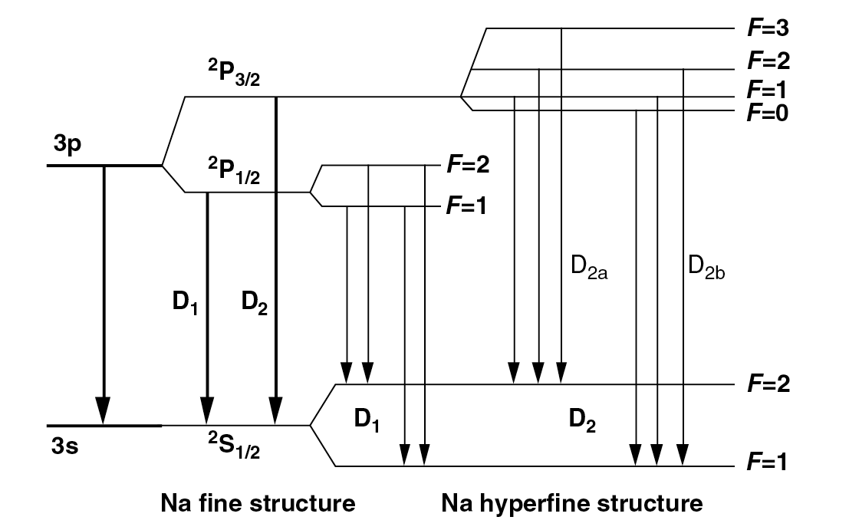
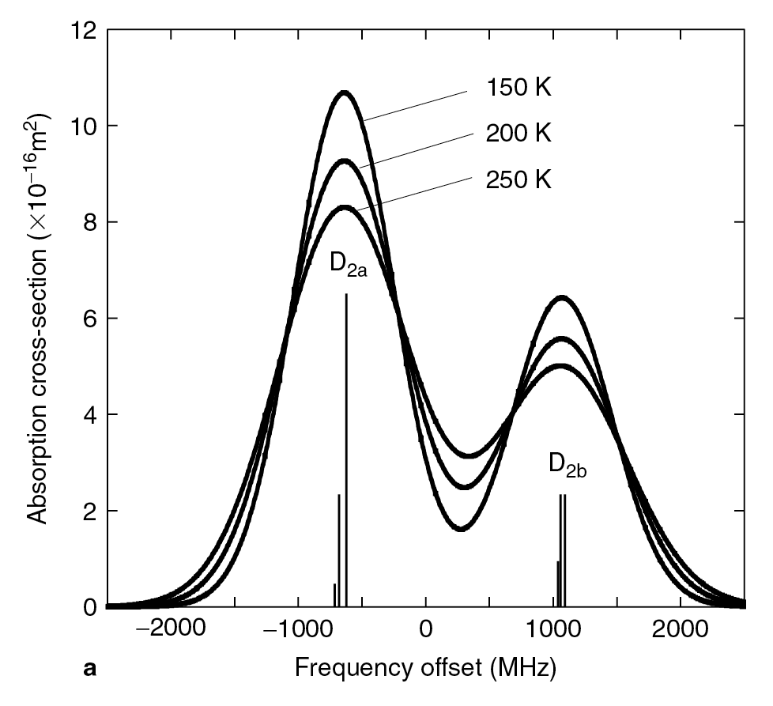
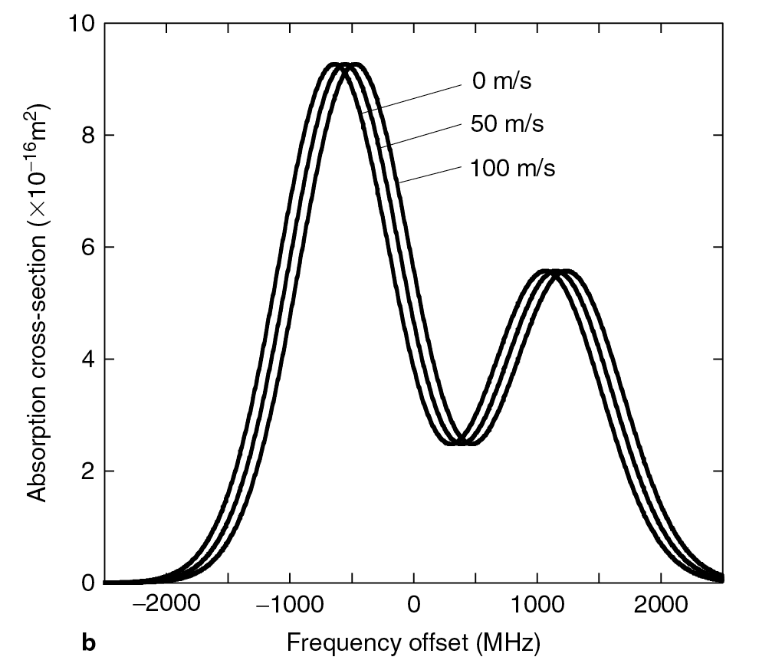
STAR Na Doppler Lidar
Na D₂ linewidth
Na D₂ peak freq
Notes:
Meteor: IAP
Metal species for temperature/wind measurements.
Also the re-entry region for space vehicles.
Abnormal seasonal variation: very cold in summer but warmer in winter - forming PMC

Slide 11

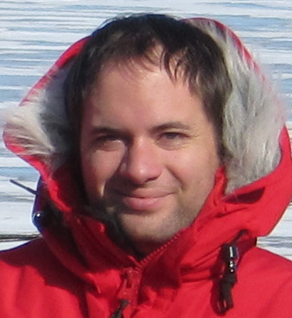
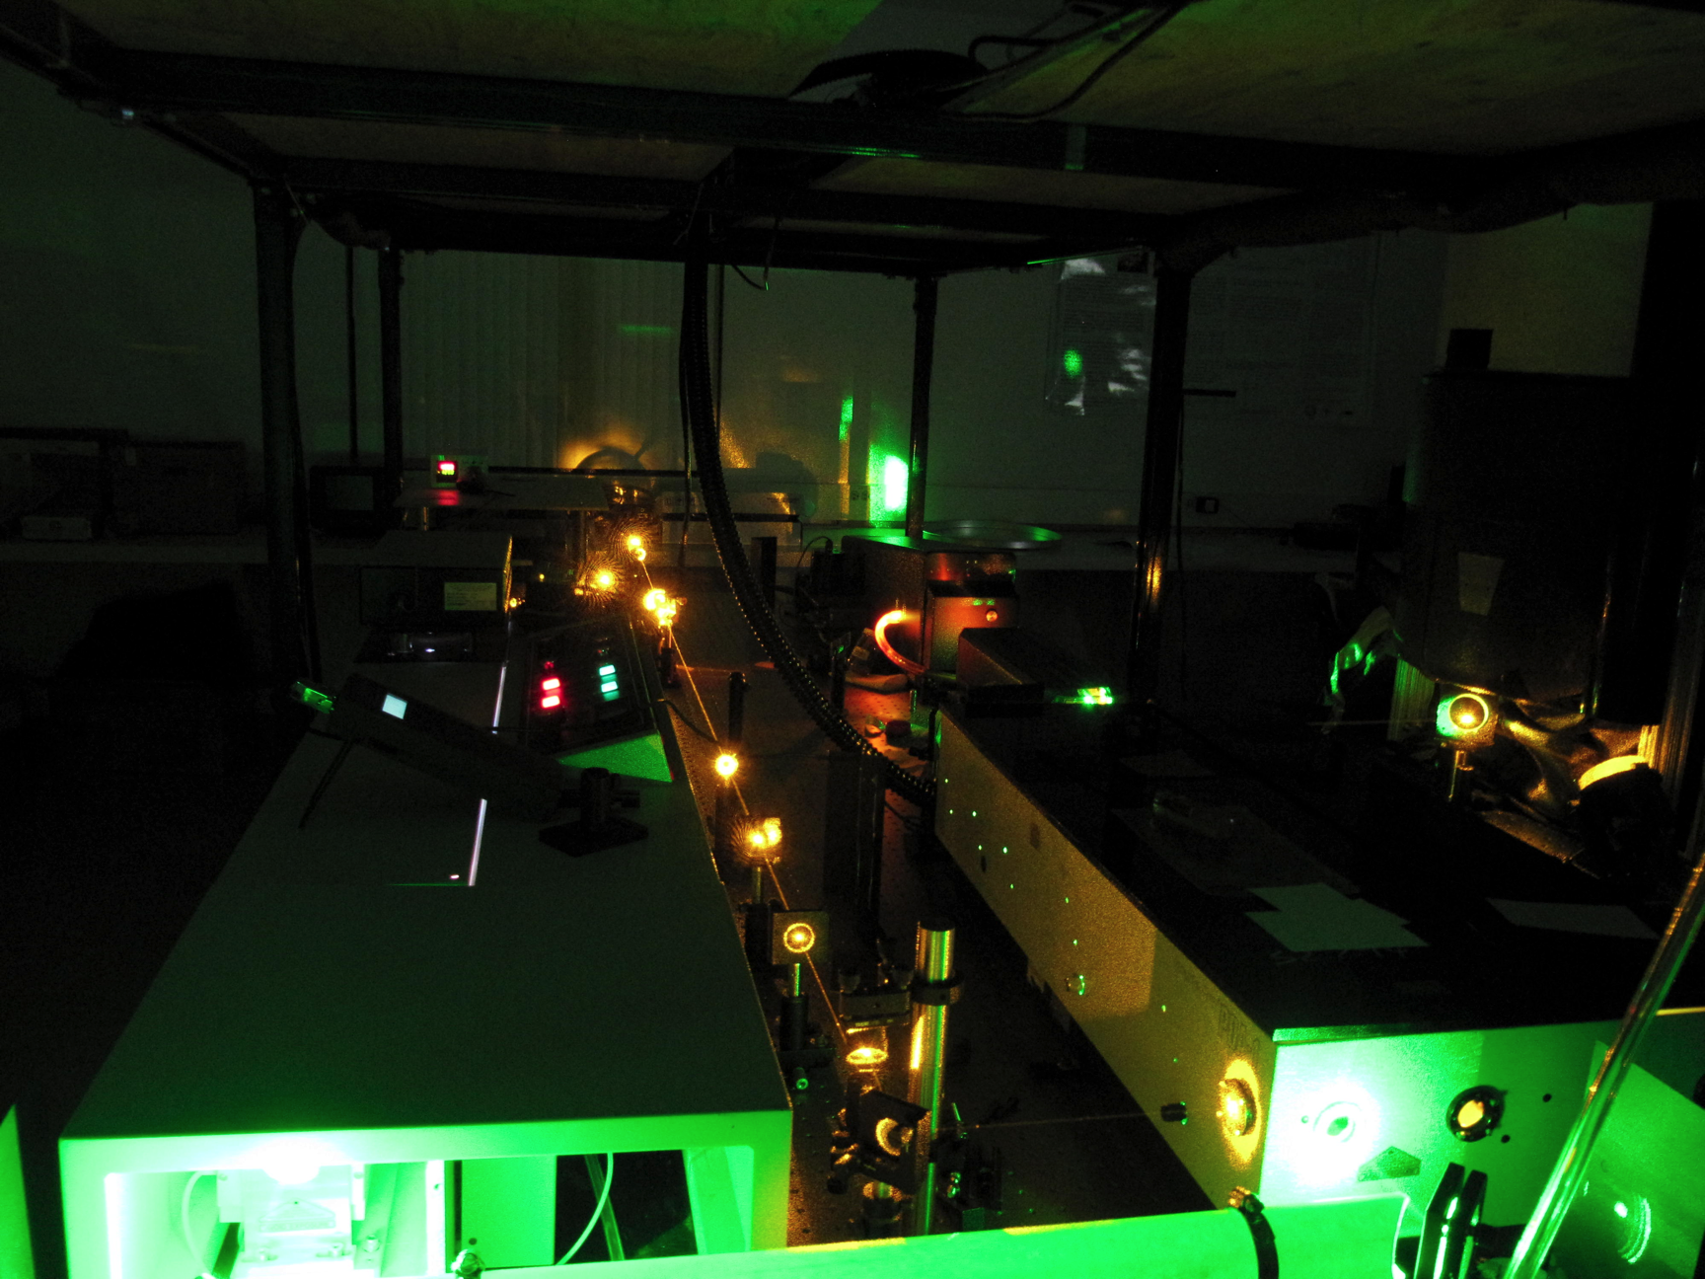
STAR Na Doppler Lidar
Student Training and Atmospheric Research lidar achieves high-resolution measurements of temp and wind [Smith et al., 2012].
Notes:
Meteor: IAP
Metal species for temperature/wind measurements.
Also the re-entry region for space vehicles.
Abnormal seasonal variation: very cold in summer but warmer in winter - forming PMC

Slide 12
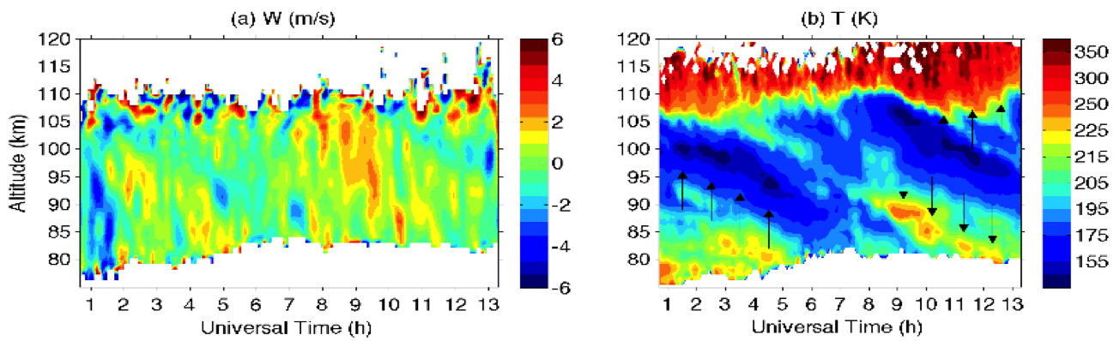
Gravity and Tidal Waves in Winds & Temp
Vertical Winds & Temp @ Boulder
[Lu et al., 2015]
Temp, Zonal & Meri Winds @ Logan
Notes:
Meteor: IAP
Metal species for temperature/wind measurements.
Also the re-entry region for space vehicles.
Abnormal seasonal variation: very cold in summer but warmer in winter - forming PMC

Slide 13
Coordinated 1-h Wave Study
[Lu et al., 2015]
λ_{z} ≈ 16 km
λ_{h} ≈ 220 km
Φ ≈ 135°
Θ ≈ 3°
A mesoscale 1-h gravity wave propagate from Logan, UT to Boulder, CO on 27 Nov 2013
Vertical, zonal and meridional winds along with temperature are used to fully characterize the wave. Vertical wind is more sensitive to detect high-freq waves than temperature.
Notes:
Meteor: IAP
Metal species for temperature/wind measurements.
Also the re-entry region for space vehicles.
Abnormal seasonal variation: very cold in summer but warmer in winter - forming PMC

Slide 14
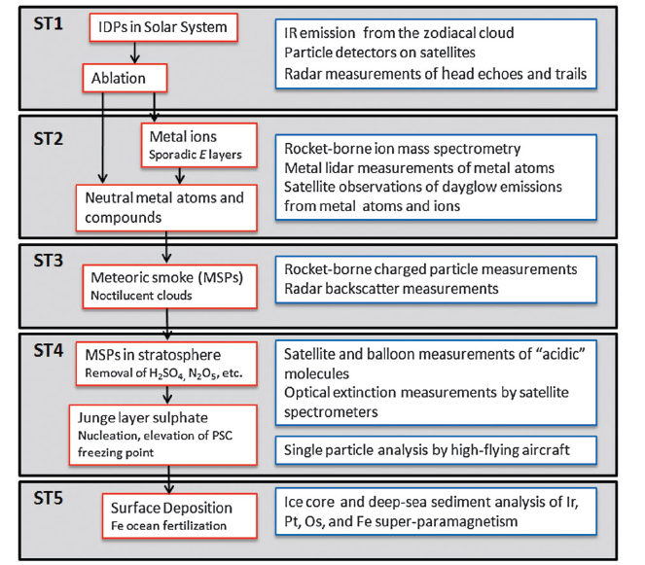
Cosmic Dust: Impacts on Earth
[Plane, 2012]
Meteoric metal atoms, ions, and compounds
Measured by lidars
Fe-rich deposition
Fertilization of life?
South Pole Water Well
Dr. Susan Taylor
Estimated daily mass influx ranges from 2-270 t/d
Notes:
When using the 1-D model to look at this June 1 event, we have found that McMurdo was in the downward transport patch for most of the time. The Fe+ ions have to be transported upward from other regions in Antarctica and then horizontally transported to McMurdo.

Slide 15
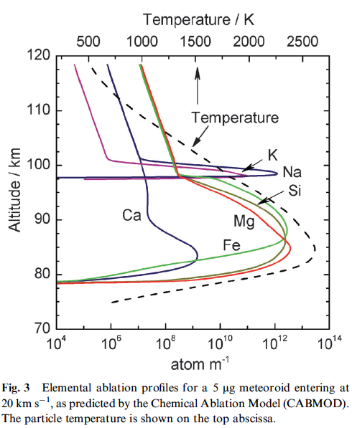
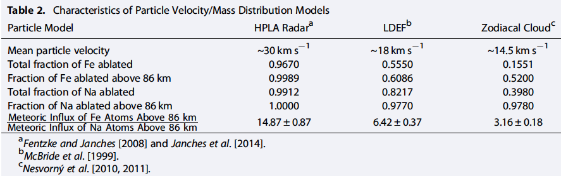
Ablation for Various Species vs. Velocity
The composition of the primitive CI carbonaceous chondrite meteorites is believed to be the most representative of the original solar nebula and is therefore an accepted reference for the composition of the cosmic dust particles [Jessberger et al., 2001].
The ratio of the elemental abundances of Fe and Na in CI chondrites is [Fe]/[Na] = 15.26 ± 0.89.
Elemental ablation profile computed by Prof. John Plane’s chemical ablation model (CABMOD) @ Leeds
[Huang et al., GRL, 2015]
Notes:
When using the 1-D model to look at this June 1 event, we have found that McMurdo was in the downward transport patch for most of the time. The Fe+ ions have to be transported upward from other regions in Antarctica and then horizontally transported to McMurdo.

Slide 16
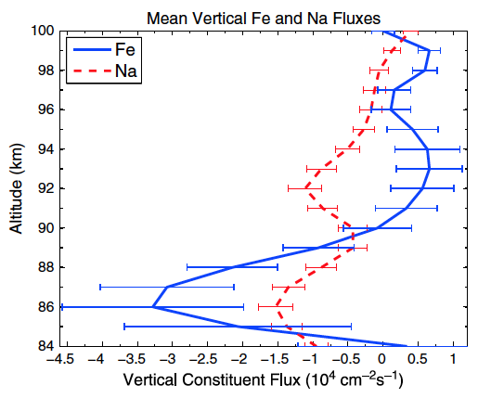
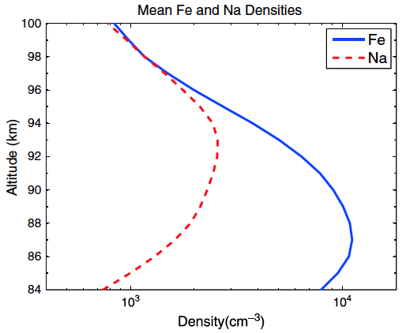
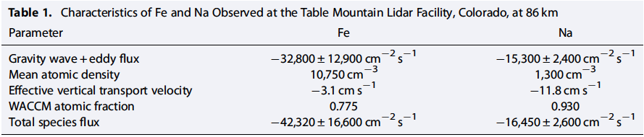
Test by Simultaneous Fe and Na Lidar Obs.
Boulder
[Huang et al., GRL, 2015]
Notes:
When using the 1-D model to look at this June 1 event, we have found that McMurdo was in the downward transport patch for most of the time. The Fe+ ions have to be transported upward from other regions in Antarctica and then horizontally transported to McMurdo.

Slide 17
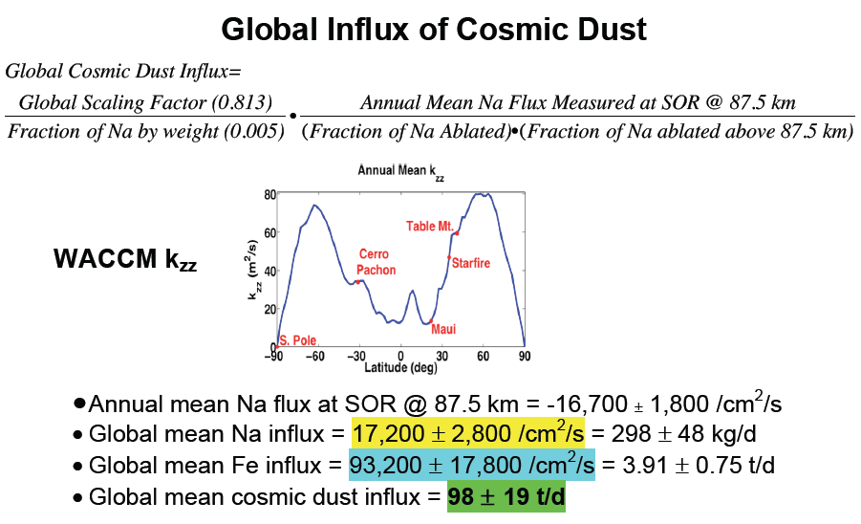
Estimate Global Influx of Cosmic Dust
102,000 ± 18,000 /cm²/s = 4.20 ± 0.75 t/d
150 ± 38 t/d
Notes:
When using the 1-D model to look at this June 1 event, we have found that McMurdo was in the downward transport patch for most of the time. The Fe+ ions have to be transported upward from other regions in Antarctica and then horizontally transported to McMurdo.

Slide 18
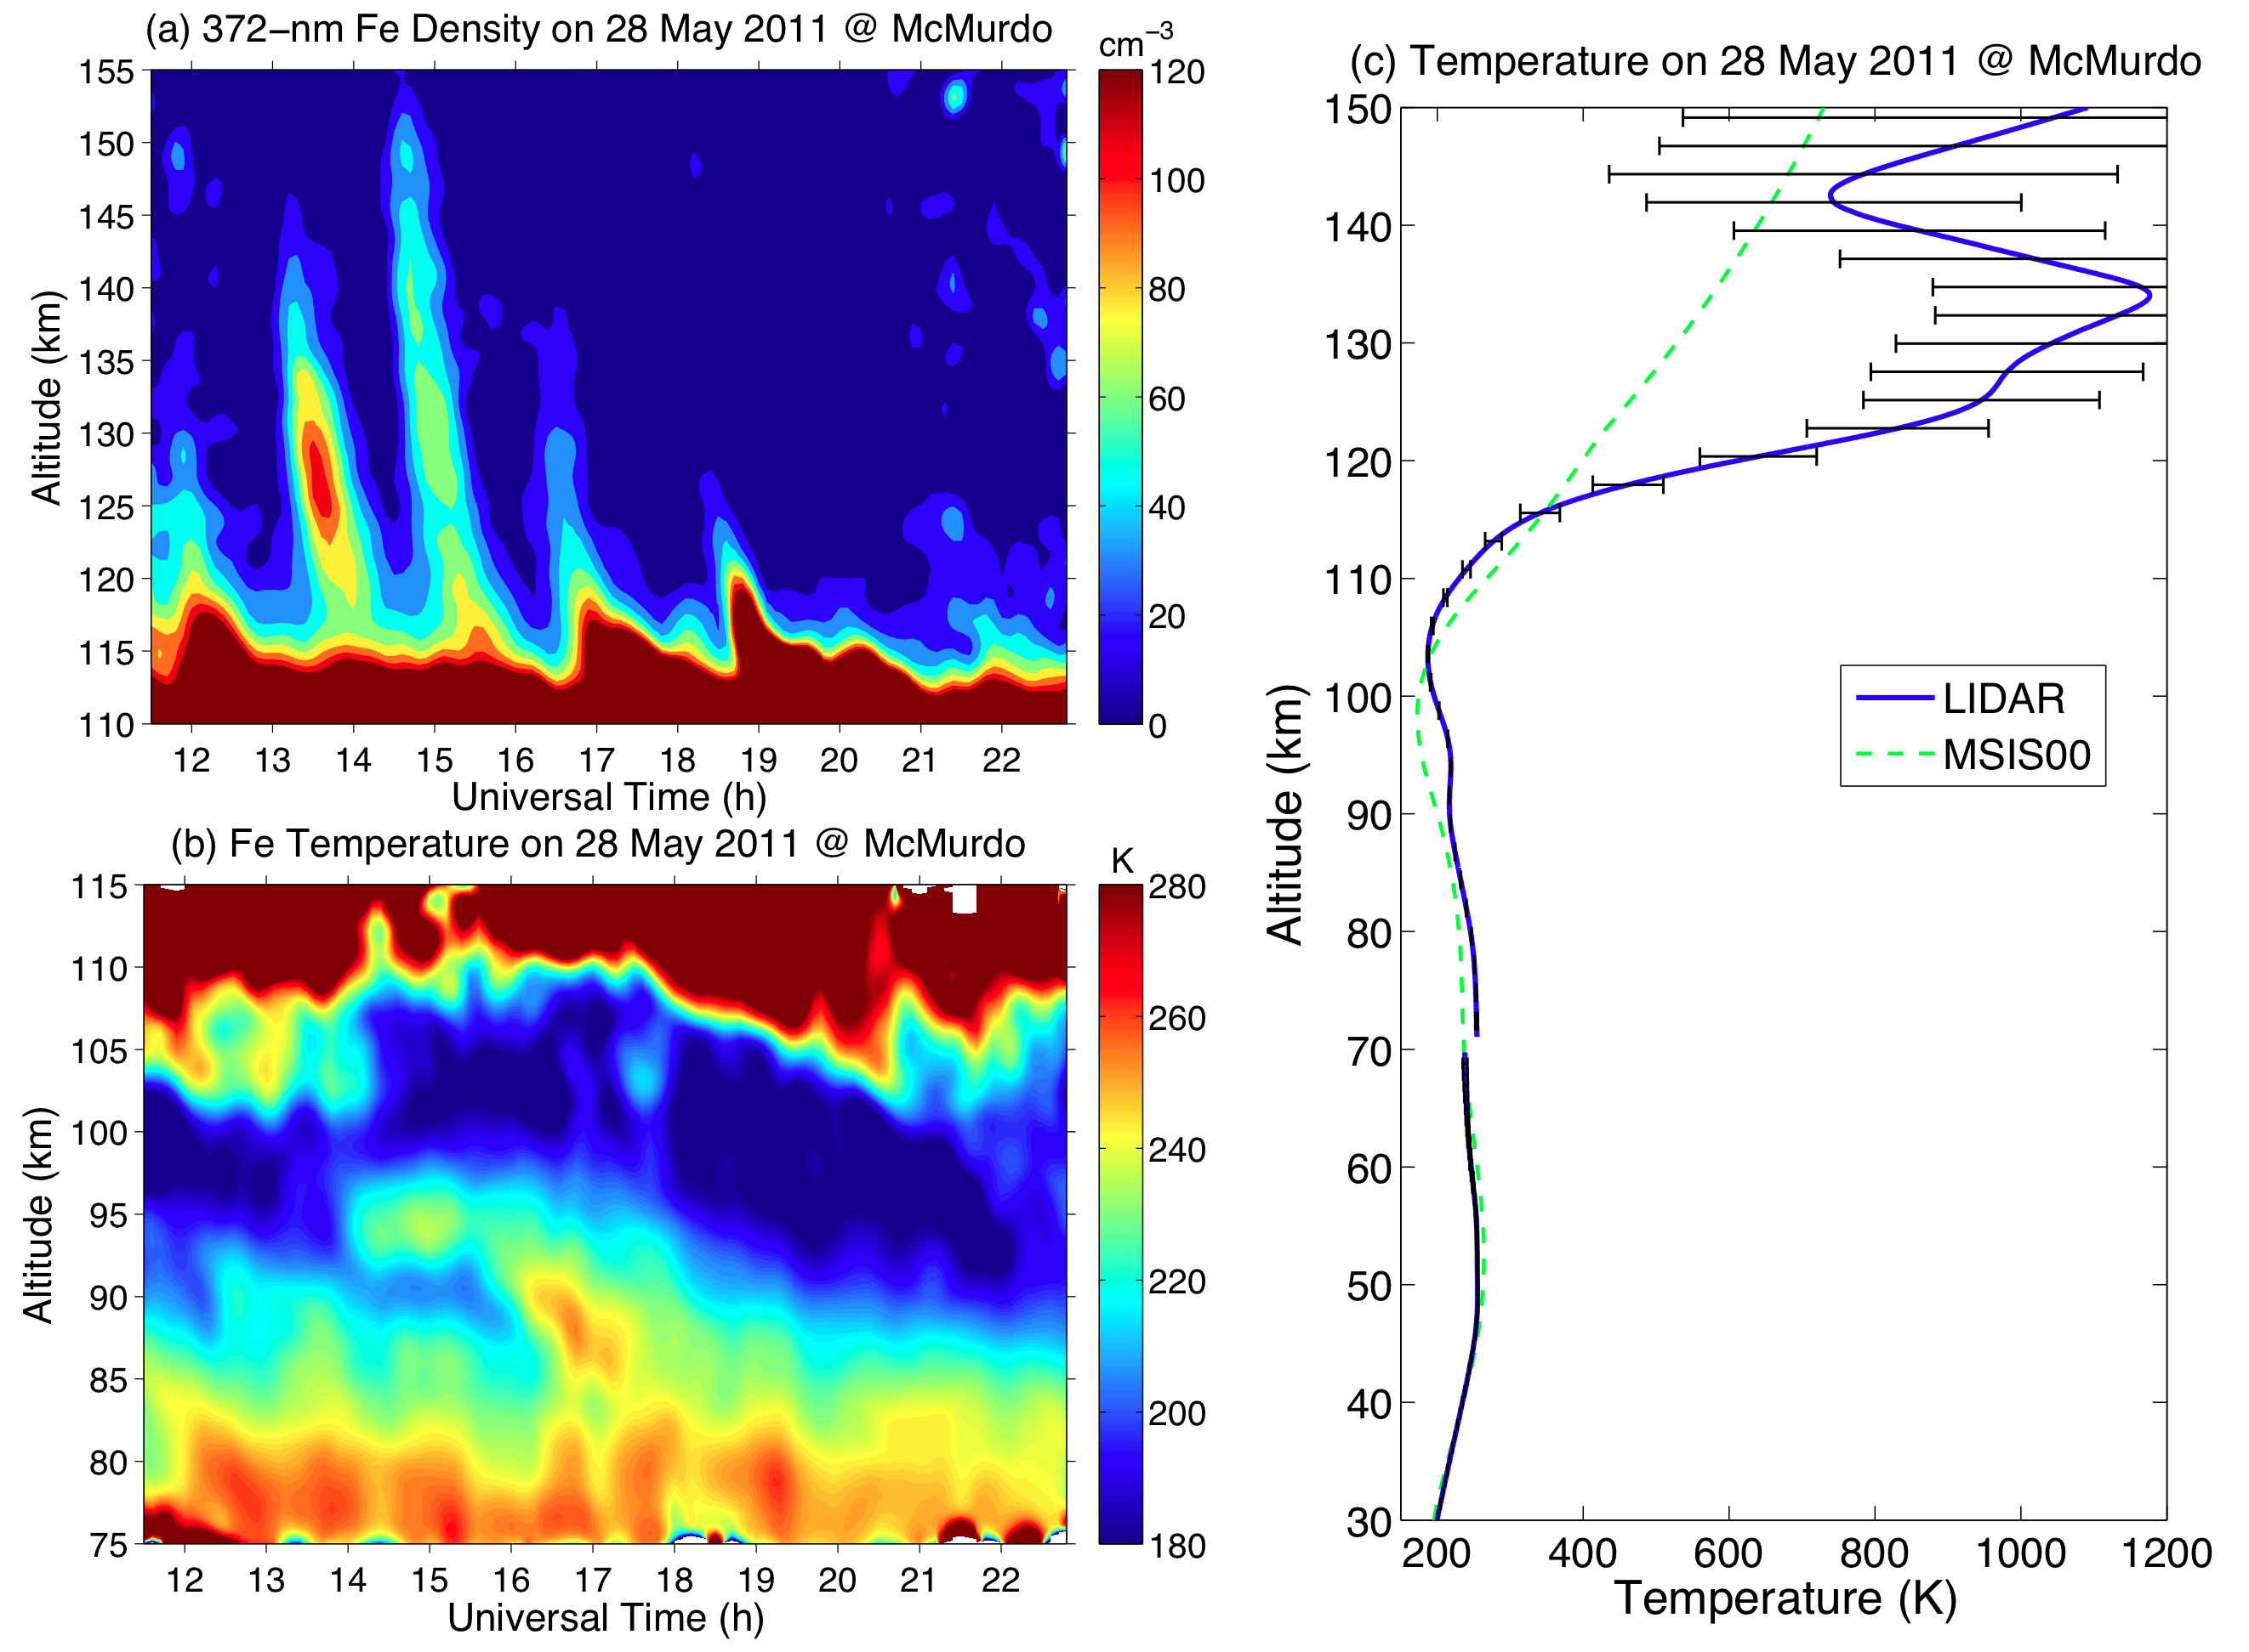
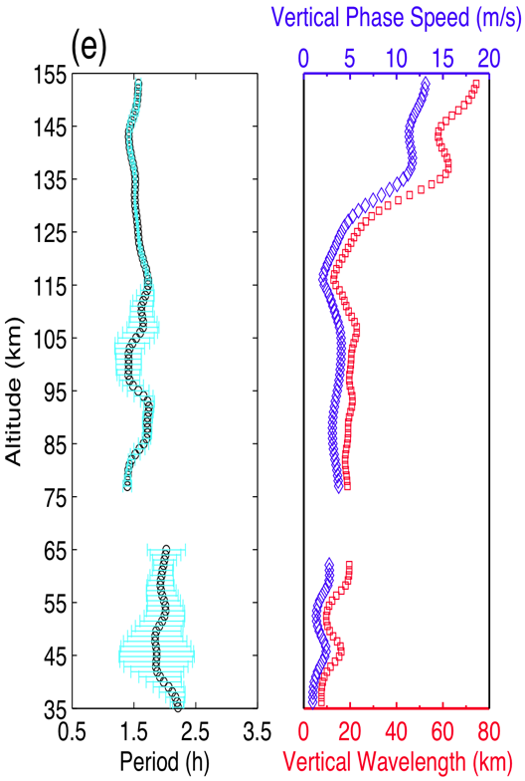
Discovery of Thermosphere Fe Layer in 2011
28 May 2011 Event
[Chu et al., 2011]
Fe density of 20-120 cm⁻³ (120-155 km) with clear gravity wave signatures Elevated temperatures peak around 130 km during a geomagnetic storm
Notes:
Gravity waves with periods of 1-3 h are also frequently seen at McMurdo, e.g., in this thermosphere Fe layer event, clear wave signatures of 1.5-2 h are seen from 30 to 155 km.
The lidar observations at McMurdo in May 2011 not only discovered neutral Fe layers in the thermosphere of 100-200 km, but also revealed the significantly elevated neutral temperature peaking around 130 km. These layers provide potential tracers for direct measurements of neutral temperature and wind in this least understood region.

Slide 19
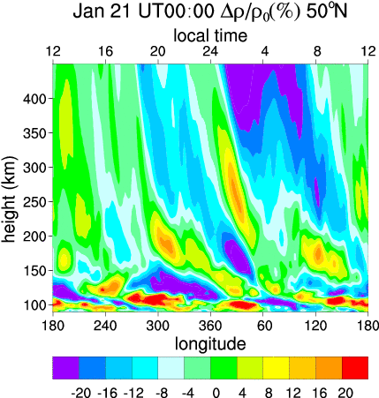
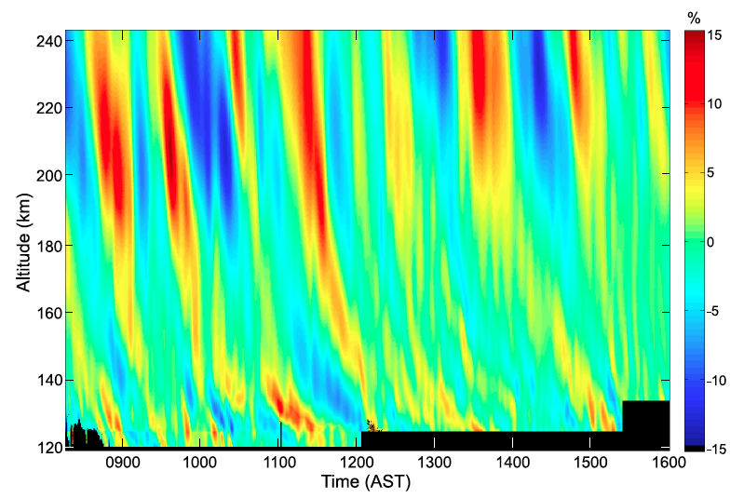
Our Theory: Fe⁺ Layers Neutralized to Fe
We hypothesize that the observed thermospheric neutral Fe layers are formed through neutralization of the vertically converged Fe⁺ ion layers that descend in height following the gravity wave downward phase progression [Chu et al., GRL, 2011].
Production: Direct electron recombination
Loss: photolysis, aurora ionization and charge transfer
Dissociative electron recombination
1) Source of Fe⁺ ions; 2) Formation of Fe⁺ layer and its shape;
3) Neutralization mechanisms; 4) Transport of Fe and Fe⁺
5) Elevated temperature vs. heating mechanisms
WAM
TIDs [Djuth et al., 2010]
The converged Fe layers in the thermosphere have ‘contrast’ ranging from 200% to near 900%,
which cannot be explained by neutral dynamics alone. Therefore, electrodynamics must be invoked.
Notes:
We hypothesize that … (read the top sentences)
The major neutralization mechanism is through the direct recombination of Fe+ with electrons.
The reason to invoke Fe+ ions is that the observed high contrast from 200-900% cannot be explained by neutral dynamics alone.

Slide 20
Thermospheric Fe/Fe+ Model for Polar Region
3-D mathematical model based on continuity equation
Meteoric source; Dynamical transport; Chemical production and loss
1-D numerical model built along the vertical Z-direction
Horizontal divergence of constituent flux
Vertical Convergence
Horizontal Divergence
Notes:
To turn this hypothesis into a real quantitative theory, Zhibin Yu developed a thermospheric Fe/Fe+ model during his PhD thesis. This 1-D numerical model is built along the vertical z-direction and based on a 3-D mathematical model, solving the ultimate meteoric source input, chemical production and loss, and dynamical transport of constituents. Both the vertical convergence caused by wave-induced vertical wind shear and the associated horizontal divergence are considered.

Slide 21
Source: Fe⁺ Transport by E and B Fields
Polar electric and magnetic fields can transport Fe+ from main deposition region to E-F regions
Layering & Transport: Wind Shear ± E-Field
The wave-induced wind shears in combination with the geomagnetic and electric fields provide the needed vertical convergence of ions. ( , vertical shear of vertical wind, E field)
Vertical shear of vertical wind is important to form the observed Fe layer shape.
Notes:
According to Prof. John Plane’s chemical ablation and sputtering model, Fe and Fe+ deposition above 120 km is negligible. There are no effective mechanisms to move neutral Fe from its main deposition region below 110 km to E-F region. But Fe+ can be transported upward by E and B fields, providing sources to the neutral Fe. Using ACE satellite data and Weimer model, we compute electric potential and then electric field for McMurdo. The 1-D model is used to calculate the vertical ion drift velocity for Fe+ on 28 May 2011. Fe+ ions are transported upward into the upper thermosphere by the polar electric field. While E-field can transport ions upward, downward, convergent and divergent, wave-induced wind shears can converge Fe+ layers even at such high latitudes. We have found that all three wind components can converge Fe+ layers, and the vertical shear of vertical wind is important to shape the neutral Fe layers to the observed wave structures.

Slide 22
Neutralization: Fe & Fe ⁺ Chemistry and Aurora
Direction electron-Fe⁺ recombination is the major neutralization channel to produce Fe.
Aurora helps convert Fe⁺ to Fe & remove Fe when decoupled from Fe⁺.
Simulation of 28 May 2011 Fe Event @ McMurdo
See Zhibin Yu’s poster on the modeling studies of thermospheric Fe layers (SA41A-4503)
Notes:
By turning off the direct recombination, our simulation shows that insufficient ozone density makes the dissociative recombination ineffective above 120 km. Our model tests have shown that direct Fe+-electron recombination is the major neutralization channel to produce Fe. Aurora helps convert Fe+ to Fe by increasing electron density, but once Fe is decoupled from Fe+, aurora helps remove neutral Fe through charge transfer with enhanced NO+ and O2+.
When combining all best-estimated parameters together, our model is able to simulate the major features of the May 28, 2011 event, like the Fe layer shape, height, density, etc.
[Fe+]=10^5 cm^-3 → [Fe]=tens to 100 cm^-3
[Fe+][e-]6.5e-12(300/T)^0.51xtime=1e5*1e5*6.5e-12*1000s=65cm^-3[Fe]

Slide 23
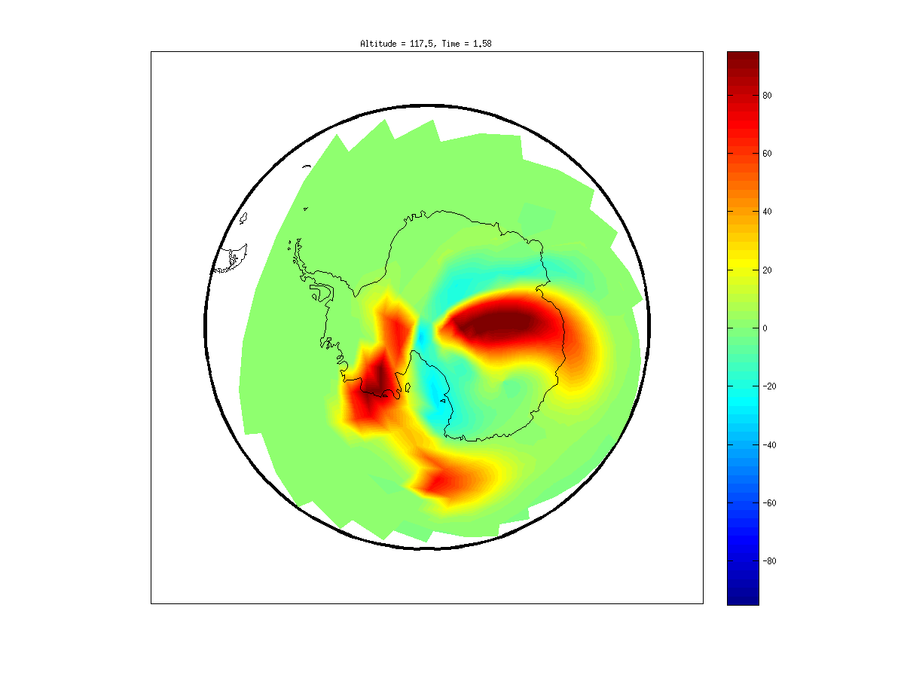
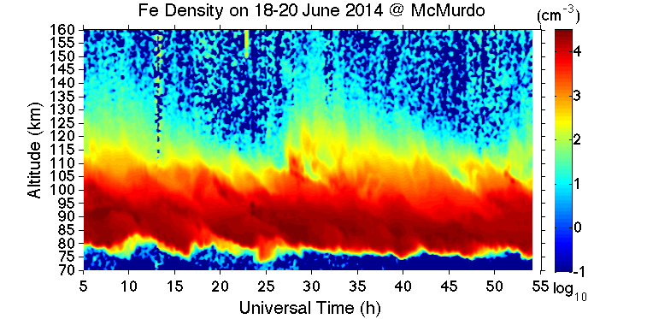
Transport vs. Wind Measurements
Diurnal variations of the convection E-field should lead to diurnal occurrence of Fe layers.
18-20 June 2014
Meteoric metal layers provide tracers for lidar to make neutral wind and temperature measurements in the SAIR
Notes:
When using the 1-D model to look at this June 1 event, we have found that McMurdo was in the downward transport patch for most of the time. The Fe+ ions have to be transported upward from other regions in Antarctica and then horizontally transported to McMurdo.

Slide 24
Influences of Wave from the Lower Atmos
Persistent 4-9 h waves: What are these waves? Where and how are they generated? What are their impacts?
Nearly impossible to answer this question without wind measurements, for diagnosis of wave sources and critical level filtering during wave propagation
Notes:
Point to Fe density, Fe temp and Rayleigh temp.
Our observations have revealed neutral Fe layers from ~70 km to over 170 km in altitudes.
The Fe temp data exhibit these strong and quite persistent inertial gravity waves of 4-9 h periods. Both Fe and Rayleigh temp have been used to study diurnal and semidiurnal tides in temperatures, and fast growth of tides are found in the lower thermosphere with dependence on Kp index.

Slide 25
Needs for Whole Atmosphere Winds and Temp
Science questions to address:
How plasma-neutral coupling processes and atmospheric waves shape the ionospheric structure and variability?
What are the magnitudes of the vertical heat, constituent and momentum transport by tides, gravity waves and turbulence?
How terrestrial weather impacts the geospace variability via vertical wave coupling?
Solar radiation flux
Geomagnetic activity
Cosmic dust influx
Plasma-neutral coupling
Neutral atmospheric dynamics
Wave dynamics and transport
Turbulence
Atmospheric escape
Climate change …
Requirements vary depending on the science topics, but a general requirement is ΔT<1 K, Δu<1-10 m/s, Δw<0.1-0.5 m/s

Slide 26
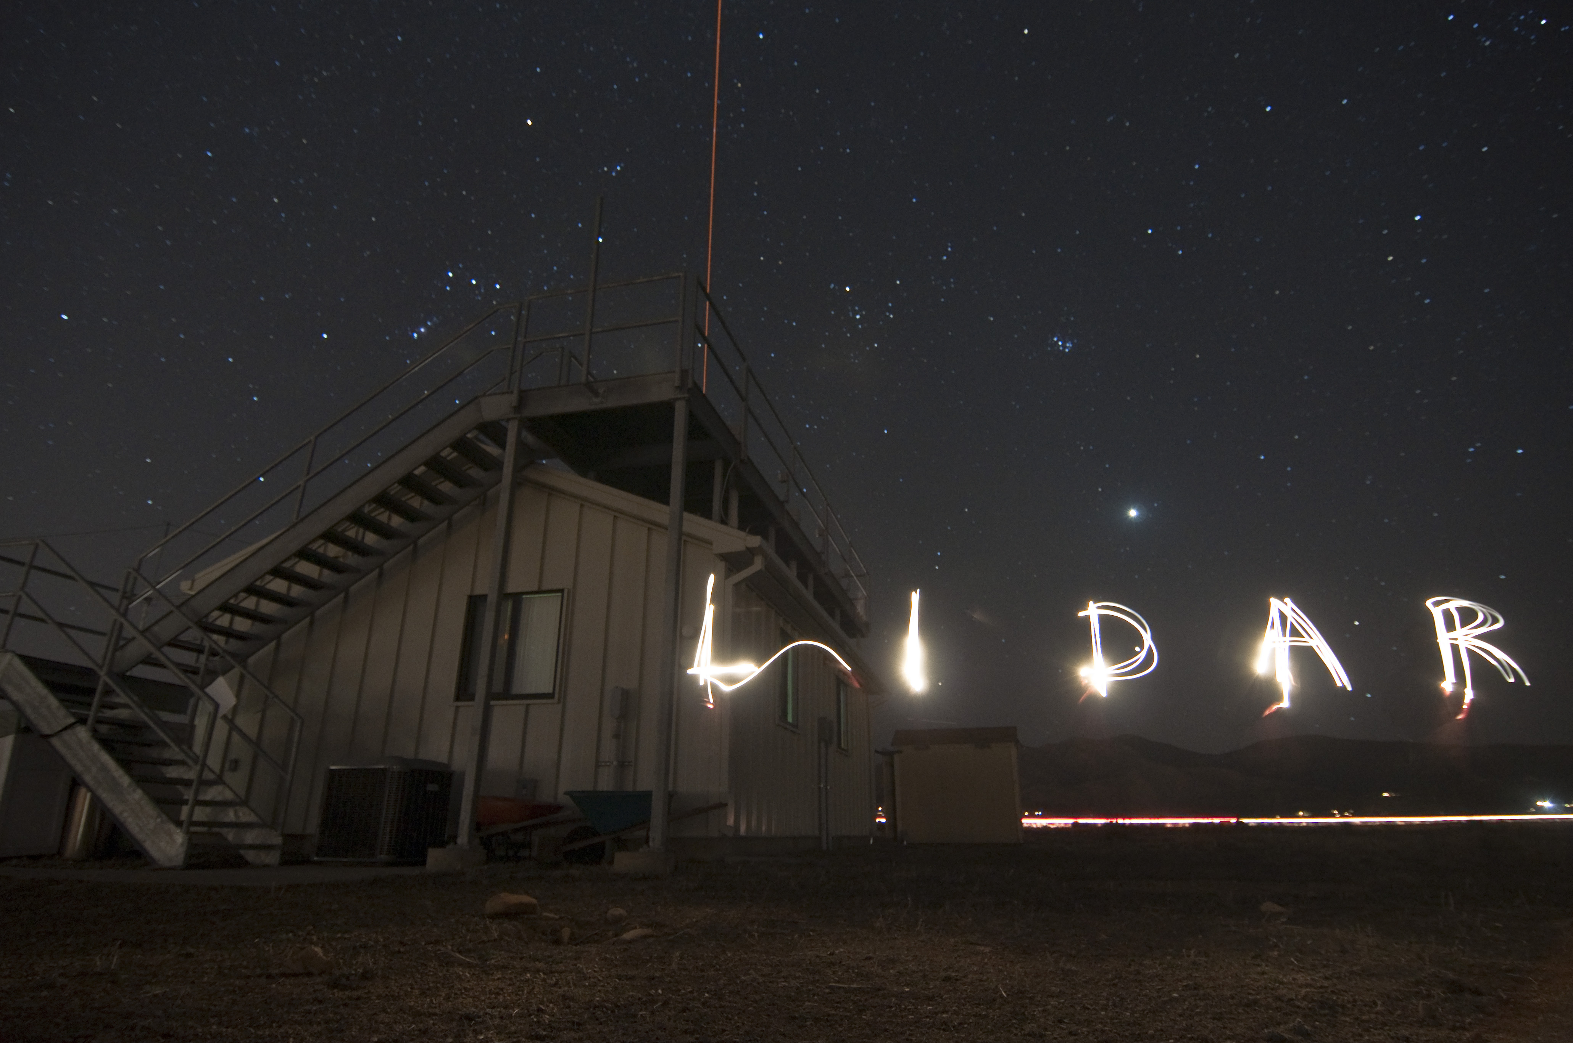
Solve the unsolved mysteries
Get to know the unknown processes
Notes:
-- As the PI for this Major Research Instrumentation Fe Doppler lidar project, I will report the progress we have made in the lidar technology development and point out the science potentials with this new lidar.
-- Co-authors of this paper include my postdoc, co-PI, and PhD students from the University of Colorado at Boulder.

