Slide 1
Advances in C-17 wing tip vortex investigations using the TODWL
G. D. Emmitt and C. O’Handley
Simpson Weather Associates
With material from Draper Laboratories
Wind Lidar Working Group Meeting
Boulder, 2015

Slide 2
Program for Flight Separation Reduction during air deliveries
Models are considered too ideal but still being pursued
Need to express risk to personnel in probabilistic terms
Most of what is known quantitatively has been obtained via groundbased DWLs with the exception of some DLR work in 2009.
This work is funded by the US Army to obtain airborne DWL data to improve the existing WTV model being developed by Draper Laboratories and to explore alternatives to current aircraft spacing criteria.

Slide 3
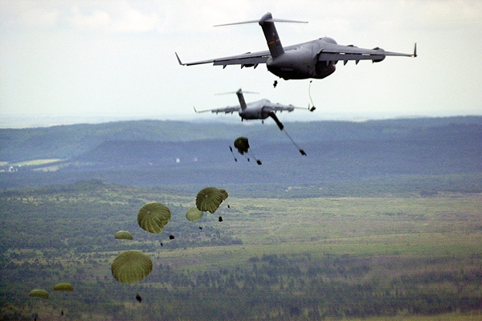
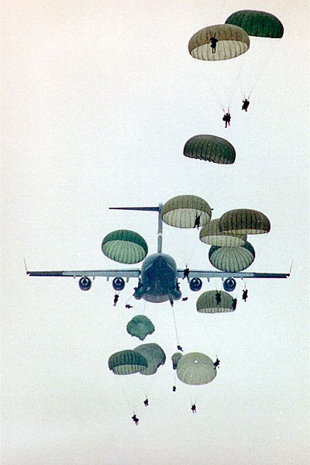
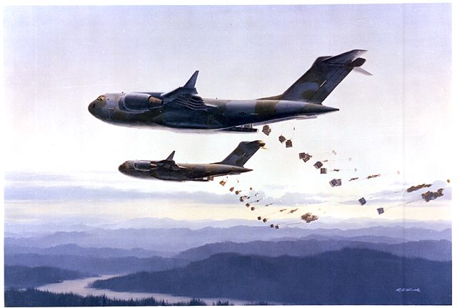

Slide 4
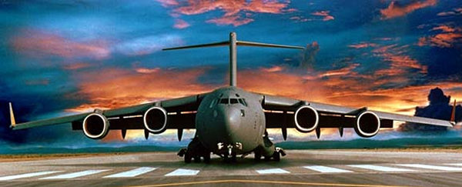
C-17 General Characteristics
Length: 174 feet (53.04 m)
Height at Tail: 55.1 feet (16.79 m)
Wing Span to Wingtips: 169.8 feet (51.74 m)
Maximum Payload: 164,900 lbs. (74,797 kg)
Range with Payload: 2,420 nautical miles
Cruise Speed: 0.74 – 0.77 Mach
Approach Speed: 130kts

Slide 5
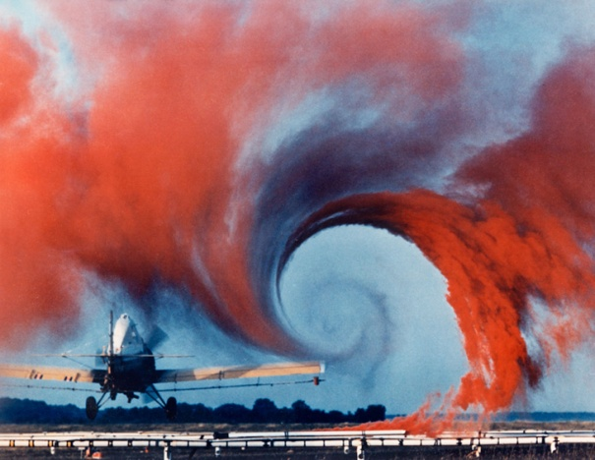
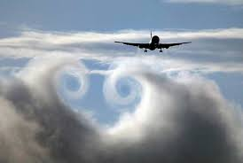
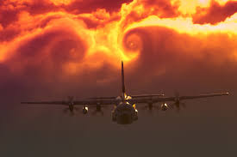
Vortex concepts and photo realizations

Slide 6
As time goes on
Provided by Fred Proctor, NASA/LaRC

Slide 7
Also possible (likely?)
Provided by Fred Proctor NASA/LaRC

Slide 8
WTV Model

Slide 9
WTV model predictions
Lifetime (s) | Distance behind aircraft (m) | Core altitude (m) | Sink Rate (m/s) | Vortex core radius (m) | Max vtan (m/s) | Radius(m) where Vtan = 5 m/s
7.50 | 0.50 | 370.73 | 1.38 | 0.42 | 119.21 | 11.58
15.00 | 1.00 | 357.93 | 1.71 | 0.60 | 84.45 | 11.58
30.00 | 2.00 | 331.71 | 1.75 | 0.85 | 59.45 | 11.58
60.00 | 4.00 | 279.88 | 1.73 | 1.20 | 42.07 | 11.58
90.00 | 6.00 | 237.80 | 1.40 | 1.47 | 23.17 | 7.75
120.00 | 8.00 | 207.93 | 1.00 | 1.70 | 14.94 | 5.81
150.00 | 10.00 | 184.76 | 0.77 | 1.90 | 10.67 | 4.65
180.00 | 12.00 | 166.46 | 0.61 | 2.08 | 8.23 | 3.82
210.00 | 14.00 | 150.61 | 0.53 | 2.24 | 6.40 | 2.94
240.00 | 16.00 | 137.20 | 0.45 | 2.40 | 5.18 | 0.00
270.00 | 18.00 | 125.30 | 0.40 | 2.54 | 4.57 | 0.00
300.00 | 20.00 | 114.94 | 0.35 | 2.68 | 3.66 | 0.00
W= 400,000 lb, V = 130 knots, Altitude = 1250 ft
Copyright  2015 by the Charles Stark Draper Laboratory, Inc. All rights reserved.

Slide 10
Circulation Calculation
Γ = 2* π * r * V(r)
r = distance from vortex core
V(r) = tangential speed at distance r

Slide 11
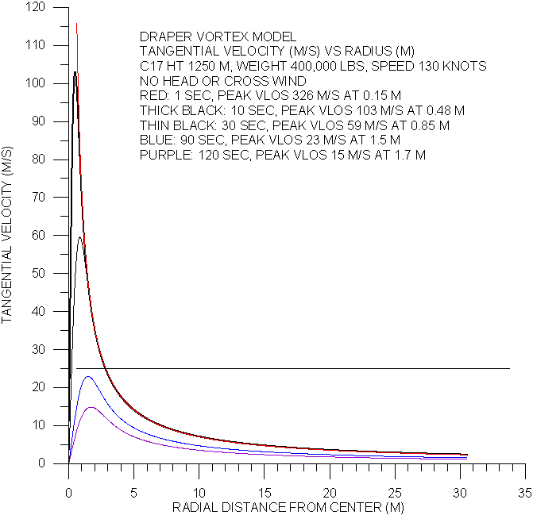

Slide 12
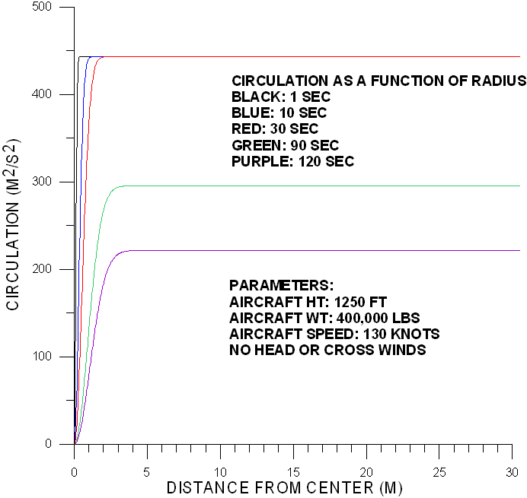

Slide 13
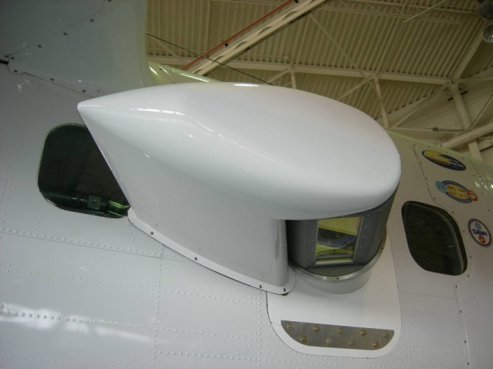

TODWL
Twin Otter Doppler Wind Lidar
Owned by Navy’s
Center for Interdisciplinary
Remotely Piloted Aircraft Studies
CTV
Controlled Towed Vehicle
Developed by UC, Irvine
CTV

Slide 14
Major considerations
Differential speed between C-17 and Twin Otter. +-10 kts of 130 kts.
Scanner slew rate
  Maximum of 30 degrees/second
What are the maximum tangential velocities expected?
  TODWL’s bandwidth is +- 25 m/s
What is the area of regard for life cycle monitoring?
  Taking cross track drift into consideration
Measurements of thermal stability and wind profiles between surface and 1000m

Slide 15
Twin Otter
1000m AGL
17 degrees
400 m
min range
C-17
200m AGL
Chirp effects
below 50 m
50 m
tip - tip
300 m
Aircraft positions and TODWL area of regard

Slide 16
TODWL Sampling Modes
Mode Name | C - 17 | T-Otter | Comments
Backslide | 600’ (130K) | 3000’ (110K) | Begin sampling with Twin Otter above and just forward of C -17; drift backwards while nadir raster scanning
Opposing | 600’ (130K) | 3000’ (140K) | Begin nadir raster sampling when TO is on opposing track to that just flown by C-17
Trailing | 600’ (130K) | 1000’ (130K) | Begin 3km behind C-17 and use dithered prospecting scan at – 6 degrees for 5 min.
Prospecting | 600’ (130K) | 1000’ (120K) | Begin 3km lateral to C-17 path and cross over DZ; do 180 and repeat going other direction.
DZ cross (GB) | 600’ (130K) | Zero‘ (Zero) | Park the Twin Otter in a position to allow the lidar to scan the DZ from a side perspective to C-17 path.
DZ along (GB) | 600’ (130K) | Zero‘ (Zero) | Park the Twin Otter in a position 3 -5 km “up approach” from the DZ to allow the lidar to scan the DZ along the C-17 path. C-17 would need to fly a J leg to avoid having vortexes hit the Twin Otter.

Slide 17
Key Issues addressed with TODWL
Capturing signals from vortices over periods of several minutes using “opposing” flight paths and “fallback” sampling.
Identifying region where vertical velocities are > 15 m/s (Danger Zone)
Identifying and mapping individual vortices throughout several minutes of lifetime (location of vortex centers).
Computing circulation values using lidar samples obtained at vortex radii ~ 10 – 20 meters.

Slide 18
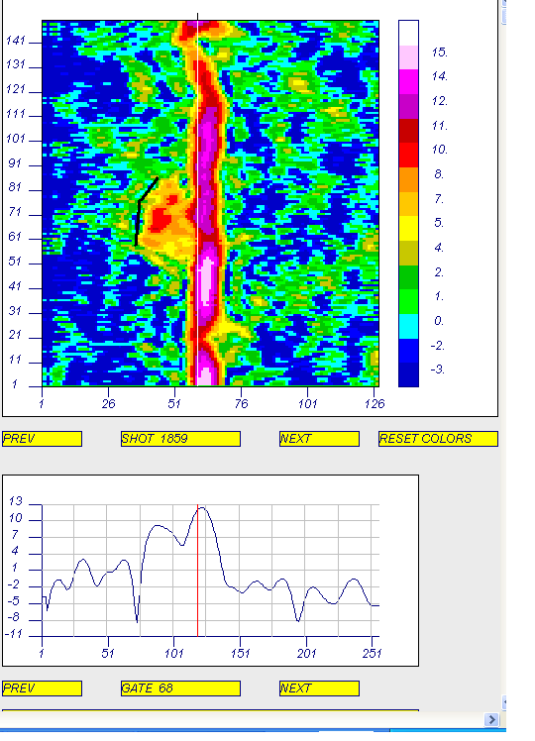
Vu(left) = 7 m/s

Slide 19
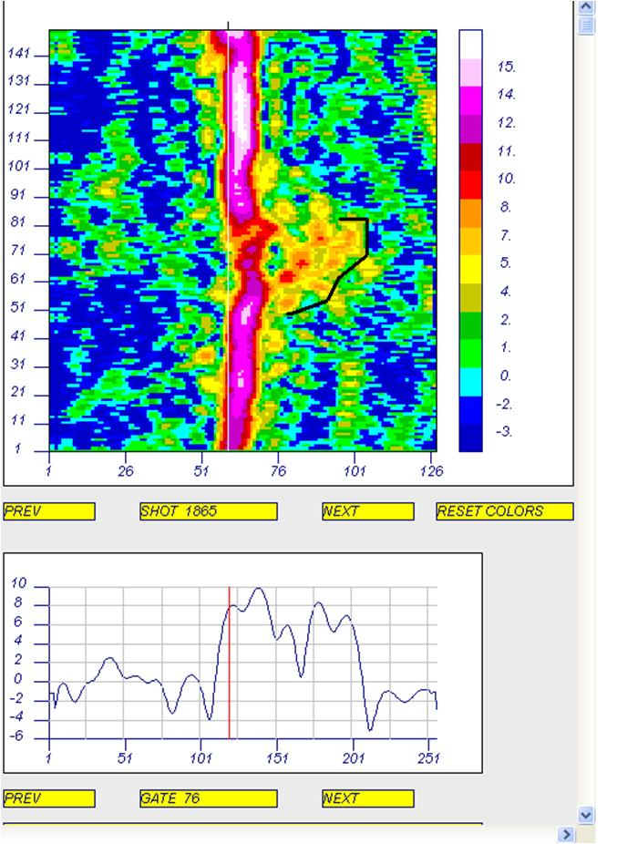
Vd (left) = 10 m/s

Slide 20
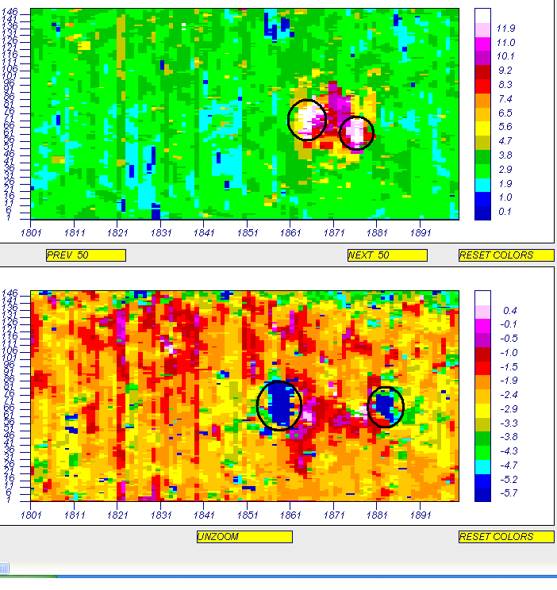
1865
1876
1859
1883
R(right) = 3.5*2.5=8.75
R(left) = 3.0*2.5 = 7.5

Slide 21
Sink Rates

Slide 22
Priority Datasets
21 Data sets for opposing flights at night (4/22-4/23)
  Most of the datasets have a data available for a vortex age between 60 to 120 seconds
No major changes in aircraft weight from first pass to last pass on a given lift
C17 speed relatively constant between passes
  Most in the 130-132 knots range
  4 outside (143.3, 134.75, 136.5, 134.1)
Date | Initial Weight | Final Weight | Notes
4/22 Night | 382280 | 374680 | ~800m altitude
4/23 Early morning | 397080 | 384680 | ~500m altitude
4/23 Early morning | 380080 | 369200 | ~400m altitude
4/23 Night | 398800 | 375600 | ~800m altitude

Slide 23
All Datasets – Height vs. Vortex Age

Slide 24
C17 Altitude ~800m
Tests conducted over two different nights
4/22/14 and 4/23/14
12 different flights passes

Slide 25
C17 Altitude ~ 800m – Height vs. Vortex Age – Right Vortex

Slide 26
C17 Altitude ~ 800m – Height vs. Vortex Age – Left Vortex

Slide 27
C17 Altitude ~ 800m – Height vs. Vortex Age
Two descent rates can be seen in the data
  The change in rates occur approximately around 60 seconds
  First 60 second mainly a higher constant descent rate
    1.71 meters per seconds – right vortex
    1.52 meters per seconds – left vortex
  After 60 seconds a slower descent rate
    More variation
    0.87 meters per seconds – right vortex
    0.70 meters per seconds – left vortex

Slide 28
C17 Altitude ~500m
Tests conducted over one early morning
4/23/14
4 different flights passes

Slide 29
C17 Altitude ~ 500m – Height vs. Vortex Age – Right Vortex

Slide 30
C17 Altitude ~ 500m – Height vs. Vortex Age – Left Vortex

Slide 31
C17 Altitude ~ 500m – Height vs. Vortex Age
Two descent rates can be seen in the data
  The change in rates occur approximately around 60 seconds
  First 60 second mainly a higher constant descent rate
    1.60 meters per seconds – right vortex
    1.49 meters per seconds – left vortex
  After 60 seconds a slower descent rate
    More variation
    1.45 meters per seconds – right vortex
    0.70 meters per seconds – left vortex

Slide 32
C17 Altitude ~400m
Tests conducted over one early morning
4/23/14
5 different flights passes

Slide 33
C17 Altitude ~ 400m – Height vs. Vortex Age – Right Vortex

Slide 34
C17 Altitude ~ 400m – Height vs. Vortex Age - Left Vortex

Slide 35
C17 Altitude ~ 400m – Height vs. Vortex Age
Smaller time of data available – around 75 seconds
Relatively constant descent rate
  1.93 meters per seconds – right vortex
  1.57 meters per seconds – left vortex
We can start to see the change in the descent rate around 60 seconds

Slide 36
Summary of All the Data
Altitude (m) | Vortex Descent Rates (m/s) |  |  |  | Mean Velocity Decay (m/s^2)
 | First 60 Sec |  | After 60 Sec |  | Ascending |  | Descending |  | Both Cores
 | Right | Left | Right | Left | Right | Left | Right | Left | Right | Left
800 | 1.71 | 1.52 | 0.87 | 0.70 | 0.022 | 0.017 | 0.016 | 0.018 | 0.019 | 0.018
500 | 1.60 | 1.49 | 1.45 | 0.70 | 0.032 | 0.028 | 0.027 | 0.015 | 0.030 | 0.022
400 | 1.93 | 1.57 | - | - | 0.048 | 0.053 | 0.014 | 0.026 | 0.031 | 0.039
Working on calculating standard deviation for the decent and decays rates

Slide 37
Progress on computing circulation

Slide 38
Circulation calculations
The maximum tangential velocities may be ~ 100 m/s per various WTV models
Since TODWL has a +- 25m/s receiver bandwidth and a ~80m Gaussian pulse length, we compute the circulation at radii where the tangential velocities are less than 10 -20 m/s.
Using techniques developed in part by the DLR during similar airborne DWL investigations in 2009.
SWA has expanded (and continues to do so) on the “spectral envelop” approach during this FSR project.

Slide 39
SWA Method*
The method is as follows:
Identify center of vortex (shot, gate)
Using envelope velocities, calculate circulation moving outward from vortex center at each shot (average separation about 2 m but varies with scan angle)
Circulation is estimated by examining a region within 10 gates of the core location.
Tabulate the strongest envelope velocity and the average envelope velocity within that region, and then calculate a circulation from each, so two estimates per shot (distance)
* Base in part on work done by DLR

Slide 40
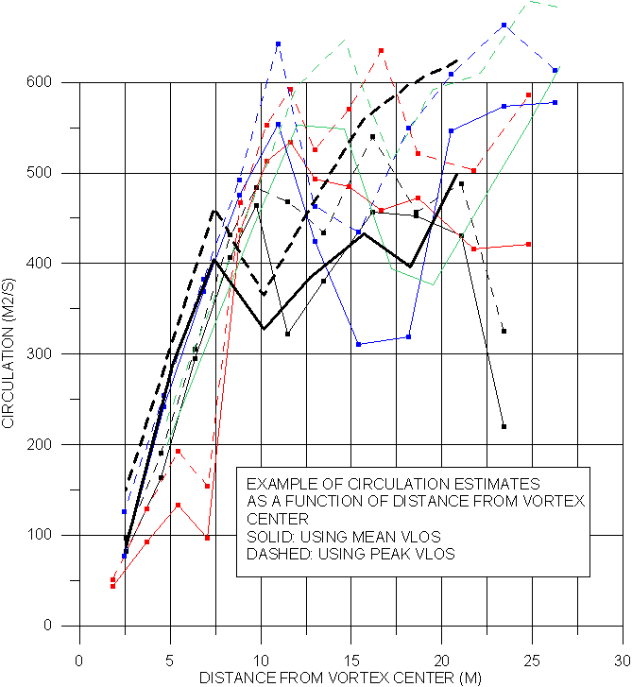

Slide 41
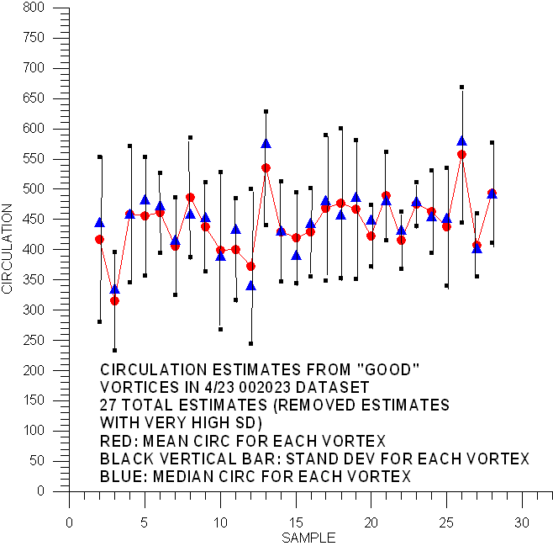
First 10 seconds of WTV lifetime

Slide 42
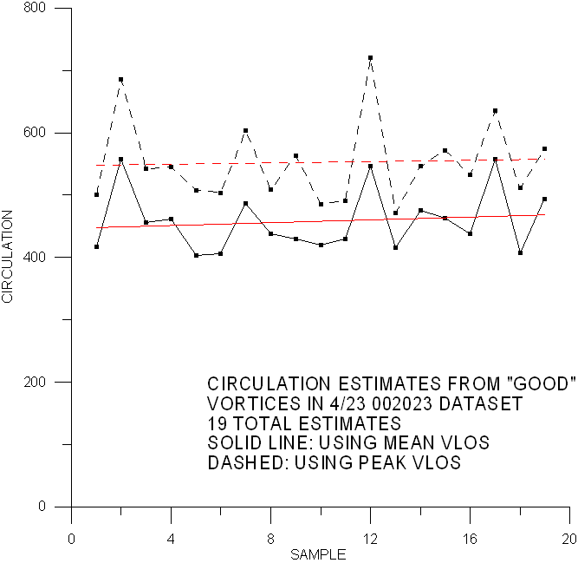

Slide 43
Radius sensitivity
The computations are very sensitive. For example, if we've picked the wrong shot for the vortex center, everything shifts by an average of 2m.
If you have a Vlos estimate of 6 m/s at 10 m, that's 377 m2/s. If you shift that 2 m you have a potential circulation range of 302 – 452 m2/s. That could possibly explain the outliers in the averaged data.

Slide 44
Summary
Using our latest algorithms, the general estimates of WTV sink rates, vortex separation distances, drift angles and circulation values appear to pass the “reasonable” test when compared with the WTV model data from Draper. But…..
There are occasions, however, where the sink rates differ between lifts conducted within the same (?) environment.
There are cases where the separation between vortices is > 50m, somewhat counter to the expectation that vortices interact destructively and “pinch” together.
There are cases where the sink rate for one vortex in a pair is consistently different that the other’s sink rate.

Slide 45
Summary of SWA algorithm errors
Given the sampling limitations of the TODWL system, we expect:
  Uncertainty in locating the centers of each vortex (+- 5 meters horizontal)
    Running average location over 10 sweeps (10 – 20 seconds) seems to be very reasonable
  Uncertainty in height assignment of individual vortex (+- 25 m vertical)
    Running average vertical location over 10 sweeps seems to be very reasonable
  Uncertainty in the estimation of the circulation (+- 30%)
    10 sweep running average circulation values are also quite reasonable and in agreement with model predictions
Therefore, our focus is now shifting to:
  Sink rates outside the envelope of expected values
  Vortex separations that exceed 60m
  Loss of detectable vortices in areas preceded and followed by detectable vortices.

Slide 46
Recommendations for next flight series
Fly the C-17 well above the boundary layer to reduce convective interference with vortices. This will improve model validation for the basic physics of WTV generation and evolution.
Fly within stable or neutral boundary layers. Marine boundary layers over the coast of California offer a good laboratory.
Fly longer legs with the C-17 (3-5 minutes instead of 2).

Slide 47
Acknowledgements
USArmy funding through Phase II SBIR to SWA
Draper Laboratories for conducting model/data comparisons
Kevin Godwin of KGS, LLC for assistance in operating TODWL in the Yuma field experiments and generating realtime/quicklook TODWL soundings used in planning the next day experiments.

