Slide 1
Developing the configuration trade space for space-based DWLs: vertical and horizontal coverage
G. D. Emmitt, S. A. Wood and S. Greco
Simpson Weather Associates
S. Majumdar (U Miami) and R. Atlas (NOAA/AOML)
Wind Lidar Working Group Meeting
Boulder, 2015

Slide 2
Overview
NASA has funded a data impact trade study through its ROSES-13 program: CYGNSS related call
Directed at Doppler Wind Lidars
Explore synergisms between AMVs, OVWs and future DWL products.
Technology neutral in details
Issues to be addressed
Swath vs lesser horizontal coverage
Upper vs lower troposphere coverage
Concentrated precision vs sample distribution (equal resources)
Temporal revisit interval benefits (GEO vs. LEO?)
Cost vs. benefit study
Cost expressed in terms of mission complexity
Benefit expressed in terms of OSSE impact metrics

Slide 3
The Nature Run
Nature Runs
T511 provided by ECMWF
WRF provided by NOAA
27,9,3,1 km nested domains
A hurricane case in August
Model cloud issues
T511 reports much greater cloud coverage than the WRF does
Plan to adjust the WRF cloud coverage post NR generation.

Slide 4
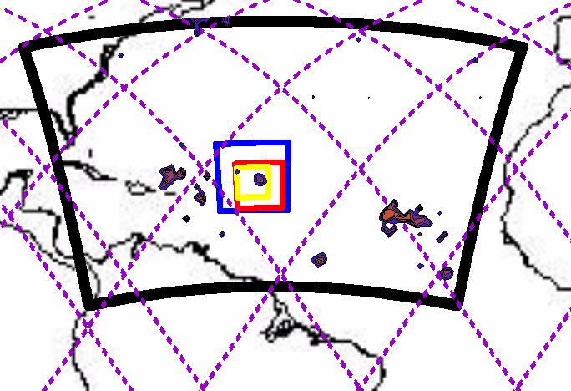
WRF MESOSCALE NR – Nested Grids (27, 9, 3 and 1 km)
Polar orbiting
satellite ground track

Slide 5
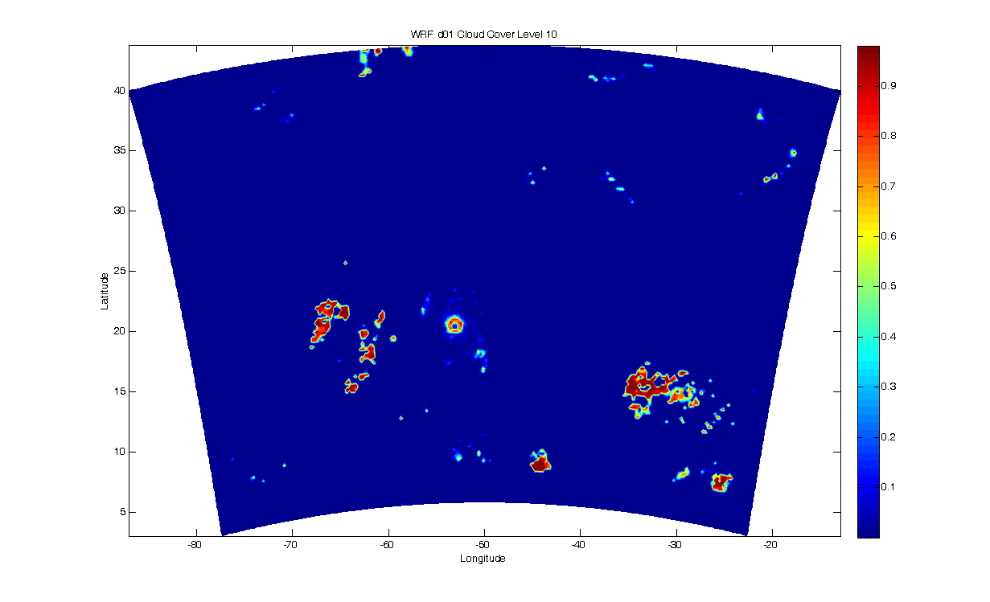
WRF MESOSCALE NR 8/04/12Z – Domain 1 Cloud Fraction Level 10

Slide 6
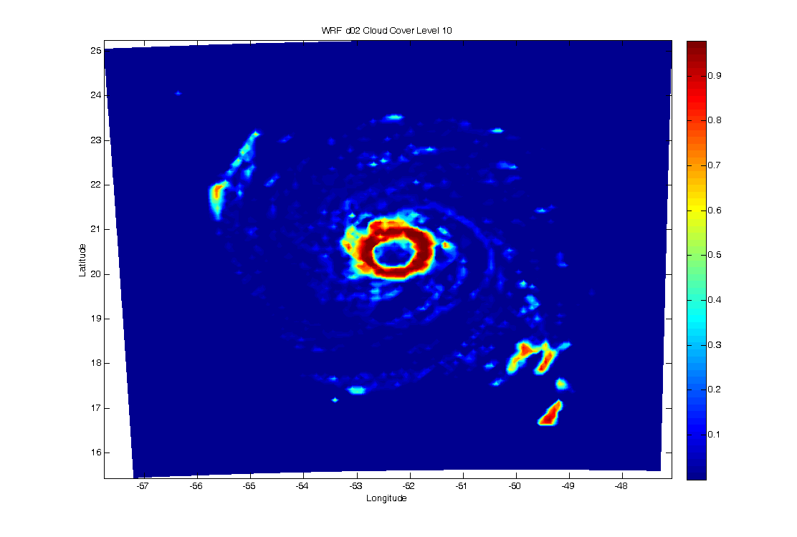
WRF MESOSCALE NR 8/04/12Z – Domain 2 Cloud Fraction Level 10

Slide 7
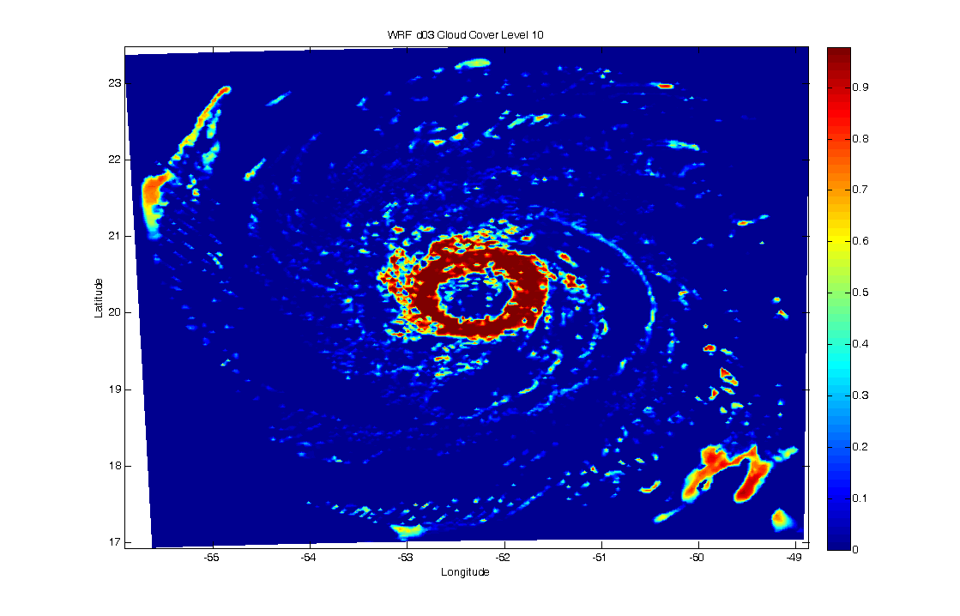
WRF MESOSCALE NR 8/04/12Z – Domain 3 Cloud Fraction Level 10

Slide 8
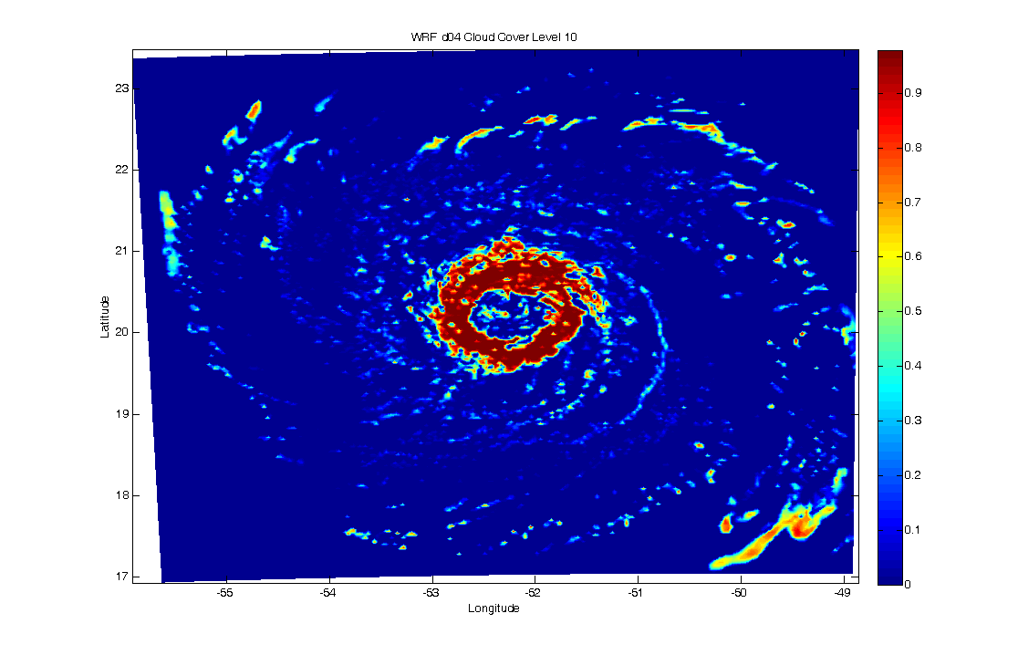
WRF MESOSCALE NR 8/04/12Z – Domain 4 Cloud Fraction Level 10

Slide 9
Nature Run Cloud Coverage Issues

Slide 13
The “reference” sampling case

Slide 14
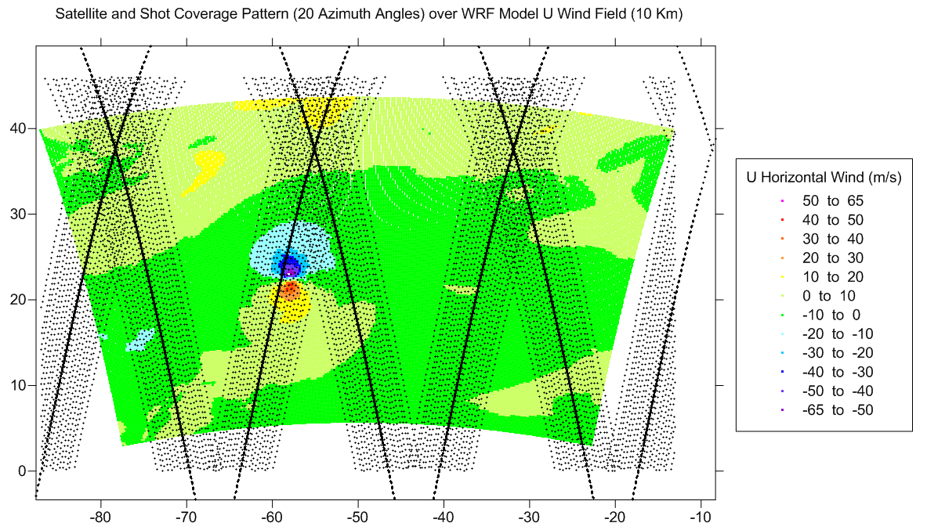

Slide 15
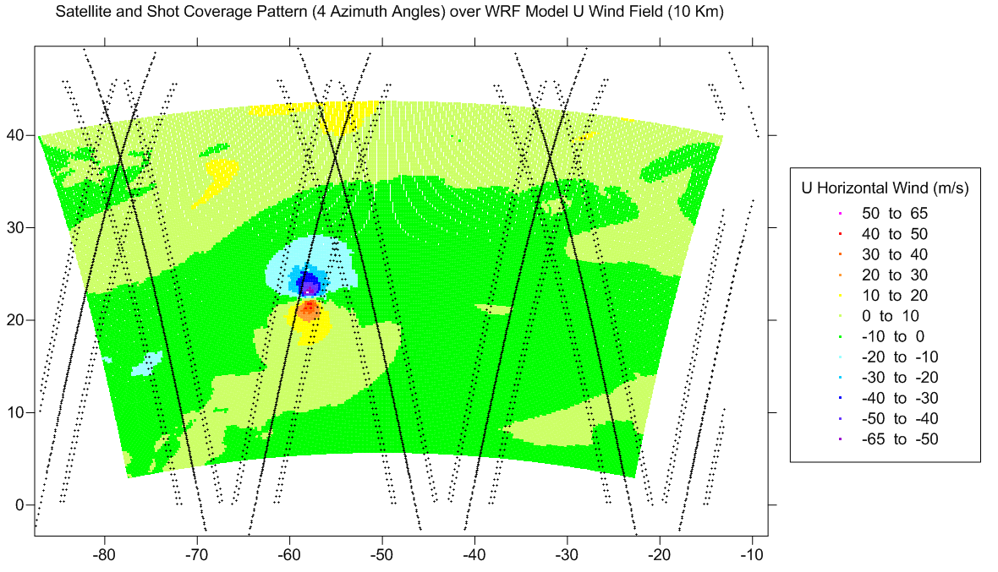

Slide 16
Summary
Cloud free DWL-like product simulations for 10 days have been completed for predictability reference experiments
Adjustment schemes to WRF NR clouds are being discussed and evaluated
Trade studies will be performed as described by Bob Atlas in previous presentation

