Slide 1
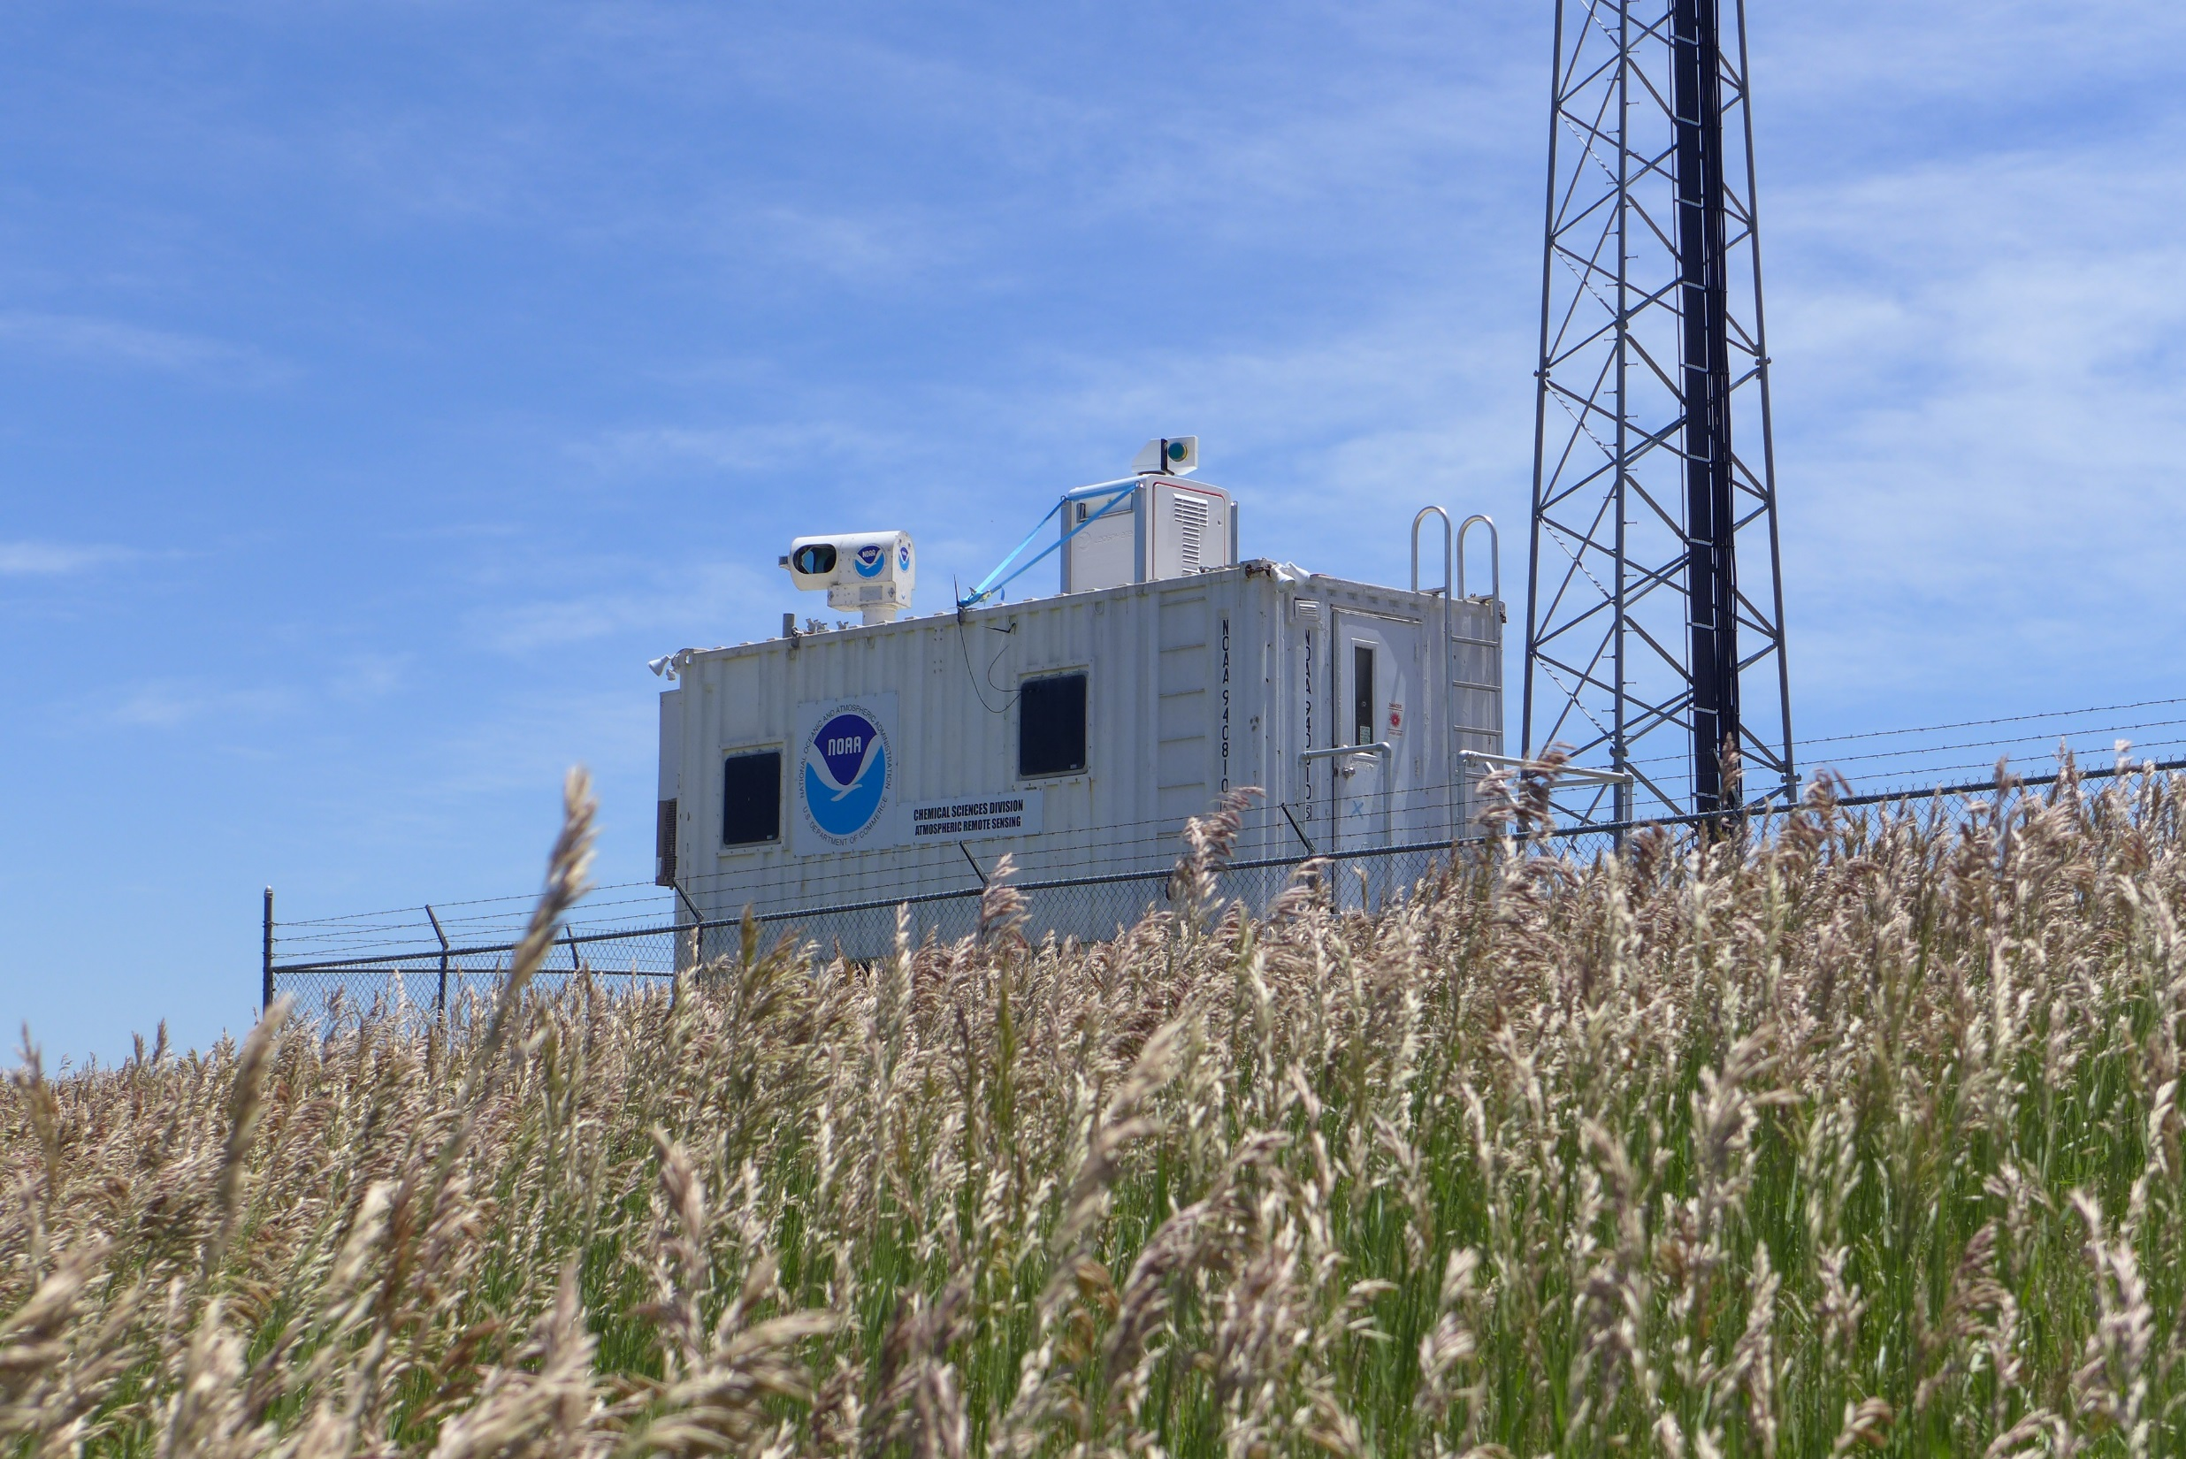
Lidar Uncertainty Measurement Experiment (LUMEX) (June 24th 2014 – July 13th 2014)
A. Choukulkar^{1,2}, W.A. Brewer², R.M. Banta², M. Hardesty^{1,2}, Y. Pichugina^{1,2}, Christoph Senff^{1,2}, S. Sandberg², A. Weickmann^{1,2}, G. Antoszewski³, B. Carroll³, R. Delgado³, J. K. Lundquist⁴, M. E. Rhodes⁴, B. Kosovic⁵, A. Muschinski⁶, K. Barr⁷, D. Wolfe⁸
¹Cooperative Institute for Research in Environmental Sciences, Boulder
²Earth Systems Research Laboratory, National Oceanic and Atmospheric Administration, Boulder
³University of Maryland Baltimore County, Baltimore County
⁴University of Colorado Boulder
⁵National Center for Atmospheric Research, Boulder
⁶North-West Research Associates, Boulder
⁷Lockheed Martin Coherent Technologies, Boulder
⁸Physical Sciences Division, National Oceanic and Atmospheric Administration

Slide 2
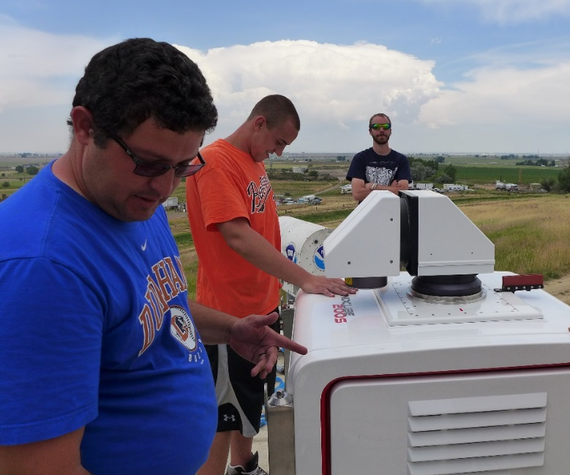
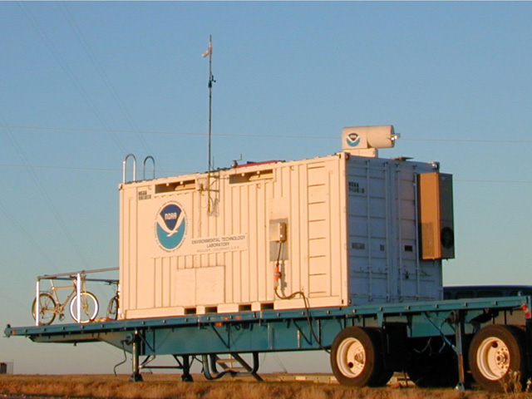
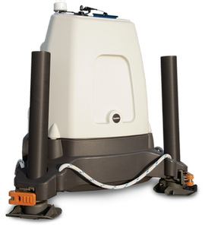
Instrumentation and Collaborators
Two WindCube V1s
Profiling lidars
Julie Lundquist et al., University of Colorado Boulder
One WindCube 200S scanning lidar
Ruben Delgado et al., University of Maryland Baltimore County
One ZephIR profiling lidar
Lockheed Martin Coherent Technologies Inc.
High Resolution Doppler Lidar (HRDL)
NOAA Atmospheric Remote Sensing Group (ARS)
BAO Tower sonics instrumented by Andreas Muschinski, North-west Research Associates

Slide 3
Goals
Sampling error analysis
Ozone flux and turbulence retrieval
Inter-comparison of single Doppler retrieval techniques
Testing dual Doppler retrievals
Study Error of Representativeness
Radar Wind Profiler Development and Evaluation

Slide 4
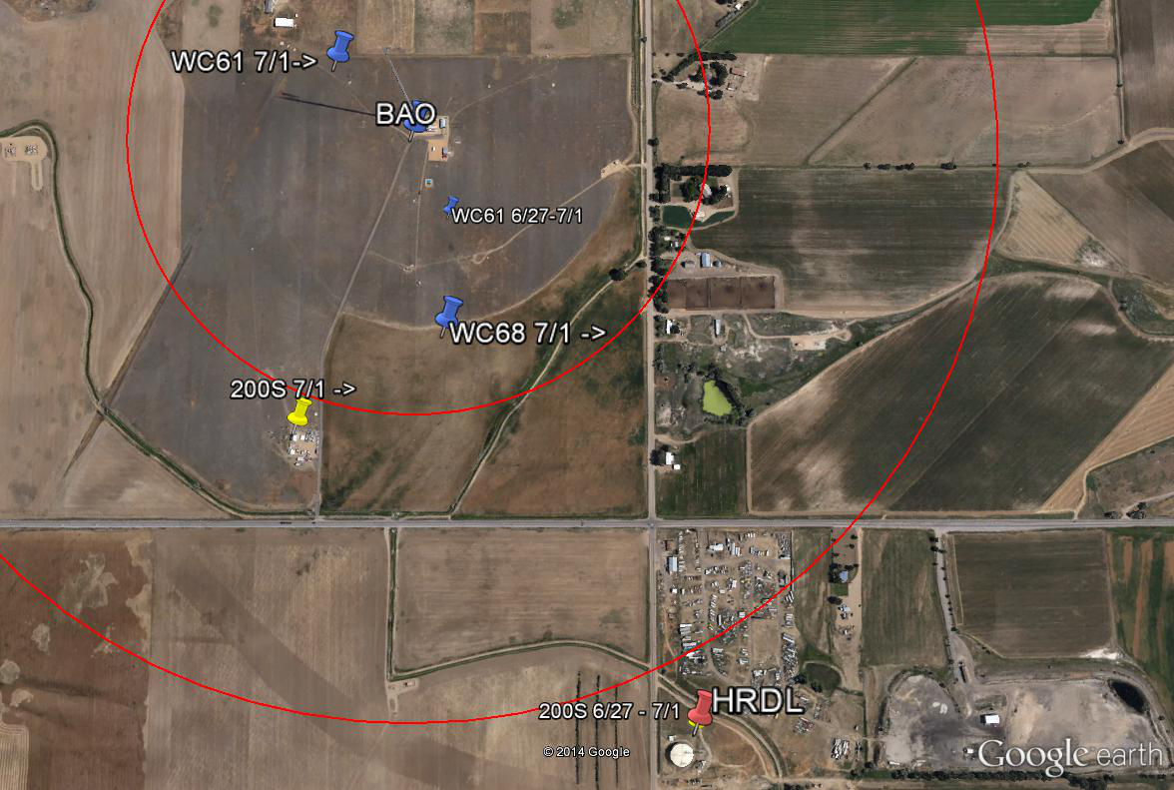
Instrument Layout
Inner red circle – 500 m
Outer red circle – 1000 m
BAO Tower
Water Tank Site
Visitor’s Center

Slide 5
Measurement Uncertainty (for Doppler Lidars)
Total Uncertainty
Sampling Error
Error of Spatial Representativeness
Vector Retrieval Error

Slide 6
I. Sampling Error Analysis
Notes:
Depending on the instrument and measurement strategy, sampling error is introduced in the measurement. For Doppler lidars this is a function of scanning strategy. This part of the experiment will help us to understand the sampling errors in the vertical velocity variance. This product is very useful for air quality applications to understand flux transport and also to determine mixing layer heights. Several analytical techniques (for example: Lenschow et al., 1994 and 2000) to determine sampling error will be tested and validated using this data.

Slide 7
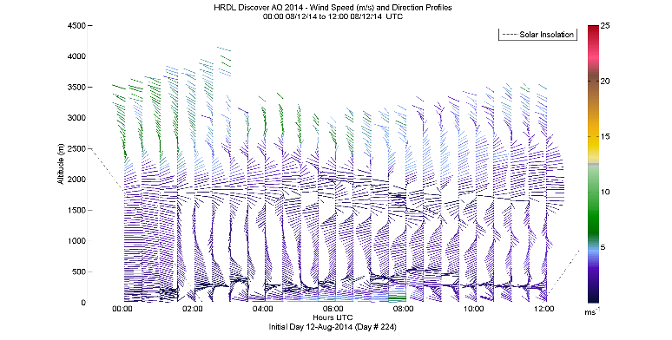
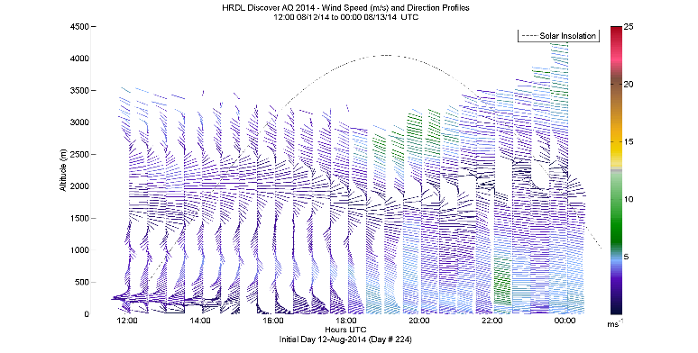
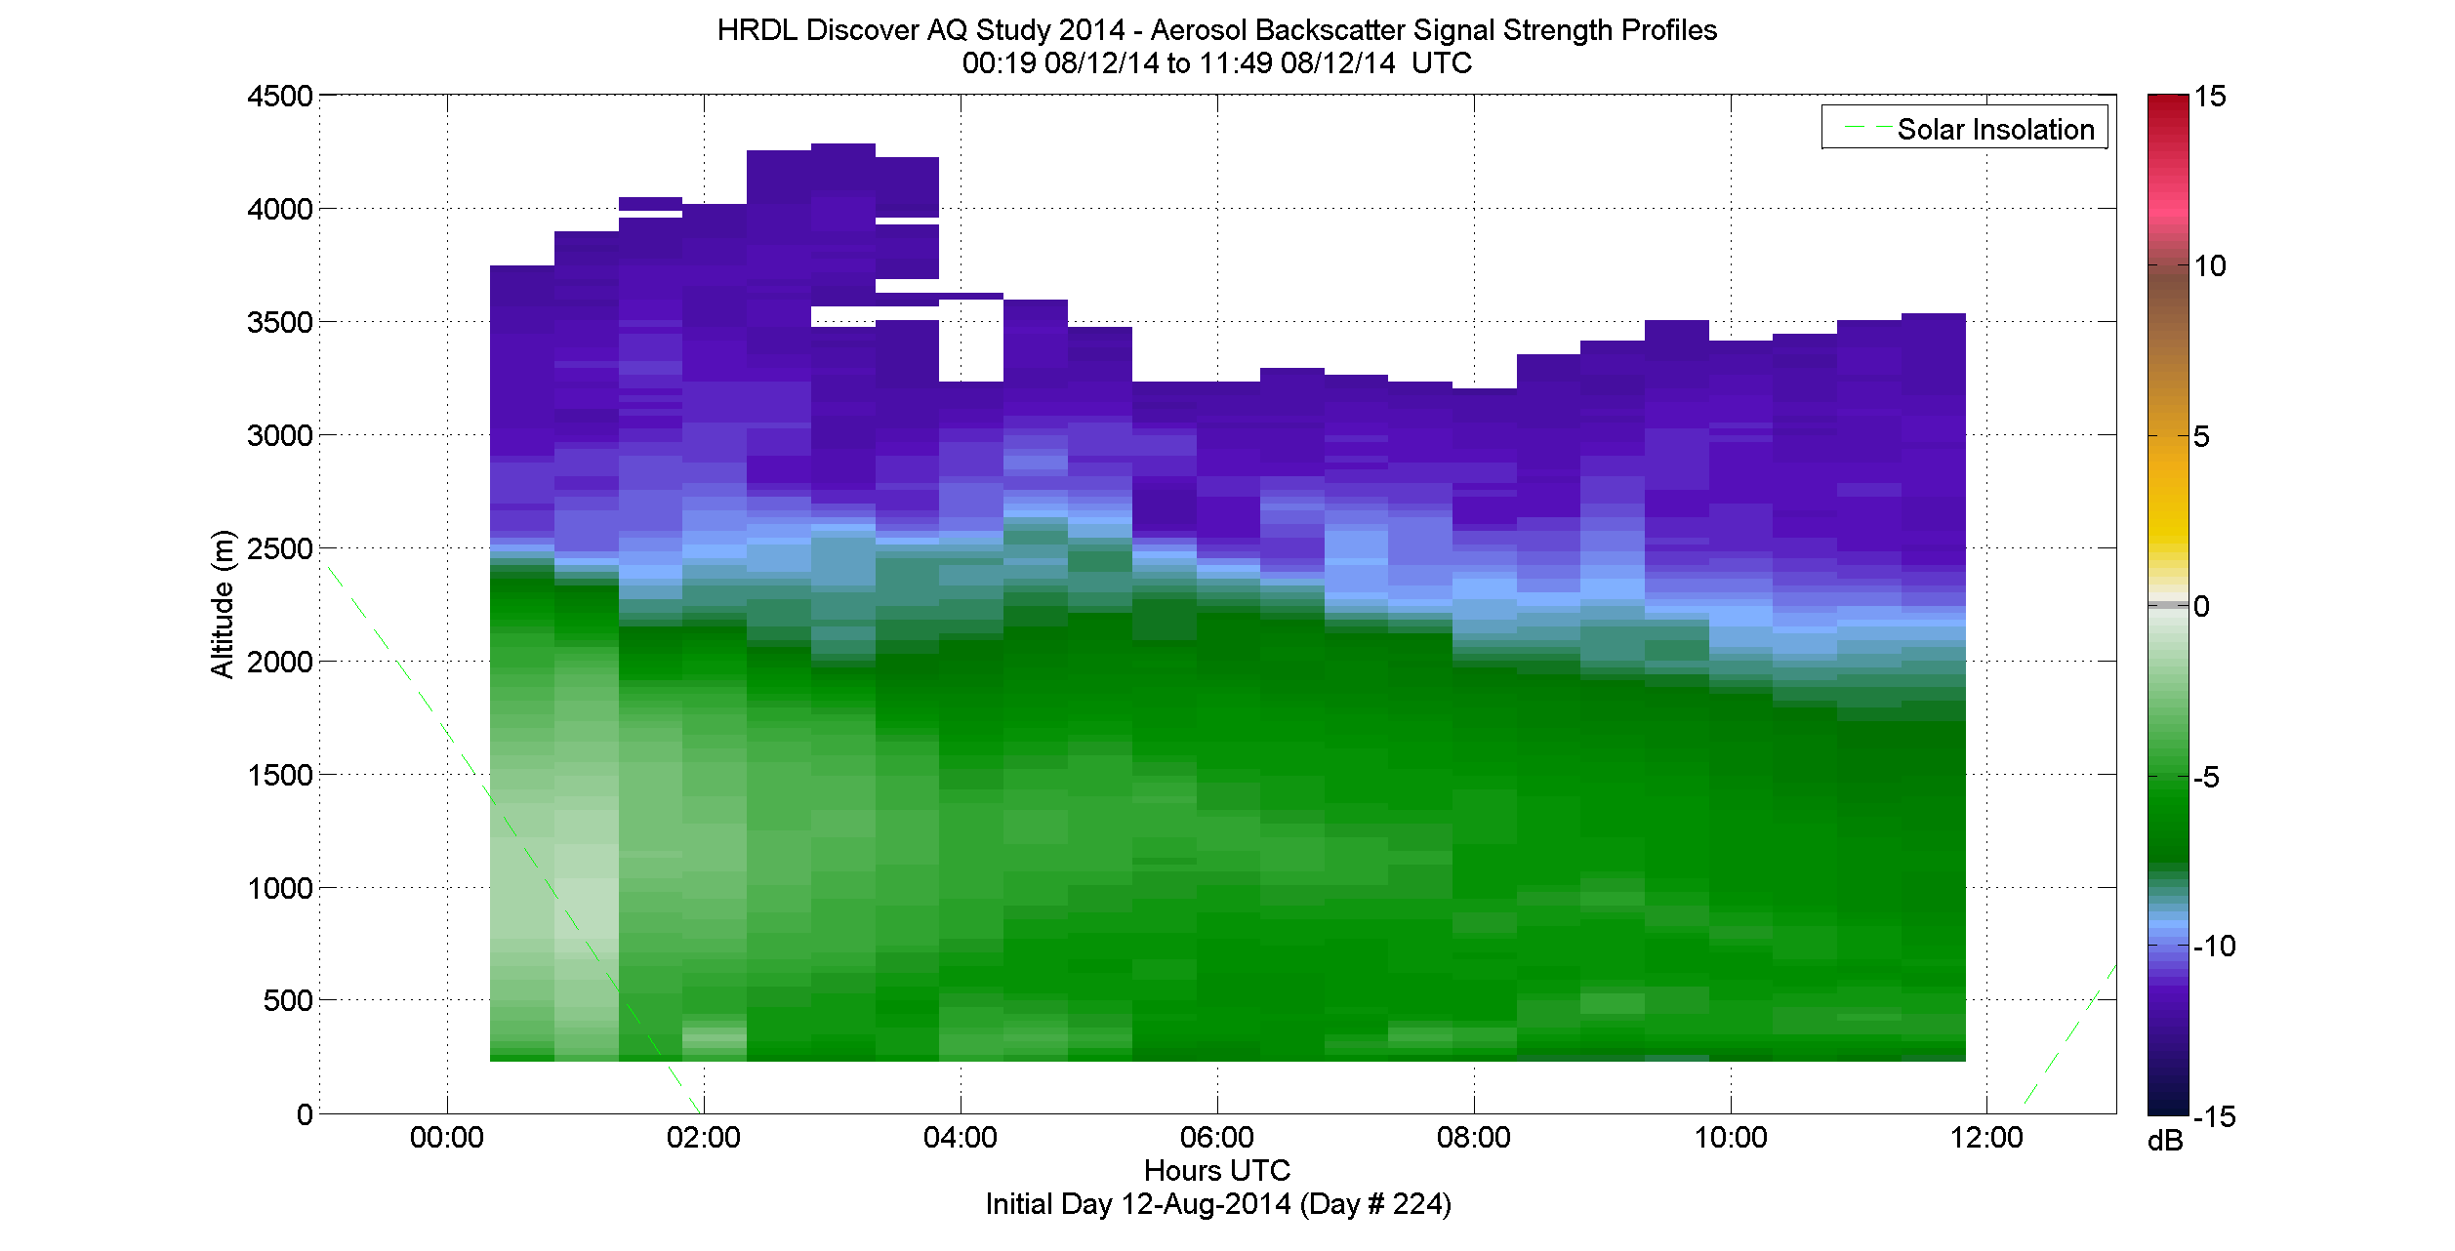
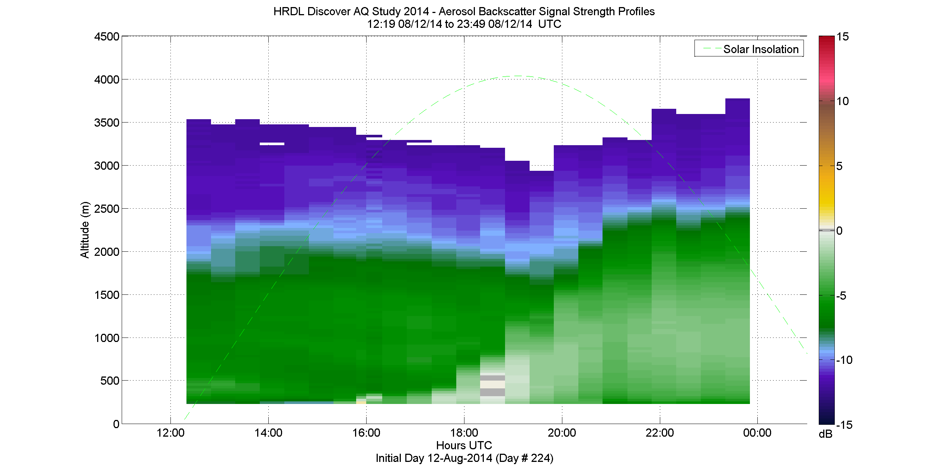
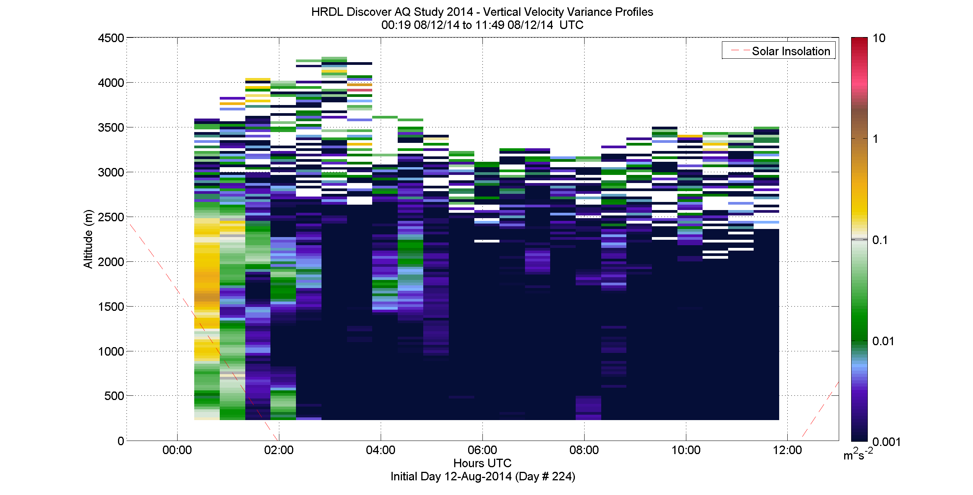
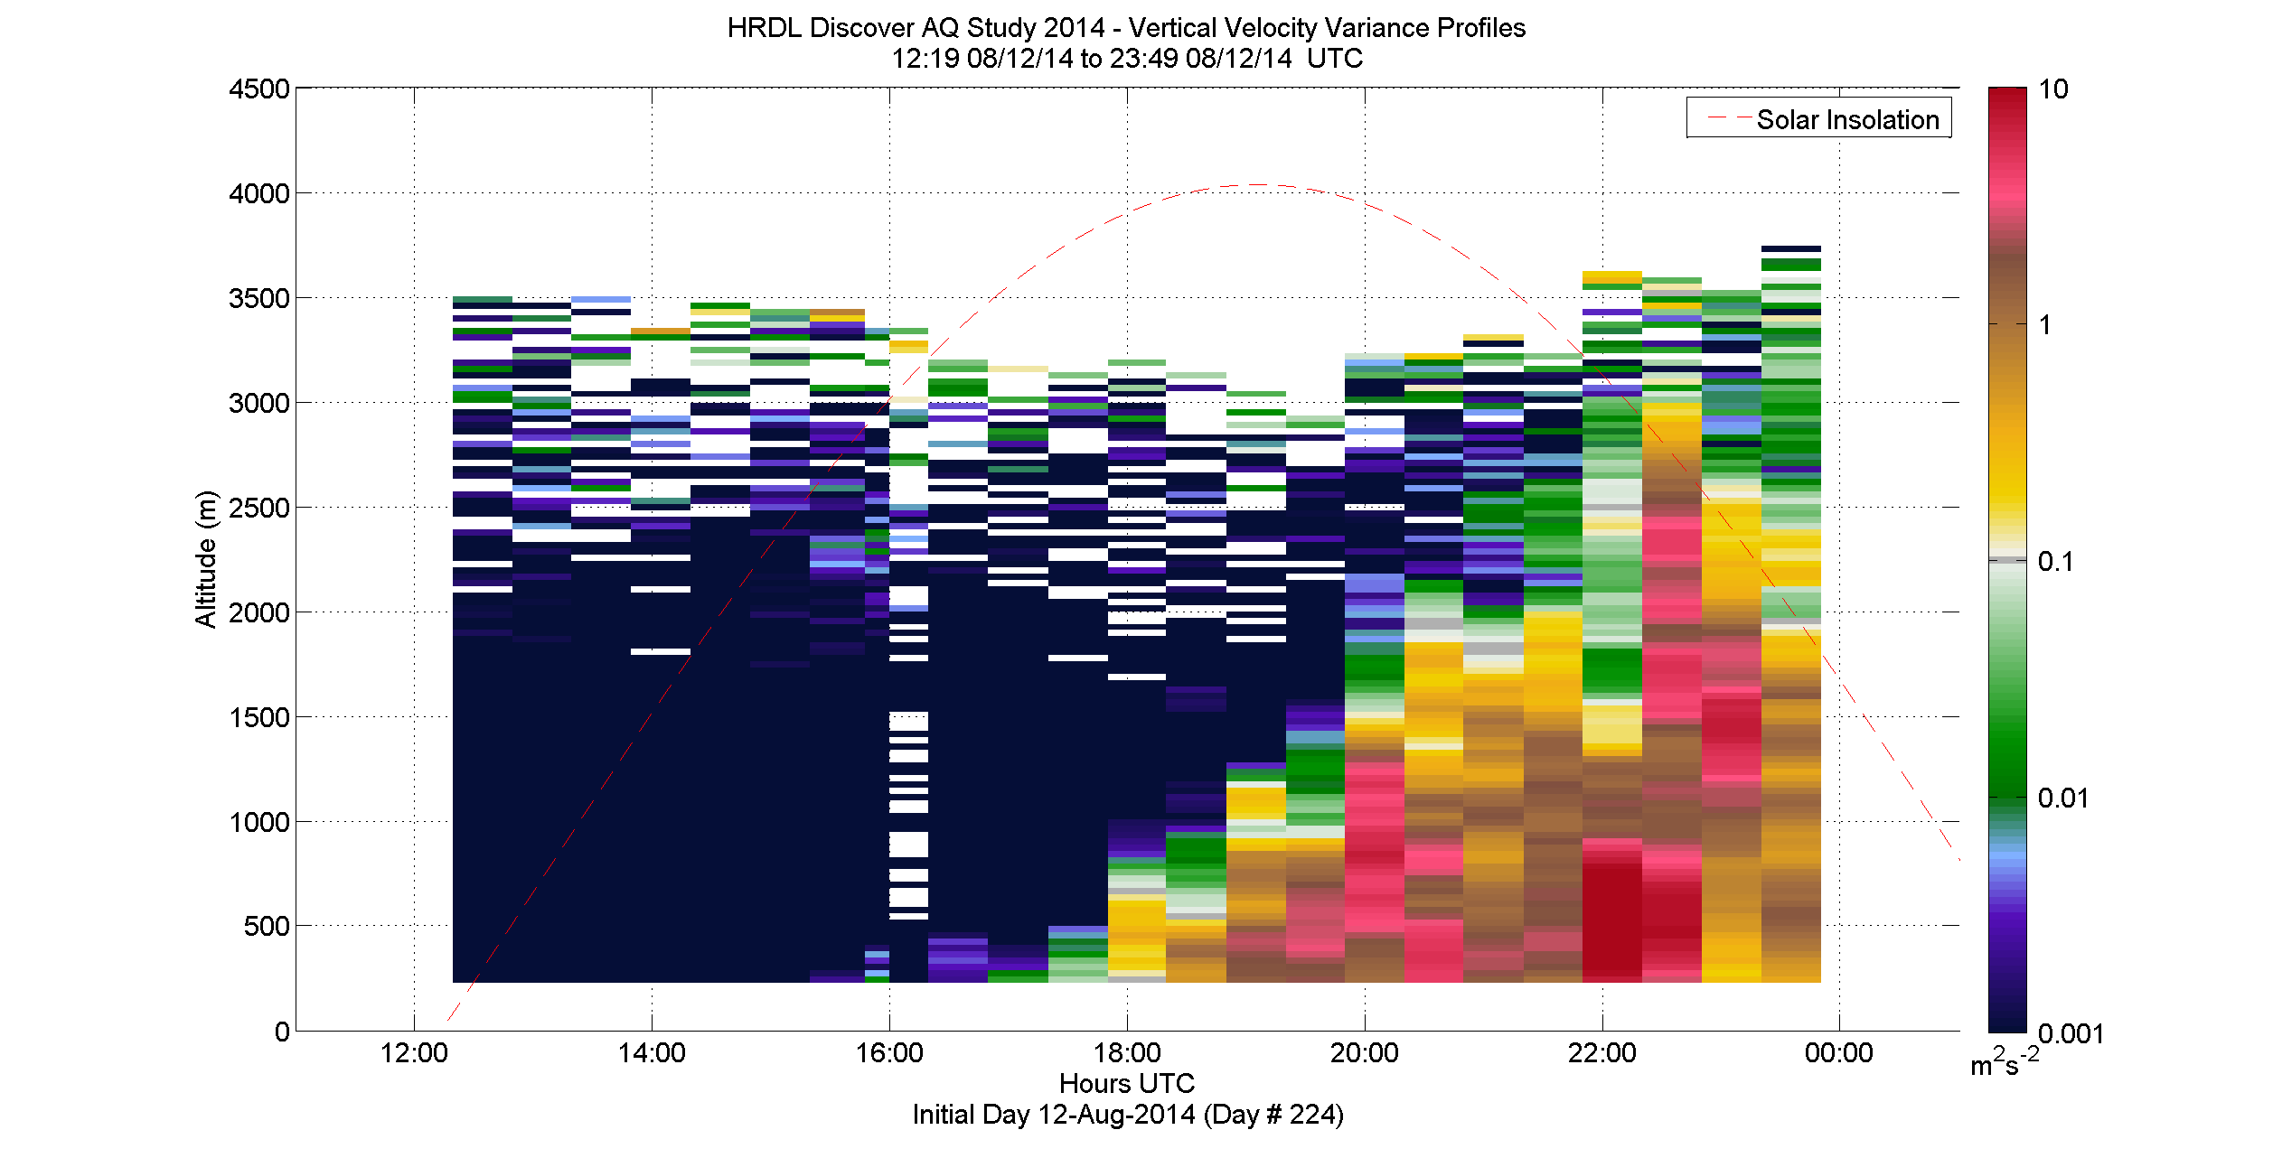
Why is this important?
Windspeed and direction profiles
Multiple deployment objectives
Designing the optimal scan queue
Aerosol backscatter profiles
0
Shallow PPI
10
High PPI
Shallow RHI
Zenith Stare
Vertical velocity variance profiles
20
minutes

Slide 8
Case 1: The textbook example
Vertical winds measured on June 29th, 2014

Slide 9
Case 1: Vertical Velocity Variance Sampling Error (July 29th, 2014 from 19:00 to 21:00 UTC)
Sampling Error calculated using method suggested by Lenschow et al., 1994 and Lenschow et al., 2000

Slide 10
Case 2: Afternoon period large scale event
Vertical winds measured on June 30th, 2014 from 20:00 to 22:00 UTC

Slide 11
Case 2: Results from Sampling Error Analysis (July 30th, 2014 from 19:00 to 21:00 UTC)

Slide 12
II. Study Error of Representativeness
Notes:
Depending on the instrument and measurement strategy, sampling error is introduced in the measurement. For Doppler lidars this is a function of scanning strategy. This part of the experiment will help us to understand the sampling errors in the vertical velocity variance. This product is very useful for air quality applications to understand flux transport and also to determine mixing layer heights. Several analytical techniques (for example: Lenschow et al., 1994 and 2000) to determine sampling error will be tested and validated using this data.

Slide 13
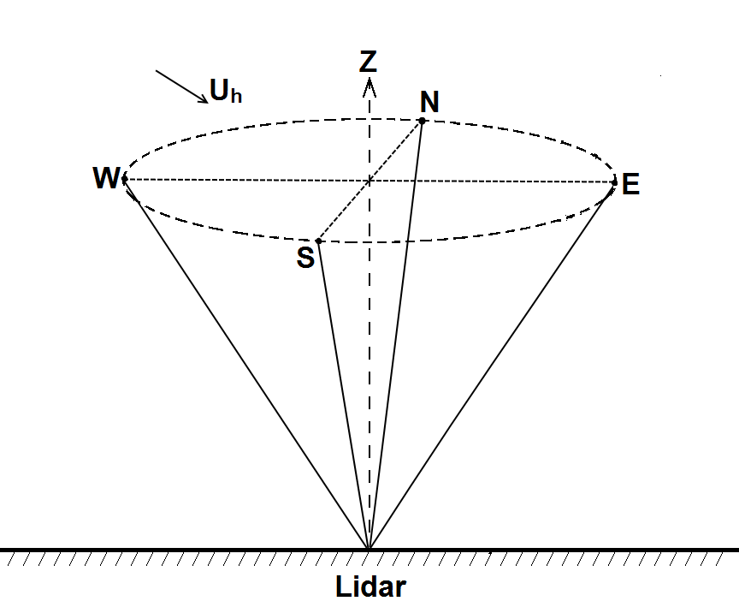
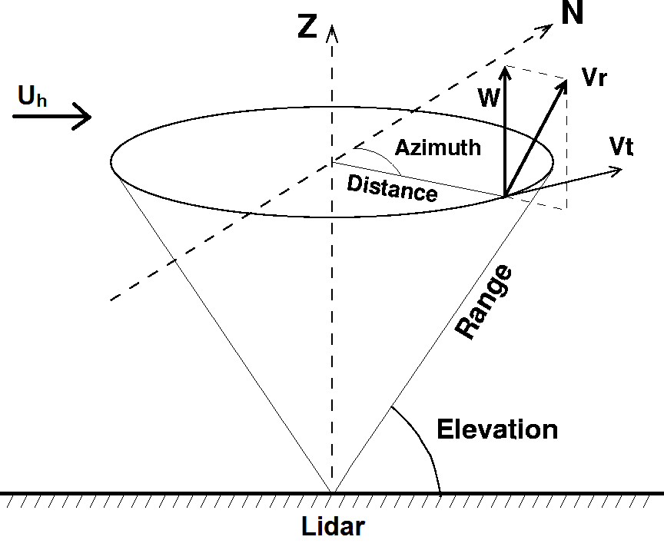
Spatial Footprint of Retrieval Techniques
Doppler Beam Swinging (DBS)
Space resolution = 20 m (vertical)
Time resolution = 2 mins
100 – 150 m
Velocity Azimuth Display (VAD)
Space resolution = 20 m (vertical)
Time resolution = 10 mins
Modified OI – 2D wind field with Space resolution = 2 x range-gate
Time resolution = Time to complete scan
1000 – 5000 m
For HRDL
Notes:
An important step when improved forecast models is comparing the forecasts with measurements. However, the question arises whether profiles of wind speed and direction provided by instruments at one location are representative of the wind speed and direction predicted by models for a grid box whose size can vary between 1x1 km² to 3x3 km². From this study we hope to have data which will help answer this question. This will enable better interpretation of the model-instrument intercomparison carried out during WFIP-2.

Slide 14
WindCube V1s Next to Each Other
2 min averaged velocities from 40m to 220m above ground

Slide 15
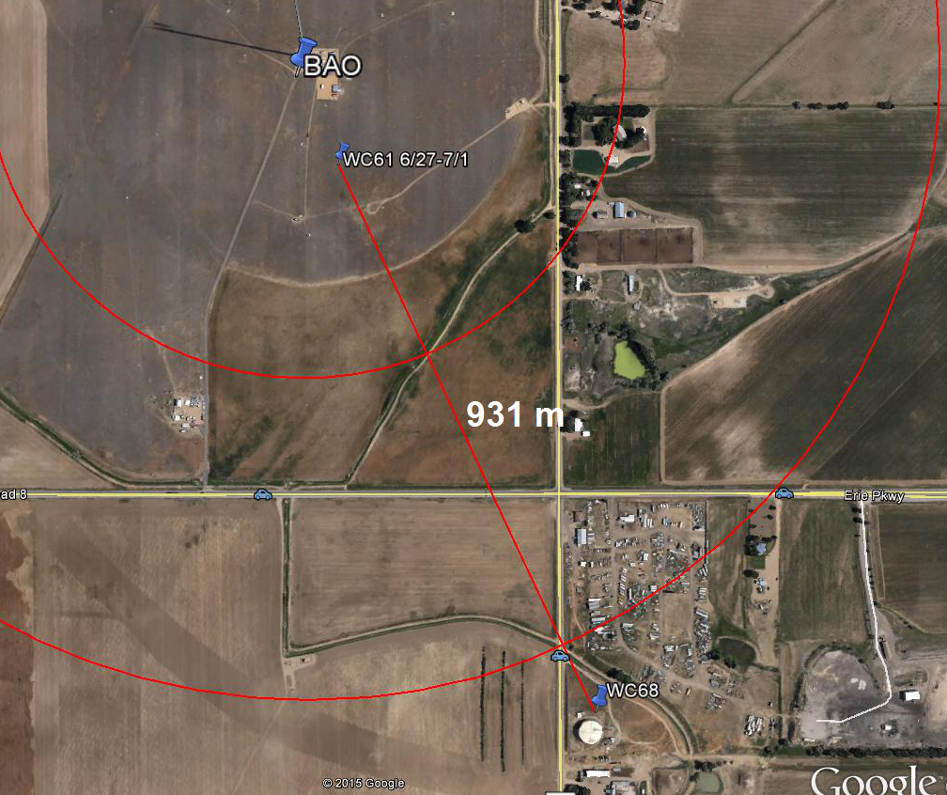
WindCube V1s Separated
2 min averaged velocities from 40m to 220m above ground

Slide 16
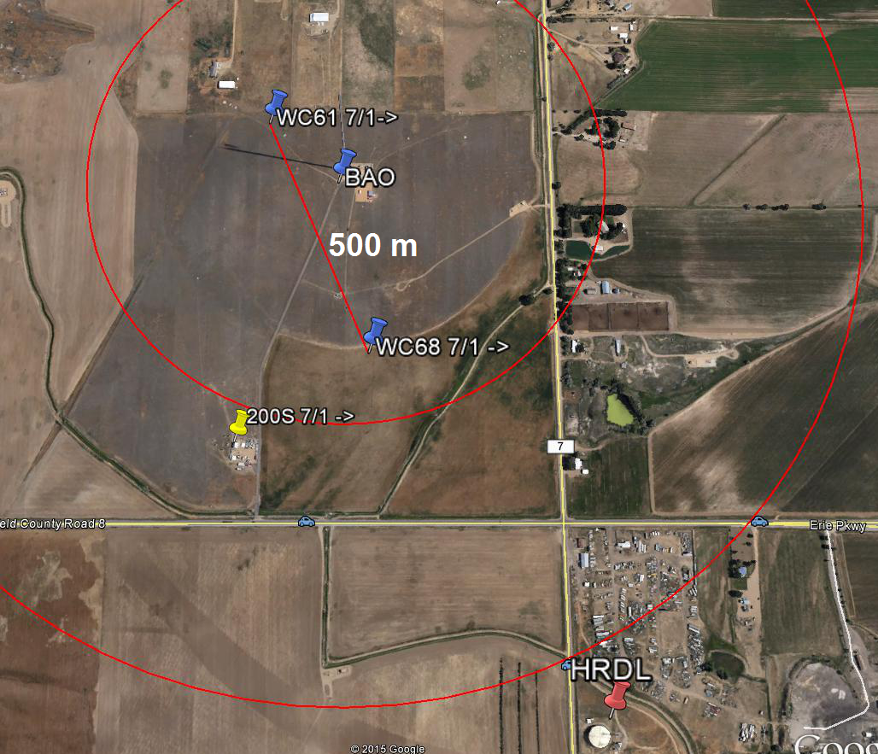
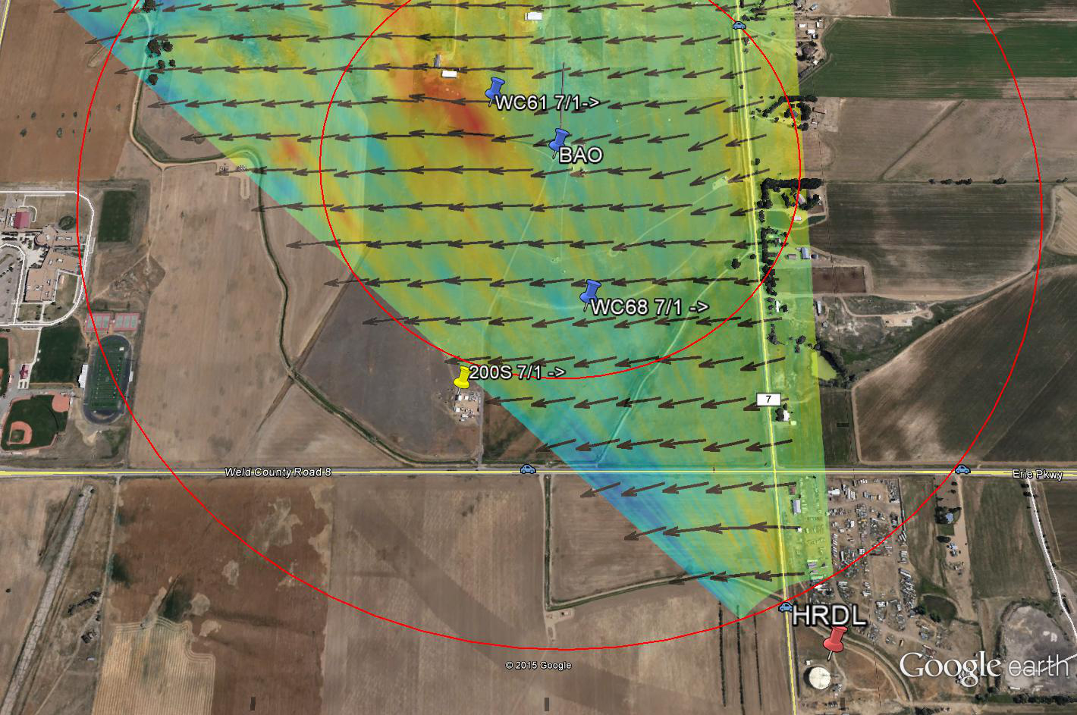
WindCube V1s Separated

Slide 17
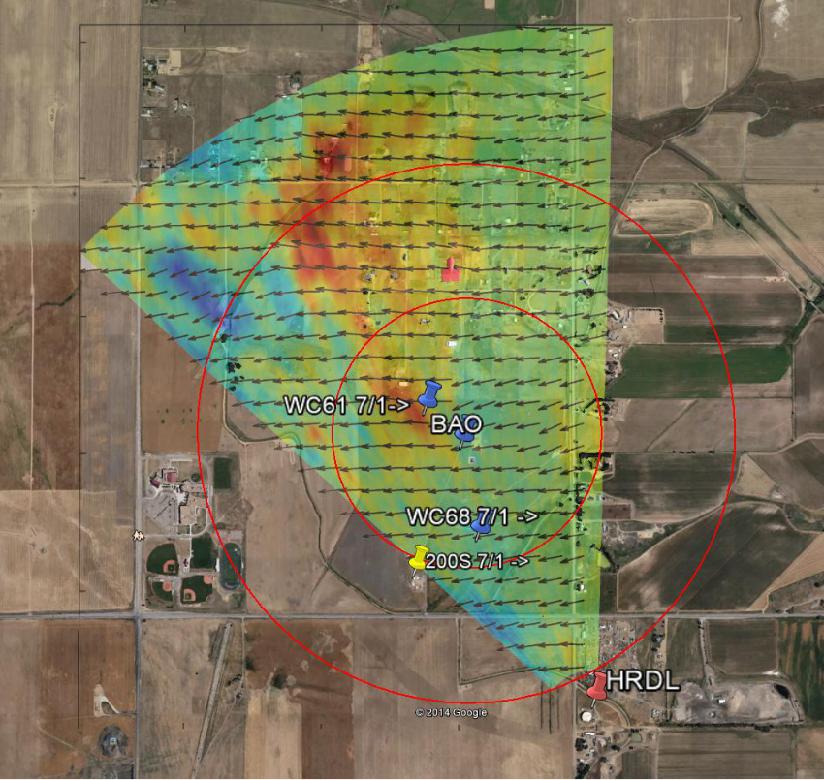
Telescoping Observation Network

Slide 18
Current/Future Work
Extend sampling error analysis using new data gathered during XPIA field study
Determine how spatial representativeness can be accounted for when comparing observations with models
Evaluating various turbulence retrieval strategies

Slide 19
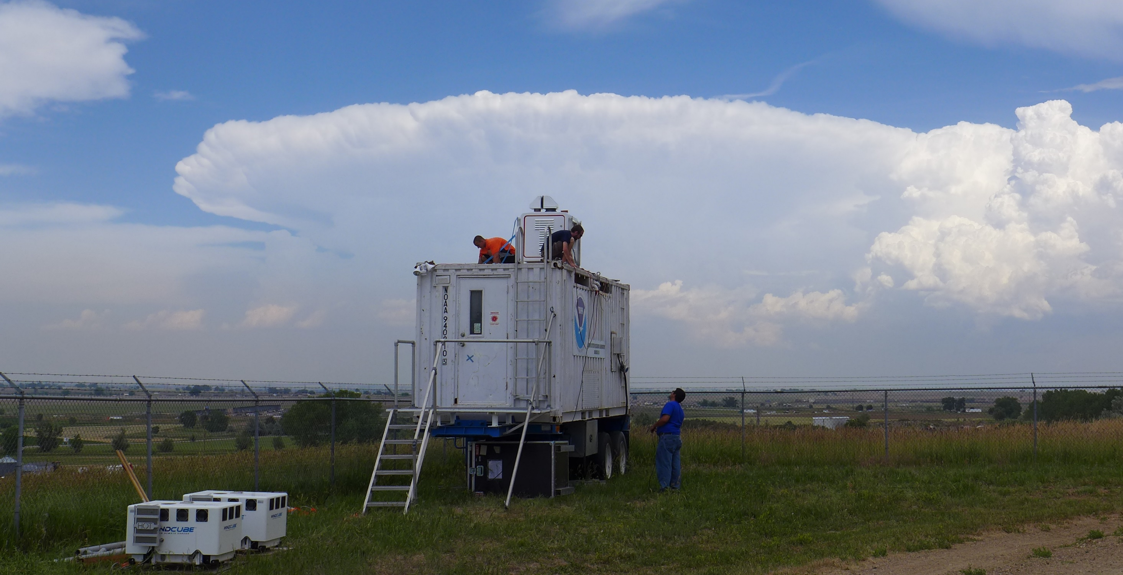
Thank You

Slide 21
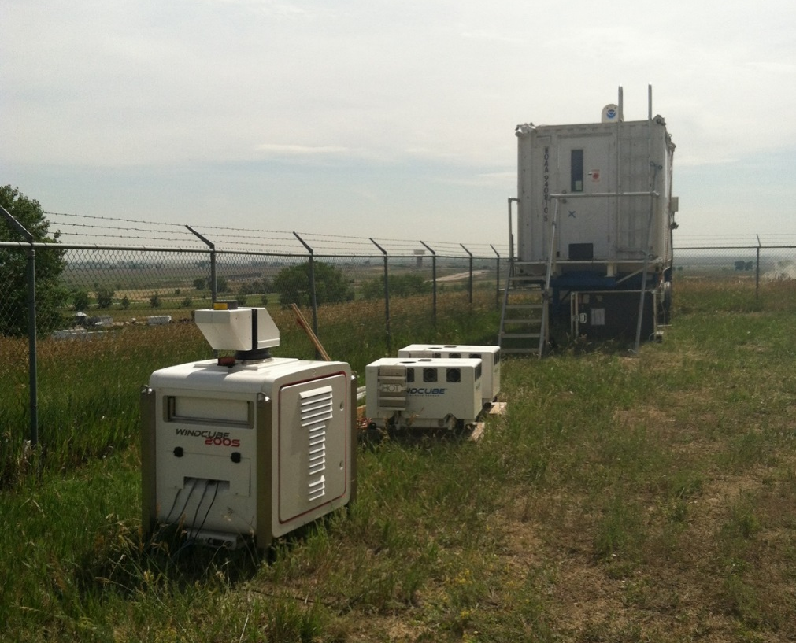
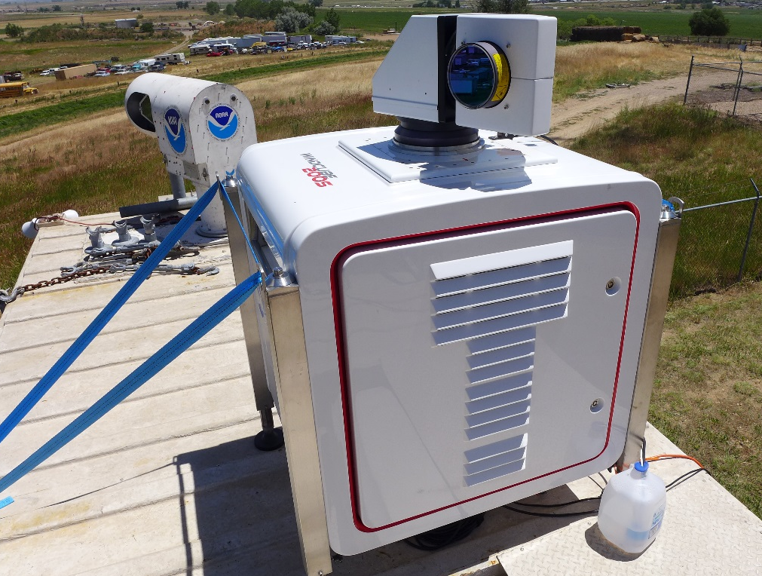
Calibration
Both WindCube V1s deployed at Water Tank site from June 23rd to June 26th.
WindCube 200S deployed on top of HRDL from June 25th to June 30th.
One WindCube V1 moved to near the BAO tower from June 27th to June 30th.
Objective: To establish the WindCube V1s as standards for comparing dual Doppler retrievals and to understand error of representativeness

Slide 22
Case 3: Transition period
Vertical winds measured on July 13th, 2014 from 16:00 to 17:00 UTC

Slide 23
Case 3: Results from Sampling Error Analysis (July 13th, 2014 from 16:00 to 17:00 UTC)

