Slide 1
Potential OSSE for
Space-based Lidar winds
Michiko Masutani

Slide 2
Observing System Simulation Experiment
Full global OSSE is conducted at JCSDA
A Nature Run (NR, proxy true atmosphere) is produced from a free forecast run using the highest resolution operational model which is significantly different from the NWP model used in Data Assimilation Systems.
Calibrations is performed to provide quantitative data impact assessment. Data impact on analysis and forecast will be evaluated.
A Full OSSE can provide detailed quantitative evaluations of the configuration of observing systems.
A Full OSSE can use an existing operational system including diagnostic tools and utilities. OSSE can also help the development of an operational system
No special data assimilation system for OSSE is required

Slide 3
Observing System Simulation Experiment
Collaboration
Full OSSEs are expensive
Sharing one Nature Run and simulated observation saves costs
Sharing diverse resources
Regional OSSE can be done with less resource at other institutes.
Global OSSE have to be conducted at major institutes.
OSSE-based decisions have international stakeholders
Decisions on major space systems have important scientific, technical, financial and political ramifications
Community ownership and oversight of OSSE capability is important for maintaining credibility
Independent but related data assimilation systems allow us to test the robustness of answers
List of references are available at
http://www.emc.ncep.noaa.gov/research/JointOSSEs/references

Slide 4
Various OSSEs Conducted in the past
TOVS,NASA (Atlas 1987)
WiNDSAT, AER (Hoffman 1990)
LAWS DWL, FSU (Rohaly and Krishnamurti 1992)
SWIFT OSSE,UK Met Office (Lahoz 2005, Keil 2004)
ADM Aeolos, KNMI,ECMWF (Stoffellen 2006)
Bracketting OSSE for DWL, by NCEP,NASA,SWA (Masutani et al 2006, 2009)
GWOS DWL,JCSDA (Riishojgaard et al 2012)
DWL Configuration,JCSDA(Ma et al 2014)
OAWL and WISCR, JCSDA,AOML,SWA (Conducted in 2012-2013)

Slide 5
JCSDA played the leading role for
International Joint OSSE Since 2006
Joint OSSE Nature Run by ECMWF
Data distribution
NASA/NCCS
Contact:
Ellen Salmon Ellen.M.Salmon@NASA.gov
NCAR
Currently saved in HPSS Data ID: ds621.0
Contact:
Chi-Fan Shih chifan@ucar.edu
ECMWF Nature run used at NOAA
Spectral resolution : T511
13 month long. Starting May 1st,2005
Vertical levels: L91, 3 hourly dump
Andersson, Erik and Michiko Masutani 2010: Collaboration on Observing System Simulation Experiments (Joint OSSE), ECMWF News Letter No. 123, Spring 2010, 14-16.
Joint OSSEs at JCSDA and collaborators
Evaluation of Infrared sounders on the geostationary Hyperspectral Environmental Suite (HES) and Microwave sounder -- JCSDA, UW/SSEC
Evaluation of Future configuration of GNSS-RO – JCSDA, ESRL
Evaluation of OAWL and WISCCR DWL -- JCSDA, SWA, AOML, BALL
Evaluation of DWSS and JPSS – JCSDA, AOML
Simulation of DWL planned from NASA (GWOS) -- JCSDA, SWA
Simulation and assimilation of Cloud Motion Vector, ASCAT – SWA, JCSDA
Evaluation of Impact of GWOS on monsoon, -- JCSDA, IITM

Slide 6
Development of OSSE Systems at JCSDA

Slide 7
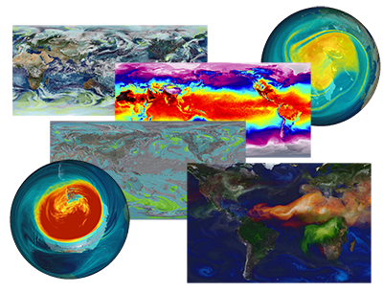
New Nature runs at JCSDA
GOES-5 Nature Run
By NASA/GSFC/GMAO
(G5NR)
GOCART model with full aerosol, full chemistry
Non-Hydrostatic
Global, 7 km, 72 level model from May 16, 2005-June2007
Data are available in 0.5deg and model resolution with 30min write up.
Pressure level data are provided in 0.5 deg
Various time mean data are also provided
Data are available through OPeNDAP to registered users.
For more detail visit:
http://gmao.gsfc.nasa.gov/projects/G5NR/
Comprehensive evaluations are conducted and posted.
Realistic climatology and many active tropical cyclones in G5NR . No serious temporal drift is apparent.
G5NR image by NASA/NCCS

Slide 8
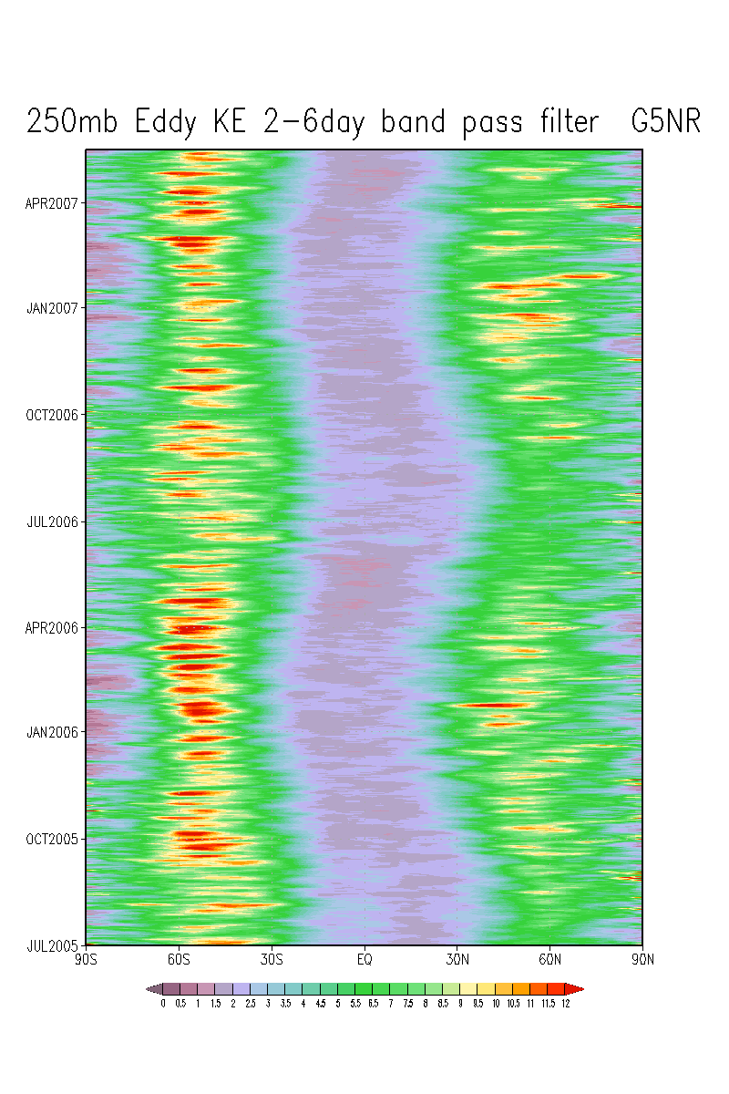
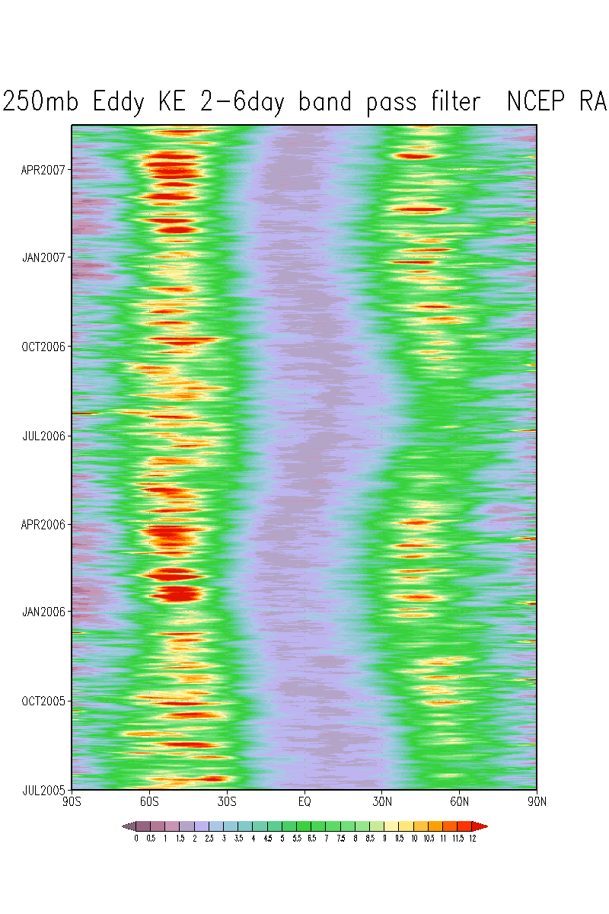
Comparison between 250 hPa Transient Eddy Kinetic Energy (tEKE)of the G5NR and NCEP(CFSR T382) reanalysis. Based on data sampled at 6-h, 2.5 degree resolution plotted as square root of variance, unit is m/sec
2–6 day band pass (Synoptic scale)
G5NR)
NCEP CFSR(T382)
m/s
Transient eddy kinetic energy (tEKE) in band passed fields is one of the standard fields included in the ECMWF atlas. (Kallberg, P. et al., 2006: ERA-40 Atlas, ERA-40 Project Report series No 19). tEKE proved to capture features which is not detected in mean fields.

Slide 9
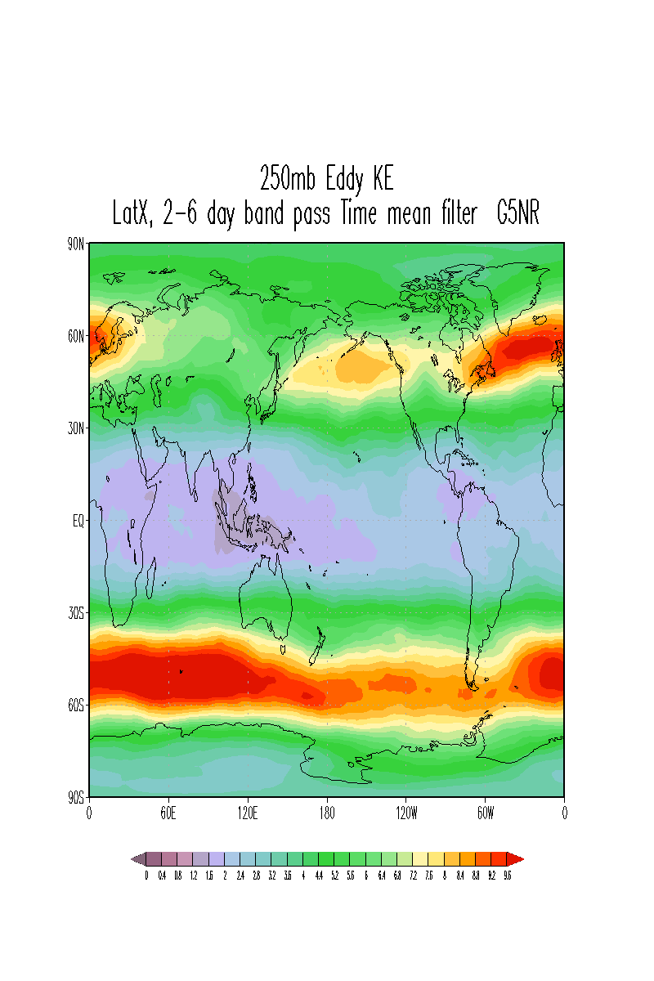
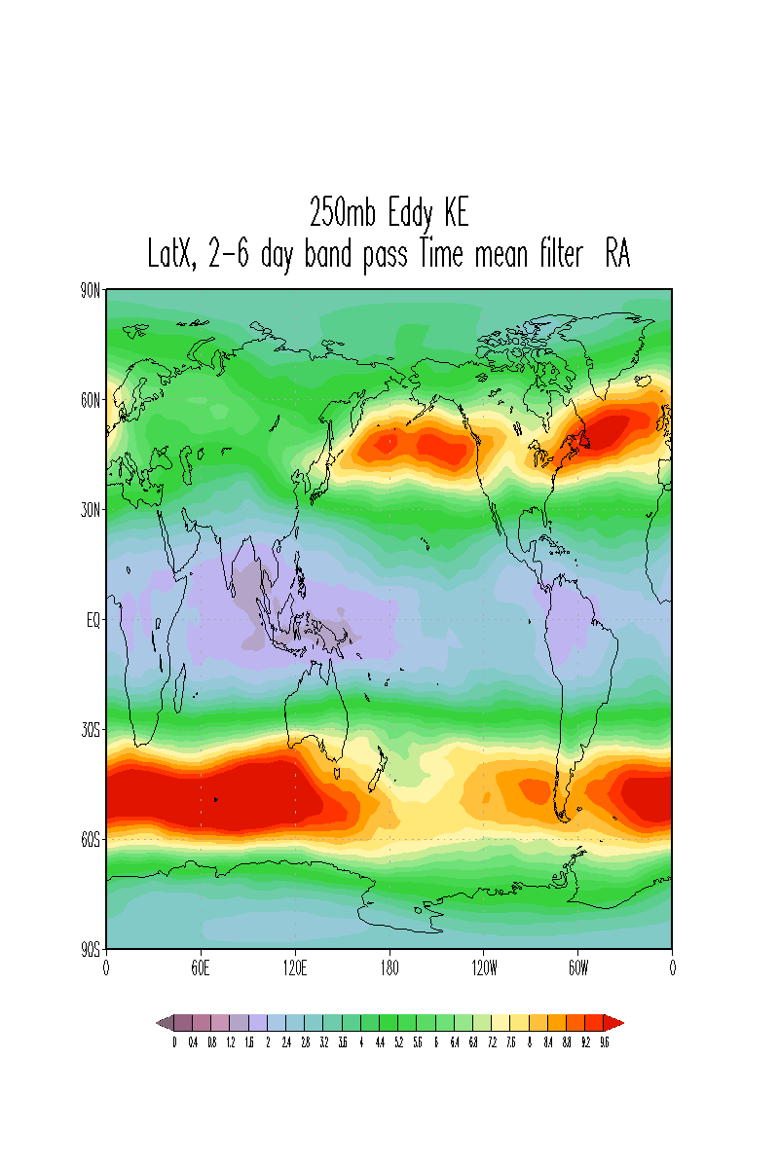
Time mean (Jul 2005 – Jun 2006), 2–6 day band pass
Comparison between 250 hPa tEKE of the G5NR and NCEP reanalysis
Based on data sampled at 6-h, 2.5 degree resolution.
Square root of variance are plotted with unit of m/sec
G5NR
NCEP CFSR Reanalysis
m/s
On all time scales, the G5NR zonally averaged tEKE does not show any serious drift away from that of the NCEP reanalysis.
On synoptic time scales (2–6 day band) G5NR tEKE is much weaker in the North Pacific jet region compared to the NCEP reanalysis.

Slide 10
Another Nature Run in preparation
ECMWF Nature Run
[Proposed configuration]
ECMWF IFS T1279 91 Level
March 1st, 2005- April 30th, 2006 (year of most active Atlantic hurricane)
High time resolution for selected period
[Sample data]
Sample data provided for hurricane period and midlatitude storm period.
[Status]
Still waiting for updated sample data and initial NR
G5NR is produced by a climate model and ECMWF model is a forecast model.
It is important to conduct OSSE with ECMWF Nature Run to confirm the OSSE results using G5NR. Particularly tropical and midlatitude interaction.

Slide 11
Simulation of observation at JCSDA
For current OSSEs
Conventional observation
Radio Sonde, Surface, Aircraft, Satellite Wind, Ship.
GPSRO (JCSDA and ESRL)
GPSRO Being simulated for bending angle are simulated.
Plan to upgrade forward model in 2015.
Simulation of Radiance
Type of radiance data location used operation in 2014
Two polar scenario (Data gap) is selected as a control:
amsua_metop-b iasi616_metop-b mhs_metop-b
seviri_m10
sndrD1_g15 sndrD2_g15 sndrD3_g15 sndrD4_g15 ssmis_f18
OSSE Package
Basic simulation codes.
GDAS code and scripts.
Verification package tested
CRTM is already posted from JCSDA web site

Slide 12
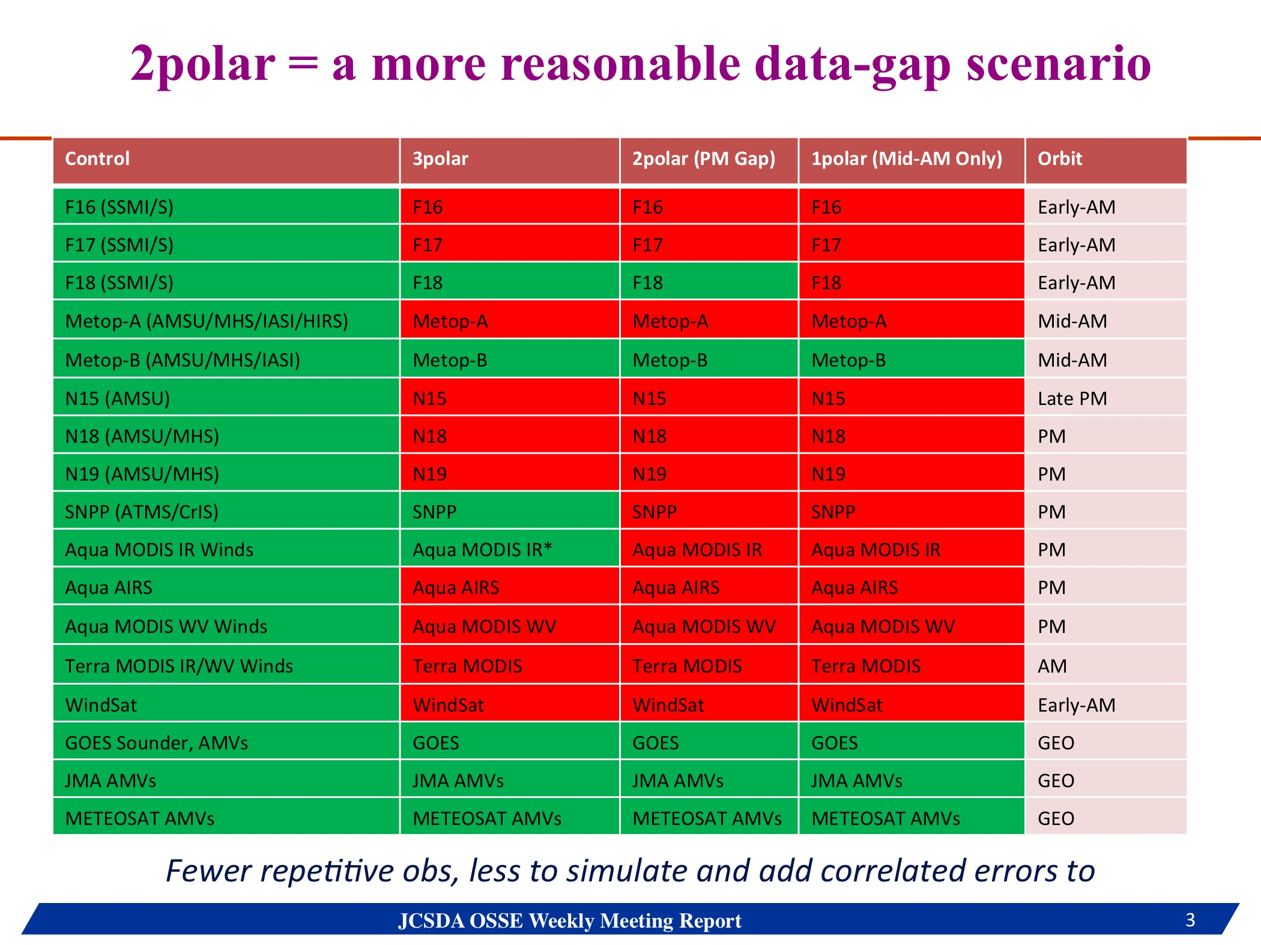
Two Polar data-gap scenario
Plan to use two Polar satellite scenario as control configuration
By NOAA/NESDIS

Slide 13
Advanced Verification Package
Included in OSSE package from JCSDA
Radiation Monitoring Package
Real
HIRS3 NOAA17
Simulated
Ch 12
Number of observations passing quality control
Contribution to the penalty

Slide 14
Current OSSE efforts at JCSDA
Conduct OSSE to Evaluate of Infrared sounders on the geostationary Hyper-spectral Environmental Suite (HES).
AIRS and IASI on full disk from Goes 13
IASI on GOES 15, M10, ISAT, JMA
Conduct OSSE to Evaluate of geostationary microsave sounders .
AMSU on GOES 15, M10, ISAT, JMA
Global OSSE experiments to assess the impact of additional future Global Navigation Satellite Systems (GNSS) Radio Occultation constellations. COSMIC-2 and beyond.
COSMIC
COSMIC-2

Slide 15
Potential OSSE for Space Based DWL
OSSE Capabilities at OSSE Test Bed/JCSDA
Access to computational resource
Access to information required for global OSSE.
Has simulated observation for control experiment.
OSSE package is being developed to simulate control observations.

Slide 16
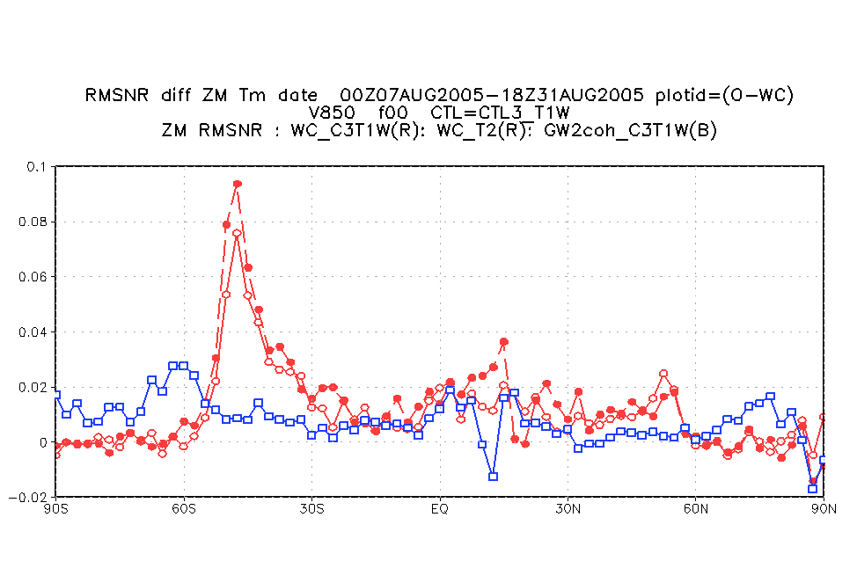
Space based Doppler Wind Lidar (DWL) in ISS orbit
Need to improve assimilation of DWL on ISS orbit
Impact on
V 850 hPa
Analysis impact (reduction of RMS Diff from NR, compared to control experiment (existing obs only). Only results from coherent Lidar are presented.
DWL with two looks to produce vector wind measurement.
Red, Solid line,open circle:ISS orbit (WISCR)T126 experiment
Red, Dashed line, closed circle: ISS orbit(WISCR) T254 experiment
Blue, Solid line, open circle: Polar orbit (Two side look subset of GWOS) T126 experiment

Slide 17
Change in OSSE system Since 2012 OSSE
Change in NCEP/GDAS system
Global 01/14/2015
* Increase horizontal resolution of the first segment of the forecast from Eulerian T574 (~27 km) to Semi-Lagrangian T1534 (~13 km)
Extend the length of forecast from 192 hours to 240 hours
* Stochastic physics in EnKF forecasts
* T574L64 EnKF ensembles
Global 05/22/2012 12Z (This upgrade is not included in JCSDA OSSE in 2012)
EnKF hybrid system
-Allow non isotropic bac ground error covariance
* GPS RO bending angle rather than refractivity
Satellite monitoring stats code included in Ops.
Preparation of DWL data
Assimilation code for DWL LOS are in operational code and tested by OSSE.
Need more work for verification utilities and preprocessors.
Controll data are changed to two polar data gap scinario

Slide 18
Proposed DWL OSSE
1. Repeat 2012 OSSE experiments with New GDAS system
Use observation already simulated. Maximum T382
2. Random error (and bias) added to control observation
Move on to the new NR (7km)
3 Simulation of DWL from the new NR
3a. SWA provide location of foot print. (Alt: JCSDA use same foot print from previous OSSE)
3b. JCSDA provide profile from NR at foot print (Volume of the data is much smaller than NR in it grid)
3c SWA simulate DWL from new NR profile.(Alt. JCSDA simulate LOS and add obs error from previous OSSE.)
Data assimilation
3D, 3D hybrid, 4D hybrid
Change resolution
Test various data assignment
5. Development
DWL monitoring utility

Slide 19
OSSE to improve other Arctic observing system
Proposal to NCEP/EMC collaboration
ISS orbit does not cover polar region.
Complementary OSSE to evaluate observation in polar region will be valuable.
NWP model and data assimilation has improved and are capable of providing reliable forecasts about 8 days in advance. The impact of Arctic weather on the midlatitudes becomes important to extend forecast capability.
Due to increasing activities in the Arctic region the economic impact of the region has increased and the cost of unreliable forecasts.
Arctic Observation community are not well aware of dealing with satellite data and data assimilation. There is a effort to introduce DA and satellite data to existing Arctic community.
ADM produce large amount of Wind observation in polar regions

Slide 20
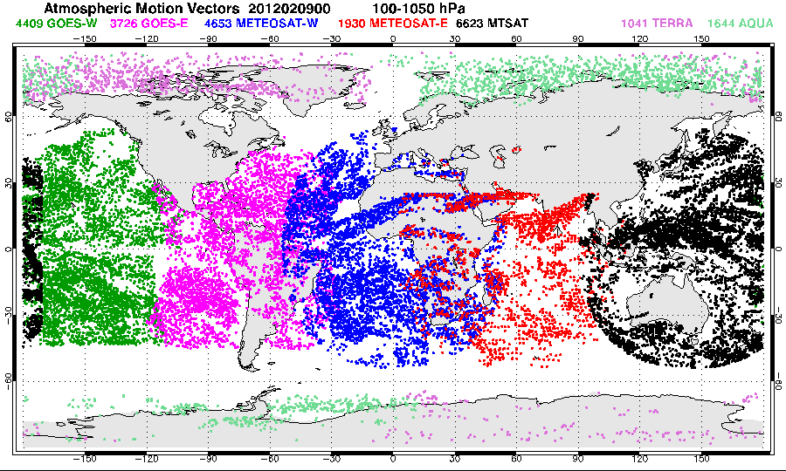
OSSEs Polar Communications and Weather (PCW) mission
Possible collaboration with Environment of Canada
PCW fill the AMV and ISS wind gap in Northern Hemisphere.
Current AMV coverage
After quality control
and thinning
More possible OSSE for Arctic Observing System
Masutani, M., L. Garand, W. Lahoz, L.-P. Riishojgaard, E. Andersson, Y. Rochon, M. Tsyrulnikov, J. McConnell, L. Cucurull, Y. Xie, S. Ishii, R. Grumbine, G. Brunet, J. S. Woollen, and Y. Sato, 2013: Observing System Simulation Experiments: Justifying new Arctic Observation Capabilities, White paper on OSSE Optimized Modelling, National Centers for Environmental Prediction Office Notes No 473. http://www.lib.ncep.noaa.gov/ncepofficenotes/files/on473.pdf

Slide 21
END

