Slide 1
PolarWinds Campaign I results and plans for Campaign II
G. D. Emmitt, S. Greco and K. Godwin
Simpson Weather Associates
Wind Lidar Working Group Meeting
Boulder, 2015

Slide 2
NASA’s PolarWinds and ADM Cal/Val
Two Campaigns:
  Campaign 1 November 2014 on UC-12B based Kangerlussuaq, Greenland
  Campaign 2 May 2015 on DC-8 based Keflavik, Iceland
Purposes are to conduct basic polar science investigations and to demonstrate technology readiness for ADM Cal/Val
Critical support from NASA Headquarters (Kakar) and LaRC(Singh)
Science and Instrument Team
  Emmitt (SWA) , Principal Investigator
  M. Kavaya(NASA/LaRC), Technology Lead
  G. Koch (NASA/LaRC), Instrument Chief Engineer
  S. Greco (SWA)
  K.Godwin (SWA)
  D. Bromwich (OSU)
  K. Heins (OSU)
  J. Cassano (CU)
  R. Foster (U Wash)
  M. Shapiro (NCAR)
  D. Winker (NASA/LaRC)

Slide 3
PolarWinds:
Campaigns 1 &2 Science Objectives
Validate numerical model forecasts and reanalysis characterizations of airflow in the lower atmosphere over the open oceans, land, ice sheets and transition zones of the Arctic.
Conduct detailed investigations into the importance of dynamic features such as Arctic low level jets and organized large eddies to the transport and fluxes of heat and energy.
Characterize and study the wind regime of the lower atmosphere over marginal ice zones in the Arctic, where ice drift and other processes are largely controlled by the low-level winds.
Provide real measurements that can be used to validate or compare with existing remote sensing platforms. Three examples will be CALIPSO aerosol measurements , MODIS Atmospheric Motion Vectors and ASCAT Ocean Vector Winds. Additional comparisons will be made with observing systems identified by ESA and the PolarWinds Science Team.

Slide 4
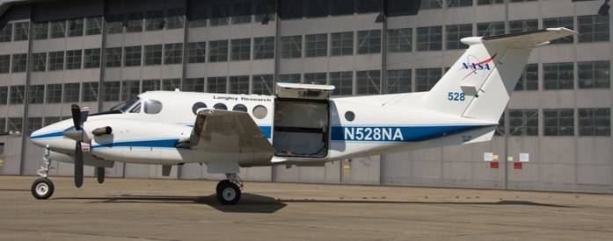
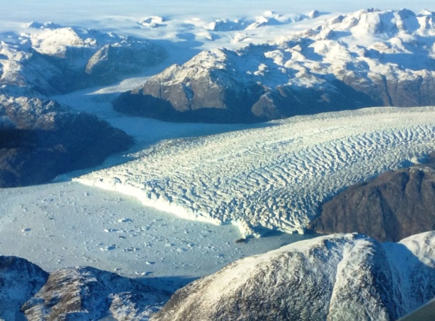
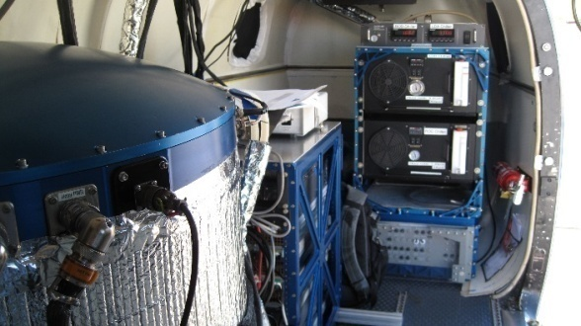
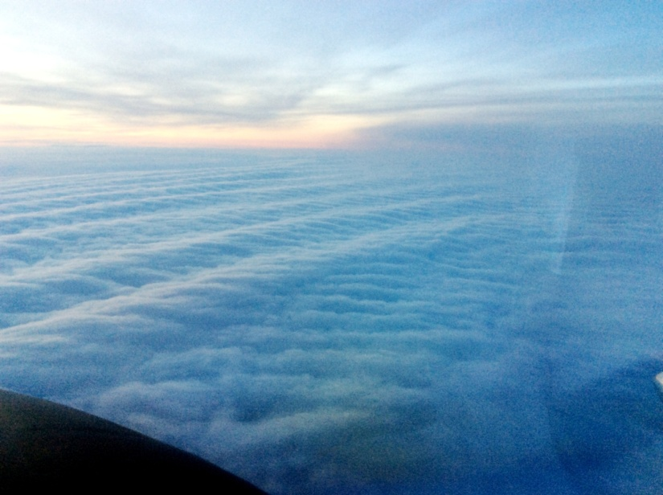
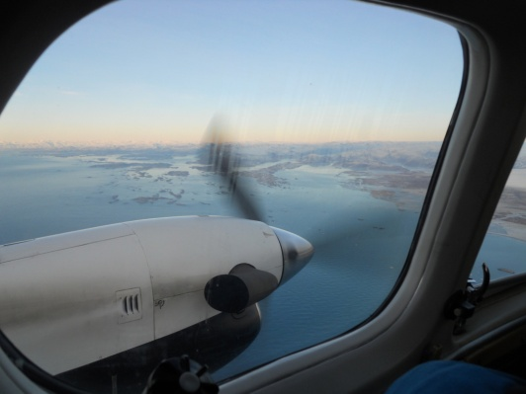
NASA/LaRC UC-12B
ADM/PolarWinds Campaign1
2014
2 um
220 mJ
10 Hz
15 cm
DAWN
Complex terrain
and surfaces
Stable Boundary Layer Laboratory
Coastal transitions

Slide 5
Mission Types
Satellite Under Pass (SUP) missions
Model Validation (MVAL) missions
ADM Cal/Val (ADM_CV) missions
OLE experiments
Tip Jet missions
Ice Cap Missions

Slide 6
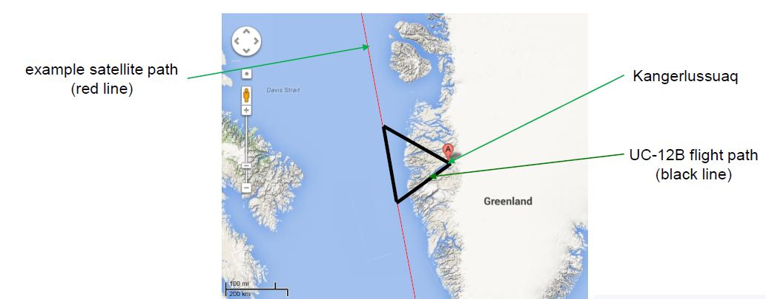
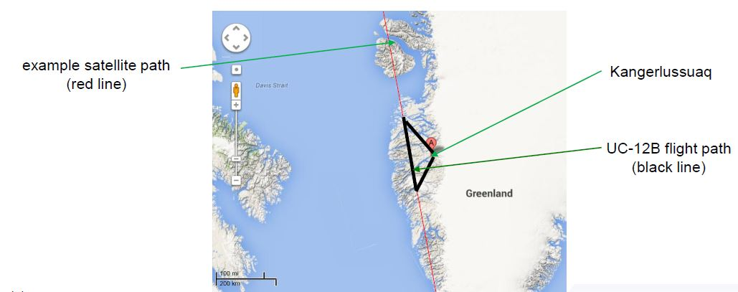
Example Campaign 1 Mission Profiles
Satellite Under Pass
ADM LOS Wind Simulations

Slide 7
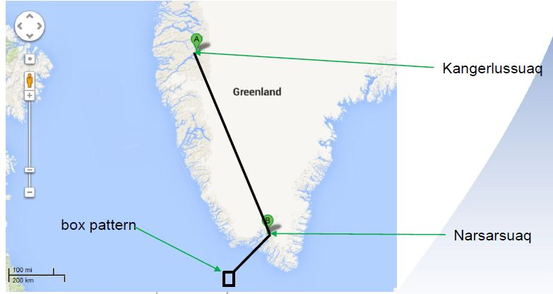
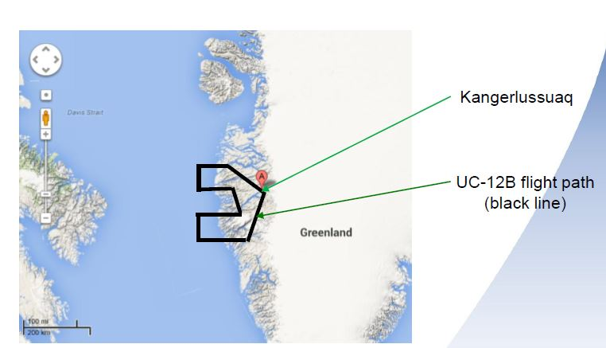
Example Campaign 1 Mission Profiles
Greenland Tip Jet Investigation
Model Validation: Land/Sea Boundary

Slide 8
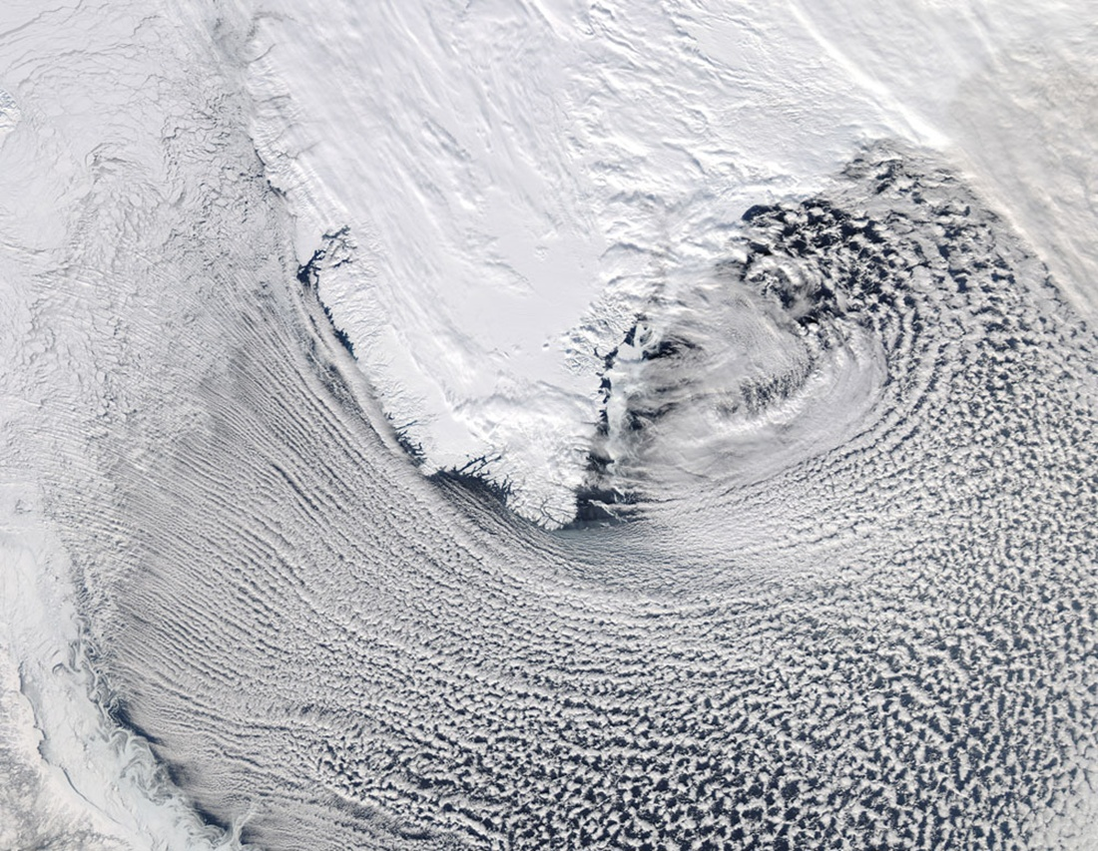
Cold air flow over ice:
smaller-scale rolls,
near-neutral, possibly
slightly stable
Cold air flow off ice,
over warmer water:
larger-scale rolls, merging,
Broadening, deepening
PBL transition from
roll regime into
convective regime
EDMF Needed

Slide 9
General Missions Summary
14 flights on 13 days
~ 45.5 science flight hours
22 ADM simulation segments
3 CALIPSO segments
~ 10 MODIS segments
~ 10 ASCAT segments
2 “Tip Jet” missions
Numerous missions overflying the Ice Cap and regions of BL rolls/waves.

Slide 10
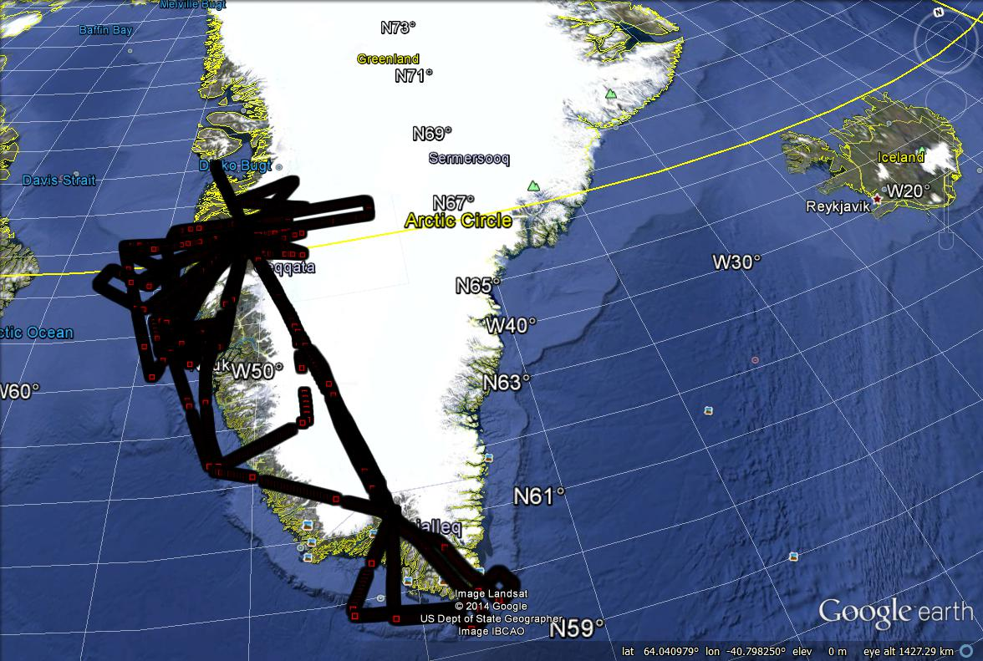
Composite of flight tracks

Slide 11
ADM/PolarWinds Case Study
11/07/14
Flight Objectives
  Model validation
  ASCAT under flight
  MODIS under flight
  ADM sampling simulation
Coastal
Complex wind patterns predicted by models
DAWN soundings below 3000m

Slide 12
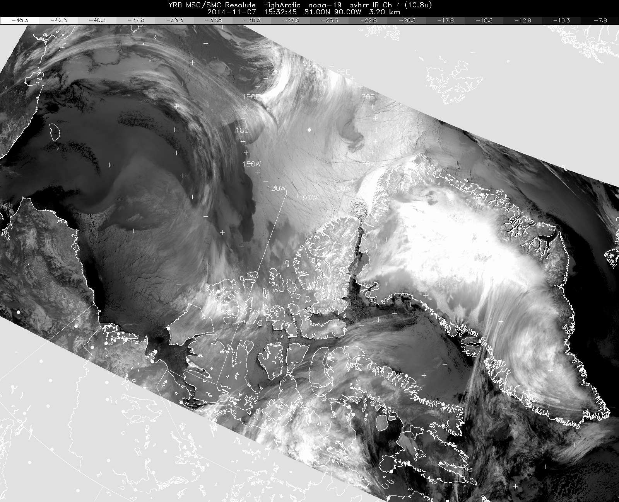
Area of investigation

Slide 13
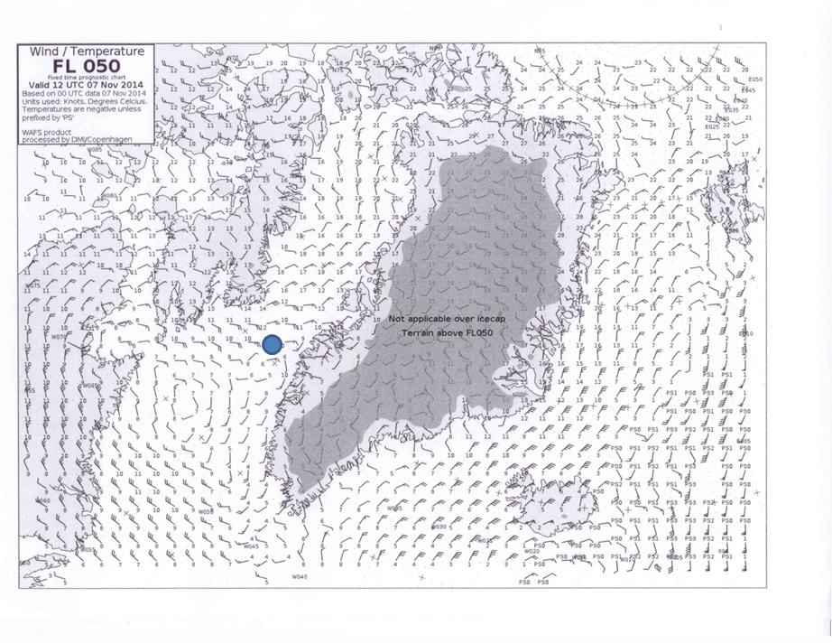
Danish Meteorological Institute 12Z forecast
winds at 5000 (~1500m)

Slide 14
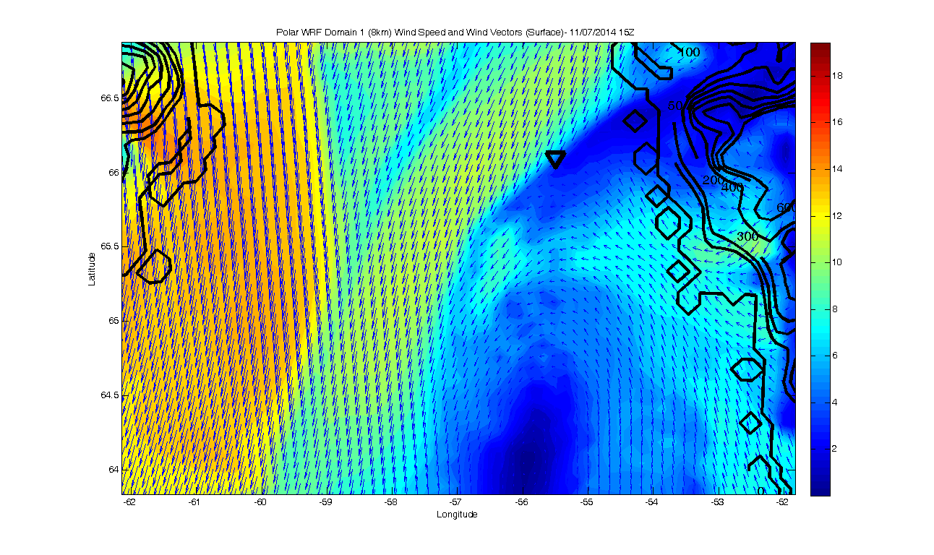
Polar WRF surface winds 11/07/14 15Z
Area of investigation

Slide 15
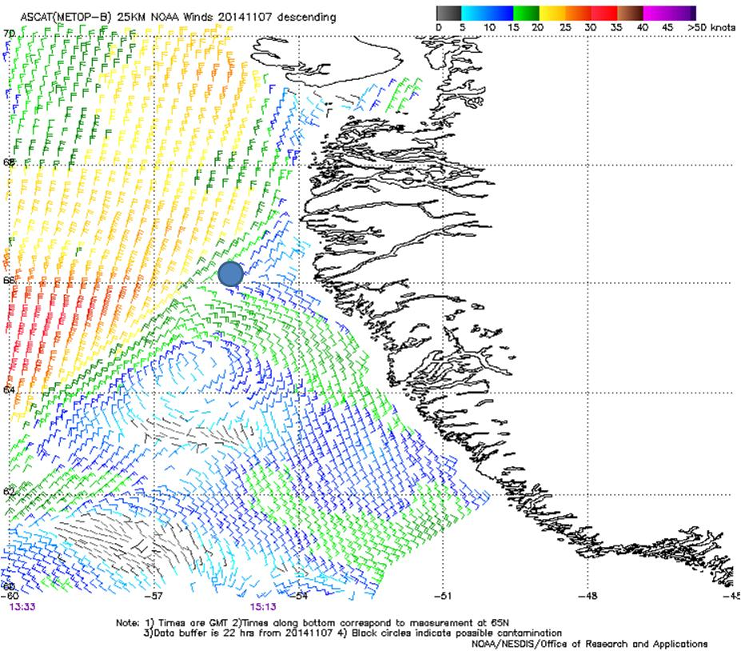
ASCAT ocean vector winds from passes at 13.33 and 15:13 GMT

Slide 16
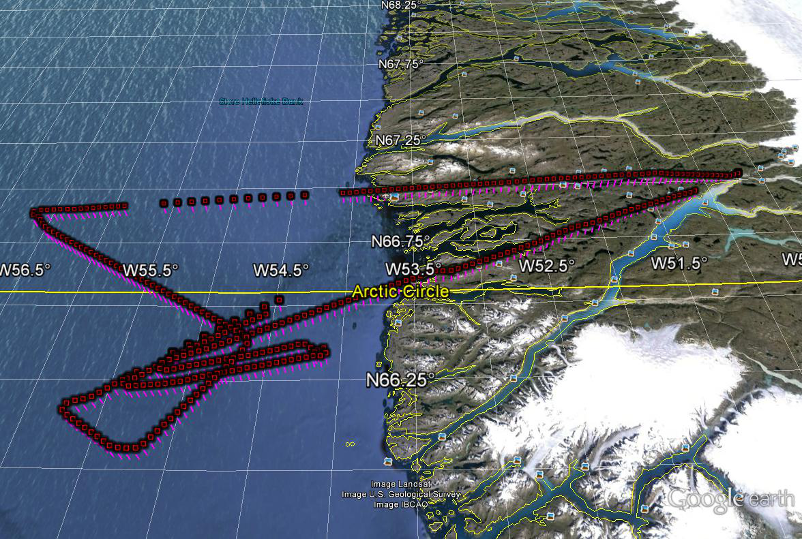
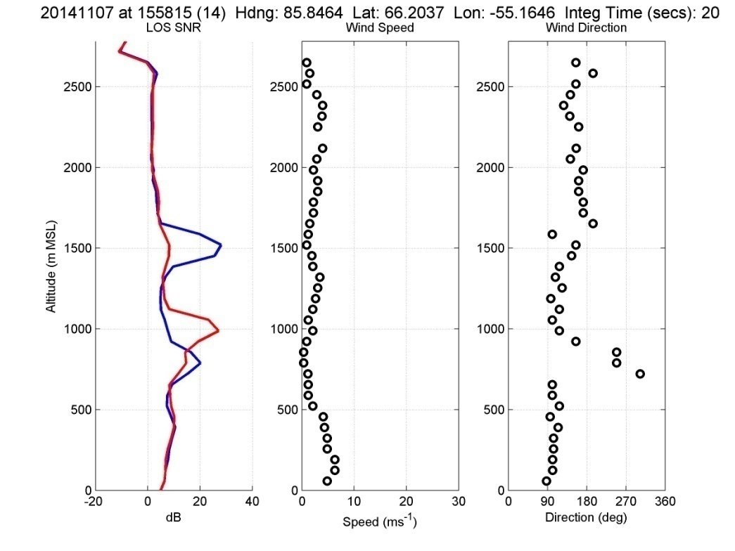
Greenland Flight 9 out of 14
11/07/14

Slide 17
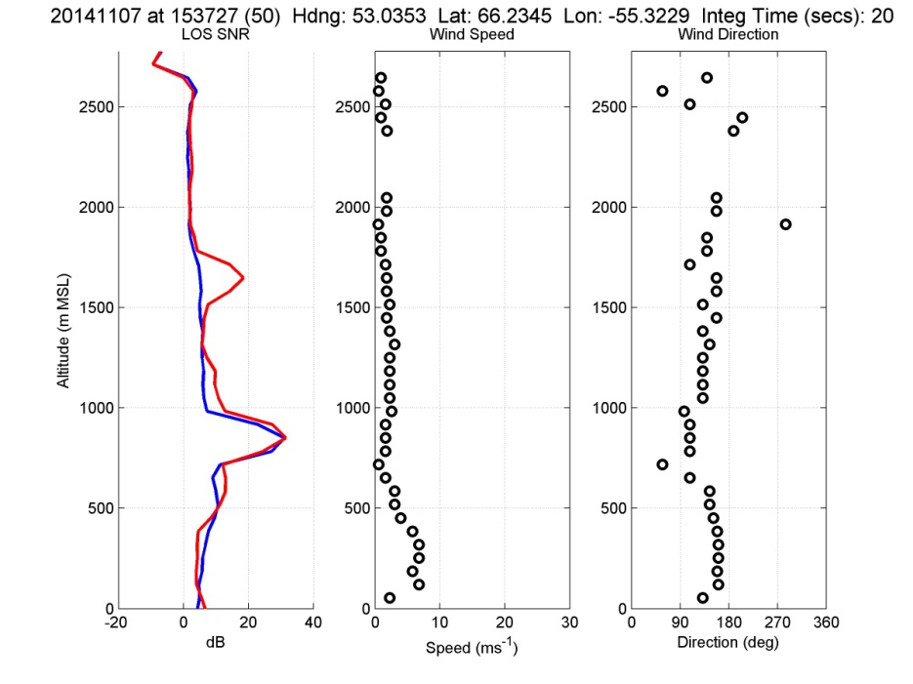
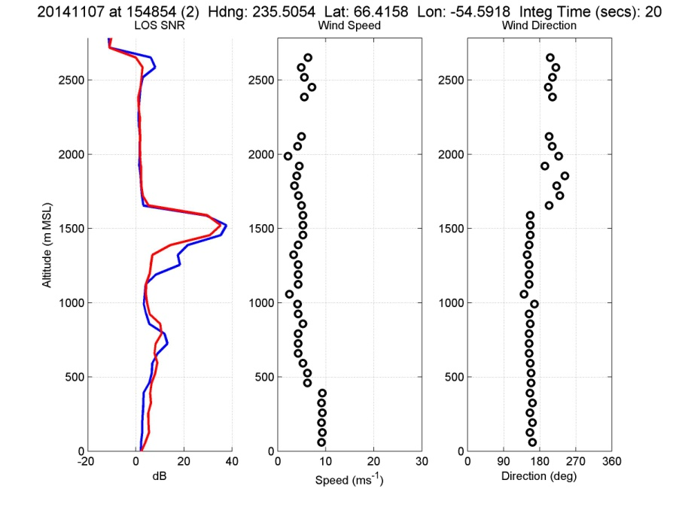
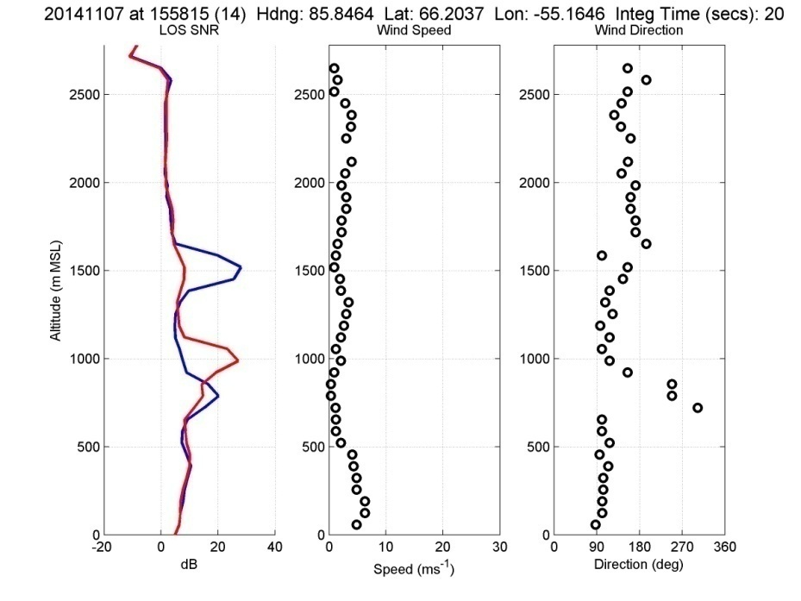
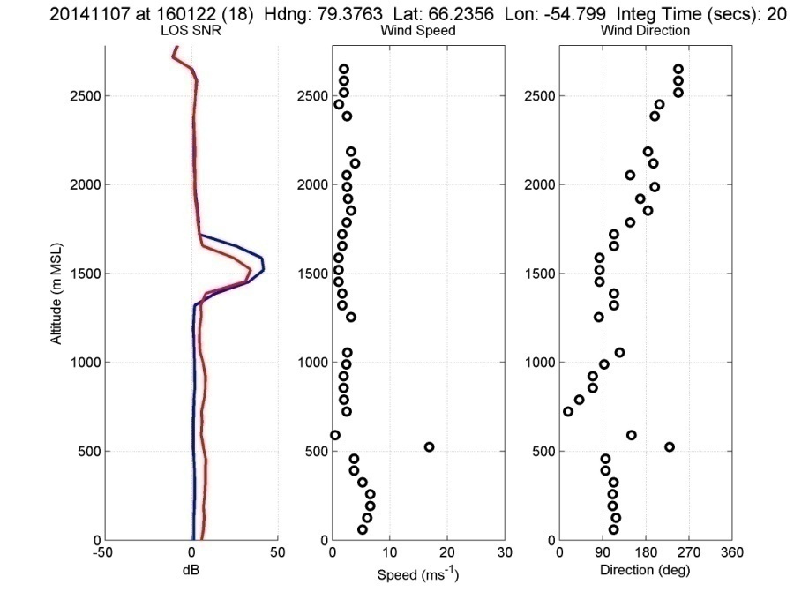
Additional sounding examples for Flight 9
Thin clouds
Weak winds w/
variable directions

Slide 18
NASA’s PolarWinds and ADM Cal/Val
Campaign 2
Based out of Keflavik, Iceland
May 11 – 29, 2015
NASA DC-8 core instrument suite
  DAWN (Nadir port 7)
  Yankee dropsondes (105)
  TWiLiTE (Nadir port 5)
Similar PolarWinds science objectives as in Campaign 1
ADM Cal/Val activities include joint missions with DLR Falcon
  Perform calibration flights with A2D/2um DWLs on Falcon
  Practice under flights for ADM Cal/Val as in Campaign 1

Slide 19
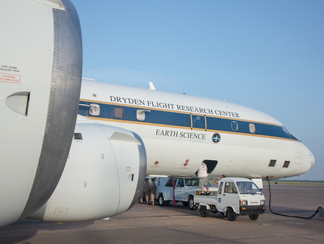
Ceiling: 12,500m
Cruse: 225 m/s
Minimum: 180 m/s
Range: 8000 km

Slide 20
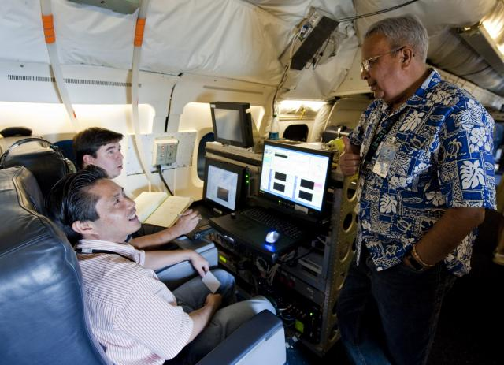
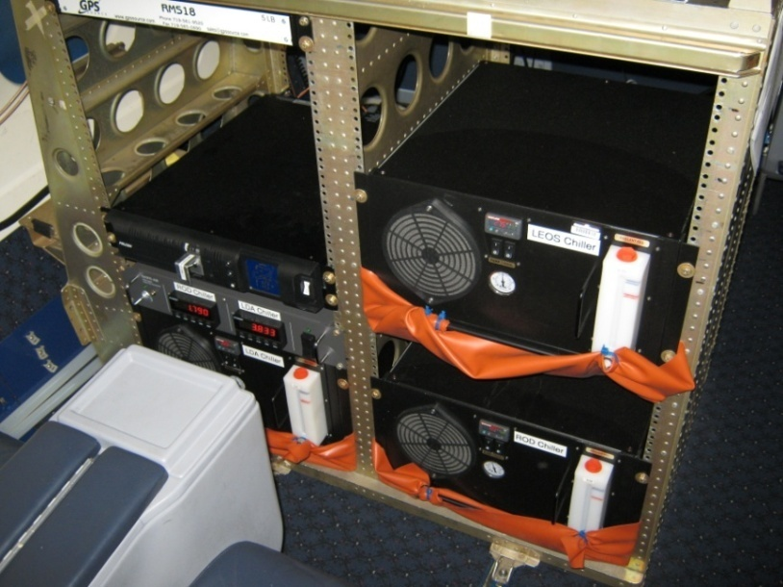
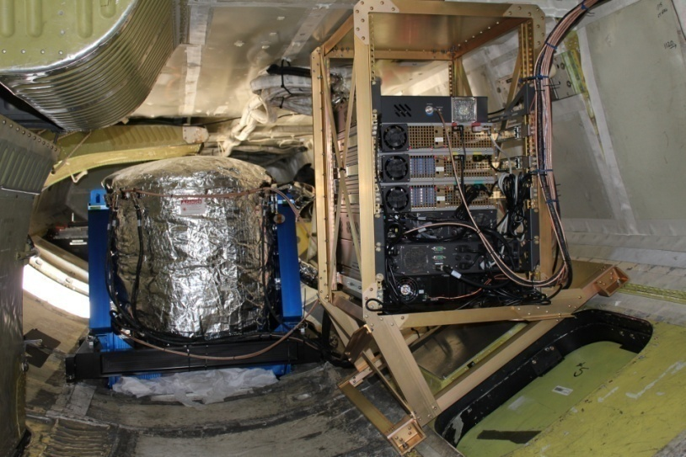
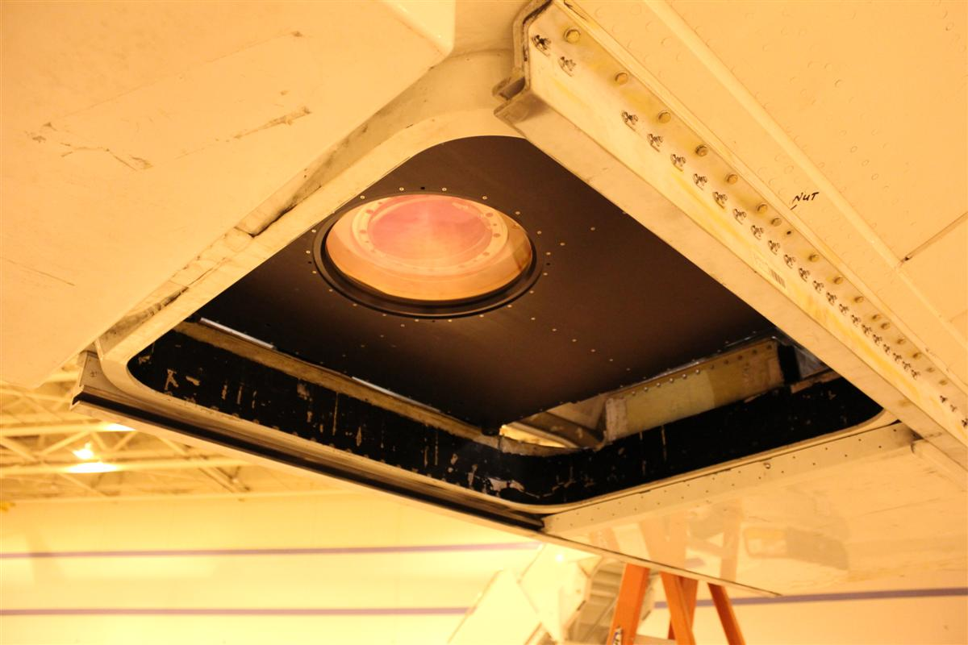
NASA Langley DAWN Wind Profiling Lidar on NASA DC-8
Operator Stations in Passenger Level
Laser Chillers in Passenger Level
2-micron
Pulsed
MOPA
0.25 J
10 Hz
200 ns
15 cm
Step-stare conical scan
30-deg nadir
Dual-balanced heterodyne detection
Laser, Optics, and Some Electronics in Cargo Level
Centered Nadir Port #7 with Shutter Open

Slide 21
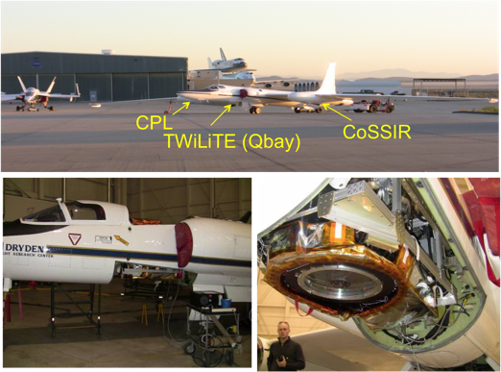
TWiLiTE on ER-2

Slide 22
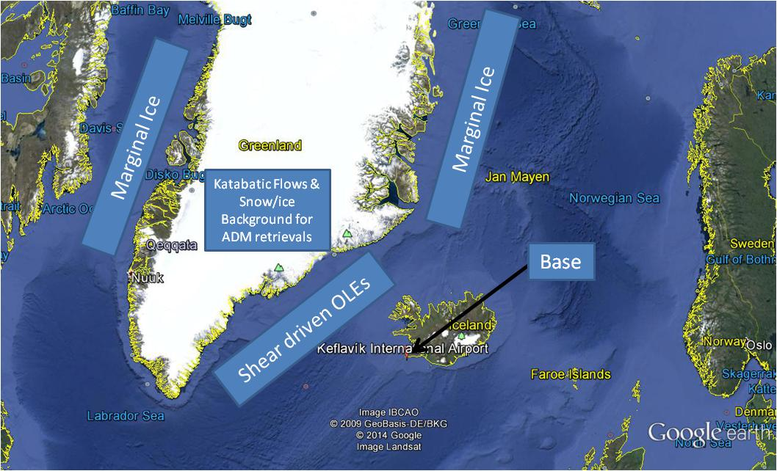

Slide 23
PolarWinds Campaign 2 Plans
Conduct flights to collect wind profiles suitable for numerical model validation and development. These flight segments will be referred to as MVAL experiments.
Conduct flights to collect wind data along and near the marginal ice zone off the east coast of Greenland. These flight segments will be referred to as SEA_ICE experiments.
Conduct flights to take wind measurements on both sides of the east coast of Greenland to measure katabatic wind flows. In addition, conduct flights to take wind measurements of possible Tip Jets (south of the southern tip) and Barrier winds (off the southeast coast of Greenland). These flight segments will be referred to as WIND experiments.
Another set of potential experiments will be conducted to measure the wake flow around Iceland. These flight segments will be referred to as ICELAND experiments.
Flights will also be conducted to measure the winds over the interior of Greenland with a focus on the Ice Cap and flying directly over the Summit. These flight segments will be referred to as SUMMIT experiments.

Slide 24
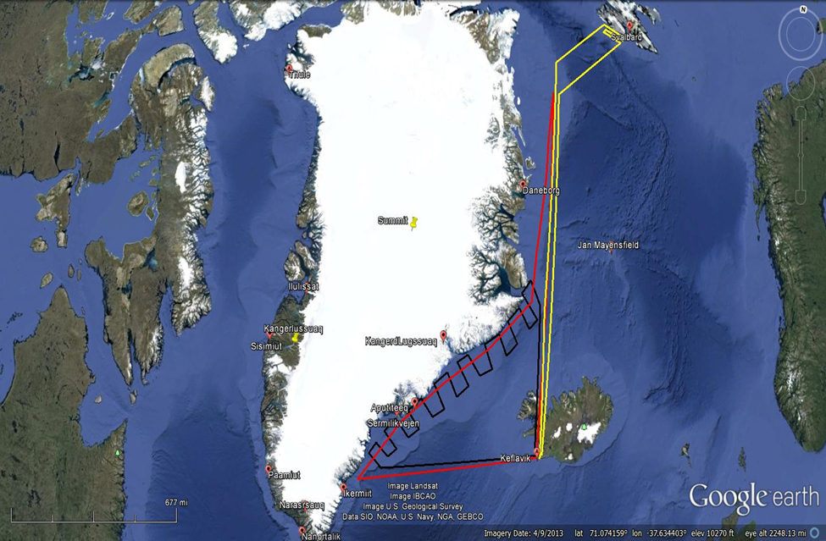
Sea Ice and coastal zones

Slide 25
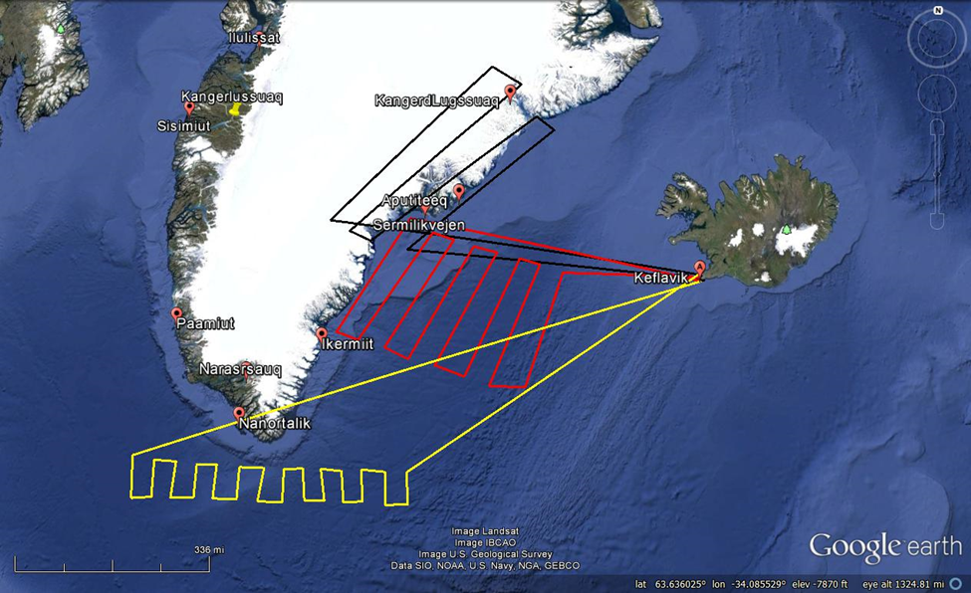
Katabatic Flows and LLJ

Slide 26
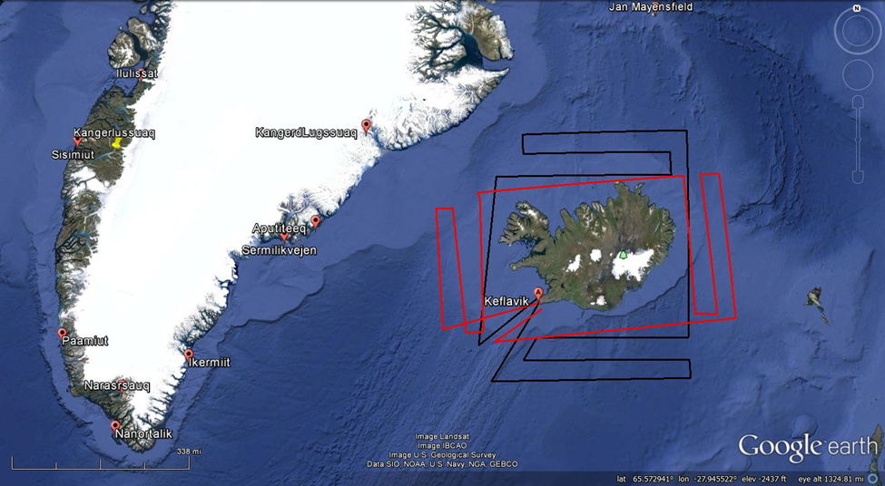
Iceland Impacts on Flow

Slide 27
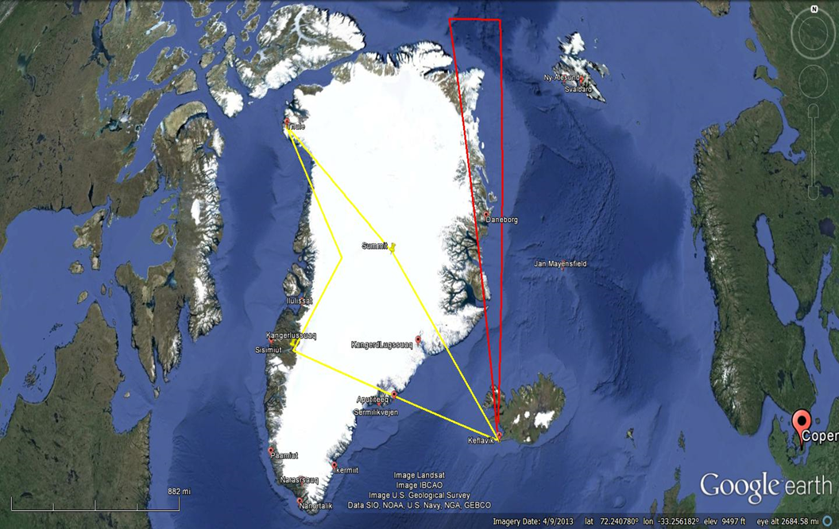
Ice Cap and Summit

Slide 28
Supporting Groundbased Observations
Radiosondes launched at 00Z and 12Z at the following sites:
BGAM Ammassalik (65.6,-37.63)
BGEM Aasiaat (68.7, -52.85)
BGBW Narsarsuaq (61.15,-45.43)
Summit (72.57,-38.45)
BGSC Ittoqqortoormiit (70.48, -21.95)
BIKF Keflavik (63.96, -22.6)
BIEG Egilsstadir (65.28, -14.4)
ENJA Jan Mayen (70.93,-8.66)
ENAS Ny-Alesund (78.91, 11.93)
Ground-based commercial DWL´s (Leosphere Windcube 200S) are operated at Keflavik airport and in Reykjavik by the Icelandic Met Office (IMO, contact Sybille von Löwis).
In addition the Icelandic Atmospheric Observatory (IAO, https://www.ncas.ac.uk/index.php/en/about-iao) situated in south-east Iceland near Vik (63°46'29.79"N 17°57'54.32"W) is equipped with a commercial DWL (HALO Photonics) operated by University Leeds (contact Barbara Brooks).
The Greenland Summit Station (72.58°N, 38.48 W, 3216 m ASL) releases 2 radiosondes per day and is equipped with an aerosol lidar from the MPL (micro-pulse lidar) network (contact Ralf Bennartz, Uni Vanderbilt, Wisconsin, Shupe et al. 2013) (http://www.esrl.noaa.gov/gmd/obop/sum/). Online data from an on-going campaign at summit station is available at http://icecaps.ssec.wisc.edu/

Slide 29
Acknowledgements
This research is being funded by NASA.
Credit goes to the DAWN instrument team at NASA/LaRC and the UC-12B crew that flew in challenging weather conditions during Campaign 1

