Slide 1
Science Objectives for the ATHENA-OAWL Venture Tech Airborne Mission
M. Hardesty
CIRES University of Colorado/NOAA
S. Tucker and C. Weimer
Ball Aerospace Corporation
D. Emmitt
Simpson Weather Associates

Slide 2
Focus of Investigation
Validate and assess the wind-measuring capability of the WB-57 Instrument
Evaluate instrument sensitivity and efficiency
Assess the effects of clouds on measurement capability and representativeness
Investigate the range of aerosol conditions encountered and capability to measure at under low backscatter
Investigate utility/degradation of land/sea surface returns on estimate
Compare with assumptions of performance used for ATHENA/OAWL modeling

Slide 3
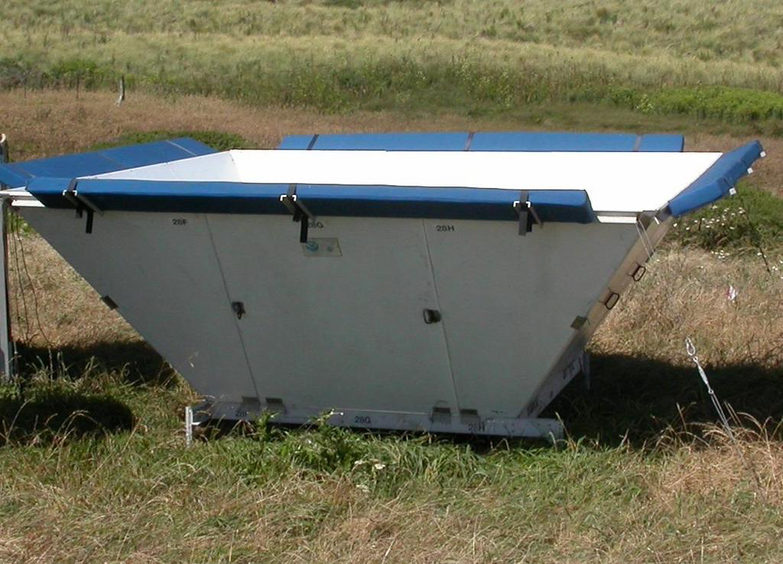
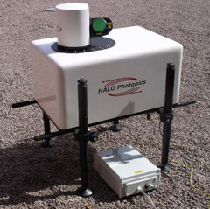
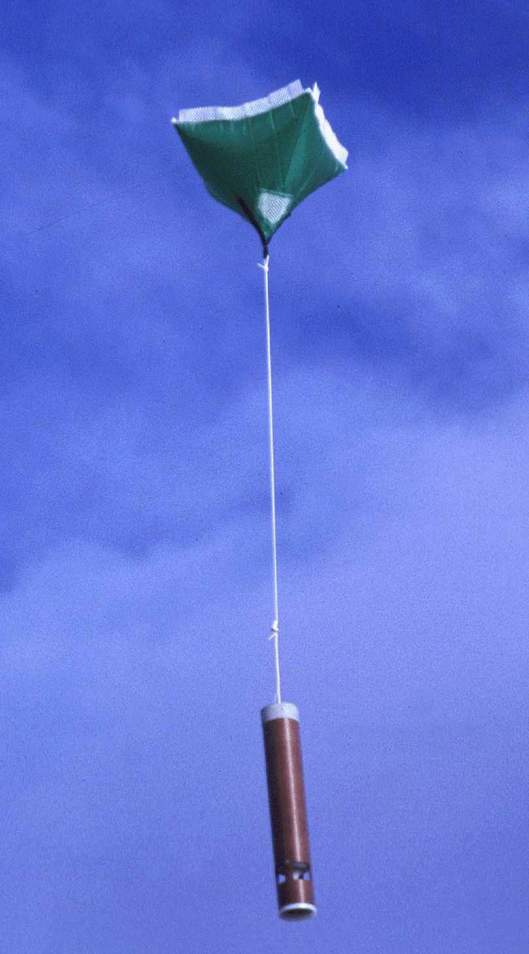
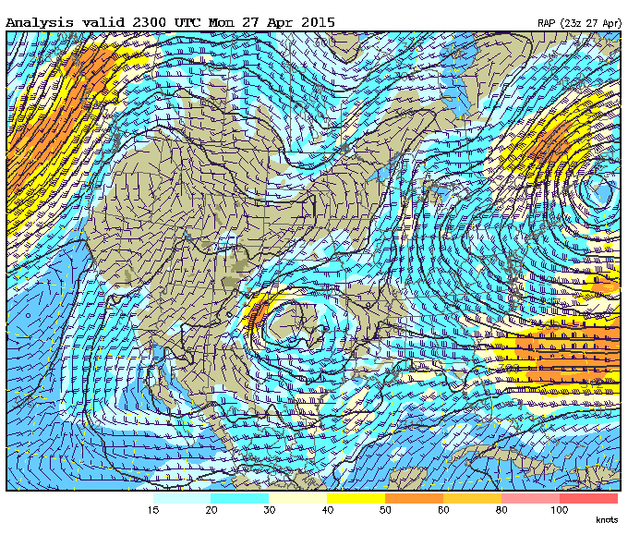
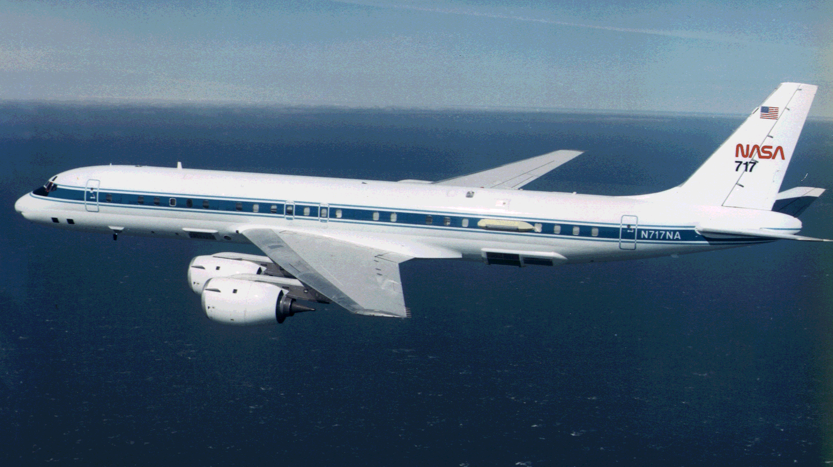
Potential data sources for wind comparisons
Wind profilers
Doppler lidars
Radiosondes
Concurrent Experiments
Dropsondes
Model analyses

Slide 4
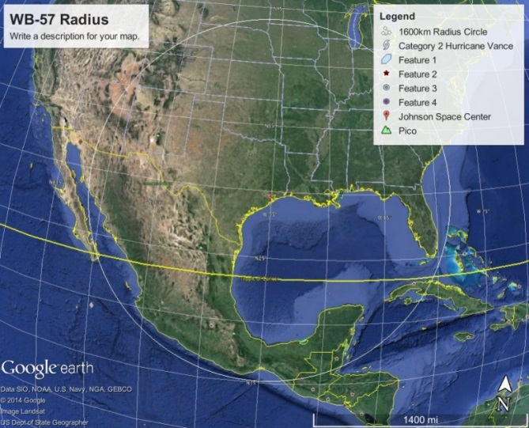
Radiosondes
Sondes will be an important intercomparison element
Arrangements being made with NOAA stations to launch sondes when aircraft is overhead
Availability of many potential launch sites provides flexibility for bad weather

Slide 5
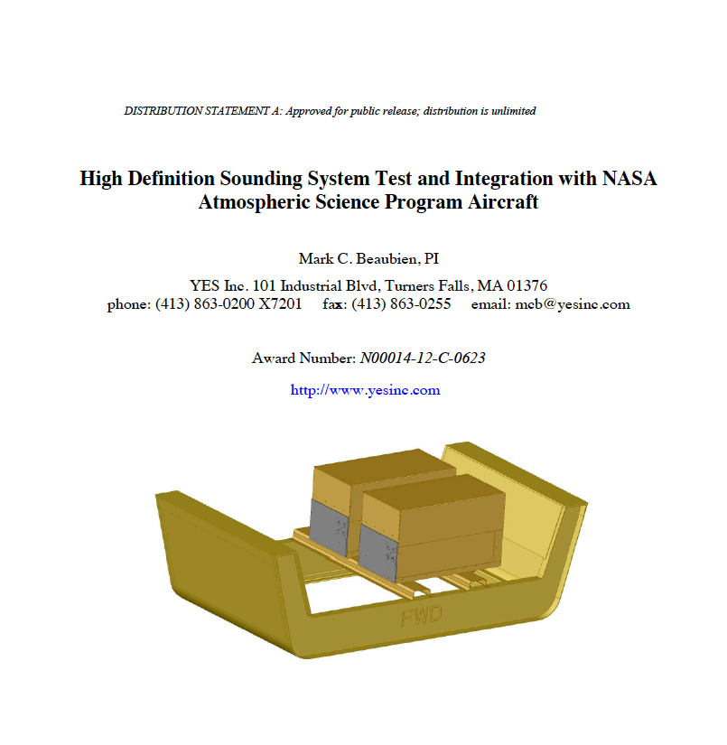
Potential for on-board dropsondes
The Navy has developed, with Yankee Environmental Systems, an automated dropsonde system that can be deployed in bay 4 of the WB-57
Preliminary discussions with ONR offer some promise that the system can be co-deployed with GrOAWL for the AOVT airborne testing

Slide 6
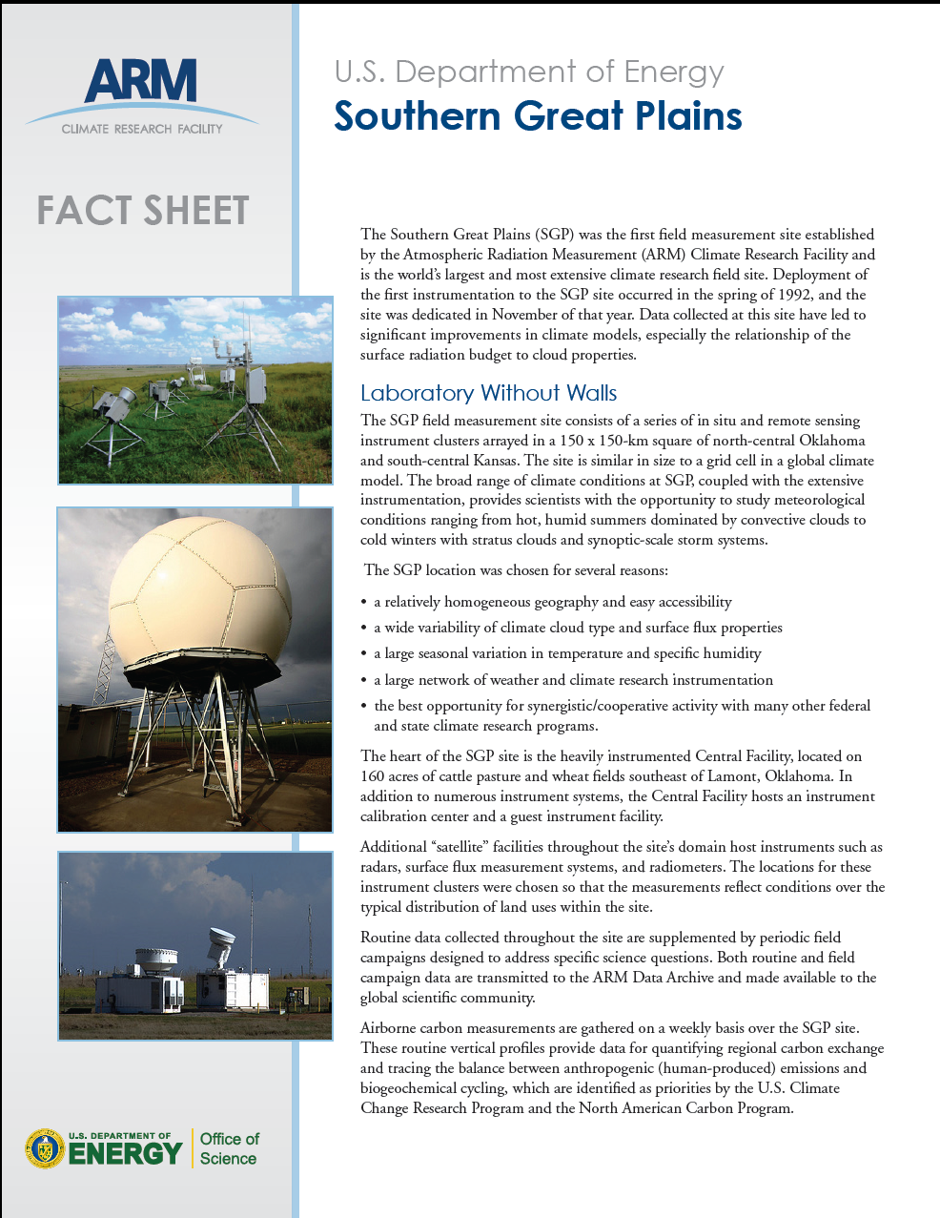
The ARM Southern Great Plains site
The ARM SGP site is an excellent comparison sit due to the large number of remote sensors for comparison with the GrOAWL lidar
Instruments include Doppler lidars, wind profiling radars, Raman lidar, Aeronet sun photometer, sonde launch capability

Slide 7
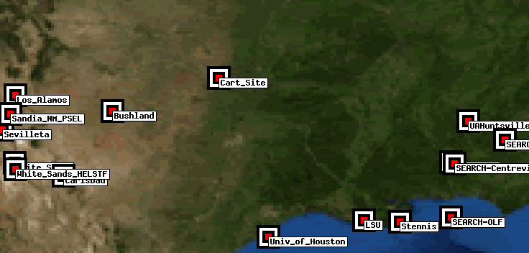
Backscatter Characterization: Aeronet
Several Aeronet sites are within range of the WB-57
Use optical depth Aeronet measurements and lidar profiles to distribute and estimate backscatter

Slide 8
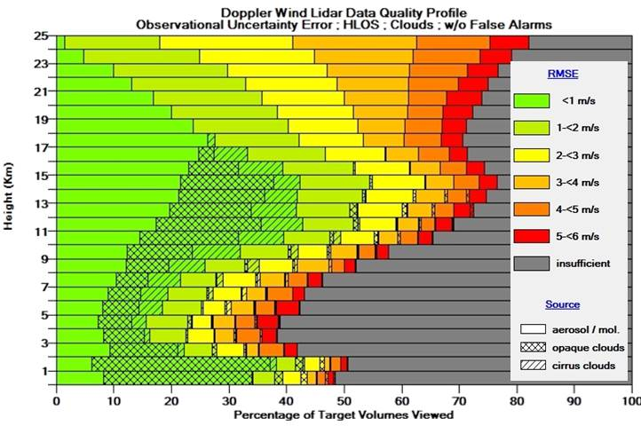
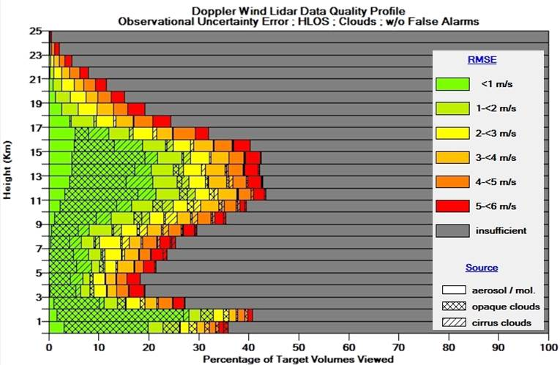
Investigating Sensitivity
GrOAWL sensitivity will be compared with that assumed in the radiometric models used to estimate space-based OAWL performance.
Relationship between measurement uncertainty, photon count, and aerosol backscatter will be determined and extrapolated to a space-based instrument

Slide 9
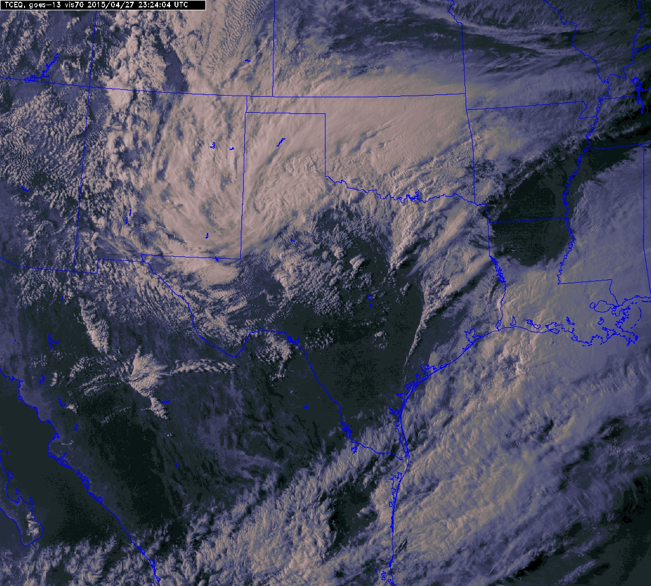
Impacts of clouds
Impacts of clouds on measurements will be investigated during the flights
Effects of clouds on wind measurement capability include attenuation, background enhancement, and irregular horizontal and vertical spatial weighting within a measurement cell

Slide 10
Range of Aerosol Conditions
OAWL ISS measurement predictions assumed a background aerosol mode.
Higher frequency of enhanced conditions will provide better performance
We will examine the data set to investigate the range of aerosol conditions encountered during the flights

Slide 11
Summary
Overall objective is to demonstrate capability of the technique as a viable candidate for a space mission
A key aspect of the GrOAWL AOVT tests will be validating the wind measurements
Critical that we can convince the community that the instrument measures winds with accuracy comparable to other Doppler lidar instruments
Other primary goals of the investigation and data analysis
Sensitivity
Measurement capability under a variety of aerosol conditions
Effects of clouds on measurement

