Slide 1



Airborne OAWL IIP-­07: Updates on the 2011
flight results and lessons learned
Sara C. Tucker
Ball Aerospace & Technologies Corp.
Working Group on Space-based Wind Lidar: 28-29 April 2015 – Boulder, CO

Slide 2
OAWL
The Optical Autocovariance Wind Lidar (OAWL) is a Doppler Wind lidar designed to measure winds from aerosol backscatter at the 355 nm and/or the 532 nm wavelength(s).
One system, one laser, global winds & aerosols.
2011: First OAWL ground tests (July) and first OAWL flights (October/November)
Instrument Evolution: Since 2011, significant additional work has been done on the instrument and algorithms (Ball IRADs, ESTO ACT’s, IIP, etc.)
Implementing Lessons learned: consistent funding and focus provides the opportunity to revisit and reprocess the 2011 aircraft data demonstrating improved results.

Slide 3
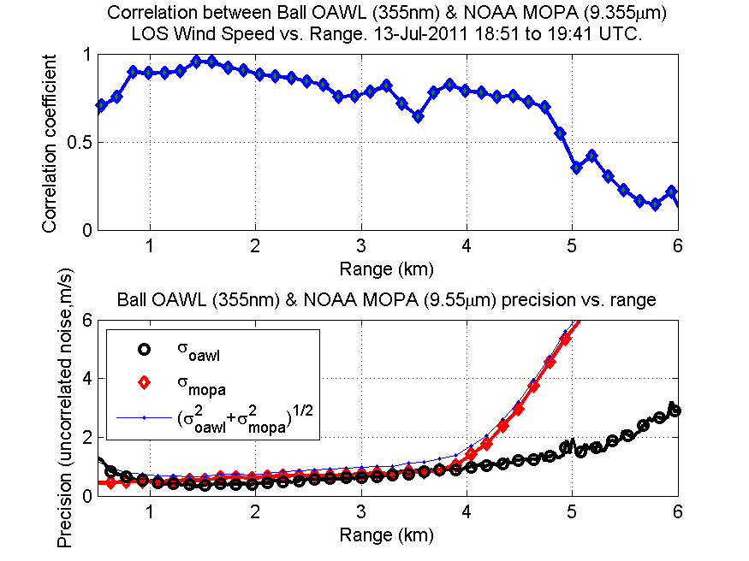
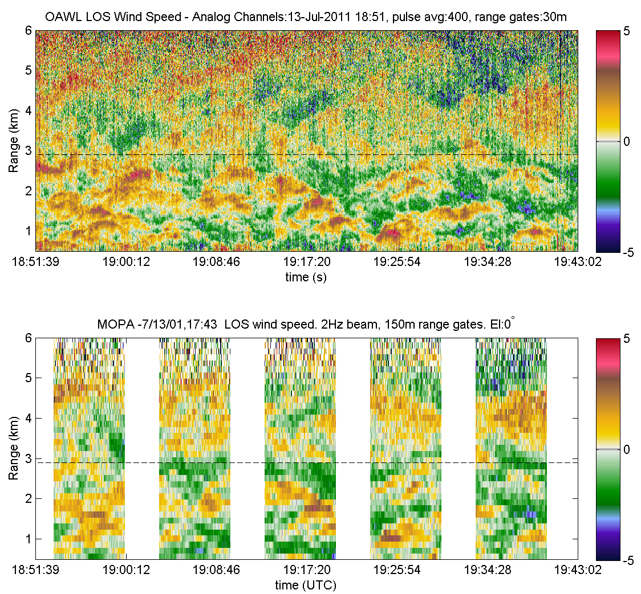

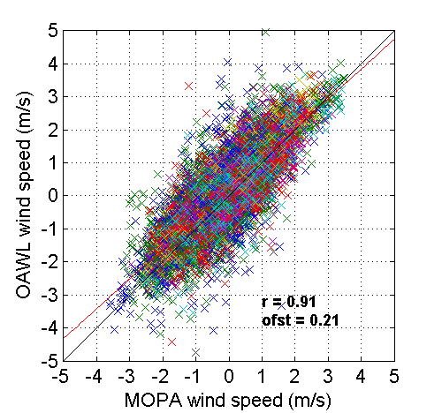


Reminder: July 2011
OAWL Ground Validation with the
NOAA Active Remote Sensing Group
Max correlation > 95%
OAWL
50 minutes
MOPA

Slide 4
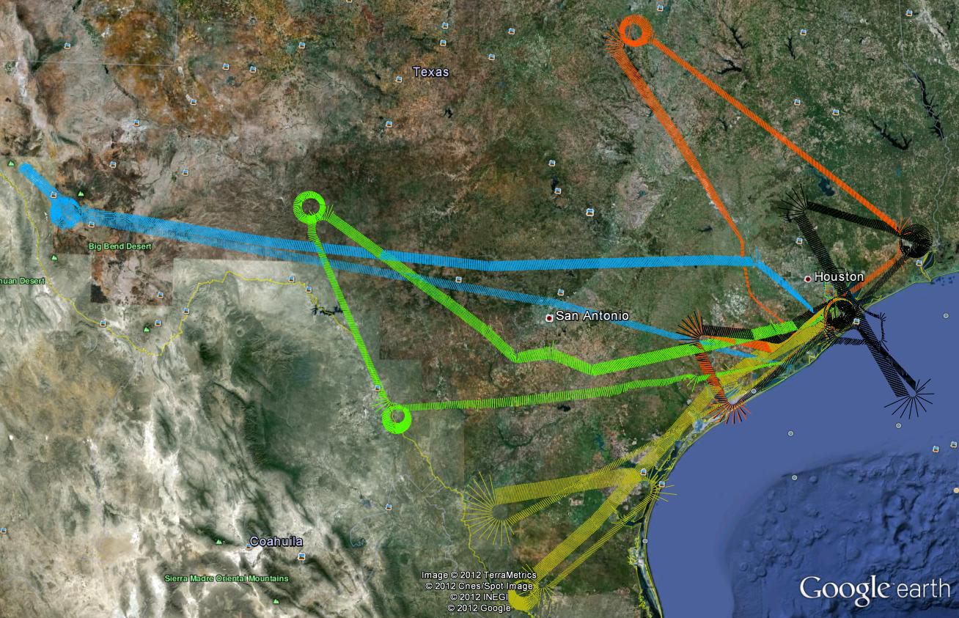
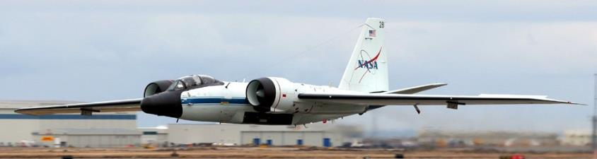
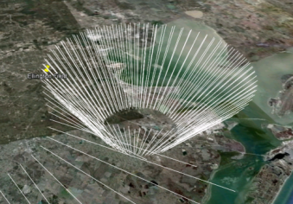
2011 Autonomous OAWL Flight Tests: NASA WB-57
OAWL Flights on the WB-57
Flight # | Flight Date
1 | 26 Oct 2011
2 | 02 Nov 2011
3 | 04 Nov 2011
4 | 07 Nov 2011
5 | 08 Nov 2011
OAWL Demonstration
autonomous operation
measured Doppler shifts from ground, clouds and aerosols.

Slide 5
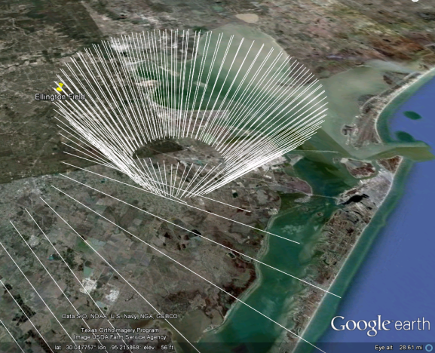
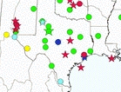
OAWL 2011 WB-57 Aircraft Demonstration
Demonstrated ability to
  operate autonomously in a low-pressure, high-vibration, cold (to -65° C), and noisy environment
  measure Doppler shifts from clouds, ground & atmosphere
Validated the Doppler measurements
  aircraft NAV data (for ground)
  radar wind profilers (for atmosphere)
Clockwise orbited the RWPs, with the OAWL LOS pointing toward the center
  Restricted aircraft to a <10° roll/bank
  This resulted in a 20-40 km radius orbit ~=10-20 km radius on the ground.
Multi-agency profiler (MAP) network

Slide 6
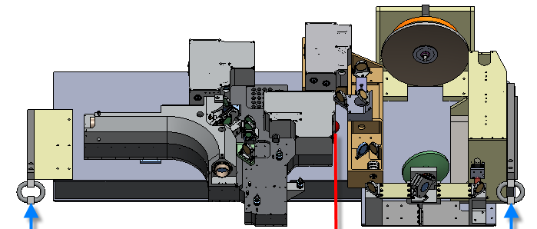
Root causes of reduced performance on WB-57
Issue | Reduced lidar SNR | Reduced Interferometer Contrast/CNR
70% vs. >85% window transmission @ 355 nm | x
20 mJ vs. 30 mJ modeled laser output | x
Residual Aircraft Torsional stresses change overlap as fuel is consumed | x | x
Strong in pallet temperature gradients |  | x
Torsional stresses put strain on interferometer, affected beamsplitter alignment |  | x
Actual aircraft vibe higher than vibe-test: May have affected alignment and laser seeding | x | x
Laser pulse length shortened (prior to and during flights) | X? | X
No kinematic mounts were used in the design of the original OAWL
Twisting of pallet translated into twisting of breadboard
This affected
  Overlap of the transmit beam and telescope FOV → reduced lidar SNR
  Alignment of the interferometer → contrast reduction → reduced wind precision
Follow-up testing and modeling has demonstrated how opto-mechanical effects produced errors in the wind precision/ accuracy

Slide 7
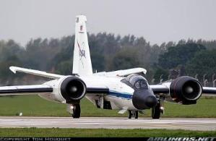
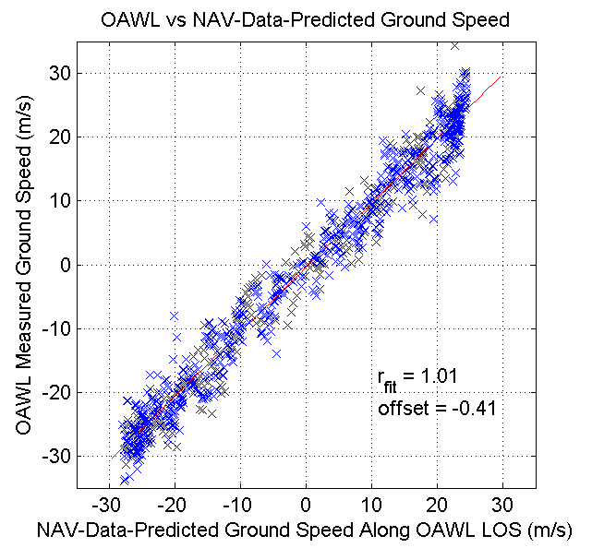
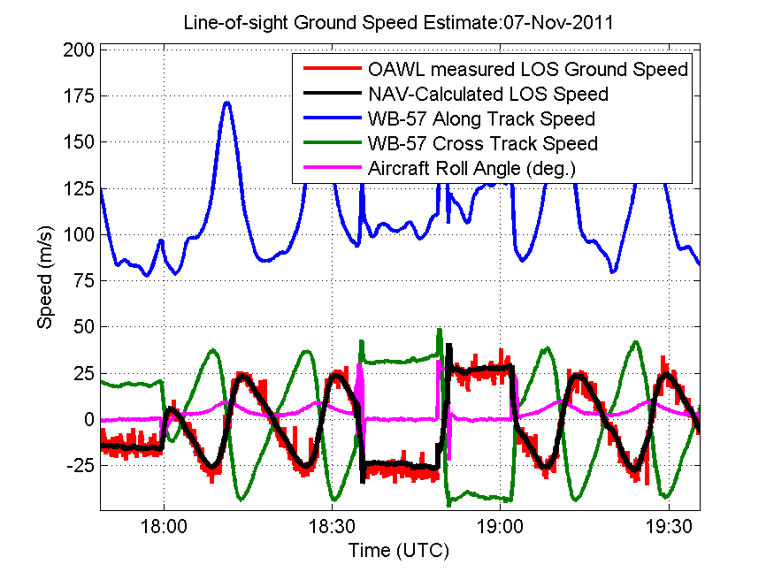
Airborne OAWL Accuracy Estimates
Nov. 2011, Autonomous
OAWL flights on WB-57.
LOS “ground speed” estimates
  1s NAV-data predicted
  OAWL measured precision of
  < 2 m/s (single 7.5 m gate, 2sec)
Accuracy limited here by pointing knowledge
Scatter plot of OAWL measured ground speed versus NAV-data predicted
(i.e. the red vs. black lines at left)
Results affected by flexible pallet

Slide 8
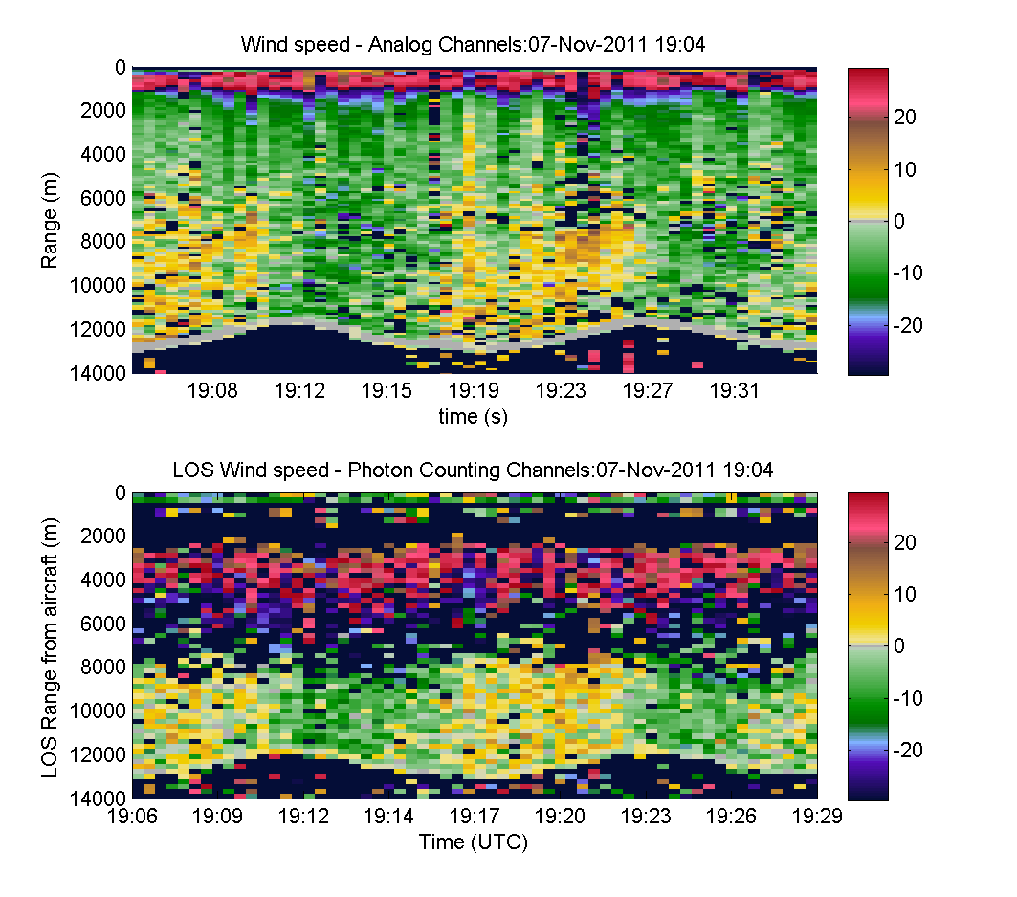
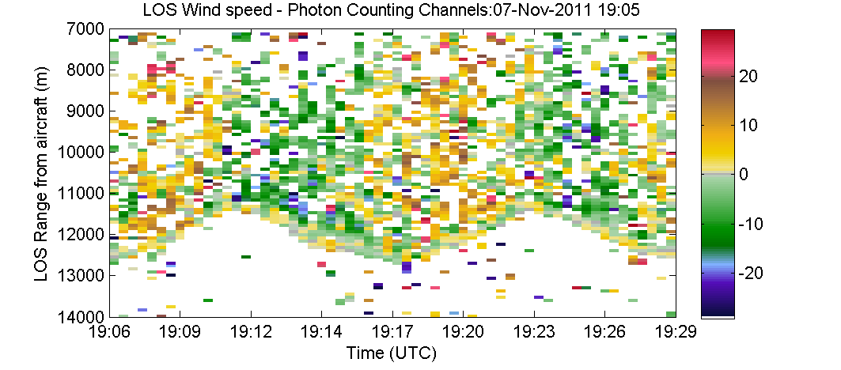
OAWL LOS wind speed vs. range from aircraft
Images show thresholded LOS wind speed estimates measured from aerosol returns
  Cool colors: winds toward lidar
  Warm colors: winds away from lidar
  Noisy estimates appear, depending on where the noise threshold is set.
30-seconds and 225 m range (160 m altitude) of data were used for each LOS fit.
Updated data: processing now compensates for:
  Leaky polarizing beam splitters (10% of p was in s)
  Nonlinearity of detectors
  Different/variable gain on detectors
MPPCs have Both PC and Analog channels used here.
Updated processing
Photon Counting Saturation Region
Original processing: Photon Counting only

Slide 9
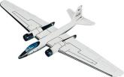

OAWL LOS wind speed vs. altitude
Use the aircraft GPS altitude and orientation (yaw/pitch/roll) to find the altitude of each LOS wind estimate in meters above mean sea level (MSL).
Ground returns show 0 speed (speeds have been processed to be ground relative)
Wind direction

Slide 10
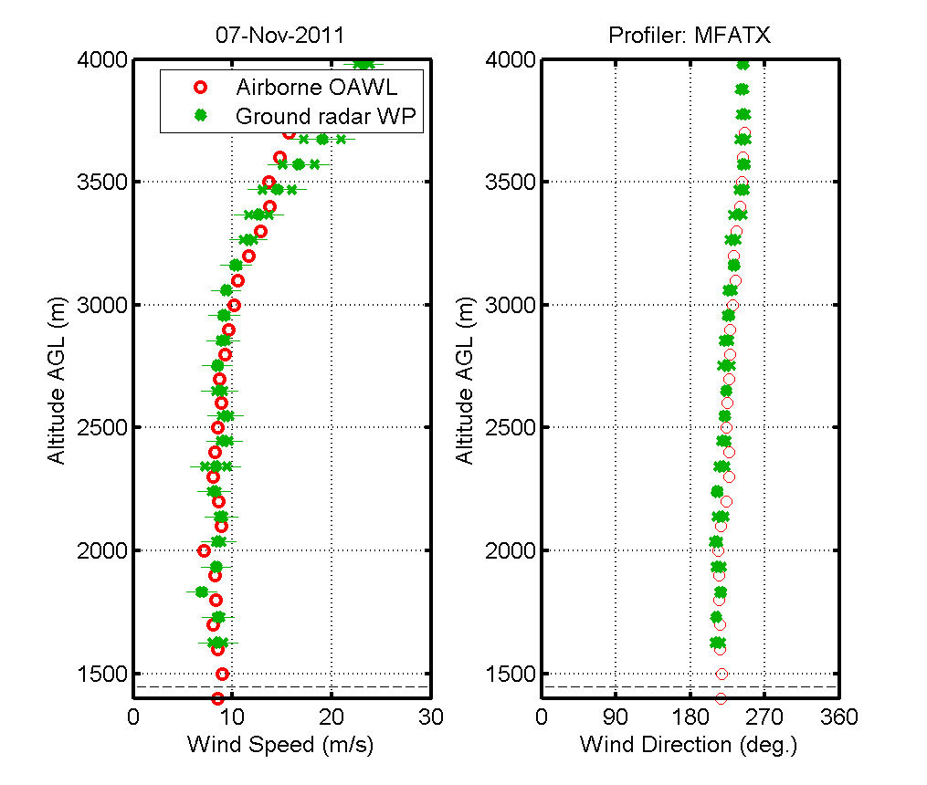
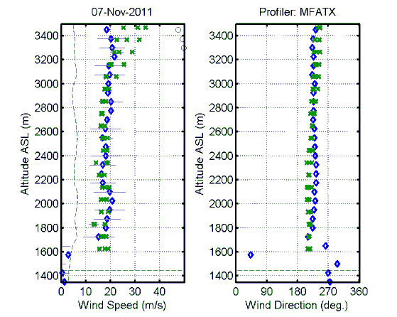
Improved profile estimates
New Improvements to OAWL data processing result in strong correlation at lower altitudes
Overlap biases – modulated by roll angles affect the speed estimates at higher altitudes (closer ranges)
Updated processing
Original processing: Photon Counting only
Altitude MSL (m)
Altitude MSL (m)
Altitude MSL (m)
Altitude MSL (m)
x RWP
OAWL
Wind Speed (kts)

Slide 11
HOAWL finding: Overlap bias affected by overlap and roll
Field distribution in pinhole vs. range for perfect alignment
Roll°
0 10
More roll, adds more bias/offset, hiding the wind speed signal
Overlap model shows the range-varying beam shape in the pinhole (= interferometer field angles)
Different field angles → velocity offsets relative to constant T0 beam
Lack of kinematic mount and sag affected alignment and telescope overlap. Thus the negative bias changed even more when the aircraft rolled to circle the RWPs
  Stronger rolls (into the wind), strong bias, offsets the negative velocities particularly in the near field (prior to full overlap)
Perfectly modeling (and removing) the actual overlap function is challenging (and not funded) but eliminating the issue is priority on AOVT
Good news: OAWL was making aerosol Doppler measurements all the way up to the aircraft (33kft). Next: eliminate the varying overlap bias – achieved using a fiber…

Slide 12
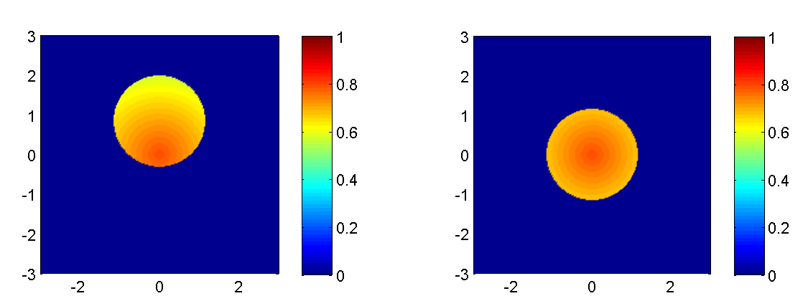
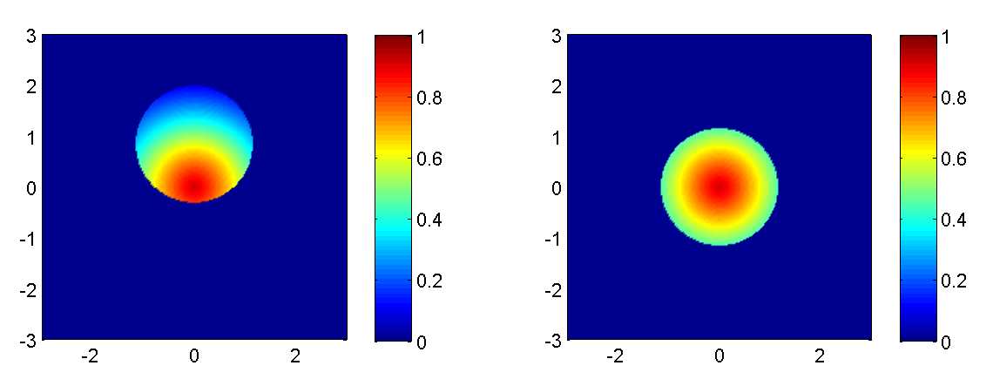
Model for beam field differences
Simple top-hat distribution field models shown here for visual
A complex pupil (e.g. telescope obscuration) adds additional variation based on beam shape/overlap.
What if T0 and return fields do not line up? ….Examples of fields offset relative to one another shown below for single fringe position
The resulting four-channel normalized fringe effects are plotted at right:
  Fairly uniform field results in small offset, little change in contrast, little phase offset: ~<1 m/s
  System misaligned/under strain → Poor field results in large offset and reduction in contrast: ~4 m/s shown here.
  If beams are perfectly coaxial and equal, potential only for contrast variation, no phase offset is observed.
Good contrast, small phase offsets
Field angles, m-rad
Reduced contrast, large phase offsets

Slide 13
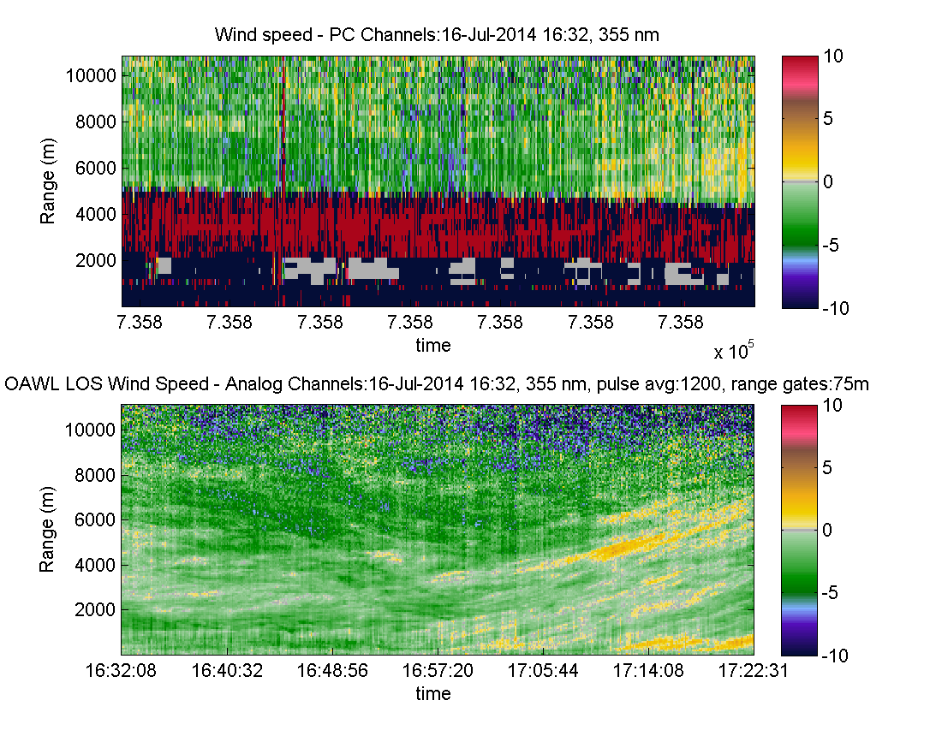
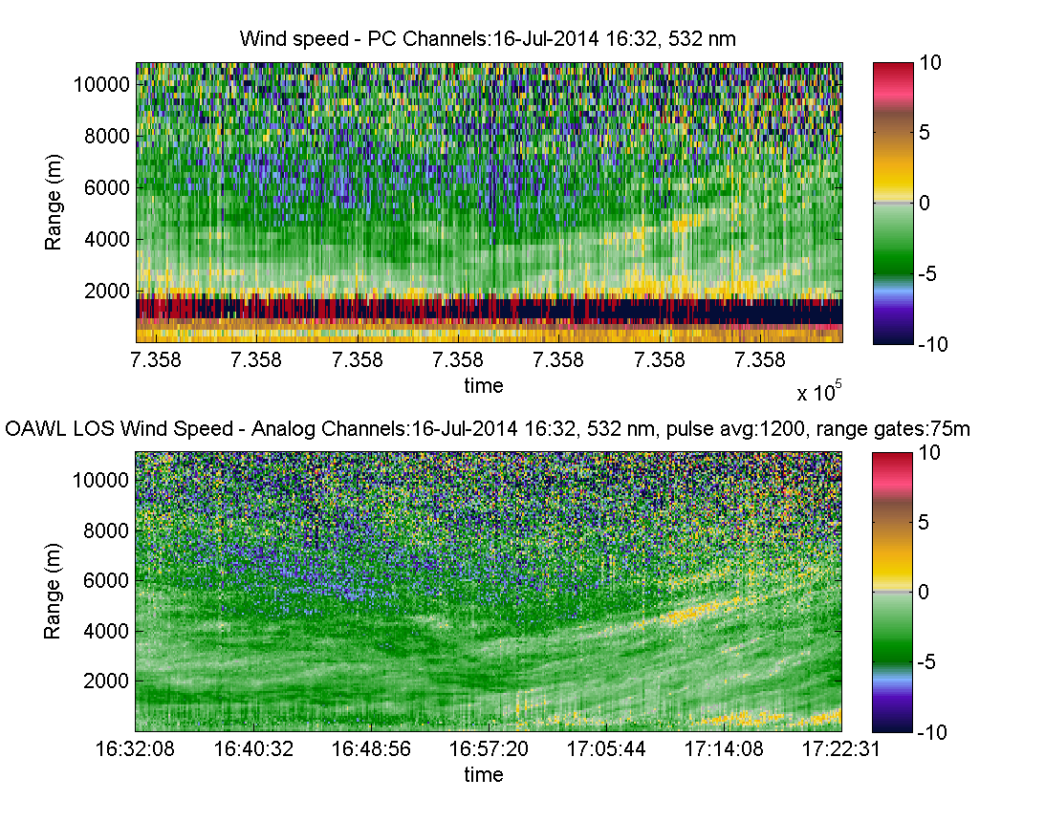
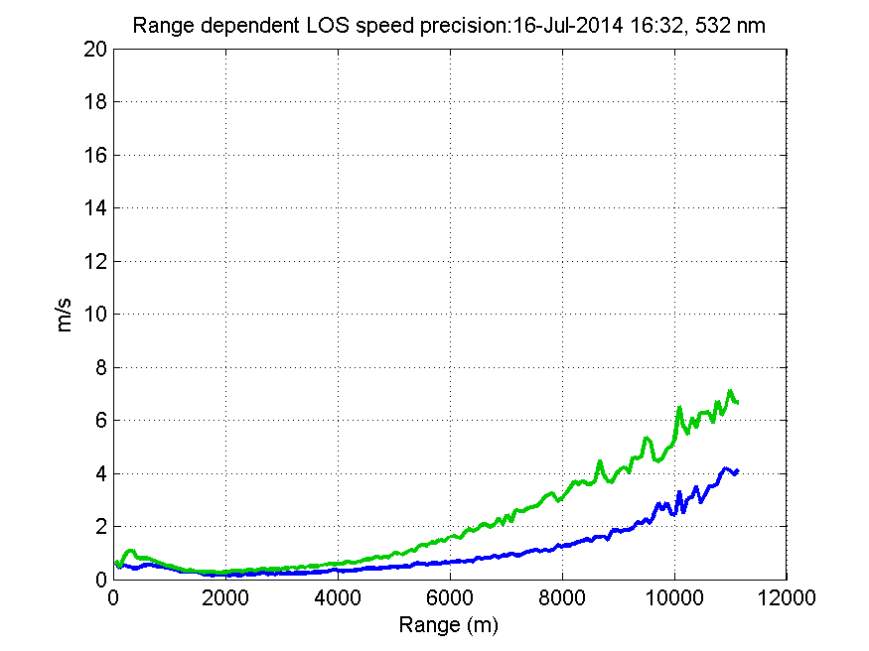
OAWL Can measure winds using both 355 & 532 nm
HOAWL ACT also provided opportunity to prove out the 532 nm measurements
Shown:
  Horizontal views at 355 and 532 nm – returns out to > 11km (analog channels)
  Strong ~0.3 km-1 extinction
  Slight (~1 m/s) bias between 532 and 355 is due to different T0 alignments – an issue eliminated on AOVT & HAWC-OAWL
355 nm
~ 4W
532 nm
<0.4 W
Precision (m/s)

Slide 14
Fix: Interferometer Fiber Coupling
Fiber coupling into the interferometer
  Ensures the input beam field of view is fixed
  Ensures the input beam field-center points is fixed (fiber optic launch on the interferometer)
  T0 and atmospheric return both come through the fiber and thus are launched into the interferometer with the:
    Same total field and
    Same field-center.
Testing has demonstrated the “overlap” issue is mitigated by the use of the fiber coupling
Approach already demonstrated by Bruneau et al.
355 & 532, T0
355 & 532 into interferometer
May not be perfectly coaxial upon combination
355&532 Atmospheric returns
Atmosphere & T0 have Identical beam properties leaving fiber

Slide 15
In summary: What have we learned?
OAWL IIP-07
  Ground-validation demonstrated the 355 nm OAWL aerosol lidar performs with sub-1 m/s precision and accuracy
  2011 NASA WB-57 flight tests demonstrated autonomous operation of the OAWL instrument, measuring Doppler shifts from the ground, clouds, and aerosols (some with <2 m/s precision)
  Thermal control in challenging WB-57 environment
  Pallet is flexible and transmits deformations through frame and wire-rope isolators
    True kinematic mounting of the optical bench and interferometer is required
HOAWL ACT
  First dual wavelength Doppler wind lidar system
  Provides understanding of the performance of different wavelengths (ground tests only).
  Developed understanding of how T0 vs. atmospheric field differences can result in phase offsets based on IFO alignment.
    Strains on the IFO change the BS alignment, reducing contrast and exacerbating phase offsets --? true kinematic mounting of the beamsplitter and interferometer is a must
  Discovered up to 10% cross-talk in detector path polarization and dichroic optics.
  Developed improved detector tuning/testing and alignment techniques
HAWC-OAWL IIP13
  Additional studies of the contrast and overlap vs. phase behavior (plus positive fiber coupling tests)
  Importance of the full performance model to understanding data behavior (interferometer, radiometric, detector, etc.)
Ball IRAD
  Real-time processing capable of handing 2X wavelengths (or 2X lasers) per FPGA
  Performance model paired with algorithm development to understand system behavior

Slide 16
Implementing Lessons Learned
Instrument performance model is increasingly refined through testing and measurement.
  Radiometric model
    Atmospheric returns, transmission budgets, etc.
  Telescope overlap model
    total transmission
    field angles
  Four channel interferometer model
    Understand bias and precision
  Detector Model
All used to predict (and understand) performance – WHY we need to implement the hardware changes and how will they impact measurements?
All lessons are being rolled into AOVT and HAWC-OAWL to keep improving and validating the measurement.

Slide 17
extras

Slide 18
OAWL Interferometer Measurement
A direct detection approach
The OAWL receiver is a Mach Zehnder interferometer:
  like a “length gauge” for light
  Measure the outgoing light wavelength relative to the system and compare to the return light.
Four channels sample the intensity of the interferometer fringe for the:
  ----- Outgoing “time-zero” (T0) pulse
  and
  ----- Atmospheric Return
Fit sinusoids (amplitude and phase)
The relative phase shift Δϕ corresponds to the wind-induced Doppler shift.
The change in fringe contrast corresponds to the aerosol loading
d1
d2
d3
d4
0° 90° 180° 270°
Detector phase

Slide 19
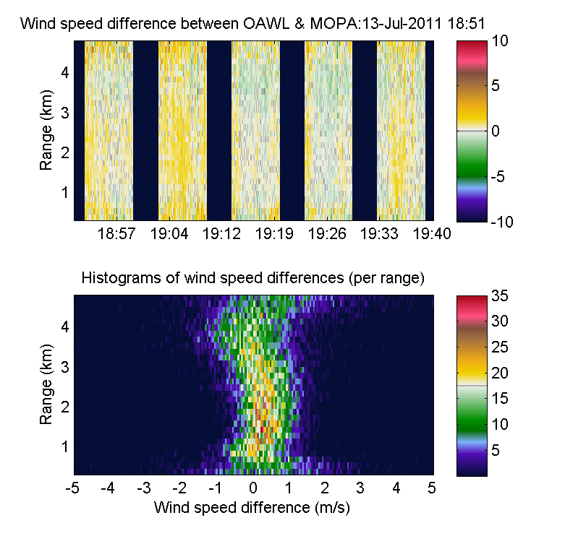
OAWL and MOPA Difference (Accuracy)
Good comparison: r=0.91
Averaged 2s &150 m data used
All data for both systems, between 1 and 5 km included (i.e. no thresholding)
Residual overlap bias (from poor overlap estimate) can be observed as a variation in the centroid (bottom left plot)

Slide 20
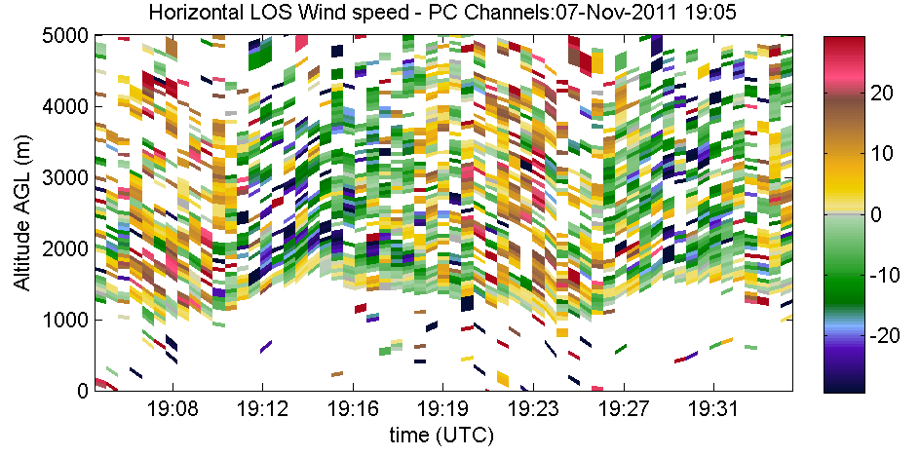
OAWL LOS speed vs. altitude → wind profile
Use pointing angle to estimate horizontal wind speed for each LOS wind estimate.
  LOS pointing angle determines earth elevation angle
  cos(elevation)⁻¹ scales from LOS to horizontal wind
Bin estimates by altitude
Organize binned estimates by the earth-relative azimuth of the LOS pointing angle
Fit sinusoid to the estimates
  Fit phase = wind direction (in earth coordinates)
  Fit amplitude = wind speed (relative to ground)
20
10
Speed (m/s)
0
-10
-20
-150
-100
-50
0
50
100
150
Earth Azimuth (deg)

Slide 21
OAWL for Winds + HSRL
Interferometers (e.g. etalons) are commonly used for HSRL and winds – but separately
In OAWL four detectors per wavelength measure the fringe phase and amplitude of a Mach-Zehnder interferometer.
Fringe phase → Doppler shift
  Doppler shift = line-of-sight wind speed
  Platform induced Doppler-shift does not effect HOAWL-HSRL retrievals
  Allows off-nadir HSRL measurements
    Avoid specular ocean reflections
Fringe amplitude → aerosol content
  No impact on the winds measurement
  No biases due to aerosol/molecular variability
Instrument improvements simultaneously increase wind and aerosol measurement precision
d1
d2
d3
d4
0° 90° 180° 270°
Detector phase

Slide 22
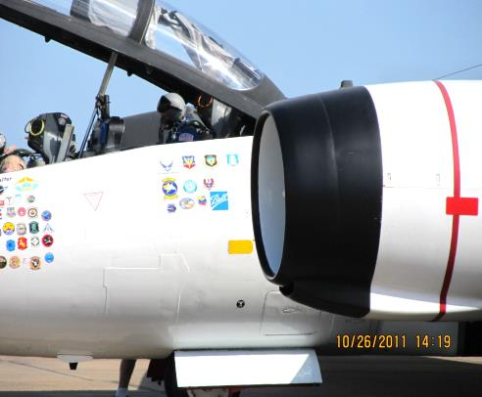
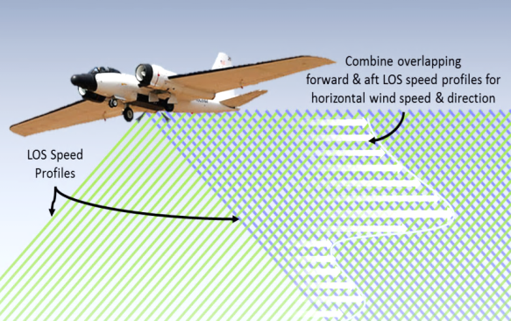
WB-57 High Altitude Research Aircraft

Slide 23
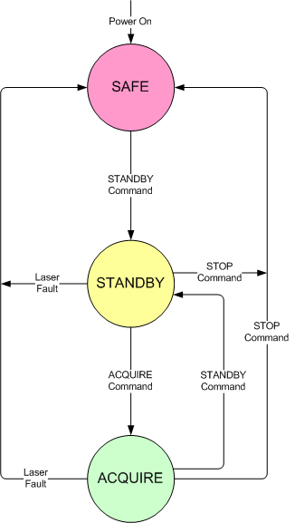
ATHENA-OAWL Software
Major system modes based on those of CALIPSO (implemented with a path to space)
Near-autonomous aircraft mode (minimal pilot interaction required for eye-safety)
Expands to fully manual control mode for engineering users
Science data viewer – for two separate looks
Builds on multiple Ball lidar software libraries

Slide 24
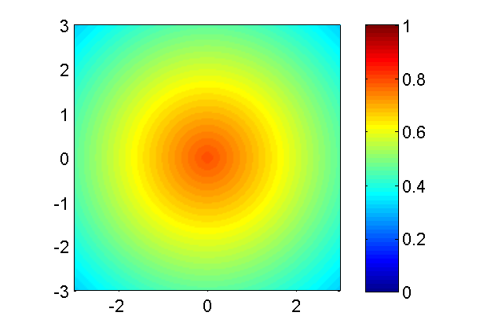
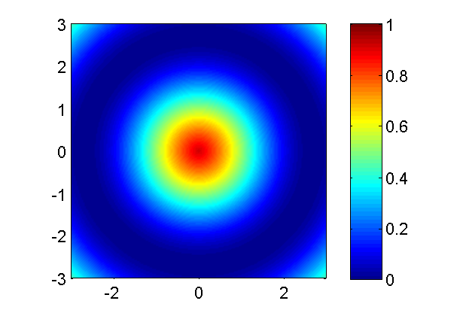
Model for field variability
β = 200 μrad
At right: images of the intensity versus the different field points in the interferometer for a given point on the fringe.
Ideally, the image would be flat across the field, and piston up and down between 0 and 1 as the system goes through fringes.
Two cases:
  Interferometer is fairly well aligned and field performance is “flat” over field angles greater than the telescope FOV.
  Strain on the interferometer (not kinematically mounted) misaligns the beam-splitter by angle β.
The larger β is, the less field widened the interferometer.
Less field widening is observed as fringe variation over the full field incident on the detectors (lower contrast).
Field angle, m-rad
Field angle, m-rad
β = 800 μrad
Field angle, m-rad
Field angle, m-rad

Slide 25
OAWL flexible technology provides options
OPD Wavelength | Long (~1m) OPD | Short (<10 cm) OPD
355 nm (UV) | Strong aerosol backscatter for good aerosol precision (1 ms) molecular return shot noise Low background noise OAWL IIP | Less precise than long OPD (2-3 m/s) but more coverage Aerosol AND molecular both add signal (fringe) → good SNR through the troposphere Low background noise
355nm & 532 nm | Aerosol winds at 2λ (see above) + Aerosols at two wavelengths HOAWL, HAWC | Two OAWL System: 355: short OPD for Molecular ←532: long OPD for Aerosol
532 nm | Lowest risk/cost approach to aerosol winds ATHENA-OAWL | short OPD buys little at 532 where there is low molecular return

