Slide 1
Two impact studies of airborne DWL data on tropical cyclone track and intensity forecasts
G. D. Emmitt, K. Godwin and S. Greco
Simpson Weather Associates
Z. Pu
University of Utah
WGSBLW, Miami,2011

Slide 2
Acknowledgements
Funding
Ron Ferek(ONR)
Operators
CDR Dan Eleuterio (NAVY)
Dan Carre’ (Simpson Weather Associates)
Michael Riemer (NPS)
Brian Tang (MIT)
Key support (software and hardware)
Chris O’Handley (SWA)
Kevin Godwin (SWA/UVA)
LMCT

Slide 3
Outline
P3DWL tropical cyclone observations (general)
Nuri case study
Hagupit case study
Plans for next impact studies

Slide 4
Mission Plan
Study of tropical cyclogenesis, intensification, transition and weakening
Based out of Guam (P3)
Other aircraft include USAF C130 and DLR Falcon
P3: dropsondes, ELDORA and P3DWL
C130: dropsondes
Falcon: dropsondes, DWL, DIAL
Use ferry flights to collect long curtains of wind soundings to test data impact on NWP.
Pax River to West Coast
West Coast to Hawaii
Hawaii to Guam

Slide 5
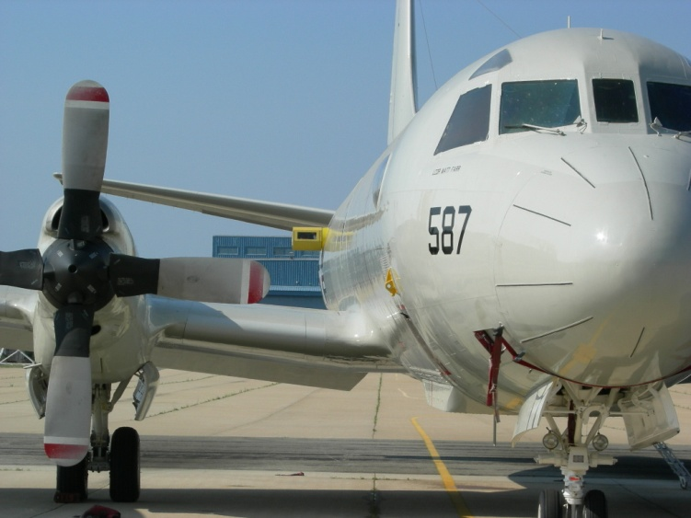
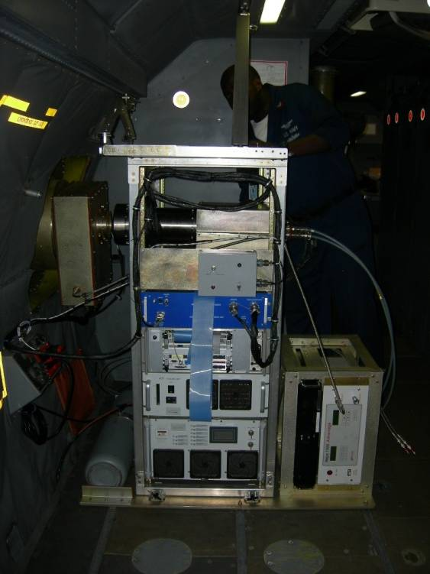
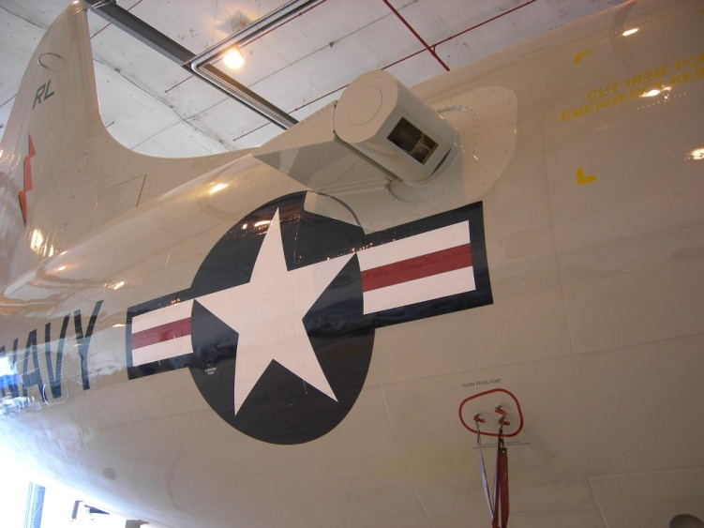
P3DWL for TPARC/TCS-08
1.6 um coherent WTX (ARL/LMCT)
10 cm bi-axis scanner (NASA)
P3 and other parts (NRL)
Analyses software (SWA/CIRPAS)

Slide 6
Basic LOS Signal
50 meter range resolution (Gaussian pulse ~ 70 meters FWHM)
10 cm beam diameter
Spectral domain (Heterodyne detection)
Frequency (LOS speed)
Spectral feature width (turbulence within the illuminated volume)
Frequency discrimination of multiple LOS motions (ground, air, precipitation signals all in same spectrum)

Slide 7
The Data
Profiles of u,v, and w above and below flight level following ~ 3km of scanning.
Information on aerosol structures, precipitation, and sea state
Challenges to signal processing and interpretation
Aircraft extreme motions (mainly rolling)
Chaotic marine boundary layer
Sprays, waves and foam
Clouds (partial obscuration)
Precipitation
Comparisons with dropsondes provides basis for developing “smarter” algorithms

Slide 8
Dropsonde Comparisons
The following series of comparisons are selected from a much larger set of DWL profiles obtained near Typhoon Hugapit.
It is expected that the curtain of DWL profiles will be used for independent diagnostics on typhoon dynamics and to assign situational observation errors to the dropsondes (mass field information) for assimilation into forecasting models.

Slide 9
Comparisons with dropsondes
While compulsory, comparisons between dropsondes and airborne DWL profiles must be done considering:
The dropsonde takes ~ 3 minutes from flight level (3km) to the surface; a DWL profile takes ~ 20 -30 seconds to construct.
With a 10 m/s wind, the dropsonde would drift 1.8 km; at 120 m/s ground speed, the P3DWL data for a single profile would cover 2.4 – 3.6 km. Separation of the near surface returns from the nearest dropsonde measurement could be ~ 5 -6 km

Slide 10
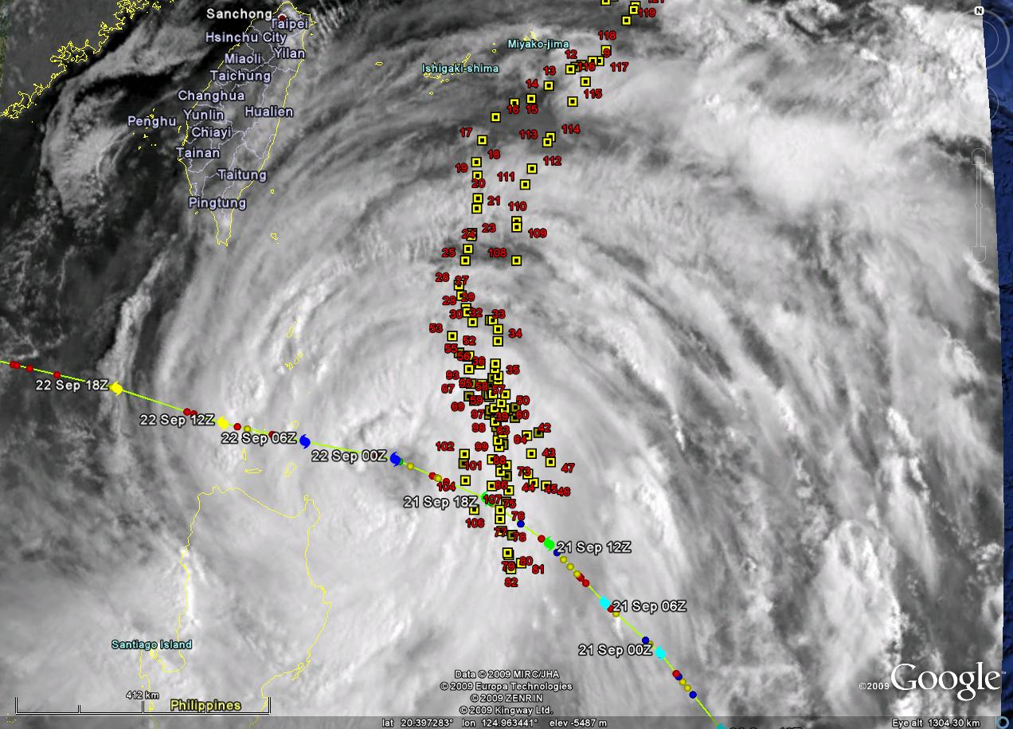

Slide 11
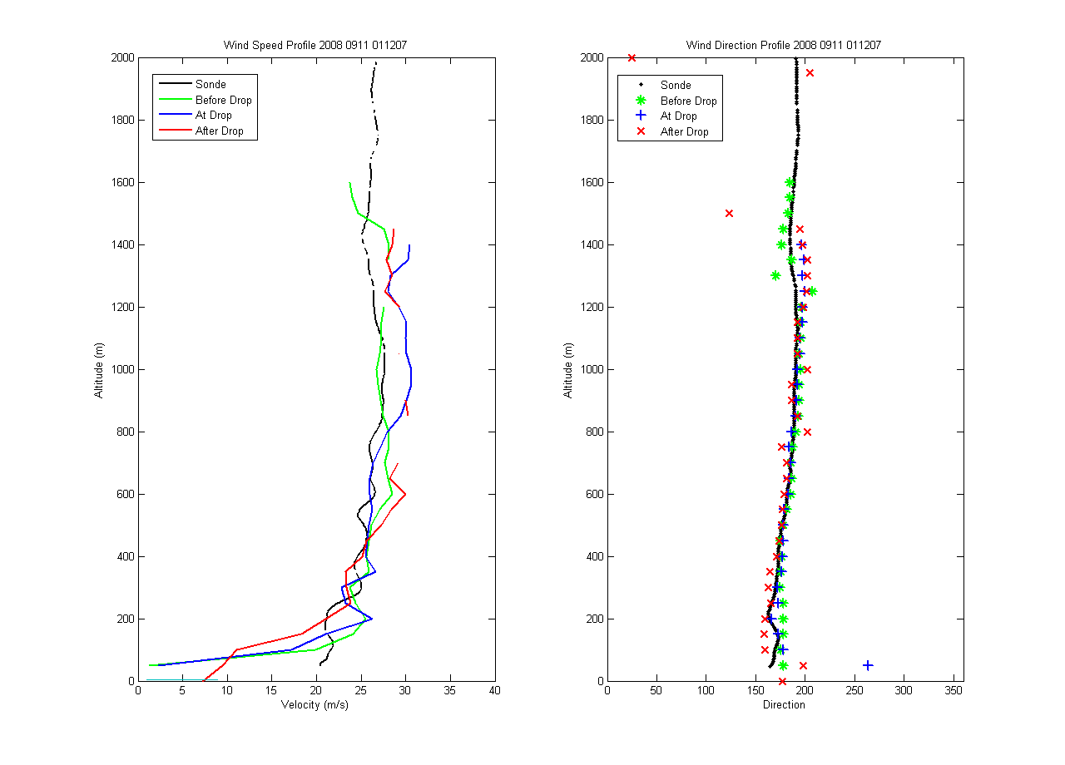
DWL vs. Dropsonde (high wind speed near eye)

Slide 12
Profiling in a turn 267 CW 205 (62 degrees)

Slide 13
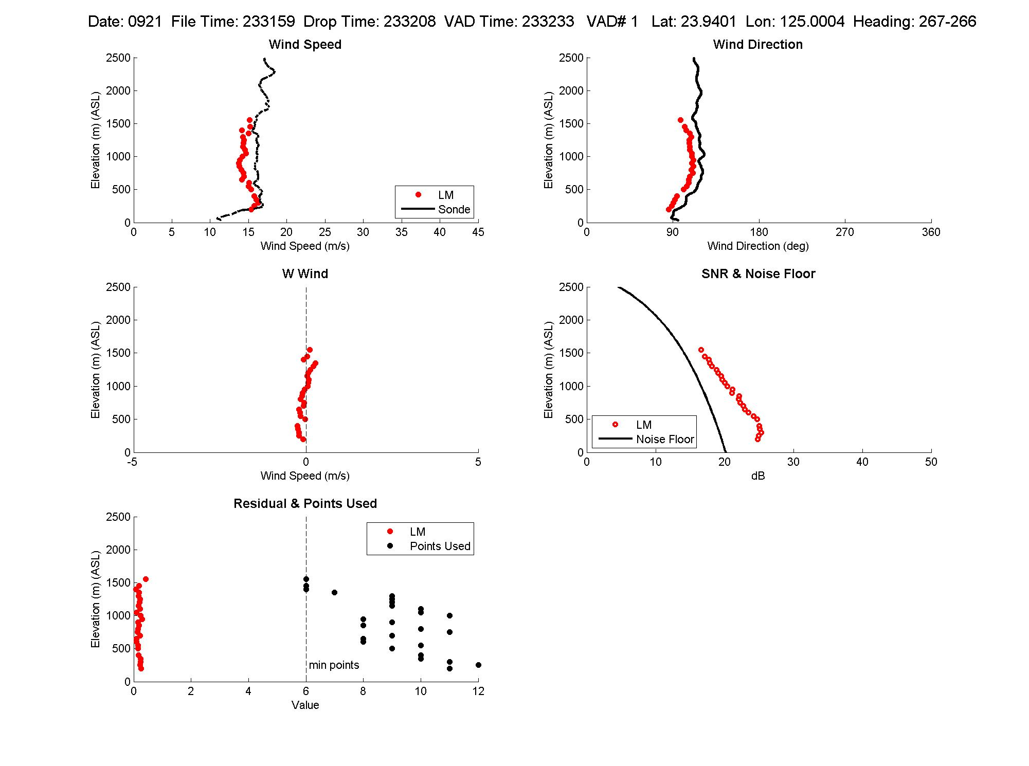

Slide 14
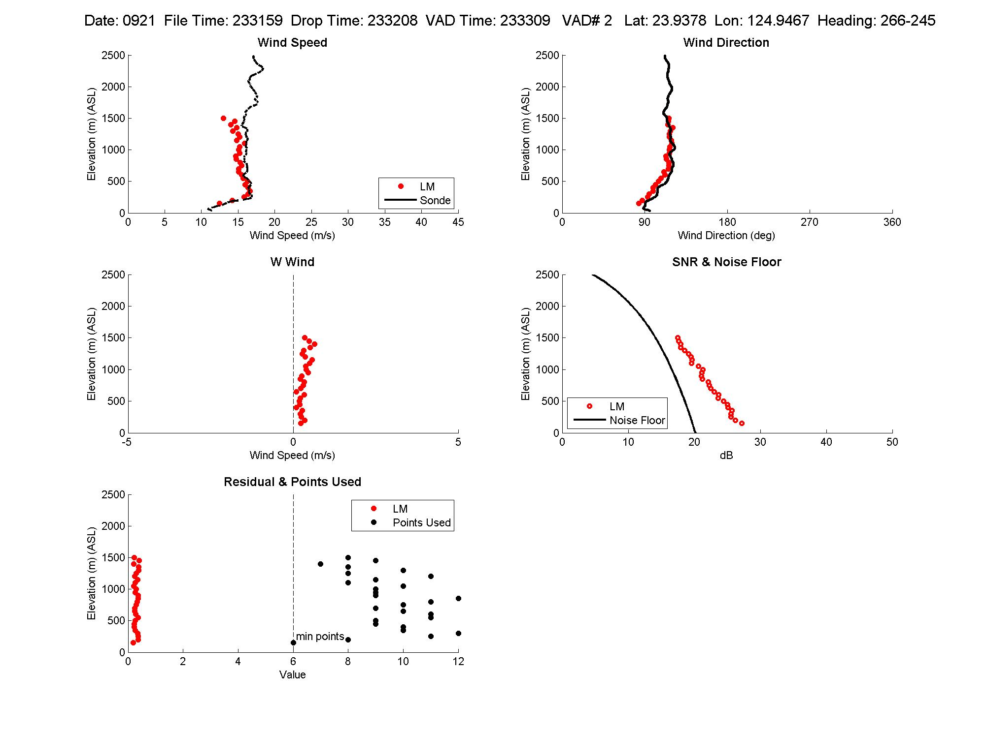

Slide 15
Profiling in a turn 327 CW 25 (57 degrees)

Slide 16
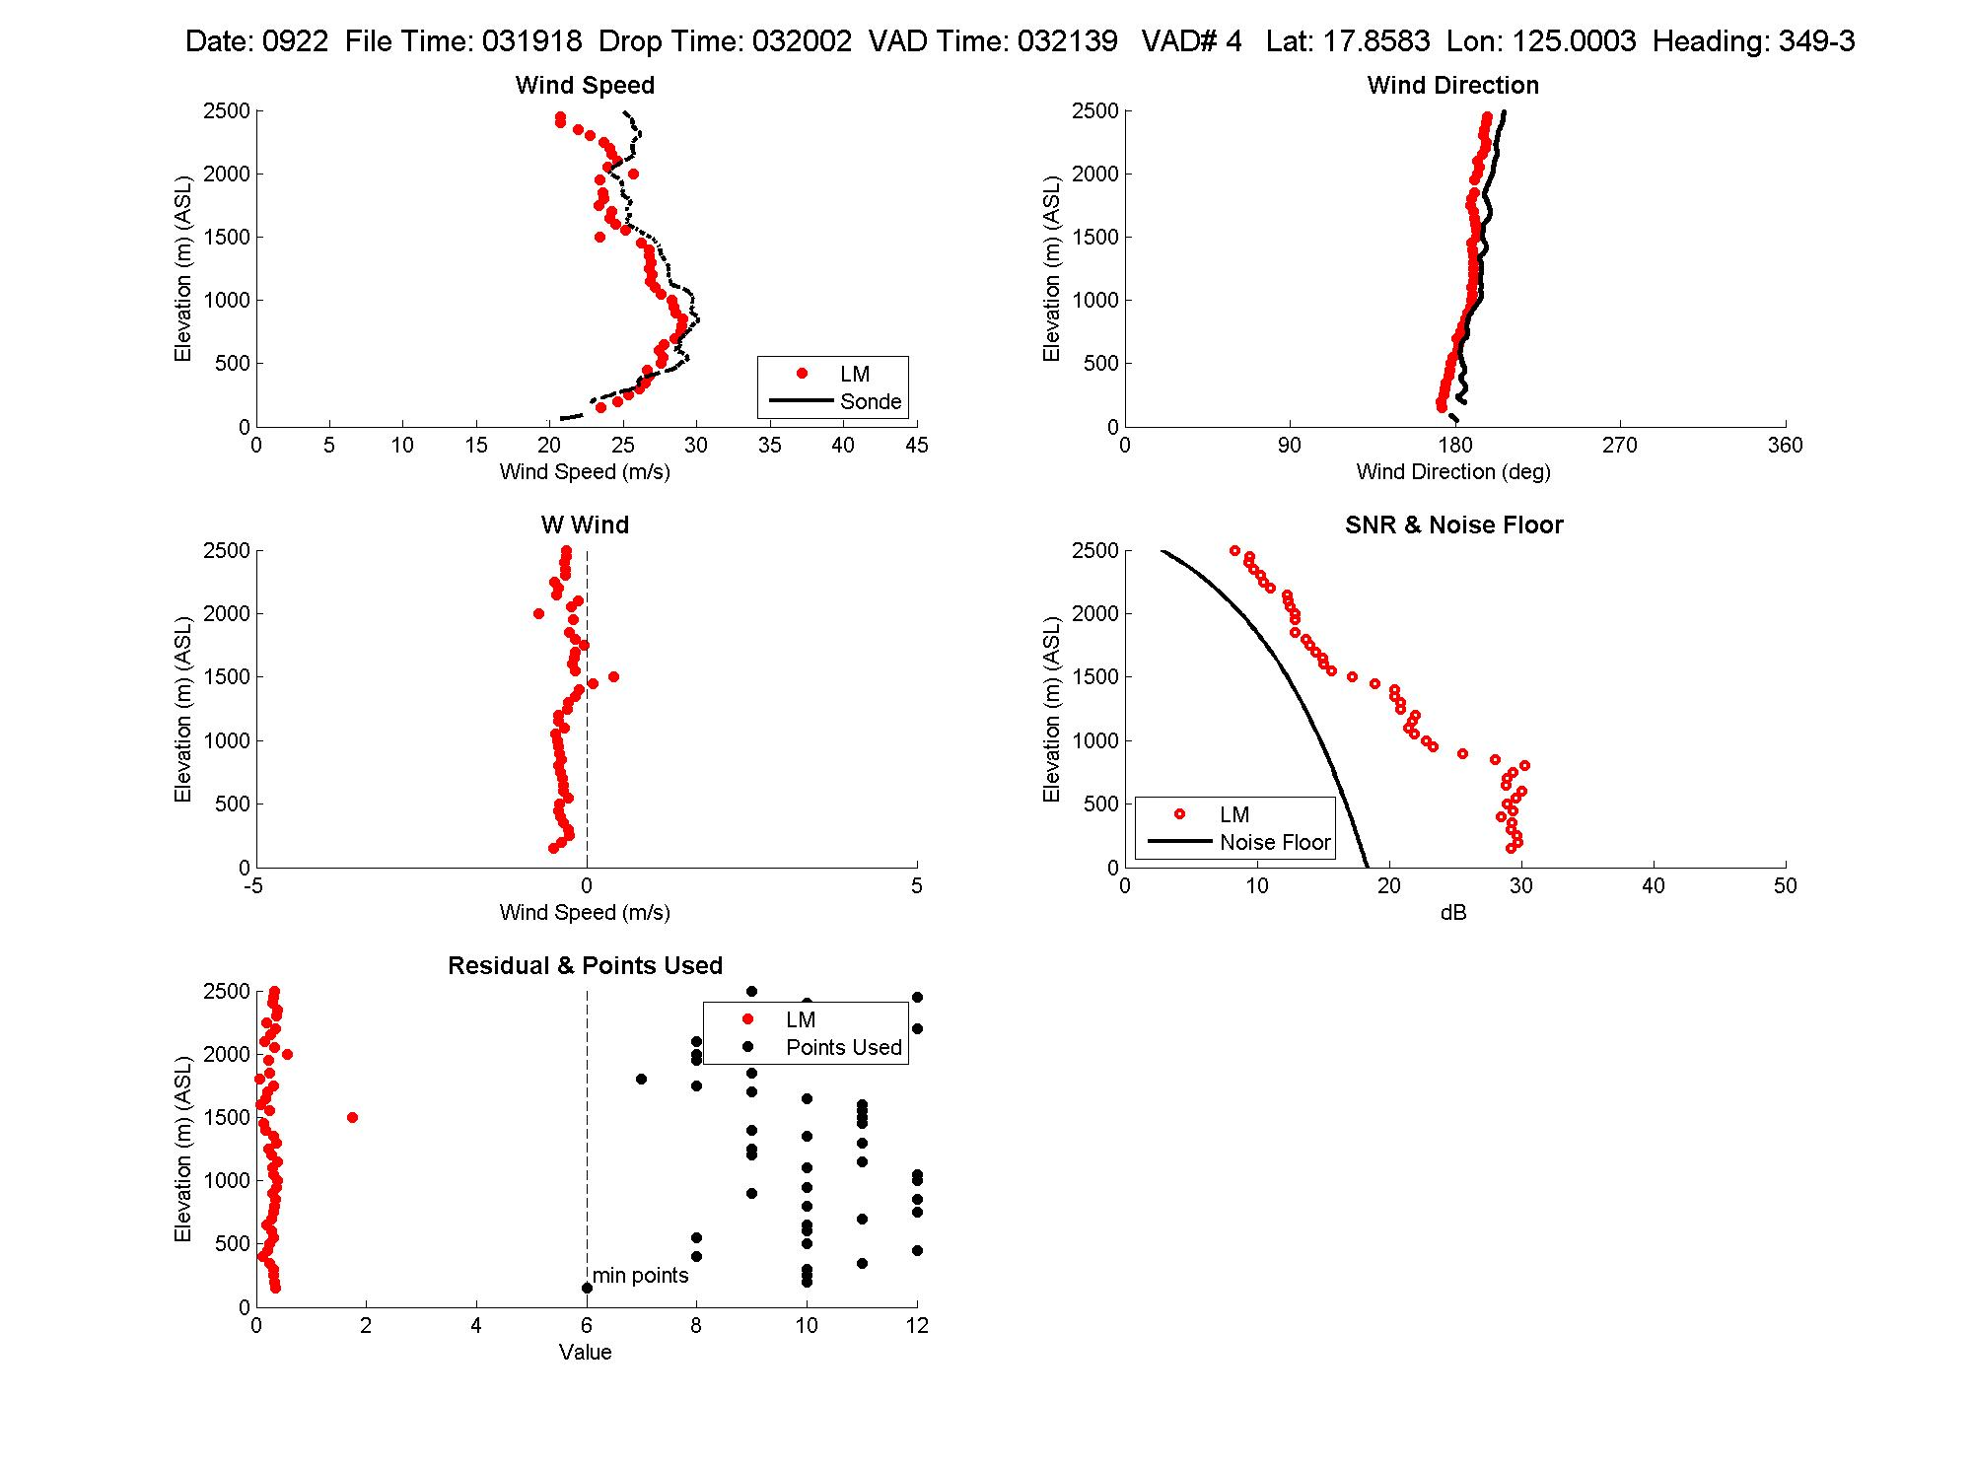

Slide 17
Profiling in rain and through clouds while turning 114 CW 75 (39 degrees)

Slide 18
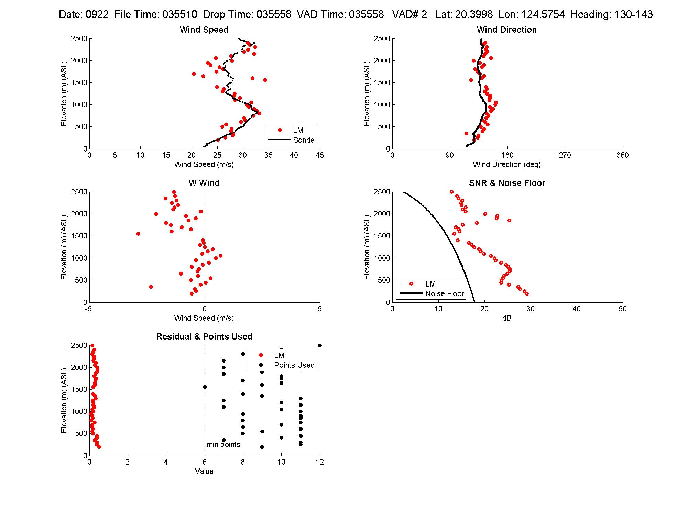

Slide 19
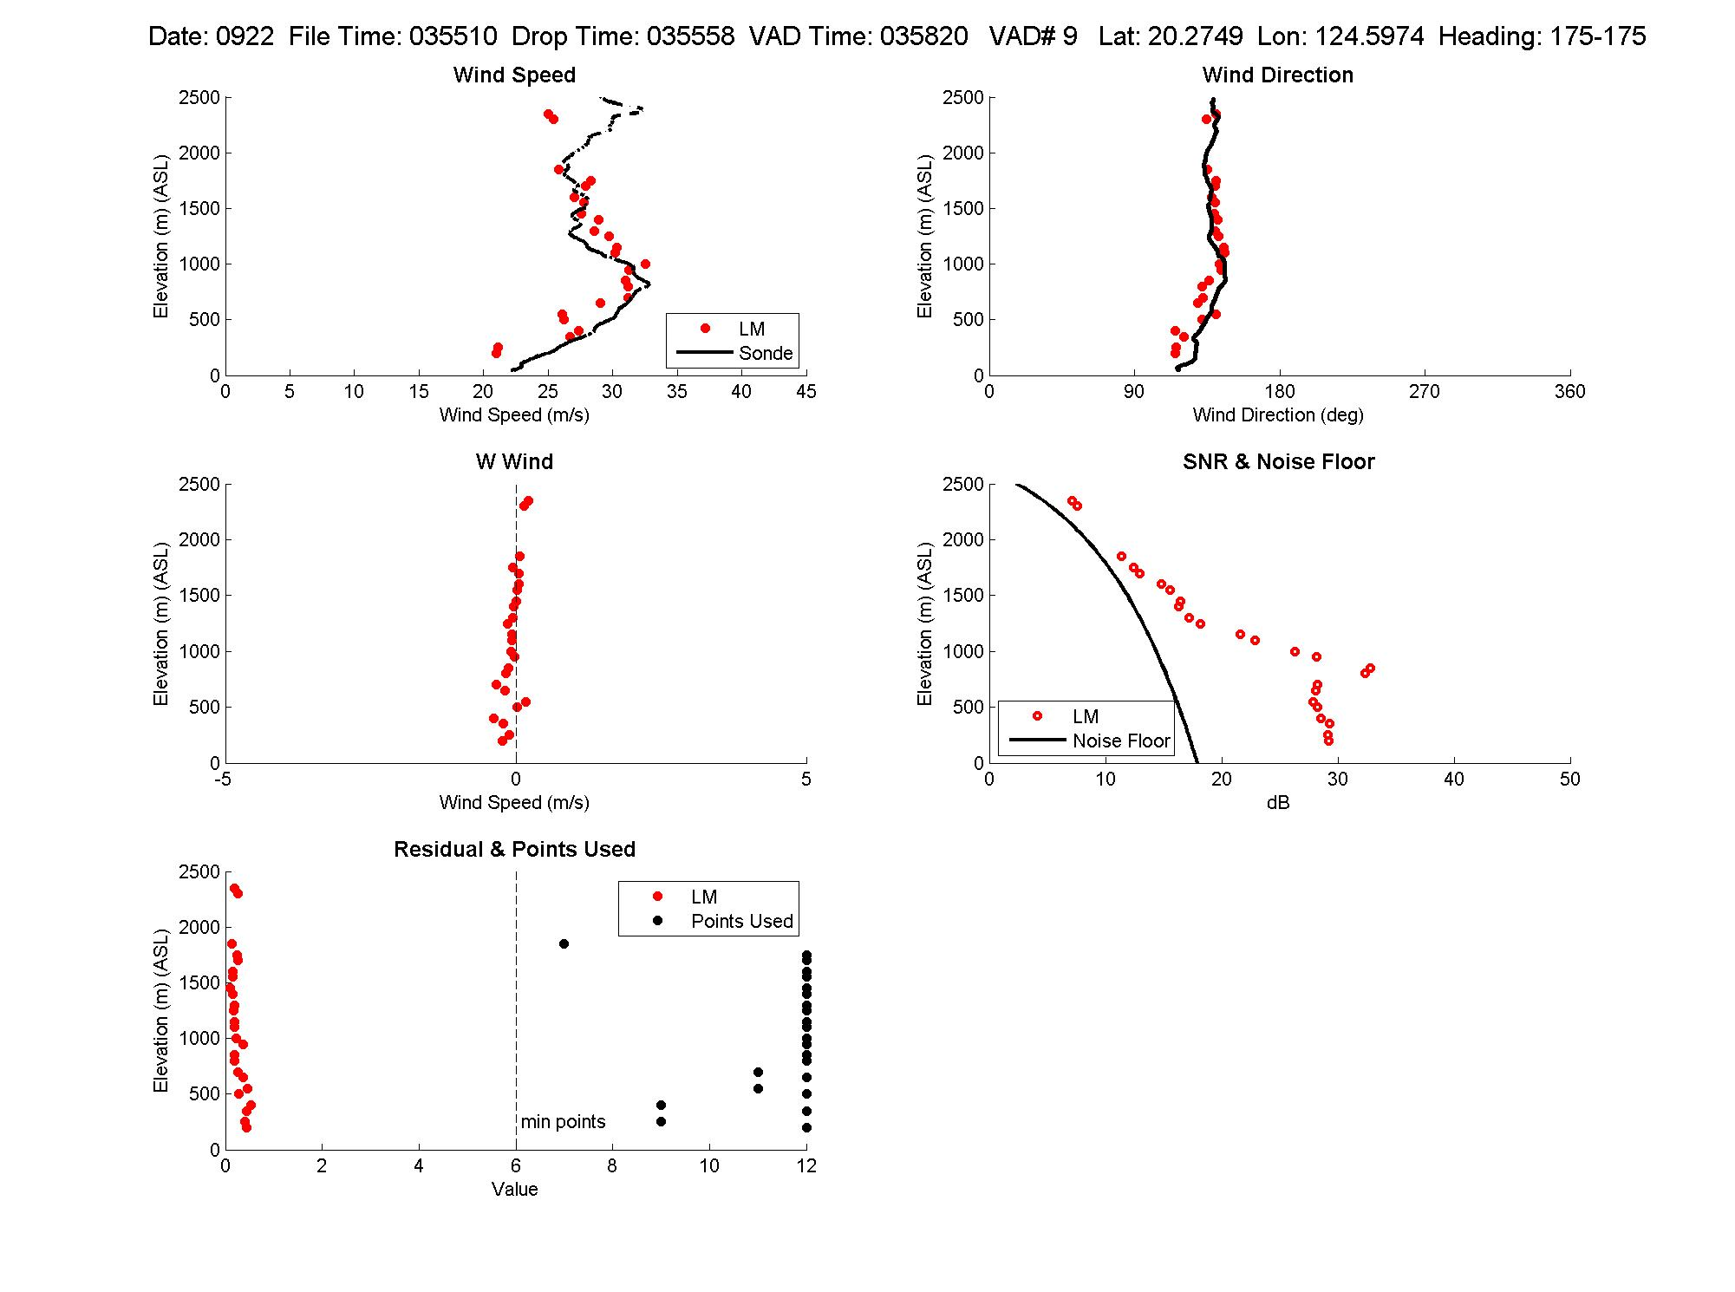

Slide 20
Data Impact Studies
Initial impact study on typhoon Nuri conducted at University of Utah and published
Zhaoxia Pu, Lei Zhang, and G. David Emmitt
“Impact of airborne Doppler wind lidar profiles on numerical simulations of a tropical cyclone”, GRL, VOL. 37, 2010
Working on additional impact evaluation for other typhoons in various segments of their life cycles.

Slide 21
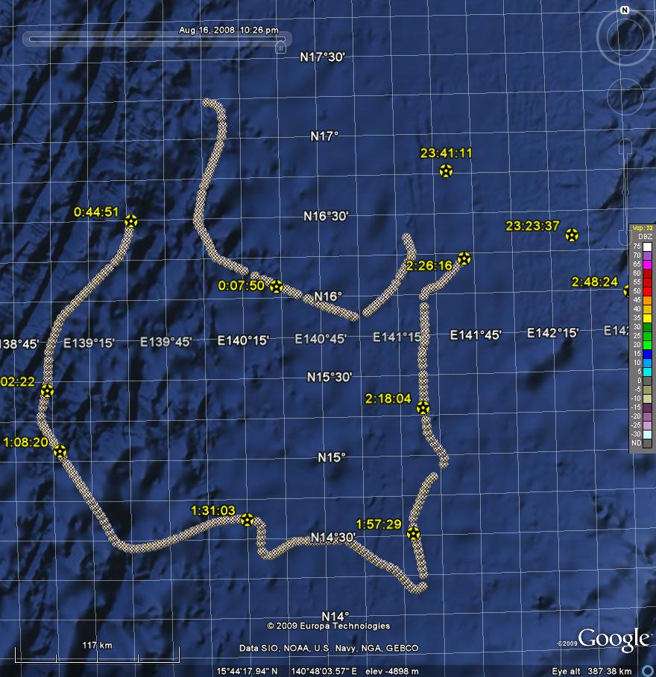
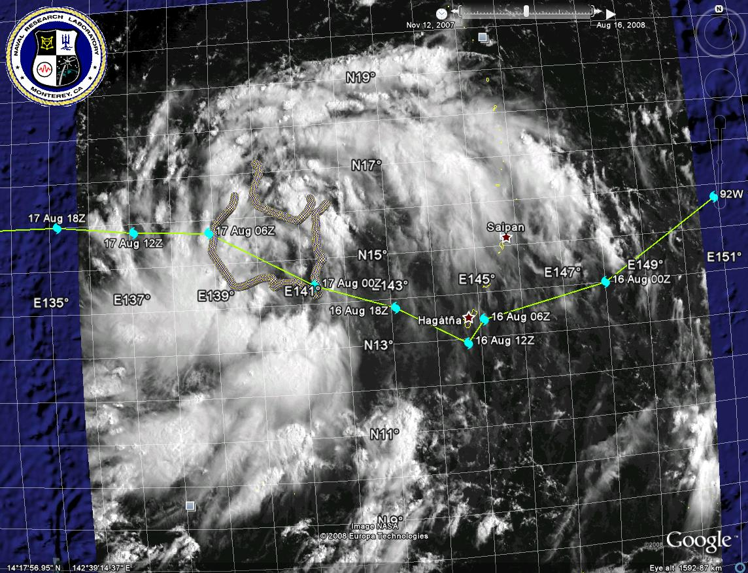
Typhoon Nuri
Courtesy G. D. Emmitt

Slide 22
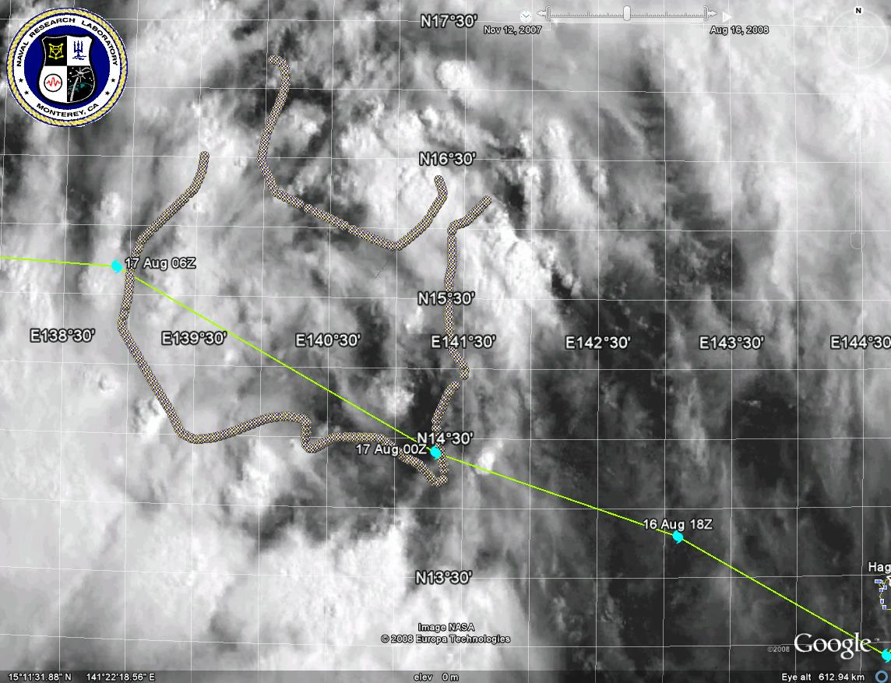

Slide 23
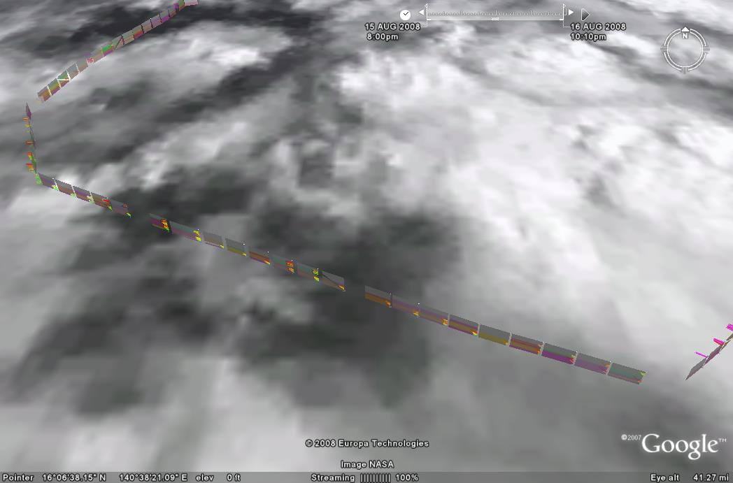
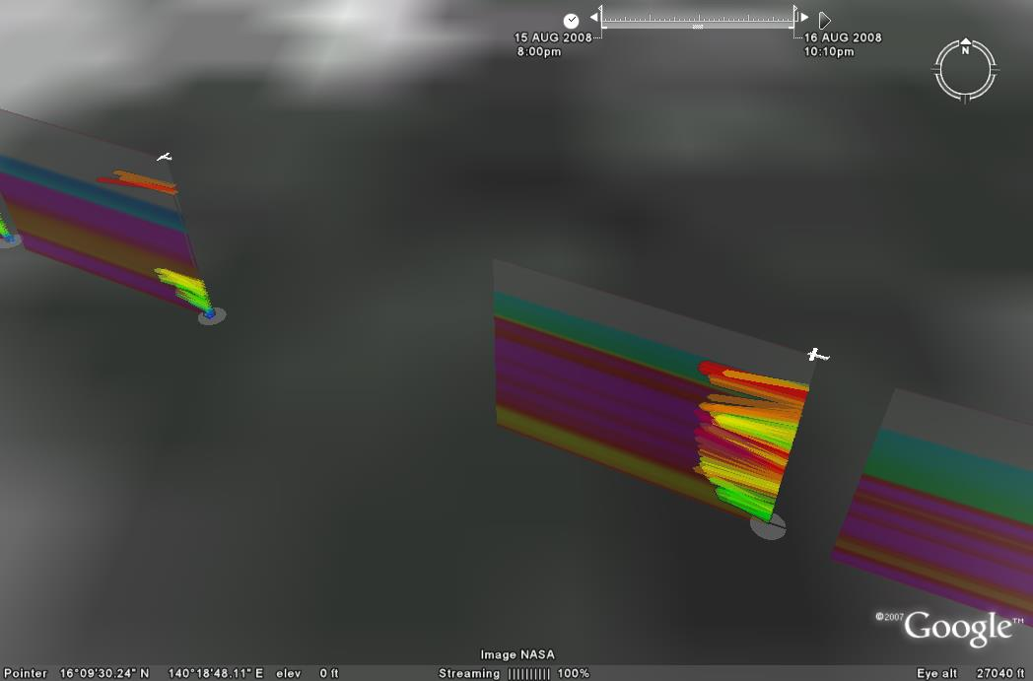
Example of P3DWL data display in Google Earth
Winds are displayed in 50 meter vertical resolution wind flags;
Panel between wind profiles contains aerosol loading as function of height

Slide 24
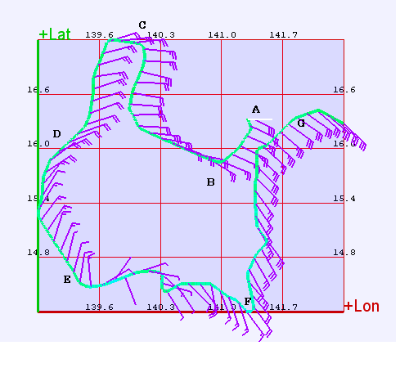
Flight level winds from P3
A –G denote location of dropsondes

Slide 25
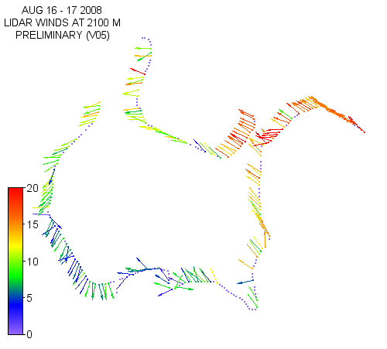
P3DWL winds at 2100 M

Slide 26
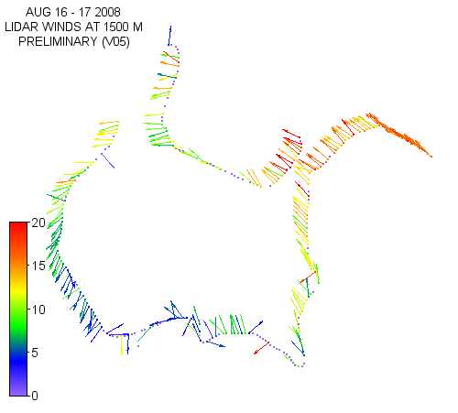
P3DWL winds at 1500 M

Slide 27
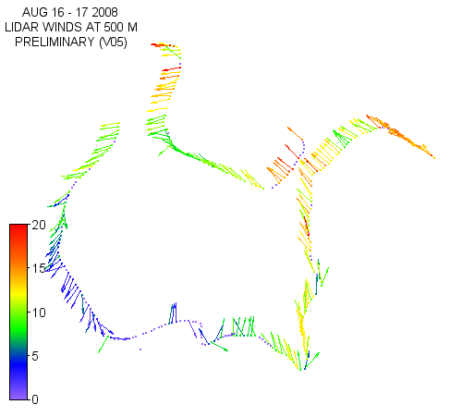
P3DWL winds at 500 M

Slide 28
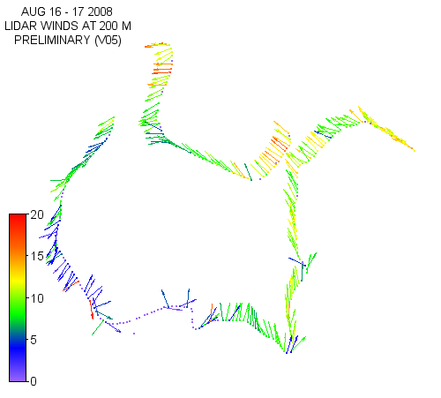
P3DWL winds at 200 M

Slide 29
DWL vs. Dropsonde
Quality of the data
Correlation of wind speed
is nearly 98%

Slide 30
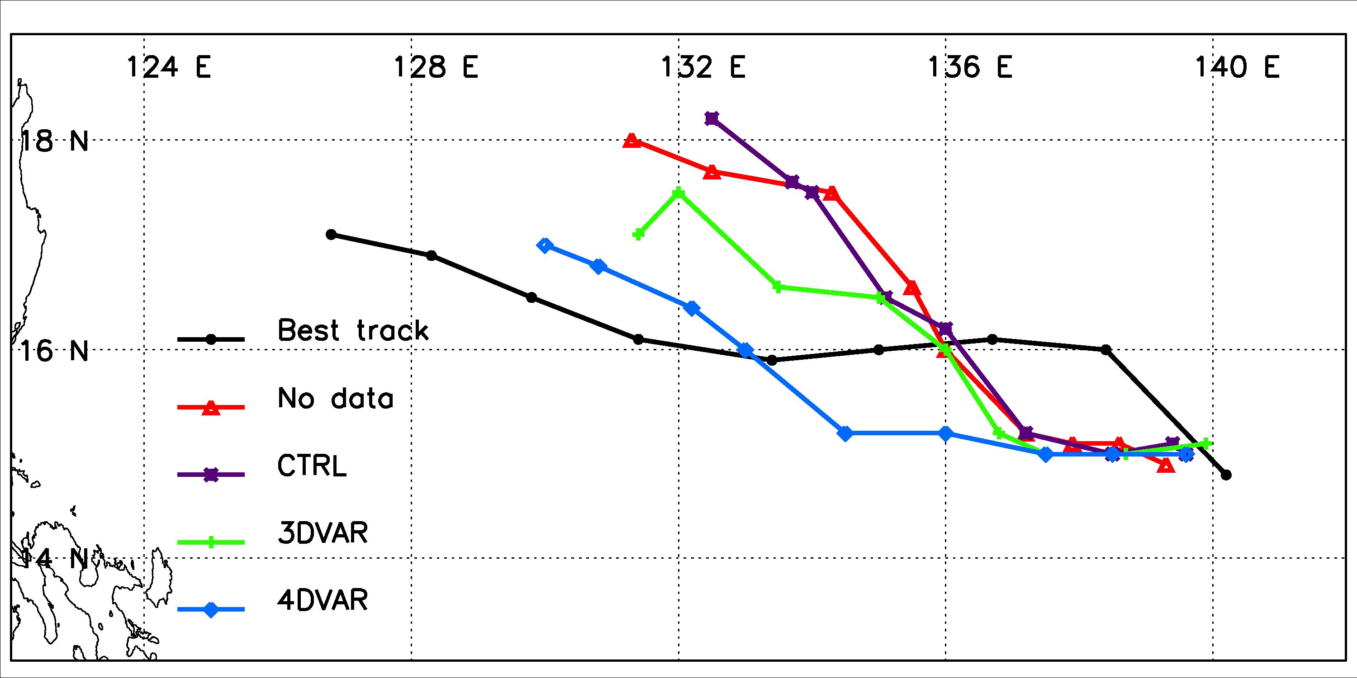
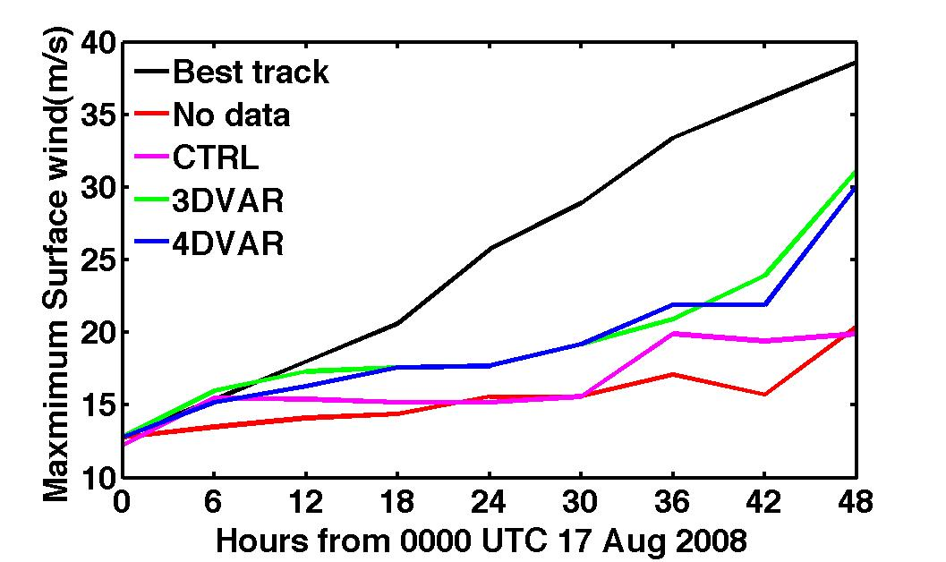
Impact of Airborne Doppler Wind Lidar
obtained near Typhoon Nuri (2008)
Model: Mesoscale community Weather Research and Forecasting (WRF) model
Data: Doppler wind Lidar (DWL) profiles during T-PARC for the period of 0000UTC –0200 UTC 17 August 2008
Forecast Period: 48-h forecast from 0000UTC 17 August 2008 to 0000UTC 19 August 2008
Control: without DWL data assimilated into the WRF model.
Data Assimilation: With DWL data assimilated into the WRF model
Assimilation of DWL profiles eliminated
the northern bias of the simulated storm
track .
Assimilation of DWL profiles resulted in a stronger storm that is more close to the observed intensity of the storm.

Slide 31
P3DWL flight near Typhoon Hagupit (September 21, 2008)

Slide 32
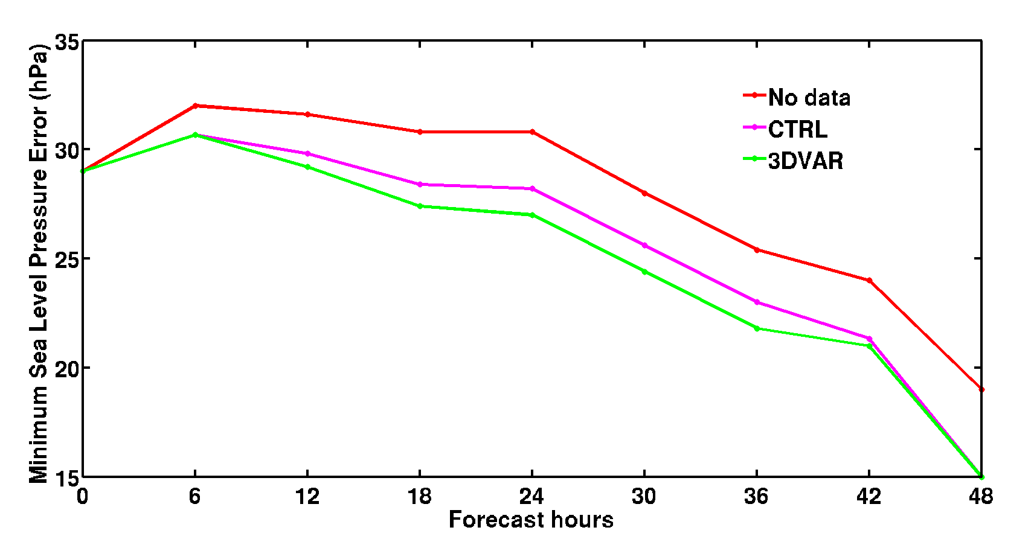
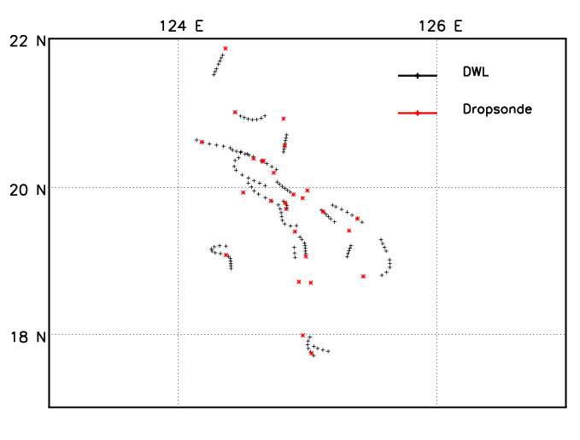
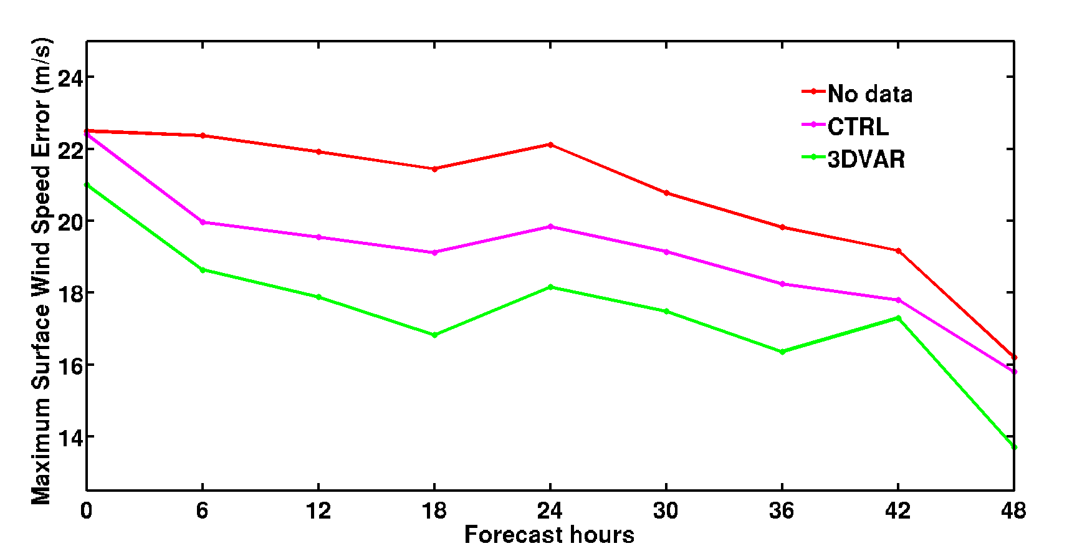
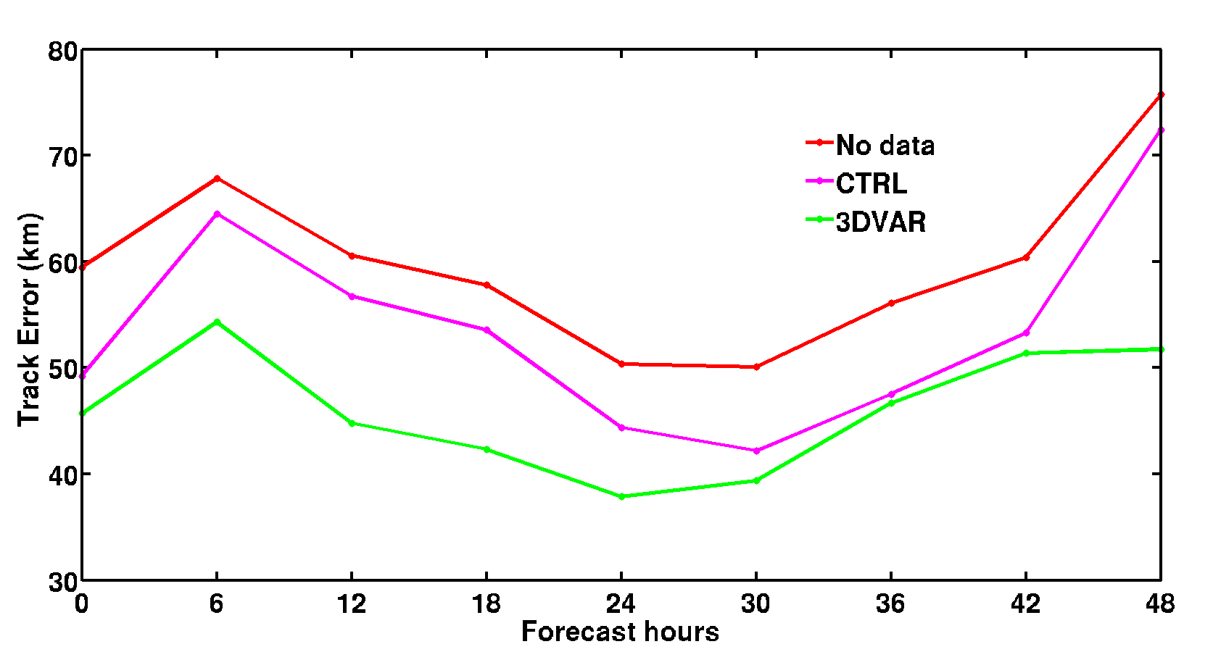
Impact of DWL wind profiles on numerical simulations of Typhoon
Hagupit’s rapid intensification
Zhaoxia Pu and Lei Zhang, Department of Atmospheric Sciences, University of Utah
G. David Emmitt, Simpson Weather Associates, Charlottesville, VA
Data: Doppler wind Lidar (DWL) profiles during 0000UTC –0430 UTC 22 September 2008
Forecast Period: 48-h forecast; 0000UTC 22 September 2008 --- 0000UTC 24 September 2008
SLP_{min}Error
Observations
V_{max} Error
Assimilation of conventional and dropwindsonde data (CTRL) shows a positive impact on Hagupit’s track and intensity forecasts.
Including the DWL wind observations in the model initialization (3DVAR) resulted in significant improvements for both the track and intensity forecasts
Track Error

Slide 33
Current research using P3DWL data
Zhaoxia Pu (University of Utah)
Nuri
Sinlaku
Hagupit
Jangmi
Foster (University of Washington)
Organized Large Eddies
Emmitt (Simpson Weather Associates)
Dropsonde comparisons
Layer Adjacent to the Surface (LAS) investigations

Slide 34
Summary
More than 10,000 profiles of the three dimensional Doppler lidar winds in the vicinity of tropical cyclones have been processed and are now available for use.
FTP site set up for P3 processed data
Questions regarding data access and utility:
gde@swa.com

