Slide 1
Space lidar winds meeting
NIA, Hampton, VA
10th – 11th July 2019
D. Wernham, on behalf of The Aeolus team

Slide 2
Contents
A little about Aeolus and some of the issues we faced before launch
Aladin instrument performance summary with the first flight laser
Switching on the second flight laser and some initial results
Where do we take it from here..?

Slide 3
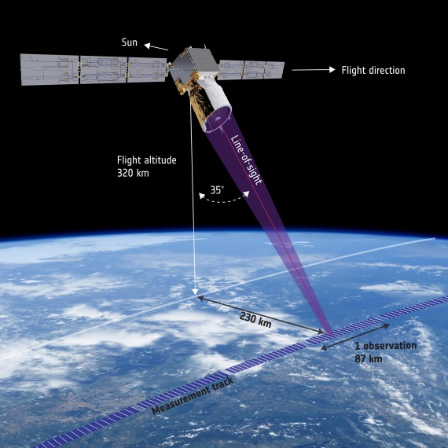
What is Aeolus supposed to do?
To improve the quality of weather forecasts and advance our understanding of atmospheric dynamics and climate processes
Demonstrate space-based Doppler Wind LIDARs potential for operational use.
Provide global measurements of horizontal wind profiles in the troposphere and lower stratosphere

Slide 4
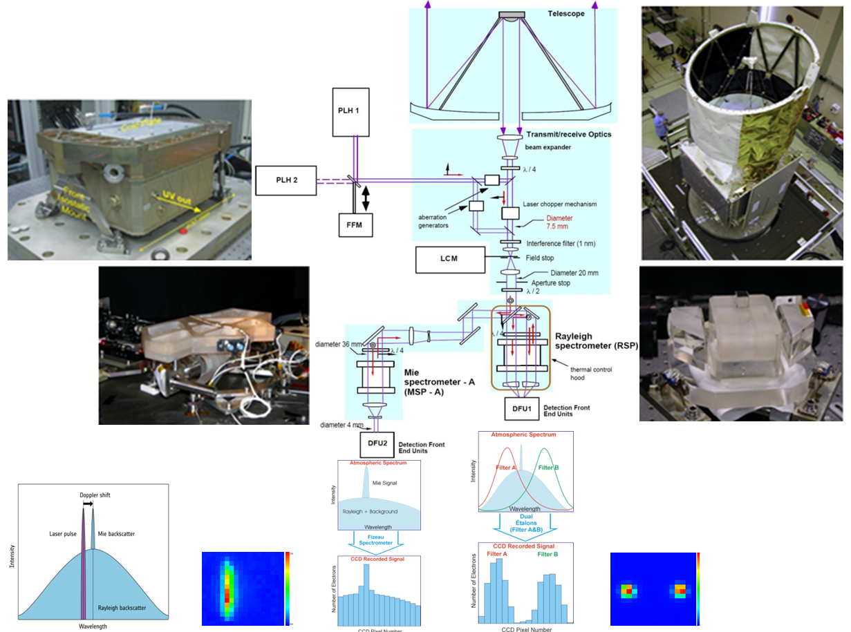
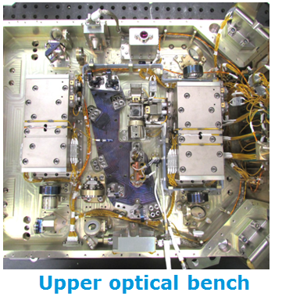
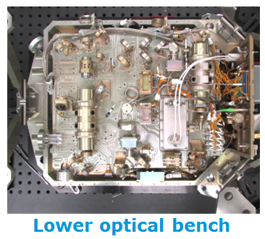
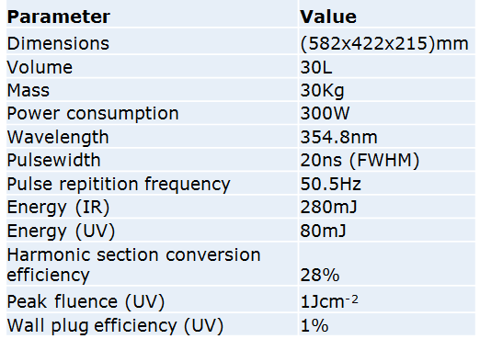
Recalling the measurement principle of Aladin

Slide 5
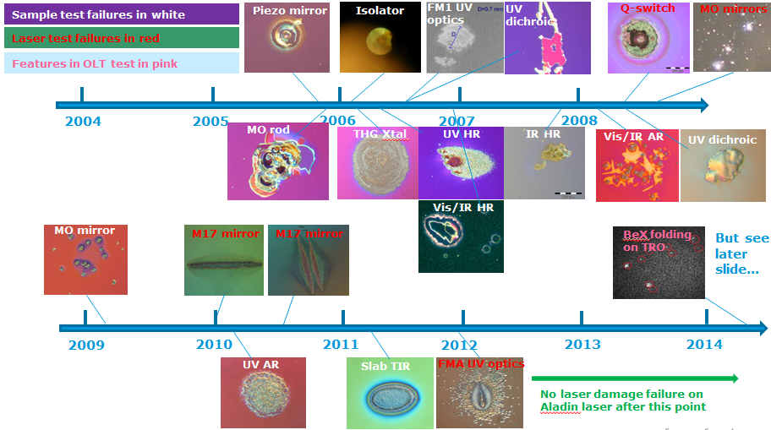
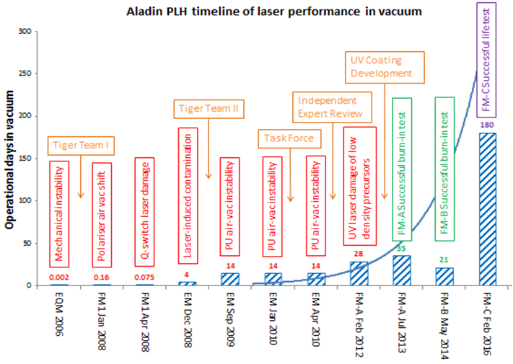
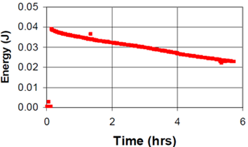
Recalling the main problems we had…
Laser-induced damage
Laser-induced contamination

Slide 6
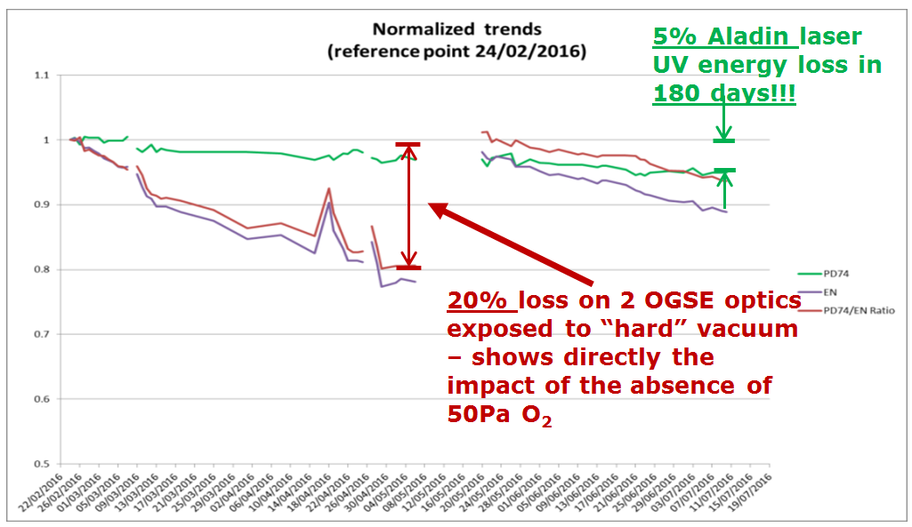
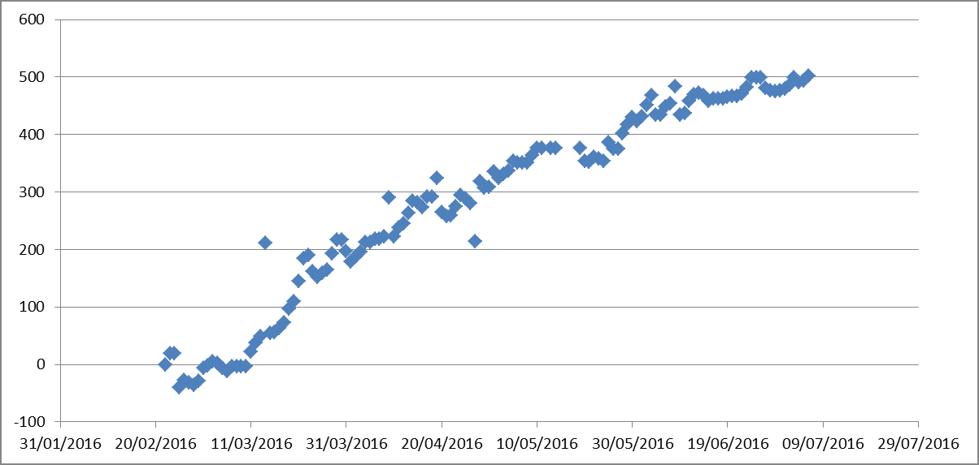
The flight-spare life-test what did we expect…?
From the 6 month test of the flight spare laser, we saw 5% degradation in UV energy (no significant LIC or LID)
We also observed a long term horizontal motion of the UV beam centroid
UV NF centroid horizontal motion (µm)
Flight-spare (FM-C) 6 month endurance test

Slide 7
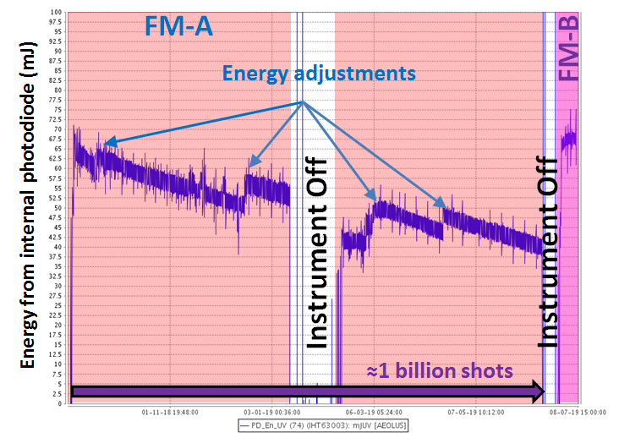
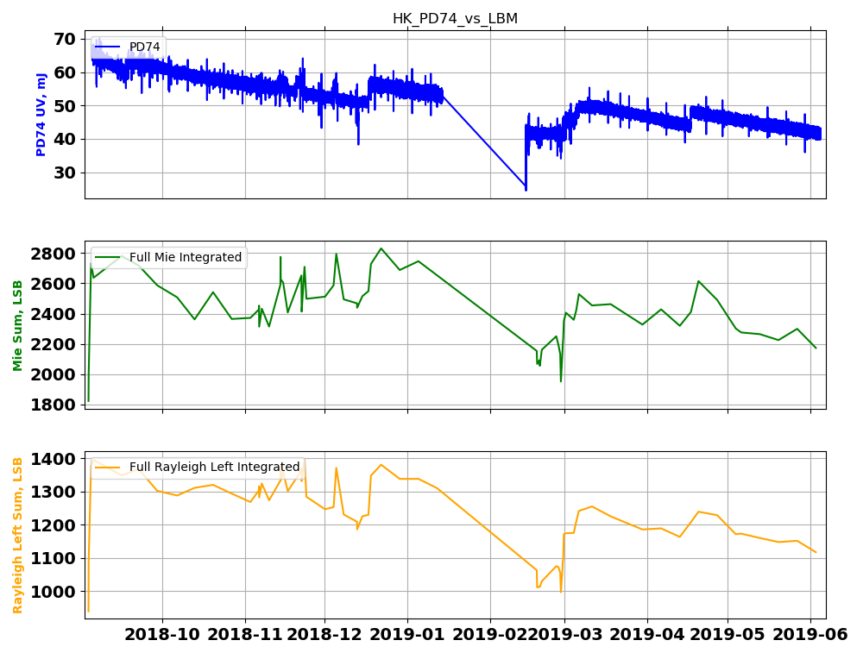
In-orbit performance summary – UV energy
Laser photodiode PD74
Instrument reference path
70mJ
PD74
∆ = -34%
∆ = -40%
Mie
40mJ
∆ = -22%
9 months operations
Rayleigh
∆ = -20%
FM-B
switch
over
15/02/2018
Significantly larger energy decrease measured by UV photodiode but…
Instrument reference path shows only around 20% loss
Launch
22/07/2018
GPS
reboot
15/02/2018

Slide 8
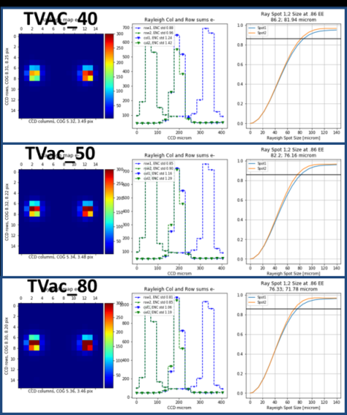
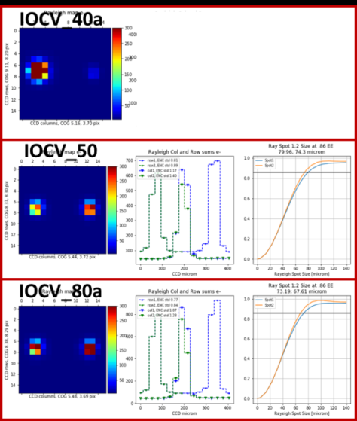
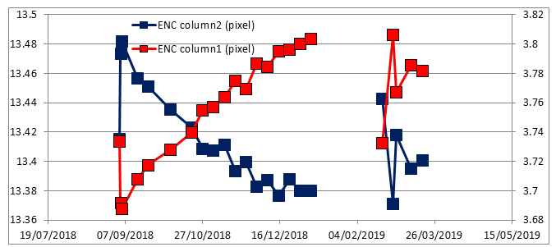
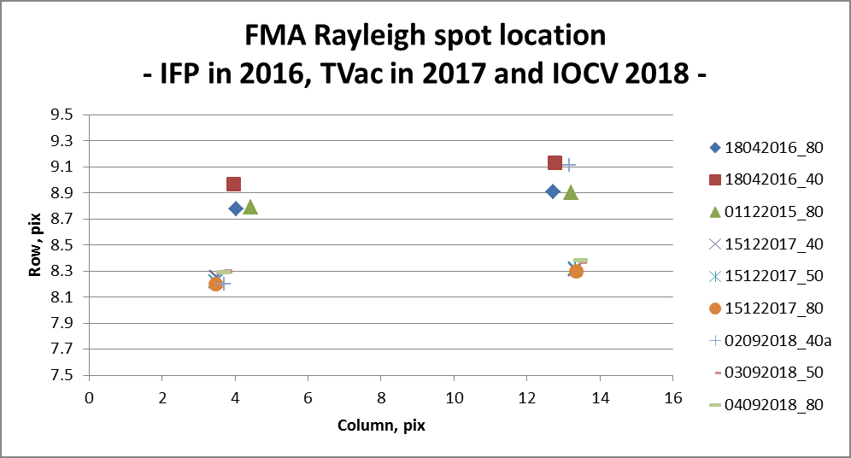
In-orbit performance summary – beam position
Spots on the Rayleigh spectrometer were consistent with the last positions in the thermal vacuum test in 2017
There has been a slow drift in the spot position over the FM-A operations which is consistent with the drift observed on the flight spare laser during the 6 month test on ground

Slide 9
In-orbit performance summary – Fluence
The fluence has remained under control throughout the 9 months of FM-A operations
We now use the peak signal on a single pixel on the Mie spectrometer to cross check and deal with potential photodiode detector drifts

Slide 10
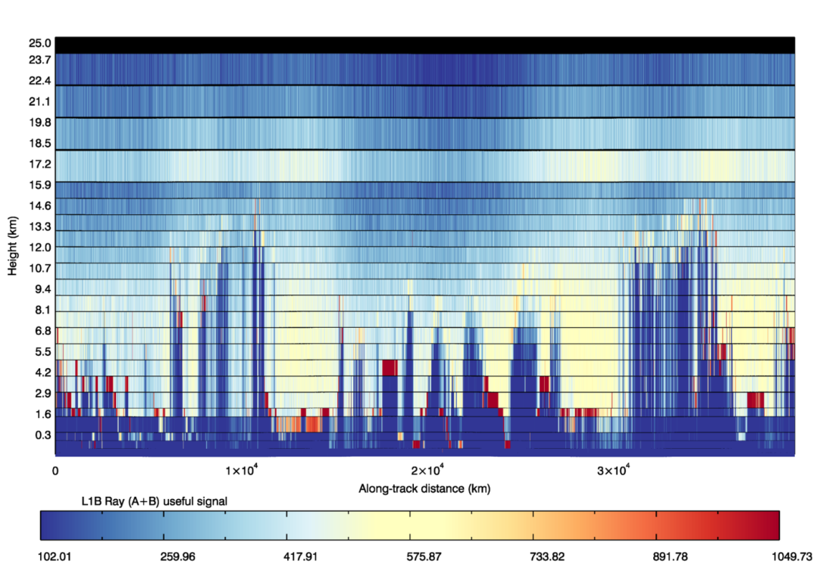
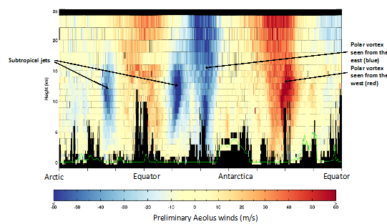
In-orbit performance summary – measuring the wind
In the first week of September 2018, Aeolus gave us first light and the first measurements of the wind
See following presentations for more details on the measurements thus far…

Slide 11
In-orbit performance summary
To improve the quality of weather forecasts and advance our understanding of atmospheric dynamics and climate processes
Several Meteorological centres have already performed analyses showing that Aeolus inputs have a positive impact on the accuracy of NWP models. On the advancement of understanding of the dynamics of the atmosphere and detailed climate knowledge we will need to be more patient…
Demonstrate space-based Doppler Wind LIDARs potential for operational use.
The potential for operational use has already been demonstrated with the demonstration of mission lifetime remaining to be verified
Provide global measurements of horizontal wind profiles in the troposphere and lower stratosphere
Aeolus has provided a data set for the last 9 months through the whole atmosphere
After many years of painful development, we have already demonstrated the main objectives of this Earth Explorer mission, we have the first Doppler wind lidar in space and the first high power UV laser to operate for a significant time in space.

Slide 12
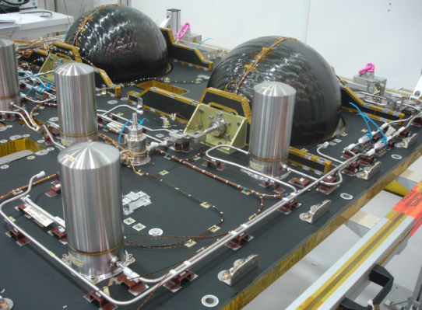
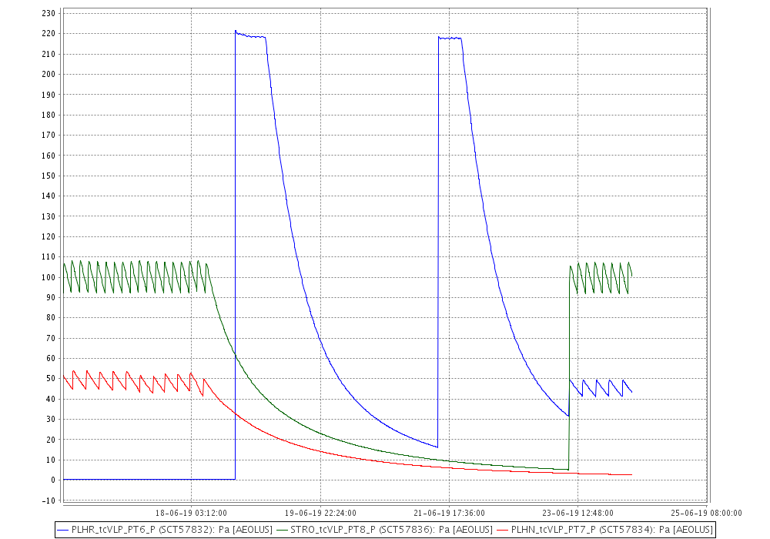
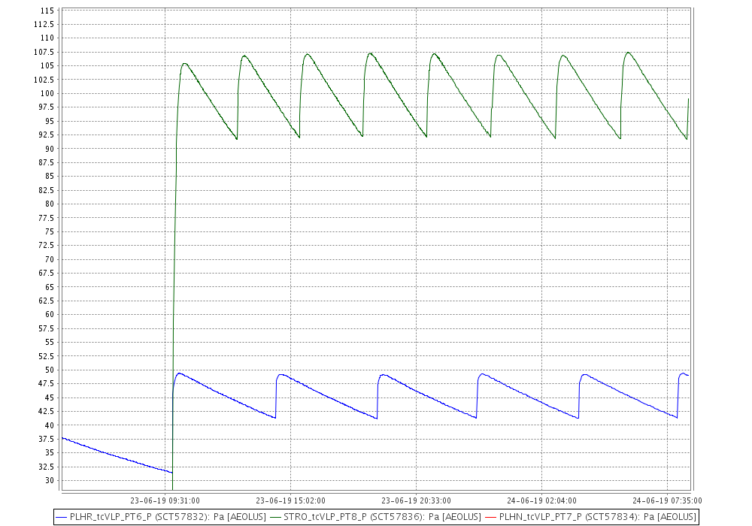
Switching on the second flight laser: FM-B – activating the In-Situ Cleaning System (ICS)
STRO P-V = 107-92Pa
PLH-R (FM-B) P-V = 49-41Pa
PLH-R (FM-B)
STRO
PLH-R (FM-B)

Slide 13
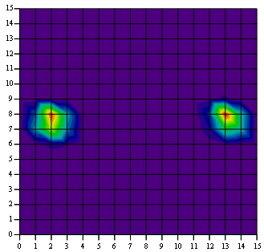
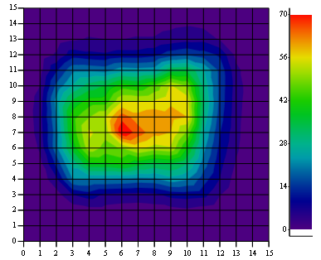
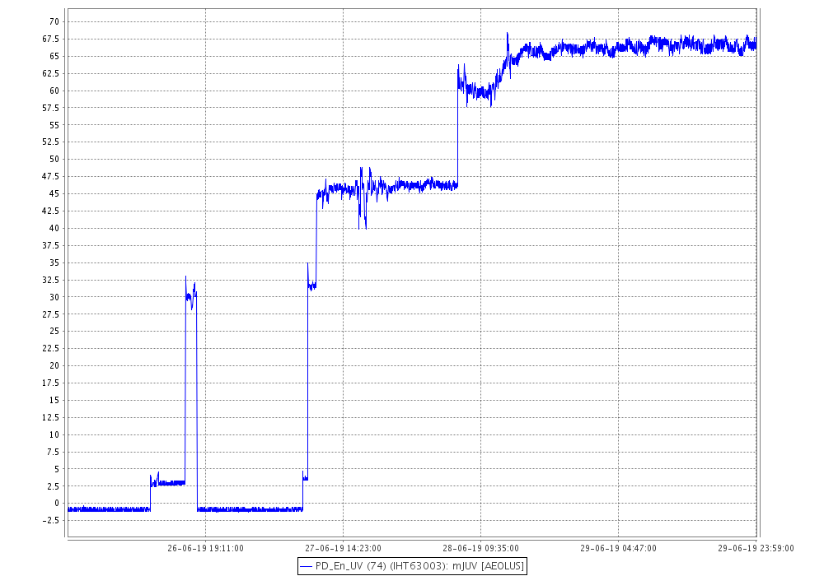
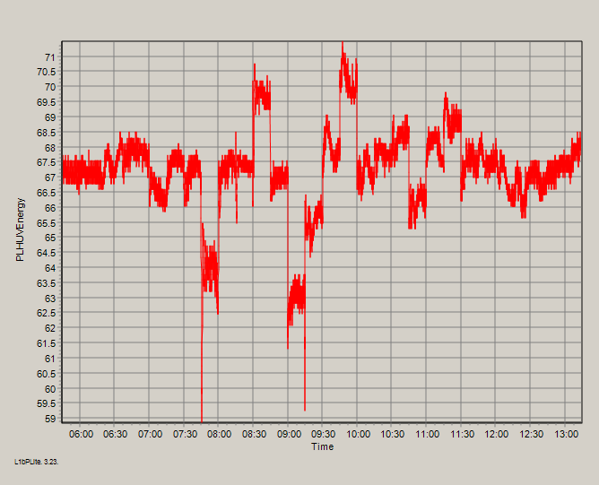
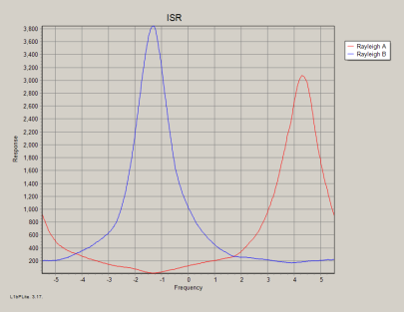
Switching on the second flight laser: FM-B – The slow laser switch-on protocol
LBM
5
4
3
2
2
Sensitivity test
1
1
ISR
Laser frequency adjustment

Slide 14
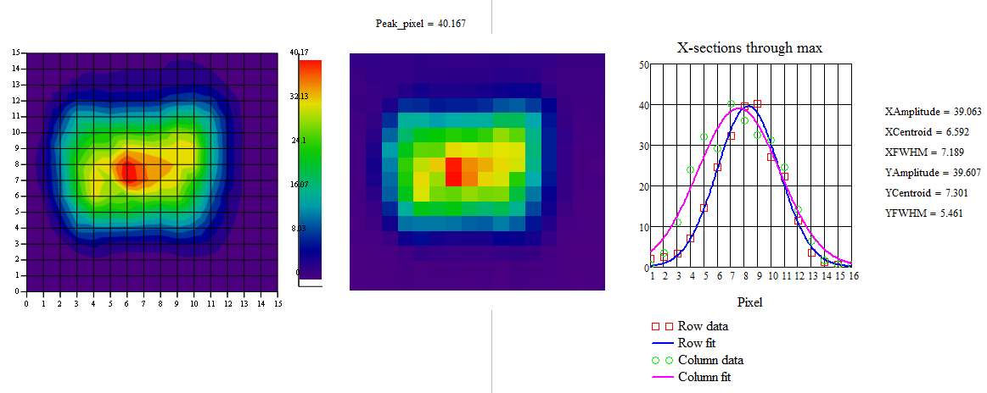
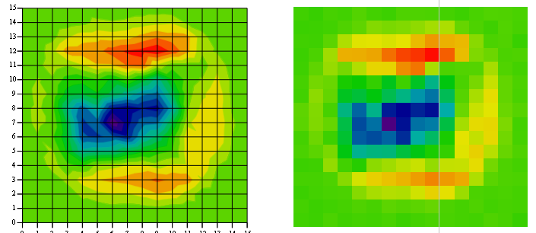
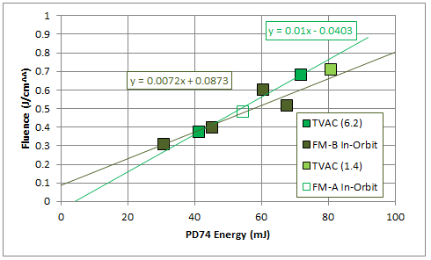
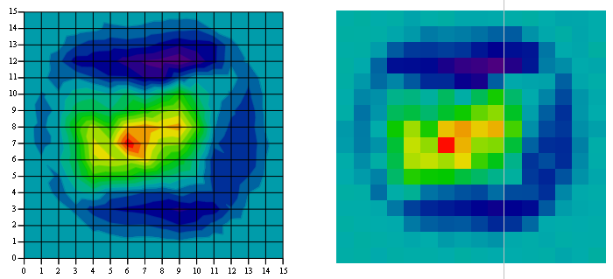
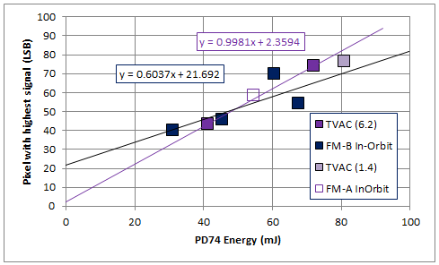
Switching on the second flight laser: FM-B – Laser Beam Monitoring
2
5
40mJ
3
50mJ
4

Slide 15
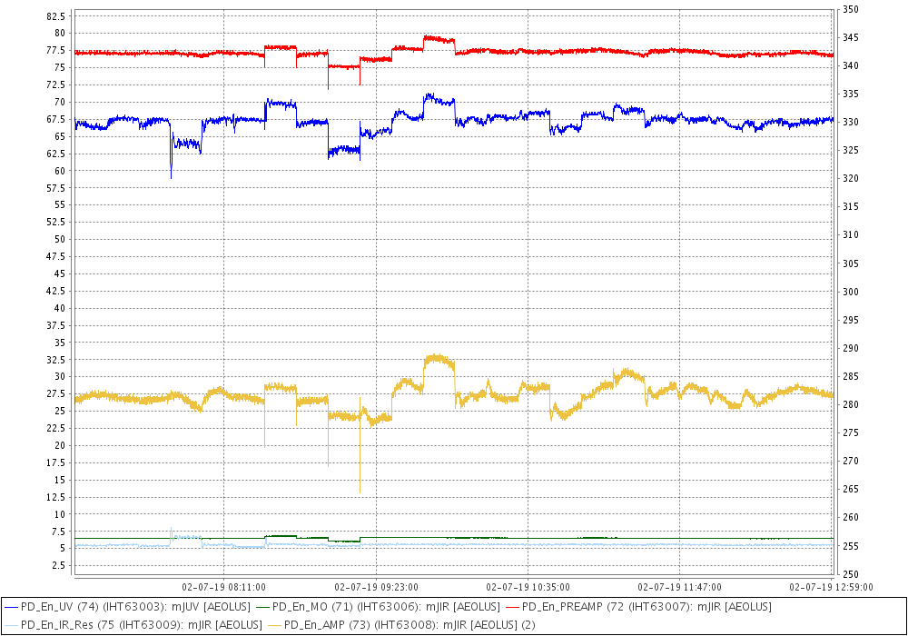
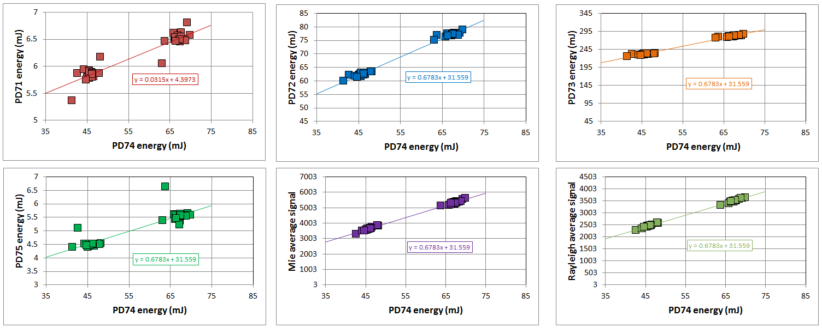
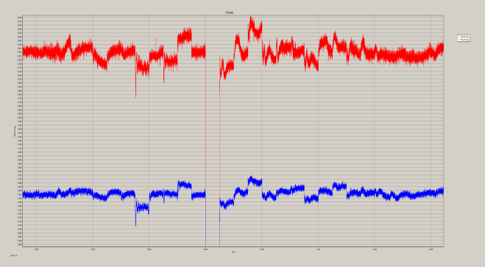
Switching on the second flight laser: FM-B – Sensitivity tests
Mie
Rayleigh
Laser internal photodiodes
Instrument reference path

Slide 16
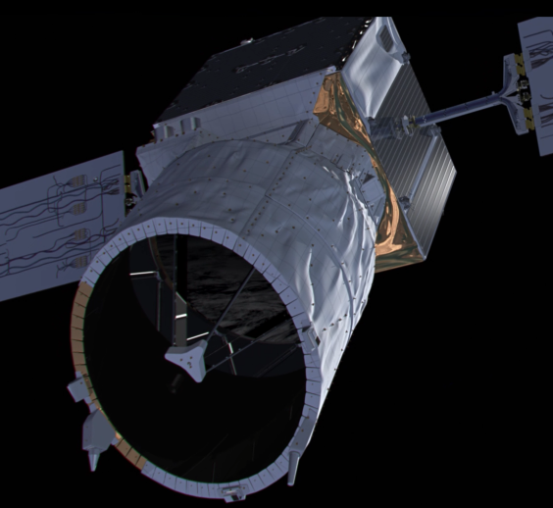
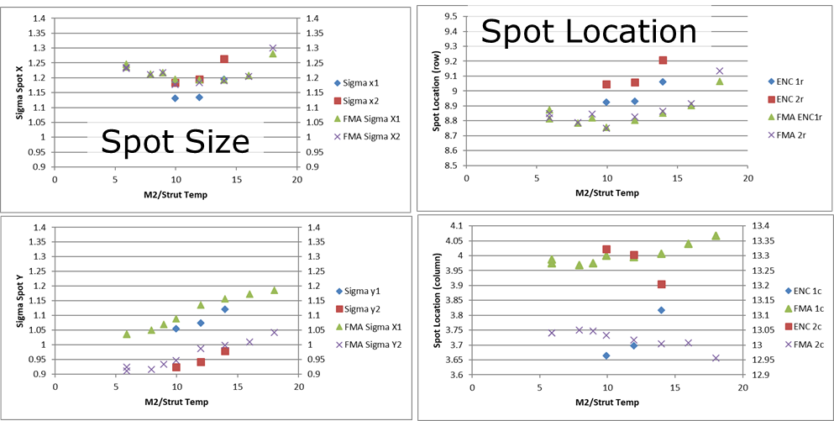
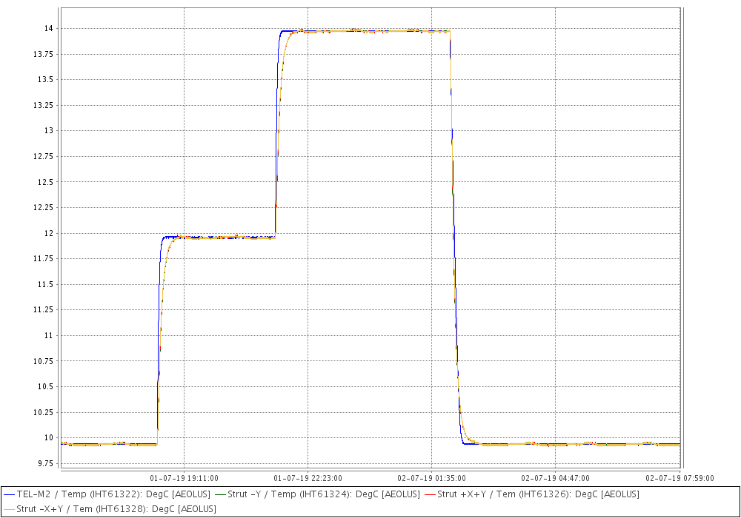
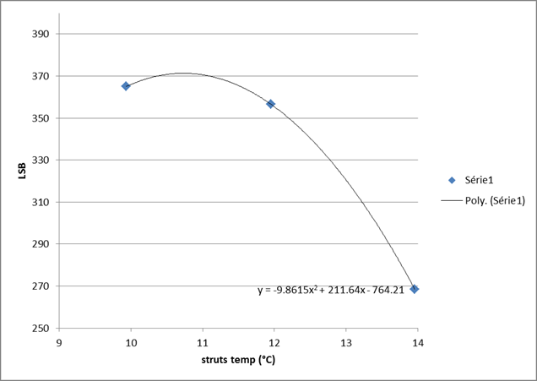
Switching on the second flight laser: FM-B – Telescope re-focussing
14°C
12°C
10°C
The reception path signal throughput has now been optimised

Slide 17
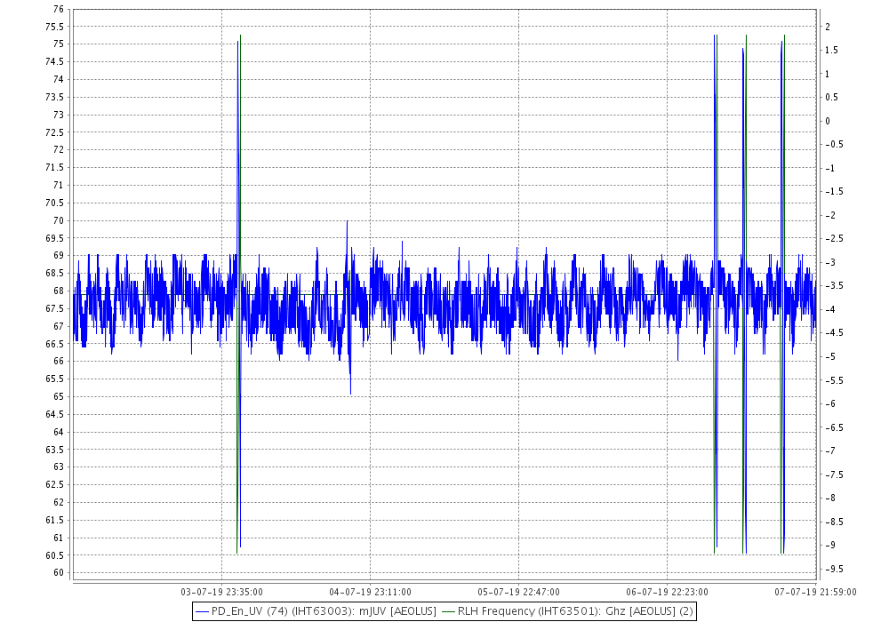
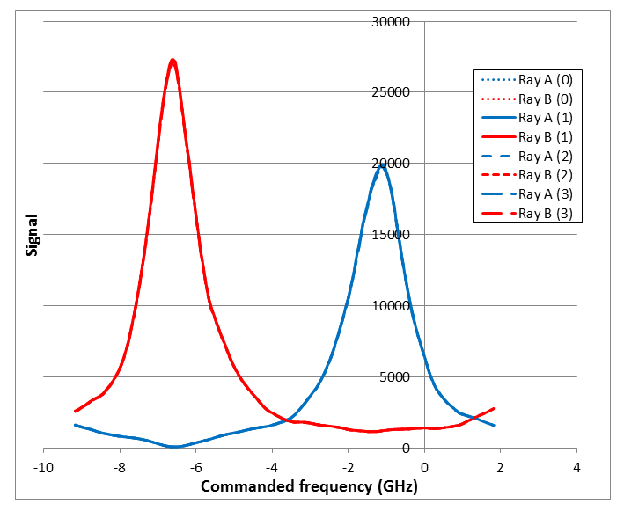
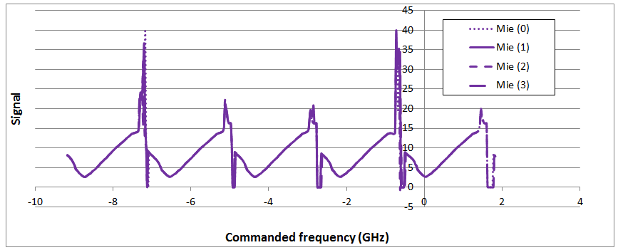
Instrument spectral registration (ISR)
0
1
2
3

Slide 18
Switching on the second flight laser: FM-B – Frequency stability
 | FMA | FMB
FWHM | 121MHz | 140MHz
Stdev STS | 8MHz | 10MHz
Stdev NADIR | 10MHz | 14MHz
FMA
7Hz
FMA, 1h, Sep 2018
FMB
FMB, 1h, June 2019
Frequency stability of the FM-B laser appears to be comparable to the FM-A

Slide 19
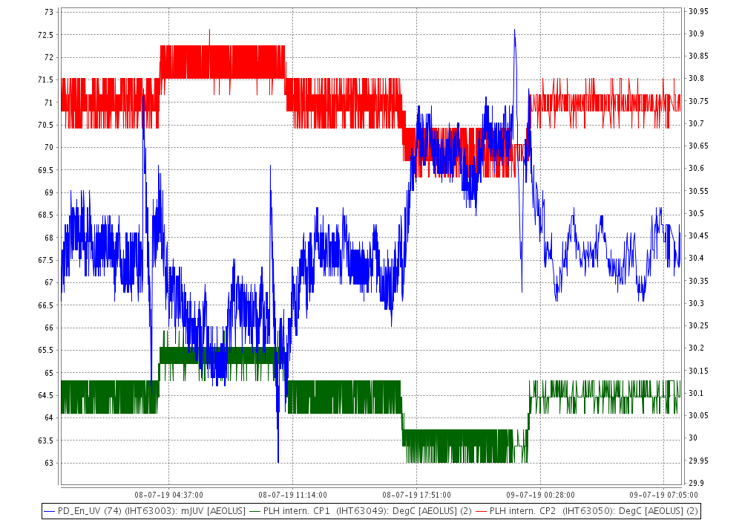
Switching on the second flight laser: FM-B – thermal sensitivity
The thermal sensitivity of the second flight laser is currently being performed
There are some signs that the FM-B is more thermally sensitive than the FM-A but it’s a work in progress…

Slide 20
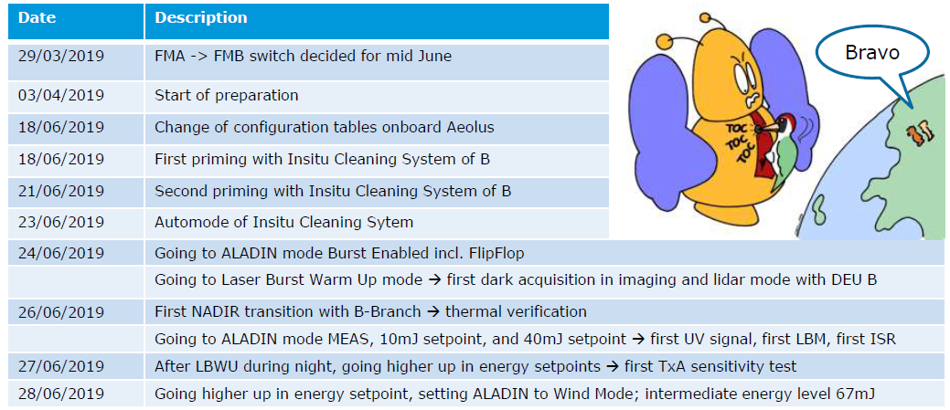
Switching on the second flight laser: FM-B -summary

Slide 21
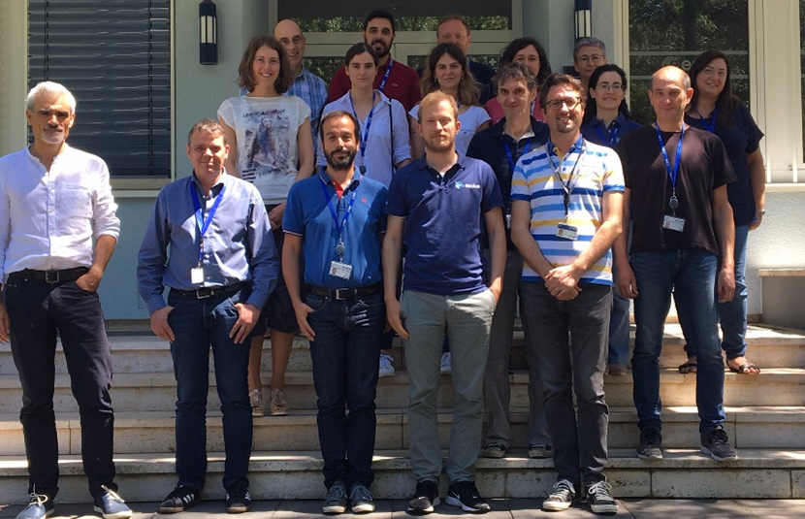
Switching on the second flight laser: FM-B - a happy team!

