Slide 1
Physical, dynamical and application aspects of the connection between Ocean Vector and Doppler Wind Lidar winds
Aeolus © ESA
Ad.Stoffelen@KNMI.NL

Slide 2
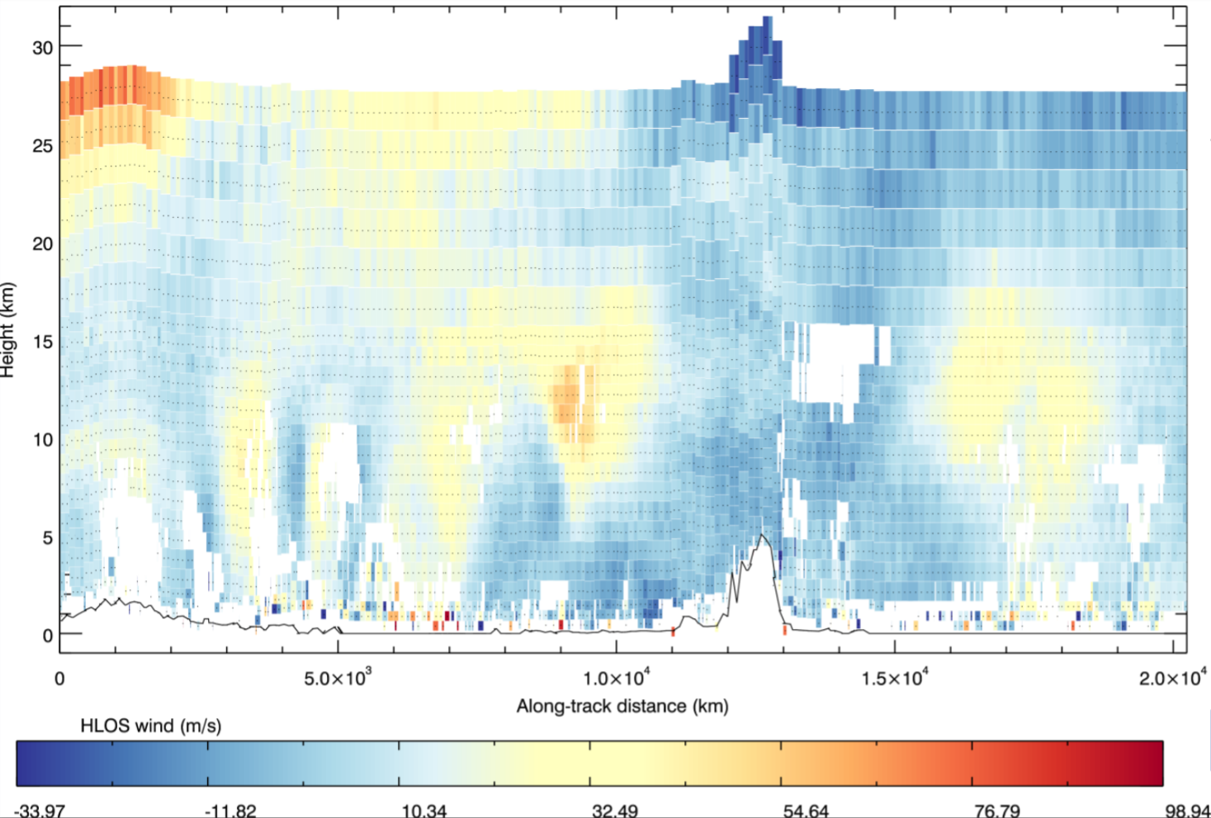
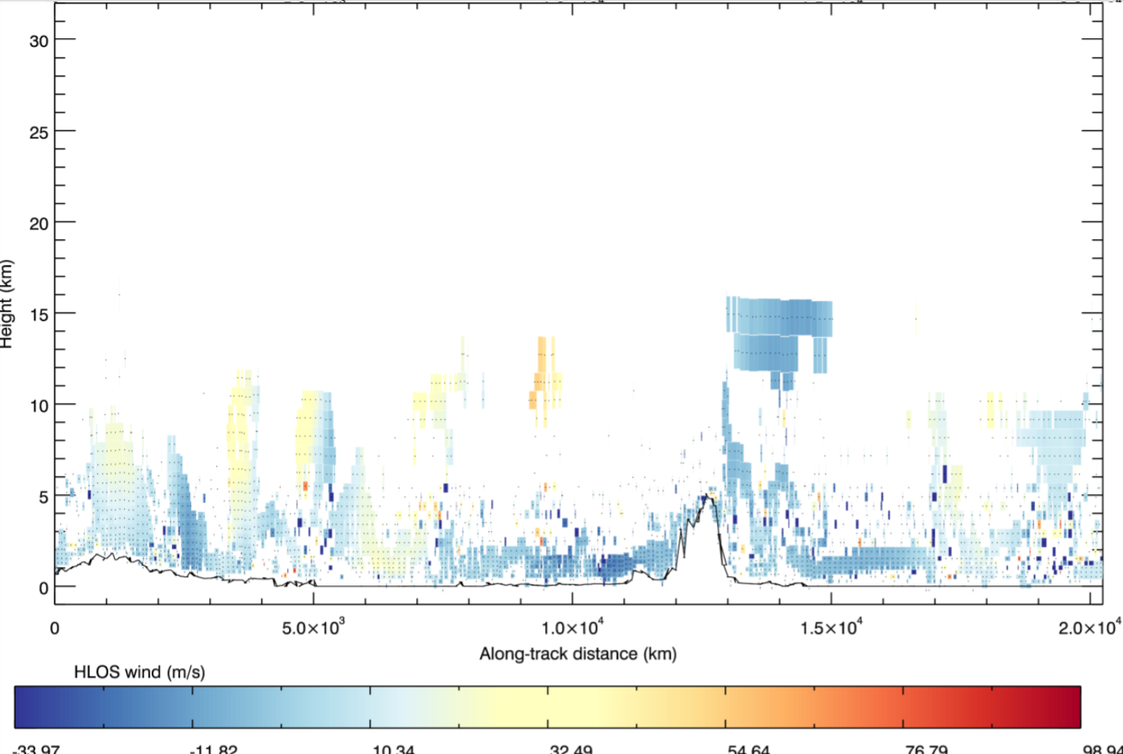

What is Aeolus demonstrating?
Molecular response (Rayleigh)
Cloud and aerosol response (Mie)
® Michael Rennie, ECMWF
Mie is most abundant and most accurate near the surface
Cloud and aerosol observations are strongly affected by heterogeneity, which results in wind and height uncertainties (Sun et al., 2014)
Aeolus sea surface return may be investigated/exploited (future work at KNMI)

Slide 3
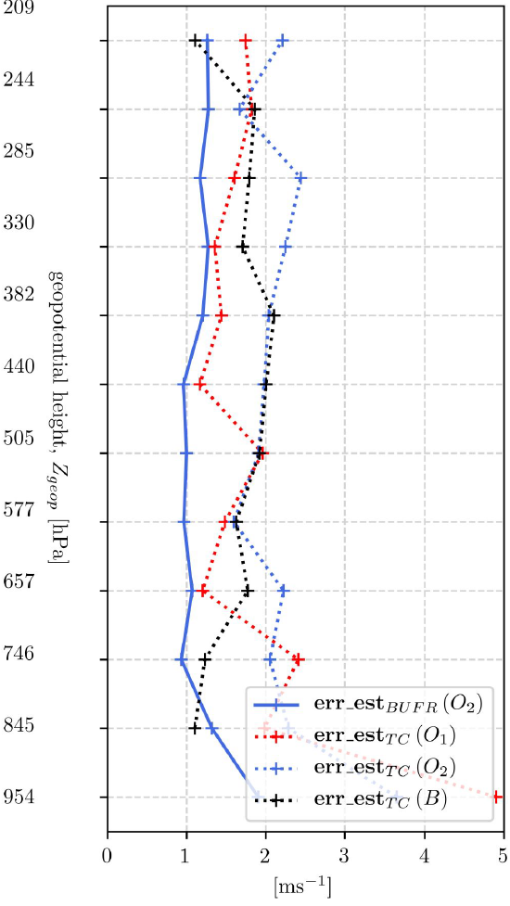
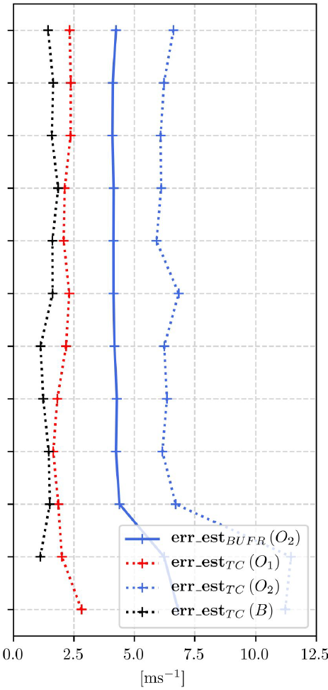
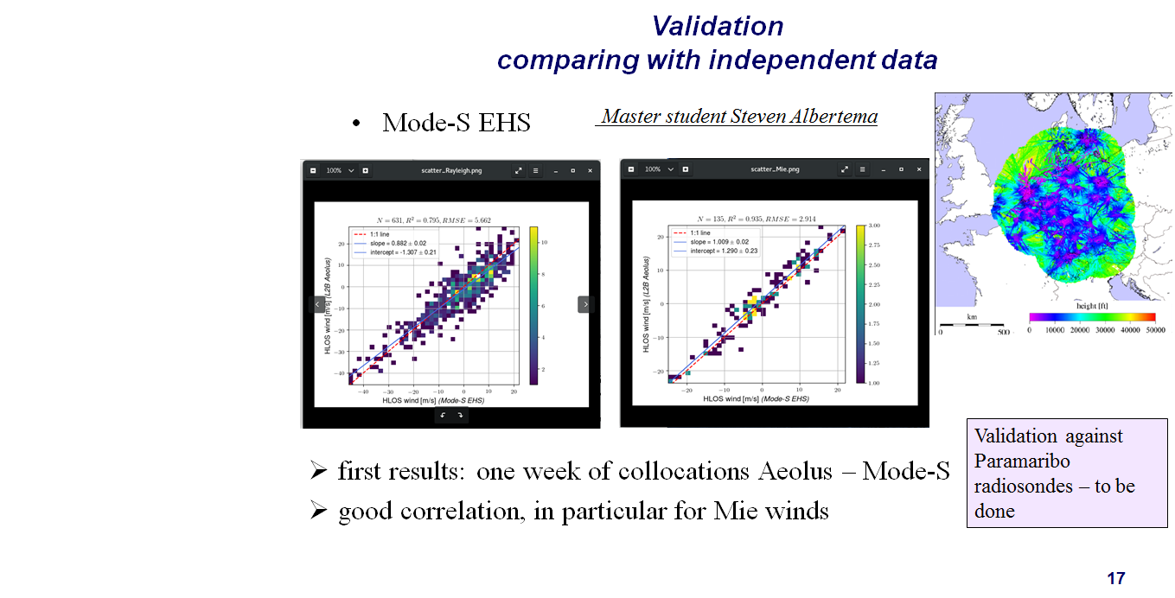
2018 wind triple collocation (laser A)
Estimated error standard deviations estimated with triple collocation for Aeolus go up to > 10 m/s for Rayleigh and > 3 m/s for Mie with laser A
Cal/Val continuing for Aeolus
Laser B ☺
Steven Albertema, KNMI
O₁=Mode-S
O₂=Aeolus
B =ECMWF
O₁=Mode-S
O₂=Aeolus
B =ECMWF
Rayleigh
Mie
+
+
+
Daily
Mode-S
EHS airplane winds
+
+

Slide 4
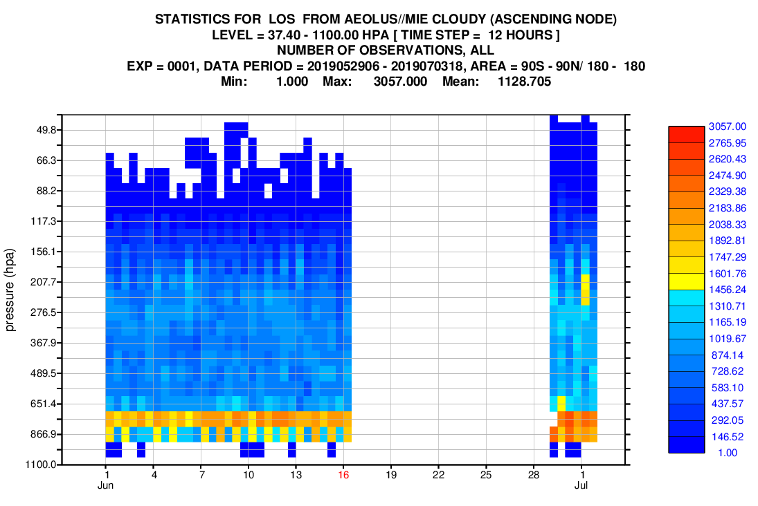
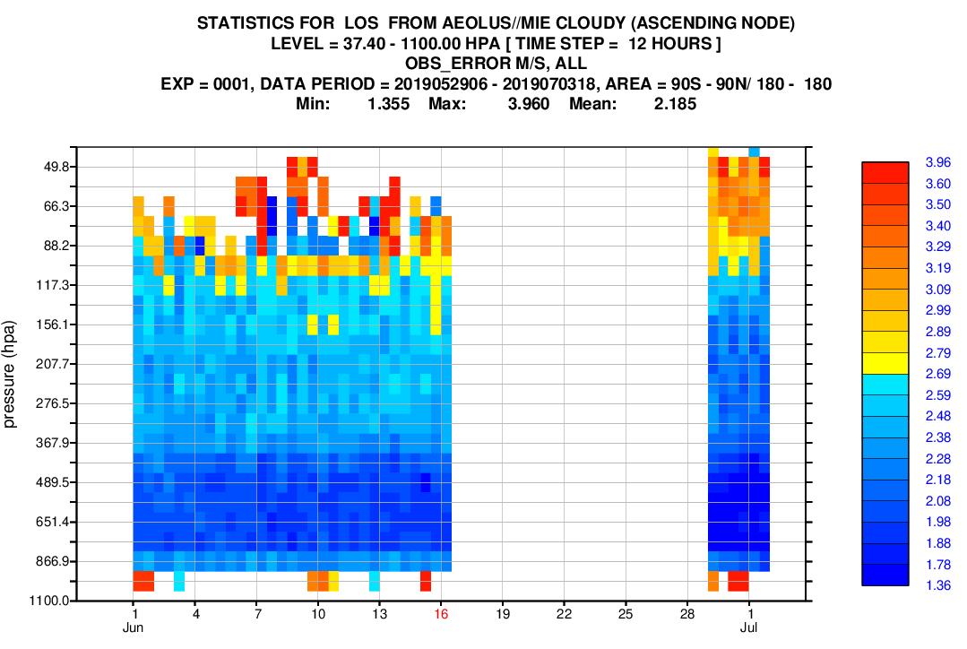
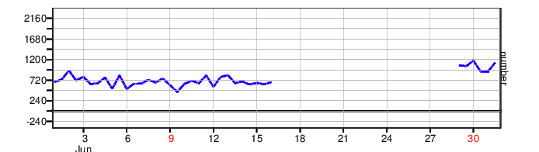
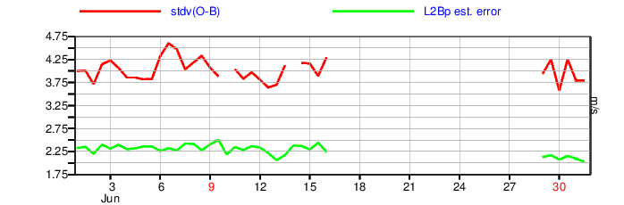
L2B Mie-cloudy time-series laser A/B
First indication of improved PBL performance with laser B
Number of observations
L2Bp estimated error
More Mie observations with FM-B
FM-A
FM-A
Estimated error is smaller with FM-B
count
m/s
Focus on ~400 hPa
33% more winds pass 4 m/s QC
Mike Rennie, ECMWF

Slide 5
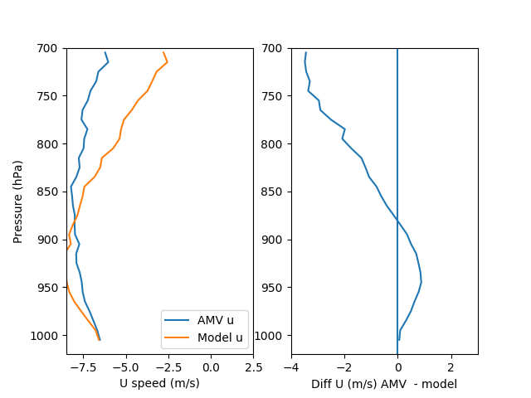
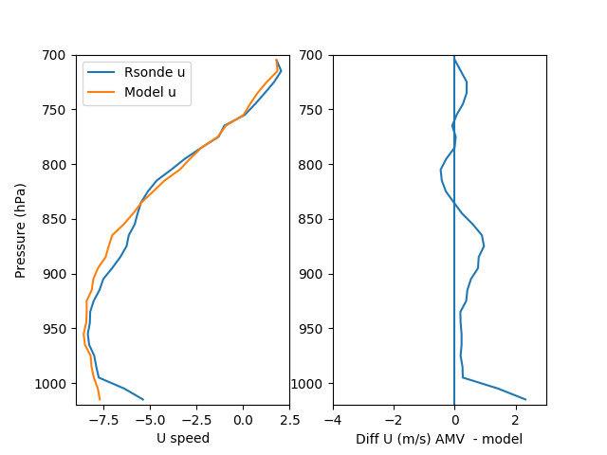
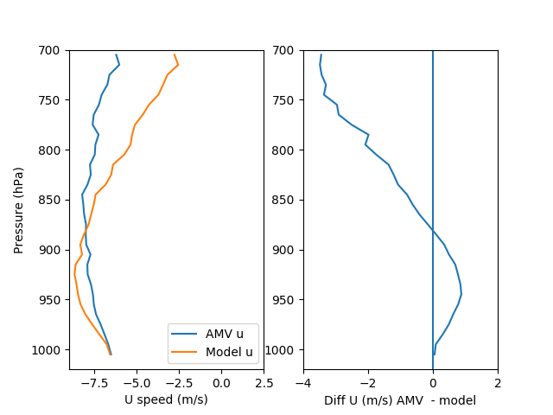
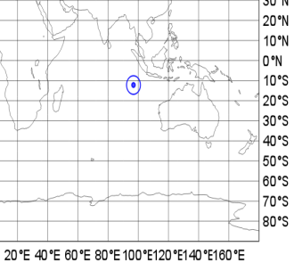
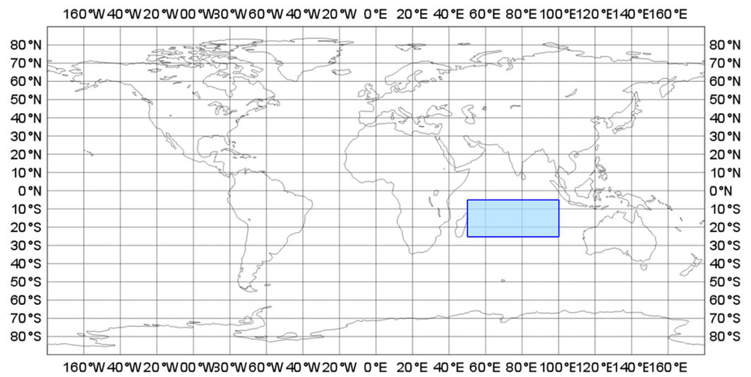
Evaluating AMVs with Aeolus: Indian Ocean example
Are some AMVs around 850-700hPa being placed too high?
Diff AMV – model background
Diff radiosonde - model
AMV ‘profiles’ show little variation with height
U wind
U wind
Nearby radiosonde showing more similar variation to model but sparse coverage from conventional data
14 Sept – 13 Oct 2018, actively used Met-8 visible winds average profile
14 Sept – 13 Oct 2018, radiosonde winds from Cocos Island site
AMV “too fast”?
AMV “too slow”?
Katie Lean

Slide 6
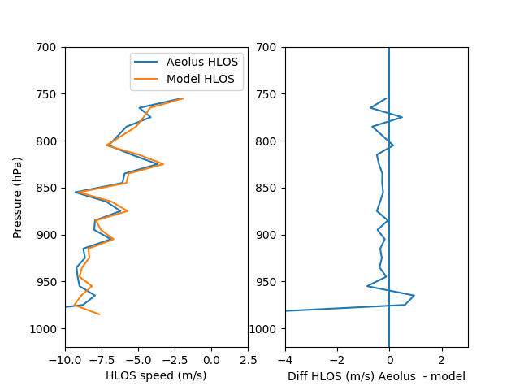
Initial results using Aeolus support model variation
Aeolus HLOS wind
Diff Aeolus - model
Aeolus shows very good agreement with model
Supports theory that AMVs may be too high
More sensitivity to AMV height assignment errors in regions of greater wind shear above boundary layer
Mie + Rayleigh winds
Mie winds only
Largely zonal flow in region of interest -> HLOS is good approximation
14 Sept – 13 Oct 2018, actively used Aeolus winds, ascending orbits only
Aeolus faster than model
Aeolus slower than model
Katie Lean

Slide 7
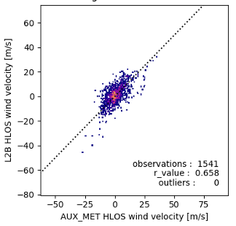
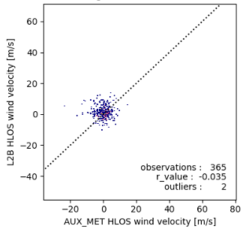
Sea detection
Preliminary test
Aeolus detects 60% of 10m wind over the ocean
No correlation over land
Relation with ocean wave action?
KNMI post-doc to look at Aeolus ocean returns
Relate Aeolus return to wind speed?
Comparison to the HY2B scatterometer (6 LTAN) or CFOSAT SCAT and SWIM (7 LTAN)
Ocean
Land
Gijs Hermans, KNMI
7

Slide 8

Ocean Vector Surface Winds Constellation
Local time coverage assessment (ground track) - NRT data access
Launch
10
11
12
13
14
15
16
17
18
19
20
21
22
23
24
01- 03
WMO observation cycle requirement: 3-6 h
03 - 05
05- 07
06:00 HY-2 A/B/C
06:00 FY-3E/G
DESCENDING NODE CROSSING TIME
07:00 CFOSAT
07- 09
08:45 ScatSat
09:30 EPS (ASCAT A/B/C)
09:30 EPS-SG (SCA)
09- 11
11- 13
12:00 OceanSAT 2/3
12:00 Meteor M/MP
Design Life
Extended Life
Design Life
Extended Life
Proposed
Operating
Approved
Source: WMO OSCAR database and direct interactions with agencies
Committee on Earth Observation Satellites
Notes:
Here the view w.r.t. local time coverage is given, where it can be observed that:
The WMO requirement for observation revisit time for winds (6 h) is not met wit the ASCAT mission only (click first animation) (source of the requirement is WMO OSCAR)
The separation between OSCAT and ASCAT (~2.5 h) was approximate the same as between HY-2A and ASCAT (3 h) (click second animation), and HY-2A is also a wide-swath scatterometer as OSCAT was, so in principle similar NRT spatio/temporal coverage could be achieved with the later mission combination.
But this requires that at least HY-2A is openly available in NRT!!!
Three examples follow on how beneficial it was to have the ASCAT+OSCAT combination flying in a constellation and providing NRT open data access

Slide 9
Accuracy Requirements
Mostly dominated by bias, except in the lower left corner
In the lower left, random errors and (sometimes) the ability to resolve features are limiting to applications
Graphic from draft OceanObs19 White paper

Slide 10
Six Recommended Improvements
Enhanced temporal coverage through an international virtual constellation to follow the fast, small transient mesoscales;
  Ongoing. Hopefully will further improve.
Improved spatial resolution to better address mesoscale variability, improve coastal sampling, and make visible the areas between rain bands in tropical cyclones;
  Resolution can be improved by adding Doppler capability (ongoing)
    This will also improve directional accuracy
  Resolution can be improved with better antennas (to be proposed)
  Resolution can be improved by using higher frequencies (to be proposed)
Instrument intercalibration for extreme strong winds;
  There are disagreements about calibration for winds >17 ms⁻¹
  We need to better understand in situ data from these wind speeds (see next)
Presented at the 2019 IOVWST

Slide 11
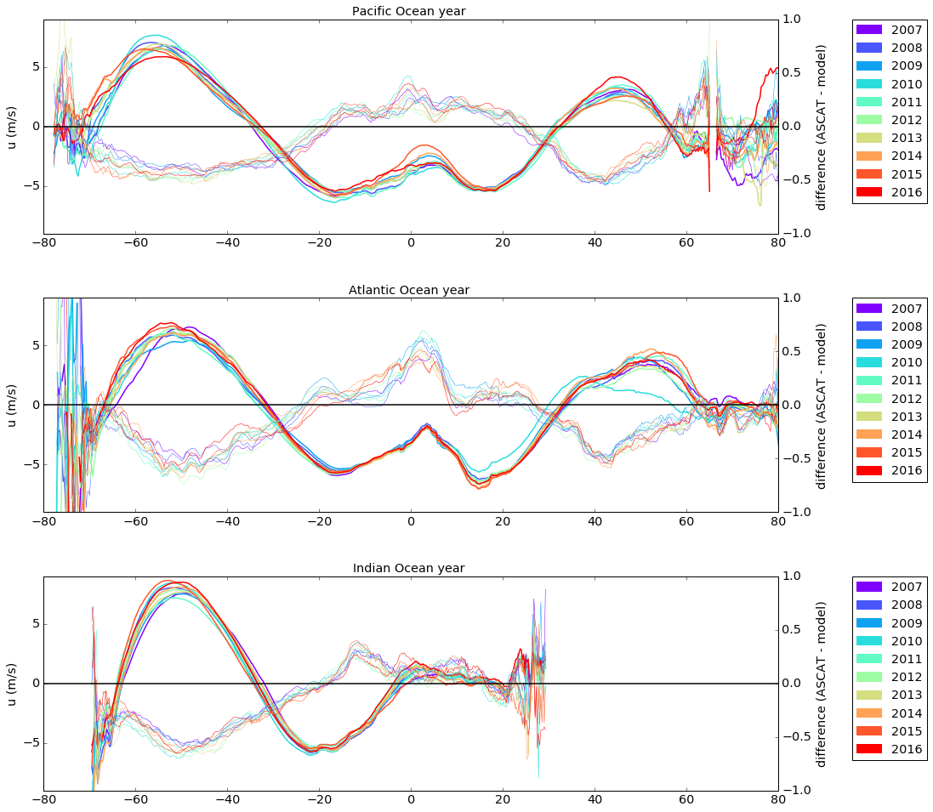
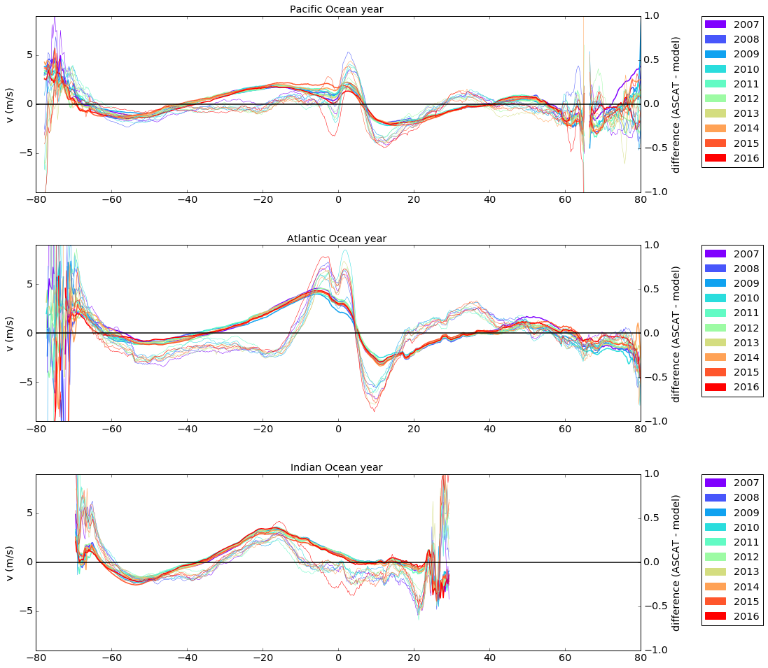
Zonal, Meridional Errors
ASCAT - ERAint
<u>
ASCAT
<v>
Belmonte&Stoffelen, 2019
→ Systematic errors are larger than interannual variability
Notes:
- Thick lines show ASCAT mean zonal (top) and meridional (bottom) winds
- Thin lines show (ASCAT minus ERA-interim) mean wind differences
→ Systematic mean ECMWF errors (up to 0.5 m/s or 10% in the subtropics and westerlies) very stable in time (~0.1 m/s interannual variability)
** 2010 was an anomalous year in Atlantic

Slide 12
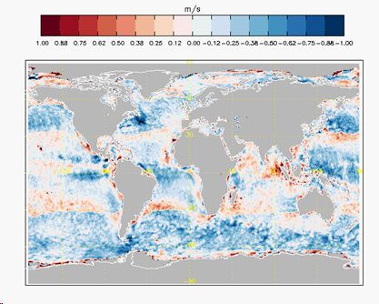
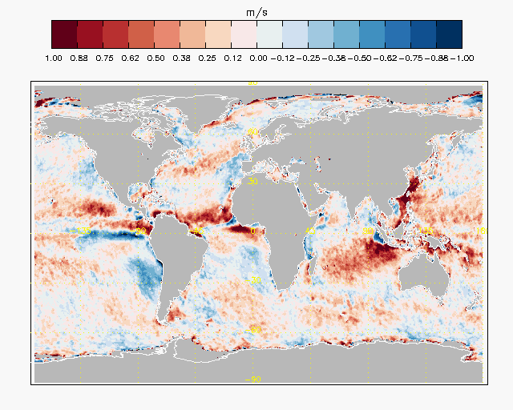
ERA5 has spatial error patterns similar to ERAint (only reduced in amplitude by ~20%)
Zonal, Meridional Errors
<u>
<v>
ERA5 - ASCAT
Belmonte&Stoffelen, 2019
→ Excess mean model zonal winds (blues at mid-latitudes and subtropics)
Defective mean model meridional winds (reds at mid-lats and tropics)

Slide 13
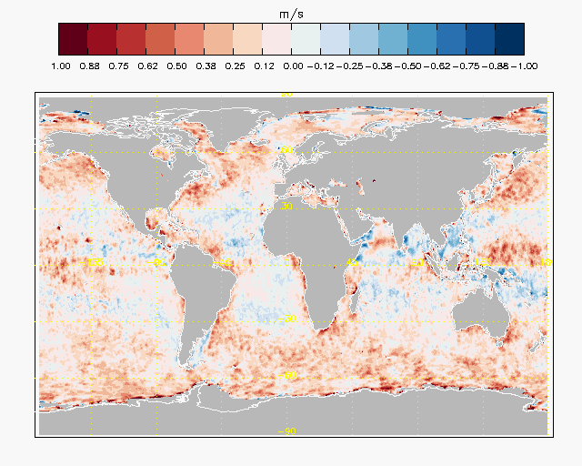
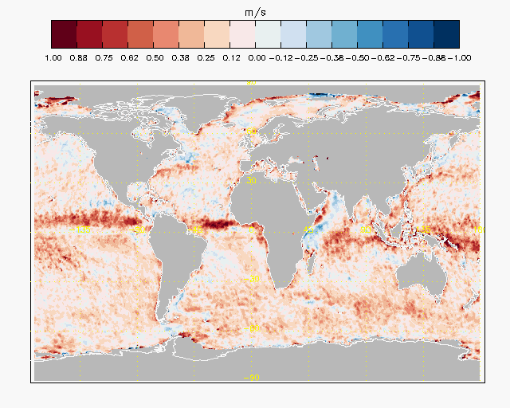
Transient Wind Errors
u’
v’
ERA5 - ASCAT
Belmonte&Stoffelen, 2019
Defective model wind variability overall:
  - Zonal (left) and meridional (right) at mid-to-high latitudes
  - Particularly meridional deficit along ITCZ
  - Locally enhanced along WBCs (ARC, ACC, GS, KE currents)
Notes:
→ Subsynoptic variability is underrepresented in atmospheric reanalysis data.

Slide 14
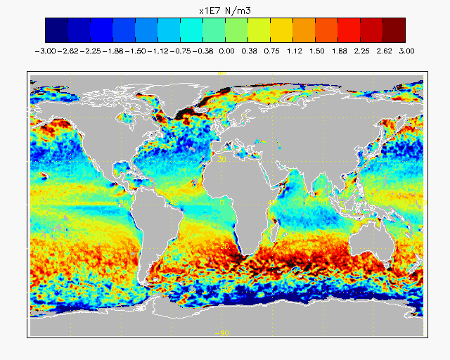
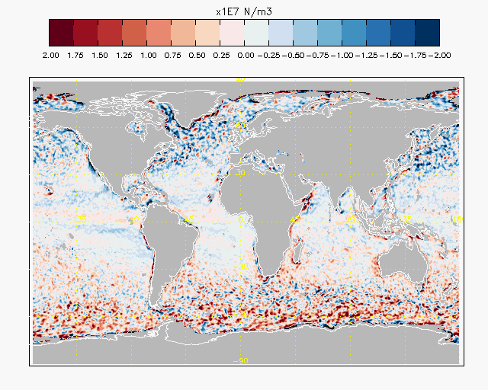
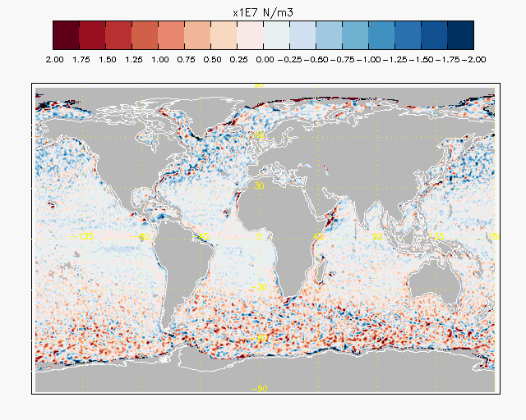
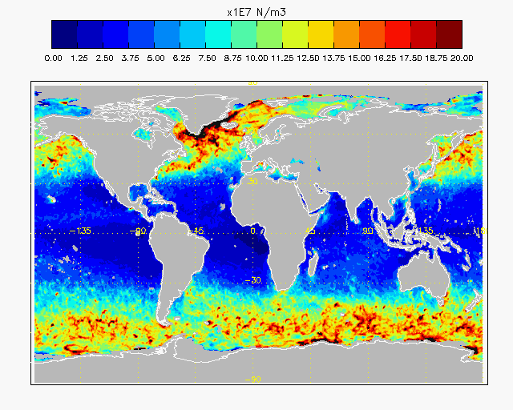
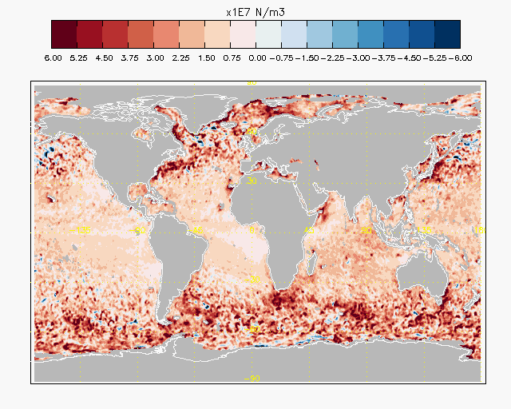
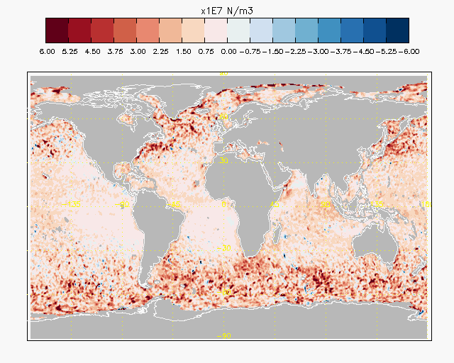
Wind Stress Curl
MEAN
ASCAT
ERAi-ASCAT
ERA5-ASCAT
EDDY
ERA mean stress curl is more cyclonic (blue NH, red SH) at high latitudes
May be caused by defective poleward meridional transport
Associated to low eddy stress curl activity → missing mesoscale turbulence
This has obvious implications for Ekman upwelling estimates
Notes:
We know that tropical air masses acquire anticyclonic vorticity as they move poleward (conservation of momentum):
Model air masses remain too cyclonic at mid and high latitudes → because of defective poleward meridional transport… (and related diffusion of momentum by mesoscale turbulence)?
ERA stress curl is too cyclonic at mid and high latitudes, with implications for Ekman upwelling estimates

Slide 15
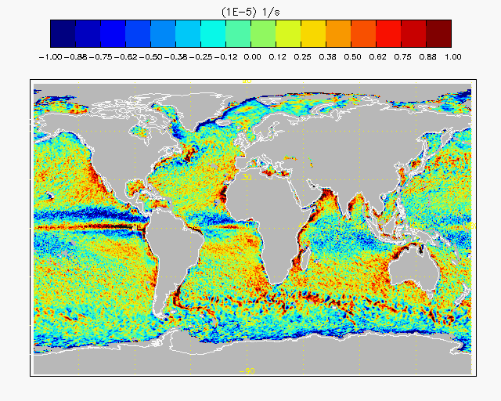
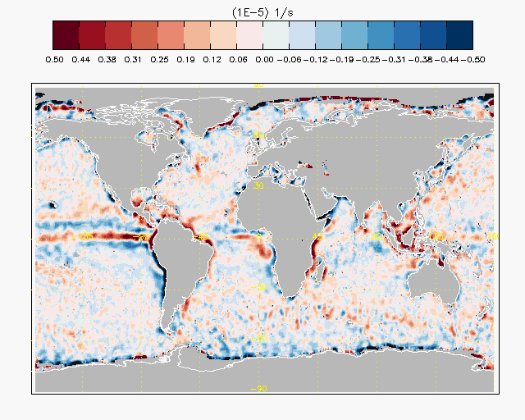
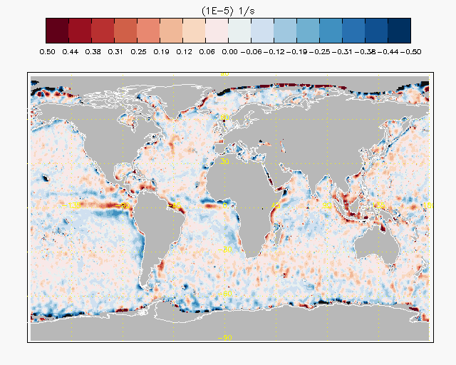
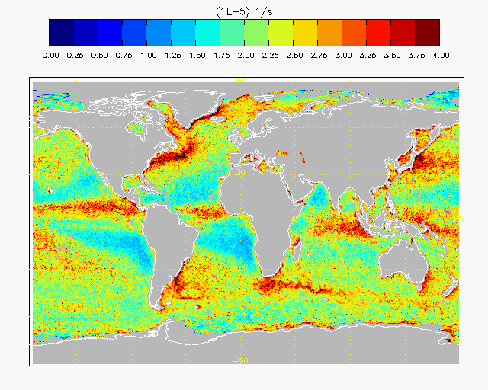
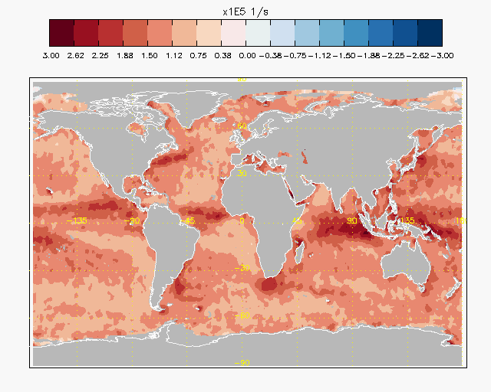
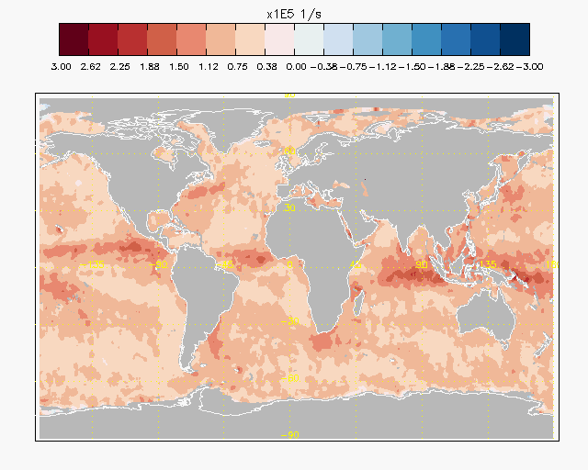
Wind Divergence Errors
MEAN
ASCAT Wind Divergence
ERAint - ASCAT
ERA5 - ASCAT
EDDY
Defective model convergence along ITCZ, weak Pacific cold tongue divergence
Missing model mean divergence (subsidence) over subtropics (red)
Missing model mean convergence over subpolar area (blue)
Lacking tropical moist convection in eddy divergence
Notes:
- missing model subsidence in subtropics (observed divergence is larger than model divergence)
- missing model convergence in the subpolar areas (observed convergence is smaller than model convergence) → residual circulation ?

Slide 16
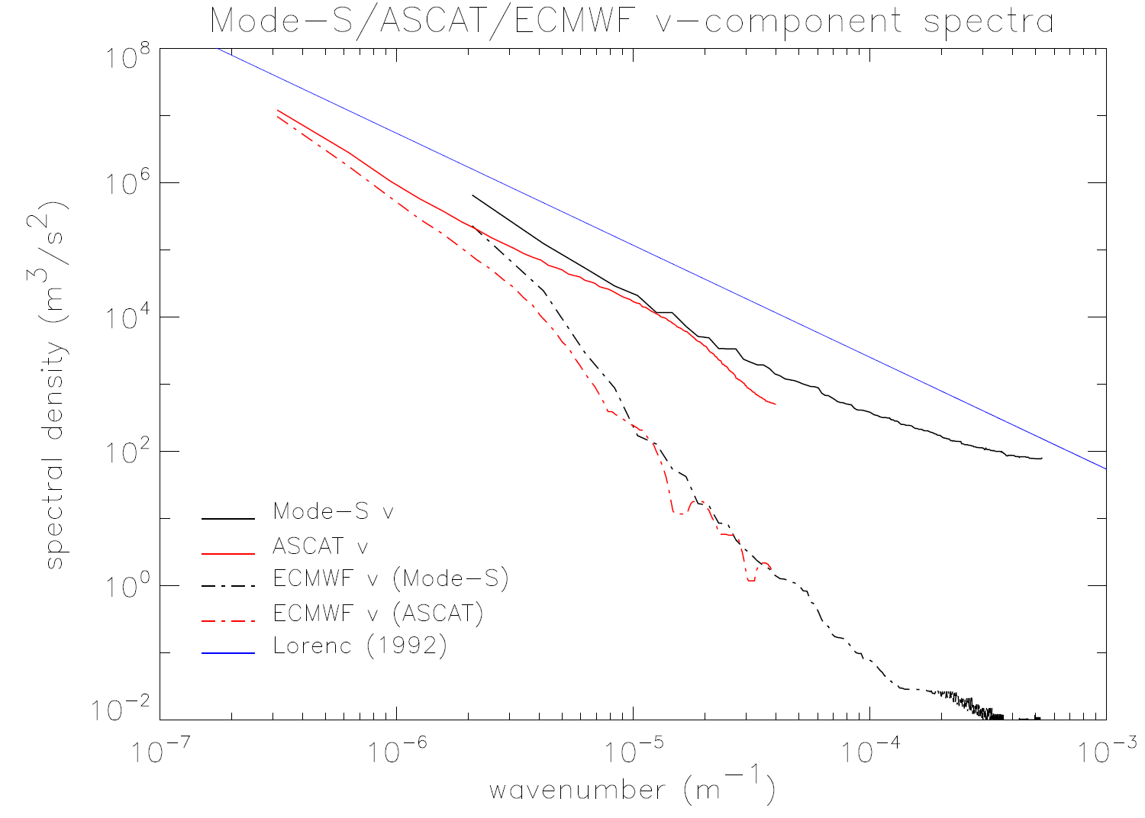
Small scales lack over ocean and upper air
k^{-5/3}
100 km
ModeS at 10 km height
ASCAT
ECMWF (ODB)

Slide 17
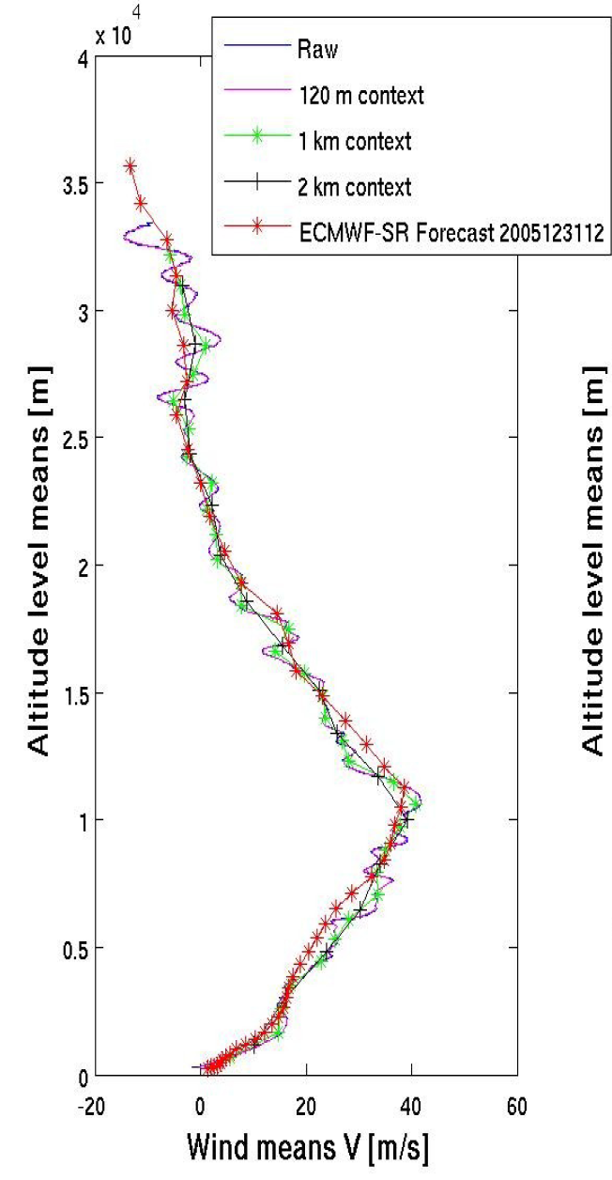
NWP model versus hi-res SPARC radiosondes
Houchi et al., 2010
ECMWF
1.5-2 km resolution
SD : 2 m/s
Shear 3 times too
low !!
Physics tuned to poor vertical shear structure

Slide 18
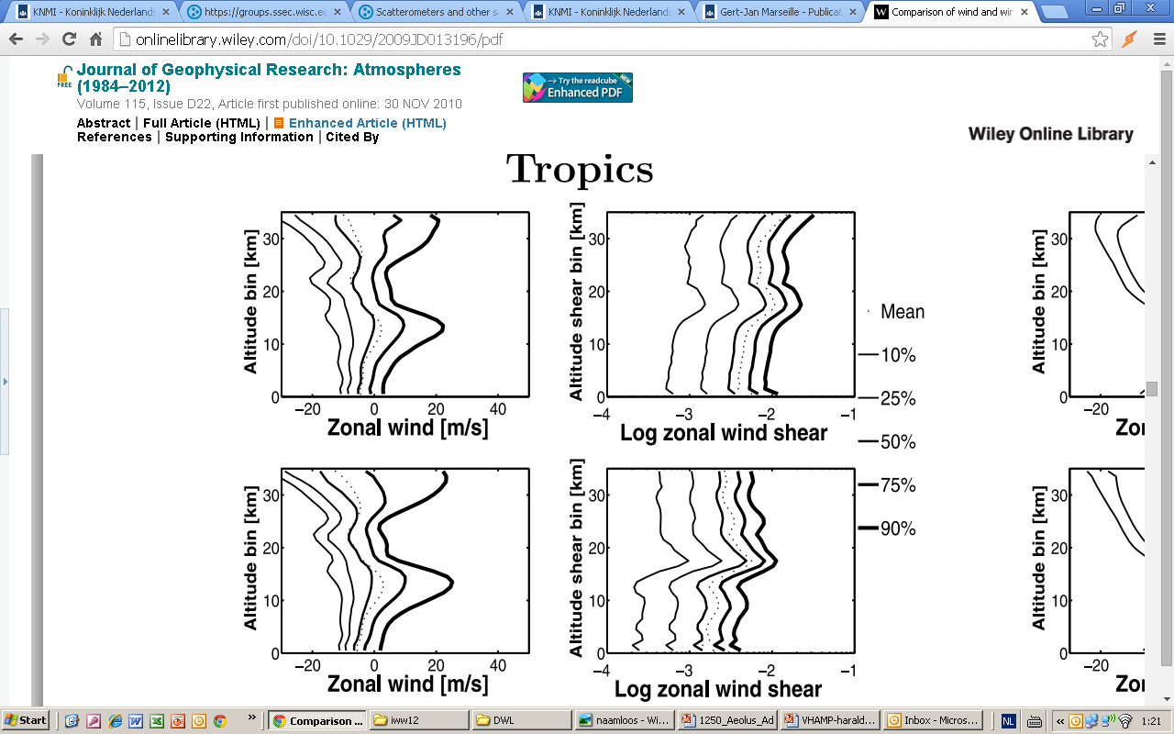
Hi-res radiosonde shear
Tropics
Collocation data base
ECMWF winds agree very well
Shear in ECMWF model 2-3 times lower, however
Tropical tropopause strongly variable
Shear determines mixing of air, cloud forming, ..
Houchi et al. 2010
RAOB
RAOB
ECMWF
ECMWF

Slide 19
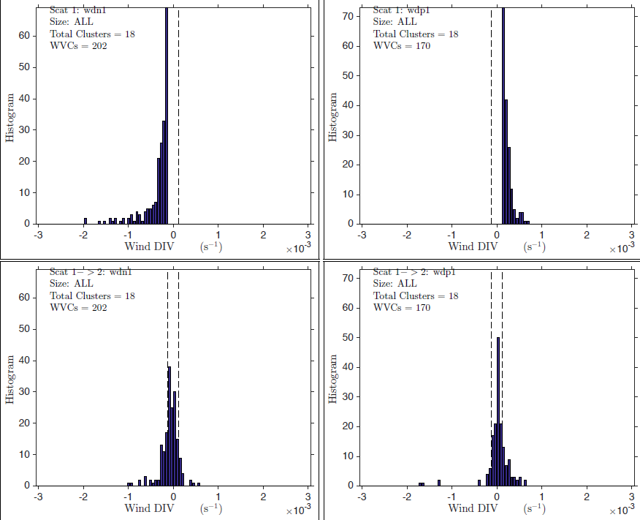
Tropical moist convection
ASCAT observes extreme convergence/divergence
Not seen in global NWP
Extreme divergence and rain occur simultaneously
Rain lags convergence by 30 minutes
ASCAT revisits many scenes after 50 minutes, after which little correlation remains in divergence/convergence
This all fits moist convection time scales
ECMWF
ECMWF
Extreme
convergence
Extreme
divergence
ECMWF
ECMWF
After 50
minutes
After 50
minutes
King et al., 2017

Slide 20
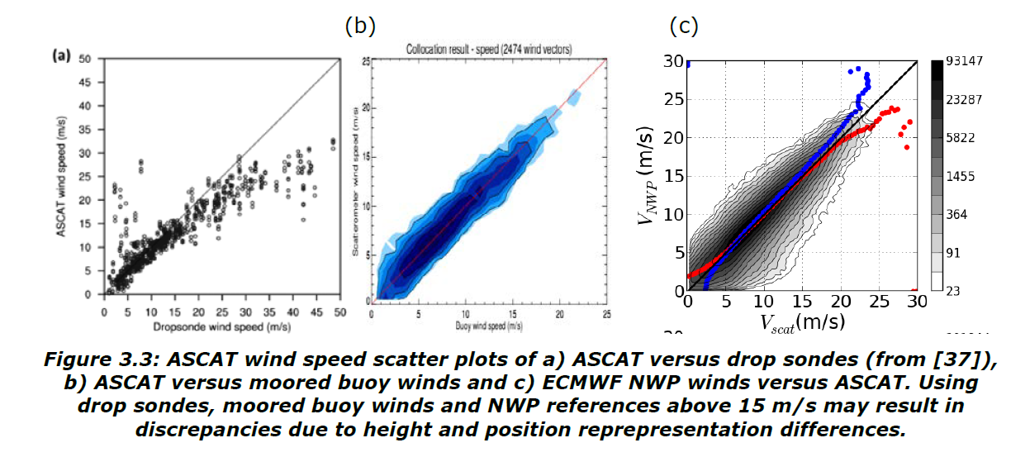
Inconsistencies in hurricanes
Chou et al., 2013
Are dropsondes too high, or moored buoys and ECMWF too low at 20-25 m/s ?
Dave Emmitt’s talk, also at the IOVWST

Slide 21
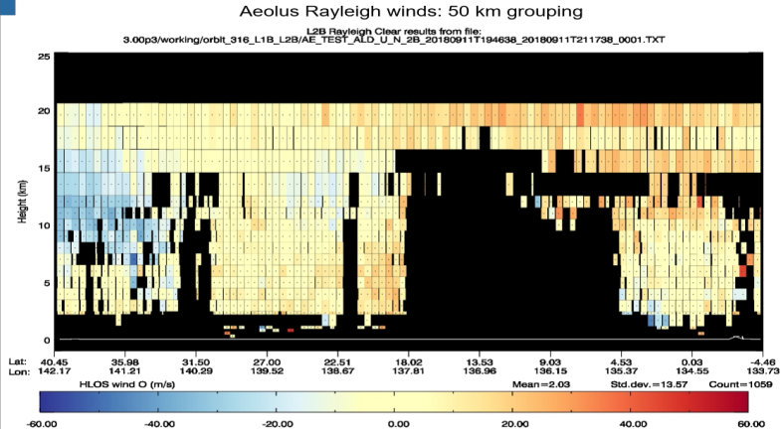
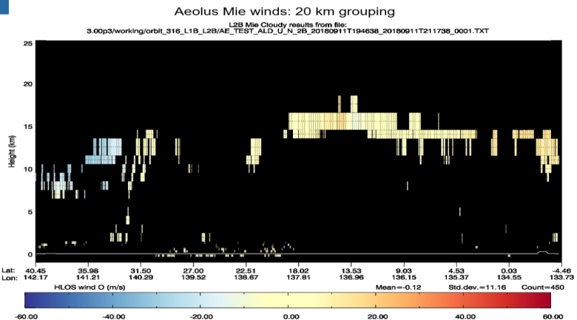
What about Aeolus in hurricanes?
May grasp shear environment
Cloud top wind (Mie)
Will not help the OVW problem
Campaigns could help (D. Emmitt)
Mie:
Rayleigh
Mangkhut

Slide 22
Conclusions
Accurate surface level winds and low-level AMVs do/will exist > 2020
Synergy with DWL Mie aerosol and cloud winds (with a good laser B!)
Scatterometers identify problems in global NWP models, connecting mesoscale turbulence, moist convection, parameterization errors and large-scale circulation errors
Aeolus will provide a more complete picture of the 3D circulation and variability and of the dynamical environment
Cloud dynamics are poorly described in models, also in relation to aerosol (recognized as DS focus); DWLs may help scatterometers and AMVs to provide a better 4D picture
Aeolus may provide ocean (sub)surface measurements of backscatter and Doppler shift, potentially helpful in modelling the dynamical air-sea interface
A white paper in review for BAMS recommends enhanced capability of clear air wind profiles using molecular responses for operational NWP (last LWG)
European stakeholders start preparing for an Aeolus follow-on

Slide 23


Slide 24
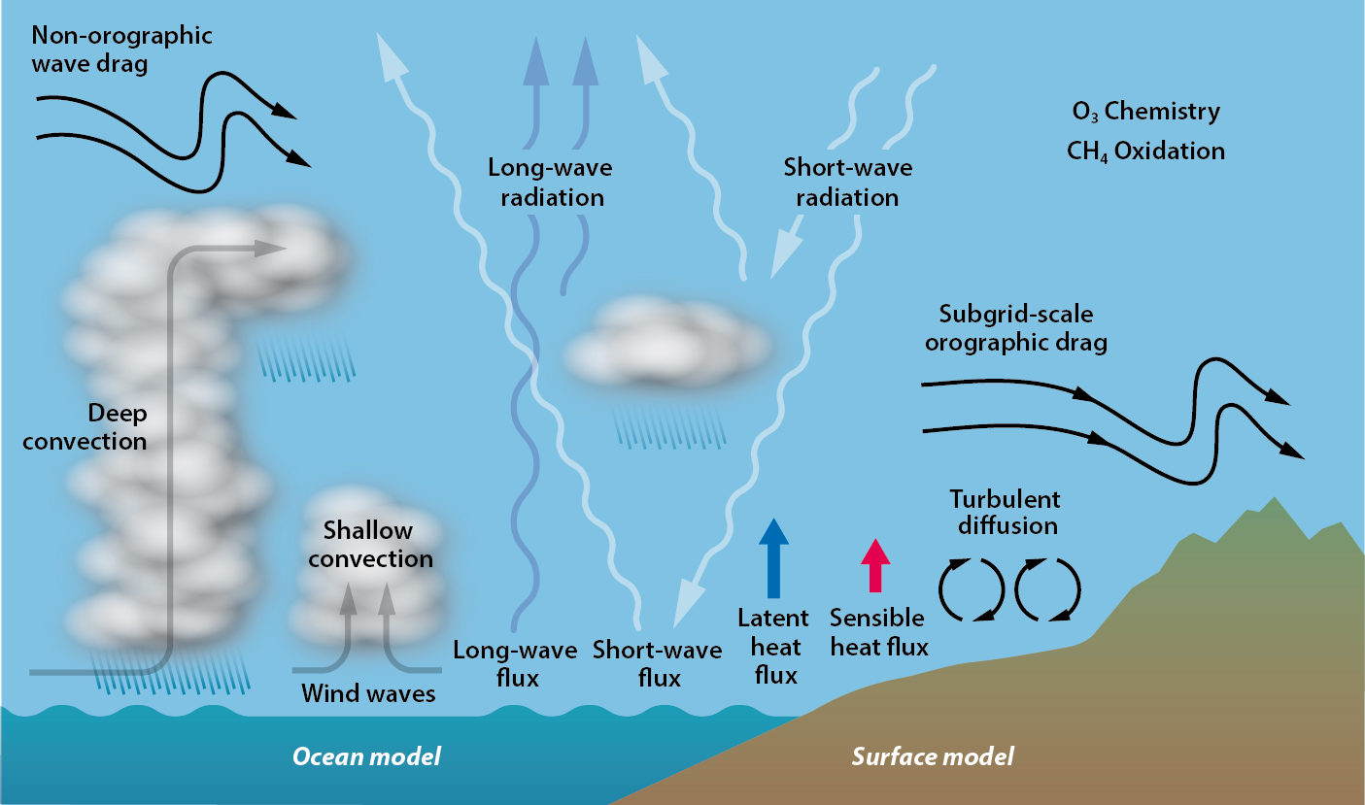
Physical processes in a NWP model
Many small-scale processes have interaction with the 3D turbulence spectrum, which dominates atmospheric dynamics in the tropics and elsewhere on scales below 500 km
Yet, few 3D wind observations exist

Slide 25
Regional NWP progress
100 km
10 km
100 km
10 km
k^{-5/3}
k^{-5/3}
ECMWF
(HiRLAM)
HARMONIE
ECMWF
(HiRLAM)
HARMONIE
u
v

Slide 26
References
[0] www.wmo.int/pages/prog/sat/Databases.html#UserRequirements
[1] www.wmo.int/pages/prog/sat/Refdocuments.html#spacebasedgos
[2] www.wmo-sat.info/oscar/
[3] aqua.nasa.gov/doc/pubs/A-Train_Fact_sheet.pdf,
Formation Flying: The Afternoon “A-Train” Satellite Constellation
[4] www.esa.int/esaMI/ESA_Publications/SEMAJUB474F_0.html ,
The Changing Earth: New Scientific Challenges for ESA’s Living
Planet Programme ESA SP-1304, July 2006
[5] www.esa.int/esaLP/SEM097EH1TF_LPgmes_0.html
[6] www.esa.int/stse
[7] www.eumetsat.int/Home/Main/Satellites/PostEPS/Resources/index.htm? [8] www.eumetsat.int/groups/pps/documents/document/pdf_peps_mrd.pdf

