Slide 1


Working Group Meeting for Space-Lidar Winds
Idealized Space-Based Doppler-Wind Lidar in a Hurricane OSSE
Lisa Bucci – NOAA/AOML
Sharanya Majumdar – University of Miami
Robert Atlas – NOAA/AOML
G. David Emmitt, Steven Greco, Sydney Wood – Simpson Weather Associates
July 10, 2019

Slide 2
Working Group Meeting
for Space-Lidar Winds
Predictability Using Wind Observations
Explore the predictability of a hurricane
  Goal: Understand how wind observations influence hurricane forecasts
  Set an upper limit for the best possible analysis and forecast
  Test different combination of input variables
Test how observations from an idealized polar-orbiting wind profiler alter the prediction of a hurricane
  Goal: Understand how variable coverage of wind observations influence hurricane forecasts
  Vary the timing of the observation coverage
  Remove observations from the inner core of the hurricane
July 10, 2019

Slide 3
Working Group Meeting
for Space-Lidar Winds
Description of OSSE
Observing
System
Simulation
Experiment
A virtual reality used to test how observations from new instruments could change a forecast
July 10, 2019

Slide 4
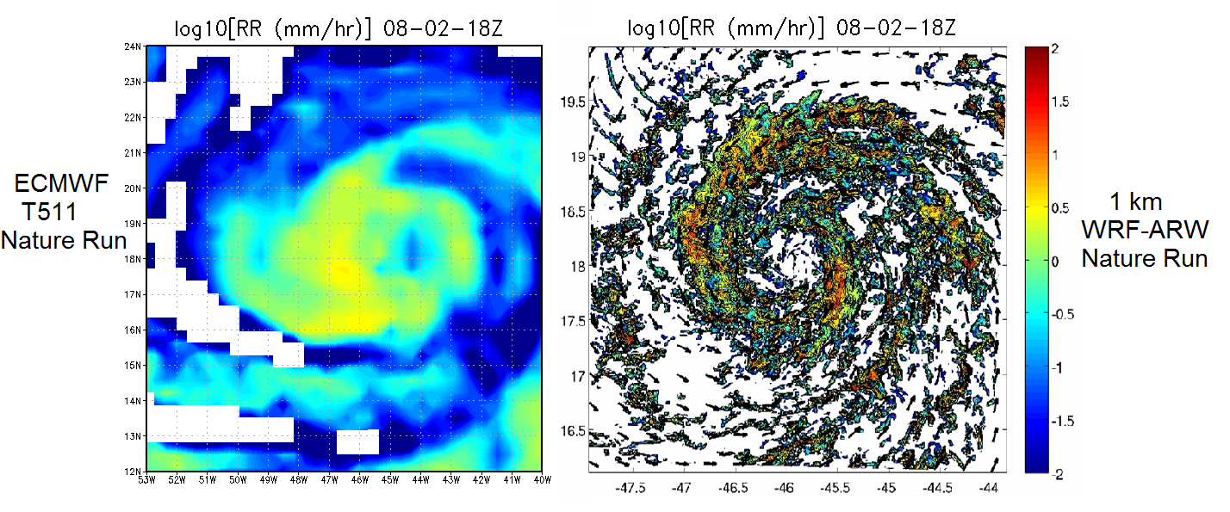
Working Group Meeting
for Space-Lidar Winds
Description of OSSE
Global Nature
Run
Regional
Nature Run
Analyses
Forecasts
Synthetic Observations
Verification
13-day WRF-ARW simulation of a nested 1-km hurricane from genesis to extra-tropical transition Nolan et al. (2013)
July 10, 2019

Slide 5
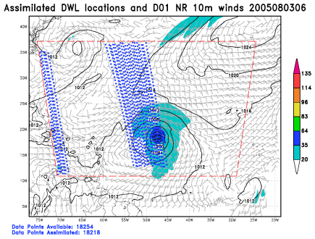
Working Group Meeting
for Space-Lidar Winds
Description of OSSE
Global Nature
Run
Regional
Nature Run
Analyses
Forecasts
Synthetic Observations
Verification
Subset the Nature Run by simulating observations (realistic spatial and temporal coverage, observation errors, etc.)
July 10, 2019

Slide 6
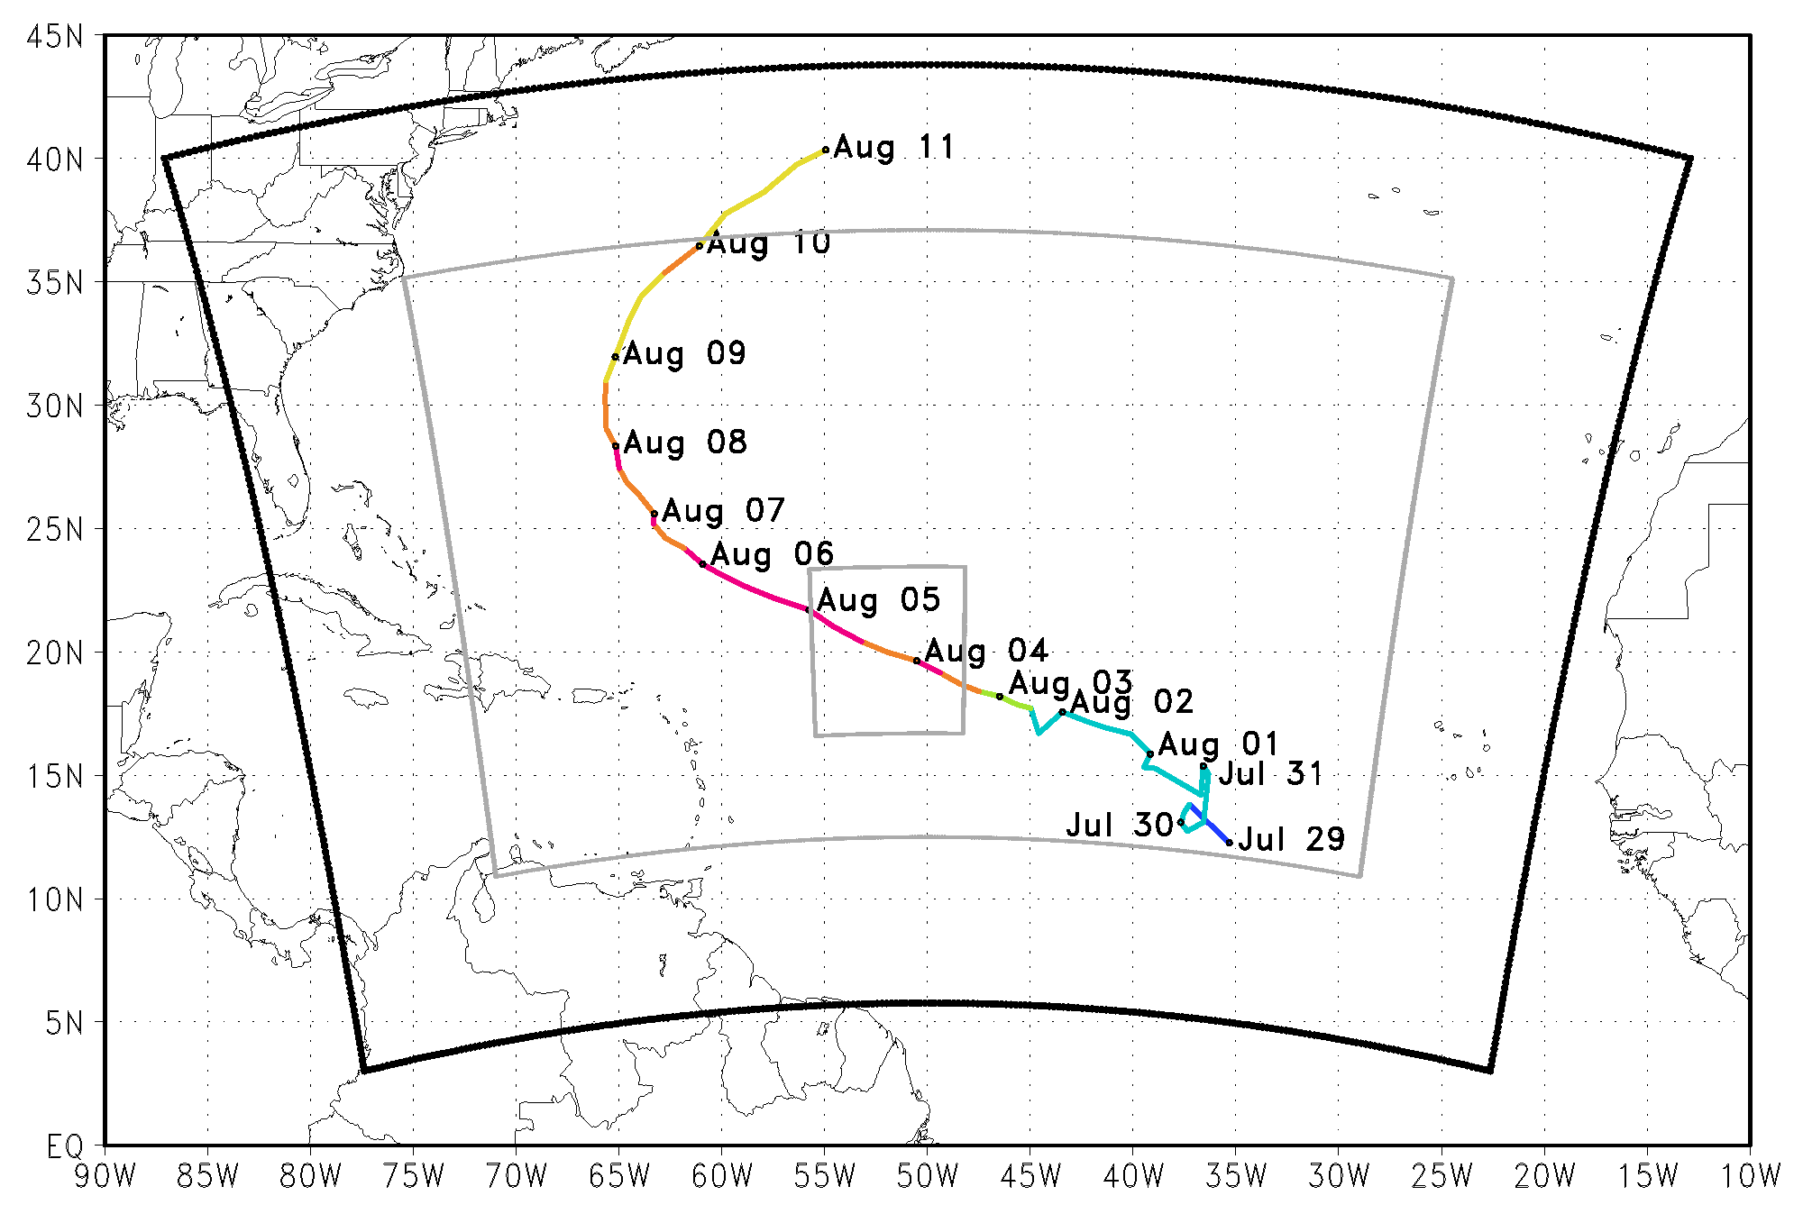

Working Group Meeting
for Space-Lidar Winds
Description of OSSE
Global Nature
Run
Regional
Nature Run
Analyses
Forecasts
Synthetic Observations
Verification
Ensemble Kalman Filter (EnKF)
30 Members
0.9 Inflation
1 scale height Vertical localization
900km Horizontal localization
July 10, 2019

Slide 7
Working Group Meeting
for Space-Lidar Winds
Description of OSSE
Global Nature
Run
Regional
Nature Run
Analyses
Forecasts
Synthetic Observations
Verification
Nature Run Model
Forecast Model
WRF-ARW
27/9/3/1 km
61 vertical levels
YSU PBL
WDM6 microphysics
HWRF
9/3 km
61 vertical levels
GFS PBL
Ferrier microphysics
VS
July 10, 2019

Slide 8
Working Group Meeting
for Space-Lidar Winds
The Upper Threshold
3 Experiment sets:
  Perfect Winds, Temperature, and Moisture
  Perfect Winds
  Perfect Temperature and Moisture
Observations from 27km Nature Run grid
16 cycles with 6 hour cycling interval
  06Z Aug 01 → 00Z Aug 05
5 day forecasts every 6 hours
July 10, 2019

Slide 9
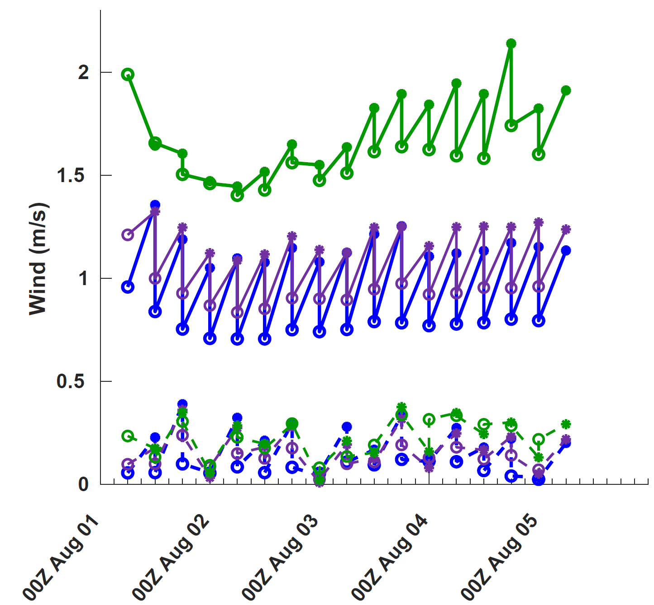
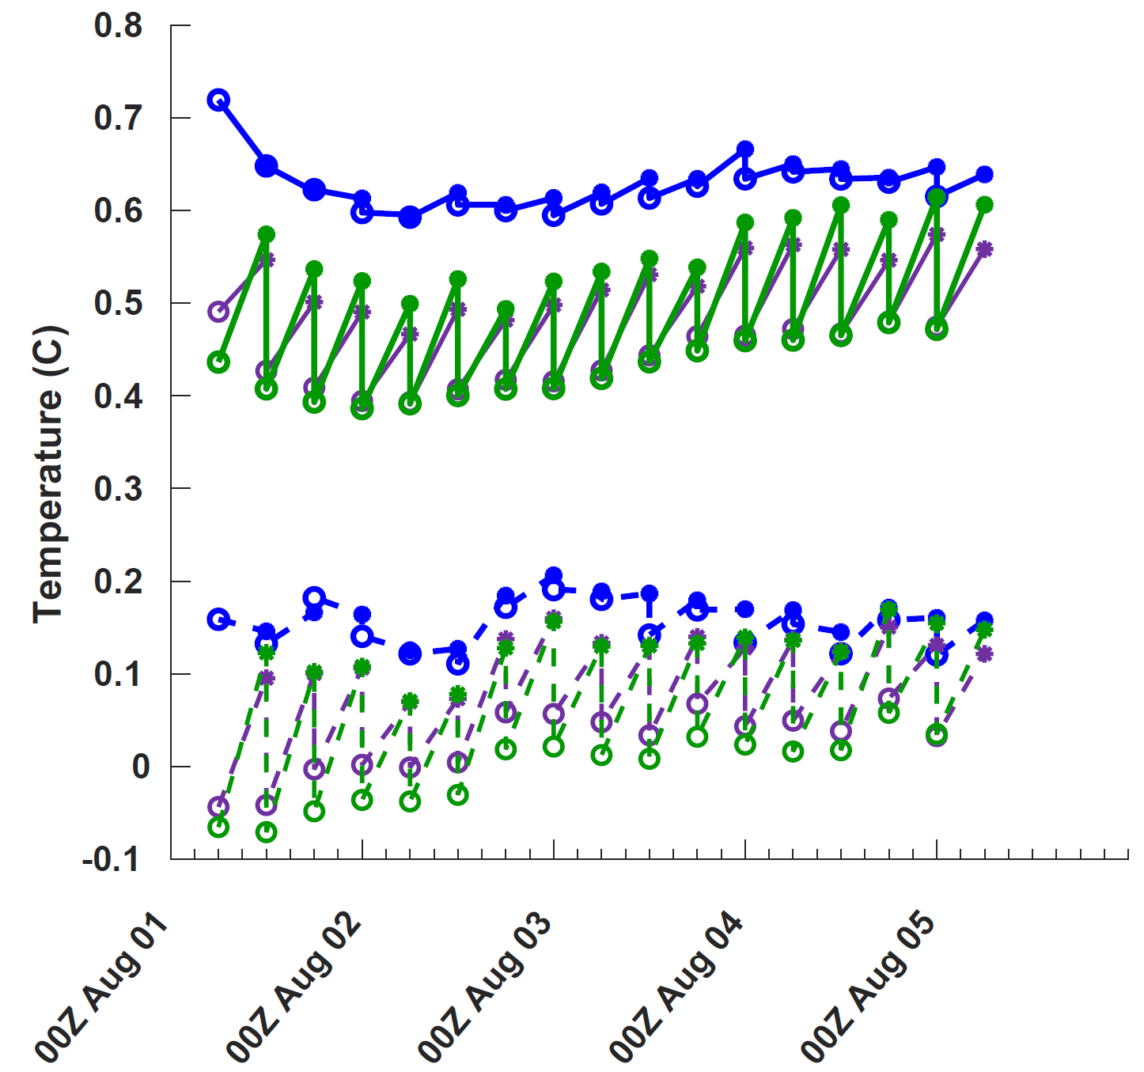
Working Group Meeting
for Space-Lidar Winds
The Upper Threshold
Perfect Wind+Mass
Perfect Wind
Perfect Mass
Bias
RMS
o = Posterior
* = Prior
July 10, 2019

Slide 10
Working Group Meeting
for Space-Lidar Winds
The Upper Threshold
Perfect Wind+Mass
Perfect Wind
Perfect Mass
Bias
RMS
o = Posterior
* = Prior
Onset of Rapid Intensification
July 10, 2019

Slide 11
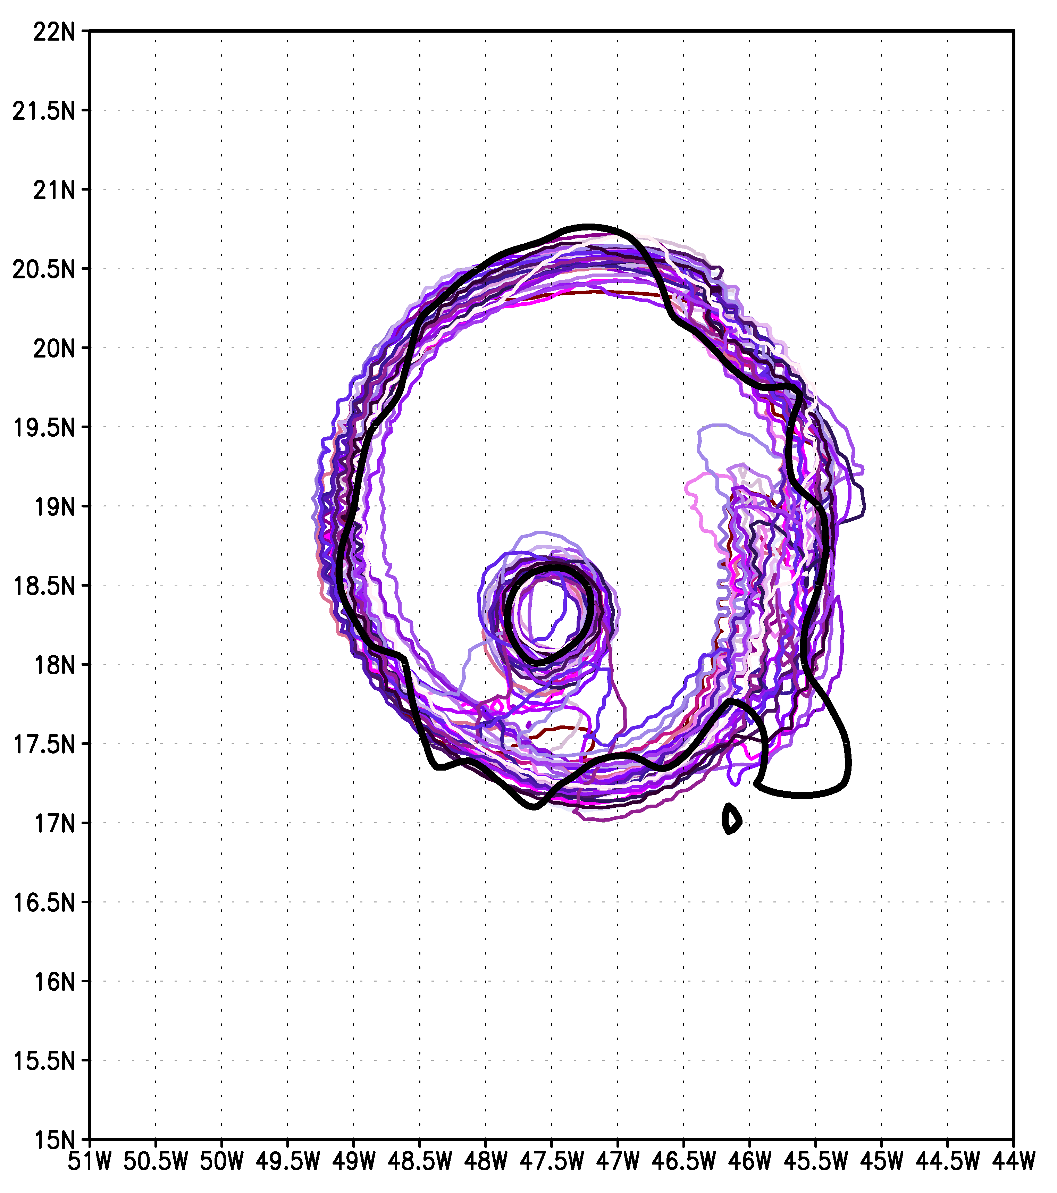
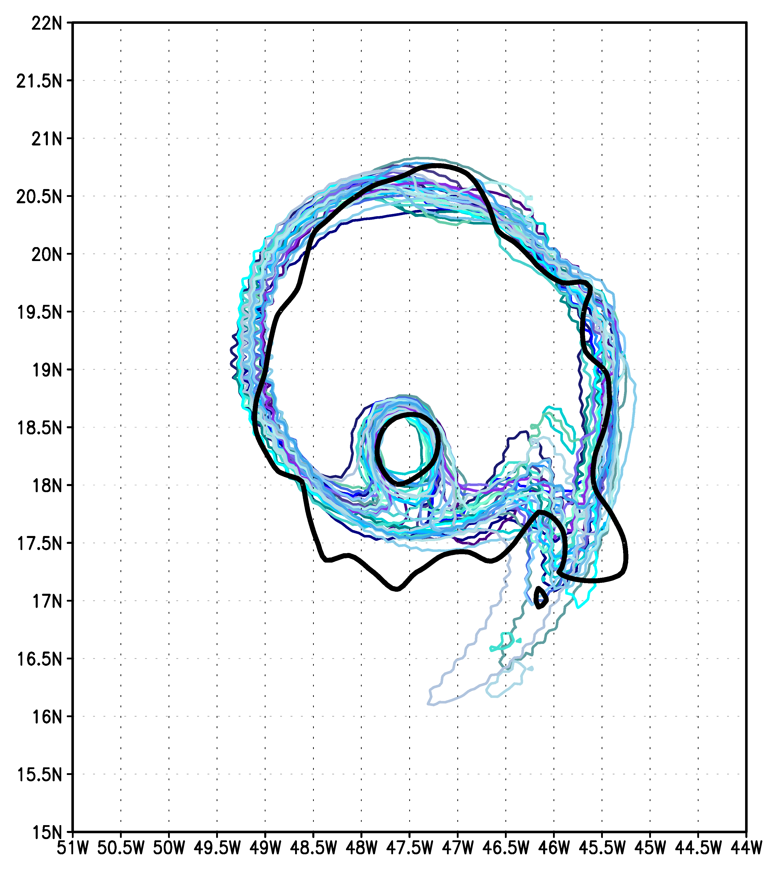
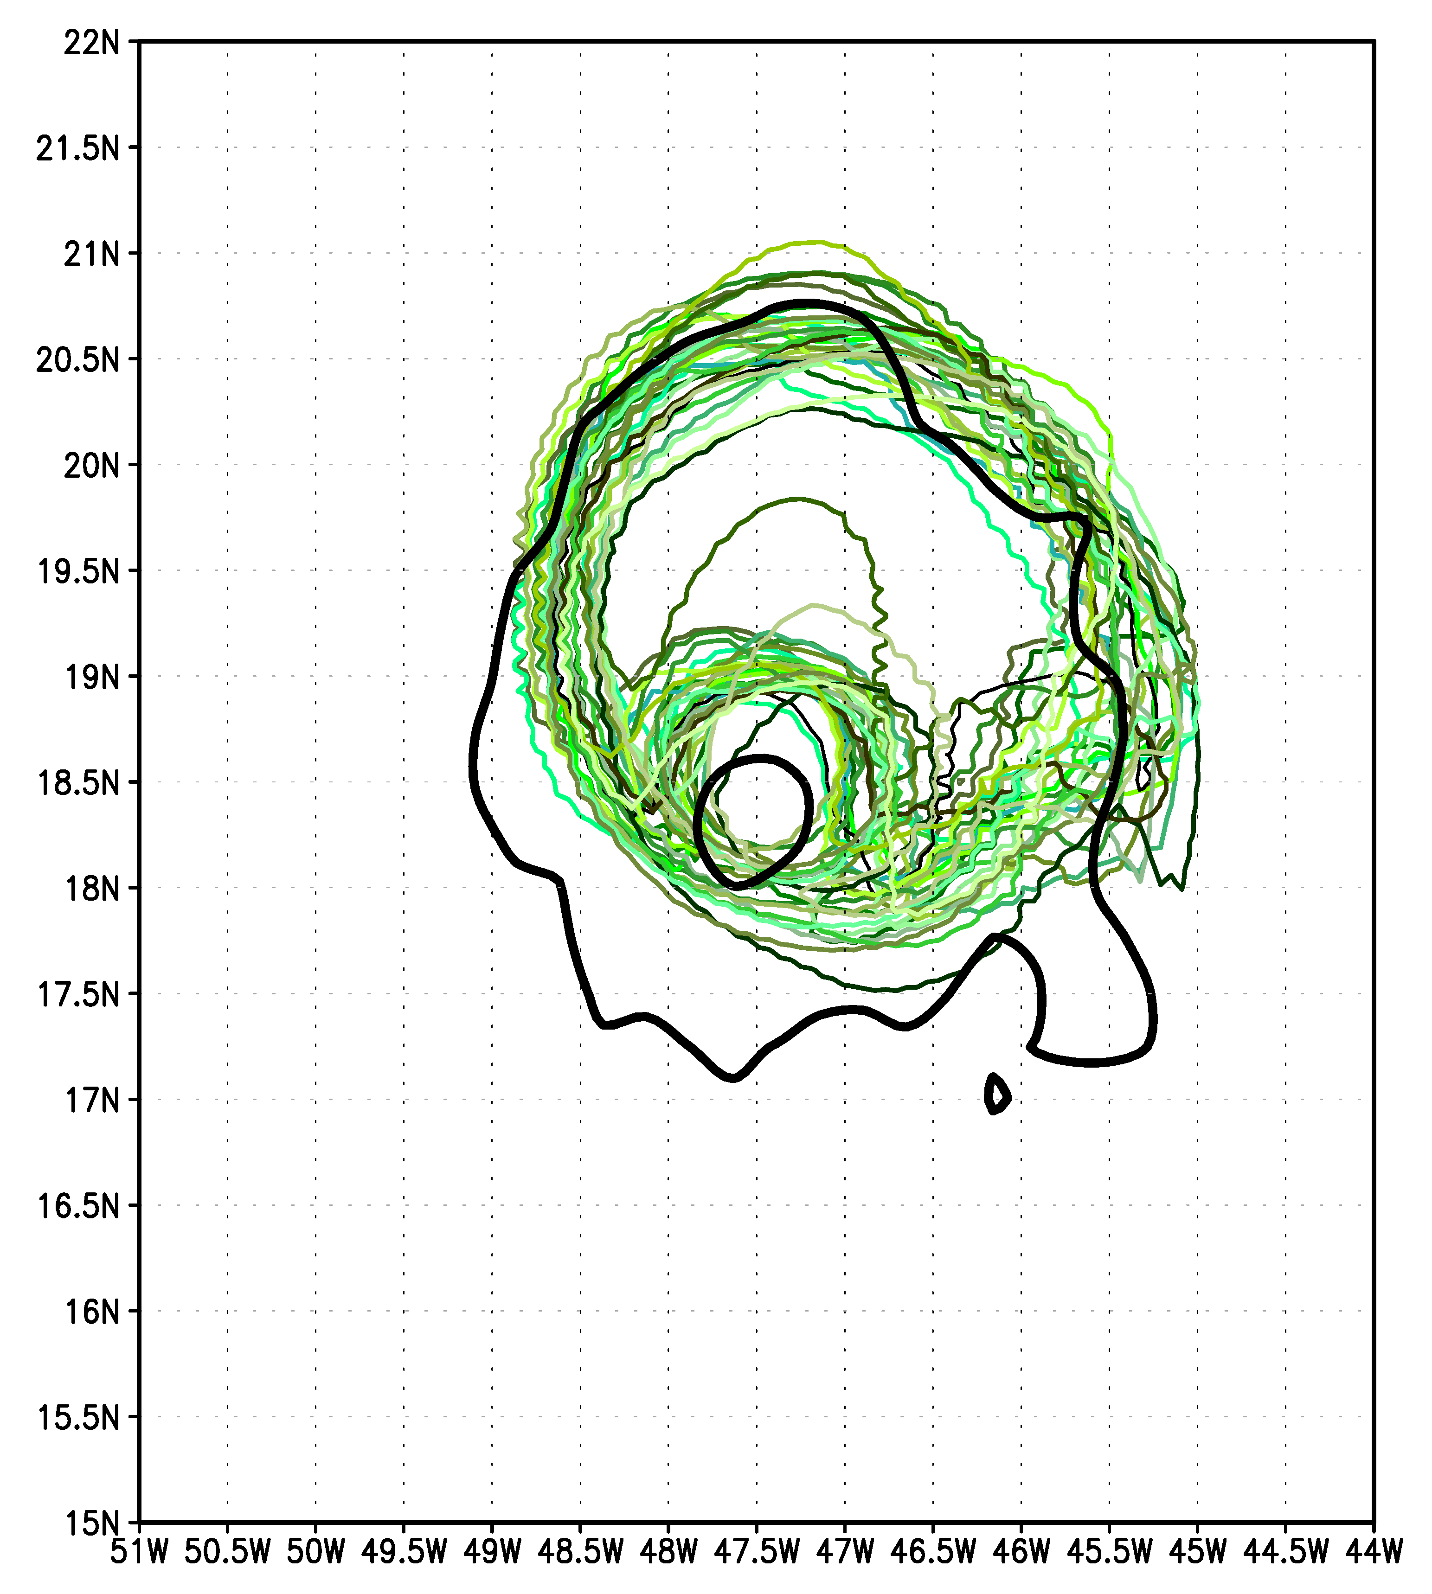
Working Group Meeting
for Space-Lidar Winds
The Upper Threshold
Perfect Winds & Mass
Perfect Winds
Perfect Mass
34-kt contour at 10m on 06 UTC Aug 3rd
Color contours: 30-member posterior analyses Black contour: NR
July 10, 2019

Slide 12
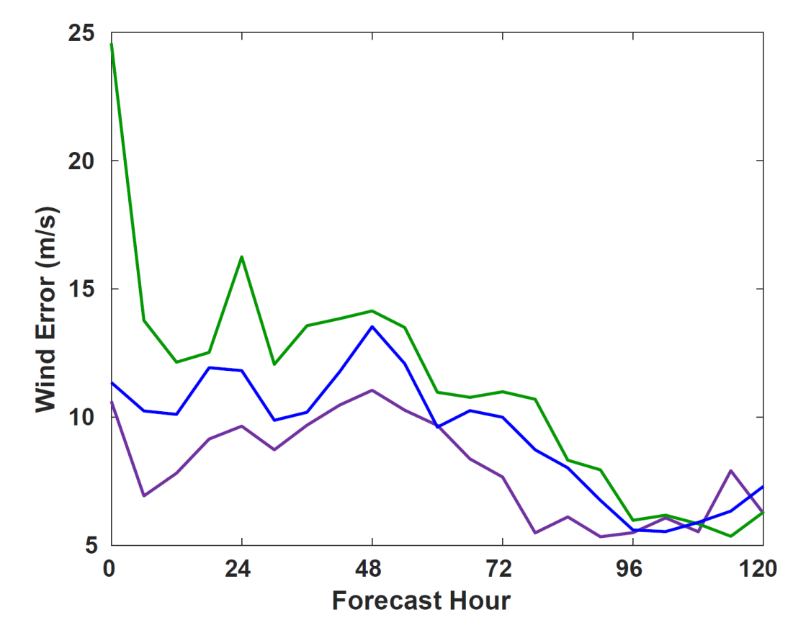
Working Group Meeting
for Space-Lidar Winds
The Upper Threshold
Perfect Wind+Mass
Perfect Wind
Perfect Mass
July 10, 2019

Slide 13
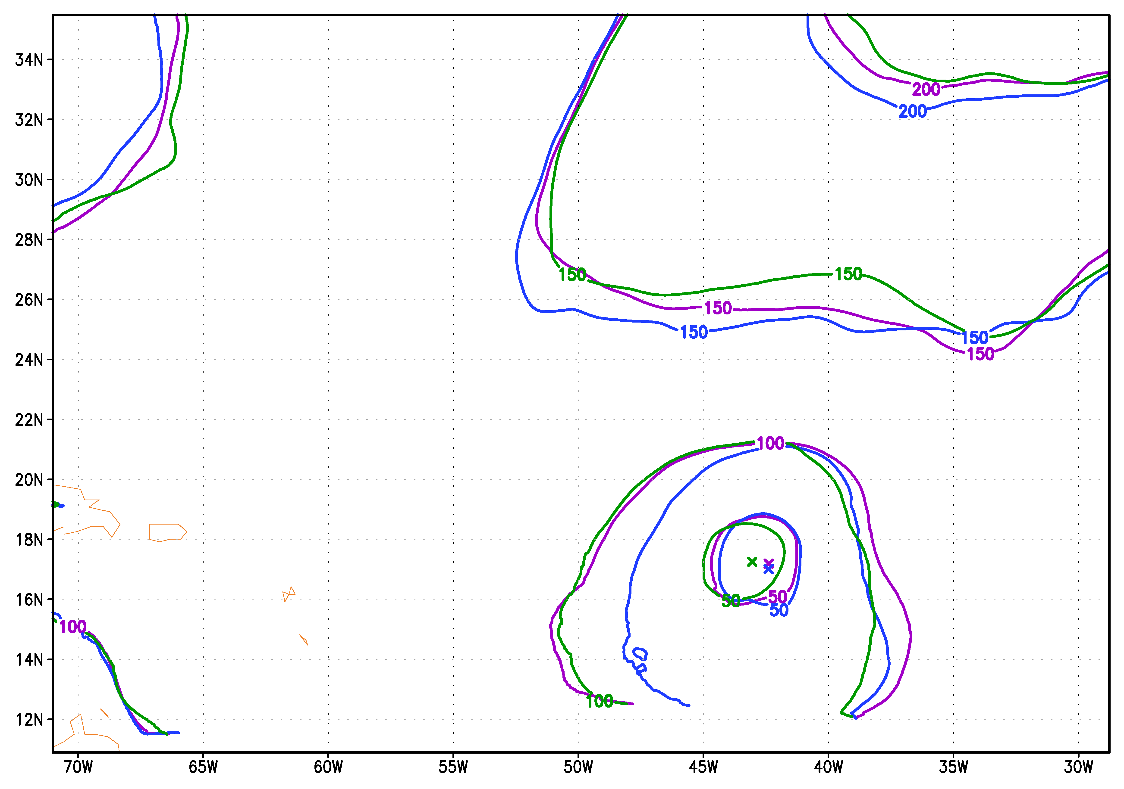
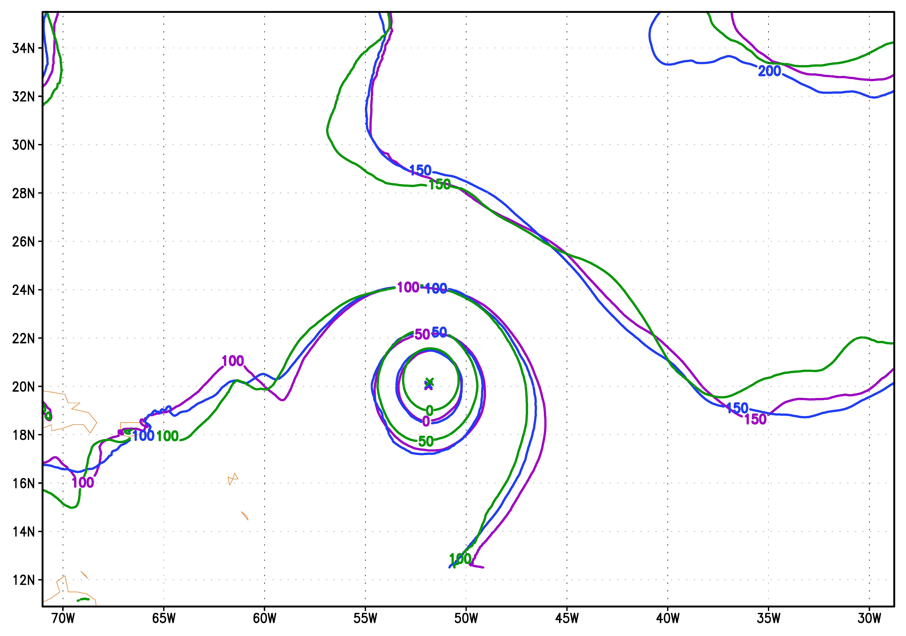
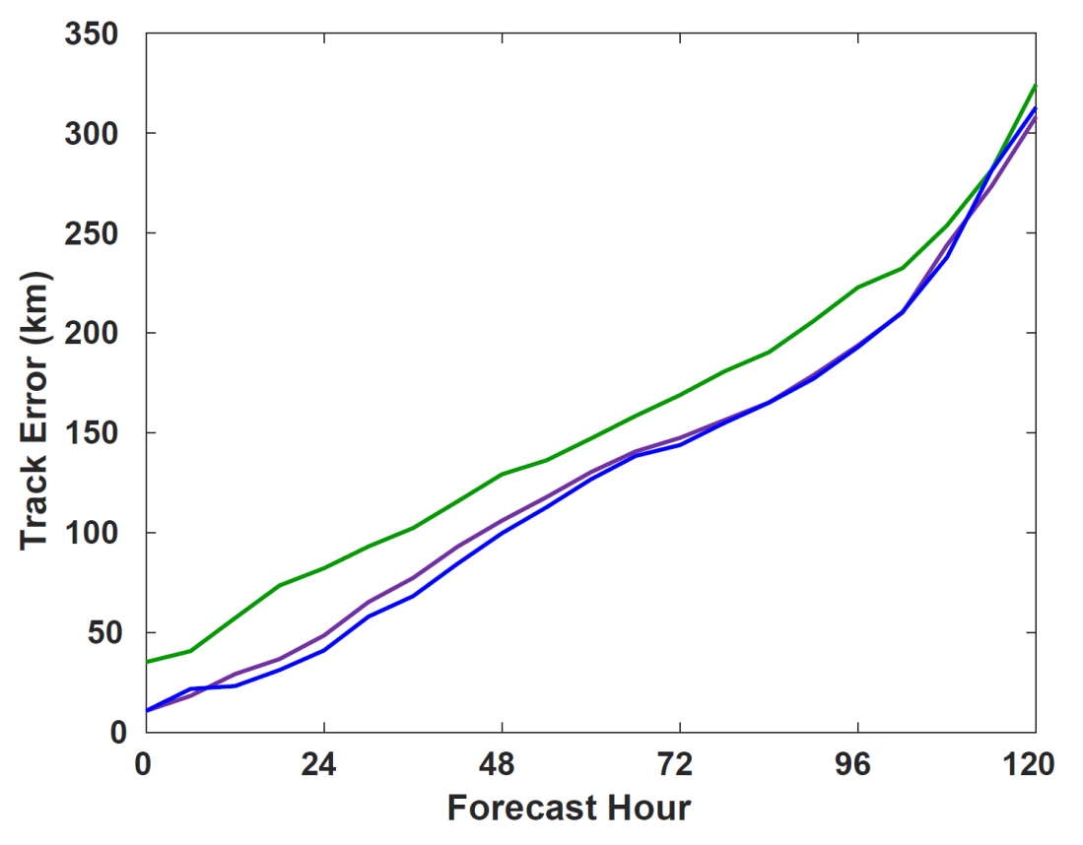
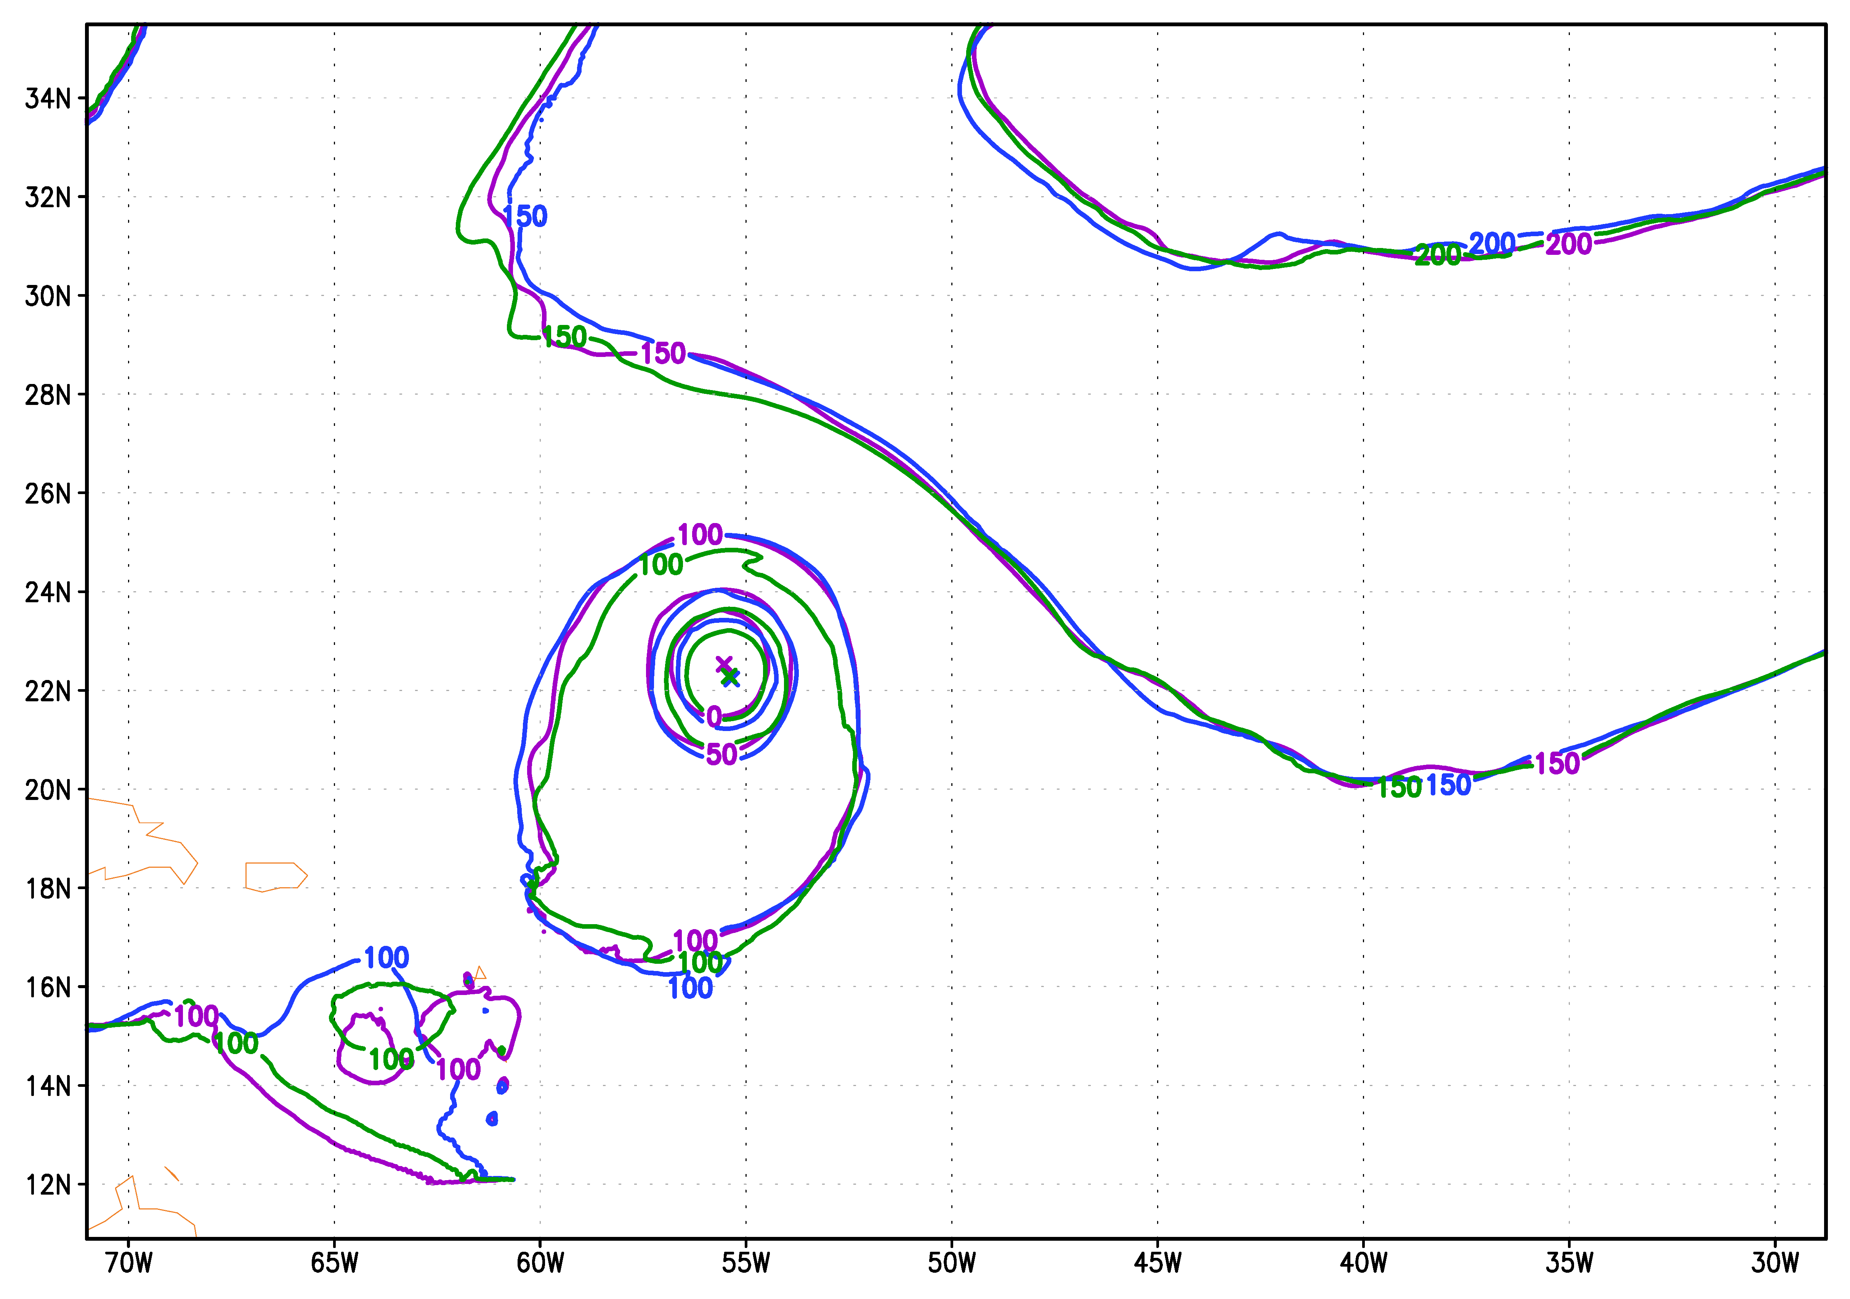
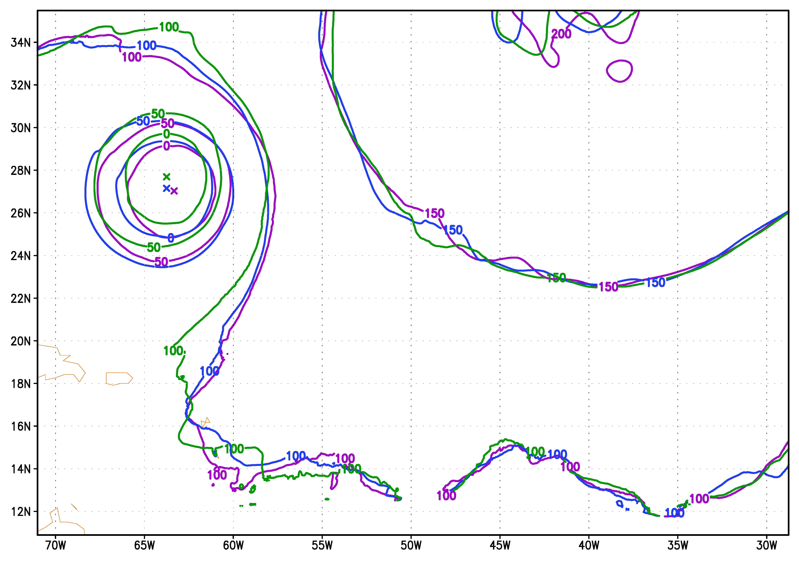
Working Group Meeting
for Space-Lidar Winds
The Upper Threshold
F000 18UTCAug01
Perfect Wind+Mass
Perfect Wind
Perfect Mass
F000 06UTCAug04
F072 18UTCAug01
F072 06UTCAug04
Early cycles
Large initial position error
Later cycles
Large along-track error
July 10, 2019

Slide 14
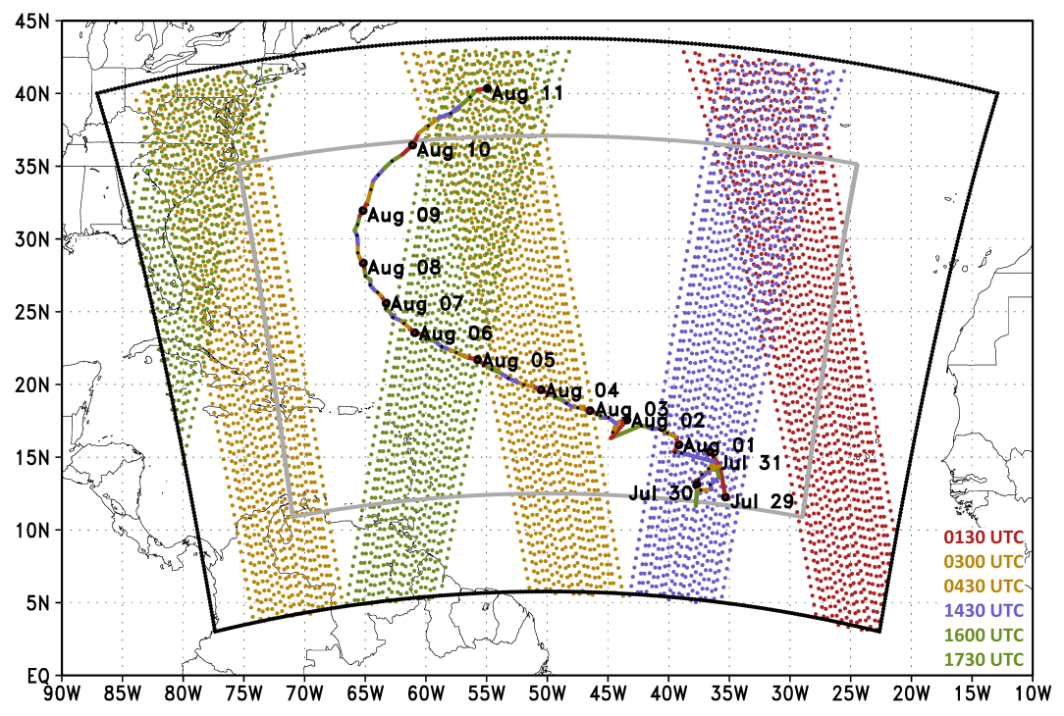
Working Group Meeting
for Space-Lidar Winds
Idealized Space-Based Wind Profiles
3 Experiment sets:
  Perfect Winds Profiles
  Perfect Winds Offset by 6 hours
  No Winds within 500 km of TC center
Observations from 27km Nature Run grid
16 cycles with 6 hour cycling interval
  06Z Aug 01 → 00Z Aug 05
5 day forecasts every 6 hours
Wind Profile Horizontal Resolution ~70km; Vertical Resolution ~1km
July 10, 2019

Slide 15
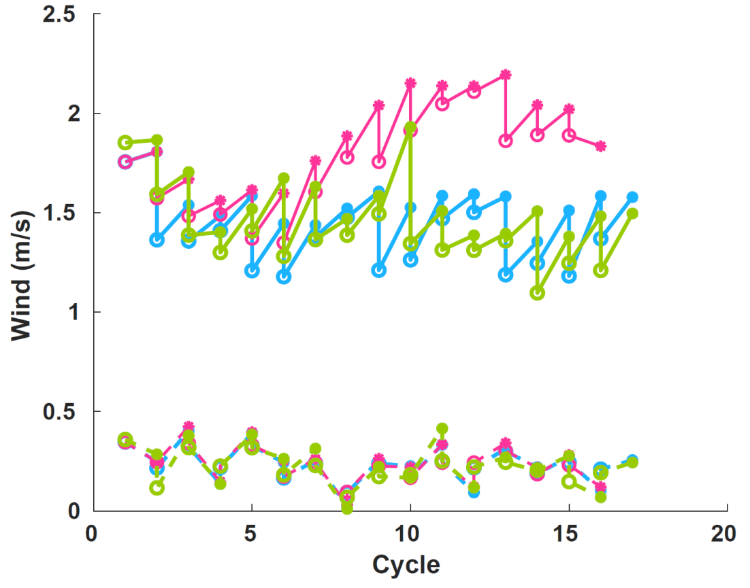
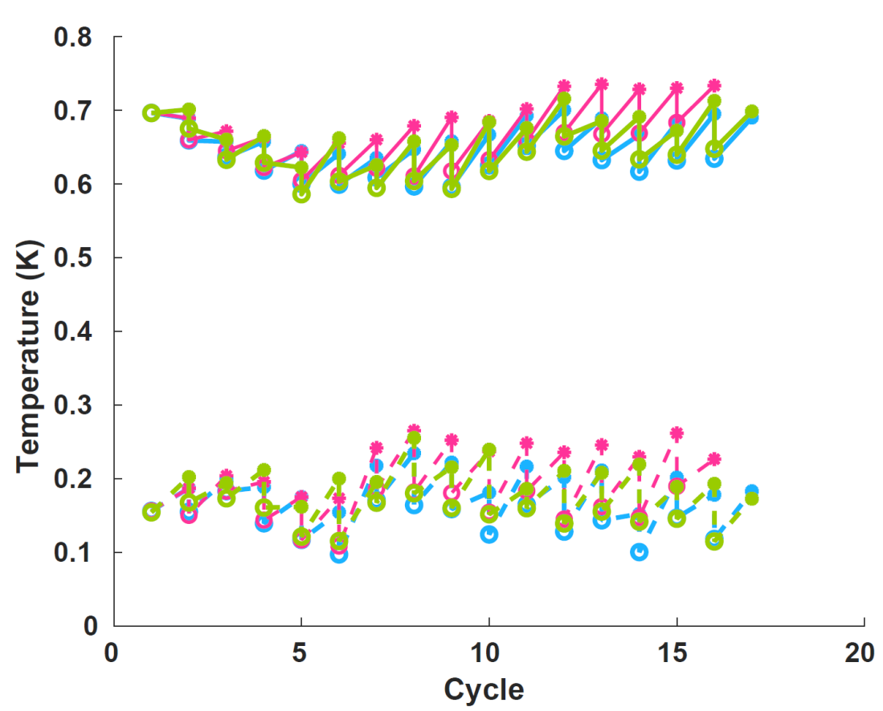
Working Group Meeting
for Space-Lidar Winds
Idealized Space-Based Wind Profiles
DWL Swath
DWL Swath 6hr offset
DWL No TC
Bias
RMS
o = Posterior
* = Prior
Onset of Rapid Intensification
July 10, 2019

Slide 16
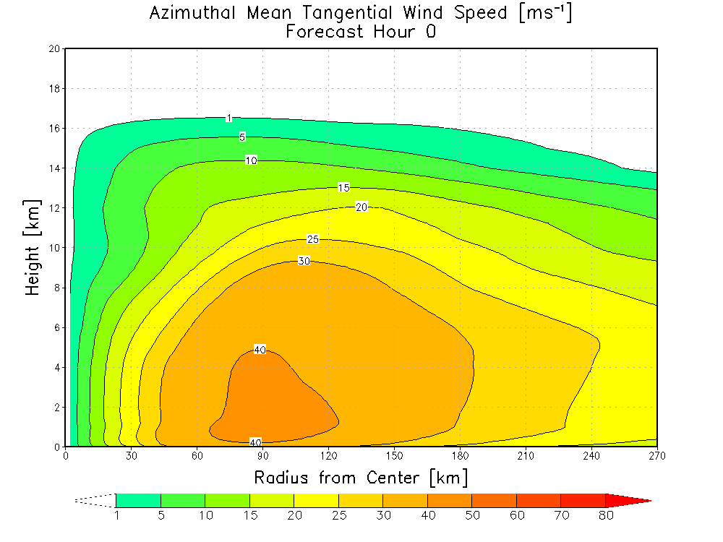
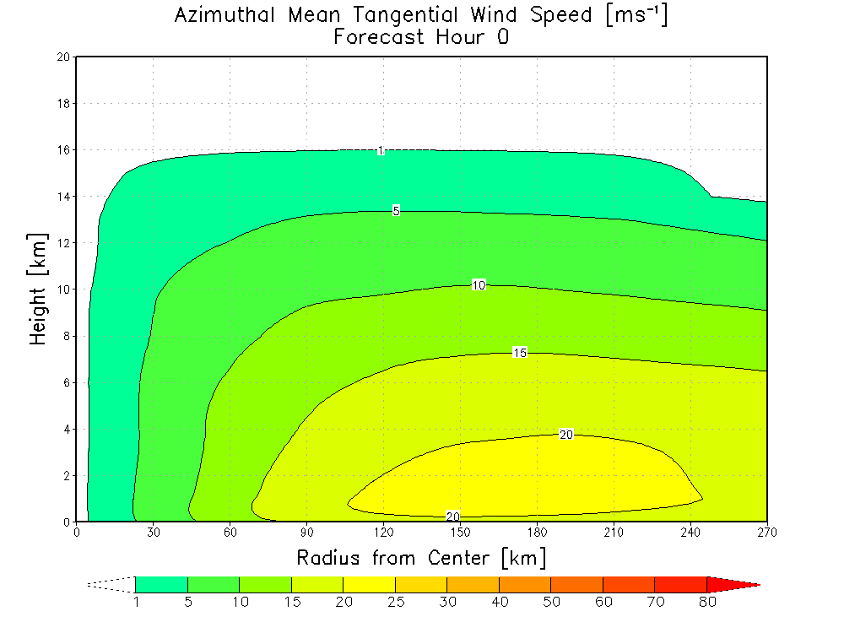
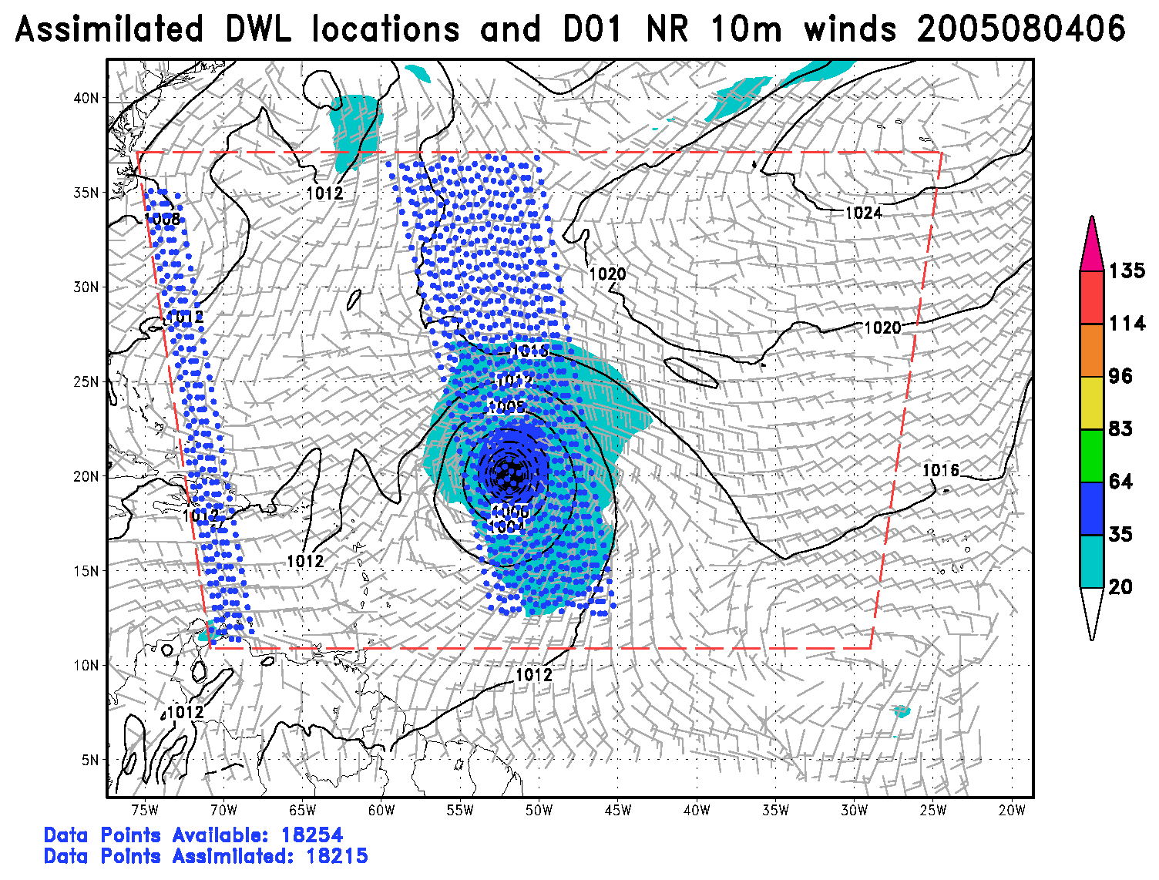
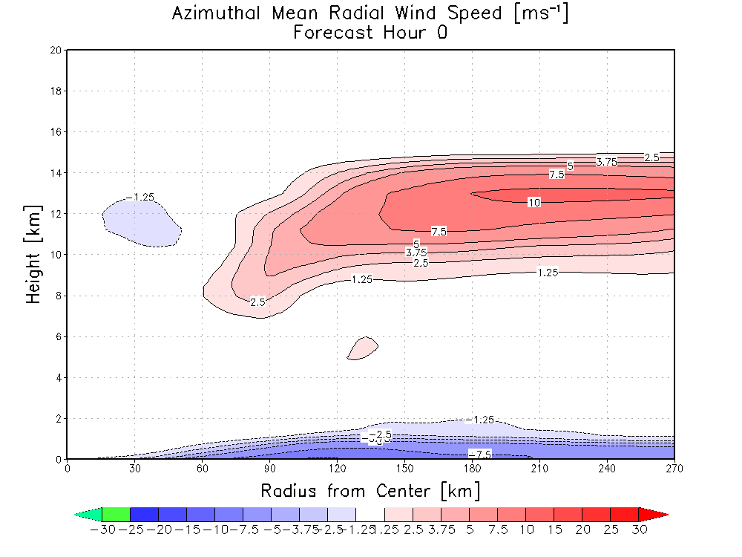
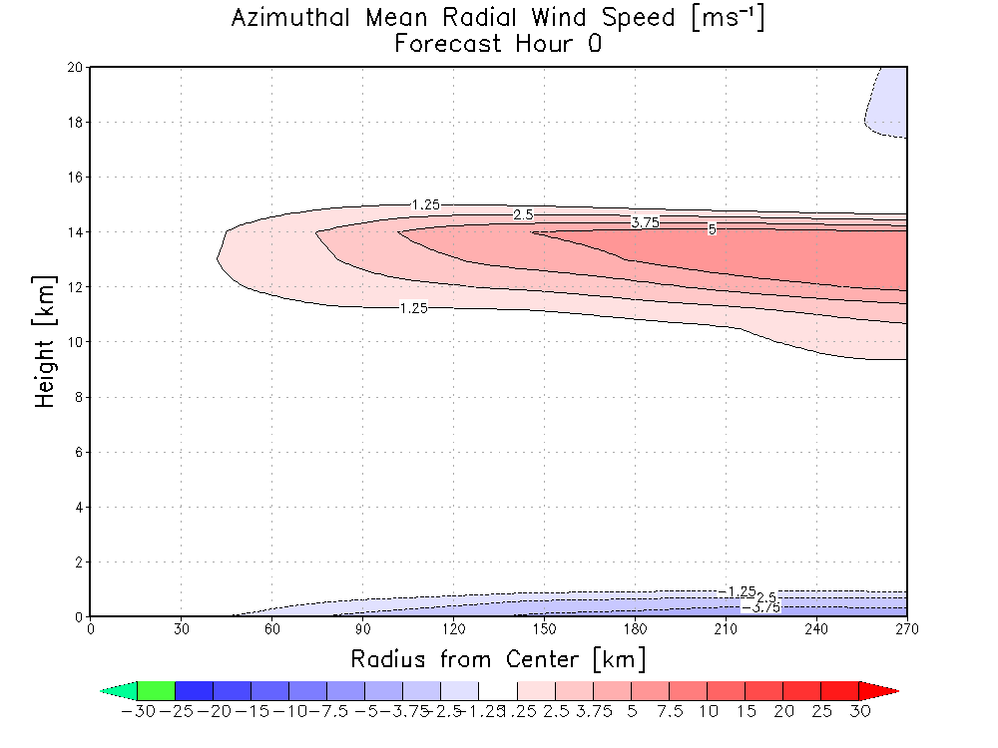
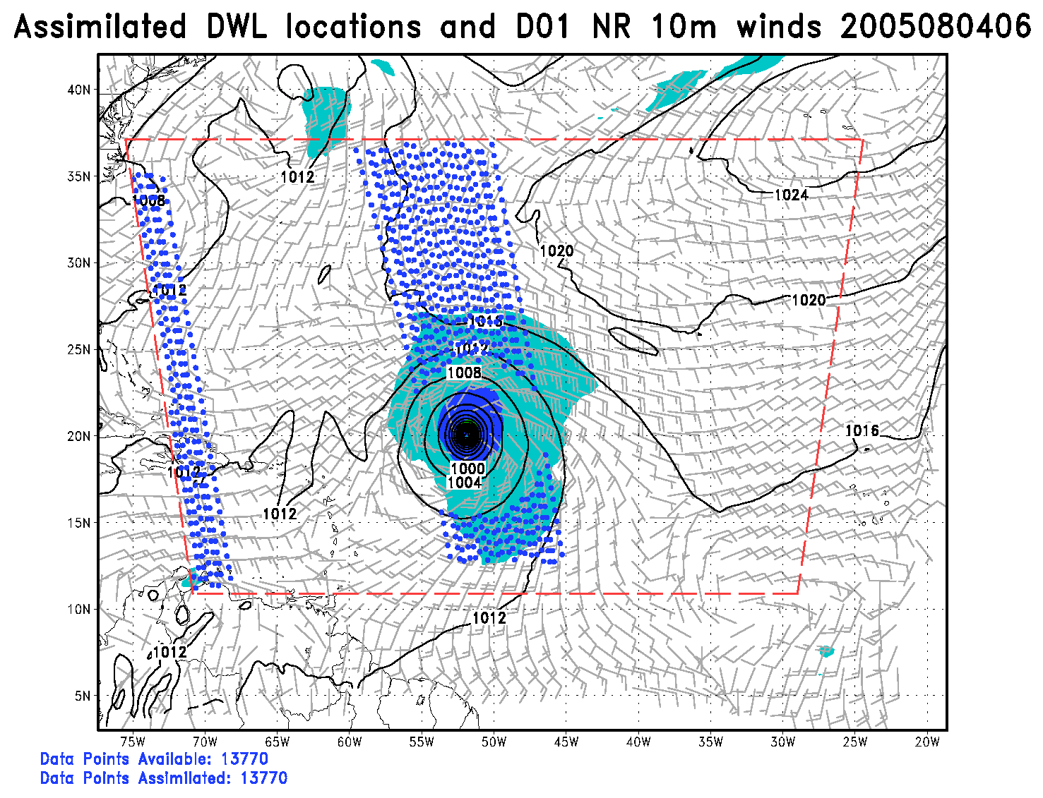
Working Group Meeting
for Space-Lidar Winds
Idealized Space-Based Wind Profiles
Azimuthally averaged tangential & radial wind analysis from August 4th, 2005 at 06 UTC
DWL Swath Perfect Vectors
DWL No TC
Observation Locations
July 10, 2019

Slide 17
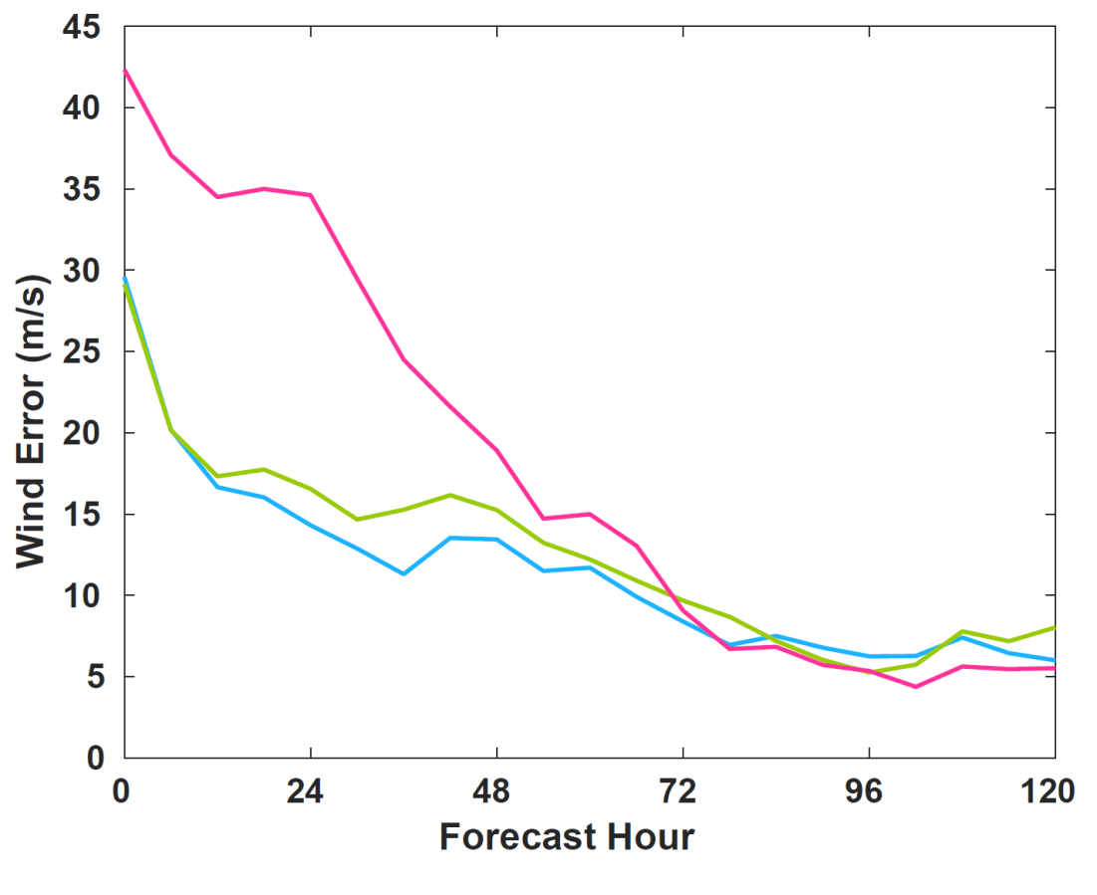
Working Group Meeting
for Space-Lidar Winds
Idealized Space-Based Wind Profiles
DWL Swath
DWL Swath 6hr offset
DWL No TC
July 10, 2019

Slide 18
Working Group Meeting
for Space-Lidar Winds
Summary & Conclusions
Combination of winds and mass observations provide the best forecast
  Wind only observations still capture good structural analysis and produce comparable forecasts
  Mass only observations fail to produce quality initial conditions
Important to study metrics beyond verifying the maximum 10m wind
Inner core observations are critical
  Especially during rapid intensification of a TC
July 10, 2019

Slide 19
Working Group Meeting
for Space-Lidar Winds
Future Steps
Move towards more realistic DWL observations
  Assimilate LOS instead of vectors
  Remove observations due to cloud coverage
  Reduce swath to single LOS
Sensitivity of hurricane forecast to radius in which observations are removed
Sensitivity of hurricane forecast to inner core only observations
Work supported by NASA ROSES and NOAA QOSAP
July 10, 2019

Slide 20
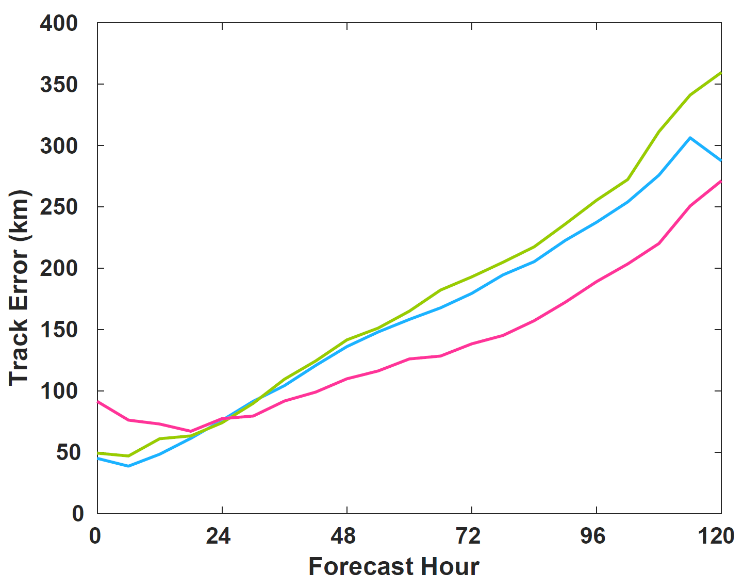
Working Group Meeting
for Space-Lidar Winds
Idealized Space-Based Wind Profiles
July 10, 2019

