Slide 1





A Systems Engineering Look at Space-Based Atmospheric Winds Missions
(with a slight lidar bias)
S. Tucker – Ball Aerospace

Slide 2
Wind Missions Systems Engineering
Mission Motives & Objectives
  What do we want to know?
Mission Requirements
  Needed capabilities & budget
Mission Architecture
  Platform, orbit, etc.
Mission Technologies

Slide 3




Motivation for Wind Lidar Mission Discussion
What do we need/want to do?
  e.g. Understand & predict severe weather; study impact of dust on tropical cyclones; and/or?
NSOSA & SPRWG: NOAA Satellite Observing System Architecture Study and the Space-Platform Requirements Working Group
  Full-tropospheric winds (Wind Lidar option) by 2030
2017 Earth Science Decadal Survey
  Atmospheric Winds now in the Explorer category - with Wind Lidar as option
  No Explorer opportunities currently planned (?)
Aeolus launched, is taking data, and showing impact
  ESA fostered a collaborative effort across all sectors -
  ESA considering a follow-on, but also looking to the international community
Notes:
5 considered highest priority for “designated” missions
6 (now 7 including Atmospheric Winds) observables can be competed for 1 of 3 “Earth Explorer” missions.

Slide 4

Mission motives
NOAA Requirements: focus on improving NWP, Protecting Lives and Property
NASA Requirements: Science. Processes, Modeling, Pre-operational
Per NSOSA: a DWL as part of a larger weather architecture
  DWL for accurate and precise measurements with high vertical resolution
  Good horizontal coverage also desired
  Optimize impact vs. cost curve
Per SPRWG: Require full tropospheric coverage
  Full troposphere: PBL and UTLS required to have desired impact
  Trades on “stripes” and coverage vs. cost
  …
Decadal Survey
  atmospheric winds a “most important” measurement.
  Might have been designated, if not for perceived readiness.
  PBL emphasis – UTLS winds and chemistry missing
  Tropical cyclones?
  Winds as secondary observation for many other science questions
Weather Focus Area
  Atmospheric dynamics, convective processes, etc.
  New approaches to modeling,
  Work that enables improved NWP.
ESTO: science drives the technology development – recent focus on innovative technologies

Slide 5
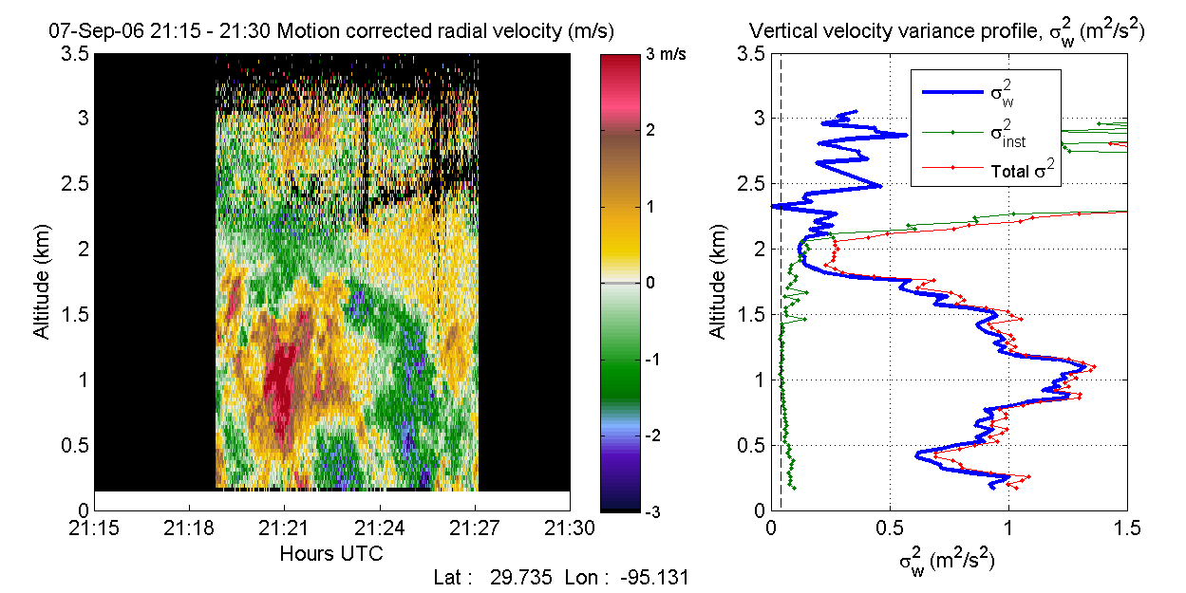
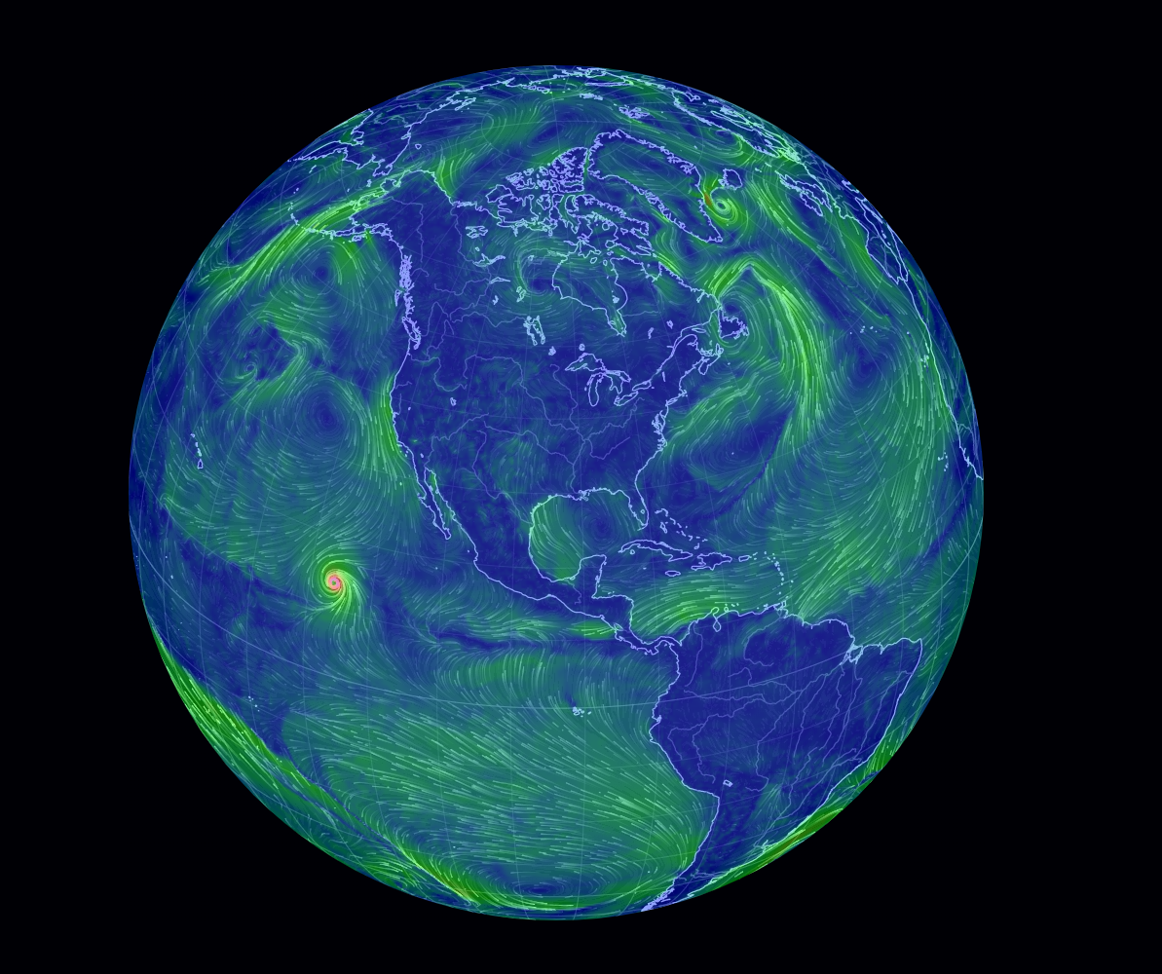
Mission motives – really-simplified
NOAA Requirements: focus on improving NWP, Protecting Lives and Property
NASA Requirements: Science. Processes, Modeling, Pre-operational
Research on model physics
Global initialization of forecast models that use tested model physics
  Global coverage
  Variable scales
  (model grids)
Research to update model physics
  Focused coverage
  PBL emphasis
  Variable scales
A well-planned mission can provide something for everyone

Slide 6
Mission Requirements
Needs/Capabilities
Options/Architecture
What scales need to be observed?
  Horizontal coverage, resolution, & spacing
    Global? Turbulence studies?
  Vertical coverage, resolution, & spacing
    Full troposphere? Just lower/troposphere? Are cloud layers sufficient?
  Temporal coverage, revisit times, profiles/day
What precision & accuracy are required?
  LOS wind speed precision/accuracy
  Vector wind precision/accuracy
  Spatial/height assignment precision/accuracy
What budget do we have? (Funding & SWAP)
Platform
Orbit, path
Wavelength(s)
TRL
Technology

Slide 7
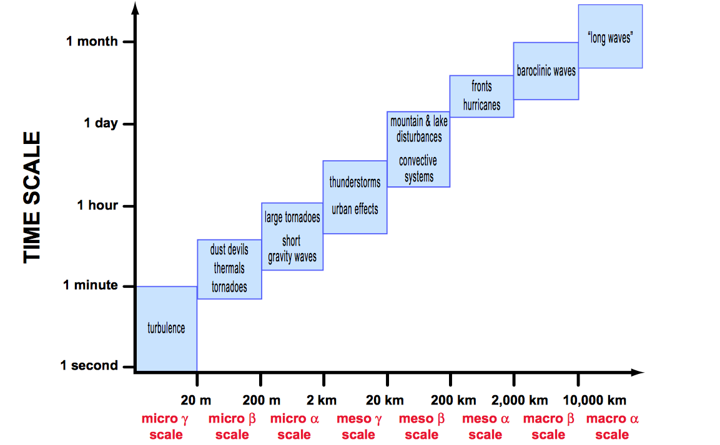
Scales of atmospheric processes
Space-based
Space-based lidar measurement
  Satellite speed (~7 km s⁻¹)
  Multi-pulse accumulation
  Measurement curtain
  Long revisit times
Space-based Lidar winds (e.g., Aeolus) - well-matched to synoptic scales and long term wind statistics
Synoptic → Need for full atmospheric profiles
Aircraft-based
Time scale
Surface-based
Modified from
Markowski and Richardson

Slide 8
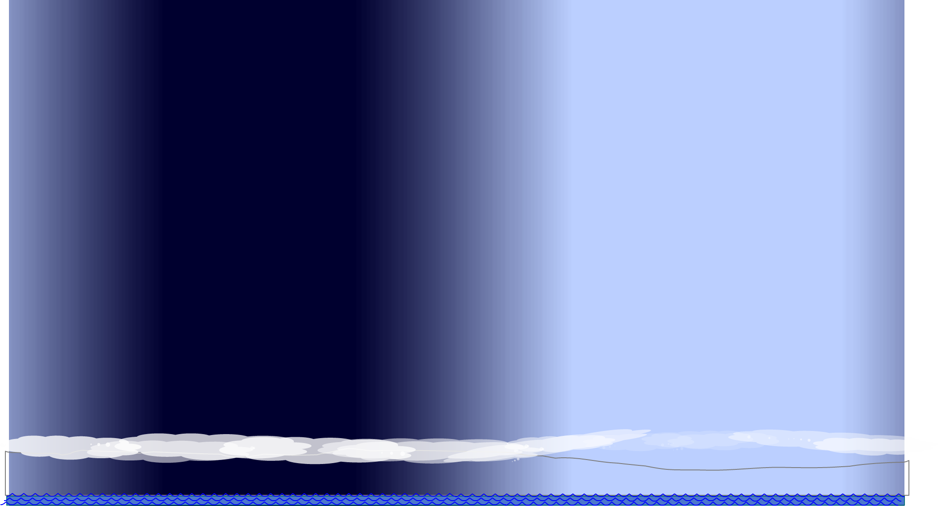
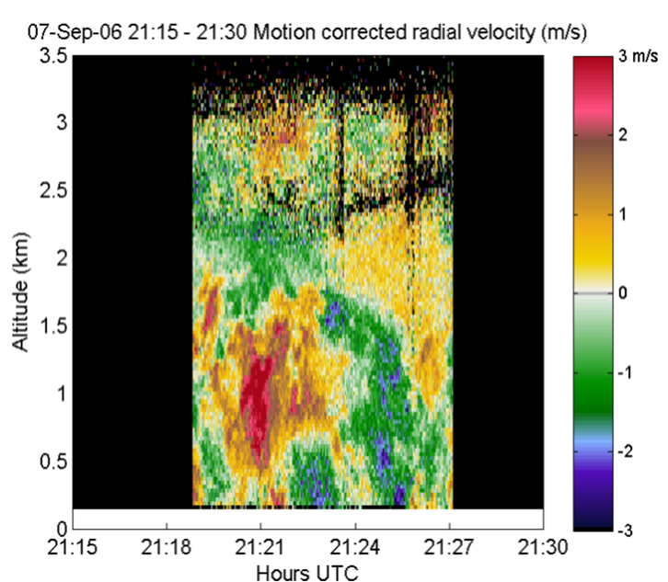
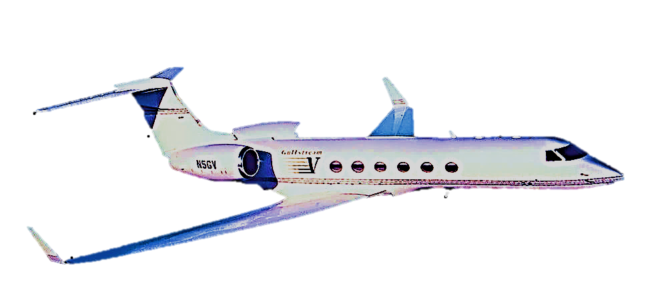
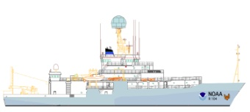
Lidar for Planetary Boundary Layer (PBL) studies
Decades of work using aerosol, WV, & wind lidars for PBL studies from ground, ship, & aircraft:
  Mixed/mixingLH, Gradient (T, WV, aerosol, etc), σ_{w}, PBL vs. LCL (decoupling), shear capping (PV)
@ >7 km/s orbit speeds – challenging to use space-based lidar for most of these observations
  CALIPSO aerosol gradients
What is it about space that adds value?

Slide 9

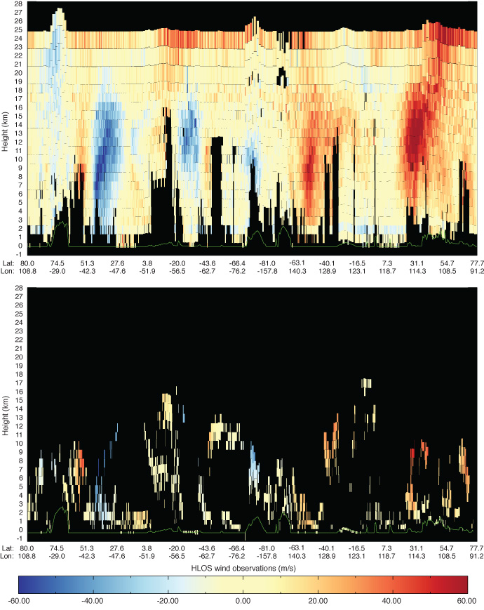
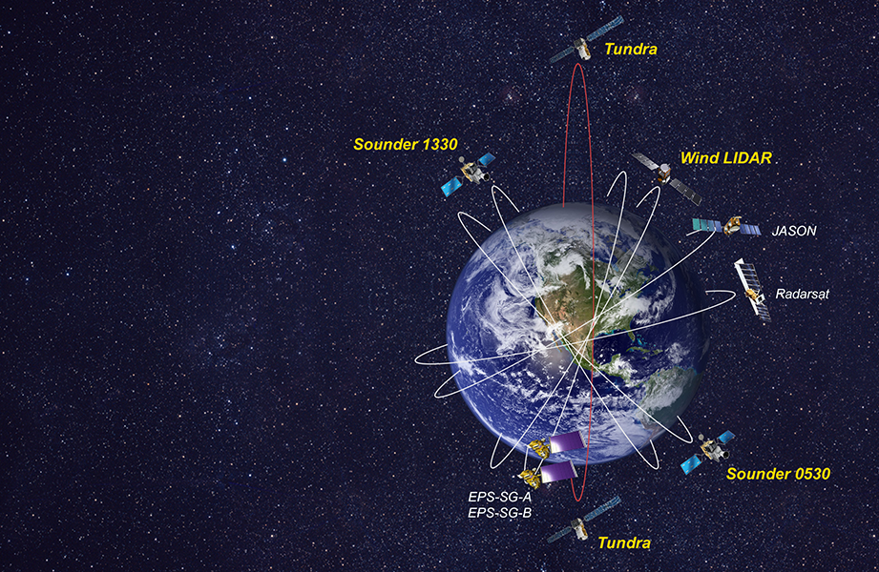
Lidar for Global Winds
Full troposphere
Aeolus Molecular (Rayleigh)
Aeolus Aerosol (“Mie”)
Images courtesy ESA/ECMWF
Based on image from NSOSA report
Notes:
Need global winds - especially in the UT/LS like Aeolus

Slide 10
Observing Atmospheric Winds
M
Molecular: UT/LS
A
Aerosol: LT/clouds
Measure 3D Winds
W
Water Vapor Features
A
W
Passive (Motion Vector, sea-state, etc.)
Active
μ-wave
Sounders
Imagers
IR-Sounders
Microwave
Optical Doppler Lidar
Optical (feature tracking lidar)
A
Lower troposphere/ aerosol scattering
A
Full-Troposphere & Lower Stratosphere
M
“Coherent” Heterodyne Detection
“Direct” Detection
1064 nm, 532 nm (CALIPSO) & 355 nm
~2 μm, (1.6 μm, ~10 μm)
LaRC
DAWN
A
Double-Edge
Fringe Imaging
Mach Zehnder
GSFC?
NOAA CSD, NOAA P-3, Halo, Leosphere,
A
M
A
M
M
A
ESA’s
Aeolus
UPMC (France)
ATHENA OAWL
Nested OAWL
Notes:
Plenty of solutions – the challenge is asking the right questions

Slide 11
Range resolved Lidar anchors cloud heights to improve AMV results…
Lidar reveals presence of thin cirrus that (if neglected) can be detrimental to sounder retrievals
Clouds & aerosols enhance OAWL precision at these layers
AMV Height error bars
Atmospheric Motion Vector
Winds error bars

Slide 12
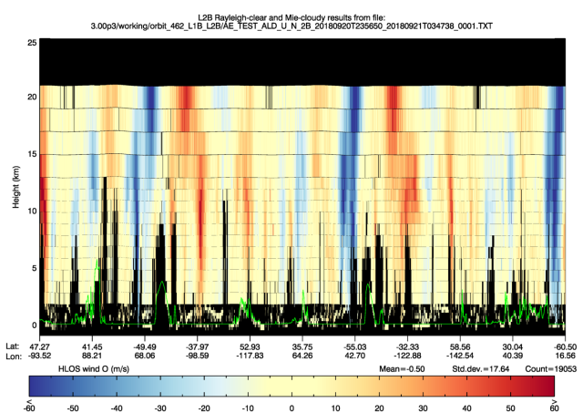
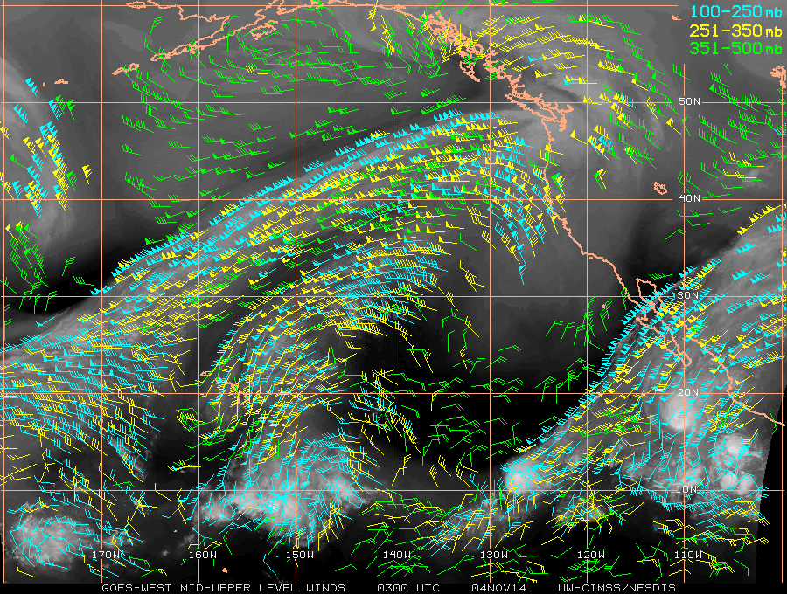
Mission Architectures
Aerosols (including clouds) and water vapor
  visible using imagers and sounders
  + motion with multiple spacecraft/views → motion vector winds
True clear air (dry air with no aerosols)
  UT/LS, large scale dynamics – poorly observed
  Aeolus Molecular lidar winds are providing lots of previously un-measured data
AMV + molecular Doppler channel for space-based operation
Lidar anchors AMV ←→ AMV extends lidar
  How far (swath) does the anchor hold?
  What is the overall benefit for lidar + AMV data?

Slide 13





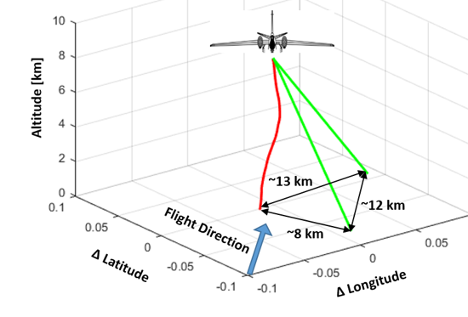
OAWL – Wind & Aerosol Lidar
Technology approach based on CALIPSO
OAWL IIP – First demonstration 2011
GrOAWL: the 2 LOS ATHENA Airborne Demonstrator built, flown, validated, and scaled to space
  2 pubs: Journal of Atmospheric & Oceanic Technology: Tucker et al., 2018 & Baidar et al., 2018
ATHENA-OAWL: EVI-2,4 proposals
  Aerosol Transport, Hurricanes, and Extra-tropical Numerical weAther using OAWL.
  Mission Systems Architecture: Design-to-cost approach: based on heritage systems (CALIPSO) and
  ISS hosting
  EVI-4, rated Category 2 (TMCO rated Selectable ).
HAWC-OAWL: Ground-based demonstrations of dual-wavelength wind and aerosol backscatter coefficient measurements
ESTO managed competitive grants: NO profit
Notes:
OAWL history
ATHENA-OAWL Objectives: Co-located wind and aerosol profiles to provide:
better understanding of relationships between aerosol radiative forcing, atmospheric dynamics and the genesis and lifecycle of tropical cyclones
understanding of the impacts of long-range dust and aerosol transport on global energy and water cycles, air quality, and climate.
breakthroughs in modeling and prediction of low and mid-latitude weather and climate.

Slide 14
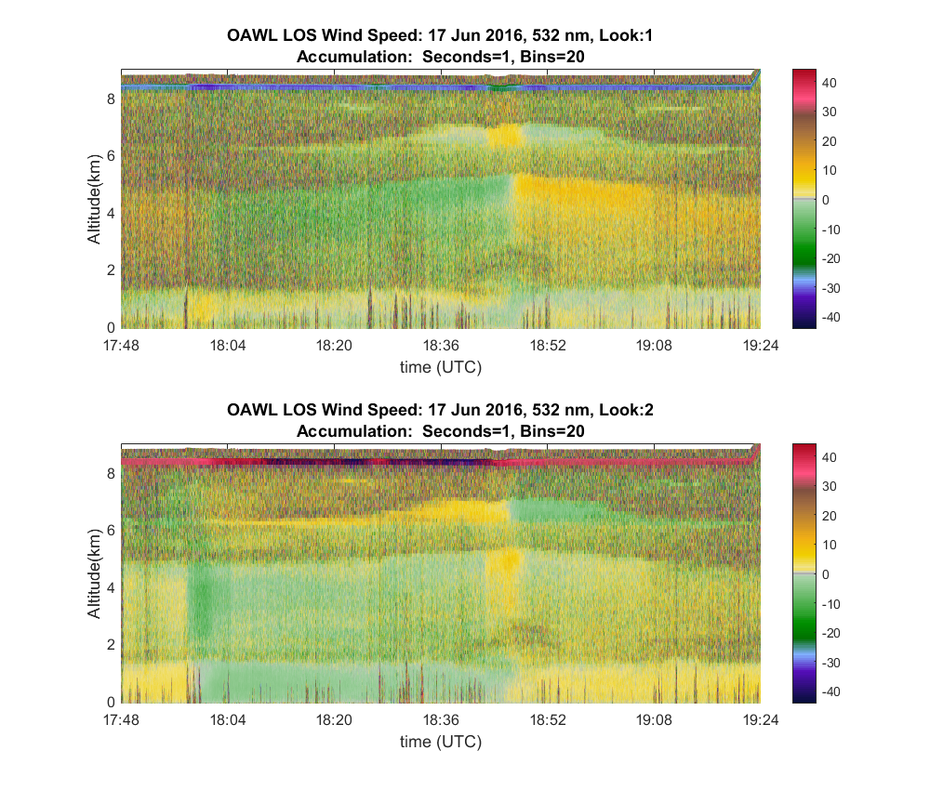
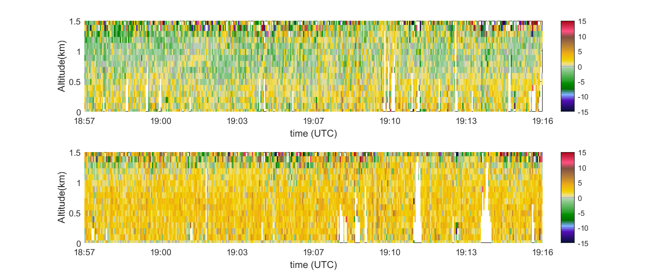
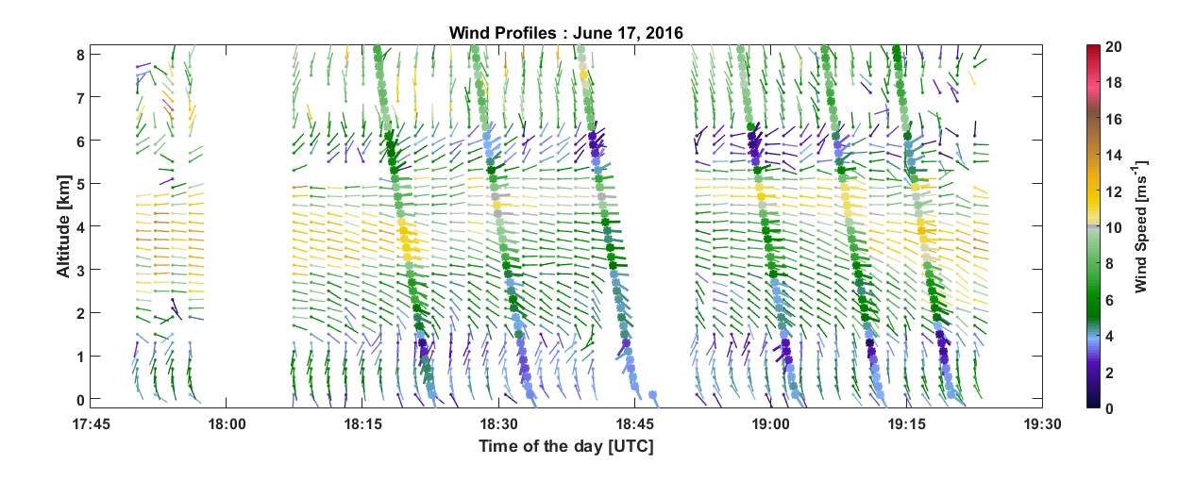
Airborne Validation: Simultaneous two-look wind profiles
17 June 2016: Forward look, 1s profiles,
<1.5 mJ/pulse (0.3 W), 532 nm
Autonomous OAWL Airborne Demonstrator built, flown, validated, and scaled to space
Dual 45° Line of Sight (LoS) wind speed data
Publications: J. Atmos. & Ocean. Tech: Tucker et al., 2018 & Baidar et al., 2018
Aft look, 1s profiles

Slide 15
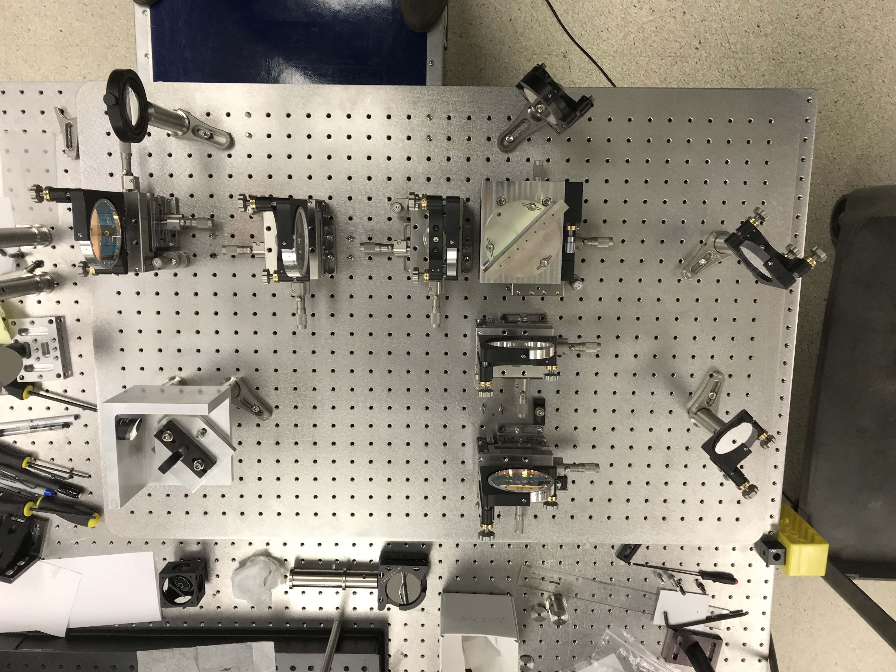
Nested-OAWL path to Full Atmospheric Wind Profiles
Current Ball IRAD demonstrating the Nested interferometer to provide Aerosol winds @ 532 nm (long OPD) and Molecular winds @ 355 nm (new short OPD)
Both wavelengths simultaneously generated in the same laser, both OPDs in the same interferometer.
DARPA-funded effort developed a UV-only short OPD OAWL interferometer
Aeolus molecular (Rayleigh) data
Aeolus aerosol (“Mie”) data
Notes:
Short (molecular) OPD is “nested” inside the long (aerosol) OPD: “Nested OAWLs”
Same detectors as used for the dual wavelength OAWL
2018 IRAD for demonstration is underway

Slide 16
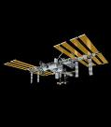
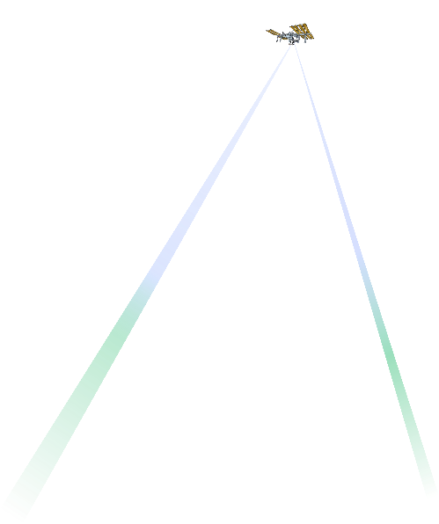
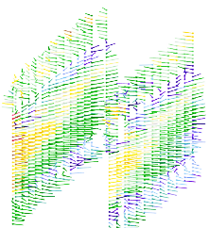

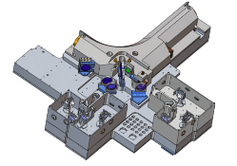
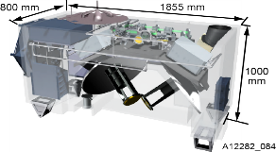

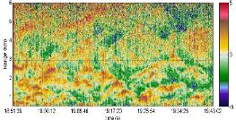
GOING BEYOND: NASA/Ball CALIPSO Lidar >12 Years on orbit!
Ball Aerospace’s Optical Autocovariance
Wind Lidar (OAWL) - Aerosol & Molecular
ESA’s ADM Aeolus (single look – 355 nm Aerosol & Molecular)
Global 3D winds
NSOSA study
ESDS
 |  |  |  |  |  |  |  |  |  |  |  |  |  |  |  |  |  |  |  |  | ‘30
 |  |  |  |  |  |  |  |  |  |  |  |  |  |  |  |  |  |  |  | ‘29
 |  |  |  |  |  |  |  |  |  |  |  |  |  |  |  |  |  |  | ‘28
 |  |  |  |  |  |  |  |  |  |  |  |  |  |  |  |  |  | ‘27
 |  |  |  |  |  |  |  |  |  |  |  |  |  |  |  |  | ‘26
 |  |  |  |  |  |  |  |  |  |  |  |  |  |  |  | ’25
 |  |  |  |  |  |  |  |  |  |  |  |  |  |  | ‘24
 |  |  |  |  |  |  |  |  |  |  |  |  |  | ‘23
 |  |  |  |  |  |  |  |  |  |  |  |  | ‘22
 |  |  |  |  |  |  |  |  |  |  |  | ‘21
 |  |  |  |  |  |  |  |  |  |  | ‘20
 |  |  |  |  |  |  |  |  |  | ‘19
 |  |  |  |  |  |  |  |  | ‘18
 |  |  |  |  |  |  |  | ‘17
 |  |  |  |  |  |  | ‘16
 |  |  |  |  |  | ‘15
 |  |  |  |  | ‘14
 |  |  |  | ’13
 |  |  | ‘12
 |  | ’11
 | ’10
’09
EVI-4 ATHENA-OAWL ISS Mission concept (TMCO rated Selectable)
Full
tropospheric operational wind lidar
Operational Airborne mission develop-ment
OAWL
Mission
concepts
ESA’s
Aeolus
Launch
On-orbit Operational Demonstration: dual lines of sight
OA Laboratory
Prototype
Operational Space Demonstration Flight build
Nested OAWL
full troposphere
demonstration
*GrOAWL
2016 demo
*OAWL-ACTs
*OAWL-IIP
2011 demo
*ESTO funded
Notes:
OAWL IIP – First demonstration 2011
GrOAWL: the 2 LOS ATHENA Airborne Demonstrator built, flown, validated, and scaled to space
2 pubs: Journal of Atmospheric & Oceanic Technology: Tucker et al., 2018 & Baidar et al., 2018
ATHENA-OAWL: EVI-2,4 proposals
Aerosol Transport, Hurricanes, and Extra-tropical Numerical weAther using OAWL.
Mission Systems Architecture: Design-to-cost approach: based on heritage systems (CALIPSO) and
ISS hosting
EVI-4, rated Category 2 (TMCO rated Selectable
– but not selected).
HAWC-OAWL: Ground-based demonstrations of dual-wavelength wind and aerosol backscatter coefficient measurements
ESTO managed competitive grants: NO profit

Slide 17

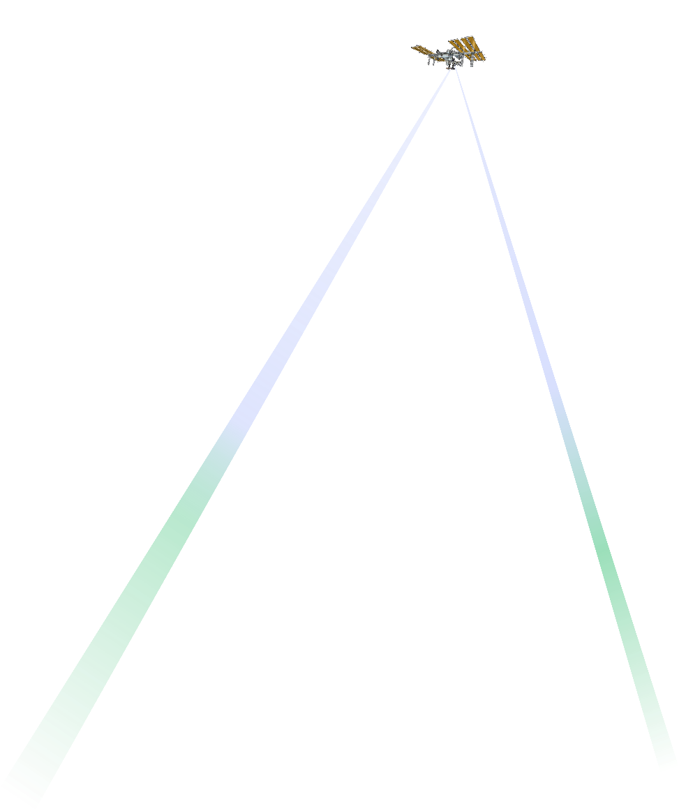


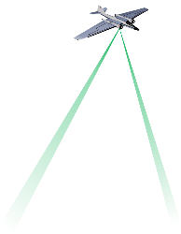
Advantages of OAWL approach
Wrapping fringes for removal of platform-motion-induced Doppler offsets in processing
Like Aeolus, OAWL offers a path to full atmospheric lidar wind profiles – and adds a second look
FPGA-based pulse/sample accumulation enables pulse-to-pulse phase referencing→ relaxed laser frequency and pointing stabilization requirements
Narrow range gates provide precise cloud height estimation
Nested OAWL provides aerosol & molecular channels (no cross calibration required)
No atmospheric linewidth calibrations required for OAWL Doppler measurements,
No aerosol “contamination” of molecular signal
Wide field of view receiver provides overlap margin (like on CALIOP)
The MZ Interferometer’s high throughput efficiency → enables two lines of sight
Aircraft Demonstrations/Validation

Slide 18
Final Questions and Thoughts
Aeolus’ successes and lessons benefit the whole community (Thanks!)
What can we accomplish together?
  Protect lives and property, while observing large scale dynamics and improving models
Let the operational and science requirements drive the mission systems design – balanced with cost and TRL
  OSSE’s already demonstrated the positive impact of global wind observations on forecast skill
  What is the objective behind pushing space-based wind lidar into a PBL mission?
  The ATHENA-OAWL Earth Venture proposal focused on extra-tropical weather and tropical cyclone research → improving science and protection of lives.
The OAWL approach provides a high TRL, reduced risk, follow-on to the Aeolus mission

Slide 19
Extras

Slide 20
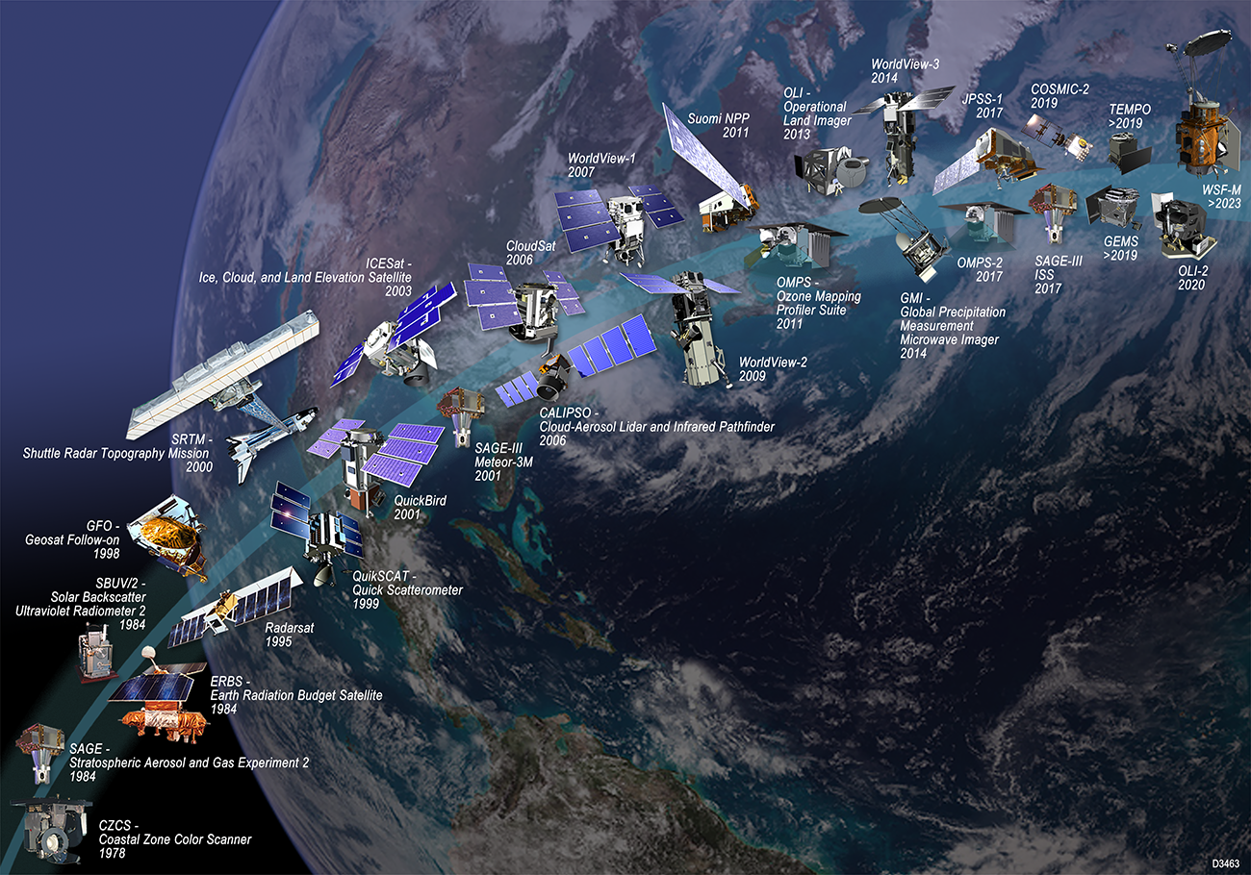

Slide 21
Notes on ESDS Explorer
NASA WFA objectives
Budget/focus (so far) on Designated Observables
  Focus/funding all at NASA centers
ESDS Decision Rules for Budget Changes.
  “The committee expects that budgets will be different from the nominal assumptions made in accordance with the committee’s statement of task.
  A critical purpose of decision rules is to maintain the scientific and technical capacity for a robust space-based Earth Science program when budgets change. Maintaining capacity is important, since that capacity takes a long time to build (in some cases, longer than the mission development time scale) and is easily disrupted.
  “The committee places the highest priority on continuity of critical missions, followed by competitive opportunities in the Earth System Explorer and Earth Venture lines, followed by the large missions. However, because the highest overarching priority is a balanced portfolio, it is important that no one aspect of the portfolio be reduced excessively, to keep others intact.
  “As a result, in managing potential budget reductions that impact the scope and/or cadence of the new measurements of this decadal survey:
    Reductions should first be accommodated by delaying the large missions.
    If additional reductions are required, the medium-sized Designated missions should be delayed, unless these delays threaten the continuity of data sets that require continuous measurement.
    Should continuity be threatened, the cadence of medium-sized competitive missions should be reduced but not to fewer than two competitions in the decade.
    The budgets for Venture and research and applications should not be reduced by more than 5% from their historical averages.”

Slide 22
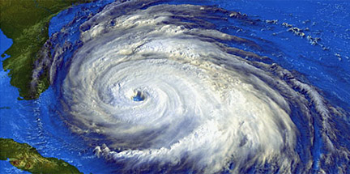
Wind lidar for operational weather
Direct wind observations are the top missing element in the GOS,
→ more important as models horizontal resolution improves.
Space-based DWL can provide:
  Direct measurements of altitude resolved wind profiles
  Measurement of convergence & divergence
  Global coverage: most important over the oceans and in the tropics
Multiple OSSE/OSE studies over decades show significant
predicted impact, examples include:
  Baker et al., Bulletin of the American Meteorological Society, 1995
  Marseille, et al., Proc. 5th Intl. Winds Workshop, EUM-P, 2000
  Riishojgaard et al., J. Applied Meteorology, 2004
  Stoffelen, et al., Quarterly J. of the Royal Met. Soc., 2006
  Marseille, G.J., A. Stoffelen, & J. Barkmeijer, Tellus A, 2008 (2 papers)
  Weissman & Cardinali, Quarterly J. of the Royal Met. Soc., 2007
  Atlas, et al., IEEE IGARSS, 2010
  Baker, et al., Bulletin of the American Meteorological Society, 2014
  Ma et al., Journal of Atmospheric and Oceanic Technology, 2014
  Atlas, et al. Journal of Atmospheric and Oceanic Technology, 2015
ESA’s Aeolus operating on orbit – starting to look at impact of lidar wind measurements.

Slide 23
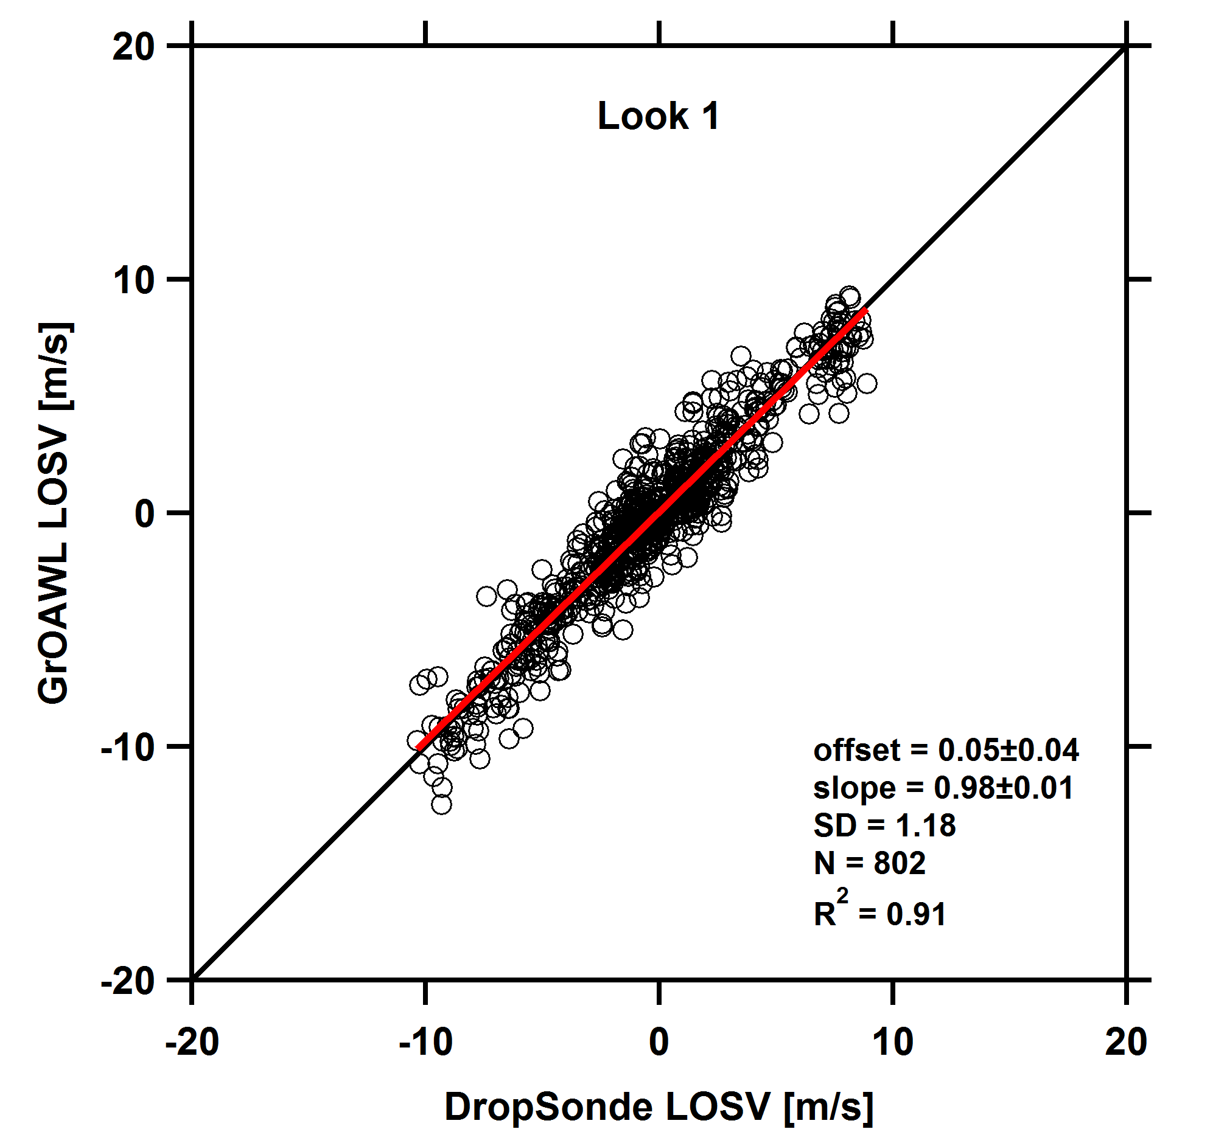
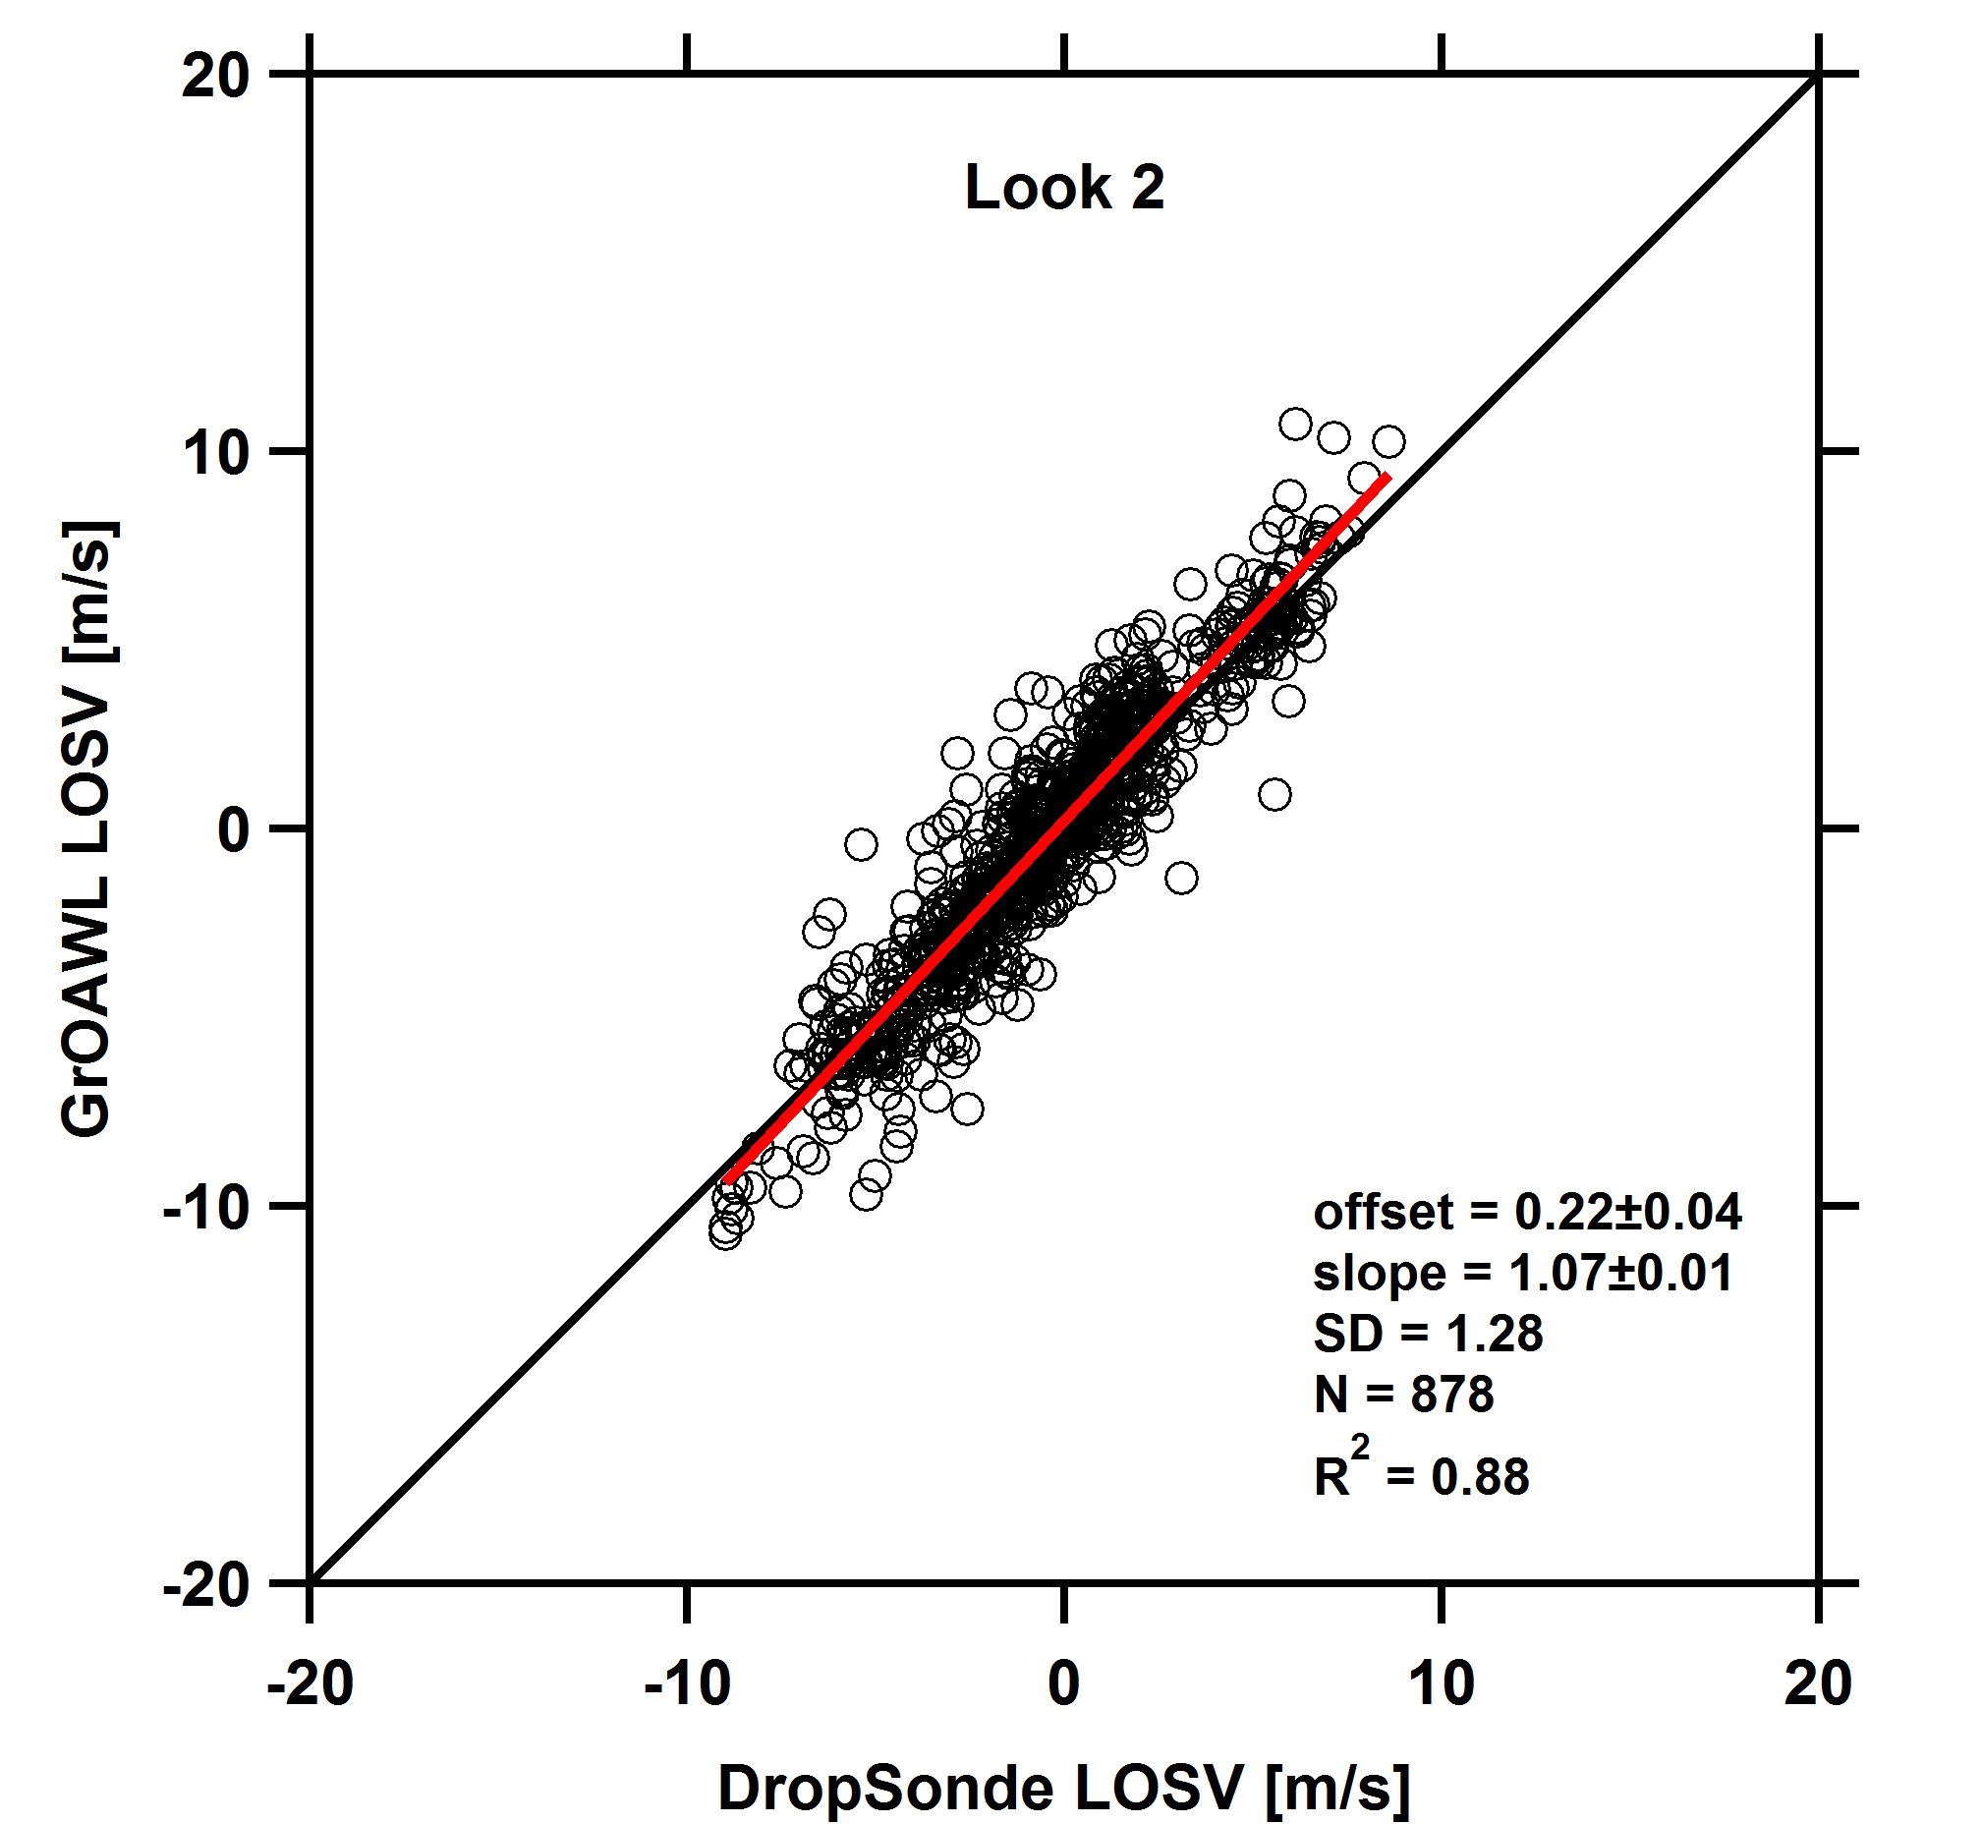
Simultaneous two-look OAWL LOS wind speed profiles
17 June 2016: Forward look, 1s profiles
Line of sight wind speed data
  8.5-10km flight altitudes,
  45° slant path angles
  <1.5 mJ/pulse, 532 nm
  27 cm eff. diameter telescopes
  Variable pulse accumulation (1s shown)
  Daytime flight w/ scattered clouds.
  Clean atmosphere/low aerosol backscatter (GEOS5 model)
Continuous coverage with each look, no switching or scanning required
Validated using 21 dropsondes from 3 validation flights
Aft look, 1s profiles

Slide 24
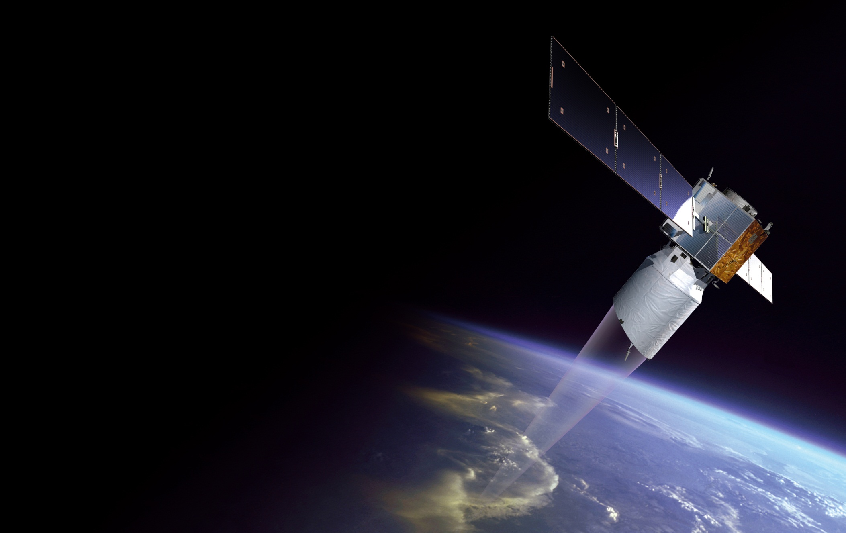
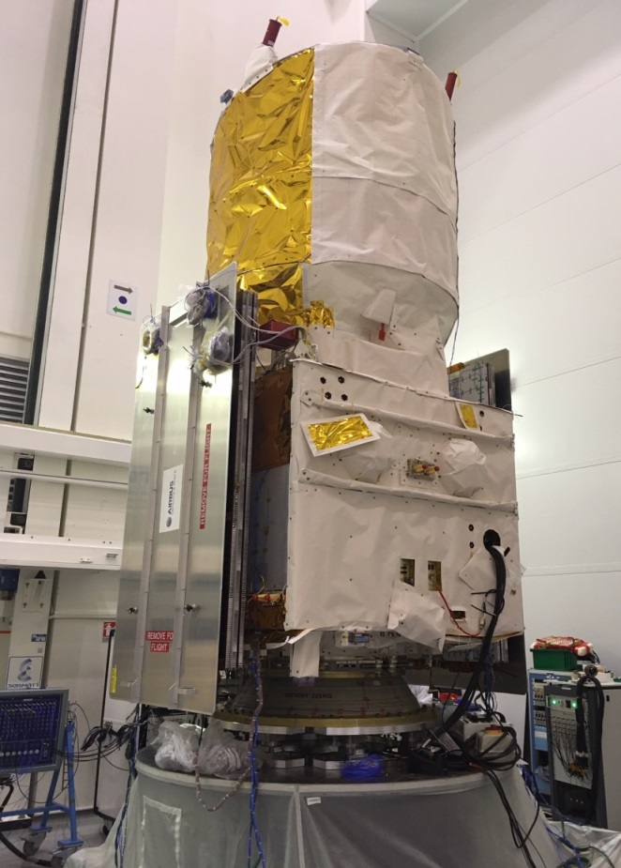
ADM-Aeolus Mission: ALADIN: Atmospheric LAser Doppler Instrument
Launched 22 August 2018
Single-look
(60%-70% of 2 looks)
Two Direct Detection channels: Aerosol & Molecular (full troposphere) - both at 355 nm
Sun-synchronous, dusk/dawn orbit, 320 km
3 year mission (consumables)
no follow-on
ESA funded – industry built
Courtesy Anne Grete Straume
Notes:
Aeolus Scientific objectives
To improve the quality of weather forecasts;
To advance our understanding of atmospheric dynamics and climate processes;
Explorer objectives
Demonstrate space-based Doppler Wind LIDARs potential for operational use.
Observation means:
Provide global measurements of horizontal wind profiles in the troposphere and lower stratosphere

Slide 25
Atmospheric Backscatter
Longer wavelengths (e.g. 2-10 µm)
  Larger aerosols present in the PBL & aerosol/cloud layers
  Less atmospheric extinction, less vertical coverage
Shorter wavelengths (532 & 355 nm)
  More scattering from aerosol/cloud layers
  Scattering off of smaller particles (UTLS)
  Molecular scattering
  High TRL lasers, telescopes, & detectors
These properties factor strongly into which lidars are best for a given application
Log scale
Notes:
TRL

Slide 26
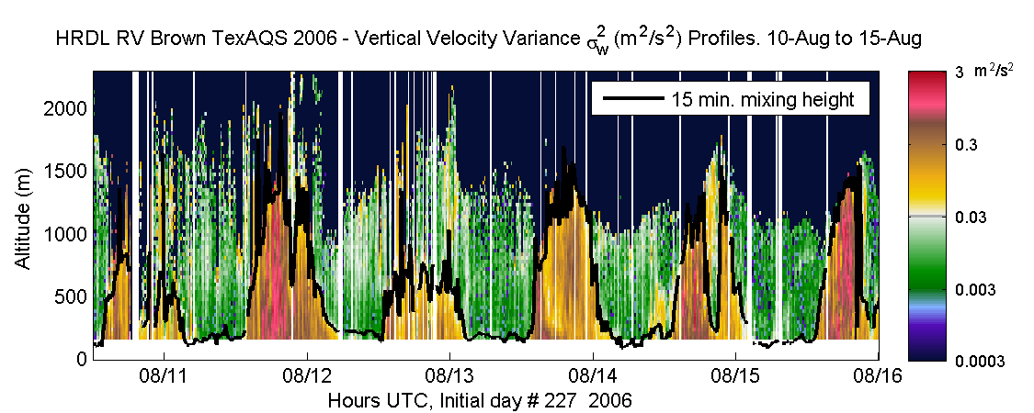
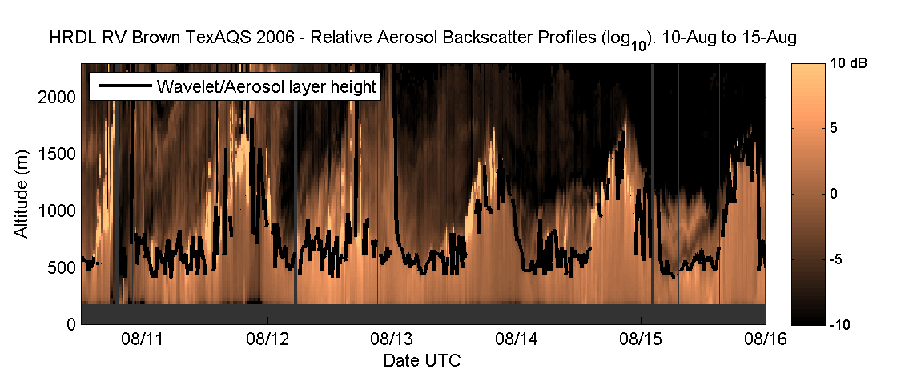
PBL/Mixing Heights
W and σ_{w}² profiles from NOAA CSD, TexAQS, 2006 data
Requires multiple pulses, noise characterization, etc. to characterize air-sea (or air-land) mixing

Slide 27
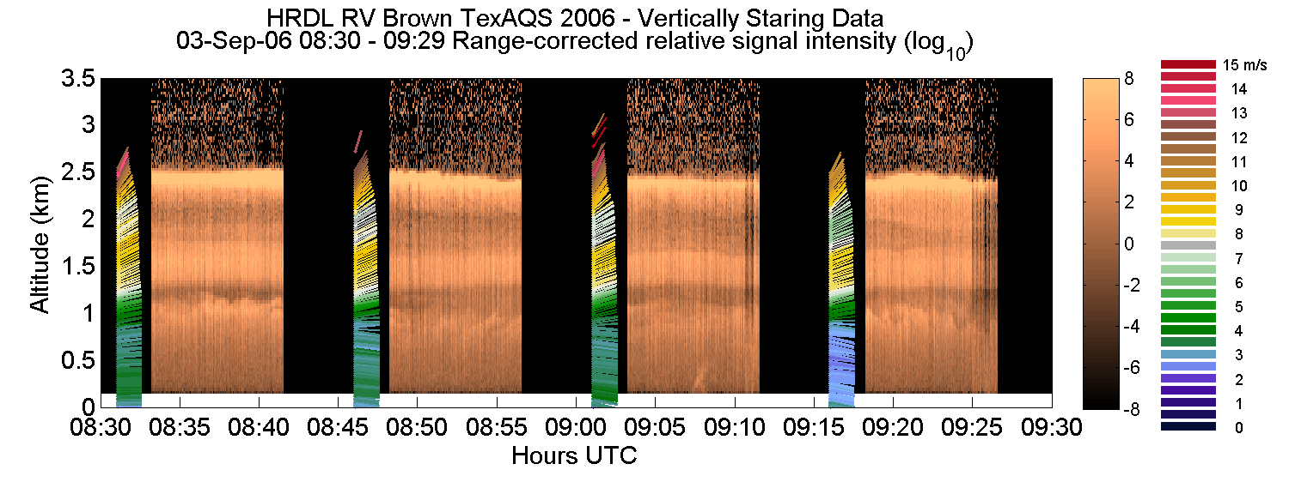
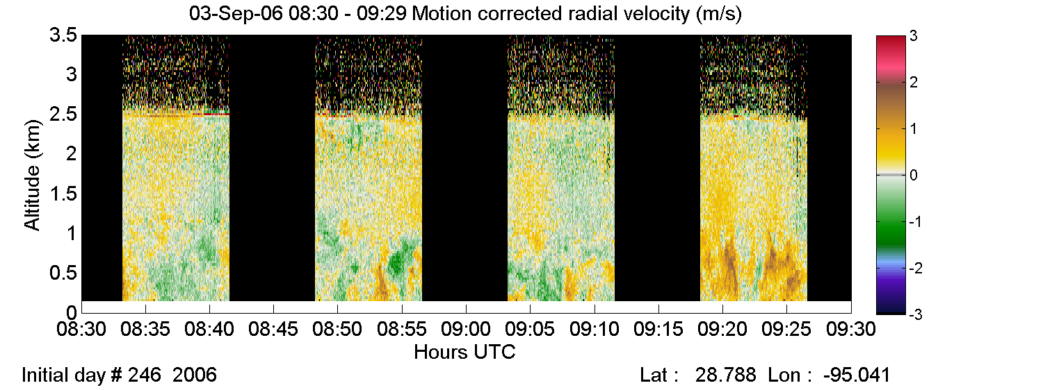
PBL Aerosol Winds & SNR

Slide 28
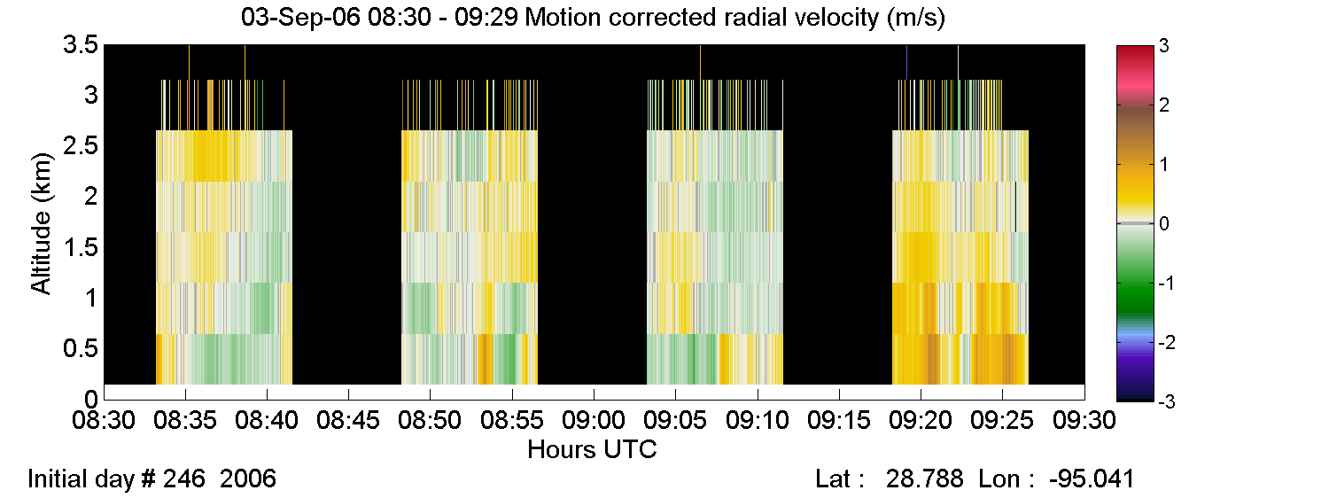
Vertical Resampling of wind fields

Slide 29
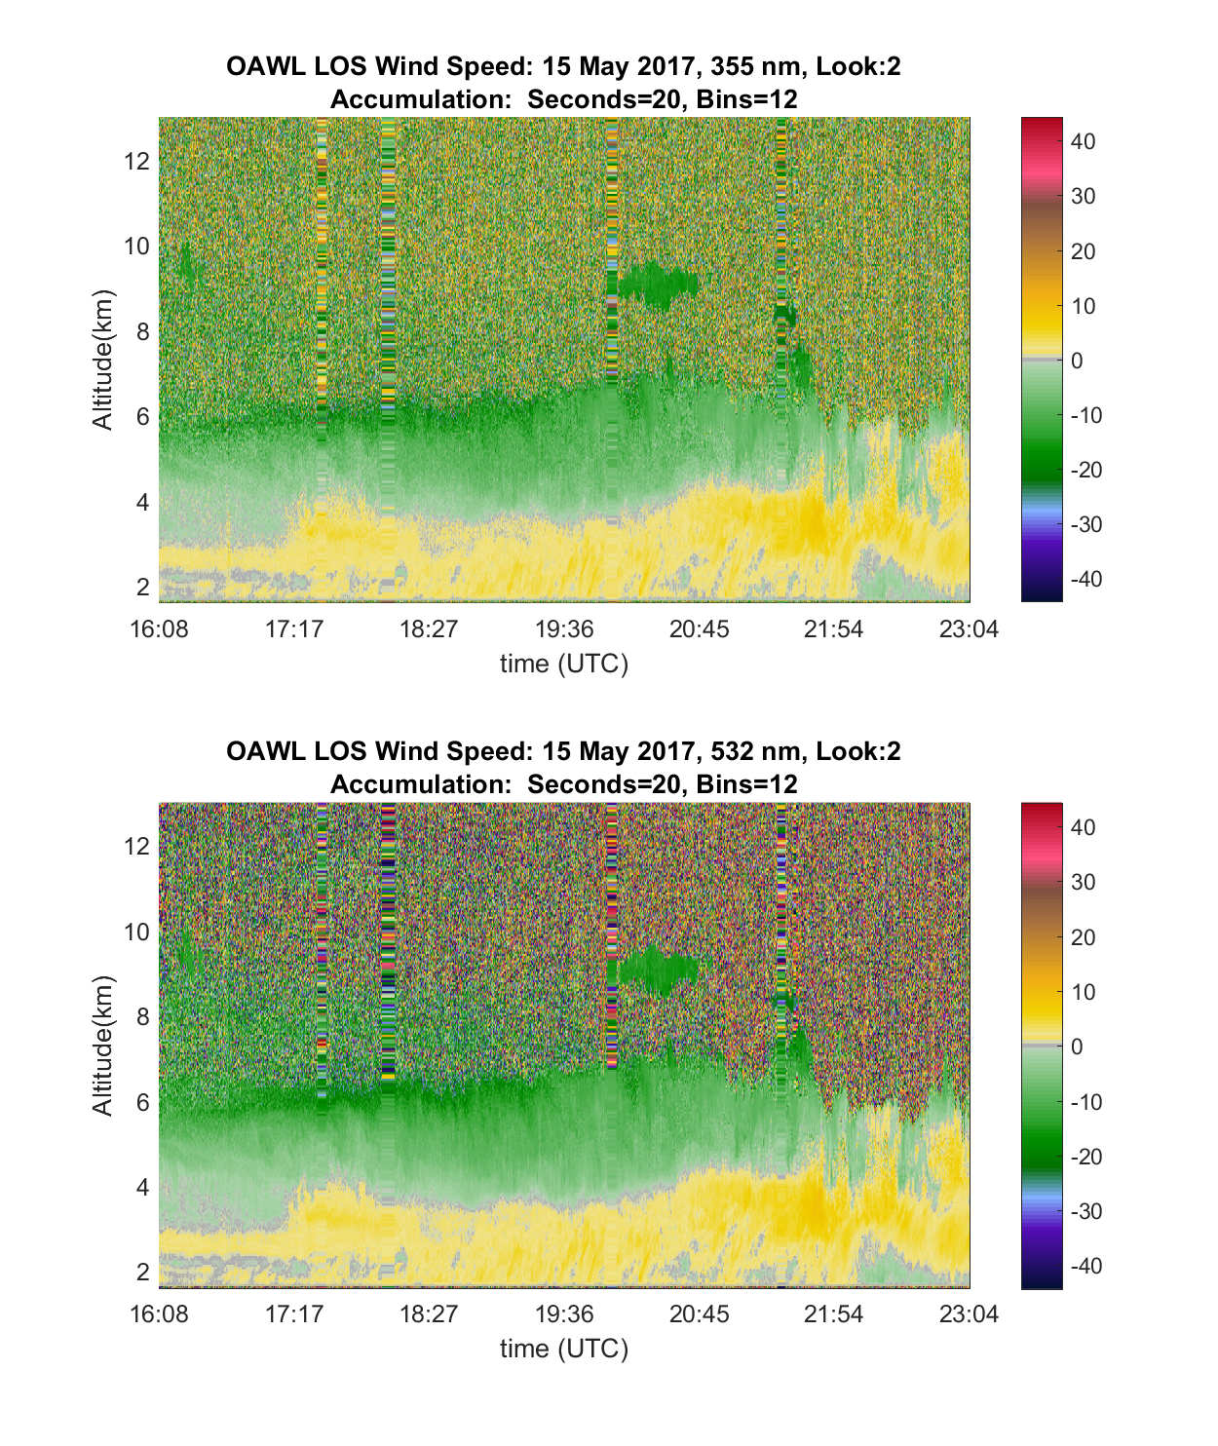
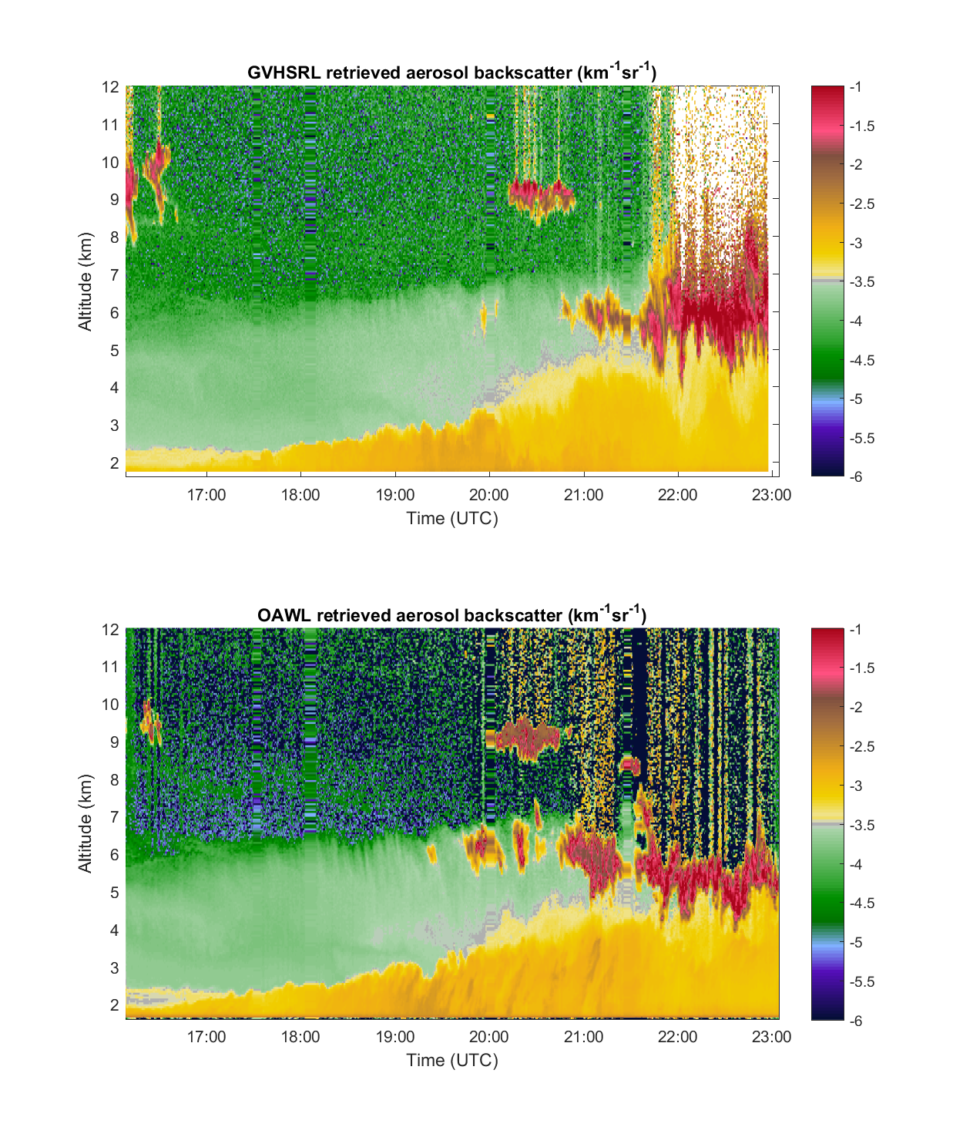
Winds & Aerosol Backscatter
OAWL LOS Winds (m/s): 355 nm
Aerosol winds @ 355 nm & 532 nm
Aerosol backscatter coefficients @ 355 & 532 nm
Other data products in development
  Cross-polarization channel for 2λ aerosol depolarization
  Aerosol extinction estimates
LOS Wind Speed – m⁻¹s⁻¹
OAWL LOS Winds (m/s): 532 nm
OAWL aerosol backscatter coefficient (km⁻¹sr⁻¹)
LOS Wind Speed – m⁻¹s⁻¹
Backscatter - km⁻¹sr⁻¹

Slide 30
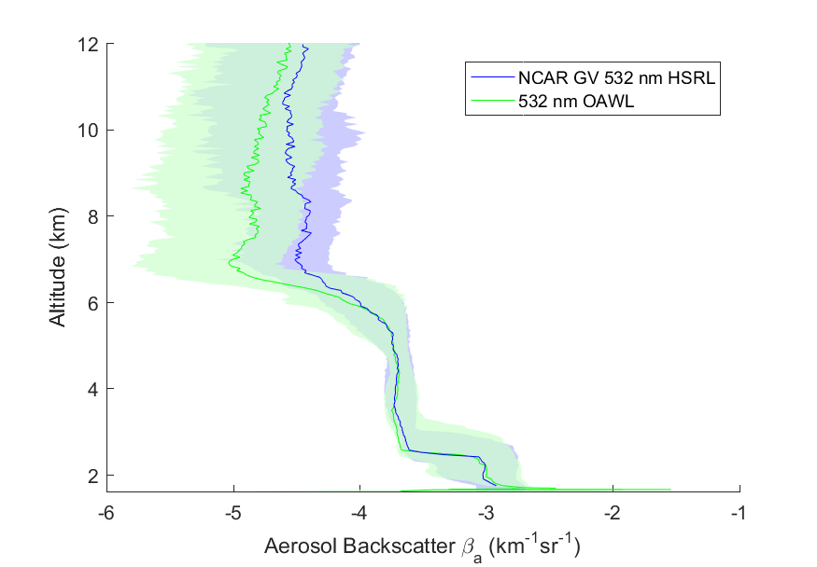

Preliminary: aerosol backscatter coefficient distributions
GV-HSRL aerosol backscatter coefficient (km⁻¹sr⁻¹)
NCAR data courtesy of
Matt Hayman and Scott Spuler
OAWL aerosol backscatter coefficient (km⁻¹sr⁻¹)
Backscatter - km⁻¹sr⁻¹
Log scale

Slide 31
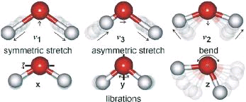
Basics: Atmospheric lidar return
Elastic scatter aerosol/cloud (“Mie”) returns: ~10-100 MHz FWHM (laser BW + turbulence in gate)
Doppler broadened molecular (Rayleigh-Brillouin) returns: ~1-3 GHz FWHM (based on wavelength, atmospheric temperature, pressure, and composition)
HSRL aims to quantify highly variable backscatter from aerosols vs. that from molecules → radiative transfer models
Doppler lidar measures Doppler-shifts/changes in frequency induced by the atmosphere moving at wind speed “V” along the lidar Line of sight
Where
  f_{o} is the outgoing laser pulse
  frequency = c/λ₀
  c is the speed of light
V_{wind}
V_{los}

Slide 32
Optical Autocovariance Wind Lidar (OAWL):
Field-Widened, Quadrature Mach Zehnder Interferometer (QMZI)
…Polarization multiplexing (QWP) provides four interference points
Like a two-port Michelson, but with static OPD and…
Field-widening via cat-eye design
0.9 m OPD
Detector B = 90°
PBS
QWP = π/2
Non-Polarizing beam-splitters
Detector A = 180°
PBS
Detector C = 0° (360°)
Detector D = 270°

Slide 33

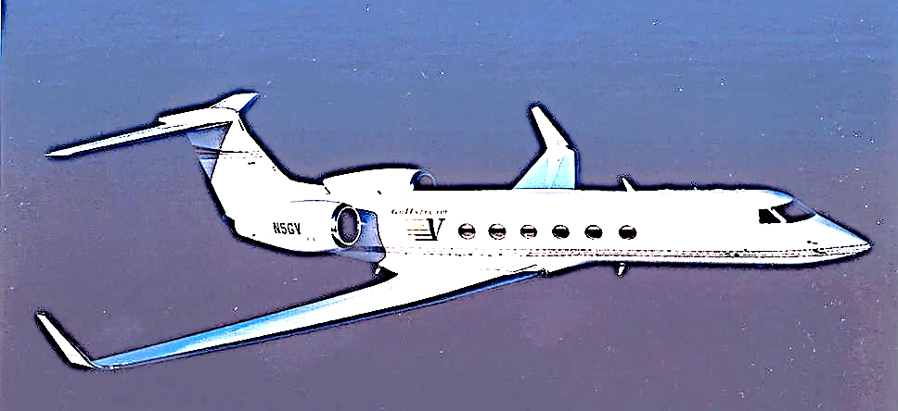
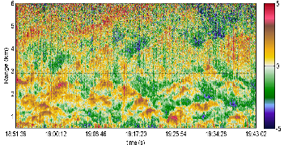
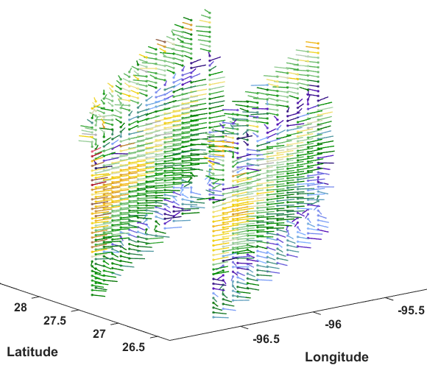
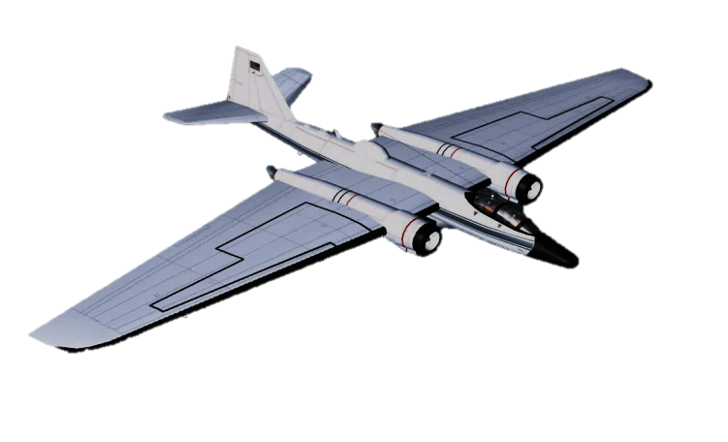
OAWL: Optical Autocovariance Wind Lidar for full 3D-Winds
Proposed EVI-4 ATHENA-OAWL ISS Mission (TMCO rated Selectable)
OA Laboratory
Prototype
Full tropospheric operational wind lidar
OAWL OSSE
ATHENA Venture Tech
OAWL
IDL
Operational Airborne mission development
On-orbit Operational Demonstration
OAWL IIP
HOAWL ACT
HAWC-OAWL
’09 | ’10 | ’11 | ’12 | ’13 | ’14 | ’15 | ’16 | ’17 | ’18 | ’19 | ’20 | ’21 | ’22 | ’23 | ’24 | ’25 | ’26 | ’27 | ’28 | ’29 | ‘30
Global 3D winds
Low-cost Operational Demonstration Flight build
Aeolus
Launch
Nested
OAWL
demo
NASA/Ball CALIPSO >12 Years on orbit!
Laser wavelength
532 nm
ESA’s ADM Aeolus (single look – 355 nm Aerosol & Molecular)
355 nm

Slide 34
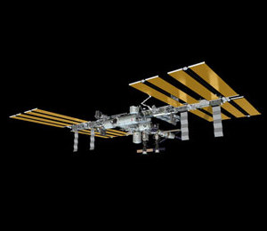
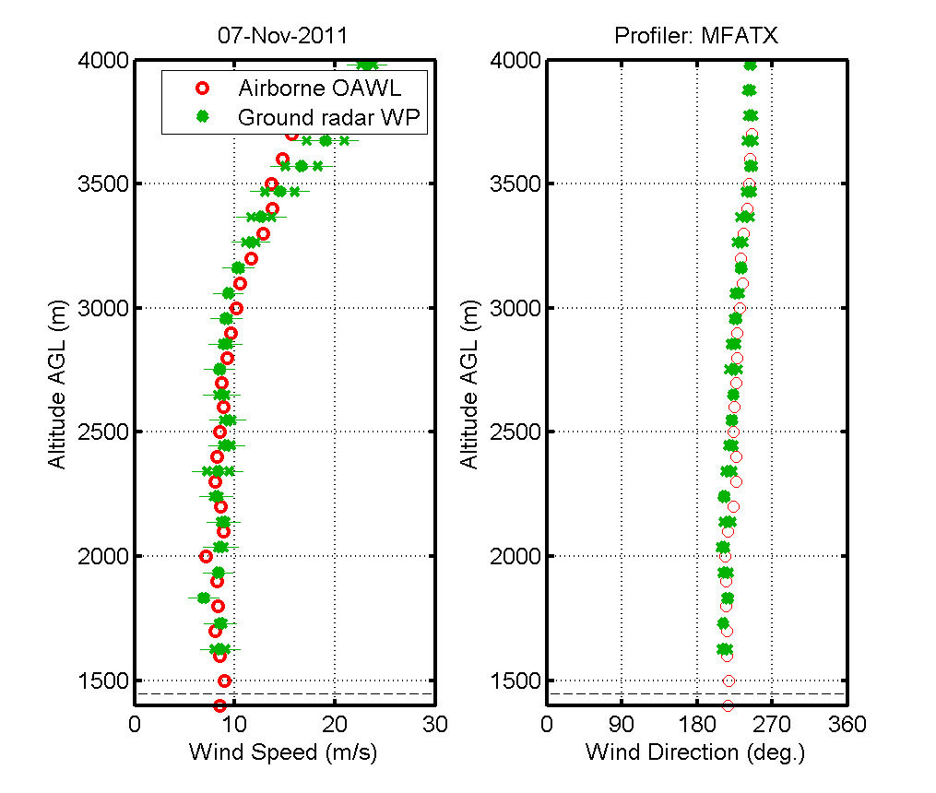

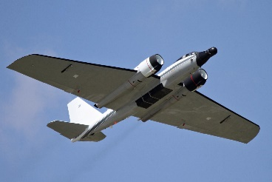
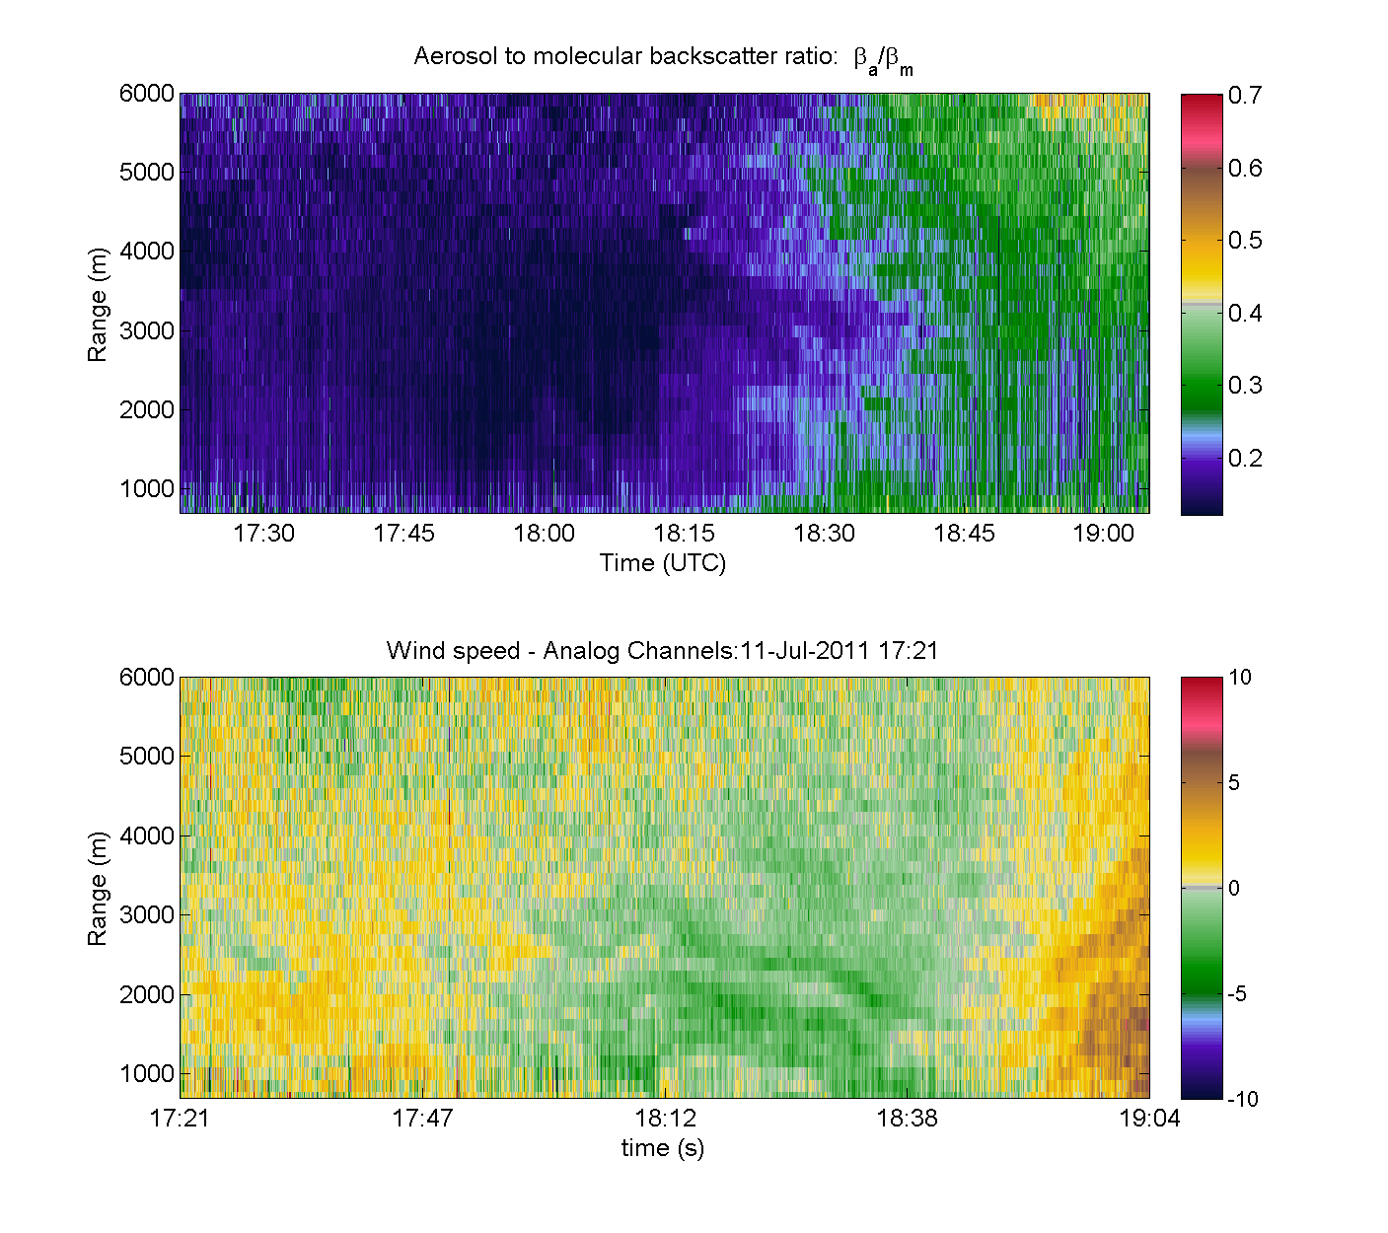
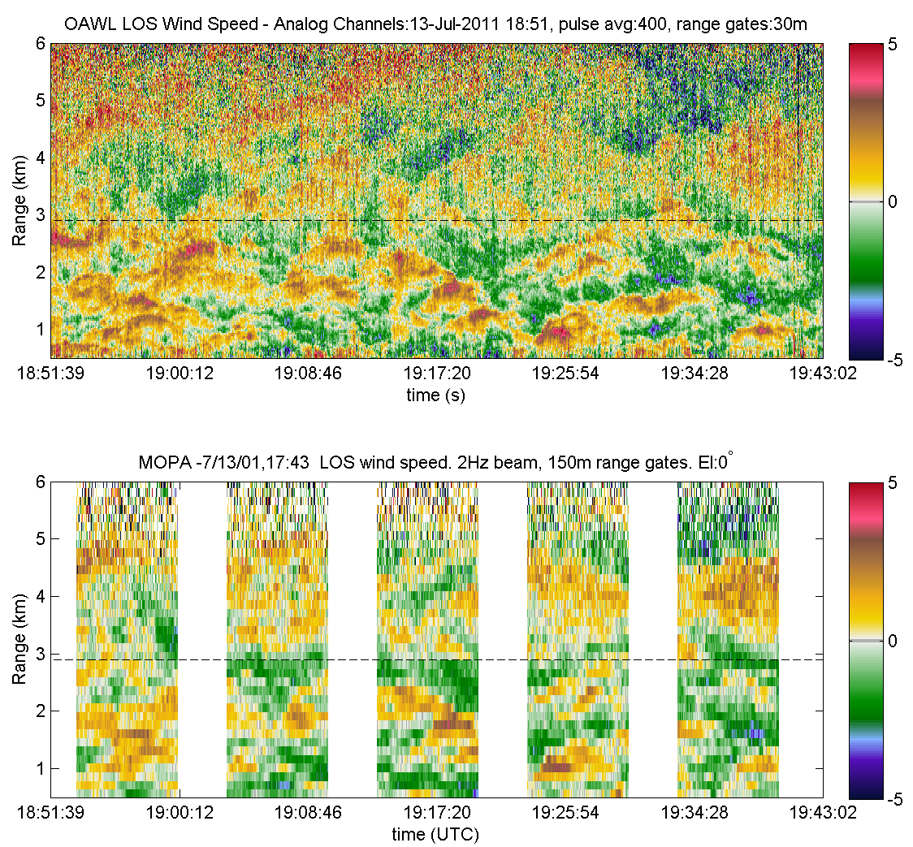
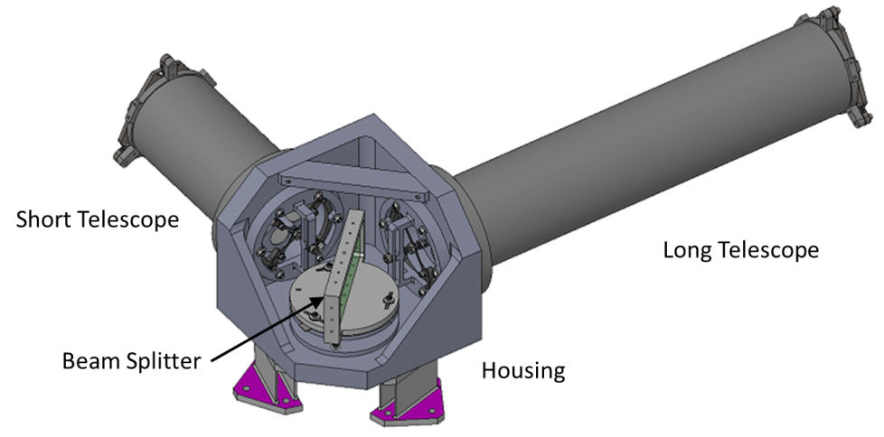
OAWL: Optical Autocovariance Wind (& Aerosol) Lidar
Since ~2003, Ball has worked in a public-private partnership with NASA and weather/wind lidar communities to advance space-based wind lidar technology and fill the global wind measurement gap.
1999-present: Ball designs, mission concepts, build and test of OAWL patented, field-widened, four-channel, Mach-Zehnder interferometer, mission concepts, and retrieval/processing algorithms
2013 & 2016 ATHENA-OAWL Mission Proposals
Altitude MSL (m)
Altitude MSL (m)
aerosols
winds
2008-2012: OAWL IIP-07
Breadboard system
355 nm only, 4x channels
Single look 12” telescope
Ground validation with NOAA Coherent system
Autonomous flights on NASA WB-57
2012-2015: HOAWL ACT
Breadboard System
Demonstrate 532 nm wavelength channels & depolarization channels
Initial HSRL Aerosol retrieval algorithms
2015-2017: ATHENA-OAWL Venture-Tech: GrOAWL
Airborne demonstrator System (WB-57)
2-lasers = 400 Hz eff. PRF
4x 532 nm channels
2 looks, 2 telescopes to demonstrate geometry for space-based operation
2014-2017: HAWC-OAWL IIP
Dual look, dual-wavelength winds + cross-polarization system
New Invar interferometer build
DC-8 hardware design/build
2018-2019: Ball IRAD
HSRL demonstrations
Nested-OAWL: Dual-wavelength aerosol & molecular winds
Full tropospheric profiling

