Slide 1
Doppler Lidar Wind Measurements Around Hurricane Maria and Hurricane Lane during NOAA Hurricane Reconnaissance Programs
S. A. Wood, G. D. Emmitt, S. Greco and L. Bucci
Simpson Weather Associates, Charlottesville, VA, USA
NOAA/University of Miami
Space Lidar Winds Meeting
July 10-11, 2019

Slide 2
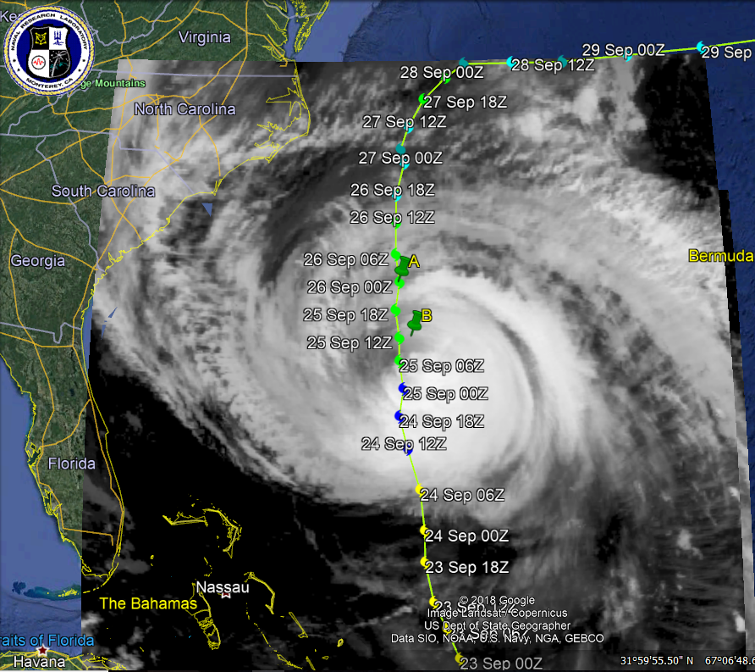
Although there are still issues such as cost, size and availability, after over thirty-five years of development, the Airborne Doppler Wind Lidar (ADWL) is now mature enough to be called operational.
Over the past fifteen years, Simpson Weather Associates (SWA) has participated in numerous ADWL missions and field campaigns that have allowed us to measure and investigate the 3-dimensional wind circulations of the lower troposphere and planetary boundary layer (PBL) and to compare with other observations (Profilers, dropsondes).
In 2017 and 2018, the ADWL was flown on the NOAA Hurricane Reconnaissance P3 aircraft making DWL wind profile measurements around Hurricane Maria and Hurricane Lane, respectively.
Introduction

Slide 3
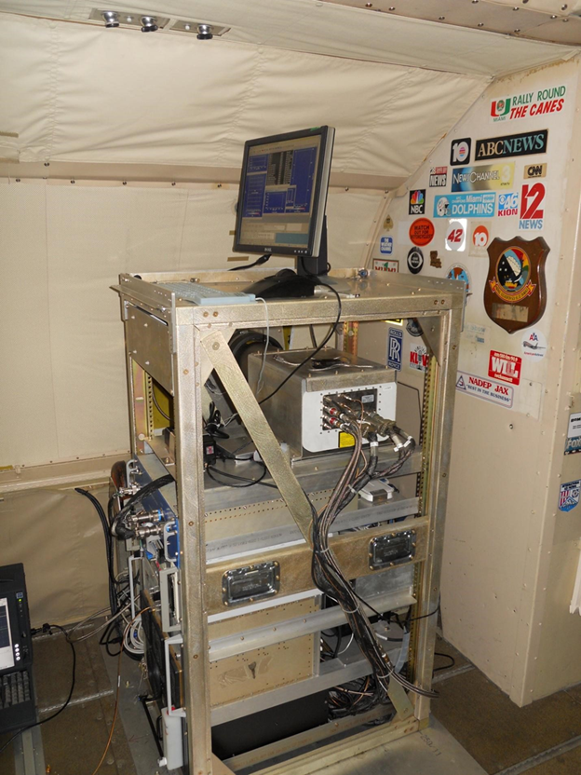
Airborne Doppler Lidar on the P3
The ADWL has successfully operated on a NOAA-P3 aircraft
to measure winds in the lower atmosphere environment and
near the center of hurricanes since 2015
1.6 μm coherent
CTI wind Tracer (LM)
Side mounted
10 cm bi-axis
scanner (NASA LaRC)

Slide 4
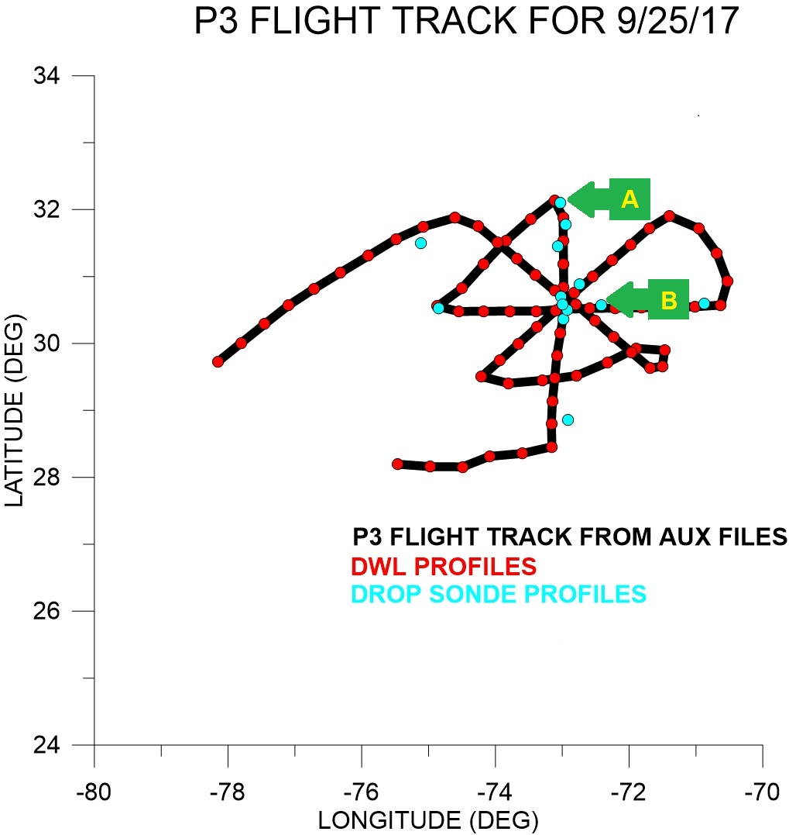
P3-DWL Hurricane Maria Investigation 9/17-25/17

Slide 5
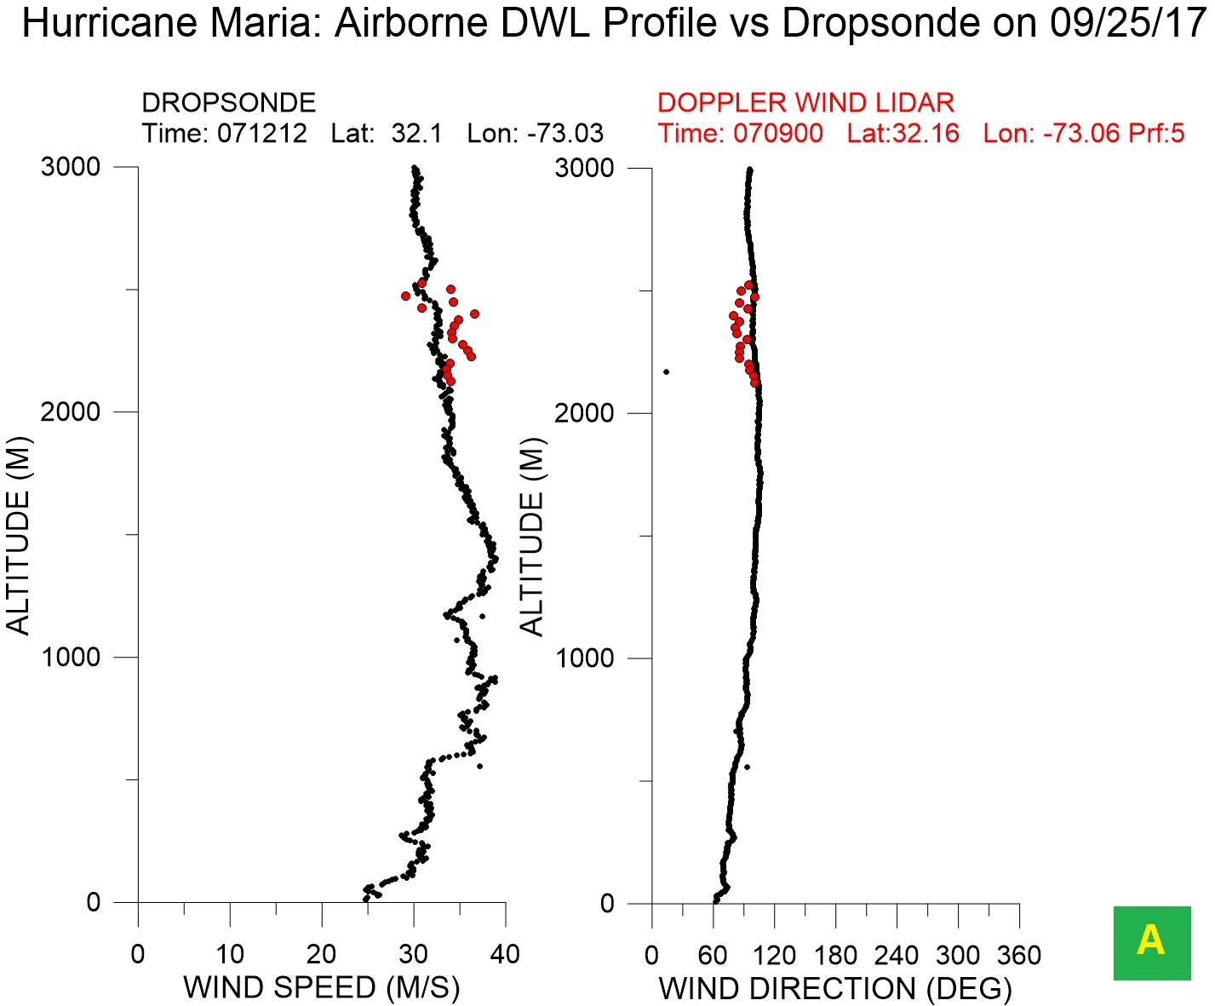
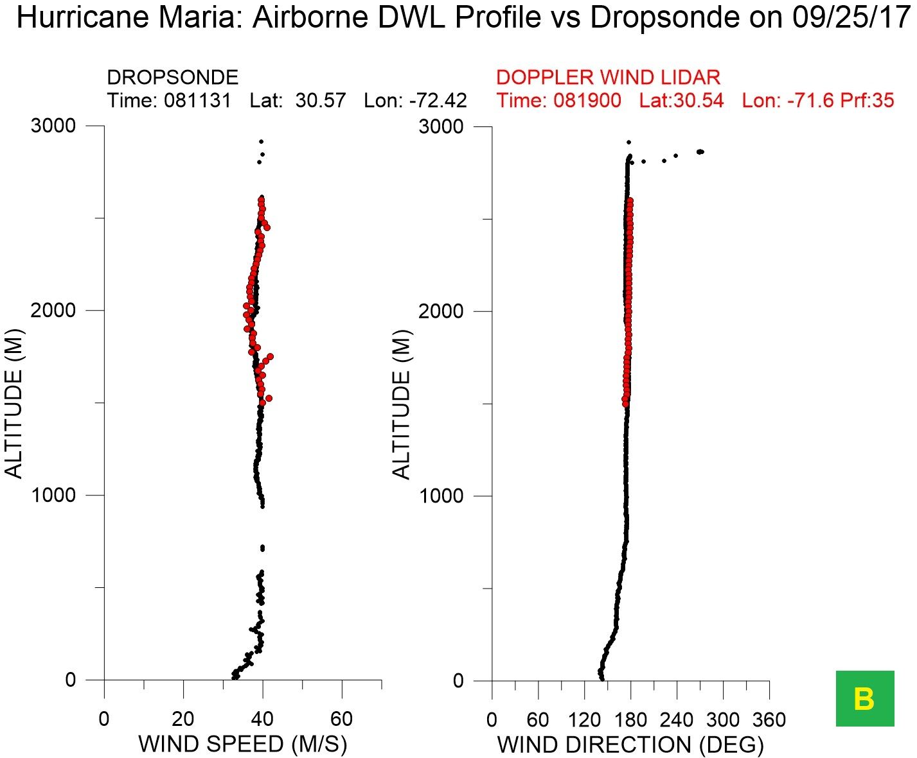

Slide 6
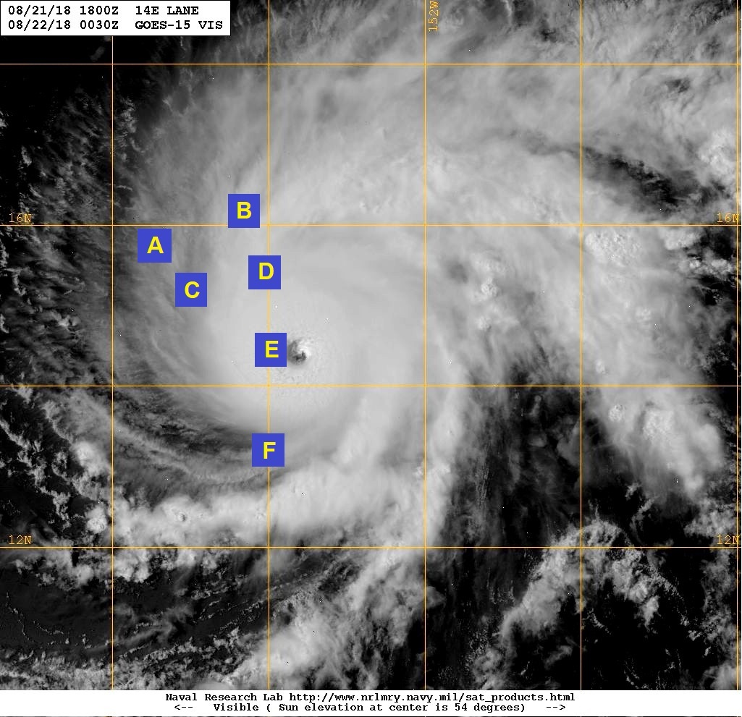
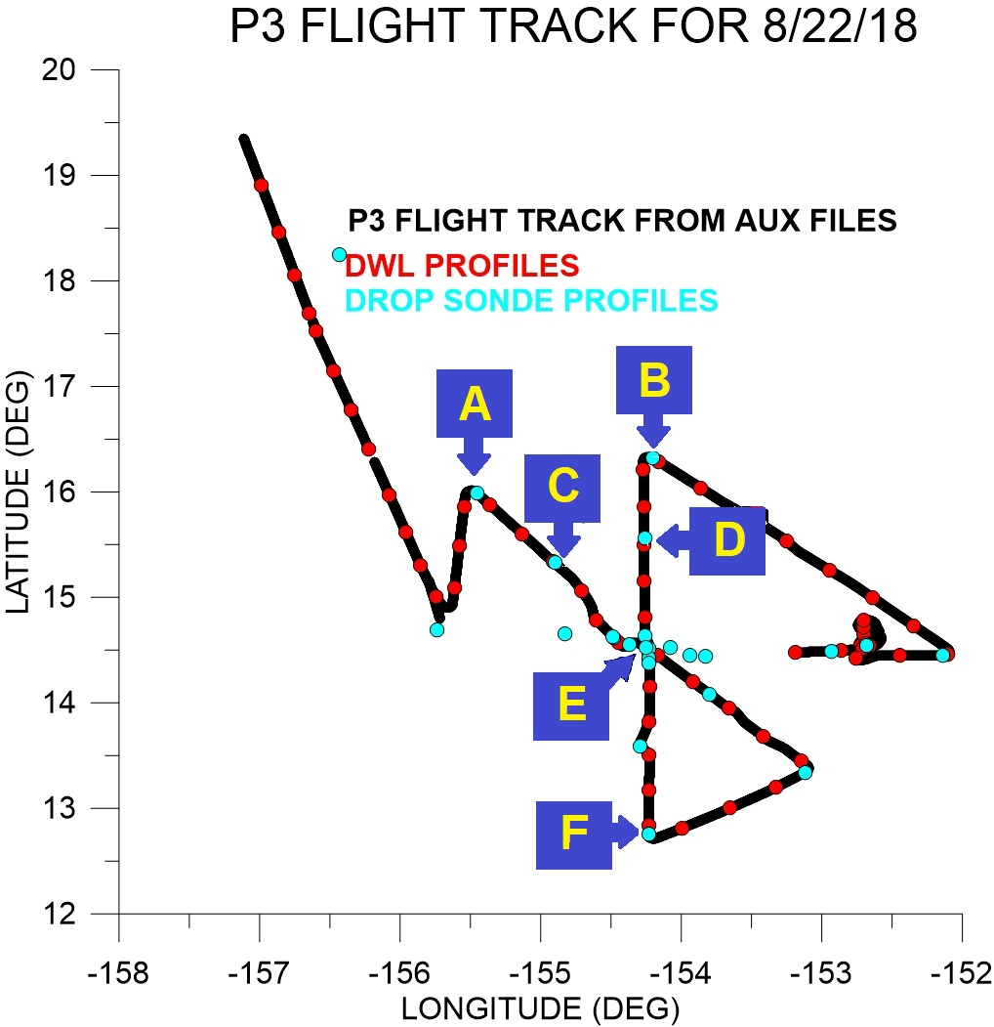
P3-DWL Hurricane Lane Investigation 8/19-22/2018

Slide 7
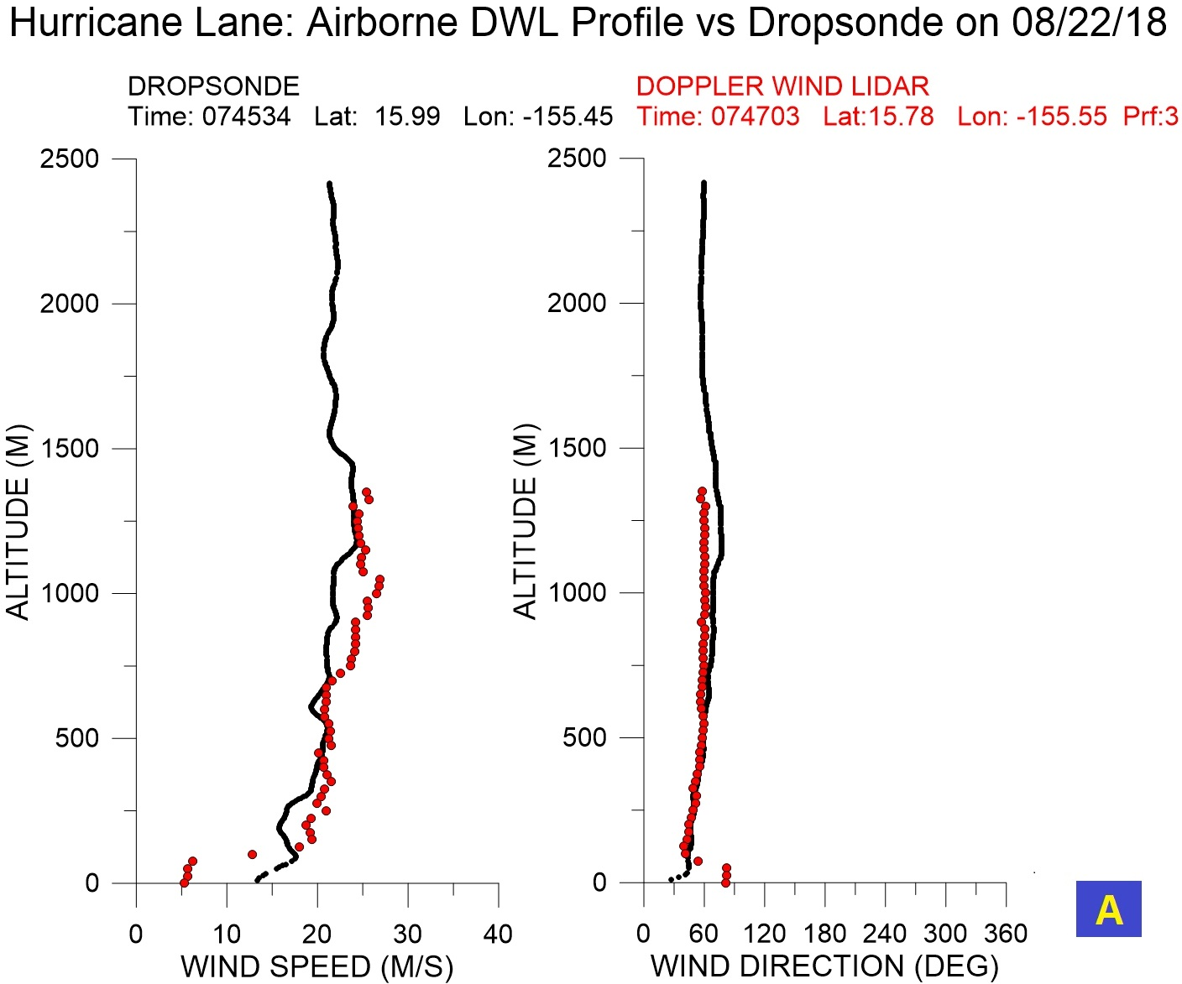
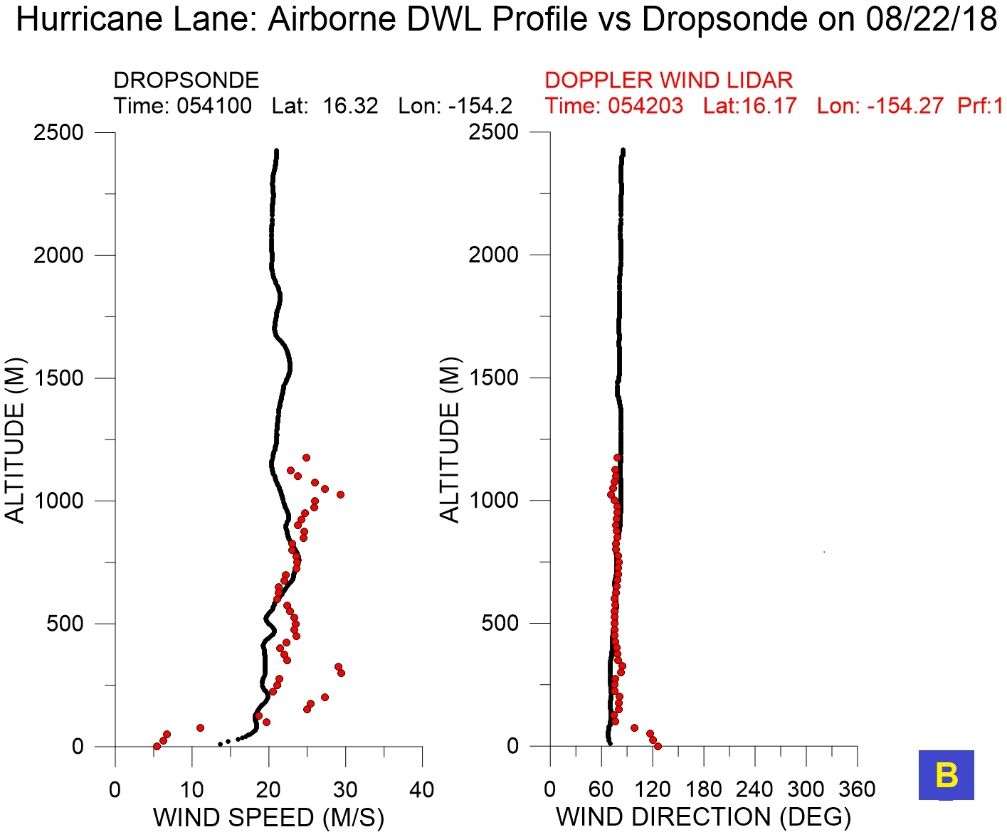

Slide 8
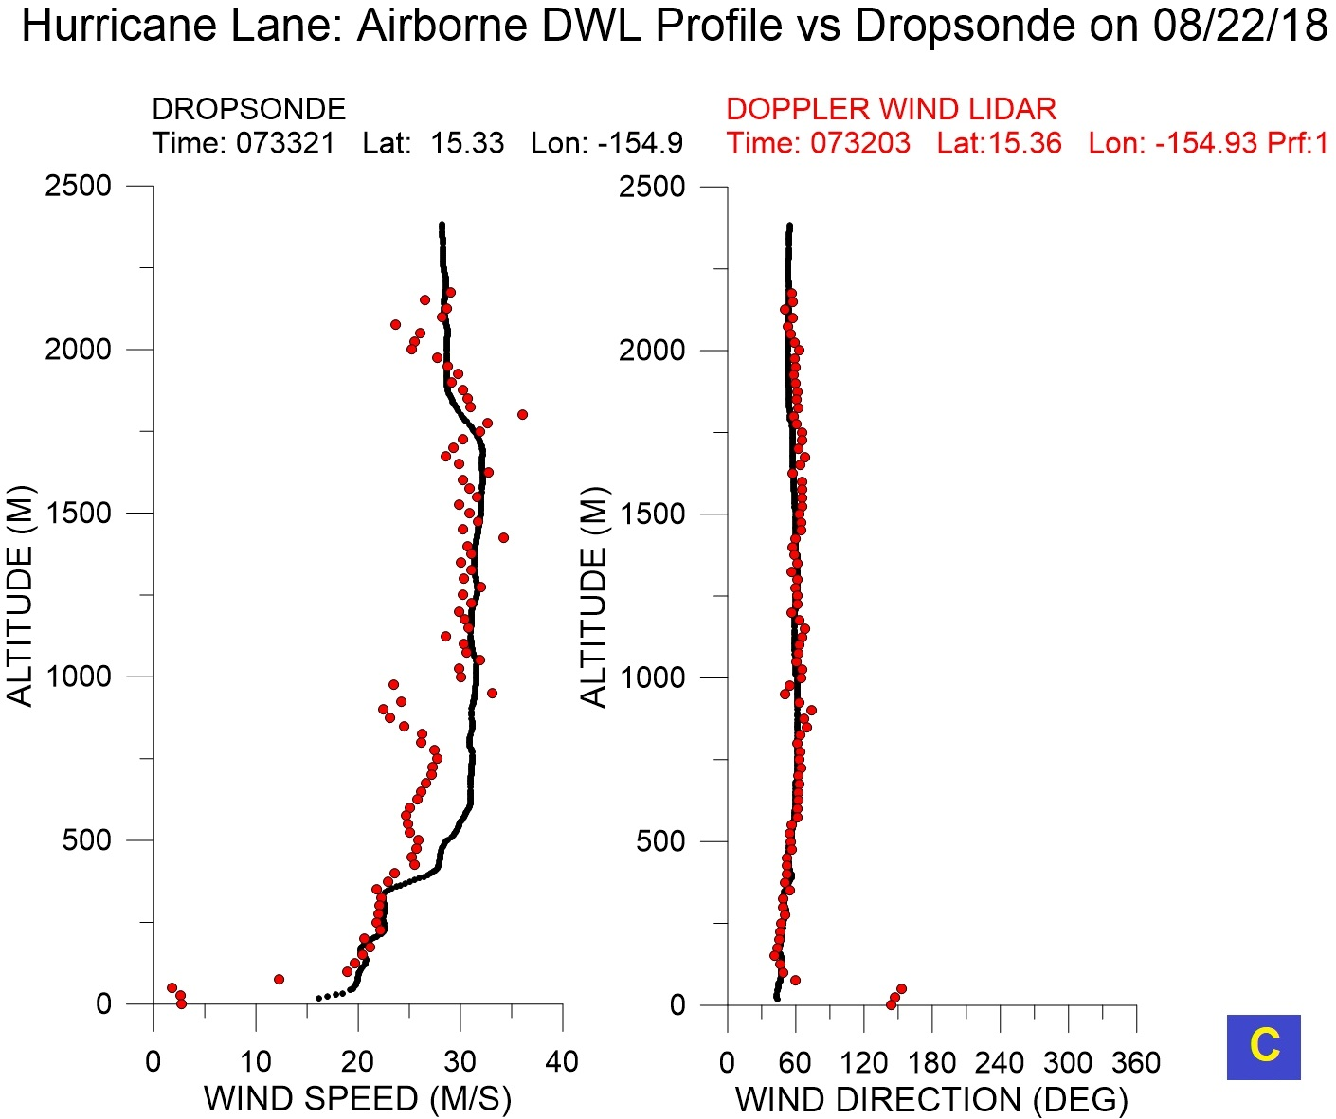
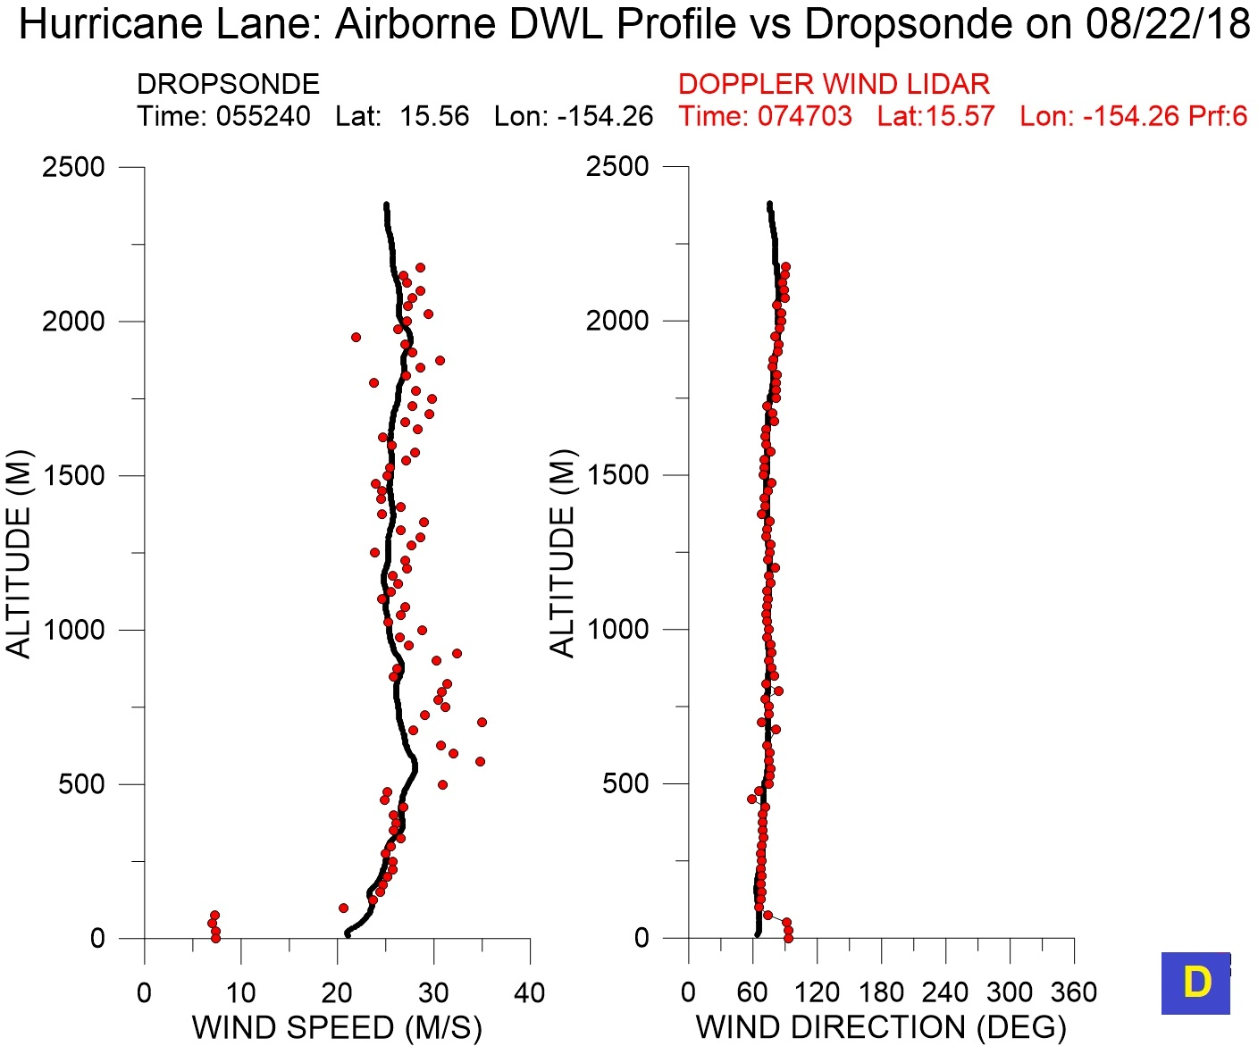

Slide 9
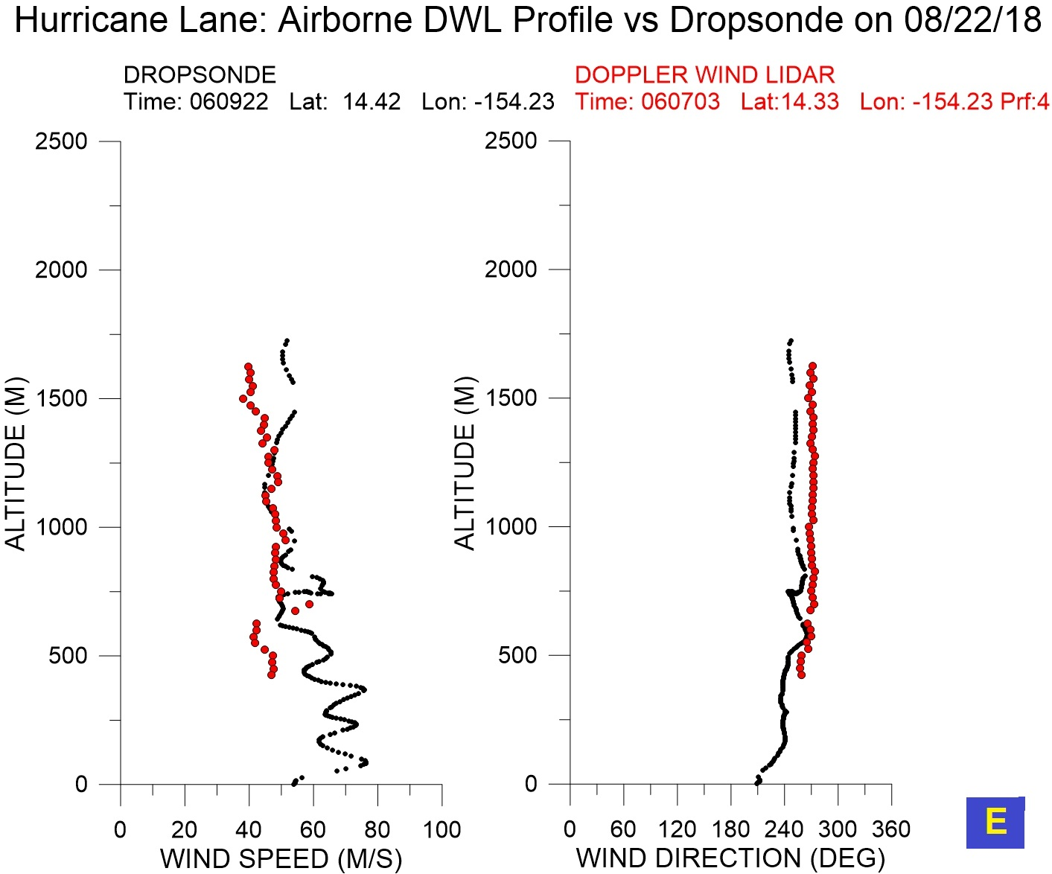
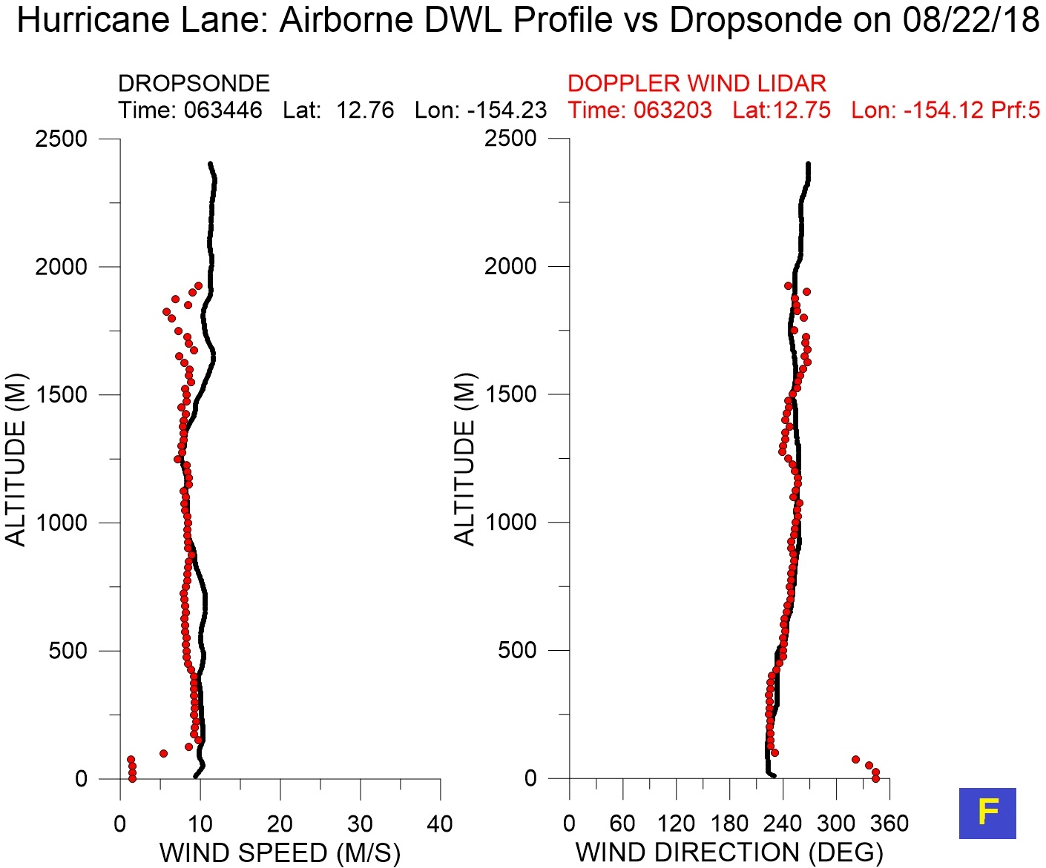

Slide 10
Summary
The ADWL successfully operates on a NOAA-P3 aircraft to measure winds in the lower atmosphere environment and near the center of hurricanes
Many of the wind profiles are complete PBL wind profiles
The processing of on-board real time ADWL data has been successful and wind profiles have been down linked to NOAA
Further processing of the ADWL data in the lower surface area region is intended
The intention is to put the ADWL onto the P3 for this hurricane season
Funded by the NOAA/University of Miami PO-0000143022 and Order AC94081

