Slide 1
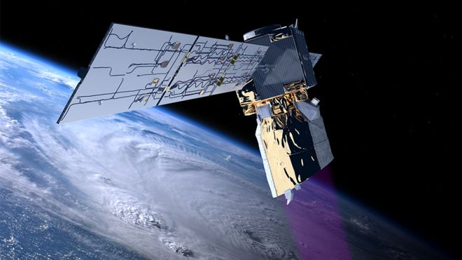
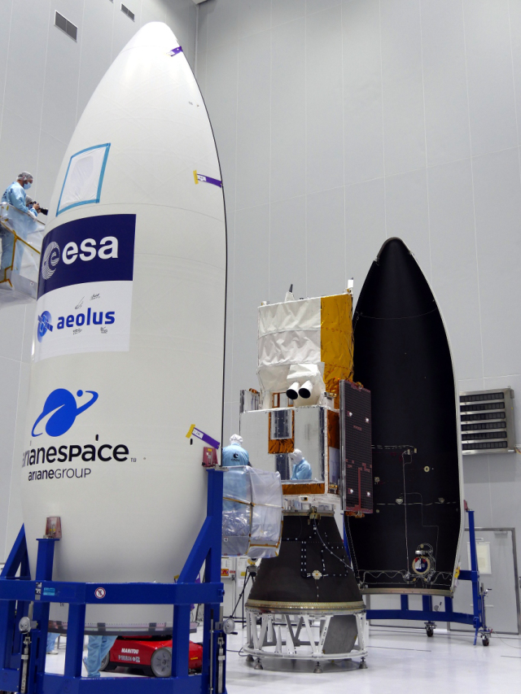
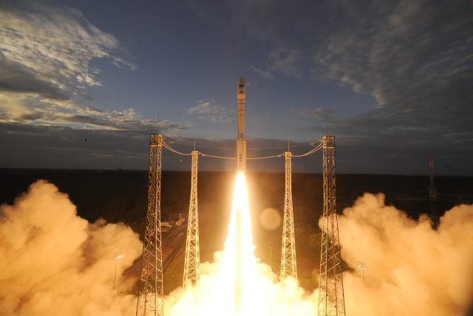
An assessment of Aeolus wind observations at ECMWF
Working Group Meeting for Space-Lidar Winds, 11 July 2019
By Michael Rennie, Lars Isaksen from ECMWF (part of Aeolus DISC)
Acknowledgements: ESA, KNMI, DLR, Météo-France, DoRIT

Slide 2
Topics
Model Validation of Aeolus:
What do Aeolus Level-2B winds look like?
Level-2B HLOS wind quality assessment
Aeolus impact:
Sept-Oct 2018 experiment
April-June 2019 experiment
Summary

Slide 3
1. ECMWF model validation of Aeolus Level-2B (L2B) HLOS winds Observation minus Background (short-range forecast) statistics

Slide 4
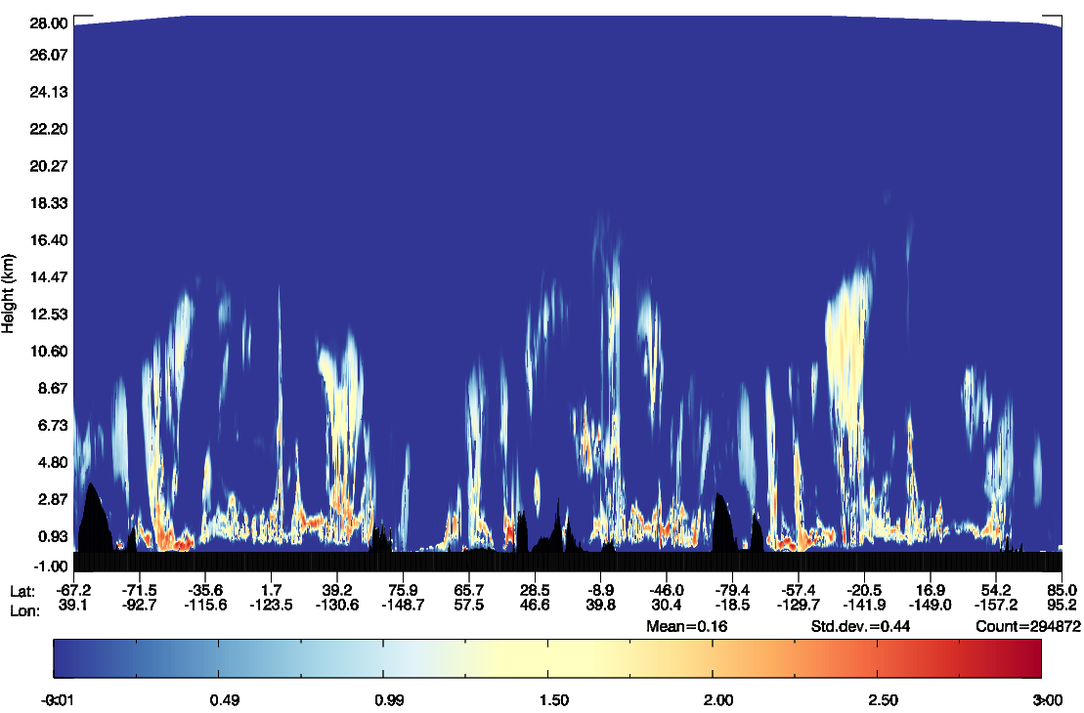
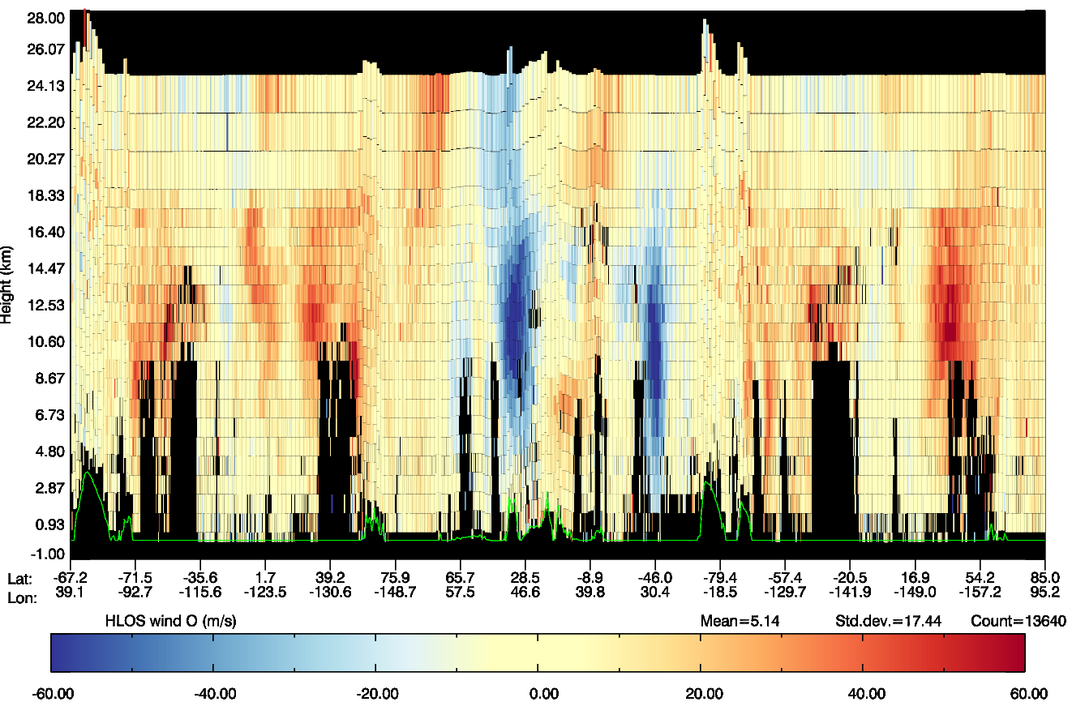
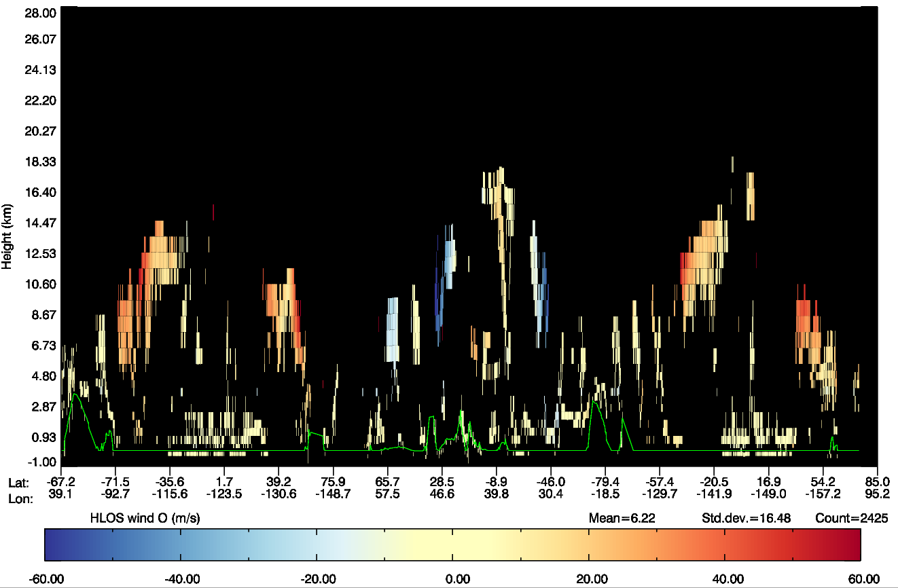
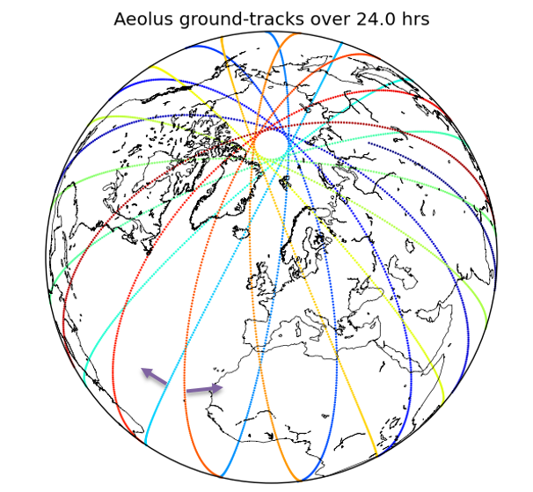
Rayleigh (clear-air) and Mie (cloudy-air) winds provide good vertical coverage
ECMWF model cloud
Mie-cloudy L2B HLOS winds – one orbit
Rayleigh-clear L2B HLOS winds – one orbit
1 day’s coverage

Slide 5
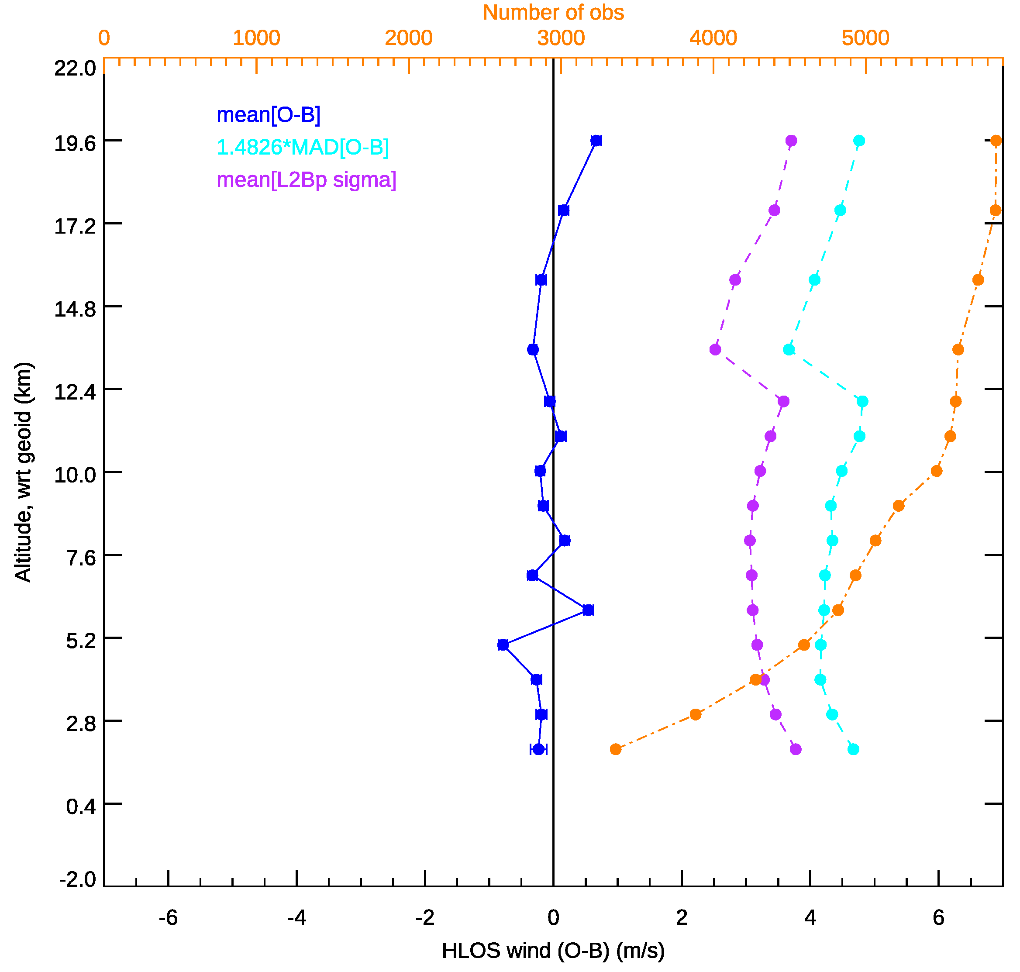
Global HLOS wind O-B statistics for L2B Rayleigh-clear from mid-September 2018 (~61 mJ/pulse)
Robust standard deviation (O-B)
Global average O-B:
Robust st. dev. = 4.3 m/s
Mean i.e. bias = 0.1 m/s
Estimated observation random error from departures $\sqrt{σ_{O−B}^{2}−σ_{B−t}^{2}}$ is ~4 m/s
Assuming $σ_{B−t}=1.6 m/s$
mean(O-B)
Obs count
L2B processor estimated error:$σ_{Oest}$

Slide 6
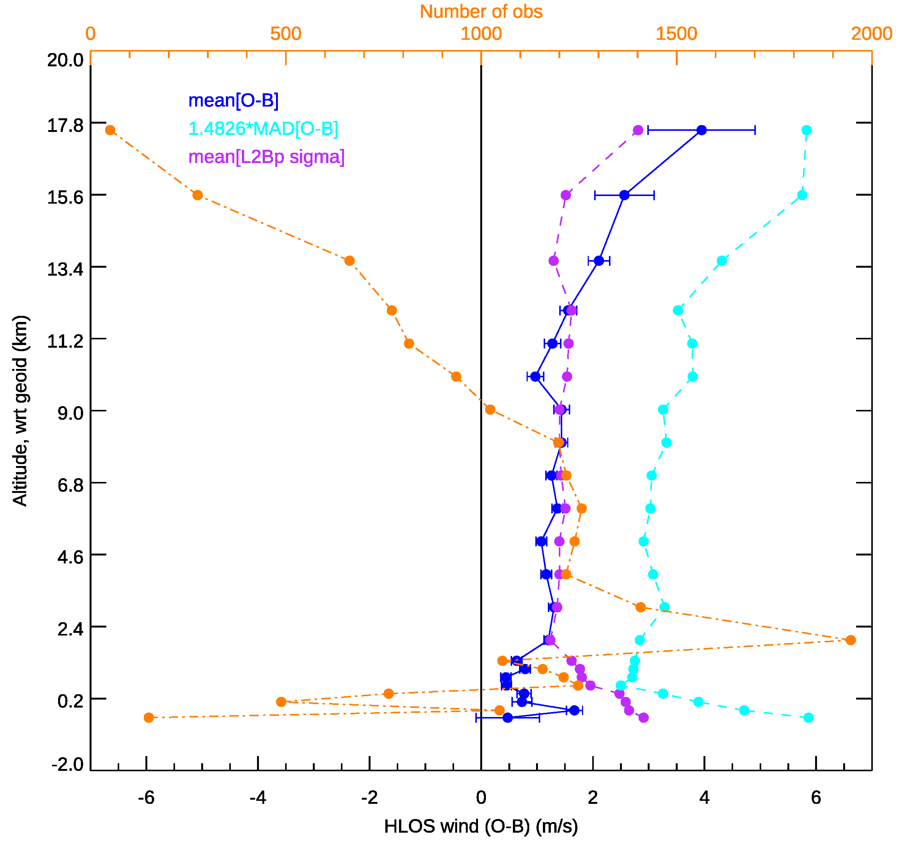
Global HLOS O-B statistics for L2B Mie-cloudy from mid-September 2018
Global average O-B:
Robust st. dev. = 2.9 m/s
Mean i.e. bias = 1 m/s
Estimated observation random error from departures $\sqrt{σ_{O−B}^{2}−σ_{B−t}^{2}}$ is ~2.4 m/s
Assuming $σ_{B−t}=1.6 m/s$
N.B. This was ~90 km averaged data

Slide 7
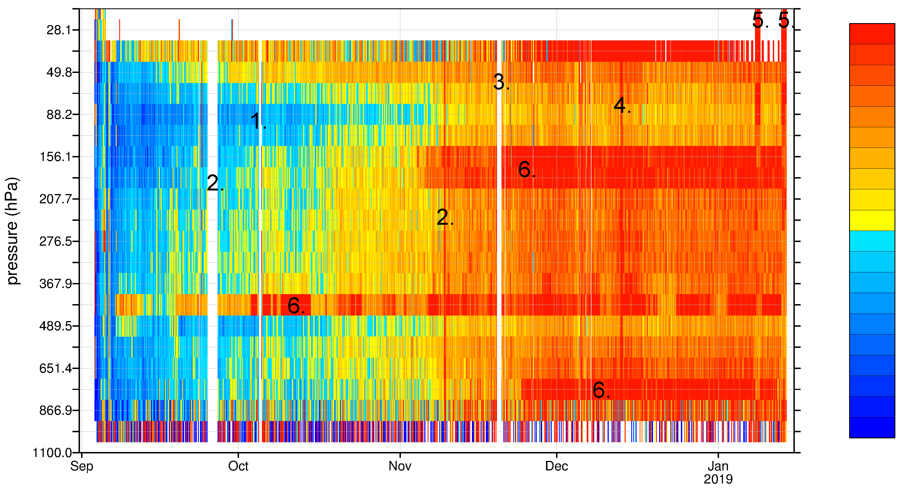
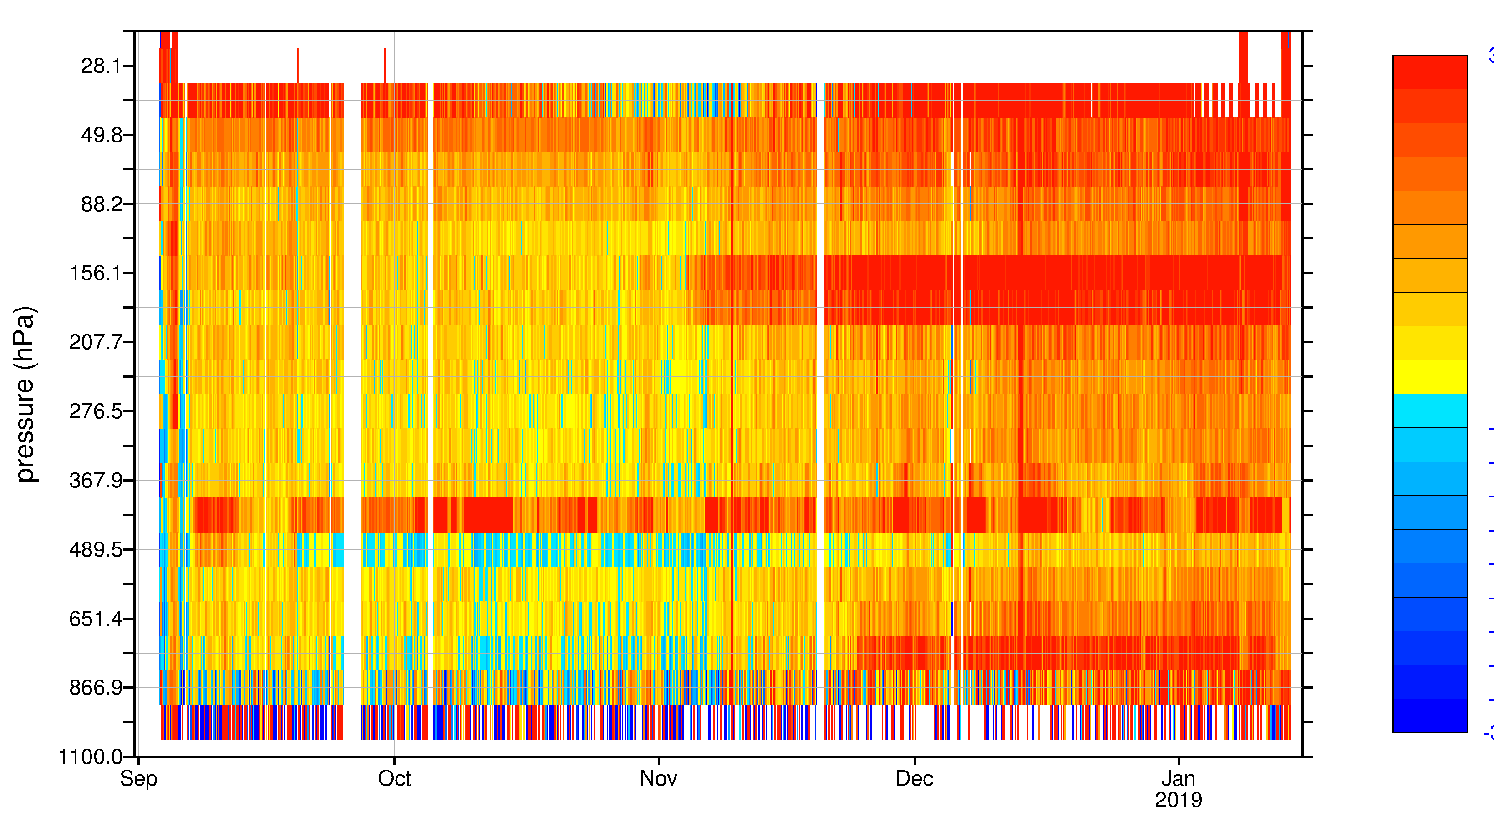
Time-series of Rayleigh-clear HLOS wind bias (mean(O-B)) during Commissioning Phase
2.7 m/s
General bias behaviour:
Increasing with time
Bias on certain pressure ranges, due to “hot” pixels which fluctuates with time
Difference between ascending and descending orbit phase, particularly in September 2018
Ascending orbit phase
-2.7 m/s
m/s
2.7 m/s
Descending orbit phase
-2.7 m/s

Slide 8
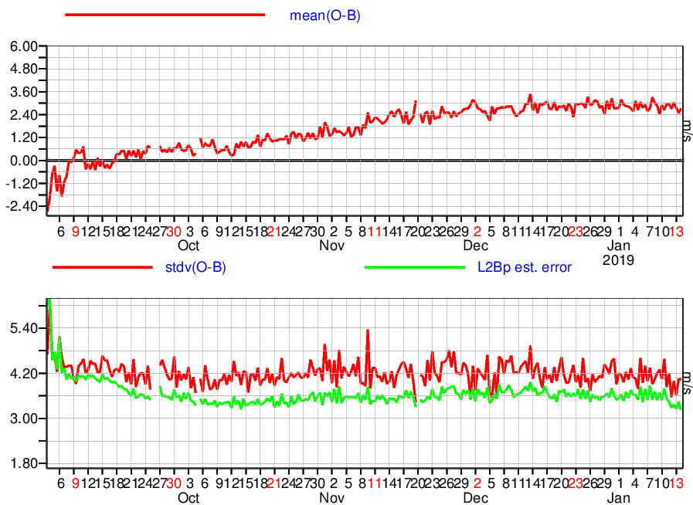
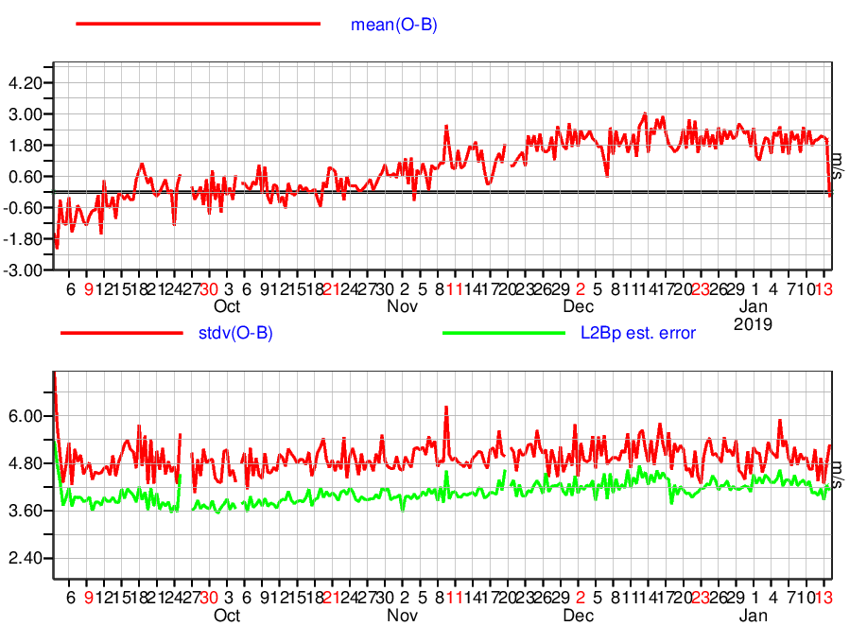
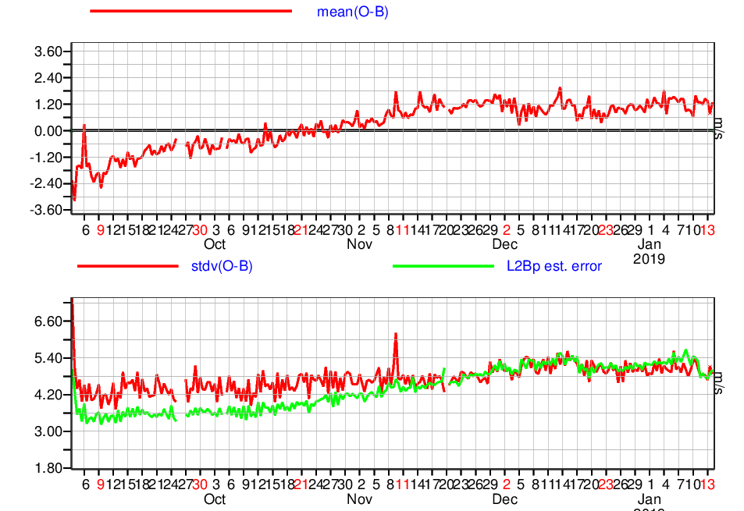
L2B Rayleigh-clear O-B stats for a mid-tropospheric pressure range, ascending, during Commissioning Phase
top row = bias, bottom row = random error
NH extratropics
Tropics
SH extratropics
Observation bias:
Positive trend; more positive in NH
Observation random error:
Higher latitude observations affected by seasonal variations in solar background noise
Tropics shows evidence of increasing noise via laser energy decrease (~0.6 m/s over 4 months)
Notes:
Calibrated global bias to the ECMWF model around 14th September
319-368 hPa

Slide 9
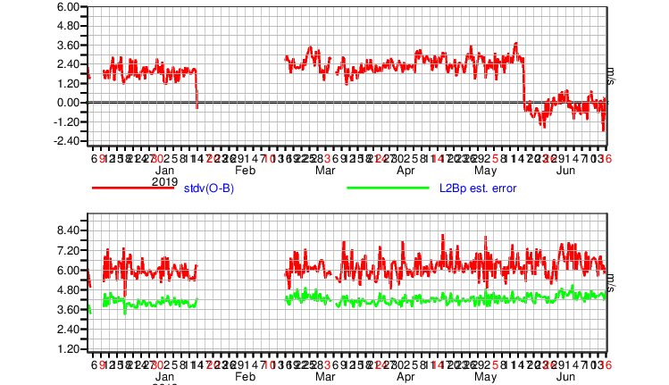
More recent (Jan-June 2019) FM-A O-B statistics; Rayleigh-clear, mid-troposphere, tropics
Period without data
New calibration file applied in operations
mean(O-B) (m/s)
Stdev(O-B)
L2Bp estimated error
(m/s)
Random error increase with time, but not that bad

Slide 10
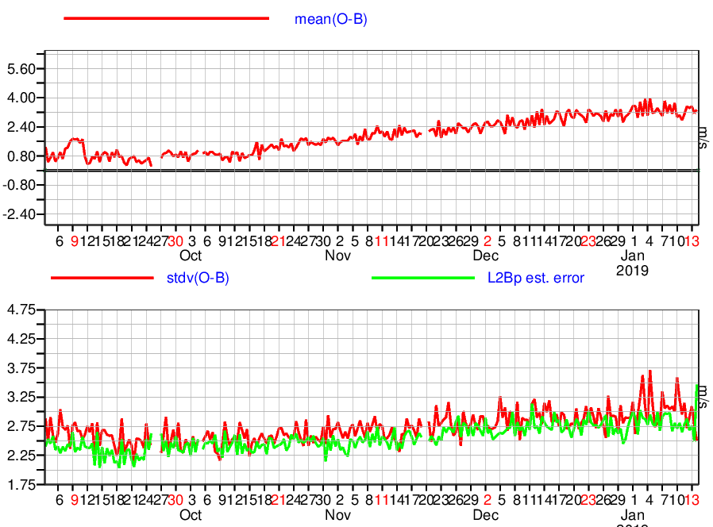
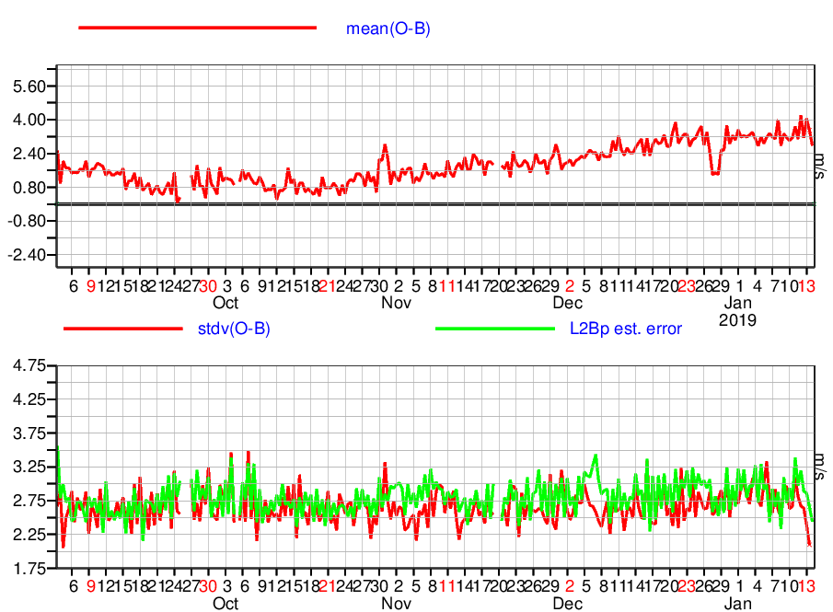
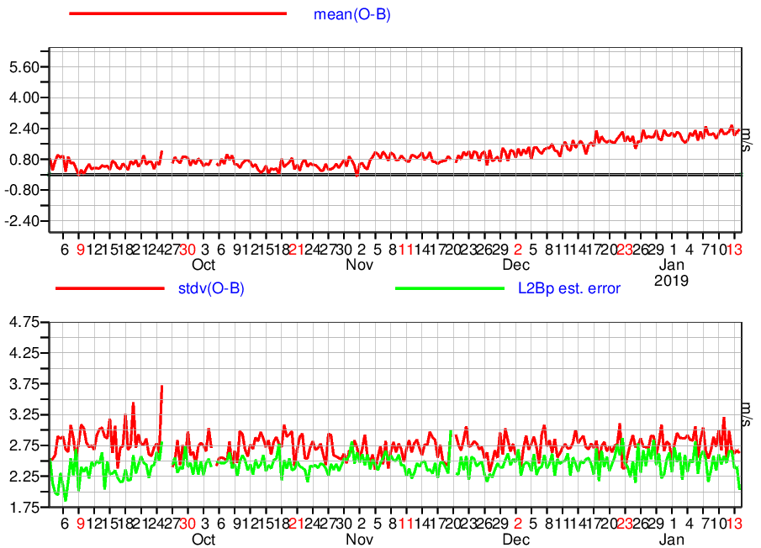
L2B Mie-cloudy O-B stats for a lower tropospheric pressure range, descending, during Commissioning Phase
top row = bias, bottom row = random error
NH extratropics
Tropics
SH extratropics
Observation bias:
Positive trend: more positive in NH
Observation random error:
Fairly steady in SH and tropics, increases in NH (not sure why)
Notes:
Calibrated global bias to the ECMWF model around 14th September. 752-867 hPa

Slide 11
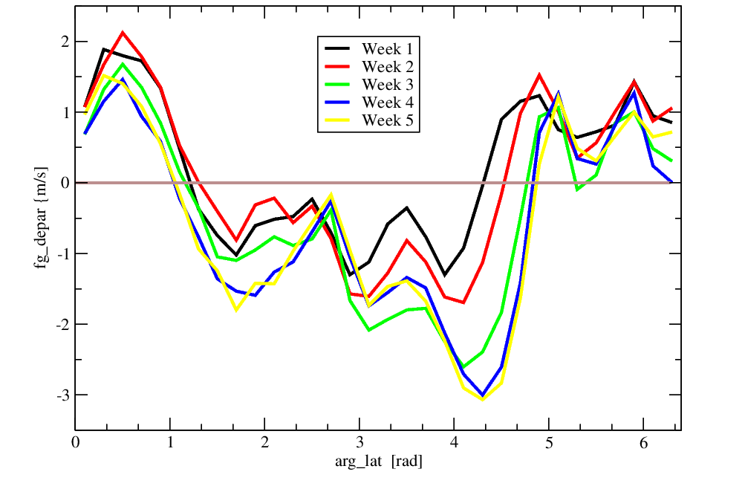
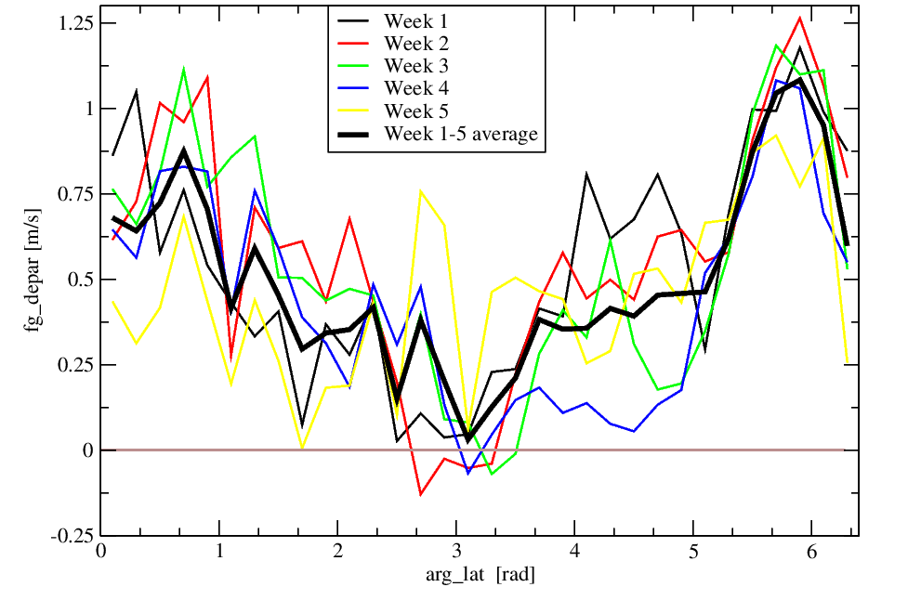
However, global stats disguise that biases vary with orbit phase angle e.g. April 2019
Rayleigh-clear biases at North Pole changed a lot during the month of April 2019
Mie-cloudy bias variable – range much smaller. Perhaps model biases/sampling issues?
NH bias development
Bias small at S. P.
Where RRC took place?
S. P.
EQ
N. P.
EQ
ascending
ascending

Slide 12
Summary of Aeolus L2B HLOS wind bias types
Range-bin specific biases that change with time:
Due to increased dark current rates on ALADIN detector pixels (“hot” pixels)
A correction has been applied in operations since 14 June 2019 – seems to be working very well
Trends in constant offset and wind speed dependent biases:
Settlement of ALADIN during early mission; hence the applied “constant” calibration became obsolete
Can be removed by using regular (weekly?) response calibrations i.e. reprocessing should solve this
Orbit phase angle dependent biases:
Still not fully understood
Larger for Rayleigh than Mie
Correlated with telescope temperatures for Rayleigh (varying with Earth albedo)
Partly due to imperfect satellite LOS velocity correction
Using ground returns as a zero-wind reference should improve this

Slide 13
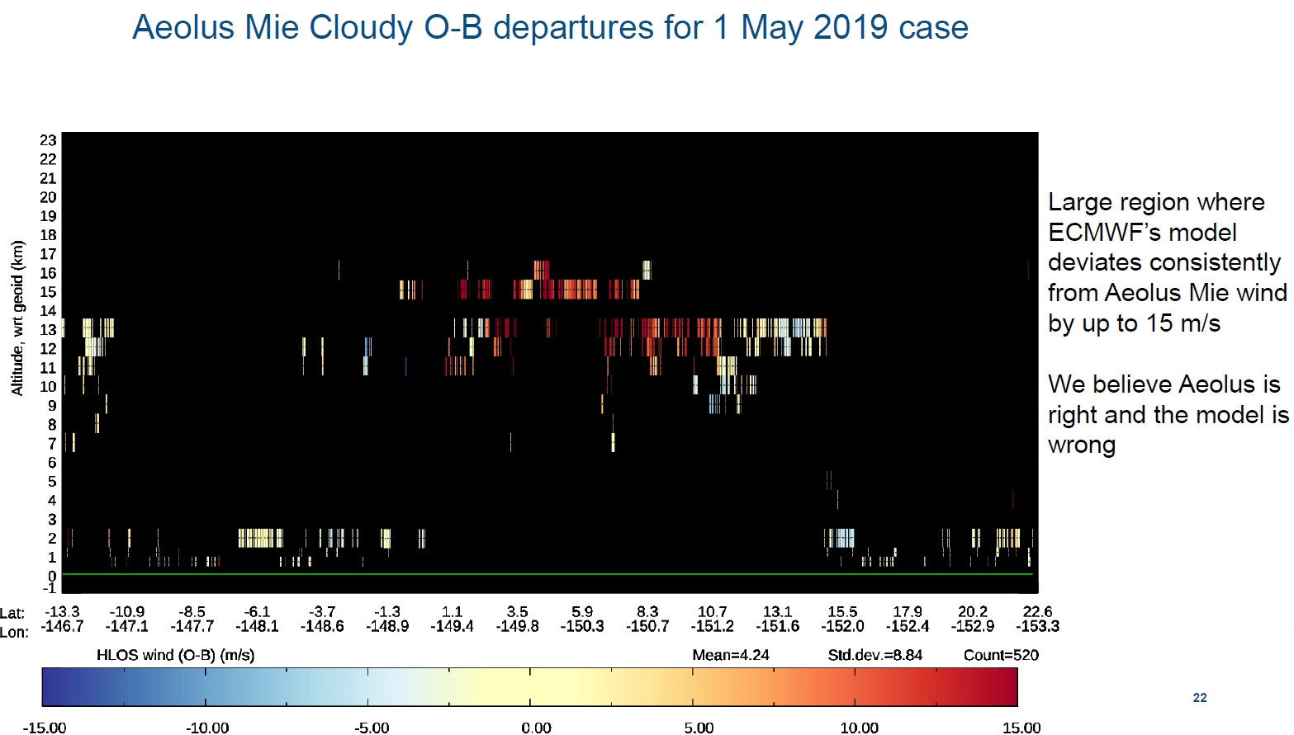
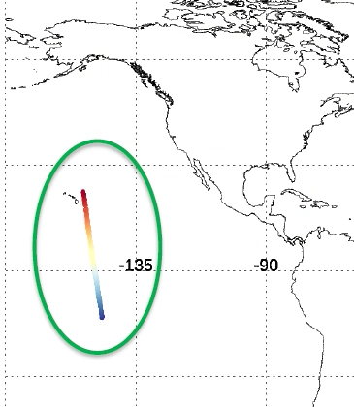
Occasionally, can see large wind errors in ECMWF model!
In this case convection seemed to be too strong (affecting jet)

Slide 14
Move from FM-A to FM-B laser
Moved to spare laser (FM-B) on 24th June 2019
Last FM-A wind data on 16th June
First FM-B wind data on 28th June
Initial FM-B verification will be presented on following slides

Slide 15
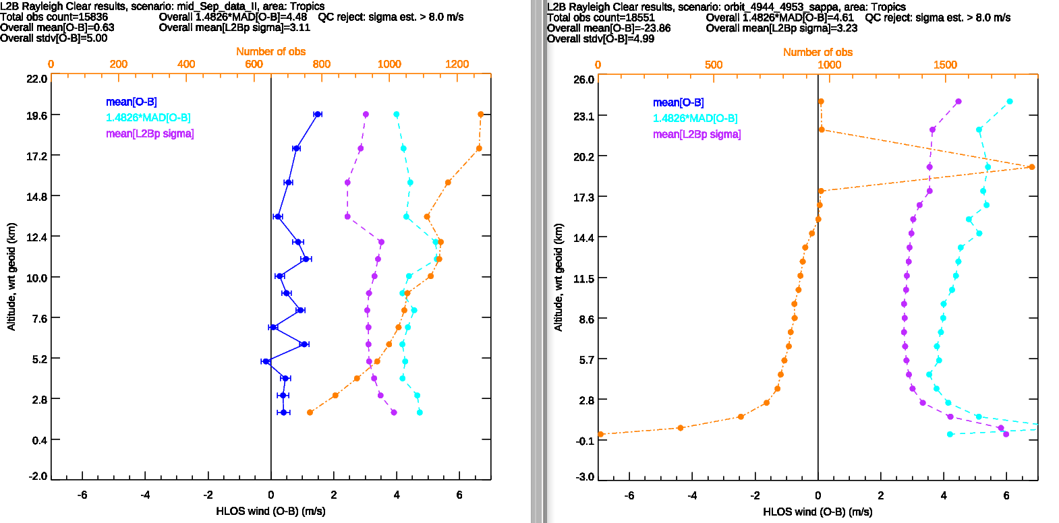
L2B Rayleigh-clear O-B stats in tropics (to reduce solar background noise effect)
FM-A data from 15 September 2018 ~61 mJ reported
FM-B orbits 4944-4953 (30th June - 1st July 2019)
~67 mJ reported
Bias is -23 m/s, therefore off the scale!
Need FM-B calibration file
Both have
1 km range-bins
~3 m/s
~2.75 m/s
FM-B signal levels and hence random errors look very promising

Slide 16
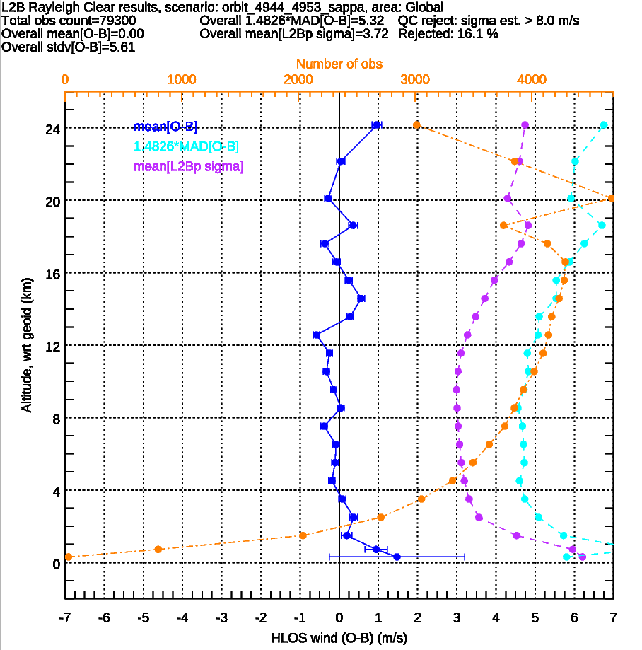
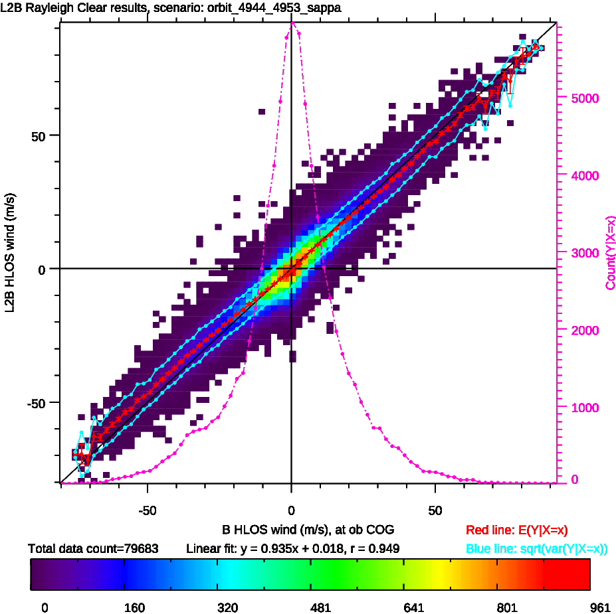
Bias correct L2B Rayleigh-clear results for FM-B (global):
If bias correct by +25.5 m/s, then can see the bias is reasonably consistent with altitude
Suggests the “hot” pixel correction is working well
Wind-speed dependent bias exists (slope 0.94): new calibration needed

Slide 17
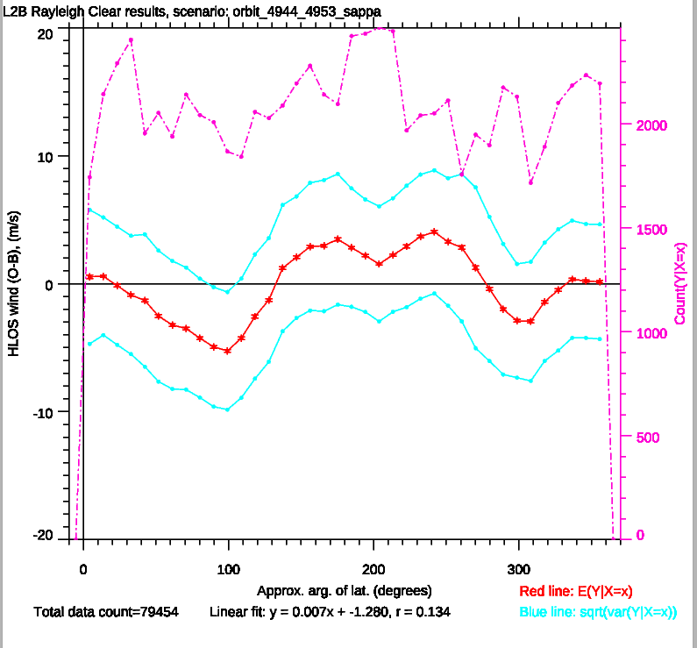
FM-B, bias corrected Rayleigh:
Rayleigh has large orbit phase dependent biases
Seems larger than FM-A
To be investigated
N. Pole
S. Pole

Slide 18
Time-series: L2B Rayleigh-clear, mid-tropospheric pressure range ~340 hPa, ascending orbits
top row = bias, bottom row = random error
S. Hemi.
Tropics
N. Hemi.
FM-B
FM-A
FM-B
FM-A
FM-B
FM-A
-25 m/s bias
4.2 m/s
5.4 m/s
3.6 m/s
3.6 m/s
2.7 m/s
3.0 m/s
33% improvement in random error in summer hemisphere

Slide 19
L2B Mie-cloudy O-B stats for FM-B:
Random errors estimates ~2 m/s
St. dev. (O-B) ~3.5 m/s
N.B. 10 km averaged winds
Bias is small (applying FM-B’s first Mie calibration)

Slide 20
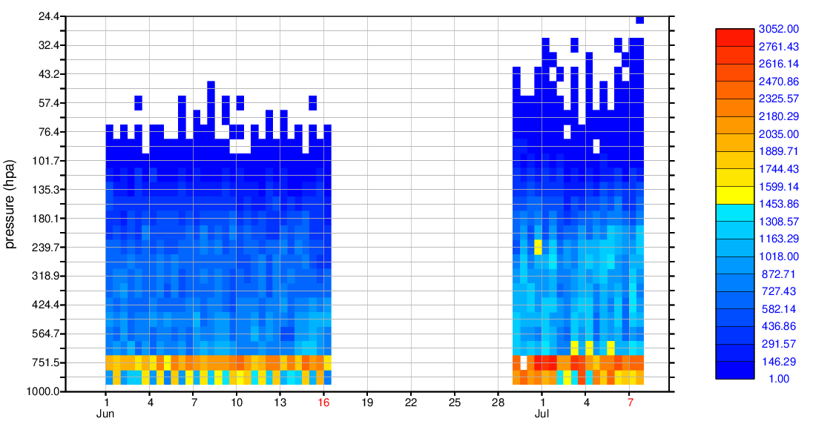
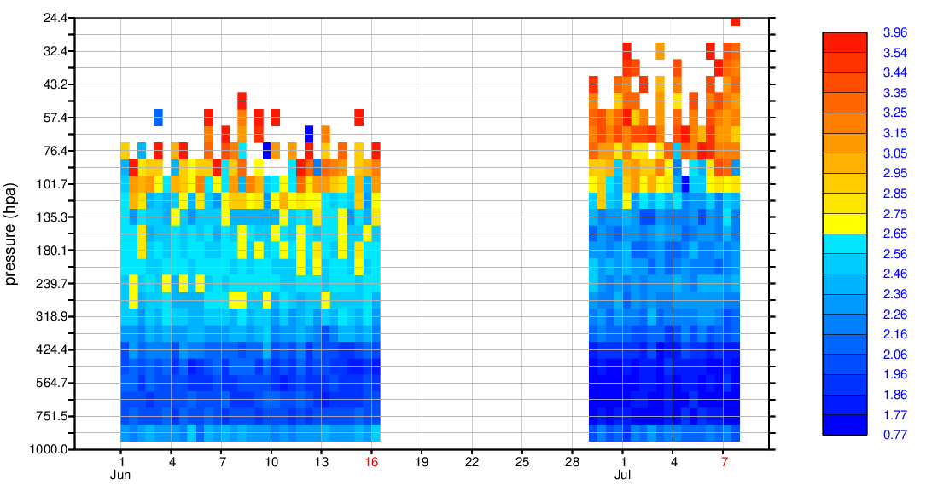
L2B Mie-cloudy time-series
Number of observations
L2Bp $σ_{est}$
FM-A
FM-B
FM-A
FM-B
More Mie obs with FM-B
Estimated error smaller with FM-B
count
m/s
Focus on ~400 hPa
Data counts
33% more winds pass 4 m/s QC
St.dev (O-B) and L2Bp est. error

Slide 21
Any questions so far?

Slide 22
2. Aeolus L2B HLOS wind NWP impact assessment at ECMWF

Slide 23
Aeolus NWP impact assessment at ECMWF
Initial impact assessment (Observing System Experiment) at ECMWF
Using the operational set-up i.e. full observing system, but lower resolution
Focus period was between 12 September and 16 October 2018
A period with relatively stable biases with time
Reported FM-A laser energy was at is greatest: ~60 mJ
In hindsight: However, biases do exist as a function of orbit phase

Slide 24
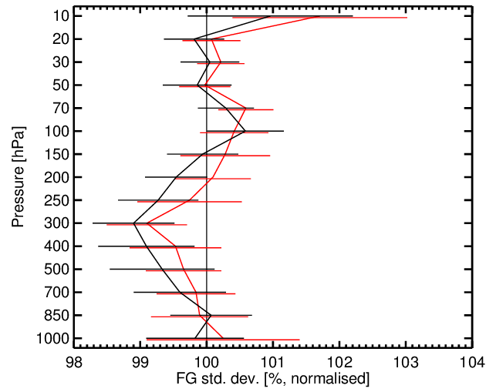
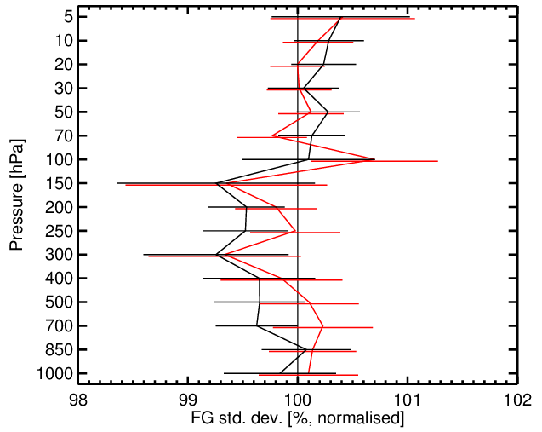
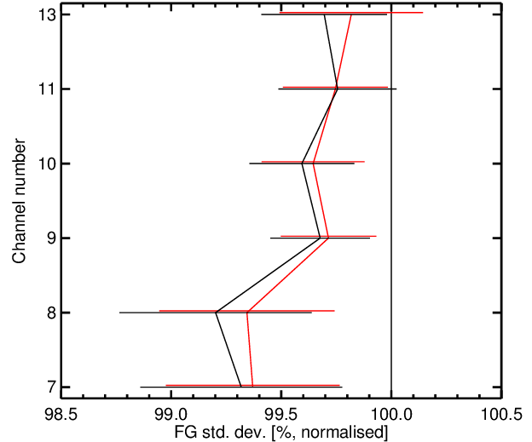
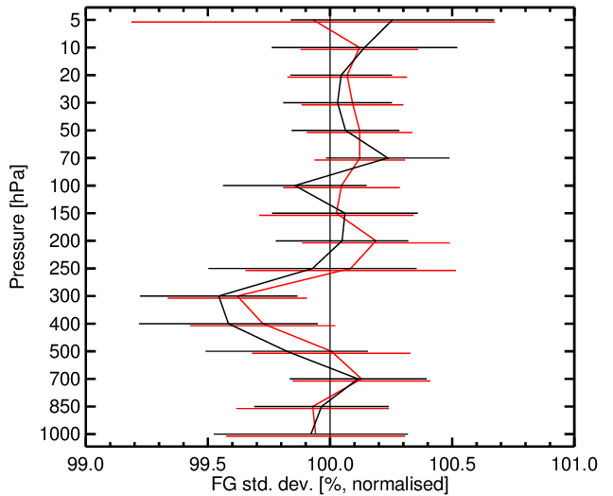
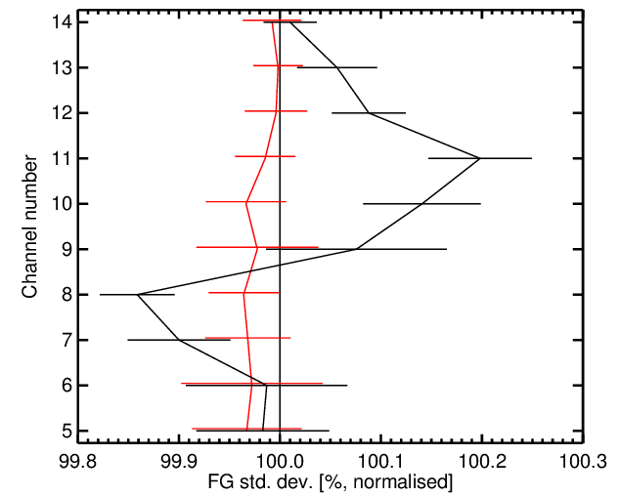
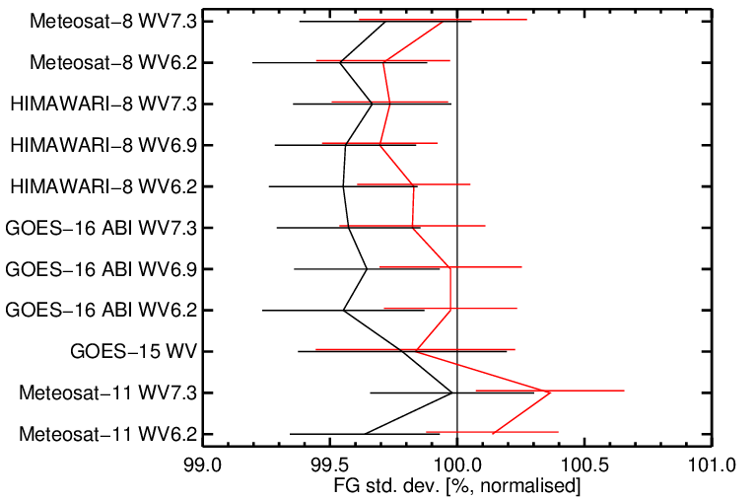
Fit of short-range forecasts to other observation types i.e. O-B std. dev. change (%) from assimilating L2B winds (period: 12/9 to 16/10)
Advanced Microwave Scanning Radiometer 2 (all-sky), global
Conventional vector wind (aircraft, radiosondes, wind profilers)
SH
tropics
Rayleigh+Mie
Mie only
Radiosonde temperature, global
AMSU (temperature info.), global
Geostationary satellites, global
Notes:
MHS provide mid-tropospheric humidity information

Slide 25
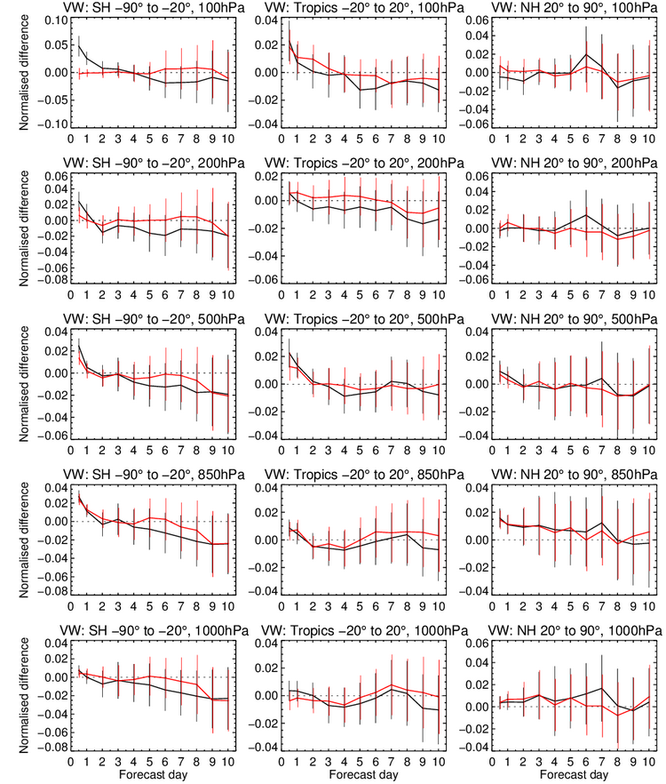
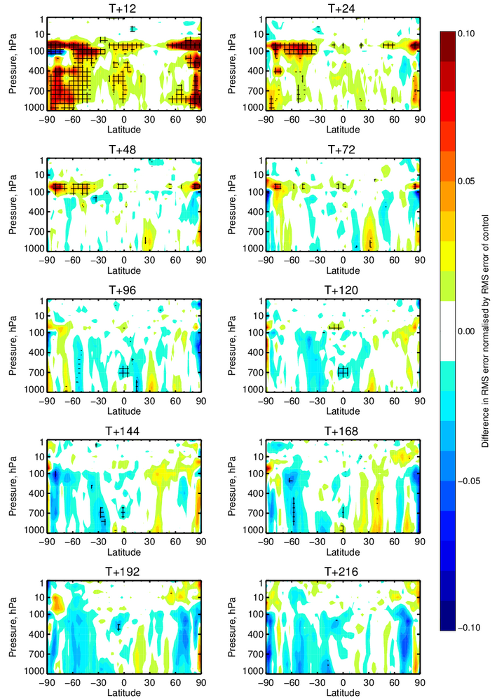
Longer range forecast impact: 12/9/18 to 16/10/18
Difference in vector wind RMSE against own analysis
Promising in SH, but lacking statistical significance
Rayleigh generally giving more impact than Mie
+10%
Rayleigh +Mie
Mie only
Rayleigh+Mie
-10%

Slide 26
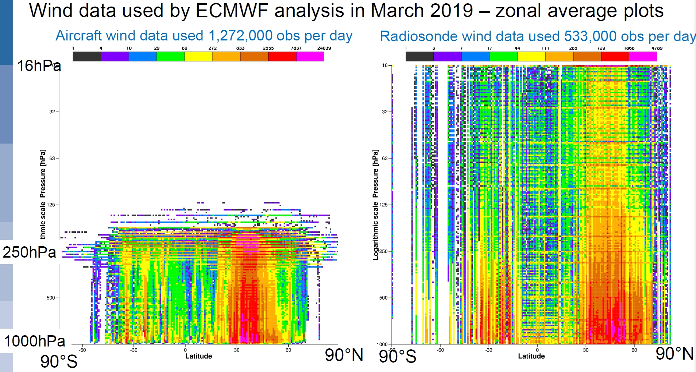
~28 km
Plots from Lars Isaksen

Slide 27
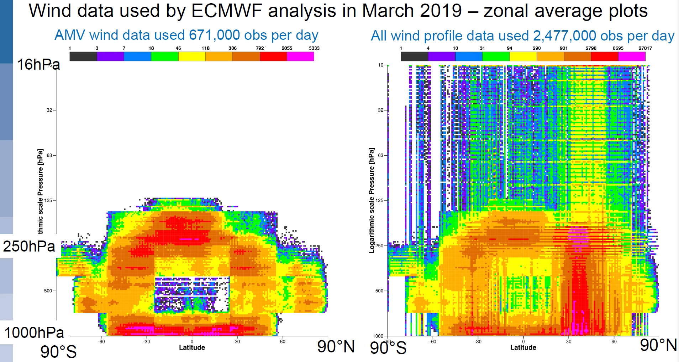
~28 km

Slide 28
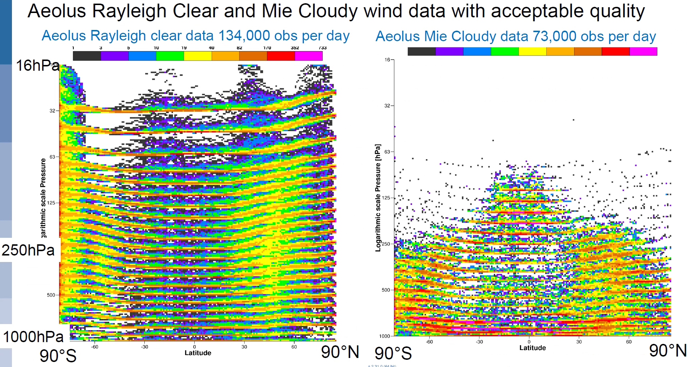
~28 km

Slide 29
More recent period NWP impact experiment: 2 April - 14 June 2019
Aim: How impact affected by various changes compared to Sep-Oct 2018 experiment?
Lower laser (FM-A) energy (~40-45 mJ)
More “hot” pixels
Using more appropriate instrument calibrations
More appropriate range-bin altitude settings
More and higher resolution Mie winds (10 km rather than 90 km)
Control:
ECMWF, normal operational observing system used, lower resolution
Experiment:
Same as control + ….
Assimilate:
Rayleigh-clear + Mie-cloudy
Hot pixel range-bins are flagged invalid for whole period (new L2Bp allows this)
Hence ~20-25% winds are rejected
No bias corrections applied

Slide 30
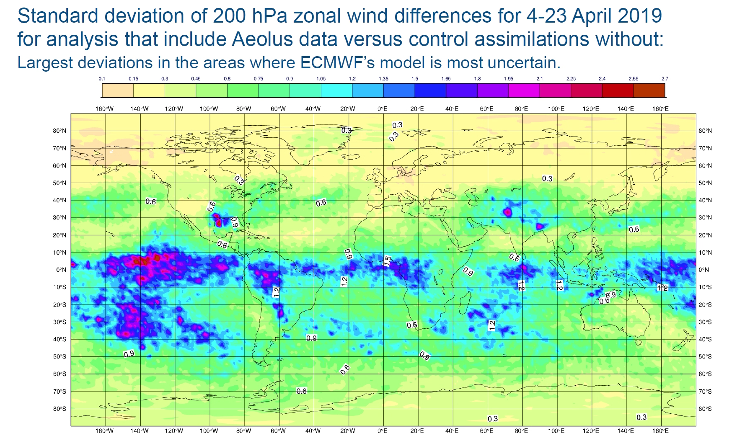
m/s

Slide 31
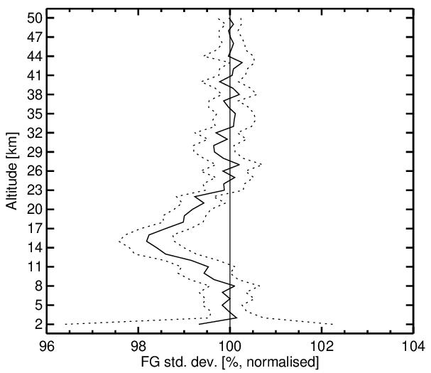
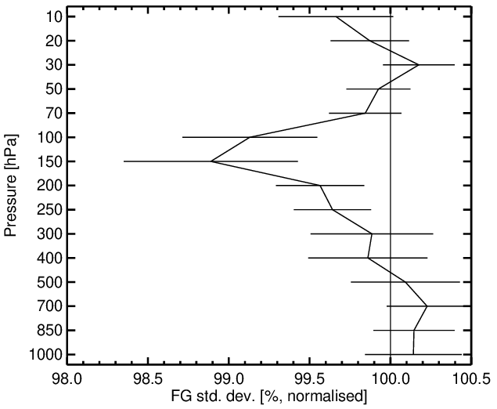
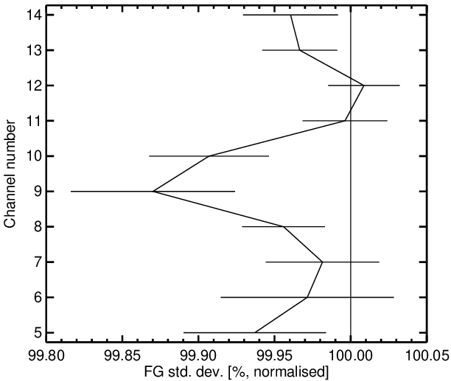
Fit of short-range forecasts to other observation types – the better results
GPSRO; tropics
Conventional vector winds; tropics
AMSU-A; global
Impact reasonable in tropics
Improved statistical significance compared to Sep-Oct 2018 period since 2.5 month experiment
AMSU-A degradation of Sep-Oct 2018 period is gone
1 km rather than 2 km Rayleigh bins in UTLS?
Less impact in mid-troposphere than Sep-Oct 2018, not so much impact on humidity
Perhaps overweighting the 10 km horiz. res. Mie winds? Thicker Mie range-bins?

Slide 32
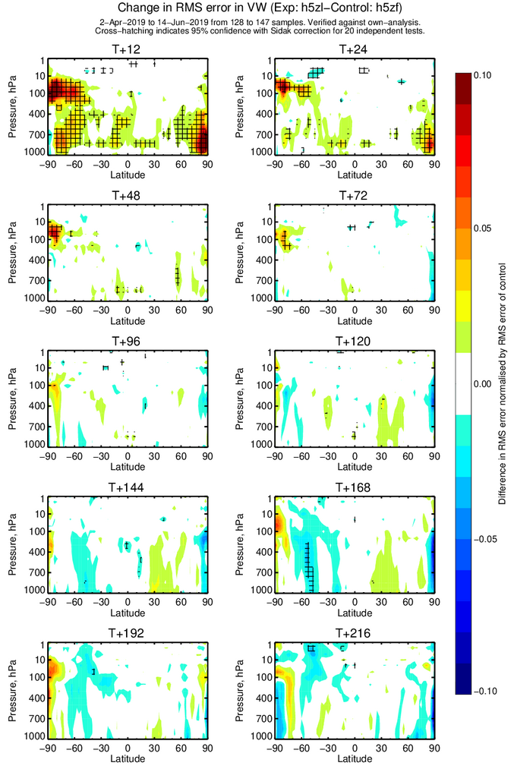
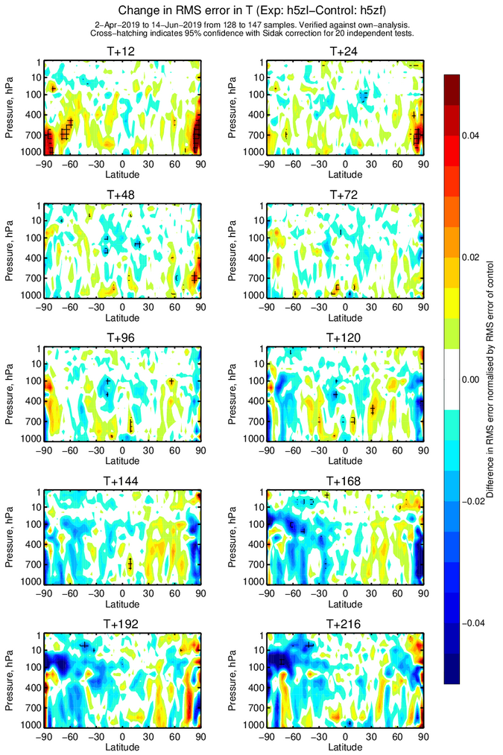
Longer range forecast impact – assessed against own analyses
Vector wind RMS error
Temperature RMS error
+10%
Positive indications for impact at longer range in SH
Degradations in NH?
But need longer period for significance
Reasonably similar pattern to Sep-Oct 2018 impact, but smaller
+4%
-4%
-10%

Slide 33
Summary on April-June 2019 NWP impact experiment
Promising to still see positive impact despite:
Lower laser energy (40-45 mJ) compared to ~60 mJ in Sept-Oct 2018 (should mean 15-20% larger st.dev. of Rayleigh winds)
Rejecting 20-25% of range-bins due to “hot” pixels (with newer L2Bp this problem is solved)
Large Rayleigh biases varying with orbit phase
Overall less impact than Sep-Oct 2018 period
Suggests we need more laser energy and the “hot” pixel correction
New: running an experiment with bias correction:
A weekly fixed bias correction of L2B winds using the model, as a function of orbit phase angle
So far: impact is improved

Slide 34
3. Summary of assessment of Aeolus from ECMWF (so far)
FM-A random errors larger than pre-launch expectations (see yesterday’s talks also)
$\text{Typical} σ_{O}$ 4-5* m/s for Rayleigh and 2-3 m/s for Mie (*depending on laser energy)
Lower Rayleigh signal → solar background noise more prominent
FM-B is so far looking very good
Varying and large wind biases
However, new/improved calibration methods are resolving this
Future and re-processed data will be more accurate
Initial NWP impact assessment at ECMWF
Short-range forecast fit to other observations shows 1-2% improvements for wind, temperature and humidity in tropics and SH
Similar magnitude to some other observation types e.g. GPSRO, AMVs, IR sounders (Bormann et al. 2019)
Considering Aeolus is only ~0.2% of number of obs. assimilated, this is promising
Mie provides a significant fraction of short-range impact and humidity improvement
Medium range impact: need more testing, but shows promise in SH/tropics for Rayleigh
Bias correction with NWP model improves impact
Overall there is plenty to be positive about, despite the issues

Slide 35
Any questions?

Slide 36
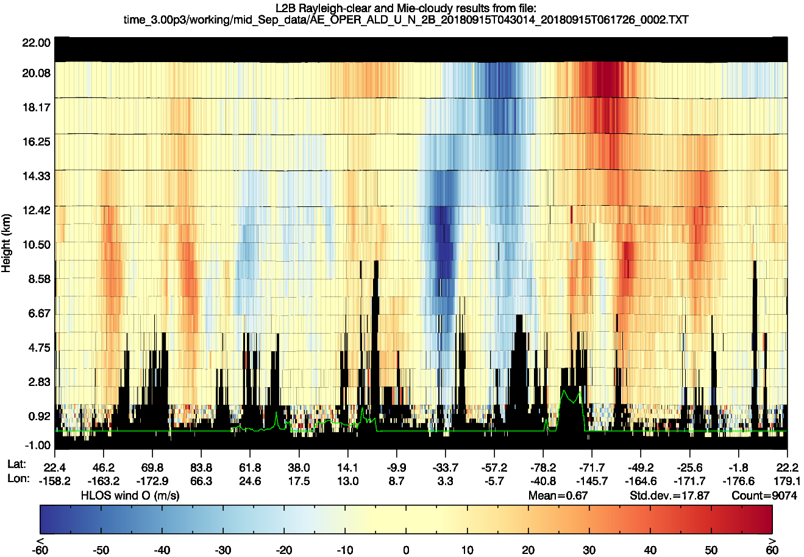
L2B Rayleigh-clear and Mie-cloudy horizontal line-of-sight (HLOS) winds
polar-night jet
ascending phase
descending phase
ascending phase
range-bin
equatorial easterlies
subtropical jet (westerlies)
extinction below optically thick clouds
polar front jet (westerlies)
N.P.
S.P.

Slide 37
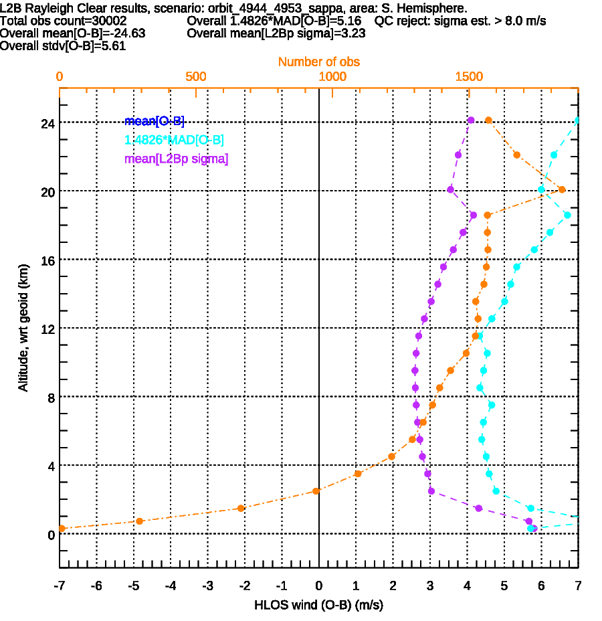
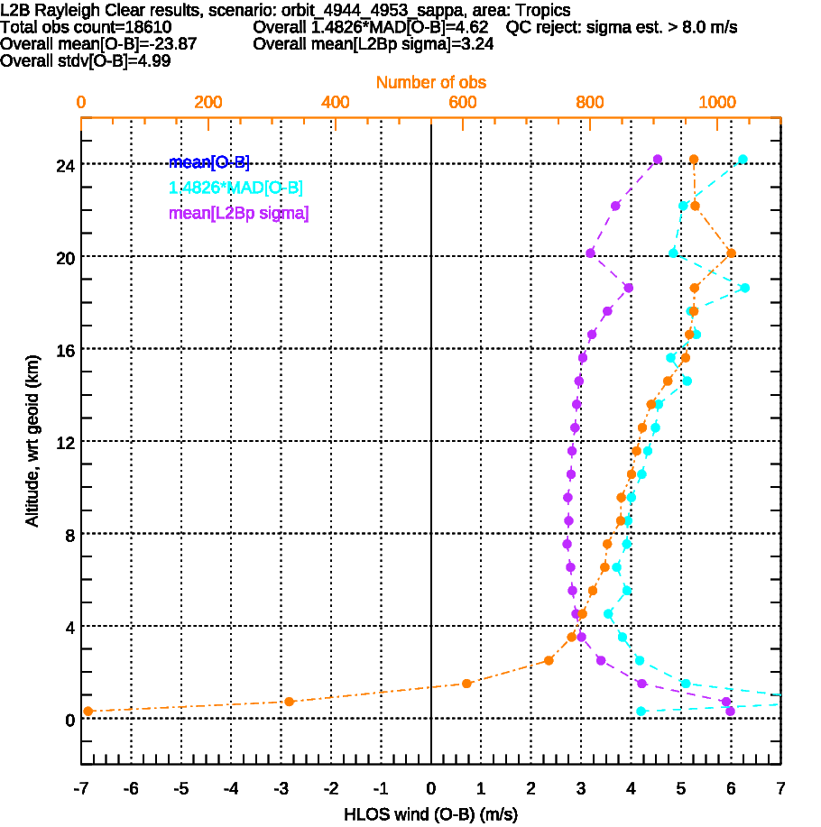
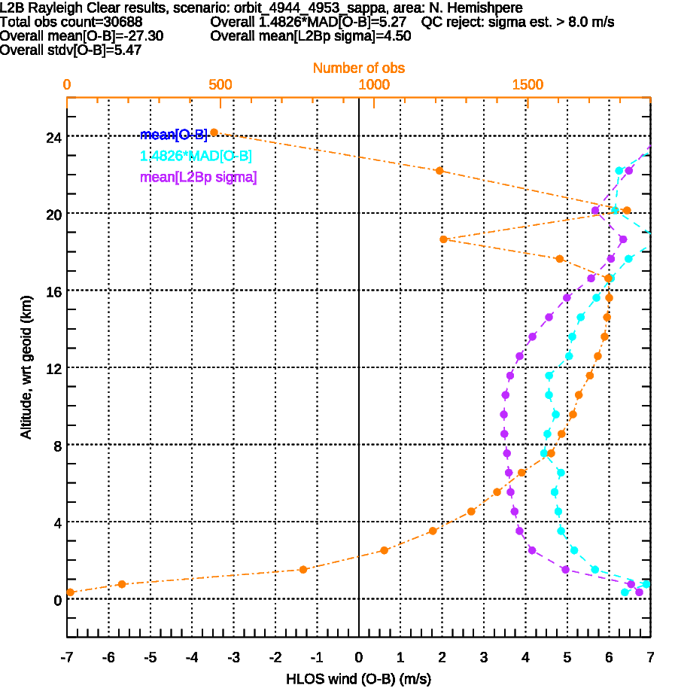
FM-B, orbits 4944-4953 (30th June -1st July 2019) ~67 mJ reported
S. Hemi.
Tropics
N. Hemi.
Best $σ_{Oest}$~2.6 m/s
Best $σ_{Oest}$~2.75 m/s
Best $σ_{Oest}$~3.5 m/s
Larger due to solar background noise

