Slide 1
NOAA 3D-winds assessment: Preliminary results from
ADM-Aeolus
Kevin Garrett¹, Hui Liu^{1,2}, Kayo Ide², Sid Boukabara¹, Ross Hoffman², Mike Hardesty³, Lidia Cucurull⁴, Jason Dunion^{4,5}, Lisa Bucci⁴ , Karina Apodaca^{4,5}, and David Santek⁶
1: NOAA/NESDIS/STAR, 2: University of Maryland, 3: NOAA/Cooperative Institute for Research and Environmental Sciences, 4: NOAA/OAR/AOML , 5: NOAA/Cooperative Institute for Marine and Atmospheric Studies, 6: NOAA/Cooperative Institute for Meteorological Satellite Studies
Satellite and Information Service
11 July 2019

Slide 2
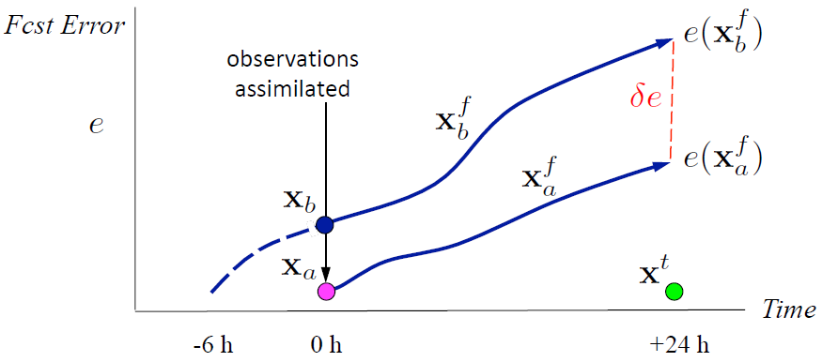
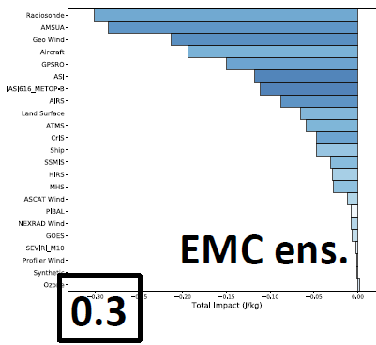
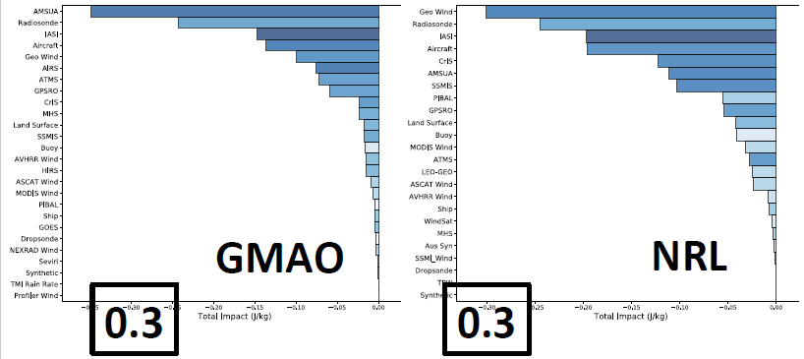
NWP impact from current wind observations assimilated
FSOI tracks forecast error reduction (δe) back to observations assimilated (innovations)
(from Langland and Baker, 2004)
Three primary ways to illustrate observing system impacts:
Observing System Simulation Experiments (OSSEs)
Observing System Experiments (OSEs, or Data Denials)
Forecast Sensitivity to Observation Impacts (FSOI) (Adjoint or Ensemble based)
FSOI Total Impact (Dry + Moist Energy (J/kg)) from EMC, GMAO, and NRL showing forecast error reduction per observation type.
(from Mahajan et al. 2017)

Slide 3
Project overview
STAR, AOML
AOML, CIMSS
Objective: Assess the value of 3D-winds (active and passive) from space for NOAA operational applications and products.
Evaluate ADM-Aeolus
References
OSSEs 3D-winds v. HLOS
NWP impacts using simulated 3D-winds and HLOS
Coordin-ation
ESA, ECMWF, GMAO, NWS, DWD, etc.
NWP Impacts
Develop QC
AMV
raob
3D-winds
NWP (O-B/O-A)
Perform OSEs
Global/Hurricane models
“aircraft”
STAR, AOML
CIRES

Slide 4
Scope of NESDIS/STAR, UMD/CICS effort
Establish ADM-Aeolus data flow from ESA, ECMWF into NOAA
Evaluation of L2B HLOS winds vs NWP (GFS, ECMWF)
Characterize errors (bias, standard deviation)
Develop QC filters
Integration of ADM-Aeolus L2B into NOAA FV3GFS
Perform impact experiments (OSEs)
Comprehensive intercomparison between ADM-Aeolus L2B HLOS, AMVs (geo/polar), radiosonde, aircraft winds
Explore varBC for AMV (anchored by ADM-Aeolus)
Provide overall value assessment

Slide 5
ADM-Aeolus data evaluation overview
Aeolus L2B HLOS Data considered
September 6 – December 31, 2018 (trends)
September 12 – October 16, 2018 (focus, mean)
Resolutions: 1-2 km in vertical, and 90 km in horizontal
L2B uncertainty: include < 8 m/s (Rayleigh) and 3 m/s (Mie)
NOAA/GFS and ECMWF/ERA analyses
0.25 degree horizontal resolution
64 levels (0-60km) for GFS; 137 levels (0-80km) for ERA
Comparison to NWP analyses
NWP wind profiles are linearly interpolated horizontally to the center of L2B wind volume, and transformed to the HLOS component speed HLOS=-usinΦ-vcosΦ)
The analyses have higher vertical/horizontal resolutions and this may introduce representativeness errors wrt to L2B winds.
Assessment of Rayleigh (clear)/Mie (cloudy)
Time evolution of statistics
Stratification by ascending/descending orbits, time spans etc
Zonal means
Error dependency on other variables (wind speed, shear, T, q)
Develop QC (include blacklist), reassess

Slide 6
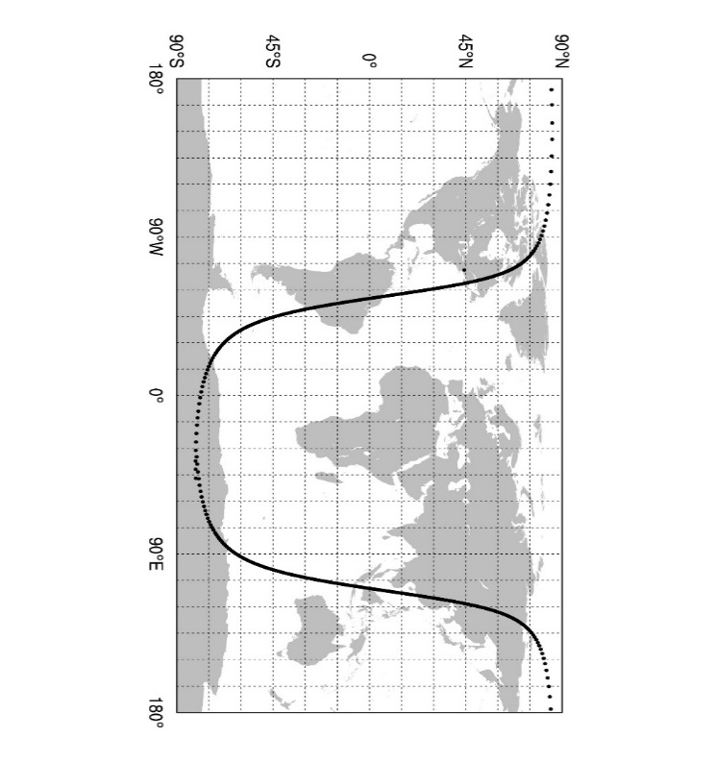
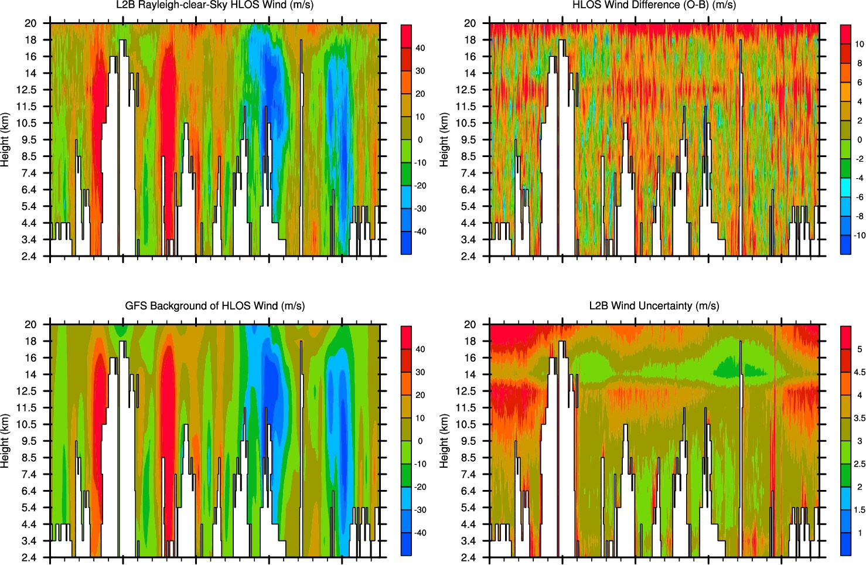
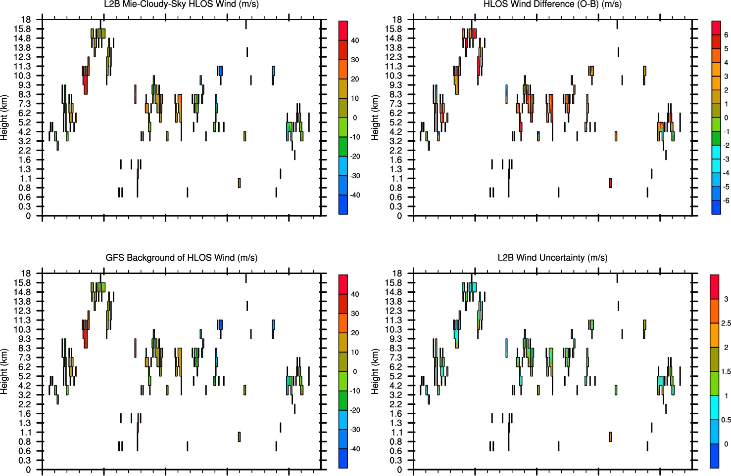
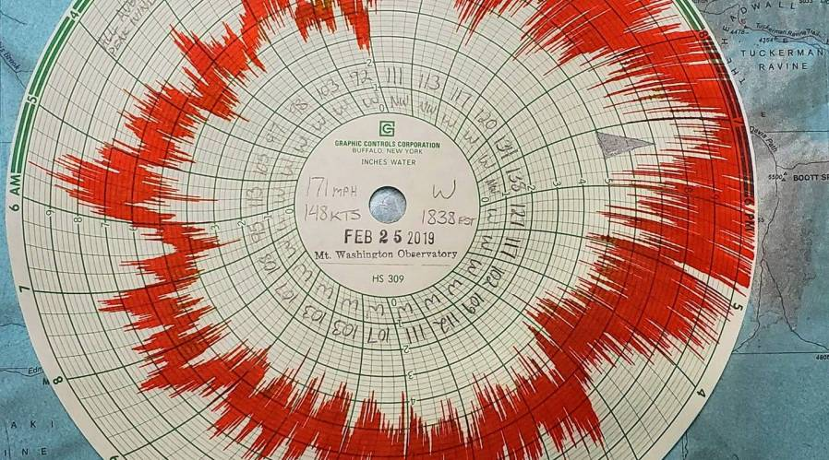
NWP Comparisons (wind curtain)
ADM-Aeolus 1 0rbit
February 25, 2019
21:25-22:55 UTC
Mt. Washington, NH Hays Chart (171 mph at 2335 UTC)
hhmm: 2125Z 2145Z 2205Z 2225Z 2245Z
Lat: 81S 12S 67N 34N 45S
Lon: 47E 53W 73W 116E 99E
hhmm: 2125Z 2145Z 2205Z 2225Z 2245Z
Lat: 81S 12S 67N 34N 45S
Lon: 47E 53W 73W 116E 99E

Slide 7
NWP Comparisons (statistical trends) Rayleigh clear vs. GFS (Sep 6-Dec 31, 2018)
Stdv
Uncertainty
Bias
L2B wind uncertainty, Stdv. and biases become larger after day 45 (Oct 20, 2018)
“Smallest uncertainty/biases”: Day 25–40, i.e., Oct 1-15, 2018.
Note the uncertainty is an L2B estimate

Slide 8
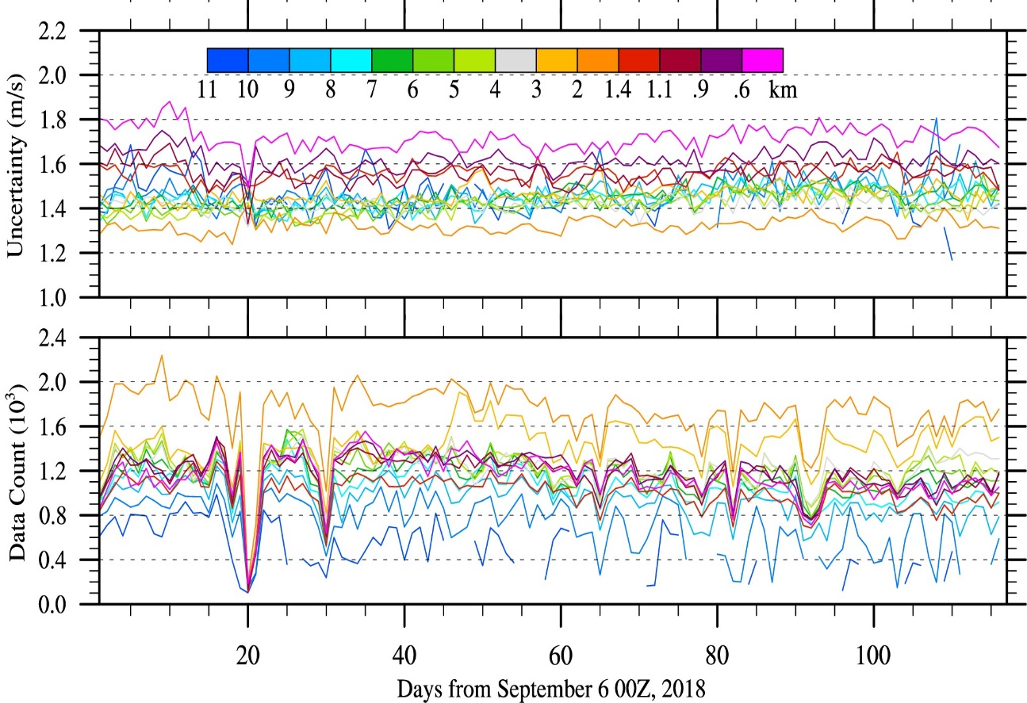
NWP Comparisons (statistical trends) Mie cloudy vs. GFS (Sep 6-Dec 31, 2018)
Stdv
Uncertainty
Bias
L2B wind uncertainty, Stdv. stable
L2B wind bias increases after day 40 to ~3 m/s

Slide 9
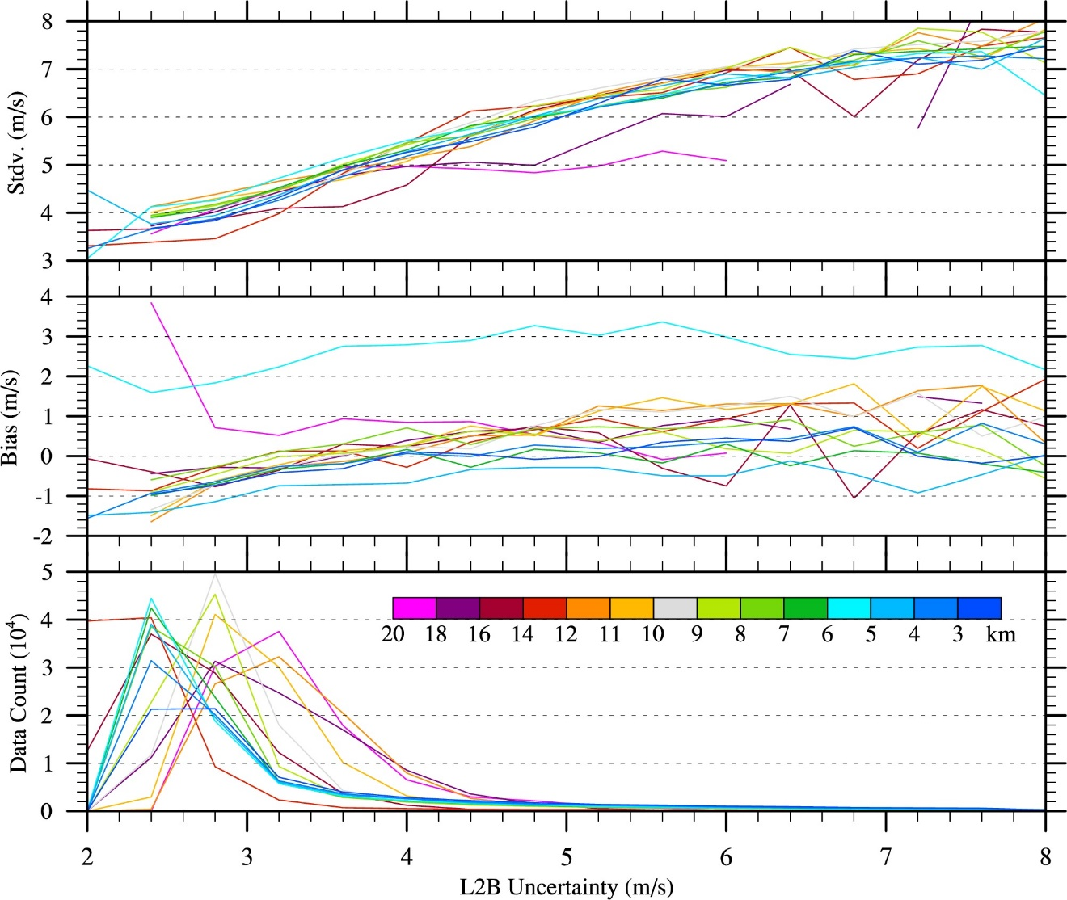
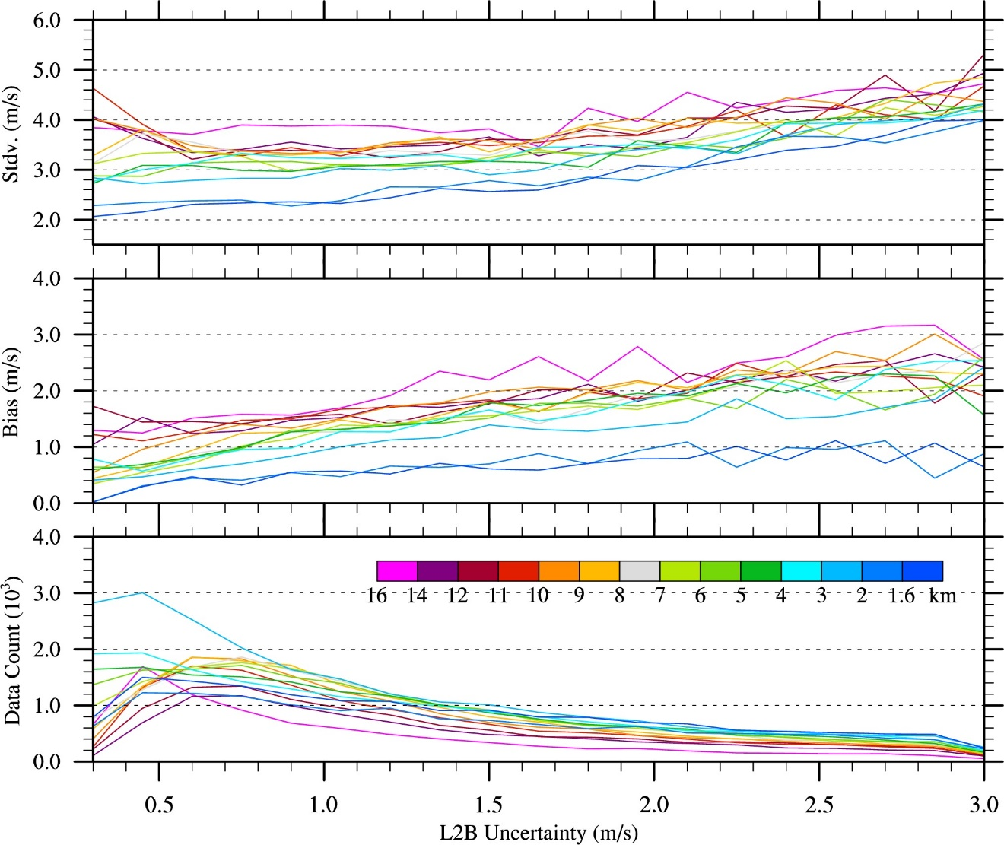
NWP Comparisons (GFS) (vs L2B Uncertainty, Sep 12-Oct 16, 2018)
Determine thresholds for QC procedures
(Rayleigh - Ascending orbits)
(Mie -Ascending orbits)
Stdv
L2B uncertainty underestimated
Bias

Slide 10
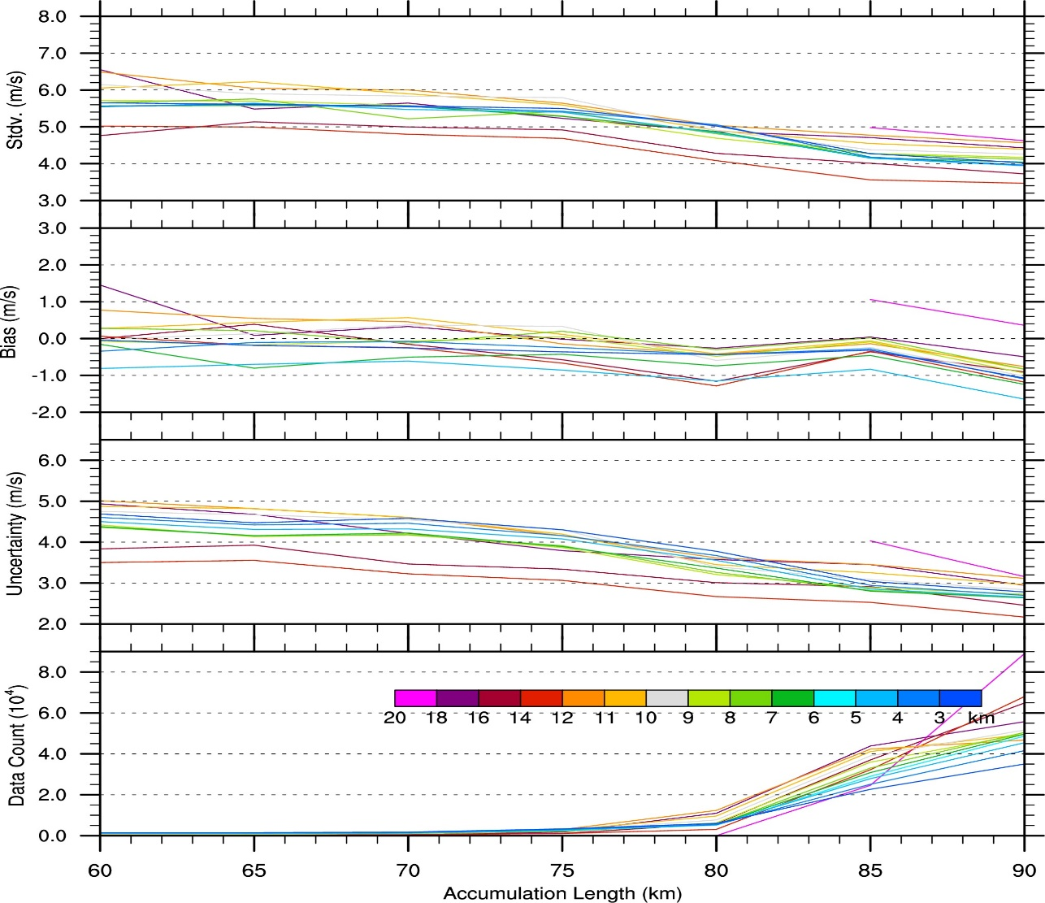
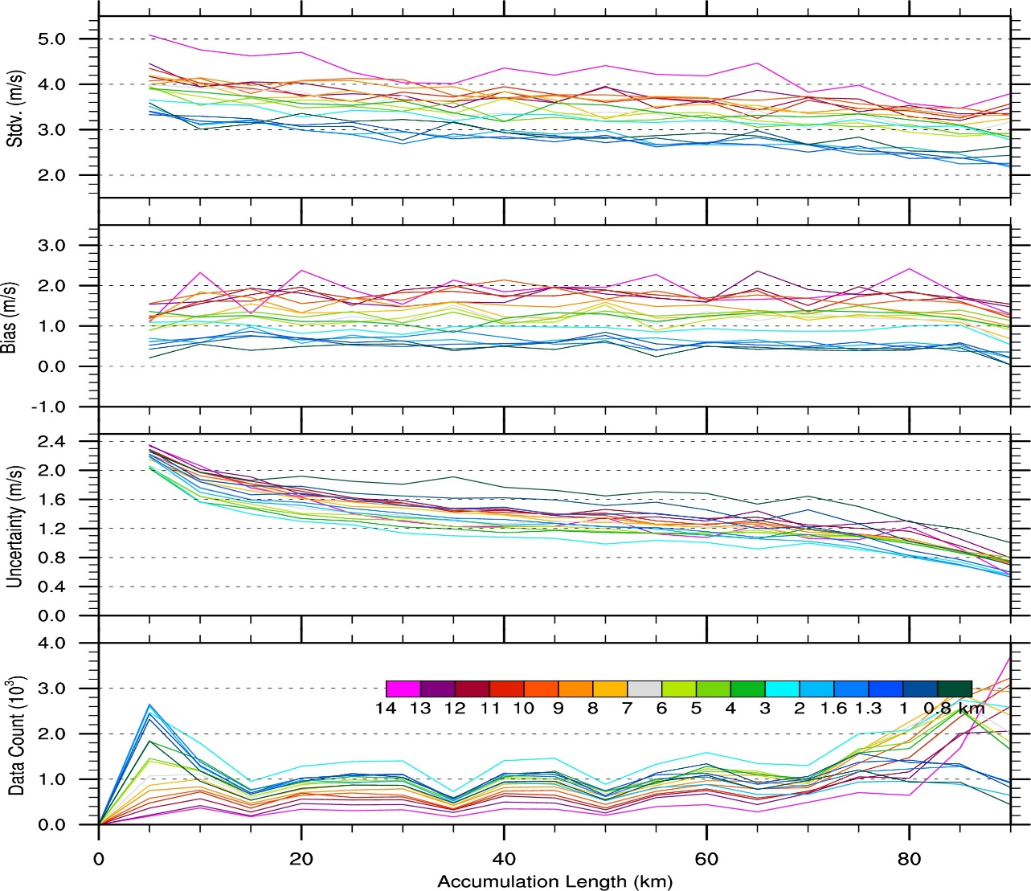
NWP Comparisons (GFS) (vs Accumulation Length, Sep 12-Oct 16, 2018)
Determine thresholds for QC procedures
(Rayleigh - Ascending orbits)
(Mie -Ascending orbits)
Stdv
Bias
Uncertainty

Slide 11
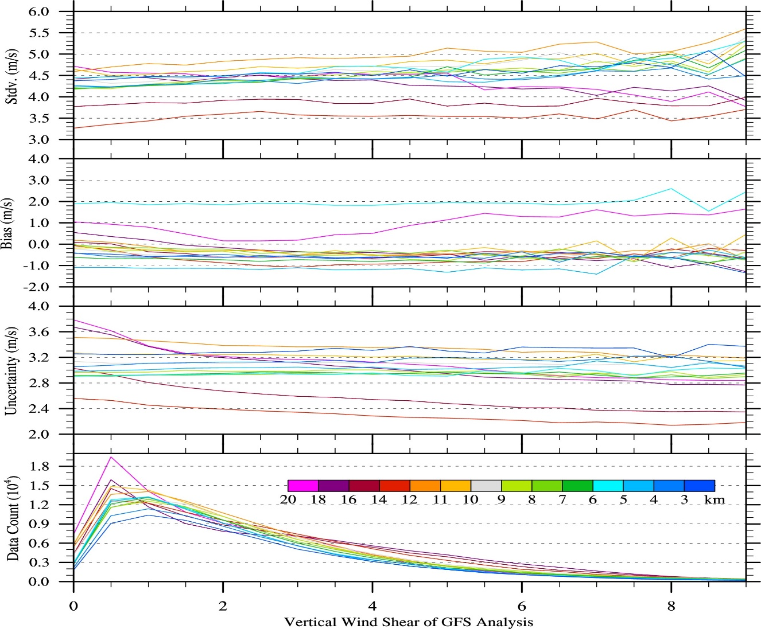
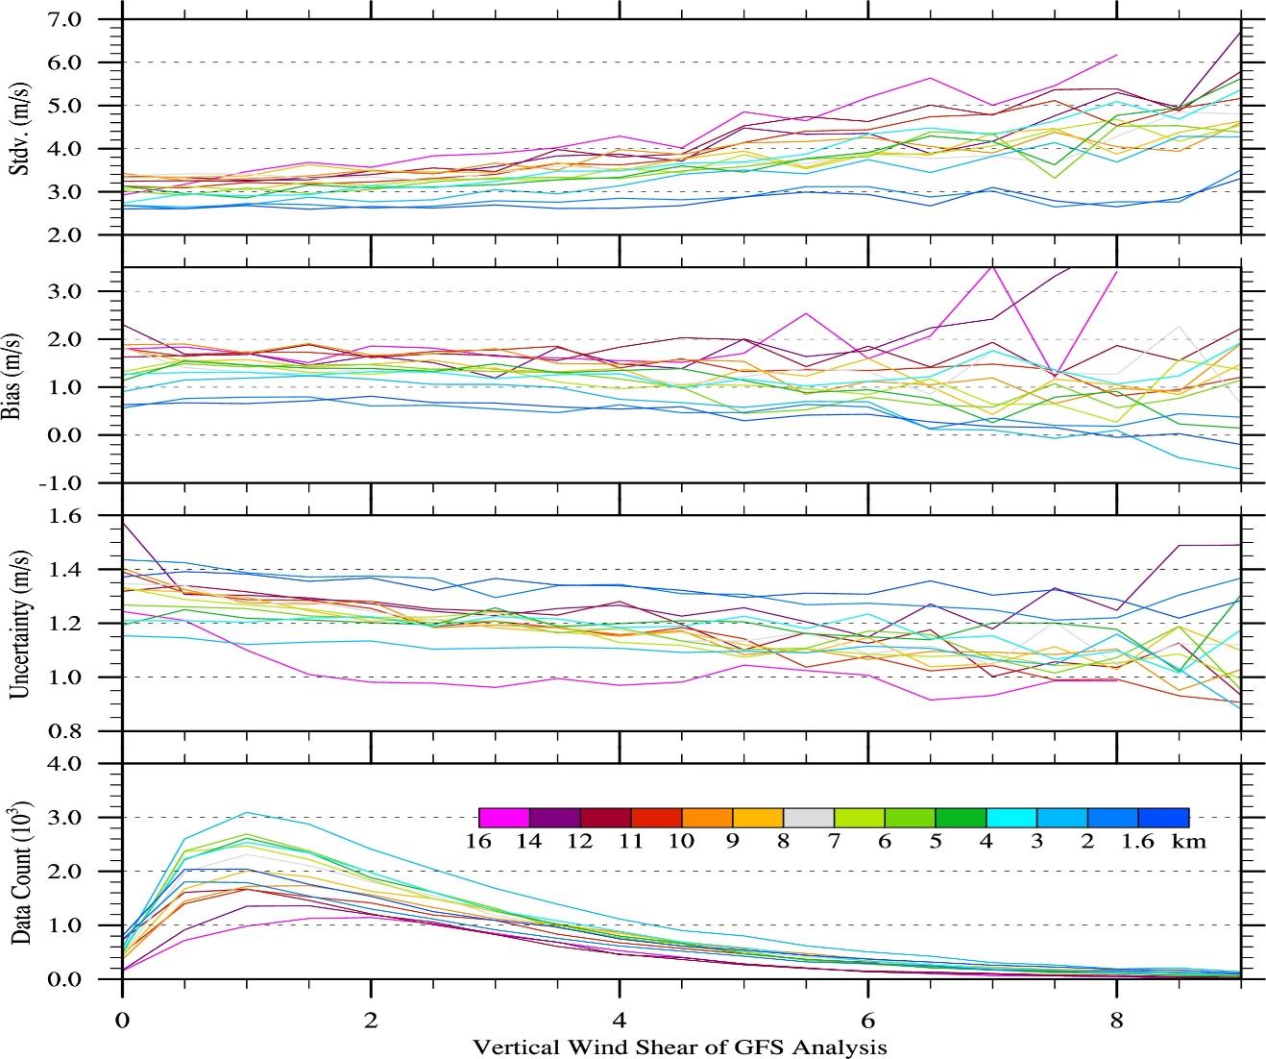
NWP Comparisons (GFS) (vs Vertical Shear, Sep 12-Oct 16, 2018)
Determine thresholds for QC procedures
(Rayleigh - Ascending orbits)
(Mie -Ascending orbits)
Stdv
Bias
Uncertainty

Slide 12
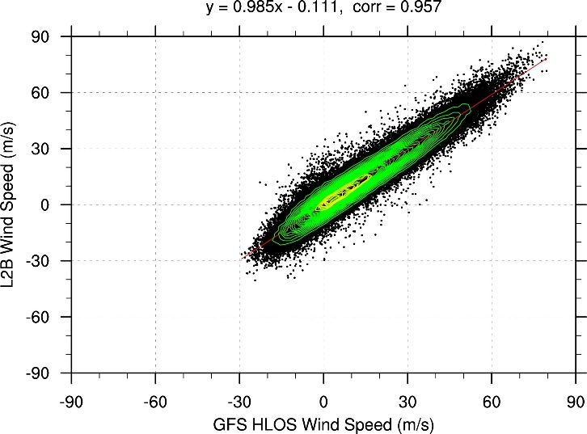
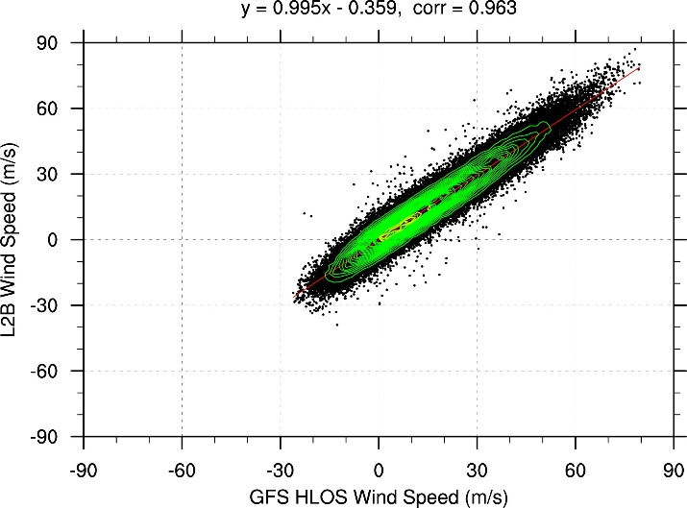
NWP Comparisons – QC Summary
QC Checks
Rayleigh clear (asc)
QC | Rayleigh clear | Mie cloudy
0. L2B uncert. advised | > 8 m/s | > 3 m/s
1. L2B uncert. strict | > 4 m/s | > 1.5 m/s
2. Accumulation Length | < 80 km | < 10 km
3. Vertical Shear | n/a | > 5 m/s/km
QC0
QC0-3
QC Impact Sep 12 – Oct 16, 2018, Stdv (bias)
Rayleigh clear (asc)
Rayleigh: (3-18km) Mie: (0.6-16km)
QC0
 | Rayleigh-asc | Rayleigh-des | Mie-asc | Mie-des
QC0 | 4.60 (-0.63) | 4.45(0.67) | 3.38(1.33) | 3.48(0.51)
QC0-1 | 4.11 (-0.70) | 4.02(0.59) | 3.05(1.08) | 3.15(0.40)
QC0-3 | 4.09 (-0.70) | 4.00(0.56) | 2.91(1.18) | 2.99(0.32)
QC0-3

Slide 13
NWP Impacts
Extension of NOAA FV3GFS to ADM-Aeolus L2B assimilation
Leveraged work done by Will McCarty in the GSI
Integrate QC checks
Implement bias correction/observation errors
Run 4DEnsVar at C384 (~25 km)
Focus period – Sep 12-Oct 16, 2019 (1 week spinup)

Slide 14
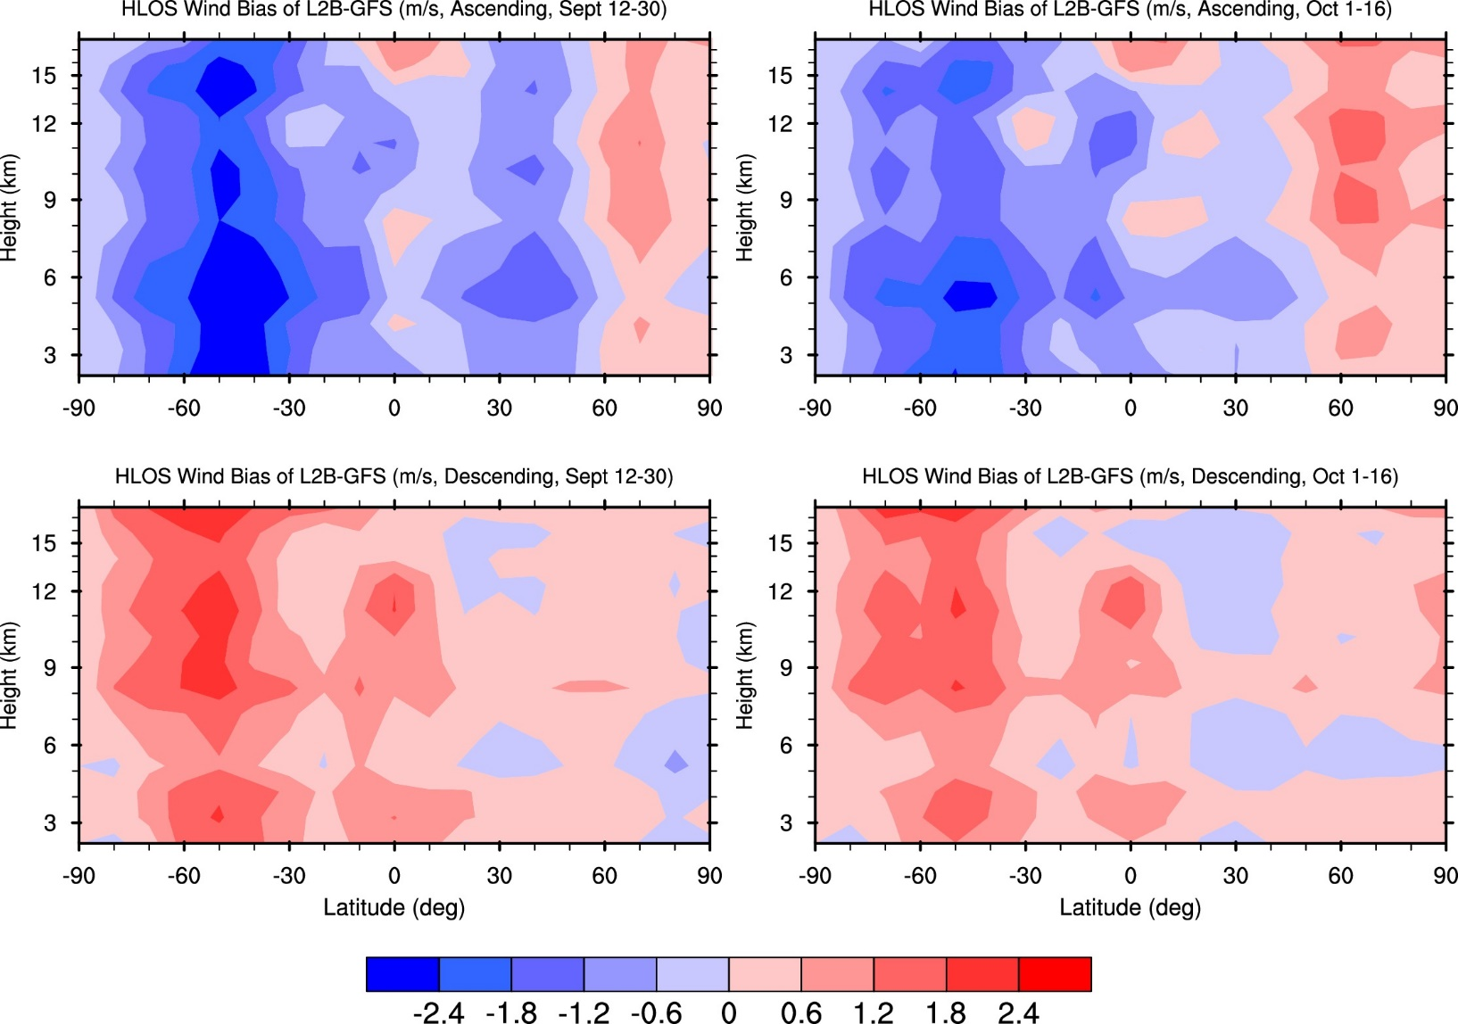
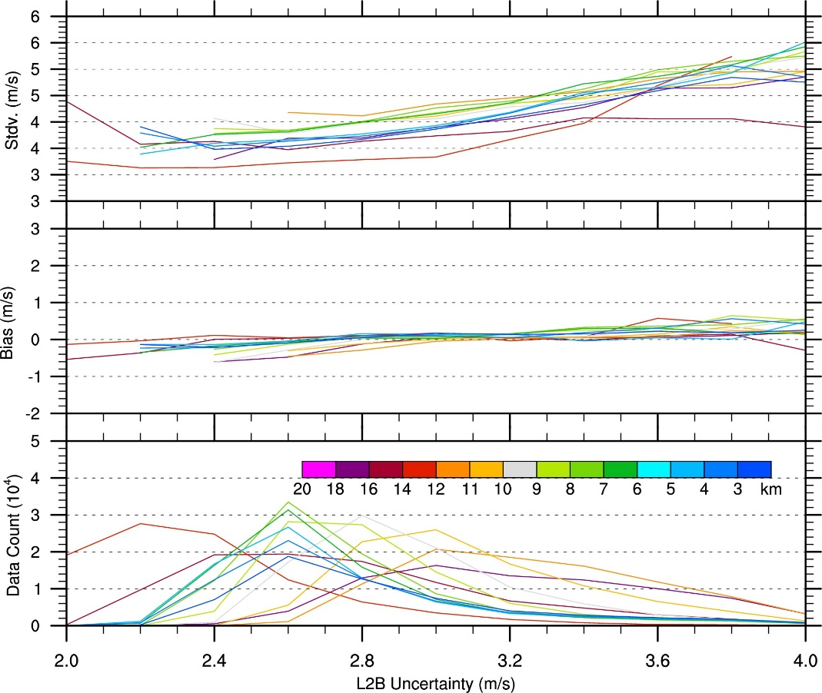
NWP Impacts – Bias correction
Apply static correction for 2 time periods
Rayleigh clear (Descending) after bias correction
Stdv
Bias

Slide 15
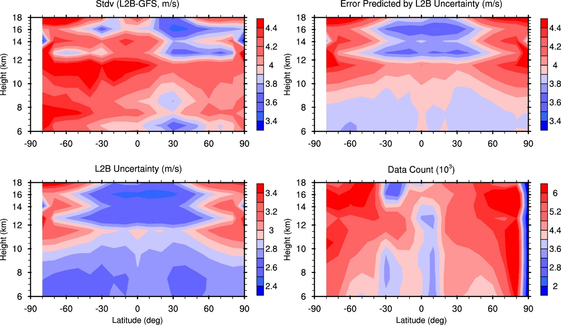
NWP Impacts – Observation errors
(Rayleigh - Ascending orbits)
Stdv
Relationship | Rayleigh clear | Mie cloudy
Ascending | 1.16 + 1.00 * L2Buncertainty | Fixed Lat/height
Descending | 1.25 + 0.94 * L2Buncertainty | Fixed Lat/height
(Ascending, Sept 12 – Oct 16, 2018)
Bias

Slide 16
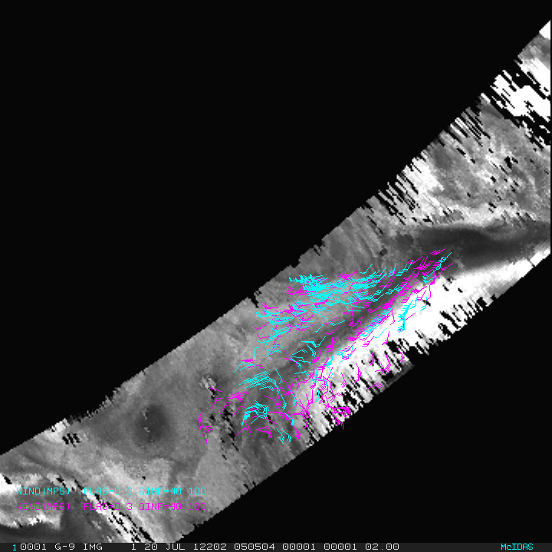
Next steps
Finalize GSI updates and run OSEs (ready for NWP Impacts Meeting)
Explore alternative bias correction/extend OSE (may shift focus to FM-B)
Generate NOAA flavor L2B
Start intercomparison to AMV/other wind obs, explore varBC for AMV with Aeolus assimilated
3D-winds (passive)/Aeolus OSSEs
AIRS 3D-Winds over North Polar Region
Ozone AMVs: 103 to 201 hPa Moisture AMVs: 359 to 616 hPa
AIRS 20 July 2012 0505 UTC 400 hPa retrieved humidity image
(courtesy D. Santek)

Slide 17
Acknowledgements
NESDIS/OPPA Technology Maturation Program for funding this project
ESA and ECMWF for providing data access, support, and feedback (cal/val wiki is extremely useful)
Will McCarty (GMAO) for GSI software
The ADM-Aeolus US cal/val team
NOAA (NESDIS, NWS, OAR), NOAA CIs (CICS, CIMAS, CIRES, CIMSS, CIRA), NASA (GMAO, JPL), and other participants

