Slide 1
Ongoing Assessment and Assimilation of Aeolus Wind Retrievals at the GMAO
Will McCarty
Global Modeling and Assimilation Office NASA Goddard Space Flight Center
Working Group Meeting on Space-Lidar Winds 11 July 2019

Slide 2
Introduction
The Global Modeling and Assimilation Office (GMAO) was prepared to monitor and assimilate the Aeolus L2B horizontal line of sight (HLOS) winds
Pre-launch test data allowed for ingest on Day 1 of L2B BUFR release via ECMWF
A statement to pre-launch preparedness both in terms of JCSDA and ECMWF/ESA delivery of useful proxy data
A control experiment (without Aeolus) using standard GMAO test configuration has been run for the initial assessment of data record through 20 Jan 2019
The Goddard Earth Observing System (GEOS) atmospheric data assimilation system
Model: GEOS Model, ~1/4° (C360 cubed sphere grid)
Analysis: GSI Hybrid 4D-EnVar, full global observing system, 1/2° analysis, 1° (C90) ensembles
Note, the GSI assimilation procedure is co-developed with NOAA partners, thus the implementation methods are similar
Monitoring and departure statistics have been calculated comparing Aeolus with the control ‘background’ (short-term forecast) fields for this period
No active assimilation experimentation yet

Slide 3
Initial Assimilation Methods
Each wind retrieval is classified by retrieval type (Rayleigh or Mie) and as Cloudy or Clear
Four subtypes are considered: Rayleigh/Clear, Rayleigh/Cloudy, Mie/Clear, and Mie/Cloudy
All observations are assimilated as single-point HLOS observations at the centroid
No effort is made to account for along-track observation resolution
Initial QC procedures:
Discard if |HLOS| > 1000 ms⁻¹ (outright discard unrealistic values)
Reject if Confidence Flag indicates invalid retrieval
For all results hereafter, a ±20 ms⁻¹ gross check is applied to the departures for initial results
Notes:
Consider 15 or 20 gross check

Slide 4
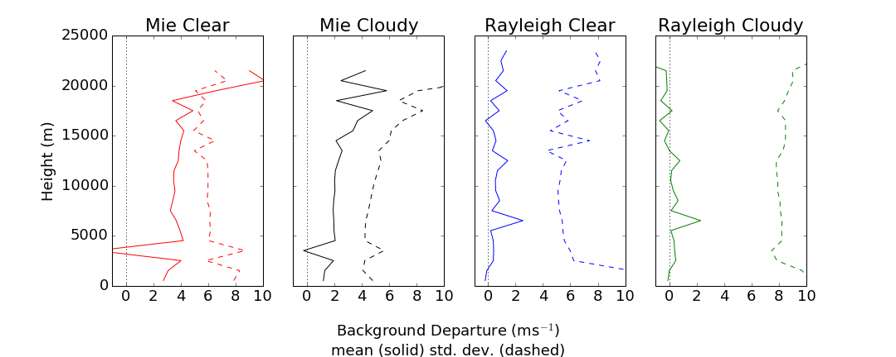
Global Statistics: 3 Sept – 30 Nov 2018
Initial comparisons to our model showed known issues
Mie retrievals are heavily biased: approaching (cloudy), exceeding (clear) 2 ms⁻¹
Rayleigh retrievals less-so
Bias > 1 m/s for cloudy; > 2 m/s for clear above ~3500 m
’Hot Pixel’ issues seen in Mie and Rayleigh
Bias spike between 6000-6500 m

Slide 5
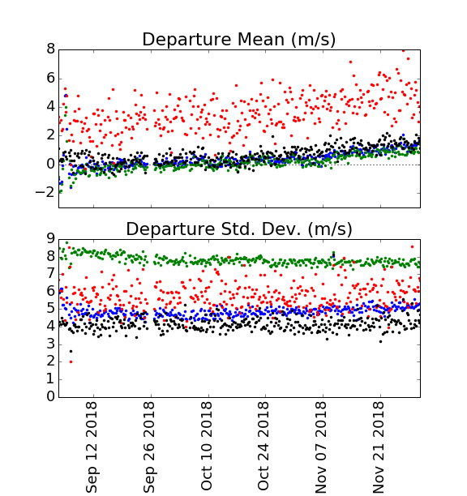
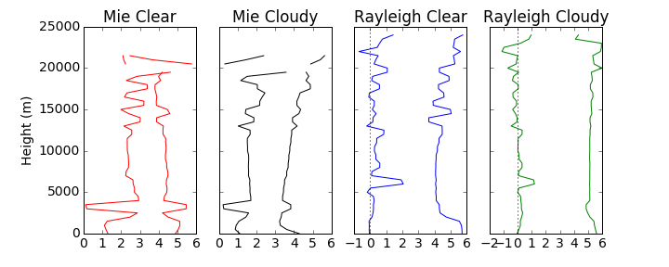
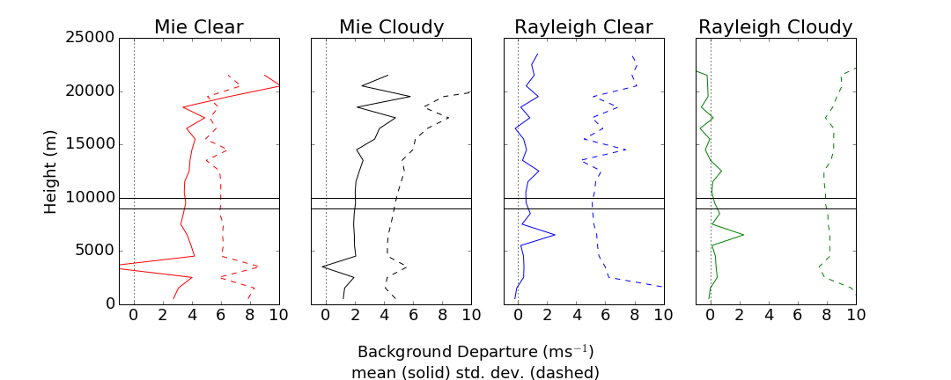
Global Statistics: 3 Sept – 30 Nov 2018
From 9000-10000 m, the larger bias is readily apparent in time series
All subtypes show some hint of an increase in bias w.r.t. time

Slide 6
Quality Control
Michael Rennie (ECMWF) & the Aeolus Team provided a list of suggested quality control and bias corrections to target the best observations for assimilation
Note: 12 Sept – 16 Oct 2018 is the targeted assimilation inter-comparison period

Slide 7
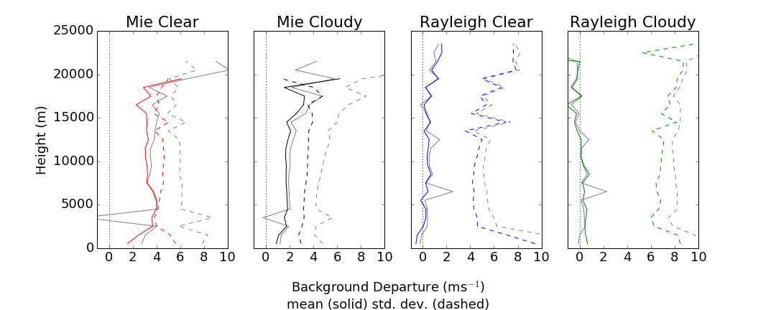
Quality Control
By applying the quality control procedures, it can be seen that for the two suggested use types (Mie Cloudy, Rayleigh Clear) that the standard deviations are dramatically reduced and the hot spot regions are avoided/resolved
Good observations may be lost using the ECMWF-suggested pressure-based blacklisting for hot spot avoidance

Slide 8
Quality Control
At this point, two key issues remain prior to initial assimilation experiments:
Large biases
Observation error handling

Slide 9
Handling Bias
From both this study and ECMWF suggestion, two components of bias need to be removed prior to assimilation
ECMWF suggested applying a -1.35 ms⁻¹ bias correction to Mie Cloudy winds
Additionally, ECMWF noted substantial biases as a function of orbit node, which cancel out in global averaging
Ascending/descending biases expected to be removed/fixed via improved calibration

Slide 10
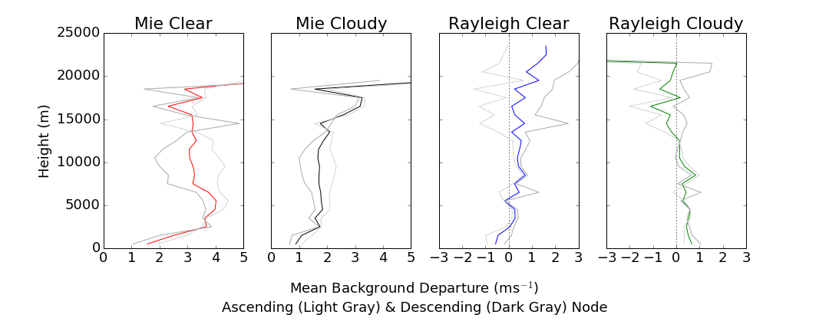
Handling Bias
From both this study and ECMWF suggestion, two components of bias need to be removed prior to assimilation
ECMWF suggested applying a bias correction of -1.35 ms⁻¹ to Mie Cloudy winds
Additionally, Gert-Jan Marseille (KNMI) and others have noted substantial biases as a function of orbit node, which cancel out in global averaging
Ascending/descending biases expected to be removed/fixed via improved calibration

Slide 11
Bias Correction
GMAO initial implementation allows for two bias corrections to be applied as a function of height
Global correction: a constant value
Node correction: Node*constant, where Node == 1 for ascending node; -1 for descending node
Values were determined from:
GMAO-derived departures
Not ECMWF-suggested correction
12-30 Sept 2018
A period of high-quality observations
Temporal drifts in bias will not be captured with static, non-adaptive bias correction

Slide 12
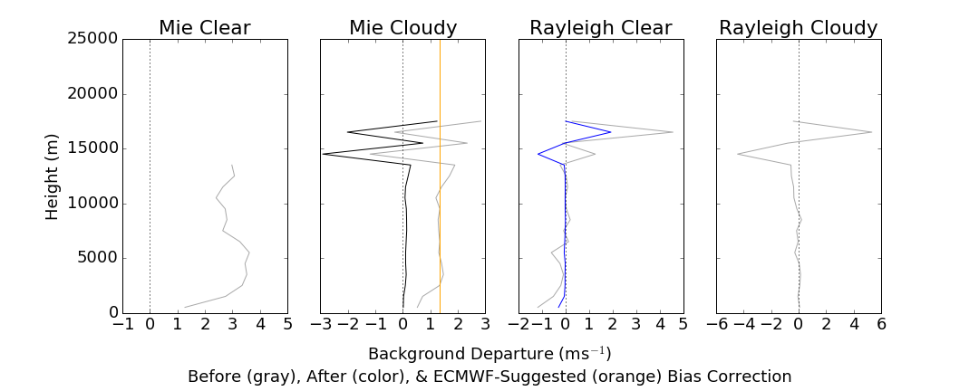
Departures after Bias Correction
Bias correction successfully removes most of the tropospheric bias
Some issue above ~ 14 km
Disconnect between mean and nodal BC (sum of each component != zero)

Slide 13
Comparison against AMVs
For comparison to AMVs, we are considering the bulk statistics for:
1-31 October 2018 (all cycles)
45°S to 45°N
Aeolus HLOS; AMV u wind component
AMVs from all GEO types: (all satellites, cloud & WV-derived winds)
Aeolus winds are bias corrected based on previous plots
The latitudinal boundaries are chosen in an effort to keep LOS & AMV comparisons somewhat consistent
Note, no colocation is performed

Slide 14
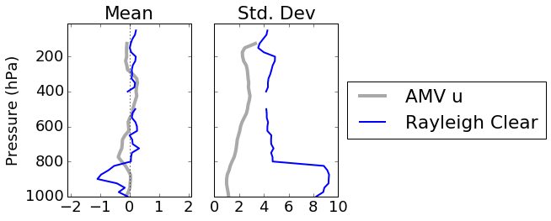
Comparison against AMVs
First, the AMVs show biases of their own
These may reflect both model biases and AMV retrieval biases
If there are model forecast biases, then it is possible that the bias is projected onto the Aeolus HLOS winds via BC procedure, since there is no anchoring performed
Not shown: AMV v means are slightly different, but standard deviations are the same

Slide 15
Comparison against AMVs
Compared to the AMVs, the Rayleigh Clear HLOS winds have:
A fundamentally different bias structure
Larger variance at all levels
A very large variance in the lowest 200 hPa

Slide 16
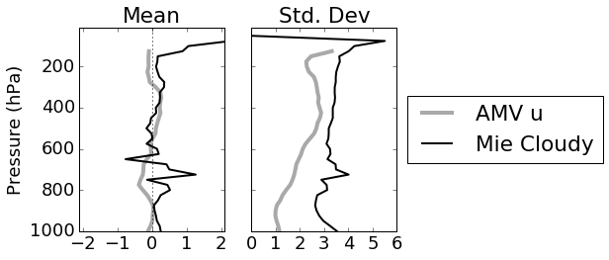
Comparison against AMVs
Compared to AMVs, the Mie Cloudy HLOS winds show:
More varying bias structures between 800 – 600 hPa
Much higher quality measurements near-surface in terms of bias and variance
Larger variance at all levels

Slide 17
Prescribing Observation Errors for Assimilation
The L2B product comes with estimates of observation error – hereafter EE
The EE is based on the retrieval – (e.g. signal-to-noise)
The applicability of this retrieval-based EE in data assimilation is under evaluation
In data assimilation, the observation error (hereafter σ_{o}) fundamentally provides the observation weight
The σ_{o} is not, however, simply an exact definition of the error in instrument space
For example, in radiance assimilation, it is not an NEdT. In temperature assimilation, it is not simply the noise level of the thermistor
Representative error is a key component of σ_{o} in data assimilation
Perhaps more important in HLOS wind assimilation – particularly for Rayleigh winds:
Scale issues (~100 km integration length) between model (handled as a single point) and observation
Sub-integration-scale variability translated to uncertainty
Therefore, σ_{o} is larger than the true observation error, so even if EE is perfect, it must be inflated
To understand the character of the EE relative to the background departures, the penalty is considered
$Penalty=\frac{1}{n} \sum{\frac{{\left(O−B\right)}^{2}}{σ_{o}^{2}}}$
For these plots, we calculate the penalty assuming σ_{o} = EE

Slide 18
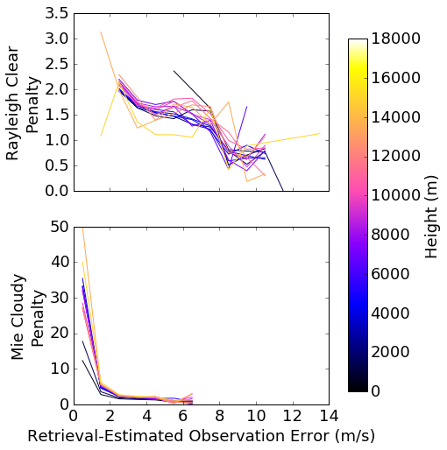
Penalty vs. Estimated Error
Penalty shows that the estimated errors for both Rayleigh Clear and Mie Cloudy HLOS winds are smaller than the variance of the background departure for most values of EE
Roughly a factor of 1.5-2x for Rayleigh Clear, as a function of height
Ratio < 1 for large error values
Mie penalties large in cases where EE is small (small denominator)

Slide 19
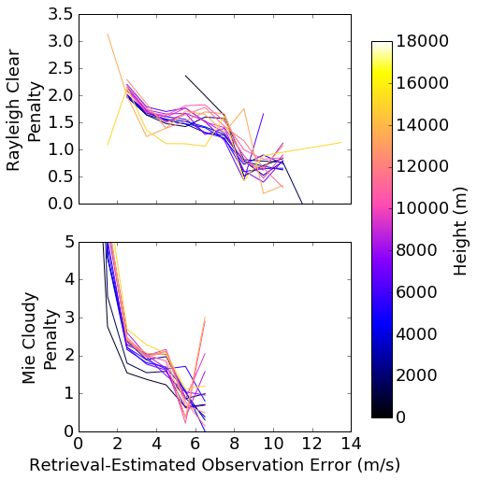
Penalty vs. Estimated Error
Zooming in, Mie Cloudy departure variance 1-2x as large for wind EE greater than 2 m/s

Slide 20
Prescribing Observation Errors for Assimilation
To account for EE in the definition of σ_{o} a simple error model has been implemented as a function of height
σ_{o}(z) = m(z) * EE + b(z)
A target penalty is used to initially tune the vertical profiles of m & b
In a perfect world, Penalty == 1:
Background error is non-zero, thus making penalty larger
Representativeness error makes σ_{o} larger than ‘pure’ observation error
Representativeness can also have horizontally and vertically correlated error structures, which are not well-handled in DA and are thus handled by inflation of error variance
A value of 0.45, which is similar to values used for AMVs, is initially used for both Mie Cloudy and Rayleigh Clear
This model was designed to provide a (overly?) simple flexibility to tune the error, either as a multiplicative inflation of EE or as an additive constant.

Slide 21
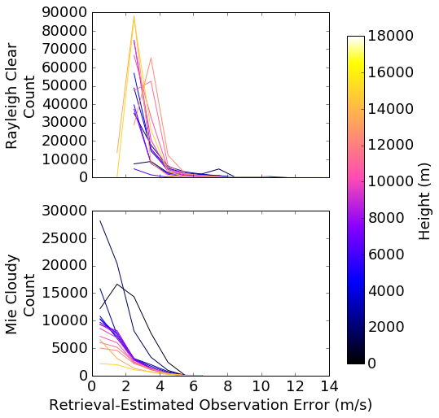
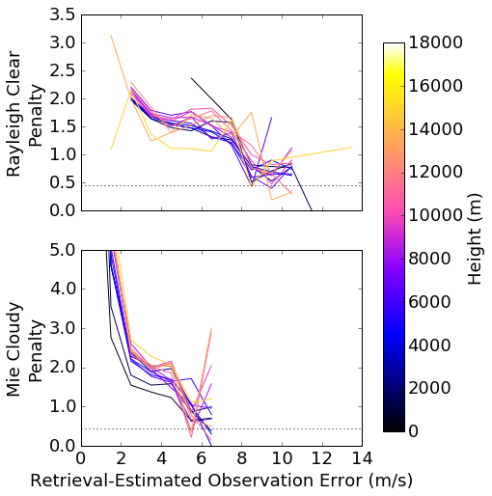
Penalty vs. Estimated Error
An important point to this tuning exercise is that all obs are tuned to a single penalty
The tuned m(z) & b(z) values will be largely weighted by EE values with the most observations

Slide 22
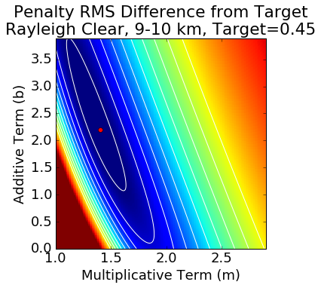
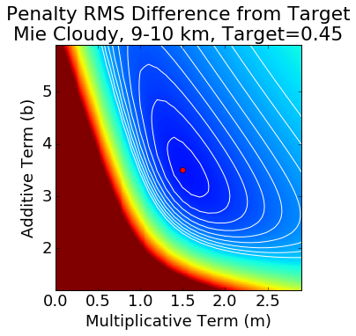
The target penalty was used to determine values of m(z) & b(z) as a function of vertical height bins
The m & b that minimize the difference between the new & target penalty (shaded/contoured) was selected at each level
Plots shown are for 9-10 km

Slide 23
At This Point…
Outside of a few minor checks and additional QC, I am mostly prepared to run full assimilation tests
CTL is run
2-4 experiments:
Pure ECMWF QC
EC QC + Additional blacklisting (e.g. Rayleigh near-surface)
Increased observation weight (tuning error to a higher penalty)
Target of first and second experiments are the Aeolus NWP Impact Assessment Working Meeting in September
Integration into GEOS Forward Processing will be easy, even if only passive
No rush due to instrument issues
Stability of second laser will determine priority
This effort has involved a lot of collaboration between the US centers – continued leverage of NESDIS TMP project is desirable

