Slide 1
Preliminary Comparisons of DAWN, Dropsonde and Aeolus Wind Observations
Steven Greco¹, G.D. Emmitt¹ , S.A. Wood¹ and Sharon Rodier²
¹ – Simpson Weather Associates, Charlottesville, VA; ² – LARC-E304/SSAI, Hampton, VA
Working Group Meeting for Space Lidar Winds
Hampton, Virginia
July 10-11, 2019

Slide 2
Airborne DAWN Underflights of Aeolus
April 17-30, 2019 NASA Airborne Campaign
Based out of Palmdale, CA
Airborne DAWN and YES Dropsonde aboard NASA DC-8
5 underpasses of Aeolus in April 2019
Over the eastern Pacific Ocean
- Two transects between US west coast and Hawaii
- Three missions off west coast of US (30 – 50 N)
- Mostly clear to partly cloudy conditions
- Low and high aerosol segments

Slide 3
DAWN Wind Measurements
DAWN
- 2 micron coherent
- 5Hz, 20 shots per look for April flights
DAWN wind vector products are low bias (< .25m/s) and good RMSD in comparisons with dropsondes (see next slide)
3-D Wind Profiles computed for 5-look DAWN scanning pattern (5 LOS)
- 20 shot integration
- 4-5km horizontal resolution
- 75m vertical resolution along LOS
- 33m resolution for vertical profiles
U and V of DAWN profile used to compute a DAWN Aeolus projection of HLOS for every scan

Slide 4
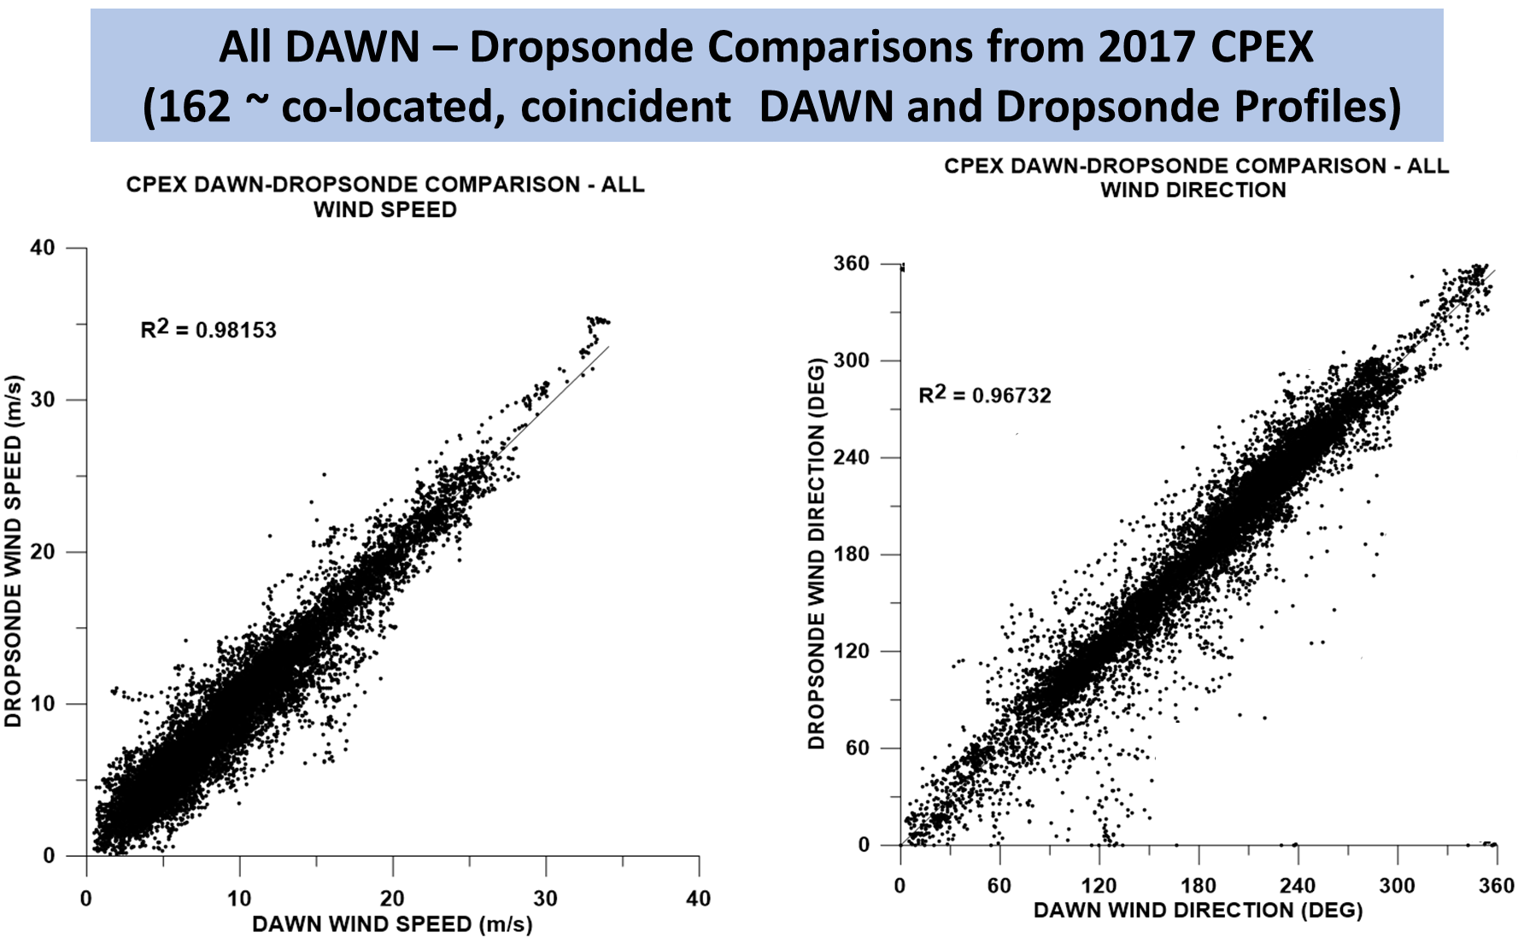
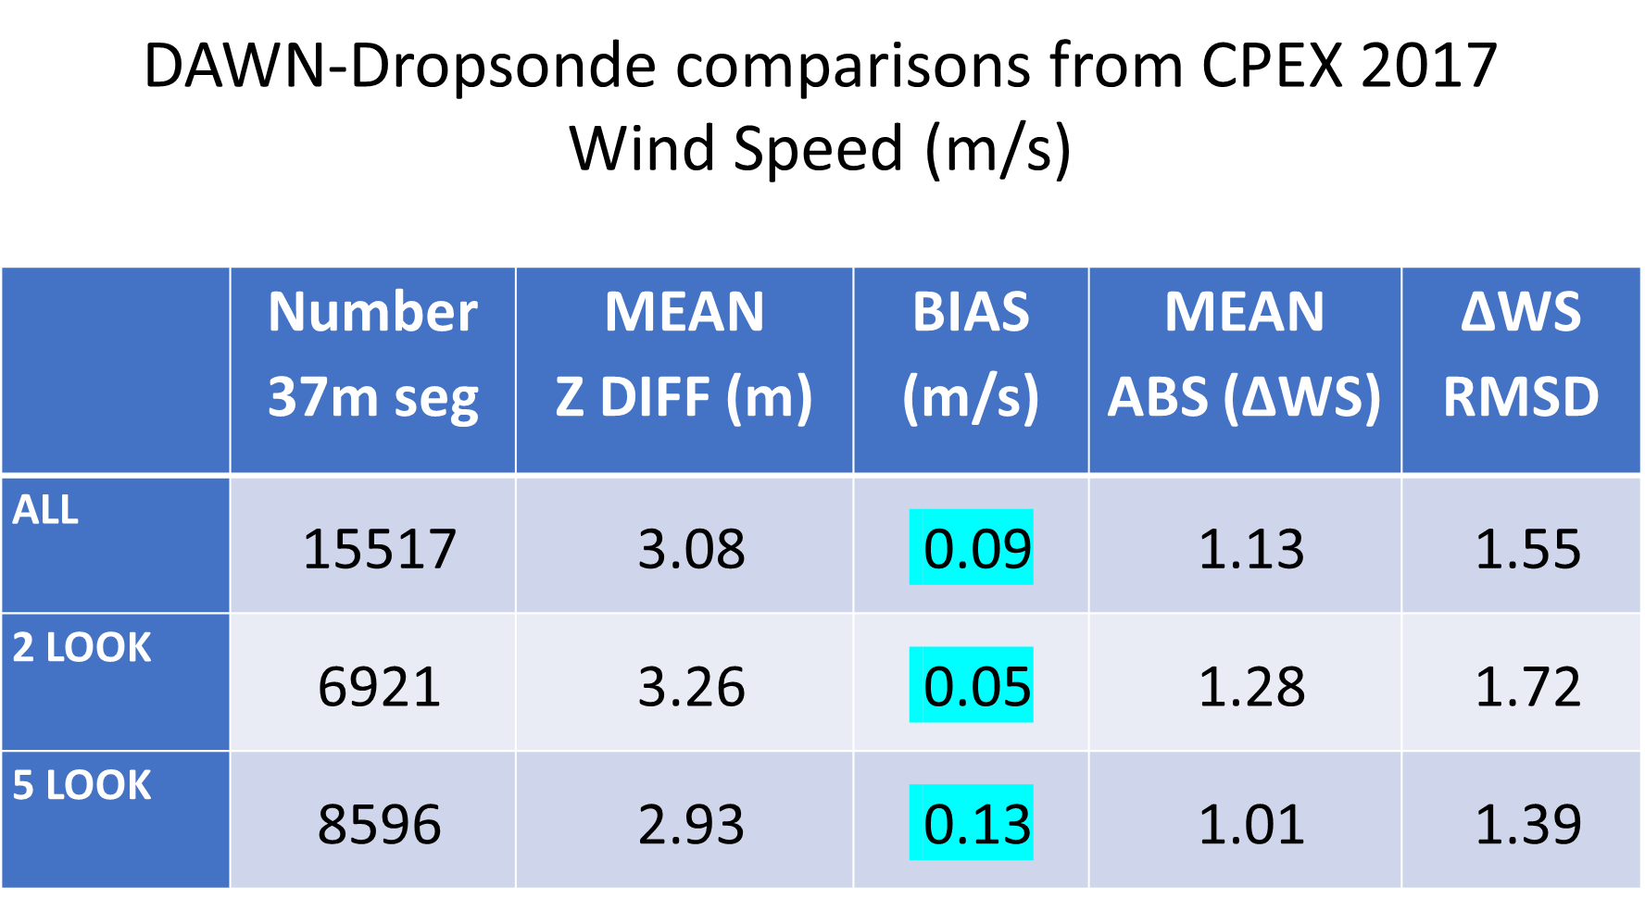
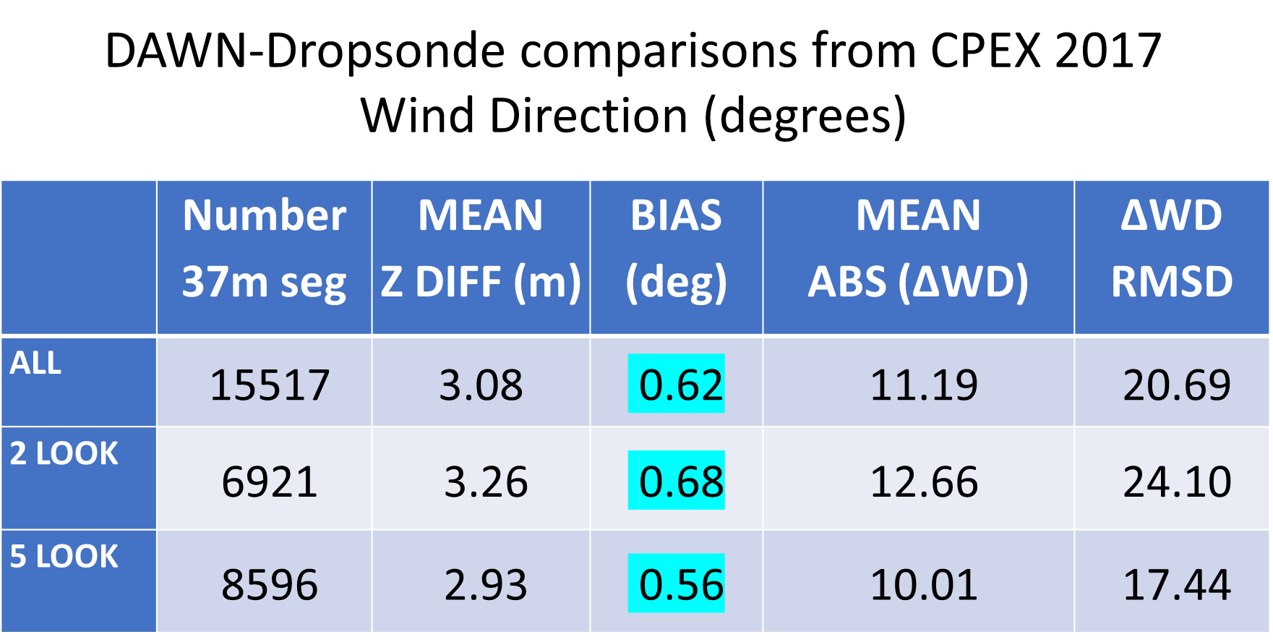
DAWN data quality
CPEX 2017

Slide 5
Aeolus LOS Wind Product
Non-scanning single LOS for Rayleigh and Mie channels
  During April underflights the first laser was operating at nearly 50% of the design optical power
  Not all biases or best calibration data have been accounted for in the preliminary comparison to be shown here
  Using Level 2B data products for comparison
  RAYLEIGH CLEAR
  RAYLEIGH CLOUDY
  MIE CLEAR
  MIE COUDY
Rayleigh derives wind from molecular returns
  Baseline horizontal integration/Observation scale: ~85km; 24 vertical levels
  Vertical resolution - ~ 250-500m in PBL/bottom 1km to 1km in troposphere
  Rejection – observation error quantifier (estimate) > 6.6 m/s (below 200 mb)
Mie derived winds from clouds and aerosols
  Horizontal integration: ~ 10-12 km; 24 vertical levels
  Vertical resolution: ~ 250-500m in PBL/bottom 1km to 1km in troposphere
  Rejection – observation error quantifier (estimate) > 4.5 m/s

Slide 6
0430 DAWN-AEOLUS HLOS COMPARSIONS
AEOLUS S-N 02:27 - 02:29Z
DAWN N-S 02:13 – 02:54Z (~ 600 km)
DAWN profiles from 5 Looks computed every ~5km
7 AEOLUS profiles along DAWN under-flight track
- Rayleigh Clear (uses 21-24 winds)
- Mie Cloudy ( uses 1-4 winds)
4) DAWN Aeolus projection HLOS shown for 123 DAWN profiles along DAWN underflight
5) 7 DAWN “Integrated” profiles each utilizing 17 individual DAWN profiles to match Aeolus Level 2B resolution

Slide 7
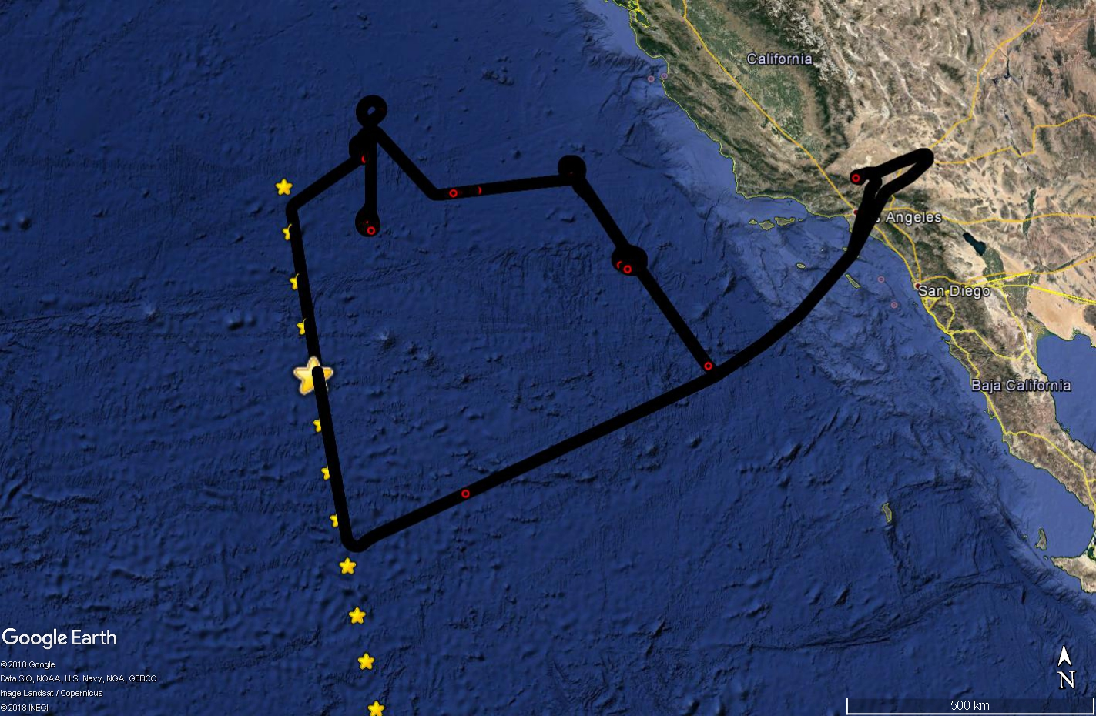

Slide 8
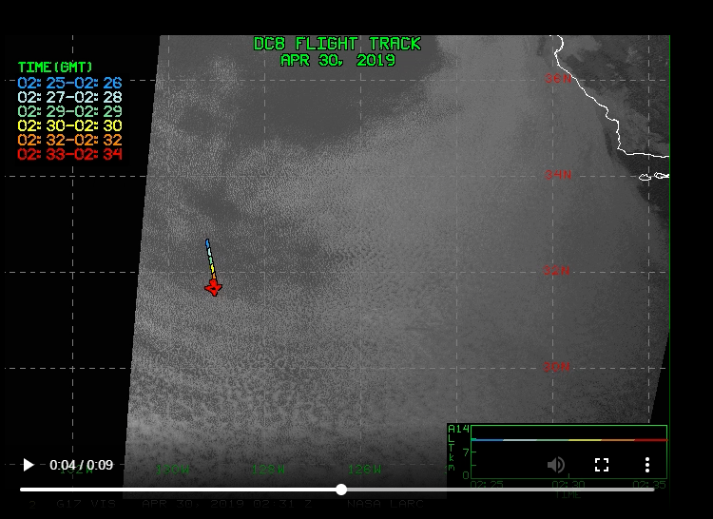

Slide 9
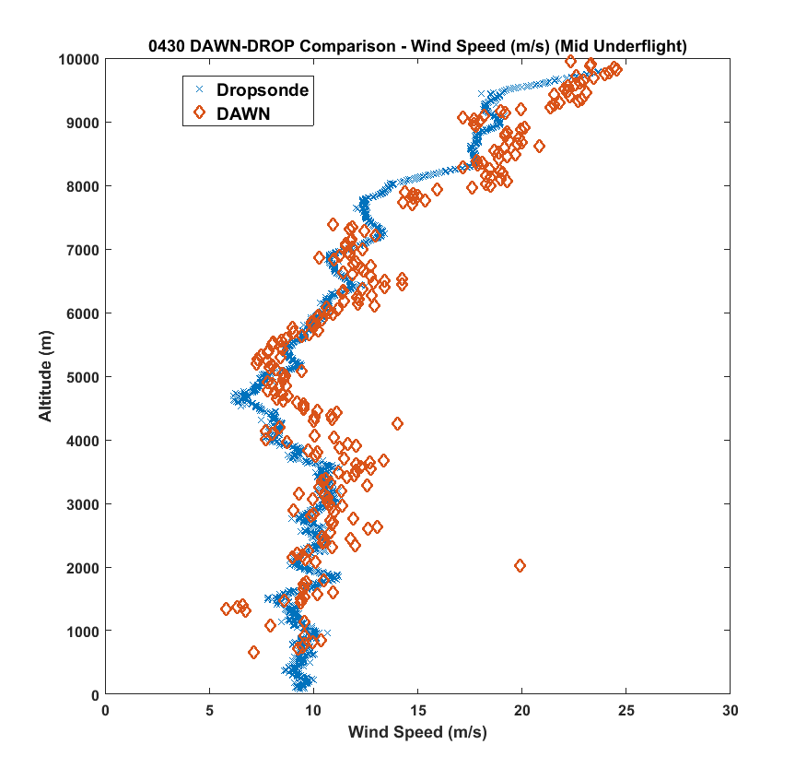
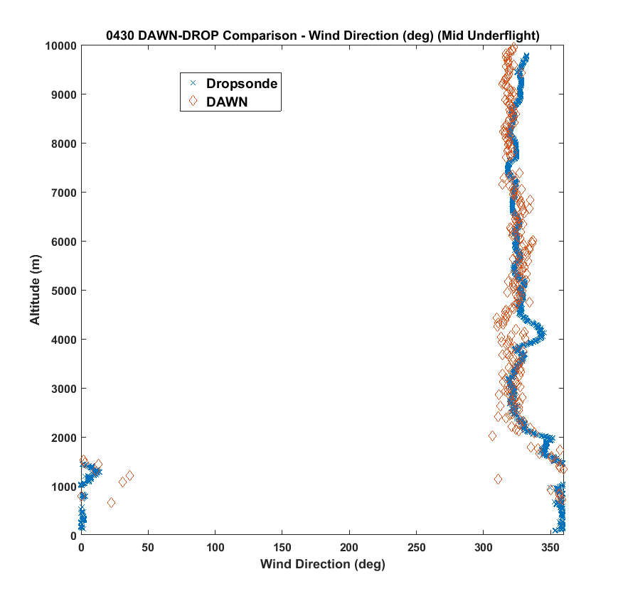
DAWN-DROP COMPARISON MIDDLE OF UNDERFLIGHT

Slide 10
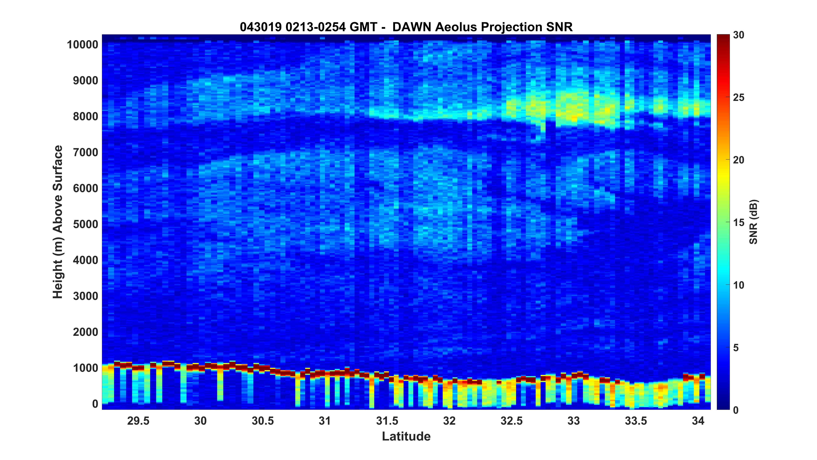
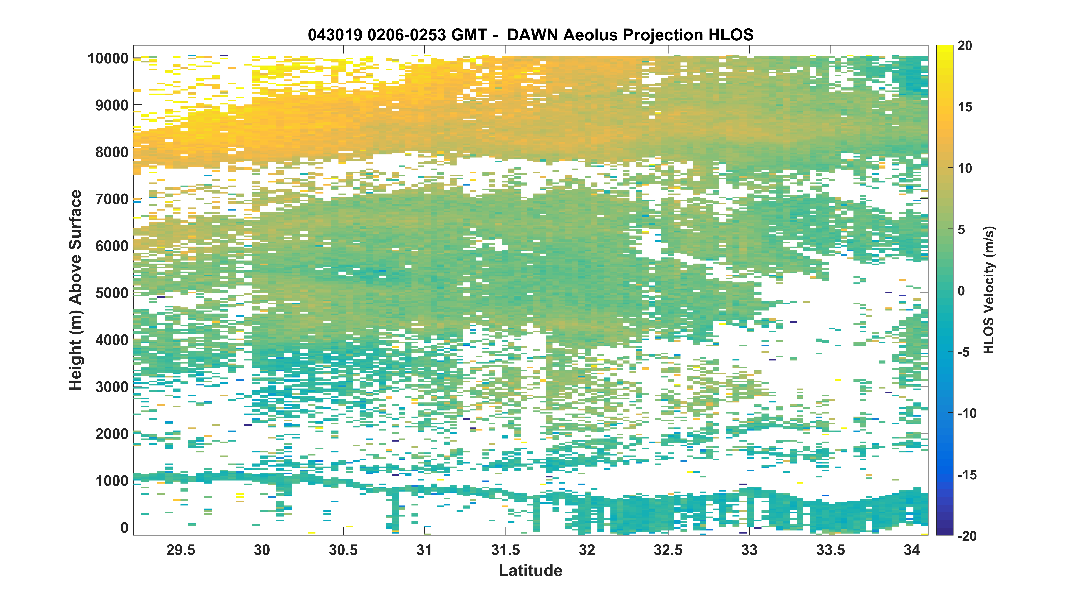

Slide 11
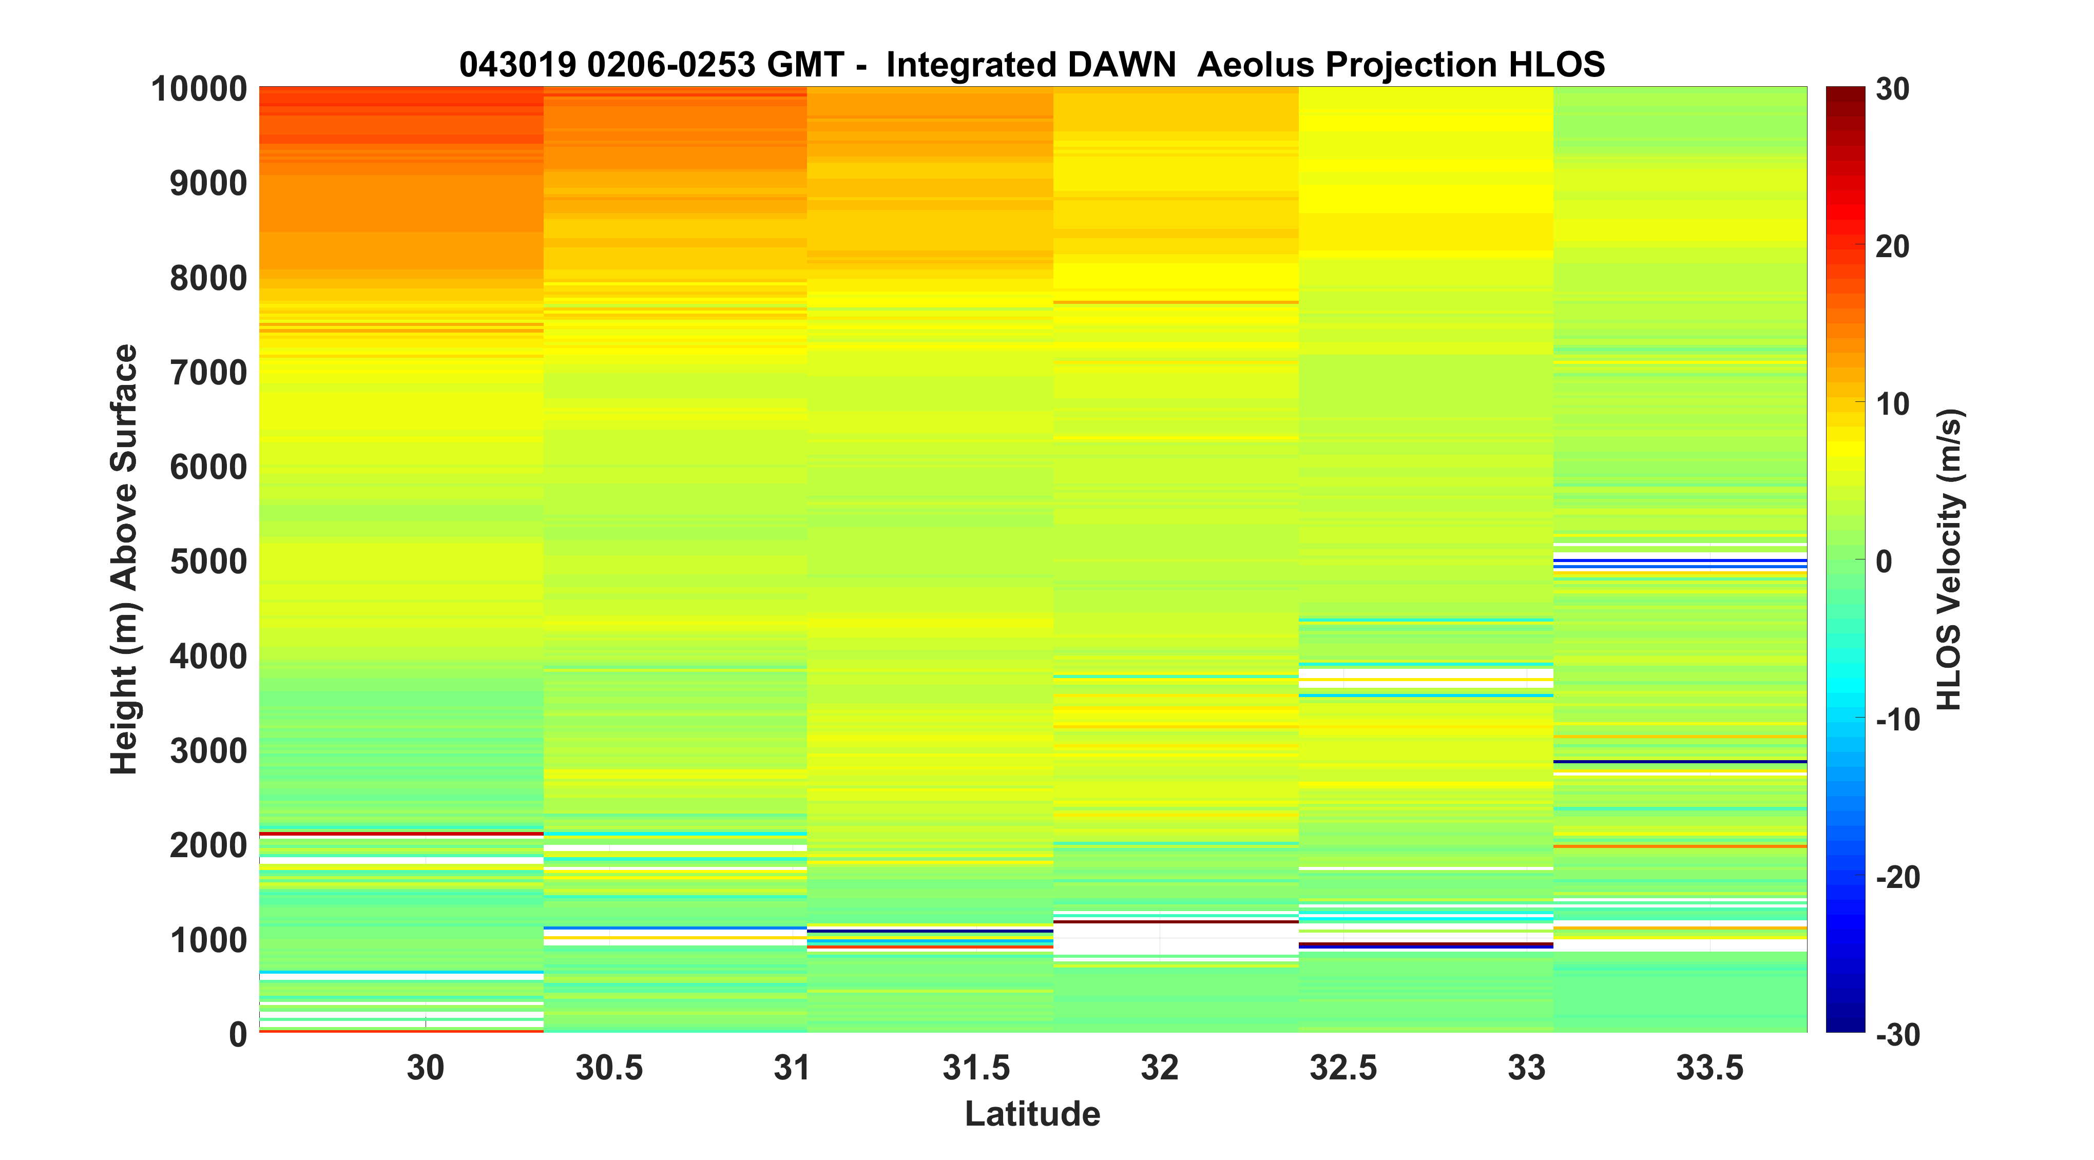
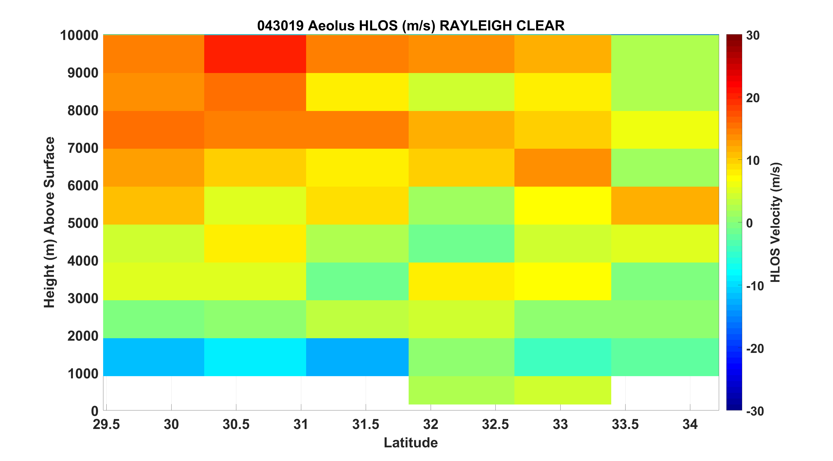

Slide 12
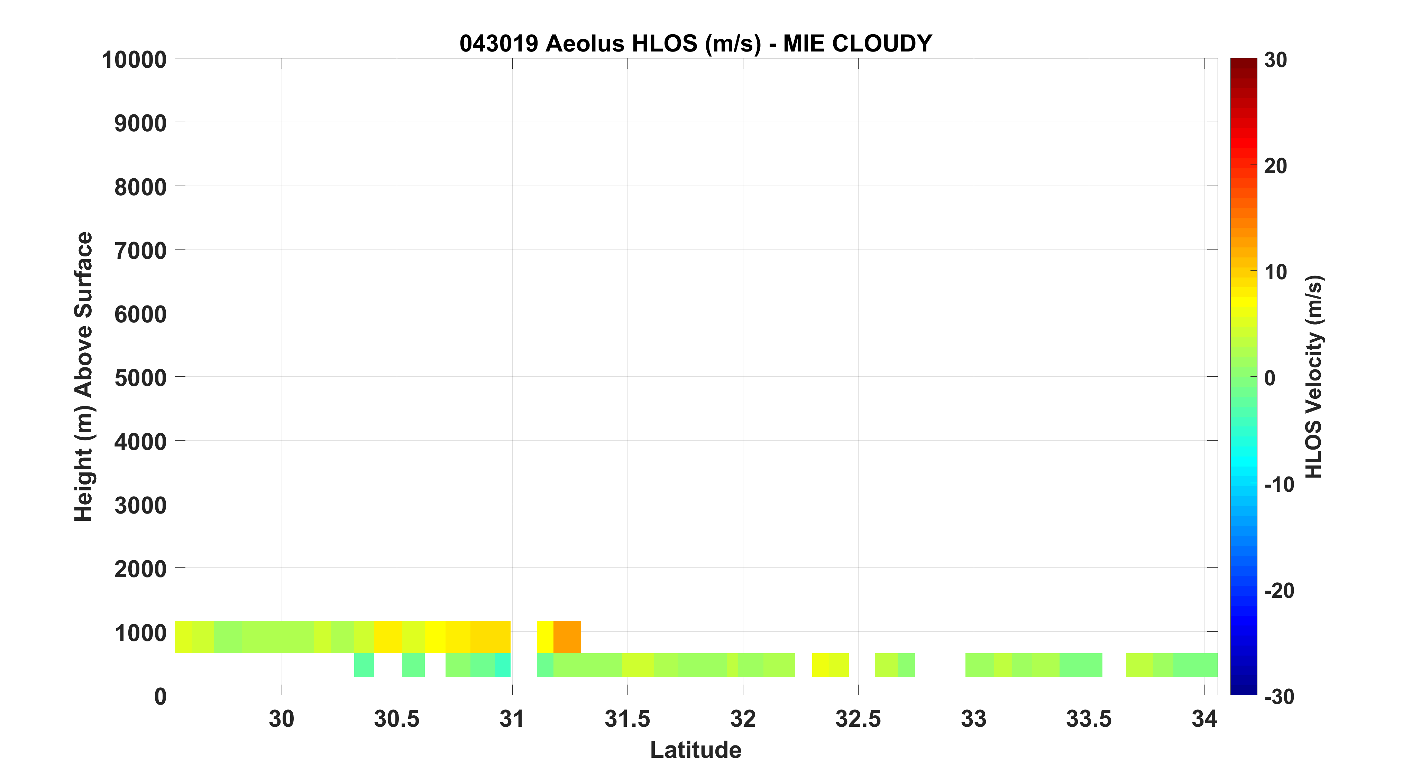

Slide 13
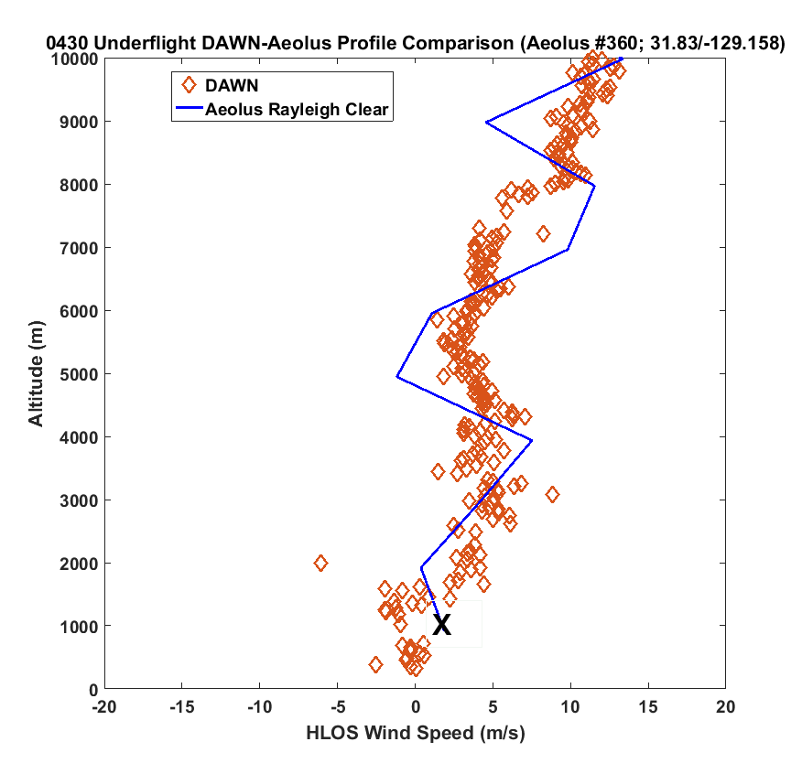
AEOLUS
DIRECTLY
OVERHEAD
X – Mie Cloudy

Slide 14
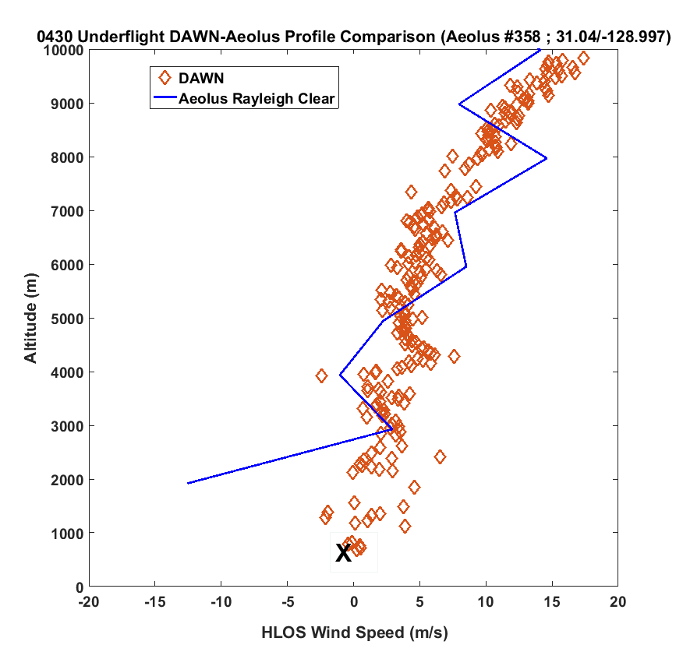
X – Mie Cloudy

Slide 15
0423 DAWN-AEOLUS HLOS COMPARSIONS
AEOLUS S-N 02:28 - 02:29Z
DAWN N-S 02:06 – 02:53Z(~ 600 km)
DAWN profiles from 5 Looks computed every ~5km (119 profiles)
7 AEOLUS profiles along DAWN under-flight track
- Rayleigh Clear (21-24 winds used)
- Mie Cloudy (1-4 winds used )
4) DAWN Aeolus projection HLOS shown for 123 DAWN profiles along DAWN underflight
5) 7 DAWN “Integrated” profiles each utilizing 17 individual DAWN profiles to match Aeolus Level 2B resolution

Slide 16
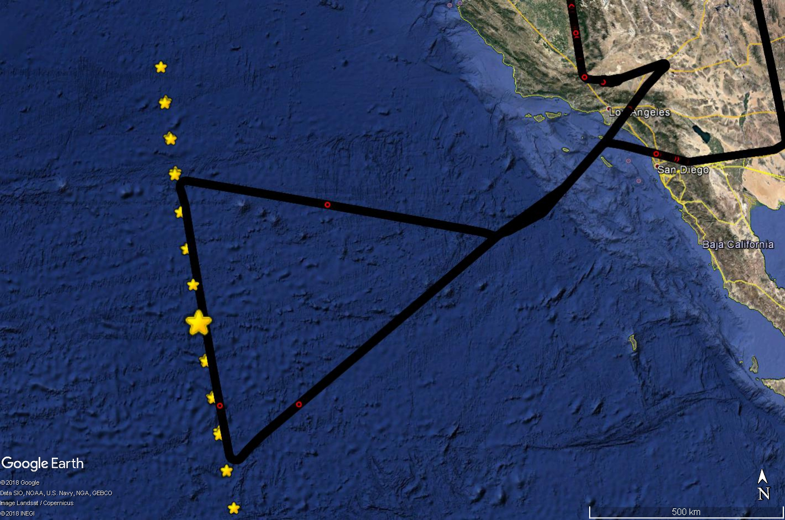

Slide 17
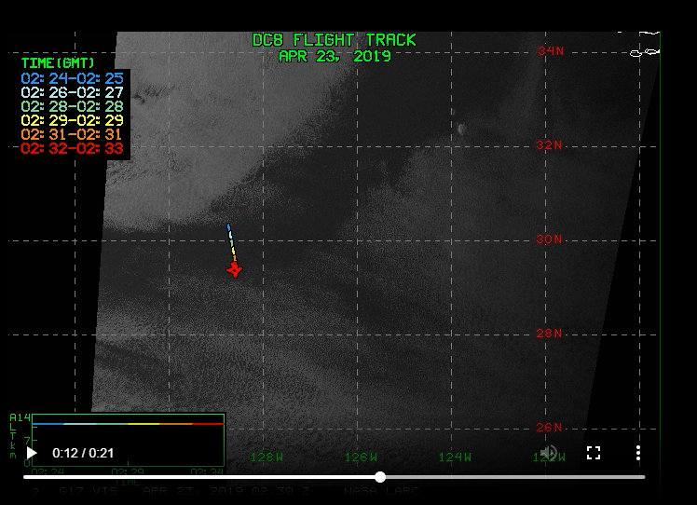

Slide 18
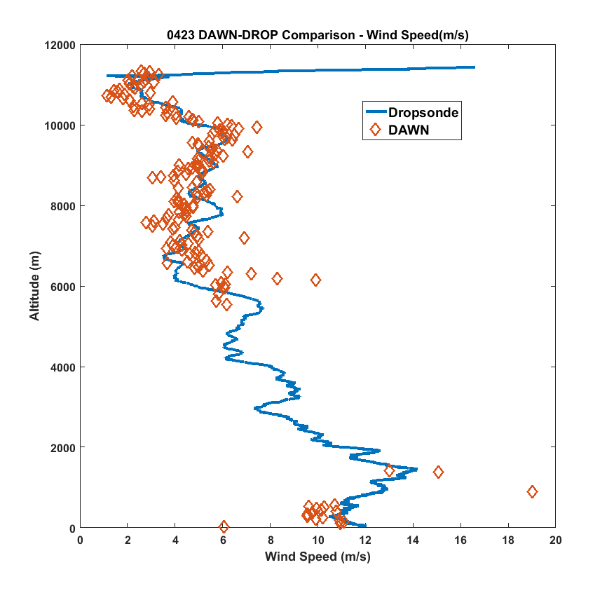
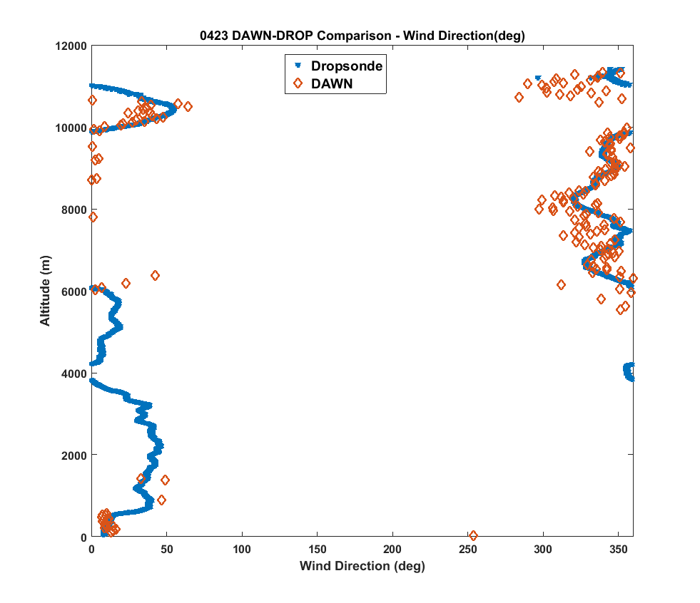
DAWN-DROP COMPARISON MIDDLE OF UNDERFLIGHT

Slide 19
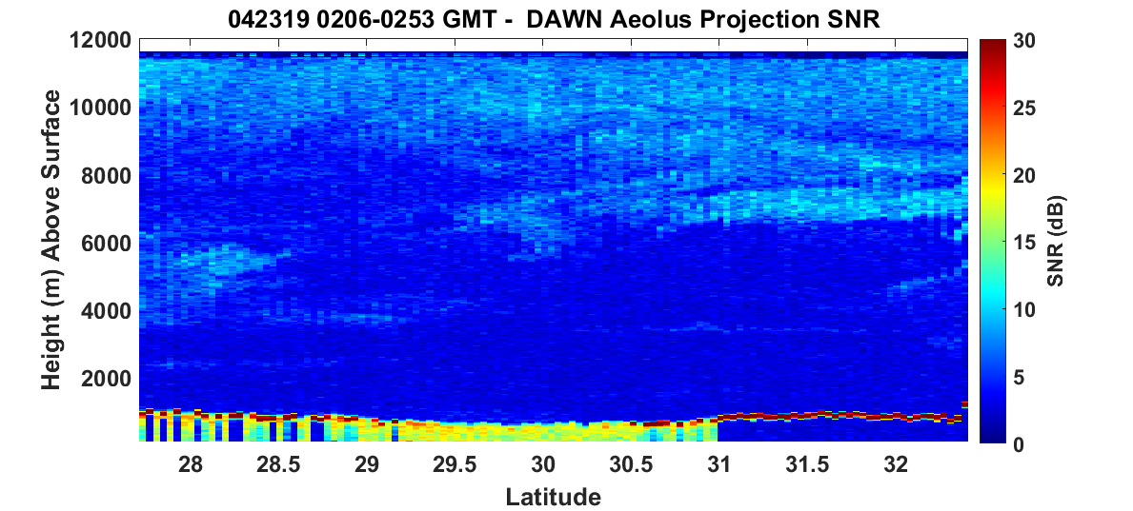
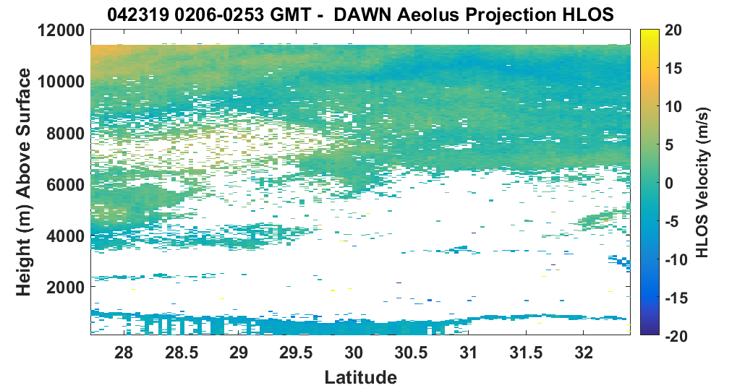

Slide 20
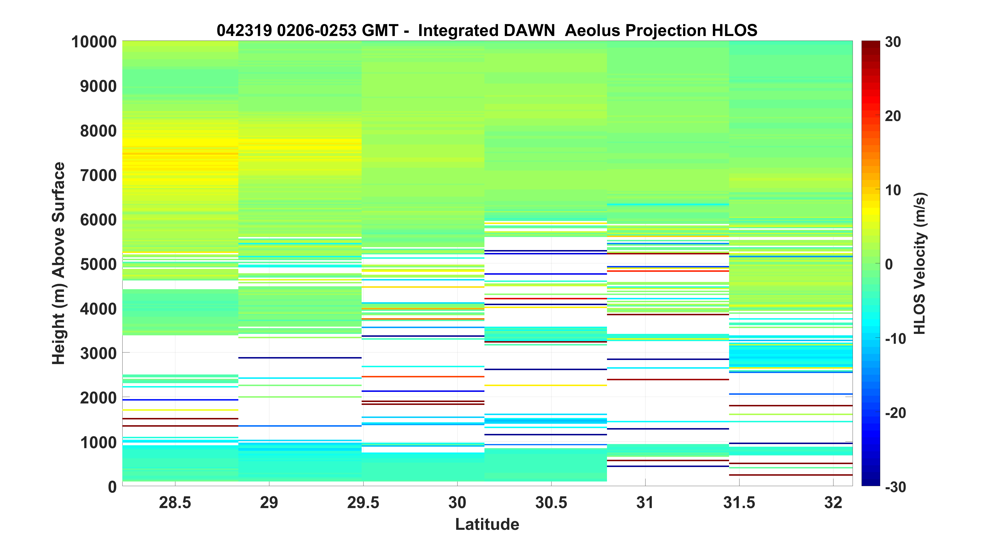
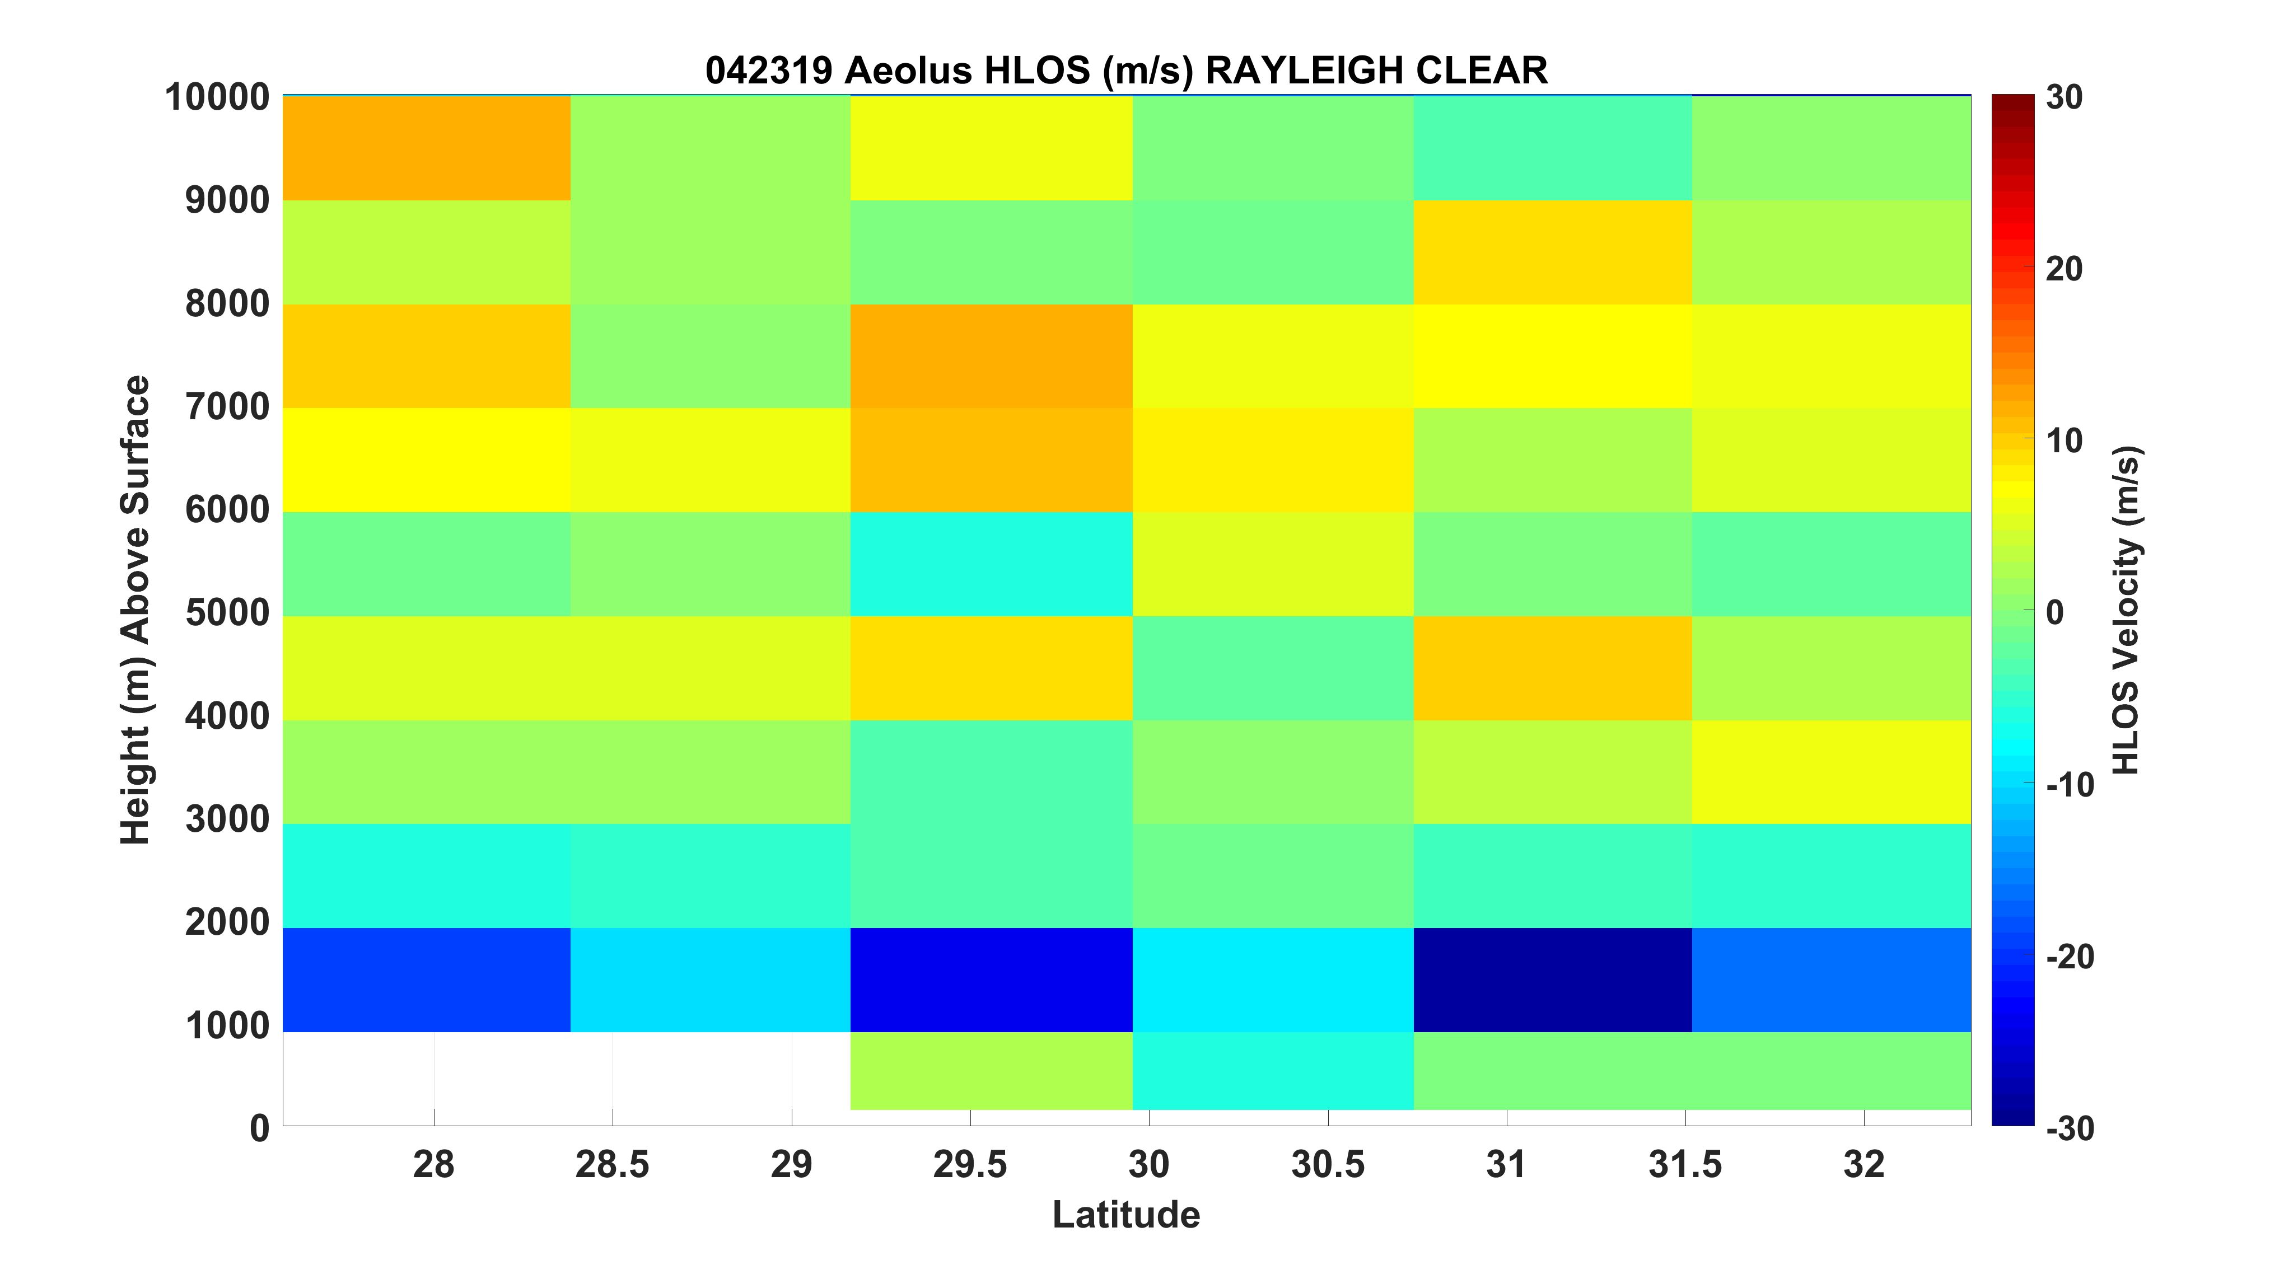

Slide 21
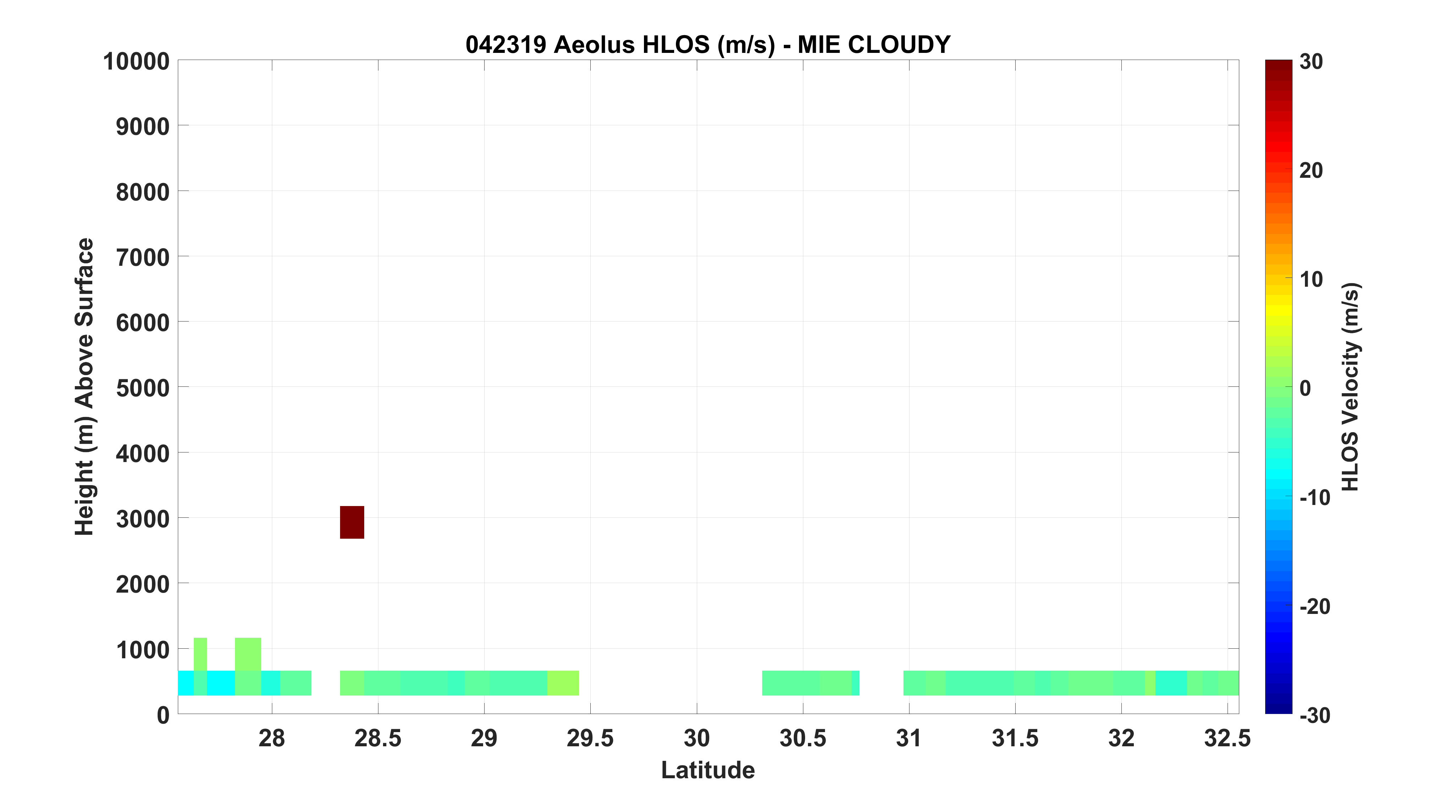

Slide 22
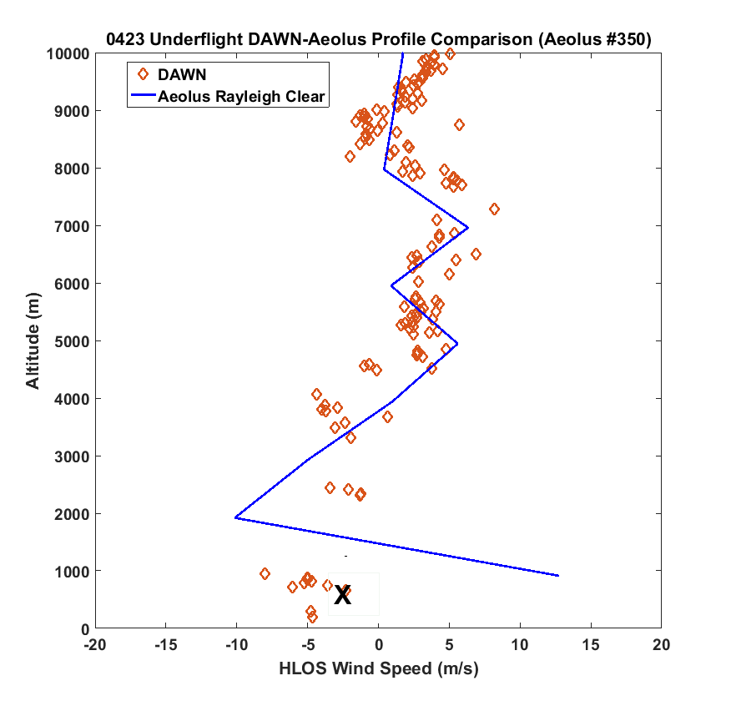
X – Mie Cloudy

Slide 23
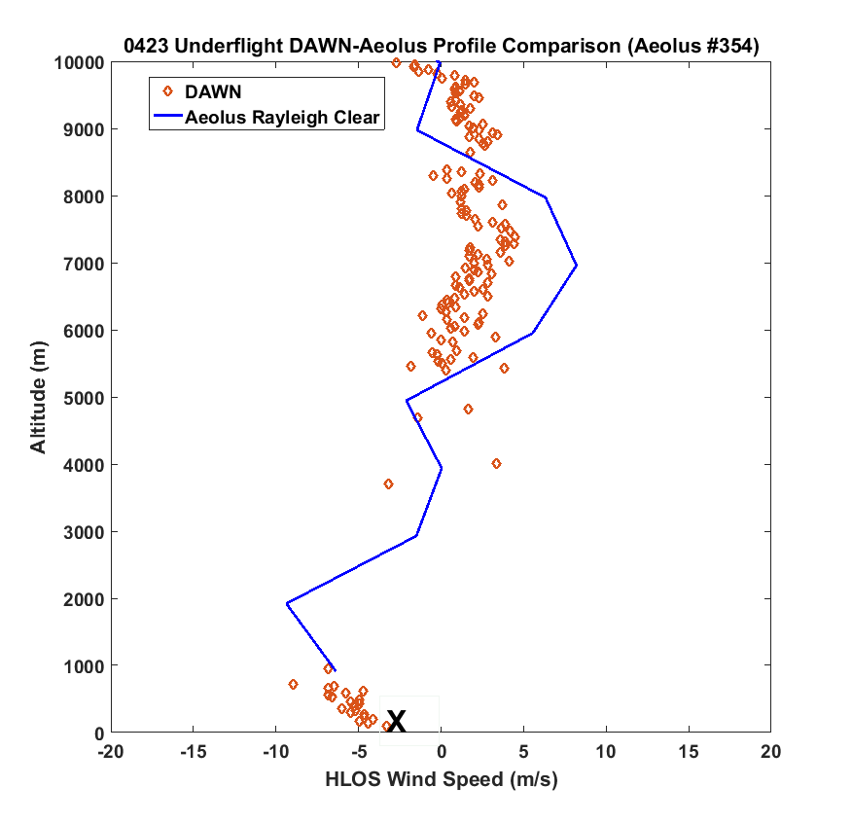
AEOLUS
DIRECTLY
OVERHEAD
X – Mie Cloudy

Slide 24
0418 DAWN-AEOLUS HLOS COMPARSIONS
AEOLUS S-N 02:56 - 03:00Z
DAWN N-S 01:51 – 03:32Z
7 AEOLUS profiles along DAWN under-flight track
- Rayleigh Clear (21-24 winds)
- Mie Cloudy (1-4 winds)
4) DAWN mostly operated in STARE (1 Look) mode, only small portion of underflight where full profiles measured
5) DAWN SNR and Aeolus projection HLOS shown for 30 DAWN profiles along DAWN under-flight (but other short segments of 2-4 scans/profiles)

Slide 25
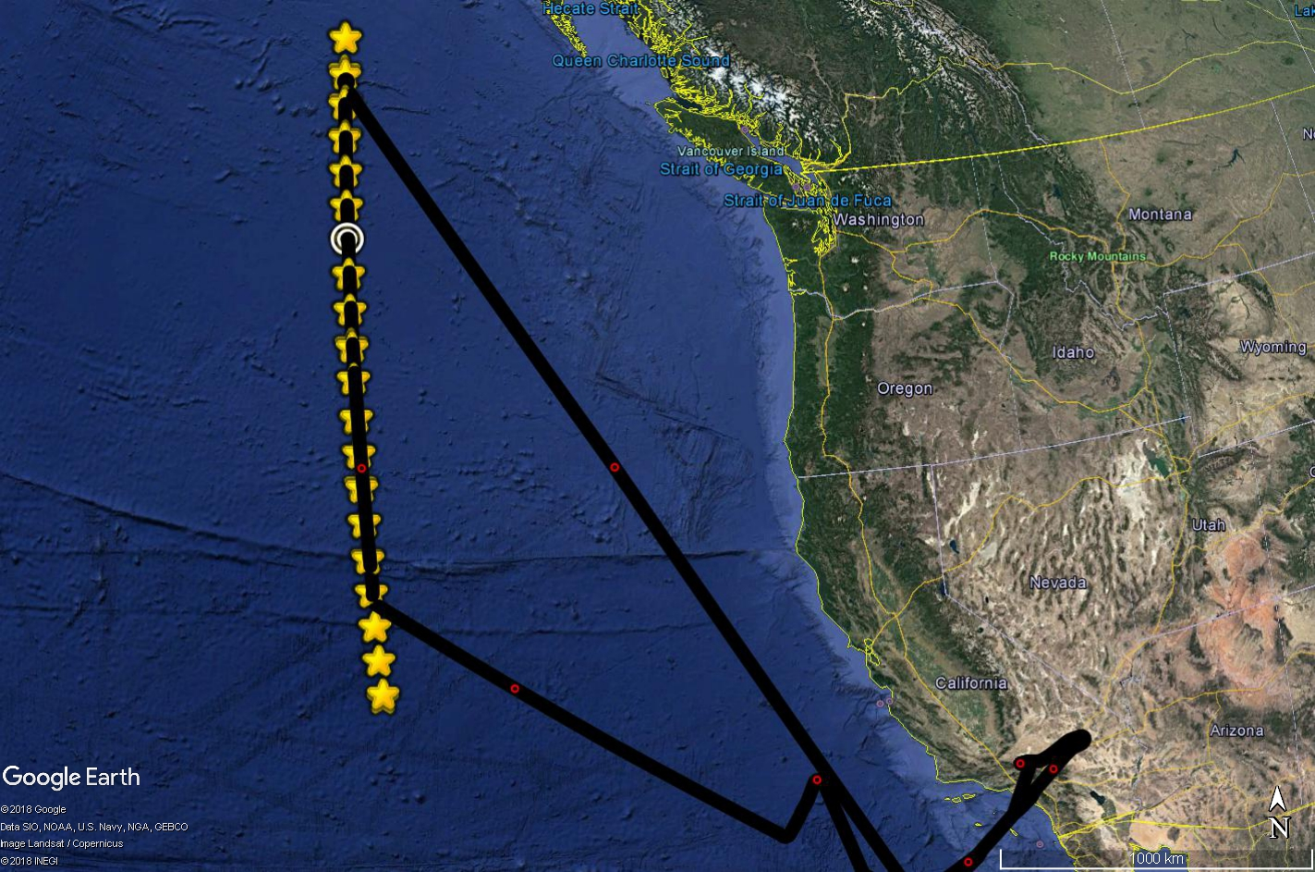

Slide 26
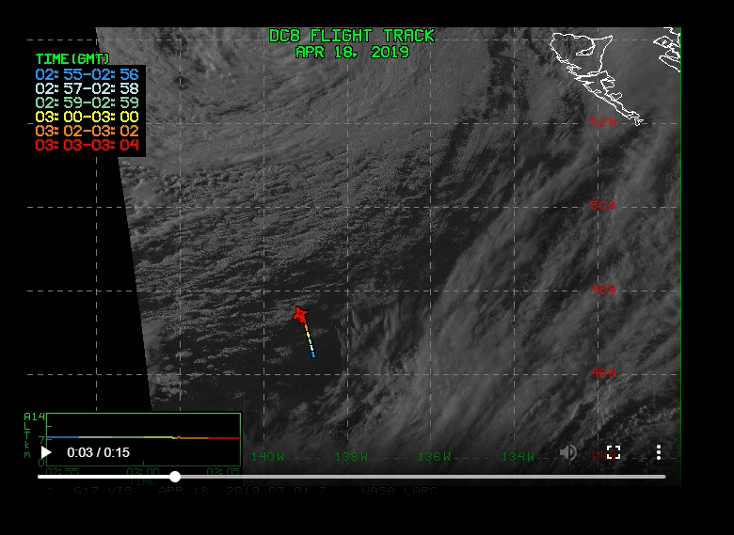

Slide 27
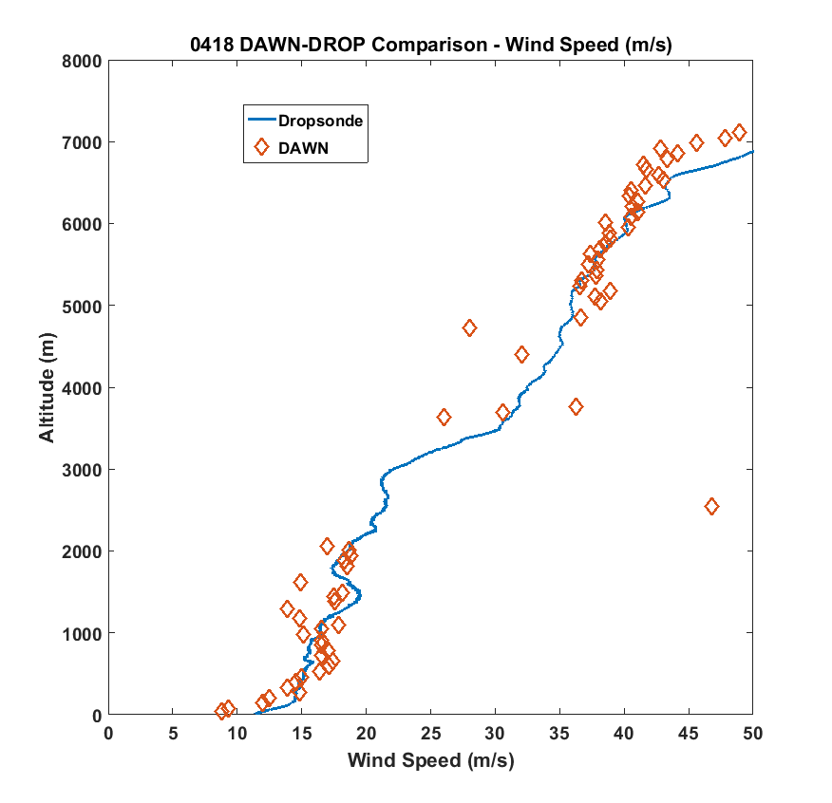
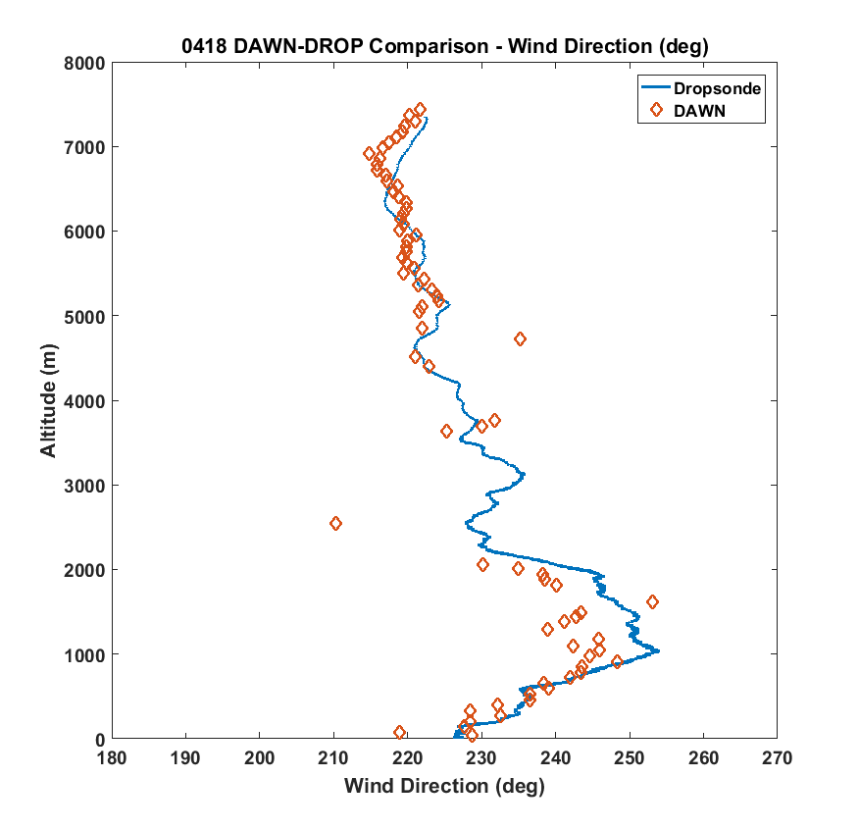
DAWN-DROP COMPARISON MIDDLE OF UNDERFLIGHT

Slide 28
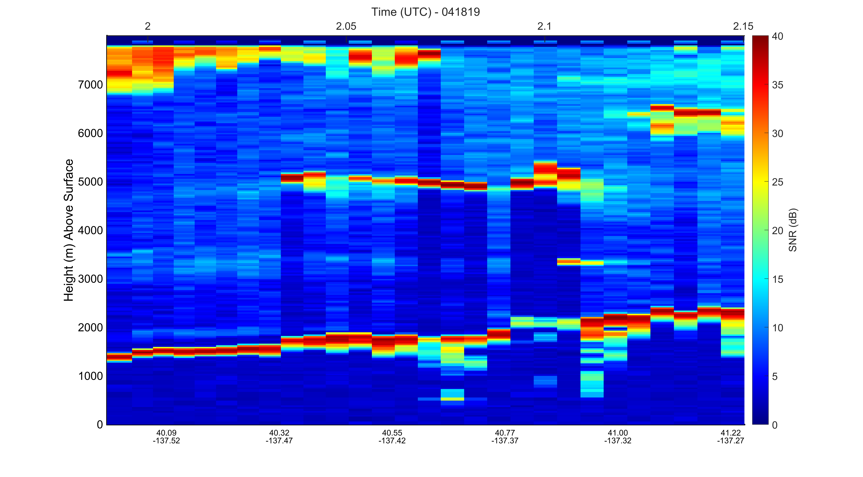
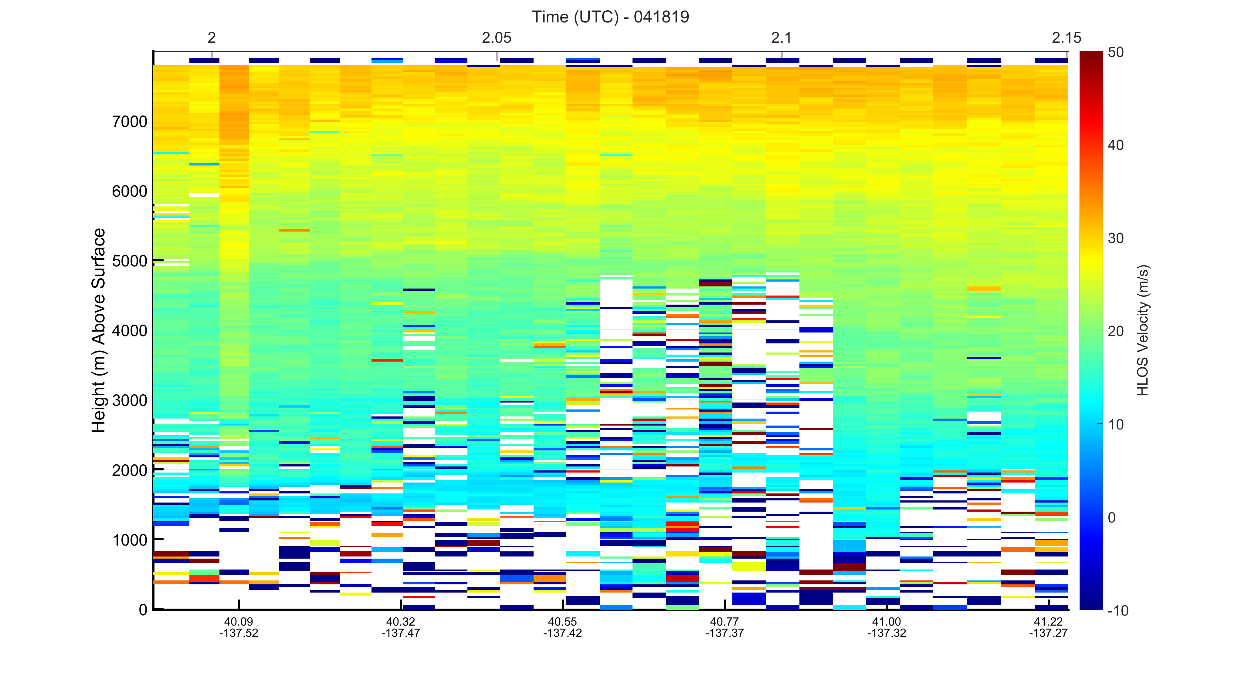

Slide 29
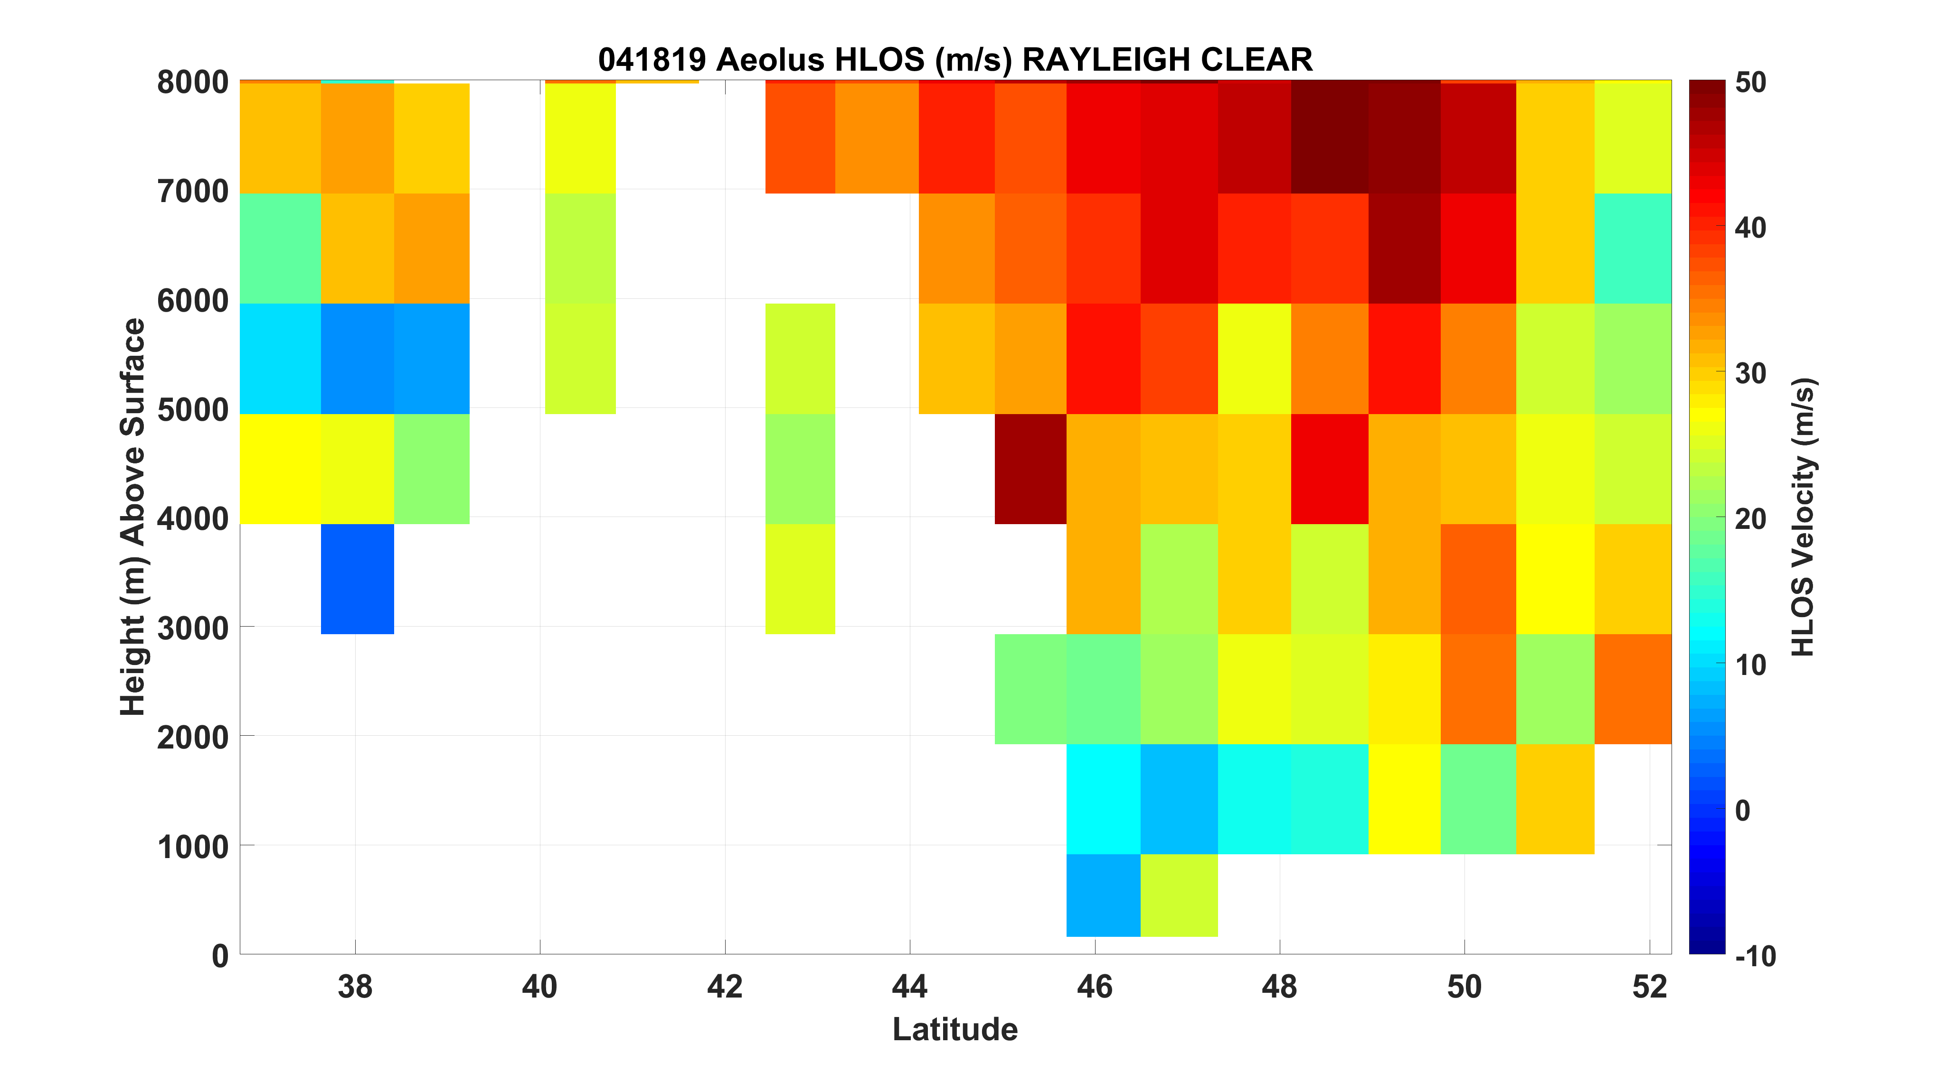

Slide 30
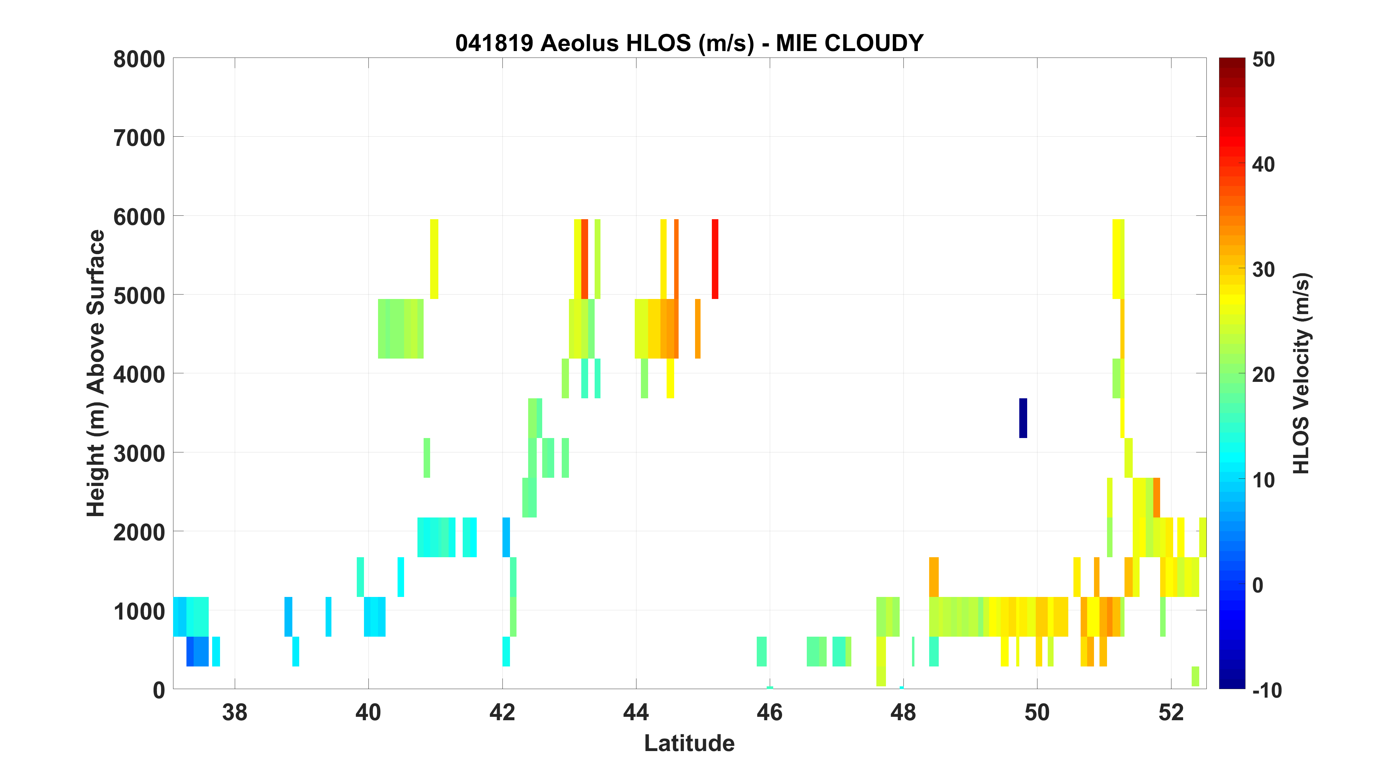

Slide 31
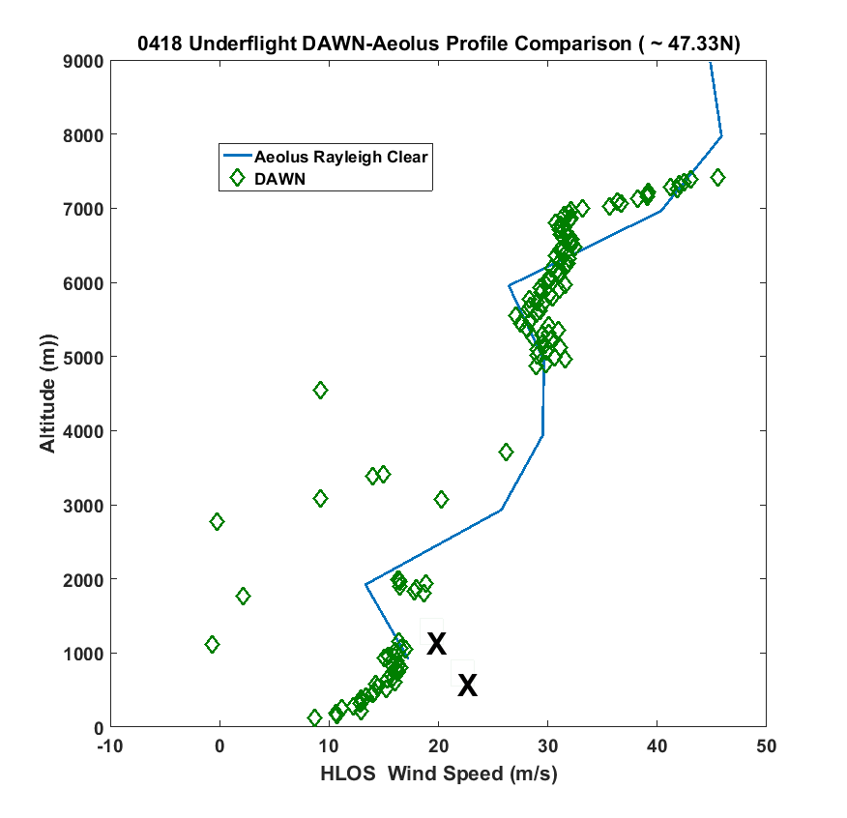
AEOLUS
DIRECTLY
OVERHEAD
X – Mie Cloudy

Slide 32
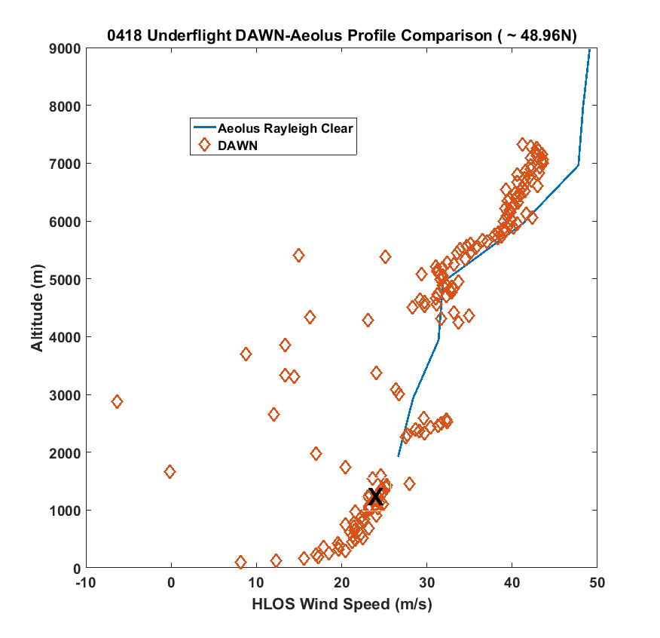
X – Mie Cloudy

Slide 33
Summary
Preliminary comparisons
- Neither data set final
- More experience needed working with Aeolus products
DAWN performed well in relatively clean/low aerosol and low to partly cloud conditions
- Comparison with Dropsondes
- Often complete profiles
Even with weakened laser in April 2019, very encouraging comparisons between DAWN and Aeolus
  RAYLEIGH Clear
More work to follow

Slide 34
ADDITIONAL SLIDES

Slide 35
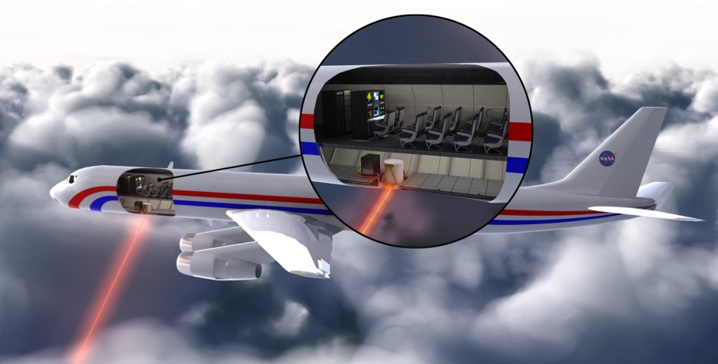
Doppler Aerosol Wind (DAWN) Lidar System
Instrument PI: Michael J. Kavaya, NASA LaRC
DAWN Capabilities
High coherent Doppler lidar sensitivity to aerosol backscatter, enabling excellent vertical resolution, accuracy, and atmospheric coverage
Provides vertical profiles of horizontal wind vectors, LOS range wind and wind turbulence profiles, and relative aerosol backscatter profiles
Optional number of azimuth angles (up to 12) permits trade of wind variability determination vs. horizontal resolution
Optional number of laser shots averaged for each LOS wind profile permits trade of atmospheric coverage vs. horizontal resolution
Data may be processed multiple ways to provide various combinations of vertical and horizontal resolution, atmospheric coverage, and expected accuracy statistics

Slide 36
Comparison setup
Ground return calibration while over Florida peninsula
  Straight and level between 3 and 4 km AGL
  Perform calibration flight segment before and after an over-water mission clouds and time permitting.
  Major changes in the DAWN system were made on June 17th.
  Calibration products:
    Pitch correction (~.5 degrees)
    Yaw correction (~.5 degrees)
    Roll correction (~ < .01 degrees)
    Height correction (timing of outgoing pulse)
    Unknowns folded into the pitch corrections (< .02 degrees)
  No other corrections made to the DAWN data prior to dropsonde comparisons.
162 dropsondes over 14 flights were used in the comparisons (~15,000 height segments of ~ 66 meter DWL vertical resolution)
Used only DAWN high resolution (66m processing gates and 33m display gates)

Slide 37
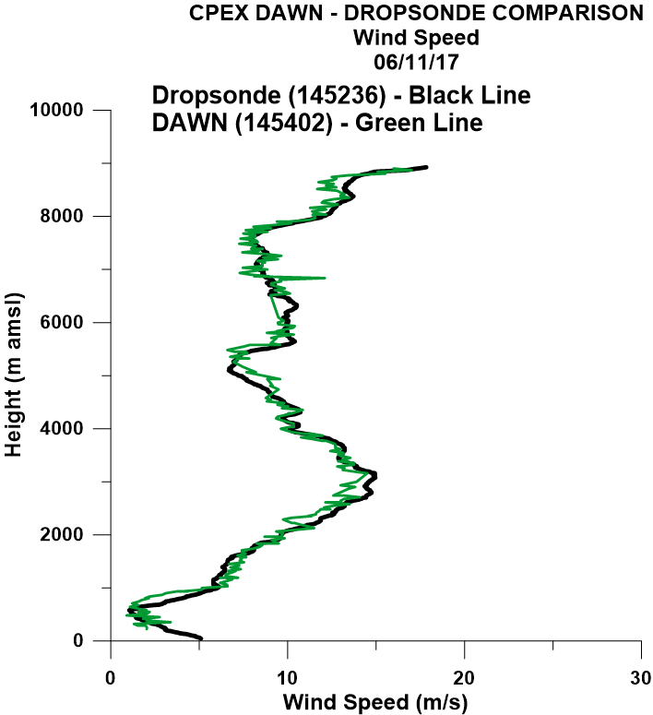
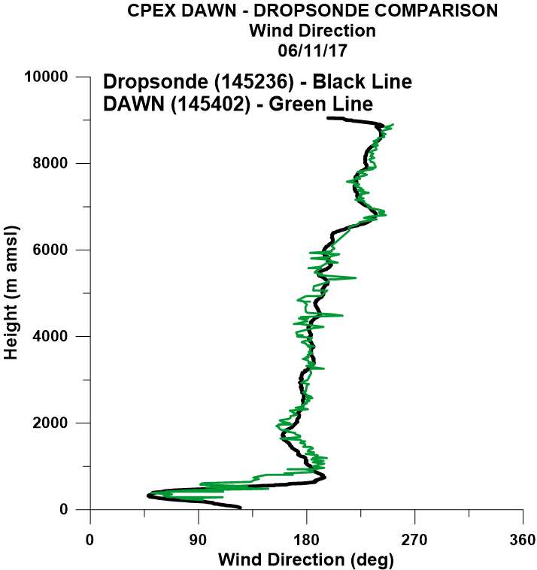
Example DAWN-Dropsonde comparison during CPEX 2017

Slide 38
Differences by height interval (km)
Height Interval | Number 37m seg | MEAN Z DIFF (m) | BIAS (m/s) | MEAN ABS(ΔWS) | ΔWS RMSD
0-3 km | 4935 | 2.52 | -0.02 | 0.95 | 1.26
3-6 km | 2079 | 2.91 | 0.26 | 1.20 | 1.62
6-9 km | 5774 | 3.32 | 0.27 | 1.14 | 1.58
9-12 km | 2732 | 3.70 | -0.20 | 1.38 | 1.84
Height Interval | Number 37m seg | MEAN Z DIFF (m) | BIAS (deg) | MEAN ABS(ΔWD) | ΔWD RMSD
0-3 km | 4935 | 2.52 | 1.62 | 9.79 | 17.5
3-6 km | 2079 | 2.91 | 0.78 | 10.10 | 18.4
6-9 km | 5774 | 3.32 | 0.31 | 14.25 | 26.4
9-12 km | 2732 | 3.70 | -0.68 | 8.09 | 11.88

