Slide 1
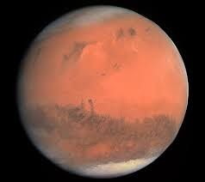
SINGLE FREQUENCY LASER DEVELOPMENT FOR MARS WIND LIDAR
Patrick M. Burns, Floyd E. Hovis, Kegan Orlowski, Moran Chen, Slava Litvinovitch
13605 Dulles Technology Dr.
Herndon, VA 20171
(703) 471-7671
www.fibertek.com

Slide 2
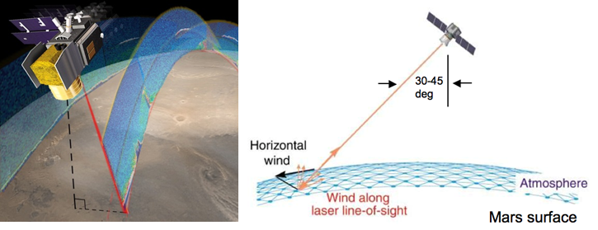
Mars Wind Lidar Systems
What and Why?
Lidar designed to measure atmospheric backscatter, depolarization profiles, and wind profiles from polar orbit.
Addresses Mars global 3-D wind structure and how it changes with local time, location, and season
Wind velocities needed for improvement and validation of Global Circulation Models (GCMs)
Knowledge of winds is critical for Entry, Descent, and Landing (EDL)
Fibertek’s part
Development of single frequency 1064nm source with space heritage
Based on laser for Cloud, Aersol, Transport System (CATS) delivered to international space station
Key laser parameters
Single frequency linewidths < 30MHz
Energy >5mJ

Slide 3
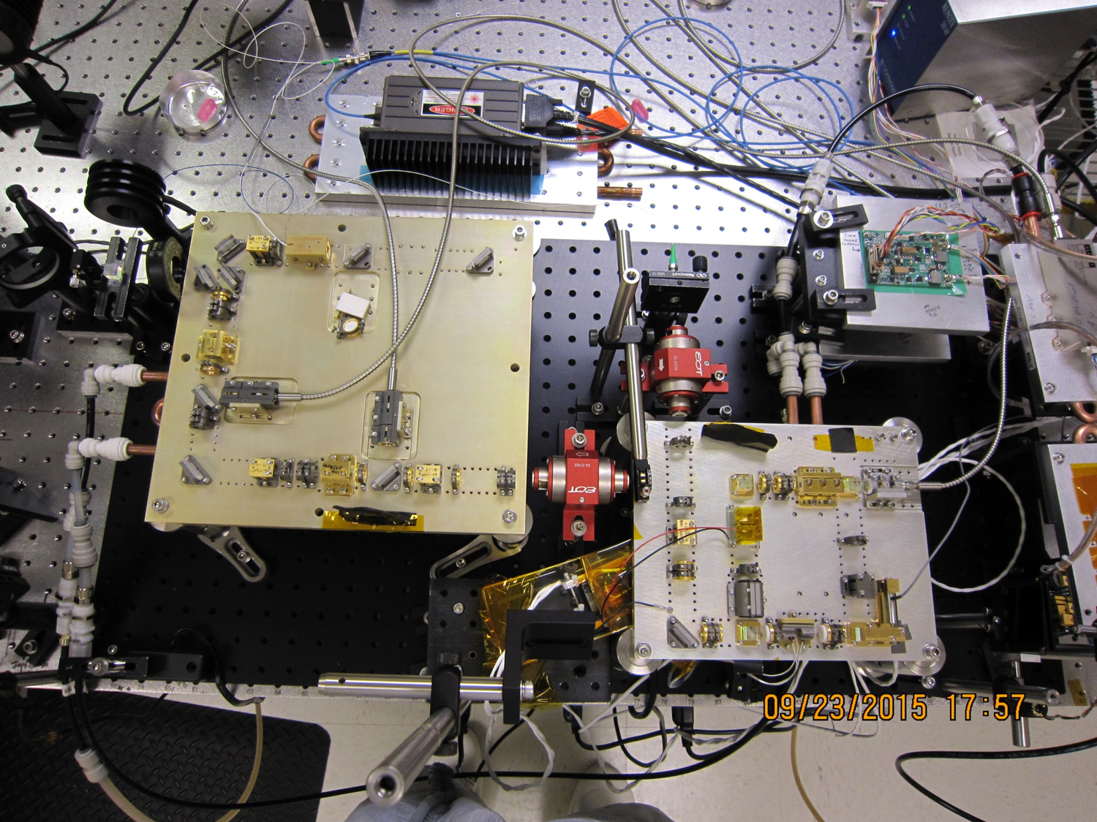
Proof of Concept
Assets retained from previous single frequency laser system
CATS Lidar
Single frequency Nd:YVO₄ MOPA ramp and fire locking
Ring oscillator
2 amplifiers
Reprate:4kHz
Power: 25W
Pulsewidth: 6ns
Linewidth: ~100MHz
Modifications to reduce linewidth<30MHz
Change oscillator gain medium from Nd:YVO₄ to Nd:YAG
Over-coupled the output coupler
Stretch pulse >20ns
Adjust
Parameters

Slide 4
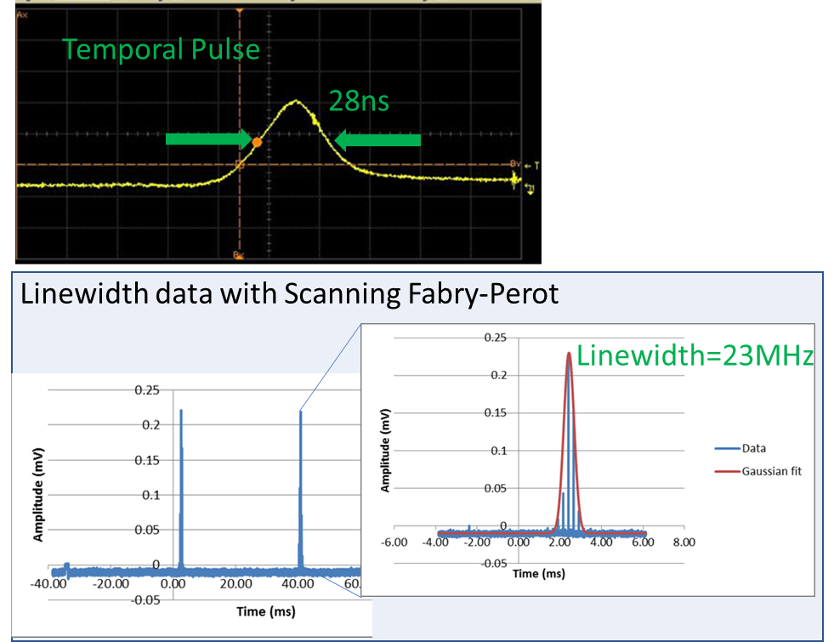
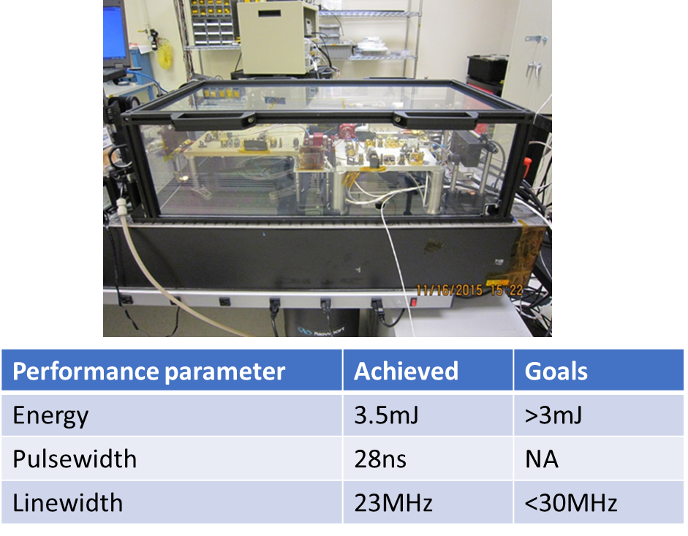
Delivered Test Bed
Allowed development for proof of concept testing of MARLI laser.

Slide 5
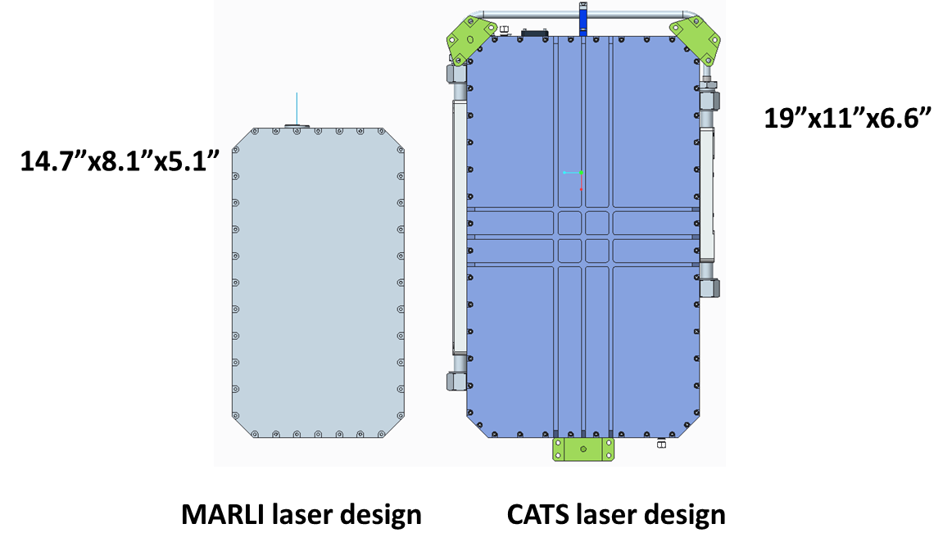
Development of Flight Concept
Desired performance
Wavelength: 1064nm
Rep-rate: ≤1kHz
Energy: 5mJ
Linewidth: <30MHz
Beam quality: M² <2
Weight of LOM: ~10 kg
MARLI system based off CATS design
Lower power, smaller package
57% of CATS footprint and 44% of CATS volume

Slide 6
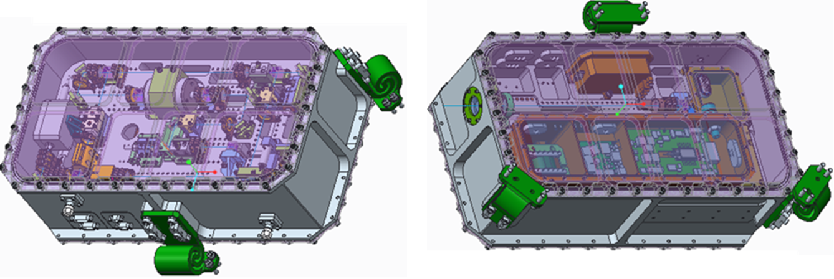
Canister design
Features
Heritage space design concept
ICESAT-2
CATS
Canister with rigid midplane
Compartmentalized
Optical compartment
Electrical compartment
Flexure mounting system
Pocketing to reduce weight

Slide 7
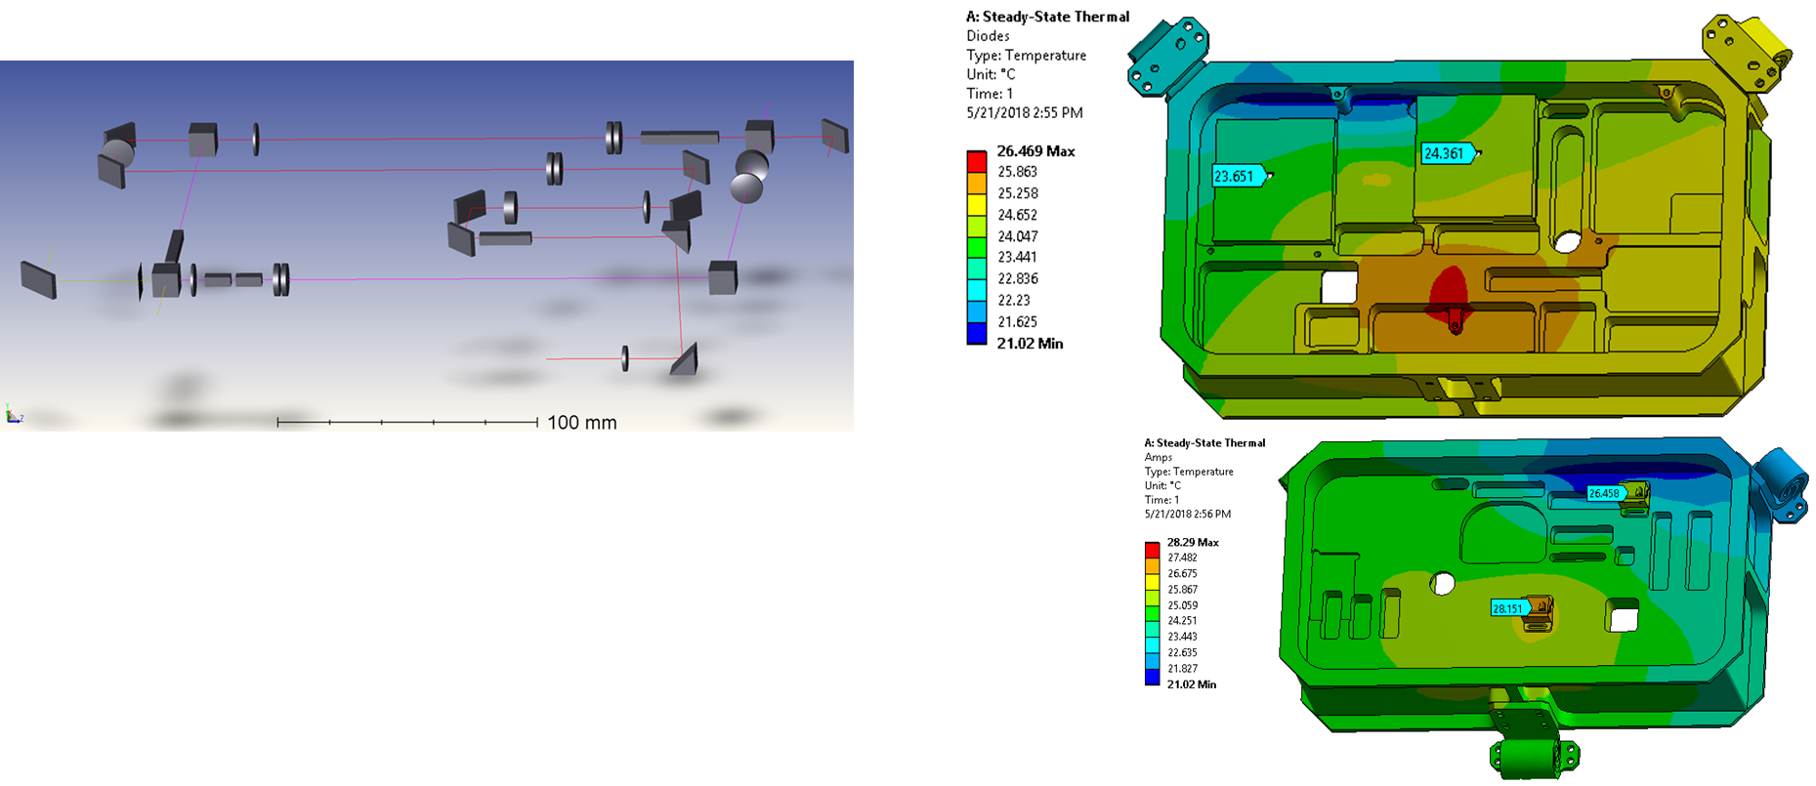
STOP (Structural Thermal Optical Performance) analysis
STOP analysis key results:
beam pointing, beam displacement under environmental simulations (thermal, pressure, vibration, etc.) are manageable
Able to meet system requirement under predictable environmental loads

Slide 8
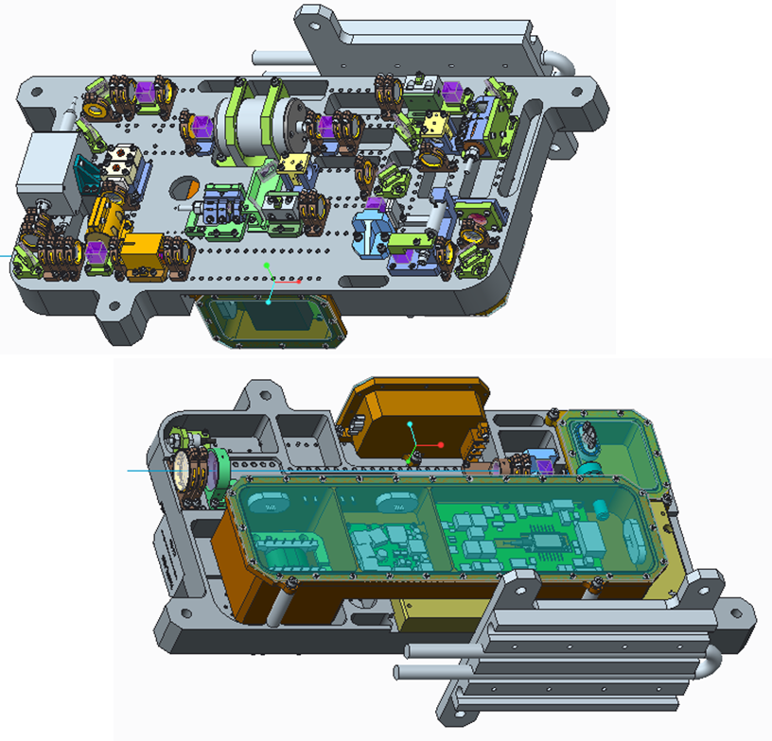
Brassboard Flight Emulator
Brassboard
Same optical layout as flight design
Uses same flight heritage mounts
Thermal interface mimics housing wall
Allows testing of key parameters and
performance over temperature

Slide 9
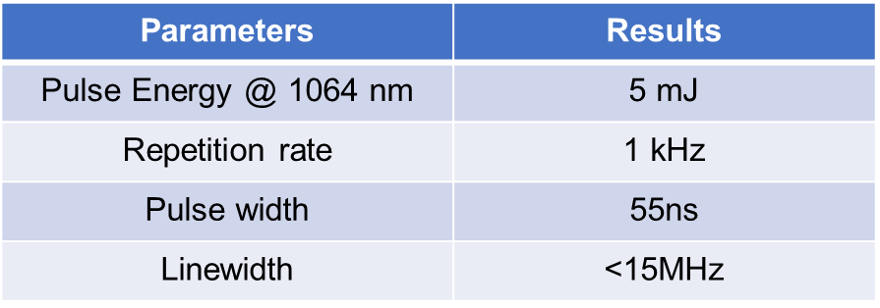
Laser Architecture & Driving Requirements
Laser Design Features:
MOPA architecture
Ring resonator
Gain heads with resonant end pumping
Polarization output coupling
Injection seeded & ramp and fire locked cavity

Slide 10
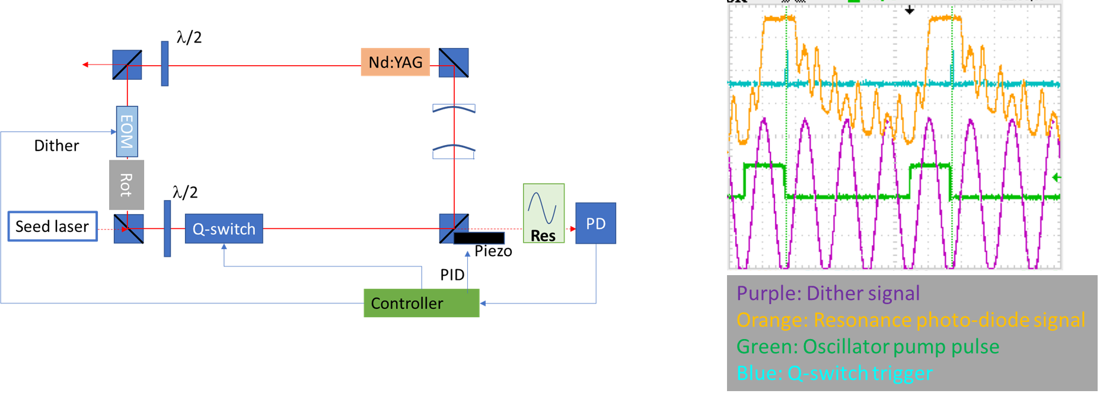
Ramp and fire Locking Scheme
Ramp and Fire Locking Schematic
Typical ramp and fire dither and resonant signal
Fibertek uses established ramp and fire injection locking techniques

Slide 11
Laser Energy & Pulse Width Results
Laser Energy output=4.6mJ
Standard Deviation of 0.3%
Temporal pulse width allows
transform limited spectral width<10MHz
Good laser energy stability
Short term Shot-to-shot energy stability:
<1% variation in
shot-to-shot pulse energy
Results in spectral width well below the performance requirements of <30MHz
Pulse energy stability reflects stable injection seeding and laser performance

Slide 12
Beam Quality
Oscillator Beam quality
Amplifier Beam quality
Beam Quality M²=1.1
Beam Quality M²=1.6
Some degradation in beam quality from oscillator to amplifier, but well within performance requirements of M²<2

Slide 13
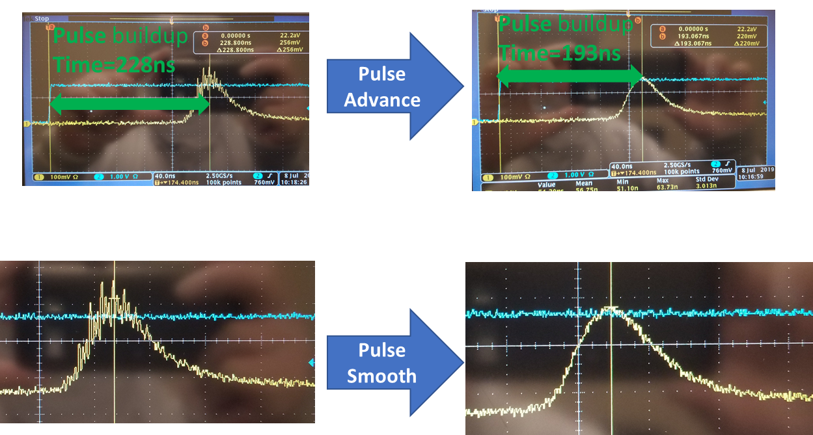
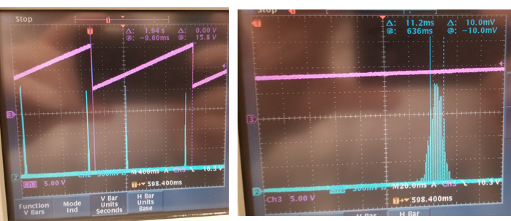
Injection Seeding Performance Single Longitudinal Mode Lasing Verified
Unseeded
Seeded & Locked
Scanning Fabry Perot Interferometer
Linewidth~12MHz
Demonstrates a well seeded
cavity

Slide 14
Summary
Fibertek, Inc. successfully developed and tested Nd:YAG laser system that achieved:
> 4.5 mJ of 1064 nm from Nd:YAG MOPA Laser
Ramp and Fire locked
Injection Seeded and tunable
Linewidth<30MHz
Ongoing work: Testing system, paving the way for space flight mission
Brassboard delivery planned for Q3 2019

