Slide 1
New AMV Wind and Height
Measurements from Stereoscopic Views with
MODIS-GOES and MISR-GOES Imagery
Dong L Wu¹, James L Carr², and Michael A Kelly³
NASA Goddard Space Flight Center
Carr Astronautics
Applied Physics Lab, Johns Hopkins University
Working Group Meeting for Space Lidar Winds, Hampton, VA July 10-11, 2019

Slide 2
Motivations
Global 3D wind observations at mesoscale
  Vertical wind profiles from lidar
  Horizontal wind fields from atmospheric motion vectors (AMVs)
AMV height assignment
  Limitations with IR method
  Limitations with single-platform stereo (e.g. MISR)
  Stereo height from multi-angle, multi-platforms (this work)
Cost-effective solutions for spatiotemporal coverage
  LEO-GEO (this work)
  GEO-GEO (NOAA development)
  Future: LEO-LEO, LEO-GEO

Slide 3
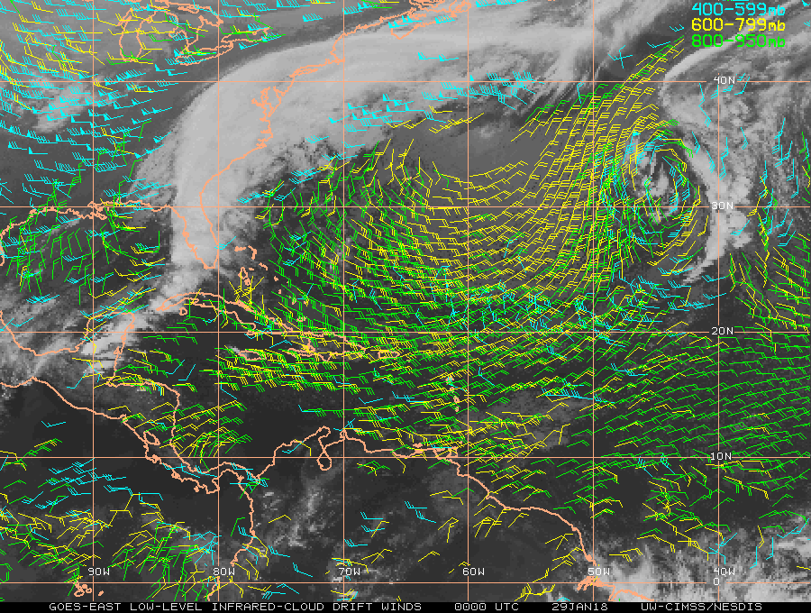
Atmospheric Motion Vector (AMV)
Washington DC
Key observable to NWP
Significant impacts (UK Met study):
  Tropics
  Small scales (<200km)
Limitations
  Height error
  Convection
  Gravity waves
Florida
Panama
1000 km
(Image Credit: CMISS, Univ of Wisc)

Slide 4
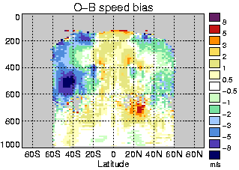
Ongoing Research with AMVs
Observation – Background
IR height assignment error
  Multi cloud layers
  Cloud inhomogeneity
  Inversion layer
  Wind shears
Stereo height
  MISR
  MISR-GOES
  MODIS-GOES
Speed bias
  Effects of convection and waves
Measurement quality control
(m/s)
Pressure (hPa)
Obs slower
Obs faster
Courtesy of International Wind Working Group (IWWG)
http://cimss.ssec.wisc.edu/iwwg/iwwg.html
Notes:
The main aim of the NWP SAF AMV (atmospheric motion vector) monitoring site is to improve our understanding of AMV error characteristics in order to enable improvements to the AMV derivation and their treatment in NWP models.
This is achieved by:
Providing a 3-year rolling archive of O-B monthly monitoring plots displaying differences between AMVs (O) and NWP model background winds (B) valid at the same location and time (see Monthly Monitoring tab). Plots are provided for the Met Office and ECMWF in the same format to enable easy comparisons. Both the AMVs and the model forecast contribute to the differences observed in the plots. Differences between centres suggest model-dependent problems whereas similarities suggest either problems with the AMVs or problems shared by the NWP models.
Producing analysis reports every 2 years to coincide with the International Winds Workshops (see Analysis Reports tab). These are detailed studies reviewing (i) the quality of new datasets and (ii) features observed in the O-B monitoring. Details are included of possible causes of the O-B features and, where relevant, actions that may help to alleviate the problems.
Carrying out some bespoke investigations e.g. to investigate diurnal error characteristics (see Investigations tab).
There are two additional aims of the site:
To provide background information on how AMVs are used in NWP (see NWP tab). As part of this the site hosts information on how AMVs are assimilated at different NWP centres.
To provide links for those interested in near real-time monitoring issues (see Real-time Monitoring tab).

Slide 5
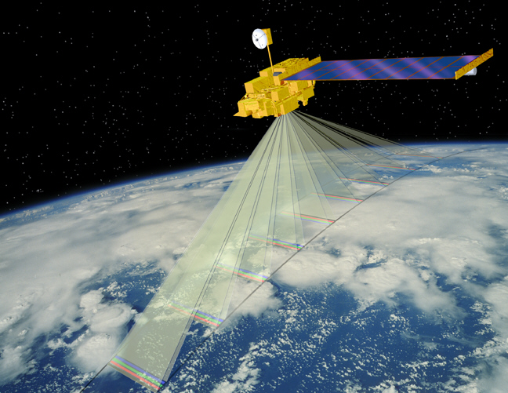
Stereo Height:
Multi-angles from a single platform (e.g. MISR)
Aliasing problem
between height and along-track wind
~7 min

Slide 6
(JAMC 2017)
MISR-GOES
MISR-MODIS

Slide 7
Effects of Stereo Height:
Single-angle from multi platforms (e.g. Dual-MetOp)
MetOp-B
Height assignment error => Wind error
MetOp-A
45 min Later
Cotton et al. (UK Met, 2016)

Slide 8
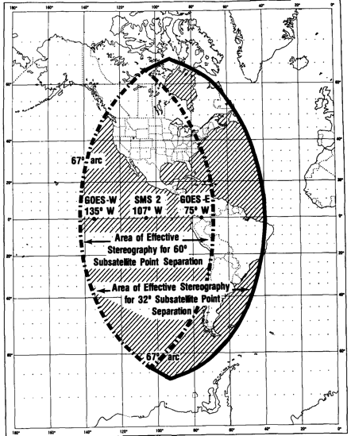
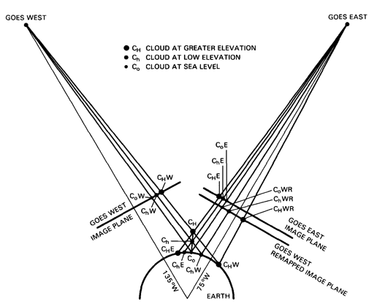
Solution #1:
GOES - GOES (stereo height and winds)
Shenk (1971) Apollo6
Hasler (1981)
Black (1982)
Fujita and Dodge (1982)
60°

Slide 9
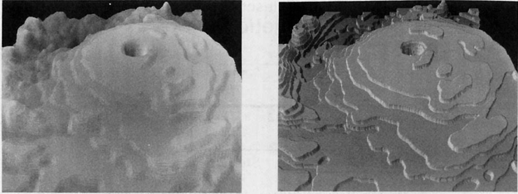
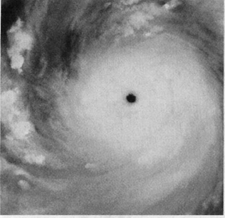
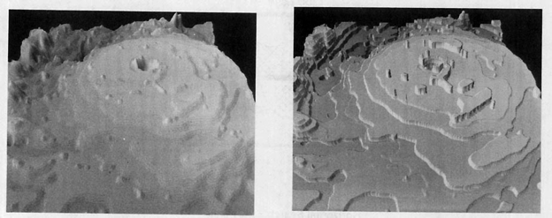
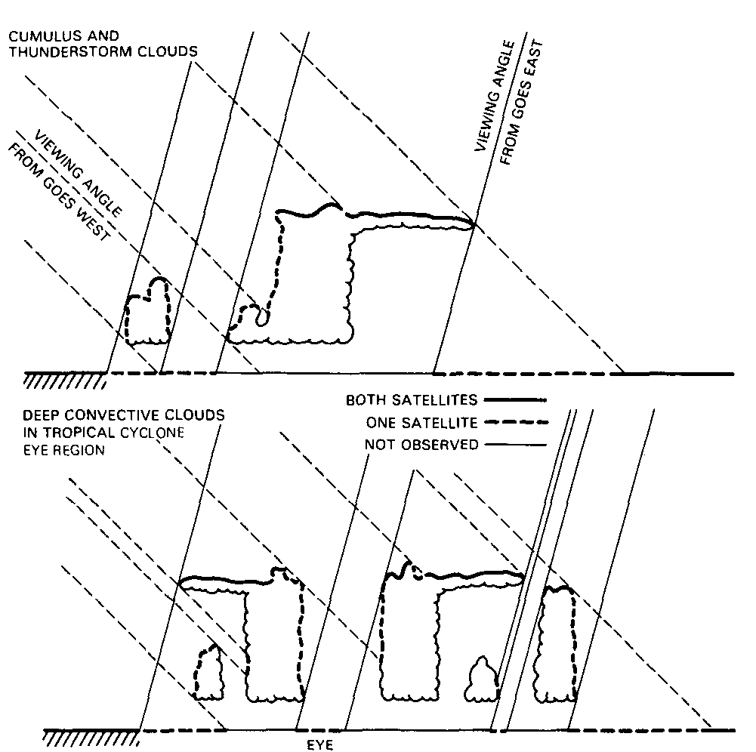
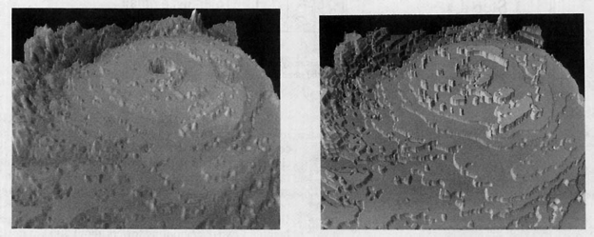
Hasler et al. (1991)

Slide 10
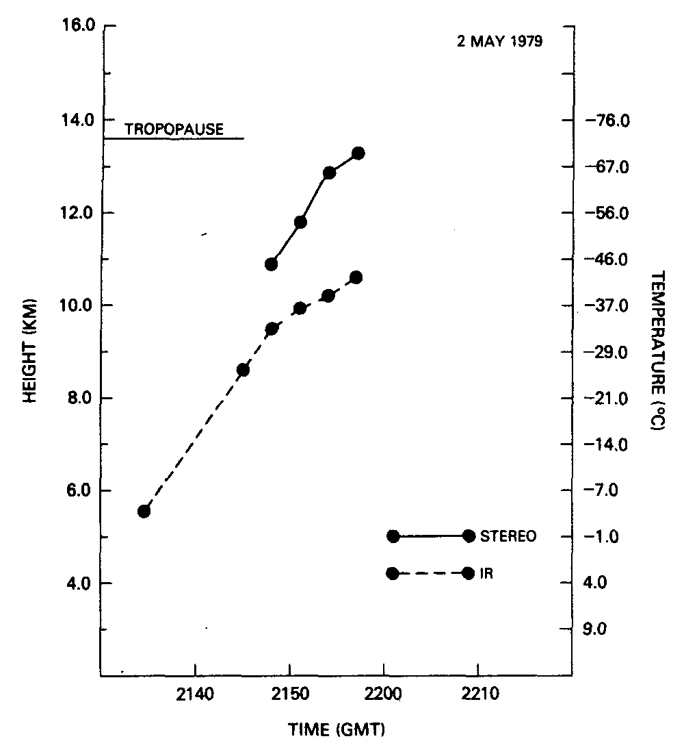
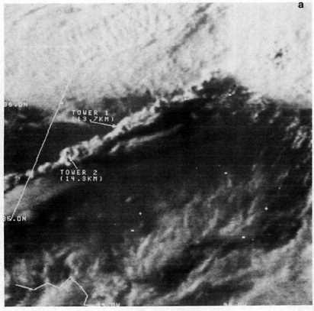
Mack et al. (1983)

Slide 11
Advanced GOES 16/17 Systems:
Accurate Image Navigation and Registration (INR) for Stereo Matching
New NOAA/STAR Study
Develop 3D-Winds capability for G-16 and G-17
Validate 3D-Wind retrievals
Results
3D-Winds code prototyped
Compared to operational Visible, IR, and WV winds
Validated with MISR-GOES code and terrain retrievals with good results
Height
NOAA/STAR Program
Jaime Daniels
Wayne Bresky
B02
Visible
James L. Carr^{1*}, Houria Madani¹ (2019)

Slide 12
Solution #2:
MISR (stereo height) + GOES (winds)
Enabled by advanced GOES-R spatial resolution and INR
Accuracy from 2.2 km sampling:
Height 200 m
Wind <0.5 m/s
New algorithm mitigates GEO height assignment (GOES) and LEO aliasing (MISR) issues

Slide 13
Validation over Clear-Sky Terrain
Estimated Height Uncertainty: <200m
Estimated Wind Uncertainty <0.5m/s

Slide 14
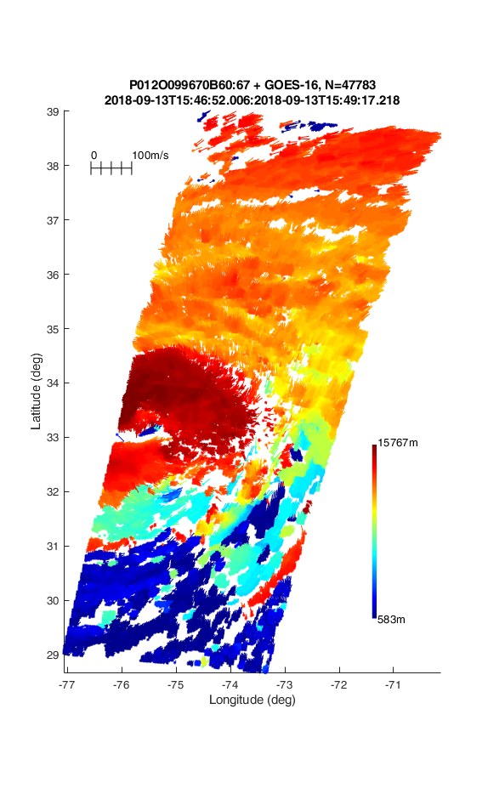
Florence (2018)
Height
15.8 km
One Frame of
30-Second
GOES MESO
Imagery
PBL
GOES MESO Imagery
0.6 km
Low-altitude winds
feeding in warm, moist air

Slide 15
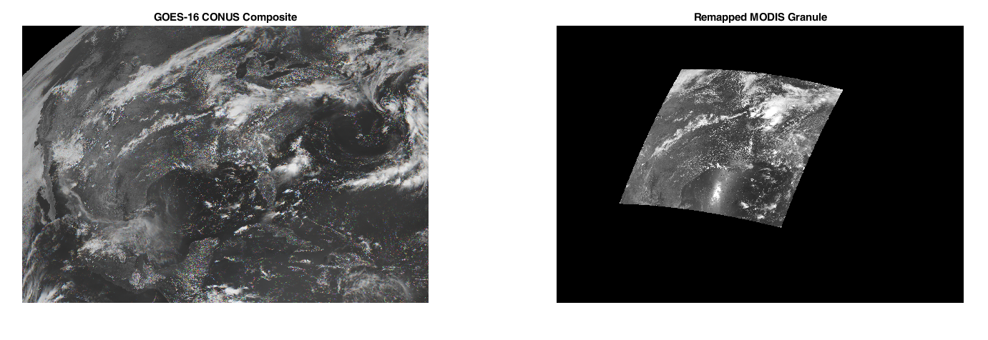
Solution #3: MODIS + GOES
(Carr et al., 2019; paper in preparation)
Larger swath coverage
Two angular looks from two platforms (i.e., LEO and GEO)
No synchronization required for LEO and GEO images
Winds from GEO rapid refresh

Slide 16
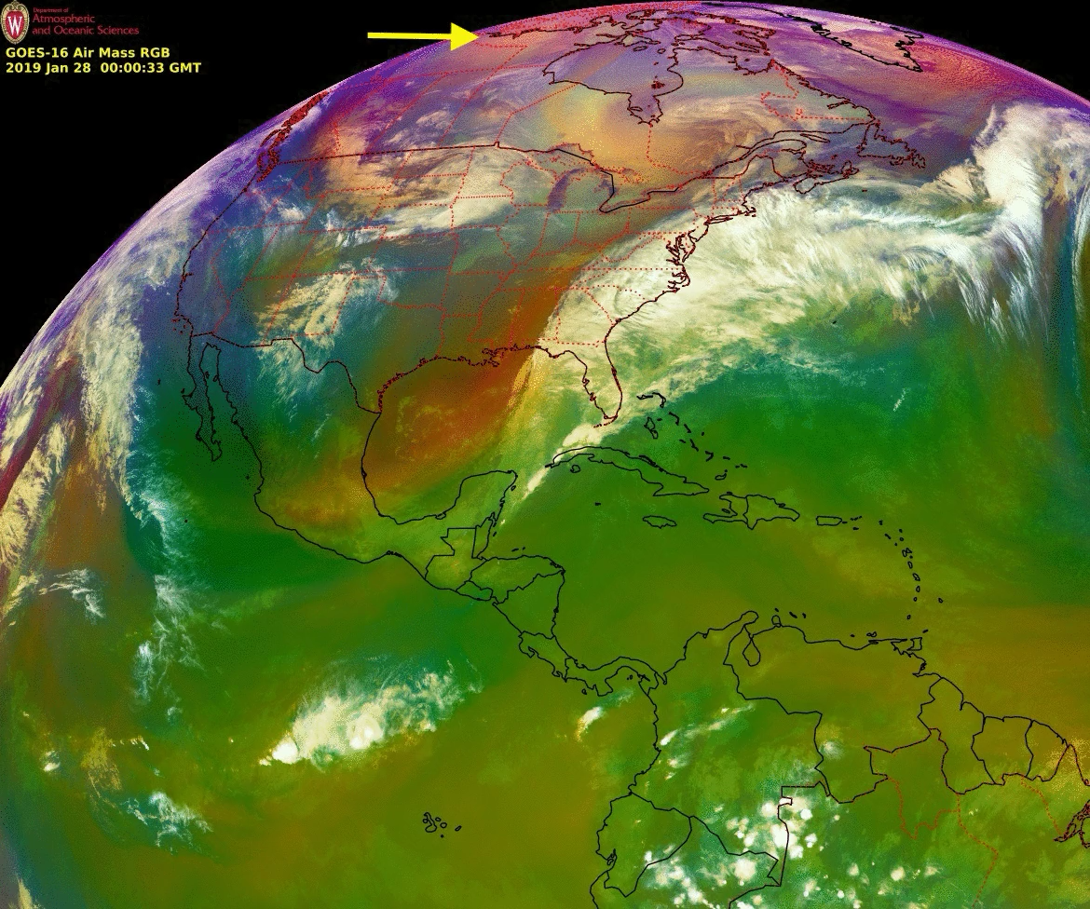
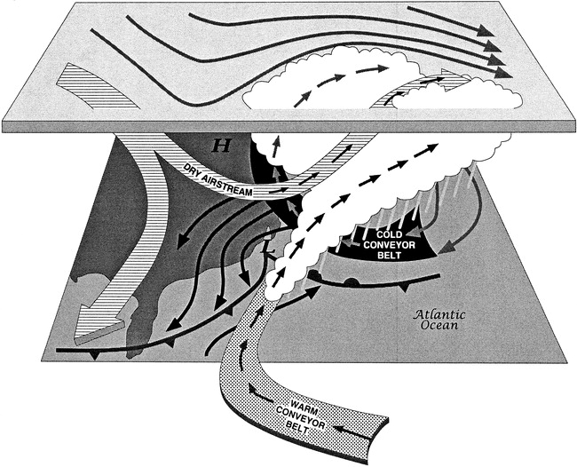
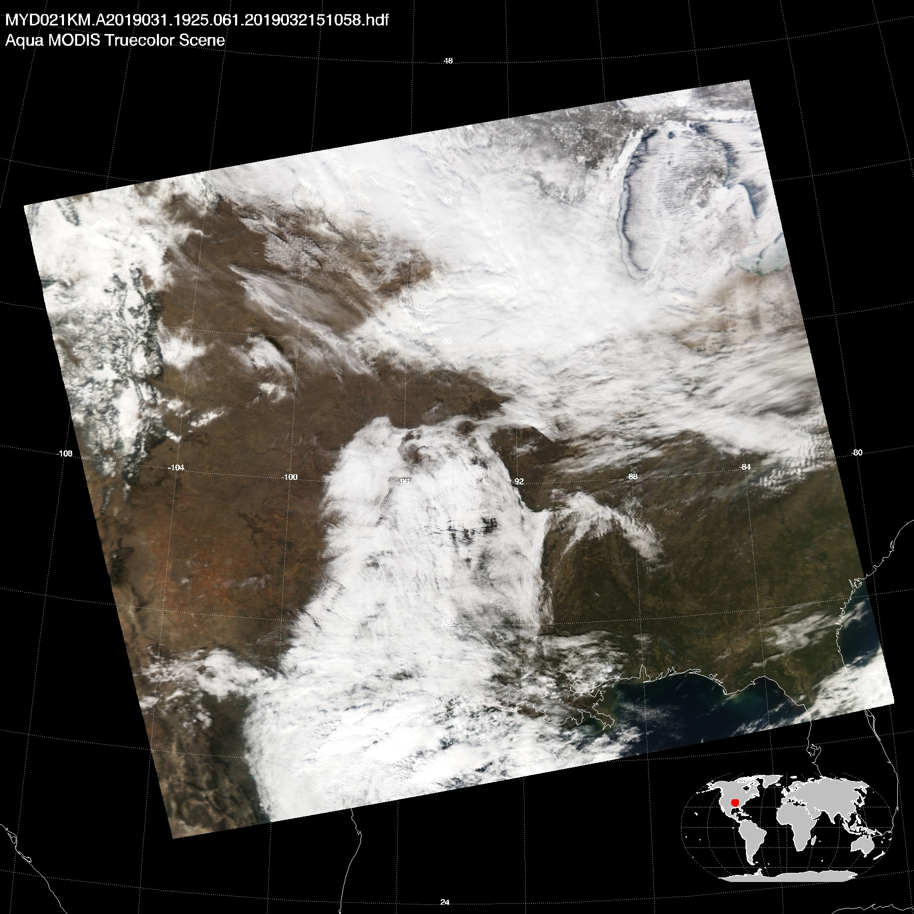
Severe Weather
From Cold Arctic Air
Jan 31, 2019
PBL?

Slide 17
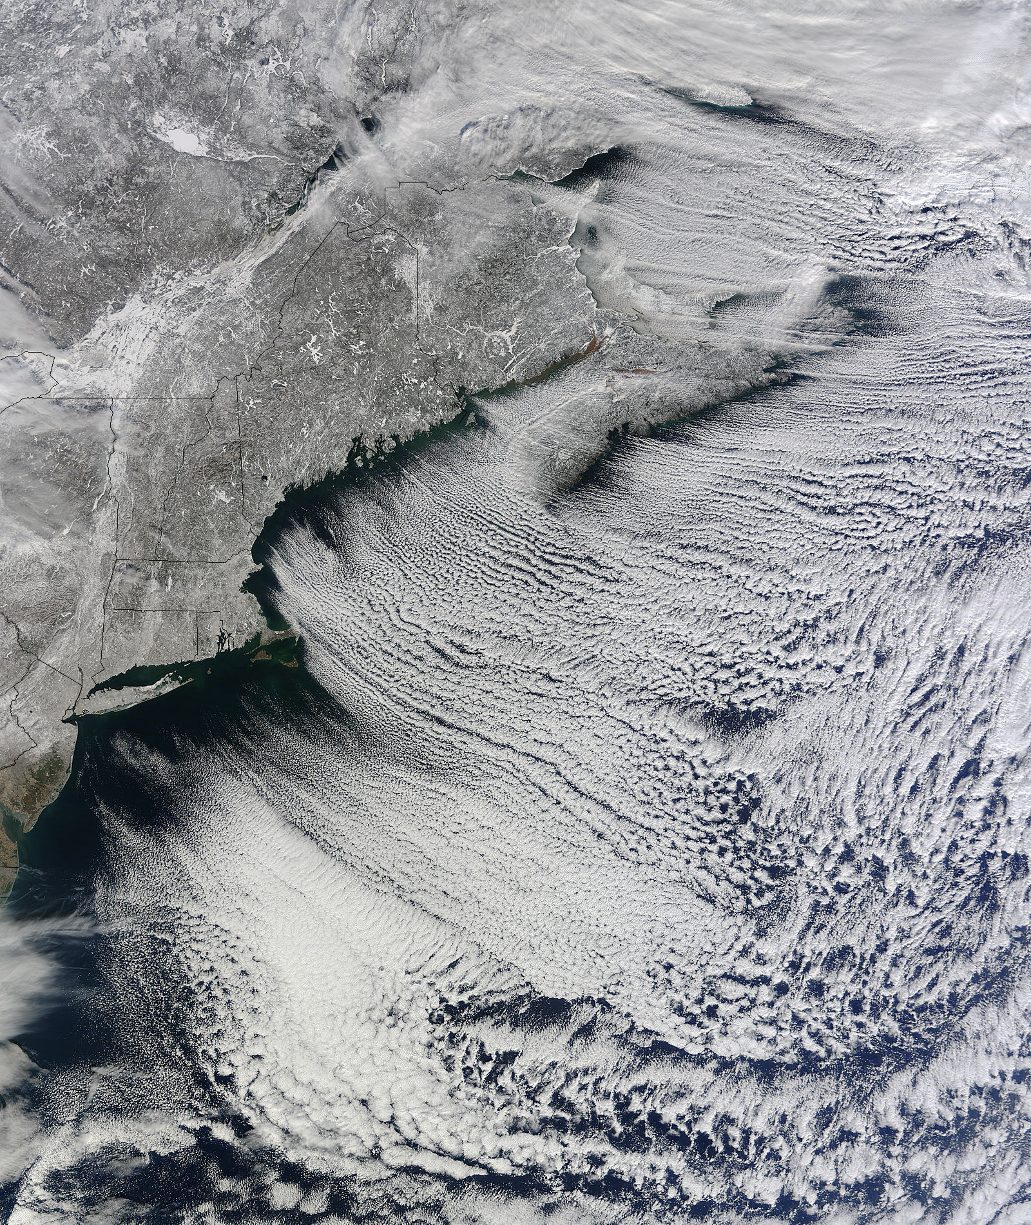

Planetary Boundary Layer (PBL) Dynamics in Cold Air Outbreak
PBL structural evolution
Strong surface-PBL coupling (e.g., radiation and latent heat)
Complex cloud microphysics
New York
Aqua MODIS
01/24/2011 UTC17:05

Slide 18
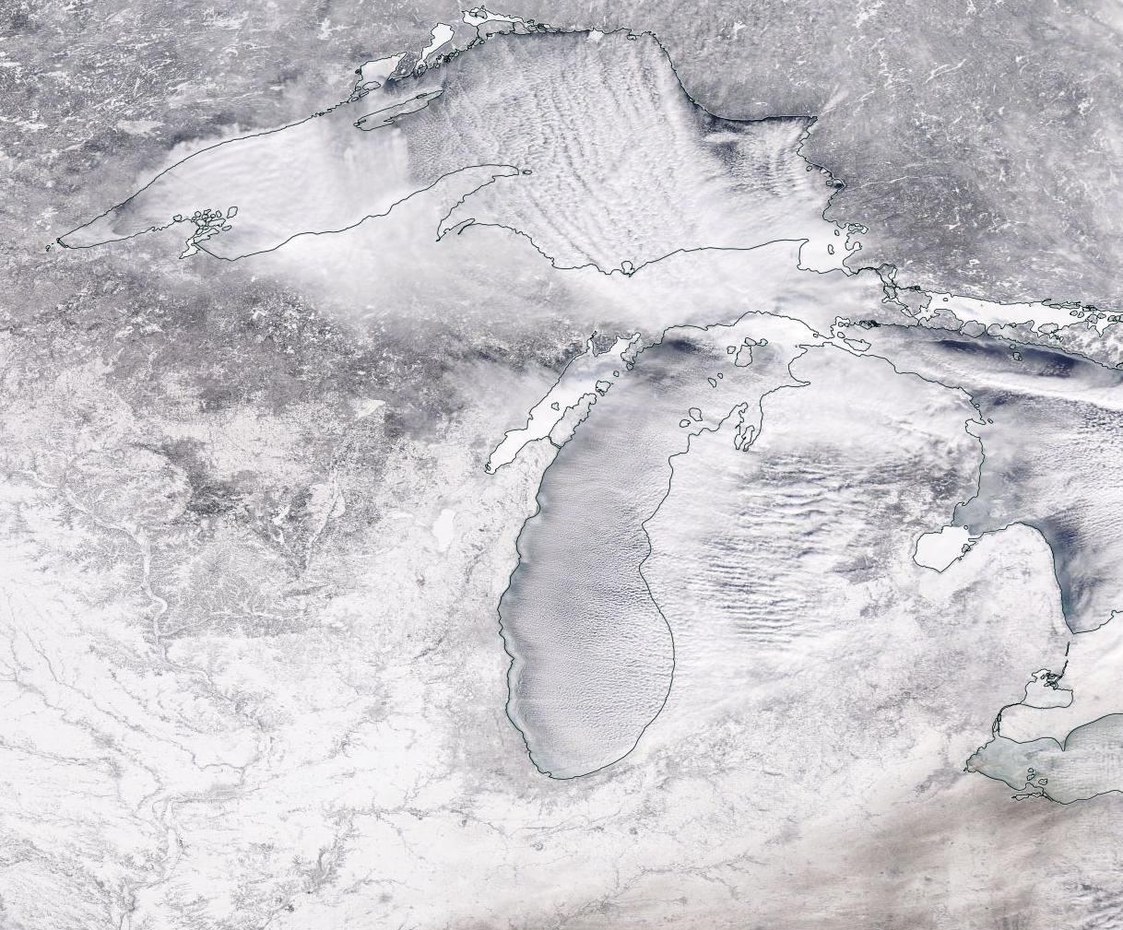
Cold Air Outbreak
Jan 31, 2019
Lake Superior
Michigan
Clouds or Not?
PBL Processes
Surface heat and moisture fluxes
Cloud and precipitation interactions
Severe downstream precipitation
(lake effect)
Cloud detection:
Wind speed < 0.5 m/s; and
Height > 300 m (lidar-like)

Slide 19
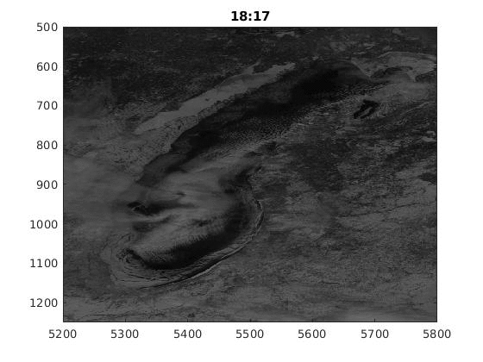
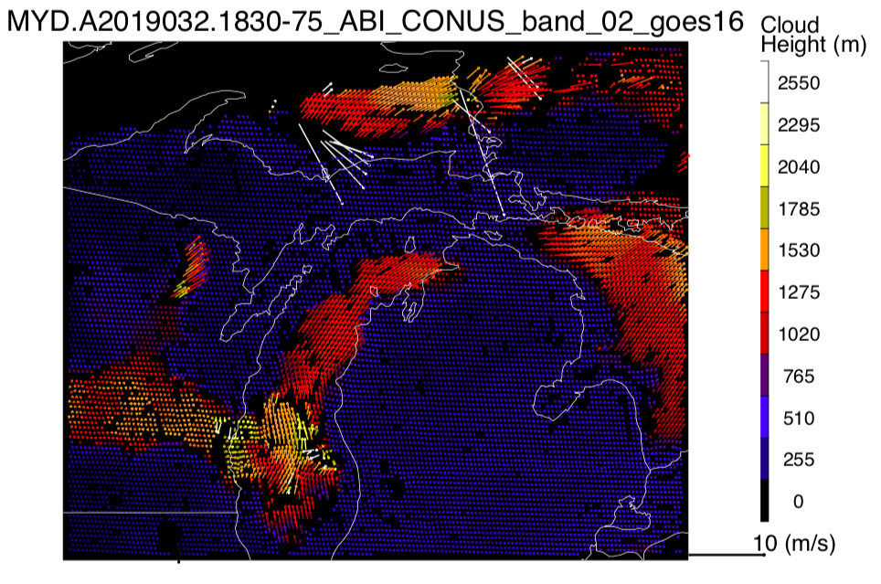
Cold Air Outbreak
(Rapid PBL wind changes on Feb 1, 2019)
Lake Superior
Michigan
PBL Processes
Surface heat and moisture fluxes
Cloud and precipitation interactions
Severe downstream precipitation
(lake effect)
Courtesy of
Diego Principe and Houria Madani

Slide 20
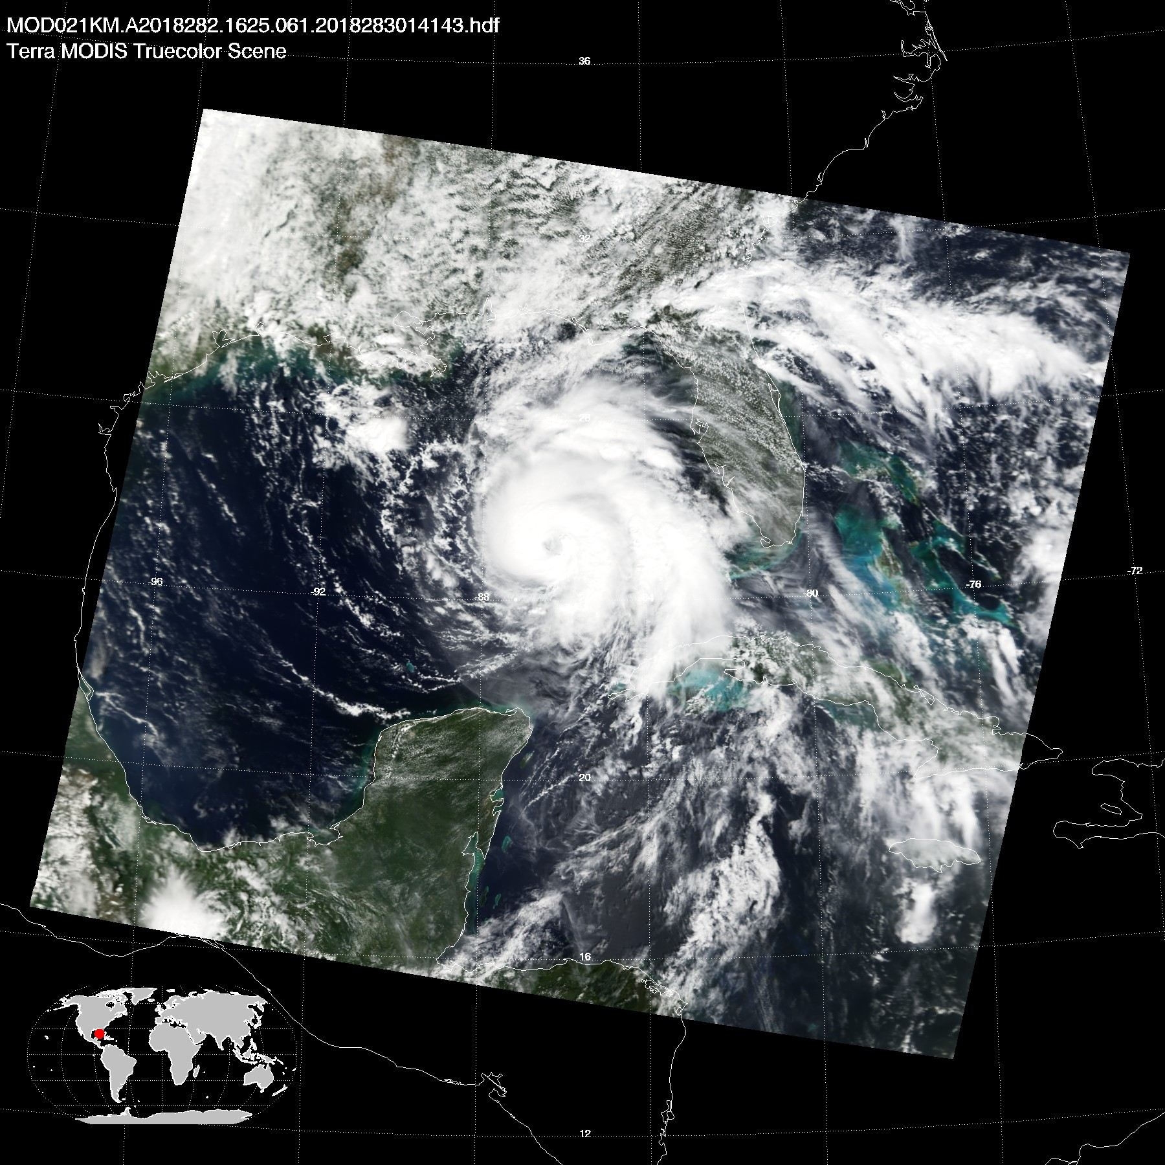
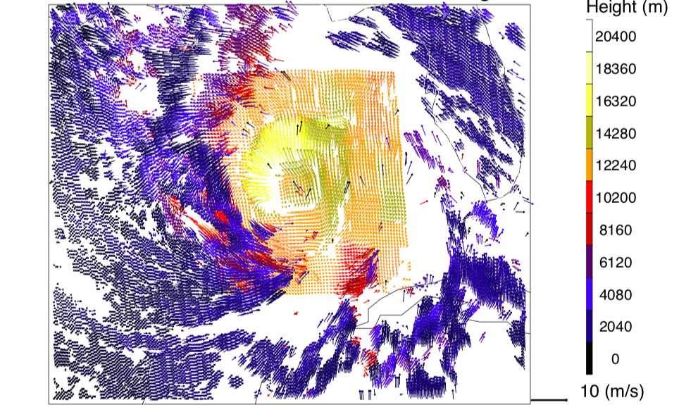
Hurricane Michael (Oct 9, 2018)
Intensification from Cat 3 to Cat 5 in two days
74 deaths with damage of $25B
MODIS-GOES 3D Winds
Rapid Intensification
CONUS + MESO Sampling

Slide 21
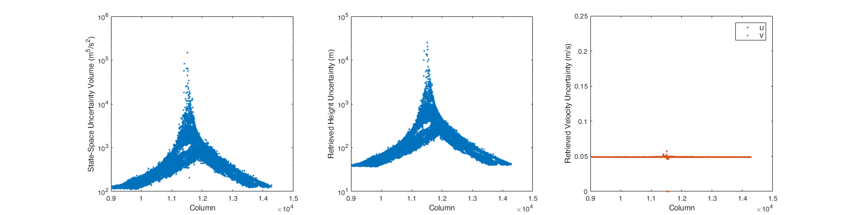
MODIS-GOES:
Pathfinder for Other Operational LEOs and GEOs
GOES
Caveats
No clear-sky winds (where DWL can); Terrain for validating height and geo-registration of imagers
Wind and height uncertainties sensitive to geo-registration error (both MODIS and GOES-16/17 have 0.1-0.2 pixel pointing accuracy)
Singularity spot for LEOs with single look
Accuracy away from singularity (under evaluation):
Height ~300 m
Wind <0.5 m/s
Singularity
MODIS

Slide 22
Solution #4: LEO-GEO and DWL
Constellation (GPM-like)
Instrument: Compact Midwave IR System (CMIS) – ESTO IIP’16
CubeSat
DWL
CubeSat
CubeSat

Slide 23
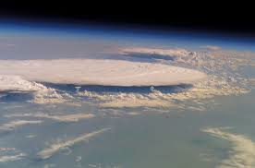
LEO-LEO (Leader-Follower)
Constellation
CubeSat
5-10 min
CubeSat
30°
30°
30°
30°

Slide 24
Summary
Synergy of lidar winds and AMVs (curtain clear-sky + areal cloudy coverage)
Stereo height from images on dual platforms without sensor synchronization
LEO CubeSat constellation (polar, global)
LEO-GEO (regional)
GEO-GEO (regional)
Global 3D winds at mesoscale
AMV height assignment
Affordable spatiotemporal coverage from stereo AMVs

