Slide 1
Winds for NASA HQ’s Weather Focus Area
Gail Skofronick-Jackson*
Atmospheric Dynamics Program Manager
July 10, 2019
Space-based Wind Lidar Working Group Meeting, Langley
*This talk draws on inputs from numerous colleagues from NASA HQ, NASA centers, and our research and applications community.

Slide 2

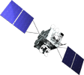



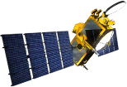


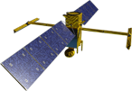



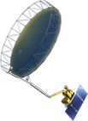



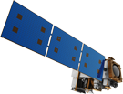

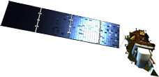

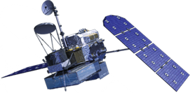

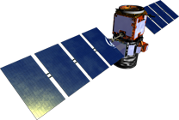

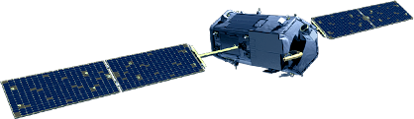
NASA Earth Science
Missions: Present through 2023
PREFIRE (2) (TBD)
(Pre)Formulation
PACE (2022)
Implementation
TSIS-2 (2020)
GeoCARB (~2021)
Primary Ops
TROPICS (6) (~2021)
Extended Ops
MAIA (2020)
Landsat 9 (2020)
Sentinel-6A/B (2020, 2025)
NISAR (2021)
ISS Instruments
LIS (2020), SAGE III (2020)
TSIS-1 (2018), OCO-3 (2019), ECOSTRESS (2019), GEDI (2020)
CLARREO-PF (2020), EMIT (TBD)
SWOT (2021)
TEMPO (2018)
InVEST/CubeSats
RAVAN (2016)
RainCube (2018)
TEMPEST-D (2018)
CubeRRT (2018)
CSIM (2018)
CIRiS (2019)
HARP (2019)
SNoOPI*
HyTI*
CTIM*
NACHOS*
* Launch date TBD
ICESat-2 (2021)
GRACE-FO (2) (2023)
CYGNSS (8) (2020)
JPSS-2 Instruments
OMPS-Limb (2018)
SMAP
(>2022)
Landsat 7
(USGS) (~2022)
NISTAR, EPIC
(DSCOVR /
NOAA) (2019)
SORCE,
TCTE (NOAA) (2019)
Suomi NPP (NOAA) (>2022)
Terra (>2021)
Landsat 8
(USGS) (>2022)
Aqua (>2022)
CloudSat (2021)
GPM (>2022)
CALIPSO (>2022)
Aura (>2022)
OCO-2 (>2022)
OSTM/Jason-2 (NOAA) (>2022)
WIND cycle-focused
WIND component
Notes:
Fleet - Earth Science Division - Missions (with color key; editable)
Aug. 18, 2018: GRACE-FO and ECOSTRESS moved to prime ops; QuickSCAT removed due to pending decommission; MAIA moved to implementation
Jan. 16, 2018: Reformatted, includes all missions, dates and cube sats
Dec. 15, 2015
Credit: NASA/J. Mottar
------------------------------
SLIDE INFO
CORRECTION DENNING PER RIVERA Feb 18, 2016
Changed misspelling of “Sentinal” to “Sentinel”
UPDATE DENNING PER FREILICH DECISIONS FEB 12, 2016
Changed OCO-3 to Formulation color and moved lower in list
Changed RBI to Formulation color
Changed GEDI to Implementation color and moved to line above it
Added TSIS-2 in Formulation color
UPDATE DENNING PER FREILICH DECISIONS FEB 4, 2016
Changed “Altimetry FO (Formulation in FY16) to “Sentinal-6A/B”
On Landsat 9, removed comma and TIRFF
Change I was going to make – “NISTAR, EPIC (NOAA’s DSCOVR) to green primary ops was already corrected
Dec. 15, 2015 – Updated: TEMPO changed to Implementation phase; NISTAR, EPIC changed to Primary Ops phase; ; OCO-3 and ECOSTRESS changed to Implementation phase; Aquarius removed; slide now fully editable. JMottar
May 18, 2015 – Added to SMD Multimedia Library.
May 18, 2015 – Updated the outdated 2014 version: TRMM was removed; NISTAR, EPIC (NOAA's DSCOVR) were added; SMAP icon was updated; moon at top left was removed; color key moved to top left.-JMottar
ID: I-EA-15-0040 (image)
ID: SL-EA-15-0068 (slide)

Slide 3
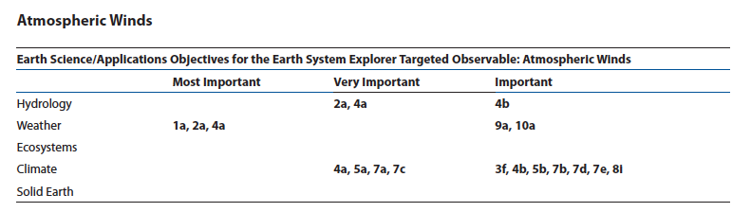
Why Winds?
From the 2017 Earth Science Decadal Survey:
Winds provide critical insight into weather forecasting, the transport of pollutants/carbon/aerosols, wind energy, cloud processes, large scale circulation, and how energy moves between the land or ocean surfaces and the atmosphere.
To advance subseasonal weather prediction sustained observations or enhanced time-space resolution observations are needed of (1) the 3D atmospheric state, including temperature, humidity, and winds; (2) the atmospheric boundary layer; (3) a number of surface characteristics and processes; and (4) advanced observations of atmospheric convection, including its mesoscale organization.

Slide 4
2017 Decadal Survey and Winds
*ESD decided to only treat observable under the Explorer program element
Notes:
Updated

Slide 5
Earth Science Division Responses to 2017 Decadal Survey
Multi-center study teams were created to assess possibilities for Designated Observables
  Aerosols-Clouds/Convection/Precipitation (combined!)
  Surface Biology and Biogeochemistry
  Surface Deformation and Change
  Mass Change
Announcement of Opportunity released for first Earth Venture Continuity (EVC) mission, focused on Earth’s radiation budget
**ROSES element released for development of science plans for Incubator (Planetary Boundary Layer, Surface Topography & Vegetation)
Developing RFPs for awards to facilitate program implementation and enhance community participation
Major communications effort internally and with community
  Weekly meetings of ESD leadership team
  Biweekly listening sessions for ESD staff
  Creation of web site and opportunity for community to pose questions and get answers
  Monthly (now bi-monthly) webinars with NASA centers
  Webinar with full community held every four months (on-site first few times) and town hall sessions at meetings.
**Limited funding flexibility (”Budget Wedge”) while completing Program of Record has precluded release of Announcement of Opportunity for Explorer Missions

Slide 6
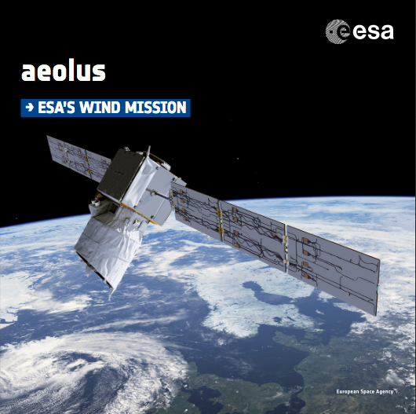
Aeolus
ESA’s Wind Mission
Launched on 22 August 2018

Slide 7
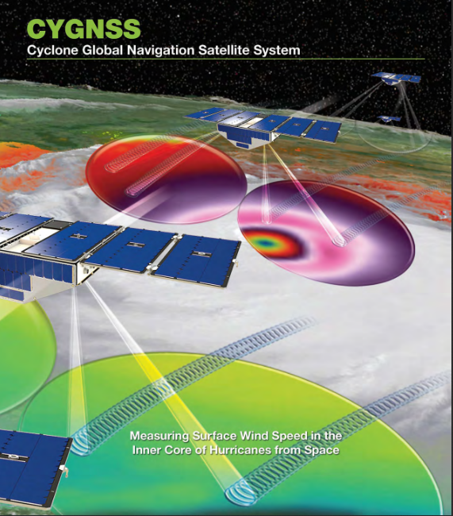
Cyclone Global Navigation Satellite System (CYGNSS)
PI: Christopher Ruf (Univ. of Michigan)
Launched: 15 December 2016
• Mission Objectives: Rapid sampling of ocean surface winds in the inner core of tropical cyclones; improving track, intensity and storm surge forecast skill
• 2.8 hr (median) & 7.2 hr (mean) revisit time between ±38° lat; 25 km spatial resolution
• Eight satellites, each carrying a 4-channel receiver capable of bi-static radar measurement of GPS signals reflected by the ocean surface
GPS signals offer frequent sampling of tropical zone soil moisture and/or surface water.

Slide 8
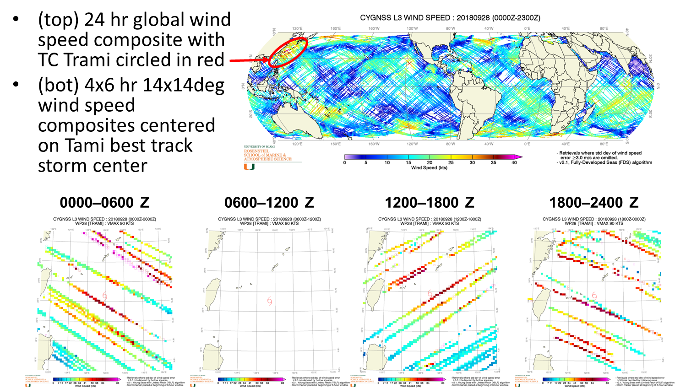
CYGNSS Temporal Sampling Example
Overpasses of Typhoon Trami on 28 Sep 2018

Slide 9
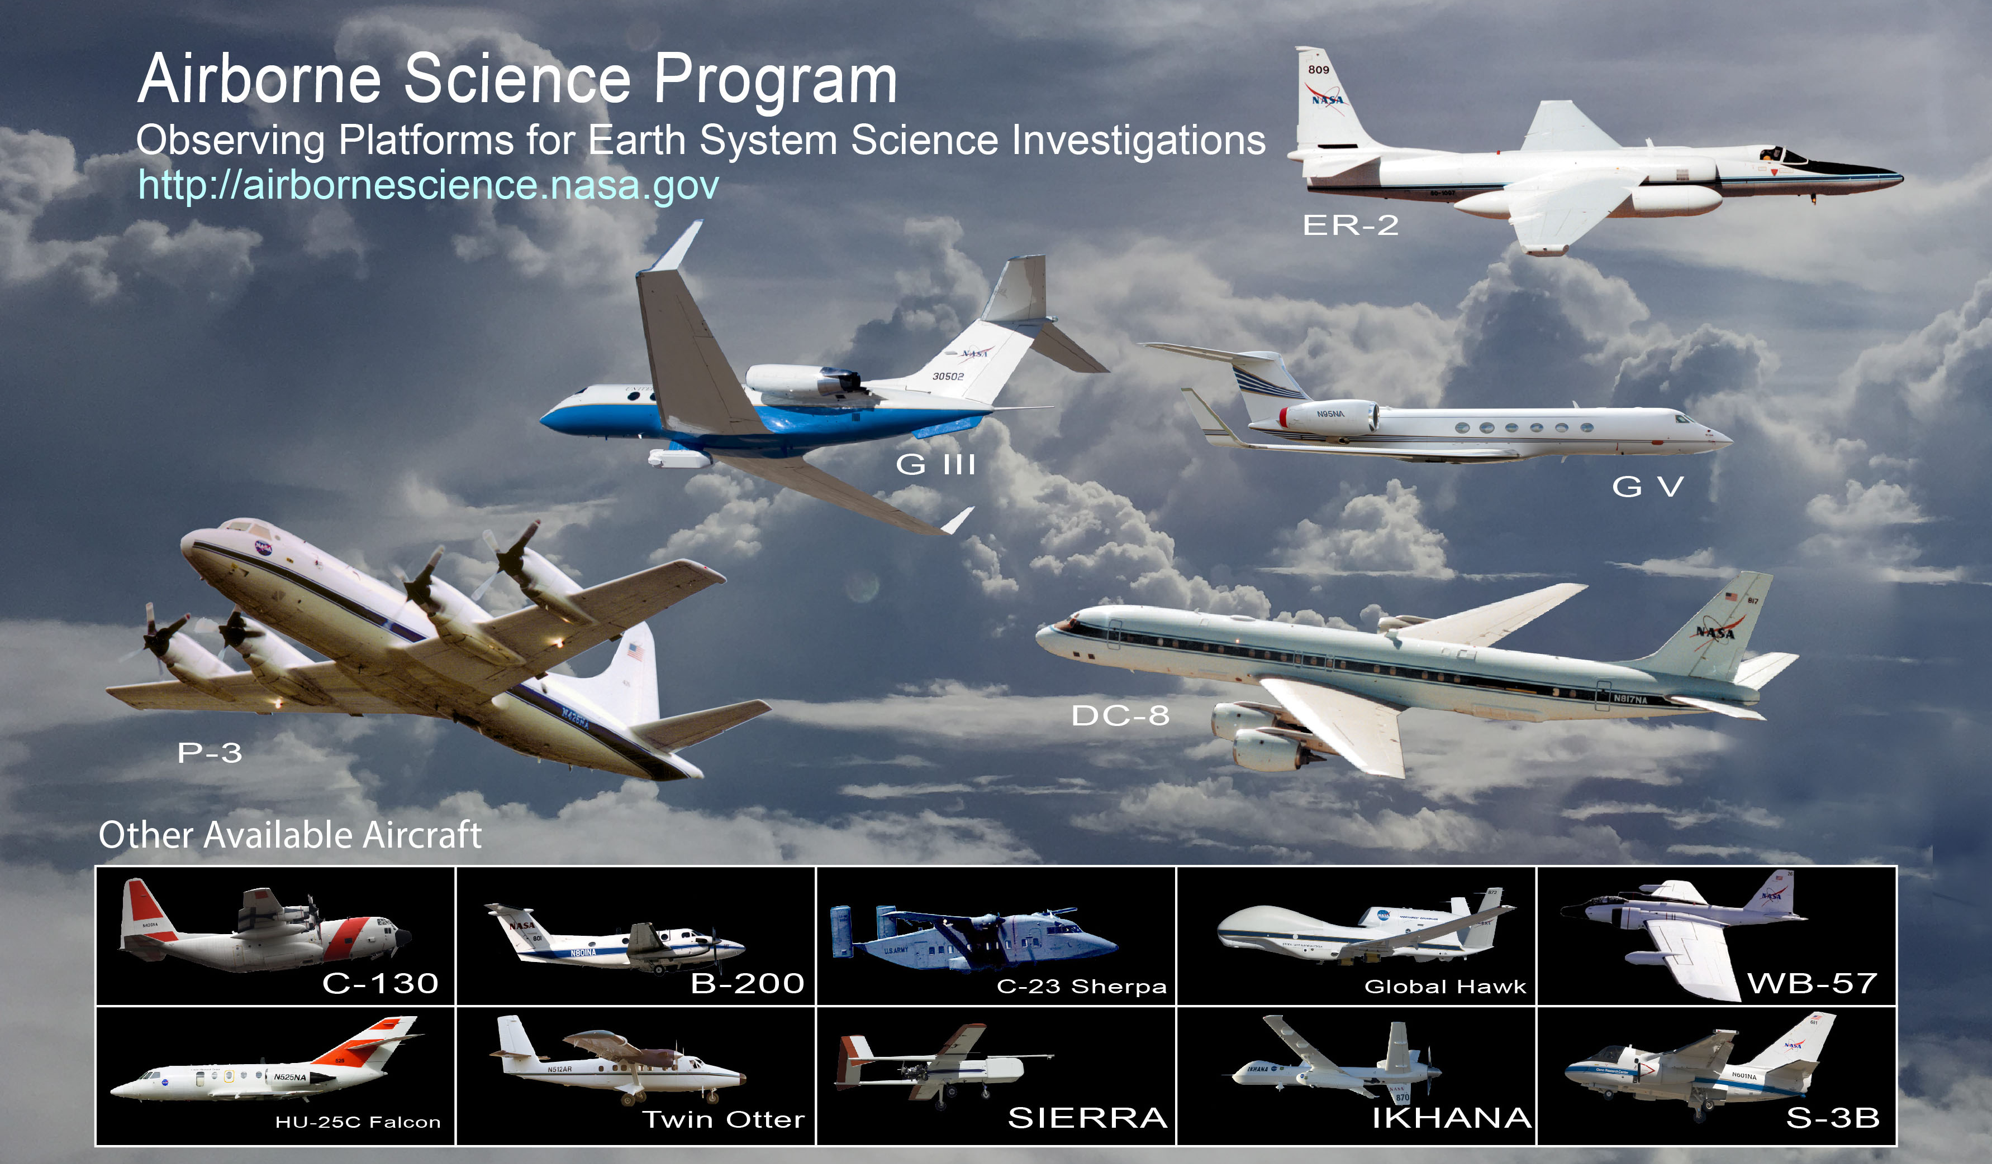

Slide 10
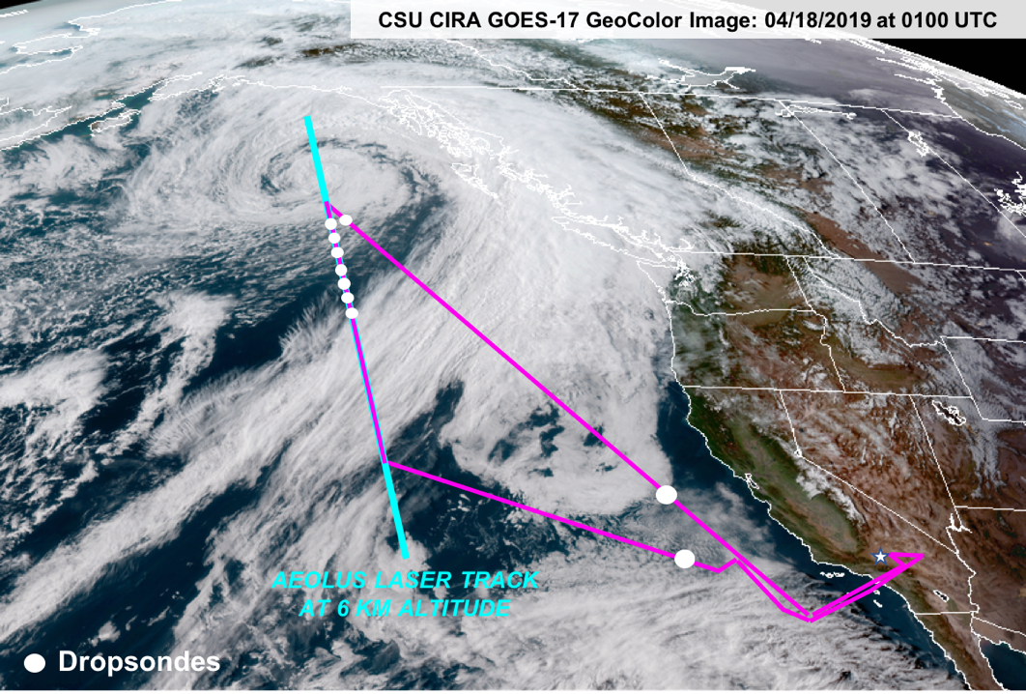
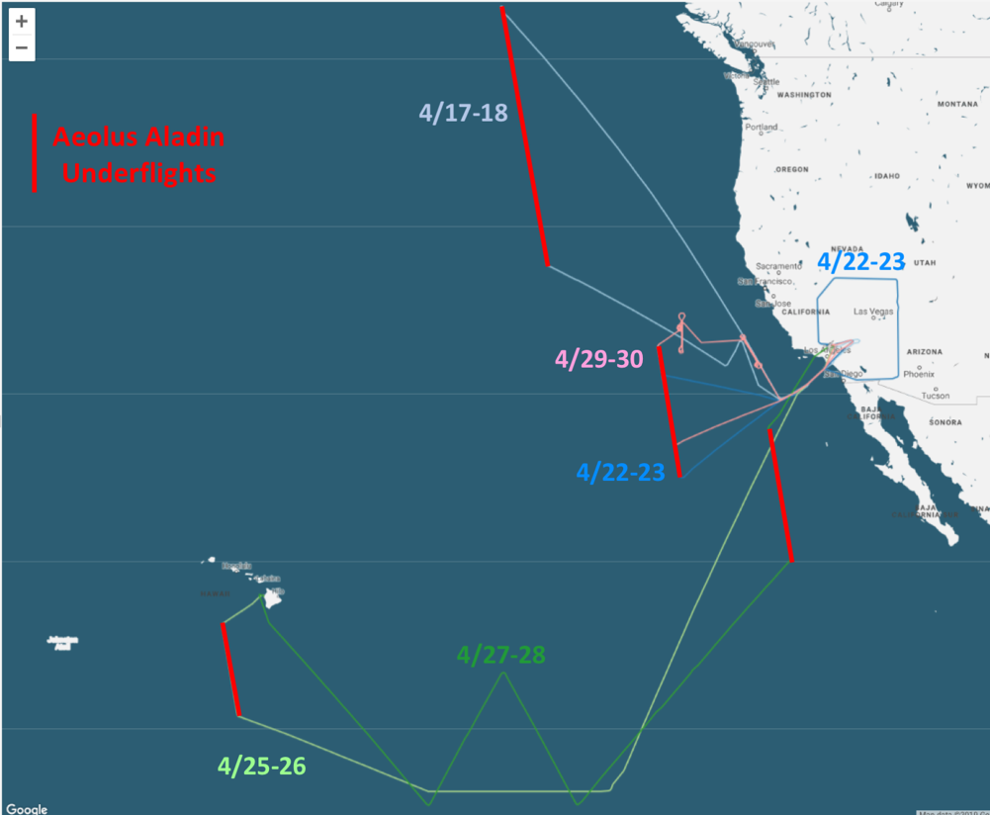
April 2019 ADM Aeolus Cal/Val Test Flights/Bedka
Kristopher Bedka (LaRC, Mission Lead), LaRC DAWN Team (PI: Michael Kavaya), LaRC HALO Team (PI: Amin Nehrir), Tsengdar Lee & Gail Skofronick-Jackson (NASA HQ), Dave Emmitt (Simpson Weather Assoc.), Sammy Henderson (Beyond Photonics), Mark Beaubien (YES Inc.)
The DAWN and HALO instruments collected ~45 hours of wind, aerosol, and water vapor profiles over the E. Pacific Ocean and Southwest U.S. aboard the DC-8 aircraft from 17-29 April 2019
  5 flights, including to/from Hawaii, sampled features including strong low pressure systems (upper left), weak wind flow above stratocumulus, an Asian dust layer, mountain waves, the polar and subtropical jet streams, and conditions across the tropical and subtropical Eastern Pacific
The objectives of this flight campaign were to characterize DAWN and HALO lidar system performance and underfly ADM Aeolus for Cal/Val
5 Aeolus underflights were conducted by the DC-8 in a variety of wind, aerosol, and cloud conditions. Winds ranging from < 5 m/s to ~60 m/s were observed
  31 dropsondes were released along the Aeolus track and 33 additional at other times during flight to validate Aeolus/DAWN winds and HALO water vapor profiles
These flights were done in preparation for DAWN and HALO participation in an international Aeolus Cal/Val campaign, scheduled to occur in summer 2020 out of Cape Verde
Other NASA Activities: Aeolus Wind Data Assimilation/McCarty

Slide 11
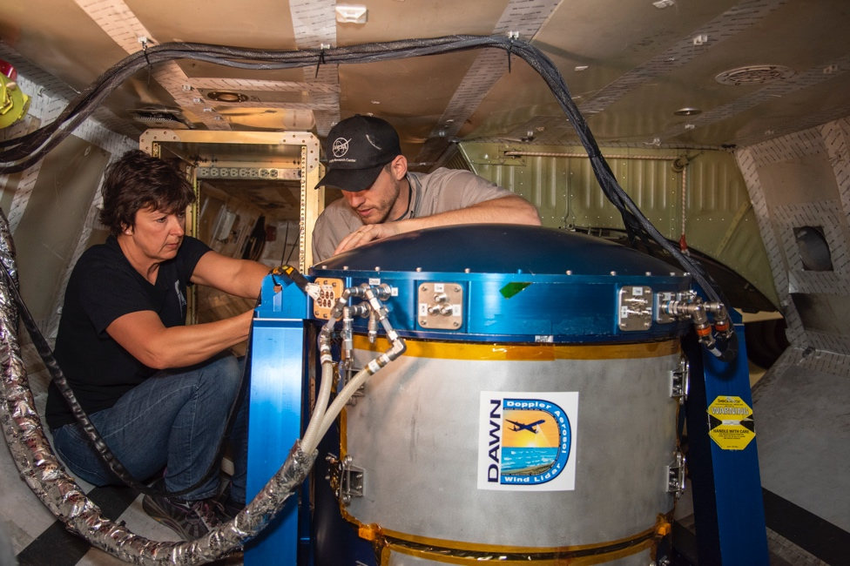
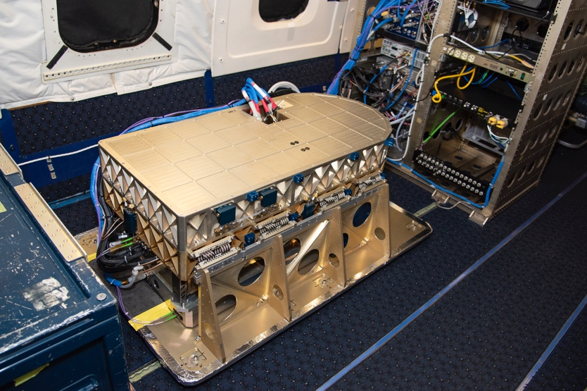
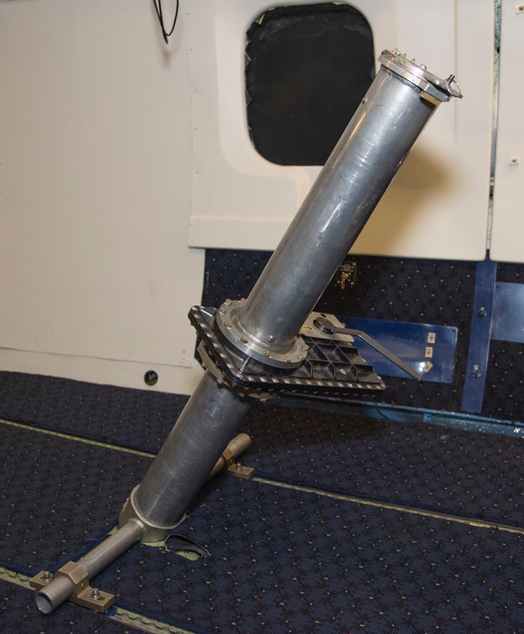
Aeolus Cal/Val Campaign 2020
Instruments under consideration
DAWN: (Doppler Aerosol WiNd lidar) is a pulsed laser, 2-micron, and solid-state. DAWN can provide vertical profiles of u, v, and w components of 3-D wind below the aircraft.
HALO: (High Altitude Lidar Observatory) is a multi-function airborne lidar to measure atmospheric H2O and CH4 mixing ratios and aerosol/cloud/ocean optical properties using the DIfferential Absorption Lidar (DIAL) and High Spectral Resolution Lidar (HSRL) techniques, respectively.
Dropsondes
APR-3: (Airborne Precipitation and Cloud Radar 3rd Generation) APR-3 provides Doppler radar measurements of clouds and precipitation at 3 frequencies (Ku-, Ka- and W-band)
Instruments Proposed (and selected) in ROSES 2019: Weather and Atmospheric Dynamics (closes Sept 16, 2019)
Dates under consideration
June 8-June 19: Instrument upload onto DC-8
June 22-26: Student Airborne Research Program (SARP) flights
July 1-3: Transit to Cape Verde (or alternate location)
July 4-August 15: Intensive observation period
August 16-18: Transit back to NASA Armstrong
August 19-21: Instrument Download
DAWN
HALO
Dropsonde

Slide 12
Wind Research Opportunities
For more information, visit:
https://nspires.nasaprs.com
2017: Ocean Vector Winds Science Team (Selected 15 of 48)
2017: CYGNSS Competed Science Team (Selected 14 of ?)
2018: Remote Sensing Theory for Earth Science (closed Apr 2, 2019, $2M/yr for 3 years)
2019: Future Investigators in NASA Earth and Space Science and Technology (closed Mar 11, 2019, Earth Science selections announced in June 2019)
2019: Interdisciplinary Science – interactions between sea ice and the atmosphere; polar ocean/biology/biogeochemical coupling; lifecycle of snow (closes Nov 15, 2019)
2019: Advanced Instrument Technology Transition (closes Oct 24, 2019)
2019: Weather and Atmospheric Dynamics (closes Sept 16, 2019)
2019: Planetary Boundary Layer Incubation Study Team (closes August 1, 2019)

Slide 13
Concluding Messages
Observing winds is an important part of an overall strategy designed to understand and address the key issues in Weather and Earth System Science.
NASA program incorporates field campaigns, modeling, and technology development, as well as enhancement and provision of satellite-based products in collaboration with end-users.
NASA broadly engages US research community through competitive programs that provide significant opportunities for community participation in all phases of these activities.
NASA is engaged domestically and internationally to integrate its programs with those of other agencies, and the broader community, and to share the results of its efforts with the public.

