Slide 1
Current DWL activity in JAXA
JAXA
Daisuke SAKAIZAWA

Slide 2
Topics
Objective
Milestone from JFY2017 to JFY2018
Outline of SLATS (Super low altitude test satellites)
Next Milestone

Slide 3
Objectives
What is the final goal using space-borne DWL mission, adding to Scientific advance?
What is dramatically changed as a result of improved NWP using DWL added to current satellite data?
  Benefit through innovation incl. improvement of NWP??
Those subjects are a great barrier to build mission in Japan.
Long-term scenario taken in H/W and Model development
Notes:
Technology development including laser, satellite buss syste, will be conducted with NICT and a supplyer
Another part, data usage, alroritghm is also expected to undergo by scientific groups
Improvement of Numerical weather predictions by using doppler lidar s important

Slide 4
Milestone from JFY2017 to JFY2018
Activity of system design, Build a space-borne DWL mission incl. international cooperation, system design
  Joint research with NICT for 2-um high energy laser & 1.6um laser study
  Development of 2um laser system have directed by NICT, JAXA joined it for space laser based on orbital, thermal, power budget.
  International cooperation with NASA-LaRC
  JAXA incl. NICT and NASA have discussed the LOI for DWL at Jul, 2017.
  Airline
  Japanese Full Service Carrier (FCS) suggests an idea by using DWL for an adaptive route to reduce a fuel.
  Airline staff was award at a competition for space business idea
  → Demands: Reduction error of wind estimation or height for Jetstream over the ocean (CAD←→JPN, USA ←→JPN)
 | JFY2017 | JFY2018
DWL
NASA/LaRCとmeeting
S-Booster
DWMeering（Jpn/USA）
CLRC
ADM evaluetion

Slide 5
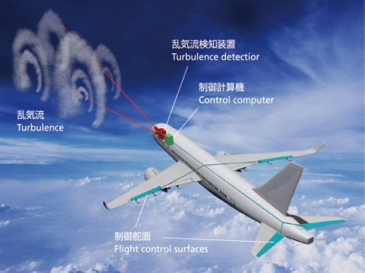
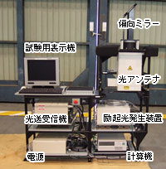
Milestone from JFY2017 to JFY2018
Coherent DWL for safe avionics have been developed
→ 1.6um wavelength, fiber + solid amplifier
→ Airborne demonstration measure a wind share 30 km away.
→ Next milestone1: joint research with Boing ecodemonstrator
→ Next milestone2: Space qualified component – optical fiber, detector are progressed under development of optical communication satellite
Wavelength standard
（DFB + Fiber）
Pre-Amp
（EDFA+EYDF）
Optical
Switch
Post-Amp
（Solid crystal）
Coupler
Signal
Processing
T/R
Optics
Optical Heterodyne
(Coupler + balanced detector)
Instrument is manufactured by Mitsubishi
Optical fiber based Coherent DWL (Block diagram)
Coherent DWL BBM for CATS

Slide 6
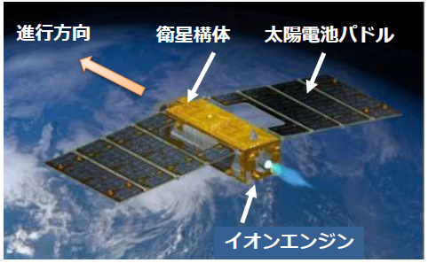
Outline of SLATS
Mission of SLATS(Super Low Altitude Test Satellite)
Demonstration of satellite bus system
Ion engine, and control of the orbit using IonE.
Evaluation of impact of AO,Air for satellite
materials are degraded due to atomic oxygen
Demonstration of attitude control using small EO optics
Get an image using optical camera with attitude and height control
Specifications of SLATS
Item | Specifications
Sensors | Optical sensor x 1 AO monitor x 2
Size | 2.5m x 5.2m x 0.9m
Mass | 400kg
Power | > 1.1kw
Lifetime | > 2 y
Operation orbit | 268 km – 180 km
Launch | 2017.12.23
Launcher | H-IIA
Direction of travel
Satellite body
Solar panel
Ion engine

Slide 7
Operation of SLATS
Launch
GCOM(798km)
Chemical fuel (RCS)
Ion engine system IES
Launch Slats
IES/RCS
Launch Slats
Error due to laucher operation
Height control
Height control
Avoid ISS
Orbit transfer
Height control (Each 28days)
Keep the altitude
Height control with IE,RCS
Target altitude
270 km
Β -60deg.
Orbit transfer
Keep altitude
Launch &
Initial chek out
Nominal operation
Time after launch [month]

Slide 8
Next milestone
Develop a long-term scenario for Space borne DWL
  Future plan for social benefit using space-borne DWL
    Advanced SLATS, and multi-satellite observation
    Combined observation using DWL, AMV, and otjer satellite data
  Study with FCS for error reduction at focused altitude over the sea
    Reduce difference between flight plan and real winds data
    Height of Jetstream, Current error 3-4m/s at jet stream
    Altitude resolution 1000ft, horizontally, 2.25 deg. e.t.c.
  Capability of Super low altitude (220～250km), incl. other orbit
    Attitude stability under impact of air resistance
    Lower radiation condition, Impact of Atomic oxygen
    Inclination, ISS-altitude, LEO

Slide 10
Algorithm User
NICT
JAXA
R&D
Airline
Joint research
Development H/W
JAXA
EORC
Discuss
NASA/NOAA

Slide 11

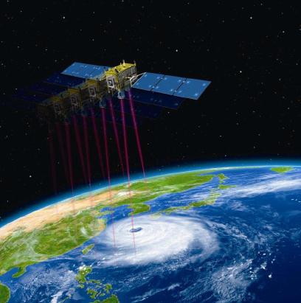
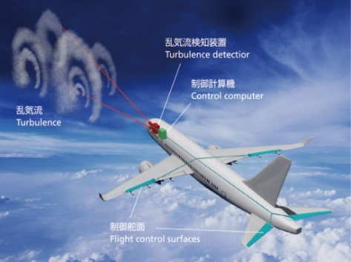
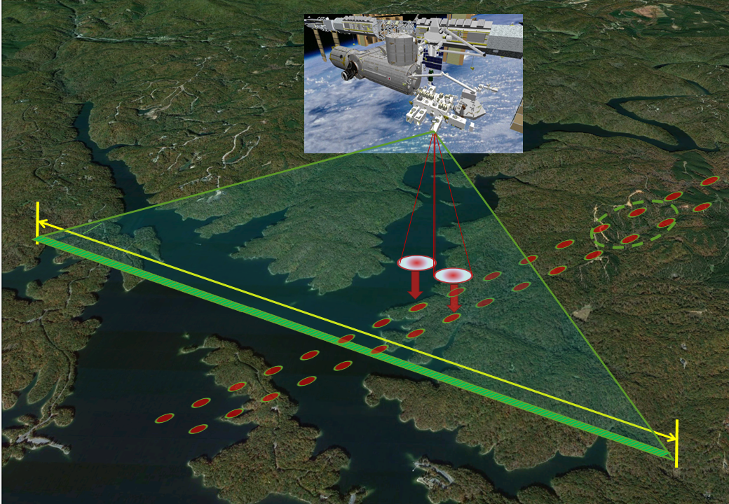
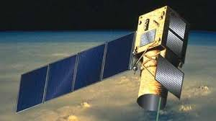
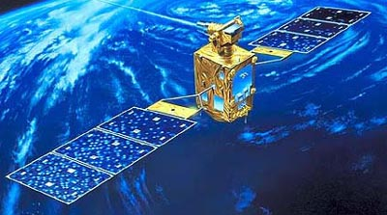
Active optical sensor:
Technology development from the past to …
Development: Advanced lidar system
Pulsed
Safe avionics
CW moduation λ(1.55 μm)
Doppler lidar (later than 2025)
8W
Development: Laser technology
DIAL
> 15W
Stable femto-second laser/amplifier
Pulse comression/stretch
High peak power tolerant thin film
3D LADAR
Stable injection seeding
Absolute wavelength control
Double pulse technique
Parametric wavelength conversion
High sensitive SWIR photon-counting
Wind turbulence detection with Doppler lidar
Progress to Development Phase
Development: Lidar system
Qsw Pulsed
Vegetation lidar (2020)
Canopy height
Above ground Biomass
Mie Scattering Lidar
Pressurized laser canister
High peak current/voltage supply
High precise laser pointing
We are HERE !
6W
Remote Sensing
CW λ(1.0/1.5μm)
Qsw Pulsed
λ(0.5μm/1.06 μm)
Loop heat-pipe
Conduction cool
Radiation tolerant optical fiber
Advanced Optical
Communication satellite (201X)
Development: Elemental
ELISE (Aborted launch 2002)
Optical multiplexing
Frequency comb.
10W
> 5W
Laser transmitter (2011～)
Optical Communication
CW λ(1.0/1.5μm)
16W
OICETS (2005-2009)
Inter-orbit communication experiment
with ARTEMIS(ESA)
long-lived LD stack
Compact large aperture telescope
High peak/Avg. power laser transmitter
0.5W
Heterodyne detection
High precision tracking system

