Slide 1
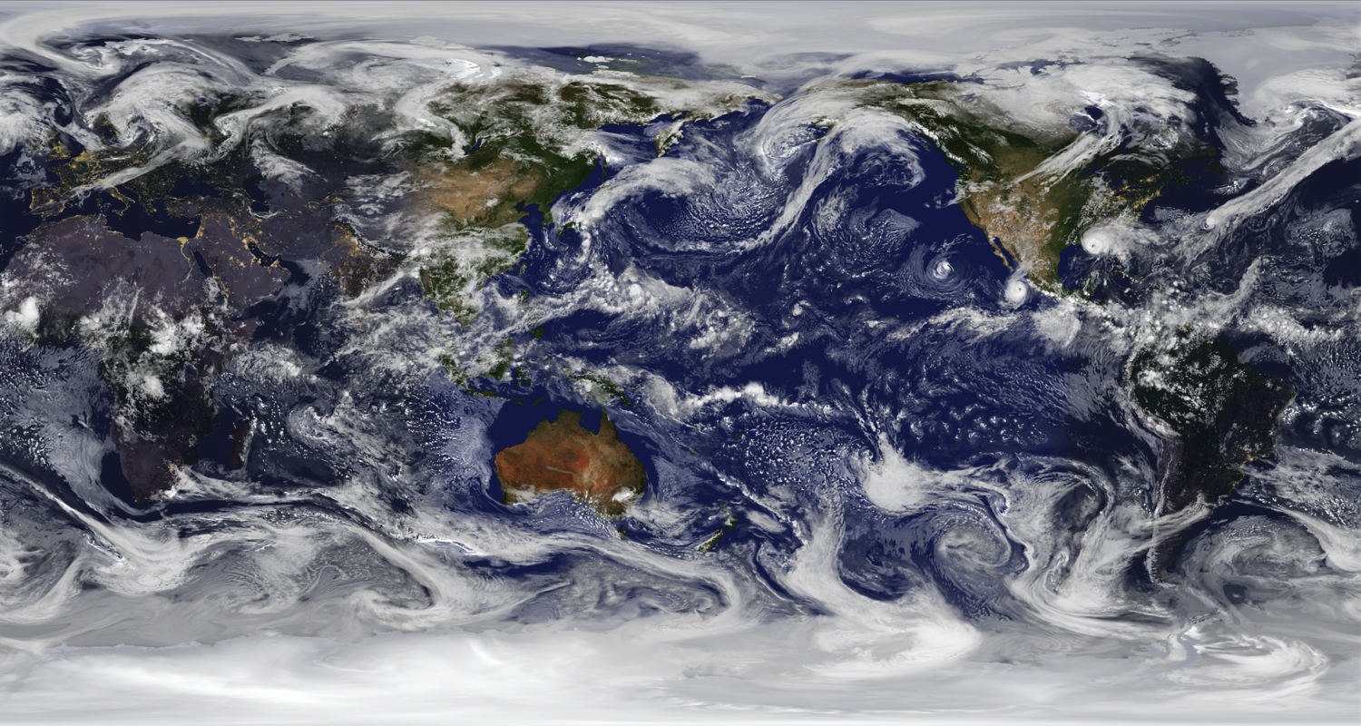
NOAA’s Quantitative Observing System Assessment Program (QOSAP)
GMAO 7km resolution global nature run
Robert Atlas and Lidia Cucurull
Office of Oceanic and Atmospheric Research

Slide 2
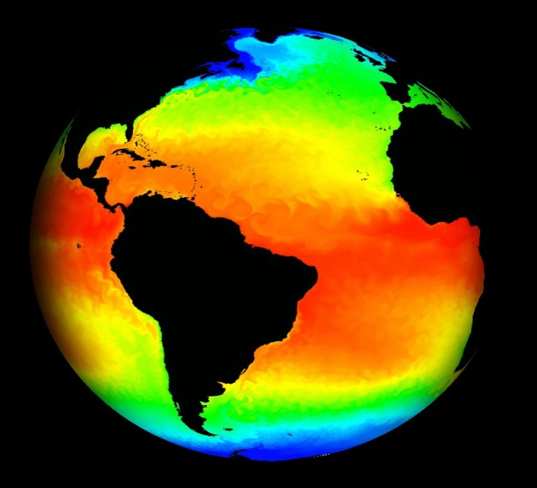
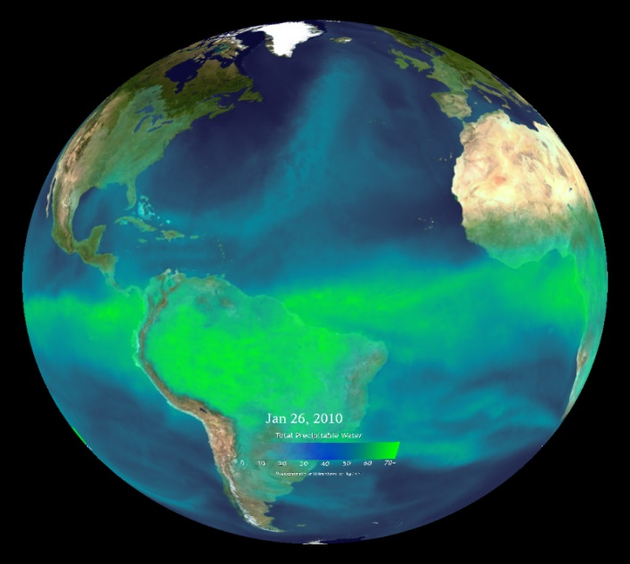
Primary Objectives
QOSAP’s primary objective is to improve quantitative and objective assessment capabilities to evaluate operational and future observation system impacts and trade-offs to assess and to prioritize NOAA’s observing system architecture.
Increase NOAA’s capacity to conduct quantitative observing system assessments.
Develop and use appropriate quantitative assessment methodologies.
Inform major decisions on the design and implementation of optimal composite observing systems.
2

Slide 3
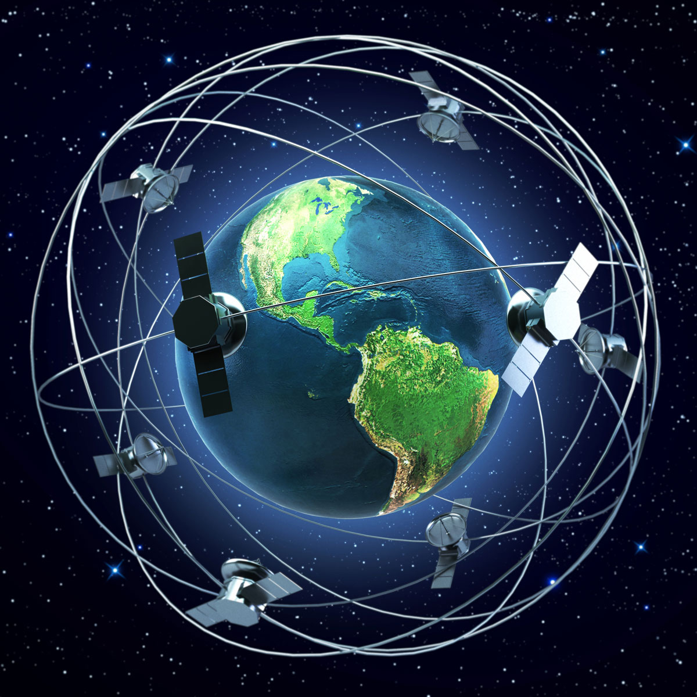

QOSAP functions
QOSAP coordinates the assessment of the impact of current and new observations across the different NOAA Line Offices.
QOSAP uses observing system experiments (OSEs) and observing system simulation experiments (OSSEs) as effective techniques to evaluate the impact of the different observation types.
These studies can help NOAA management prioritize mission designs in a cost-effective way by analyzing tradeoffs in the design of proposed observing systems.
  Maintain OSSE and OSE inventory up to date in NOAA google drive (hyperlink above).
3

Slide 4
QOSAP Organization Chart
Champion
(Craig McLean)
NOSC
(Oversight)
TPIO
(NOSIA Integration)
Executive Lead
(Gary Matlock)
QOSAP
Program Director
Bob Atlas
QOSAP
Program Deputy Director
Lidia Cucurull
Sid Boukabara
NESDIS
Gregory Dusek
NOS
James Yoe
NWS
Lidia Cucurull
OAR
Bonnie Ponwith
NMFS
Jonathan Taylor
OMAO
Derek Posselt
NASA/JPL
Notes:
The Line and Staff Offices are working well together and it is paying dividends with the advances being made.

Slide 5
Prioritization Schema
For each proposed assessment topic/question we answer:
Question 1: Is there a pressing need for the assessment to be executed in FY? [Yes/No]
Question 2: Does NOAA currently have the capabilities in place to execute the assessment in FY? [Yes/No]
Question 3: Are there existing resources available in FY for the assessment? [Yes/No] Estimate the amount needed/or additional above existing $ [$k]
Question 4: Can the assessment be completed in FY? [Yes/No]
Question 5: Potential value to NOAA and partners? [High, Medium, Low]
5

Slide 6
Objectives of an OSSE
To provide a QUANTITATIVE assessment of the potential impact of proposed observing systems on earth system science, data assimilation, and numerical prediction.
To evaluate and/or develop new methodology for the processing and assimilation of new types of data. (This enables improved and more rapid operational use of new observing systems).
To evaluate tradeoffs in the design and configuration of proposed observing systems (e.g. coverage, resolution, accuracy and data redundancy).
To optimize the global observing system for weather and climate, as well as other applications.
6

Slide 7
Basic Concepts
In OSSEs
  “Nature Run” is proxy for Real Nature
    Free run of forecast model
      Realistic phenomenology and variability vs. Nature
    As independent as possible from Data Assimilation system model
      Correlated biases introduce optimism
      Construction of observations from Nature Run should also be independent
  Truth is known
    Verification vs truth can reveal characteristics of data assimilation system
  New observations can be simulated

Slide 8
Basic Concepts (cont)
Simulated observations should be as realistic as possible
  Exhibit same system impact as real observations
  Contain same kinds of errors as real observations (e.g. representativeness)
For application to advanced observing systems
  Data Assimilation system should be leading edge but well tested
  OSSEs should be run periodically leading up to deployment of new instruments

Slide 9
Process and key aspects of a credible OSSE
Will the study be completed in time to be useful?
Is the NR and the differences between the NR and forecast models realistic?
Are the coverages and error characteristics of simulated observations realistic?
Are the forecast accuracy and impacts of existing observing systems in the OSSE comparable to the real world?
What are the limitations of the OSSE system? Conclusions should not be drawn that go beyond these limitations

Slide 10
Previous OSSEs (aimed at global NWP)
EVALUATED THE RELATIVE IMPACT OF TEMPERATURE, WIND AND MOISTURE DATA - These experiments showed wind data to be more effective than mass data in correcting analysis errors and indicated significant potential for space-based wind profile data to improve weather prediction. The impact on average statistical scores for the northern hemisphere was modest, but in approximately 10% of the cases a significant improvement in the prediction of weather systems over the United States was observed.
EVALUATED THE RELATIVE IMPORTANCE OF UPPER AND LOWER LEVEL WIND DATA.- These experiments showed that the wind profile data from 500hpa and higher provided most of the impact on numerical forecasting.
EVALUATED DIFFERENT ORBITAL CONFIGURATIONS AND THE EFFECT OF REDUCED POWER FOR A SPACE-BASED LASER WIND SOUNDER (LAWS).- These experiments showed the quantitative reduction in impact that would result from proposed degradation of the LAWS instrument.
DETERMINED DATA REQUIREMENTS FOR SPECIFIC MISSIONS-These experiments evaluated different coverages, resolutions, and accuracies for proposed missions.

Slide 11
Previous OSSEs (continued)
DEVELOPED AND TESTED IMPROVED METHODOLOGY FOR ASSIMILATING SATELLITE SCATTEROMETER DATA. - Applying this methodology resulted in the demonstration of the first significant positive impact of real scatterometer data in 1983.
DEVELOPED AND TESTED DIFFERENT METHODS FOR ASSIMILATING SATELLITE SURFACE WIND SPEED DATA.- This led to assimilation of SSM/I wind speed data to improve ocean surface wind analyses.
EVALUATED THE QUANTITATIVE AND RELATIVE IMPACT OF ERS AND NSCAT YEARS PRIOR TO THEIR LAUNCH.- These results were confirmed after the launch of both instruments.
EVALUATED THE QUANTITATIVE IMPACT OF AIRS SOUNDING DATA AND THE IMPORTANCE OF CLOUD-CLEARING. These results were also confirmed by later data impact experiments with real AIRS data.

Slide 12
Who performs OSSEs in NOAA
Virtually all OSSEs in NOAA are either performed by or are coordinated by NOAA’s Quantitative Observing System Assessment Program (QOSAP).
The QOSAP Team consists of representatives from all of NOAA’s Line Offices.
Weather related OSSEs are performed by a team consisting of scientists from OAR/AOML, NESDIS/STAR and CIMSS.
North Atlantic Ocean OSSEs are performed by scientists at AOML in collaboration with the University of Miami.
OSSE capabilities for other ocean basins, coastal oceans, and for climate are being developed, but are not yet available.
12

Slide 13
Current Status of OSSEs in NOAA
      Numerous OSSEs have been performed using the global OSSE system based on an ECMWF T511 nature run and the regional Hurricane OSSE system developed at AOML. (These have evaluated Geo HSS, GNSS RO, CYGNSS, TROPICS, DWL, UAS, Recon Aircraft, and others.)
      A state of the art global OSSE system based on the NASA Cubed Sphere at 7 km resolution NR has been developed and is currently being used in multiple OSSEs to evaluate issues relating to satellite, sub-orbital, and in situ observing systems. (These are focused right now on GNSS RO and GEO HSS.)
      New and expanding regional OSSE systems for high impact weather are being developed. (This includes an advanced Hurricane OSSE System based on the basin scale version of HWRF.)
      A state of the art ocean OSSE System has been developed and is expanding. (OSSEs related to the role of ocean observations in hurricane prediction are being performed.)
13

Slide 14
An OSSE with Doppler Wind Lidar (DWL)
AC 500-hPa geopotential heights
with wind lidar
without wind lidar
with wind lidar
without wind lidar
with wind lidar
without wind lidar
Addition of DWL in weather models would improve the forecasts of hurricanes
LESS INTENSITY ERROR with DWL
Forecast hour
Forecast hour
Atlas et al. 2015
Atlas et al. 2015
14
Notes:
Optical Autocovariance Wind Lidar (OAWL)
Regional OSSE study using satellite-based DWL
gCTRL = Control data assimilated in NCEP’s global forecast model (GFS) used for initial and boundary conditions
gOAWL = Control+DWL data assimilated in GFS
Addition of DWL data in global model would improve track/intensity forecast of hurricane in regional (HWRF) model

Slide 15
An OSSE with Doppler Wind Lidar (DWL)
RMSE tropical winds
with wind lidar
without wind lidar
with wind lidar
without wind lidar
Forecast hour
Forecast hour
Atlas et al. 2015
Atlas et al. 2015
15
Notes:
Optical Autocovariance Wind Lidar (OAWL)
Regional OSSE study using satellite-based DWL
gCTRL = Control data assimilated in NCEP’s global forecast model (GFS) used for initial and boundary conditions
gOAWL = Control+DWL data assimilated in GFS
Addition of DWL data in global model would improve track/intensity forecast of hurricane in regional (HWRF) model

Slide 16
An OSSE with Doppler Wind Lidar (DWL)
with wind lidar
without wind lidar
LESS TRACK ERROR with DWL
Addition of DWL in weather models would improve the forecasts of hurricanes
LESS INTENSITY ERROR with DWL
Forecast hour
Atlas et al. 2015
Atlas et al. 2015
16
Notes:
Optical Autocovariance Wind Lidar (OAWL)
Regional OSSE study using satellite-based DWL
gCTRL = Control data assimilated in NCEP’s global forecast model (GFS) used for initial and boundary conditions
gOAWL = Control+DWL data assimilated in GFS
Addition of DWL data in global model would improve track/intensity forecast of hurricane in regional (HWRF) model

Slide 17
Summary
NOAA’s Quantitative Observing System Assessment Program (QOSAP) coordinates OSE and OSSE across NOAA and strives to ensure that all OSSEs are performed in a credible manner.
OSSEs provide an effective means to:
  Evaluate the potential impact of proposed observing systems
  Determine tradeoffs in their design
  Evaluate new data assimilation methodology
Great care must be taken to ensure the realism of the OSSEs and in the interpretation of OSSE results.
OSSEs are currently being conducted to assess the potential impact of many new observing systems in current data assimilation systems.
Rigorous OSSE methodology is being extended to air quality, severe storm, ocean, climate and biological applications.
Recent OSSEs continue to show significant potential for DWL to improve NWP.

Slide 18
Backup slides

Slide 19
Current
ECMWF T511, T1279 GMAO 7km Cubed sphere WRF 1 km and HWRF Basin-scale Hurricane NRs
OSSE TESTBED COMPONENTS
Validation of End-to-End OSSE Set-up
- Realism of simulated observations and input
- Impact model not too close to NR
Nature Runs
Simulated Observations
DAS
Forecast
Model
Current and
Scatterometer
Rawinsonde
Surface
Aircraft
TOVS
AIRS
AMV
Future
DWL
CMIS
Molnya
UAS
CL Balloon
GPS Sounding
Buoy Rocket
Current
GSI
4DVAR
EnKF
Hybrid
Regional
WRF
HWRF
NAM
Global
GFS
FIM
Validation and Augmentation
OSSE Metrics
Valid.
Cyclones
Mean fields
Clouds
Precip
Aug.
Clouds
Aerosols
Turbulence
Cyclones, Fronts, Jets
Anomaly Correlation
Air Traffic Routing
Precip.Utility Load Mgmt.
Targeting Observation schems

Slide 20
Recent NOAA AOML OSSE Publications
Androulidakis, Y.S., V.H. Kourafalou, G.R. Halliwell, M. Le Henaff, H.S. Kang, M. Mehari, and R. Atlas. Hurricane interaction with the upper ocean in the Amazon-Orinoco plume region. Ocean Dynamics .
Atlas, R., V. Tallapragada, and S. Gopalakrishnan. Advances in tropical cyclone intensity forecasts. Marine Technology Society Journal, 49(6):149-160 (doi:10.4031/MTSJ.49.6.2) (2015).
Atlas, R., L. Bucci, B. Annane, R. Hoffman, and S. Murillo. Observing System Simulation Experiments to assess the potential impact of new observing systems on hurricane forecasting. Marine Technology Society Journal, 49(6):140-148 (doi:10.4031/MTSJ.49.6.3) (2015).
Atlas, R., R.N. Hoffman, Z. Ma, G.D. Emmitt, S.A. Wood, S. Greco, S. Tucker, L. Bucci, B. Annane, R.M. Hardesty, and S. Murillo. Observing system simulation experiments (OSSEs) to evaluate the potential impact of an optical autocovariance wind lidar (OAWL) on numerical weather prediction. Journal of Atmospheric and Oceanic Technology, 32(9):1593-1613 (doi:10.1175/JTECH-D-15-0038.1) (2015).

Slide 21
Recent NOAA AOML OSSE Publications
Boukabara, S.A., I. Moradi, R. Atlas, S.P.F. Casey, L. Cucurull, R.N. Hoffman, K. Ide, V.K. Kumar, R. Li, Z. Li, M. Masutani, N. Shahroudi, J. Woollen, and Y. Zhou. Community global Observing System Simulation Experiment (OSSE) package: CGOP—Description and usage. Journal of Atmospheric and Oceanic Technology, 33(8):1759-1777 (doi:10.1175/JTECH-D-16-0012.1) (2016).
Boukabara, S.A., T. Zhu, H.L. Tolman, S. Lord, S. Goodman, R. Atlas, M. Goldberg, T. Auligne, B. Pierce, L. Cucurull, M. Zupanski, M. Zhang, I. Moradi, J. Otkin, D. Santek, B. Hoover, Z. Pu, X. Zhan, C. Hain, E. Kalnay, D. Hotta, S. Nolin, E. Bayler, A. Mehra, S.P.F. Casey, D. Lindsey, L. Grasso, K. Kumar, A. Powell, J. Xu, T. Greenwald, J. Zajic, J. Li, J. Li, B. Li, J. Liu, L. Fang, P. Wang, and T.-C. Chen. S4: An O2R/R2O infrastructure for optimizing satellite data utilization in NOAA numerical modeling systems: A step toward bridging the gap between research and operations. Bulletin of the American Meteorological Society (in press).
Halliwell, G.R., A. Srinivasan, V. Kourafalou, H. Yang, D. Willey, M. Le Henaff, and R. Atlas. Rigorous evaluation of a fraternal twin ocean OSSE system for the open Gulf of Mexico. Journal of Oceanic and Atmospheric Technology, 31(1):105-130 (doi:10.1175/JTECH-D-13-00011.1) (2014).

Slide 22
Recent NOAA AOML OSSE Publications
Hoffman, R.N., and R. Atlas. Future observing system simulation experiments. Bulletin of the American Meteorological Society, 97(9):___-___ (doi:10.1175/BAMS-D-15-00200.1) (2016).
Hoffman, R.N., S.-A. Boukabara, V.K. Kumar, K. Garrett, S.P.F. Casey, and R. Atlas. An empirical cumulative density function approach to defining summary NWP forecast assessment metrics. Monthly Weather Review (in press).
Kourafalou, V.H., Y.S. Androulidakis, G.R. Halliwell, H.-S. Kang, M. Mehari, M. Le Henaff, R. Atlas, and R. Lumpkin. North Atlantic Ocean OSSE system development: Nature Run evaluation and application to hurricane interaction with the Gulf Stream. Progress in Oceanography (submitted).
Lee, P., R. Atlas, G. Carmichael, Y. Tang, B. Pierce, A.P. Biazar, L. Pan, H. Kim, D. Tong, and W. Chen. Observing System Simulation Experiments (OSSEs) using a regional air quality application for evaluation. In Air Pollution Modeling and its Application XXIV, D.G. Steyn and N. Chaumerliac (eds.). Springer International Publishing, 599-605 (doi:10.1007/978-3-319-24478-5_97) (2016).

