Slide 1
Uncertainty in Operational
Wind Analyses Rolf Langland and Ryan Maue
Working Group on Space-Based Lidar Winds
Boulder, CO Feb 7-8 2018

Slide 2
Objectives
Quantify the uncertainty (differences) in current operational analyses of the atmosphere – winds, temperature, height, moisture. ECWMF, GFS, others
Analysis differences are a proxy for actual analysis error, which cannot be precisely quantified.
Consider implications of analysis uncertainty for NWP and plans for the future global observing network, including space-based wind lidar.

Slide 3
Causes of Analysis Differences and Error
Gaps in global atmospheric observing network
Variations in observation accuracy and bias
Differences in observation selection for assimilation
Observation quality control decisions
Limitations of data assimilation techniques (imperfect estimates of observation and background errors, correlated errors, etc.)
Notes:
Different DA systems
Model error

Slide 4
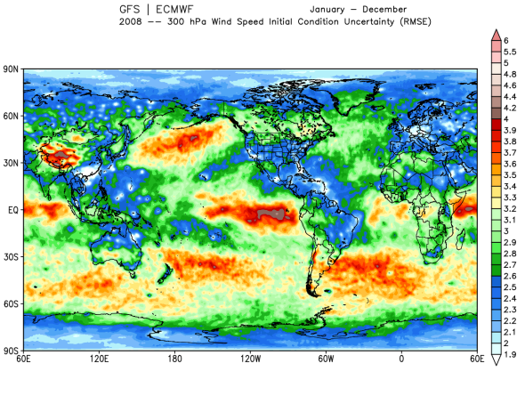
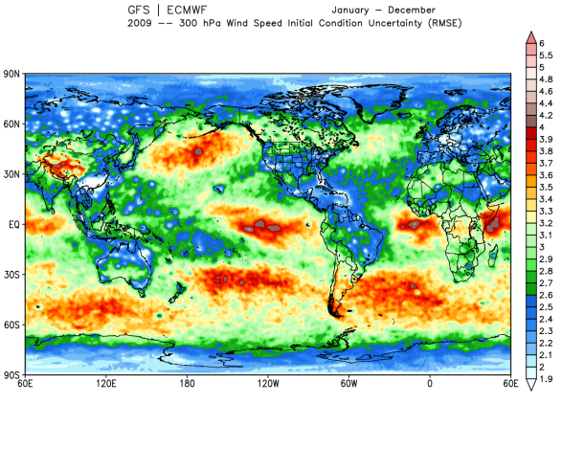
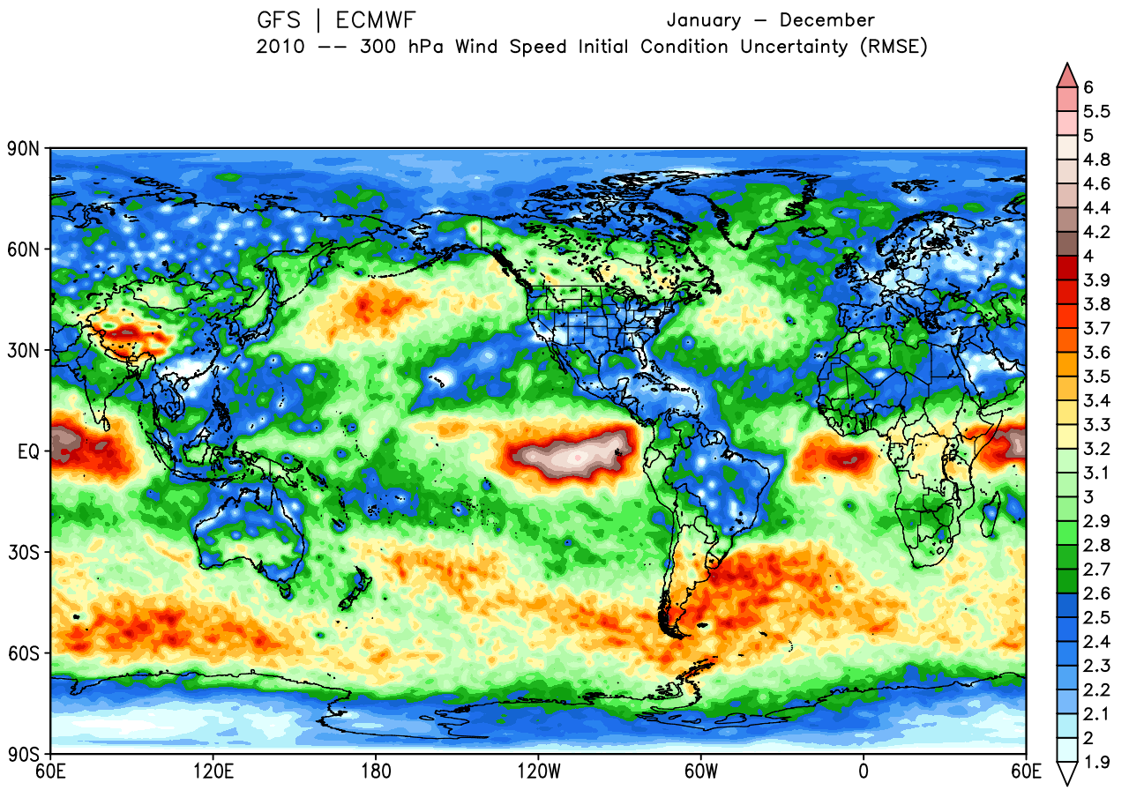
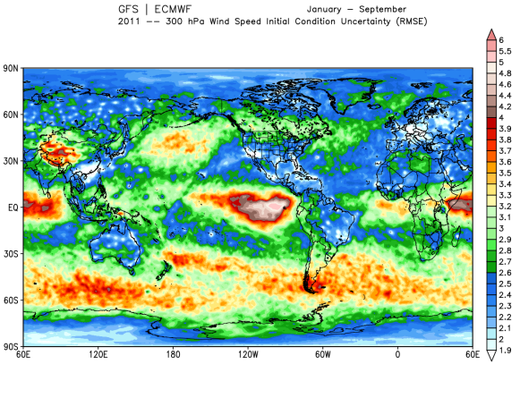
300mb Analyzed Wind Speed
RMS Difference [ECMWF & GFS]
2008 (Jan-Dec)
2009 (Jan-Dec)
Analysis uncertainty is primarily a function of the observation data distribution and relative data accuracy, rather than intrinsic variance of the atmosphere.
2010 (Jan-Dec)
2011 (Jan-Sep)

Slide 5
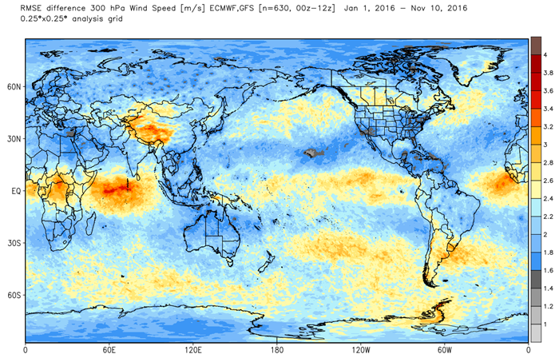
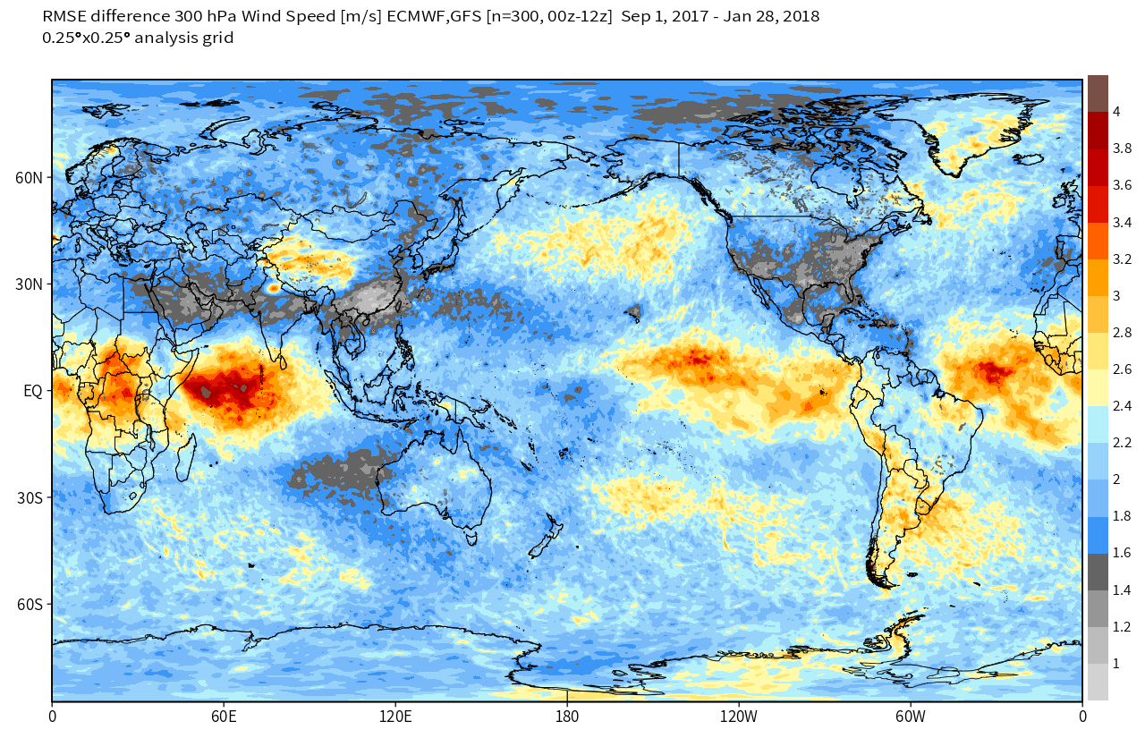
300mb Analyzed Wind Speed
RMS Difference [ECMWF & GFS]
2016 (1Jan-10Nov)
Sep 2017 – Jan 2018
Uncertainty (by this measure) of 300mb wind analyses has decreased slightly from 2008 to 2018
Significant regional differences in accuracy of wind analyses remain

Slide 6
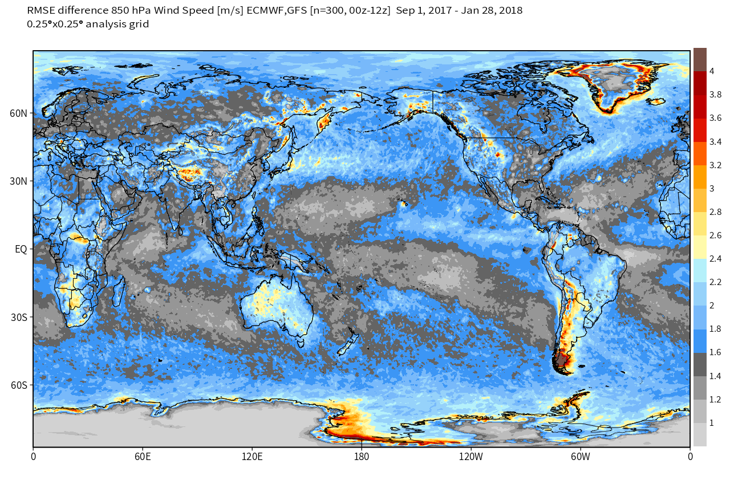
850mb Analyzed Wind Speed
RMS Difference [ECMWF & GFS]
1Sep 2017 – 28Jan 2018
In lower troposphere (850mb) uncertainty of wind analyses over oceans in certain regions is fairly well-constrained !
Surface scatterometers equatorward of 50° ?

Slide 7
Summary
Uncertainty (error) in current atmospheric wind analyses varies substantially between regions of the globe. Largest analysis uncertainty in the upper troposphere (300mb) is generally over oceans, esp. in southern hemisphere.
Analysis uncertainty is primarily a function of the observation data distribution and relative data accuracy, rather than intrinsic variance of the atmosphere. This pattern has changed very little in the past decade.
While atmospheric analyses and re-analyses are generally used as ‘truth” (no error bars) this may not always be a good assumption.
Reductions in analysis uncertainty can be used to validate impact and benefits of new observing systems.

