Slide 1






A Roadmap For Meeting Full Tropospheric Wind Measurement Needs
Sara C. Tucker & Carl Weimer
Ball Aerospace and Technologies Corp
Mike Hardesty
University of Colorado, CIRES and NOAA/ESRL

Slide 2
Motivation
2017 Earth Science Decadal Survey
  Wind lidar in incubation and Explorer categories
NOAA Satellite Observing System Architecture (NSOSA) Study and the Space-Platform Requirements Working Group (SPRWG)
  Full-tropospheric winds (likely from Wind Lidar) wanted by 2030
  How do we get there from here?
  1. First, where are we? Farther along than last DS.
  2. What are the goals & requirements (for NASA and for NOAA)
  3. What paths can we take to get there?
Some perspectives (only 11 years in) and roadmaps

Slide 3
Wind Lidar Missions: Past
M
Molecular: UT/LS
A
Aerosol: LT/clouds
Measure 3D Winds
Passive
Active
Mission definition
Microwave
Optical (feature tracking lidar)
Optical Doppler Lidar
A
PBL/aerosol scattering
A
Full-Troposphere & Lower Stratosphere
M
“Coherent” Heterodyne Detection
“Direct” Detection
1064 nm, 532 nm (CALIPSO) & 355 nm
~2 μm, (1.6 μm, ~10 μm)
Mission Architecture
LaRC
DAWN
A
Double-Edge
Fringe Imaging
Mach Zehnder
NOAA CSD, Halo, Leosphere,
GSFC?
A
M
A
M
M
A
ESA’s
Aeolus
UPMC (France)
ATHENA OAWL
Nested OAWL

Slide 4
Atmospheric Backscatter
Longer wavelengths
  Larger aerosols present in the PBL & aerosol/cloud layers
  Less atmos. extinction, but less coverage
Shorter wavelengths
  More scattering from PBL and cloud layers
  Scattering off of smaller particles in UTLS
  Molecular scattering
These properties factor strongly into which lidars are best for a given application
Log scale

Slide 5
CCOPE/ADLS
(Airborne)
NOAA
Mini-MOPA
NOAA TeaCO
LAWS Panel
LAWS Team
NOAA HRDL
VALIDAR
DAWN 1 IIP
DAWN 2 IIP
SPARCLE
←← DAWN Flights →→
CO2
Solid State Heterodyne
Direct Detection
Zephyr
← TWiLiTE Flights →
Edge Technique
GroundWinds
TWiLiTE IIP
A2D Airborne
Fringe Imaging HRDI
Fringe Imaging Lidar
GLOW Double Edge
TWiLiTE AITT
Optical Autocovariance
Decadal Survey
3D-Winds Hybrid
Aeolus Launch
GTWS
GWOS
WISSCR
ATHENA-OAWL
ESA’s ADM Aeolus (single look – 355 nm Aerosol & Molecular)
NASA/Ball CALIPSO >11 Years on orbit!
launched
Optical Autocovariance (OA) Wind Lidar
Original OA system development at Ball
History: A partial timeline of space-based Doppler wind lidar
OAWL Prototype
OAWL OSSE
OAWL IIP
OAWL IDL
HOAWL & FIDDL ACT
HAWC-OAWL IIP
AOVT
Notes:
>30 years of NASA investments in wind lidar technology
Multiple technology investments from NASA ESTO.
NASA/NOAA Working Group on Space-Based Wind Lidar (“LWG”, formerly the LAWS science team, 1989)
2007 NRC Decadal Survey “3D-Winds” mission (Tier 3): defined as a hybrid of two separate lidar systems, with two different lasers, on one spacecraft.
The past decade:
Risk tolerance at NASA has decreased significantly
Budgets have decreased as well: NASA asked to do more and more
Industry technology investments help to make missions possible
Contractor efforts are increasingly scrutinized/audited (DCAA)

Slide 6

Wind Missions Now: Range of objectives?
NOAA Requirements focus on improving NWP: Lives and Property
NASA Requirements: Science. Processes, Modeling, Pre-operational(?)
Per NSOSA: a DWL as part of a larger weather architecture
  DWL for accurate and precise measurements with high vertical resolution
  Good horizontal coverage also desired
  Optimize impact vs. cost curve
Per SPRWG: Require full tropospheric coverage
  Full troposphere: PBL and UTLS required to have desired impact
  Trades on “stripes” and coverage vs. cost
  …
Decadal Survey
  atmospheric winds a “most important” measurement.
  Might have been designated, if not for perceived readiness.
  PBL emphasis – UTLS winds and chemistry missing
  Tropical cyclones?
  Winds as secondary observation for many other science questions
Weather Focus Area
  Atmospheric dynamics, convective processes, etc.
  New approaches to modeling,
  Work that enables improved NWP.
ESTO: science drives the technology development

Slide 7
Wind Missions Now
M
Molecular: UT/LS
A
Aerosol: LT/clouds
Measure 3D Winds
W
Water Vapor Features
A
PBL/aerosol layers
A
Full-Troposphere & Lower Stratosphere
W
M
Mission definition
Horizontal Resolution/Spacing
Vertical Resolution/Spacing
Wind precision
Height assignment precision
Vertical Resolution/Spacing
W
Passive
Yes, and…
Active
Mission Architecture
Microwave
Sounders
Optical feature tracking lidar
Stereo Imaging
(GOES-16&S Vis, MWIR,…)
Microwave
A
W
A
Optical Doppler Wind Lidar
IR-Sounders
M

Slide 8

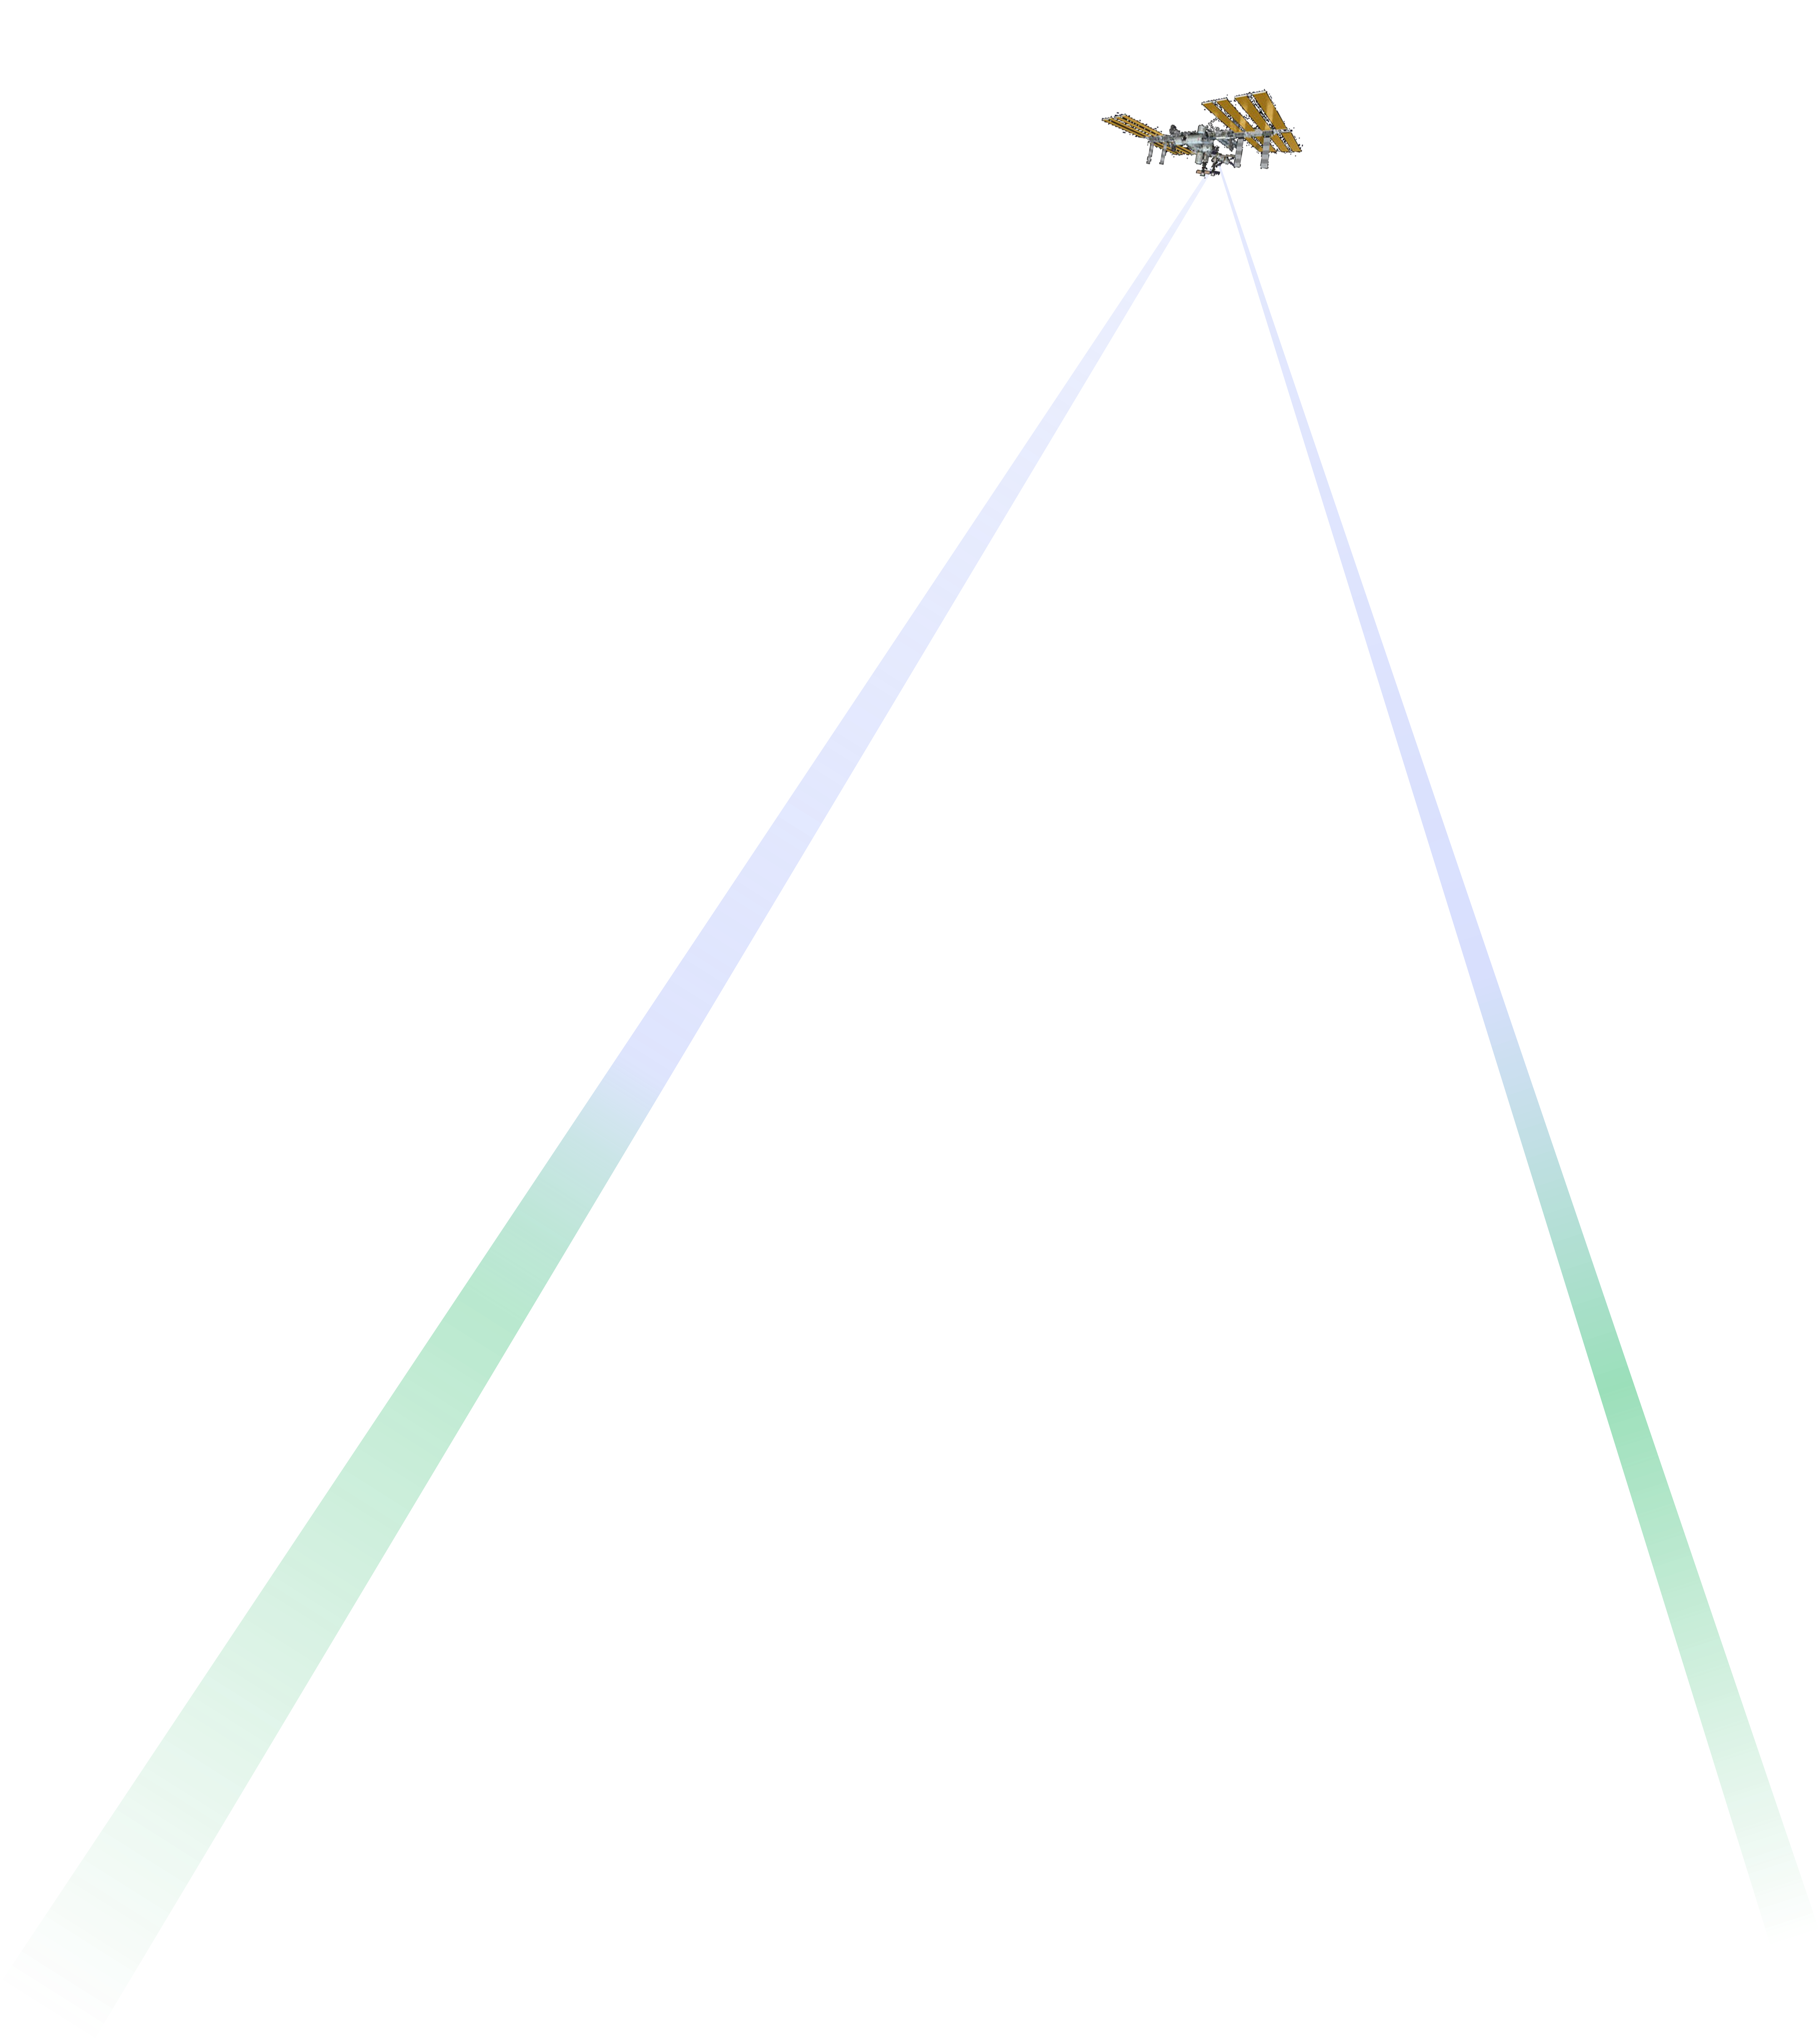
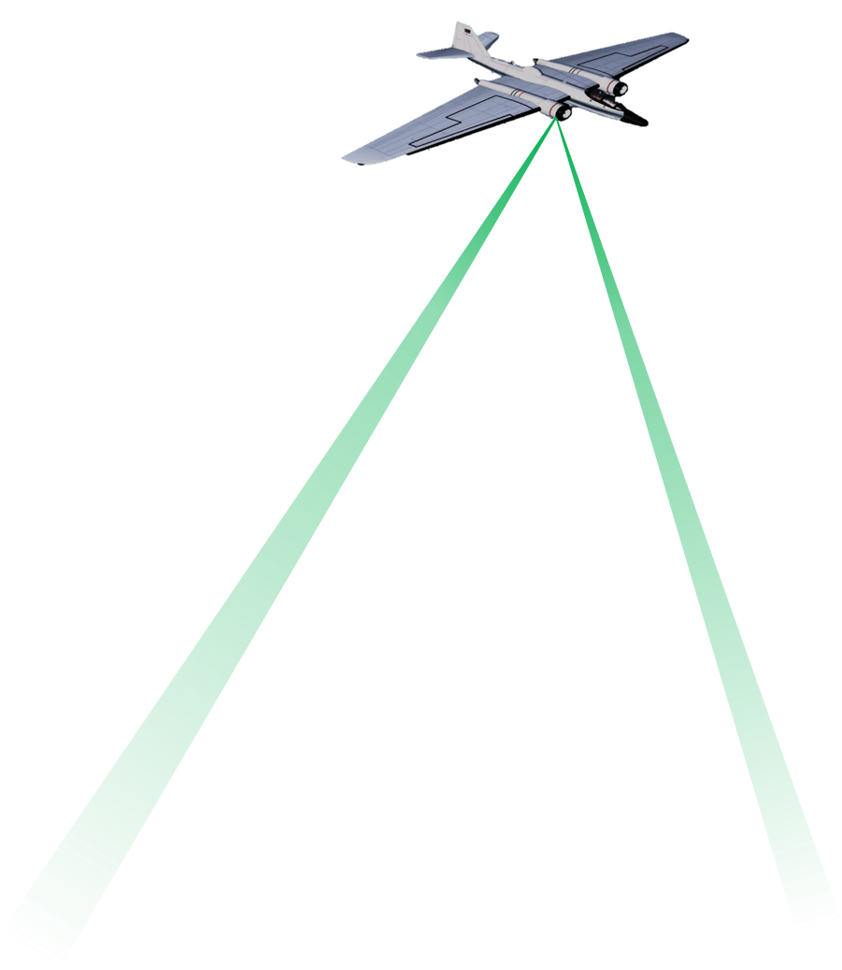
Wind lidar measurements from space:
Aerosol & molecular coverage
OAWL: path to full atmospheric wind profiles:
Two wavelengths (same laser) used to measure winds from both aerosols AND molecules
  @ 532 nm – provides precision using aerosol returns
  @ 355 nm – provides coverage using molecular returns
High altitudes: fewer aerosols & clouds, so UV wavelengths are used to measure winds using lidar returns from just molecules
(e.g. ESA’s Aeolus mission, UV OAWL)
Aerosol-DWL’s (Green-OAWL, Coherent detection) provide good returns in lower troposphere and where aerosol layers or thin clouds are present
Airborne & ground DWLs are best for boundary layer studies at scales that would be smeared by space-based orbit speeds (~7.2 km/s)

Slide 9
IR Sounding AMVs where Water Vapor features available: GOES (GEO) and 4-12 LEO Sounders
DWL where air is clear (UTLS): anchors cloud
heights to improve AMV results…AND provide
true winds along lidar curtain path
See Folger & Weissman, 2014 & 2016
Height error bars
Winds error bars

Slide 10
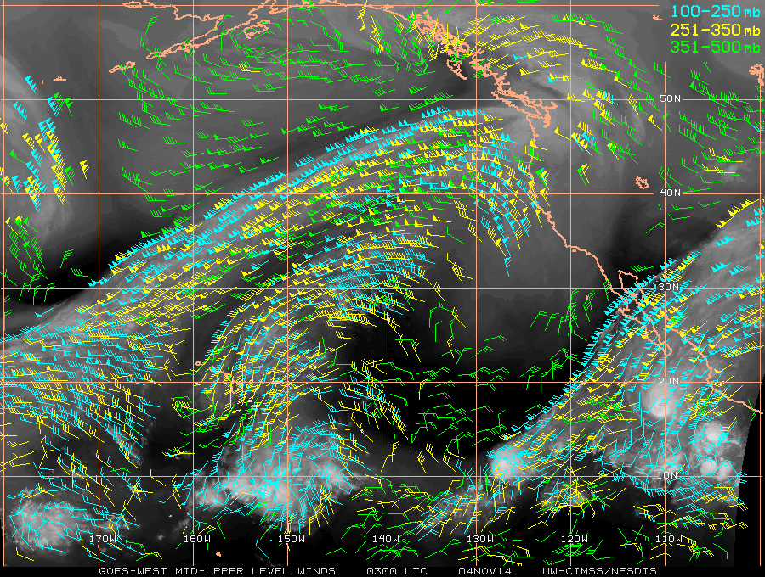
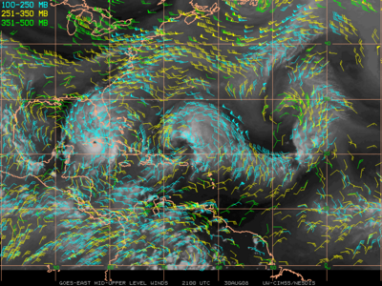
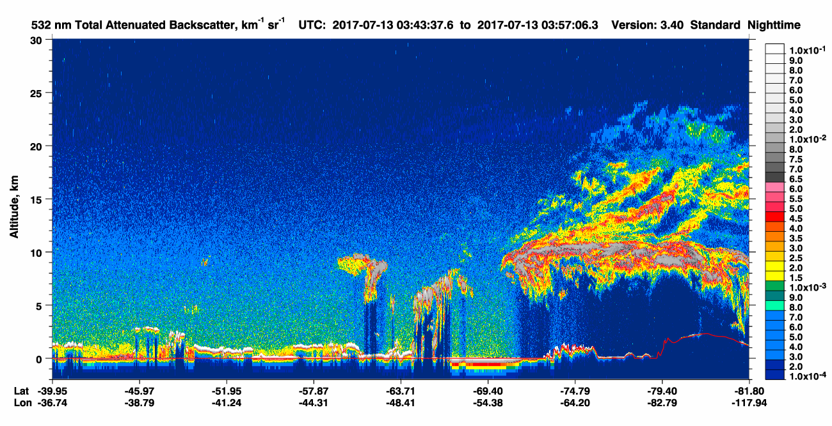
Lidar winds: Studies on the swath of AMV improvement when anchored?
Credit: CIMSS , U.Wisconsin-Madison
Credit: NASA

Slide 11
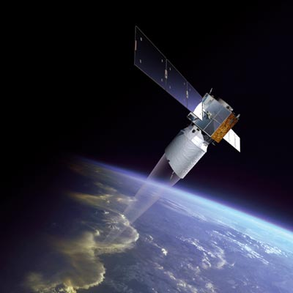
NSOSA (AMS): Potential timeline for wind lidar technology maturation roadmap: laser focused
2017-2019: ongoing NASA-funded laser transmitter technology development
2020-2022: A 3-year build and test of laser transmitter ETU, managed by NASA with Industry involvement, deliverable to the operational wind lidar system project in early 2023
2019-2020: NOAA funded pre-Phase A lidar system study tasks
2021: Phase A of operational wind lidar system begins
Environmentally tested laser transmitter subsystem delivery in early 2023.
2012
2013
2016
Aeolus
Pre-Phase A
2019-2020
Phase A
2021
Qual.
2023
2030

Slide 12
Getting to operational: Full Troposphere
Not just about lasers….systems
2030 NOAA 3D-Winds
ESDS Explorer
TMCO Approval
Sounder demos
Flight qual. EDUs
EVI-2 on ISS
Cat. 3
EVI-4 on ISS
Cat. 2
Full Trop winds system Demo
OAWL Prototype Demo
GrOAWL 2-look airborne demo
Current TRL Qualifications
ESDS Incubation
HAWC-OAWL
(2λ, 2 look)
OSSEs
Short OPD MZI* OAWL
HEUVD
Hardware/Mission
ESDS
Forcing functions
CALIPSO
NSOSA
Aeolus
*nested or not
2012
2013
2016
now
Pre-Phase A
2019-2020
Phase A
2021
Qual.
2023
2030

Slide 13
Science and Operational Winds
Airborne OAWL Flight demos
Cal/Val
Sounder demos
2030 NOAA 3D-Winds
Aeolus
Full Trop winds system Demo
Flight qual. EDUs
HEUVD
Test Flights
ESDS Incubation
Test Flights
EVI-5,6?
ESDS Explorer
OSSEs & more
Coherent System Laser Space Qualification
Aerosol/Cloud mission definition
Coherent Airborne PBL science
Coherent System
Space Qualification
Airborne PBL science missions
Cal/Val
now
Pre-Phase A
2019-2020
Phase A
2021
Qual.
2023
2030

Slide 14
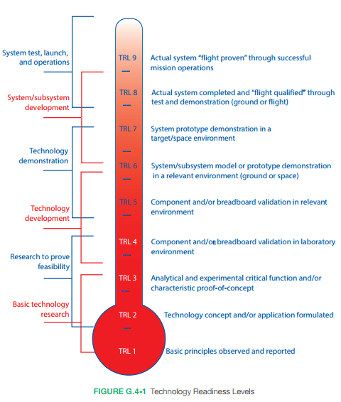
Roadmaps: More than just Systems and TRL
Learn from Aeolus & CALIPSO
Technology Development
  Technical Readiness
  Full enterprise participation
  NASA Systems Engineering Handbook definitions →
Mission Development
  Coverage: # spacecraft
  Orbit, Spacecraft, Launch
  Ground System (low latency!)
Mission Science Development
  Science Readiness
  Data products, ATDB
  Data assimilation
  Calibration/Validation

Slide 15
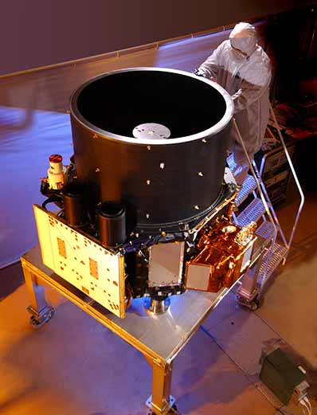
TRL
1 2 3 4 5 6 7 8 9
Aircraft
Demos
Brassboard IFO EDU build & test
Ground
demos
2λ Winds
CALIPSO & ICESAT
telescopes, detectors
Receiver
Environmental Test
Lab demos
Performance scaling to space
Concept
HSRL, GOLD,
& TWiLiTE
Lifetime-testing
Laser
HEUVD
Thermal/vacuum/ shock/vibe test
System Thermal/Vacuum/ Shock/Vibe Testing
OAWL1& GrOAWL lasers
National Instruments/ Labview
PC EDU w/ space-qualified equivalents
PC w/ Space-qualified parts
NASA/Ball CALIPSO >11 Years on orbit!
ESA’s Aeolus (355 nm lasers)
Elect. & SW
Payload
Controller (PC) &
data acq. development
Thermal/vacuum/ shock/vibe test
Real-time processed winds (FPGA)
2λ synergy studies
Science Implementation Plan
Data & Science
2λ OSSE
355 OSSE
Cal-Val planning
OSSEs
ATBD
Airborne Validation
Instrument Design Lab
Airborne flight tests
Mission
EVI-4 (2016)
proposal
Ground Validation
EVI-2 (2013)
proposal
Free-flyer mission designs

Slide 16
Extras

Slide 17
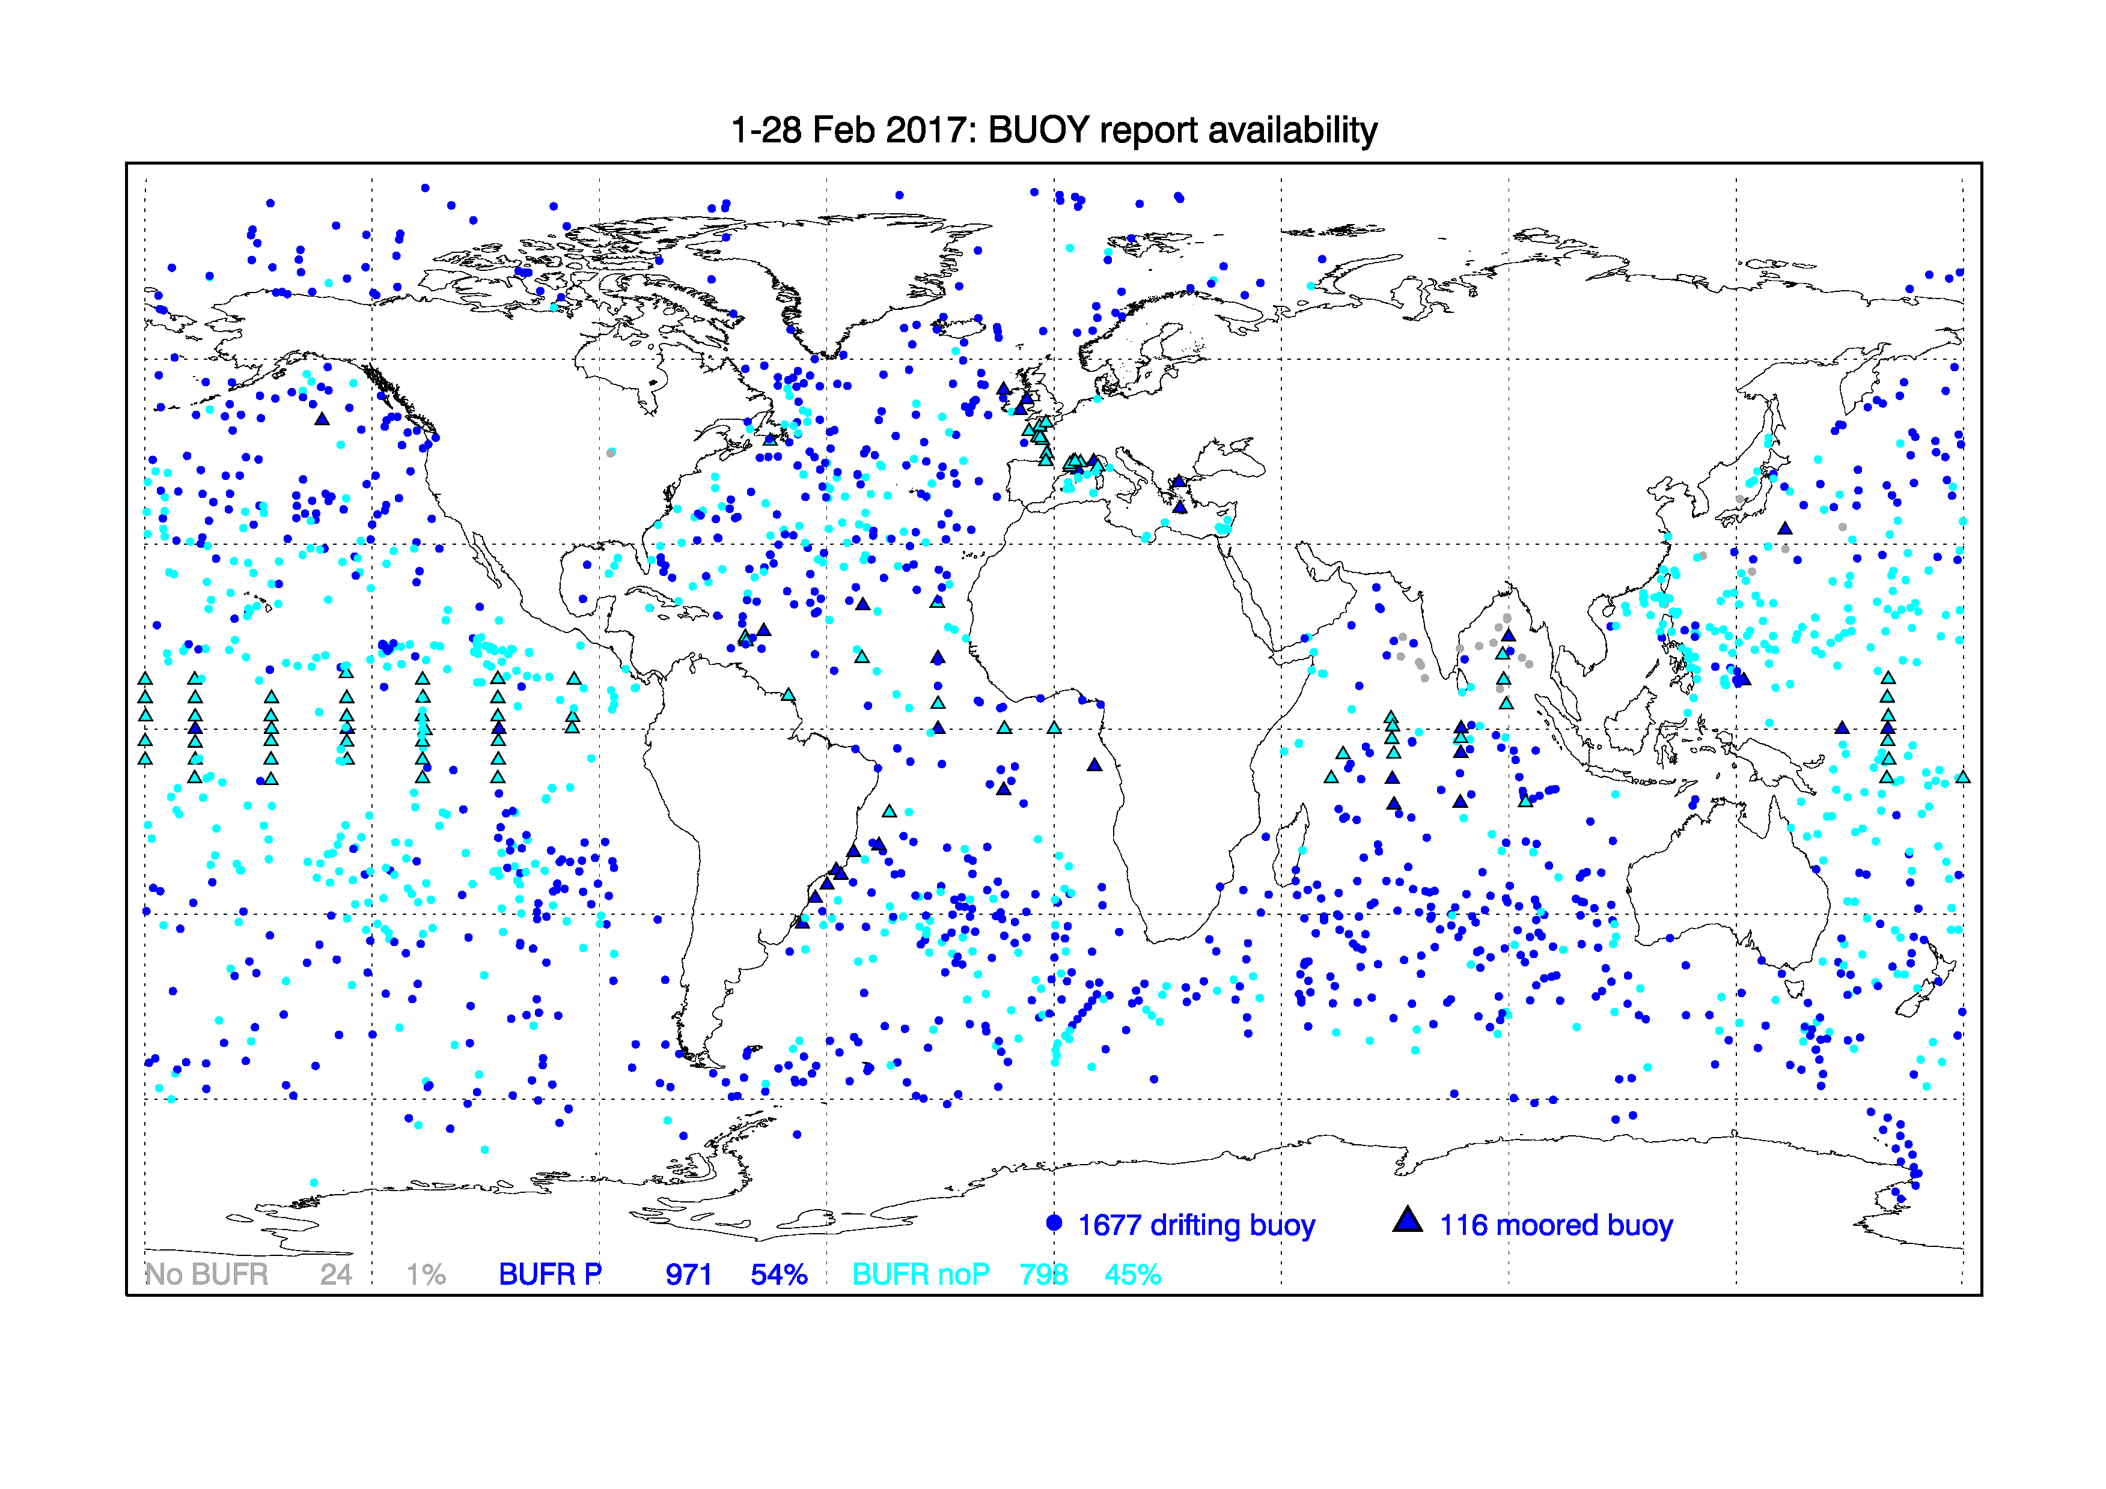
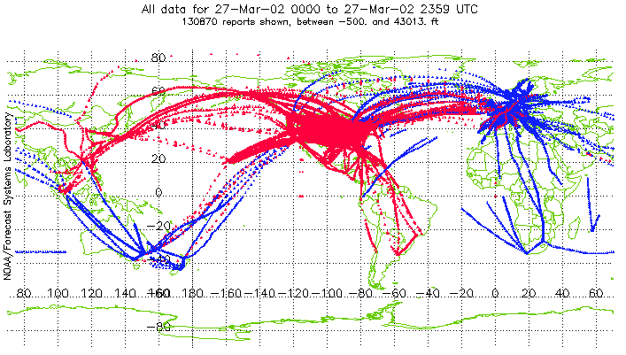
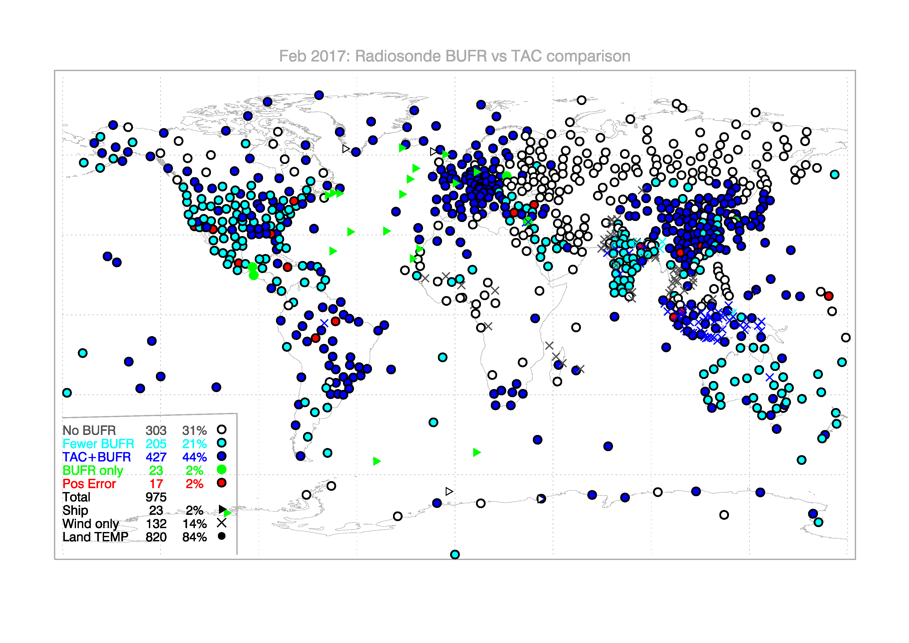
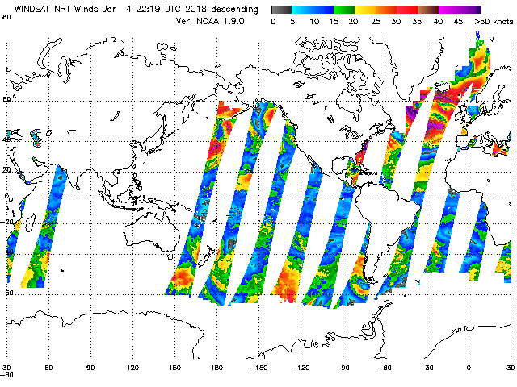
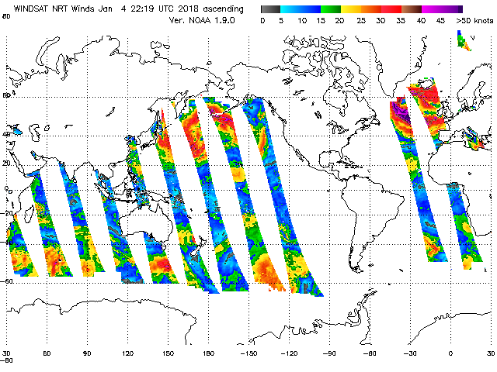
Passive, Yes, AND aerosol + molecular wind lidar
Provide profiles over oceans and SH
Improve precision and vertical resolution
Extend winds vertically
In-situ Profiling
Motion Vector
(aerosol/cloud tracking)
Surface
Aircraft
Surface Buoys
Aircraft (in-situ)
Scatterometry
Radiosondes
Visible or water vapor channels
Requires 3 cloud images, cloud brightness temp, cloud mask, cloud height, cloud top pressure
Requires Cloud/WV Features

Slide 18
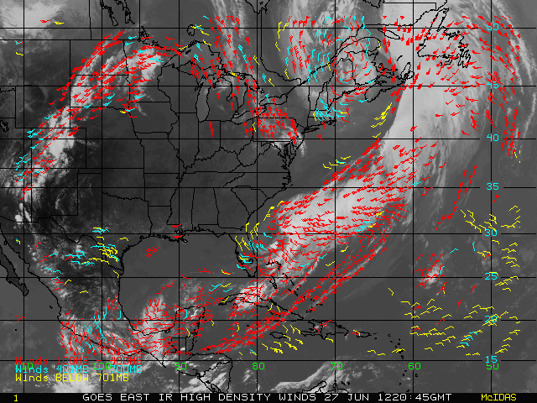
Atmospheric Motion Vectors and lidar
Height Assignment Uncertainty
  Up to 70% of AMV error (Velden & Bedka, 2009)
Using CALIPSO to assign heights
  Folger & Weissman, (2014 & 2016): used CALIPSO cloud height measurements to anchor Meteosat-10 AMV layer heights
  Up to 15% improvement in co-located (50km, 30 min.) AMVs vectors from Metosat-10.
  lidar-based height bias adjustments (from previous days) resulted in up to 7% improvement, affecting all AMVs
Will multiple sounders drive down the height assignment errors?
Cloud Drift and WV
GEO:
  GOES/Himawari8/MeteoSat/etc., Visible and IR
Polar:
  MODIS Cloud Drift Winds (Arctic, Antarctic, Aqua, Terra), AVHRR (Arctic, MetOp-B), VIIRS (Arctic)

Slide 19
OAWL: Looking Ahead
Future Science/Mission Opportunities
Science Community Input
NASA ESTO & ESSP Tech Development
Ball Technology Development & Intellectual Property
Earth Science Decadal Survey
NSOSA Needs
Aeolus Experience
ESDS Wind Lidar Explorer Mission
ATHENA-OAWL
EV-I Concept
EVI-Science Demo on ISS
Sounder Demos
Flight qualified EDU
TMCO approved
ATHENA-OAWL Venture-Tech (airborne)
Full Trop winds system Demo
Aerosol Winds
or
Full Tropo-sphere?
2030
Operational Winds Missions (NOAA, DoD, NASA, commercial)
ESDS Incubation
HAWC-OAWL IIP
2λ, 2 look
HEUVD (Fibertek)
Airborne Science
Missions (Cal-Val, EV-S, etc.)
Interferometer & Full trop IRADs
Notes:
Ball has made investments to invent and develop the technologies
ESTO investments enable Ball to incorporate our technologies into engineering demonstration systems and science studies
Ball is tied to both the science and technology development communities to help influence the direction of future missions incl. Decadal Survey.

Slide 20
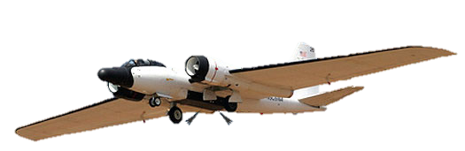
Aeolus

Slide 21
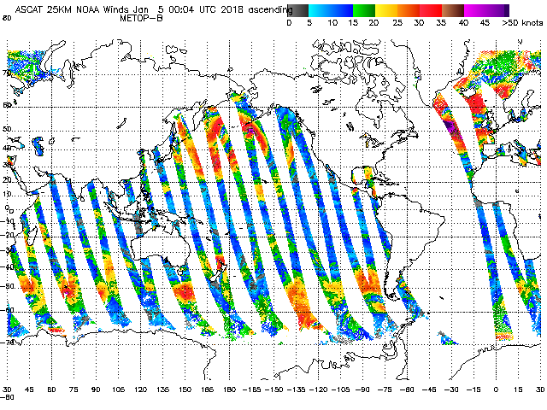
3D-Winds Data synergy: Wind lidar provides direct wind measurements to anchor wind retrievals from complementary systems
AMVs from imaging and/or sounding instruments
GOES & POES thermal gradient winds
Scatterometry: DWL for vertical extension of surface winds
Mid IR Stereoscopic imaging
  Compact Midwave Imaging System (CMIS, Kelly, APL/JHU)
  Small, lightweight imaging sensors could easily be deployed with a DWL system
  Provide context as well as swath extension of winds for the DWL measurements

Slide 22
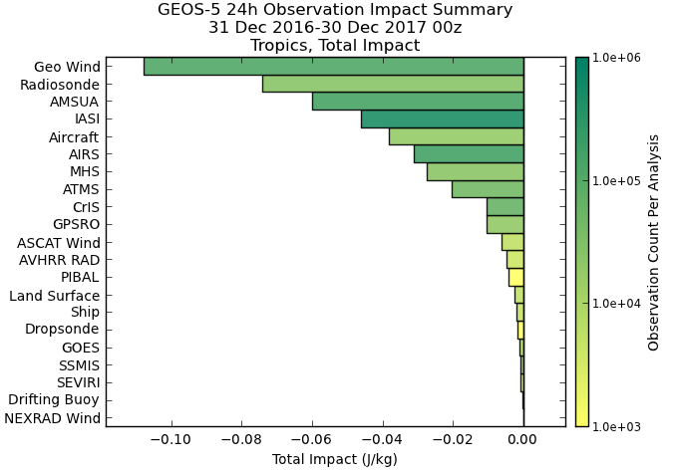
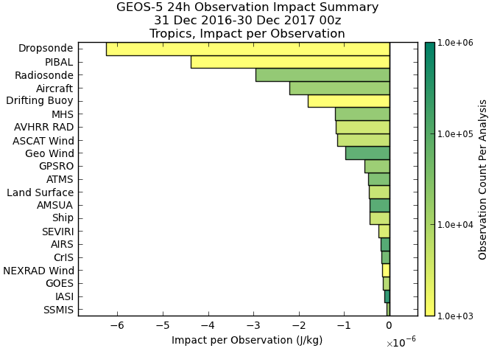
Observations with strongest impacts on forecast
GEOS-5 Impact Summaries: 2017, Tropics
Observations that include winds (retrieved or measured)
Wind measurements have large impacts per observation (especially in the tropics)…
…but there are currently far fewer wind field than mass field measurements.
Tropics, total impact
Tropics,
impact per observation

Slide 23
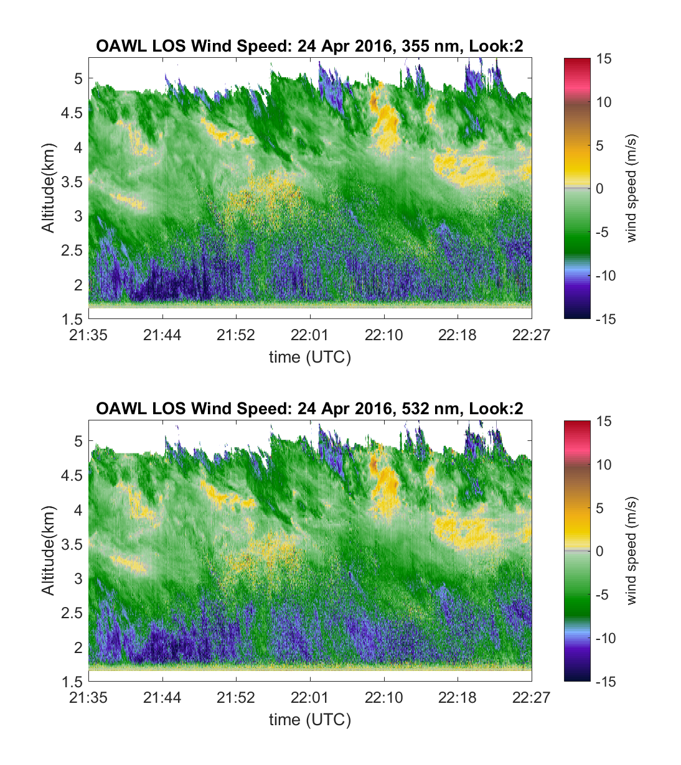
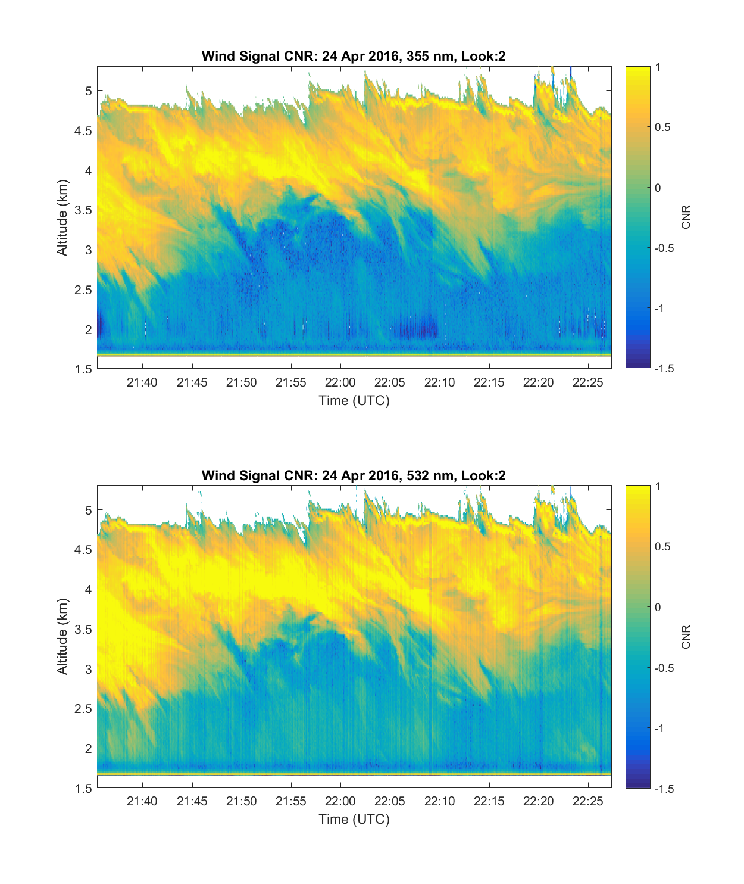
DWL can measure winds in clouds too

Slide 24
2017 Earth Science Decadal Survey
Atmospheric Winds
Recognizing the cross-panel importance of the PBL and the challenges of obtaining 3D measurements of horizontal wind, temperature, humidity, and aerosol and trace gases in the PBL, optimal approaches could be:
  To combine Doppler lidar wind profiling with hyperspectral infrared sounding to provide the 3D structure of horizontal wind. This can be further combined with near-surface microwave scatterometer wind over ocean, and ground-based wind profiling, high vertical resolution profiles from radiosondes and commercial aircraft measurements during taking off and landing.
  …
  To bring Doppler Lidar and hyperspectral infrared observations together in a dynamically consistent way through data assimilation and numerical modeling.

Slide 25
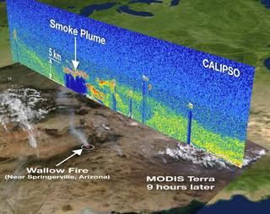
Wind Lidar offers:
Range resolved wind measurement
curtains with precise knowledge of
measurement height
  Like CALIPSO, the lidar “swath” is
  vertical – a curtain vs. a carpet
  Adds vertical dimension to swath data
Wind measurements that don’t require
features –
  Direct measurement of Doppler frequency shifts in scattered light - no tracking or multiple satellites/revisit time is required
  (for OAWL): SNR is increased with more aerosols (e.g. when clouds are present)
Wind measurements at higher altitudes (molecular channels)
  Same technology used in GrOAWL can be used to measure winds from molecular-only returns
DWL can anchor other measurements

Slide 26
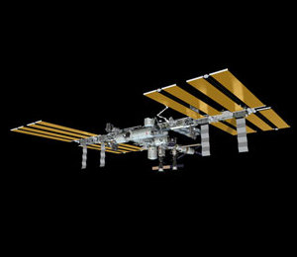
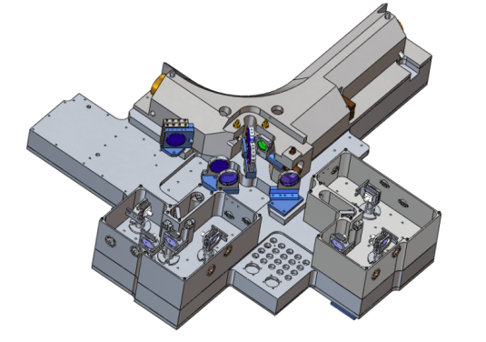
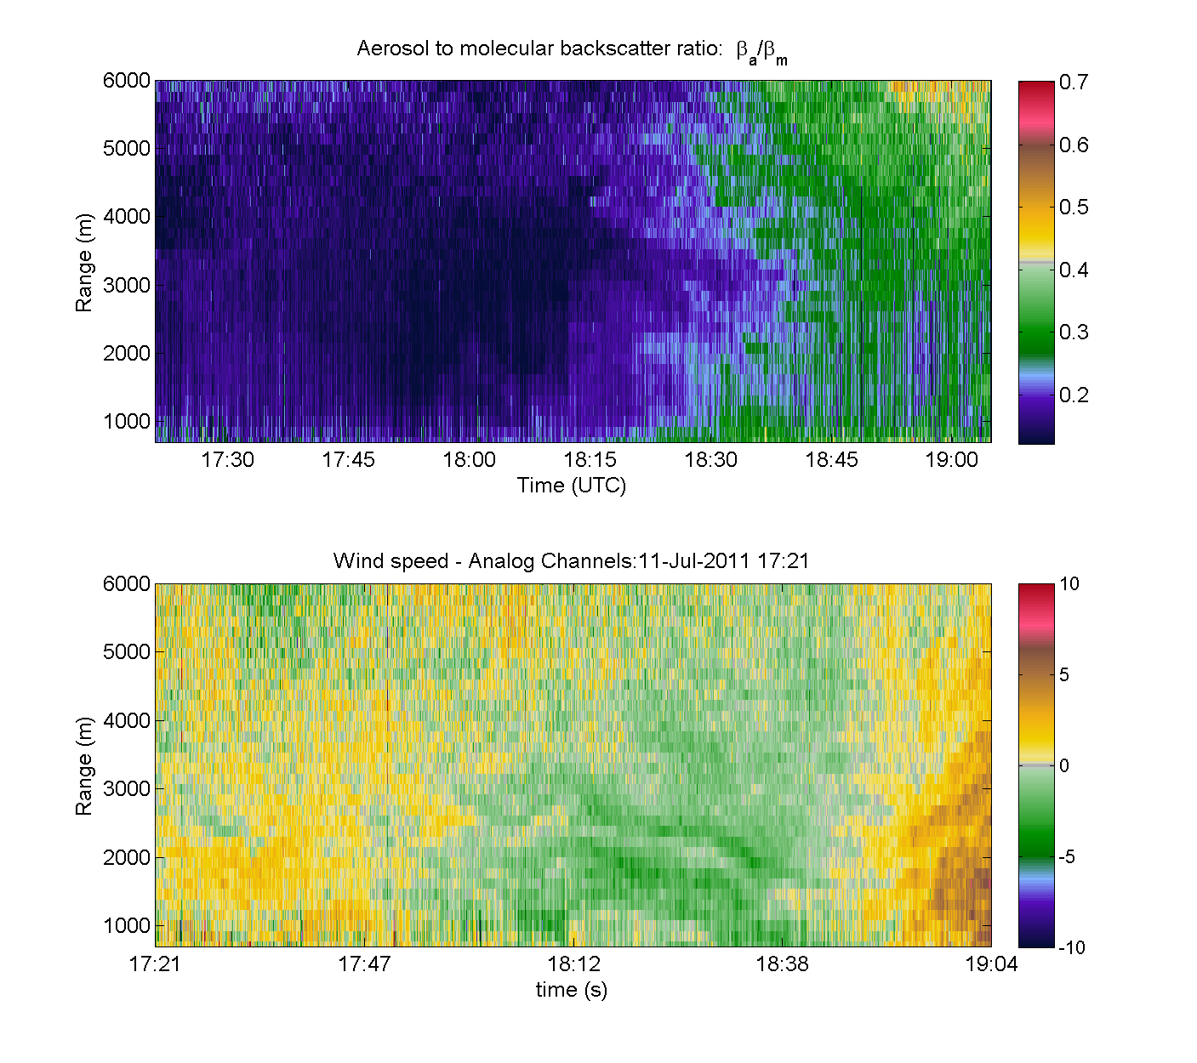
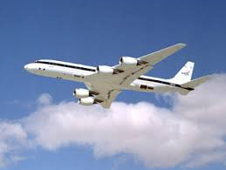
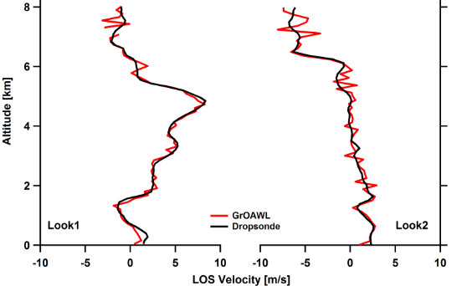
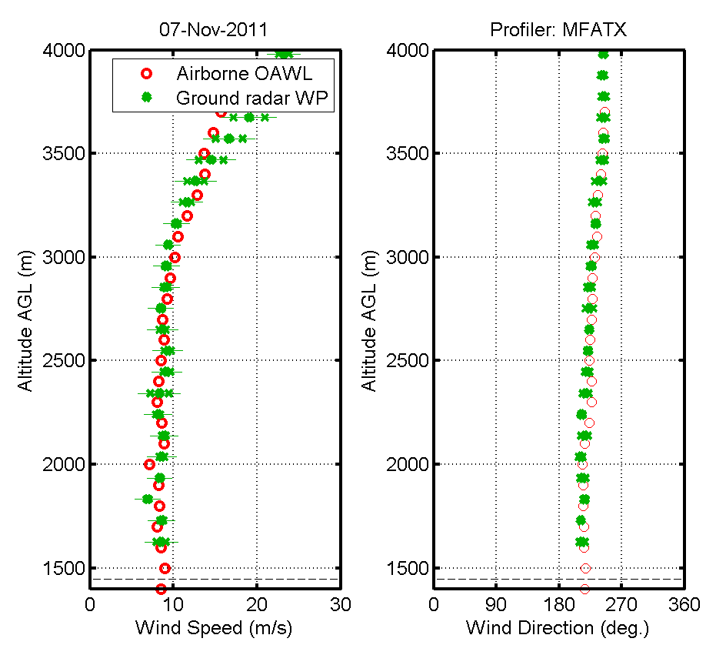
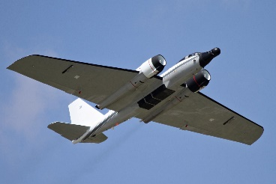
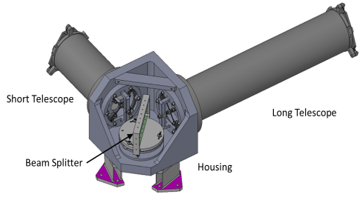
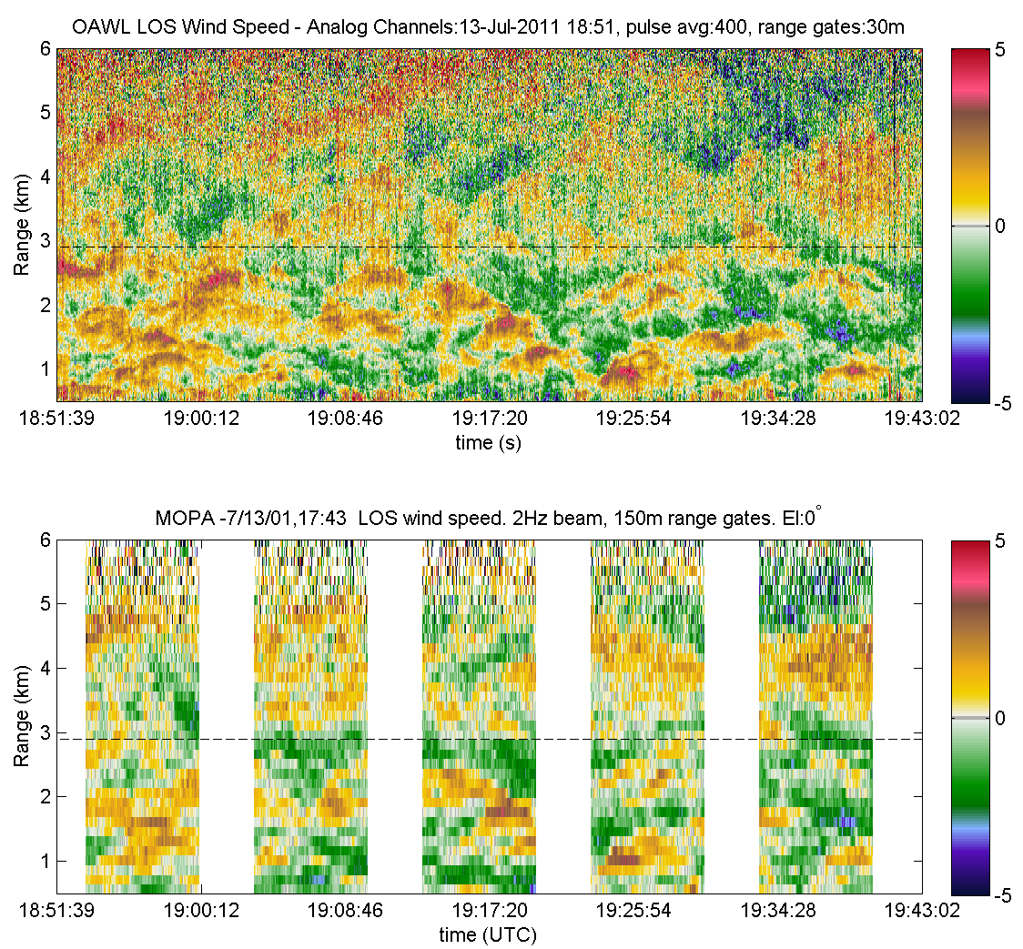
The Evolution of OAWL
Since 2003, Ball has worked in a public-private partnership with NASA, NOAA, and weather/wind lidar communities to advance space-based wind lidar technology and fill the global wind measurement gap.
2013 & 2016 ATHENA-OAWL Mission Proposals
1999-present: Ball design, build and test of OAWL receivers, mission concepts and retrieval/processing algorithms
aerosols
winds
Altitude MSL (m)
Altitude MSL (m)
2008-2012: OAWL IIP-07
Breadboard system
355 nm only, 4x channels
Single look 12” telescope
Ground validation with NOAA Coherent system
Autonomous flight tests on NASA WB-57
2012-2015: HOAWL ACT
Breadboard System
Demonstrate 532 nm wavelength channels & depolarization channels
Total 10 channels
HSRL Aerosol retrieval algorithms
2015-2017: ATHENA-OAWL Venture-Tech: GrOAWL
Airborne demonstrator System (WB-57)
2-lasers = 400 Hz eff. PRF
4x 532 nm channels
2 looks, 2 telescopes to demonstrate geometry
2014-2017: HAWC-OAWL IIP
Two look airborne system (build on GrOAWL)
Dual Wavelength + depol. Channels
Athermal interferometer build and demonstration
DC-8 hardware design/build

