Slide 1
Synergistic Active and Passive Wind Observations for Studying Dynamical Processes in the Troposphere
Dong Wu (1), Jie Gong (1,2), Michael Kelly (3), and James Carr (4)
NASA/Goddard Space Flight Center (GSFC)
Universities Space Research Association (USRA)
Applied Physics Lab (APL), Johns Hopkins University (JHU)
Carr Astronautics
Working Group Meeting on Space-Based Lidar Winds, Boulder, CO Feb 8, 2018

Slide 2
Outline
Passive AMV technique
  Pros
    2D coverage in (x, y)
    Winds from H2O and cloud features
    Simultaneous determination of wind vectors
Active lidar technique
  Pros
    2D coverage in (z, x/y), incl. lower stratosphere
    Winds from aerosol and cloud profiles
    Accurate height determination
Challenging problems in atmospheric dynamics
    Poleward heat and moisture transport
    Tropopause folds
    PBL structure and dynamics
    Vertical winds and convection
Note on 2017 Decadal Survey
  Cons
    Height Assignment (e.g., in PBL, Tropopause Folds)
    Multi-layer clouds
    Standing wave features (e.g., Orographic clouds)
    Limited coverage over convection
  Cons
    Limited coverage in (x, y)
    Limited cloud penetration
Good Examples:
A-Train
TRMM
GPM

Slide 3

Quick Fact Sheet about Earth:
Cloudy (~70%)
Aerosols (~12%)
Snow/Ice Surfaces (~9%)
“Boulder Blue” (~9%)

Slide 4
CALIPSO Backscatter Occurrence Frequency
Strong
Weak
Weaker
Null
Courtesy of T. Wang

Slide 5
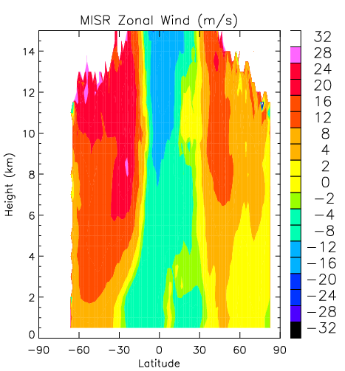
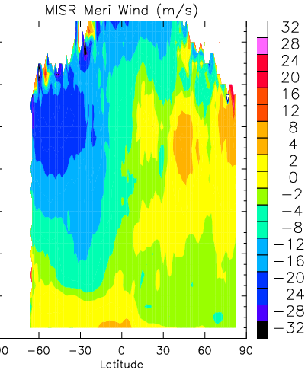
MISR Winds (July Mean)
Terra/MISR is in the A-Train unfortunately!
Tropopause folds
Strong dU/dz
Boundary layer

Slide 6
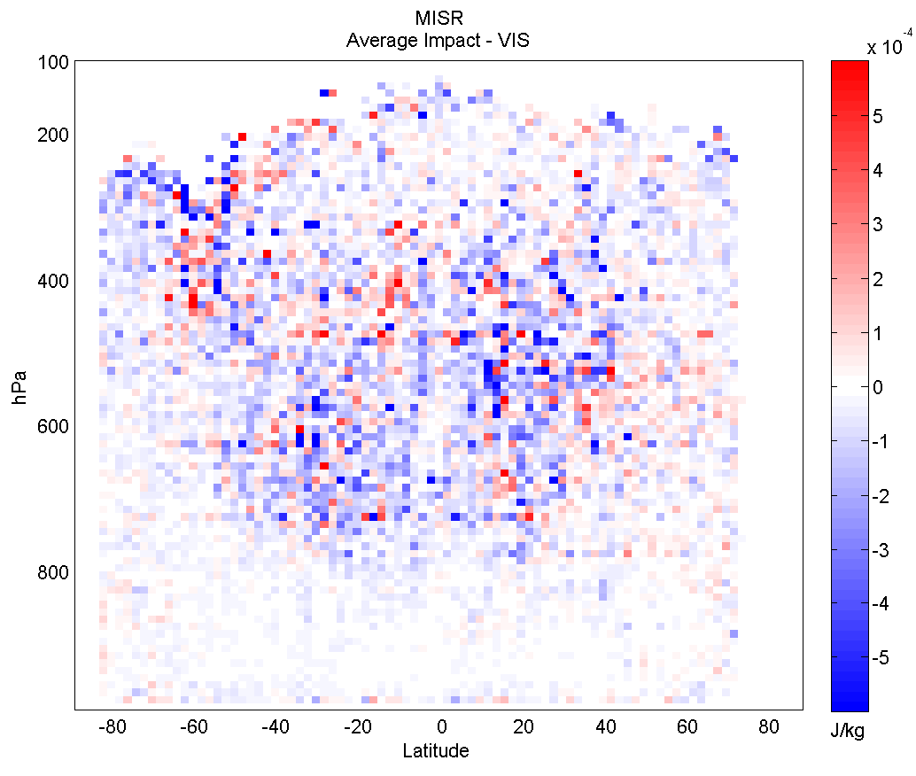
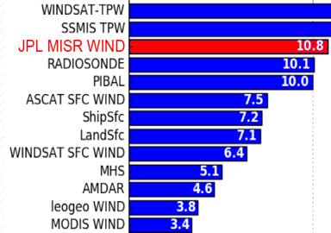

MISR Wind Impacts in Navy Global Environmental Model (NAVGEM)
(Nancy Baker, Patricia Pauley, Rebecca Stone, NRL)
Study Report #1
Pressure (hPa)
Baker et al. (AMS, 2014)
LEO-GEO winds at mid-to-high latitudes assimilated in the NAVGEM system.
Positive forecast impacts of MISR winds seen mostly in the mid-troposphere where satellite wind observations are less abundant relatively.
Per observation forecast impact of MISR winds ranked as 3rd among all wind observation types.
Additional benefit of MISR winds found at high latitudes, low altitudes, and in the Southern Hemisphere.
Similar benefit found with near-real-time (NRT) MISR winds.
Latitude
Per-obs forecast impact in NAVGEM
Navy Global Environmental Model

Slide 7
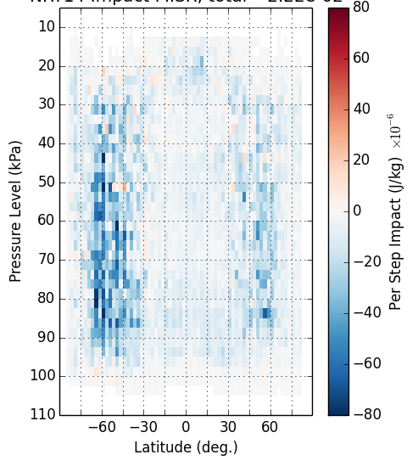
MISR Wind Impacts in GEOS-5 DAS
(Junjie Liu and Kevin Mueller, Caltech/JPL)
Study Report #2
MISR wind impact
Mueller et al. (MWR, 2017)
Pressure (kPa)
LEO-GEO winds not assimilated in the GEOS-5 system, explaining large impacts of MISR winds seen at SH/NH mid-to-high latitudes where satellite winds are lacking.
~6000 MISR observations assimilated in each 6-hour assimilation cycle.
Positive forecast impacts doubled by assimilating cross/along-track winds with different proportional covariance, compared to assimilating u/v winds.
Per observation forecast impact of MISR winds ranked as 2nd among all observation types.
Total MISR wind impact, accounting for 2.2 % of all observations, ranked as 10th among all types.
Per-Obs Impact in GEOS-5
Pibal
MISR
Raob
Satwind
MODIS
AIRS
Notes:
Make a histogram plot

Slide 8
Solutions to AMV Height Assignment Problem
Stereo approach
  Stereo height = Pattern height
Active sensing techniques
  Lidar wind profile

Slide 9
Stereo Heights from Simulated Data
Domain: 512 x 512 km
Grid size: 1 km
Nadir and 45° views
No background winds
Pattern matching size: 20 km
CRTM calculations:
  11 μm
  T(z), H₂O(z)
  Ice, Water, Rain, Graupel, Snow profiles
  Penetration depth
45°

Slide 10
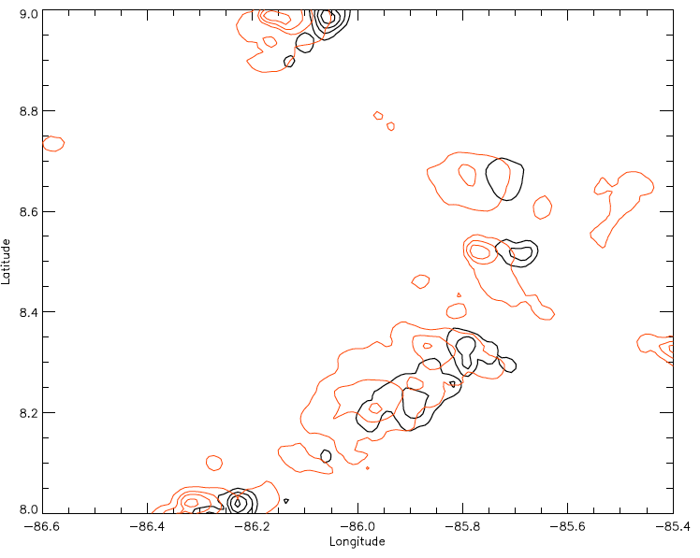
20x20 km
Different height assignment methods:
Domain mean
Domain max
Domain max group
…

Slide 11
Stereo Height vs. IR Height
3 km
3 km

Slide 12
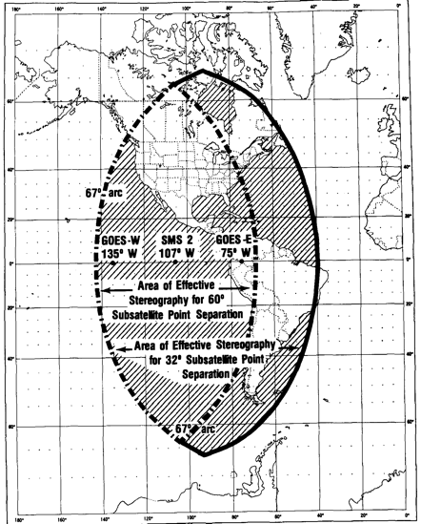
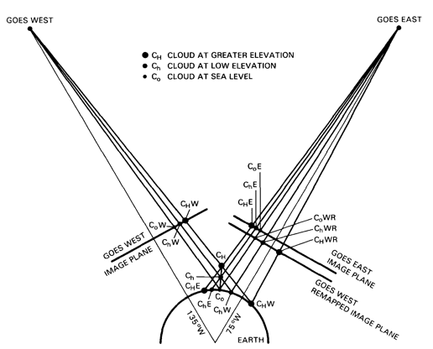
Two-GOES Concept with 60°
Shenk (1971) Apollo-6
Hasler (1981)
Black (1982)
Fujita and Dodge (1982)
60°

Slide 13
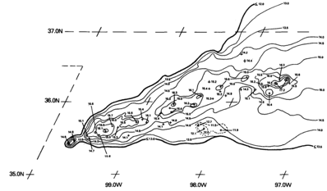
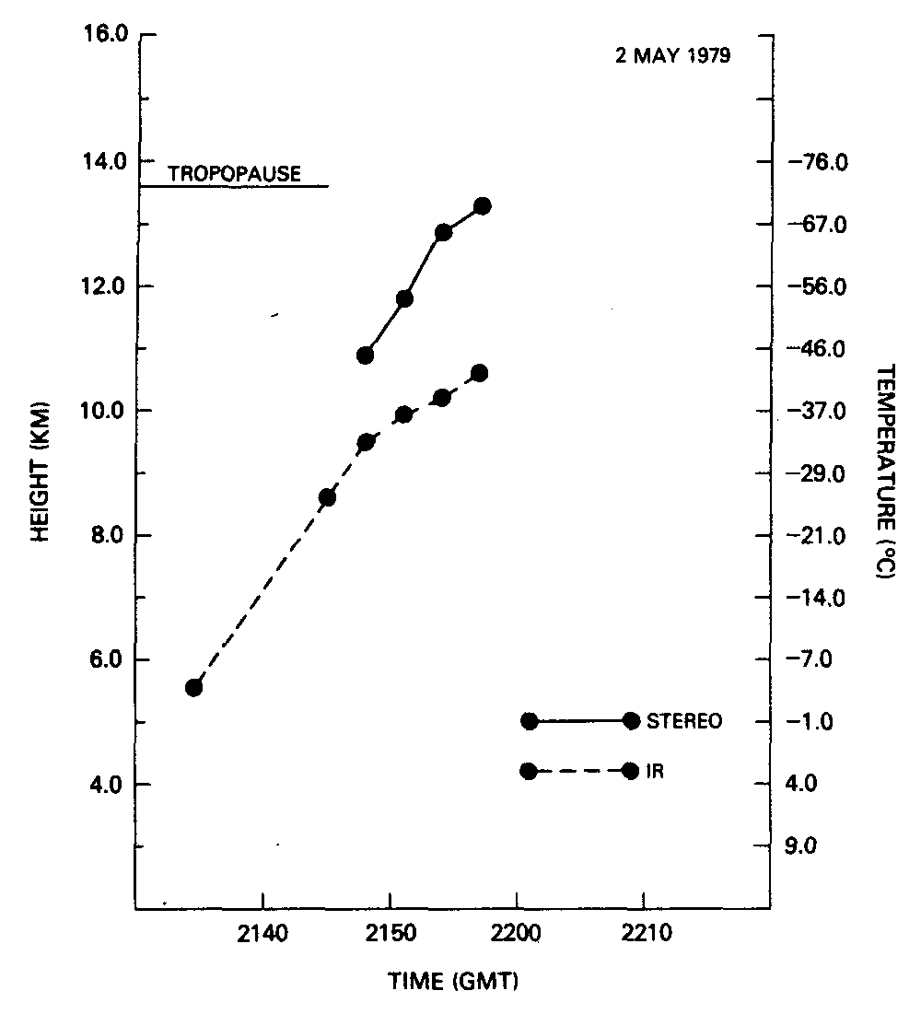
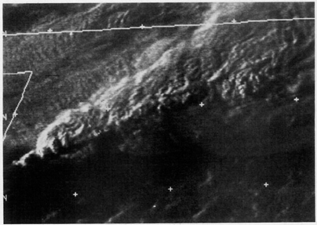
Stereo vs. IR Height from Two-GOES Retrievals
Mack et al. (1983)
Stereo ht
~2 km higher
Vertical growth:
4-8 m/s
30 min.

Slide 14
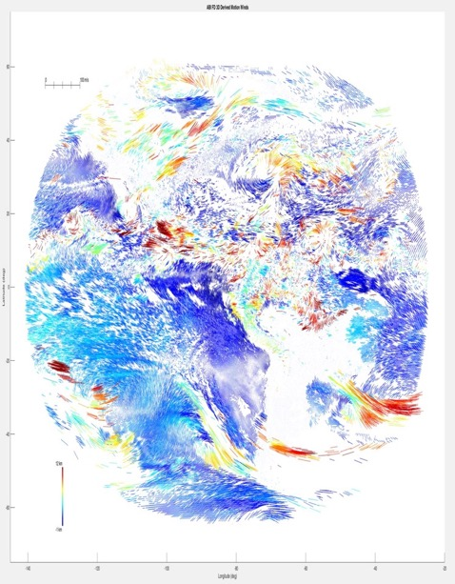


Two-GOES Concept from 15°
(Courtesy of Jim Carr)
GOES-13
GOES-R/16
15°

Slide 15
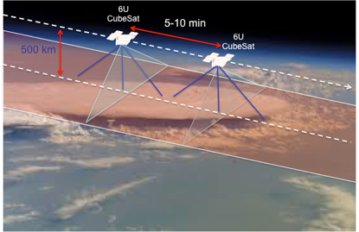
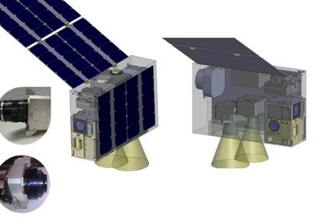
CubeSat(s) + GEO(s)
CubeSat Winds

Slide 16
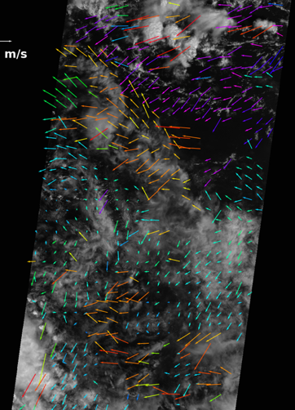
Improving AMV Height Registration with LIDAR
Collocated Lidar profile and AMVs
Best speed match in strong shear
Dependence on cloud regions
Evaluation on a global basis
Inside a 20km-Domain
Z
Profile
Z
IR-Method
Z
Stereo
u
u
u
Lidar Wind
IR Wind
MISR Wind
MISR 17.6 km AMV
(courtesy of K. Mueller)

Slide 17
Challenging Problems in
Atmospheric Dynamics
Poleward transport
Tropopause folds
Vertical wind and convection
PBL structure and winds

Slide 18
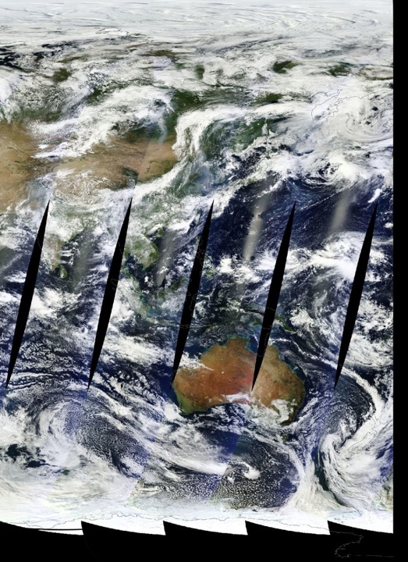
Poleward Transport
Reanalysis winds are too zonal!
Stratosphere-troposphere exchange
  Trace gas and aerosol transport
Arctic warming
  Heat transport
  Moisture transport
Energetics of extrotropical cyclones and extreme weather
  Cloud and precip processes
  Formation of strong low-level jet

Slide 19
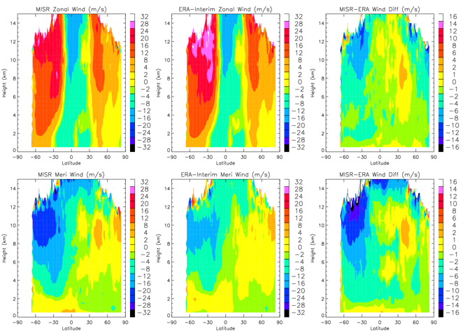
MISR – ERA Differences
S = MISR is slower
F = MISR is faster
July (2001-2012)
MISR
ERA-I
Diff
Zonal (U)
Slower MISR winds in the poleward side of jets
S
S
S
S
F
F
Meridional (V)
Stronger poleward MISR winds in the upper trop
Slightly southward bias in the lower trop
Stronger tropical conversion with MISR winds
Reanalysis winds are too zonal in the extratropical jets

Slide 20
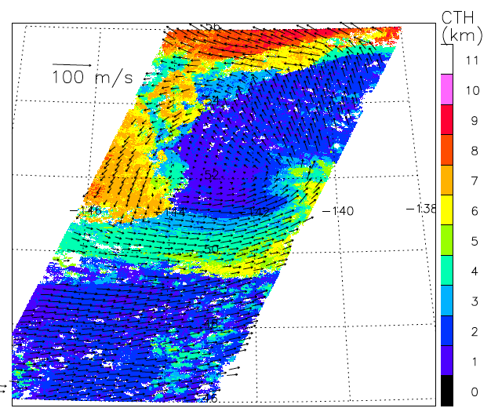
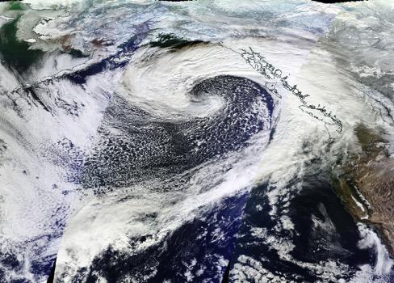
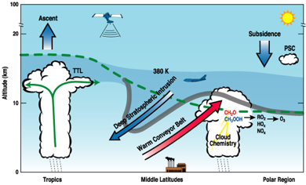
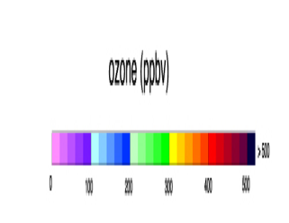
Extratropical Tropopause Folds and Transport
MODIS
MISR CTH and Winds
Strong
Surface
Winds
Stratospheric
Intrusion
O₃
H₂O
Courtesy of N. Prive
GEOS-5
Notes:
MISR and MODIS observed a tropopause folding and occulted cyclone event on Nov. 22, 2012 in the northeast Pacific. Spiral winds down to the lower troposphere are evident in MISR 17.6-km measurements with a strong jet below 4km altitudes, which go under the polar upper-tropospheric jet, wrapping up around the low pressure center.

Slide 21
Vertical Winds and Convection
Courtesy of
B. Geerts
E. Linacre
The COMET®
Importance
  Moist convection and influences on cloud, precipitation, and extremes
Atmospheric composition and air quality
Processes
Initiation and organization
Multi-scale and coupling
Shallow and deep

Slide 22
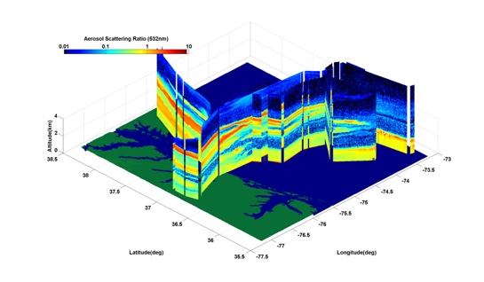
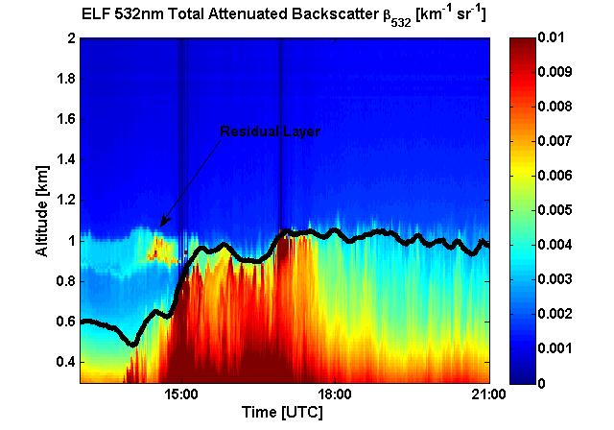
Boundary Layer Structures and Dynamics
Importance
  Flux coupling (moisture, heat, pollutant, CO₂, etc)
Wind energy
Processes
Turbulence and mixing
Latent heating
Waves and stratification
Complexities
Shallow
Cloud-topped
Nonhomogeneous
Nonstationary
Terrain-modified
Multi-scale
HOMOGENOUS PBL OVER BALTIMORE
UMBC Elastic Lidar Facility (ELF)

Slide 23
A Note from 2017 Decadal Survey
Innovative
ALADIN
HSRL
DAWN
OAWL
LIDAR =
Lidar Approaches
 | Designated | Explorer | Incubation | Observables | Comments
Atmospheric Winds |  | x | x | Winds | LIDAR
Aerosols | x |  |  | Aerosol & Cloud properties | LIDAR RADAR
Clouds, Convection, Precipitation | x |  |  | Cloud & Precip properties | LIDAR RADAR
PBL |  |  | x | Winds Structure Mixing | LIDAR LIDAR
LIDAR =
CATS
CubeSat
2007 DS
ACE
PACE
+ LIDAR Altimetry

