Slide 1
Airborne DWL: hurricane and boundary layer studies
G. D. Emmitt, S. Greco and O’Handley (SWA)
and
Kavaya and Winker (NASA/LaRC)
Working Group on Space-based Lidar Winds
Boulder, Colorado
7-9 February, 2018

Slide 2
US Agency Airborne DWLs currently being used in atmospheric research
Coherent DWLs funded to perform atmospheric research through SWA
  TODWL (ONR and USArmy)
    2 um MAG 1A WindTracer flown on Twin Otter
  P3DWL (NOAA/AOML)
    1.6um WTX flown on NOAA P3
  DAWN (NASA)
    2 um flown on DC-8 and UC-12B
  HALO-TX (ONR)
    1.6um HALO adapted for airborne use on NPS Twin Otter

Slide 3
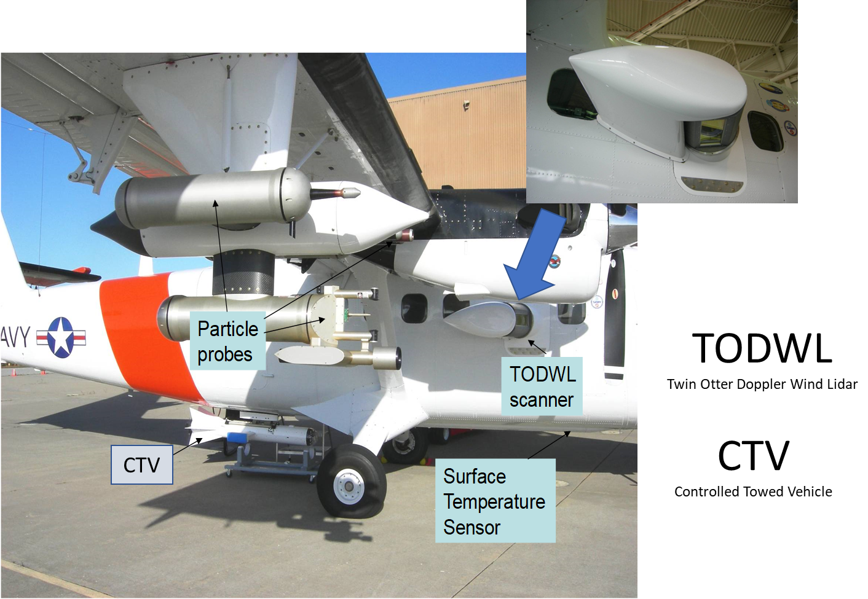
TODWL activities
Phase II C-17 wing tip vortex study funded by USArmy
  Collaboration with K. Allen and D. Ligon (USArmy)
  Phase III planned for summer 2018
Boundary layer roll study off Monterey coast funded by ONR
Collaboration with Naval Postgraduate School (H. Jonnsson) and University of Washington (R. Foster)
In planning:
  Forest fire management using airborne DWL observations with numerical models (UMd and others)
  Airborne mapping of gas leak emission rates (NDA)

Slide 4
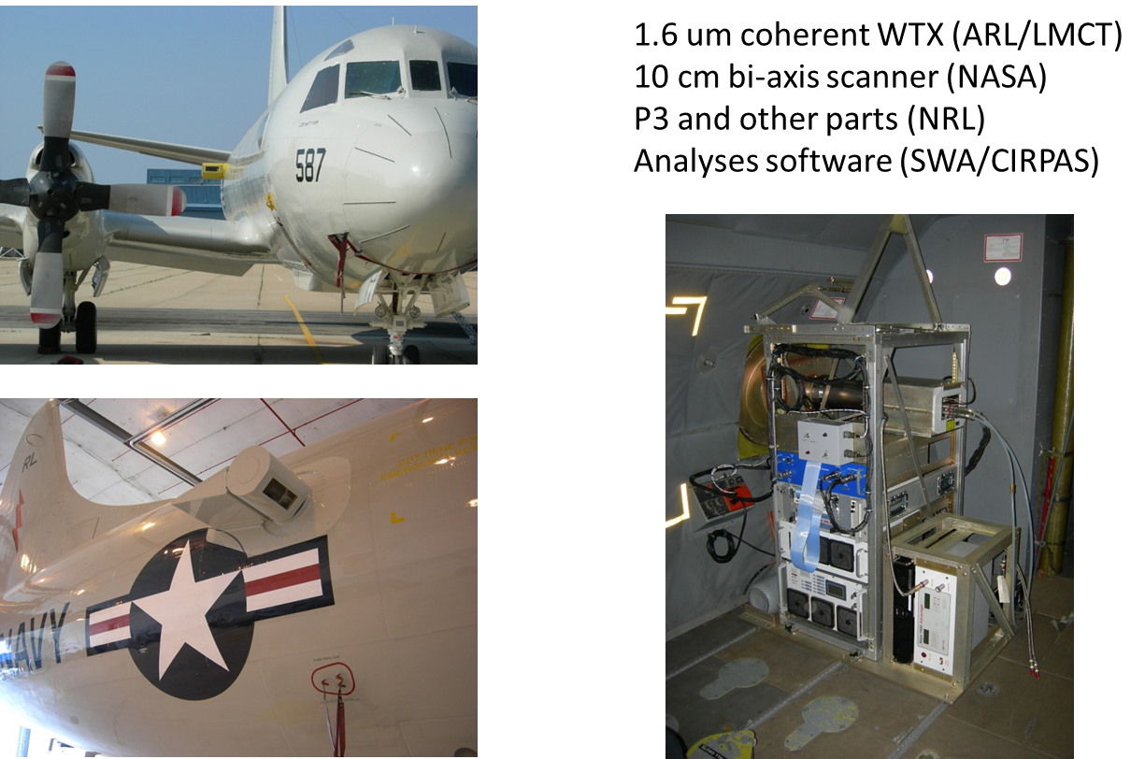
P3DWL science activities
Collaboration with J. Zhang (University of Miami) & Lisa Bucci and R. Atlas (NOAA/AOML)
Airborne DWL hurricane research transitioning into operations
P3DWL flown in 2016 and 2017
  Paper in final stages for submission to journal
P3DWL to be flown in 2018 with onboard wind profile processing and downlinking of profiles (LOS, u,v,SNR,GOF,FWHM) to operations center

Slide 5
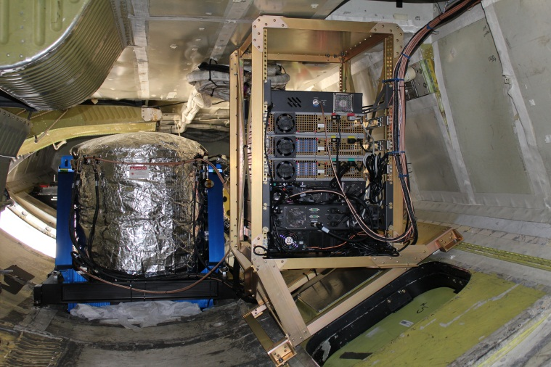
DAWN instrument and science activities
Collaboration with NASA/LaRC, CPEX Science Team and Co-I Z. Pu (University of Utah)
NASA is funding several activities related to DAWN as an airborne DWL
  PolarWinds I and II data processing and archive at NASA/LaRC ASDC
  CPEX data processing and archiving at NASA/LaRC ASDC
  Preparation for DAWN’s use in ADM Cal/Val 2018/19
  Development of three advanced signal processing tools specifically designed for DAWN
    Adaptive Sample Integration
    Supervised Signal Search Algorithm
    Multiple LOS Integration Algorithm (similar to MFAS)
Planning for field missions including EUREC4A and EVS-3.
Expected use in testing WINDSP sampling strategies

Slide 6
HALO-TX adaptation to mobile operations
Collaboration with S. de Wekker and M. Bossche (University of Virginia)
ONR requested a smaller SWAP DWL for use on its Twin Otter
Funded through a DURIP at UVa
Dual purpose DWL:
  Trailer hosted for wind profiles on the move using airborne operations software developed for TODWL
  Twin Otter hosted to allow multiple “significant” instruments to fly together…TODWL still used when appropriate

Slide 7
Comments (1)
These US agency airborne DWLs are not the only systems available for science investigations and technology evaluations. The Europeans have been flying a coherent DWL for many years in science campaigns and more recently, a direct detection molecular DWL. Japan and China have airborne DWL programs. Ball’s airborne OAWL represents a very valuable “non-coherent” DWL that needs to be included in future research campaigns.
The collective use of these airborne DWLs for science investigations and various support applications enhances the advocacy for a space-based mission.

Slide 8
Comments (2)
Field campaigns need to be designed to specifically address the sampling issues related to an orbiting lidar’s small footprint (illuminated volumes) and DWL representation in OSSEs and other modeling studies such as those ongoing with PolarWinds, CPEX and HFIP data.
A special effort is being made with the DAWN data from CPEX and PolarWinds to develop a set of reference cases (under various weather conditions) where the sample density, patterns and measurement precision/bias mimic those for a space based DWL.
OSSEs designed to evaluate synergisms between wind observing systems, both currently operational and proposed, should use the airborne DWL data to “calibrate” or “validate” the sampling and measurement errors used in the OSSE data assimilation.

Slide 10
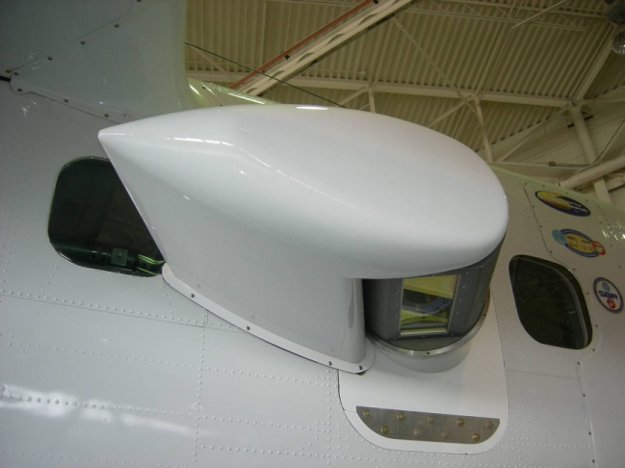
TODWL
Twin Otter Doppler Wind Lidar
CTV
Controlled Towed Vehicle
CTV

Slide 11
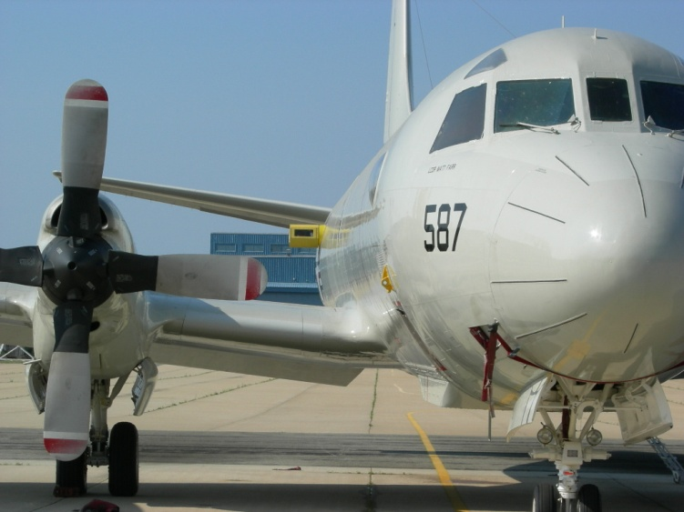
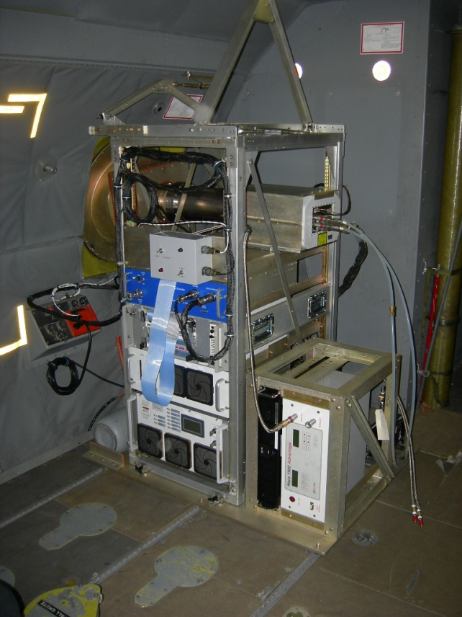
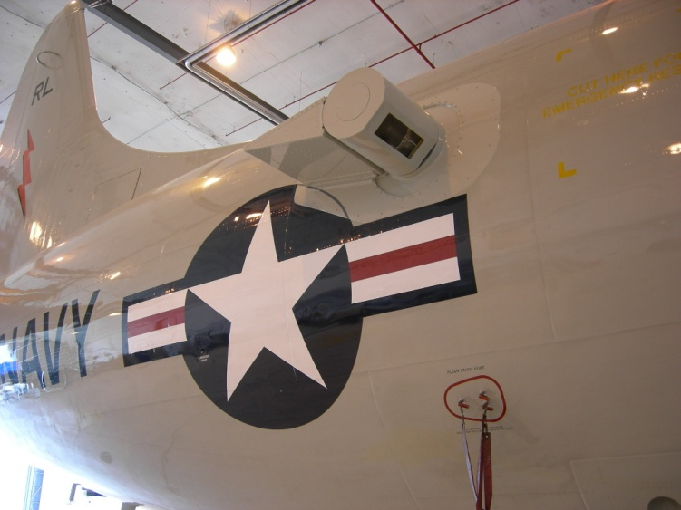
P3DWL for NOAA HFIP
1.6 um coherent WTX (ARL/LMCT)
10 cm bi-axis scanner (NASA)
P3 and other parts (NRL)
Analyses software (SWA/CIRPAS)

Slide 12
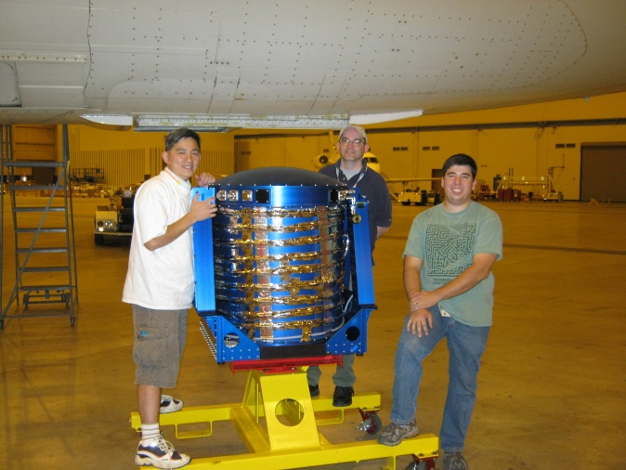
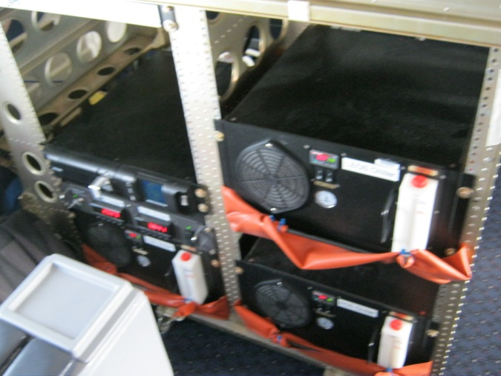
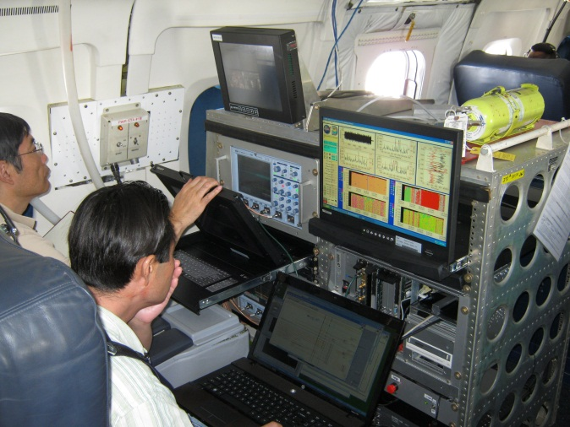
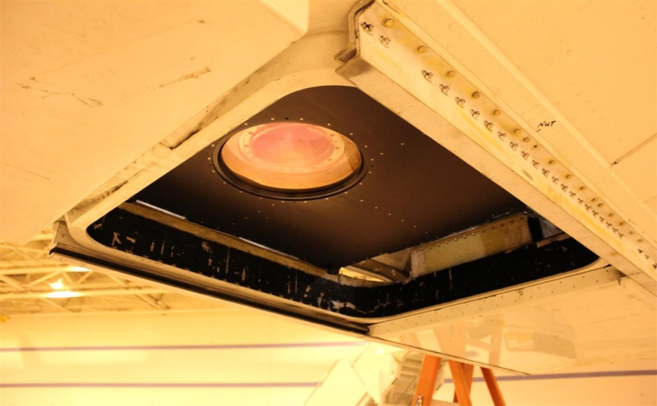
DAWN Integration on DC-8: PolarWinds 2014-2015

Slide 13
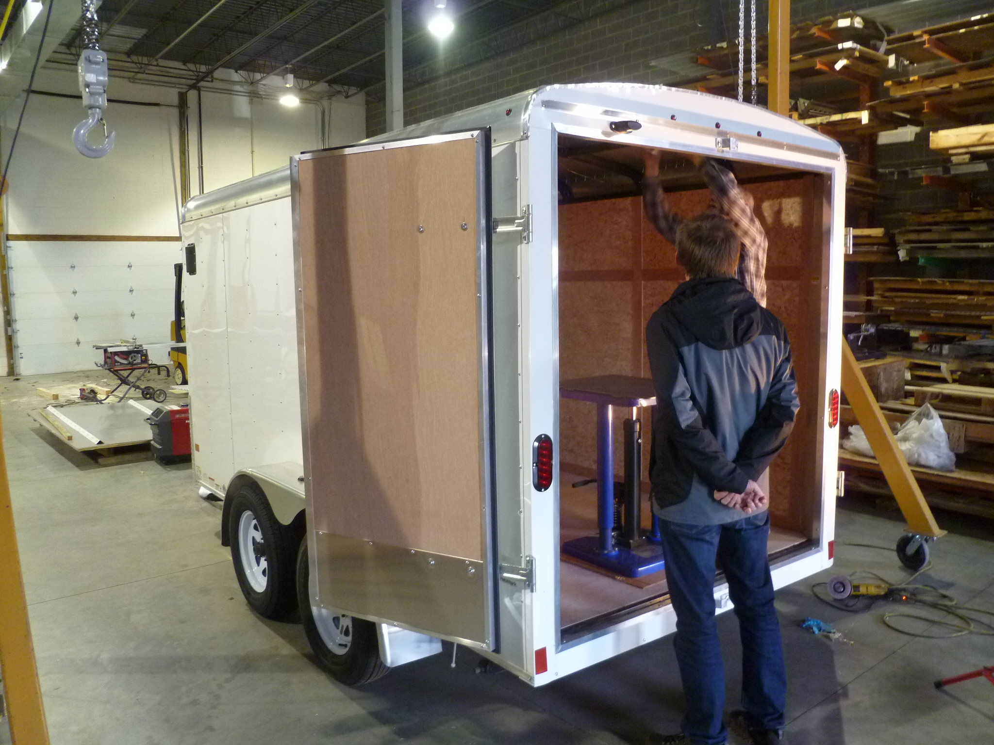
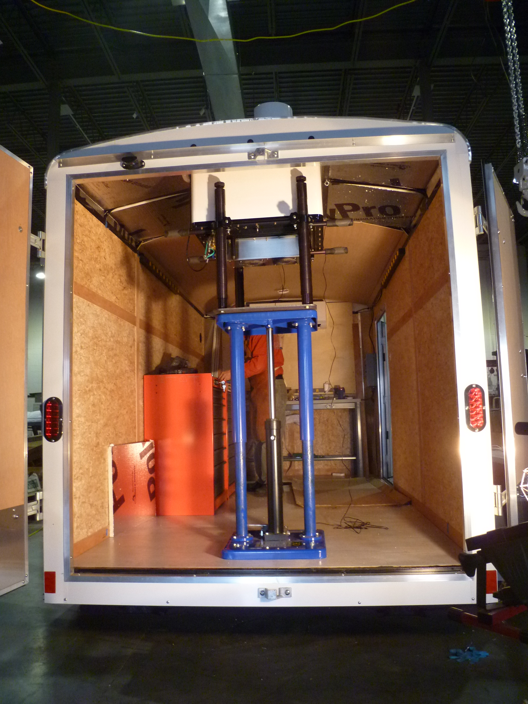
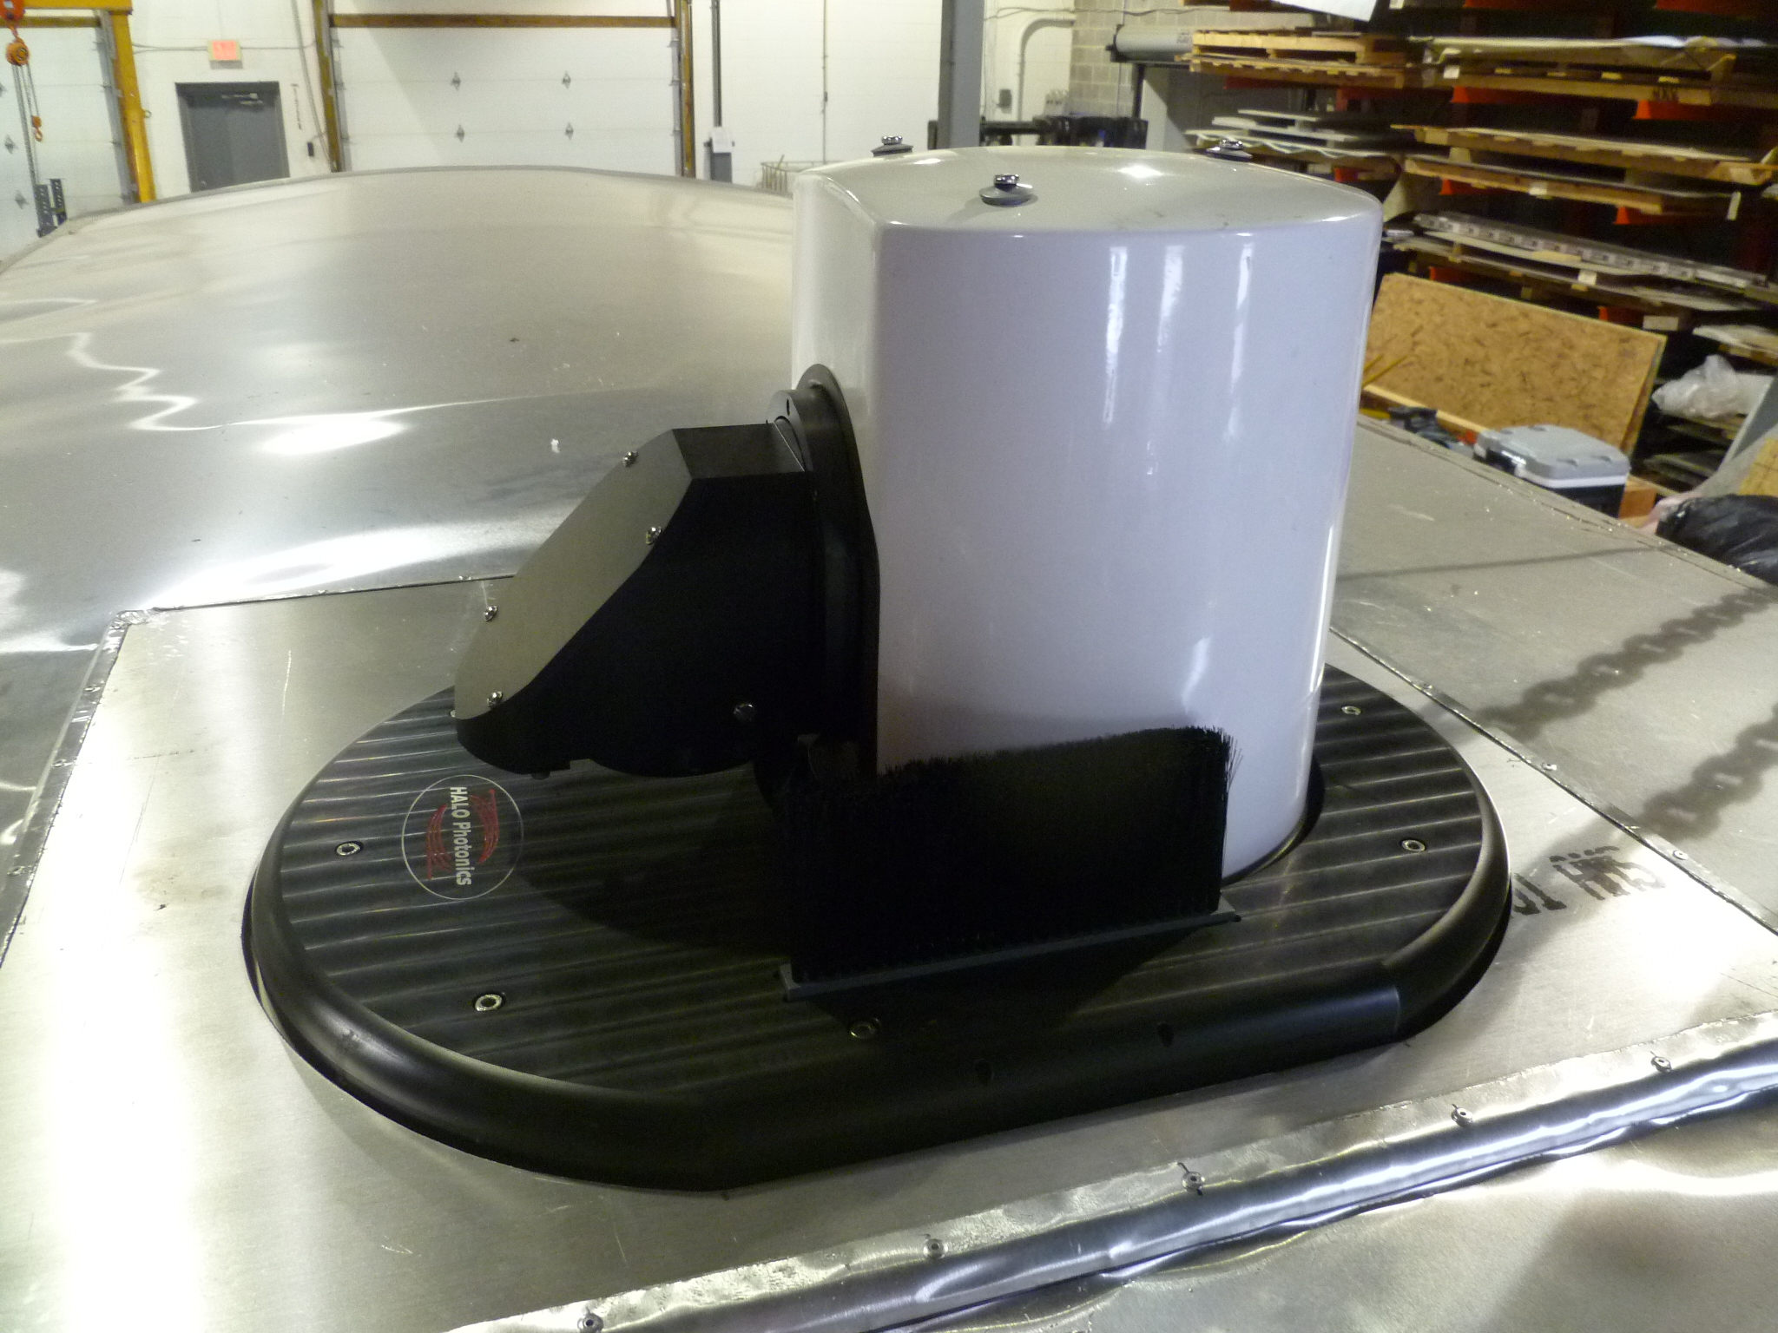
HALO-Trailer

