Slide 1
ATHENA/OAWL: Measuring Winds from the International Space Station
Mike Hardesty
CIRES/NOAA
Carl Weimer and Sara Tucker
Ball Aerospace

Slide 2
ATHENA-OAWL Overview
Earth Venture Instrument – 4 (EVI-4) Proposal to NASA in 2016
Submitted previously to EVI-2 (2013)
EVI-2 mission not Selected for space – Category 3 – too high of risk
Concept was selected for Risk Reduction Funding to advance its Technology Readiness – ATHENA-OAWL Venture Technology (AOVT)
PI: Mike Hardesty (CIRES- CU/NOAA)
Lars Peter Riishjojgaard - Deputy PI
Wayman Baker - Project Scientist
CU-LASP is the Mission Center
Ball Aerospace is the Instrument Provider – Doppler Wind Lidar
Focused Science Mission
Tropospheric dual Line-of-Sight Winds plus aerosols with emphasis on tropics and ocean regions
The mission was not selected (EVI-4 selection was announced Monday)
Debrief in the next 2 weeks
Rated Category 2 (selectable) as reviewed by TMC
Category II. Well-conceived and scientifically or technically sound investigations which are recommended for acceptance, but at a lower priority than Category I.
Science was highly rated

Slide 3
ATHENA-OAWL Science Objectives
Create a breakthrough in prediction and understanding of low and mid-latitude weather and climate via improved sampling of wind profiles.
Improve our understanding of the effects of the interaction between aerosol radiative forcing and atmospheric dynamics on the genesis and lifecycle of tropical cyclones via collocated aerosol and wind measurements in the tropic.
Improve our understanding of the impact of long-range dust transport and aerosol transport on global energy and water cycles, air quality, and climate via collocated aerosol and wind measurements

Slide 4
ATHENA-OAWL Science Team
Mike Hardesty, CIRES/NOAA, PI
Bob Atlas, NOAA/AOML
Iliana Genkova, IMS/NCEP
Vijay Tallapragada, NOAA/NCEP
Arlindo daSilva, NASA/GMAO
Dave Emmitt, SWA
Mary Forsythe, UKMO
Ron Gelaro, NASA/GMAO
Lars Peter Riishojgaard, UMD
Michael Rennie, ECMWF
Lars Isaksen, ECMWF
Shoba Kondragunta, NOAA/NESDIS
Rolf Langland, NRL
Frank Marks, NOAA/AOML
Oreste Reale,USRA/GESTAR
Oliver Reitebuch, DLR
Peter Pilewskie, LASP
Sunil Baidar, CIRES/NOAA
Sara Tucker, Ball
Floyd Hovis, Fibertek
Carl Weimer, Ball

Slide 5
ATHENA-OAWL Science Questions
How much can forecast skill be improved in the tropics and mid-latitudes with accurate, uniformly-spaced wind profile measurements?
How much can additional wind profiles improve climate reanalysis and knowledge of tropical jets?
What impact will DWL wind profile measurements have in reducing the uncertainty in AMVs and determining if cloud and water vapor features are ideal tracers?
What is the role of the tropical wind field in influencing the genesis and lifecycle of tropical cyclones?
What is the impact of ATHENA concurrent wind-aerosol profile measurements on long range aerosol transport and its implication for representing the global energy and water cycles and aerosol forcing of climate and air quality?

Slide 6
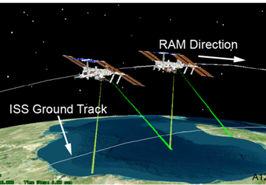
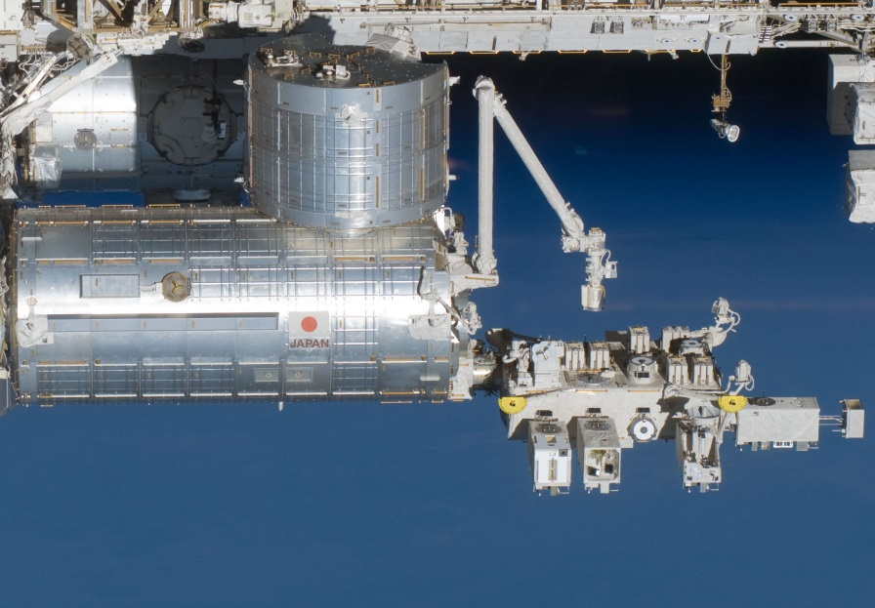
ATHENA-OAWL on the ISS
Japanese Experiment Module – Exposed Facility
Excellent platform for Earth remote sensing, including Lidars:
CATS-ISS (aerosol-cloud) onboard since 2015
GEDI (Forest Canopy) due in 2018
ISS lifetime is planned up to 2024
Each slot has power capability of up to 3000 W (and coolant)
Power, Coolant, Bandwidth are shared and as the Platform fills up, less is available
Current Payloads in development are limited to 800 W for continuous operation
Future Payloads (EVI-4) are limited to 500 W

Slide 7
ATHENA-OAWL Mission implementation
Measurement Parameters | Benefit
ISS Orbit provides quasi-uniform sampling over >80% of the Earth’s surface | Orbit focuses on the middle latitudes where the scientific demand for additional wind profiles is strongest
Measurement range from the surface up to 25 km altitude | Coverage of the entire depth of the troposphere and the lower stratosphere
Vertical resolution ≤ 1 km | Meets WMO requirements for NWP and climate reanalysis applications
Horizontal resolution ≤ 100 km
Wind Measurement with precision of < 3 m/s (aerosol dependent) | Augments the radiosonde network with ≥10× more coverage over the oceans
2-orthogonal 40° off nadir LOS looks | Measures both components of the horizontal wind

Slide 8
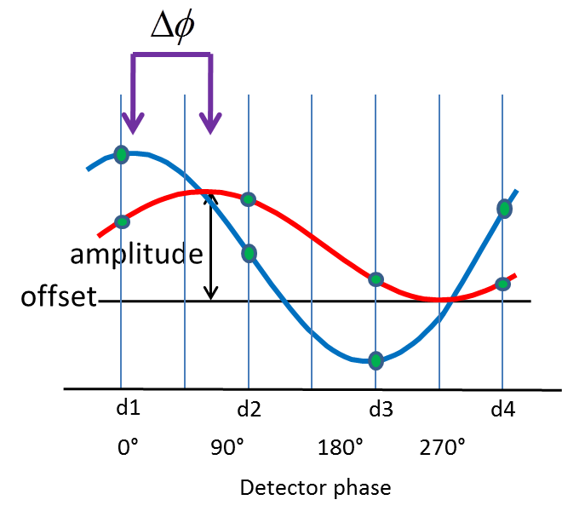
Doppler Wind Lidar Approach
Laser light scattered from particles moving with the wind will have its wavelength (frequency) shifted according to the Doppler Effect
Optical Autocovariance technique uses optical interferometry to measure the Doppler shift
Shift in the fringes is proportional to the shift in the wavelength
Mach Zender interferometer gives best throughput
Technique requires that each laser pulse be measured at transmit and receive in order to measure the shift
This has the significant advantage of not requiring frequency stabilized lasers (though narrowband lasers still required)
Two Line-of-Sight (LOS) measurements 90° apart are made and each assimilated separately into the weather prediction models
ATHENA-OAWL will operate at 532 nm using aerosol scatter for Doppler measurements
ADM-AEOLUS (launch 2018) also uses interferometry (but at 355 nm) for Doppler measurements:
Fizeau for Molecular scattering
Double Edge Etalon for aerosol scattering
Interferometer Fringes:
Transmitted
Backscattered
LOS – Line of Sight
OPD – Optical Path Difference
∆Ф – Phase Shift

Slide 9
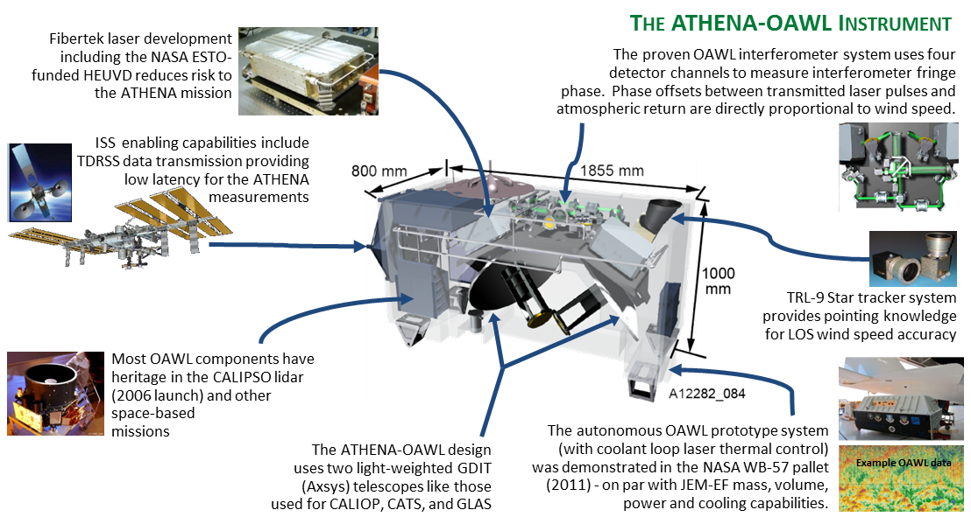
ATHENA-OAWL Instrument Overview

Slide 10
Summary
ATHENA-OAWL was rated selectable but was not selected for an EVI-4 mission. Missed opportunity for a major step forward in earth science and space remote sensing technology
Implementation of ATHENA-OAWL would enable important dynamical and aerosol science with emphasis on low-latitude regions.
ATHENA-OAWL was based on heritage designs from CALIPSO to minimize risk and reduce cost to fit under the tight EV-I cost cap.
Performance predictions and wind measurement capability of the ATHENA design were demonstrated during the 2016 airborne tests (Sunil Baider and Sara Tucker talks).
ATHENA-OAWL would have been a step toward a full-atmosphere (aerosol and molecular scatter), Decadal Survey type mission.
We will digest the debrief and decide where to go next

