Slide 1
Recent Progress on Lasers for Space-Based Winds
Fibertek, Inc.
13605 Dulles Technology Drive
Herndon, VA 20171
fhovis@fibertek.com
703-471-7671

Slide 2
Outline
High Efficiency UV Demonstrator (HEUVD) Lifetime Testing
Pump Diode Life Test Program
ATHENA-OAWL EVI-4 Transmitter Overview
Progress On Tm Fiber Laser Development for a Coherent Winds Pump
Compact Lasers for Planetary Winds

Slide 3
High Efficiency UV Demonstrator (HEUVD) Lifetime Testing

Slide 4
Program Objectives & Approach
ESTO funded program to design and build a UV lifetime demonstrator to serve as a test bed for advancing the TRL of the technology in support of future NASA missions.
  Full conductive cooling
  Increased UV lifetime by lower outgassing contamination
  532 nm and 355 nm lifetime testing
  Vibe and TVAC testing
Program objectives as revised in March 2015 per contract modification #6
  Conduct a 50 x10⁹ shot high-fluence UV life test using a 20 kHz drive laser
  Configure the HEUVD system hardware for 150 Hz, 250 mJ @ 1064 nm operation
  Conduct a 1.5 x10⁹ shot high-fluence Green life test
  Conduct a 1.5 x10⁹ shot low-fluence UV life test
  Conduct a 1.5 x10⁹ shot high-fluence UV life test
  Conduct thermal-vacuum & vibration testing of the laser optical module

Slide 5
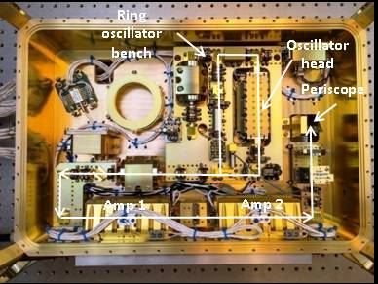
HEUVD Transmitter Design Validated by Performance and Lifetime Testing
Sealed , dual compartment design
  Reduced sensitivity to contamination
  Vacuum alignment stability
Contamination processing and control per ICESat-2 standards
  Improved lifetime
Pure conductive cooling to a single external thermal interface
  Simplifies thermal design
  Required for a space-based system
  Amplifiers mounted on laser module wall
Flexure mounted for high launch vibration levels
Full power 532 nm lifetime successfully completed
  1.2 billion shots
Half power (50 mJ/150 Hz) UV lifetime test successfully completed
  1.5 billion shots
Full power (100 mJ/150 Hz) UV lifetime test has just started
Resonator & preamplifier compartment
Power amplifier & nonlinear conversion compartment

Slide 6
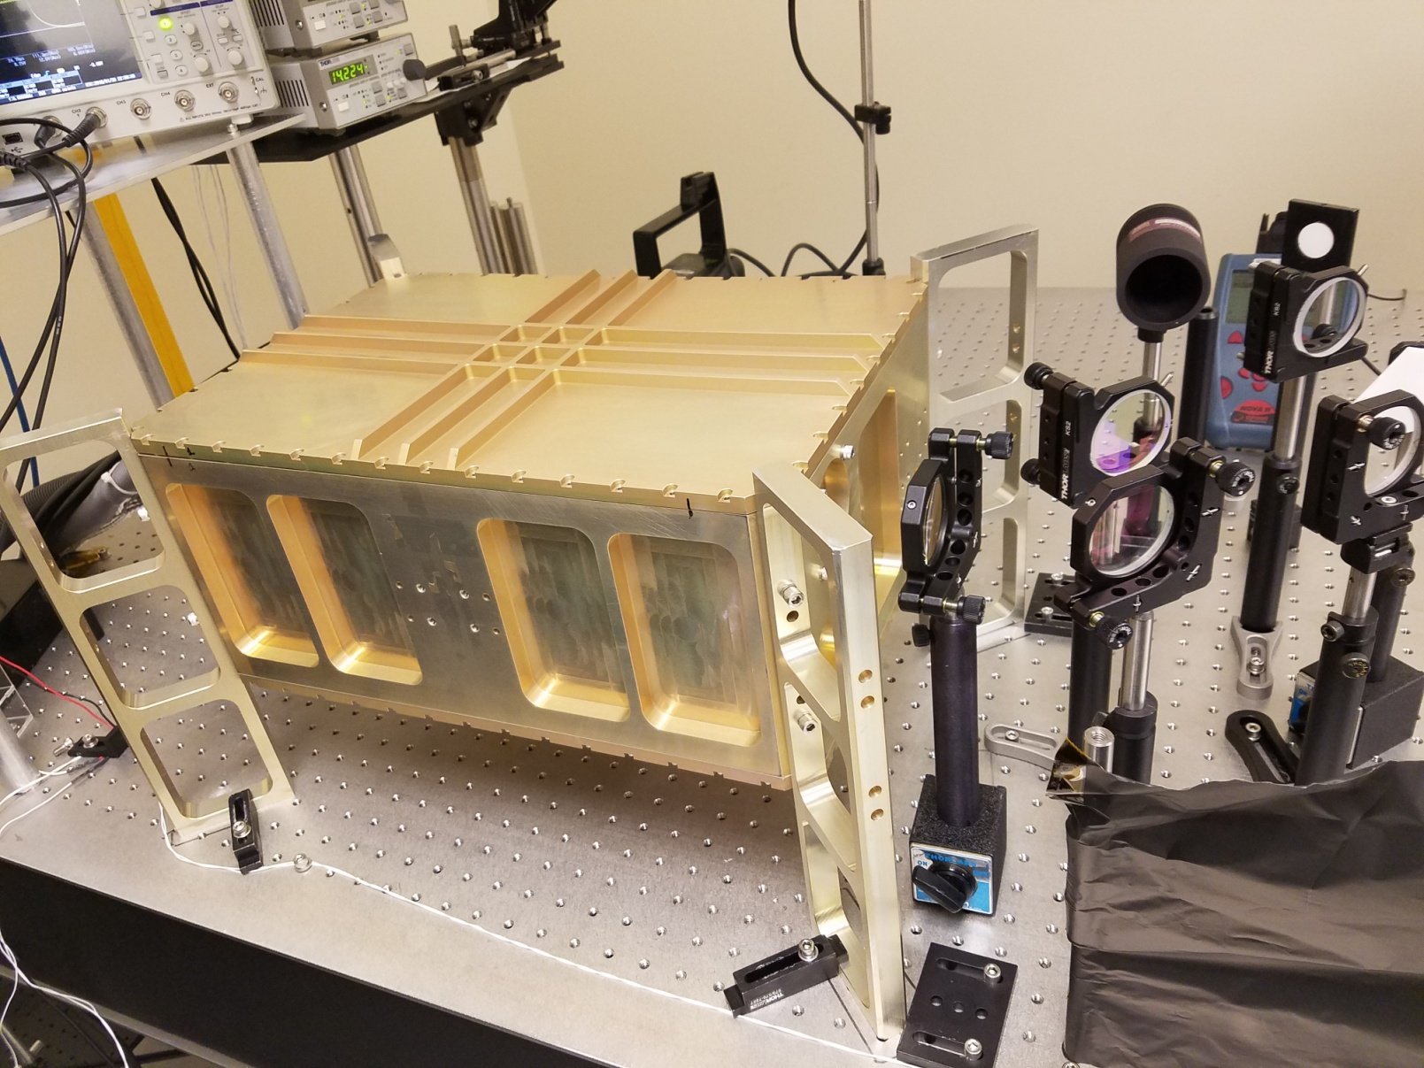
Full Power Life Test Set Up
Laser Optics Module

Slide 7
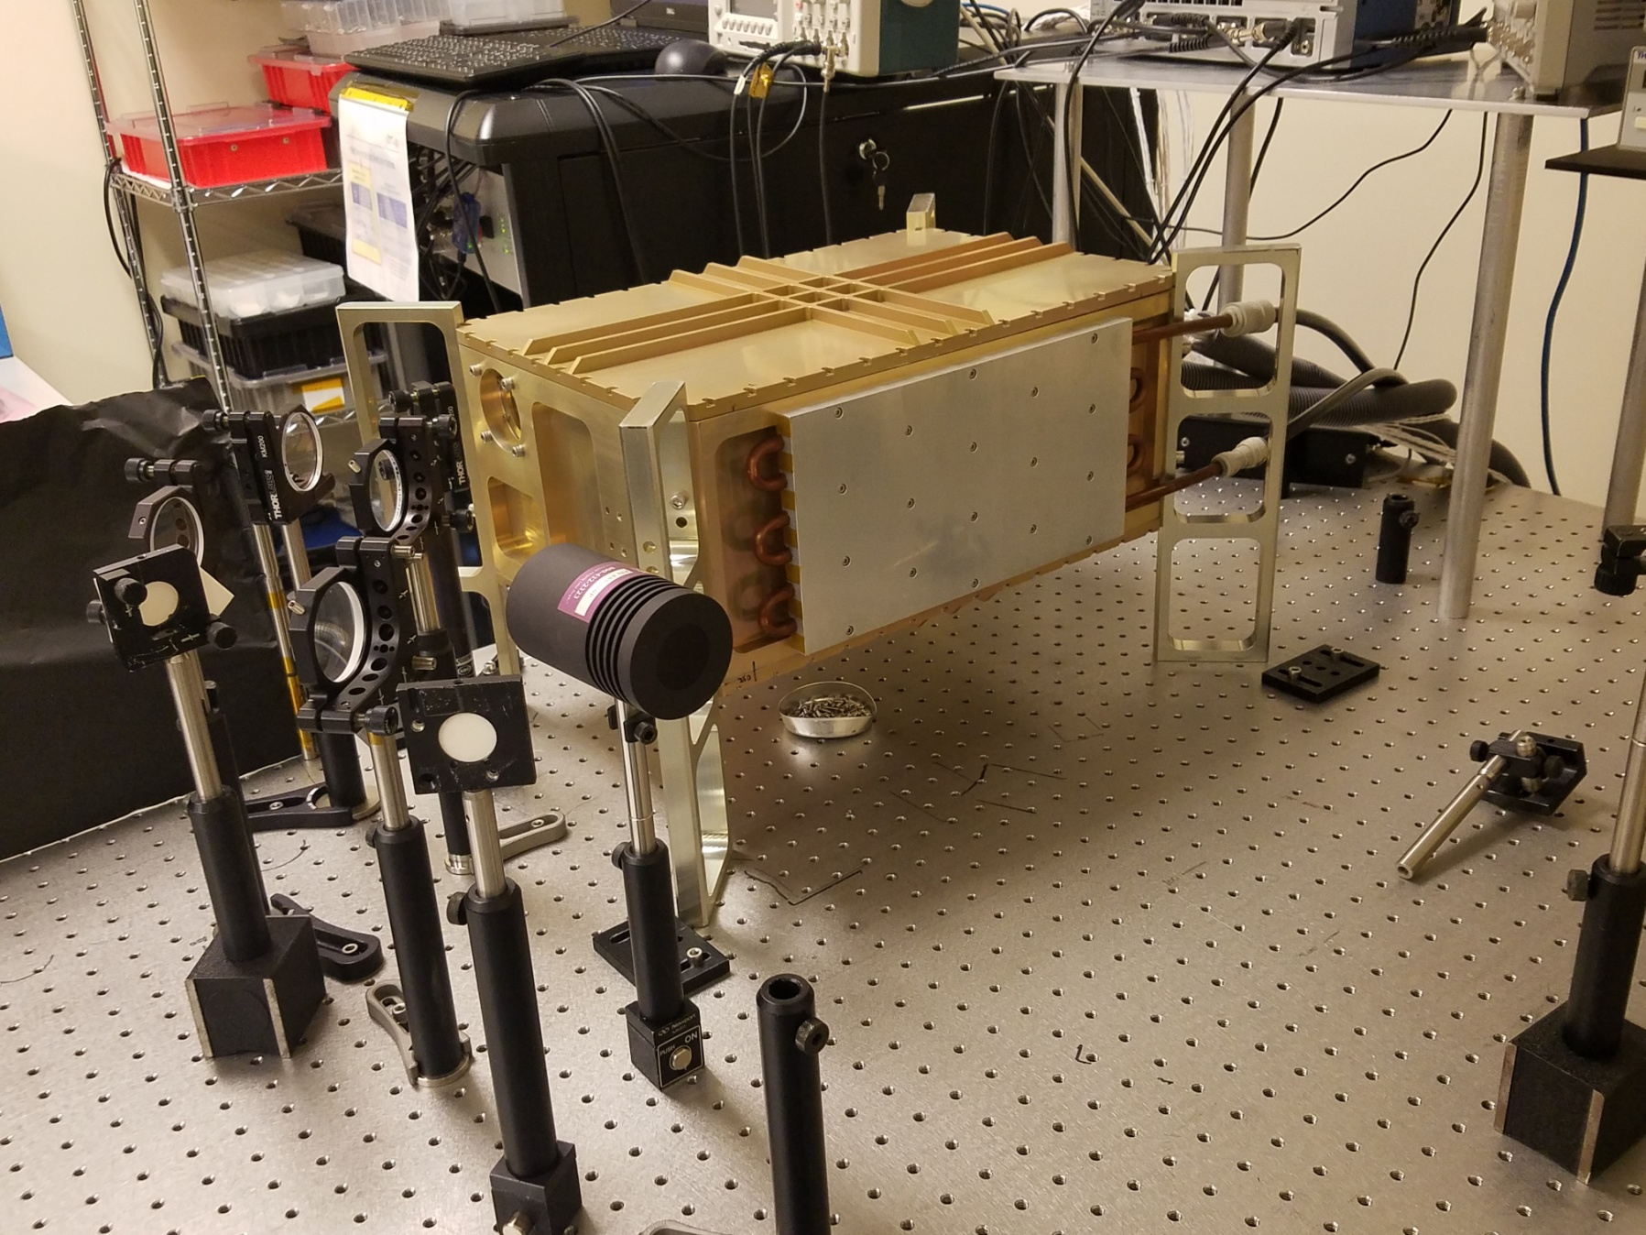
Full Power Life Test Set Up
Laser Optics Module
Single external thermal interface

Slide 8
150 Hz Laser System Summary
1 µm optical performance has met or exceeded all design objectives
532 nm results met or exceeded all design objectives
Full conductive cooling was successfully demonstrated
Parameter | Objective | Demonstrated
Pulse Repetition Rate | 150 Hz | 150 Hz
1064 nm Pulse Energy | 250 mJ | 275 mJ
532 nm Pulse Energy | 135 mJ | 165 mJ
1064 nm Pulse Width | 10 – 20 ns | 14 ns
532 nm Pulse Width | 10 – 20 ns | 11 ns
1064 nm Beam Quality | 2.0 M² | 1.9 M²
532 nm Beam Quality | 3.0 M² | 2.2 M²

Slide 9
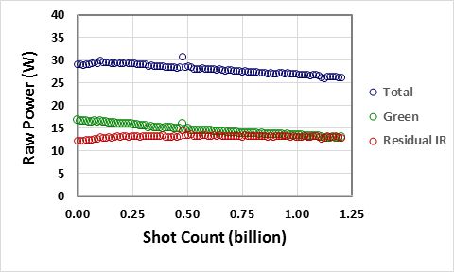
532 nm Life Test Summary
150 Hz repetition rate
1.2 billion shots at completion
Total power down 9%
532 nm power down 19%
  Due to changes in 1064 nm pump power and corresponding decreases in nonlinear conversion
No evidence of any optical damage in the 1064 nm pump laser or 532 nm generation leg
High current, lower pump pulsewidth improved efficiency but reduced diode life time
  System was updated for lower current operation to with an expectation of achieving ≥ 2.3X diode lifetime improvements

Slide 10
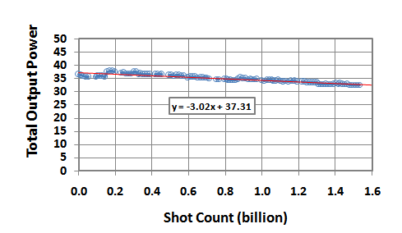
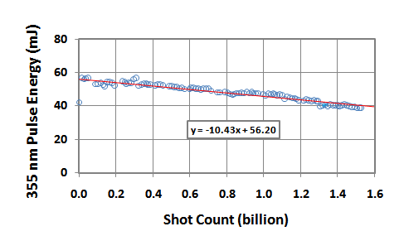
355 nm Half Power Life Test Summary
Life Test Data – Total Output Power
Life Test Data – 355 nm Output Energy
Parameter | Value | Units
Shot Count | 1.529 | 10⁹ shots
Start Test Power | 37.31 | W
End Test Power | 32.70 | W
Power Degradation | 12.4 | %
Power Degradation | 8.1 | %/10⁹ shots
Parameter | Value | Units
Shot Count | 1.529 | 10⁹ shots
Start Test Energy | 56.2 | mJ
End Test Energy | 40.3 | mJ
Power Degradation | 28 | %
Power Degradation | 18.6 | %/10⁹ shots

Slide 11
355 nm Half Power Life Test Summary
150 Hz repetition rate
1.53 billion shots
Total power is down ~12%
  Determined from sum of UV power and residual 532 nm plus 1064 nm powers
  Driven by drop in 1064 nm power due to continued diode degradation
  Diode derating did not have anticipated effect and needs further investigation
UV power is down ~28%
  Primarily due to drop in 1064 nm pump power
Identified areas for improving optical robustness
  Air gap waveplates
    Switch to ICESat-2 style optically waveplates
  Triple AR fused silica optics
  Diode derating to achieve decay rate compatible with 15x10⁹ shot missions

Slide 12
UV Demonstrator Status
Assembly of the UV demonstrator is complete through all three amplifiers and the SHG section
The 20 kHz UV lifetest has been successfully completed
4 month 532 nm lifetime successfully completed
Update to pump diode operational parameters with expectation of achieving ≥ 2.3X improvement in diode lifetime was implemented
4 month half power UV lifetest (50 mJ/150 Hz) was completed with encouraging results
  Proved value of contamination control to reduce UV optical damage
  Surfaced a larger than expected diode decay rate
System updates are complete and the 4 month full power UV lifetest (100 mJ/150 Hz) has been started
  Replaced air gap waveplates, triple AR lenses, and several external diagnostic optics
  Reconfigured and re-characterized 1064 nm pump laser
Environmental testing will follow the full power UV lifetest

Slide 13

Pump Diode Life Test Program

Slide 14
Diode Lifetime Program Overview
Motivated by next generation cloud and aerosol transmitter requirements
  15 billion shot mission lifetime
Decay of HEUVD pump diodes was larger than expected (~10%/billion shots)
Joint program between Fibertek and NASA Langley
  NASA Langley Co-I’s: Amin Nehrer and Farzin Amzajerdian
Fibertek role
  Define diode lifetime requirements
  Survey and evaluate diode vendors
  Procure diodes
  Jointly develop diode test plan with LaRC
  Support diode testing at NASA Langley
NASA Langley role
  Jointly develop diode test plan with Fibertek
  Develop detailed test procedure
  Pre life test diode characterization
  Execute diode testing
  Post life test diode characterization

Slide 15
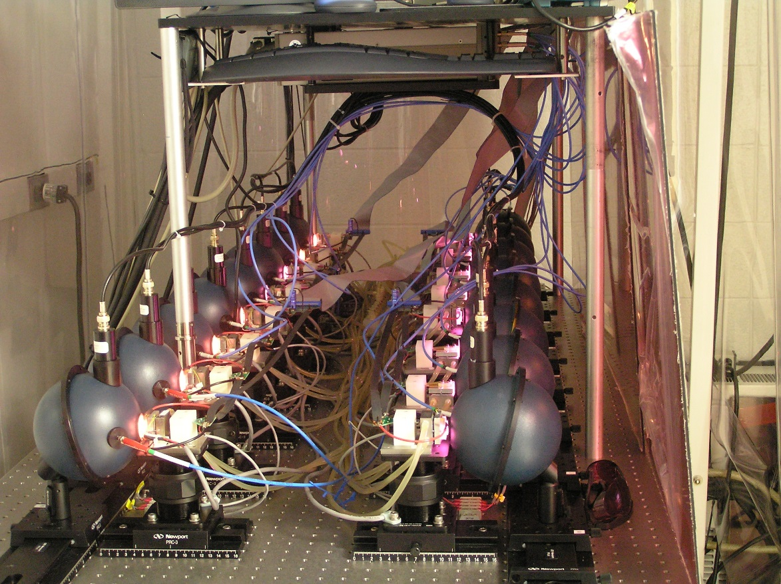
NASA Langley Lifetime Test Facility
Fully-automated
Running 24/7

Slide 16
Diode Lifetime Program Status
Developed more detailed model of impact of diode decay on 355 nm output of HEUVD
  15% decay in all pump diodes leads to 22% decay at 355 nm
  Resulted in goal of 1%/billion shot pump diode decay
Developed detailed diode specification
Contacted 4 potential diode vendors
  1 no bid
  1 provided marginal response
  2 provided detailed responses
    Data based diode derating recommendations
    Previous space-qualification of pump diodes
Formal RFQ has been sent to both compliant vendors
Current plan is to procure diodes from both vendors
Testing will be done to validate recommended diode deratings
  Half of diodes will be tested full power and duty cycle specifications
  Half of diodes will be tested at derating expected to achieve 1%/billion shot decay

Slide 17
ATHENA-OAWL EVI-4 Transmitter Overview

Slide 18
ATHENA-OAWL Transmitter Design Validated by HEUVD Performance and Lifetime Testing
Required 1064 nm output is met with margin with oscillators and only amps 1 & 2
SHG will replace amp 3
Output telescope will replace THG and original SHG
Sealed , dual compartment design
  Reduced sensitivity to contamination
  Vacuum alignment stability
Contamination processing and control per ICESat-2 standards
  Improved lifetime
Pure conductive cooling to a single external thermal interface
  Simplifies thermal design
  Required for a space-based system
  Amplifiers mounted on laser module wall
Flexure mounted for high launch vibration levels
Combination of full power 532 nm life test plus half power UV lifetest demonstrates system robustness
  2.7 billion shots with no significant 1064 nm or 532 nm optical degradation
Oscillator & 2 pre-amplifiers provide required 1064 nm output
SHG goes here
Expansion scope goes here
SHG and expansion scope compartment

Slide 19
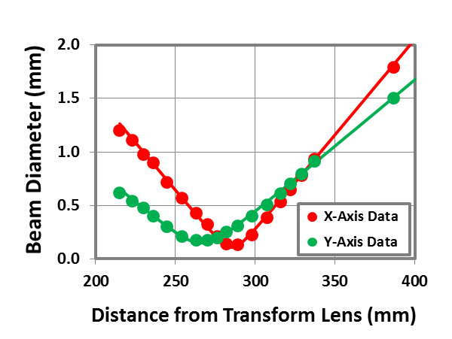
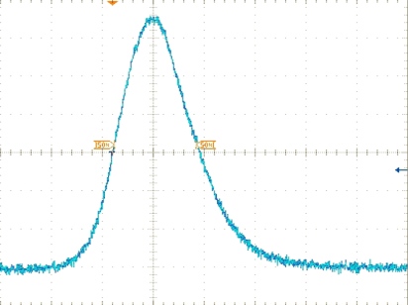
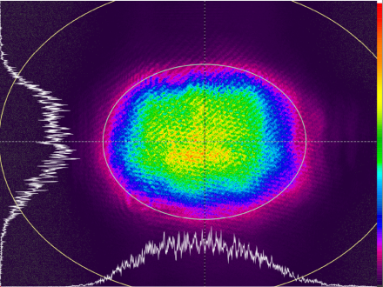
150 Hz HEUVD Pre-Amplifier 1064 nm Performance
HEUVD Transmitter Performance Exceeds the Athena-OAWL Requirements With Only Pre-Amps
< 100 mJ @ 1064 nm will meet the Athena-OAWL 532 nm requirement of 50 mJ
  Allows for additional diode derating for longer lifetime
Power amplifier compartment will be used for SHG and an expansion telescope
  7X internal beam expander will meet the Athena-OAWL divergence requirement
Parameter | Demonstrated | Athena-OAWL Requirement
Pulse Energy | 205 mJ | 100 mJ
Pulse Width | 15 ns | >25 ns
Beam Quality | 1.4 M² | < 2 M²
Temporal Distribution
Spatial Distributions
Propagation Parameters
15 ns
FWHM
Near Field
3.69 x 2.78 mm
M²_{X} = 1.45
M²_{Y} = 1.37
M^2-QSW - AMP 2 Output.xmcd
10 ns/div

Slide 20
Progress On Tm Fiber Laser Development for a Coherent Winds Pump

Slide 21
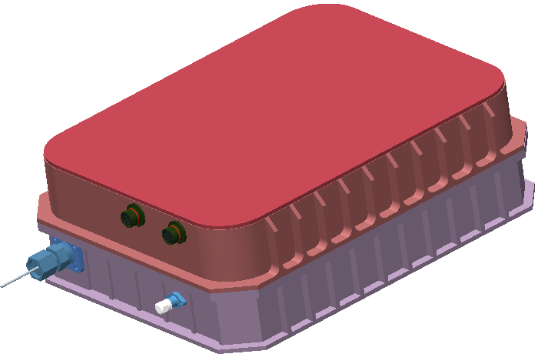
Tm Fiber Laser Design is Ready for CDR
Ultra-compact, efficient, with high reliability
  Reliability > 95% over 5 years 24/7 operation.
  Expect 3-5 Year ISS mission
Thermal and vibrational analysis have been complete
  Thermal issues are well controlled
  Mechanical structure has been analyzed and shown to have good margins of safety relative to GEVS raandom vibration profiles
Estimated SWaP:
  Size: 14″ x 11″ x 4.5″
  Mass : 13.2kg.
  Power: 470 W input for at 100 W CW output
Efficiency: ~ 20%
Pure conductively cooling

Slide 22
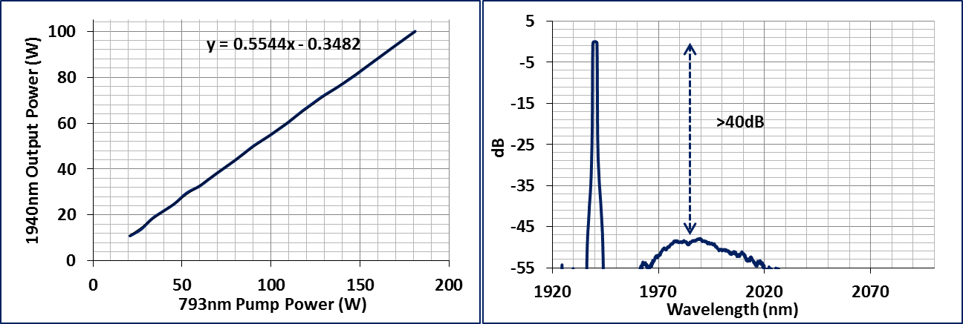
100 W with Low ASE Demonstrated
>40 dB sideband suppression

Slide 23
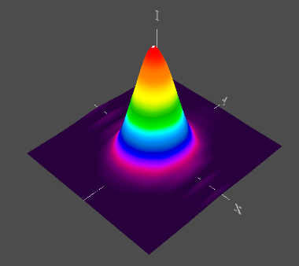
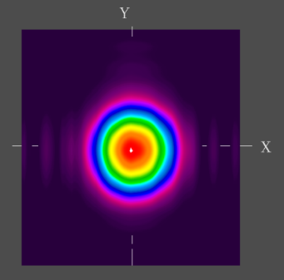
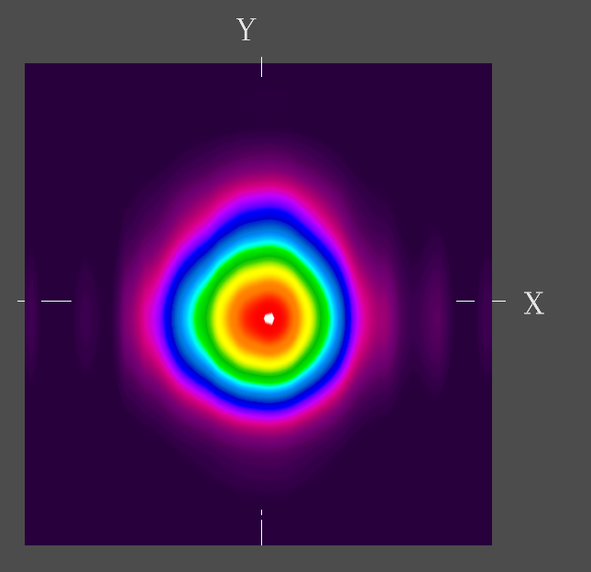
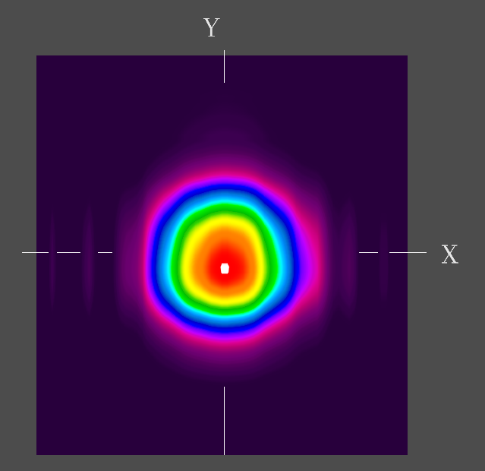
Near Diffraction Limited Output With Narrow Lanewidth Has Been Achieved
M_{X}²=1.05
M_{y}²=1.10
Far Field images @ 46W
M² < 1.1
Linewidth < 0.3nm
3D
2D

Slide 24
Compact Lasers for Planetary Winds

Slide 25


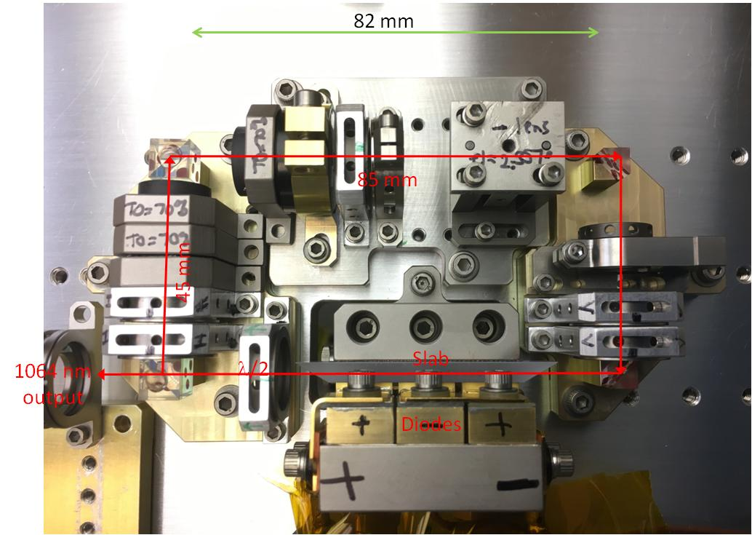
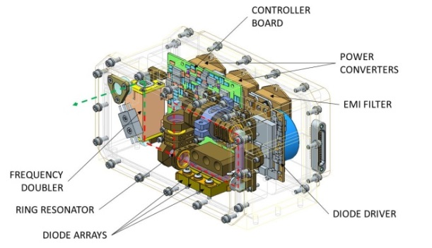
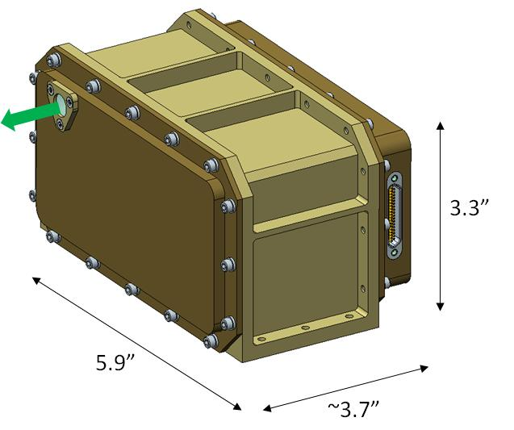
Laser Transmitters for Planetary Remote Sensing Instruments
Target: Europa surface and Mars orbiter
Science:
Remote µ-Raman Instrument on a Europa lander
  Sample identification without sample collection to evaluate evidence of life/habitability on Europa
  Information not possible with passive sensors
Wind and aerosol lidar on a Mars Orbiter
Wind fields to support global climate models
Aerosol size and distribution for atmospheric radiative heating and energy transfer models
Provides vertical and horizontal resolution of winds and aerosols not achievable with passive sensors
Mode spacing of oscillator matched to OPD of OAWL style Mach-Zender based receiver
Mars winds laser design goal is 2 mJ @ 2kHz
Brassboard version of the compact oscillator developed for EDL
Objectives:
Refine µ-Raman and wind lidar models to refine laser performance requirements
Develop a laser transmitter design that operates from ‑25C to +55C in 300 krad mission
Build a brassboard laser transmitter and test performance over temperature
Conceptual design for a compact laser transmitter that will support planetary remote µ-Raman and wind lidar instruments
CoIs:
Nigel Martin, Pat Burns, and Khoa Le/Fibertek
Sara Tucker/Ball Aerospace
M. Nurul Abedin/NASA Langley
Notes:
NASA’s next Mars surface mission to follow MSL will advance the search for signatures of habitability and begin focusing on detection and structural characterization of a wider range of complex organic compounds, both volatile and nonvolatile, in carefully selected samples. The knowledge to be gained with MSL on the host environment, preservation, concentration, and complexity of organics found at Gale Crater may lead to a highly streamlined sample search and selection process at a future landing site. An organic analysis investigation would then have the significant opportunity to examine not only the bulk organic inventory, but the detailed structural diversity and fine spatial distribution of that inventory, directly informing critical aspects of habitability and feeding forward to Mars Sample Return. At the same time, given very limited expected payload resources, an appropriately advanced organics analysis capability must be realized with instrumentation miniaturized well beyond the current state-of-the-art in flight hardware. Moreover, the associated investigation must now be sufficiently well-defined to achieve technology readiness level (TRL) 6 in the next two-to-three years, depending on the mission opportunities, severely limiting the range of potential advanced approaches. We propose to develop to TRL 6 a next-generation Linear Ion Trap Mass Spectrometer (LITMS) investigation that directly and
fully addresses these measurement and development objectives. LITMS combines two extremely powerful approaches to organics analysis, those of pyrolysis gas chomatography/mass spectrometry (GCMS) and Mars-ambient laser desorption mass spectrometry (LDMS), linked through a single, highly-miniaturized linear ion trap (LIT) mass analyzer. The LITMS effort will take advantage of the significant recent development (also to TRL 6) by our team of the Mars Organic Molecule Analyzer - Mass Spectrometer (MOMA-MS) for the 2018 ExoMars mission. LITMS will feature further miniaturization and substantial analytical enhancements, identified during
the MOMA-MS development but not realized due to schedule or mission architecture limitations. These include the ability to analyze both positive and negative ions, the extension of the mass-to-charge (m/z) range to lower values to detect elements, and enhanced performance with tandem mass spectrometry (MS/MS) for structural analysis of complex organics. In addition, LITMS will include integrated development in conjunction with newly-developed sample processing and handling technology, that will enable direct pointby- point laser analysis of nonvolatile organics along the length of an extracted drill core, without having to remove or process fines and
thereby without any fundamental limitation on the number of such analyses during the mission.

Slide 26
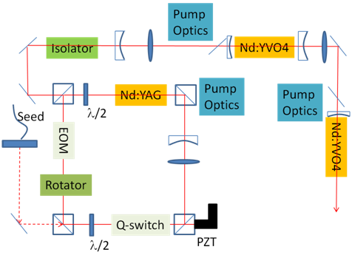
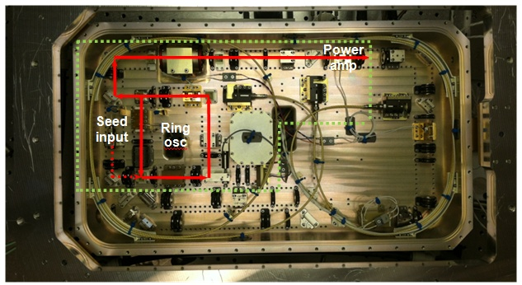
Laser Transmitter for 1 µm Direct Detection Mars Wind Lidar
Brassboard left from CATS was used to perform proof of design tests
Flight design will be a version of CATS reduced in size by ~2X
  Performance goal is 5 mJ at 1kHz
Breadboard laser performance
Breadboard laser layout
Laser Parameter | Goal | Demonstrated
Wavelength | 1064 nm | 1064 nm
Pulse energy | 3 mJ | 3.4 mJ
Repetition rate | 1 kHz | 4 kHz
Linewidth | < 30 MHz | 25 MHz
Spectral Purity | > 2% | 300:1
Pulse width | >20 ns | 28 ns
Beam Quality | M² < 2 | 1.5
Polarization purity | > 30: 1 | >100:1
Region outlined in green shows possible size reduction from the CATS Laser
Notes:
NASA’s next Mars surface mission to follow MSL will advance the search for signatures of habitability and begin focusing on detection and structural characterization of a wider range of complex organic compounds, both volatile and nonvolatile, in carefully selected samples. The knowledge to be gained with MSL on the host environment, preservation, concentration, and complexity of organics found at Gale Crater may lead to a highly streamlined sample search and selection process at a future landing site. An organic analysis investigation would then have the significant opportunity to examine not only the bulk organic inventory, but the detailed structural diversity and fine spatial distribution of that inventory, directly informing critical aspects of habitability and feeding forward to Mars Sample Return. At the same time, given very limited expected payload resources, an appropriately advanced organics analysis capability must be realized with instrumentation miniaturized well beyond the current state-of-the-art in flight hardware. Moreover, the associated investigation must now be sufficiently well-defined to achieve technology readiness level (TRL) 6 in the next two-to-three years, depending on the mission opportunities, severely limiting the range of potential advanced approaches. We propose to develop to TRL 6 a next-generation Linear Ion Trap Mass Spectrometer (LITMS) investigation that directly and
fully addresses these measurement and development objectives. LITMS combines two extremely powerful approaches to organics analysis, those of pyrolysis gas chomatography/mass spectrometry (GCMS) and Mars-ambient laser desorption mass spectrometry (LDMS), linked through a single, highly-miniaturized linear ion trap (LIT) mass analyzer. The LITMS effort will take advantage of the significant recent development (also to TRL 6) by our team of the Mars Organic Molecule Analyzer - Mass Spectrometer (MOMA-MS) for the 2018 ExoMars mission. LITMS will feature further miniaturization and substantial analytical enhancements, identified during
the MOMA-MS development but not realized due to schedule or mission architecture limitations. These include the ability to analyze both positive and negative ions, the extension of the mass-to-charge (m/z) range to lower values to detect elements, and enhanced performance with tandem mass spectrometry (MS/MS) for structural analysis of complex organics. In addition, LITMS will include integrated development in conjunction with newly-developed sample processing and handling technology, that will enable direct pointby- point laser analysis of nonvolatile organics along the length of an extracted drill core, without having to remove or process fines and
thereby without any fundamental limitation on the number of such analyses during the mission.

