Slide 1
The Airborne Cloud-Aerosol Transport System (ACATS): A status and update on development efforts at GSFC
Wind Lidar Meeting
Feb 7th
Boulder, CO
Scott Ozog
PhD Candidate
NASA Goddard Space Flight Center
University of Maryland

Slide 2
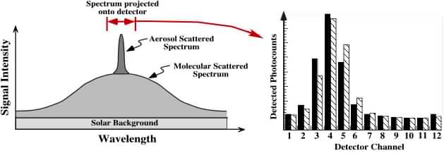
ACATS HSRL & Doppler Wind Lidar
Fabry-Perot fringe imaging lidar at 532nm
Rooted in heritage work from Matt McGill & Paul Hays (Univ. of Michigan)
Small enough to fit in ER-2 wing super-pod
Array of 24 detectors to resolve the spectrum and returned Doppler shift
1.2 Free Spectral Ranges imaged
Rotating HOE used to retrieve 4 separate LOS wind vectors
0°, 90°, 180°, and 270° at 45° off nadir angle
Optimized for retrievals in aerosol layers only
Notes:
-Tech demo optimized to be built with parts at the time for the small space of the superpod
- Single wavelength because of what was available
-Emphasis on coming from Matt McGill work

Slide 3
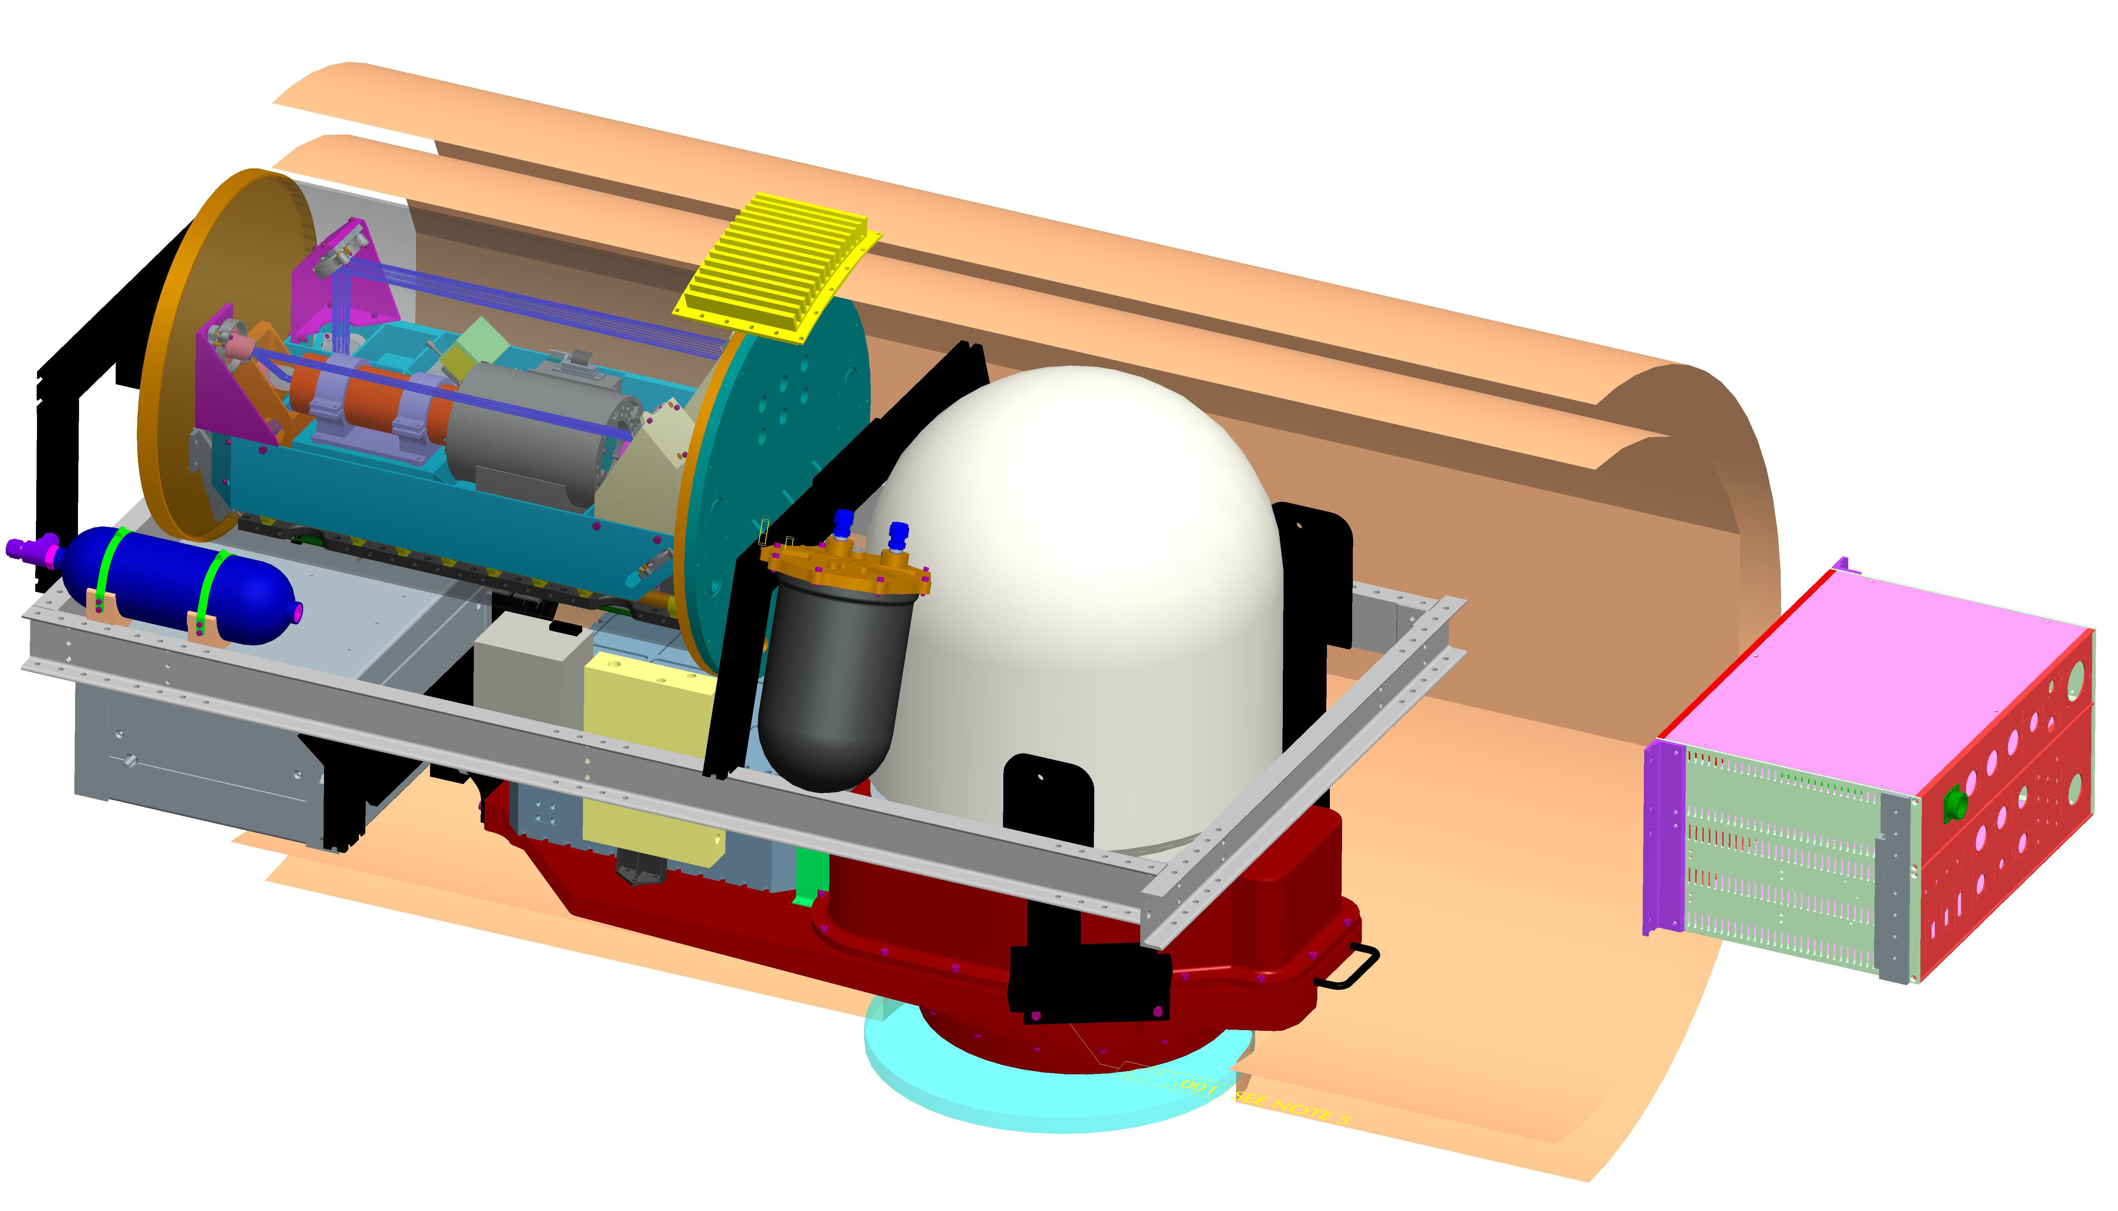
ACATS Lidar Investments
etalon &
controller
[SBIR, ESTO]
circle-to-point optic
[IRAD, SBIR]
receiver development
[IRAD, STTR]
laser
[SBIR, ESTO]
data system
[SBIR, ESTO]
detector subsystem
[ESTO]
HOE telescope
[SBIR, ESTO, IRAD]
Leveraging investments was key to an inexpensive development.
Notes:
Slow process built from parts we had (Frankenstein): Originated summer 2008
Bits and pieces over time
Still worked well given the manner in which was built / different from dedicated $5 million to instrument and labor efforts

Slide 4
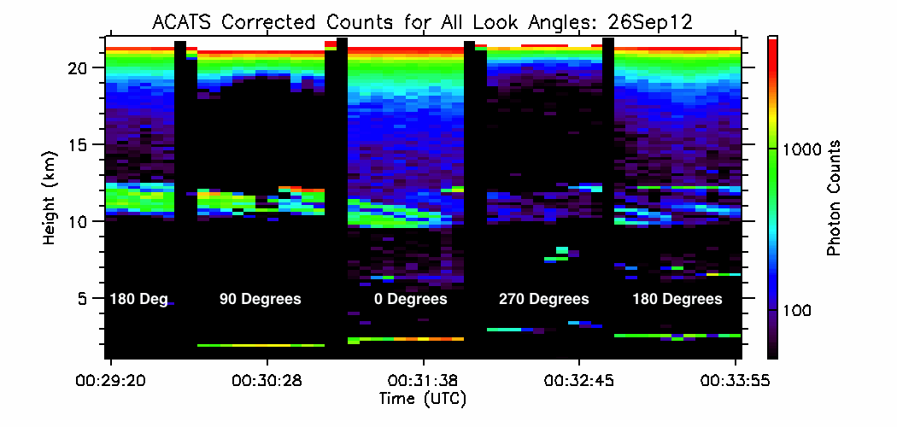
Initial Results
ACATS first science flights were September 2012
13 ER-2 flights out of Wallops Island, VA
Telescope rotation to all 4 looks angles worked well
Dwell time set to 60 seconds for each look angle
Telescope alignment worked well for first flights
Has since been improved for each look angle
0º (fore)
Rotates CCW
270º (left)
90º (right)
180º (aft)
4
Notes:
Emphasize that it worked will given its non traditional path of development

Slide 5
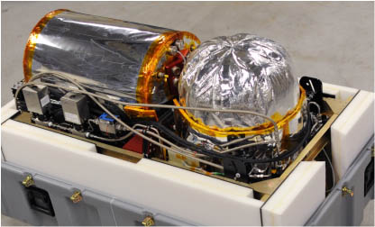
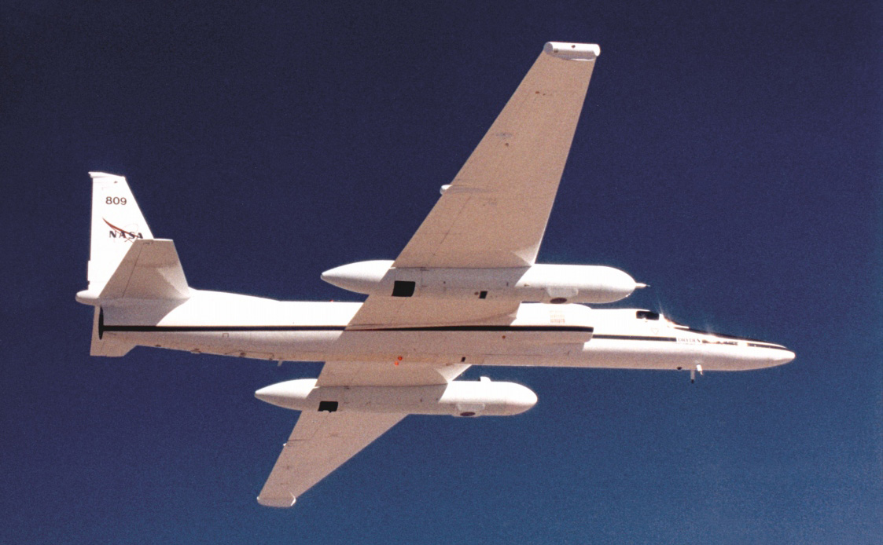
ACATS HSRL & DWL
No dedicated funding
On going side work at Goddard
All flights have been piggybacked with CPL
2012, 2014, 2015
Airborne tech demo test bed
Fit in Superpod
Seeded laser
Fringe imaging multi-channel HSRL
Rotating HOE
Focus was on HSRL retrievals
Yorks et al. 2014:
The Airborne Cloud–Aerosol Transport System: Overview and Description of the Instrument and Retrieval Algorithms
Worked as an HSRL
Issues discovered with calibration and reference spectrum
Horizontal wind algorithms never fully tested
Flies in ER-2 Superpod

Slide 6
ACATS Updates/Improvements
Past few years have had dedicated PhD student working on ACATS
New hardware integrated into ACATS telescope (IRAD 2017)
Improved consistency and reliability of etalon calibration
Improved retrieval of laser reference spectra
ACATS has been operating at NASA GSFC collecting zenith pointing data of clouds and aerosols for algorithm and hardware testing

Slide 7
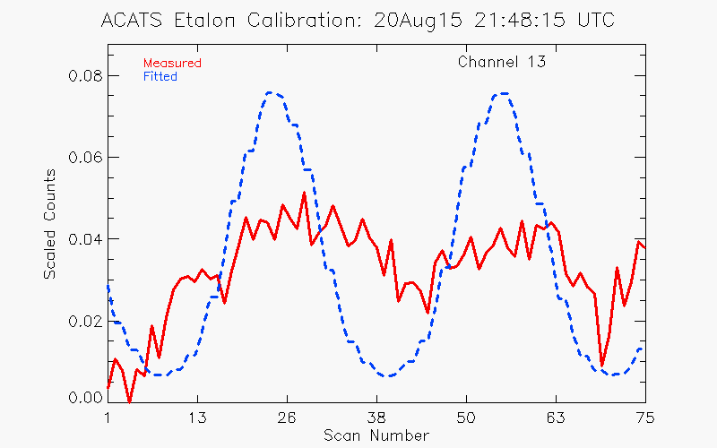
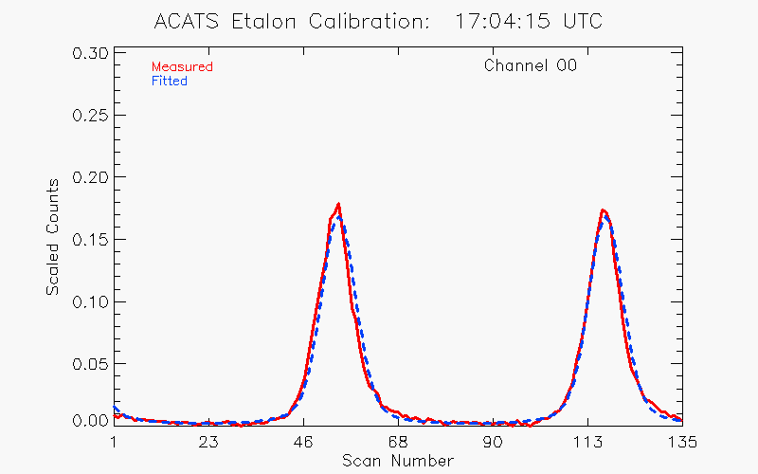
Improved Etalon Calibration
Old Calibration
New Calibration
Poor Fit
Accurate Fit
Old Calibration Method
Notes:
After demo flights, worked, but now well. Sat around with no dedicated funds and campaigns

Slide 8
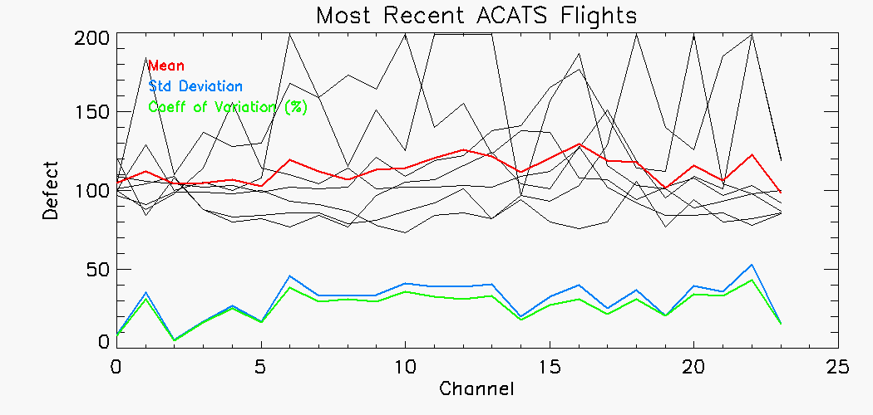
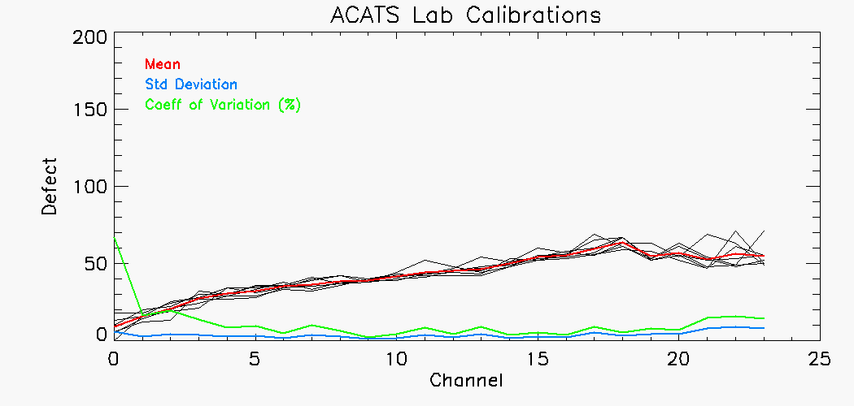
Improved Etalon Calibration
Old Calibration Consistency
New Calibration Consistency
Old Calibration Method

Slide 9
ACATS Wind Test Data
Notes:
60 second integration for reference spectrum
360 second (6min) interval
Focus on and reiterate this is up looking, not flight data, looking at vert wind, expected zero wind

Slide 10
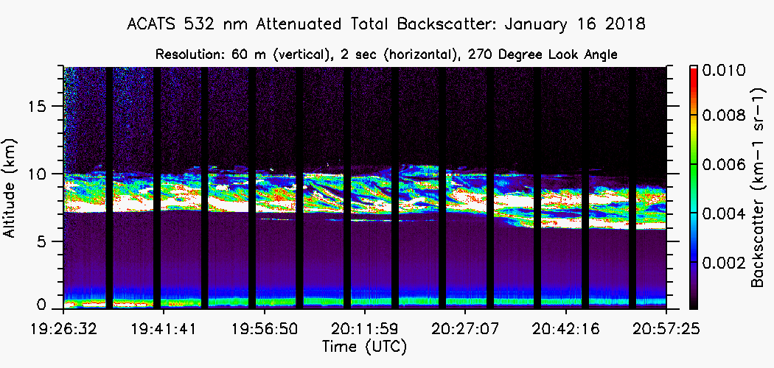
ACATS Wind Test Data
Laser reference spectra were retrieved at 6 minute intervals
Spectra created from 60 second integration period
Future testing will be done to optimize these specs
Notes:
This slide my be taken out. Information can be given on previous slide for time sake

Slide 11
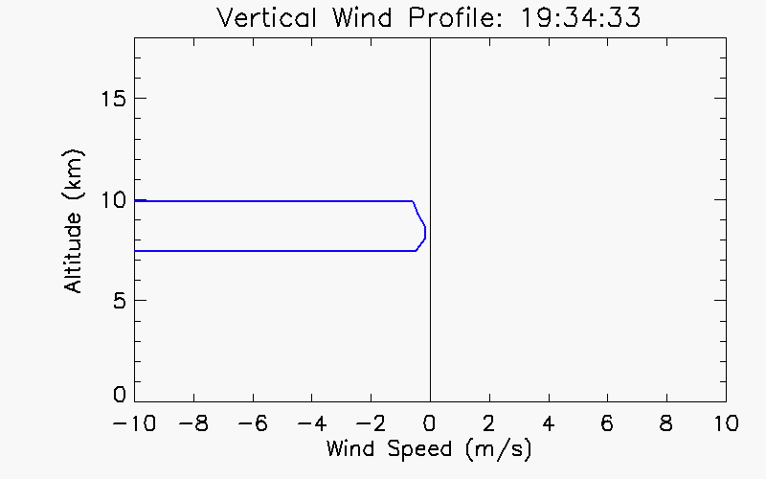
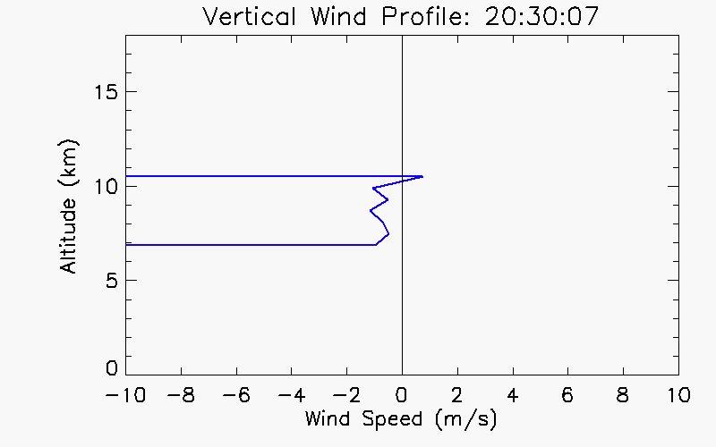
ACATS Vertical Wind Profiles
Vertical Resolution: 0.6 km Horizontal Resolution: 25 seconds (5 km airborne)
Notes:
Emphasis on limited to pointing zenith, wind should be zero, here’s our test
Looking into layer only, ignoring overlap region from the ground (not problem plane) emphasis again ACATS is optimized for aerosol layer only
19:34:33 Mean = -0.37 m/s
20:30:07 Mean = -0.58 m/s

Slide 12
Future Work & Conclusion
No dedicated funding source for ACATS
Is wind lidar work going on at GSFC
Still undergoing algorithm updates and testing
Improve wind retrievals
Improve HSRL products
Next planned flights Summer 2018 out of Palmdale, CA
Piggyback (like all previous flights)
Test updated etalon calibration and horizontal wind retrievals from airborne environment
Further plans
Science tool in future field campaigns
Potential cal/val instrument
Stepping stone to future space missions
Notes:
What if we had money?
-Could buy flight hours, dedicated personal, build new receiver and/or etalon for Rayleigh, etc. Could do lots with dedicated funding

Slide 13
Back Up

Slide 14
Back Up
A Fabry-Perot interferometer is used to
resolve the spectral signature.
Wavelength is a function of radius
in the image plane.
The challenge is to efficiently measure
the annular image.
normalized intensity
14
radial displacement

Slide 15
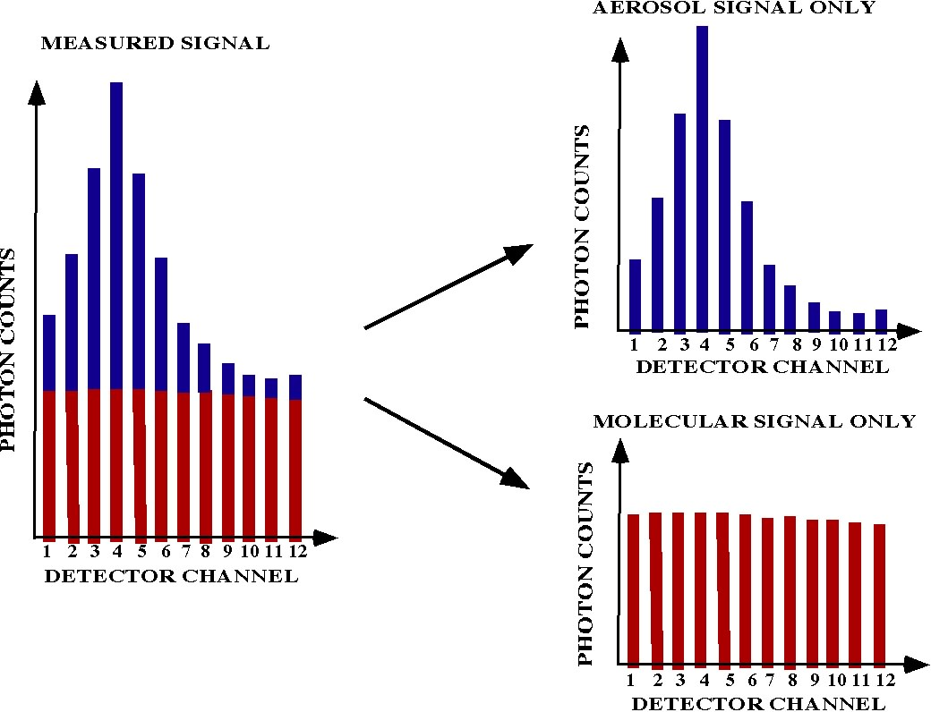
Back Up
Use of a Fabry-Perot interferometer results in different system response for the aerosol and molecular components of the total signal. In fact, the molecular return is imaged as a nearly flat spectrum that can be subtracted from the total signal.

Slide 16
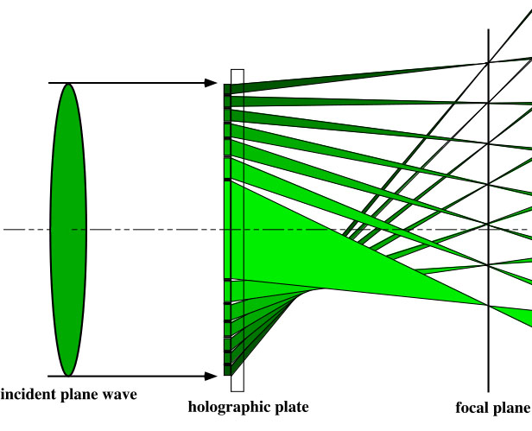
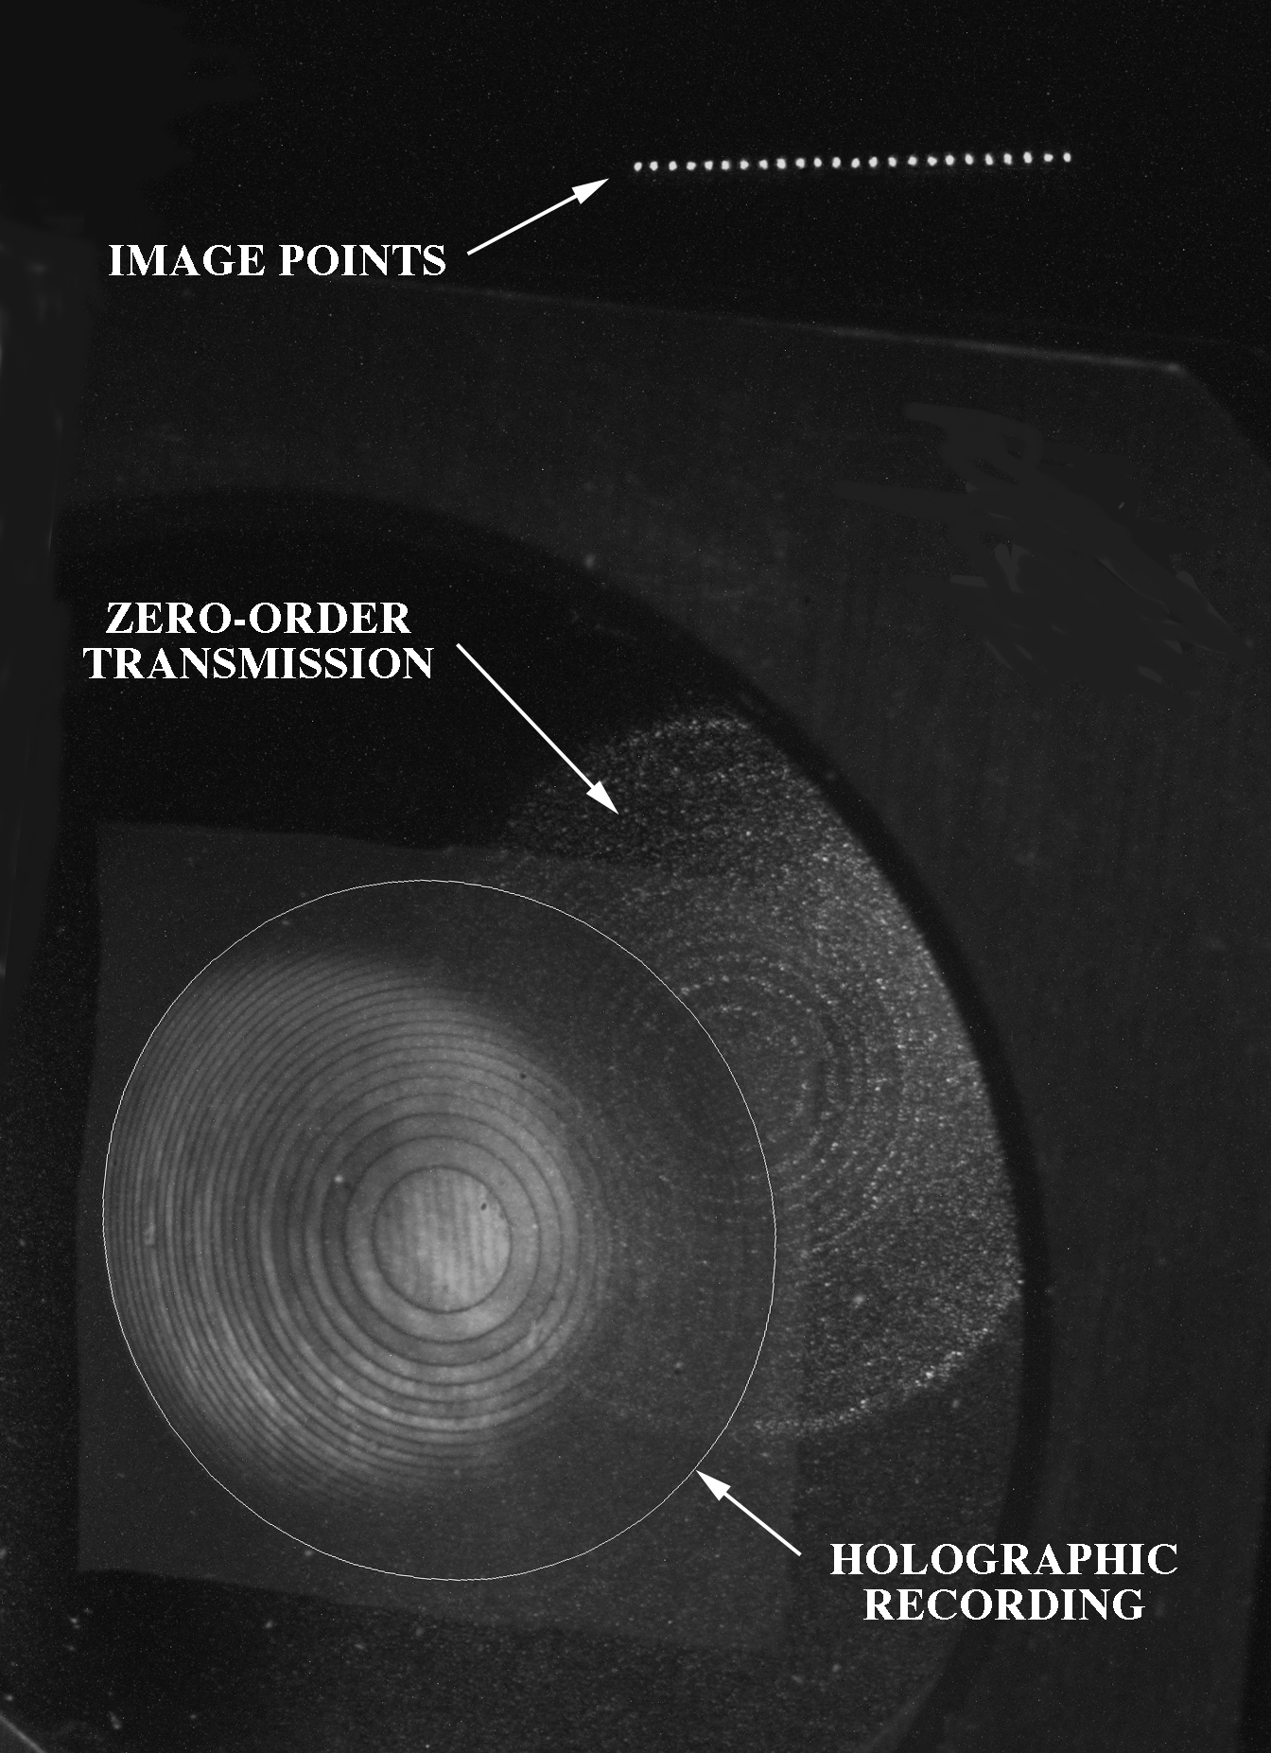
Back Up
Our solution: use a custom holographic optical element with a linear array detector to measure the fringe pattern.
U.S. Patent #631908

Slide 17
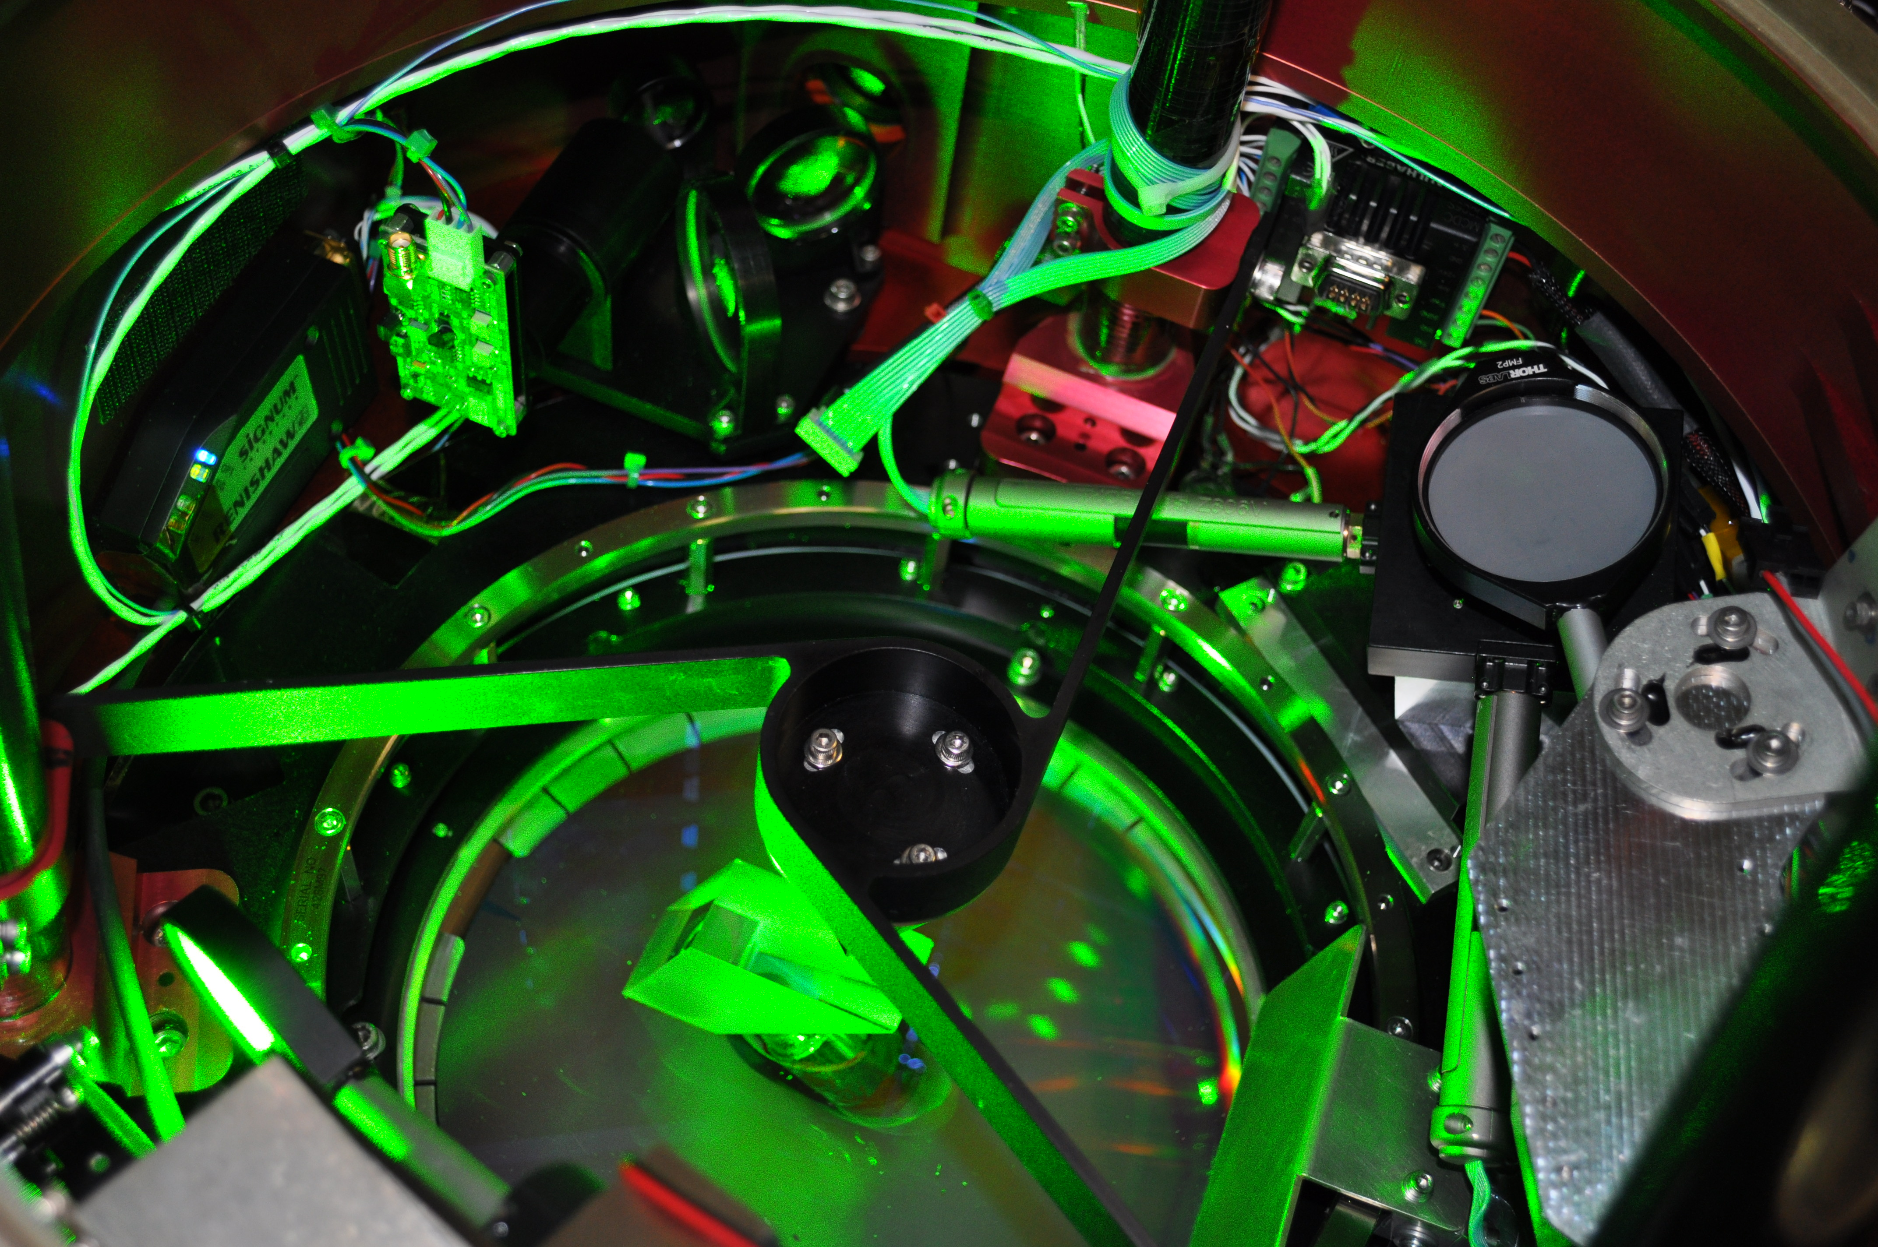
Back Up
Filter over
fiber head
Delrin
Mounted servos

Slide 18
Back Up
laser type | Nd:YAG, seeded
operating wavelength | 532 nm
laser repetition rate | 200 Hz
laser output energy | ≤ 10 mJ/pulse
laser beam divergence | 100 μrad, full angle
telescope diameter | 8 inches
viewing angle | 45 degrees
telescope field of view | 300 μrad, full angle
bandpass filter | 150 pm FWHH
etalon spacing | 10 cm
etalon reflectivity | 85%
orders imaged | 1.2
detector channels | 24
measurement dynamic range | 480 m/s (L-O-S)
platform altitude | ~ 20 km (65,000 ft)
platform speed | ~ 200 m/s
wind error | 2 m/s (L-O-S)
aerosol extinction error | 0.025 km-1
vertical resolution (wind) | 0.5 – 1.0 km
vertical resolution (aerosol ext.) | 300-600 m
horizontal resolution (wind) | 25 seconds (~ 5 km)
horizontal resolution (aerosol ext) | 25 seconds (~ 5 km)

Slide 19
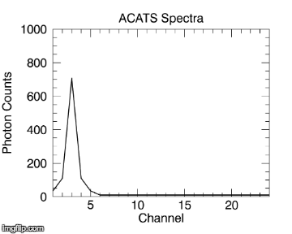
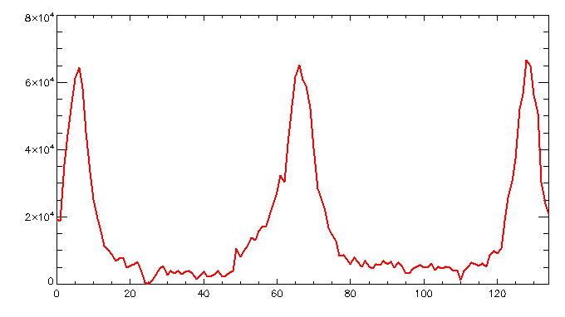
Etalon Scan
During calibration ACATS software changes the etalon plate spacing in short steps (pm), which moves the fringe pattern (peak) across all 24 channels (etalon scan)
Each channel’s response during scan is measured
ACATS Spectrum During Scan
Measured Response Channel 1
Photon Counts
Scan Step
Notes:
Calibration also known as an etalon scan

Slide 20
Etalon Transmission Fit
Etalon transmission function and transmission parameter
Iterative least squares fitting technique is applied in post processing to determine what calibration value (defect value) yields the best fit
Notes:
-Here we have the transmission function for an etalon which is a function of its plate spacing, # channels, wavelength, and defect
-Defect starts at 0 and increased by intervals of 1 to determine what value yields best fit

Slide 21
ACATS Lidar Equation

Slide 22
ACATS Least Squares Retrieval
Re-write the equation in matrix form:
Same equation can be written more generally as:
Use weighted least-squares fit to find solutions for 3 parameters
W is weighting matrix
G is generalized matrix to be inverted

Slide 23
ACATS Algorithms: Wind
Wind products
Laser tilted 45º to measure LOS component of wind
Use scanning scheme, assuming that the wind field over the sensed volume is horizontally homogeneous
Flight software directs ACATS to stop and stare at four look angle positions (azimuth aircraft-relative angles):
2 orthogonal LOS measurements are corrected for aircraft motion and used to compute horizontal wind (Lee et al. 1994; Leon and Vali 1998)
0º (fore)
Rotates Counter-Clockwise
270º (left)
90º (right)
180º (aft)

Slide 25
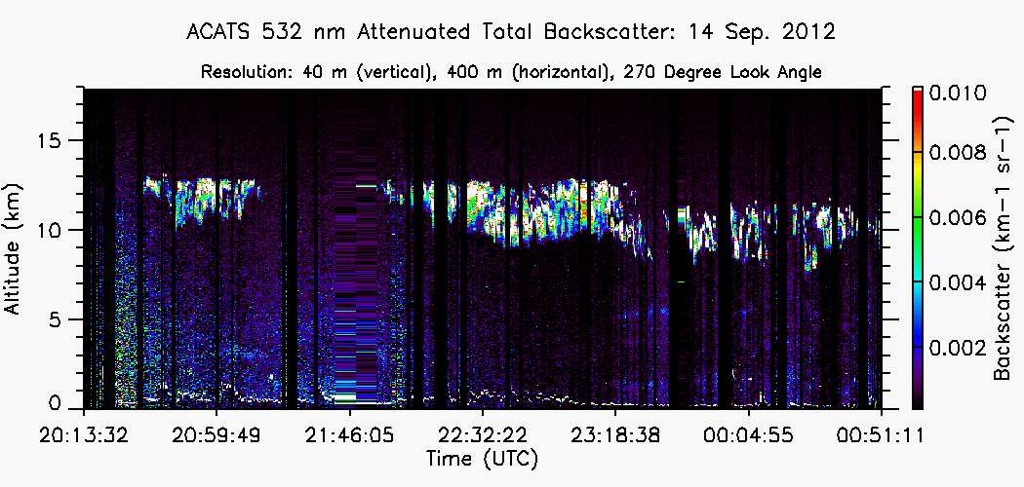
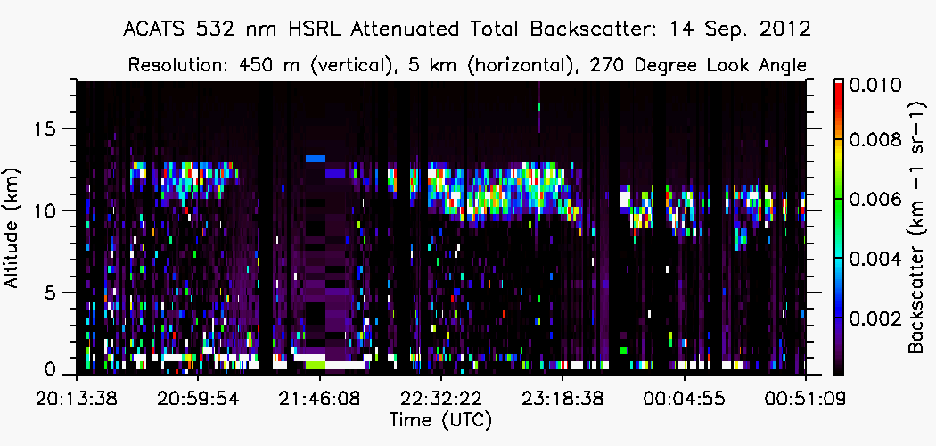
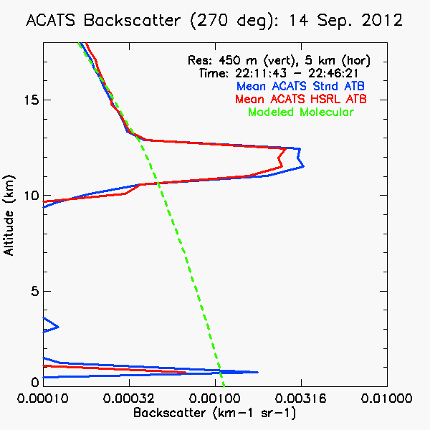
Initial HSRL Results
Standard vs HSRL:
Agreement within 10% for ATB computed using HSRL method (red) and ATB using standard lidar technique (blue)
17

