Slide 1
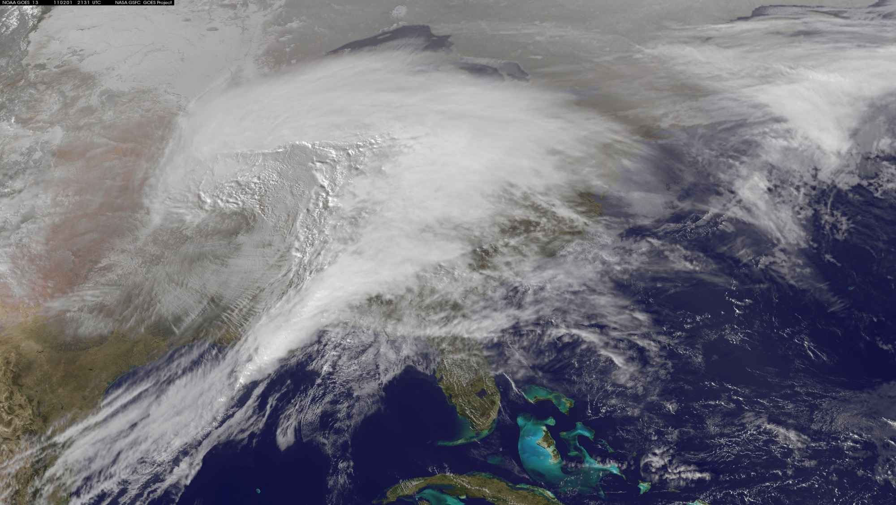
Simulating 3D Atmospheric Motion Vectors (AMVs) using Water Vapor Feature Tracking
Derek J. Posselt¹
Hui Su¹, Longtao Wu¹, Lei Huang², Hai Nguyen¹, Chris Velden³, Dave Santek³
¹Jet Propulsion Laboratory, California Institute of Technology, Pasadena, CA ²University of California, Los Angeles, CA ²CIMSS/University of Wisconsin, Madison, WI

Slide 2
Atmospheric Winds: Systems Approach
Emerging consensus that a systems approach is needed for space based observation of atmospheric winds
Lidar: high accuracy, limited sampling in space and time
AMVs (or other approaches): lower accuracy, broader coverage, possibility of relatively rapid revisit
Key questions:
What are the relative strengths / drawbacks of AMVs as a component of a global 3D winds observing system?
What is the most effective synergy among various measurement techniques and sampling strategies?
Notes:
Measurements of 3D winds have been called out as important for 10+ years. Much of the focus has been on Doppler wind lidar, and we anticipate this will be a key component in a future winds mission. However, lidar has spatial and temporal sampling issues (infrequent sampling, and limited swath). We are exploring the efficacy of lower-accuracy, but more frequent and spatially dense observations from feature-tracked water vapor and clouds.

Slide 3
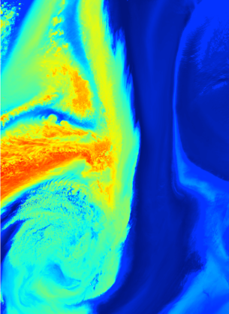
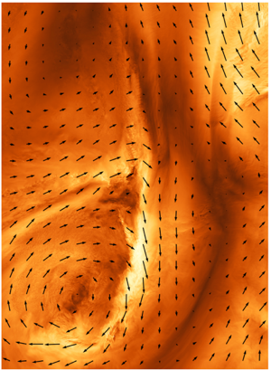
Atmospheric Motion Vectors
Use of image processing (and other) techniques to track atmospheric motion from sequences of images
Heritage in tracking clouds and water vapor
Known to be uncertain, and to contain ambiguities (more on this in a minute)
Motivation to systematically explore the potential efficacy of AMVs, and quantify their uncertainties
More effective use in DA/OSSEs
Evaluation of various AMV measurement concepts
Potential synergy with other wind measurements
Model Water Vapor
Model Wind Speed and Direction

Slide 4
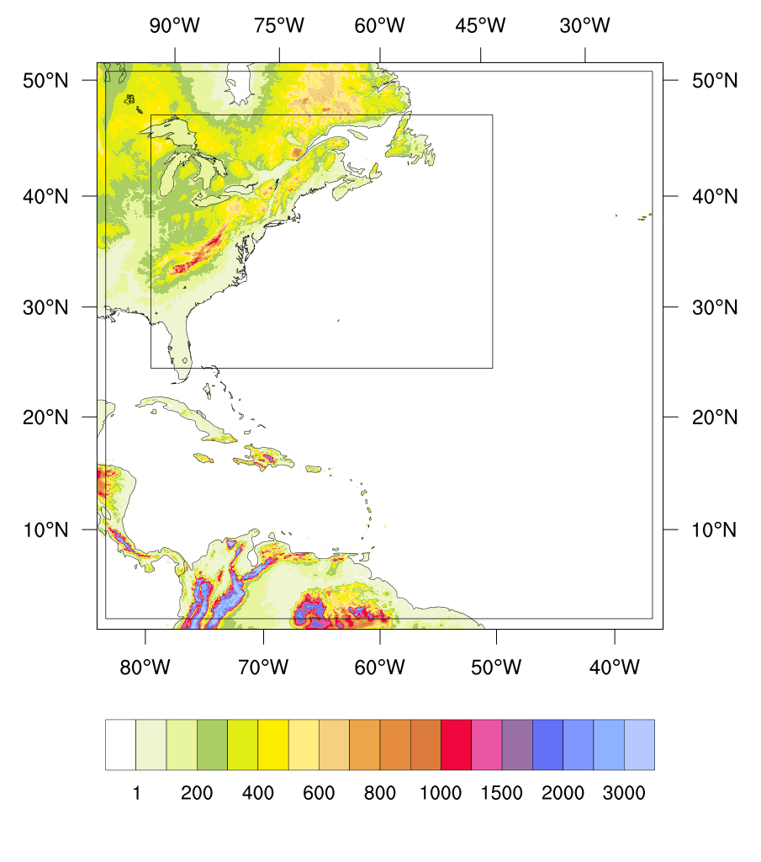
AMV Retrieval Uncertainty Analysis (“Pre-OSSE” - Atlas and Emmitt)
Produce a high resolution simulation of a representative case (nature run): known water vapor and wind – “truth”
Retrieve atmospheric motion vectors from this nature run
Vary assumptions used in the tracking methodology
Modify the instrument sampling properties (spatial and temporal)
Compare retrieved with true winds
Quantify uncertainties by comparing AMVs to the “true” winds
Compute RMSE and the state dependence of errors – where/when are AMVs expected to perform reasonably well / poorly?
Explore the effect of coarse spatial (horizontal and/or vertical) resolution
(Ultimately) use functional uncertainties in forecast OSSEs through collaboration with GMAO and NOAA QOSAP
Model Water Vapor
Model Wind Speed and Direction
Domain configuration for WRF
Nature Run 21-25 Nov 2006
Notes:
We are using a high-resolution simulation of an observed event to examine error characteristics of passive feature-tracked winds.
The figure shows three domains from a WRF simulation of an extratropical cyclone that occurred 21 – 25 Nov 2006. The model details are:
3 nested domains at 20/4/1.33 km (3591 km x 2660 km D03)
75 levels with model top at 50 hPa
Output every 5 minutes on D03 from 00 UTC 22 Nov 2006 to 06 UTC 23 Nov 2006 for 30 hours, ~14 TB/run
Vary initial/boundary conditions, microphysics, boundary layer scheme, initialization time to produce a 10-member ensemble

Slide 5
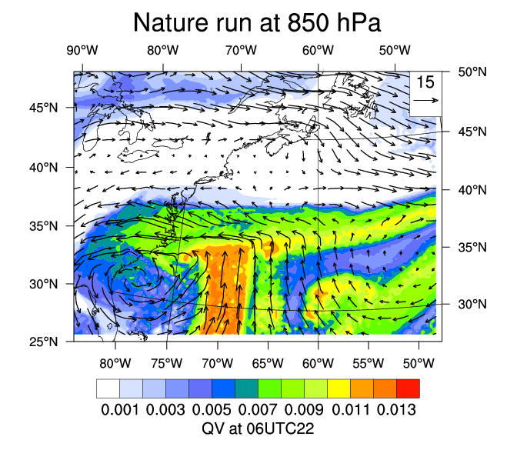
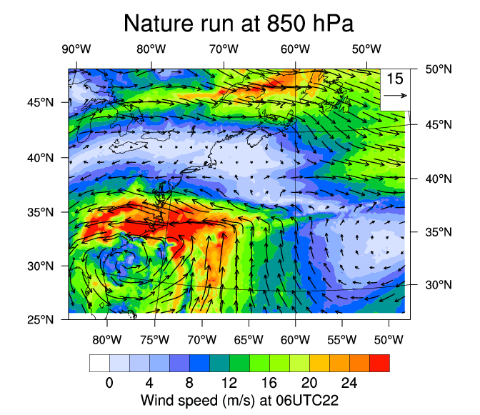
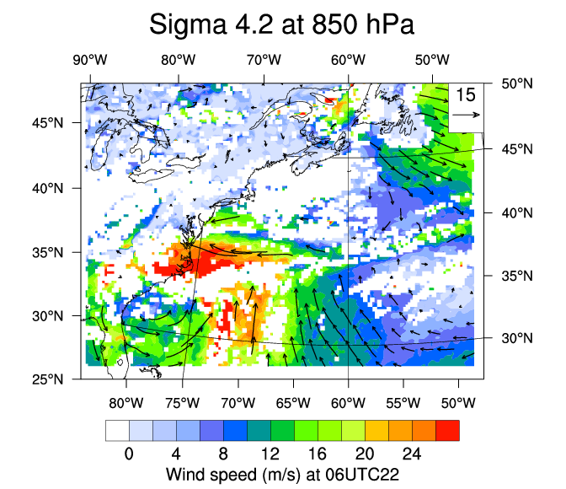
Initial Results: 5-Minute dt, 1.33 km dx,dy
Water Vapor (kg/kg)
“True” Winds (m/s)
AMVs (m/s)
Tracking algorithm recovers the approximate distribution of winds in the cyclone
There are obvious gaps (low water vapor content)
Explore sensitivity to tracking algorithm settings, time interval, and field of view

Slide 6
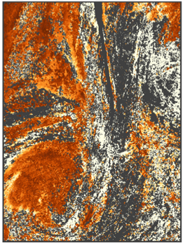
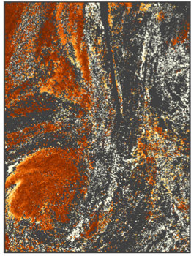
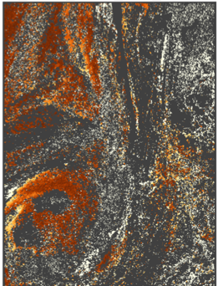
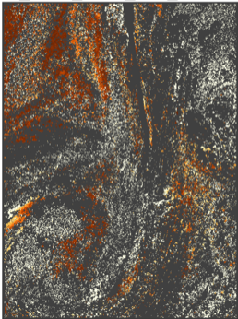
Sensitivity to Sampling Interval
Retrieval coverage sensitivity to sampling intervals
Vector difference (m/s)
5 minute delta
10 minute delta
15 minute delta
20 minute delta
No cloud mask, vapor and winds are noise-free and at model resolution
Brighter colors = larger retrieval errors
Gray areas indicate regions without retrieved wind (algorithm failure)
Trade between coverage (rapid revisit) and accuracy (longer revisit intervals)
Notes:
Observe how the ”brightness” of the image (error) decreases with increasing interval, while the sampling density becomes increasingly sparse.
A key design consideration is sampling frequency. With longer intervals between observations, errors are generally smaller, but coverage is worse.

Slide 7
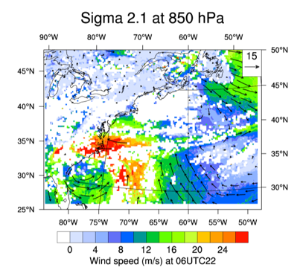
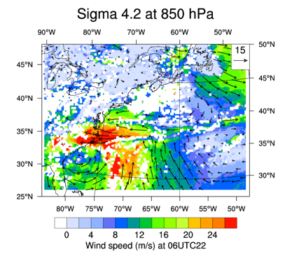
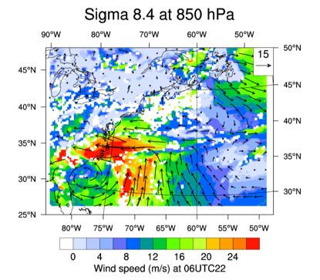
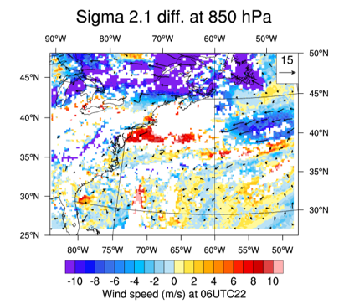
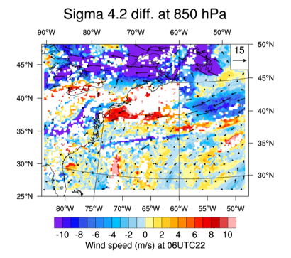
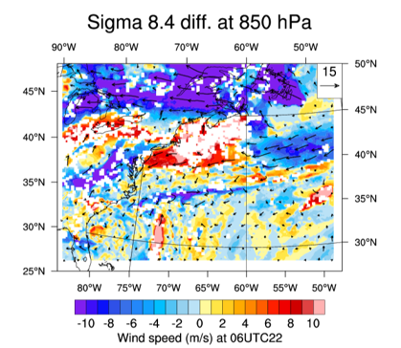
Sensitivity to Field of View
15 km x 15 km FOV
30 km x 30 km FOV
60 km x 60 km FOV
Tracking over smaller FOV:
Higher accuracy
Smaller coverage
15 km x 15 km FOV
30 km x 30 km FOV
60 km x 60 km FOV

Slide 8
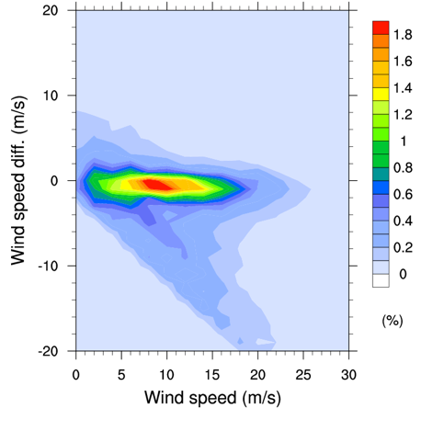
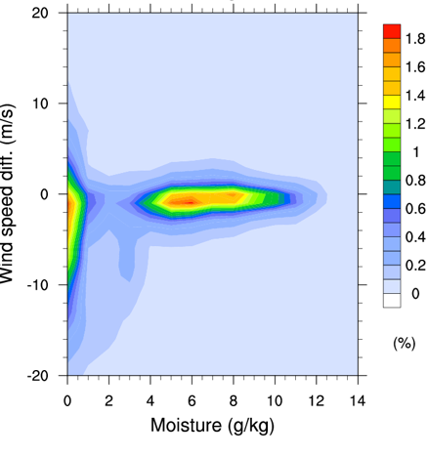
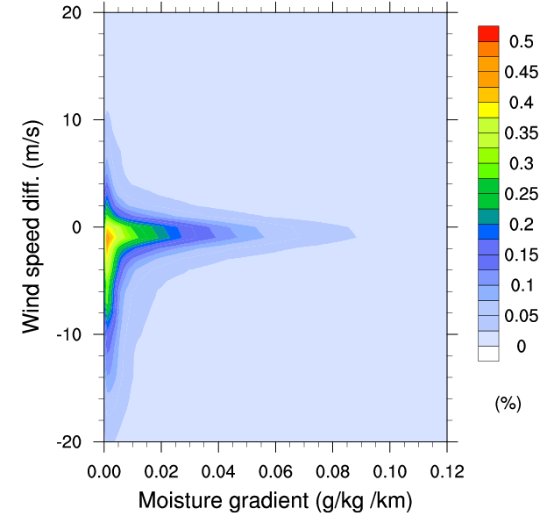
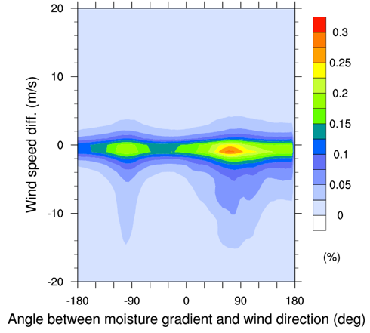
State Dependent AMV Errors
Retrieval errors are generally within ±2 m/s.
Large errors occur when moisture content is low or wind direction is perpendicular to moisture gradient.
Angle Between Wind Direction & Vapor Gradient
Wind Speed
Vapor Content
Vapor Gradient
Y-axis: Difference between retrieved AMV wind speed and nature run.
Notes:
These plots show the wind speed error, as measured by the difference between winds in the nature run, and retrieved winds, as a function of (from left to right): wind speed, water vapor content, water vapor gradient, and angle between vapor gradient and (true) wind.
The results show that there is a low bias in the retrieved winds, reflecting the inability to retrieve winds where the gradient is weak or perpendicular to the flow. Errors are largest at low water vapor contents, small gradients, and for flows perpendicular to water vapor gradient.

Slide 9
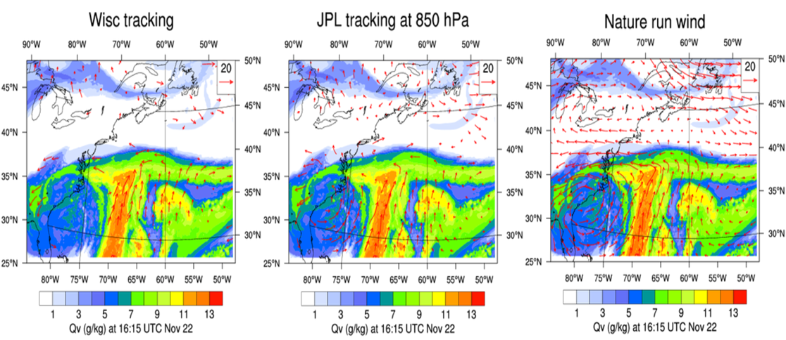
Comparing Feature-Tracking Algorithms
Operational GOES-R AMV algorithm has more stringent quality control, resulting in smaller RMS error but less coverage of AMV winds.
No
retrieval
U. Wisconsin algorithm: operational GOES-R AMV feature-tracking algorithm
JPL algorithm: simplified MISR CMV feature-tracking algorithm

Slide 10
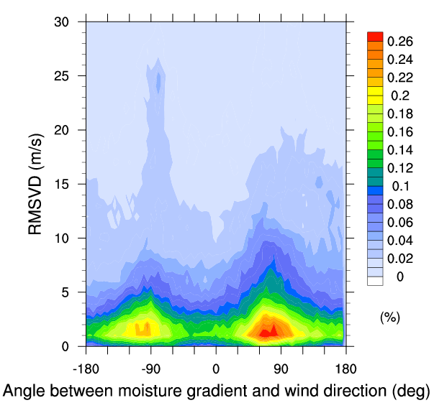
Wind Retrieval Uncertainty: Outcomes
Quantified accuracy of AMVs: most vectors have uncertainties < 2 m/s, however…
State dependence: error is large where
Water vapor content is small
Wind vectors are oriented along vapor contours
Algorithm sensitivity: trade-off between accuracy and coverage
Rapid sampling: large coverage, low accuracy
Large FOV: smaller coverage, higher accuracy
Notes:
We are now in a position to expand our experiments to explore various possible mission configurations. As we do, we are working to exploit parallel computing architectures and machine learning techniques to rapidly and efficiently assess a large spectrum of possible designs.

Slide 11
AMV Retrieval Uncertainty: Next Steps
Caveats:
Did not account for clouds/precipitation
Tracked full resolution water vapor fields
Used a relatively simple feature tracking algorithm
Did not apply any image enhancement
Next steps:
Mask clouds and/or precipitation – assess yield and uncertainty
Smooth fields consistent with IR and MW sounders
Employ more sophisticated image tracking techniques (e.g., optical flow)
Extend analysis to other regions and times
Use state-dependent error characteristics in forecast OSSEs
Utilize machine learning to estimate uncertainties from static fields – expand utility of error analysis to a much larger suite of nature runs
©2017. All rights reserved. A portion of this research was carried out at the Jet Propulsion Laboratory, California Institute of Technology, under a contract with the National Aeronautics and Space Administration.
Optimal Observing System
Sub-Optimal Algorithm

