Slide 1
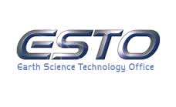
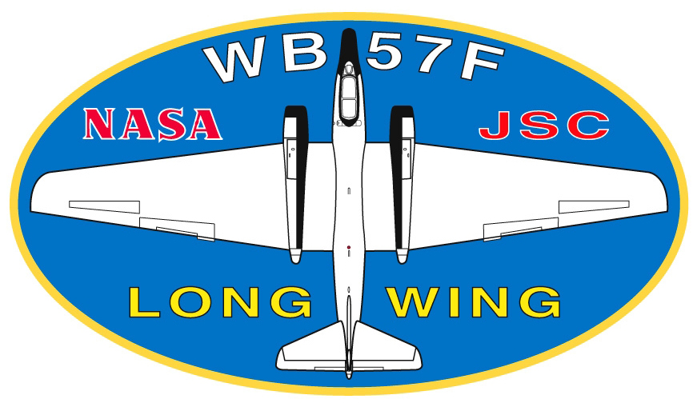
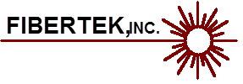
An OAWL Overview: The ATHENA airborne demonstrator-GrOAWL, HAWC-OAWL for the DC-8, and new technology developments for space-based operation
Sara C. Tucker, Carl Weimer, and the Ball OAWL teams
Ball Aerospace and Technologies Corp
Sunil Baidar, Mike Hardesty
University of Colorado, CIRES and NOAA/ESRL

Slide 2
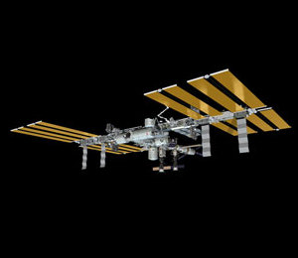
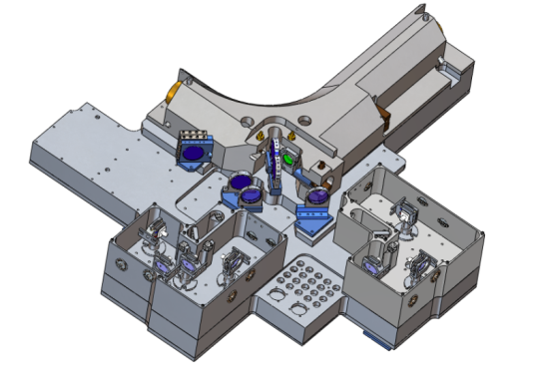
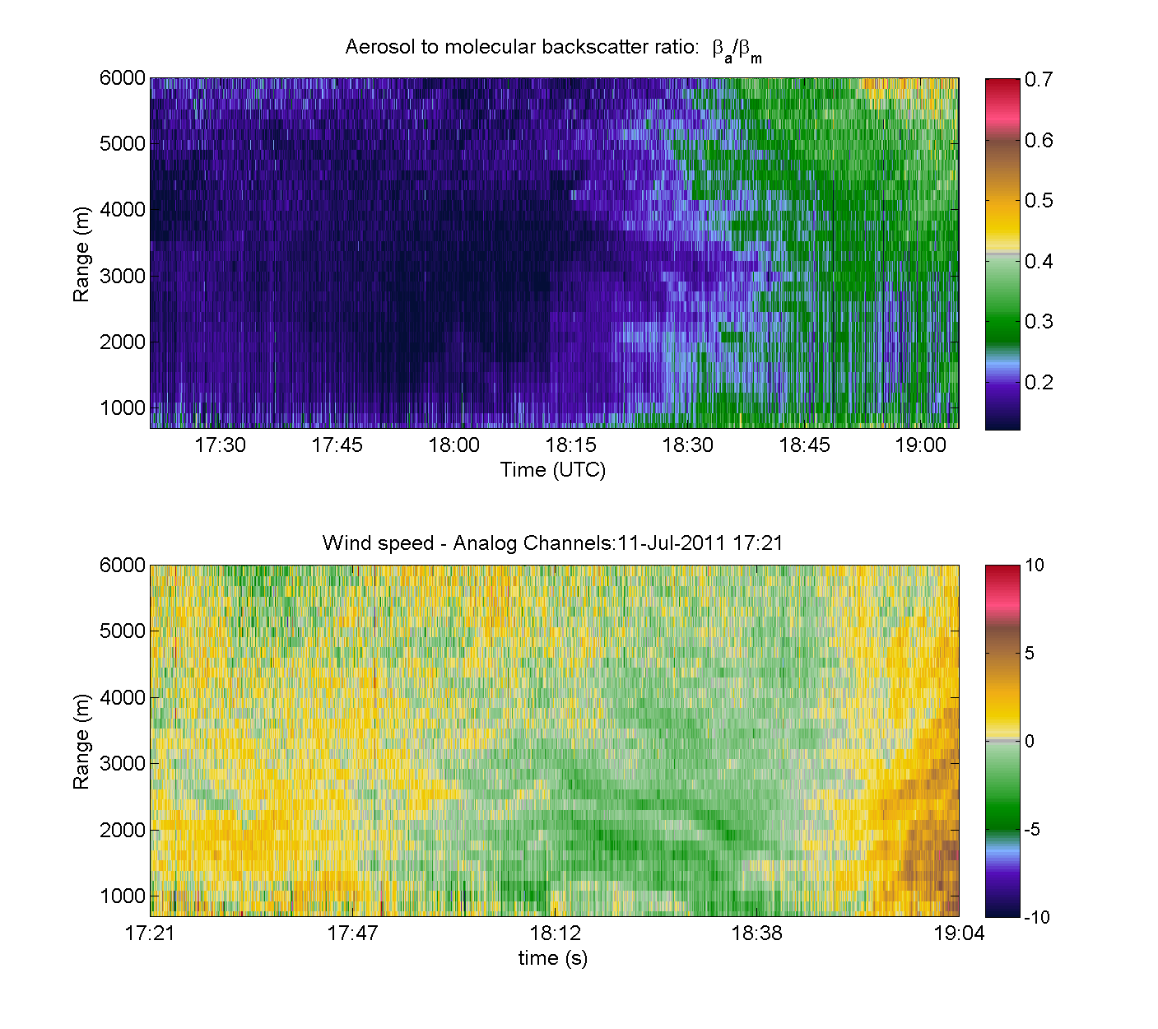
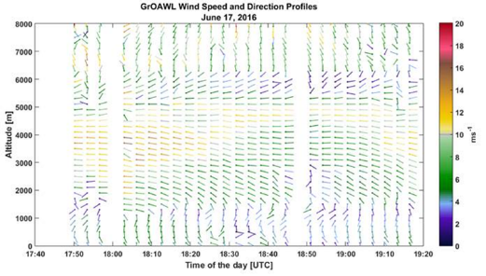
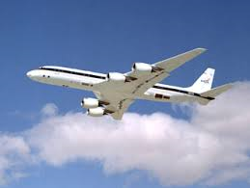
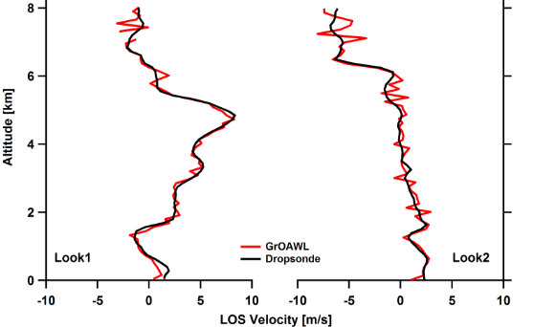
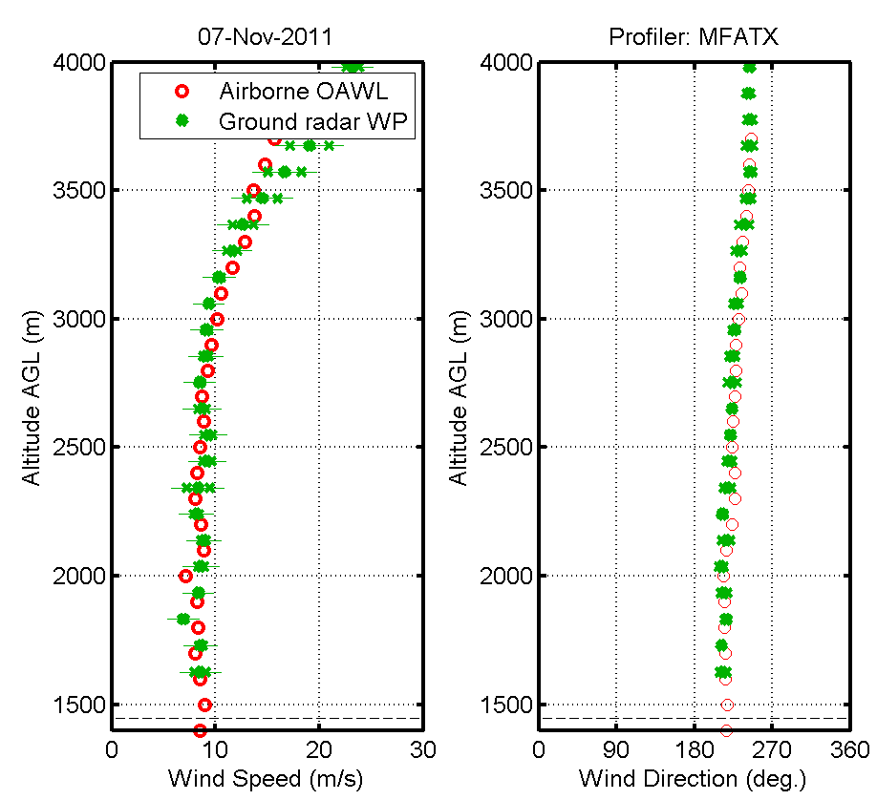
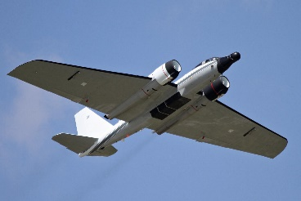
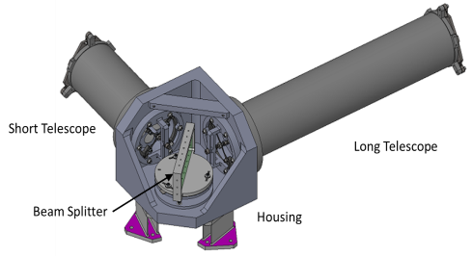
The Evolution of OAWL
Since 2003, Ball has worked in a public-private partnership with NASA and weather/wind lidar communities to advance space-based wind lidar technology and fill the global wind measurement gap.
2013 & 2016 ATHENA-OAWL Mission Proposals
1999-present: Ball design, build and test of OAWL receivers, mission concepts and retrieval/processing algorithms
aerosols
winds
Altitude MSL (m)
Altitude MSL (m)
2008-2012: OAWL IIP-07
Breadboard system
355 nm only, 4x channels
Single look 12” telescope
Ground validation with NOAA Coherent system
Autonomous flight tests on NASA WB-57
2012-2015: HOAWL ACT
Breadboard System
Demonstrate 532 nm wavelength channels & depolarization channels
Total 10 channels
HSRL Aerosol retrieval algorithms
2015-2017: ATHENA-OAWL Venture-Tech: GrOAWL
Airborne demonstrator System (WB-57)
2-lasers = 400 Hz eff. PRF
4x 532 nm channels
2 looks, 2 telescopes to demonstrate geometry
2014-2017: HAWC-OAWL IIP
Two look airborne system (build on GrOAWL)
Dual Wavelength + depol. Channels
Athermal interferometer build and demonstration
DC-8 hardware design/build

Slide 3
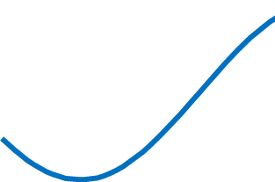
Optical Autocovariance Wind Lidar (OAWL)
Field-widened, Mach-Zehnder Interferometer (MZI): Patent #s: US7929215B1, US8077294B1
Four detector channels sample interferometer fringe phase (wind) and amplitude (aerosol). --- Outgoing “T0” pulses --- Atmospheric Returns at range
Fringes wrap – no “out of band” concerns. Unwrap 2π jumps (100 m/s discontinuities) in processing.
Platform motion translated to phase, added to T0 phase offset and “wrapped”
T0 phase offset used to adjust detector returns for every pulse - prior to accumulation/phase fit: no laser pulse-to-pulse stability requirements
After accumulation, the shifted detector values are fit to determine the return phase, Δϕ, related to the line-of-sight wind speed, V_{LOS} by
QWP
d1
d2
d3
d4
0° 90° 180° 270°
Detectors at constant ACF phase

Slide 4
ATHENA-OAWL Venture Tech Green-OAWL (GrOAWL)

Slide 5
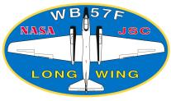
ATHENA-OAWL Venture Tech: Built and flew the Green-OAWL Airborne Demonstrator
2013 ATHENA-OAWL EVI-2 → Earth Venture Technology Development funding from NASA ESSP
ATHENA-OAWL Venture Tech (AOVT) awarded in 2015 to build Green-OAWL (GrOAWL)
2 year AOVT Accomplishments:
Built a two-look, two laser , 532 nm wavelength, airborne aerosol DWL system.
High TRL electronics, control, and real-time processing
Performed autonomous airborne flight testing to demonstrate the two-look 532 nm measurement
Assessed flight measurement performance: precision and accuracy using dropsondes
Demonstrated the two look concept for space-based platforms
Scaled system performance to space, (like A2D for Aeolus)
Raised OAWL TRL for EV-I 2016 proposal

Slide 6
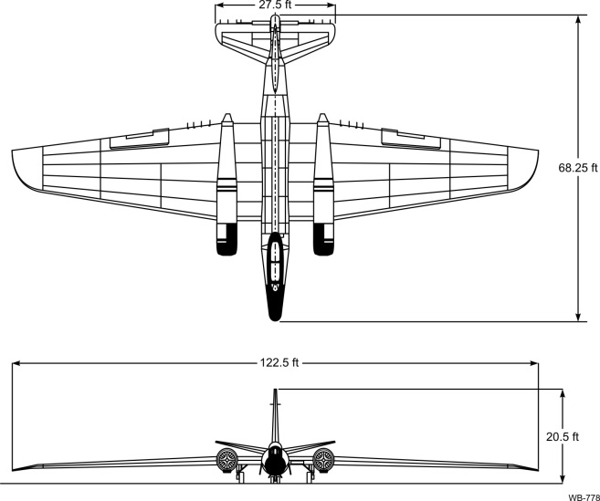
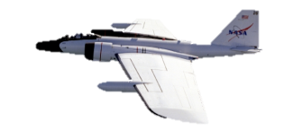
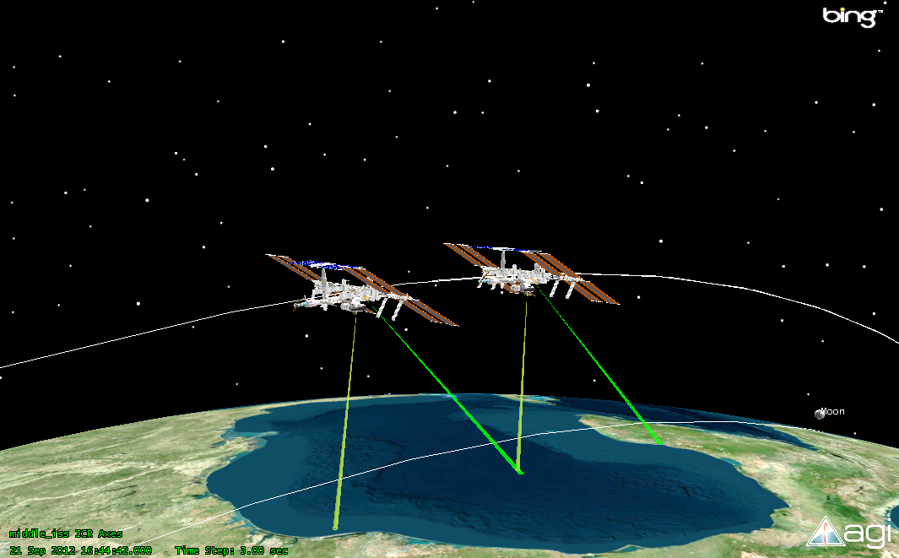
Two-look system geometry – for airborne and space
Head-on view
Top view
Az=45°
Side view
starboard
El=45°
Az=135°
ISS orbit
RAM direction
ISS Ground
Track

Slide 7
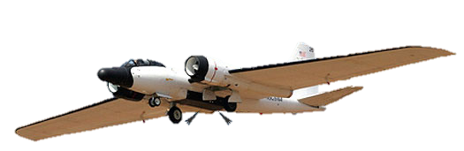
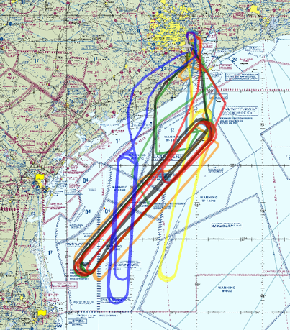
GrOAWL Airborne Flight Testing
Flights on NASA WB-57 Jet, out of Ellington Field (Johnson Space Center)
System operated remotely from ground (INMARSAT) or by SEO (backseater) for laser operations
8 flights, ~38 flight hours, ~22 hours lasing, 3 flights with sondes
Flew racetrack patterns over warning areas in the Gulf of Mexico (revisit, dropsondes, flight pattern changes)
1 hr revisit times
Real-time flight pattern changes
Dropping the sondes for winds validation
NASA WB-57 jet

Slide 8
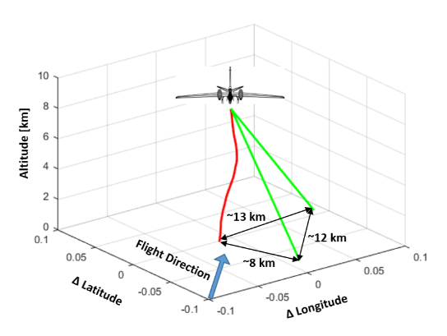
Simultaneous two-look LOS wind speed profiles
Line of sight wind speed data:
<1.5 mJ/pulse (0.3 W) at 532 nm wavelength
Daytime operation with scattered clouds.
Clean atmosphere: very low aerosol backscatter
Two-separate looks measure orthogonal horizontal Doppler shifts (u and v winds)
Continuous coverage in each look, no switching, no gaps
Altitude (km)
Altitude (km)

Slide 9
HAWC-OAWL

Slide 10
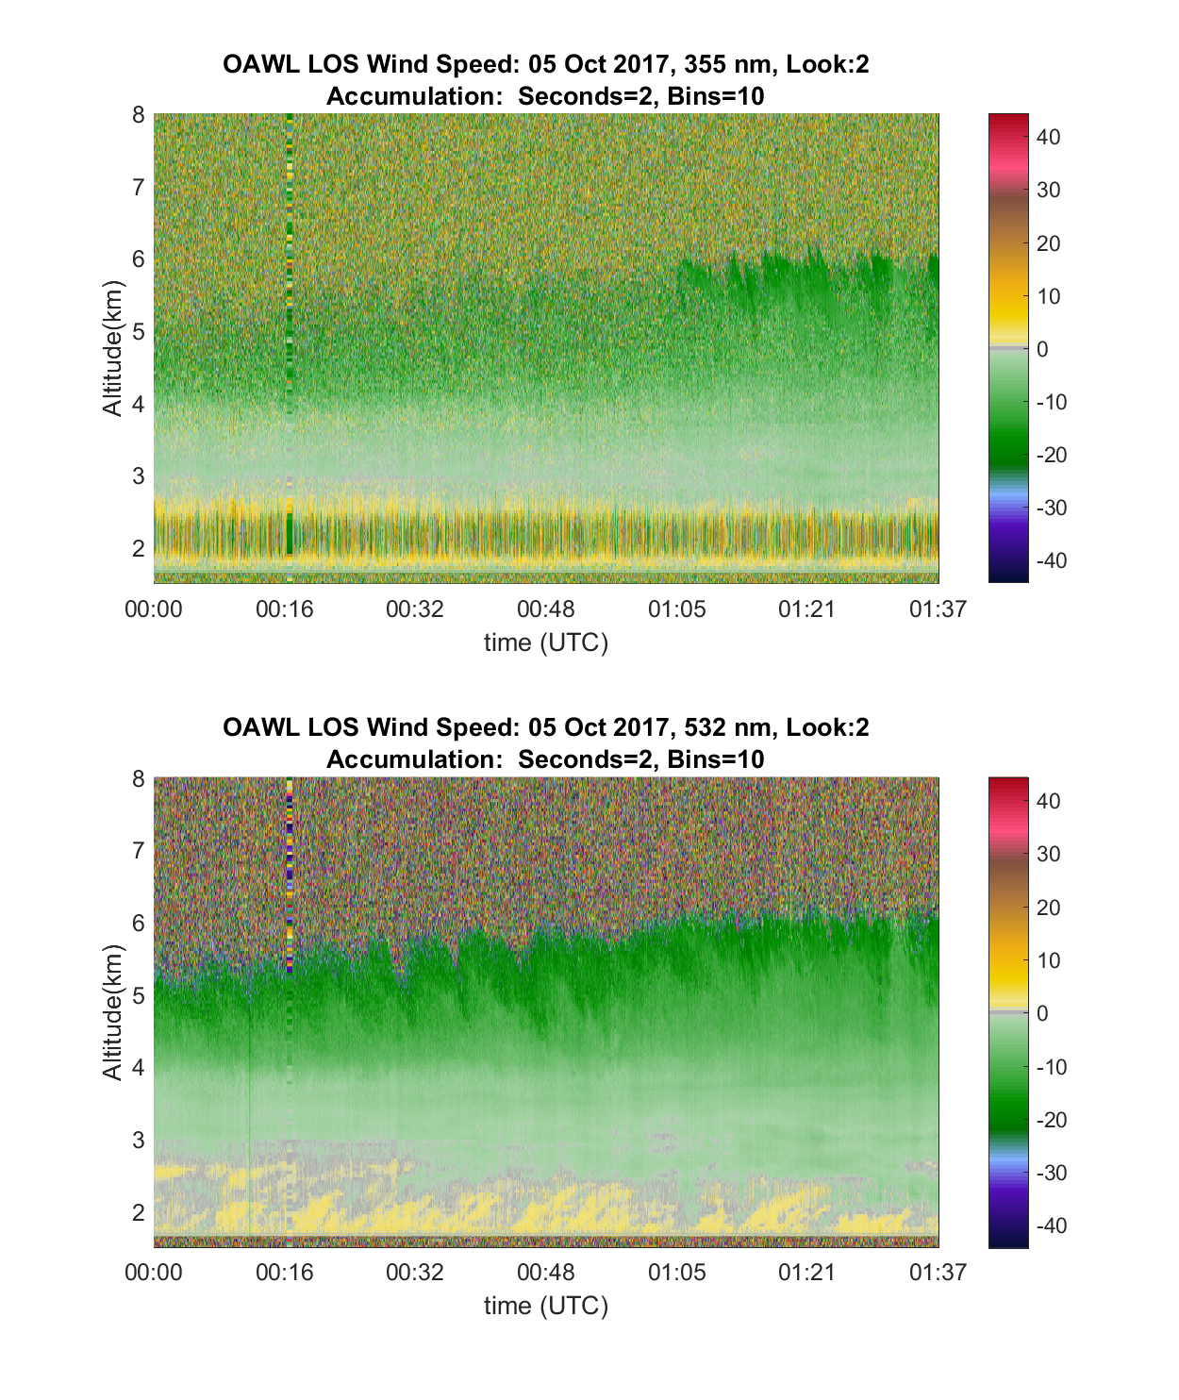
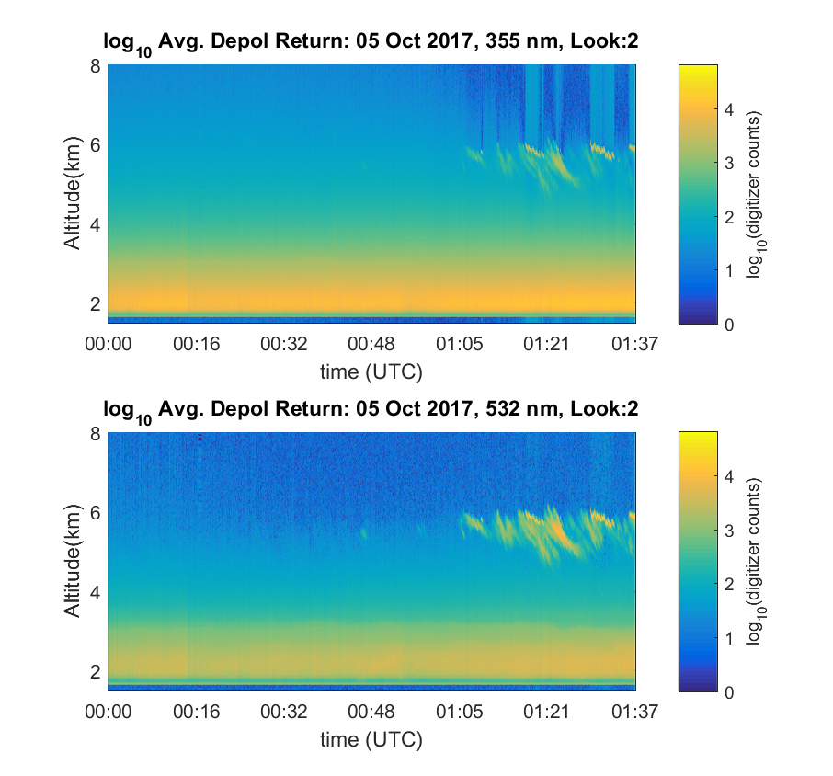
HAWC-OAWL
Dual wavelength Winds and dual wavelength depolarization measurements → Lead eventually to HSRL measurements
5 Oct 2017: 355 nm: 2 s, 86 m
5 Oct 2017: 532 nm: 2 s, 86 m

Slide 11
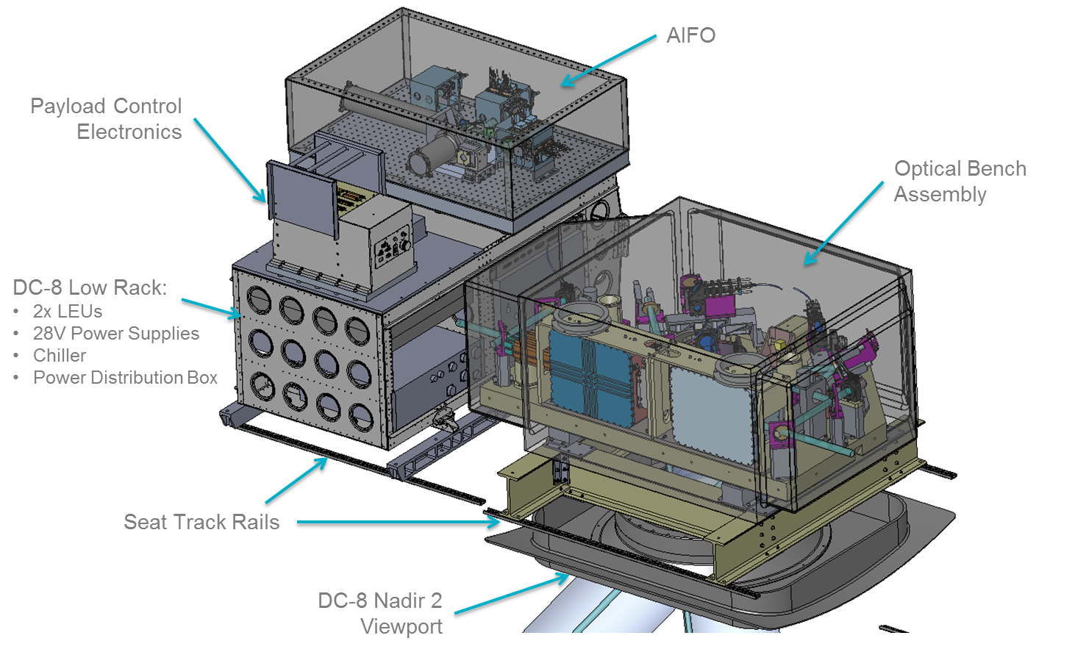
HAWC-OAWL is ready for the DC-8
Pre/post GrOAWL detectors
Dual wavelength interferometer winds + depolarization
Reconfiguration for DC-8
AITT funding not provided to non-NASA centers since 2009.
Other options to perform test flights??

Slide 12
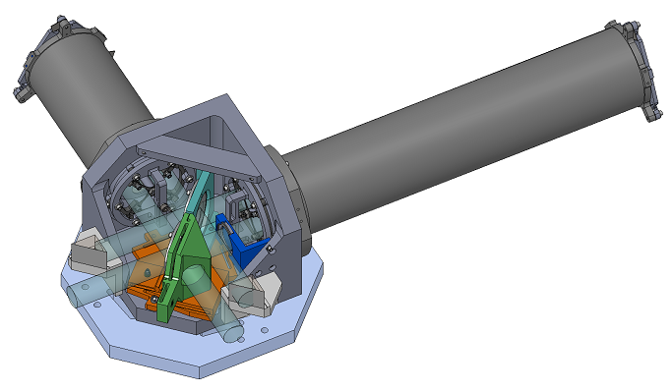
HAWC-OAWL Interferometer
Design Objectives:
Largely athermal design
Built to meet two objectives:
high contrast, high performance
ability to withstand aircraft vibration and thermal variations
sometimes these conflict
Field-widening to 10 mrad+ to handle large telescopes with 1-λ wavefront surface figure

Slide 13
Interferometer Testbed Nested-OAWL
Current IRADs

Slide 14
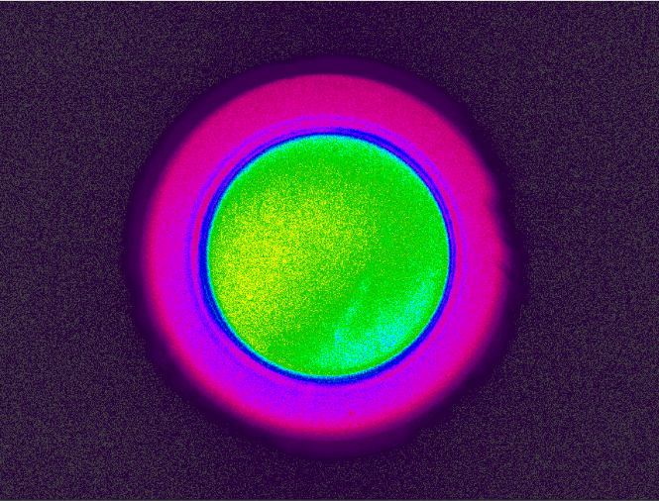
Interferometer Testbed IRADs (Ball Funding)
Completed Interferometer alignment
Tested at 532 nm and 355 nm
Excellent field widening & fringe contrast
More field widening allows for larger/less costly telescope
Extremely repeatable and stable
Next steps
Add’l interferometer characterization
Detector integration
Atmospheric testing (with full lidar)
Environmental tests (e.g. vibe, vacuum, thermal) to raise TRL
13 mrad
10 mrad
~91%
3.5 mrad
~96%
Fringe across field

Slide 15
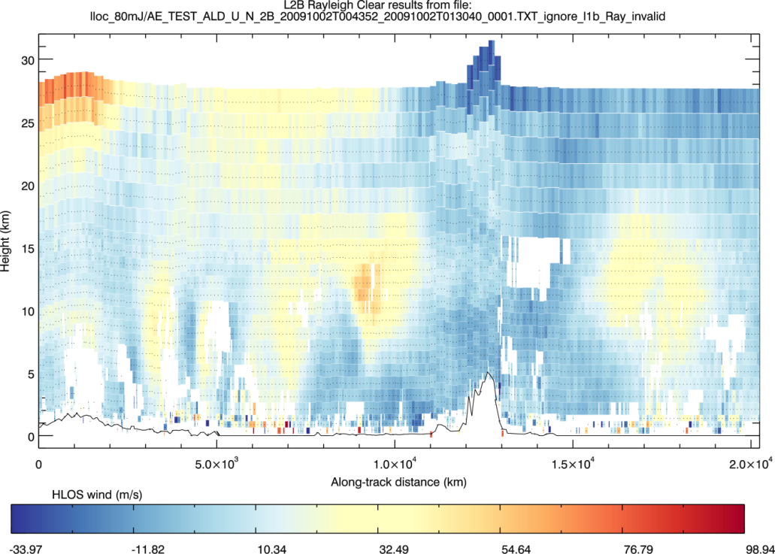
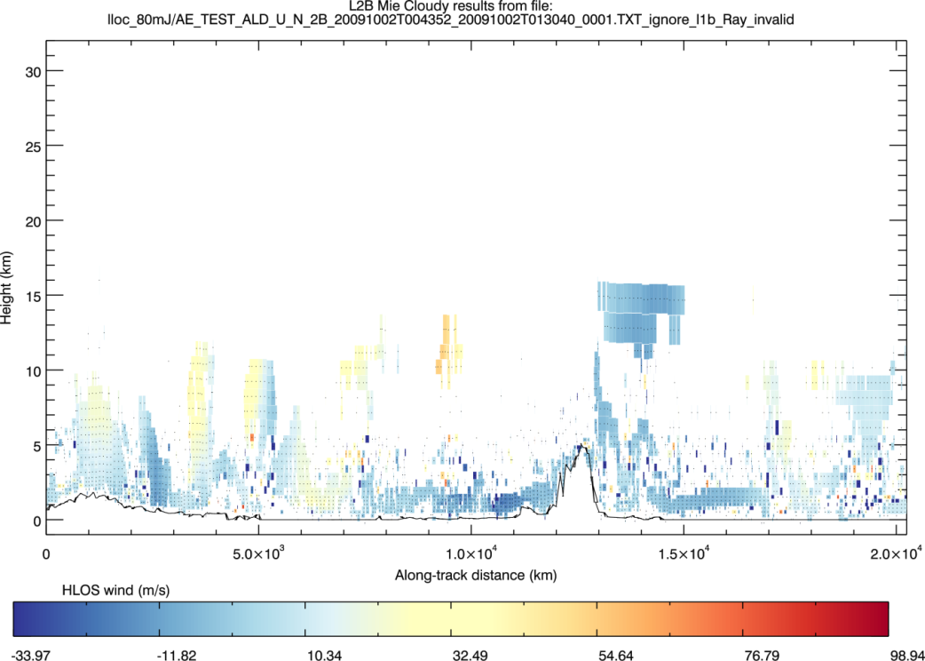
Full profiles with two looks
Aeolus simulated molecular
Upper atmosphere, molecular winds needed (full tropospheric coverage)
The Venture Tech effort
demonstrated OAWL aerosol winds at two wavelengths
validated the instrument model for predicting performance in space
A small change to the OAWL design offers winds from aerosol and molecular returns
Full-atmosphere achieved with a single, efficient OAWL receiver with less complexity/lower risk than “Hybrid” or Aeolus dual channel
Aeolus simulated aerosol

Slide 16
OAWL for Full Atmosphere Wind Profiling
OAWL path to full atmospheric wind profiles
Measure aerosol winds @ 532 nm – more precision using the existing long OPD
Measure molecular winds @ 355 nm – more coverage using a new short OPD
BOTH wind measurements can achieved by using two systems or a “nested” interferometer:
Short (molecular) OPD is “nested” inside the long (aerosol) OPD: “Nested OAWLs”
Same detectors as used for the dual wavelength OAWL
2018 IRAD for demonstration is underway
355 nm lasers:
Aeolus has qualified a 355 nm wavelength laser for space
Fibertek also working qualification of 355 nm HEUVD laser system
Upper atmosphere – molecular
Lower atmosphere – aerosol
1
0.9
0.8
0.7
0.6
Backscatter (a.u.)
0.5
0.4
0.3
0.2
0.1
-6
-4
-2
0
2
4
6
Offset center frequency (GHz)

Slide 17
Example of MZI with short OPD: Molecular returns
Mach Zehnder Interferometers (MZI) have more throughput than Double Edge
Additional comparison info available on request

Slide 18
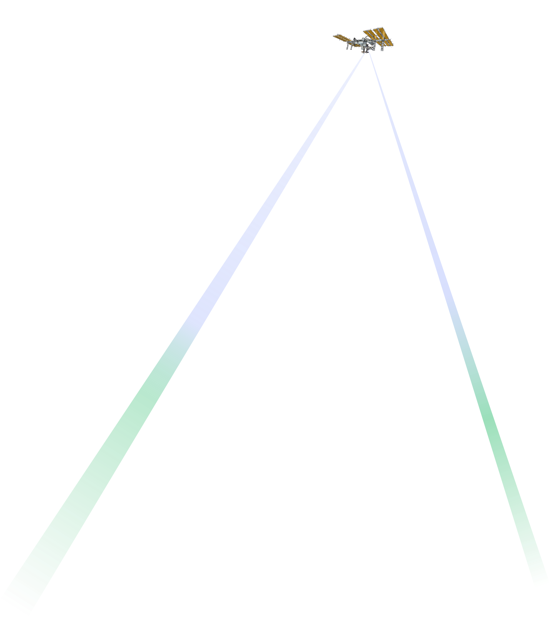
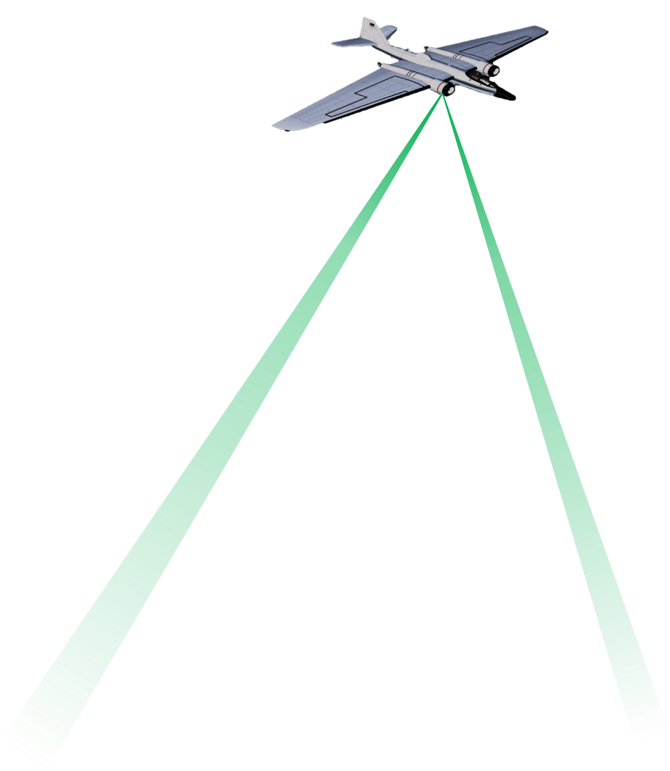
Wind lidar measurements from space: Aerosols, molecules, and scales
OAWL: path to full atmospheric wind profiles:
Two wavelengths (same laser) used to measure winds from both aerosols AND molecules
@ 532 nm – provides precision using aerosol returns
@ 355 nm – provides coverage using molecular returns
High altitudes: fewer aerosols & clouds, so UV wavelengths are used to measure winds using lidar returns from just molecules (e.g. ESA’s Aeolus mission, UV OAWL)
Aerosol-DWL’s (Green-OAWL, Coherent detection) provide good returns in lower troposphere and where aerosol layers or thin clouds are present
Airborne & ground DWLs are best for boundary layer studies at scales that would be smeared by space-based orbit speeds (~7.2 km/s)

Slide 19
Looking ahead

Slide 20
Space-Based OAWL Roadmap: Up to 2018
Future Science Mission Opportunities
Science Community Input
NASA ESTO & ESSP Engineering Demonstrations/Studies
Ball Technology Development & Intellectual Property
Earth Science Decadal Survey
Mission Definition Science Team
System Requirements
System Architecture
Athermal Interferometer
Pointing Requirements
Prototype interferometer
FPGA Real-time winds processing
Architecture Studies
Winds algorithm development
Radiometric modeling
Aeolus
Ball Investments inventing technologies
(2003+)
ATHENA-OAWL EV-I Concept
Earth Venture Mission (Science Demonstration, ISS)
Operational Winds Missions (NOAA, DoD, NASA, commercial)
OAWL IIP-07: First system – 355 nm
OSSE: 355 OAWL impact
GSFC IDL: Cost & tech. feasibility
HOAWL ACT: 2λ winds & HSRL algorithms
FIDDL ACT double Edge Lab demo
ATHENA-OAWL Venture-Tech (airborne)
Earth Science Decadal Survey Wind Lidar Mission
NASA ESTO Investments Ball technologies incorporated into demonstration systems (2008+)
HAWC-OAWL IIP
HEUVD (Fibertek)
Notes:
Ball has made investments to invent and develop the technologies
ESTO investments enable Ball to incorporate our technologies into engineering demonstration systems and science studies
Ball is tied to both the science and technology development communities to help influence the direction of future missions incl. Decadal Survey.

Slide 21
OAWL: Looking Ahead
Future Science/Mission Opportunities
Science Community Input
NASA ESTO & ESSP Tech Development
Ball Technology Development & Intellectual Property
Earth Science Decadal Survey
NSOSA Needs
Aeolus Experience
ATHENA-OAWL EV-I Concept
ESDS Wind Lidar Explorer Mission
EVI-Science Demo on ISS
Flight qualified EDU
TMCO approved
ATHENA-OAWL Venture-Tech (airborne)
Aerosol Winds
or
Full Tropo-sphere?
Full Trop winds system Demo
2030
Operational Winds Missions (NOAA, DoD, NASA, commercial)
ESDS Incubation
HAWC-OAWL IIP
2λ, 2 look
HEUVD (Fibertek)
Airborne Science
Missions (Cal-Val, EV-S, etc.)
Interferometer & Full trop IRADs
Notes:
Ball has made investments to invent and develop the technologies
ESTO investments enable Ball to incorporate our technologies into engineering demonstration systems and science studies
Ball is tied to both the science and technology development communities to help influence the direction of future missions incl. Decadal Survey.

Slide 22
Incubation Possibilities
NSOSA Needs
Aerosol Winds
or
Full Troposphere?
Aeolus Experience
ESDS Incubation
Technology
Mission
HEUVD Flight Qualification
Payload Control Flight Qual
Free-flyer mission development
Orbital dynamics studies
HEUVD 355 nm Lifetime Testing
Detector Flight (Re)Qualification
Data Assimilation
ATBD
Airborne Science
Missions (Cal-Val, EV-S, etc.)
Full troposphere/ Nested OAWL build & demo
OSSE Studies w/ lidar +AMV + ?
355 & 532 nm Full trop OSSE
Notes:
Ball has made investments to invent and develop the technologies
ESTO investments enable Ball to incorporate our technologies into engineering demonstration systems and science studies
Ball is tied to both the science and technology development communities to help influence the direction of future missions incl. Decadal Survey.

Slide 23
OAWL Summary
OAWL: 2009-2012
OAWL demonstration (with NOAA lidar, airborne with RWP)
Space-based mission development: EVI-2
Funding for Venture Tech
AOVT GrOAWL
First two-looks
Results flowed to EVI-4
Space-based mission development: EVI-4
TMCO approved – technology ready
HAWC-OAWL
Dual look, dual wavelength
Ready for the DC-8
Interferometer and Nested-OAWL IRADs
Full tropospheric winds
Next steps in technology developments
Full-tropospheric (Nested OAWL) demonstration
Mission development

Slide 24
Why OAWL?
From Space
From Aircraft
OAWL Doppler Wind Lidar designed to have a high heritage path to space
High TRL components based on CALIPSO (direct detection): wavelength, optics, filters, etc.
Field widened receiver works well with large telescopes; diffraction limited is not required. 1-λ aberrations OK.
Nd:YAG – (including 532 nm) laser technology already proven in space:
11+ years on CALIPSO
Slightly higher power and single mode operation being demonstrated on HEUVD
OAWL can also operate at 355 nm –(Aeolus & HEUVD qualifying the laser)
355 and 532 nm wavelengths see scattering/returns from large portions of the atmosphere.
OAWL offers a full atmosphere solution
OAWL wavelengths and autonomous operation enable high altitude airborne studies
ESA’s 355 nm Aeolus CalVal
OAWL is the only validated US 355 nm aerosol wind lidar for Aeolus aerosol channel validation
Suborbital Science missions
OAWL’s small wavelengths scatter from smaller aerosol modes, like those found in the arctic and at higher altitudes
OAWL’s autonomous real-time winds provide immediate feedback to mission science

Slide 25
Extras

Slide 26
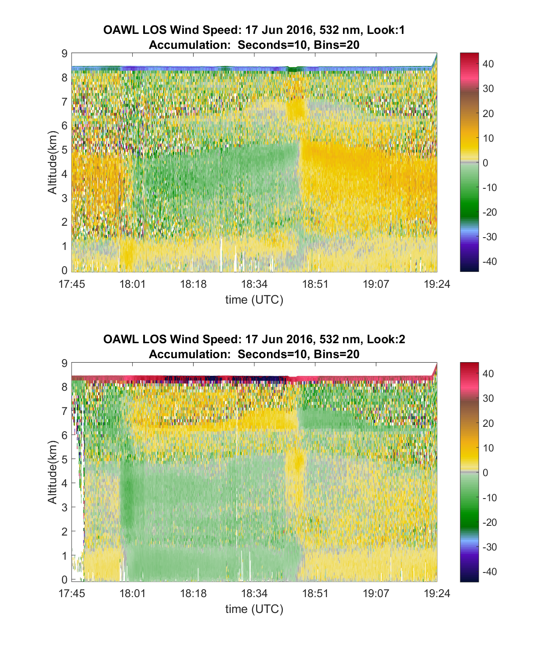
Simultaneous two-look LOS wind speed profiles
17 June 2016: Forward look
Line of sight wind speed data:
<1.5 mJ/pulse (0.3 W) at 532 nm wavelength
Daytime operation with scattered clouds.
Clean atmosphere: very low aerosol backscatter
Two-separate looks measure orthogonal horizontal Doppler shifts (u and v winds)
Continuous coverage in each look, no switching, no gaps
Aft look

Slide 27
System Parameters
Parameter | OAWL-P | GrOAWL ’16 | HAWC-OAWL
Laser Wavelength(s) – Nd:YAG fundamental wavelength: 1064 nm | 355-nm | 532-nm | 532-nm & 355-nm (from same Nd:YAG laser)
Pulse repetition rate | 200 Hz | 200 Hz per laser = 400 Hz for data system
Operational laser pulse energies | 20 mJ | variable: 200μJ to 2.5 mJ (nom. 1.5mJ) | 532-nm: up to 2.5 mJ used 355-nm: 10-12 mJ
Laser pulse length | ~18 ns | ~22-26 ns
Laser pulse bandwidth | ~42 MHz | ~30 MHz | 532-nm: 32 MHz 355-nm: 33 MHz
Interferometer Optical Path Difference | 90 cm
Interferometer unambiguous LOS velocity range: | 532-nm: ±44.3 ms⁻¹ 355-nm: ±29.6 ms⁻¹
Telescope effective aperture diameter | 25 cm | 28 cm | 29 cm
Number of lasers/telescopes/looks | 1 | 2 | 2 @ dual wavelengths
Detectors: Hamamatsu Multi-Pixel Photon Counting (Model Number) | 4x 355-nm channels (S10362-025) | 4x 532-nm channels (s12571-025) | 4x 355-nm IFO channels 4x 532-nm IFO channels 1x 355-nm depolarization 1x 532-nm depolarization (s12571-025)
Detector Quantum Efficiency (Hamamatsu MPPC) | 0.23 | 0.32 | 532: 0.32 355: 0.26

Slide 28
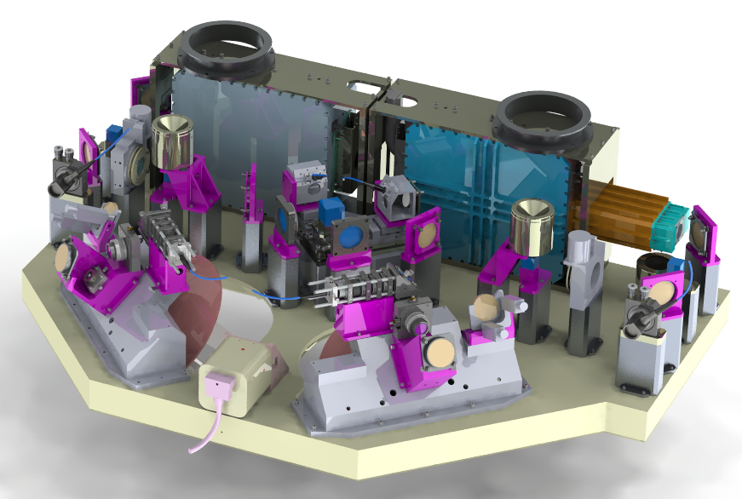
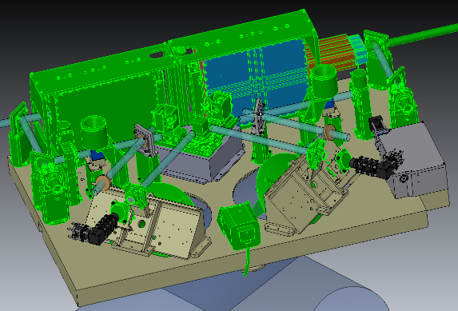
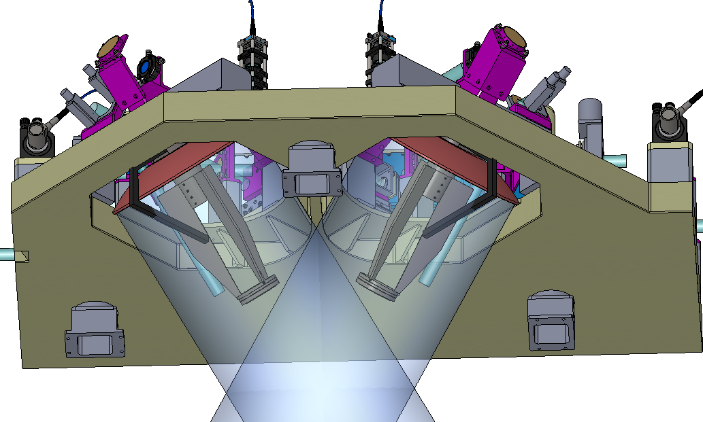
HAWC OAWL
New
Pre/post GrOAWL detector path designs
Dual wavelength interferometer winds + depolarization
Athermal Interferometer build/test
Reconfiguration for DC-8 – with 2 looks
Re-Use

Slide 29
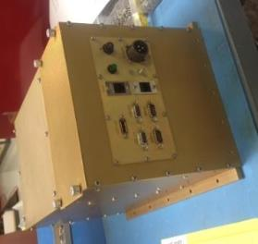
Electronics subsystem is at high TRL
Conduction cooled payload controller & single board computer running linux in space-flight like configuration
Custom, FPGA-based, System Control & Auxiliary Data boards
Custom, FPGA-based, Lidar Data Acquisition and Processor boards
4-6 channels/board
Sample ranges as low as 1.1 m
Detector electronics: control & sampling
Airborne GrOAWL processing demonstrated processing with >4x margin over the space ATHENA-OAWL.
Both boards designed with “space-equivalent” parts.
Remote system operation – most functions autonomous except for critical ones like “start” and “lase”.
Real-time LOS wind speed profile processing

Slide 30
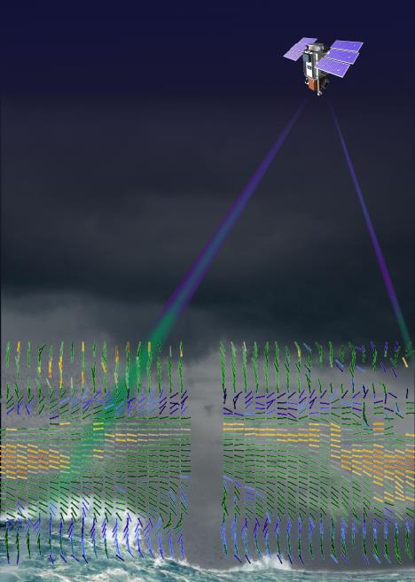
Optical Autocovariance Wind Lidar (OAWL) Technology is ready for space-based demonstration
Wind lidar can provide critical wind profiles, especially over the oceans and tropics
OAWL technology has been proven in ground and airborne demonstrations.
High TRL OAWL technology (based on CALIPSO) is ready to be demonstrated on orbit.
ESA’s Aeolus system expected to launch Mid-2018; no planned follow-on

Slide 31
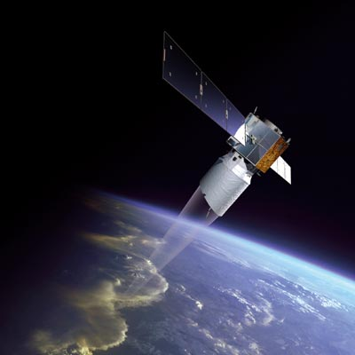
Future of Space-Based Wind Lidar
2016 AOVT “GrOAWL” flights (April/May) –
Demonstrated and validated wind measurements
Scaled performance to space
2016: ESA’s Aeolus Mission (ADM)
Single-perspective line-of-sight winds
Through TVAC
Planned launch: Summer 2018
Aerosol & molecular channels: Both at 355 nm
2017: Aeolus Calibration/Validation Effort
US CalVal team led by Mike Hardesty w/ investigators from NOAA, NASA, universities, & industry.
OAWL: Only known 355 nm aerosol wind lidar system in US → can provide validation for Aeolus 355 nm aerosol channel
2018-2027: Earth Science Decadal Survey
Incubation funding
Potential explorer mission
2018: NOAA SPRWG/NSOSA: Operational mission by 2030

Slide 32
Thanks to:
ESTO for IIP and ACT development funding
ESSP and ESTO for the Venture-Technology funding
The Ball OAWL engineering teams
The NOAA-ESRL/CU-Boulder-CIRES science team: Mike Hardesty and Sunil Baidar
Fibertek (Floyd Hovis)
Mark Beaubien of Y.E.S. & ONR for dropsonde validation support
The engineering team, crew, pilots, and program staff of the WB-57 for all their excellent flight support

Slide 33
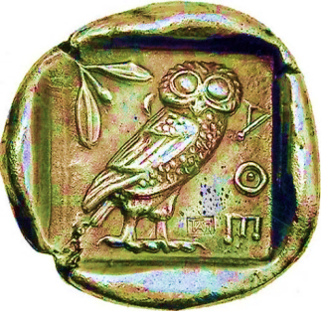
ATHENA-OAWL: path-finding science for next-generation global weather prediction and climate analysis
ATHENA-OAWL: Aerosol Transport, Hurricanes, and Extra-tropical Numerical weAther prediction using the Optical Autocovariance Wind Lidar (OAWL).
Design-to-cost approach to NASA Earth Venture Instrument based on heritage systems such as the Ball-built CALIPSO lidar
A two-look wind lidar system to provide vertically resolved estimates of U and V winds
Co-located wind and aerosol profiles

Slide 34
ATHENA-OAWL Venture Technology The Green-OAWL Airborne Demonstrator
ATHENA-OAWL Venture Tech (AOVT): NASA Venture Technology development funding
Built an airborne OAWL system to demonstrate the two look geometry for space based wind lidar
First known demonstration of this lidar concept
Validated the OAWL technology and the two look winds approach (2016 flight tests)
ISS for Earth Venture Instrument
RAM direction
ISS Ground
Track

Slide 35
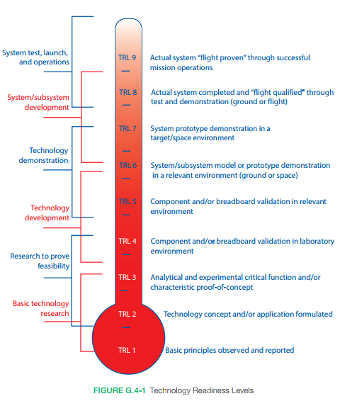
OAWL Path to space
High TRL subsystems
Category | ATHENA-ISS | Free-Flyer: Full Atmospheric Mission
Laser | ESTO-funded Fibertek 532 nm laser development & qualification | ESA’s Aeolus 355 nm laser demonstration + Fibertek 355 nm + 532 nm HEUVD laser qualification
Interferometer | The OAWL interferometer system proven in flights and ground-testing and other MZI-based lidar systems. TRL6 environmental testing in 2017
Electronics & Software | All OAWL electronics components have space-qualified equivalents. Payload control based on CALIPSO & TEMPO OAWL demonstrated autonomous operation (2011 and 2016) from WB-57 aircraft with real-time winds & satellite downlink
Structural & Optical | ATHENA-OAWL optical/mechanical system components have heritage in the CALIPSO lidar (2006 launch) and other space-based missions.
 | Aluminum for ISS |  | Graphite/Beryllium for Free Flyer
Telescopes | GDIT (Axsys) telescopes like those used for CALIOP, CATS, MOLA, and GLAS, ATLAS – Diffraction limited is not required. 1-λ error OK.
Platform | ISS enabling capabilities: power, cooling loop, and TDRSS → providing low latency for the ATHENA measurements | BCP 2000 or CNES (CALIPSO-like) satellite + ground stations
Pointing | Star tracker system provides required pointing knowledge for LOS wind speed accuracy

Slide 36
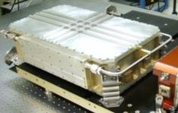
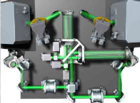
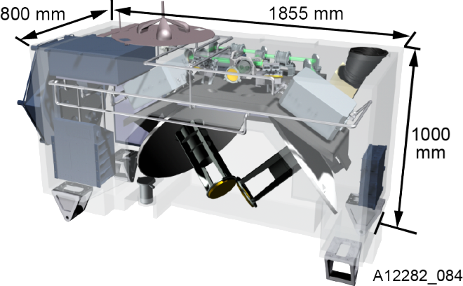
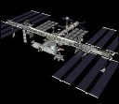
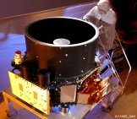
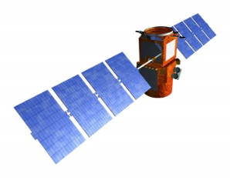
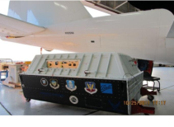
The ATHENA-OAWL Instrument
Design-to-cost approach based on the successful CALIPSO lidar
ESTO-funded Fibertek 532 nm (and UV)) laser development & qualification
The proven OAWL Mach Zehnder interferometer system
ISS enabling capabilities: power, cooling loop, and TDRSS → providing low latency for the ATHENA measurements
Star tracker system provides pointing knowledge for LOS wind speed accuracy
Most OAWL components have heritage in the CALIPSO lidar (2006 launch) and other space-based missions
The autonomous OAWL prototype system in the NASA WB-57 pallet (2011) - on par with JEM-EF mass, volume, power and cooling capabilities.
GDIT (Axsys) telescopes like those used for CALIOP, CATS, and GLAS

Slide 37
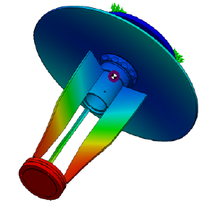
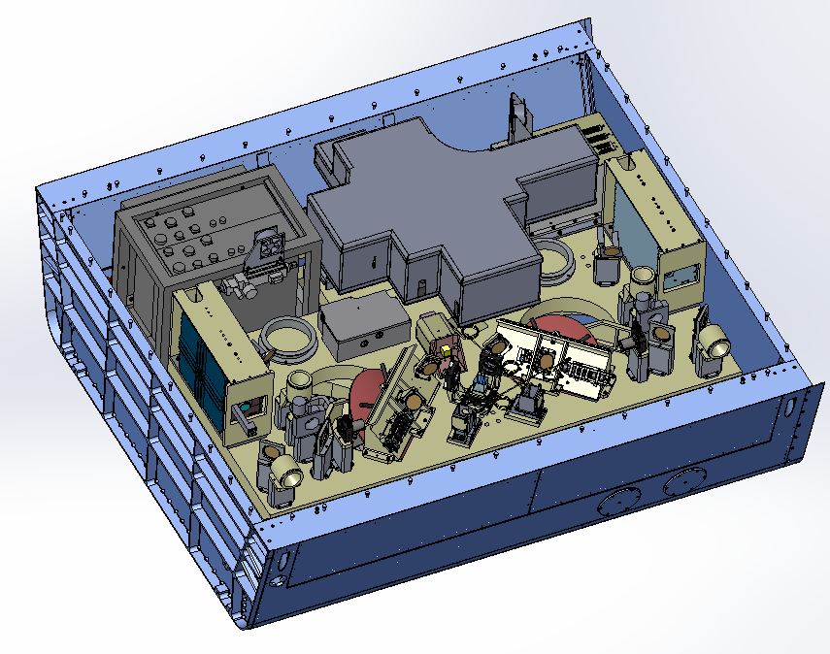
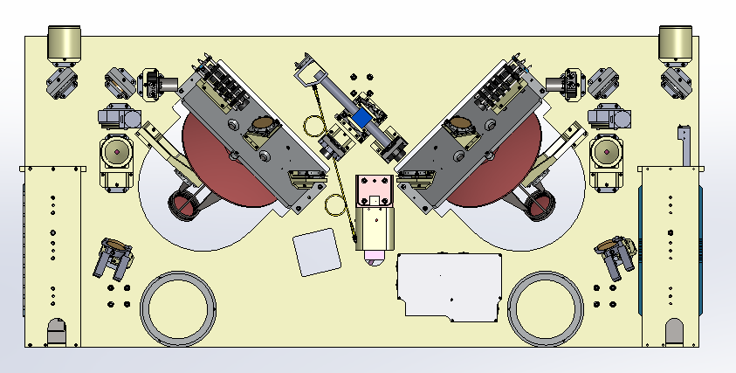
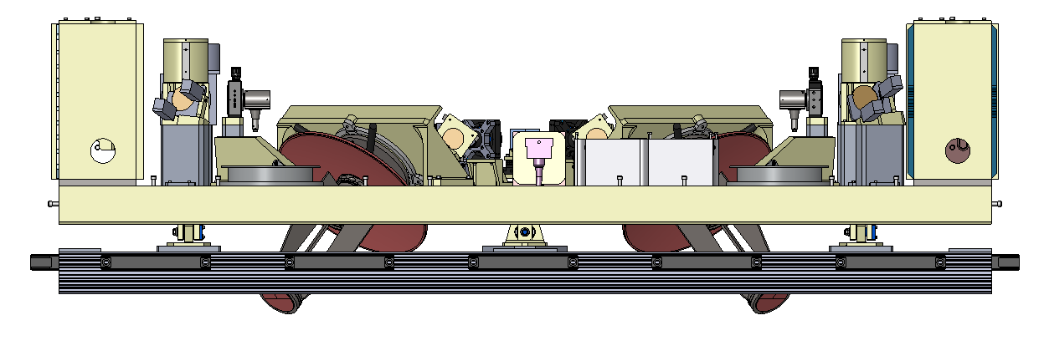
Optical Bench
Electronics chassis
Laser Electronics rack
Lasers
New Optical Bench
Two-lasers (one new, one refurbished) synchronized to interleave pulses
Two ~30cm diameter (10 cm obscuration) telescopes.
transmit/receive optics
Variable 532 nm laser transmission
Two axis boresighting
GPS/IMU
Fiber coupling connects the combined returns into the interferometer.
1064 Dump
AFT
FORWARD
1064 Dump
Telescopes
Interferometer with thermal cover
FM2
T0 Pickoff
T0 Injection
PBS Combiner & HWP’s
T0 Injection
T0 Pickoff
FM2
FM1
PBS & HWP
F1
F1
FM1
532 Dump
PBS & HWP
FM3
F/8 Col
FM3
F2
F2
532 Dump
BSM
BSM
Laser
Laser

Slide 38
OAWL
OAWL IRAD development: 2004-present
OAWL prototype: 2009-2012
Space-based mission development: EVI-2
AOVT GrOAWL → EVI-4
HAWC-OAWL
Interferometer and Nested-OAWL IRADs
Next steps in technology developments

