Slide 1
Review of GrOAWL airborne validation and new results from ground-based studies
Sunil Baidar^{1,2}, S. C. Tucker³, R. M. Hardesty^{1,2}
1. CIRES, University of Colorado Boulder, Boulder, CO
2. NOAA Earth System Research Laboratory, Boulder, CO
3. Ball Aerospace & Technologies Corp., Boulder, CO

Slide 2
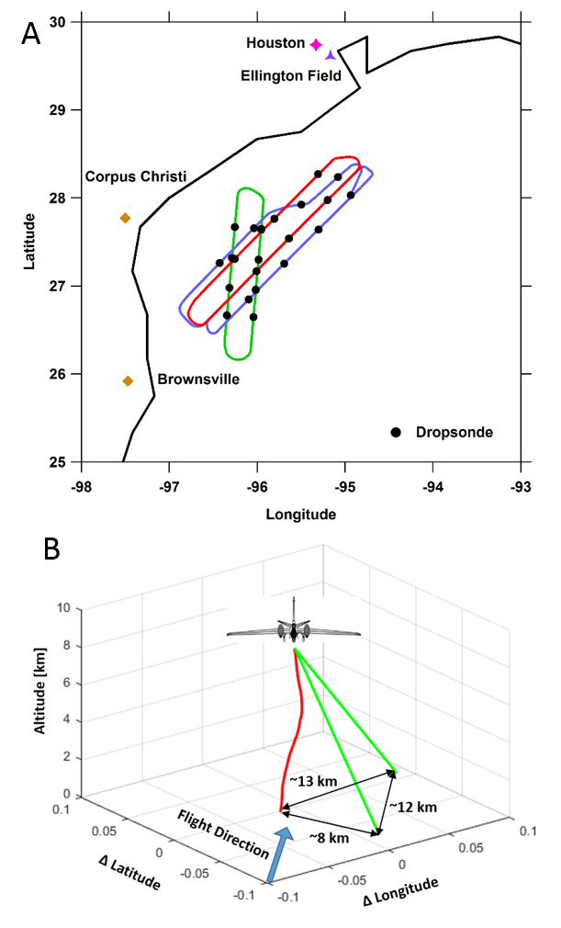
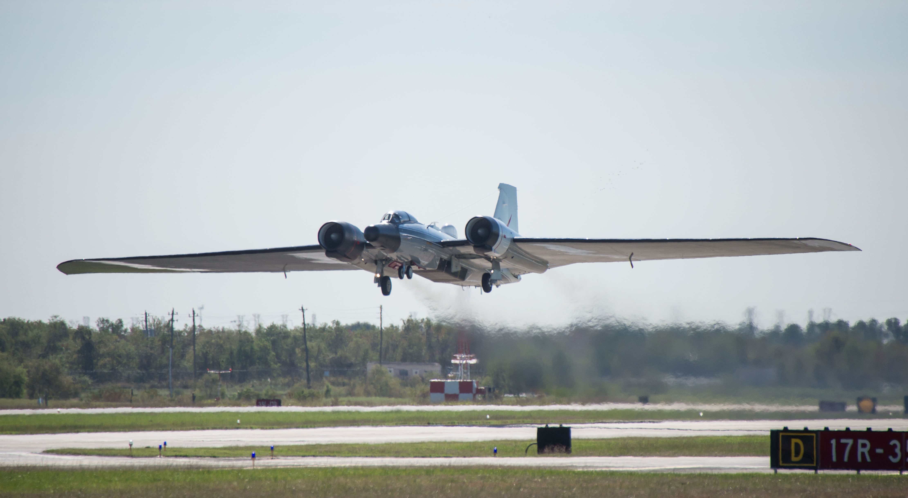
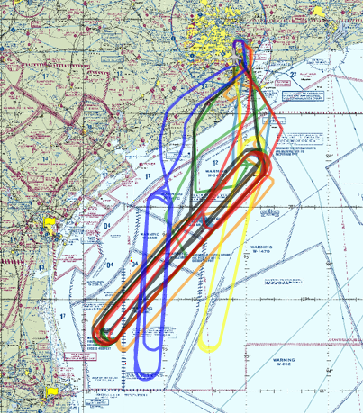
GrOAWL AOVT flights
Deployed on NASA WB-57
May-June 2016
8 flights
5 engineering
3 validation
Racetrack patterns over the Gulf of Mexico
Revisit times: ~1hr/loop
Launched dropsondes from the aircraft (48 total)

Slide 3
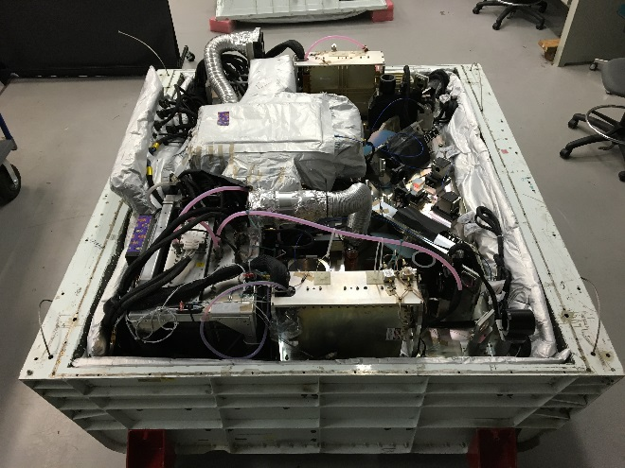
Goals: airborne measurements
Validate the GrOAWL winds with independent measurements.
Accuracy of measured winds
Demonstrate the two look ATHENA-OAWL mission concept.
Combine two looks to retrieve horizontal winds
Determine instrument performance during the flights.
Scale airborne GrOAWL performance to space-borne OAWL instruments.

Slide 4
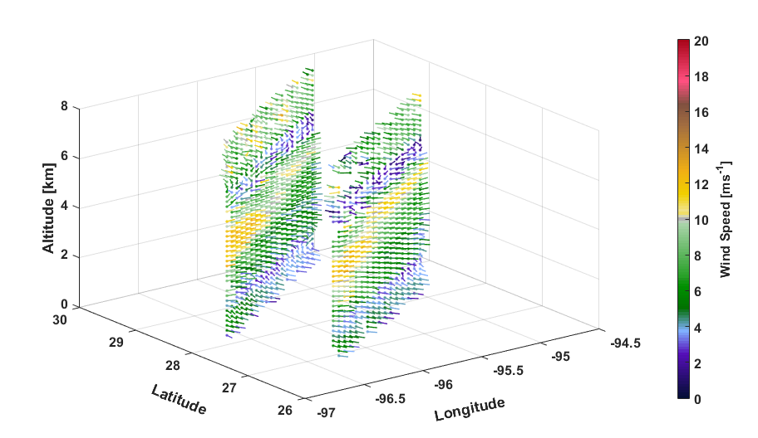
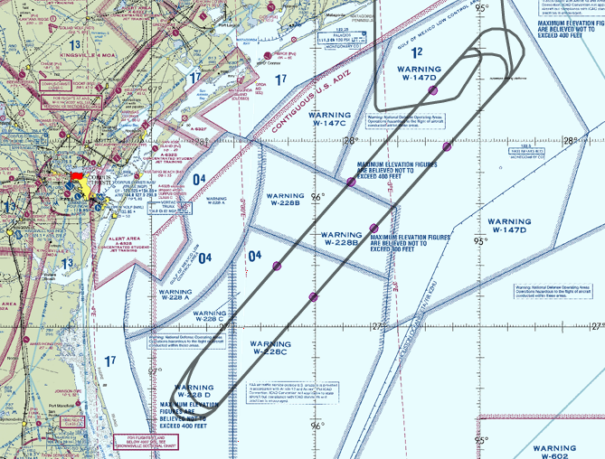
GrOAWL data
Time resolution: 10 seconds
Vertical resolution: ~120 m
Look 1 (FWD)
Look 2 (AFT)

Slide 5
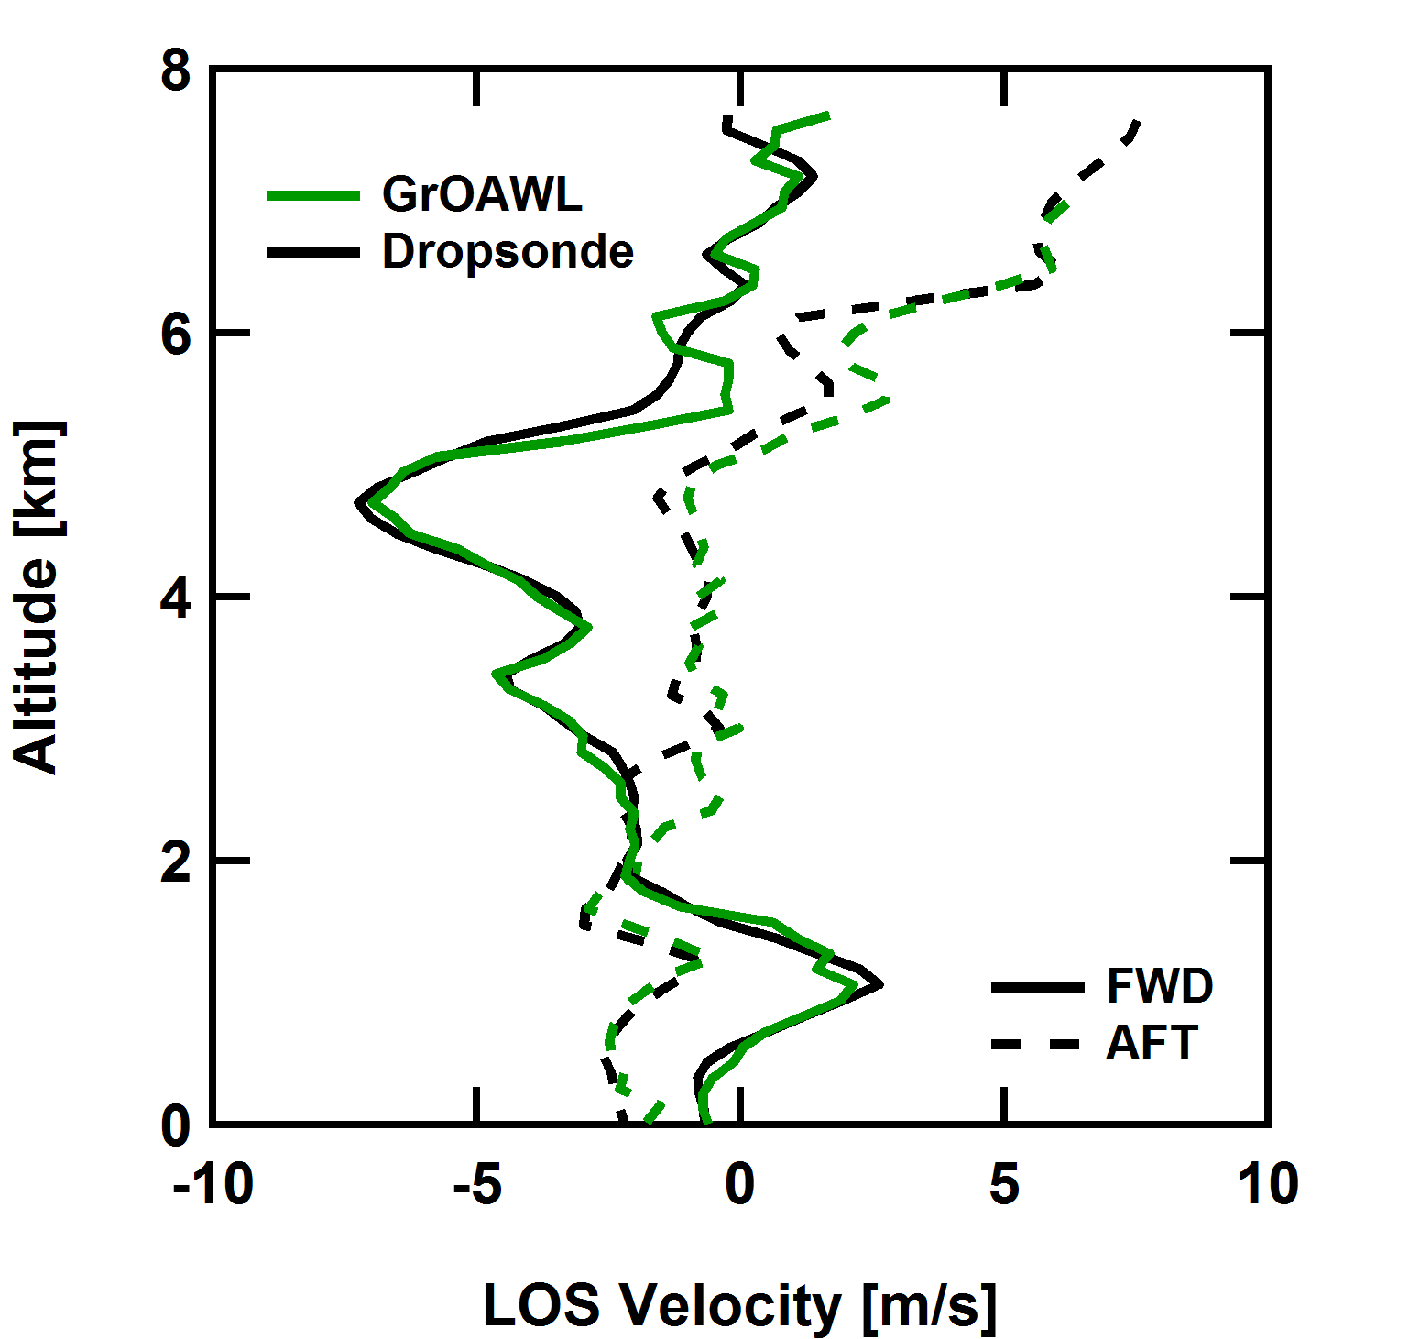
Dropsonde Comparisons
Excellent agreement with collocated dropsondes.
Notes:
Add a slide with only the GrOAWL data. (like animation? 60

Slide 6
Accuracy
21 total dropsondes from 3 validation flights
Dropsonde data is considered the “True Value”
10 seconds data

Slide 7
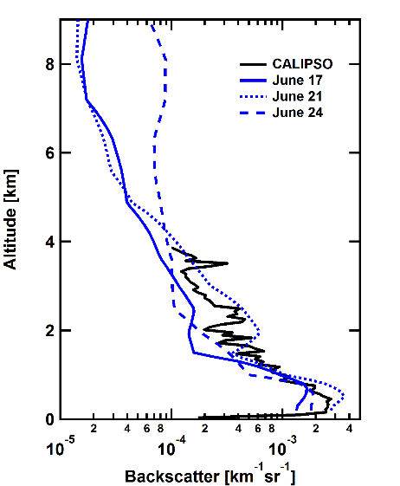
GrOAWL Performance
Two tuning parameters:
Instrument Throughput Efficiency: affects total photons (lidar SNR)
Instrument Contrast: ability to resolve fringes (winds CNR)
Instrument performance ~3.3x lower compared to ideal performance.
Notes:
Ground based measurement along with NCAR HSRL instrument is ongoing. – to better understand the instrument performance under low aerosol conditions.

Slide 8
Summary: Airborne Flights
Validated GrOAWL measured winds using collocated dropsondes.
Successfully demonstrated the ATHENA-OAWL two look concept.
Sensitivity was reduced (~3.3x) compared to ideal performance of the instrument.

Slide 9
Ground based Measurements

Slide 10
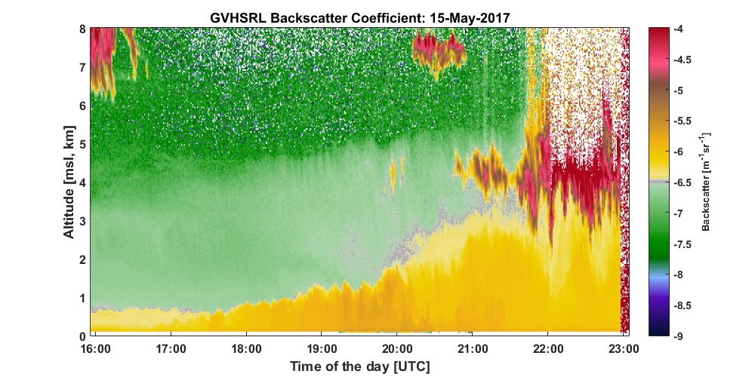
Goals: Ground based Measurements
Validate the instrument performance/instrument performance model in a well characterized environment.
Does the system measure winds with the expected precision for the parameters provided?
Verify reduced performance during the flights is related to the platform and the operating environment.

Slide 11
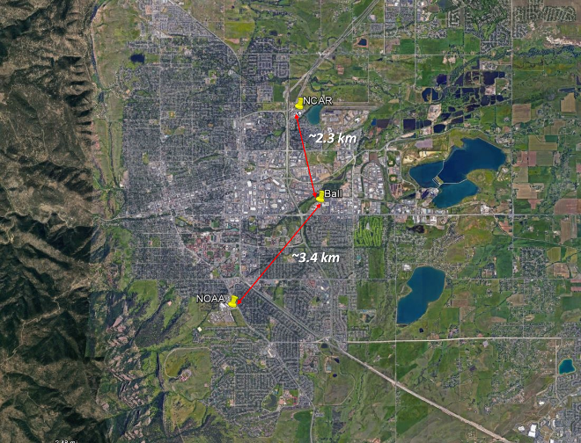
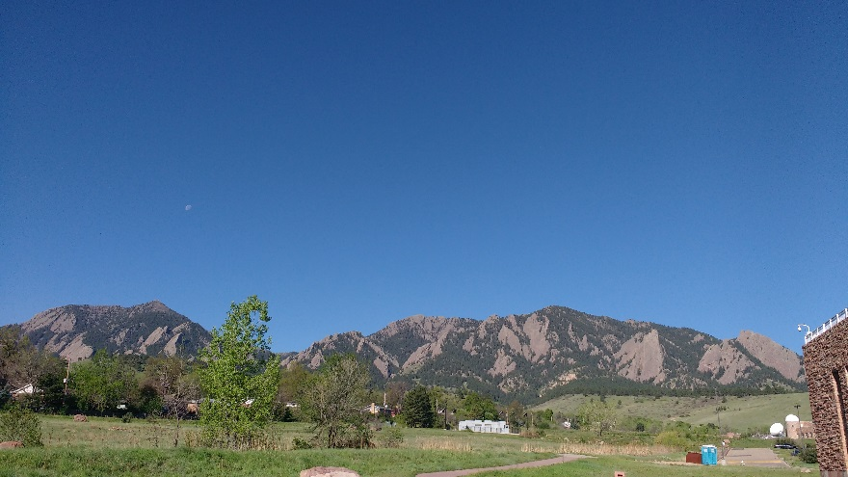
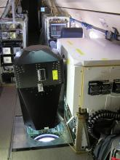
Measurements
3 two-day measurement periods.
15 and 16 November 2016
11 and 12 April 2017
15 and 16 May 2017
Instrumentation:
GrOAWL (winds) at Ball
pointing at 30° elevation and ~270° azimuth
HSRL (aerosol) at NCAR
operates at 532 nm, pointing vertically, 45 sec profile
provides aerosol backscatter, extinction, depolarization ratio
2 Daleks (winds, WINDCUBE 200S) at NOAA
– for the measurement period in May 2017 only
Dalek01: VAD scan at 60° elevation angle
Dalek02: PPI scan between 260° and 270° azimuth at 30° elevation
HSRL on the NCAR GV
Notes:
Photo is from May 16 at around 8 am.

Slide 12
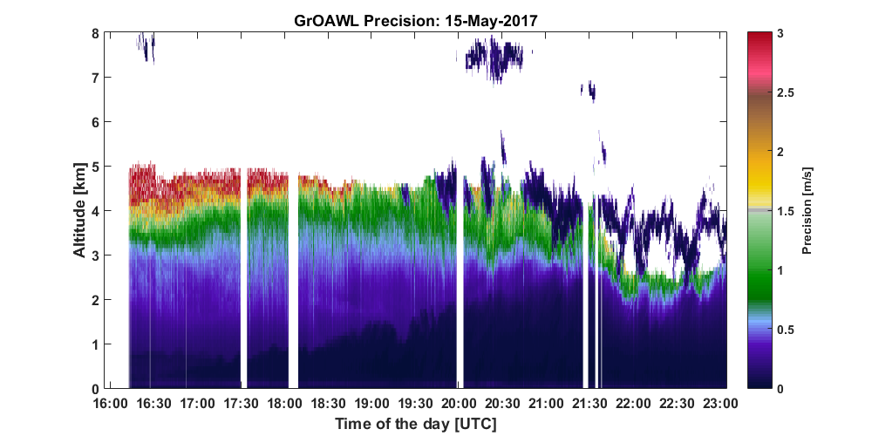
Using HSRL data to predict GrOAWL precision
Simulate GrOAWL wind precision for every wind profile using the closest HSRL aerosol backscatter and extinction profile in time.
Notes:
Laser pulse energy: 1.25 mJ (we know it is less that 1.5 mJ due to burns in the optics)
Adjust surface albedo to match the number of background photons.

Slide 13
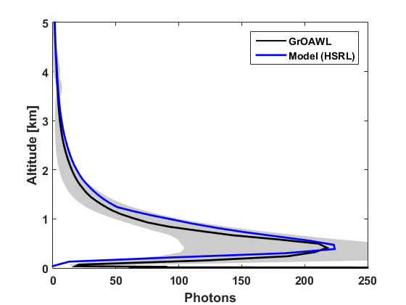
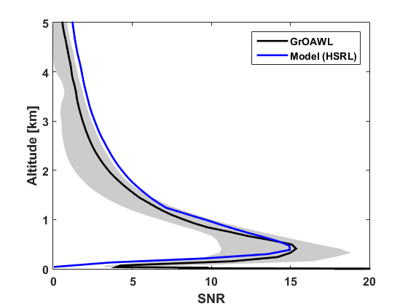
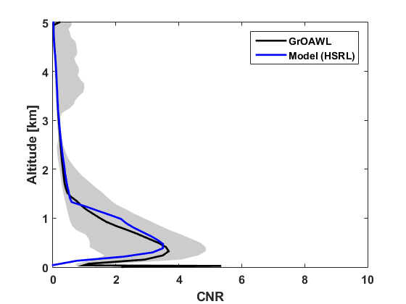
Using HSRL data to predict GrOAWL precision
Two tuning parameters:
Instrument Throughput Efficiency: affect total photons (lidar SNR)
Complicated by presence of additional turning mirror
Agrees within ±10 % over six days.
Instrument Contrast: ability to resolve fringes (winds CNR)
Median T0 contrast range over six days: 0.65-0.71

Slide 14
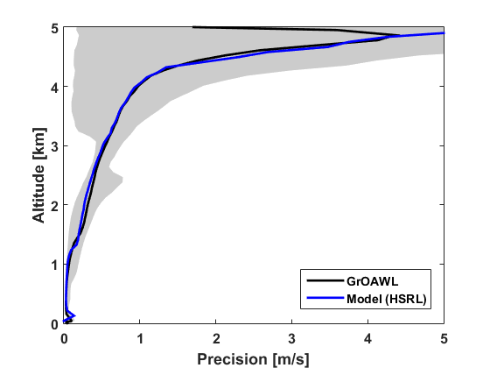
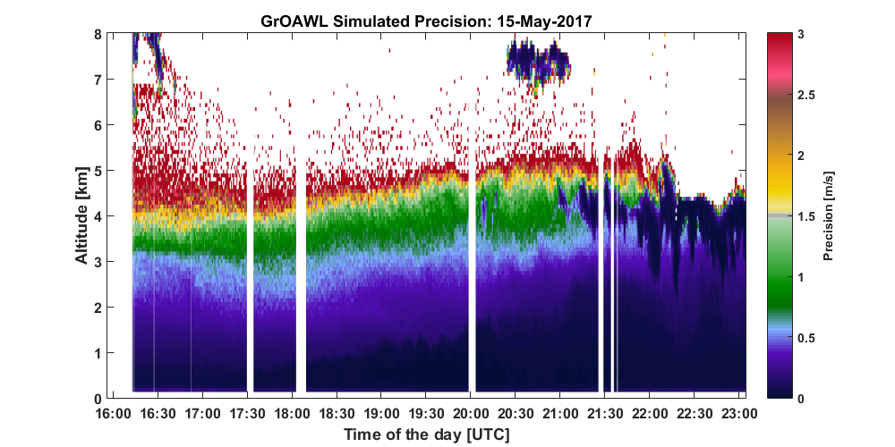
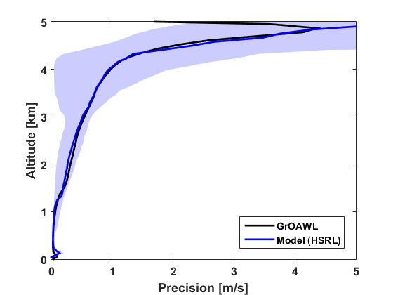
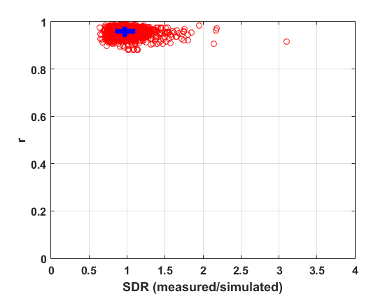
Using HSRL data to predict GrOAWL precision
Validates the GrOAWL instrument performance model.

Slide 15
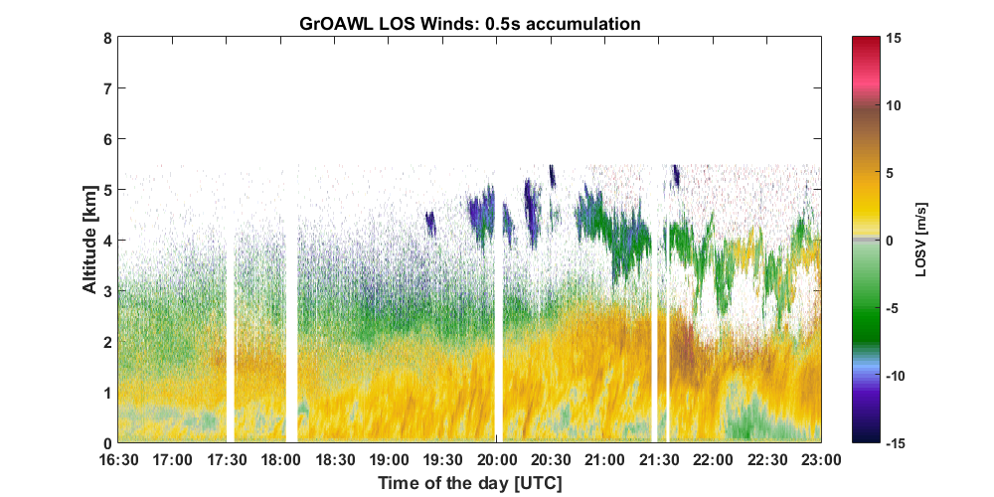
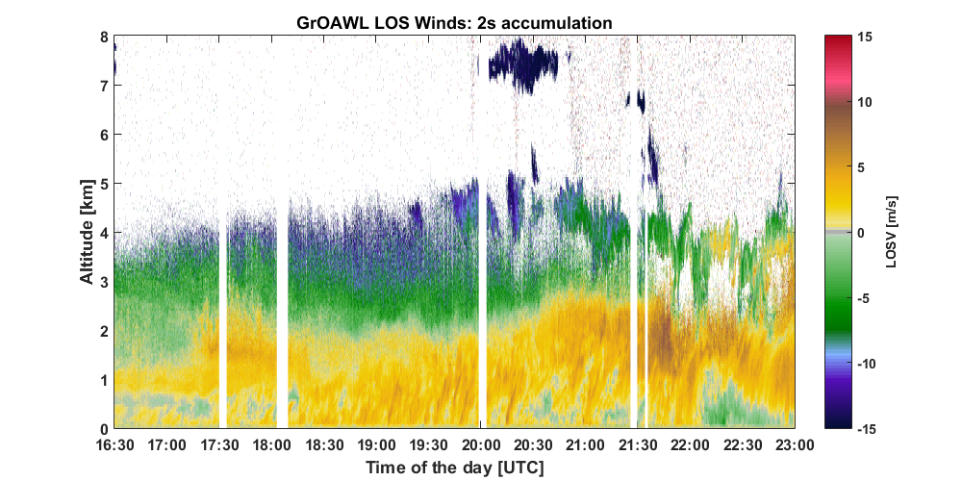
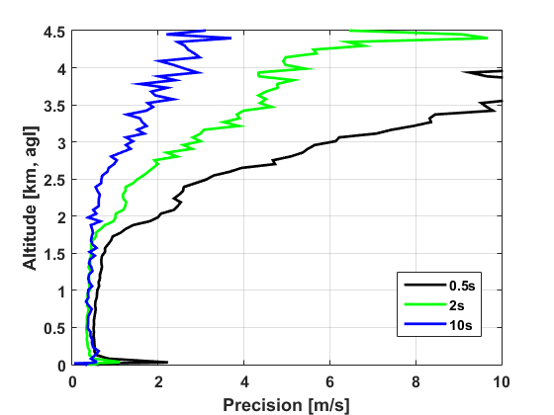
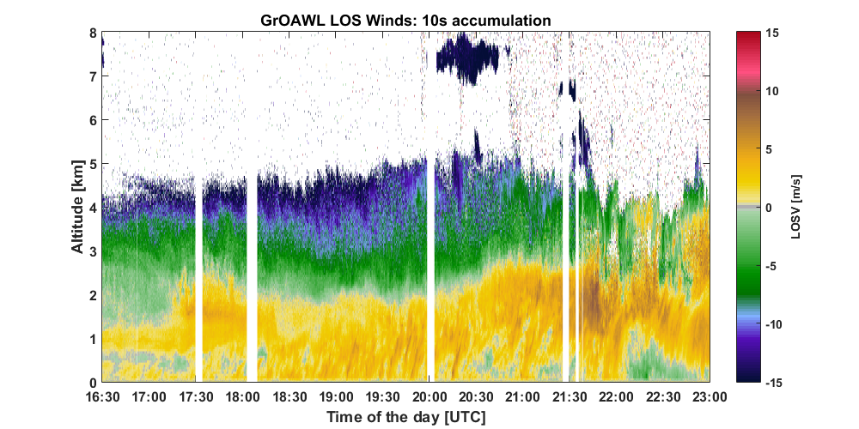
LOSV Measurements
Accumulation improves data coverage.

Slide 16
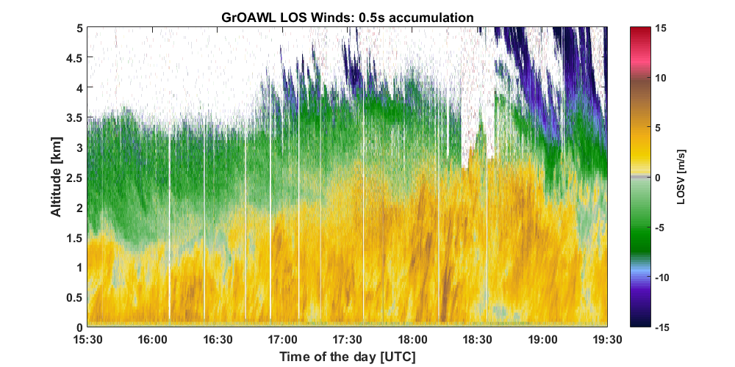
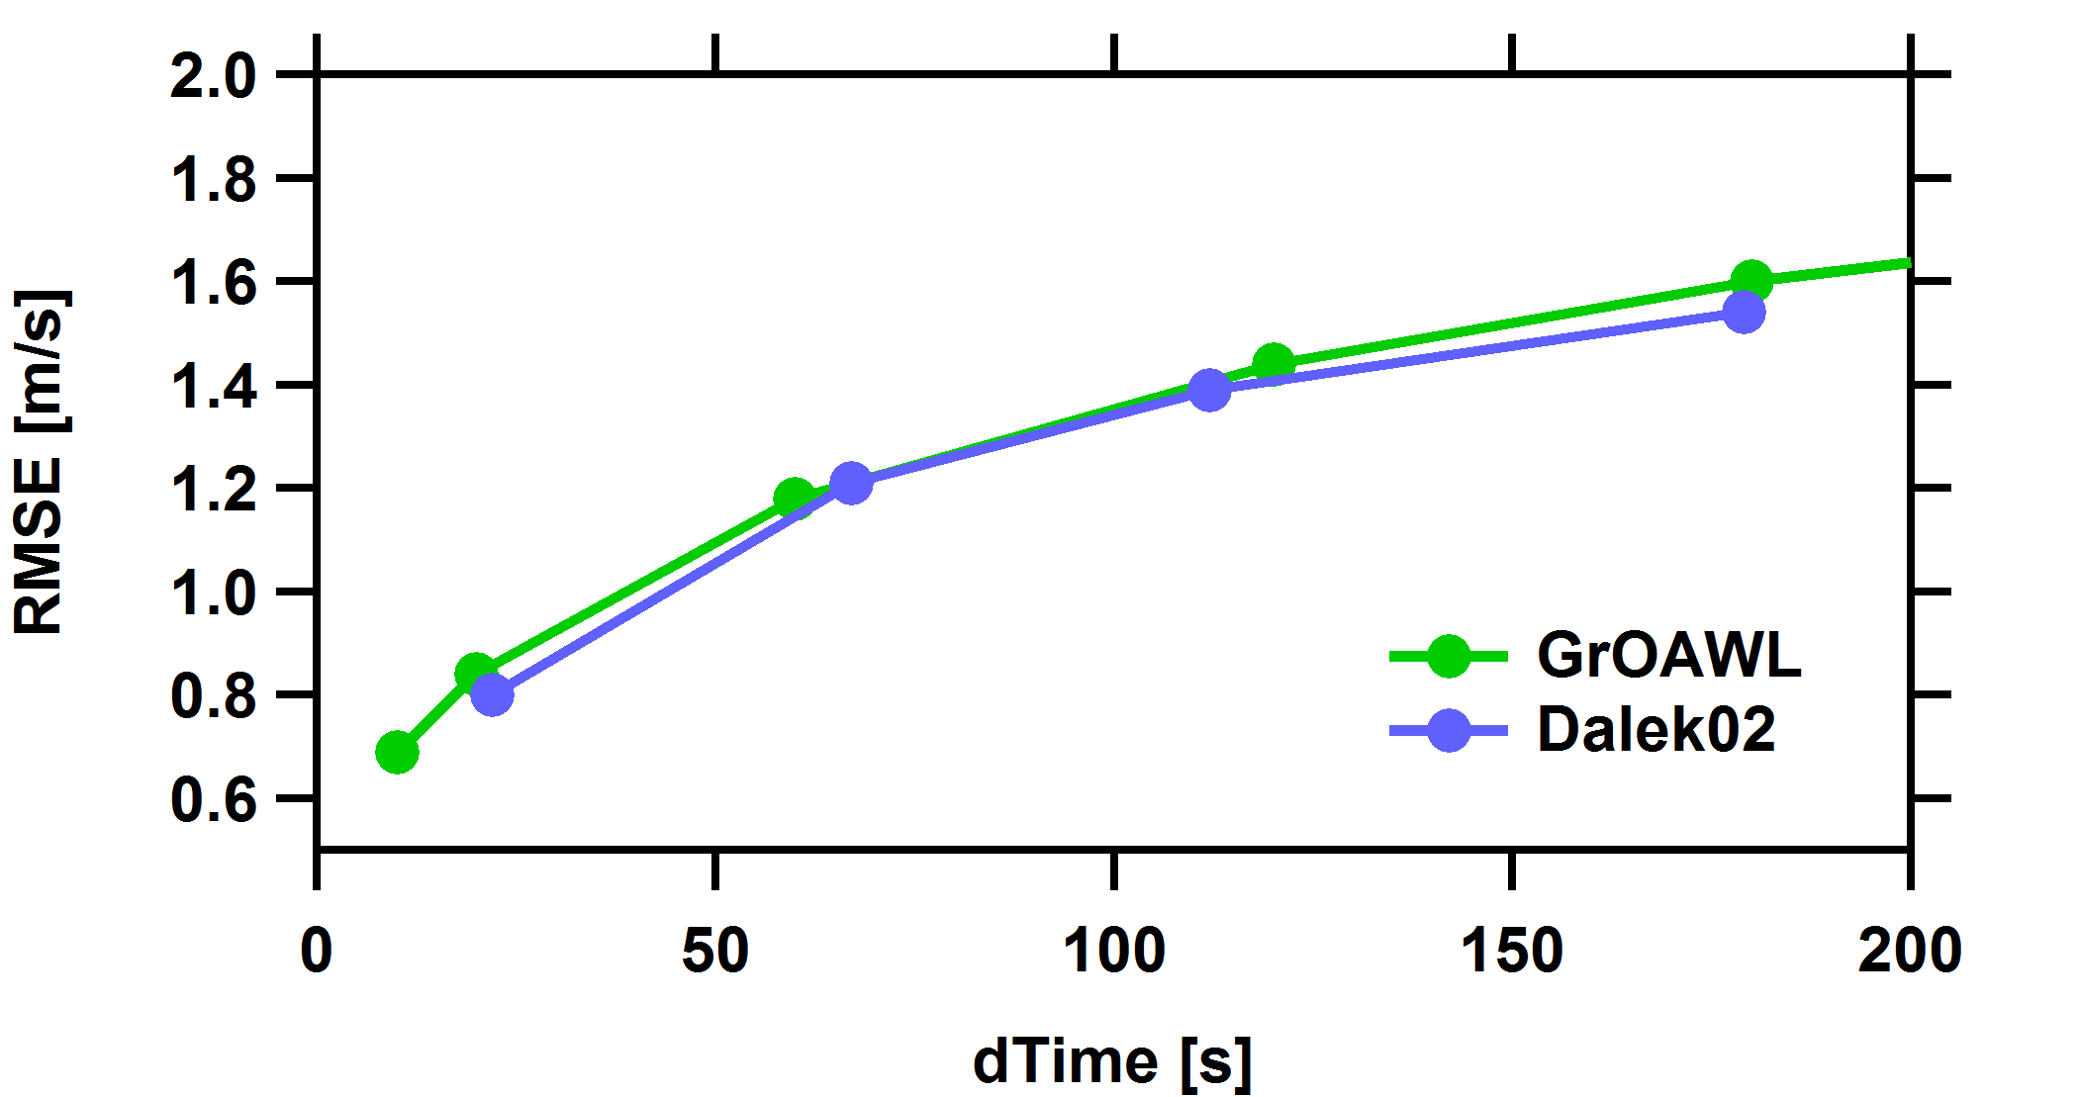
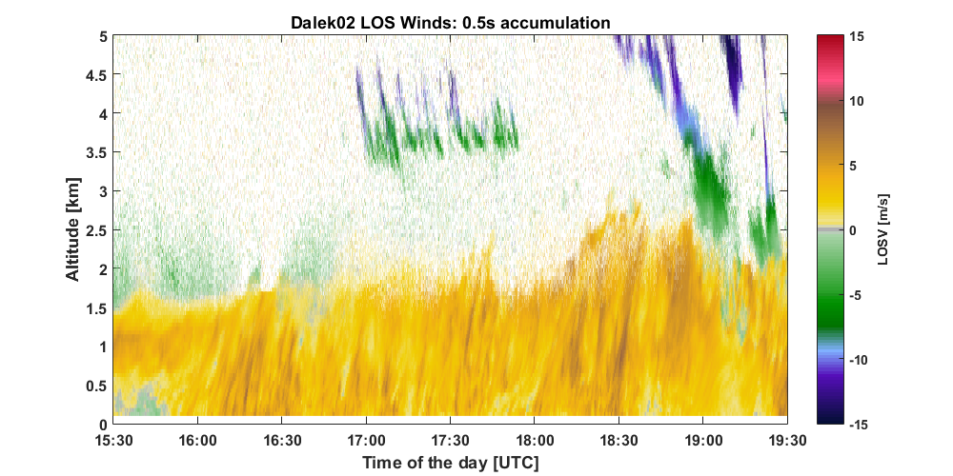
LOSV comparison
Very good agreement in a complex environment.

Slide 17
Summary: Ground-based Measurements
Verified instrumental issues encountered during the AOVT flights are related to the platform and the operating environment.
These issues are not present or very limited during the ground based measurements.
Validated the GrOAWL instrument performance model.
Excellent agreement between the measured and simulated wind precision.
GrOAWL performs as expected in a well characterized atmosphere.
GrOAWL instrument performance is very well understood.
Additional validation of the GrOAWL measured winds.
Very good agreement between GrOAWL and Dalek measured winds in a complex environment.

Slide 18
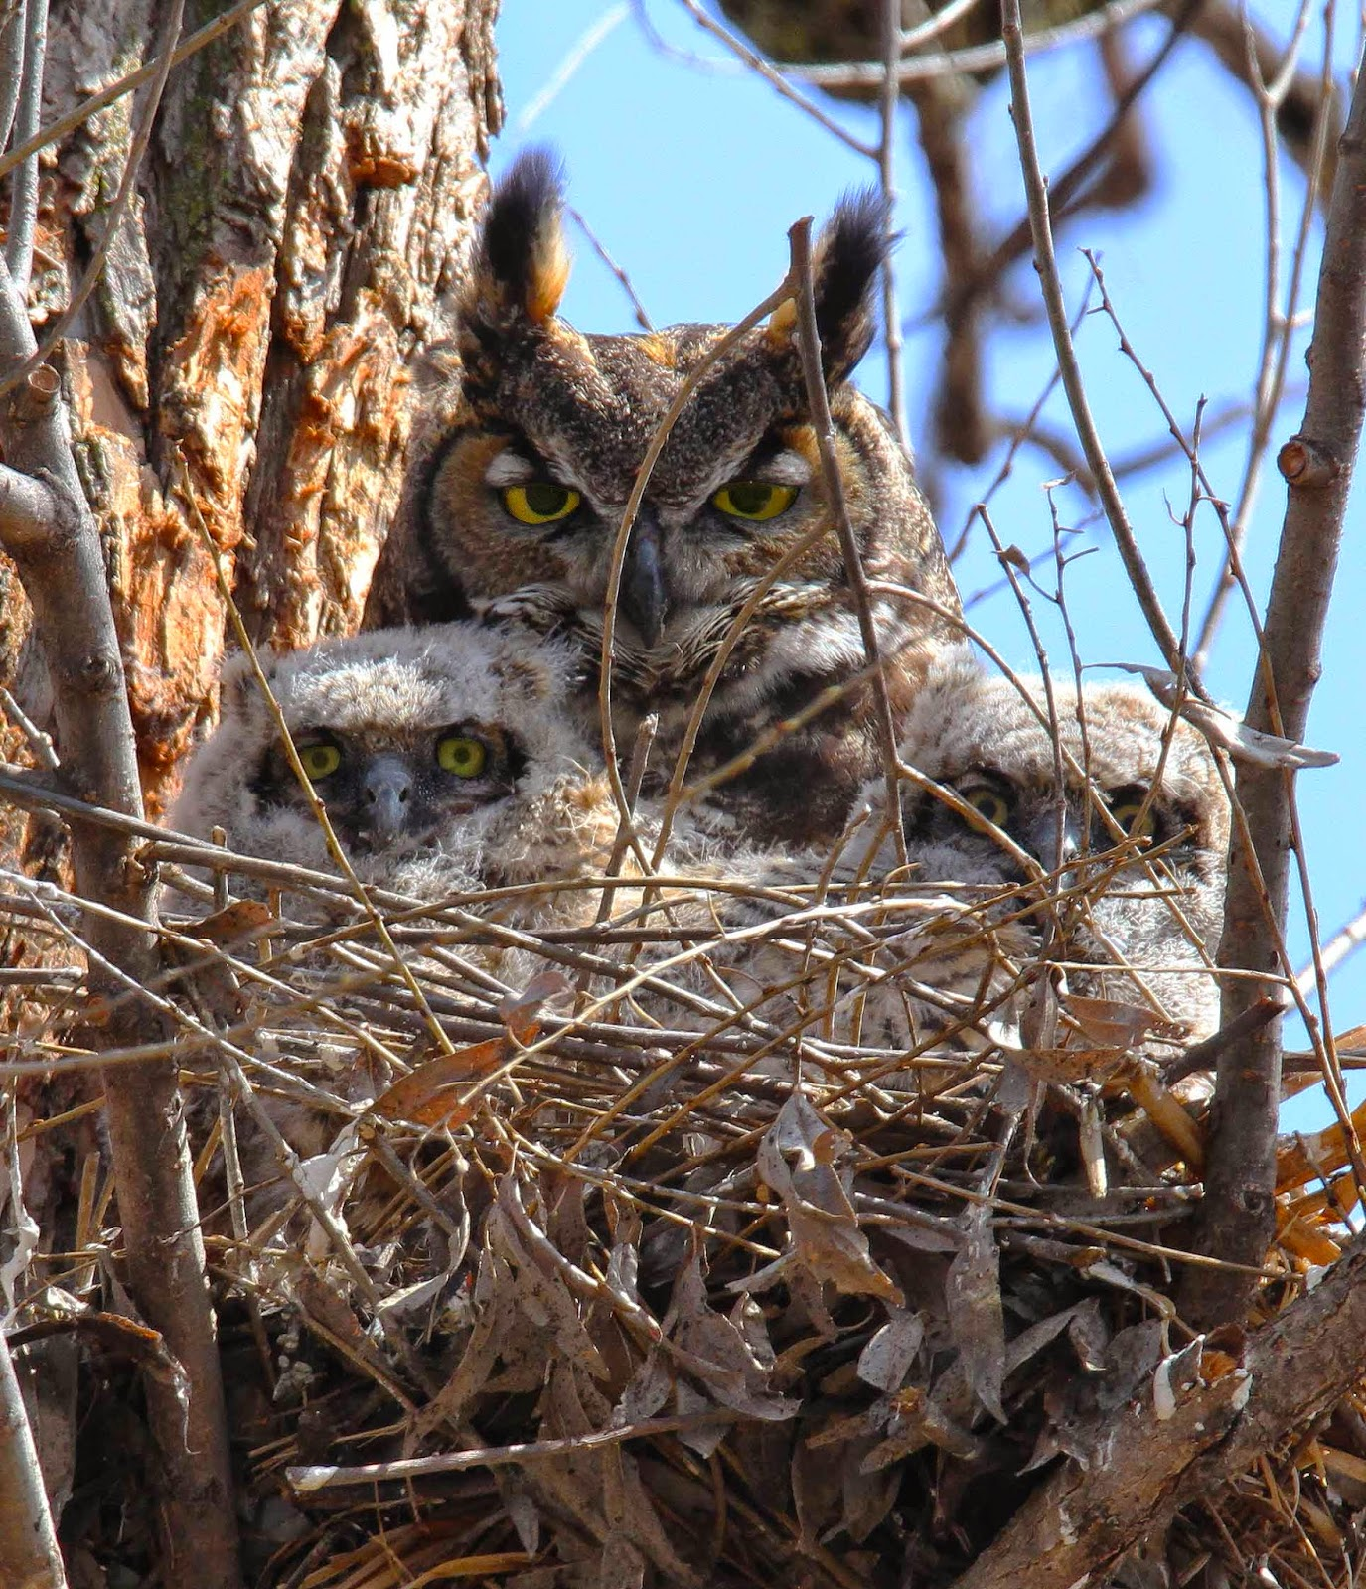
Thanks to:
ESSP and ESTO for the Venture-Technology funding
The Ball GrOAWL engineering team
Fibertek (Floyd Hovis)
YES (Mark Beaubien) & ONR for dropsonde validation support
NWS Corpus Christi office for the sonde launches
The engineering team, crew, pilots, and program staff of the WB-57 for all their excellent flight support
NCAR HSRL and NOAA Doppler wind lidar teams for ground based measurements

Slide 19
Extras

Slide 20
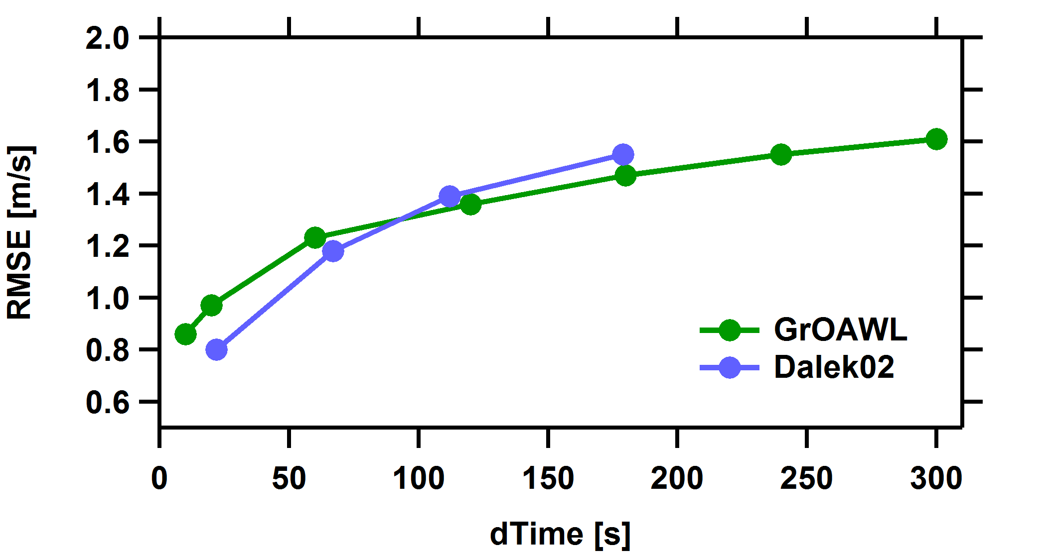
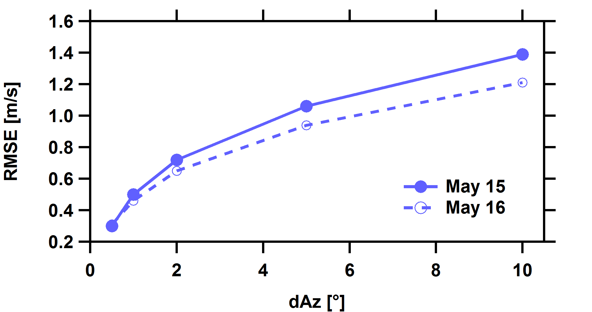
Atmospheric Variability

Slide 21
LOSV comparison

Slide 22
LOSV Comparison
Very good agreement in a complex environment.

Slide 23
Accuracy
21 total dropsondes from 3 validation flights
Dropsonde data is considered the “True Value”
1 minute data (6 x 10 seconds profiles)

Slide 24
Wind Speed and Direction
Wind Speed
Wind Direction
Very good agreement between GrOAWL and Dropsondes.
Notes:
30

