Slide 1
NASA Earth Science Technology Update
Working Group on Space-based Lidar Winds
Boulder, CO
Feb 7, 2018
Pamela S. MIllar
Associate Director/Program Manager
Earth Science Technology Office

Slide 2


  Earth Science Technology:
  Recent Investments for Wind Measurements
Award | PI / Organization | Project
IIP-13 | Kevin Maschhoff, BAE Systems | MISTiC Winds: Midwave Infrared Sounding of Temperature and humidity in a Constellation for Winds
IIP-16 | Michael Kelly, JHU-APL | Compact Midwave Imaging System
IIP-QRS-16 | Michael Kavaya, NASA LaRC | 3-D Global Winds: A high pulse rate, lower technology risk coherent wind lidar for airborne science and a global winds pathfinder mission
Directed 2013 | Floyd Hovis, Fibertek | High Power UV Laser Lifetime Demonstrator
IIP-13 | Sara Tucker, Ball Aerospace | HSRL for Aerosols, Winds, and Clouds using Optical Autocovariance Wind Lidar (HAWC-OAWL)
EVI-14 | R. Michael Hardesty, University of CO | Green OAWL Airborne Demonstrator / ATHENA-OAWL: Atmospheric Transport, Hurricanes and Extratropical Numerical Weather Prediction with OAWL
Portfolio of active and passive measurement techniques
Competed and directed
Notes:
Starting with the Instrument side of ESTO…

Slide 3
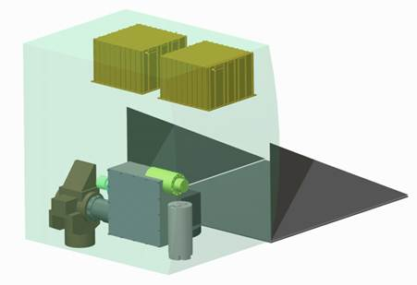
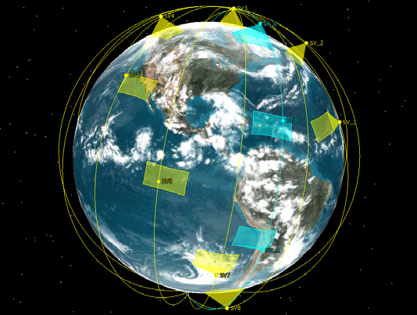
  Midwave Infrared Sounding of Temperature and
  humidity in a Constellation (MISTiC) Winds
PI: Kevin Maschhoff; BAE Systems
Project Start/End Date: May 2014 - May 2018
Develop a miniature high resolution, wide field, thermal emission spectrometry instrument that will provide global tropospheric profiles of atmospheric temperature and humidity at high (2-3 km) spatial resolution.
  Spectral frequency: 1950 cm⁻¹ – 2450 cm⁻¹
  Spectral resolution: 1.7 cm⁻¹ – 2.3 cm⁻¹
  Radiometric sensitivity < 200 mK and accuracy < 1%
A constellation of 12 microsatellites, using 4 orbital planes each with a 3-satellite formation would provide vertically resolved tropospheric winds and atmospheric state measurements globally every 3 hours.
  These observations, when assimilated into high resolution weather models, would enhance short-term and severe weather forecasting
  In addition, this observation capability would be a critical tool in the study of transport processes for water vapor, clouds, pollution, and aerosols.
MISTiC will fit on a µSat for launch as a Secondary Payload on a Small Adaptor
IR Sounding
Constellation
705 km
Orbits,
Sun-Synchronous
Motion
Vector
Winds
Formation
Constellation shown in yellow provides observations of the same area every 90 minutes. Constellation shown in blue provides three observations of a region with separation of a few minutes-to support vertically resolved motion vector winds observation
Task ongoing

Slide 4
  Compact Mid-Wave Imaging System
PI: Michael Kelly; JHU/APL
Project Start/End Date: Jan. 2017 – Jan. 2020
Develop a compact MWIR sounder to enable
Day/night stereo wind retrieval with accurate height assignment (re: GOES) and unambiguous along-track and cross track components (re: MISR)
Small-satellite constellations to perform MW measurements to study dynamical structure of global cloud regimes
    2.25 micron channel for cloud optical path and equivalent radius
    3.75 micron for discrimination of night-time clouds
    4.05 micron for sea surface temperature and fire detection
Task ongoing

Slide 5
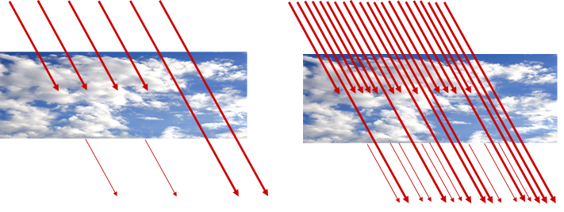
  Advanced Coherent Lidar for 3-D Global Winds
PI: Michael Kavaya; NASA LaRC
Project Start/End Date: April 2017 – May 2020
Design, build, and demonstrate an advanced pulsed, 2-micron, coherent wind lidar space pathfinder (SP) to validate lidar technology, atmospheric models, and numerical weather prediction models for an optimized future 3D-Winds space mission
  Wavelength: 2.053 um
  Pulse Energy / Rep Rate: ~32 mJ / ~300 Hz
  Enable a future optimized operational hybrid wind lidar space mission using pathfinder mission results, significantly improving operation in regions with significant cloud cover, and reducing representativeness error
Provide a risk reduction engineering model for advancing space mission readiness
Higher pulse rate architecture offers potential for greater science return as well as reduced instrument risk
Task ongoing

Slide 6
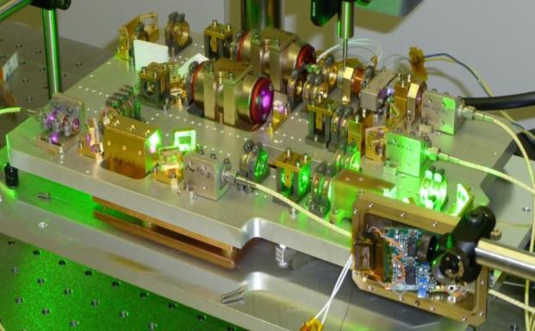
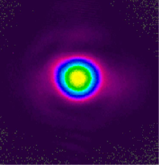
  Directed technology development and
  current SBIR–funded Winds focused efforts
High Efficiency UV Laser Demonstrator (HEUVD)
PI: Floyd Hovis; Fibertek
Develop and demonstrate a highly efficient, ruggedized UV, 355 nm, laser with a lifetime in excess of a billion shots needed for many future space-based Earth Science active remote sensing measurements including Tropospheric winds and clouds and aerosols
Use the laser as a test bed for
  high energy 532 nm life testing
  UV conversion technologies
  non-linear optical materials evaluation
Advance the space flight readiness of 532 nm and UV laser technology
Two SBIR funded tasks currently supporting coherent wind detection:
Compact 2-Micron Transmitter for Remote Sensing Applications
- Beyond Photonics, 2016 Phase II
Spaceflight 1.94 Micron Tm Fiber Laser Transmitter
- Fibertek, 2016 Phase II
705 km
Orbits,
Sun-Synchronous
Task ongoing

Slide 7
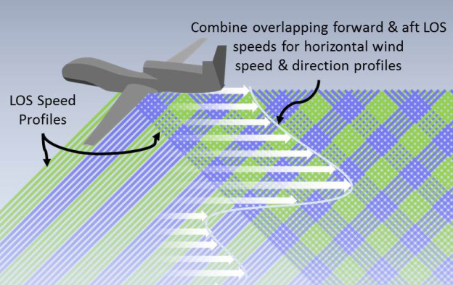
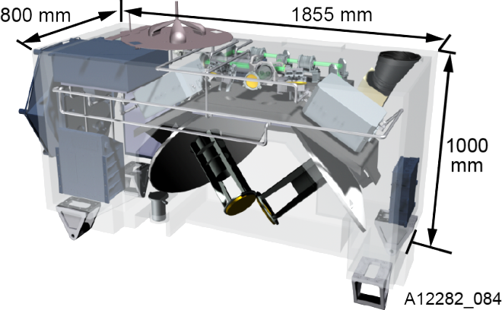
  HSRL for Aerosols, Winds, and Clouds using Optical Autocovariance Wind Lidar (HAWC-OAWL)
PI: Sara Tucker; Ball Aerospace & Technologies Corp.
Project Start/End Date: June 2014 – Sept. 2017
Advance the instrument technology toward a space-based configuration for global Earth system studies and to enable simultaneous Earth science measurements of winds and aerosol properties required for the study of aerosol-wind-cloud interactions.
  Measure LOS winds with 1-3 m/s (aerosol & altitude dependent) precision at two wavelengths: 355 nm and 532 nm from ground & high altitude aircraft platform
  Measure profiles of aerosol backscatter, aerosol extinction, and aerosol depolarization at these wavelengths
Demonstrate a two-look configuration (separated in azimuth by 90⁰) for airborne wind and aerosol data acquisition
Example of the overlap geometry from aircraft
(or space) for forward and aft pointing beams of different wavelengths (355 and 532). Beams are separated in azimuth by 90° and both point off nadir by 45° .
Task completed

Slide 8
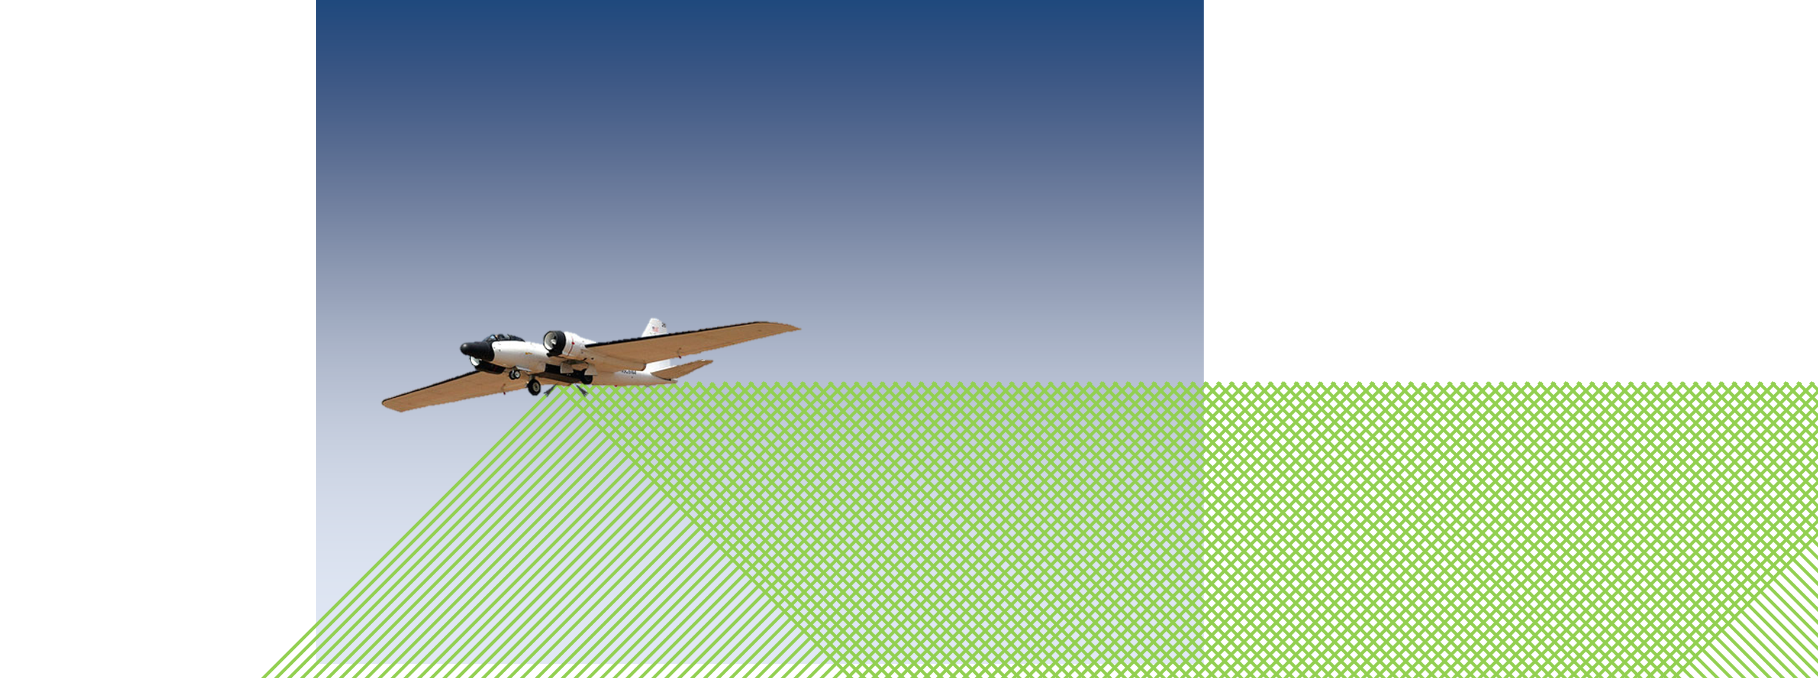
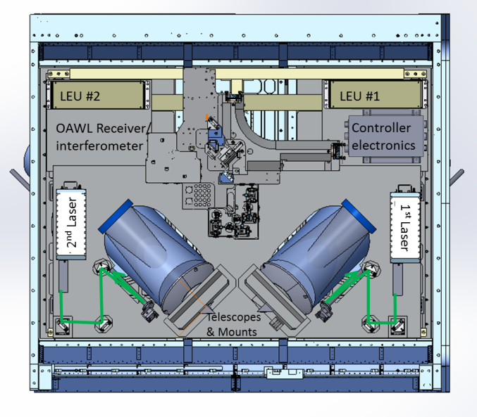
  Green OAWL (“GrOAWL”) Airborne Demonstrator for the ATHENA-OAWL Earth Venture Mission
PI: Michael Hardesty; Univ. of Colorado
Project Start/End Date: March 2015 – Aug. 2017
Develop the OAWL receiver into a rugged airborne 532 nm wavelength aerosol Doppler wind lidar with two look angles from a single platform
Perform high altitude aircraft test flights measuring LOS wind (1-3m/s) profiles from two looks over a series of atmospheric aerosol conditions
Validate the airborne system performance using ground-based weather radiosondes
GrOAWL will measure LOS wind profiles along two directions from the NASA WB‐57 aircraft. The two 532nm (green) beams are pointed 45 off the horizontal and are separated by 90 in azimuth so that as the aircraft flies forward, profile curtains overlap, providing two azimuthally orthogonal measurements of LOS speed in the same atmospheric volume.
Parameter | Value
Laser Frequency | 532 nm (doubled Nd: YAG)
Pulse Rep. Rate | 200 Hz
Laser Pulse Energy | 2-8 mJ; >20 mJ available
Telescope Area(s) | <0.05 m ²
Interferometer OPD | 0.9 m
Free spectral Range | 167 MHz
Range Resolution | >= 7.5 m (30-200 m typical)
Time Resolution | 1-30 seconds, based on aerosol loading
OAWL Airborne Demonstrator concept for the NASA WB-57 pallet showing two lasers and two telescopes for the two lines of sight
Task completed

Slide 9
  Earth Science Information Technology:
  Recent AIST Investments Useful to Wind Measurements
Award | PI / Organization | Objective Area | Project
AIST-11, 14 | Matthew French USC/ISI | On Board Processing | SpaceCubeX: A Hybrid Multi-core CPU/FPGA/DSP Flight Architecture for Next Generation Earth Science Missions
AIST-14 | Mike Lieber Ball Aerospace | On Board Processing | Model Predictive Control Architecture for Optimizing Earth Science Data Collection
NASA STMD | Rich Doyle JPL | On Board Processing | High Performance Spaceflight Computer (HPSC) with USAF
AIST-14, 16 | Jacqueline Le Moigne-Stewart | Mission Planning | Tradespace Analysis Tool for Designing Earth Science Distributed Missions
AIST-16 | Joel Johnson OSU | Mission Planning | A multi-platform mission planning and operations simulation environment for adaptive remote sensors
AIST-11, 14 | Hook Hua JPL | Science Data Processing | Agile Big Data Analytics of High-Volume Geodetic Data Products for Improving Science and Hazard Response
An OSSE Investigating a Constellation of 4-5um Infrared Sounders
  Funded jointly by R&A and ESTO
  Performed by Will McCarty/GSFC/ Global Modeling and Assimilation Office

Slide 10
ESAC 2017 - Implications for ESTO
We have done a preliminary mapping of the targeted observables, and as expected we don’t see many holes…
Decadal has recommended small changes in balance with more resources on technology:
  $20M/year for Incubation
  ESTO budget increase from 3% to 5%
  Learned from talking to ESD and other element collegues (Flight, R&A...) that this will happen
Reorganization to accomodate the incubation recommendation is not trivial, not a big challenge but needs thoughtful consideration
  There will likely be changes in portions of the portfolio – this is being worked out in concert with flight and R&A

