Slide 1
Discussion of the 2017 Decadal Survey and Future Implications for Wind Measurements from Space
Dr. Wayman E. Baker
NOAA (Retired)
Lidar Working Group Meeting, February 7, 2018

Slide 2
Table 6.4: Priority Targeted Observables & Science & Applic Objectives Ranked as Most Important or Very Important
Aerosol Vertical Profiles W-1a, 2a, 5a
Aerosol Properties W-1a, 2a, 3a, 4a, 5a
Temperature, Water Vapor, PBL Height W-1a, 2a, 3a, 4a
Atmospheric Winds W-1a, 2a, 4a
Precipitation and Clouds W-1a, 2a, 3a, 4a
Ice Elevation W-2a, 3a
Surface Characteristics W-3a
Snow Depth and Snow Water Equivalent W-2a, 3a
Soil Moisture W-2a, 3a
Ocean Surface Winds & Currents W-1a, 2a, 3a
Vegetation, Snow, and Surface Energy Balance W-3a
Cloud microphysics and vertical motion W-4a

Slide 3
Weather and Air Quality Panel Excerpts from Narrative
“Three-dimensional horizontal wind vector measurements from space-borne wind profilers (Baker et. al, 2014) would be transformative to weather and air quality forecasting, both in the PBL and the free troposphere.”
Among the challenges emphasizing the need for space-based observations is:
“Developing/improving the initialization of atmospheric variables (particularly global tropospheric horizontal vector winds, and including better utilization of data in cloudy/precipitating regions) and surface variables critical to subseasonal prediction (e.g. sea ice, snow, soil moisture, ocean mixed-layer) that are significantly under-observed today.”

Slide 4
Water and Air Quality Panel Excerpts from Table 3.3 Societal or Science Questions/Goals and Earth Science/Applications Objectives
“Question W-1: What PBL processes are integral to air-sfc (land, ocean, & sea ice) exchanges of energy, momentum & mass, & how do they impact weather forecasts & AQ simulations? “
“Objective W-1a: Determine the effects of key PBL processes on weather, hydrological, and AQ forecasts at minutes to subseasonal time scales.”

Slide 5
Weather and Air Quality Panel Excerpts from Table 3.3 Societal or Science Questions/Goals and Earth Science/Applications Objectives (Cont.)
“Question W-2: How can environmental predictions of weather & AQ be extended to seamlessly forecast Earth System conditions at lead times of 1 week to 2 months?”
“Objective W-2a: Improve the observed and modeled representation of natural, low-frequency modes of weather/climate variability (e.g., MJO, ENSO), including upscale interactions between the large-scale circulation and organization of convection and slowly varying boundary processes, to extend useful prediction by 50% at lead times of 1 week to 2 months”.

Slide 6
Weather and Air Quality Panel Excerpts from Table 3.3 Societal or Science Questions/Goals and Earth Science/Applications Objectives (Cont.)
“Question W-4: Why do convective storms, heavy precipitation, and clouds occur exactly when and where they do?”
“Objective W-4a: Measure the vertical motion within deep convection to within 1 m/s and heavy precip within 1 mm/hour to improve model representation of extreme precip and to determine convective transport and redistribution of mass, moisture, momentum, and chemical species.”

Slide 7
Concerns
Wind measurements in the PBL are important for many reasons (i.e., air-sea interactions, forecasts of mesoscale events, determining the spatio-temporal structure of air pollutants, etc.) as discussed in Chapter 7.3 of the Decadal Survey Report.
But, in the context of large-scale NWP, including forecasting tropical cyclones, the emphasis on PBL dynamics seems inconsistent with substantial scientific evidence that horizontal vector wind measurements in the mid and upper troposphere are more important. See the next three slides, for example.

Slide 8
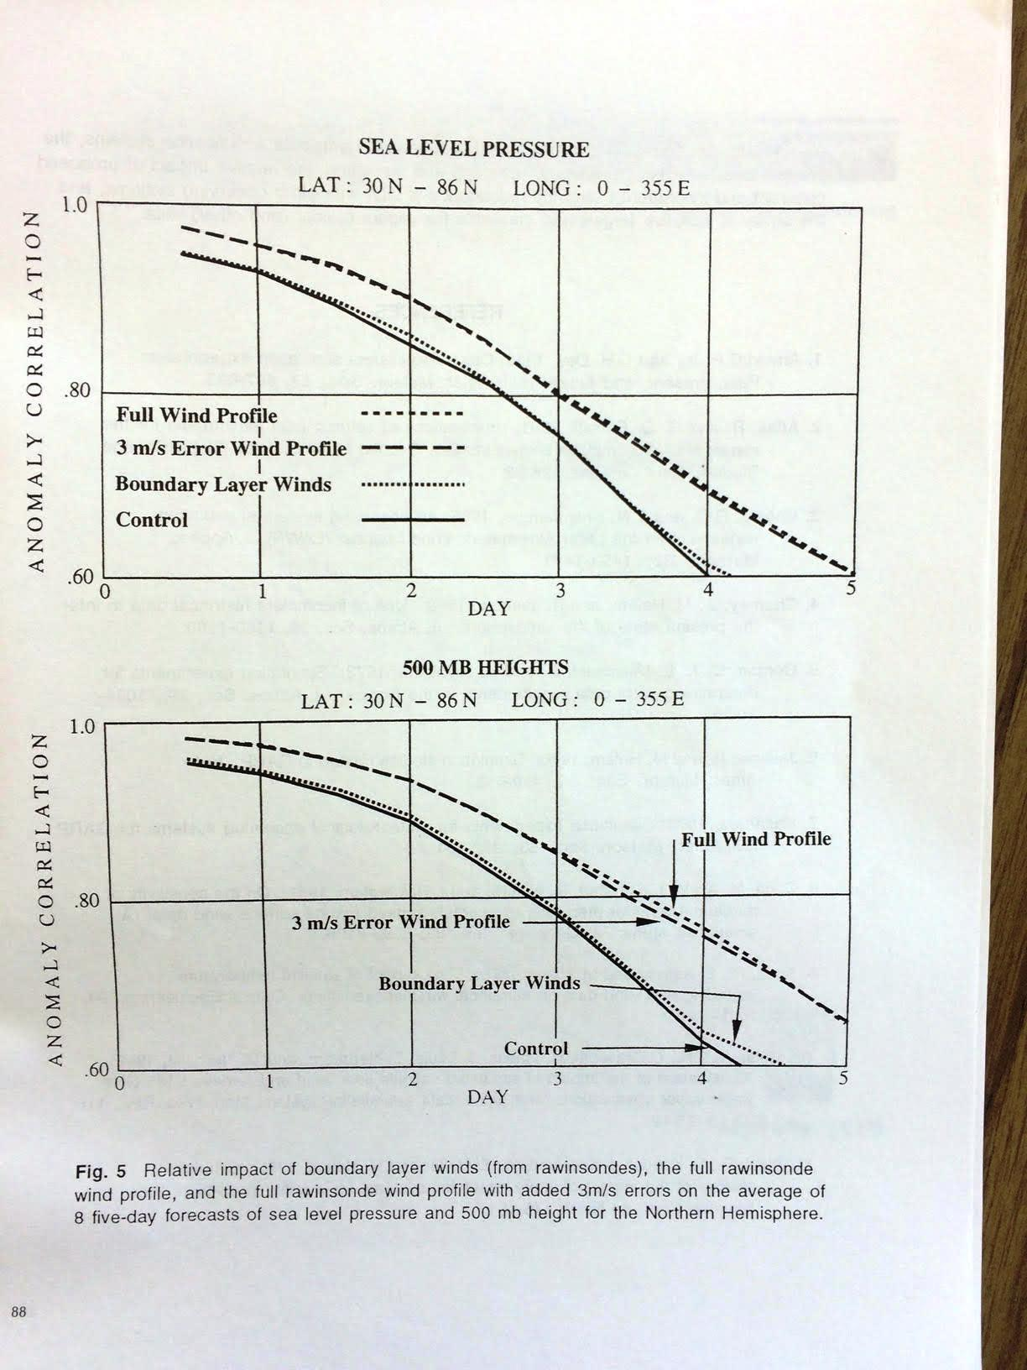
From Atlas (1998): OSEs showing impact (via AC score) of RAOB data in the PBL vs. full RAOB profiles on 8 five-day forecasts over the N. Hemisphere extratropics

Slide 9
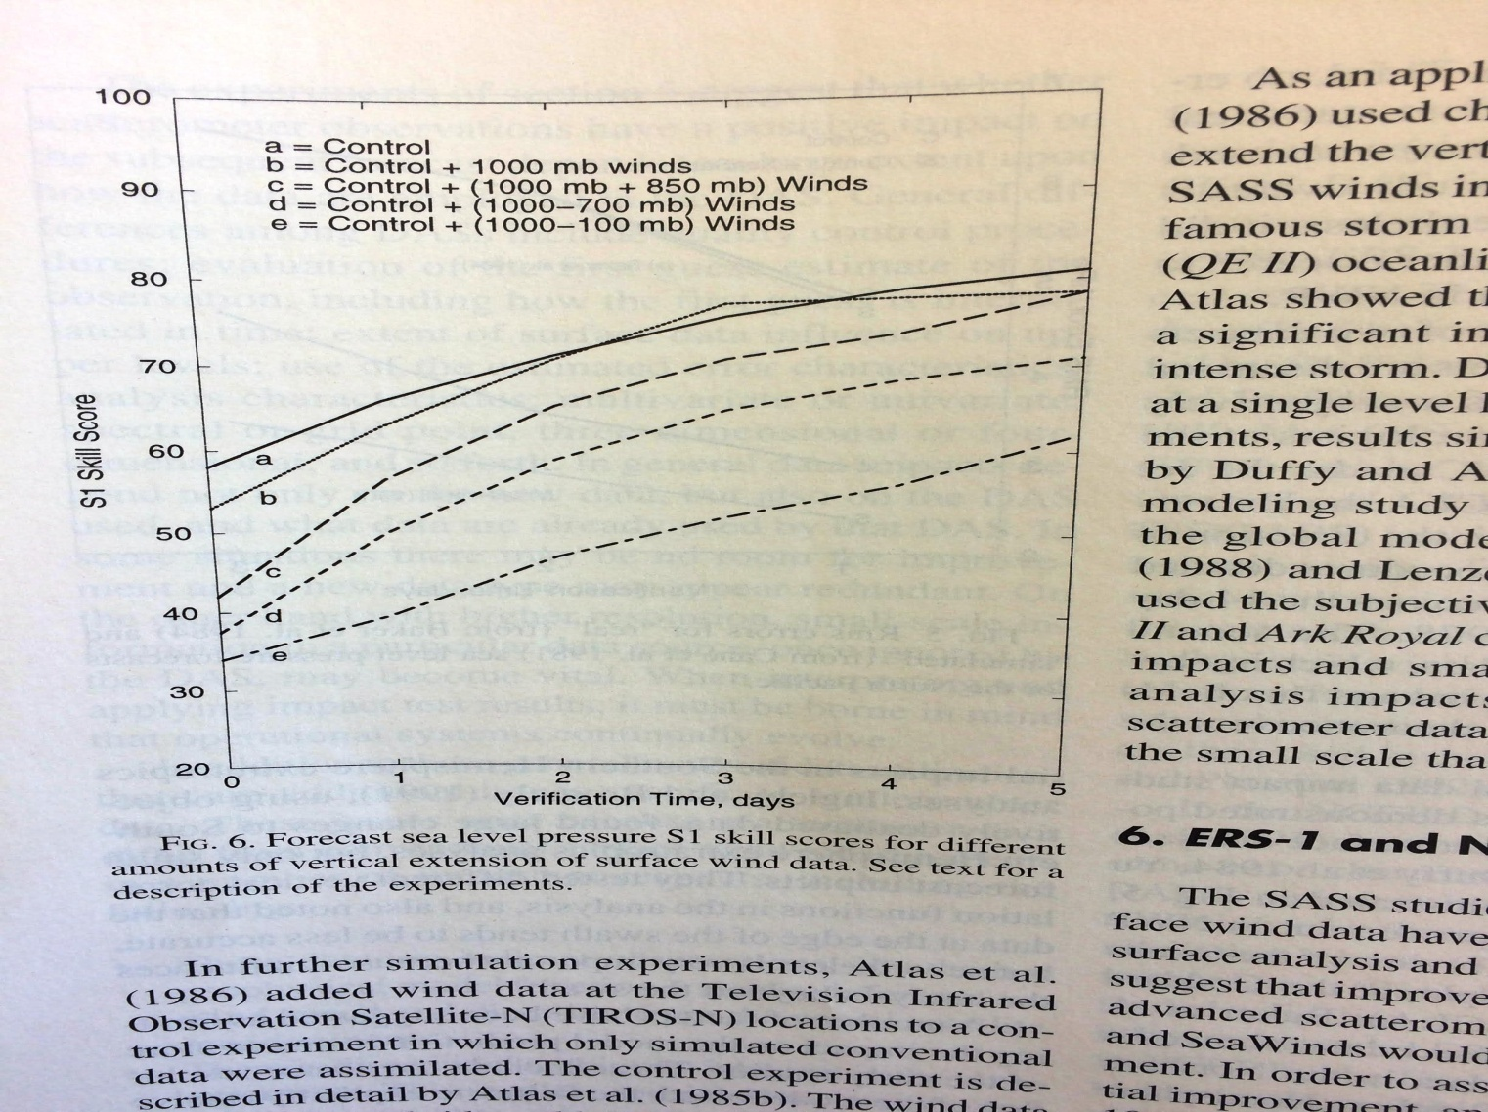
From Atlas et al. (2001): OSSEs showing impact (via S1 skill score) for different amounts of vertical extension of simulated surface wind data over the S. Hemisphere extratropics.
Note: One additional result not on this figure where only simulated winds from 500 hPa – 100 hPa were assimilated showed almost the same skill as an experiment where winds were assimilated from 1000 hPa – 100 hPa.

Slide 10
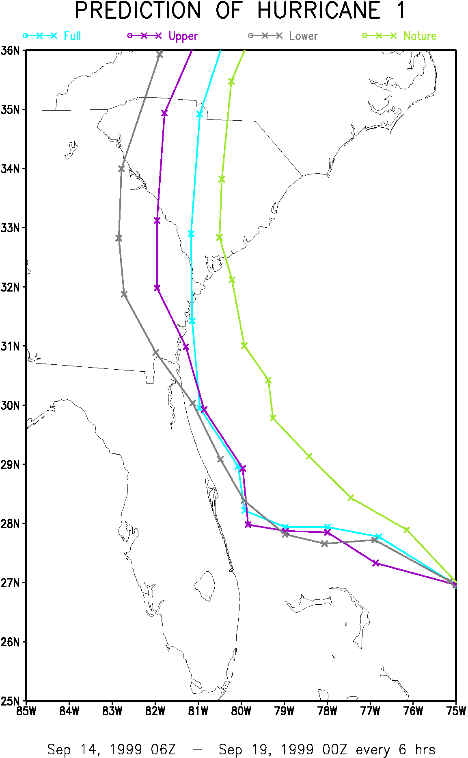
From R. Atlas 1999 Slides: OSSEs showing importance of mid and upper level winds vs. winds from lower levels
Nature (“truth”)
CTRL + Full lidar profile
CTRL + Upper lidar
(500 hPa and above)
CTRL + Lower lidar (1000 hPa - 700 hPa)

Slide 11
Concerns (Cont.)
In terms of economic impact, the 2017 hurricane season was the most devastating ever with losses estimated to be more than $200 B for Hurricanes Harvey, Irma, and Maria (https://www.wunderground.com/cat6/2017-us-hurricane-damages-206-billion-highest-record?__prclt=WJS9y2TK).
However, the Decadal Survey Report only discusses these events in a paragraph under “Motivation.” There do not appear to be any scientific questions and goals devoted specifically to the tropical cyclone prediction problem.
The next two slides offer some examples of goals that could have been used.

Slide 12
NOAA/Hurricane Forecast Improvement Project (HFIP) 10-year Goals
Reduce the forecast track error by 50% for days 1 through 5
Reduce the average forecast intensity error by 50% for days 1 through 5
Increase the probability of detection for rapid intensification to 90% at day 1, decreasing linearly to 60% at day 5, and decrease the false alarm ratio for rapid intensity change to 10% for day 1, increasing linearly to 30% at day 5. The focus on rapid intensity change is the highest-priority forecast challenge identified by the NHC.
Extend the lead-time for hurricane forecasts out to day 7 (with accuracy equivalent to that of the day 5 forecasts in 2006, approximately 260 nautical miles.

Slide 13
Science Objective from the 2016 ATHENA-OAWL Proposal
Reduce the tropical cyclone track error by 25% at 96 h lead time for forecasts with a steering current uncertainty
Note: Success in meeting this objective is critically dependent on measuring winds in the mid and upper troposphere.

Slide 14
Excerpts from Table S.2: Observing System Priorities Targeted Observables, Science/Applic. Summary, Candidate Measurement Approaches, & Program Elements
“Atmospheric Winds: 3D winds in troposphere/PBL for transport of pollutants/carbon/aerosol & water vapor, wind energy, cloud dynamics & convection, & large-scale circulation”
“Could be measured by active sensing (lidar, radar, scatterometer); or passive imagery or radiometry-based atmos. motion vectors (AMVs) tracking; or lidar**”
Listed under both “Explorer” and “Incubation” program elements. Clarification is on the next two slides.
** Could potentially be addressed by a multi-function lidar designed to measure 2 or more Targeted Observables (such as Ice Elevation, Snow Depth & Snow Water Equivalent, Terrestrial Ecosystem Structure, and Sfc Topography & Vegetation)”

Slide 15
Excerpts from Chapter 3, Page 67: A Prioritized Program for Science, Applications, and Observations
"The Atmospheric Winds Targeted Observable (TO) corresponds to TO-4 in Appendix C. It is included both in the Earth Science and Applications from Space (ESAS) 2017 recommendations for the Earth System Explorer and the Incubation program element. The committee believes Atmospheric Winds is not yet ready for immediate implementation with acceptable risk, but could be during the decade with proper technology advances. The expectation is that Incubation investment could reduce risk sufficiently to accomplish that. A detailed description is included in the Incubation section.“ (On the next slide)

Slide 16
Excerpts from Chapter 3, Page 74: Table 3.8: [Three] Targeted Observables (Atmospheric Winds, PBL, & Sfc Topog. & Veg.) selected by the Committee to be addressed through the Incubation program element
“For Atmospheric Winds: “Improve understanding of measurement needs through advanced Earth system modeling representative of winds in coupled atmosphere-ocean-land-ice models with realistic PBL.
Explore the best combination of active (lidar, radar) and passive (radiometry) technologies that can leverage ESTO investment in active technologies and Program of Record (POR) AMVs from GOES-R and international GEO and LEO satellites.
[Conduct] mission concept studies to define which measurement needs can be addressed with state-of-the-art technology via Venture and/or Earth System Explorer opportunities and which require further development.
[Develop] strategic technology investments to ensure flight maturity of needed measurement technologies by end of decade."

Slide 17
Future Implications for Wind Measurements from Space
Compelling scientific evidence gathered over the past 30 years and rapid advances in wind lidar technology since the 2007 Decadal Survey, drive the following conclusions:
Wind lidar technology is ready for space (Aeolus, OAWL)
- Aeolus has completed thermal-vac test; launch expected in 2018
- OAWL is at TRL 5 with planned environmental testing to reach TRL 6
With winds measured in the mid and upper troposphere, the key science objectives should include the following:
1. Improve medium-range (days 3 – 7) weather forecasts, and
2. Reduce the tropical cyclone track error for forecasts with a steering current uncertainty
Measuring winds in the PBL is important

Slide 18
Future Implications for Wind Measurements from Space (Cont.)
I concur with the 2017 Decadal Survey recommendation to:
Explore the best combination of active (lidar, radar) and passive (radiometry) technologies that can leverage ESTO investment in active technologies and POR AMVs from GOES-R and international GEO and LEO satellites
But, additional mission concept studies, including OSSEs, to achieve an optimal global wind observing system should be done in parallel with the first U.S. space-based wind lidar mission
Measuring winds in the PBL from space is very important (i.e., air-sea interactions, forecasts of mesoscale events, determining the spatio-temporal structure of air pollutants, etc.)
But, the priority should be the mid and upper troposphere because of the compelling scientific evidence and the readiness of the wind lidar technology

