Slide 1
The NOAA Satellite Observing System Architecture (NSOSA) Study
Frank W. Gallagher III
NOAA / NESDIS / Office System Architecture and Advanced Planning
7 February 2018

Slide 2
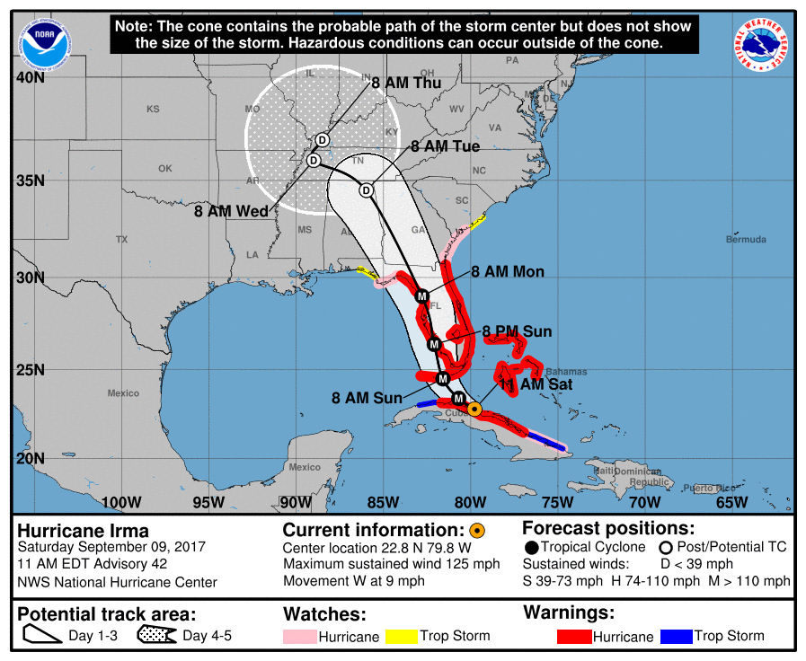
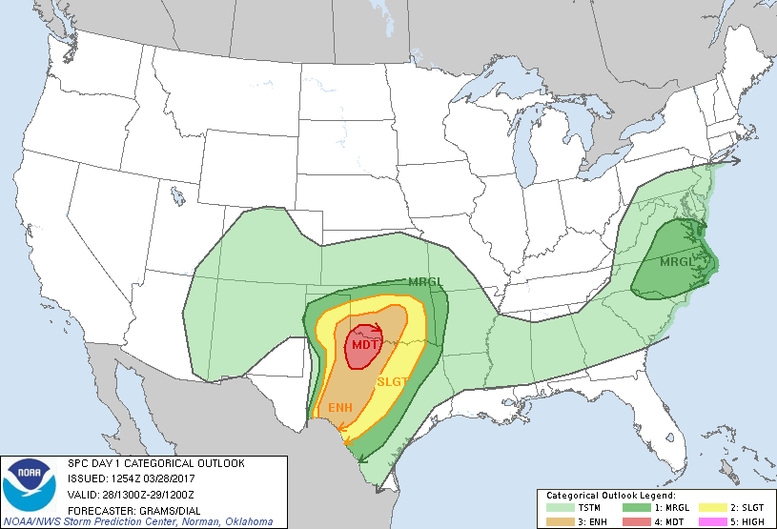
NSOSA Study Background
NOAA Satellite Observing Systems Architecture (NSOSA) study is examining the space segment architecture decisions for space systems post GOES-R/S/T/U and JPSS-1/2/3/4
Which observation functions should be allocated to which orbits?
Should we retain the legacy architecture or seek major change?
Which observation functions should be improved?
Addressing NOAA operational needs, from defined requirements
Observations that result in warnings, watches, baseline weather and space weather forecasts, and ocean or fisheries actions
Scoped to address NOAA systems, with a knowledge and inclusion of partner contributions and relationships
Intended to result in Pre-Phase-A program activities

Slide 3
Planning for the Future
NOAA User Prioritized Requirements
Strategic Priorities
National Weather Service
National Marine Fisheries Service
National Ocean Service
Office of Oceanic and Atmospheric Research
Operational Considerations (NOAA/DoD/ Partners)
Policies & Standards
Technology Opportunities
Architecture Analysis
Instrument Capabilities Allocated to Orbits
Replenishment policies
Cost estimates
Technology roadmap
Pre-Phase A
Commercial Engagement
Partner Sources
Program(s) of Record
NOAA Ground
Source Agnostic Data
Notes:
Buy, Barter, Build

Slide 4
Baseline and Timing
POR2025
2020
2025
2030
2035
2040
2045
2050
GOES
NSOSA Scope
JPSS
COSMIC
DSCOVR/SWFO
Assume NOAA Enterprise Ground - Including Secure Ingest, etc.
Ocean Altimetry
MTG
EPS-SG / Sentinel
JMA-GEO
Radarsat
Assumed Partner Continuation
2028
GOES-S Flies Out

Slide 5
Study Ground Rules
Determine the most cost effective space segment architectures for performing NOAA weather, space weather, and environmental remote sensing (excluding land mapping) missions, beyond the POR to 2050
Priority to Operational NOAA Functions
Launch services provided by NASA KSC Launch Services Program.
Include partnerships (e.g., EUMETSAT, JAXA, CSA)
Team Members
Aerospace Corporation
NASA GSFC
NASA JPL
NASA KSC
SPRWG
JHU APL
MIT-LL
NESDIS - TPIO & OSGS
NESDIS - ACIO

Slide 6
Goals of the NSOSA Study
Fundamental Goal
Determine the most cost-effective satellite architecture options for NOAA environmental observation satellites in the post-GOES, post-JPSS era
Related goals
Identify the big alternatives for the satellite architecture, determine the tradeoff rules. Why do we prefer one major alternative over another? What would drive us one way versus another?
Downstream goals
Identify the needed next generation programs and when we need to start them
Lay the ground work for those next generation programs (functions/requirements allocated, trade cases, technology roadmaps)

Slide 7
Intended Outcomes of Study
Inform choices and opportunities about the next generation constellation architecture to:
Start pre-formulation in 2019/2020 of next generation programs that must start that early
Structure follow-on studies to resolve any open issues that can wait
Identify long-lead investments in technology, so that we can establish funding needs and partner priorities starting in 2018
Identify any high value partnership changes or opportunities where engagement in 2018 is important
Provide a clear vision/roadmap of the NOAA satellite next generation
Provide rigorous analysis to drive architecture decisions

Slide 8
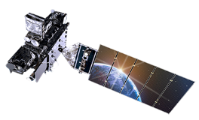
Study Methodology
Functions / Goals
NOAA Operational
NOAA Non-Operational (Science)
NOAA Leadership Priorities
Strategic & Cost Goals
Obs Mission Value
Results
High-Value Alternative Architectures
NSOSA
Study
Architectures
Cost Estimates
Integrated Roadmaps
Technology Roadmaps
SPRWG
Space Platform Requirements Working Group
Enterprise Ground
Software and Hardware capability and capacity
Notes:
SPRWG Starting point was
NOAA COURL and WMO OSCAR
Enterprise Ground provided the NESDIS ground baseline
Output cost estimates include cost deltas associated with hardward and software changes driven by space architectures

Slide 9
NSOSA Study Approach
NSOSA
Study
Value Model
Space Platform Requirements Working Group
Instrument Catalog
Constellations Considered
Trade Studies
Performance Evaluation
Integrated Roadmaps
Customer Impacts
General Study Results
Value Model Development
Score Alternatives
Instrument Catalog Development
Integration, Trades, Architecture Selection
Design and Cost Alternatives
Constellation Alternative Synthesis
Three full architecture cycles enable:
user engagement, learning, fine tuning
High-Value Alternative Architectures

Slide 10
Linking NOAA Requirements to the NESDIS Architecture Study
Value Model expresses relative mission value of performance choices and drives the analysis
NESDIS established a Satellite Platform Requirements Working Group (SPRWG) to work with the study team on this model
Used NOAA requirements database, NESDIS/TPIO COURL and tools, and WMO OSCAR requirements reference database as a starting point
Projected needs to 2028 and beyond
Translated requirements into architecture objectives
Linked performance choices to requirements satisfaction metrics
Value Model is the basis for mission satisfaction scoring of architecture options

Slide 11
The EVM (Environmental Data Record (EDR) Value Model)
The EVM is a table listing each objective (sometimes called “requirements”) for NOAA’s space-based observational system of 2030 and beyond, together with the performance attributes of each objective.
A Functional Objective (often just Objective) is something we want to measure-e.g. temperature soundings, a visible image, a solar corona image.
Group A - Weather, climate, oceans, chemistry objectives
Group B - Space weather objectives
Group C (Communications Objectives) were handled in a binary sense.
There are also Strategic Objectives, such as assurance of core capabilities (Group D Objectives)
SPRWG focused on Group A and B objectives
NOAA Leadership interleaved and ranked Group A, B, and D objectives collectively

Slide 12
EVM Capability Levels
Set capability levels for objectives to include:
Study Threshold (ST): The level at which decreases in capability no longer present a compelling investment, i.e., alternatives with capability below this level will be rejected. Guidelines are no objectives with ST level greater than Program of Record 2025. Some objectives have zero ST performance.
Expected (EXP): The capability reflecting consensus expectations from the users. Often, but not always, roughly equal to today’s capability.
Maximum Effective (ME): The level at which increases in capability no longer present a compelling investment (i.e., alternatives with capability above this level will receive no additional credit). Generally a significant improvement over today’s capability.

Slide 13
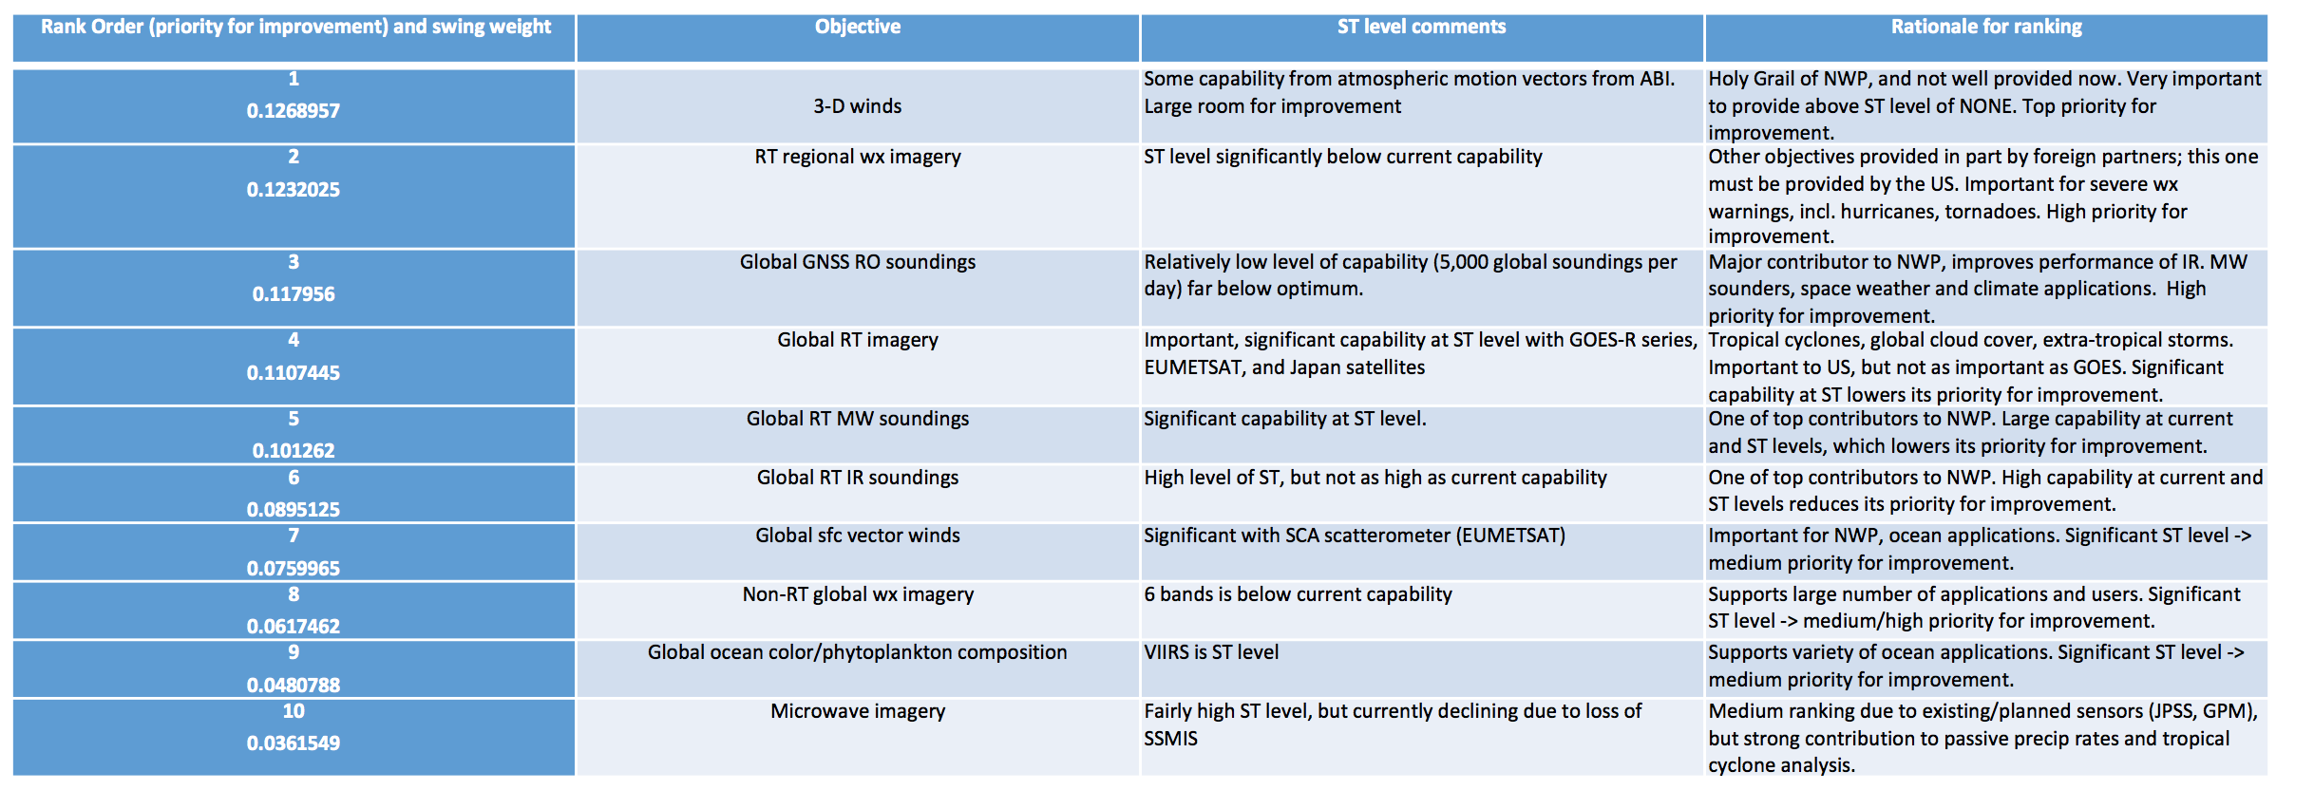
Rank Order of Objectives 1-10 in Group A
Ranked in order of improvement from ST to ME.

Slide 14
EVM Example: Objective A13
A13: 3D Winds (Horizontal Wind in the Troposphere)

Slide 15
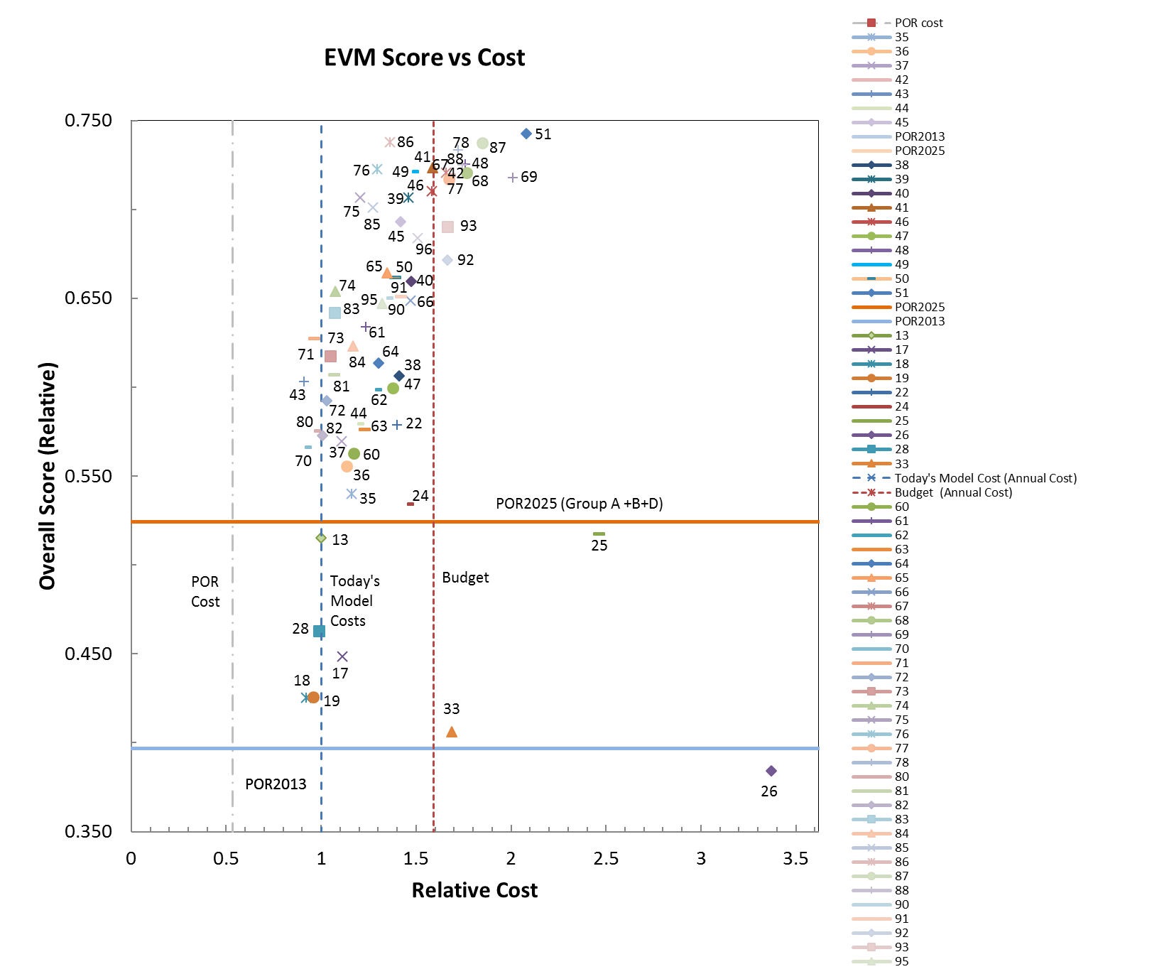
Constellation Analysis
Evaluated nearly 100 different constellations (not all shown here)
All of them met the ST level of performance
Efficient Frontier Curve

Slide 16
Constellation Analysis – Doppler Wind Lidar (Cycle 3)
Evaluated nearly 100 different constellations (not all shown here)
All of them met the ST level of performance
Non-Zero ST level for 3D winds – ST level met by non-lidar solutions
Many constellations have a Doppler wind lidar as a capability
Cycle 3 Constellations that included a Doppler wind lidar

Slide 17
Exemplar “Hybrid” Architecture
This is an example architecture that was evaluated as part of the NSOSA analysis.
Core System
Hosted GEO Wx imagers E/W (cross-grade from ABI, not equal)
Government weather-only Center GEO (includes imager+, lightning mapper, in situ SWx)
Hosted GEO instruments of opportunity
Comprehensive SWx at L1
LEO sounders (0530, 1330)
Commercial user-facing communications
Data service buys (e.g., GNSS-RO)
Trade Elements
Dedicated L5 SWx
ABI++ capabilities on center GEO – “SuperGOES”
Doppler wind lidar
Tundra (polar inclination) with cross-grade ABI and auroral imager – Also covers global weather imaging needs
1330 LEO Imager
“Heavy” MW capabilities (e.g. large MW imager)
Additional Sounders (0530, 1530, crossing, etc.)

Slide 18
Next Steps for NOAA
Synthesize NSOSA analysis with Decadal Survey analysis
Outreach to industry partners in high interest topic areas
Instrument approaches to select performance points
Hosting approaches for sustained constellations
Potential service demonstrations
Further develop GEO, LEO, SWx, and other long-term roadmaps within NOAA and with partners
Targeted trade studies within these areas to address specific identified issues
Inform budget development and decision process

Slide 19
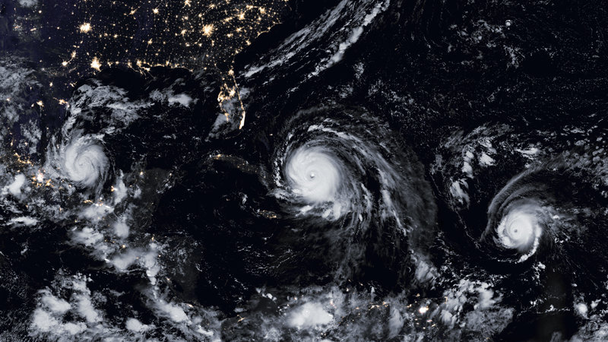
NOAA Space Future Opportunities
NSOSA Study identified opportunities for NOAA to:
Provide improved capability
Provide greater agility
Engage in new business practices
Do this at a reasonable cost

